Slide 1


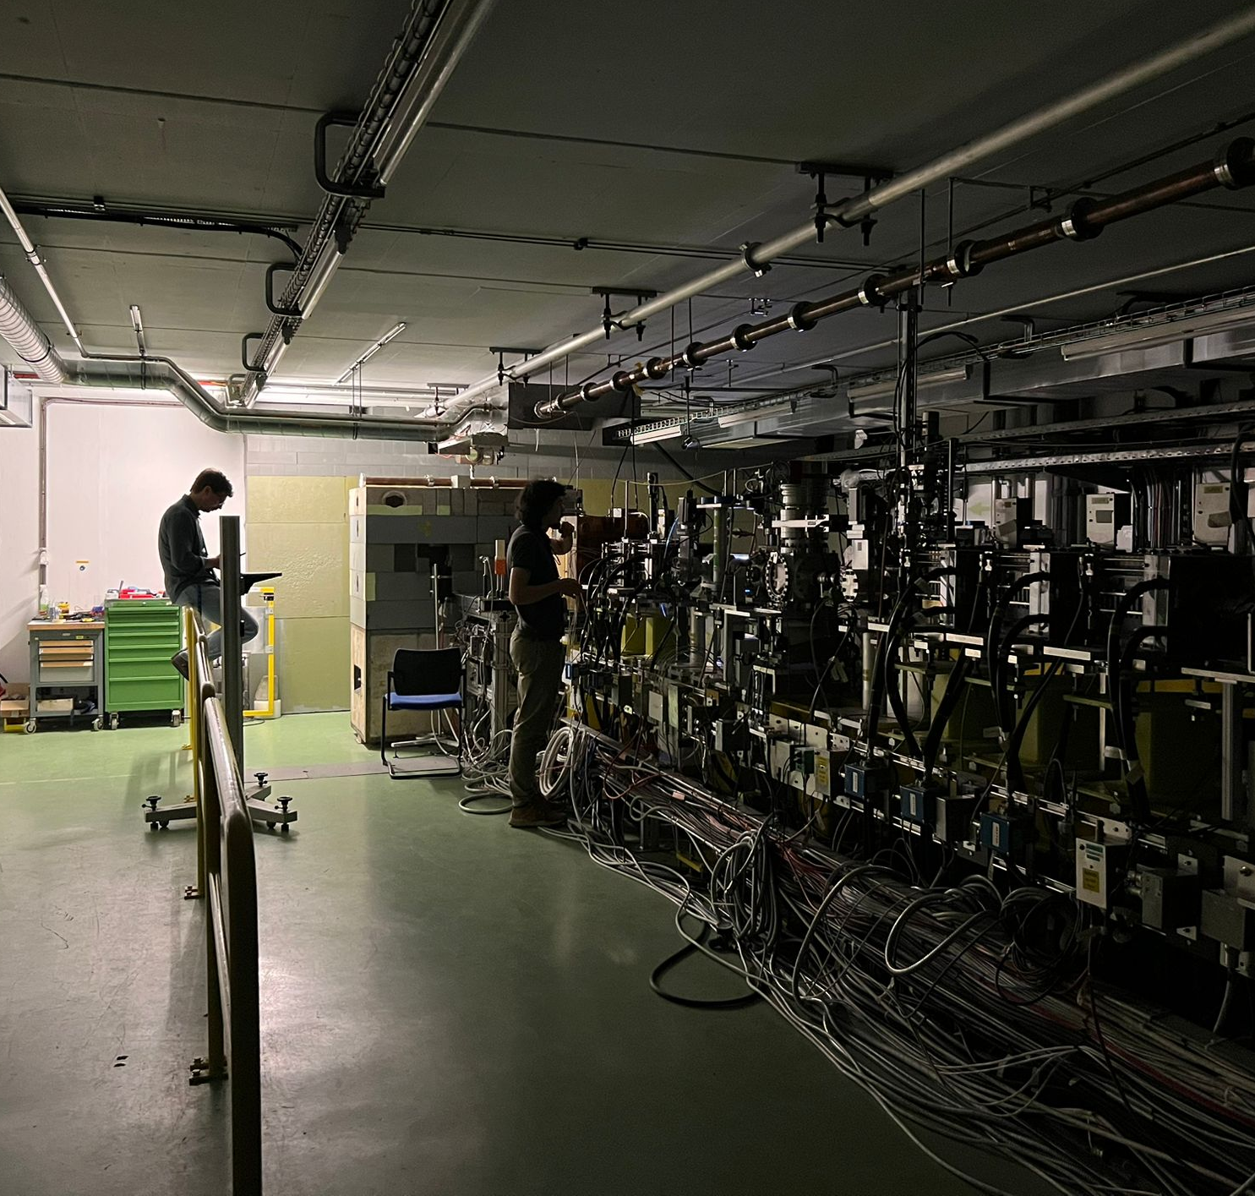

CLEAR, operational status and VHEE activities
4th International Workshop on Very High Energy Electron Radiotherapy
Daresbury, UK
Giacomo Tangari - giacomo.tangari@cern.ch

Slide 2
CLEAR, operational status and VHEE activities
4th International Workshop on Very High Energy Electron Radiotherapy
Daresbury, UK
Giacomo Tangari - giacomo.tangari@cern.ch

Slide 3
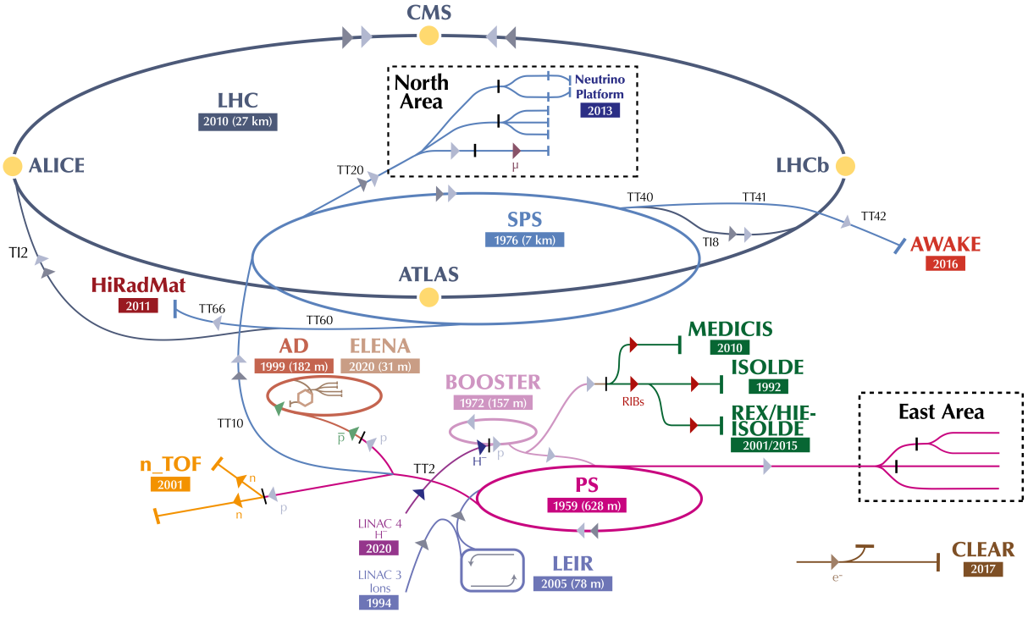
What is CLEAR?
CERN Linear Electron Accelerator for Research
Versatile linear accelerator facility, supports R&D in accelerator technologies and applications.
Provides electron bunches with energies up to ~200 MeV, flexible bunch structure and timing.
Key applications:
Accelerator component testing (e.g., diagnostics, kickers, RF systems)
High-gradient structure experiments
Plasma wakefield acceleration studies
Machine Learning
Medical beam applications

Slide 4
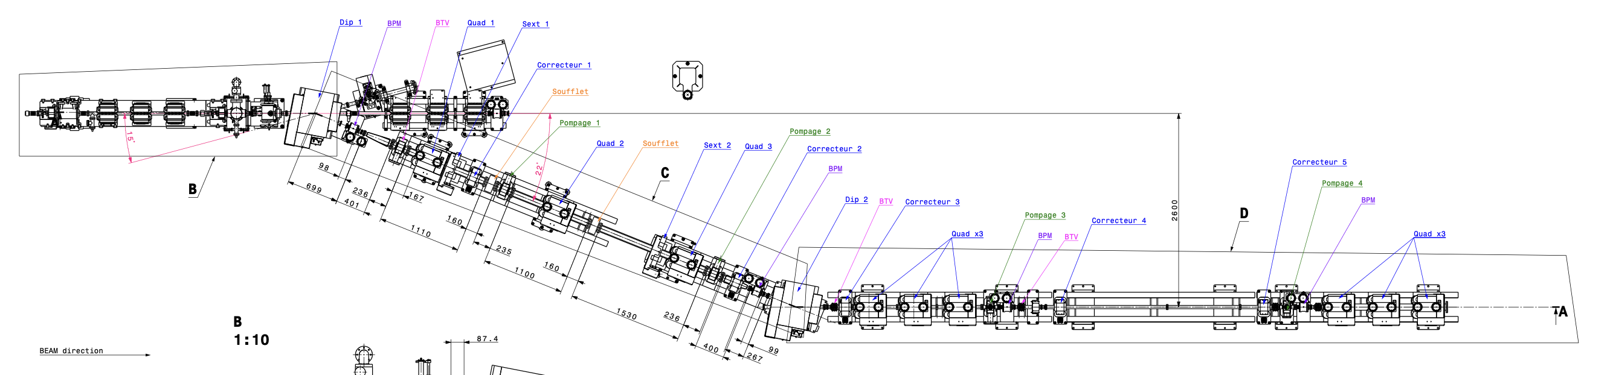
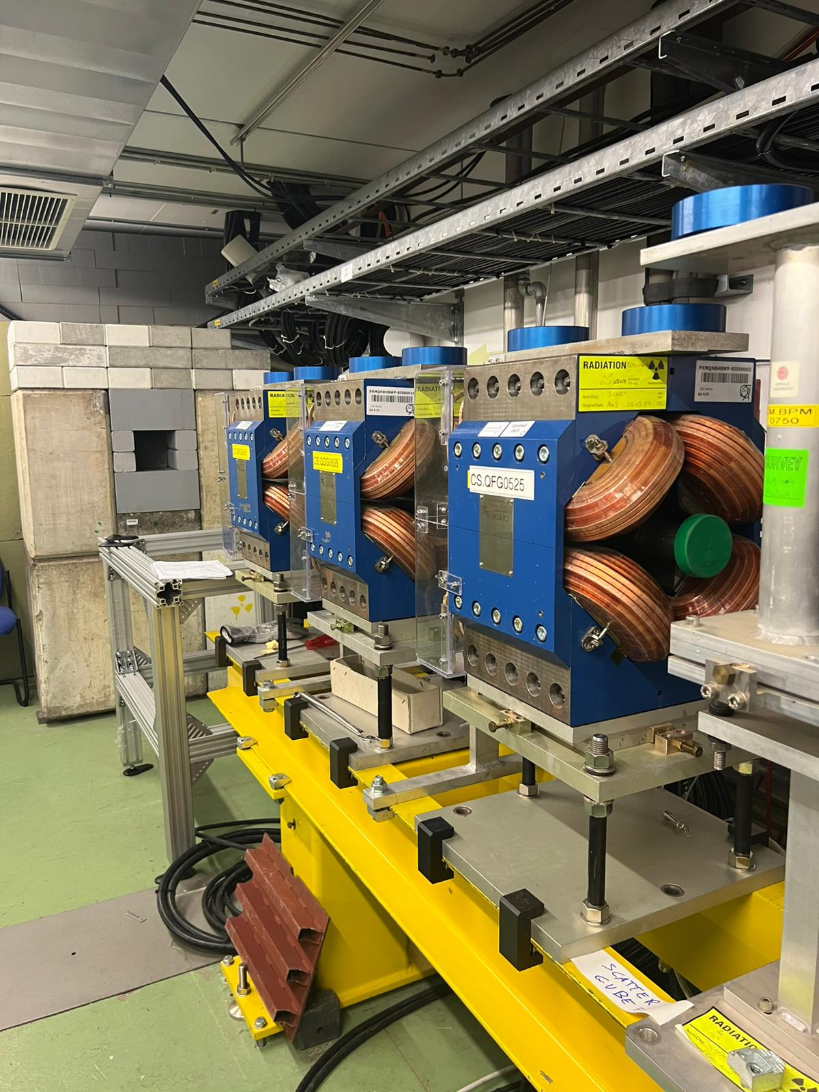
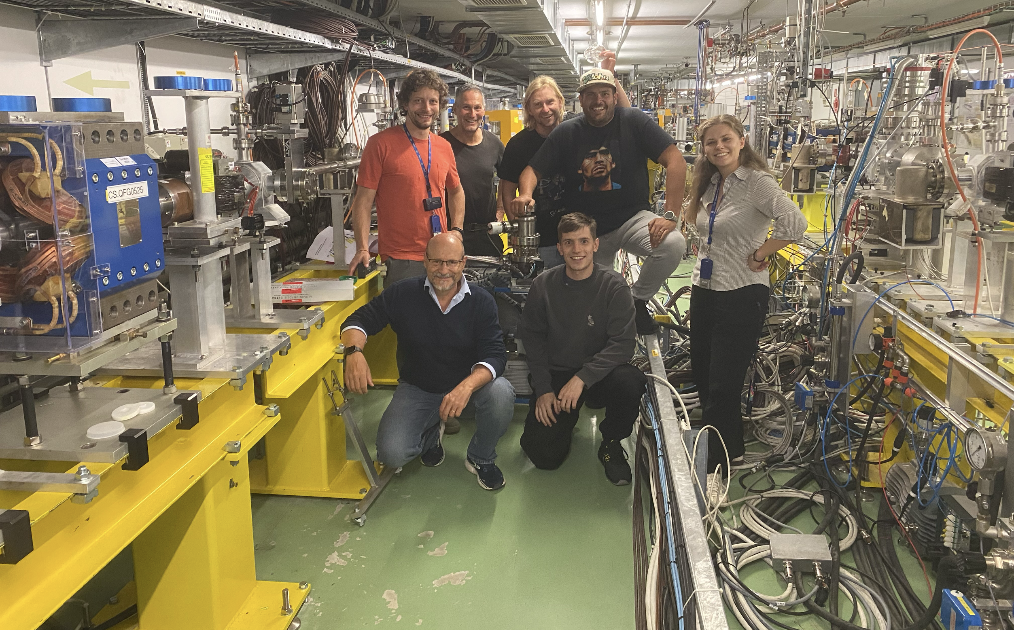
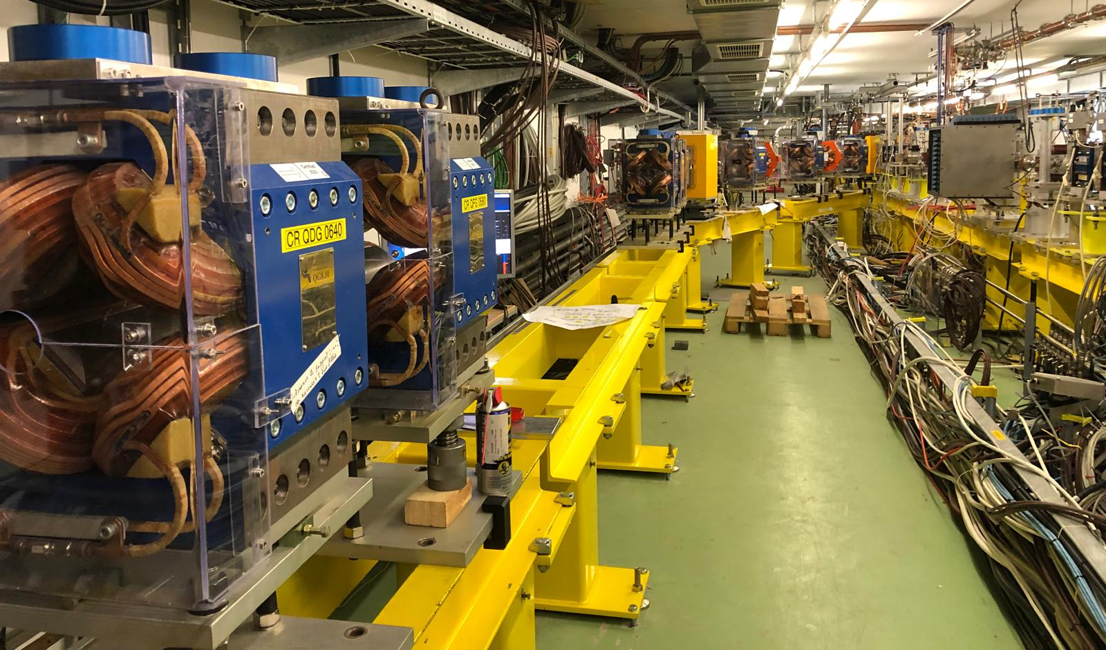
CLEAR 2nd Beamline

Slide 5
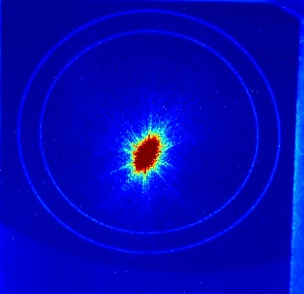
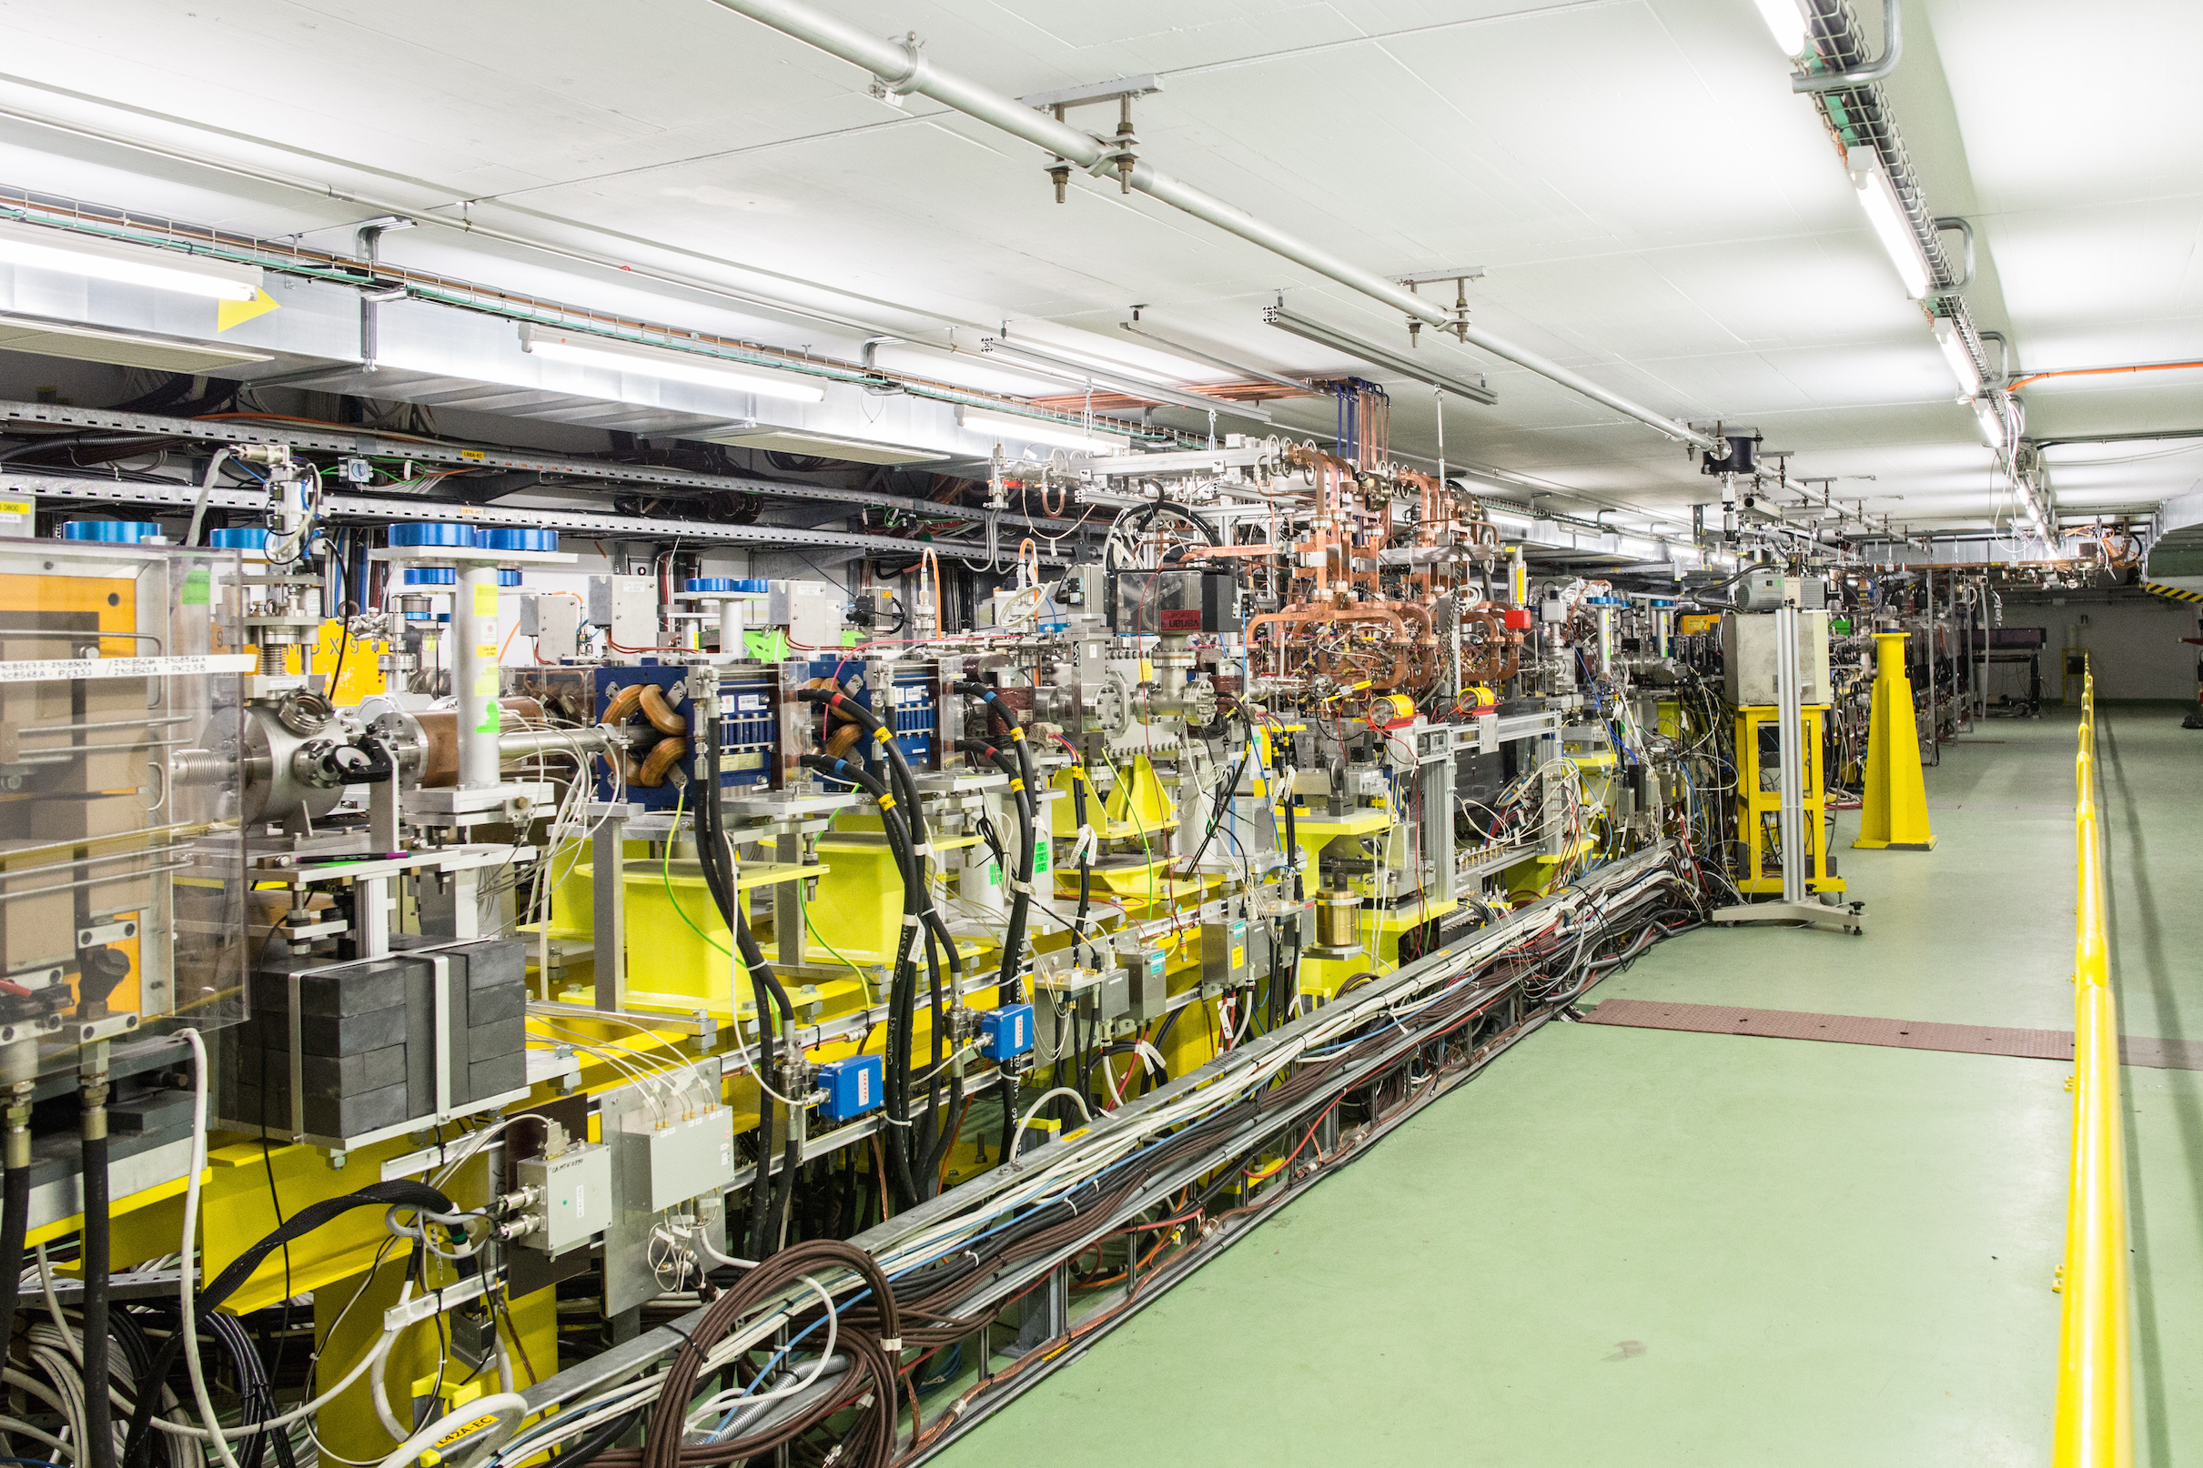
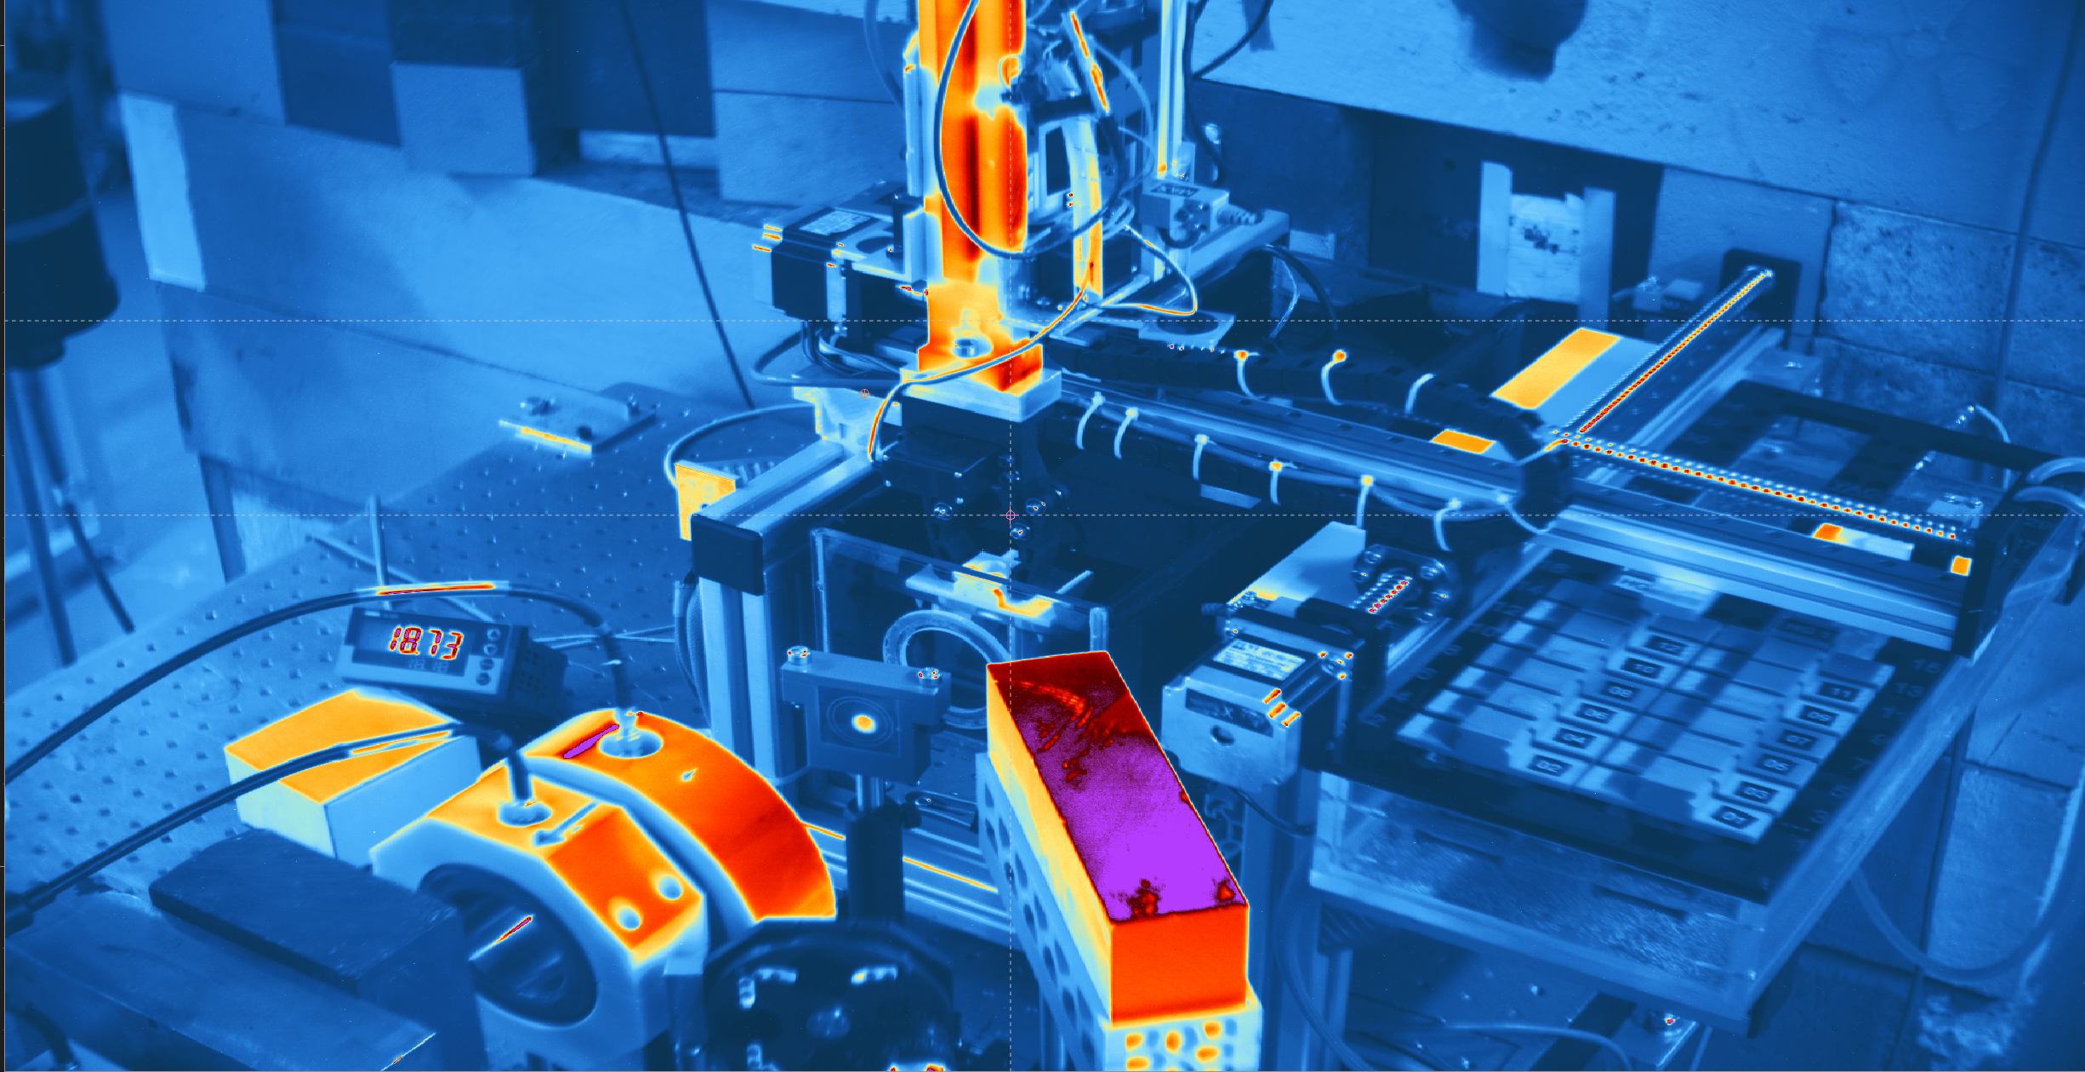
Operational Tools
CLEAR DAQ
Data acquisition system for automated, synchronized collection of beamline measurements.
CLEAR Online Dosimetry
Real-time dose measurement and feedback for radiation-sensitive applications.
CLEAR Robot
In-house developed robot, leveraged during irradiations to move holders from the storage box to the beam trajectory.
Scan Worker
Framework to automate multi-parameter scans (e.g., laser, RF settings) and coordinate data acquisition.
CLEAR Simulations
Accompanying simulation framework to compare with experimental results.

Slide 6
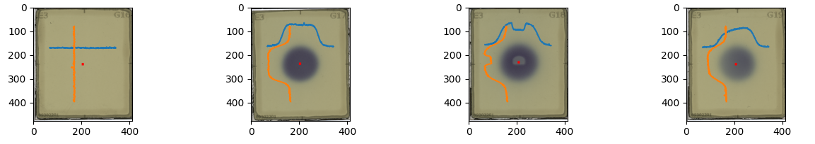
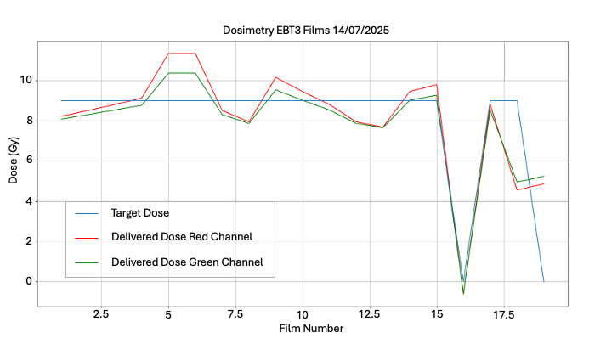
Film Dosimetry
Use of Gafchromic films placed in direct contact with the biological samples during irradiation.
Films provide the effective experimental dose, independent of real-time predictions.
They also act as a “photograph” of the beam, revealing key information:
Beam profile and uniformity → ensures homogeneous irradiation of the sample area.
Delivered charge → correlation between accelerator settings and actual dose.
Additional effects → detection of contributions such as dark current and leakage, which alter the intended dose distribution.
To be checked
Up to 5 Gy of extra dose for 2m30s exposure with laser shutters closed

Slide 7
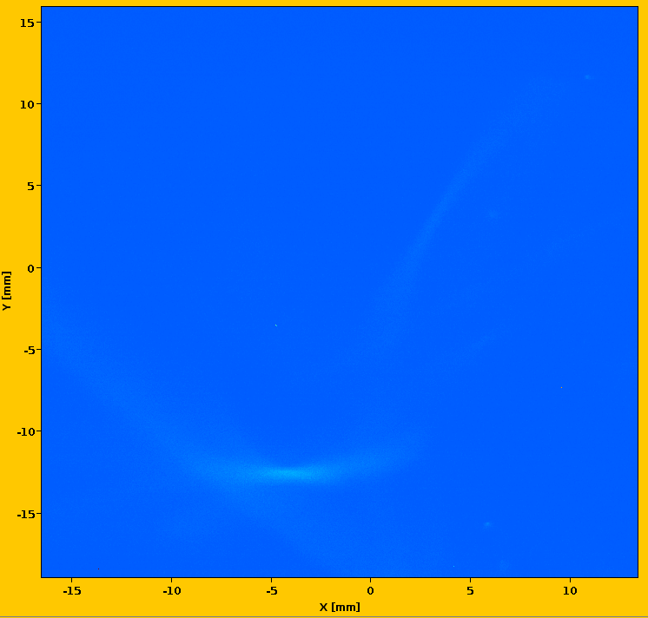
Dose Perturbations
Observed Secondary Contributions can lead to non-negligible impact on the experiments.
Dark Current
Defined as unwanted electron emission from RF structures without laser injection.
Increases linearly with irradiation time.
Produces a “dose tail”.
Leakage
Acts as a background dose, always present in the beamline.
Reduces spatial resolution and beam concentration on samples.
Next steps: investigate strategies to mitigate dark current and leakage.
DC w/ screen | DC w/o screen | Leakage
1.40 pC | 2.20 pC | 6.20 pC
1.23 pC | 2.18 pC | 6.36 pC
1.30 pC | 2.15 pC | 6.90 pC
Average charge values measured at the end of the line, obtained from 1000 pulses (10 Hz repetition rate over 100 seconds).

Slide 8
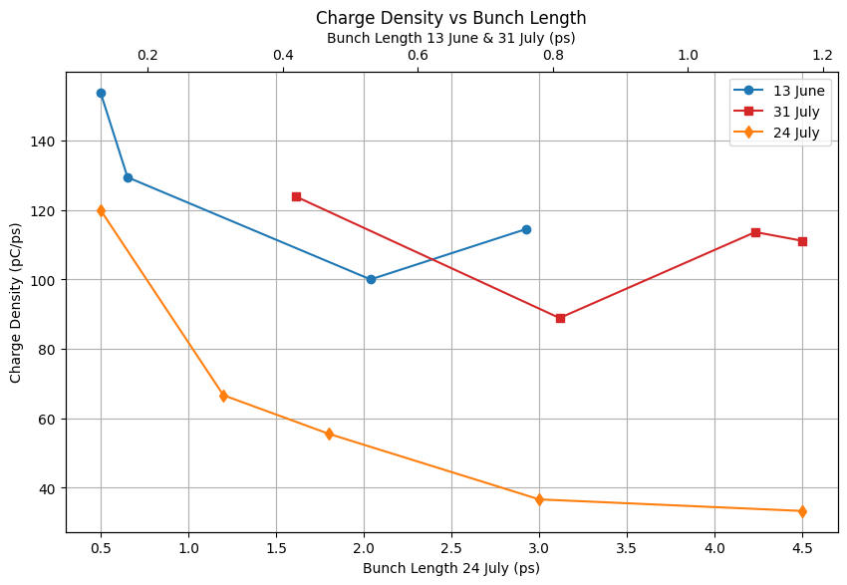
Shorter Bunches
Possible Strategy: increase the charge density of the beam.
Achieved by shortening the bunch length.
Check the instantaneous dose rate and the subsequent effect based on the beam delivery:
In Conventional high charge density may increase complex biological damage and decrease sparing effect;
In FLASH it could trigger a temporal-biological sparing effect.
First measurement campaigns are confirming the procedure and, thus, the charge density increase.
But is it the right path?

Slide 9
References and Publications
Papers, used as a reference in this presentation, regarding CLEAR can be found at clear.cern/content/publications.
Some of the presented work is preliminary and has not been published yet.
Many thanks to the whole CLEAR team and the various users.

Slide 10
Questions? Ideas?
Thank You!
clear.cern.ch

Slide 11
Backup Slides

Slide 12
CLEAR Parameters
Beam parameter | Range
Energy | 30 – 230 MeV
Energy Spread | < 0.2 % rms (< 1 MeV FWHM)
Bunch Length | 0.1 ps – 10 ps rms
Bunch Charge | 5 pC – 3 nC
Number of bunches per pulse | 1 to ~150
Maximum total pulse charge | 80 nC
Normalized emittances | 3 μm to 30 μm (bunch charge dependent)
Repetition rate | 0.8 to 10 Hz
Bunch spacing | 1.5 GHz or 3 GHz

Slide 13
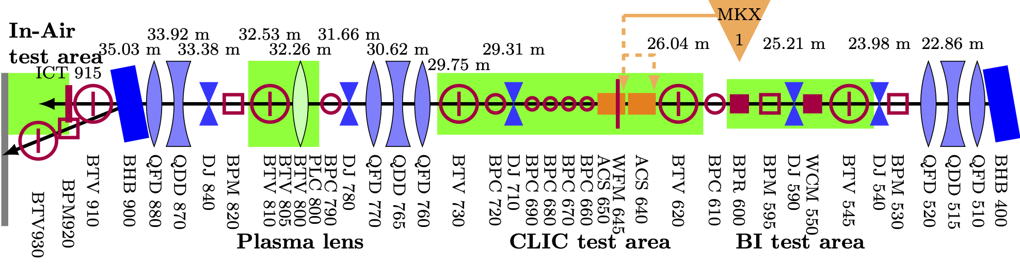
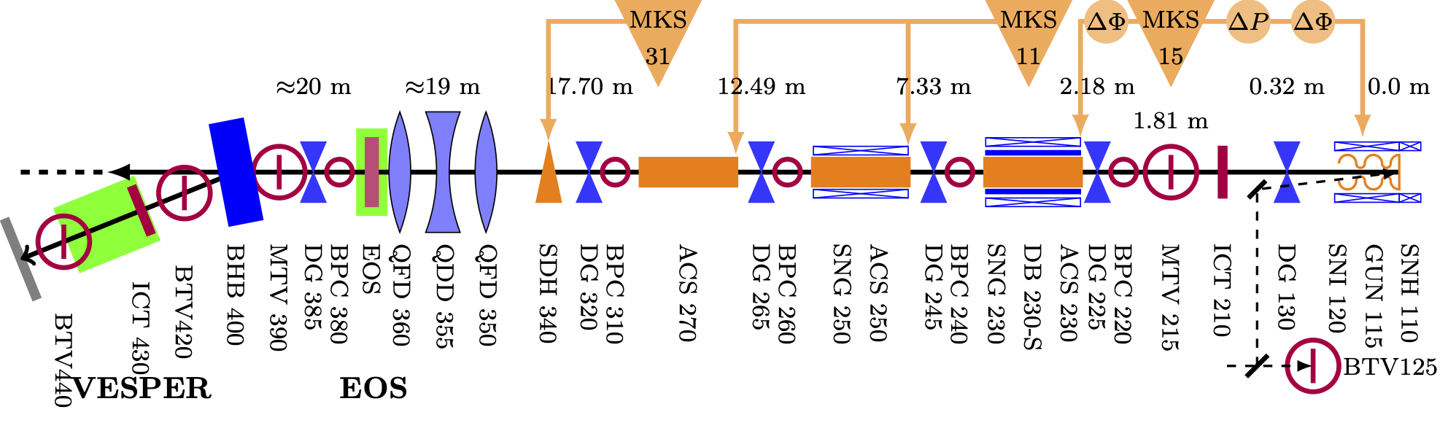
CLEAR Line
CLEAR New Beamline

Slide 14
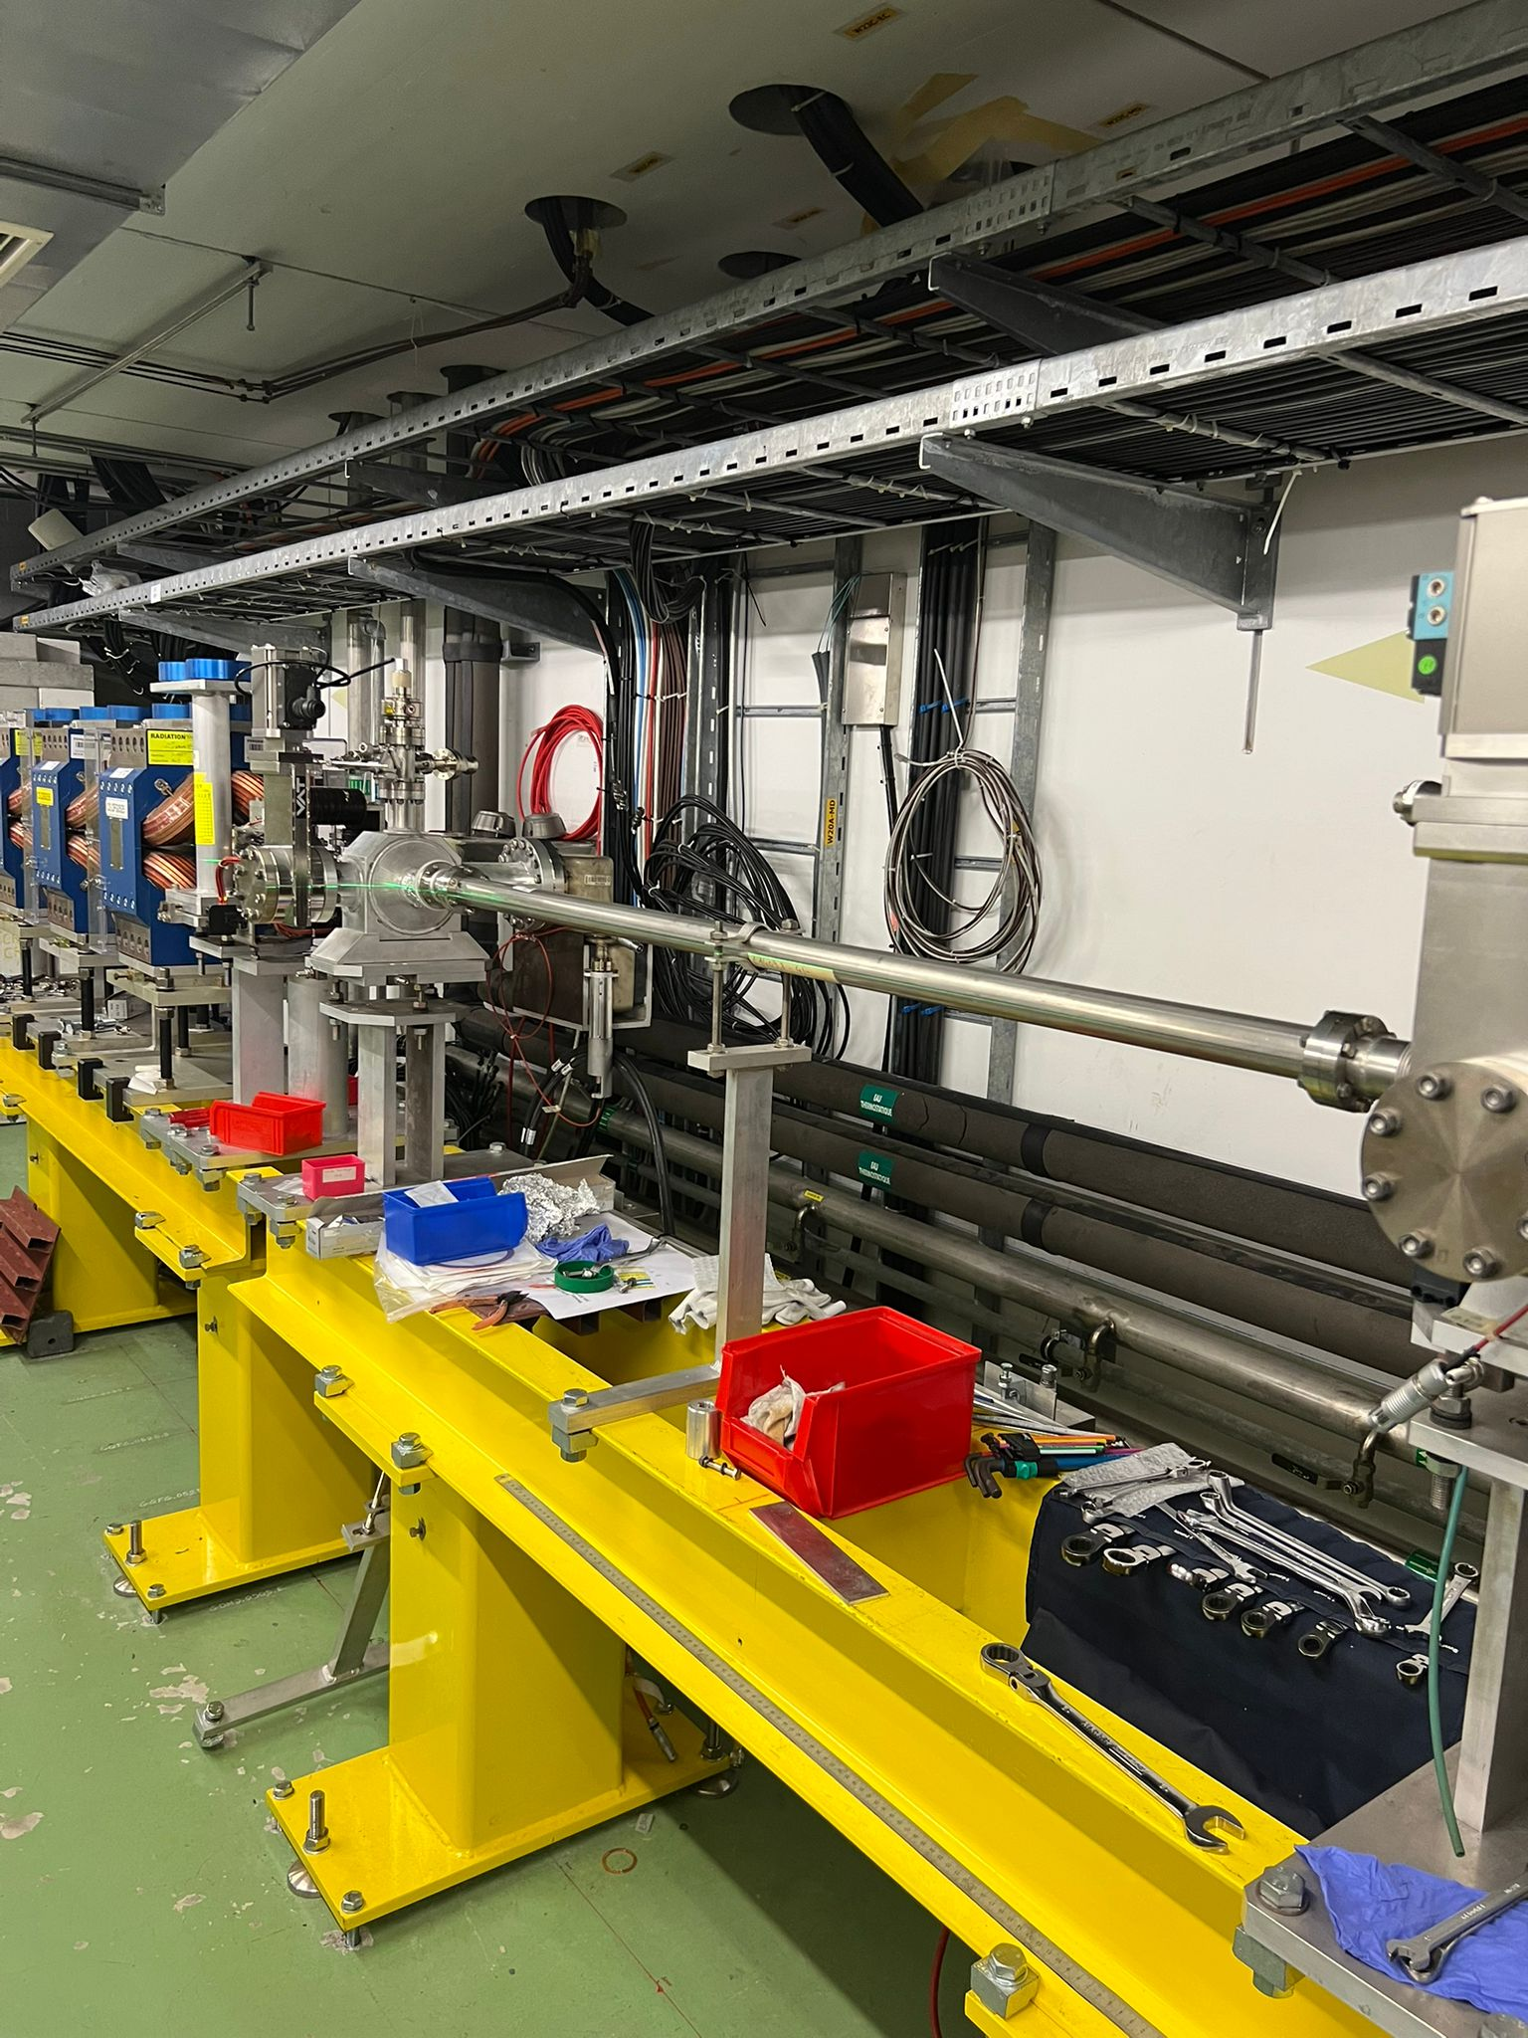
2nd Beamline Photos

