Slide 1

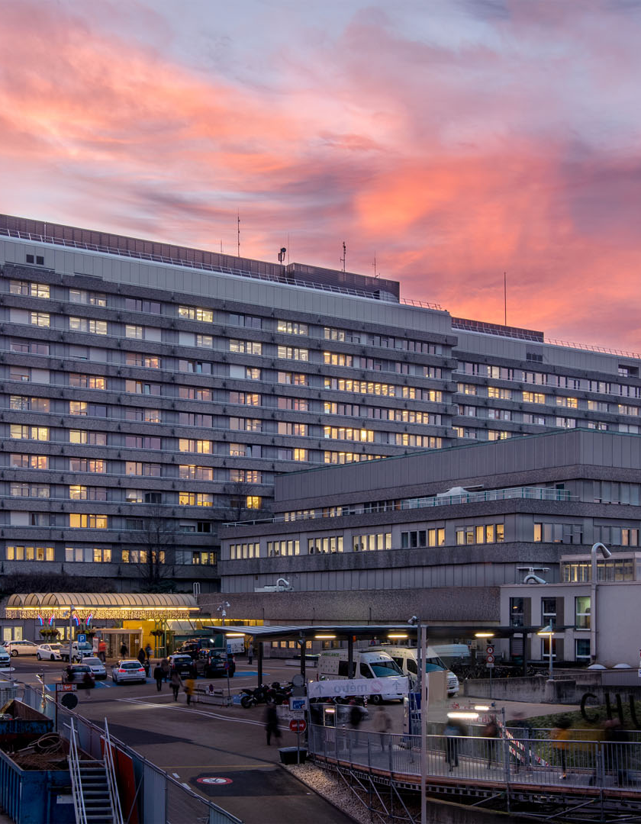

The optimal Very High Energy Electron beam parameters to treat glioblastoma using Pencil Beam Scanning
Katie O’Shea¹, Michele Zeverino¹, Luis Schiappacasse², François Bochud¹, Raphaël Moeckli¹, Till Tobias Böhlen¹
¹ Institute of Radiation Physics, Lausanne University Hospital and Lausanne University, Lausanne, Switzerland
² Department of Radiation Oncology, Lausanne University Hospital and Lausanne University, Lausanne, Switzerland
VHEE Workshop – Daresbury – 16.09.2025

Slide 2
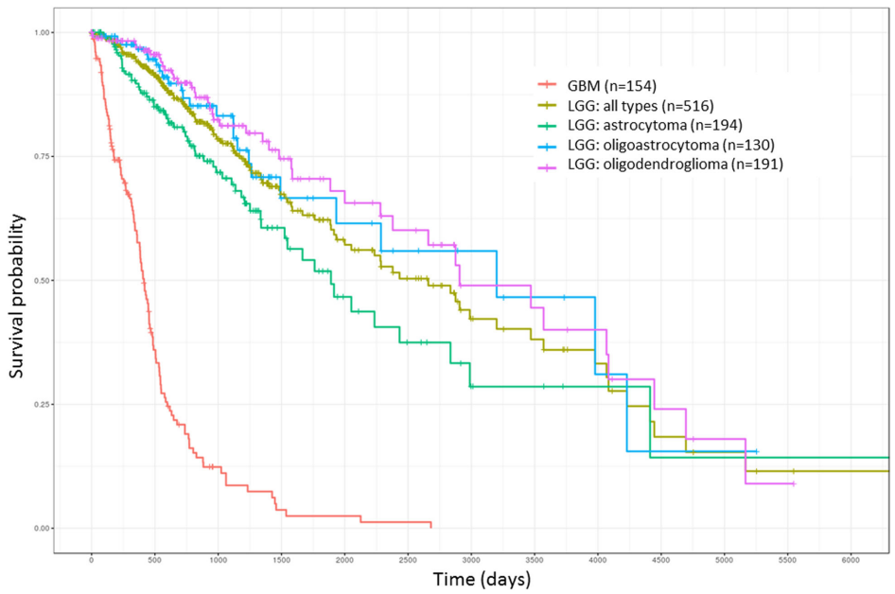

Motivation
Glioblastoma Most common central nervous system tumour
Poor prognosis
VHEE Deep-seated tumours Inhomogeneous media Potential for FLASH at ultra high dose rates
Hsu, Justin Bo-Kai, et al. "Identification of potential biomarkers related to glioma survival by gene expression profile analysis." BMC medical genomics 11.Suppl 7 (2019): 34.

Slide 3
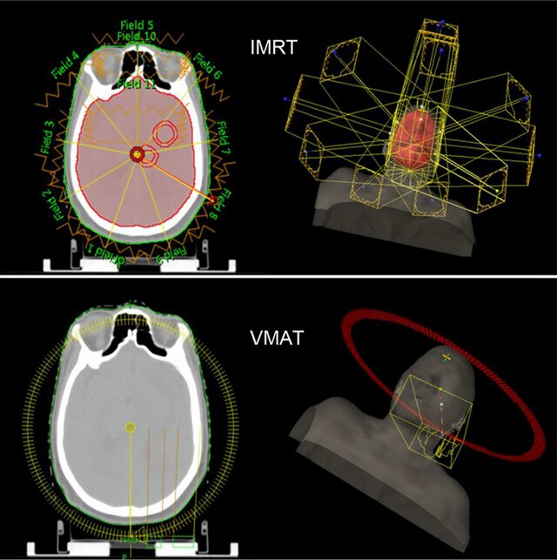
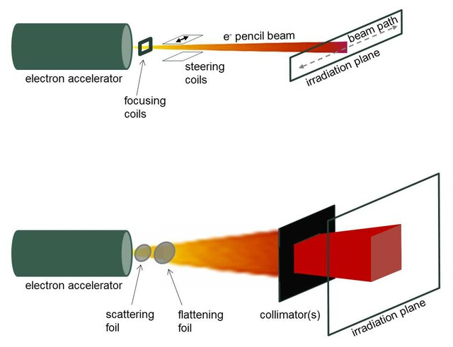
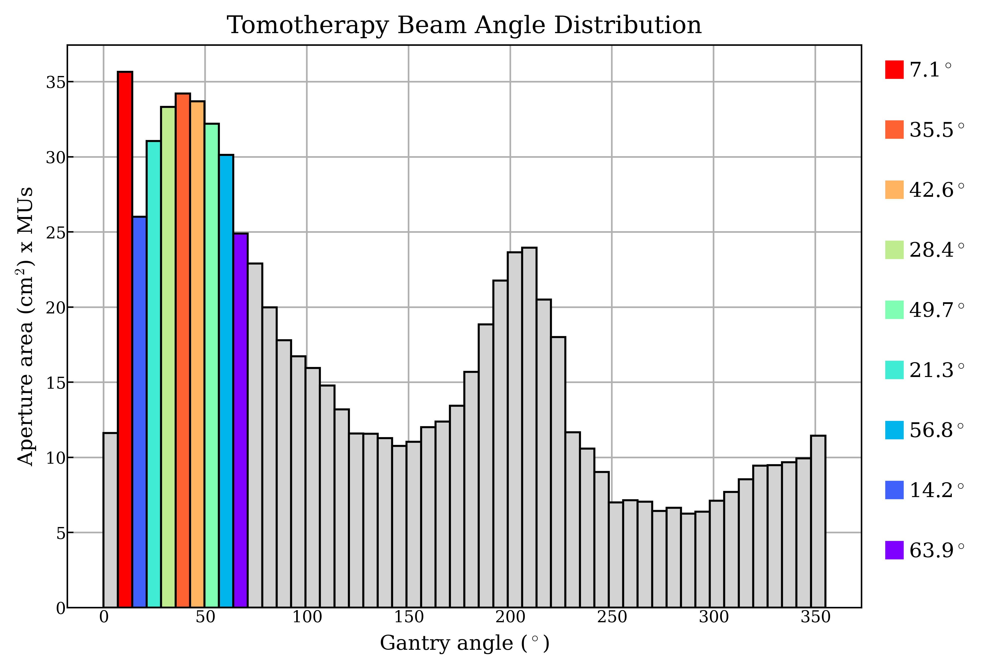
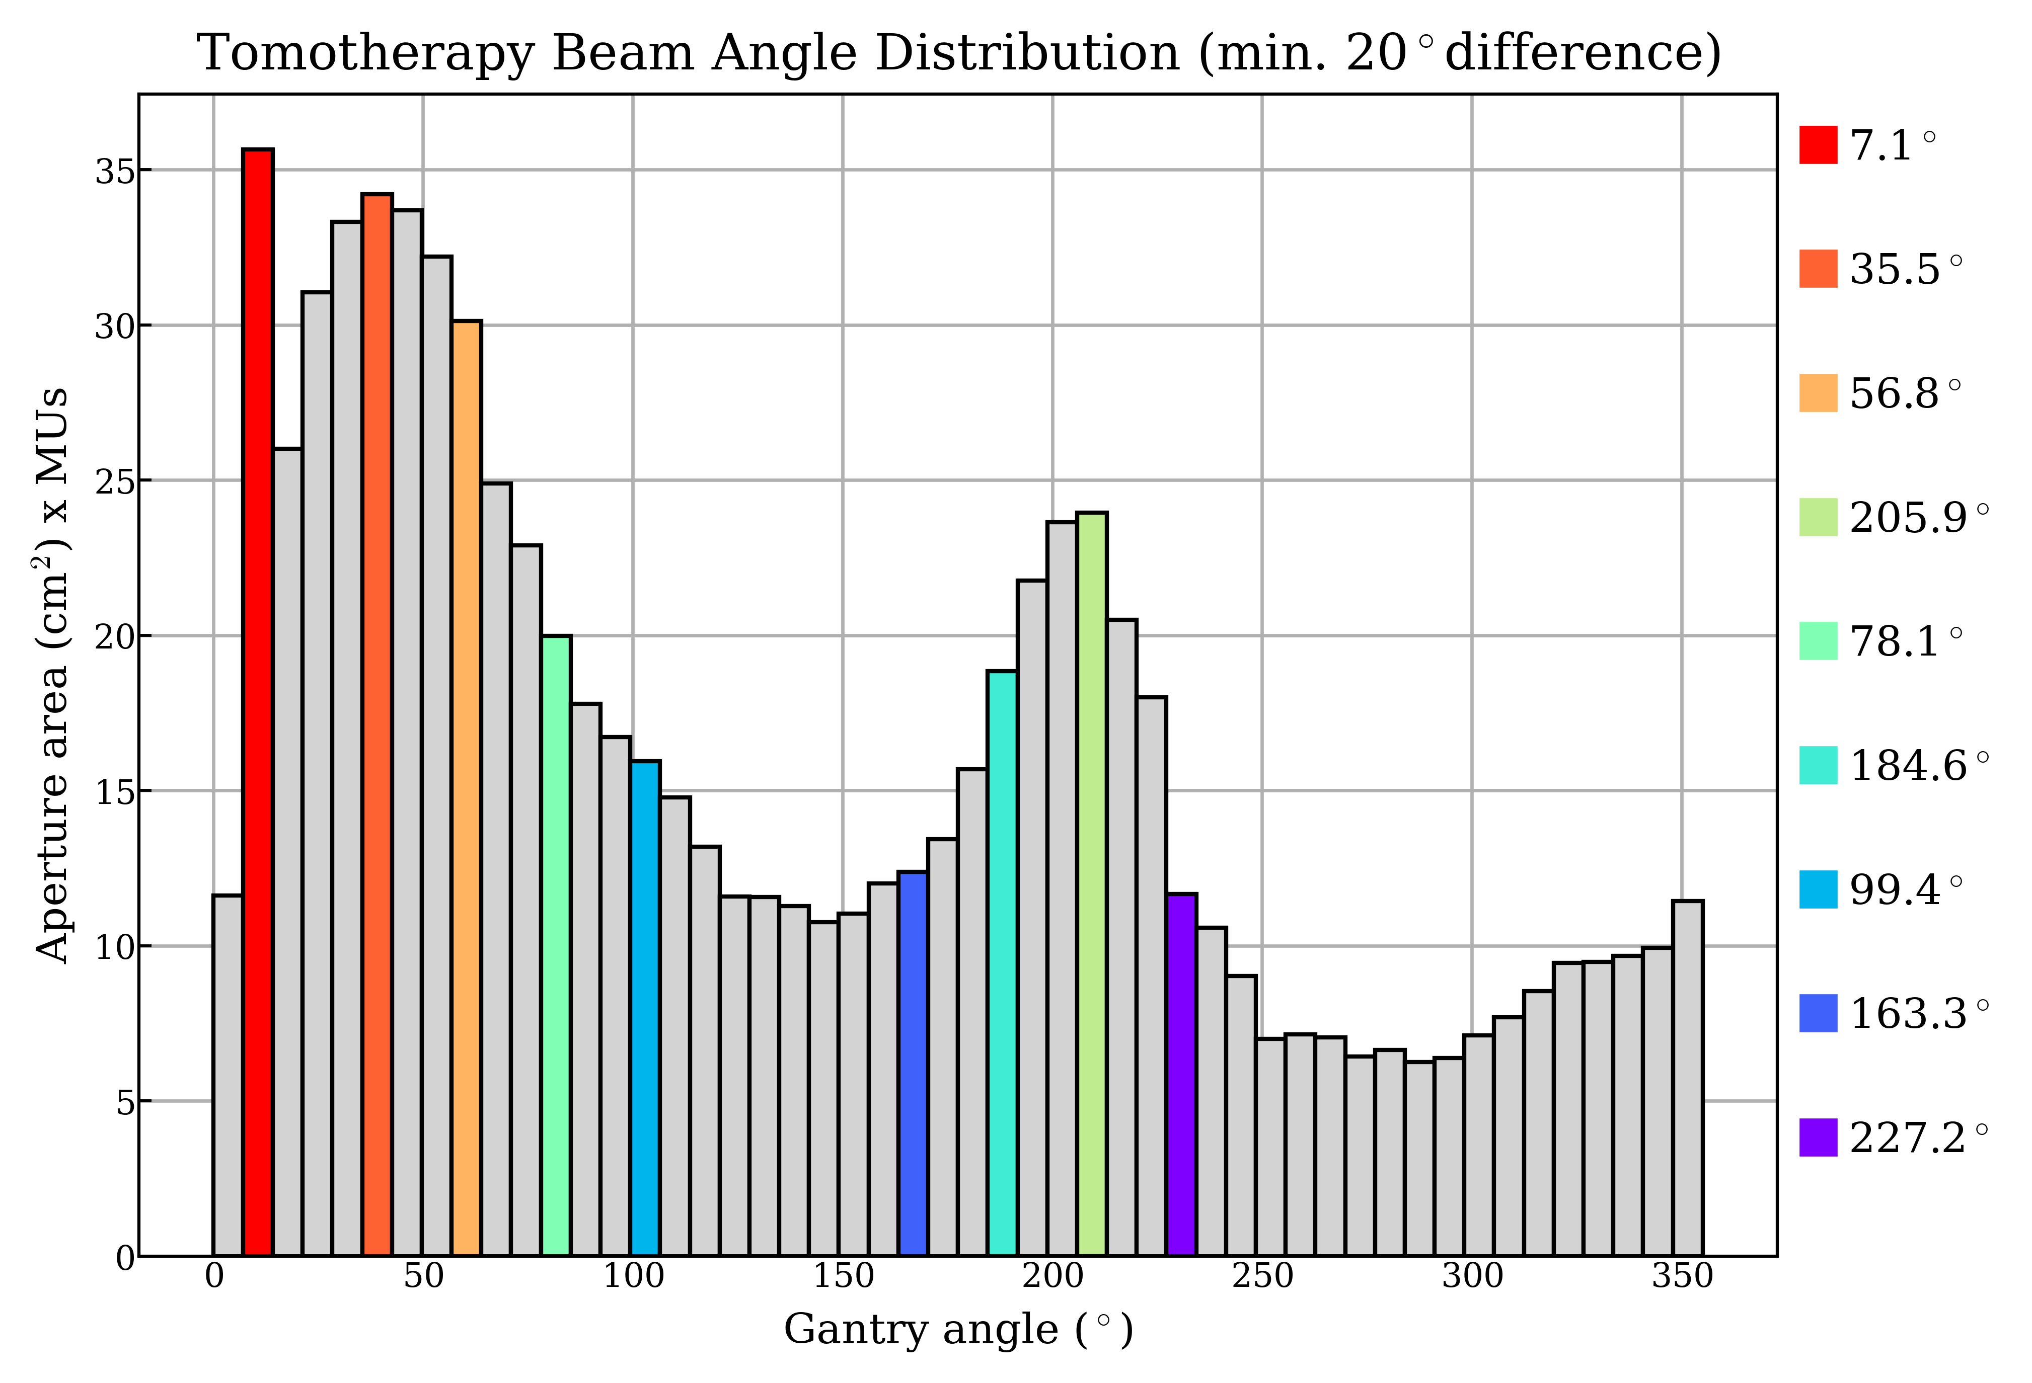
Motivation
10 patients
Beams: 2-16 beams
Beam placement: Equidistant (EQD) or Beam Angle Optimised (BAO)
Energies 50-250 MeV
Spot sizes (FWHM) (spacings)
5 mm (1-3σ)
10 mm (1-3σ)
15 mm (1σ)
20 mm (1σ)
9 beam
Equidistant
Balasubramanian, S., et al. Radiation and Environmental Biophysics 63.1 (2024): 47-57.
Adrich, Przemysław. Nuclear Instruments and Methods in Physics Research Section A 817 (2016): 93-99.

Slide 4
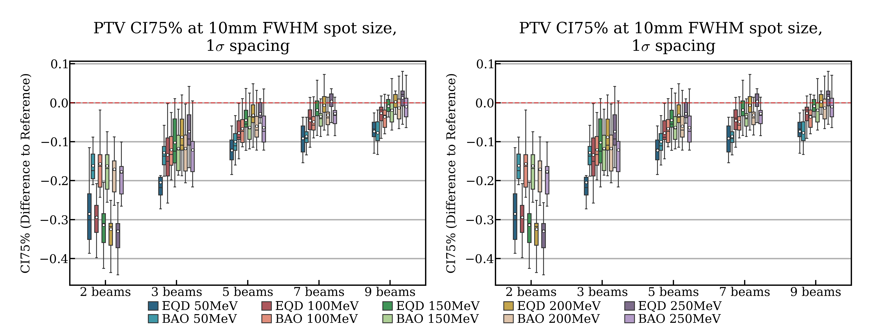
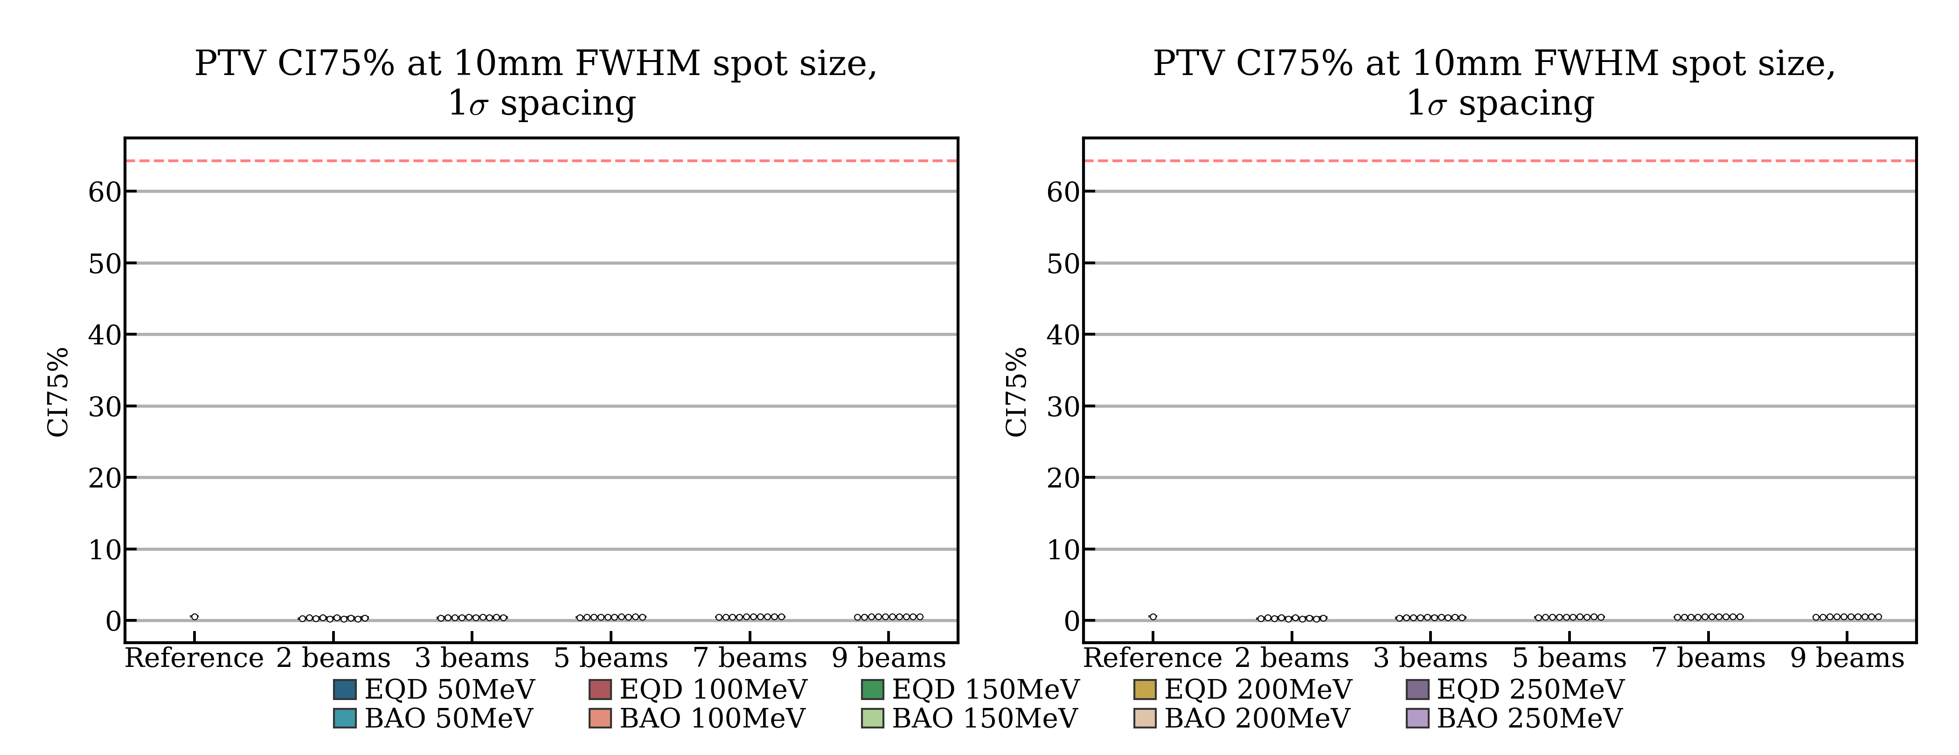
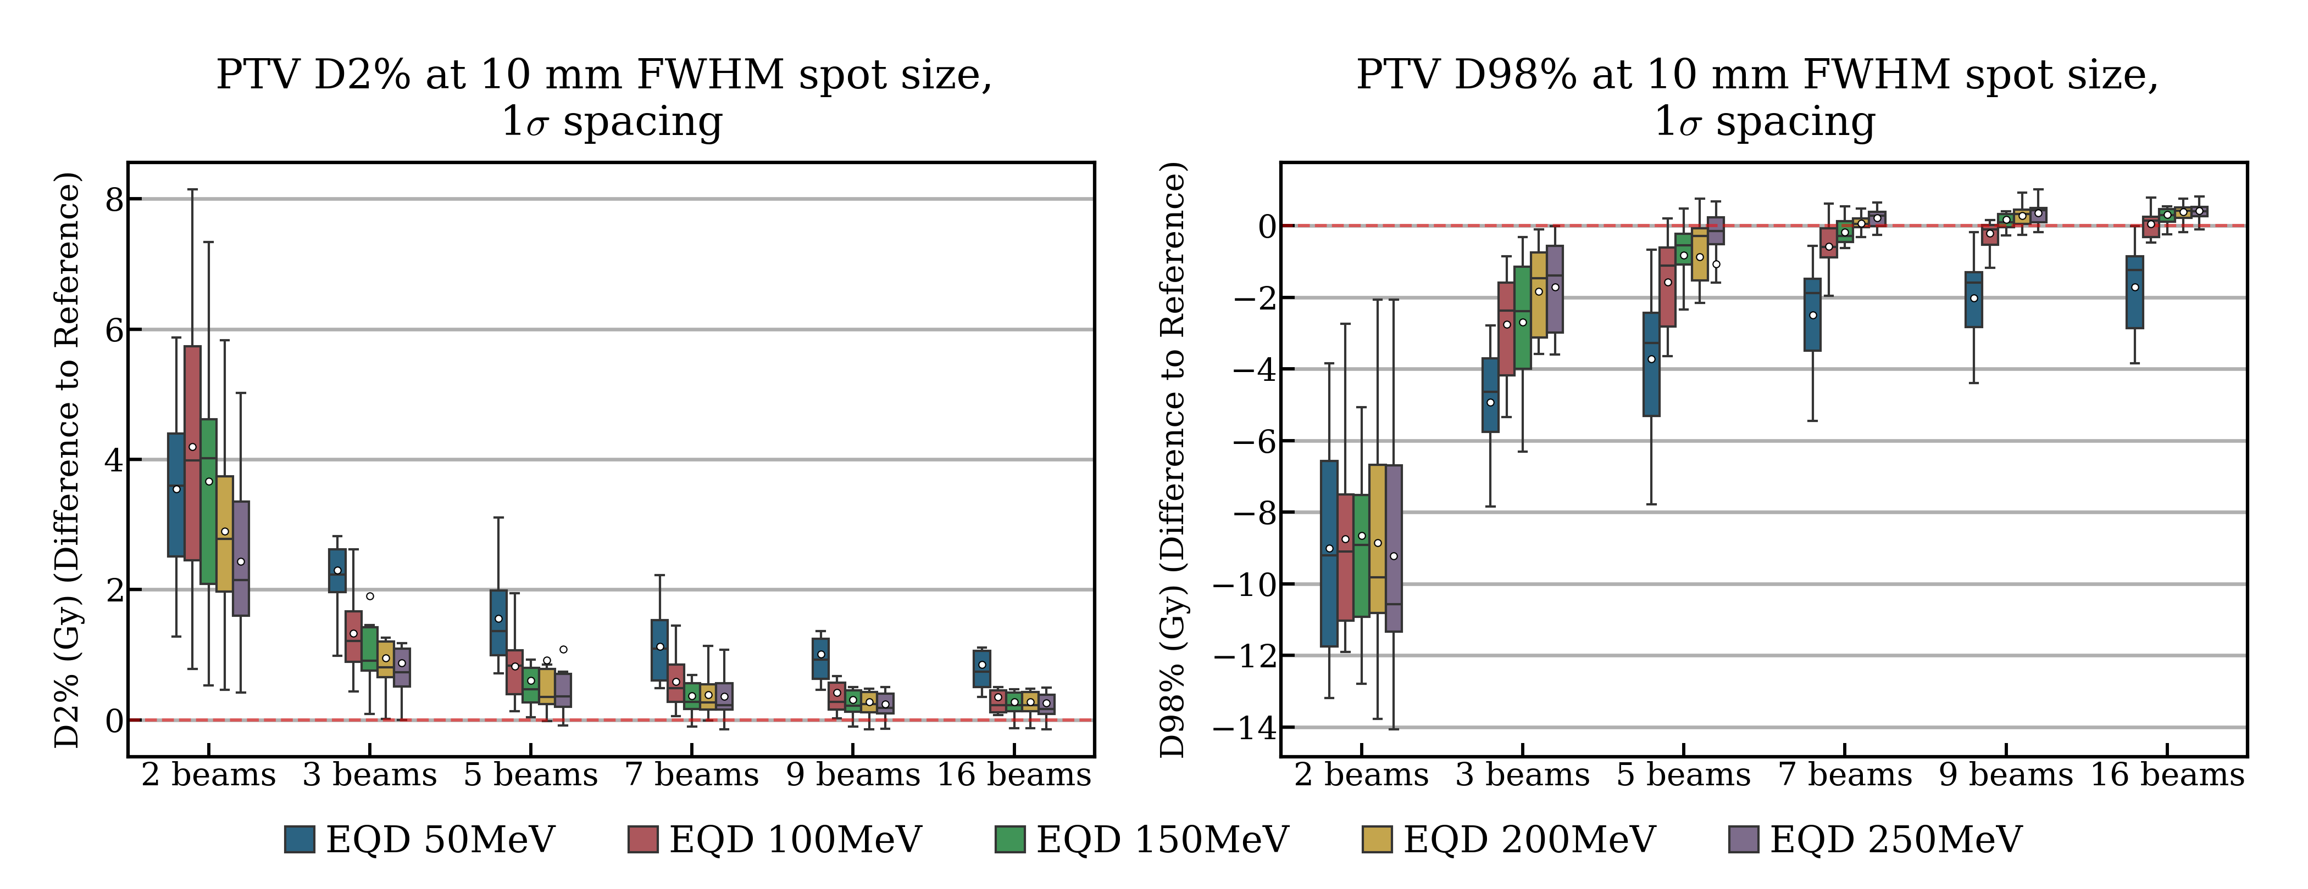
Results
EQD selected over Beam Angle Optimised (BAO)
Beam count ≥ 5 beams and energies ≥ 150 MeV required

Slide 5
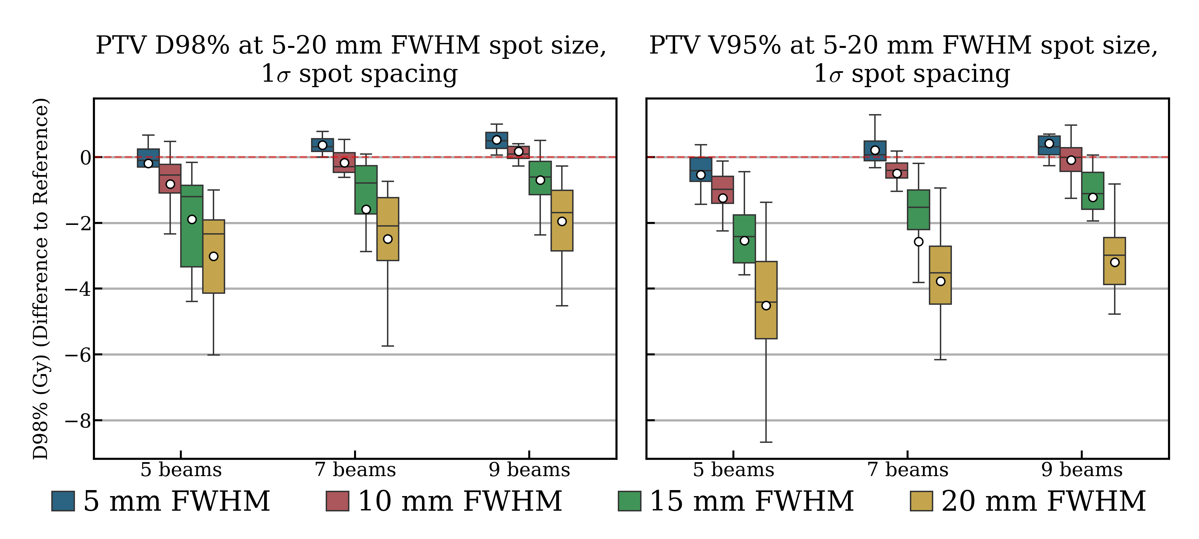
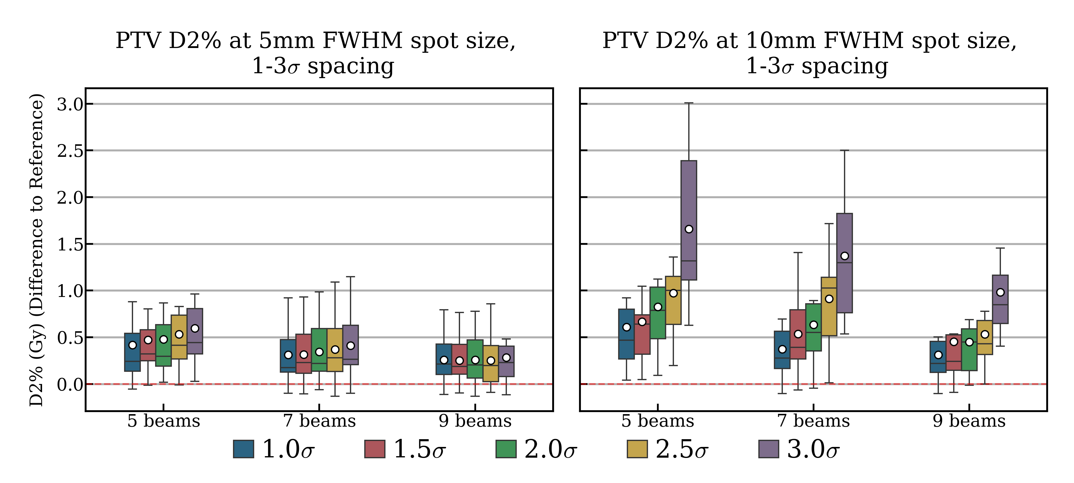
Results
Spot sizes ≥ 15 mm FWHM degraded conformity and PTV coverage
Spacing up to 3σ at 5 mm FWHM
Spacing up to 2σ at 10 mm FWHM

Slide 6
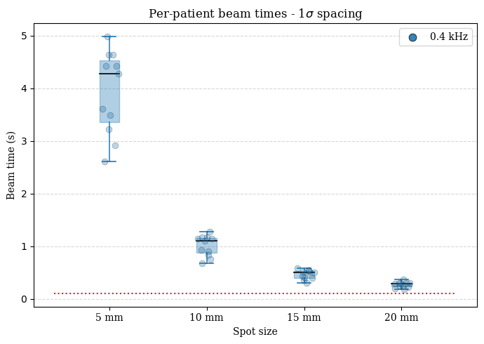
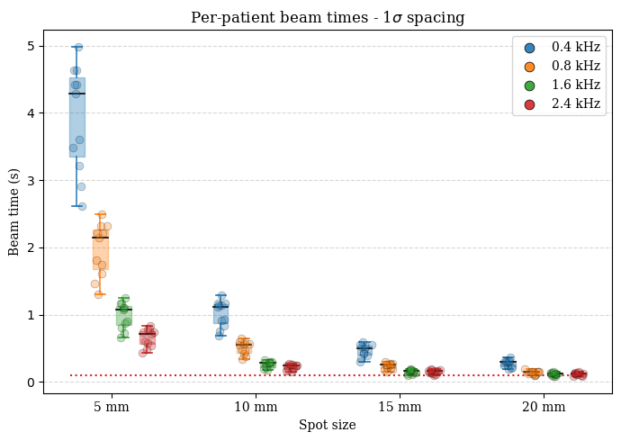
Conclusion and future work
Physical dose parameters:
Spot sizes (FWHM) (spacing):
5mm (1-3σ)
10mm (1-2σ)
Beams: ≥ 5 beams
Placement method: Equidistant
Energies: ≥ 150 MeV
Future work:
Energy modulation
Temporal aspects
Magnitude of FLASH sparing

Slide 7
Thank you!
Any questions?

