Slide 1


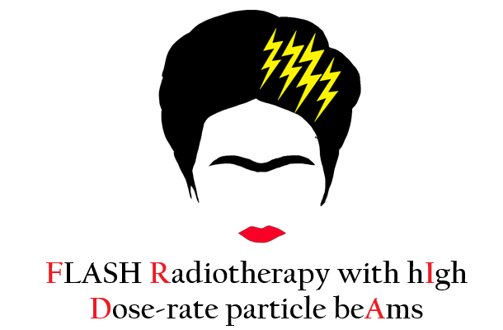





Power and Beam Dynamics Optimization for a VHEE FLASH LINAC
Stefano Farina
Notes:
‹#›

Slide 2

Introduction
Goal: Understand the leading design choices for a VHEE FLASH LINAC.
Such an accelerator has to be as compact and cost effective as possible for a future implementation in hospital environment.
Optimized aspects for a 100 MeV machine:
RF Power Source – Minimizing power (20 MW ?).
RF Cavities – Balance between gradient, simplicity, compactness.
Electron Source – High current for UHDR.
Beam Delivery – Simple and feasible schemes.
VHEE 2025 15–17 set 2025 - STFC, Daresbury Laboratory
S. Farina et al.
‹#›
Notes:
‹#›

Slide 3
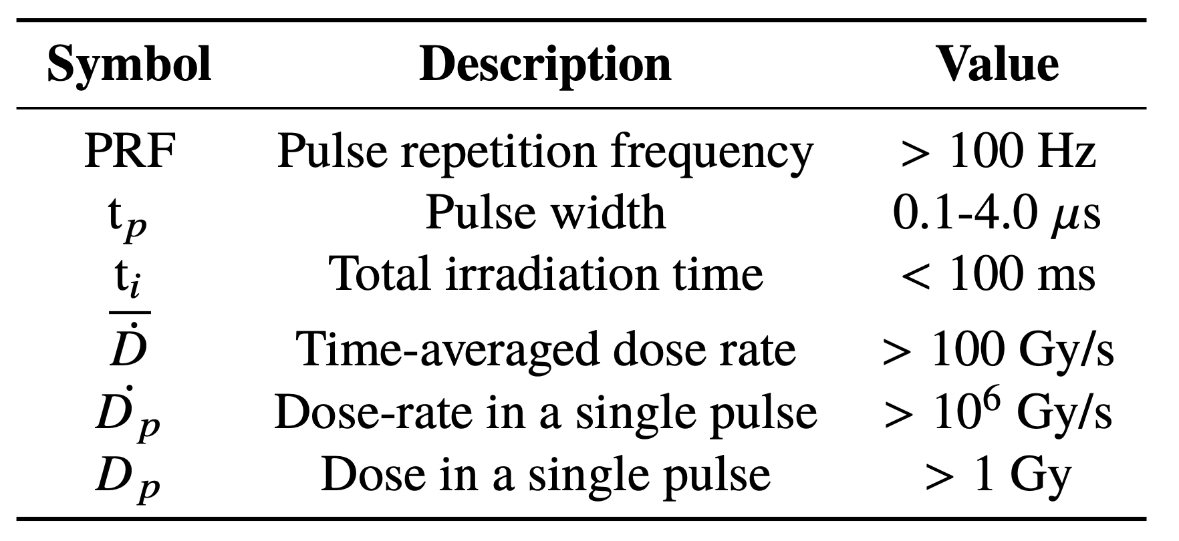
FLASH Radiation Parameters
FLASH irradiation spares healthy tissues from damage while maintaining the same effectiveness as conventional irradiation in inhibiting tumor growth
Courtesy of L. Giuliano
VHEE 2025 15–17 set 2025 - STFC, Daresbury Laboratory
S. Farina et al.
‹#›
Notes:
‹#›

Slide 4
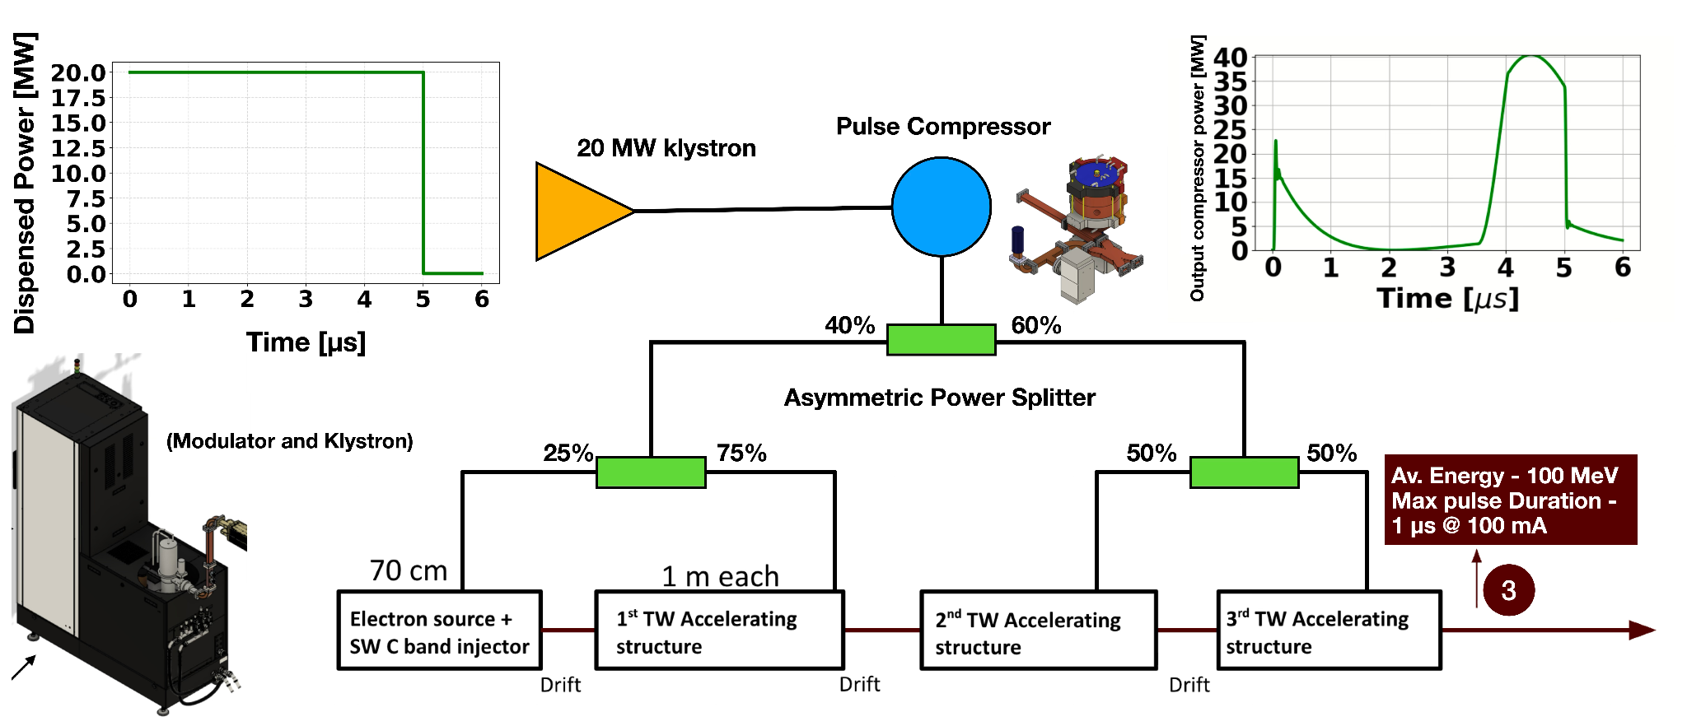
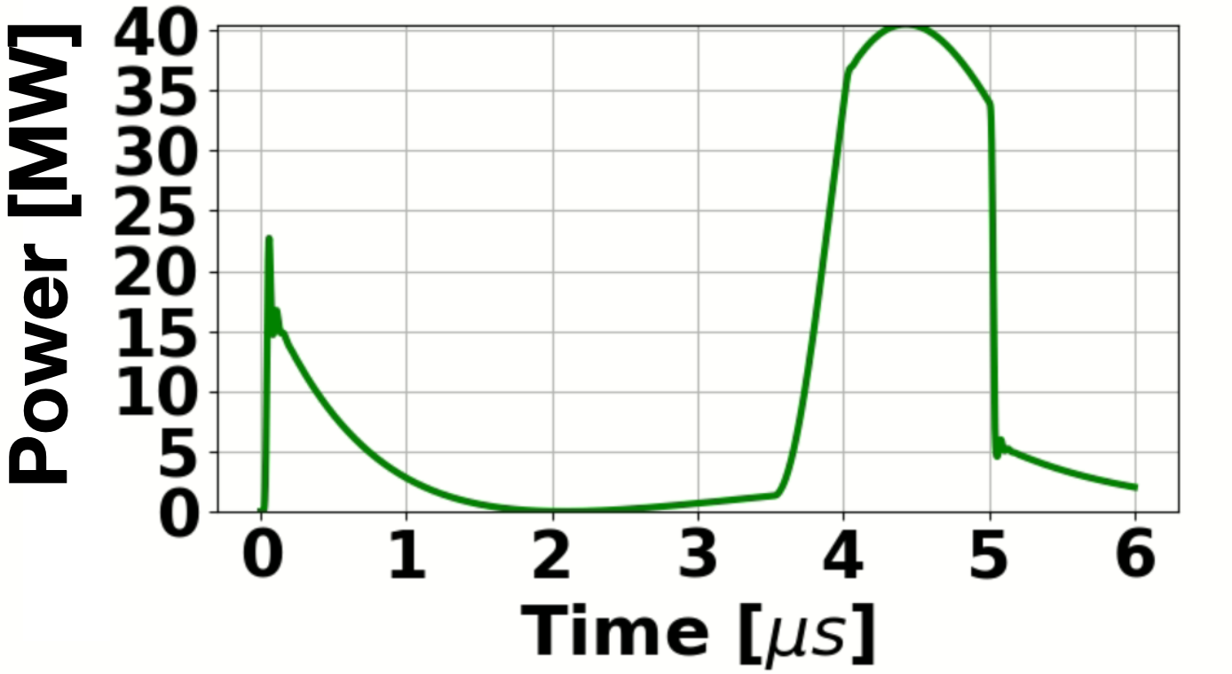
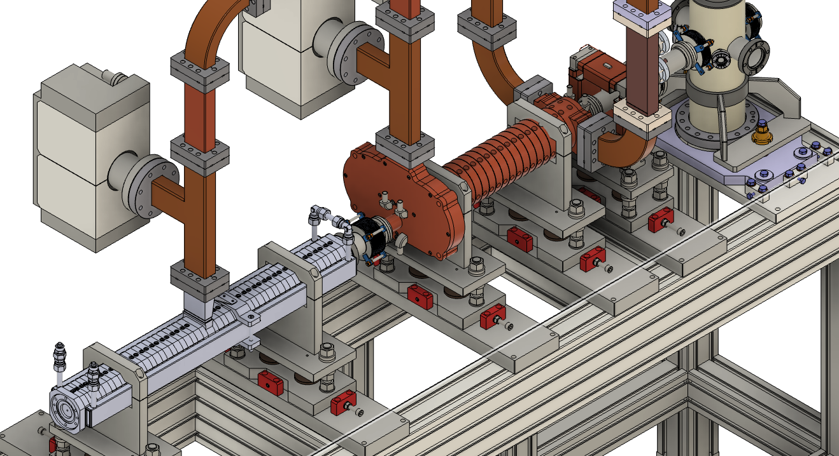
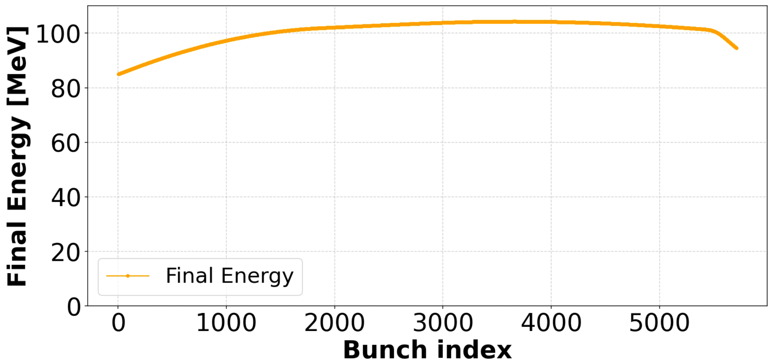
Design of 100 MeV FLASH LINAC
Compressed pulse
1 μs
beam
70 cm
1 m each
30 MV/m (loaded)
Drift
Loaded
VHEE 2025 15–17 set 2025 - STFC, Daresbury Laboratory
S. Farina et al.

Slide 5
Design of 100 MeV FLASH LINAC
Compressed pulse
1 μs
beam
Klystron Power | 20 MW
Resonant Frequency | 5.712 GHz (C Band)
Final Energy (Loaded) | 100 MeV
Pulse Repetition Frequency | (100 - 200) Hz
Single Pulse duration | (0.1 - 1) μs
Single Pulse charge | ( 1 - 100 ) nC
Number of Structures | 4
Length | 4.35 m
Drift
VHEE 2025 15–17 set 2025 - STFC, Daresbury Laboratory
S. Farina et al.

Slide 6
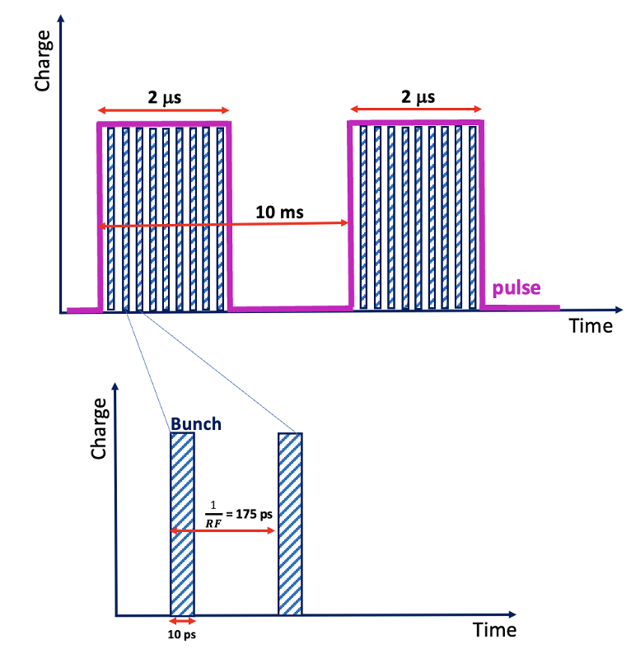
Electron Beam Structure
Current
1 µs
1 µs
Max: 100 mA
175 ps
10 ps
VHEE 2025 15–17 set 2025 - STFC, Daresbury Laboratory
S. Farina et al.

Slide 7
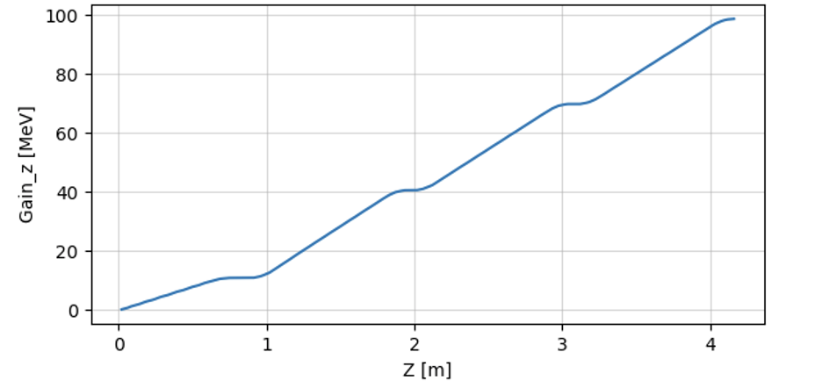
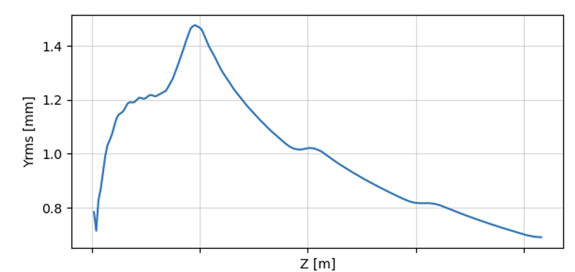
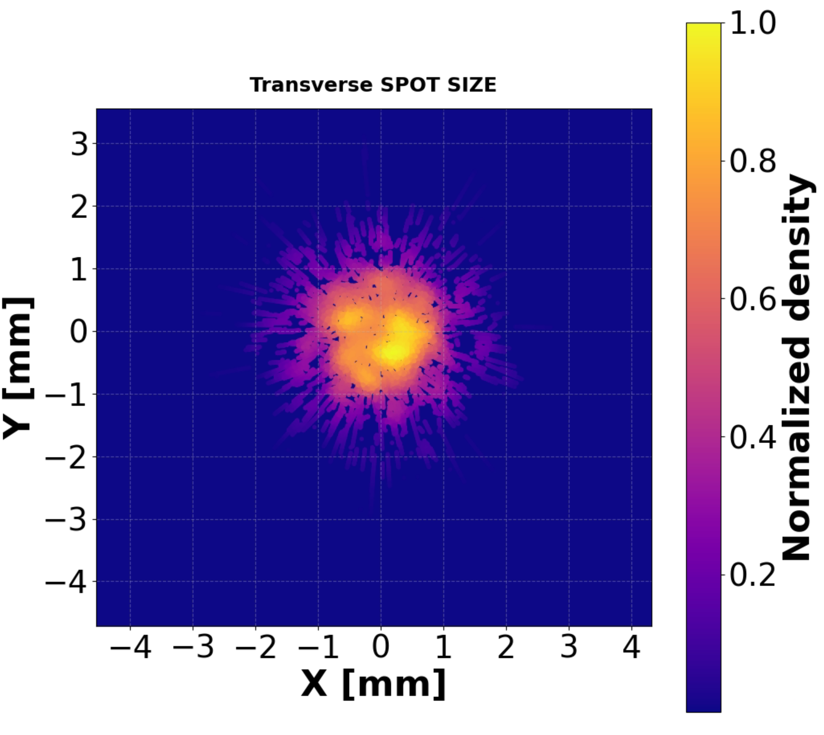
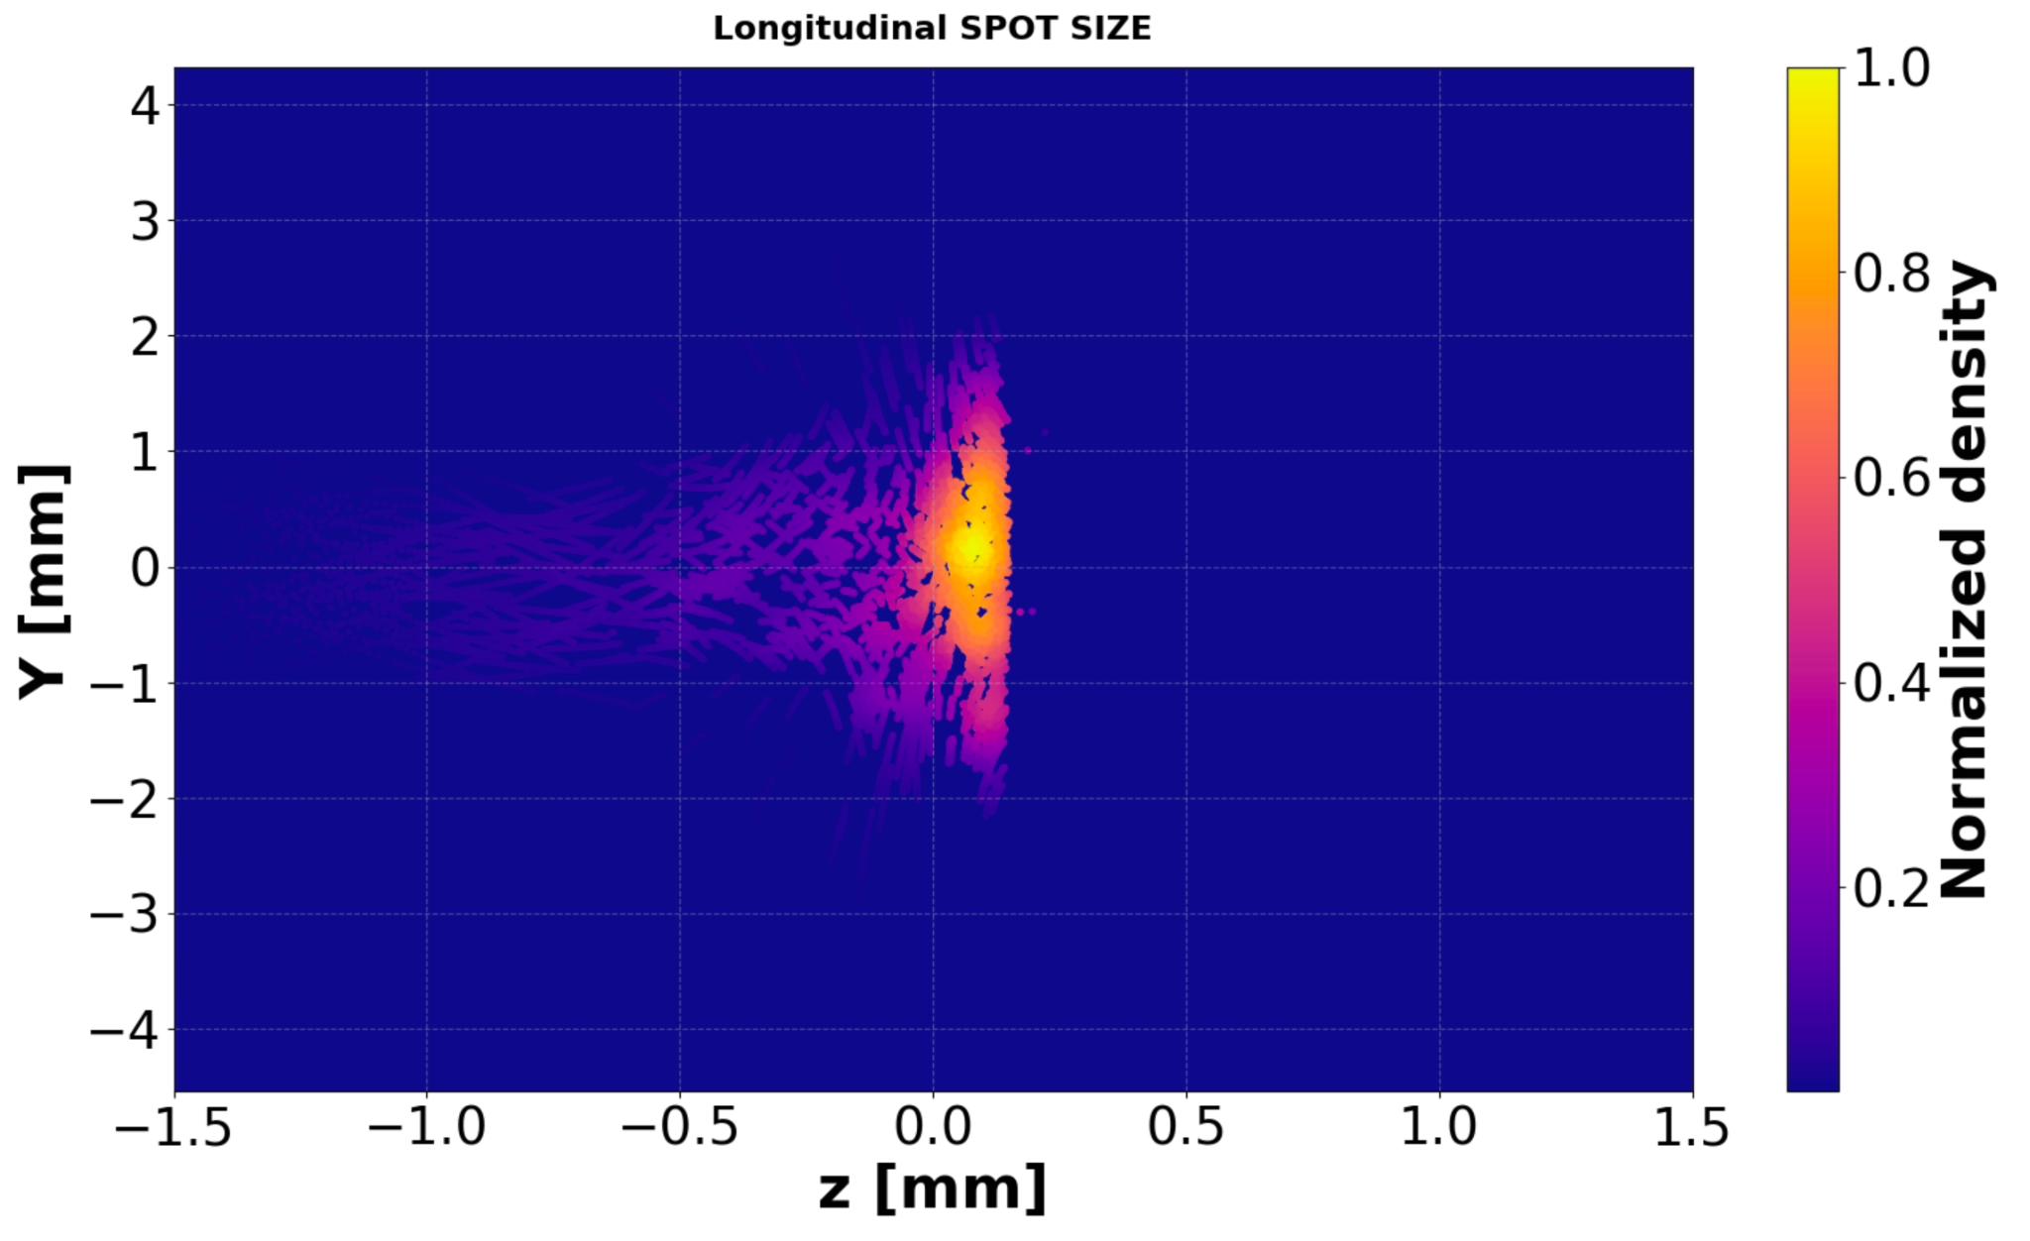
Beam Dynamics Simulations with ASTRA
Previous slides calculation drove the beam dynamics study for the single 1 μs 100 nC pulse establishing the accelerator layout and working point. Then they have been implemented in the ASTRA Simulation tool.
VHEE 2025 15–17 set 2025 - STFC, Daresbury Laboratory
S. Farina et al.

Slide 8
Beam Dynamics Simulations with ASTRA
Previous slides calculation drove the beam dynamics study for the single 1 μs 100 nC pulse establishing the accelerator layout and working point. Then they have been implemented in the ASTRA Simulation tool.
Simulations confirm the feasibility of the proposed working point, showing 100 MeV of simulated energy and good beam transport.
VHEE 2025 15–17 set 2025 - STFC, Daresbury Laboratory
S. Farina et al.

Slide 9
Beam Dynamics Simulations with ASTRA
Previous slides calculation drove the beam dynamics study for the single 1 μs 100 nC pulse establishing the accelerator layout and working point. Then they have been implemented in the ASTRA Simulation tool.
Simulations confirm the feasibility of the proposed working point, showing 100 MeV of simulated energy and good beam transport.
With a higher power Klystron the structures would sustain larger fields making it possible to reach up to 130 MeV
VHEE 2025 15–17 set 2025 - STFC, Daresbury Laboratory
S. Farina et al.

Slide 10
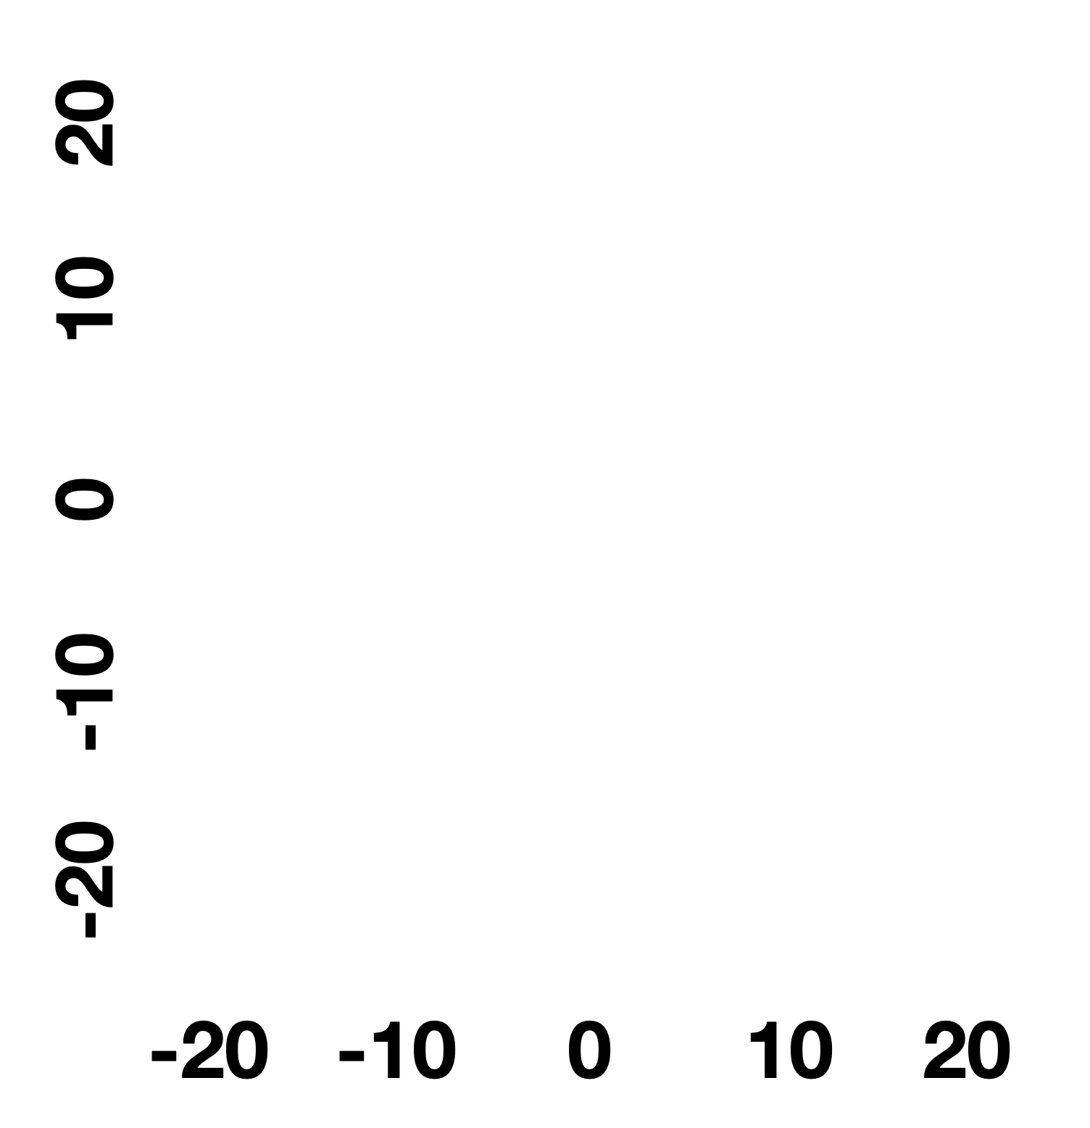
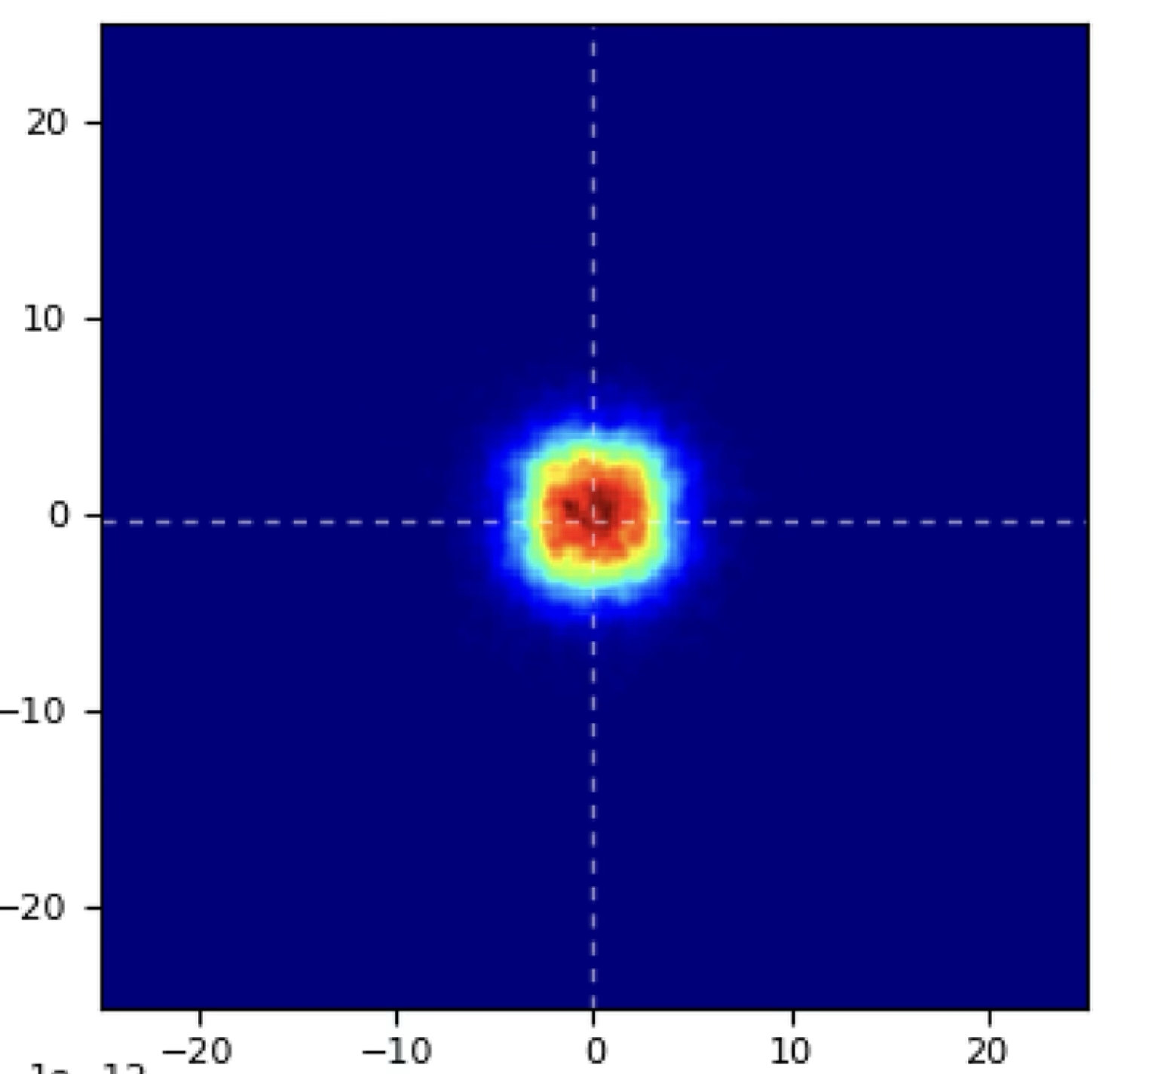
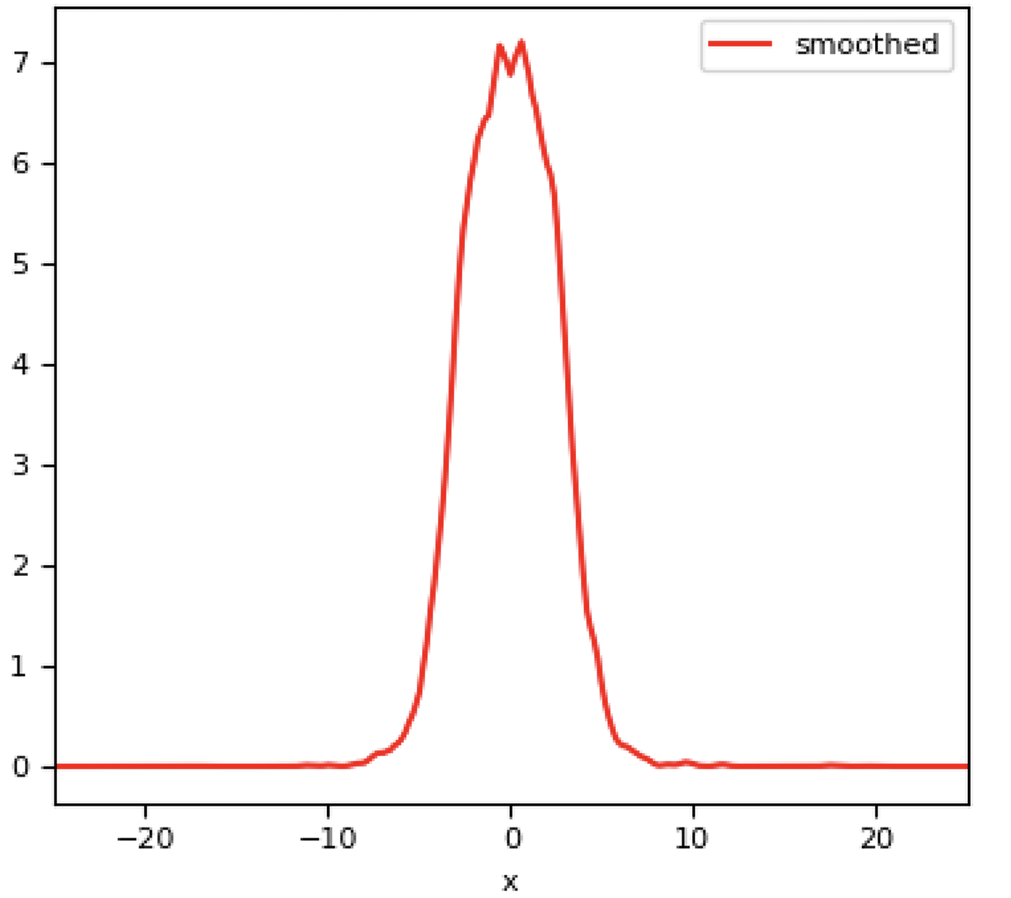
Beam Dose Profile - Large Field
After the LINAC a 0.5 mm PEEK target is placed to increase transverse momentum. After 1 m We have a 10x10 cm beam.
LINAC exit
PEEK
Y [cm]
Beam Profile
X [cm]
(Courtesy of G. Franciosini)
-20 -10 0 10 20
X [cm]
VHEE 2025 15–17 set 2025 - STFC, Daresbury Laboratory
S. Farina et al.
S. Farina et al.
‹#›
Notes:
‹#›

Slide 11
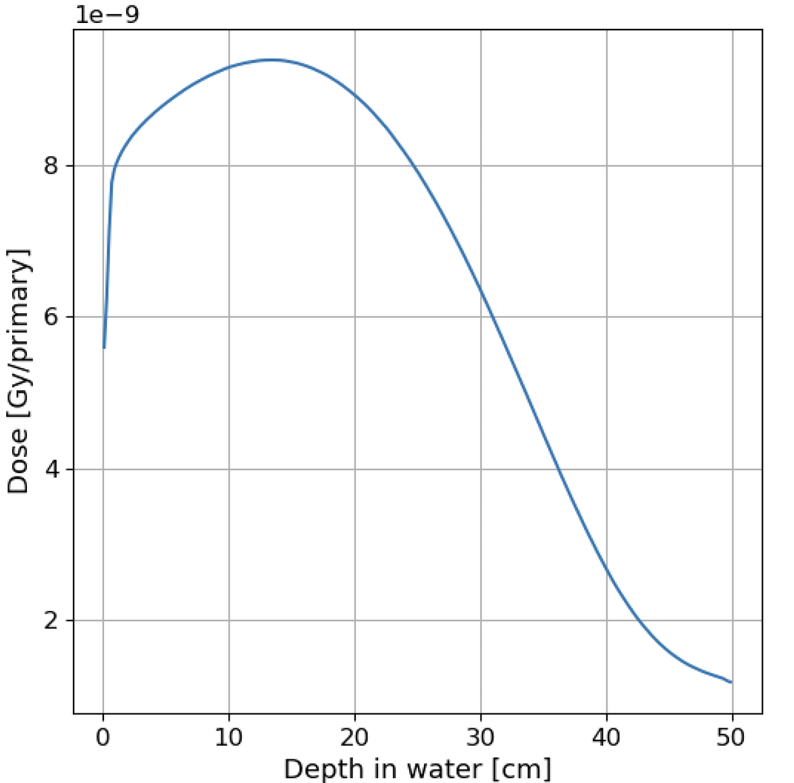
Beam Dose Profile - Large Field
After the LINAC a 0.5 mm PEEK target is placed to increase transverse momentum. After 1 m We have a 10x10 cm beam.
LINAC exit
Dose profile
Arbitrary units
6
4
2
0
PEEK
Y [cm]
Beam Profile
With 100nC of MAX charge, the MAX dose per pulse is 4 Gy in 1 µs
X [cm]
(Courtesy of G. Franciosini)
(Courtesy of G. Franciosini)
-20 -10 0 10 20
X [cm]
VHEE 2025 15–17 set 2025 - STFC, Daresbury Laboratory
S. Farina et al.
S. Farina et al.
‹#›
Notes:
‹#›

Slide 12
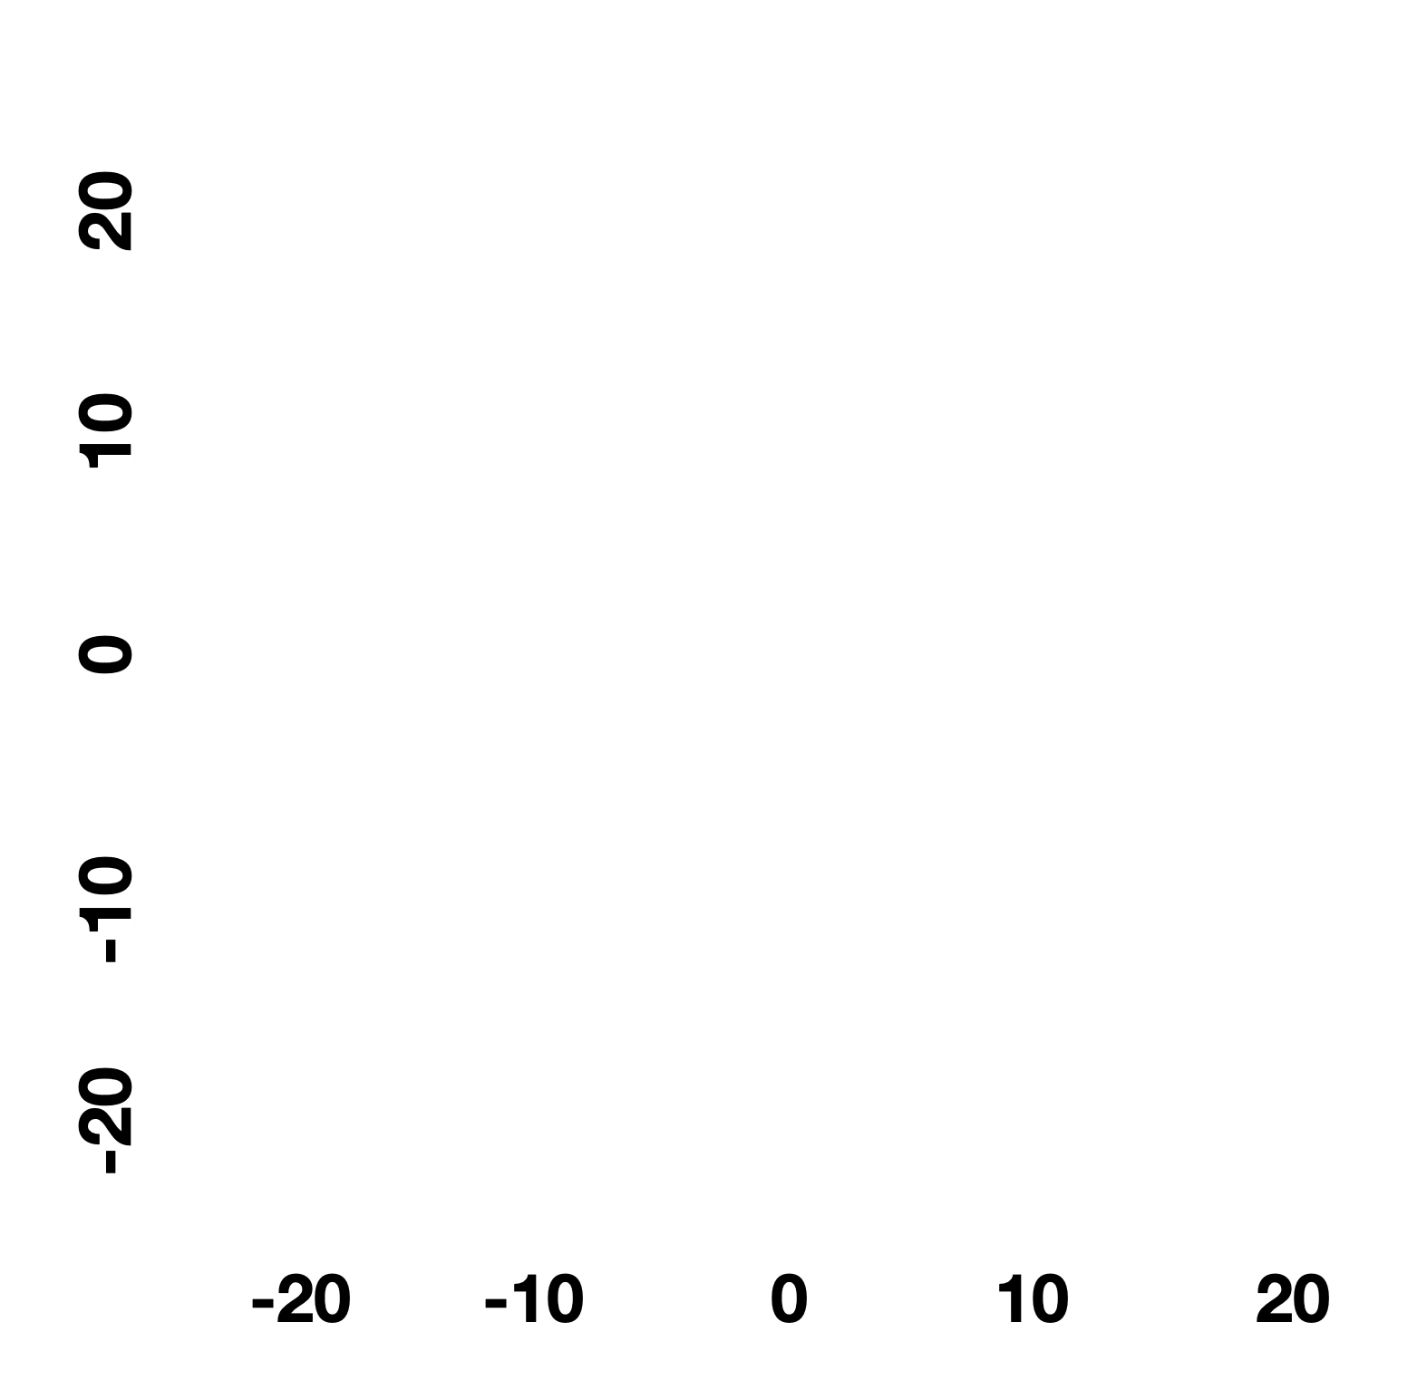
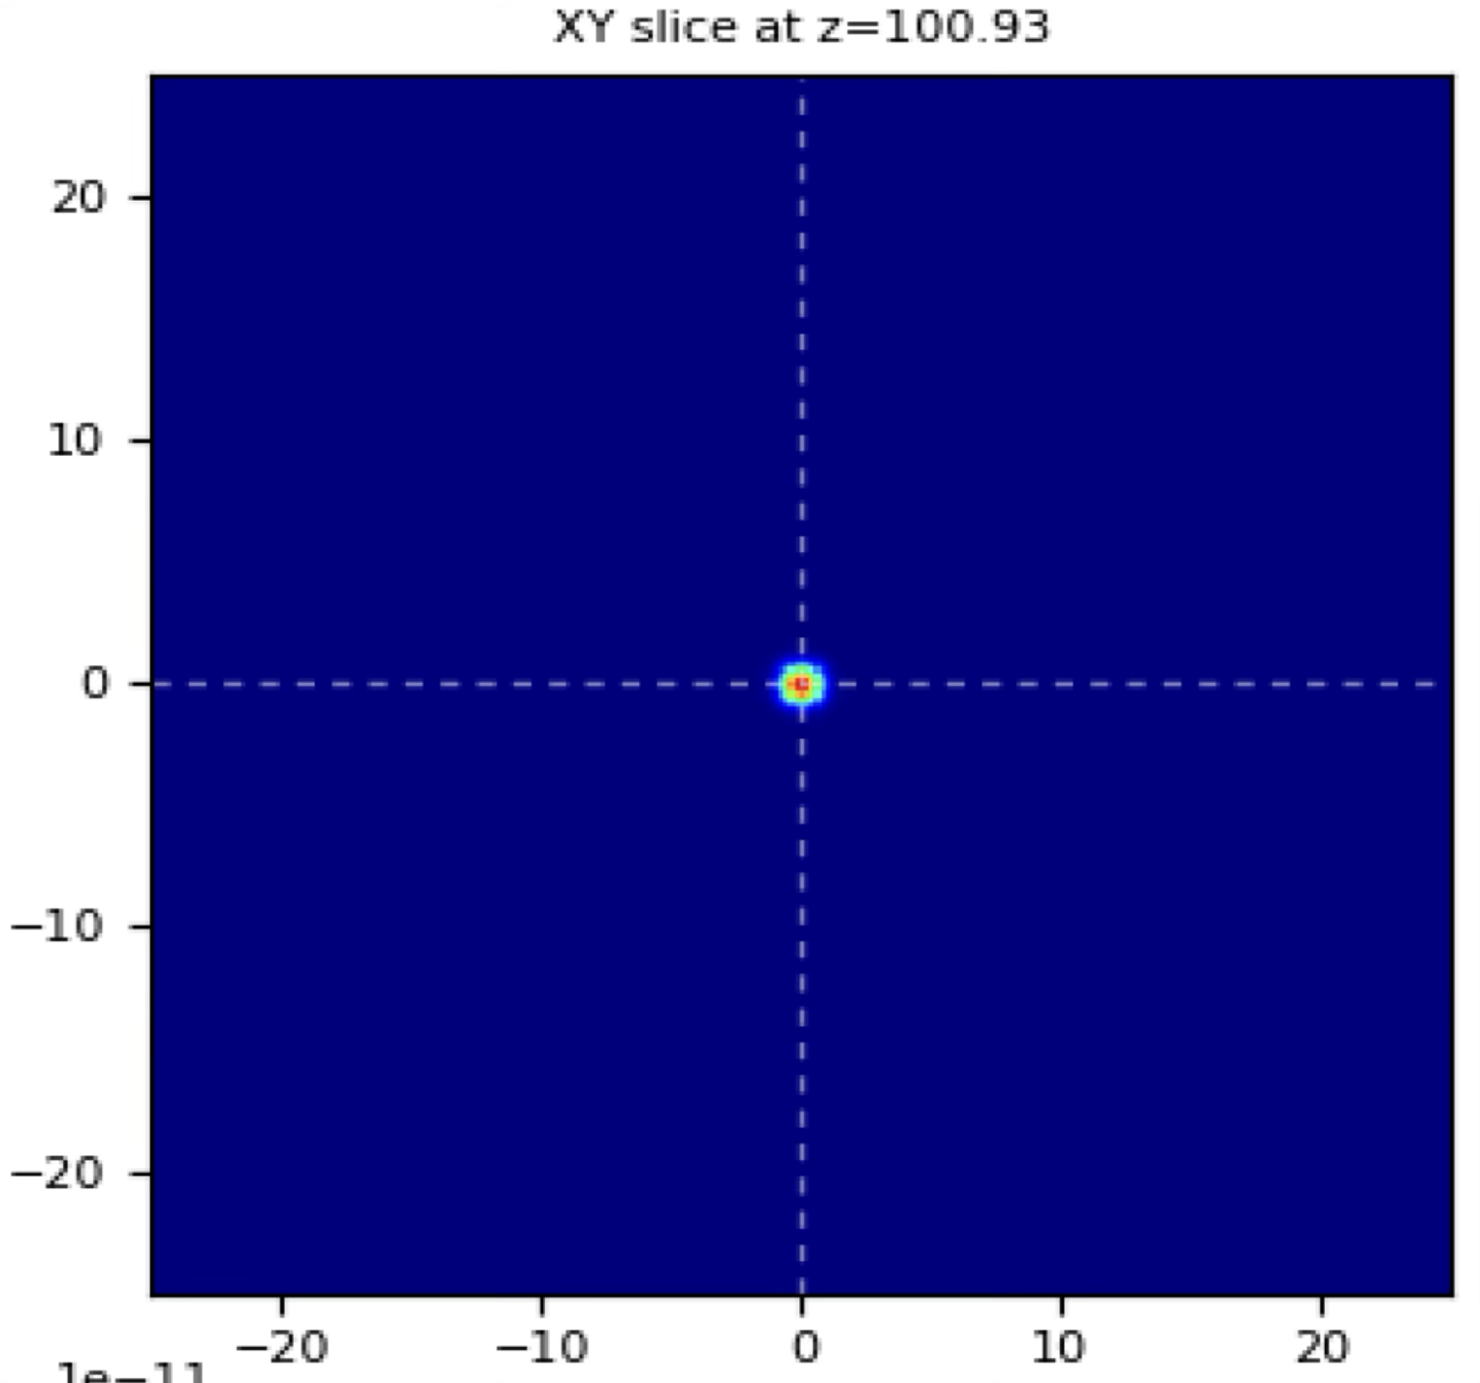
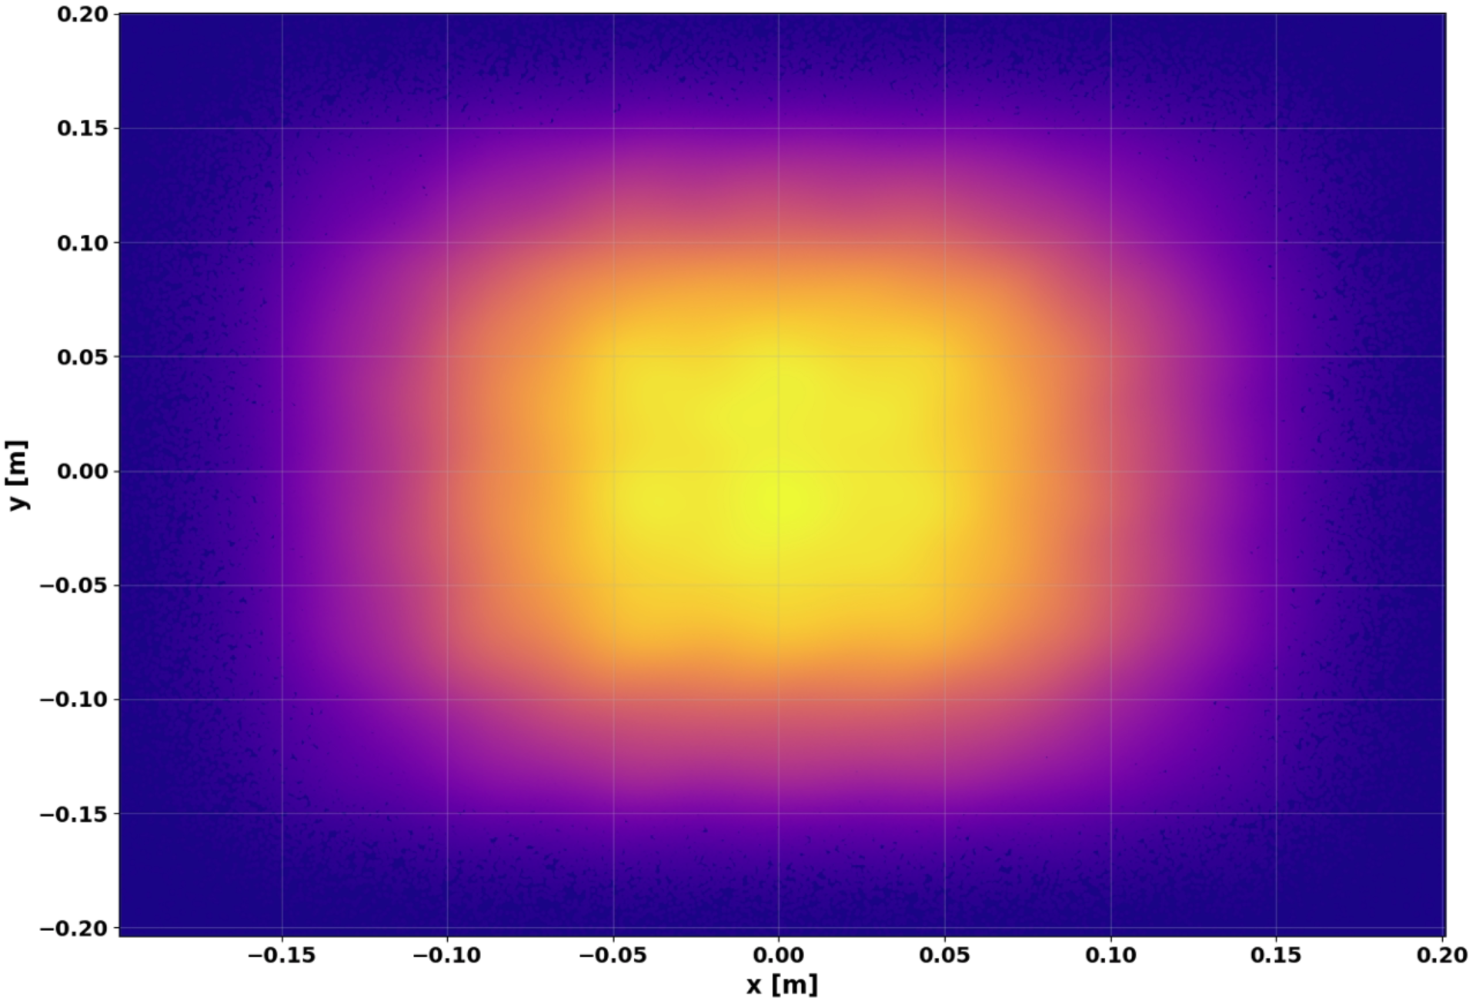
Beam Dose Profile - Pencil Beam Scanning
Y [cm]
6 x 6 cm Scanned surface
X [cm]
In 100 ms we can have 16 pencil beams and scan a wide surface with 0.15 T dipoles and 1 m drifts.
VHEE 2025 15–17 set 2025 - STFC, Daresbury Laboratory
S. Farina et al.

Slide 13
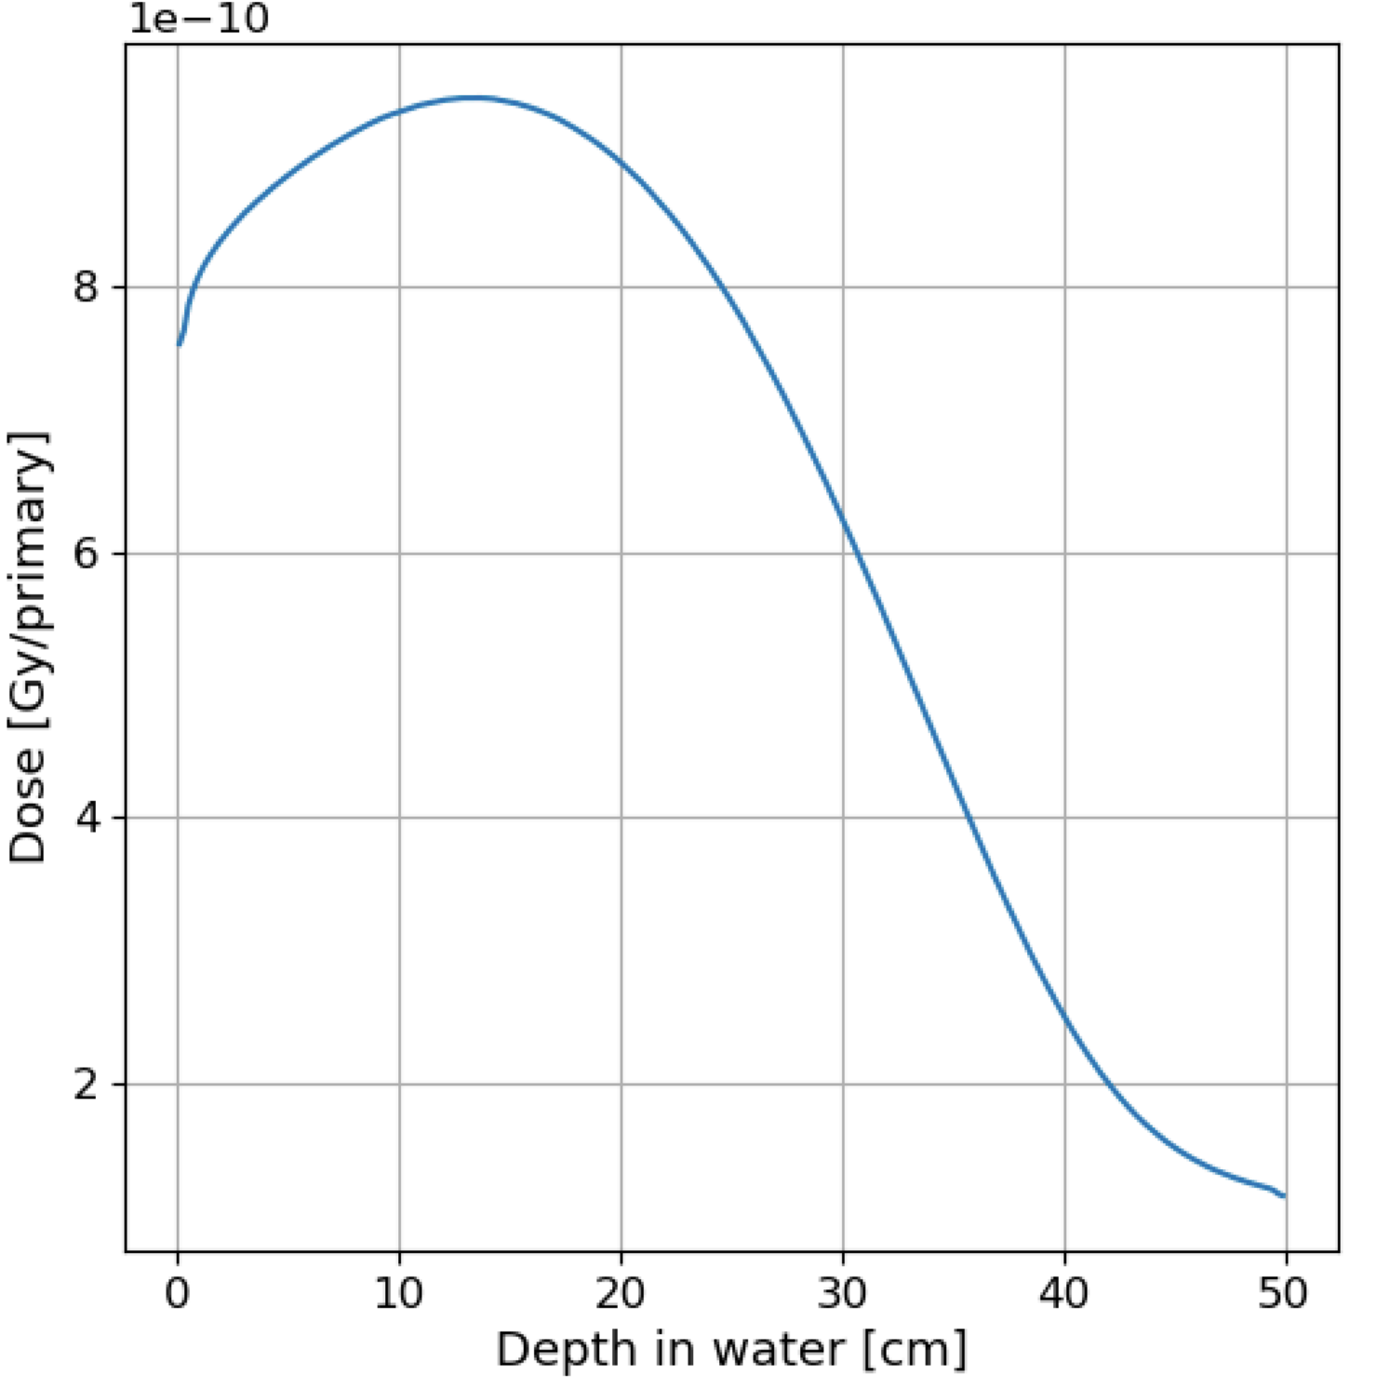
Beam Dose Profile - Pencil Beam Scanning
-9
Dose profile
Y [cm]
Arbitrary units
1.75
1.25
0.75
0.25
6 x 6 cm Scanned surface
With 100nC of MAX charge, the MAX dose per pulse is 100 Gy in 1 µs
X [cm]
In 100 ms we can have 16 pencil beams and scan a wide surface with 0.15 T dipoles and 1 m drifts.
VHEE 2025 15–17 set 2025 - STFC, Daresbury Laboratory
S. Farina et al.

Slide 14
Conclusions
The proposed strategy and layout guarantee VHEE electrons in a compact way optimising the minimal power.
Timing and transported charge are in the FLASH regime.
Beam dynamics simulations show that the beam has the desired features.
Initial study for the wide field implementation shows its feasibility in a relative compact way delivering 4.32 10⁶ Gy/s.
Initial study for the pencil beam scanning gives the basic features for the required dipole fields. Considering the Max Charge per pulse the single PB can deliver up to 116 10⁶ Gy/s.
VHEE 2025 15–17 set 2025 - STFC, Daresbury Laboratory
S. Farina et al.

Slide 15
Thank you for your attention!
VHEE 2025 15–17 set 2025 - STFC, Daresbury Laboratory
S. Farina et al.

Slide 16
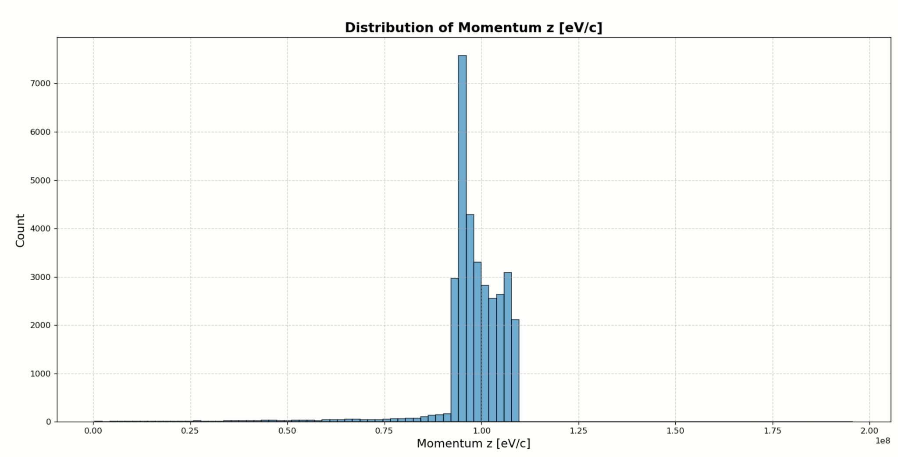

Slide 17
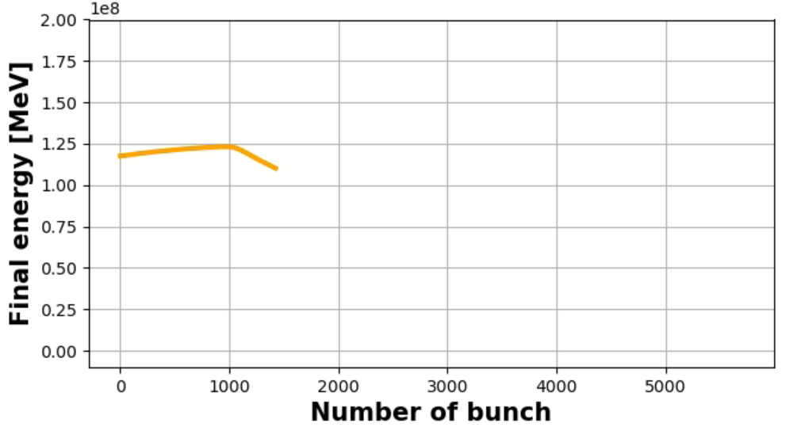
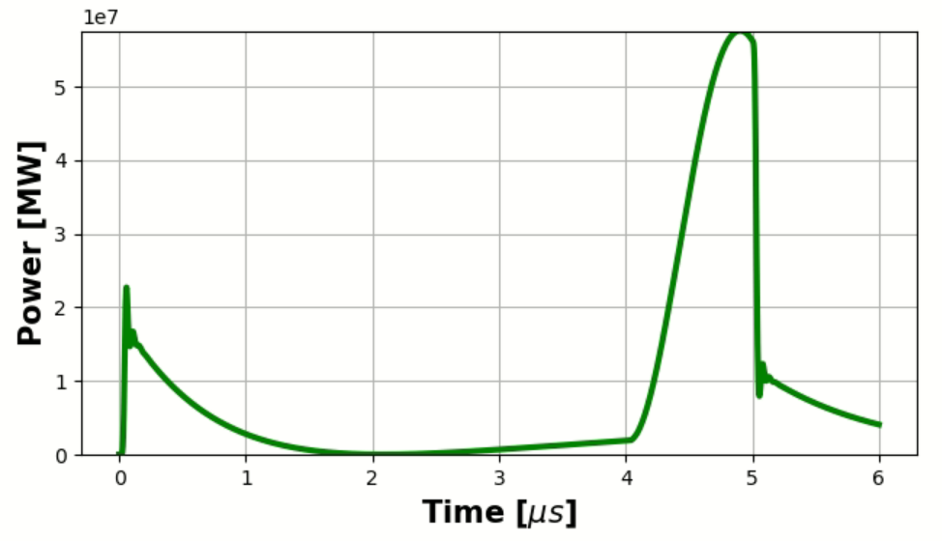
Short pencil beam (10 nC) with 20 MW @ 115 MeV Av. Energy

Slide 18
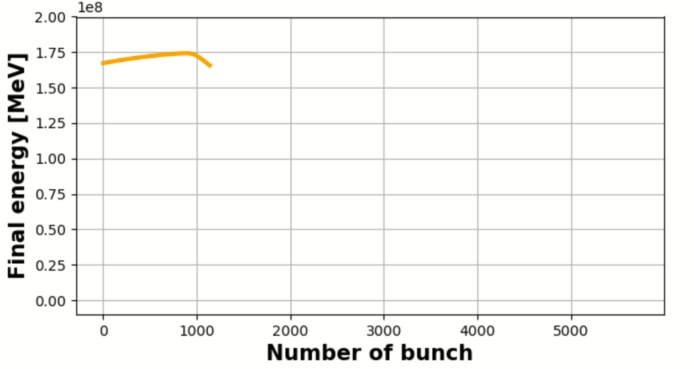
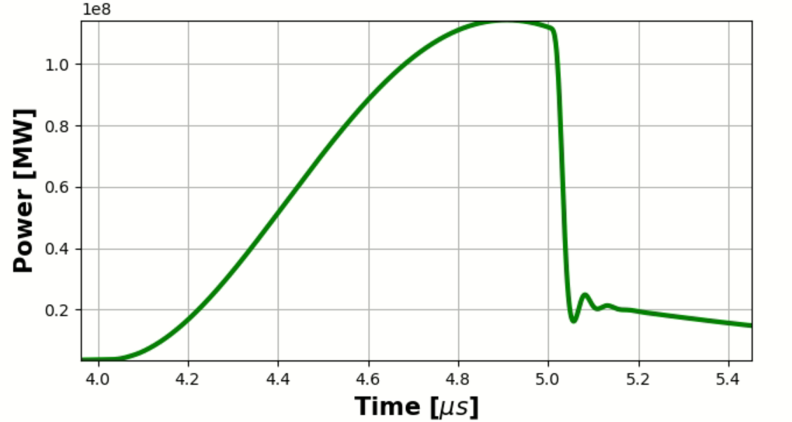
Short pencil beam (10 nC) with 40 MW @ 115 MeV Av. Energy

Slide 19
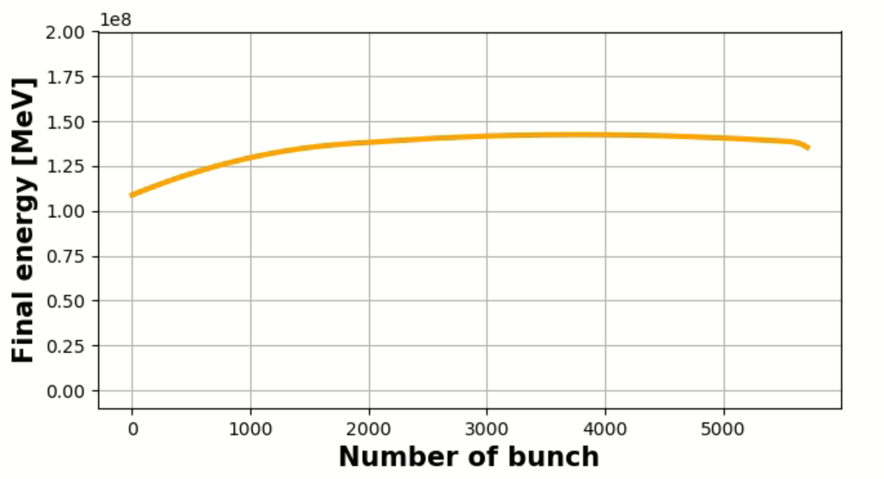
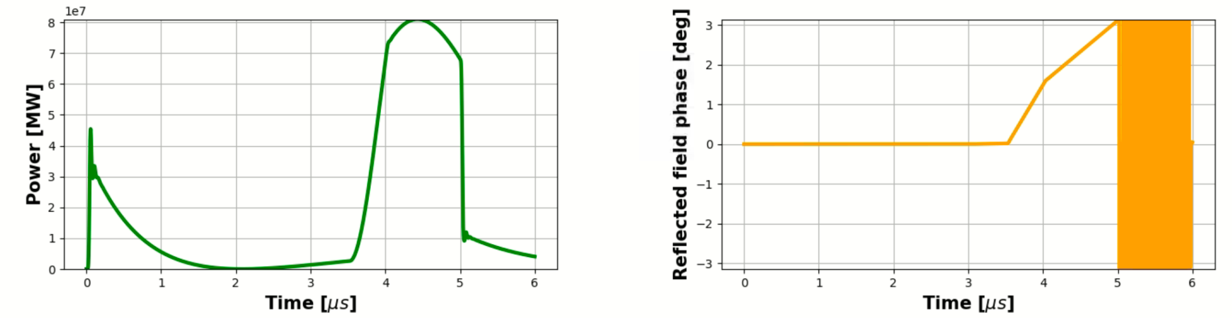
Long pulse ( 1 µs )
In the future we may feature a more powerful klystron @ 40 MW - Still the cavities can work at this regime Loaded Traveling wave cavity gradient 43 MV/m

