Slide 1
350 MeV electron beamline of the
VIGAS project in Tsinghua University
Hongyu Li
on behalf of VIGAS team in THU
VHEE25, 15th-17th.09.2025, Daresbury, U.K.
Notes:
Hello everyone! I am Hongyu Li from Tsinghua University. I ‘m s student of professor Jiaru Shi. Since he has a heavy teaching load recently and couldn’t make it to the workshop, I’ll giving this presentation on his behalf to introduce the

Slide 2
OUTLINE
Introduction
Overview of the Beamline
The S-band injector
The X-band linac
Progress and summary

Slide 3
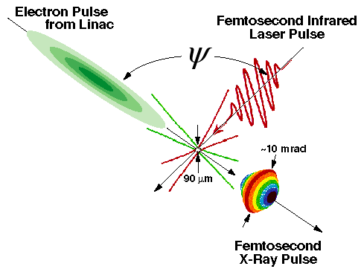
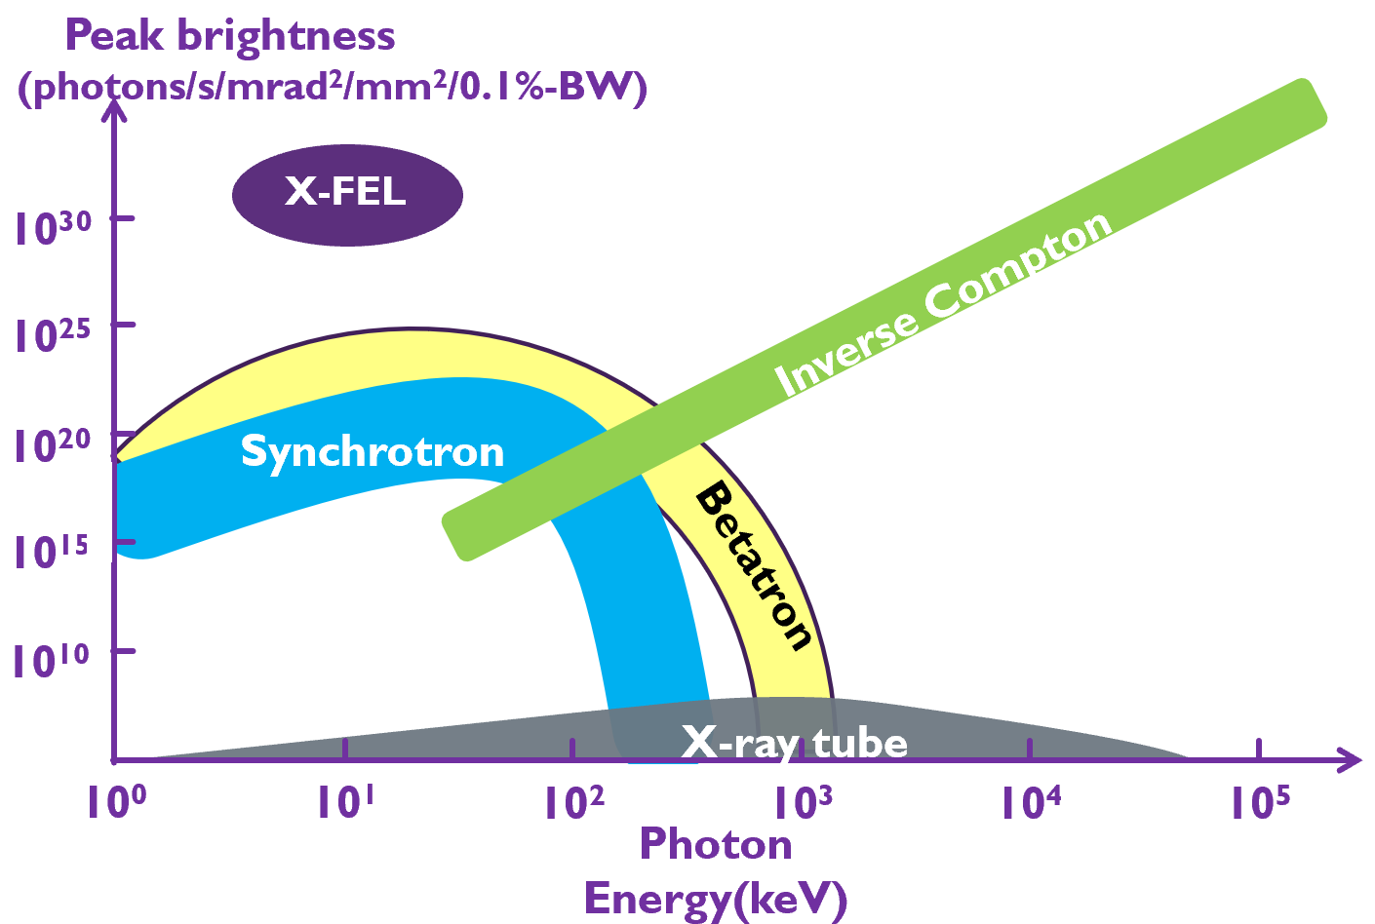
Introduction
VIGAS: Very compact Inverse-compton-scattering GAmma-ray Source
Characteristics
Quasi-monochromatic
Continuously adjustable Gamma-ray energy
Small source size ~10um
Controllable polarization
Ultra-short pulse length (fs~ps)
Advantages
High peak brightness
Gamma-ray
Compact
Affordable
Notes:
VIGAS stands for very compact inverse compton scattering gamma ray source. The inverse Compton scattering describes a scheme where a high intensity laser is scattered from high energy electrons, and the laser photons are transformed into x-ray photons due to the Doppler shift.
The Scatterd x-ray has many good characteristics: its spectrum is quasi-monochromatic, the X-ray energy is continuously adjustable. The source size is pretty small, typically at 10 micrometer scale so it can be used for phase contrast imaging. The polarization is controllable since it is determined by the incident laser. Due to the short incident laser pulse length and electron bunch length, the scatted x-ray has ultra-short pulse length in the range of femtosecond to picosecond.
This figure shows the comparison between inverse Compton scattering source and other light source, from which we can see that the ICS source not only has the high peak brightness but also have the high photon energy. Besides, the incident electron energy needed for ICS typically is about several hundred MEV, so the facility of ICS is much more compact and affordable.

Slide 4
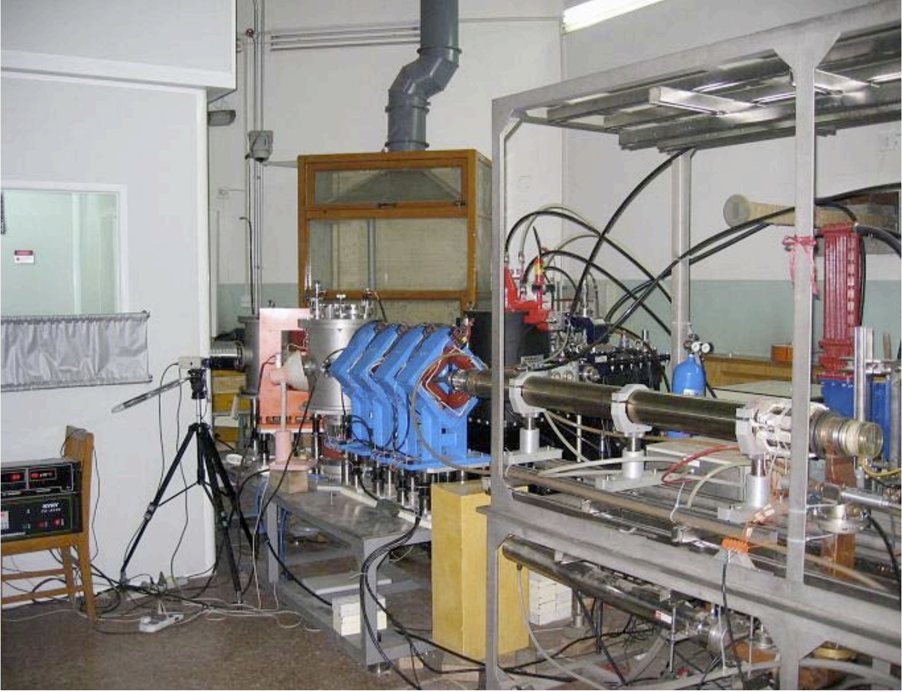
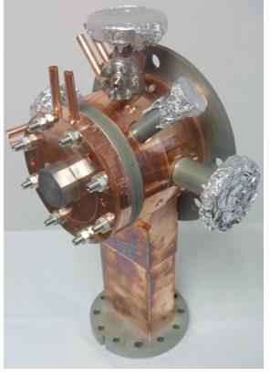
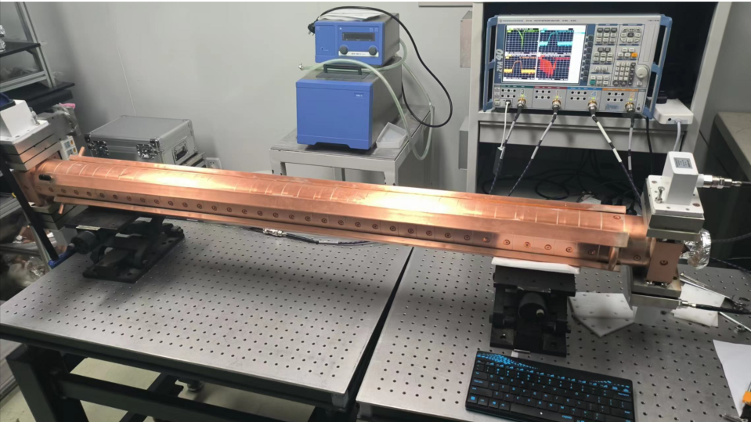
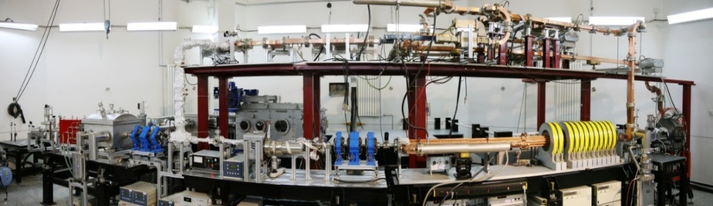
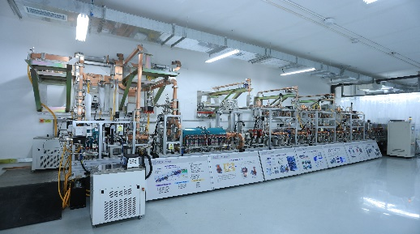
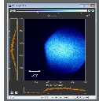
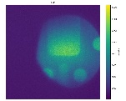
ICS Studies at Tsinghua
2001
2002
2006
2009
2011
2016
2021
2024
2025
Beginning of the TS studies in THU
Collaboration on TS with CAEP
Generation of the 1st scattered X-ray signal at TTX,
4.6 keV, 1.7×10⁵ph/s
Soft X-ray generation experiment using photocathode rf gun at the TTX,
290 eV, 1 ps, 6.4 x10⁴ph/s
Generation of the 1st hard X-ray pulse at TTX,
51.7 keV, 1.0×10⁷ph/s
High-quality X-ray imaging experiment, 20-50 keV, 2.0×10⁸ph/s
Beginning of VIGAS project
VIGAS installation complete
Generation of high-energy X-rays in VIGAS collision experiment
Notes:
Tsinghua University has been studying Inverse-Compton-Scattering since 2001. This began with the study of Thomson Scattering. In 2002, Tsinghua started to collaborate with the China Academy of Engineering Physics. In 2006, Tsinghua Thomson Scattering X-ray source generated the first scattered X-ray signal. Then in 2009 and 2011, the first generation of soft X-ray signal and hard X-ray signal were respectively achieved. In 2021, Tsinghua University proposed VIGAS project, aiming to achieve much higher energy in 5 years. In this year, VIGAS project had successfully generated 500 keV X-ray during collision experiment.

Slide 5
Introduction
Goals of VIGAS project:
Gamma-ray energy: 0.2~4.8 MeV continuously adjustable
Gamma-ray energy spectrum bandwidth(rms): <1.5% (w/ collimator)
Photon production (photon/s):
  >4×10⁸ @0.2~2.4 MeV; >1×10⁸ @2.4~4.8 MeV
Photon production in 1.5% bandwidth (photon/s):
  >4×10⁶ @0.2~2.4 MeV; >1 ×10⁶ @2.4~4.8 MeV
Polarity: adjustable from linear to circular
Notes:
The goal of VIGAS project is to generate gamma-ray whose energy is 0.2-4.8 MEV which should be continuously adjustable. With collimator, its spectrum bandwidth should be below 1.5%.
The total photon production is on the order of ten to the eighth, while within the bandwidth there should be on the order of ten to the sixth. Its polarity should be adjustable from linear to circular.

Slide 6
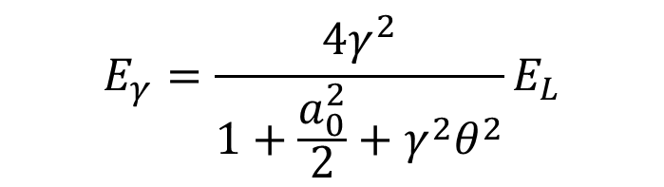
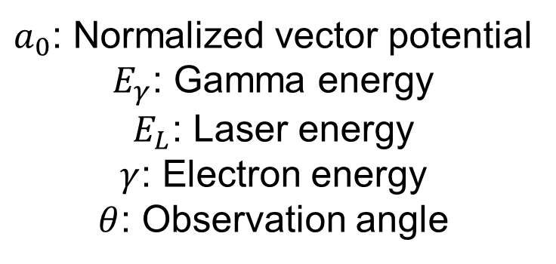
Introduction
Gamma-ray energy: 0.2~4.8 MeV continuously adjustable
  Collision angle between electron bunch and laser: 180 degree
Laser energy:
800nm: 1.54 eV
400 nm: 3.08 eV
Electron energy:
Maximum > 320 MeV
Minimum < 92 MeV
$$E_{γ}=\frac{4γ^{2}}{1+\frac{a_{0}^{2}}{2}+γ^{2}θ^{2}}E_{L}$$
$a_{0}$: Normalized vector potential
$E_{γ}$: Gamma energy
$E_{L}$: Laser energy
$γ$: Electron energy
$θ$: Observation angle
200 keV gamma-ray @800nm & 92 MeV electron
2.4 MeV gamma-ray @800nm & 320 MeV electron
4.8 MeV gamma-ray @400nm & 320 MeV electron
Notes:
In VIGAS project, the collision angle between electron beam and laser is 180 degree. The laser wavelength is fixed at 800 nanometers or 400 nanometers. To produce gamma-ray of 0.2-4.8 MEV energy, the electron beam energy should be 92-320 MEV continuously adjustable.

Slide 7

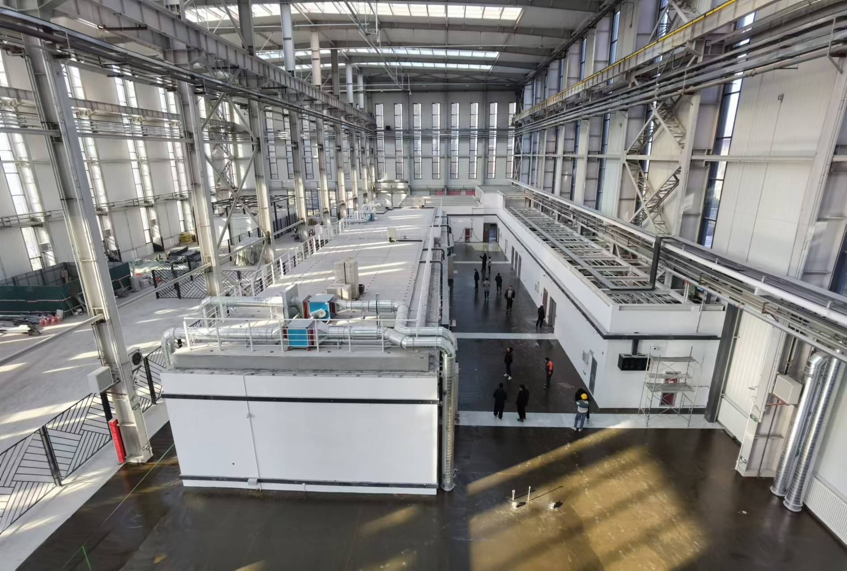

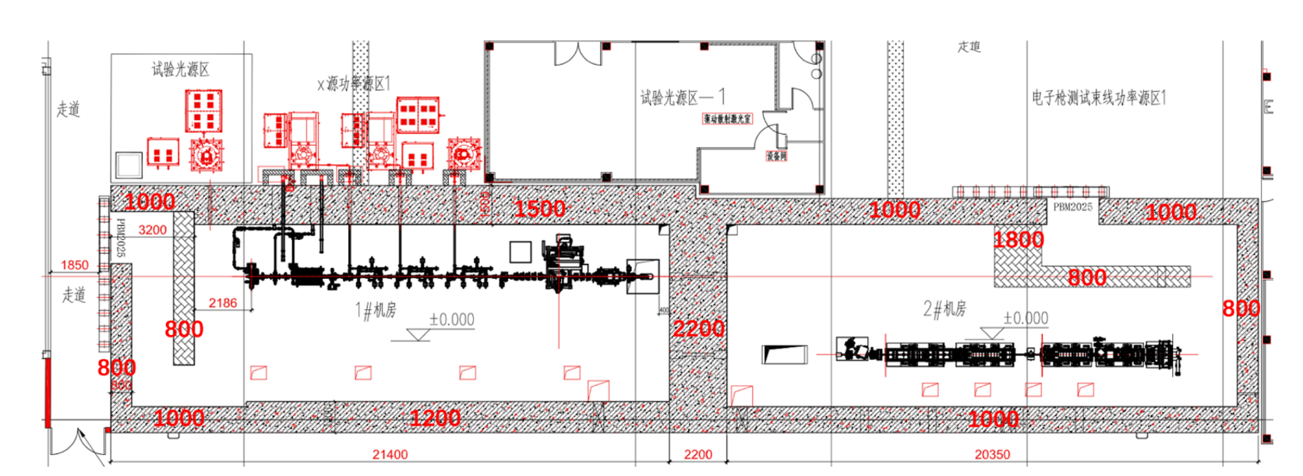
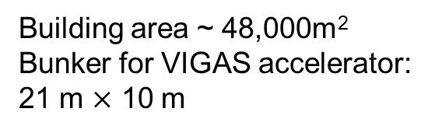
Footprint
Building area ~ 48,000m²
Bunker for VIGAS accelerator:
21 m $×$ 10 m
Accelerator section:
generating gamma ray
User section:
Gamma ray application
Notes:
The facility of VIGAS locates in the north of Beijing and it is about 20 miles away from Tsinghua University. The total area of the building is about 48 thousand square meters and the bunker for VIGAS accelerator is about 21 meter by 10 meter.
The blue star indicates the Tsinghua University location, and the red star refers to the location of VIGAS project.
These two are the exterior and interior pictures of the building and this one is the accelerator bunker top view.

Slide 8
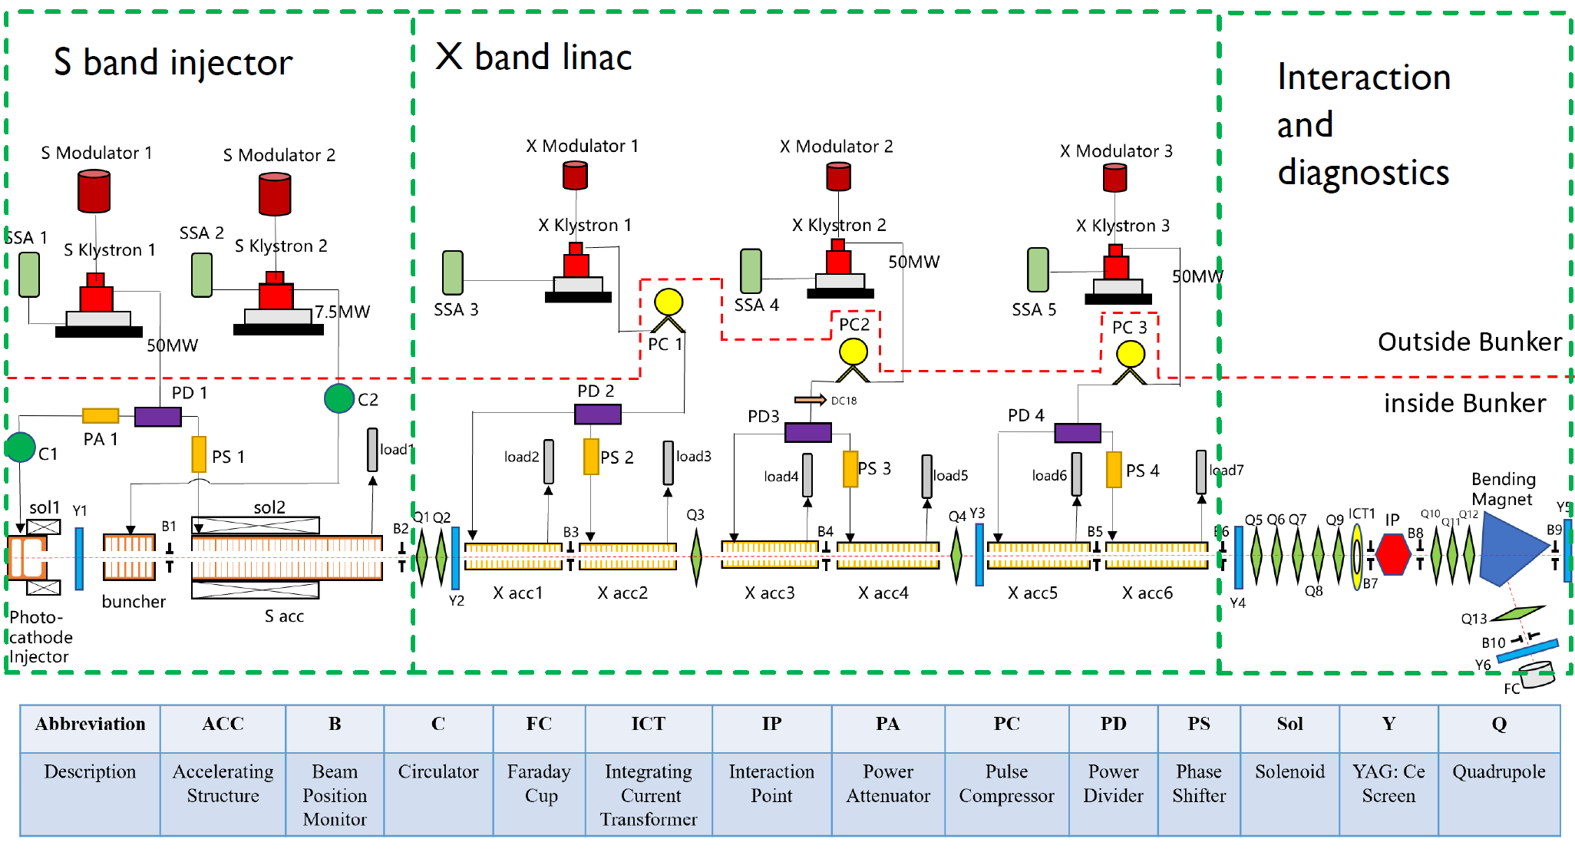
Overview of Accelerator System
80MV/m
50 MeV *6
VIGAS Subsystems:
Accelerators subsystem
Laser subsystem
Detection subsystem
Control and synchronization subsystem
Radiation protection subsystem
Properties | Value
Electron energy | 50-350 MeV tunable
Charge | >= 200 pC
Normalized emittance | < 0.6 mm mrad
RMS bunch length | < 2 ps
RMS energy spread | < 0.3%
RMS beam size @IP | < 20 um
11.8 meters
14 meters
Design parameters of accelerator subsystem
Notes:
The VIGAS project has many subsystems. Today we mainly focus on the accelerator part.
The beamline schematics are illustrated in the Figure, with all elements abbreviations listed in the table below. The length from photoinjector cathode to the electrons and lasers interaction point is less than 12 meters, while the total length including the electron beam energy diagnostic system is about 14 meters. The entire beamline can be divided into two sections: the S-band high brightness injector section and the X-band main accelerator section. The S-band injector section comprises an S-band photoinjector and a traveling-wave accelerator powered by a 50-megawatts klystron. Additionally, there is a S-band 7-cell standing-wave buncher located between them. Its could compress the bunch length and is powered by another 7.5-megawatts klystron. The photoinjector solenoid sol 1 and S-band traveling-wave accelerating structure solenoid sol 2 serve as the focusing elements and play roles in emittance compensation.
The X-band main accelerator section comprises three identical modules, each consisting of a 50-megawatts X-band klystron, a pulse compressor, and two high-gradient X-band accelerating structures. The pulse compressor serves to increase the peak power of the RF while compressing the pulse length. Subsequently, the power emitted from the pulse compressor is split and fed into two accelerating structures. At the end of the S-band injector, the electron bunch energy is approximately 50 MeV. Each X-band accelerating structure provides an energy gain of 50 MeV, enabling the total electron energy at the end of the X-band main accelerator section to reach 350 MeV.

Slide 9
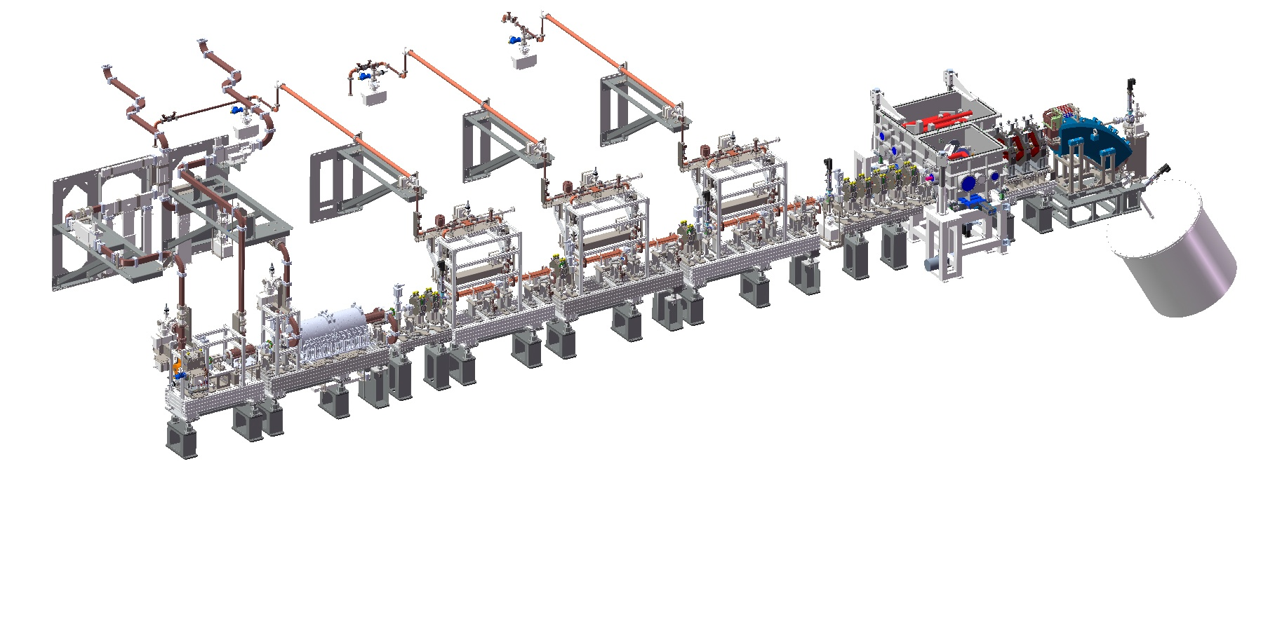
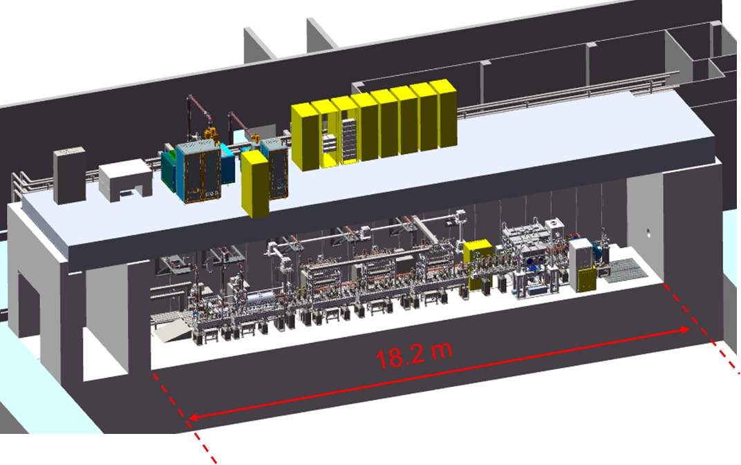
Overview of Accelerator System
Notes:
This is the schematic diagram of the entire beamline.

Slide 10
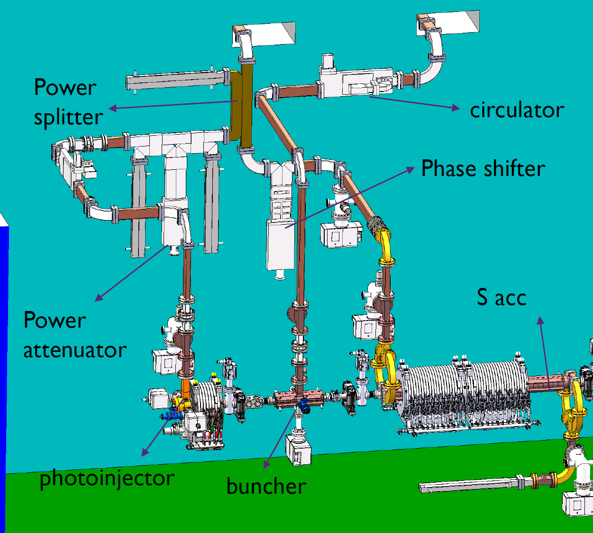
S-band waveguide system
50 MW power from Canon E3730A feeds for photoinjector and S acc
  5dB power splitter
  Phase shifter for S acc phase control
7.5 MW power from Canon E3772 feeds for buncher
Consider RF loss due to waveguides and components
 | Transmitted power (MW) | Needed power (MW)
Photoinjector | 11.7 | 7
S acc | 29 | 21
buncher | 6.4 | 3
Notes:
The S-band waveguide system contains 2 canon klystrons. One is 50 megawatts canon E3730A which feeds for photoinjector an S-band accelerator, the other is 7.5 megawatts canon E3772 which feeds for the buncher. After considering the RF loss due to waveguides and components, the power transmitted to 3 components still maintains an adequate margin.

Slide 11
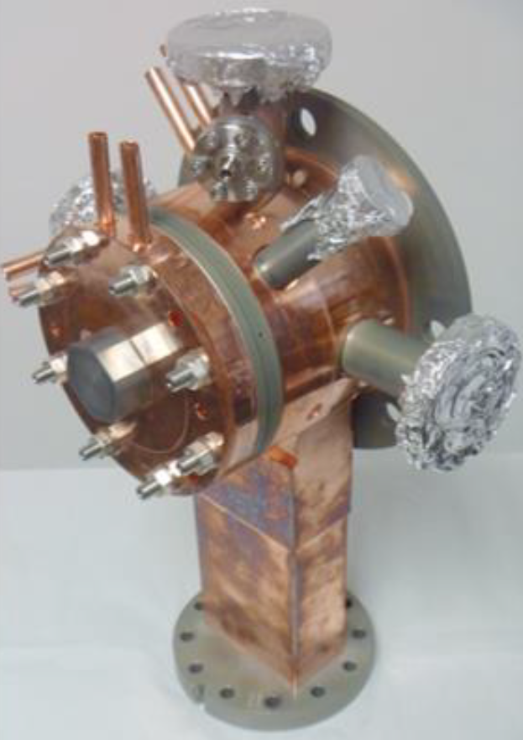
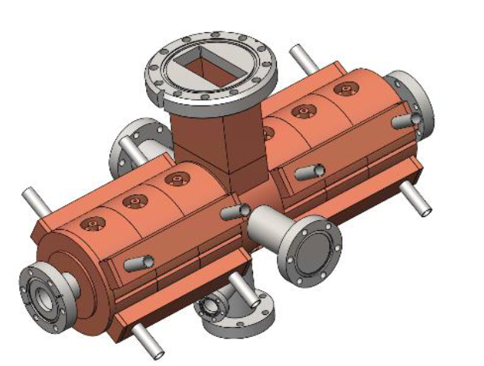
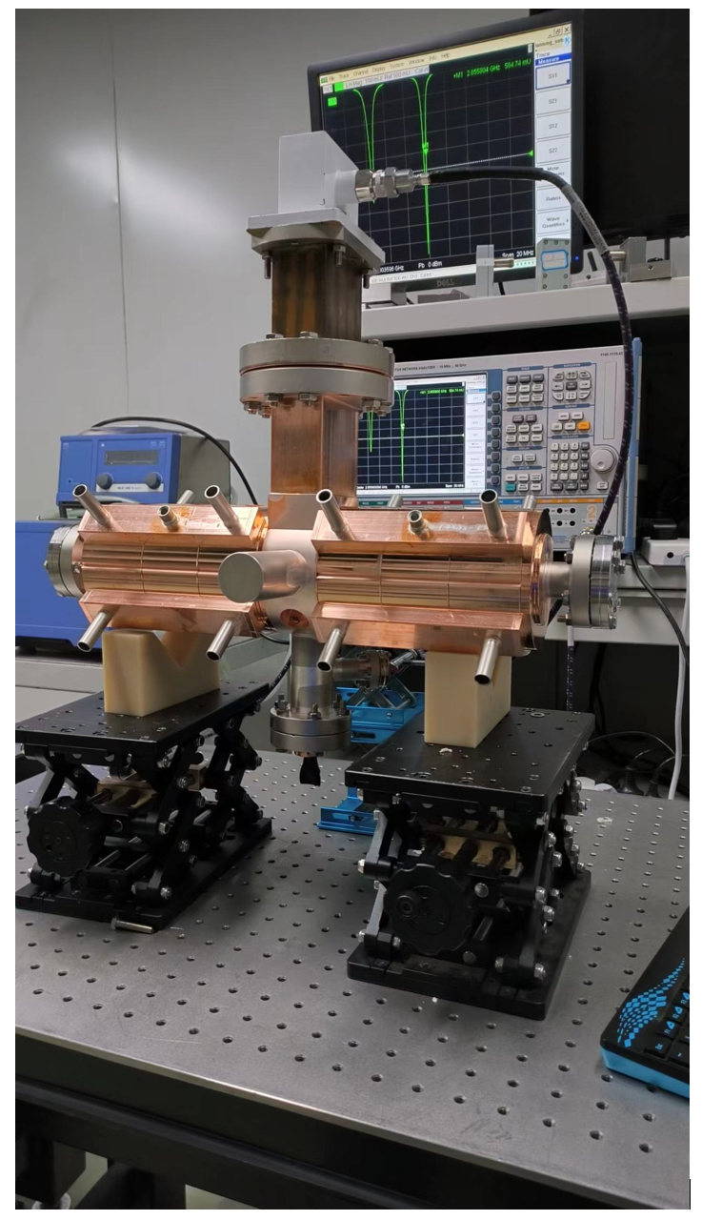
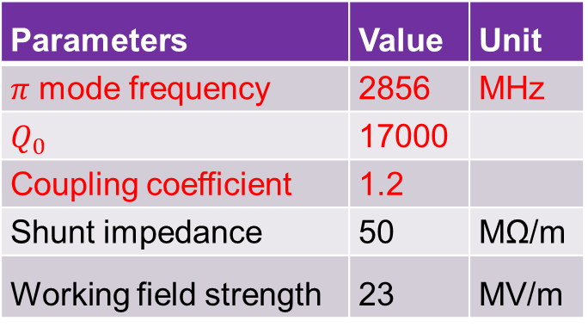
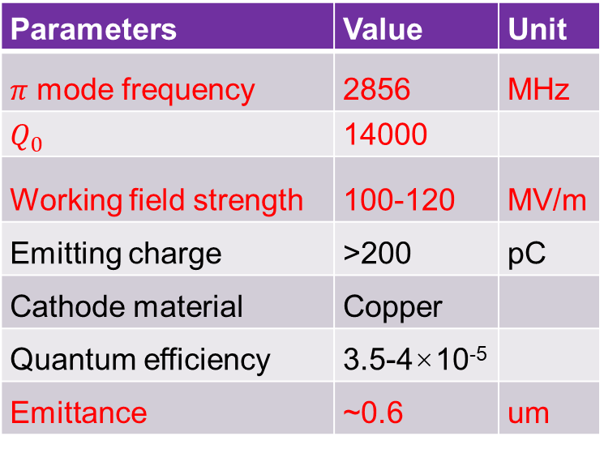
S-band injector & buncher
Zheng, Lianmin, et al. NIMA 834 (2016): 98-107.
Parameters | Value | Unit
$π$ mode frequency | 2856 | MHz
$Q_{0}$ | 14000
Working field strength | 100-120 | MV/m
Emitting charge | >200 | pC
Cathode material | Copper
Quantum efficiency | 3.5-4×10⁻⁵
Emittance | ~0.6 | um
Parameters | Value | Unit
$π$ mode frequency | 2856 | MHz
$Q_{0}$ | 17000
Coupling coefficient | 1.2
Shunt impedance | 50 | MΩ/m
Working field strength | 23 | MV/m
Parameters of S-band injector
Parameters of S-band 7-cell buncher
Notes:
These are parameters of the S-band injector and buncher.
Through structural optimization, after approximately 50 hours of high-power adjustment, the injector is capable of stable operation at 120 megavolt per meter, a repetition rate of 10 Hertz, and a pulse length of 1.6-microsecond.
The 7-cell standing-wave buncher could compress the bunch length and accelerate it to about 8 MEV.

Slide 12
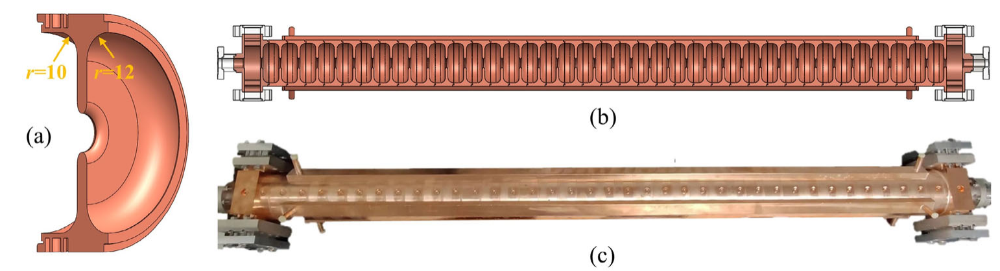
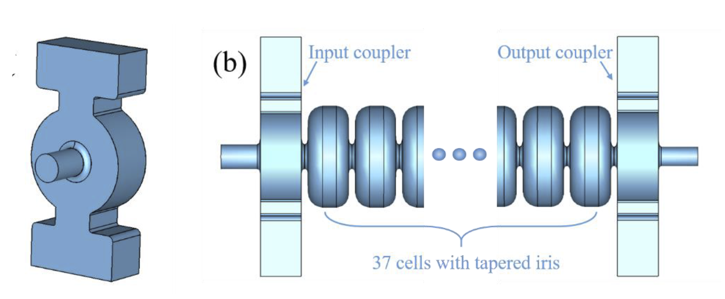
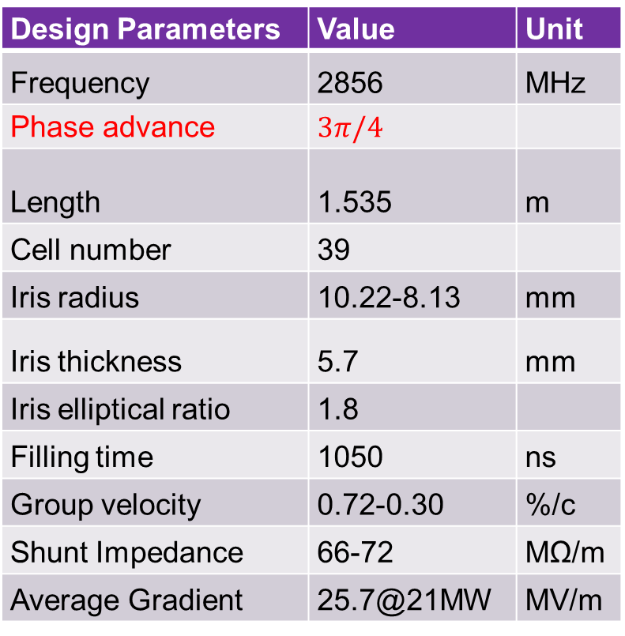
S-band TW acc
Design Parameters | Value | Unit
Frequency | 2856 | MHz
Phase advance | $3π/4$
Length | 1.535 | m
Cell number | 39
Iris radius | 10.22-8.13 | mm
Iris thickness | 5.7 | mm
Iris elliptical ratio | 1.8
Filling time | 1050 | ns
Group velocity | 0.72-0.30 | %/c
Shunt Impedance | 66-72 | MΩ/m
Average Gradient | 25.7@21MW | MV/m
Lin, Xian-Cai, et al. Nuclear Science and Techniques 33.11 (2022): 147.
Notes:
The S-band accelerating structure adopts a low group velocity design, thereby achieving higher gradients with the same input power. The 3π over 4 mode is selected to balance high shunt impedance and low group velocity. Considering that the bandwidth of low group velocity structures is narrower, it is necessary to extend the filling time to achieve a steady-state gradient.

Slide 13
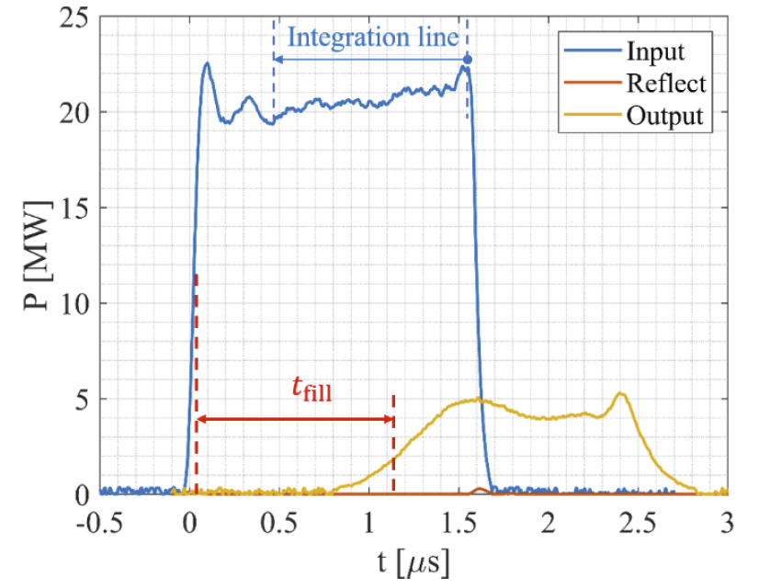
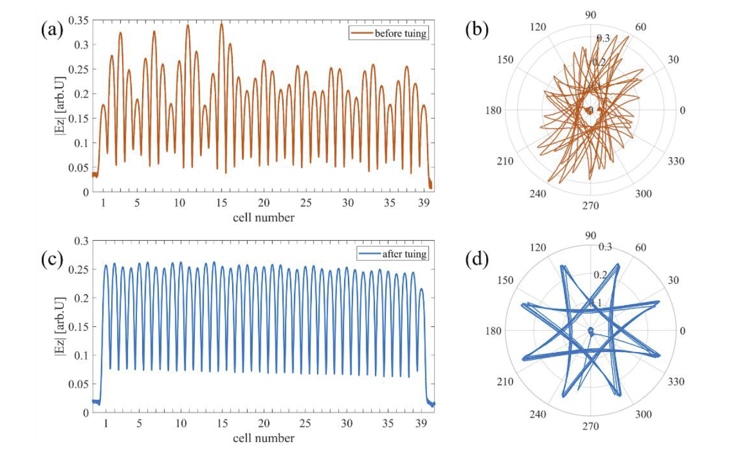
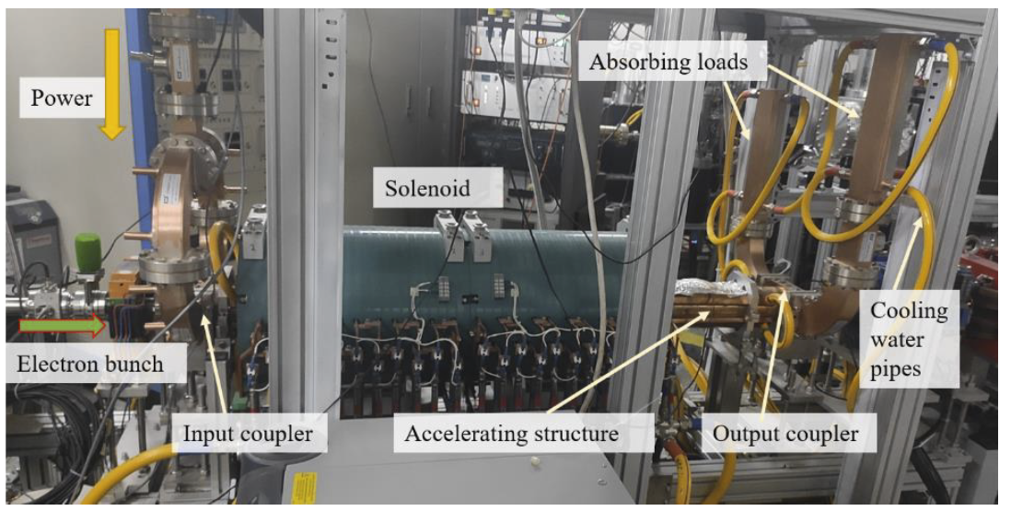
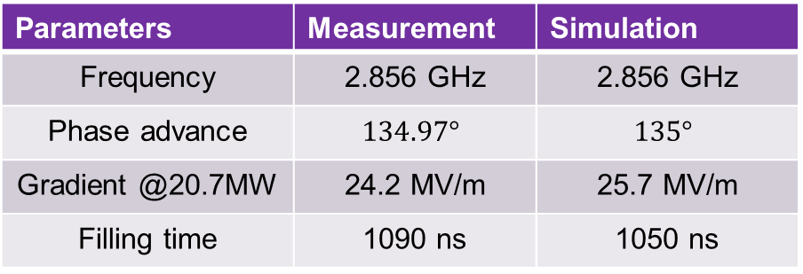
S-band TW acc
High power tested
Conditioning:
  120 hours
  4 million pulses
Parameters | Measurement | Simulation
Frequency | 2.856 GHz | 2.856 GHz
Phase advance | $$134.97°$$ | $$135°$$
Gradient @20.7MW | 24.2 MV/m | 25.7 MV/m
Filling time | 1090 ns | 1050 ns
Notes:
This accelerator is first installed at a beamline for the terahertz experiment at Tsinghua University. After conditioning for 120 hours and 4 million pulses, an average gradient of 24.2 megavolt per meter was achieved at a power of 20.7 megawatts, reaching 94% of the design value. The measured electron beam energy gain is 37.2 MEV.

Slide 14
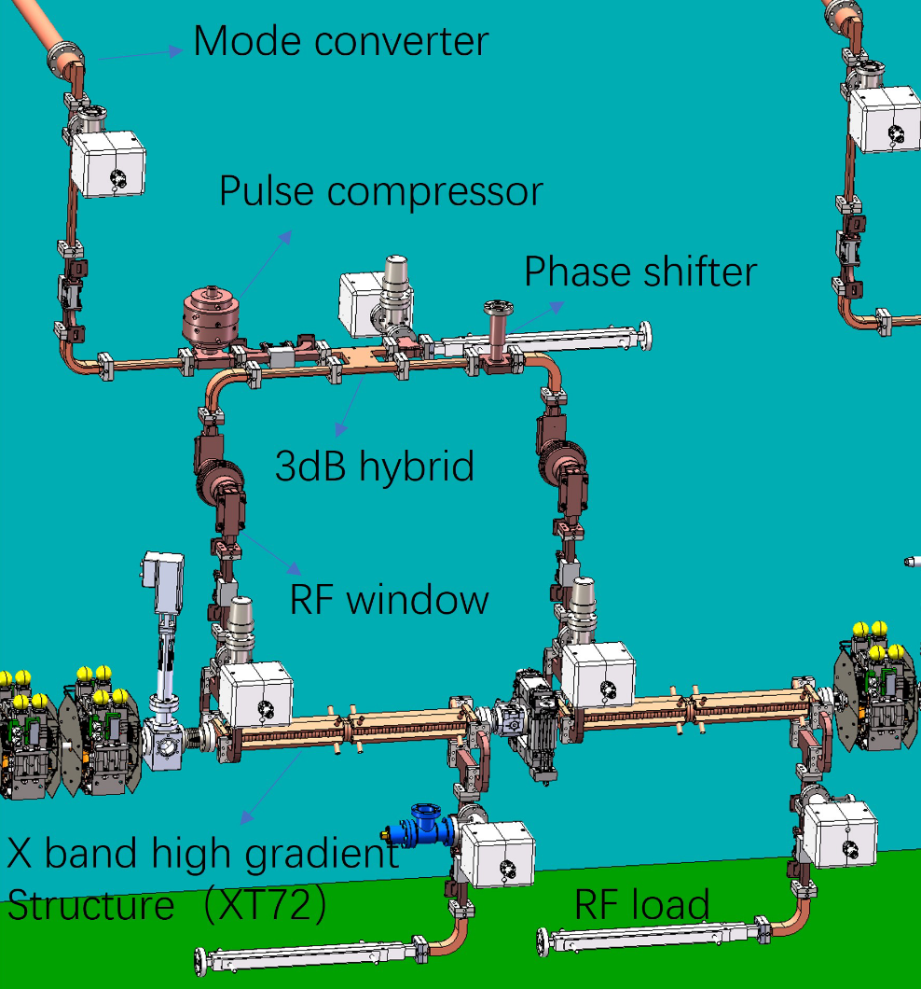
X-band waveguide system
One klystron
  50MW, 1.5us
One pulse compressor (SLED I type)
Maximum rf loss due to waveguides and rf components from klystron to Xacc is about 0.9dB
Peak power at Xacc input is about 91 MW if power compressor gives gain factor as 4.5
Two X band high gradient structures
  Average gradient ≥ 80 MV/m
  Energy gain per structure > 50 MeV
  Filling time < 150ns
Notes:
The X-band waveguide system contains 3 identical modules, each consisting of a 50-megawatts klystron, a pulse compressor, and 2 high-gradient X-band accelerating structures.
After the power compressor gives gain factor as 4.5, as well as considering the power loss due to waveguides and other components, the peak input power of X-band accelerator is about 91 megawatts.
Each high-gradient structure could achieve average gradient of over 80 megavolts per meter, which gives the electron beam an energy gain of over 50 MEV.

Slide 15
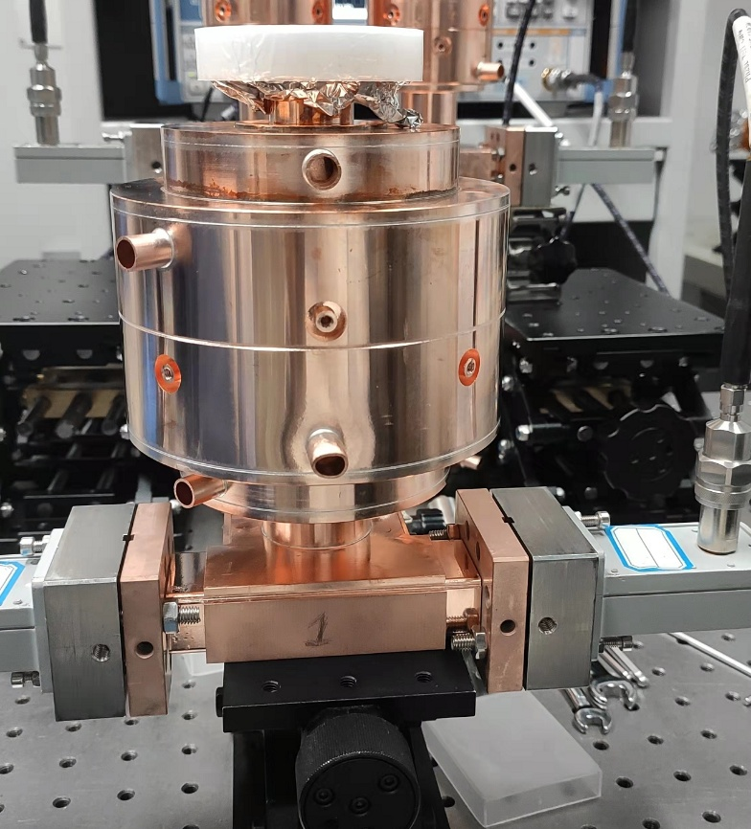
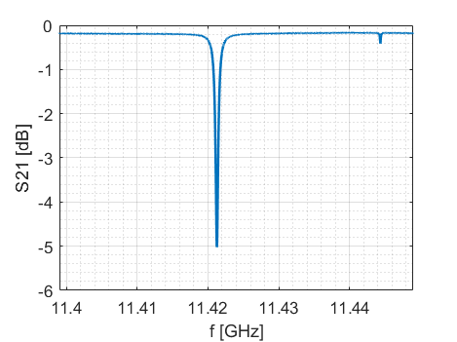
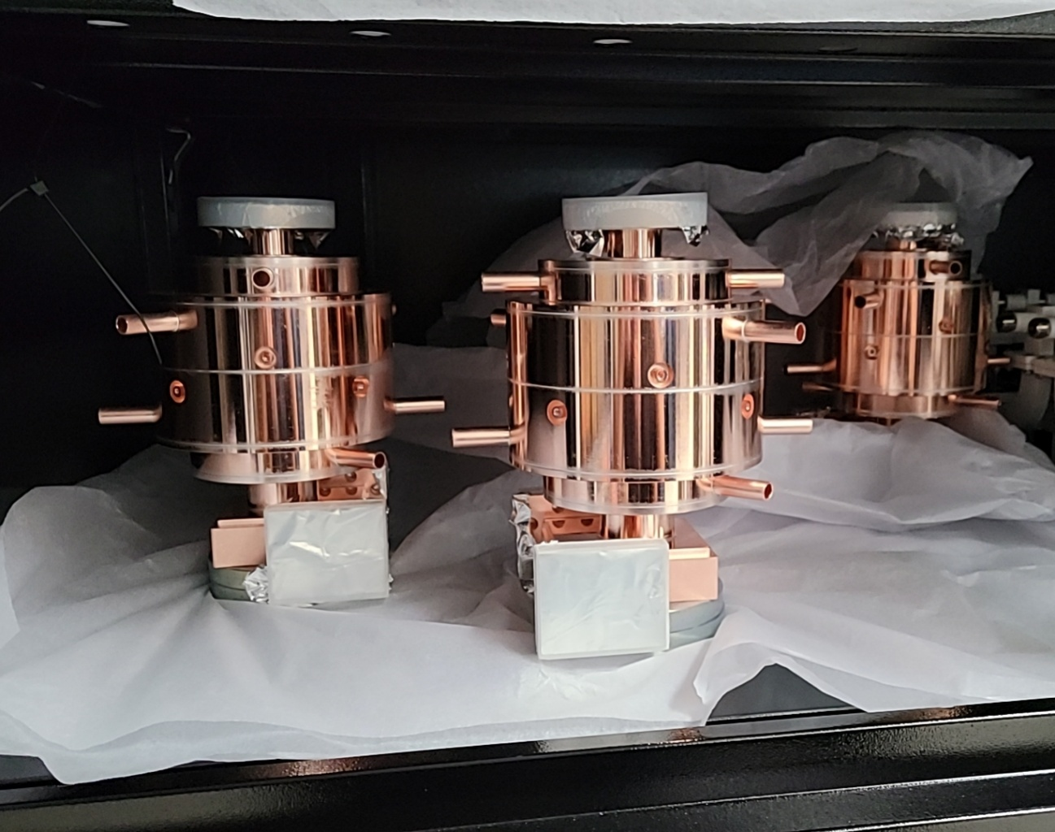
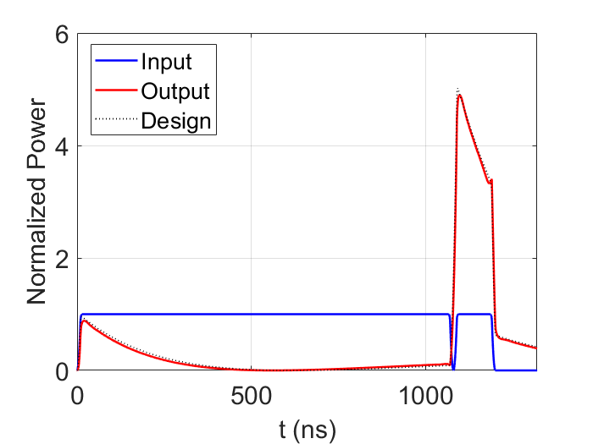
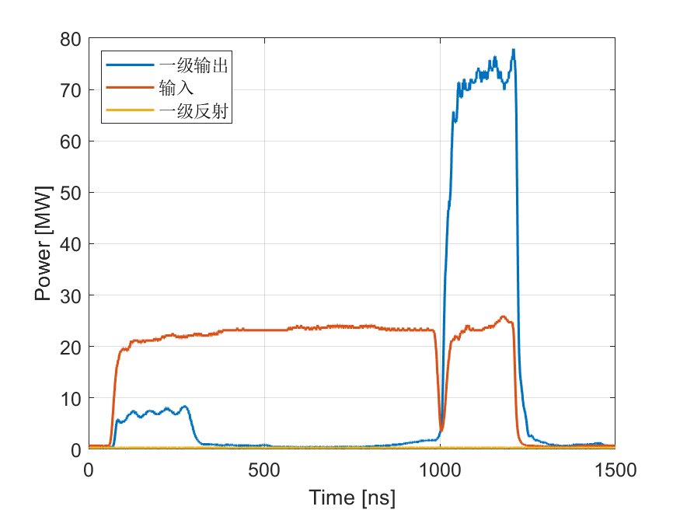
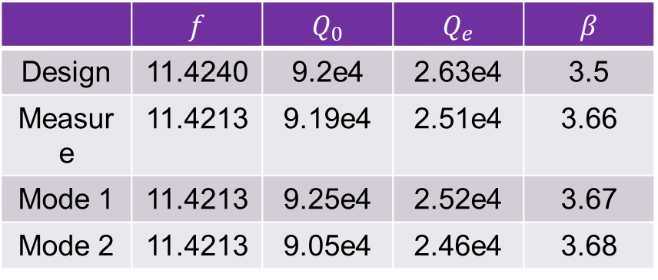
X-band pulse compressor
 | $$f$$ | $$Q_{0}$$ | $$Q_{e}$$ | $$β$$
Design | 11.4240 | 9.2e4 | 2.63e4 | 3.5
Measure | 11.4213 | 9.19e4 | 2.51e4 | 3.66
Mode 1 | 11.4213 | 9.25e4 | 2.52e4 | 3.67
Mode 2 | 11.4213 | 9.05e4 | 2.46e4 | 3.68
*Modes 1 and 2 are parameters of two polarization modes reconstructed from measured S-parameters (TE₁₁₄)
Output
Input
Reflect
*Franzi, Matthew, et al. PRAB19.6 (2016): 062002.
Notes:
The X-band power compressors have been high-power tested and reached power gain of 4.5.

Slide 16
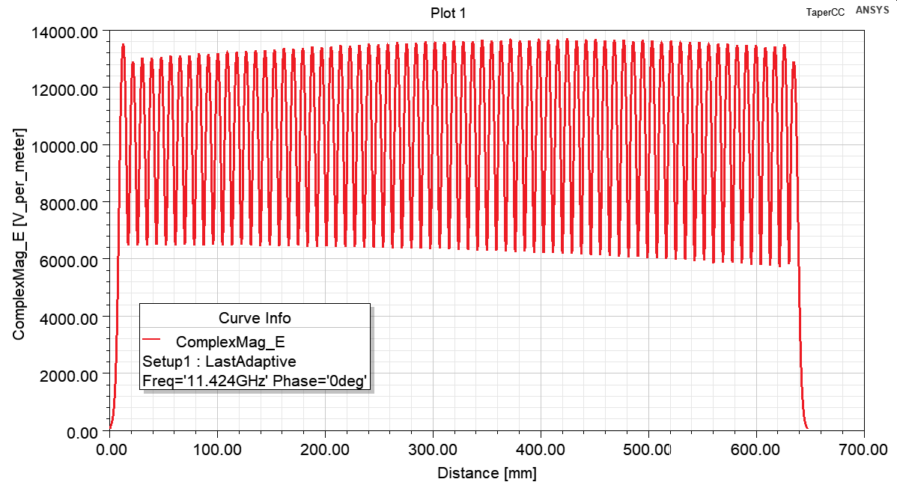
X-band TW linac
We switch to CG scheme with maximum surface field 20% lower than CI
Parameters | CI | CG
Iris aperture a [mm] | 3.5 | 3.92 ~ 3.12
Iris thickness d [mm] | 1.8 | 1.8
Shunt imp. R [MΩ/m] | 101 | 93 ~ 109
Group velocity v_{g}/c | 2.20% | 3.22% ~ 1.46%
Quality factor Q | 6990 | 7020 ~6970
Filling time T_{f} [ns] | 95 | 97
E_{s} [MV/m] | 224 | 185
S_{c} [MW/mm²] | 5.65 | 4.50
β of pulse compressor | 3.5 | 3.5
Pin @80MV/m with pc [MW] | 81.3 | 80.1
Notes:
Previously we designed and fabricated a X-band high-gradient structure of constant-impedance. However, its surface fields in the first several cells were too large which limited its high-gradient performance. Thus we switch to constant-gradient scheme, whose maximum surface field is 20% lower than constant-impedance scheme. Their designed parameters are compared and shown in the table. With lower maximum surface fields, the constant-gradient structure could reach the same gradient at lower input power.

Slide 17
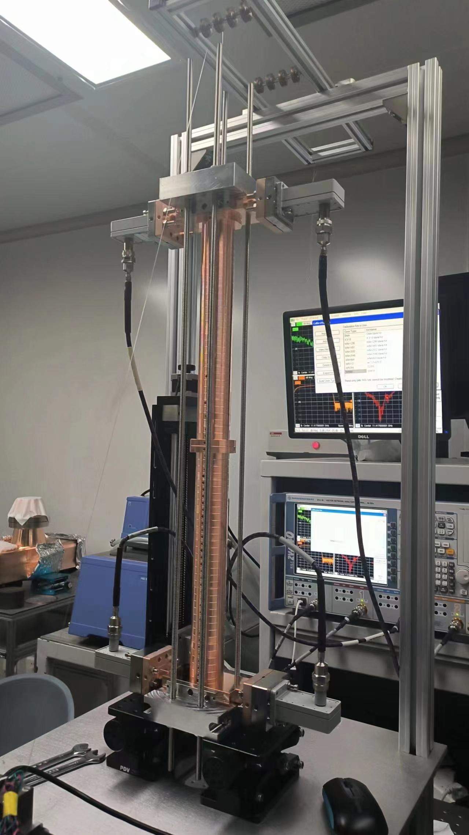
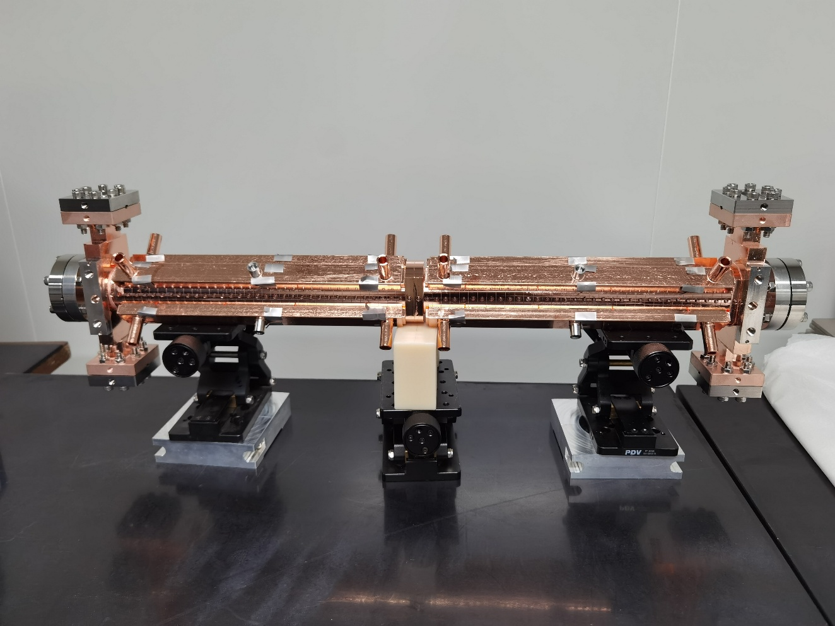
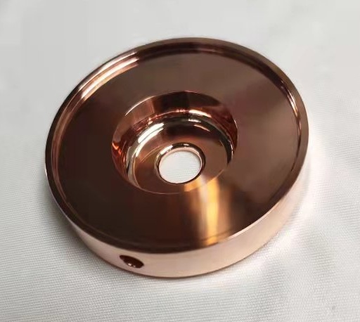
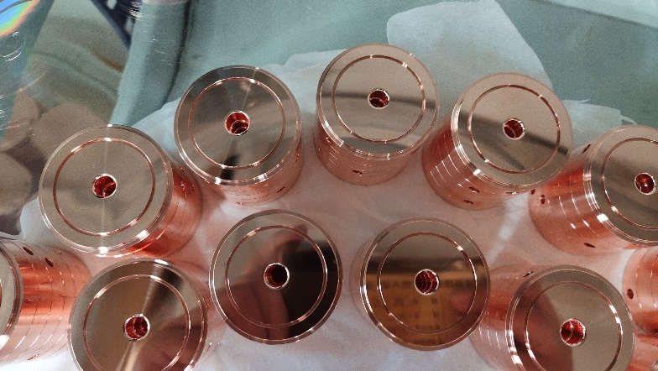
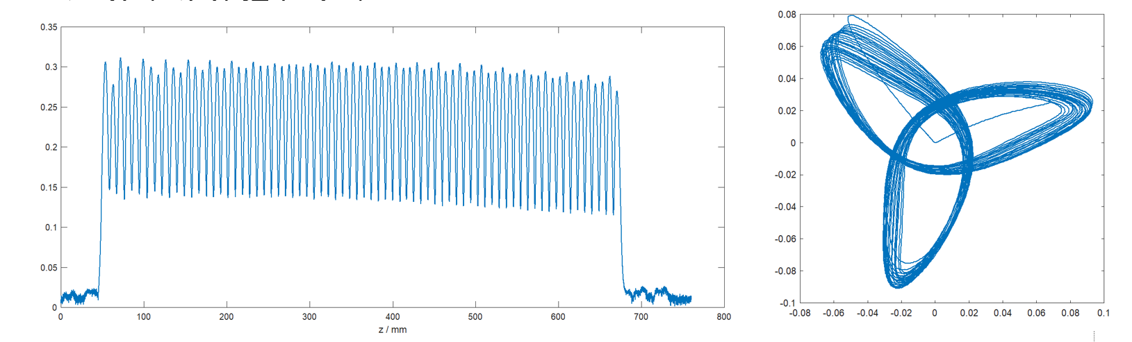
X-band TW linac
XT72 (X-band Tapered structure with 72 cells)
COST: CG 20% higher than CI
Same Tuning procedure
High power conditioning started from Oct. 20, 2023
Gao, Qiang, et al. PRAB 27.9 (2024): 090401.
Notes:
We named this X-band constant-gradient traveling-wave accelerating structure as XT72. Its costs is 20% higher than the constant-impedance one, while their tuning procedure are the same. Its high-power conditioning started from October, 2023.

Slide 18
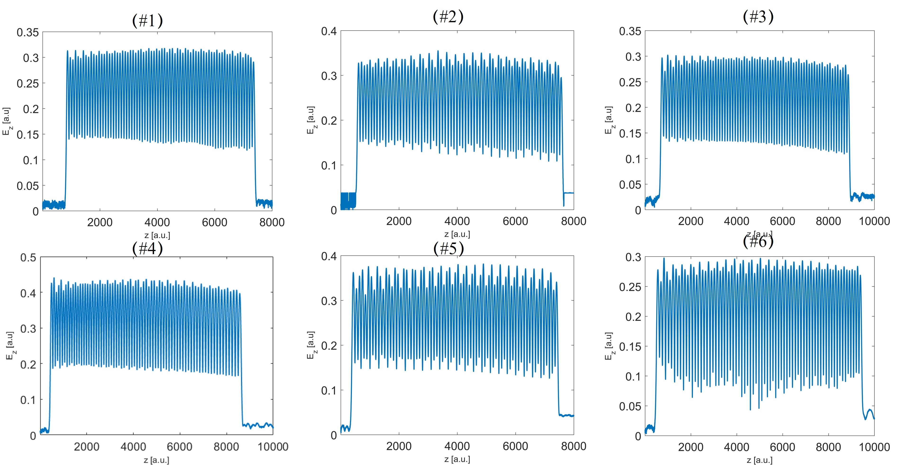
X-band TW linac
Tuning results of XT72 #1-#6
  using local reflection method
Notes:
These are the tuning results of six XT72, using traditional beam-pull method.

Slide 19
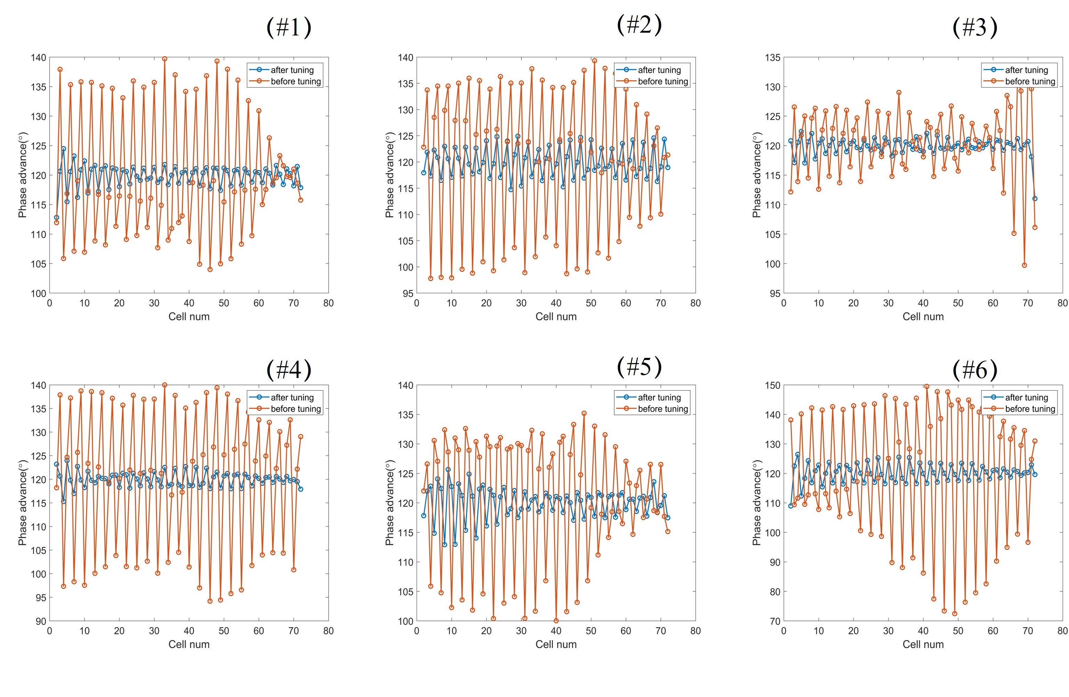
X-band TW linac
Tuning results of XT72 #1-#6
Structure Number | Phase Advance
#1 | 119.87±1.85°
#2 | 120.12±2.87°
#3 | 119.92±1.54°
#4 | 120.01±1.58°
#5 | 120.02±2.61°
#6 | 120.11±3.17°
Notes:
Orange lines are the condition before tuning, while blue lines are the condition after tuning. The phase advances of all accelerating cavities have been adjusted to within an error range of 3 degrees.

Slide 20
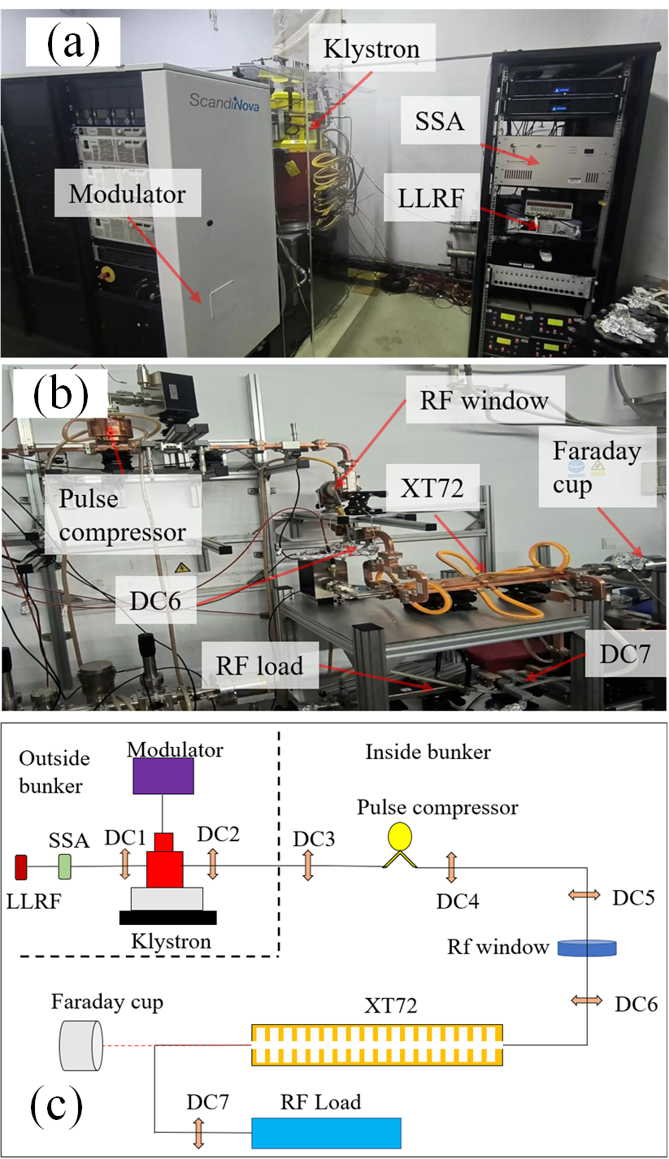
High power test @ Tpot-X
Tsinghua high POwer Test stand for X-band (TPOT-X)
  50 MW CPI VKX8311B Klystron
  Pulse compressor (energy gain factor of 4)
  Direction couplers (DC) for signal detection
  Conditioning XT72#1-#6
Notes:
High-power conditioning of the XT72 structures was conducted at the Tsinghua’s TPOT-X facility. The RF power source consisted of a CPI VKX8311B klystron which outputs 50 MgeaWatts, 1.5 microseconds pulses @ 40 Hertz, as well as a 4-times-gain pulse compression system. The low-level RF system generated phase- and amplitude-modulated RF pulses using a signal generator, solid-state amplifier, and phase inverter. Key diagnostic tools including a Faraday cup for measuring dark current, and 7 directional couplers. DC 1-4 for tracking outputs, and DC 6or7 for transmitted and reflected power.

Slide 21
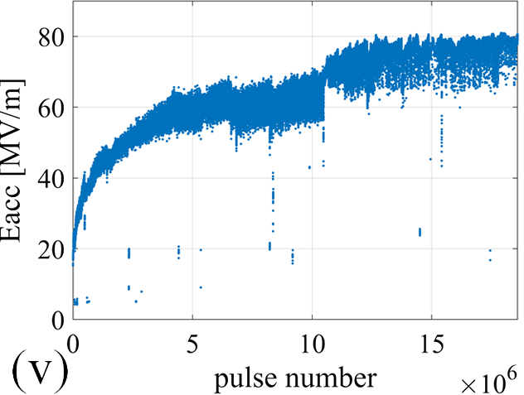
High-gradient performance of XT72 #1
BD in XT72 →
Gradient @ 80MV/m
BDR rate 1e-4
Breakdown event
evenly distributed
Compared with XC72 (CI)
XT72 has better performance
BD in XC72 →
Notes:
This is the high-gradient performance of the 1st XT72. It reached the goal of 80 megavlots per meter as well as BreakDown rate of ten to the minus four. Compared to the constant-impedance structure, breakdown events distributed much more evenly during XT72’s conditioning process.

Slide 22
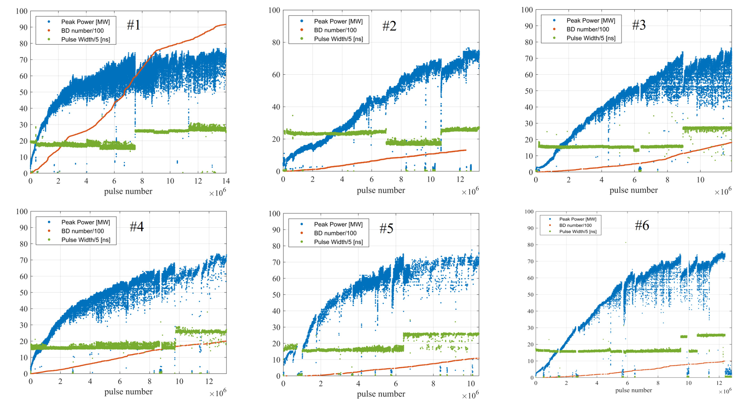
Conditioning results
Blue line:
Input power/MW
Green line:
Pulse Width/5 ns
Red line:
BD number/100
All 6 accelerating structures were conditioned
To reach 80MV/m, ~15 million pulses, About 100 hours of conditioning at 40Hz
Notes:
These are conditioning results of 6 XT72 structures. Blue line is input power, green line is pulse width and red line is accumulated breakdown number.
A two-phase conditioning strategy was used: first, we used short-pulse, 80 nanoseconds to rapidly achieve the gradient of 80 MegaVolts per meter; Then we reduced the gradient to 80% and extending the pulse width to 120 nanoseconds. These 6 structures required an average of about 15 million pulses to reach 80 MV/m @120 ns pulse width, corresponding to a breakdown rate of about ten to the minus four.

Slide 23
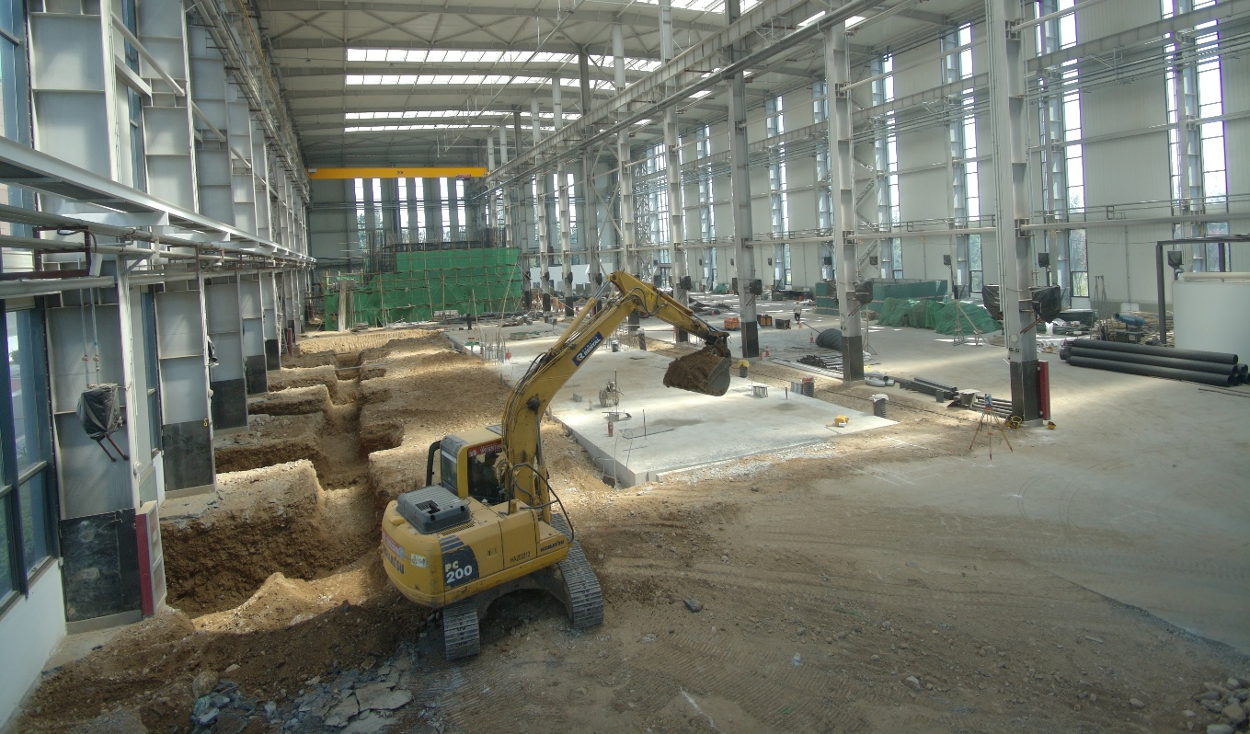
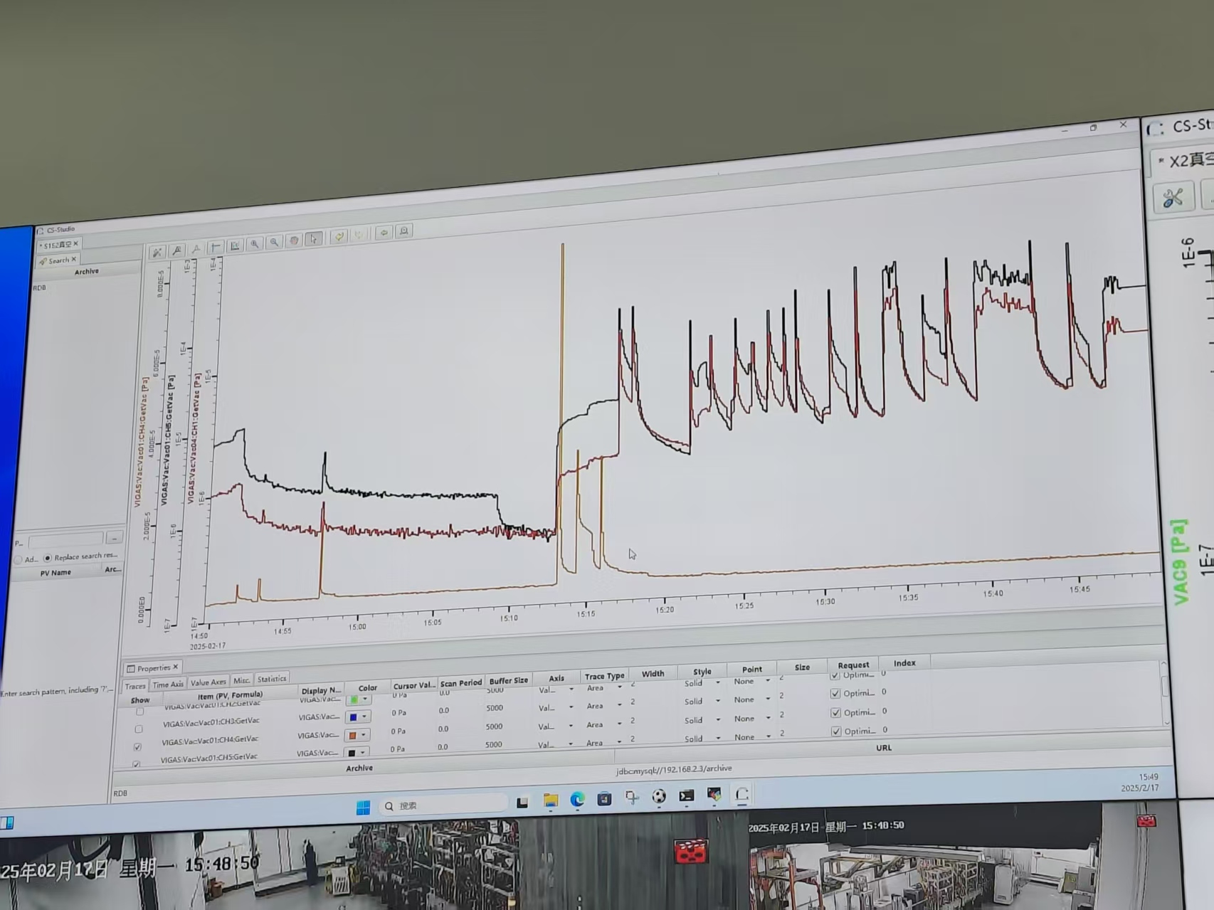

Progress and summary
2024.06
Bunk ready
2023.9
2024.12
Commissioning started
Notes:
The factory building was ready on Sep. 2023. In mid 2024, the bunk is ready. At the end of 2024, the beamline commissioning started.

Slide 24



Progress and summary
Successful generation of high-energy X-rays in collision experiment in mid-2025
Blue line：MCP (X-ray)
Red：BPM signal (e-beam)
Green：PD signal (scattered laser)
During the adjustment of the relative delay between the e-beam and the scattered laser, the X-ray signal detected by the MCP
The X-ray (~500keV) spot
9 m from the interaction point
Notes:
By adjusting the relative delay between the e-beam and the scattered laser, the first signal of high-energy X-ray was observed in the middle of this year. Its energy is about 500 KEV.

Slide 25



Progress and summary
VIGAS as a compact ICS source, total length ~13.5m, up to 350MeV beam energy, 4.8MeV photon
Installation completed in 2024
Successful generation of high-energy X-rays in collision experiment in 2025
S-band commissioning completed; X-band commissioning will be completed soon
Beam and scattered laser are under optimization
Notes:
In summary, VIGAS project is a compact ICS source, total length is about 14 meters, and can produce up to 350 MEV beam energy as well as 4.8 MEV photon. Its installation was completed in 2024 and first generated high-energy X-ray in 2025. Currently S-band modules commissioning has been completed, X-band commissioning would be completed soon. Beam and scattered laser are under optimization.

Slide 26







Proposed 100MeV VHEE facility
(a) flattop output without AM
(b) flattop output with AM
Correction cavities
Storage cavity
50MW 1.5us 40Hz klystron
K
150MW 300ns
Power splitter
24 nC/pulse, 40 Hz
Flash rate(>40 Gy/s) in 6×6cm² radiation field.
Main linac
DC e-gun
S
>100 Hz burst mode possible
Buncher
< 2 m
8 MeV
100 MeV
Under development
Based on XT72 design
Energy measurement
with a stack of steel sheets
Transverse distribution
Notes:
Besides VIGAS project’s 350MEV beamline, Tsinghua University also proposed a X-band 100MEV VHEE facility. It includes a DC electron-gun, a power compressor, a X-band backward-traveling-wave buncher, and two main X-band linacs. The total length of this beamline is designed to be less than 2 meters. The pulse compressor and buncher have been high-power tested, while the X-band linac is based on XT72 design, and still under development.

Slide 27

Thank you for your attention!
dych@mail.tsinghua.edu.cn
shij@tsinghua.edu.cn
Notes:
Thanks for your listening!

