Slide 1


International Workshop on Very High Energy Electron Radiotherapy, September 17, 2025
VHEE Activities at ASU
Mark Holl
Arizona State University
This work supported by the National Science Foundation under grants 2153503 and 1935994
1
30-10
Notes:
New science: full coherence, stability and tunability, attosecond resolution, AI and ML co-design
Started on FELs in ’90s. HGHG leading to DUVFEL at Brookhaven. Helped with design of LCLS and FERMI@Trieste
10 years ago worked with colleagues to apply laser and accelerator technologies to compact x-ray sources

Slide 2
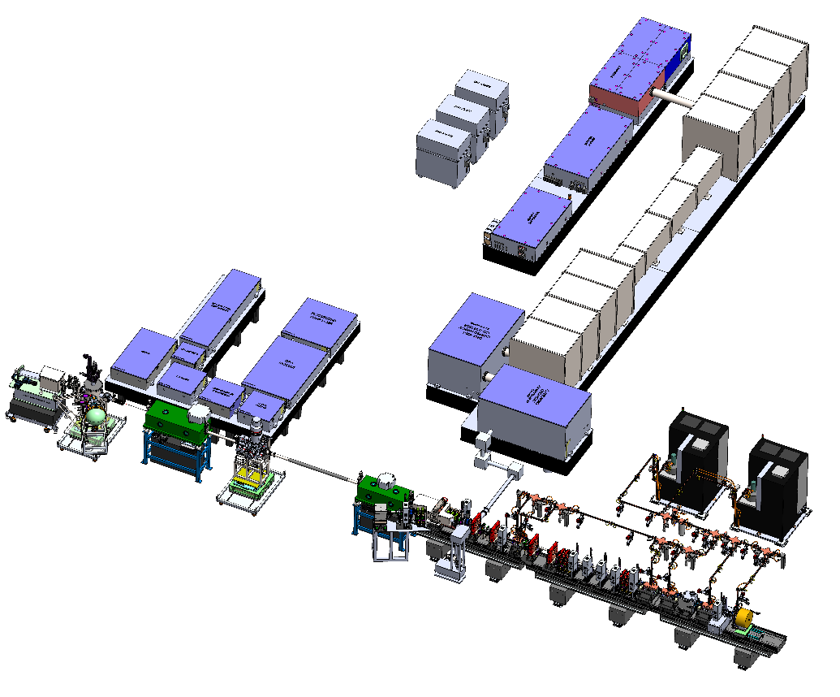
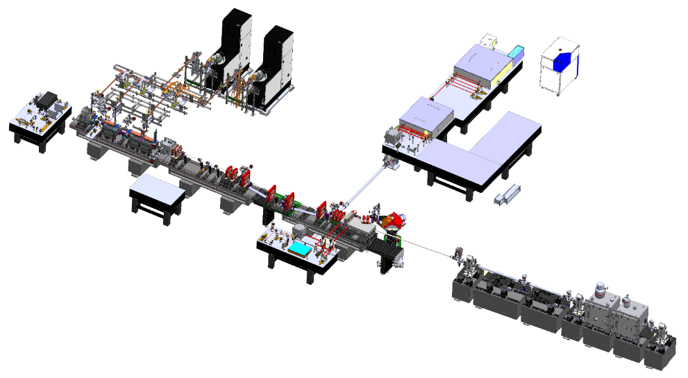
NSF CXFEL Project – What is it?
A two-phase project to build a compact fully coherent x-ray laser
(and now also, VHEE FLASH)
CXLS
Phase 1 Hard X-ray ICS Source
CXFEL
Phase 2 Soft X-ray Coherent Laser
Built and now commissioning
5 year construction began March 15, 2023 under $90.8M NSF midscale RI-2 award

Slide 3
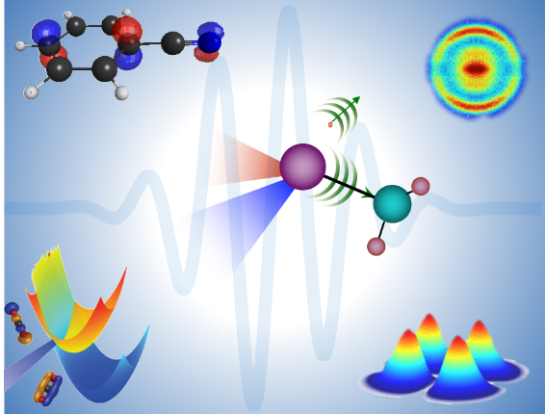
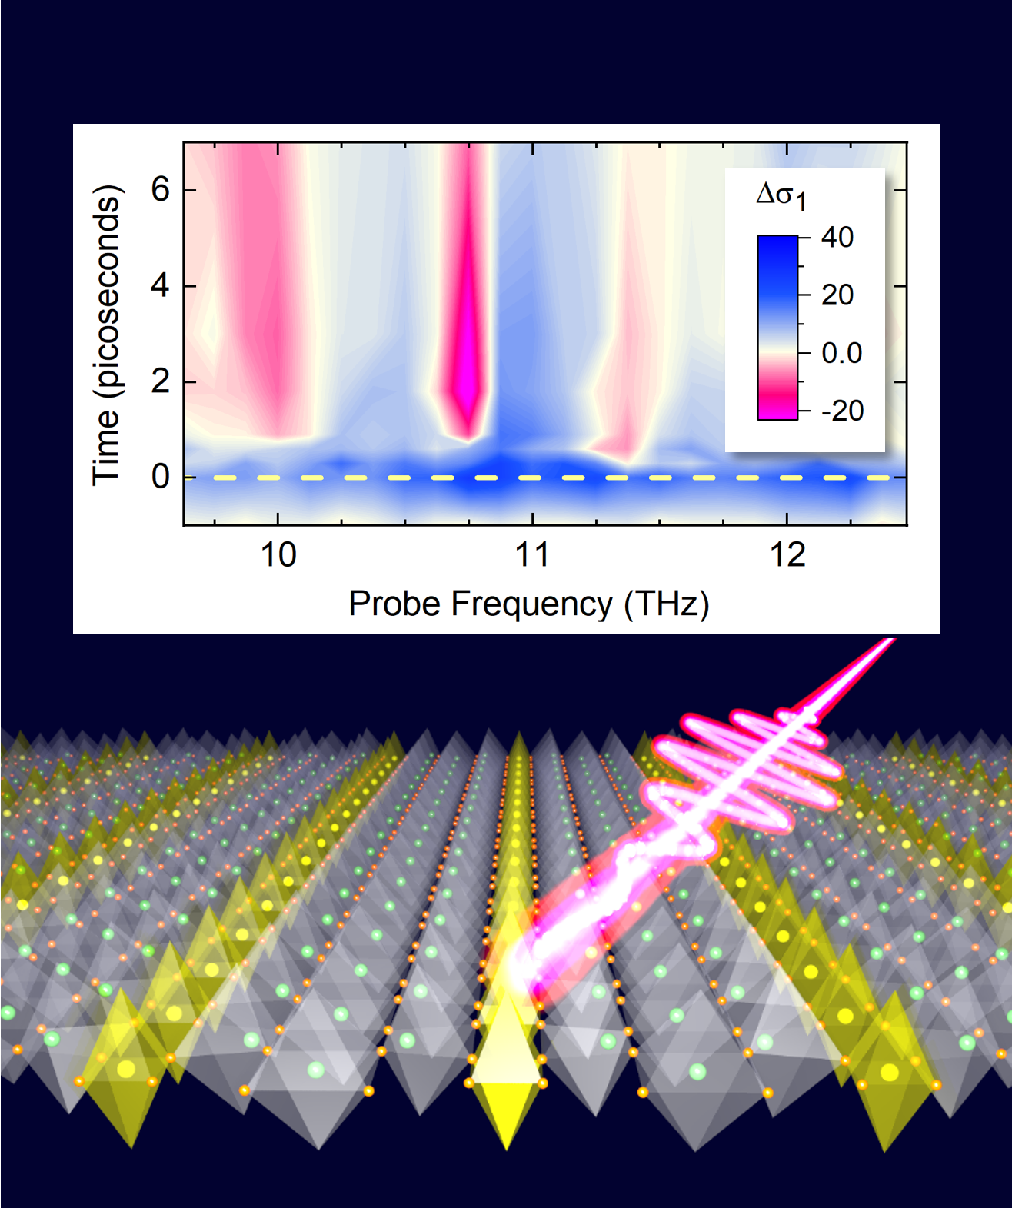
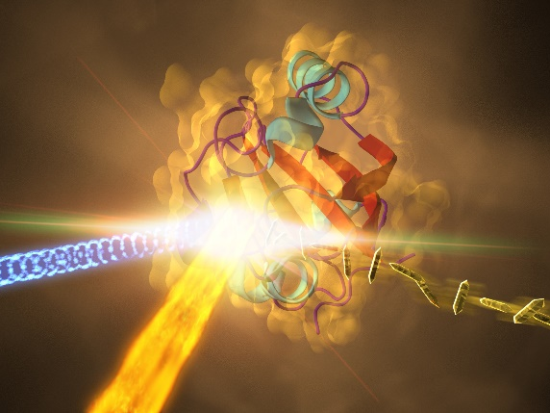


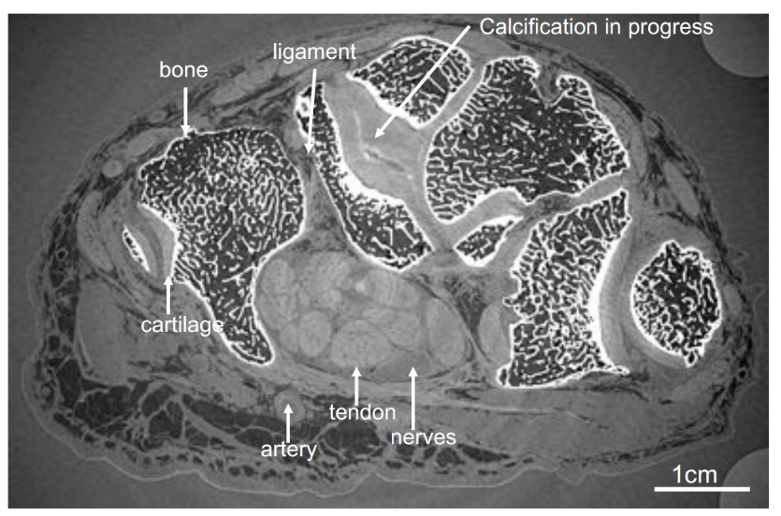

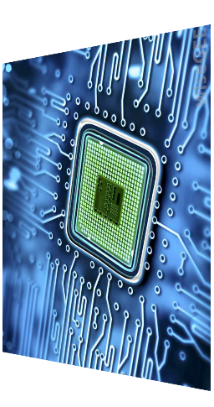

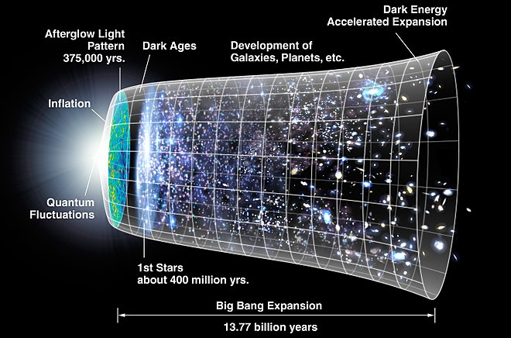
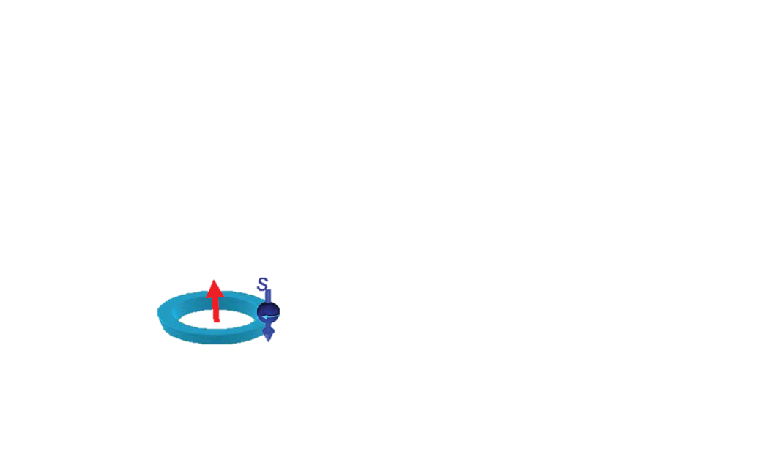
Ultrashort X-ray Probes: Structure & Dynamics
What happens in matter on “ultrashort” time scales?
Catalysis & Renewable Energy
Quantum Materials
Light-Driven Phases
Biomolecular
Movies
Time
…
Micro Electronics
nanoseconds
10⁻⁹
Molecular Vibrations
picoseconds
10⁻¹²
THz waves
Electronic
Interactions
femtoseconds
Visible light oscillation
10⁻¹⁵
attoseconds
Atomic Quantum Dynamics
Advanced Imaging
Matter in
Extreme Conditions
10⁻¹⁸
Adding a vision for VHEE FLASH instrument research!
3

Slide 4
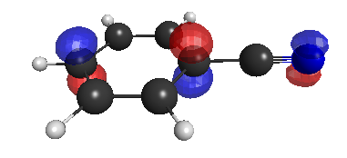
CXFEL LASERS
ICS Laser
Laser Undulator
Sample Excitation
Photoinjector
RF acceleration
Nano-bunching
x-rays
e
Experimental Laser
Cathode Laser
Notes:
Generate electrons, kick electrons around, hit the sample at same time as x-rays

Slide 5
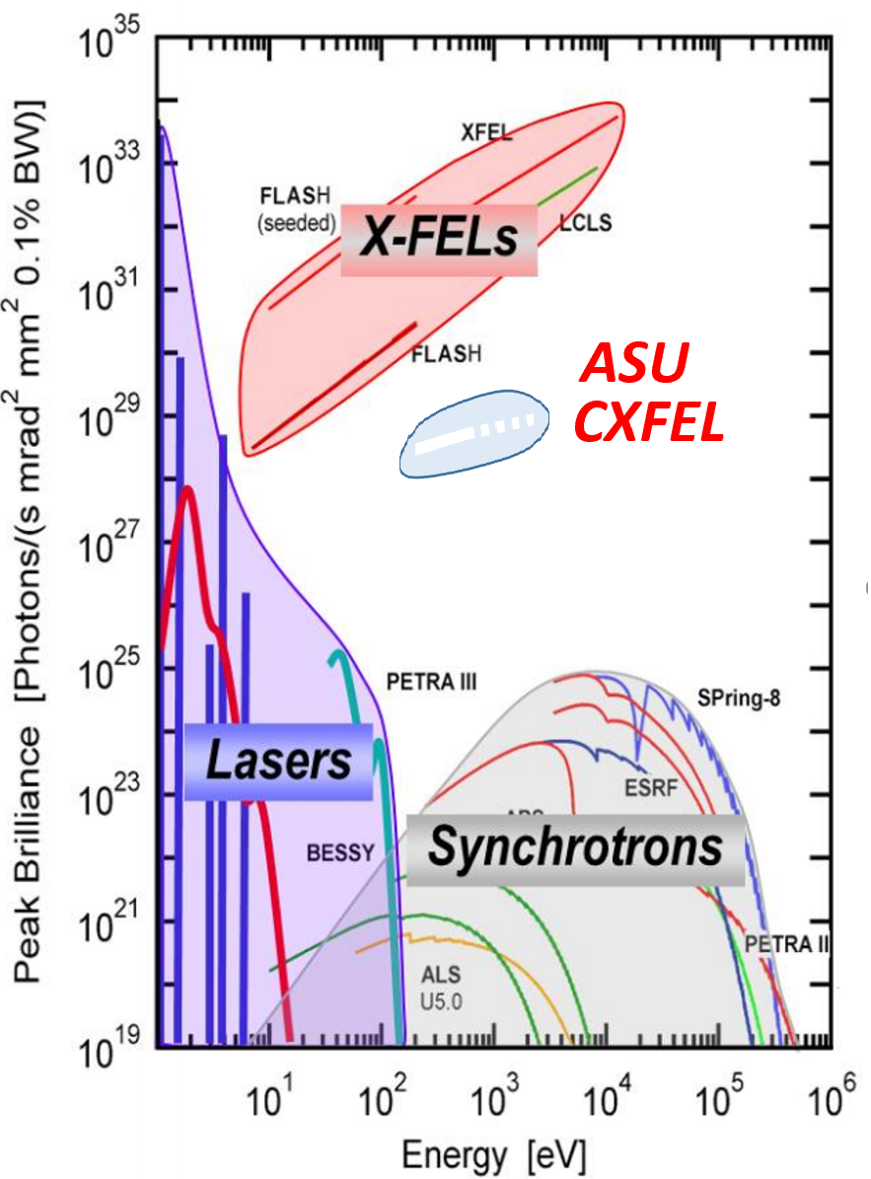
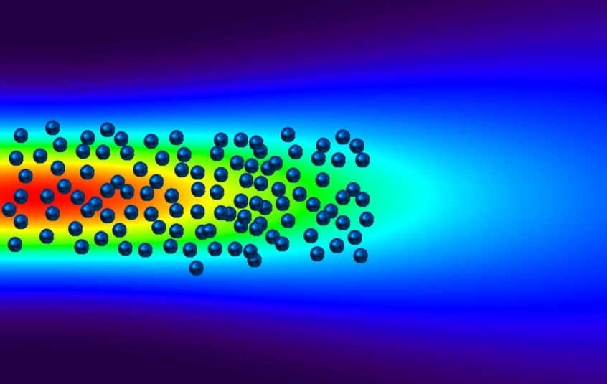
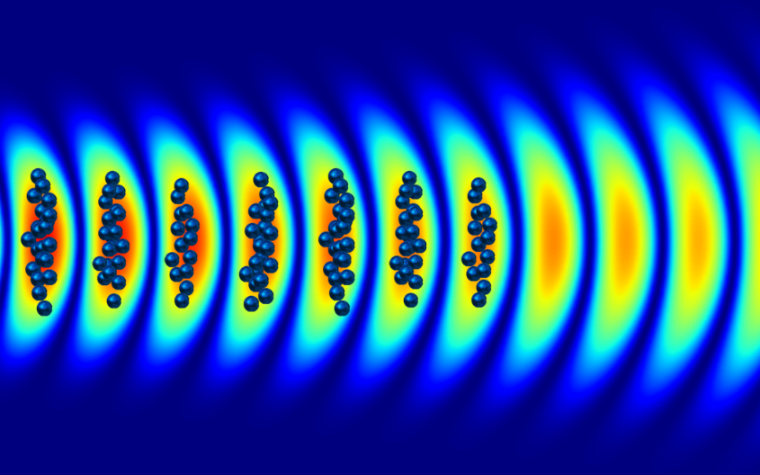
Compact X-ray Free Electron Laser (CXFEL)
Unique attosecond soft X-ray source (250 eV – 2.5 keV)
Full coherence in space & time
Pulse durations into attosecond regime
High stability (pulse-to-pulse and intra-pulse)
Unique control of X-ray pulse phase & amplitude
λ_{x}
Electron bunching via diffraction and emittance exchange
5

Slide 6
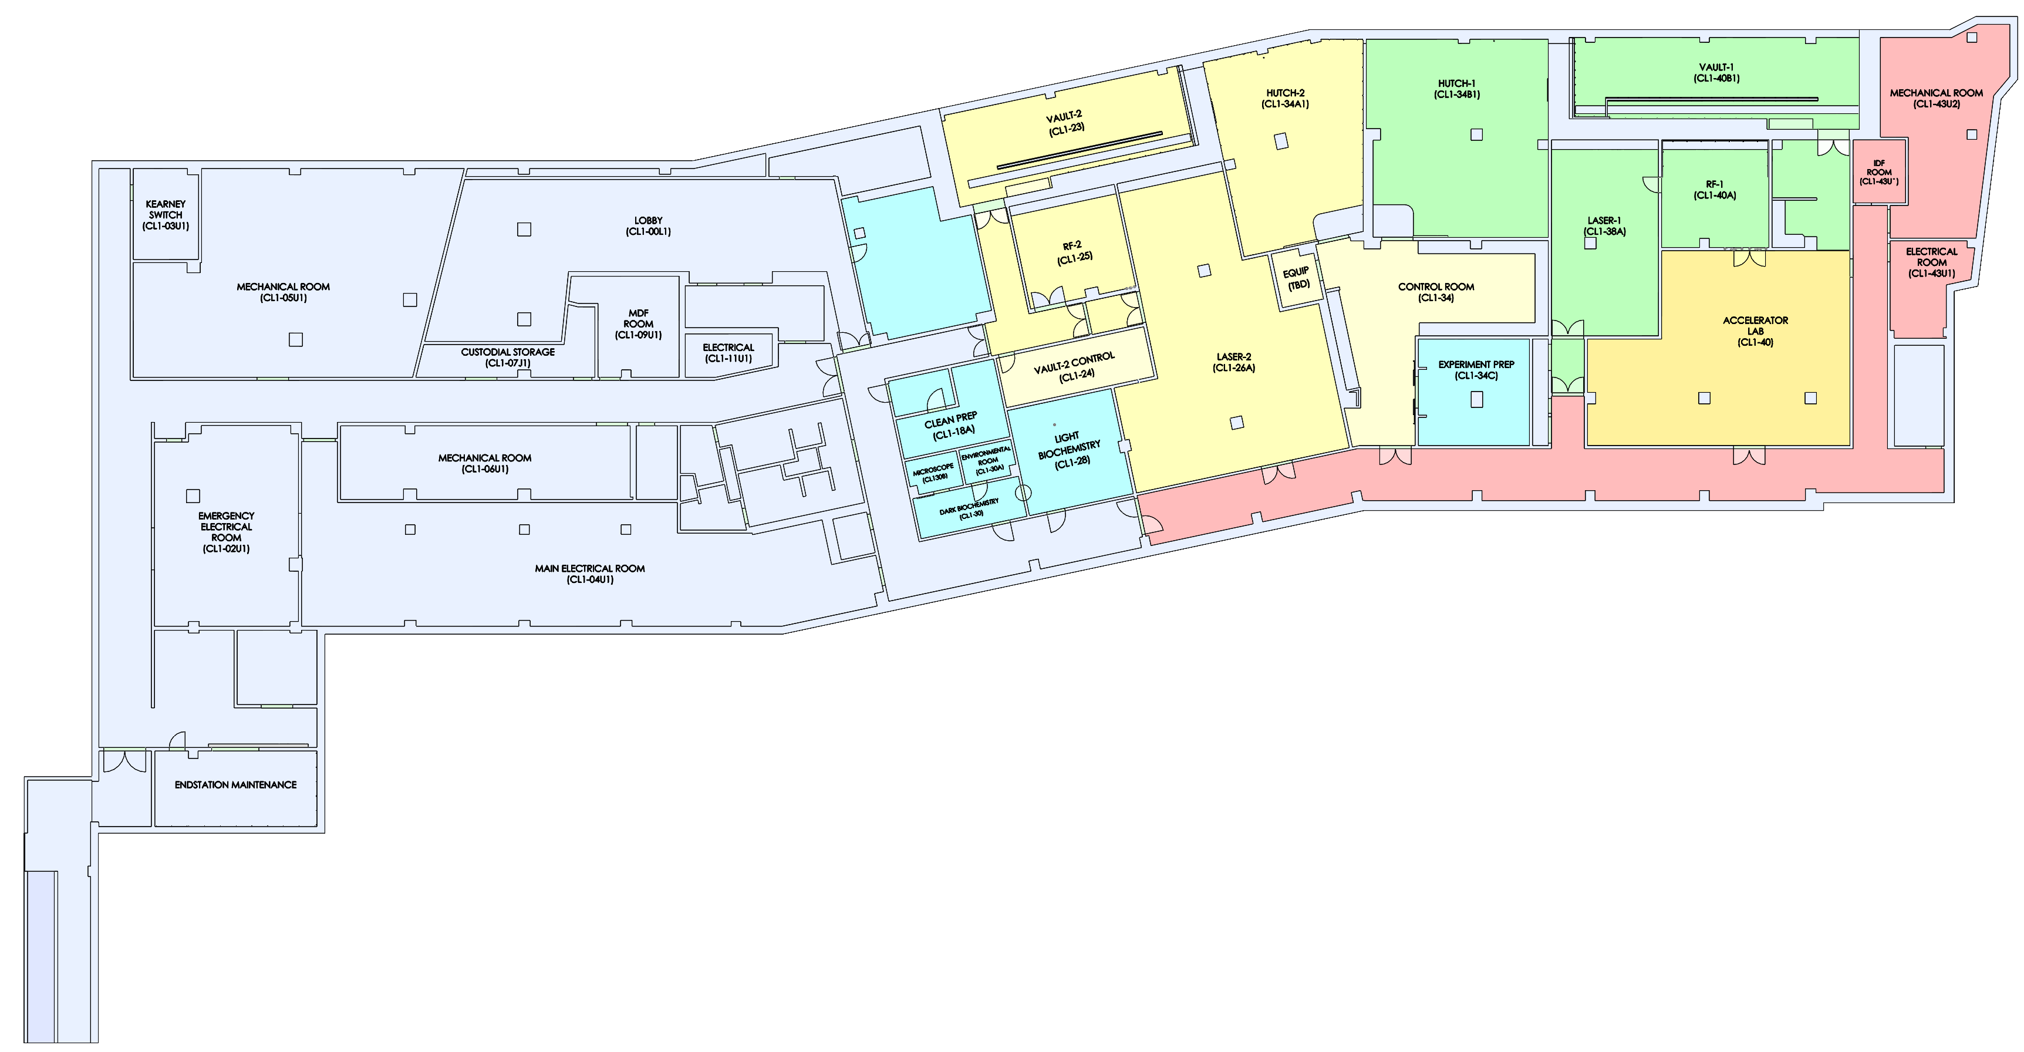
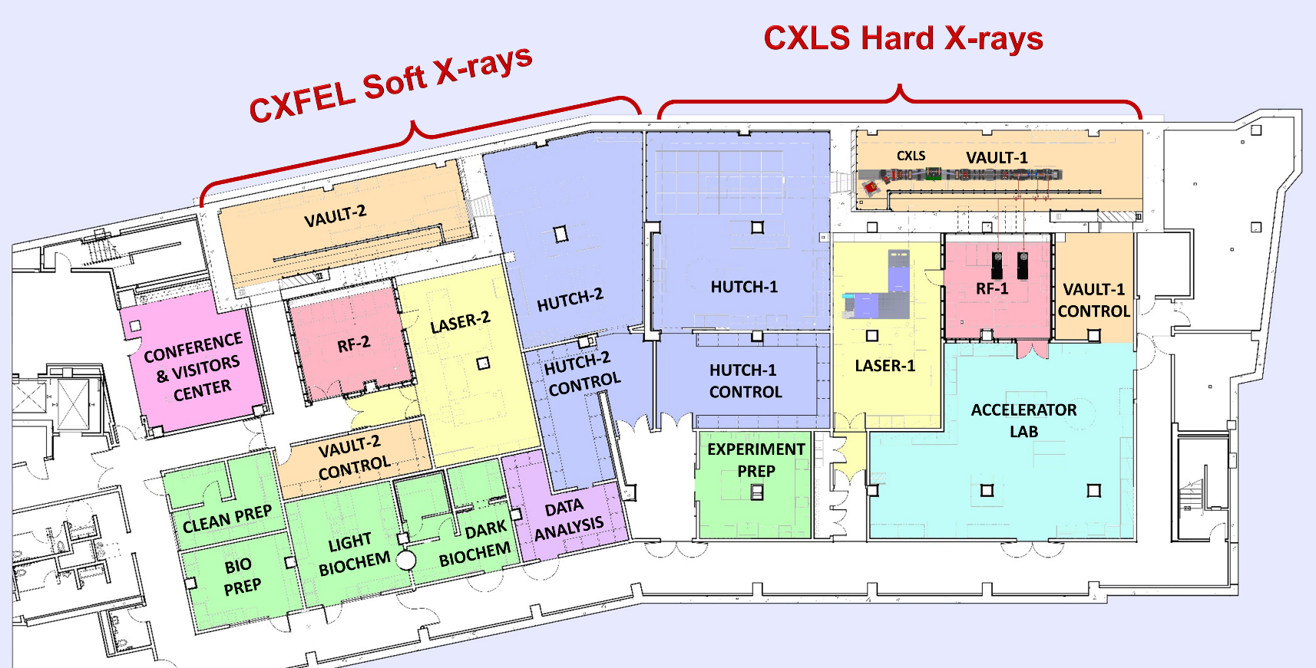
LAB RENOVATION SCOPE
AFTER
VAULT-2
HUTCH-2
RF-2
CONTROL ROOM
VAULT-2 CONTROL
LASER-2
From shell to instrument ready
ENDSTATION
MAINTENANCE
CXFEL BEAMLINE
CXLS BEAMLINE
ACCELERATOR LAB
USER LABS
6
BEFORE

Slide 7
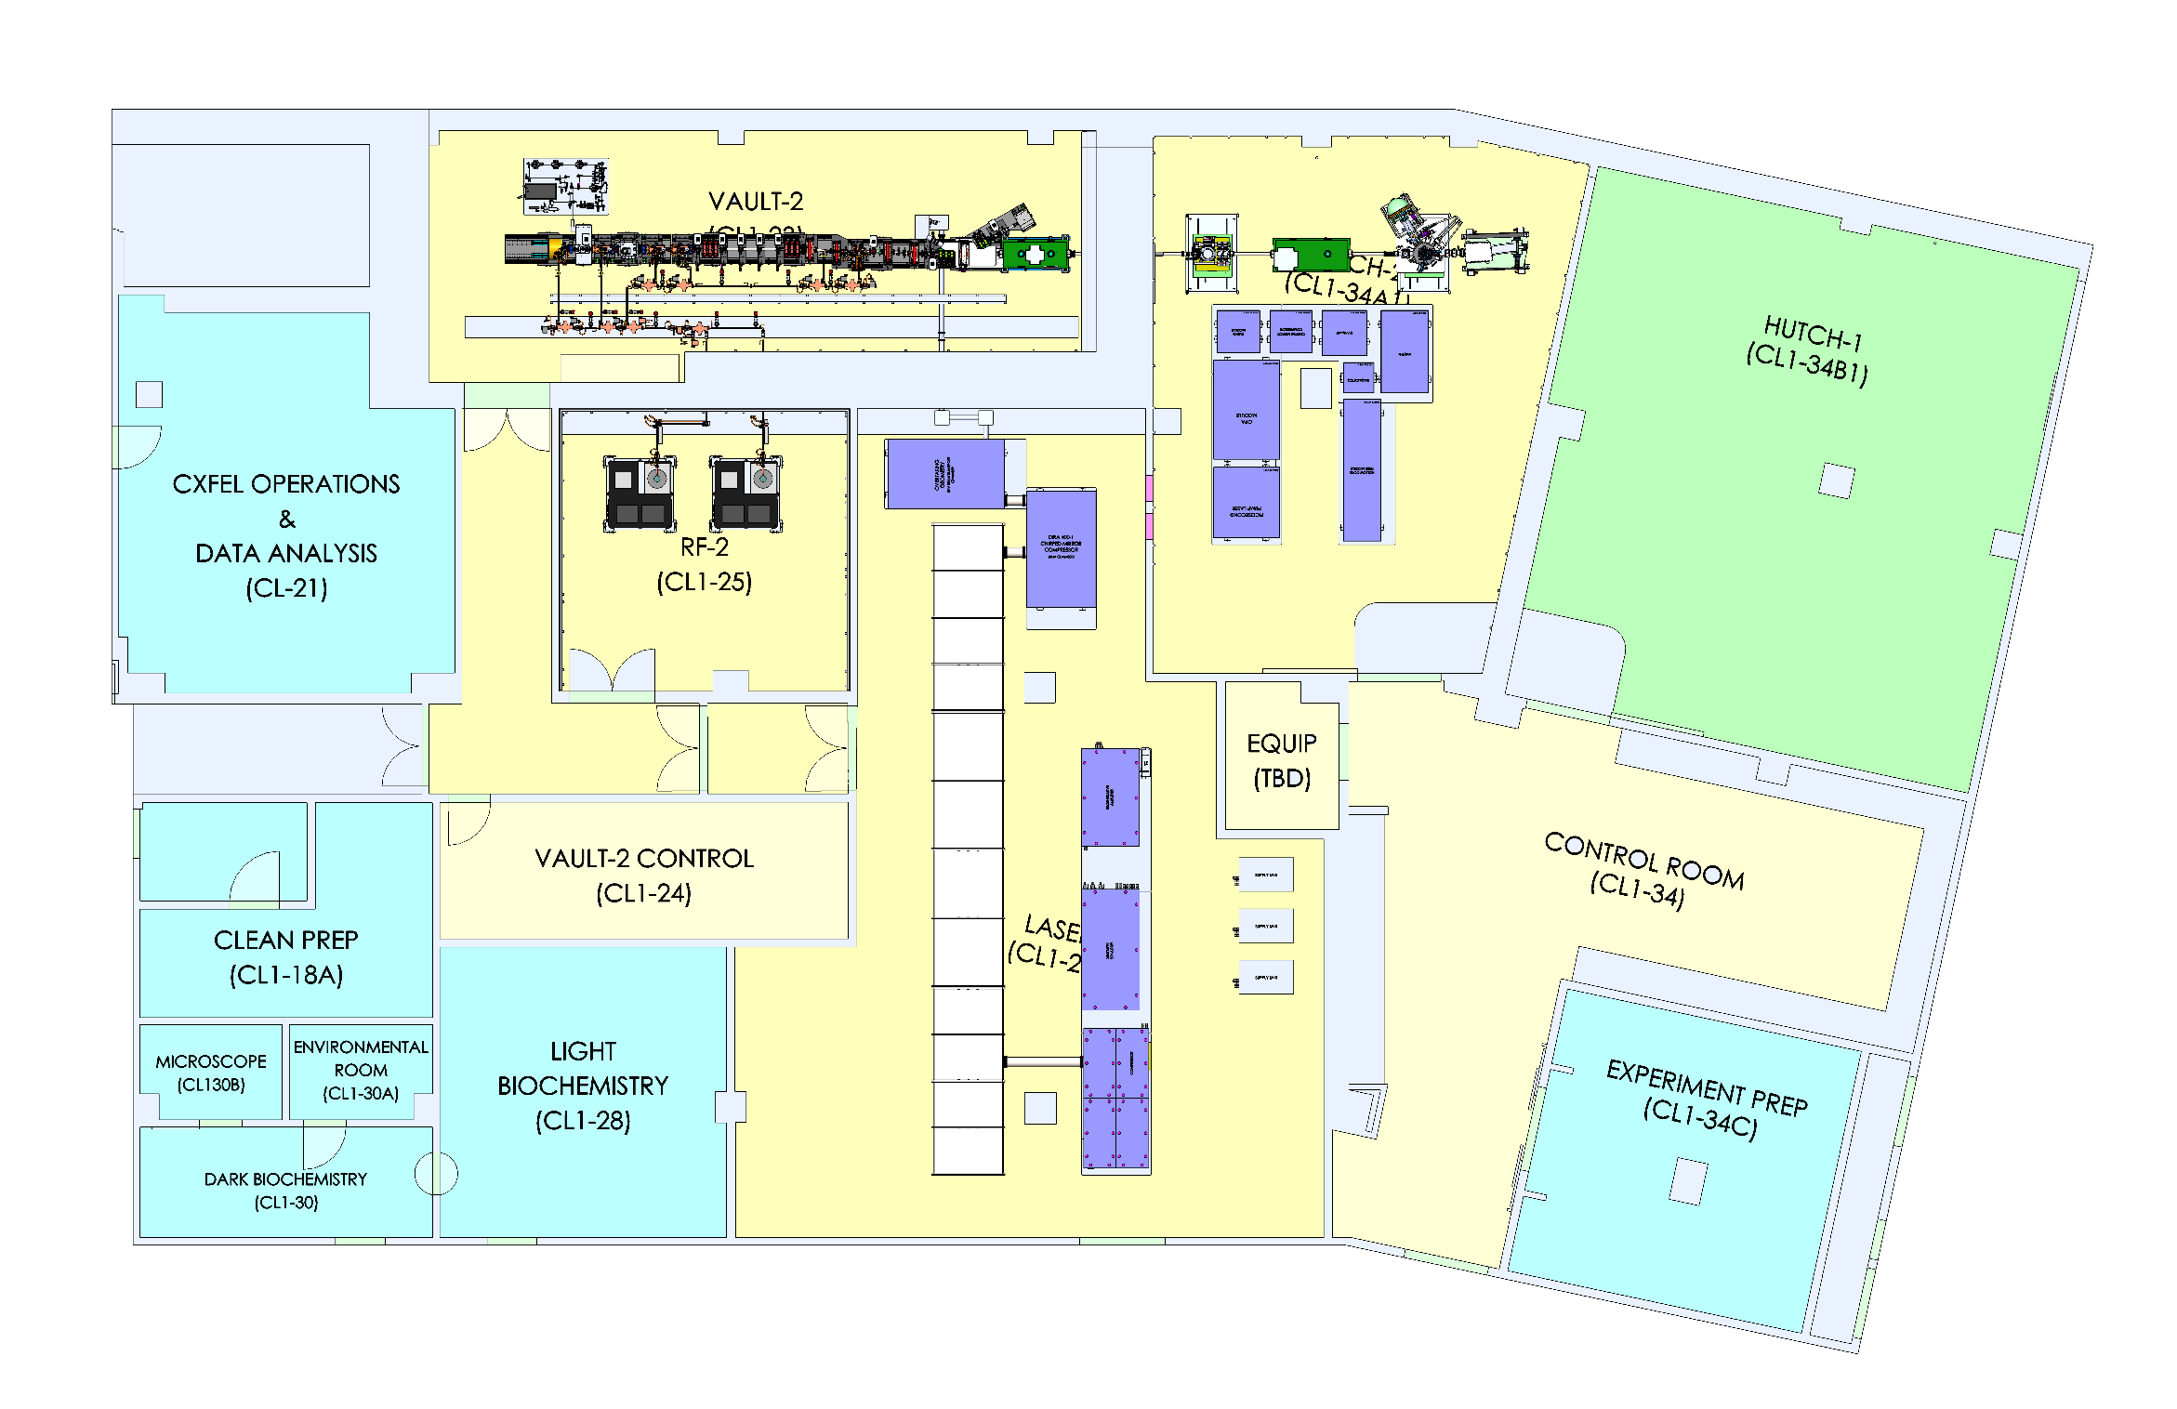
Room Data Sheets (major renovations)
HUTCH-2:
Research power
PCW (w/booster)
N2, CA, He
HVAC (T, %RH, part.)
Lighting
Penetrations
Shielding
Gantry
Roughing vacuum
Exhaust
PPS Interlock
Network
ENDSTATION MAINTENANCE:
Similar to HUTCH-2 for out of beamline work on endstations and maintenance when not on the beamline.
VAULT-2:
Research power
PCW and PPCW
N2, CA, VAC
HVAC (T, %RH, part.)
Lighting
Penetrations
Shielding
PPS Interlock
Network
RF-2:
Research power
Increase 480 VAC, 3-ph from 200 A to 400 A
N2, CA, VAC
HVAC (T, %RH, part.)
PPCW
Water cooling systems
Gantry
Network
EQUIPMENT:
Research power
Sound insulation
PCW (w/booster)
N2, CA
HVAC (T, %RH, part.)
Lighting
Roughing vacuum
Exhaust
Network
VAULT-2 CONTROL:
Research power
PCW
HVAC
Lighting
Locate LLRF, Magnet PS, Local computation/storage, EPICS IOC servers
Network
NEW LASER-2:
Research power
PCW and PPCW
N2, CA, VAC
Process gases
HVAC (T, %RH, part.)
Lighting
Penetrations
PPS Interlock
Network
RELOCATE:
DARK BIO, ENV, MICROSCOPE
NEW CONTROL ROOM:
Research power
Network
7

Slide 8
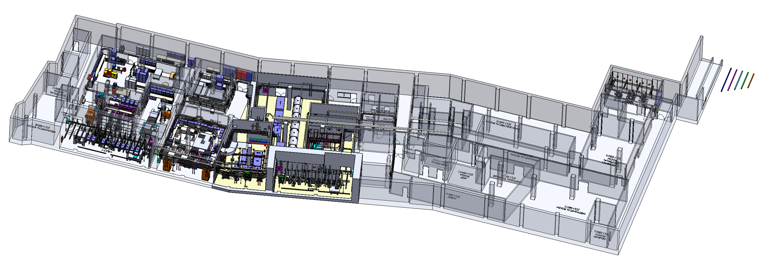
CXLS/CXFEL
Integrated Facility Modeling

Slide 9
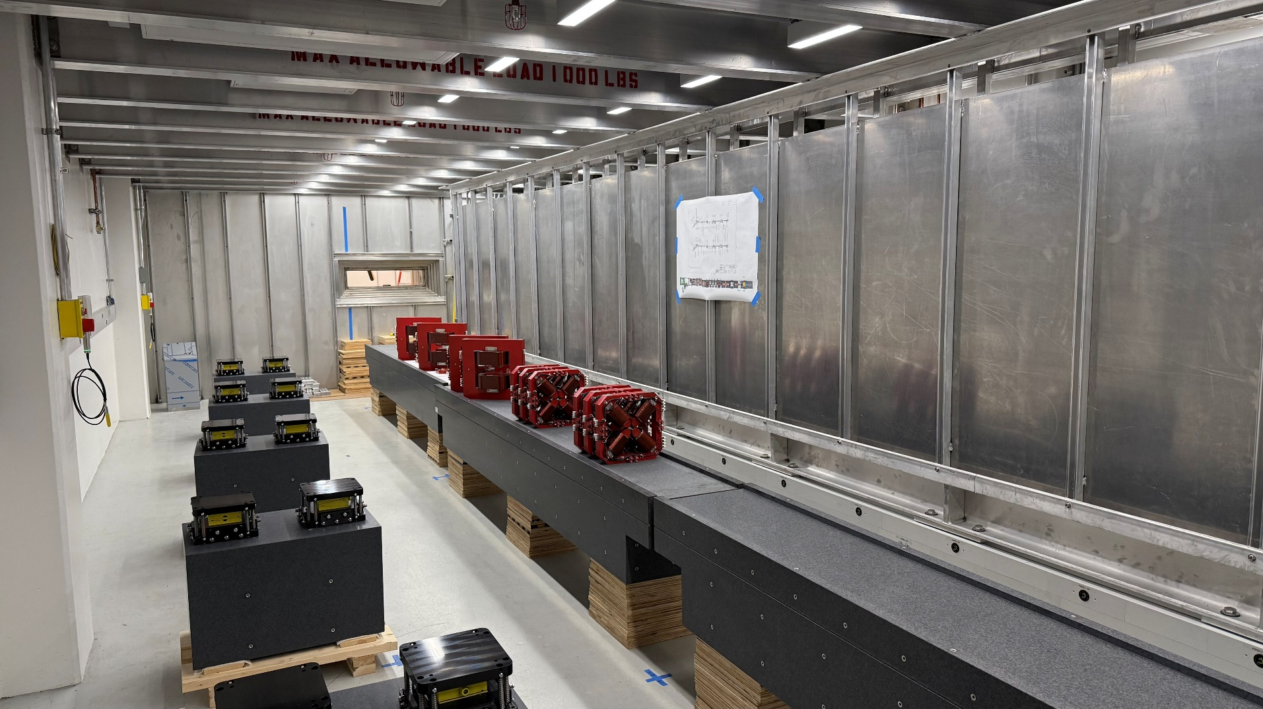
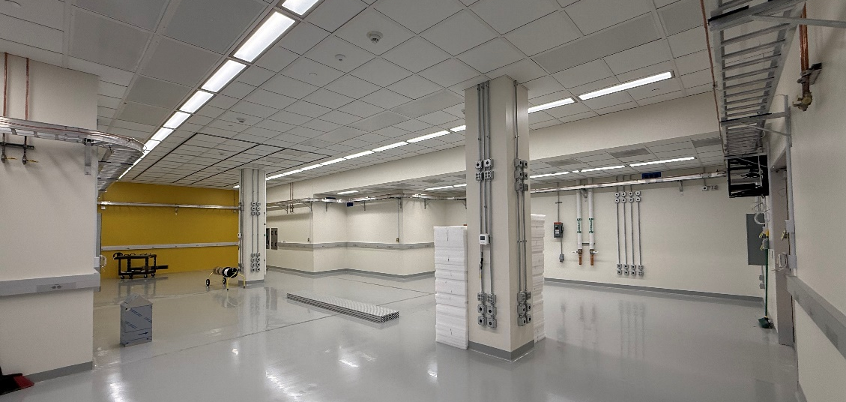
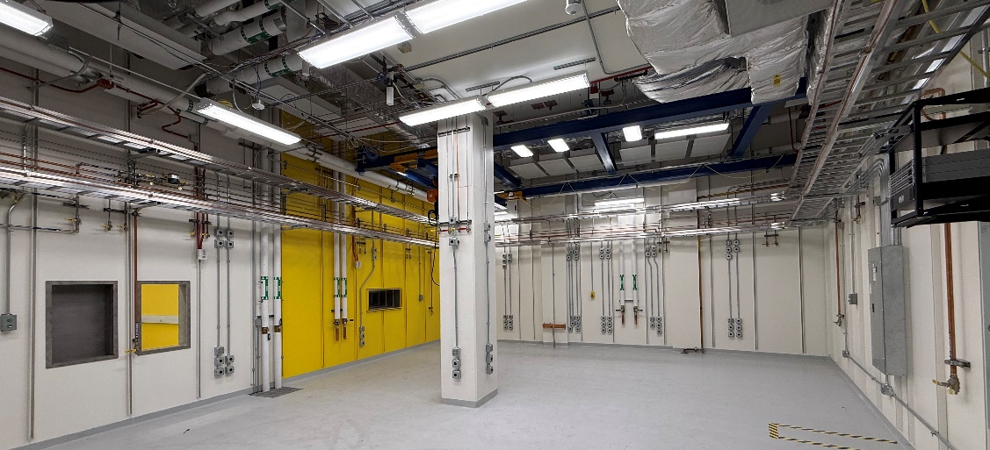
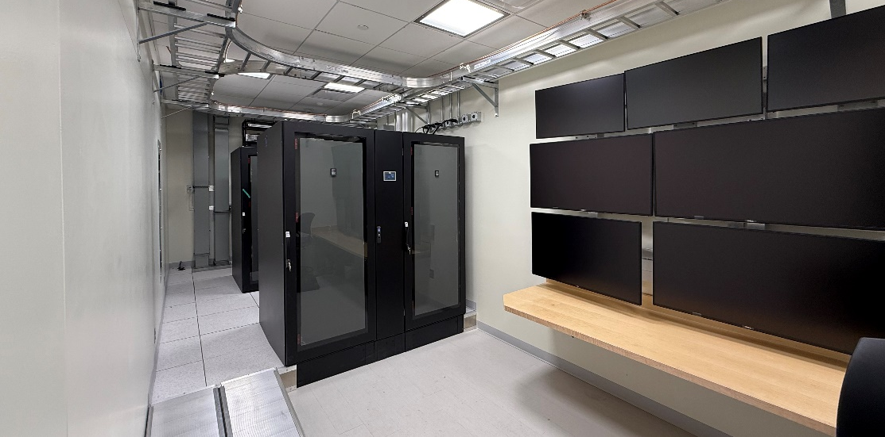
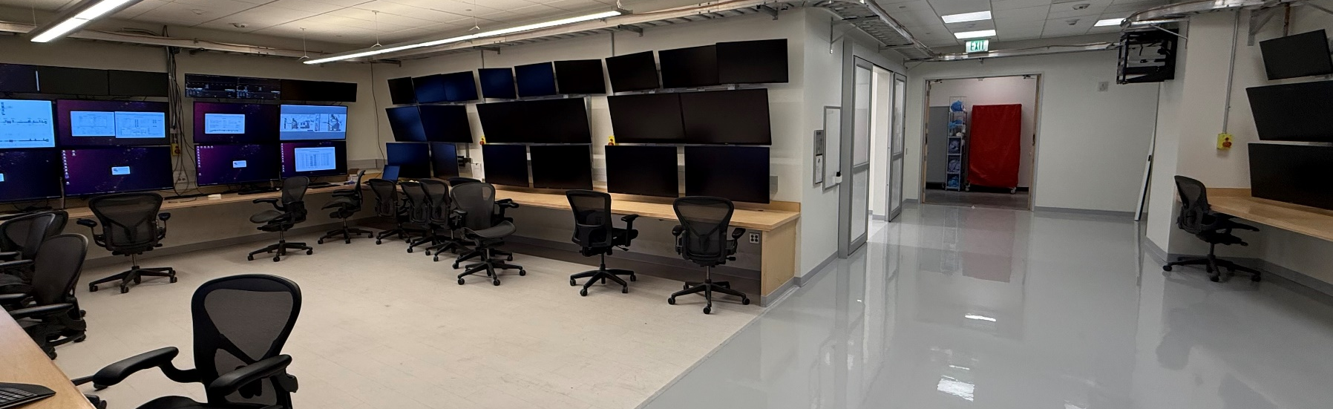
VAULT-2
LASER-2
HUTCH-2
VAULT-2 CONTROL
CONTROL ROOM

Slide 10

ASU Compact X-Ray Light Source (CXLS)
Photoinjector
6 MW Radio-Frequency Source
with UV laser
9.3 GHz “Klystrons”
IR Drive Laser
200 W, 1 ps (DIRA)
Pulse Compressor
Linear Accelerator
~30-40 MeV electron energy
Science Endstation
& Tunable Pump Laser
Interaction point
~10 meters
Femtosecond
X-ray Output (1 kHz)
Initial optics: 9.25 keV
10
Notes:
Ultrafast X-ray source (in commissioning) to provide 100-1000x brightness of conventional liquid-metal X-ray sources

Slide 11
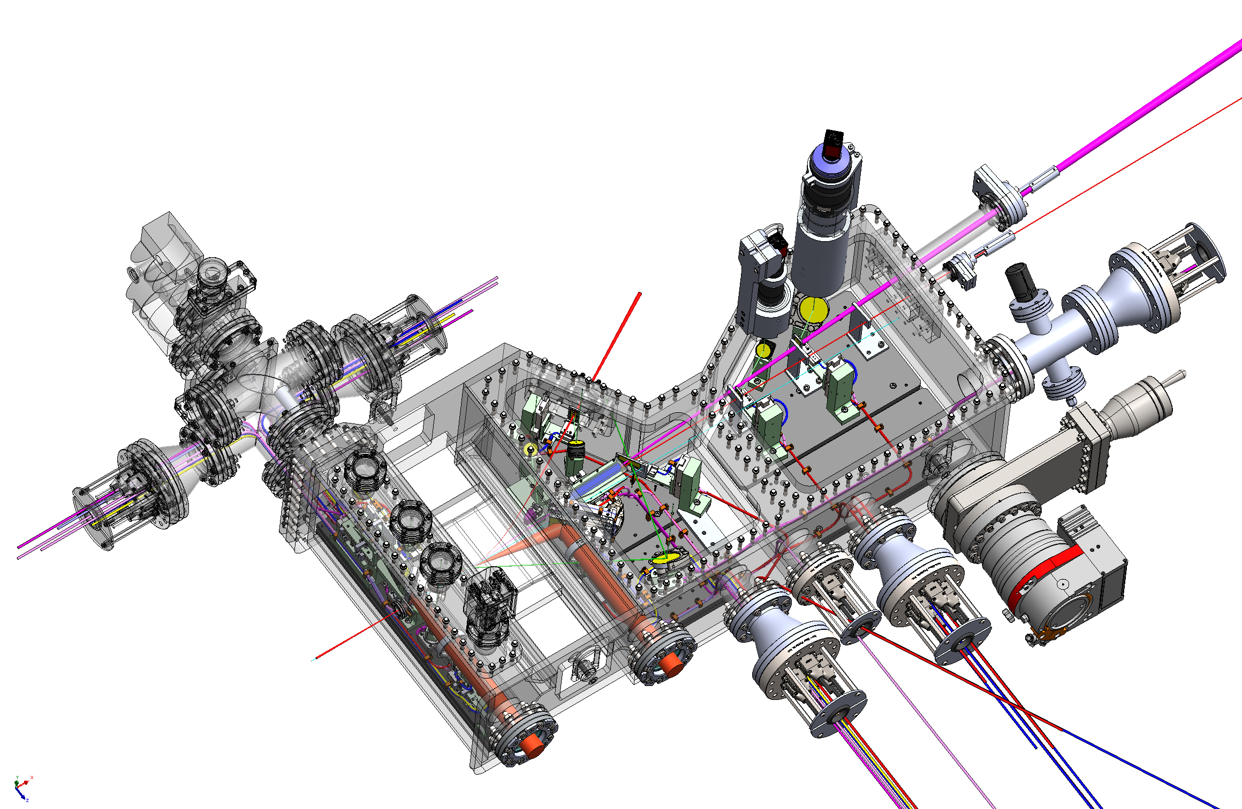
CXLS Interaction Point Chamber
with Montel Optic (9.25 keV)
Free Divergent
Beam
Montel
Optic
Collimated
Beam
Interaction
Point
Electron
Beam
IR Beam
(undulator)

Slide 12
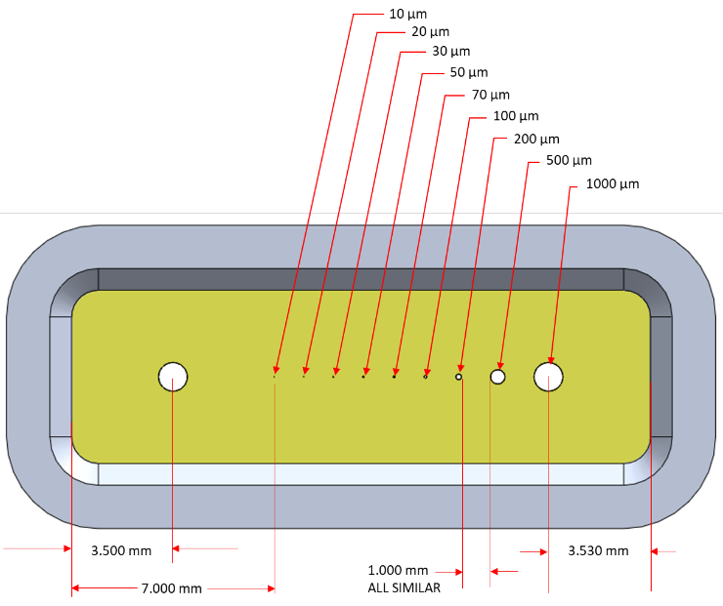
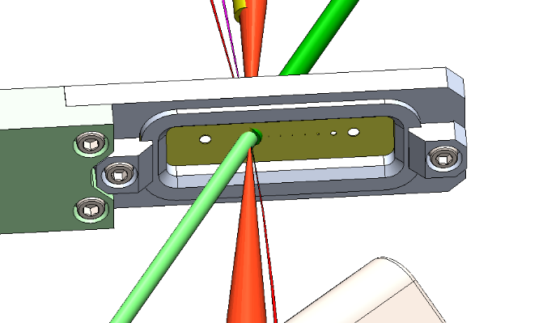
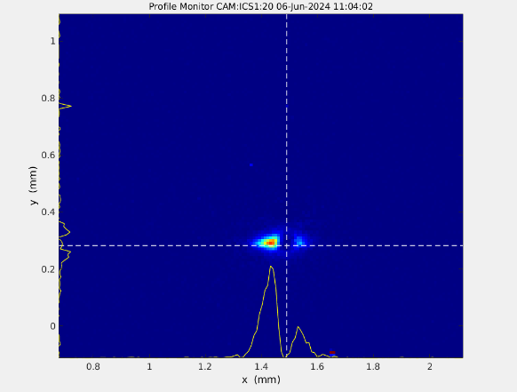
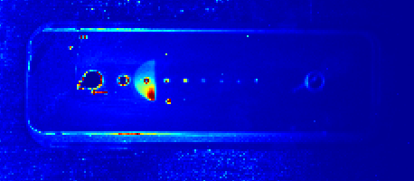
Holey YAG at Interaction Point
Laser-drilled precision holes add novel abilities to YAG.
Improves spatial resolution from 15 um to 3 um
Transforms YAG from invasive diagnostic to noninvasive
YAG has remarkable ability to provide fs timing info and micron spatial overlap between laser and e-beam.
E-beam through small hole showing horizontal tails
Holey YAG illuminated by ebeam
12

Slide 13
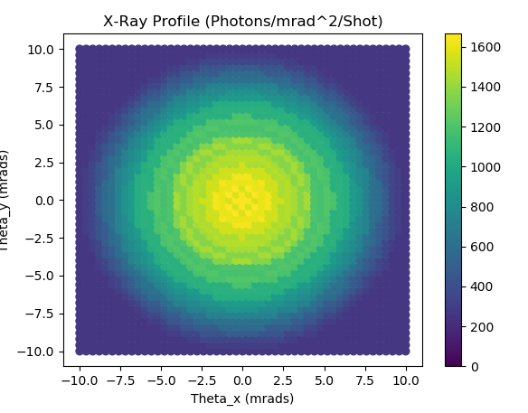
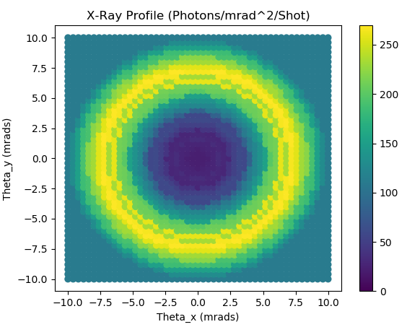
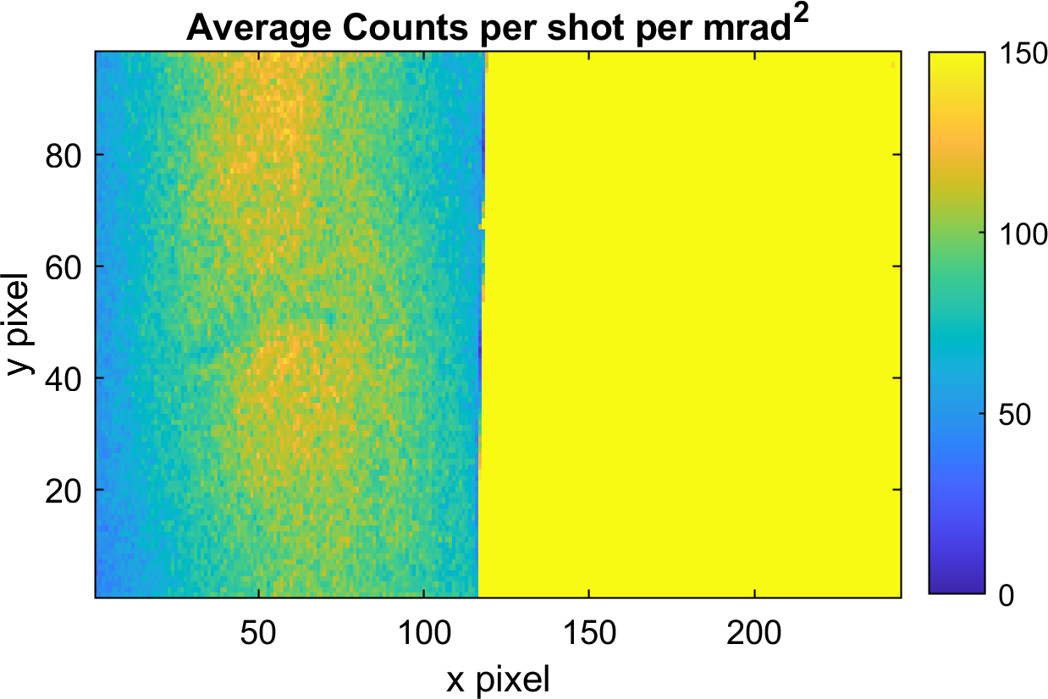
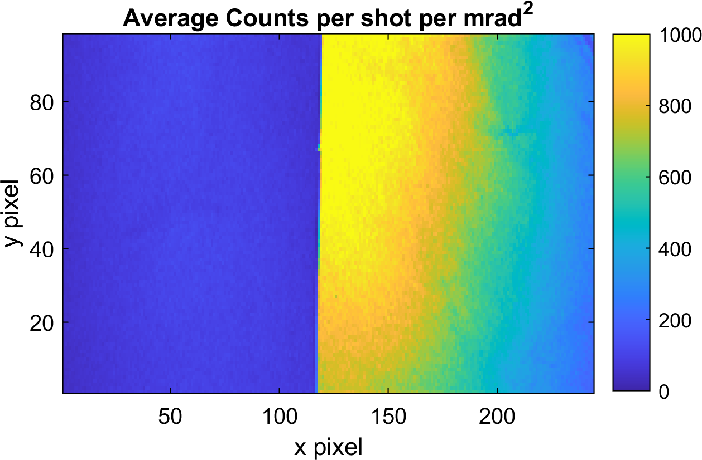
X-ray Results: Validated X-ray Photon Energy, Flux Estimates
Cu Foil
No Foil

Slide 14
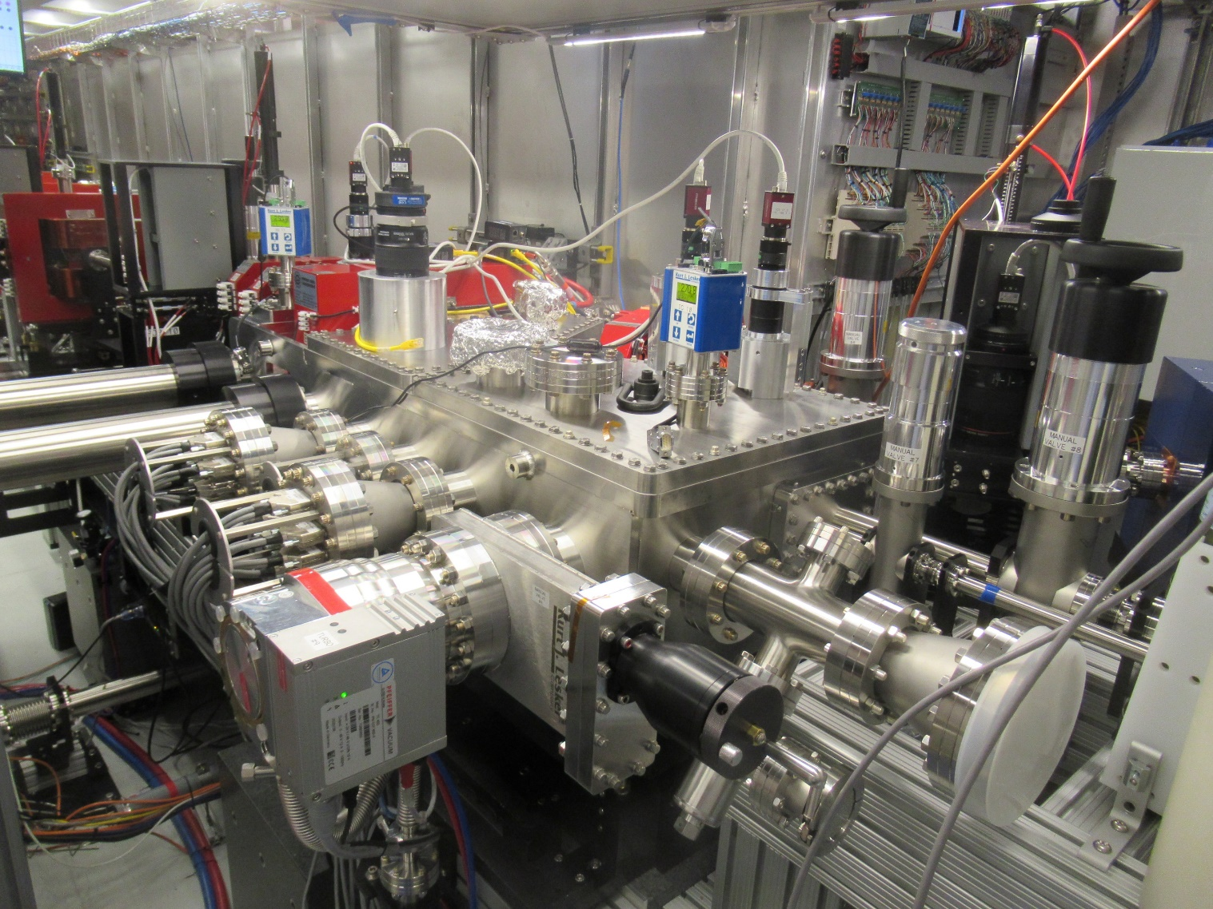
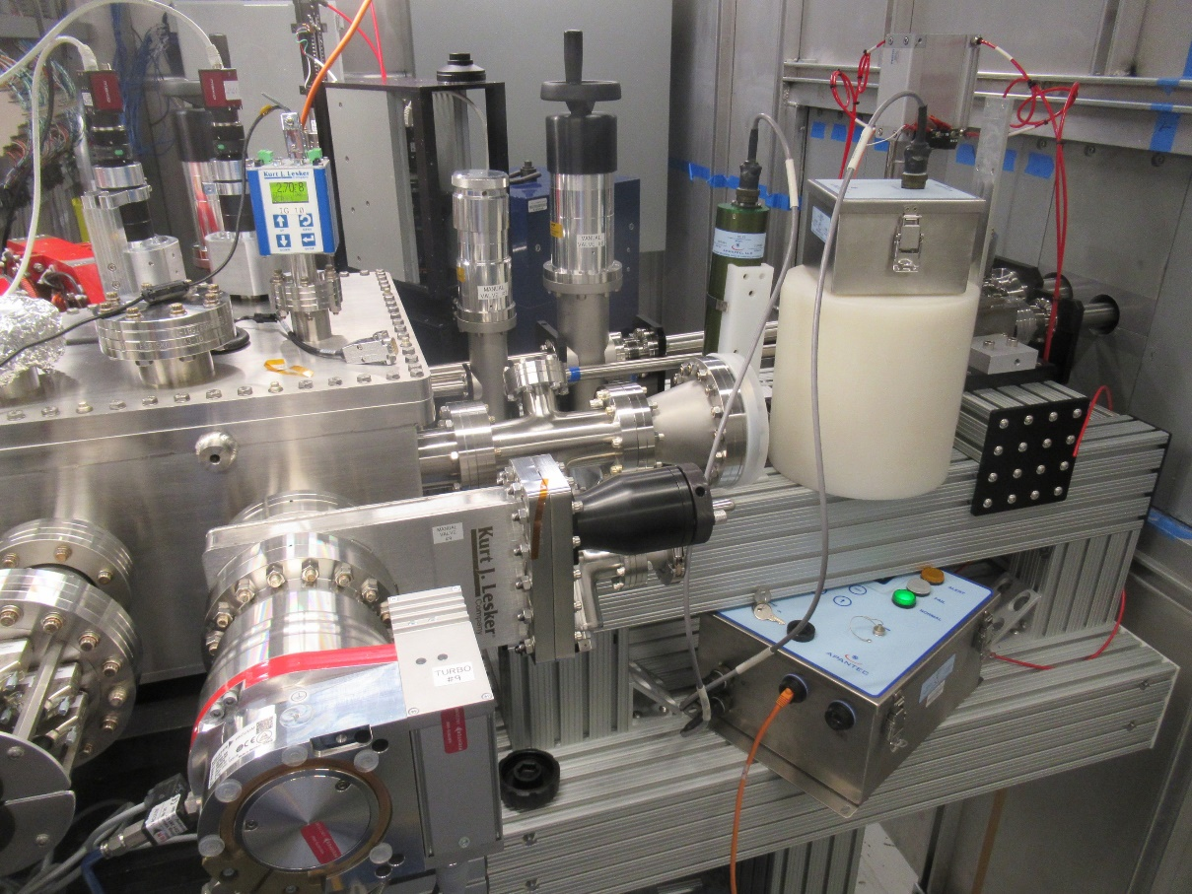

Slide 15
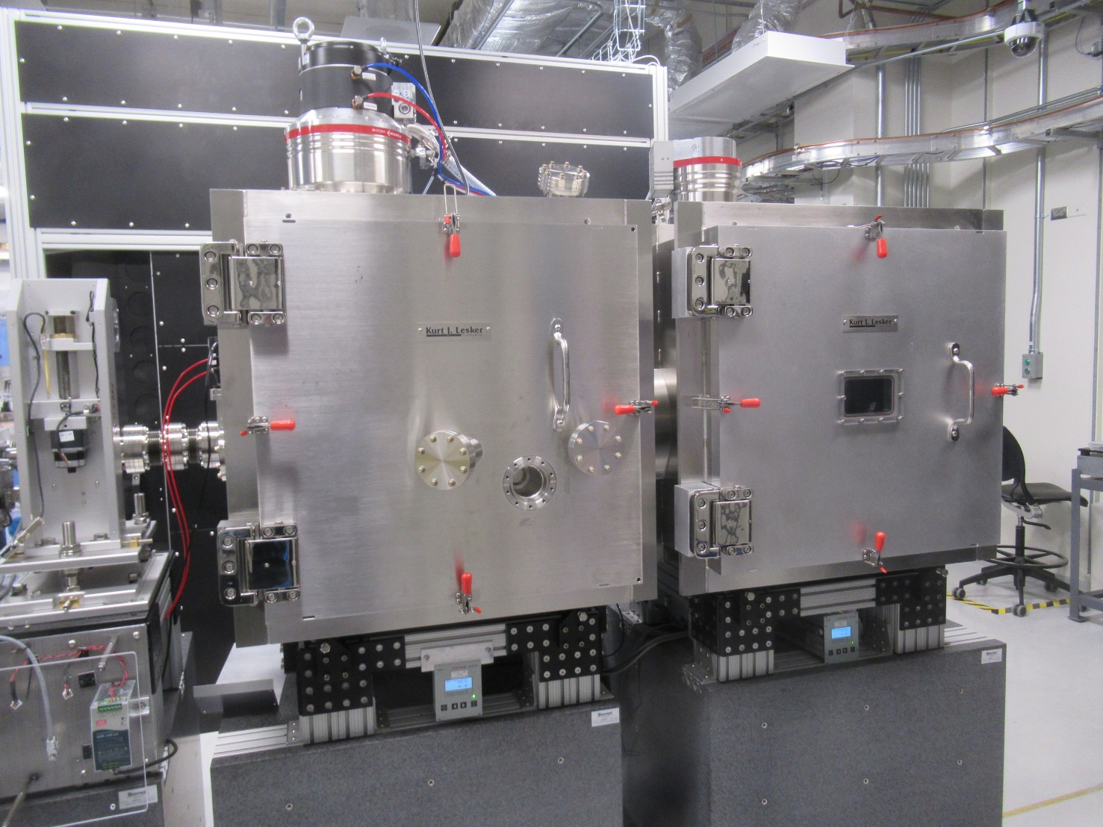
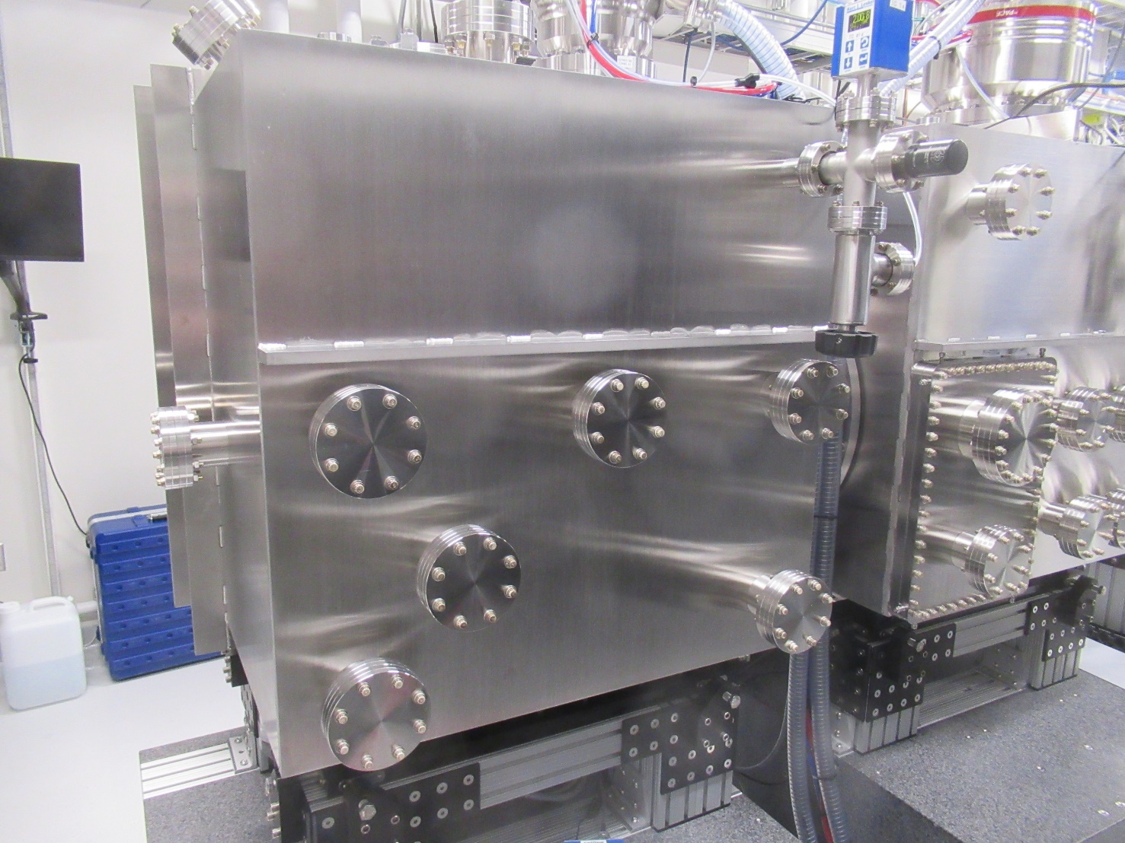

Slide 16
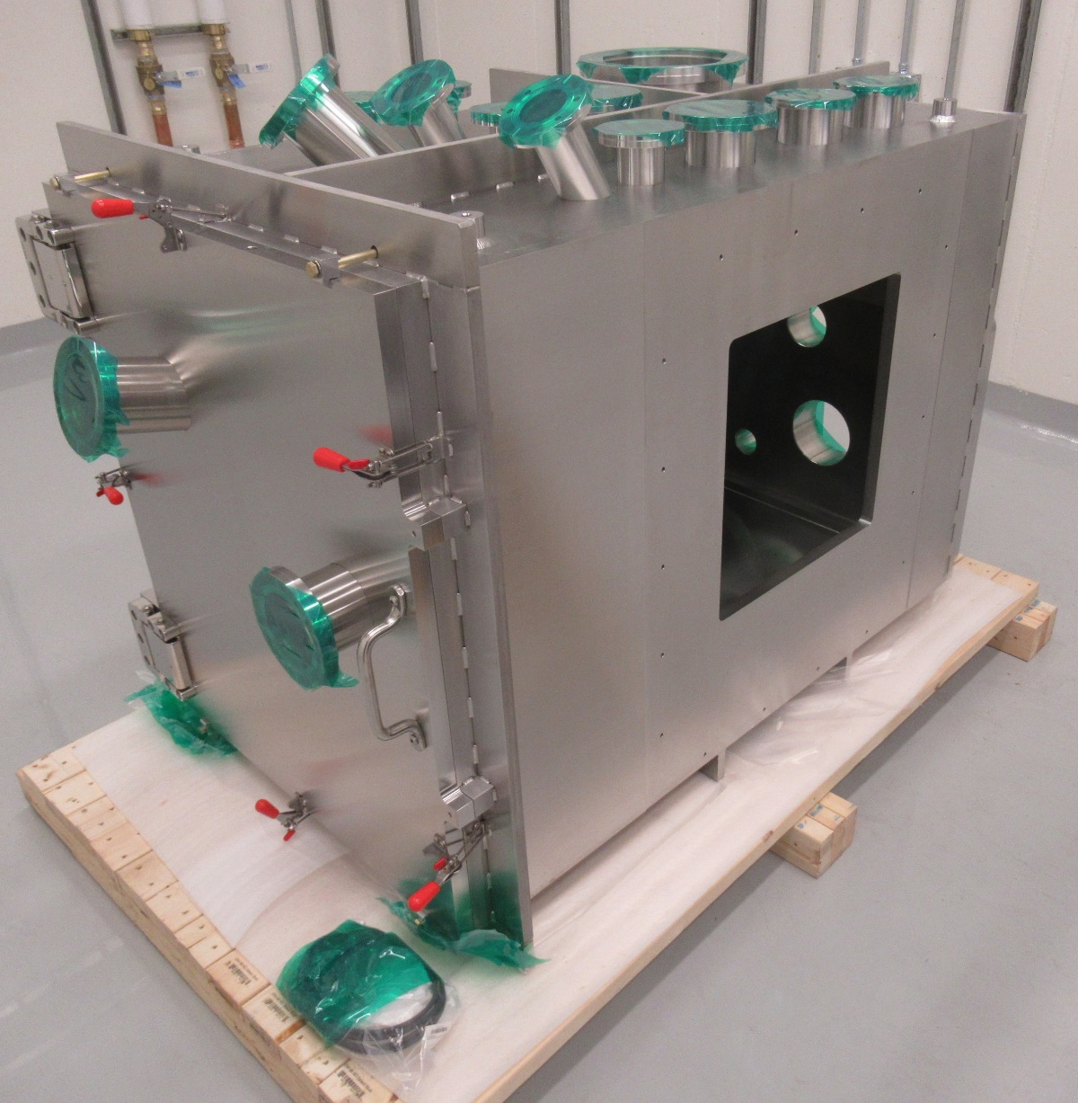
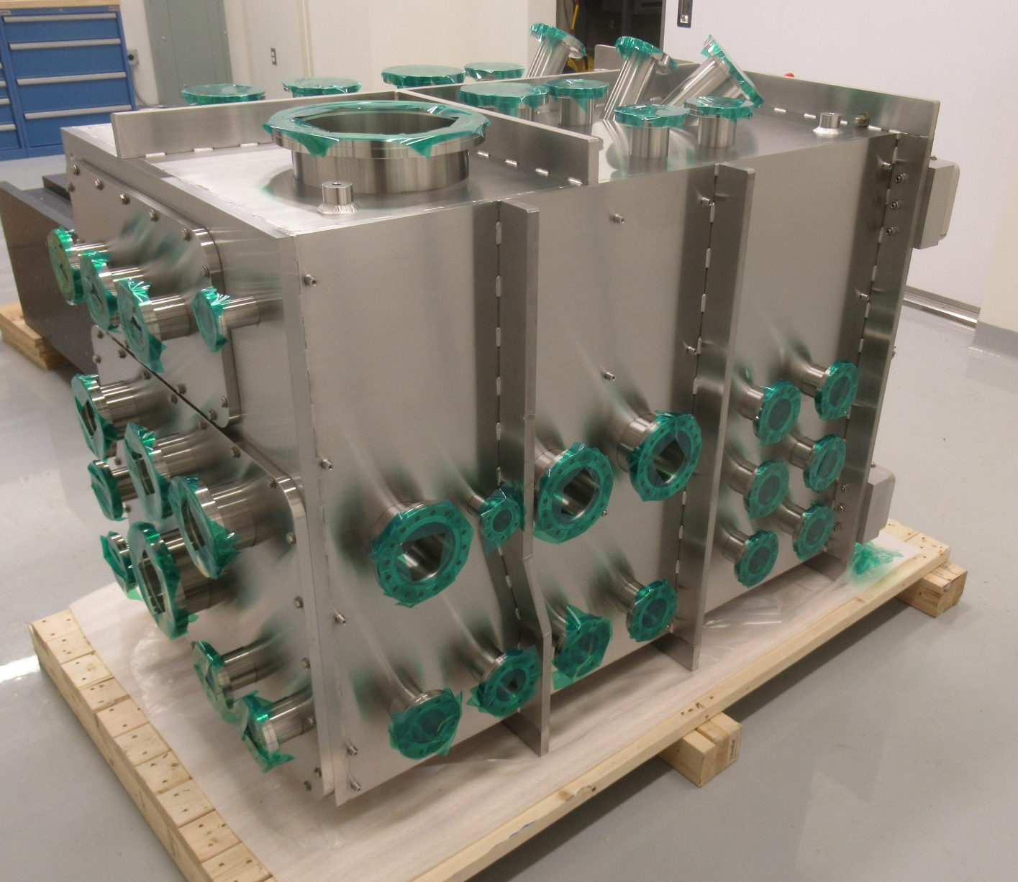

Slide 17
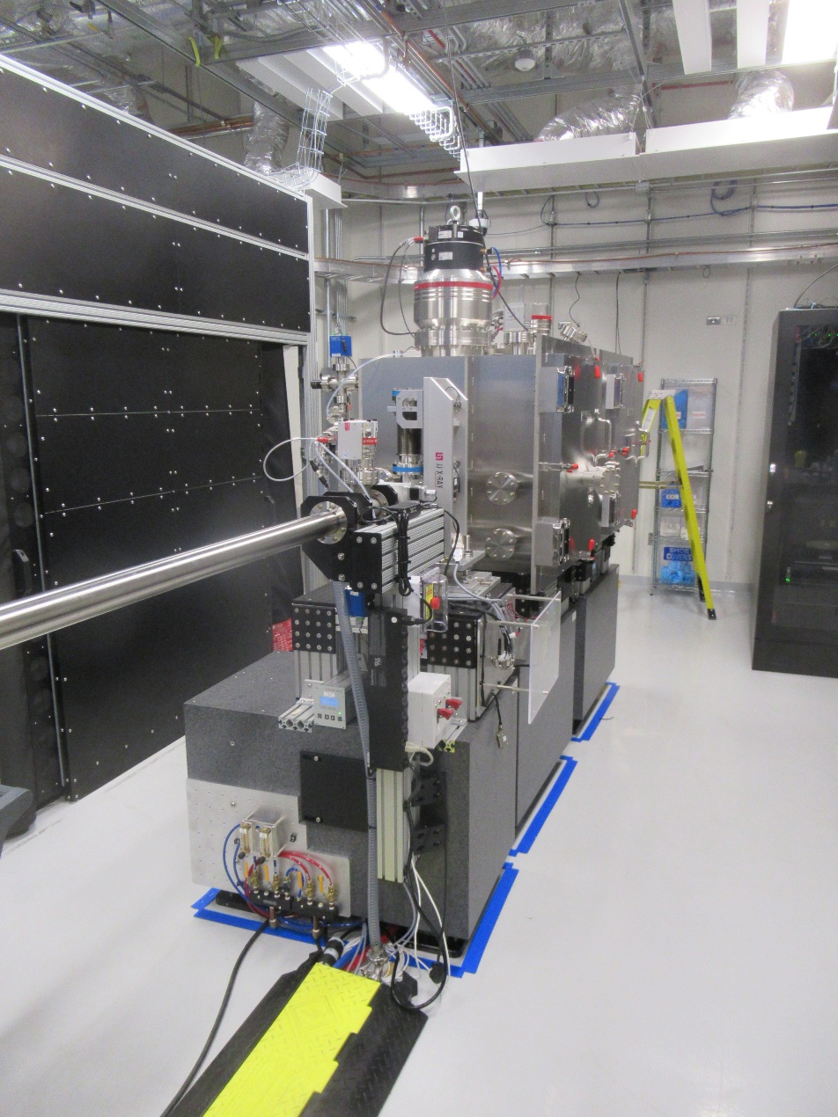
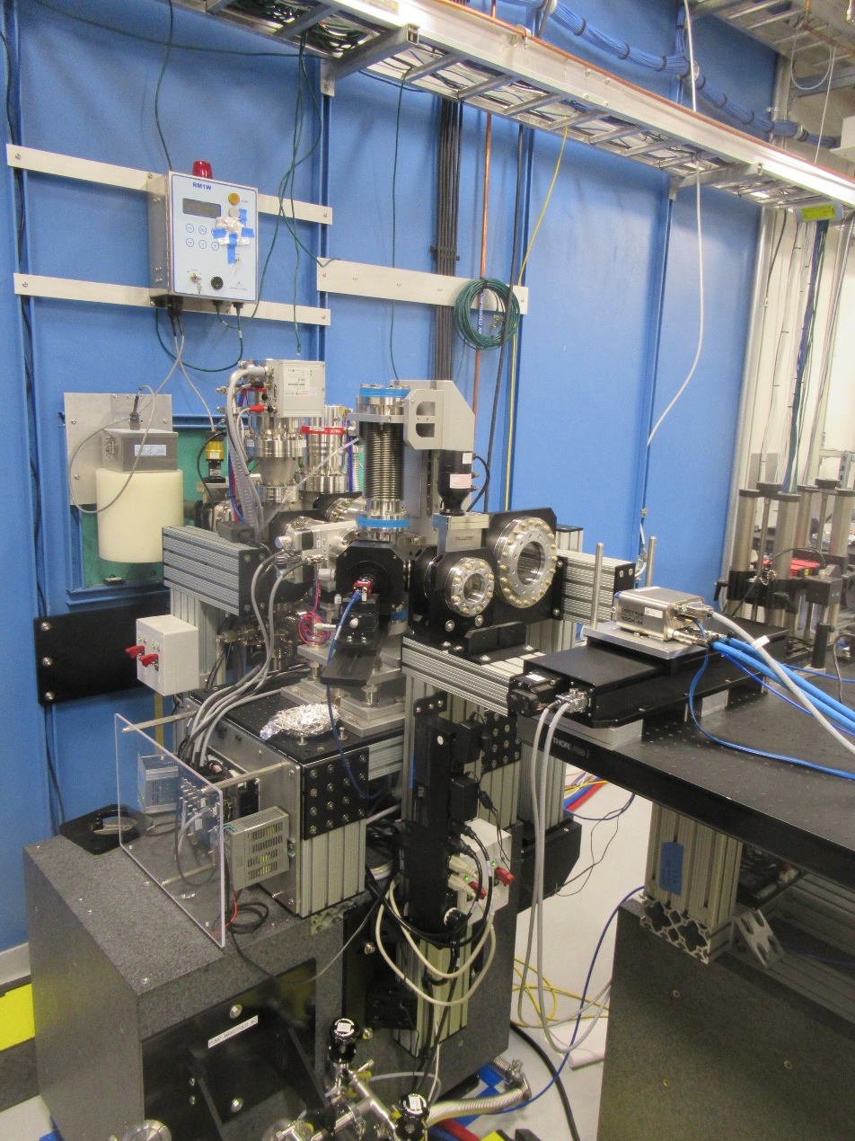

Slide 18
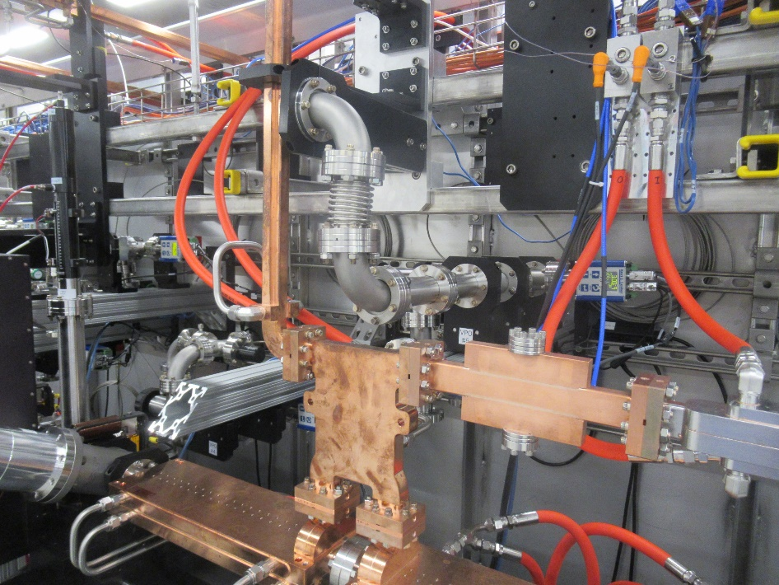
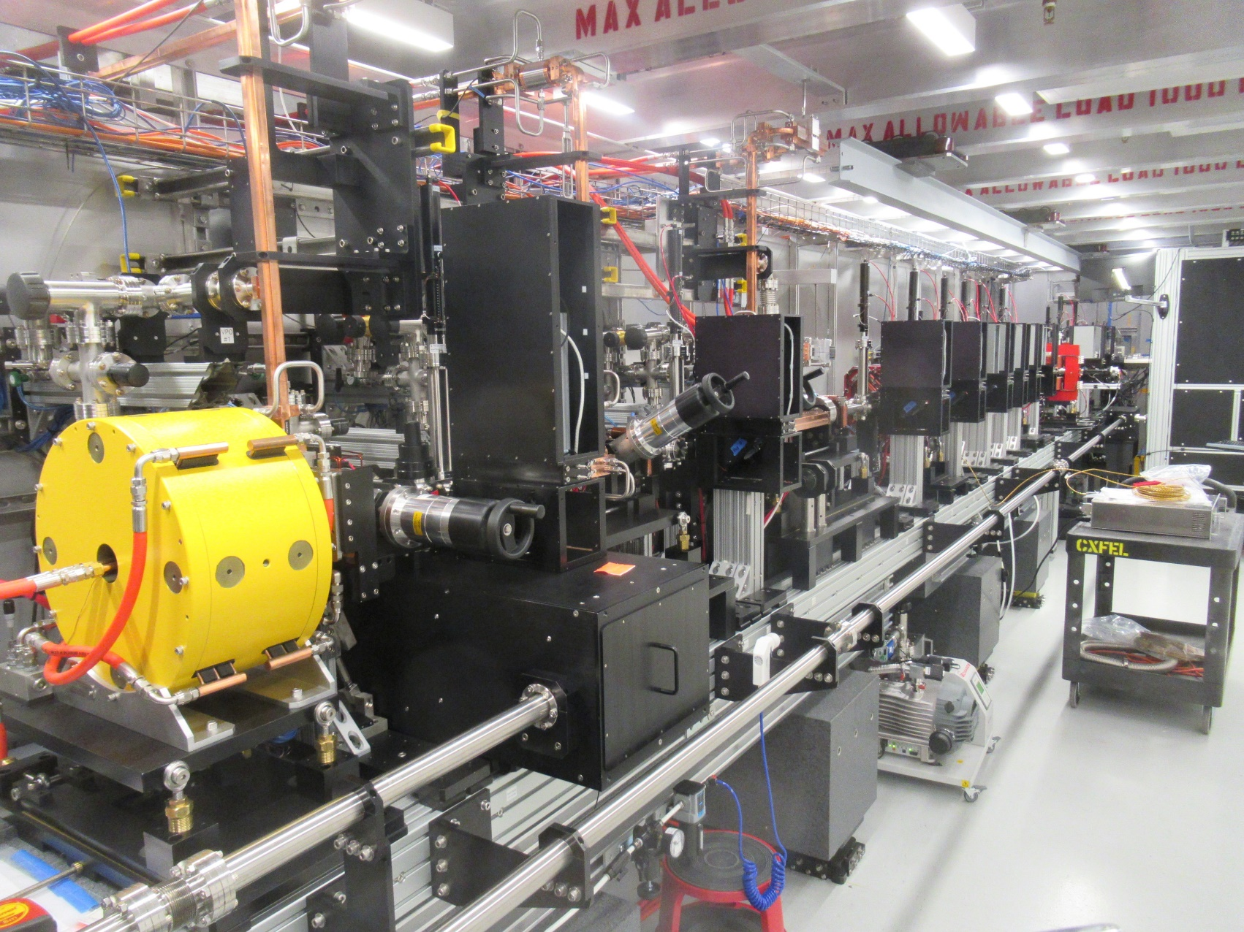
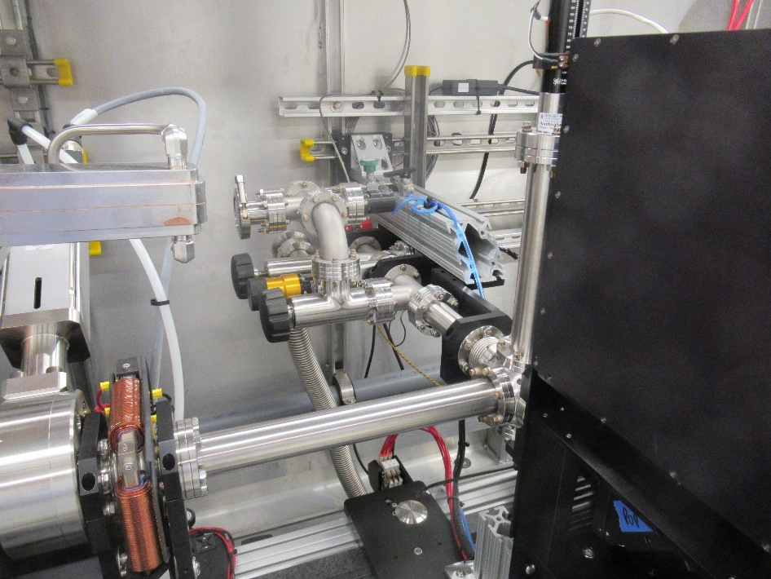

Slide 19
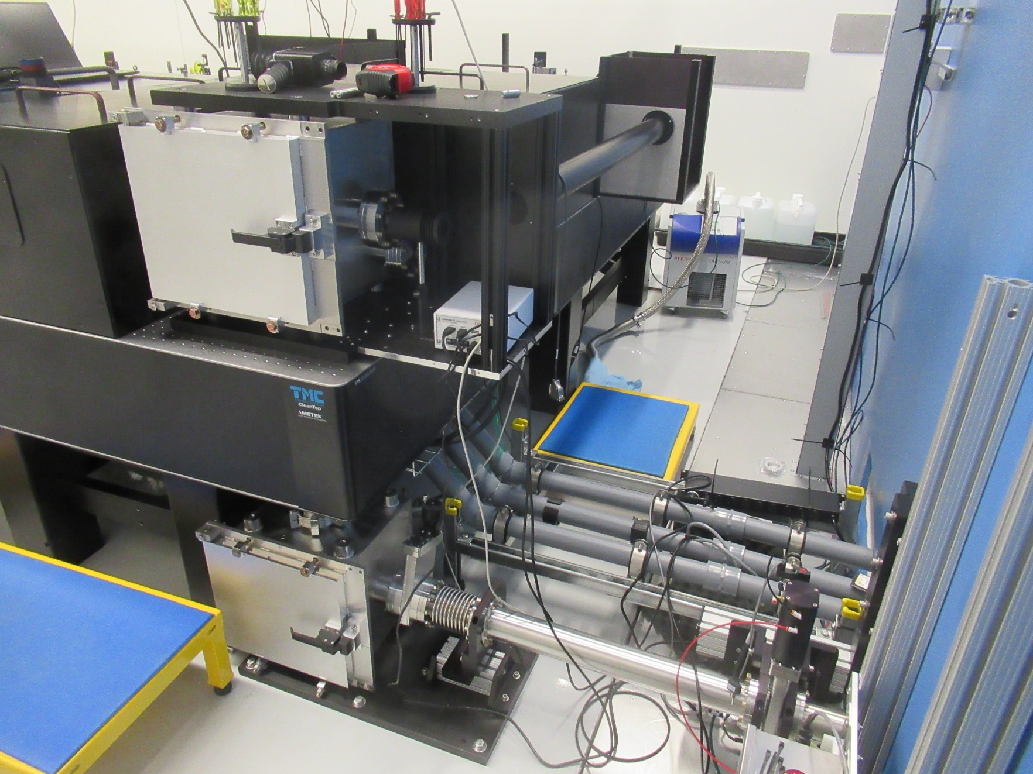
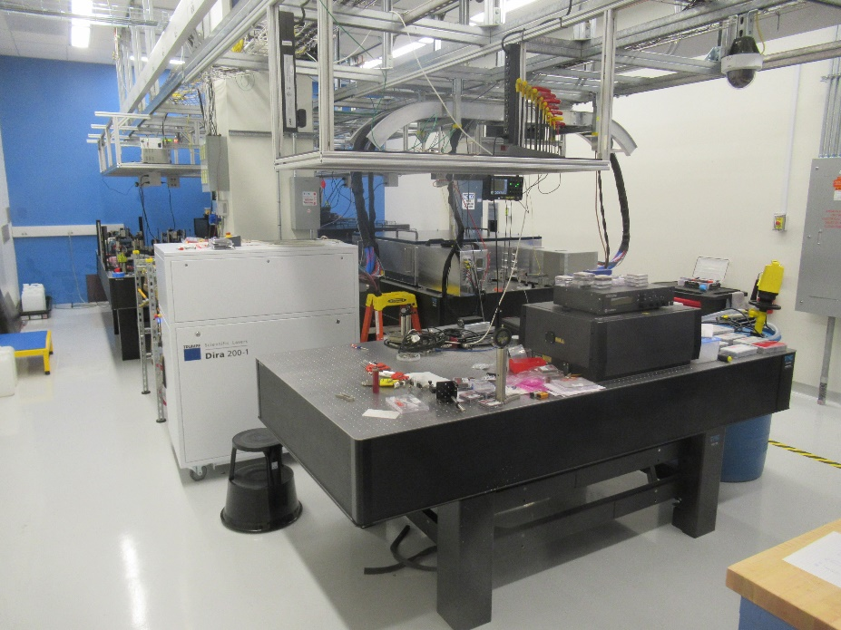

Slide 20
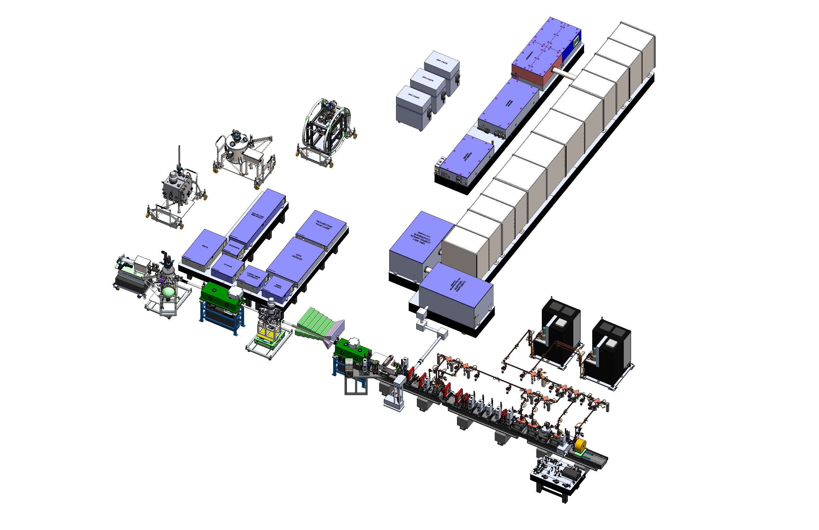
CXFEL Facility

Slide 21
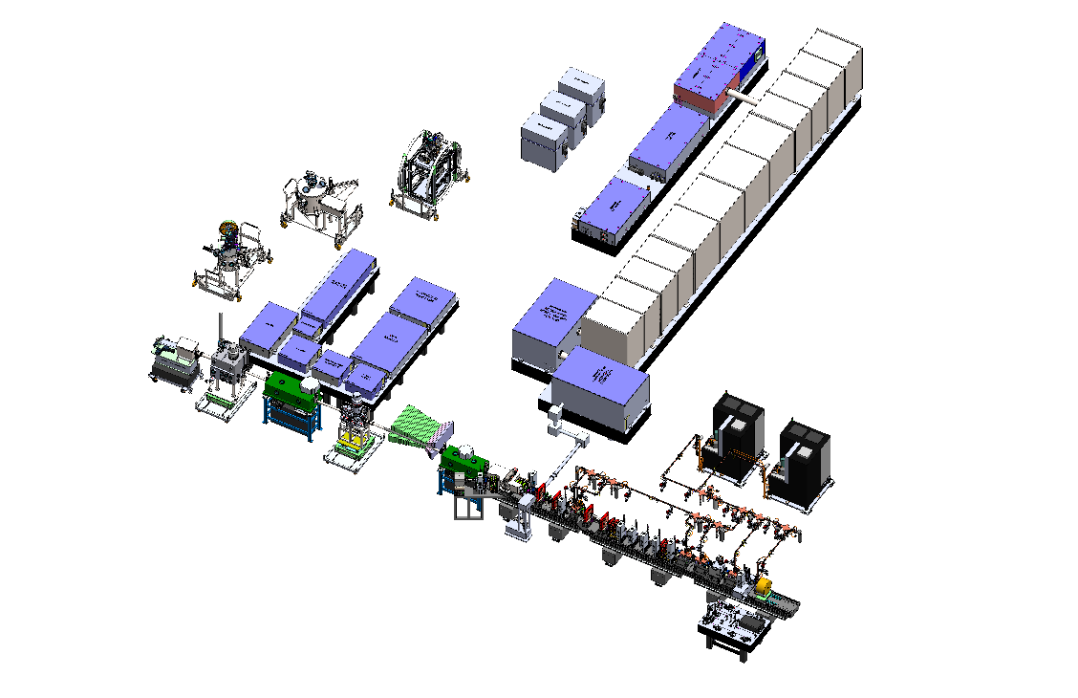

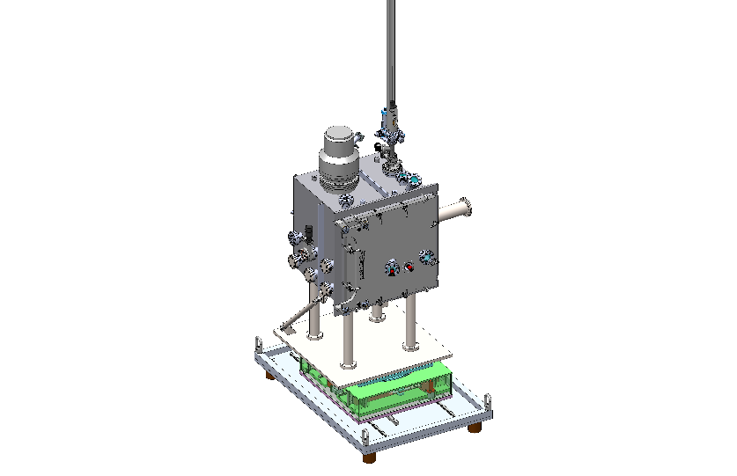
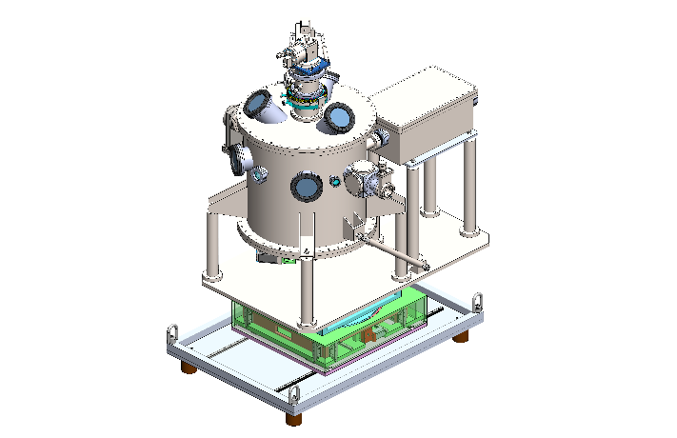


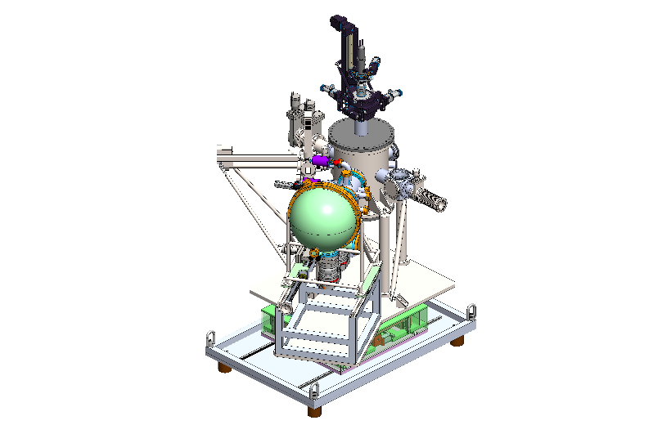
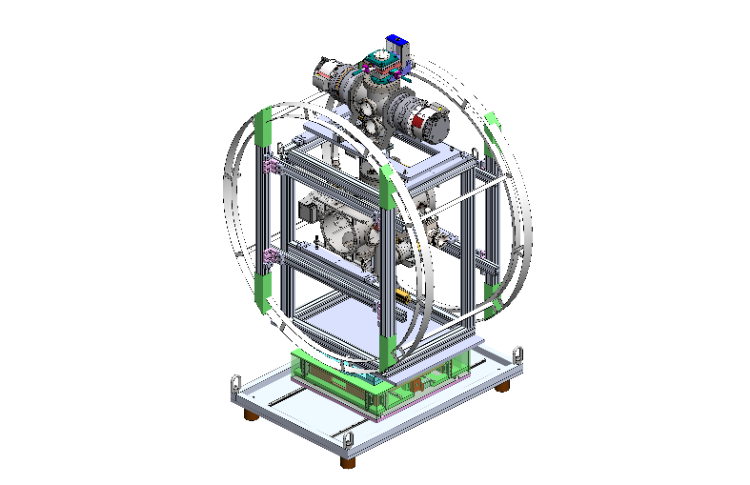
USS-B
USS-Q
USS-A
CAM
VHEE FLASH RESEARCH

Slide 22





CXFEL ICS Laser Components
Grating Compressor
Input laser
Spectrum
Multipass Amp
Pulse duration
Regen Amp
OscillatorSeed
PHASE 2
Output
chirped mirrors
Herriott Cell
Output
Herriott cell
Chirped Mirror
Compressor
Overtaking Geometry and Beam Transport
22

Slide 23


Slide 24

CXFEL RF Waveguide and Structures
RF Isolator X2
(ASU, TibaRay)
Pulse Compressor
(ASU, TibaRay)
VPSPD X8
(ASU, TibaRay)
RF Deflector (ASU, SLAC)
Waveguide straights & bends
(ASU, Dymenso)
Dry Load X9
(ASU)
20-cell linac X3 (ASU)
Photoinjector
(ASU, SLAC, Dymenso)

Slide 25


The development of dual-moded manifold $\frac{3π}{4} phase advance distributed coupling Linac$
Design Study Motivation:
The $3π/4$-phase advance structure is the most efficient incarnation of a distributed coupling linac
The natural implementation calls for four manifolds; 4 physical manifolds have many mechanical and electrical implementation problems:
  Requires more four layers to be bonded together, very hard to achieve uniformly
  Two of the cutting planes have crossing currents that require careful brazing
  Very awkward tuning pin locations; nearly impossible to seal the structure for vacuum integrity with the tuning pin holes penetrating the joints between layers
  Very awkward coupling geometry from the four manifolds, requiring external hybrids
Solution:
  Implement the four manifolds into two Physical manifolds, each carrying two modes.
  The two modes when excited together have no currents in the cutting plane: the structure can be built from two blocks only.
  The coupling to the two manifolds is naturally a hybrid, the reflection during filing time exists the structure through a separate set of ports
At ASU, we are developing a new paradigm for Linear accelerators, the ultimate distributed coupling linac

Slide 26

Applications of the new linac topology to VHEE
At ASU, we are developing this new multimoded manifold DCL for our CXFEL project; it has the following specifications:
  Shunt impedance~156 M$Ω$/m
  Surface field to accelerating field ratio ~ 2
  Filling time~ 147 nanoseconds (@9.3 GHz)
Applying this modality to a VHEE structure:
  Using 3 linacs $yields$ an effective shunt impedance of 468 M$Ω$/m
  Power requirements for a 1-meter-long structure to deliver 100 MeV would be ~21.5 MW
  With our newly developed pulse compressor intended for the CXFEL system, the Klystron power requirements are 5.3 MW, which is a perfect fit for our 6 MW klystrons.
  The klystron can operate up to 1 kHz. The system will be able to supply about $2.6×{10}^{13} \frac{electrons}{sec}$ ~ $4.2 μA$ of average current at 100 MeV

Slide 27
CXFEL Labs
CXLS
Phase 1 Hard X-ray ICS Source
CXFEL
Phase 2 Soft X-ray Coherent Laser
Built and now commissioning
0.2 µA at ~40 MeV at 1 kHz
space prior to beamdump can be purposed for biological research
0.2 µA at 100 MeV at 1 kHz
Space prior to the beam near the beamdump can be purposed for biological research
can be upgraded to 2 µA (but requires funding)

Slide 28
Future Accelerator Development for VHEE
The accelerator technology used for the CXFEL incorporates novel elements that are suitable for building a compact VHEE system
We a crycooler and we plan to build a system that can produce 100 MeV in one meter using a 6 MW klystron with a pulse compressor
This system will generate up 4.2 µA of average current and is intended to to be suitable for FLASH research

Slide 29
CXFEL includes 90+ People in 13 Institutions
Biochem
Fromme, Petra (co-PI)
Ansari, Adil
Brown, Michael (U AZ)
Frank, Matthias (UC Davis)
Grant, Tom (U. Buff.)
Hu, Hao
Kirian, Rick
Kuhl, Tonya (UC Davis)
Lattman, Eaton
Liu, Wei
Ourmazd, Abbas (UW-Mil)
Phillips, George (Rice)
Ros, Alexandra
Schmidt, Kevin
Schmidt, Marius (UW-Mil)
Schwander, Peter (UW-Mil)
Weierstall, Uwe
Quantum Materials
Teitelbaum, Sam (co-PI)
Tongay, Sefaatin
Botana, Antia
Comin, Riccardo (MIT)
Chuang, Yi-De (LBL)
Erten, Onur
Gedik, Nuh (MIT)
Hanlon, Dillon
Kaindl, Robert (co-PI)
Mahmood, Fahad (UIUC)
Mitrano, Matteo (Harvard)
Reis, David (Stanford)
Roy, Sujoy (LBL)
Trigo, Mariano (SLAC)
Attosecond AMO
LaForge, Aaron (Lead)
Sandhu, Arvinder (co-PI)
Centurion, Martin (U Neb)
Cryan, James (SLAC)
Gessner, Oliver (LBL)
Nelson, Keith (MIT)
Rolles, Daniel (KSU)
Rudenko, Artem (KSU)
Shalaby, Islam (UA)
Shivaram, Niranjan (Purdue)
Weber, Thorsten (LBL)
Instrument
Tantawi, Sami (Lead)
Dolgashev, Valery (SLAC)
Graves, William (Emeritus)
Jaswal, Rejul
Karkare, Siddharth
Li, Zenghai (SLAC)
Loos, Henrik
Malin, Lucas
Matlis, Nicholas
Nanni, Emilio (SLAC)
Qiang, Ji (LBL)
Thornton, Trevor
Education
Warble, Kelli (Lead)
Ahuja, Moksh
Alvarez, Roberto
Bartoletti, Luca
Cifuentes, Lidia
Dahal, Sajal
DeMott, Ross
Eckrosh, Kevin
Everett, Eric
Gaskin, Austin
Gonzalez, Noah
Jang, Philip
Lee, Hyung-Seo (Julia)
Leonard, Nicholas
Martinez, Anastasia
Narayanan, Sathya
Pekin, Rasmus
Redd, Aaron
Richardson, Albert
Rivera, Jonathan
Ros, Elena
Russo, Gavin
Tamayo, John
Tilton, Sean
Tripathi, Shreya
Vasquez, Alexis
Velarde, Annelise
Vernan, Chiran
Villegas, Diego
Walker, Ted
Engineering
Holl, Mark (Chief Engineer)
Dupre, Alan
Gardeck, Alex
Houkal, Jeff
Jachim, Steven
Ness, Richard
Rednour, Steven
Smith, Dean
Vela, Juan
OSPREY Distributed Control Systems (consultant)
Data Analysis
Botha, Sabine (Lead)
Kirian, Richard
Grant, Thomas
Ansari, Adil
Hosseinazedeh, Ahmad
Management
Sandhu, Arvinder (Project Director)
Sarracino, Andrew (Project Manager)
Winkel, David
Clark, Deanna
Reichanadter, Mark
Al-Qadi, Mona
Steve Ellis, NSF Program Officer Div of Bio Infrastructure

Slide 30
Thank you!
Questions?

Slide 31

Scandinova K1 modulators Stellant (L3) L6145 klystrons
9.3 GHz
1 kHz rep rate
6 MW for 1 us
CXLS Layout
LightConversion Yb:KGW
1030/515/258 nm
1.5 mJ/shot at 1030
0.15 mJ/shot at 258
200 fs, 1 kHz
Trumpf Yb:YAG
1030 nm
200 mJ/shot
1 ps
1 kHz
M^2 = 1.2
diagnostics and matching quads
chicane compressor
ASU-Tibaray
photoinjector
9.3 GHz
1 kHz
120 MV/m
4.5 cell
4 MeV energy
200 pC
1 ps
X-ray chambers
1e8 photons/shot
6-20 keV
300 fs
1 kHz
Electron diffraction
Tibaray linac
9.3 GHz standing wave
1 kHz
25-30 MV/m
20 cells/section X 3 sections
30 MeV final energy
Final focus and interaction point
CXLS length is 10 m from cathode to beam dump

