Slide 1



UHDR-VHEE dosimetry with silicon carbide detectors
Giuliana Milluzzo
Istituto Nazionale di Fisica Nucleare, Sezione di Catania, Catania (Italy)
Massimo Camarda, Chinonso Okpuwe, Gabriele Trovato, Damiano Zitelli, Francesco Romano

Slide 2
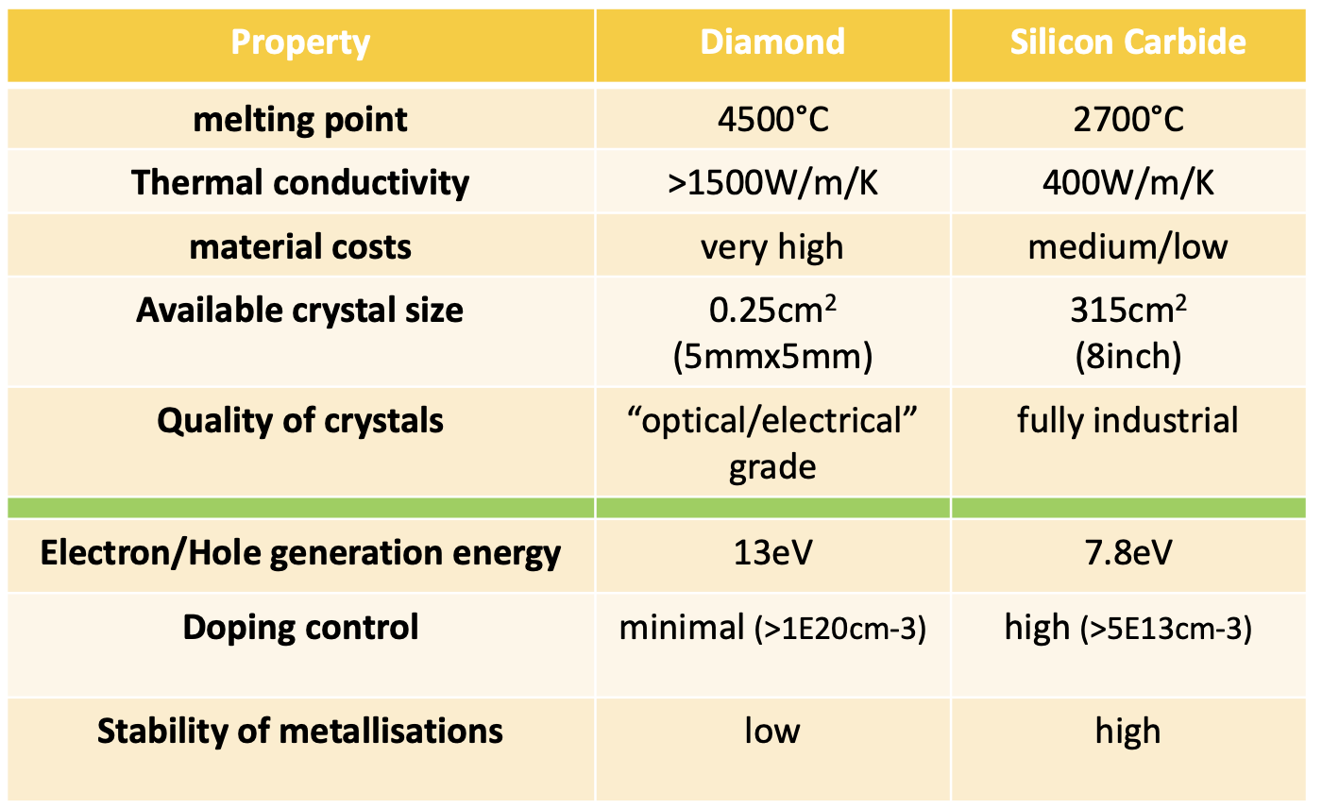
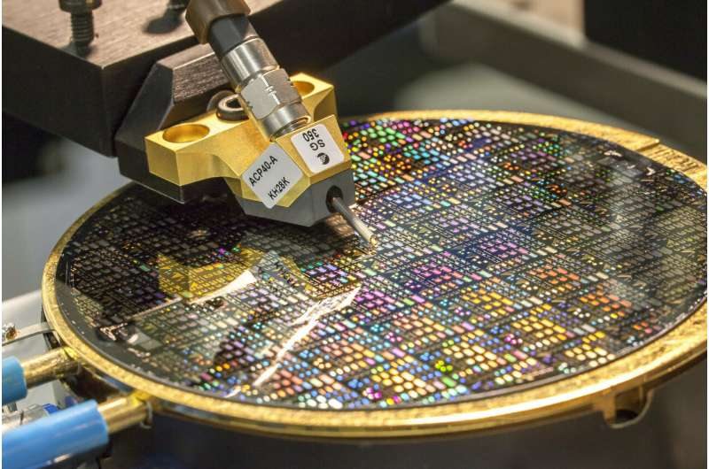

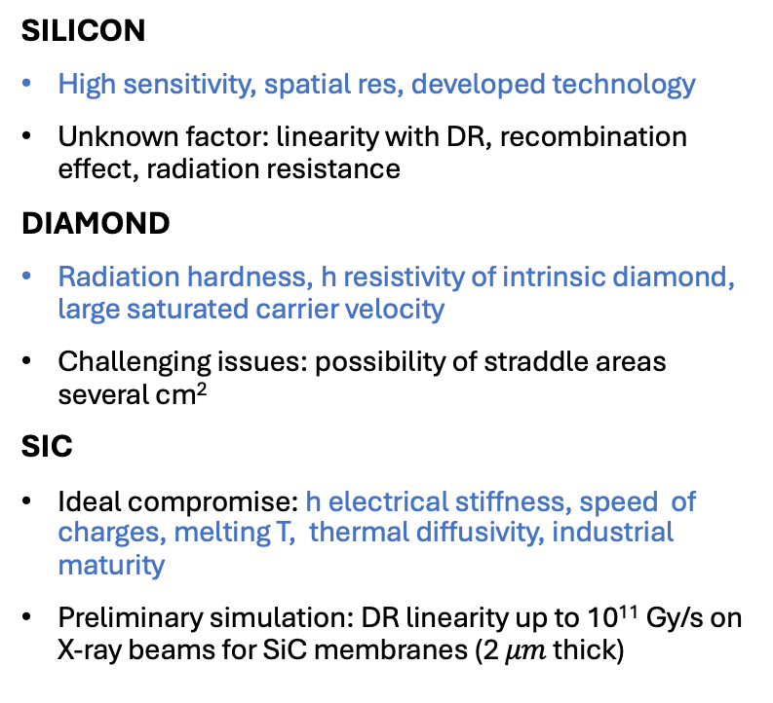
Semiconductors radiation detectors
SILICON
High sensitivity, spatial res, developed technology
Unknown factor: linearity with DR, recombination effect, radiation resistance
DIAMOND
Radiation hardness, h resistivity of intrinsic diamond, large saturated carrier velocity
Challenging issues: possibility of straddle areas several cm²
SIC
Ideal compromise: h electrical stiffness, speed of charges, melting T, thermal diffusivity, industrial maturity
Preliminary simulation: DR linearity up to 10¹¹ Gy/s on X-ray beams for SiC membranes (2 $μm$ thick)
Silicon
Diamond
Radiation hardness
High signal to noise ratio
High time resolution (ns) and fast collection time
Large area devices
SiC
Diamond and SiC are expected to be less sensitive than Si → Advantage for UHDR application (reduce tot charge released in the sensor chn)
+

Slide 3


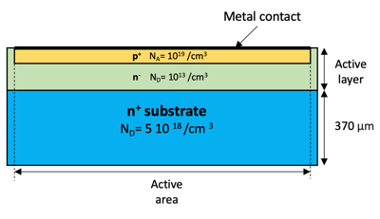
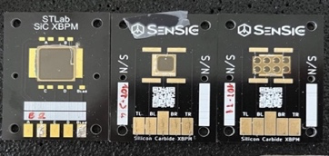
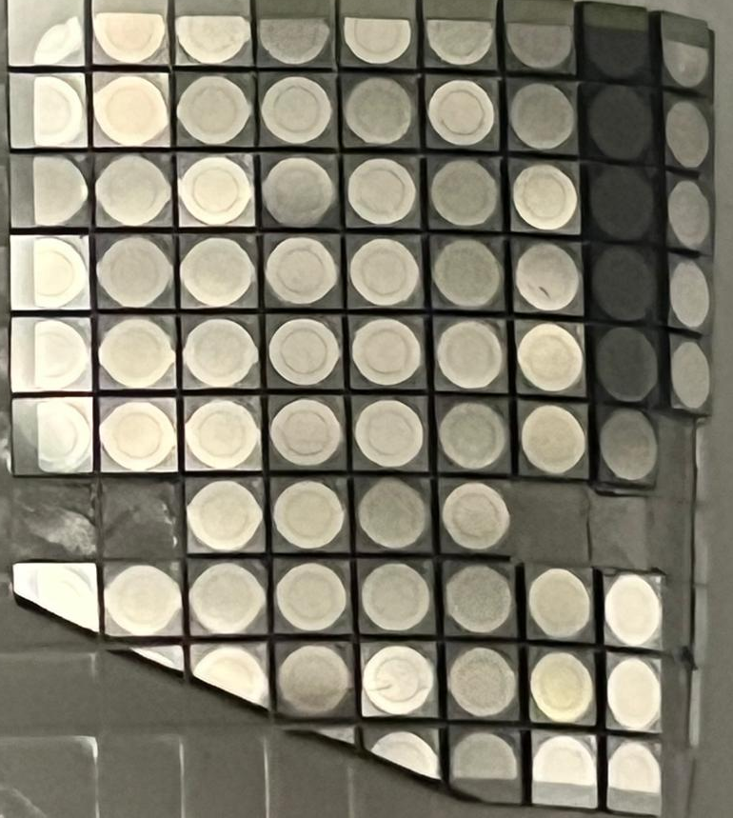
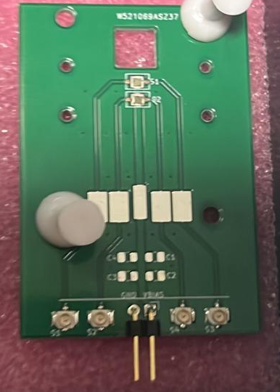
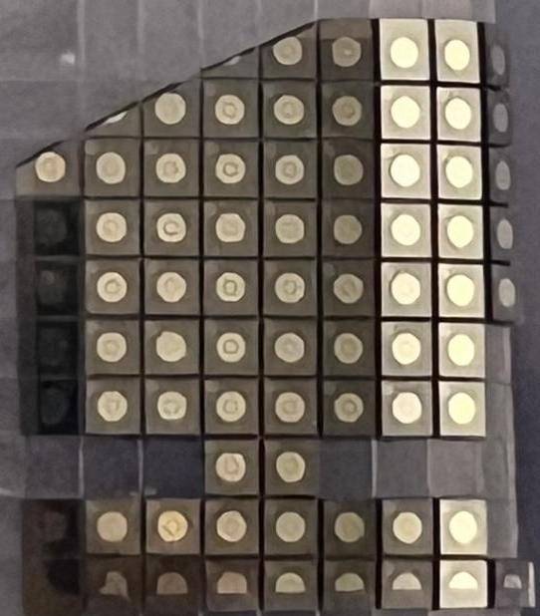
Silicon carbide detectors
FRIDA
PiN diodes: 4-100 mm², 10 um thick
Schottky diodes: 300-800 um diameter, 22 um thick
Guard ring structure to reduce superficial leakage
10x10 mm ² 5x5 mm^{2.} 2x2 mm ²

Slide 4
Silicon carbide based dosimeter development
Radiation dosimetry
Proving the suitability of SiC detectors for dosimetry
in FLASH radiotherapy
Beam monitoring of the beam parameters
Adapting the technology for enabling the beam monitoring
Reference and relative dosimetry:
Developing advanced engineered systems for QA measurements under reference conditions for clinical translation

Slide 5
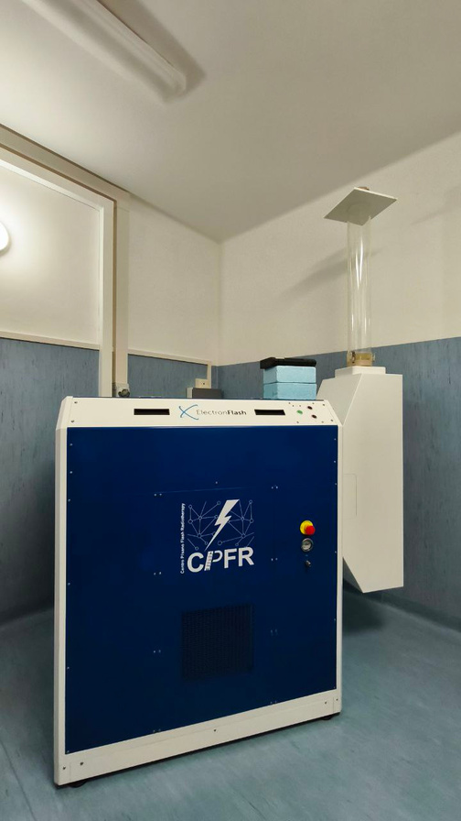
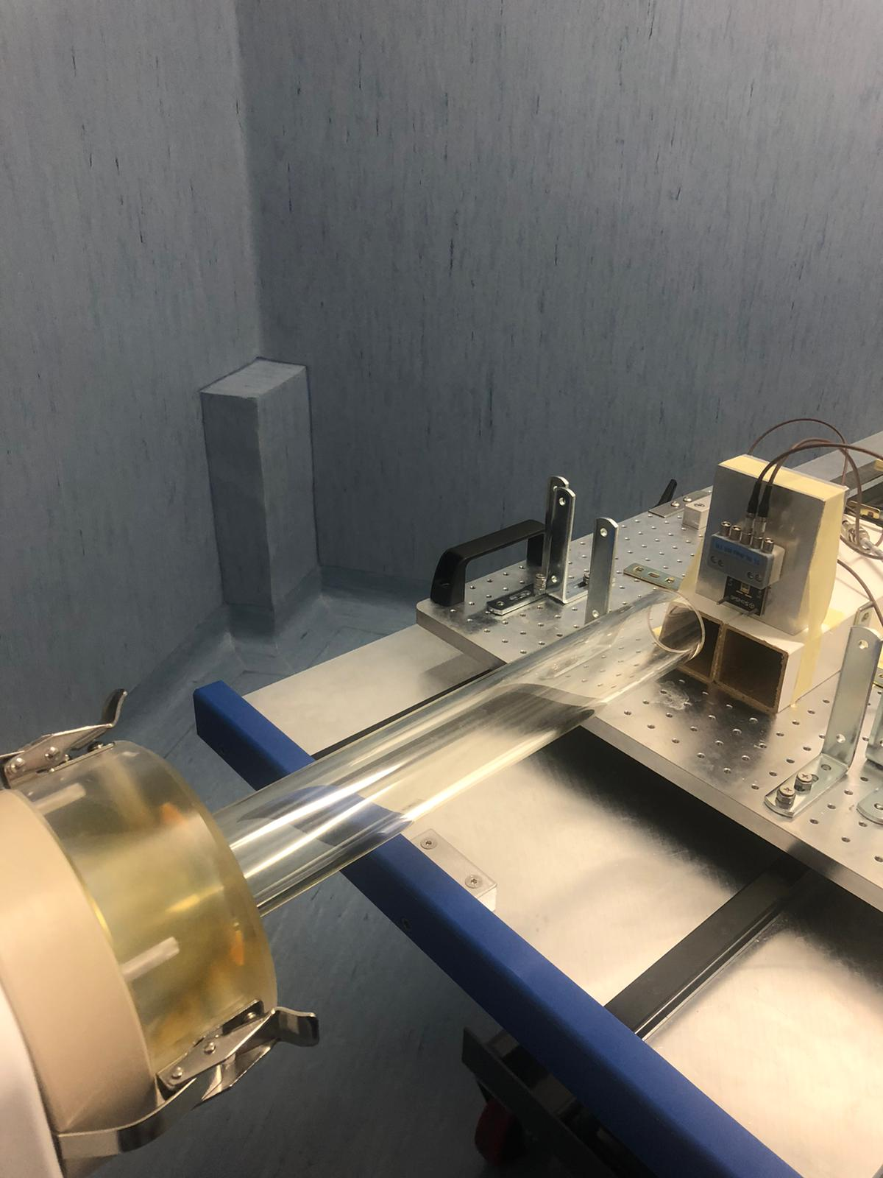
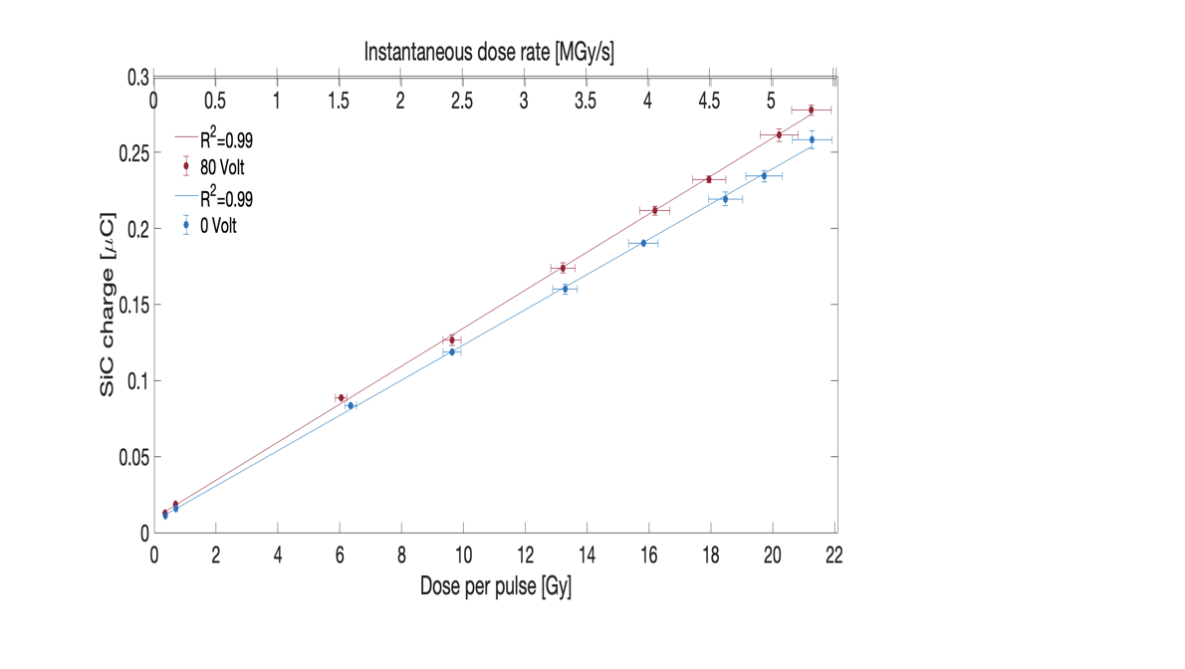
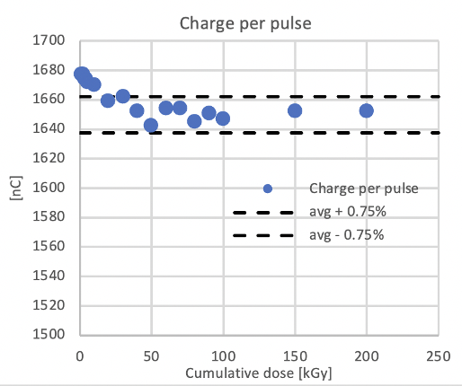
Characterization with 9 MeV UHDR electron beams
4 mm²/10 um PiN detector
800 um/22 um Schottky detector
1.5%
Alanine
DPP [Gy/pulse]
Flash diamond
F. Romano et al., (2023), Appl Science
G. Milluzzo et al., (2024) Medical Physics
First measurement of radiation hardness
Experimental setup
Detectors: 10x10, 5x5, 4.5 mm² 10 um thick SiC at the build-up
Acquisition: Keithley electrometer
Reference dosimeters: Alanine dosimeters
Single pulse duration: 0-5-4 us
Dose per pulse: from 0.1-20 Gy
Average instantaneous dose rates
in the single pulse up to 5 MGy/s

Slide 6


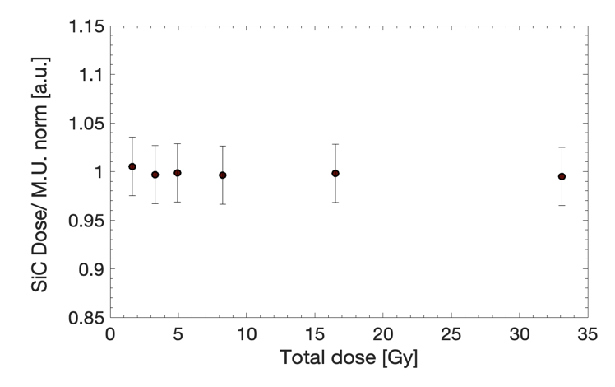
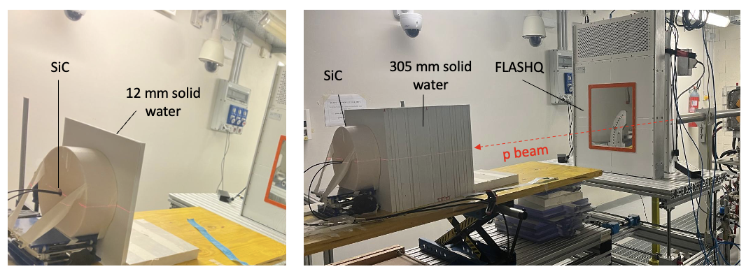
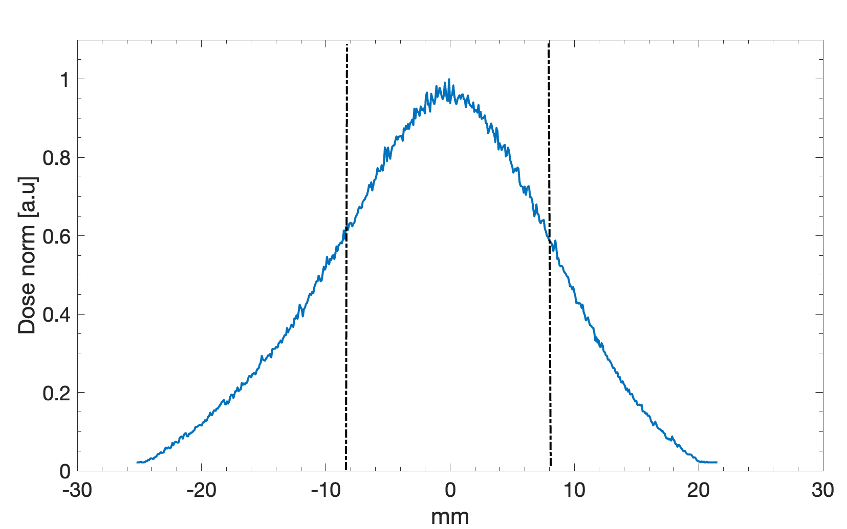
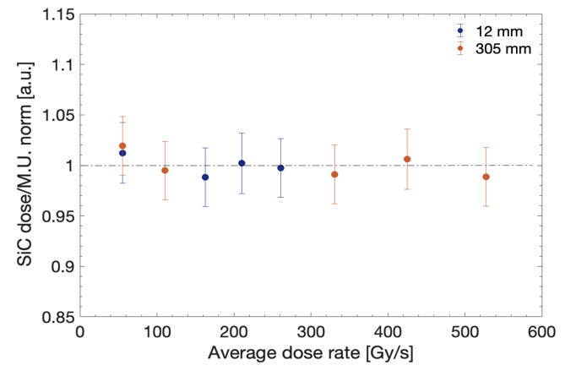
Characterization with 228 MeV UHDR proton beams
Proton beams @ 228 MeV
Variable beam current from 1 nA up to 500 nA
Variable irradiation time from 10 ms up to seconds
Varying the irradiation time 30-200 ms, constant dose rate ~160 Gy/s,
PPC05
Varying the dose rate and irradiation time 30-200 ms, constant dose ~10 Gy
G. Milluzzo et al., accepted in Physics Medicine and Biology (2025)
PPC05

Slide 7
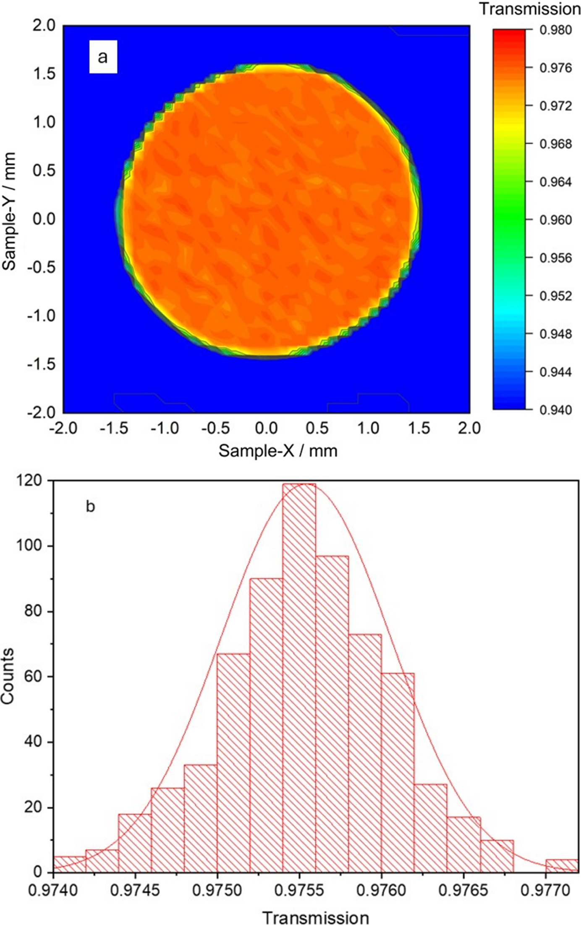
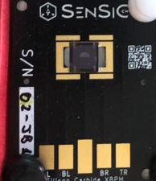
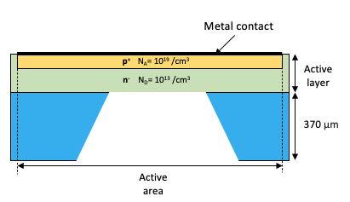
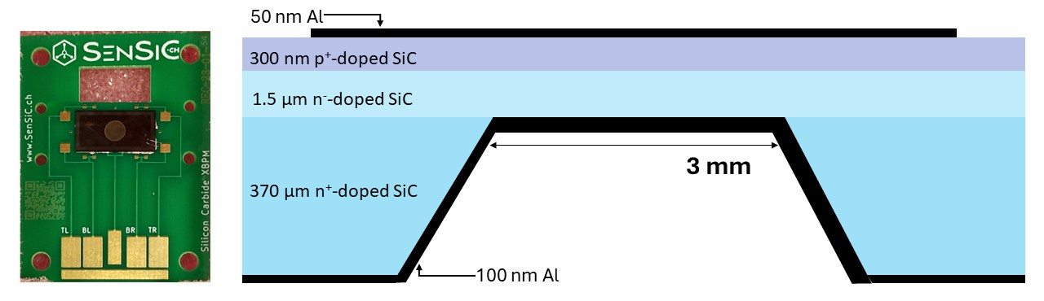
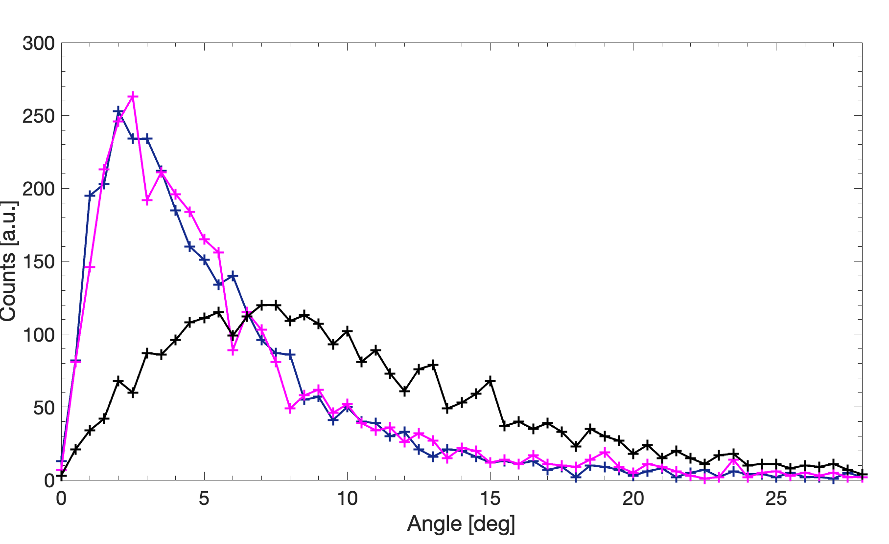
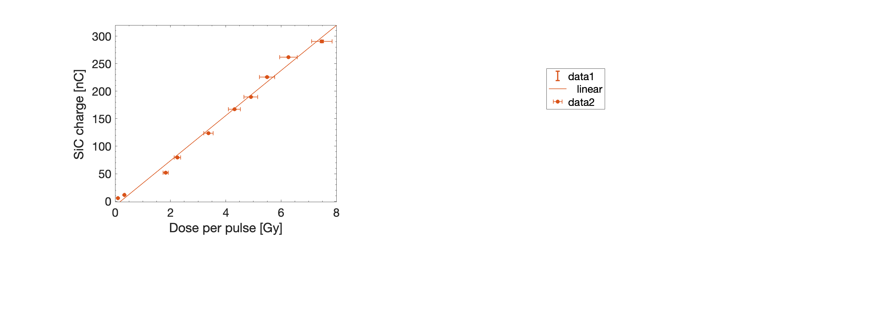
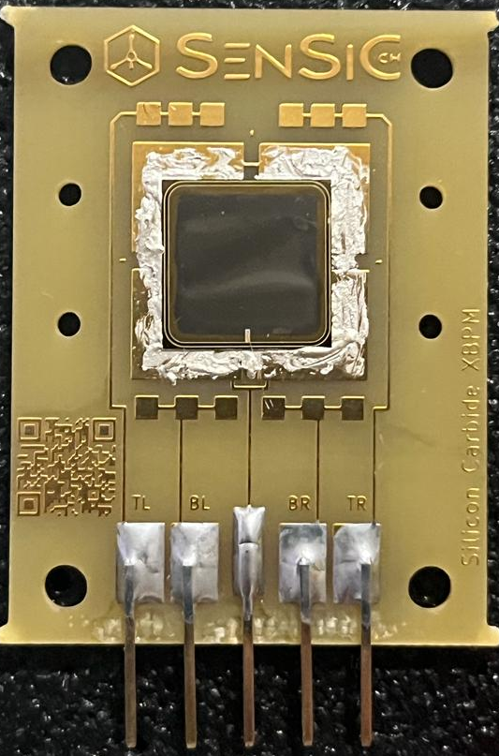

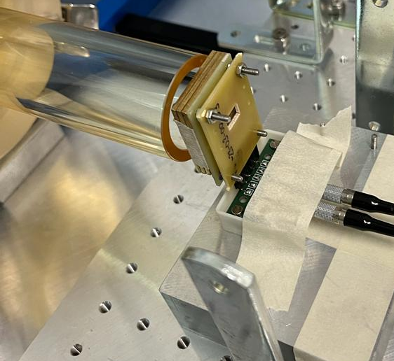
Ultra-thin SiC free-standing membranes for beam monitoring
8 KeV x-ray beams
Thick substrate bulk electrochemically removed from the back of the detector
Thickness:
0.1-10 um
Area:
1-3 mm
G. Trovato et al., J. Synchrotron Rad. (2025). 32, 118–124
Fist characterization with UHDR low energy electron beams @ CPFR
Energy & Angular distribution spread: improving the transparency
Large area membrane
9 MeV e- beam
Before
After 10 um+400 um thick substrate
After 10 um thick SiC
1 cm

Slide 8

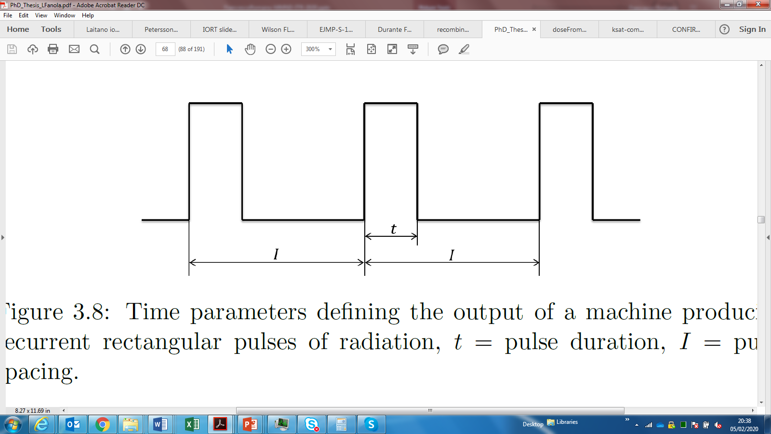
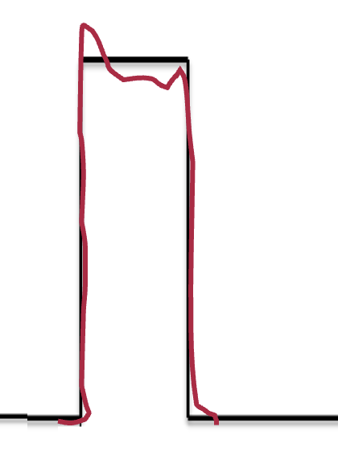
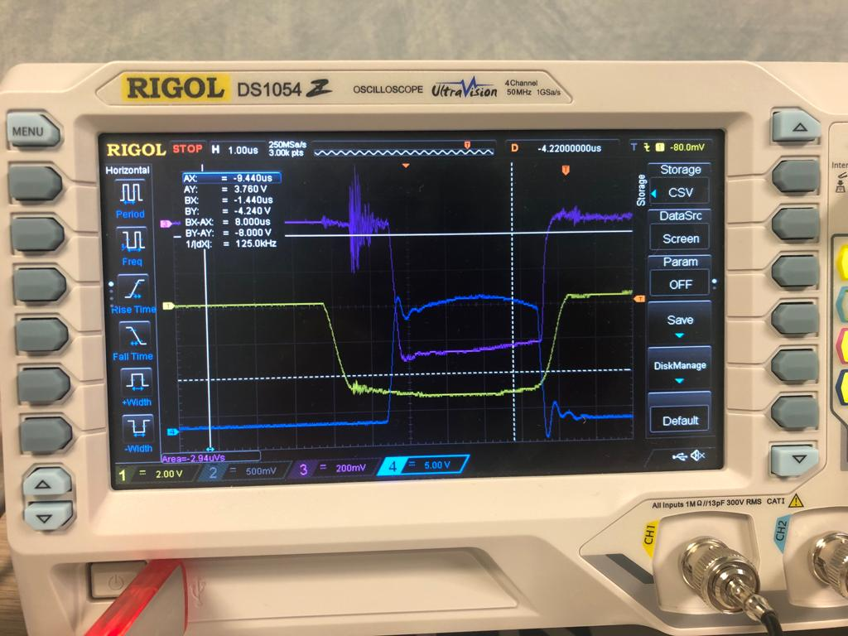
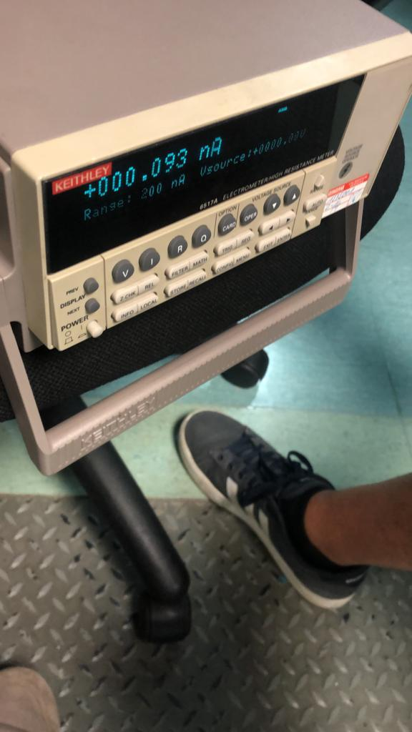
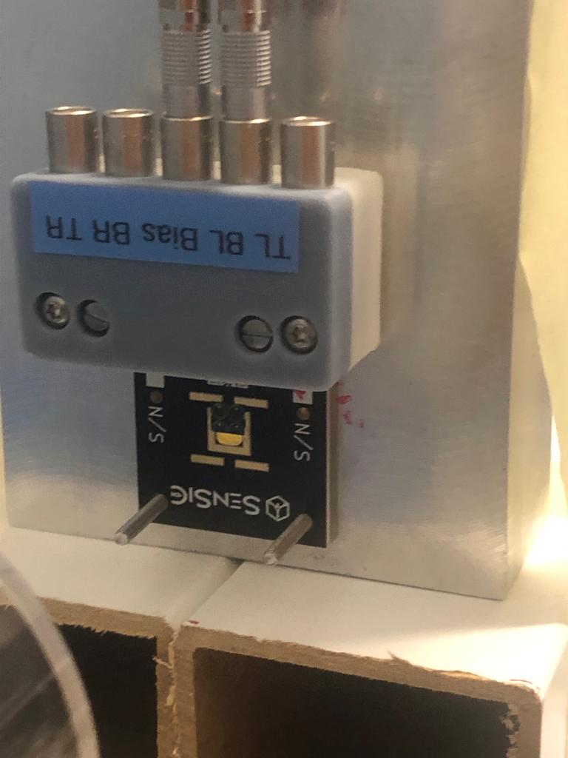
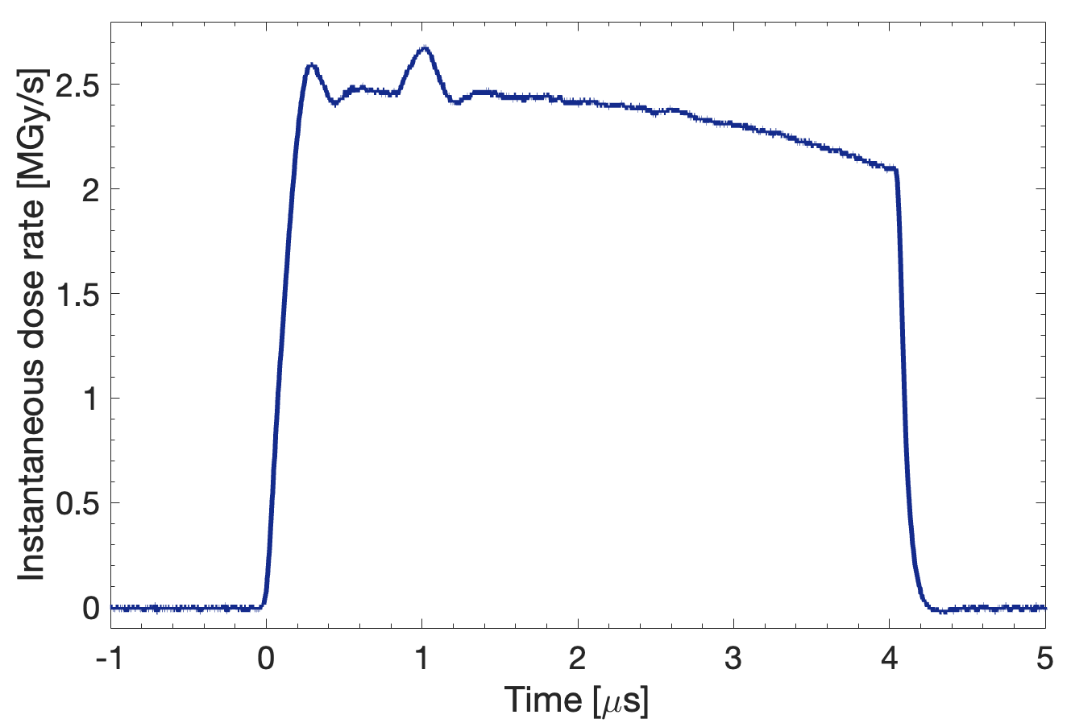
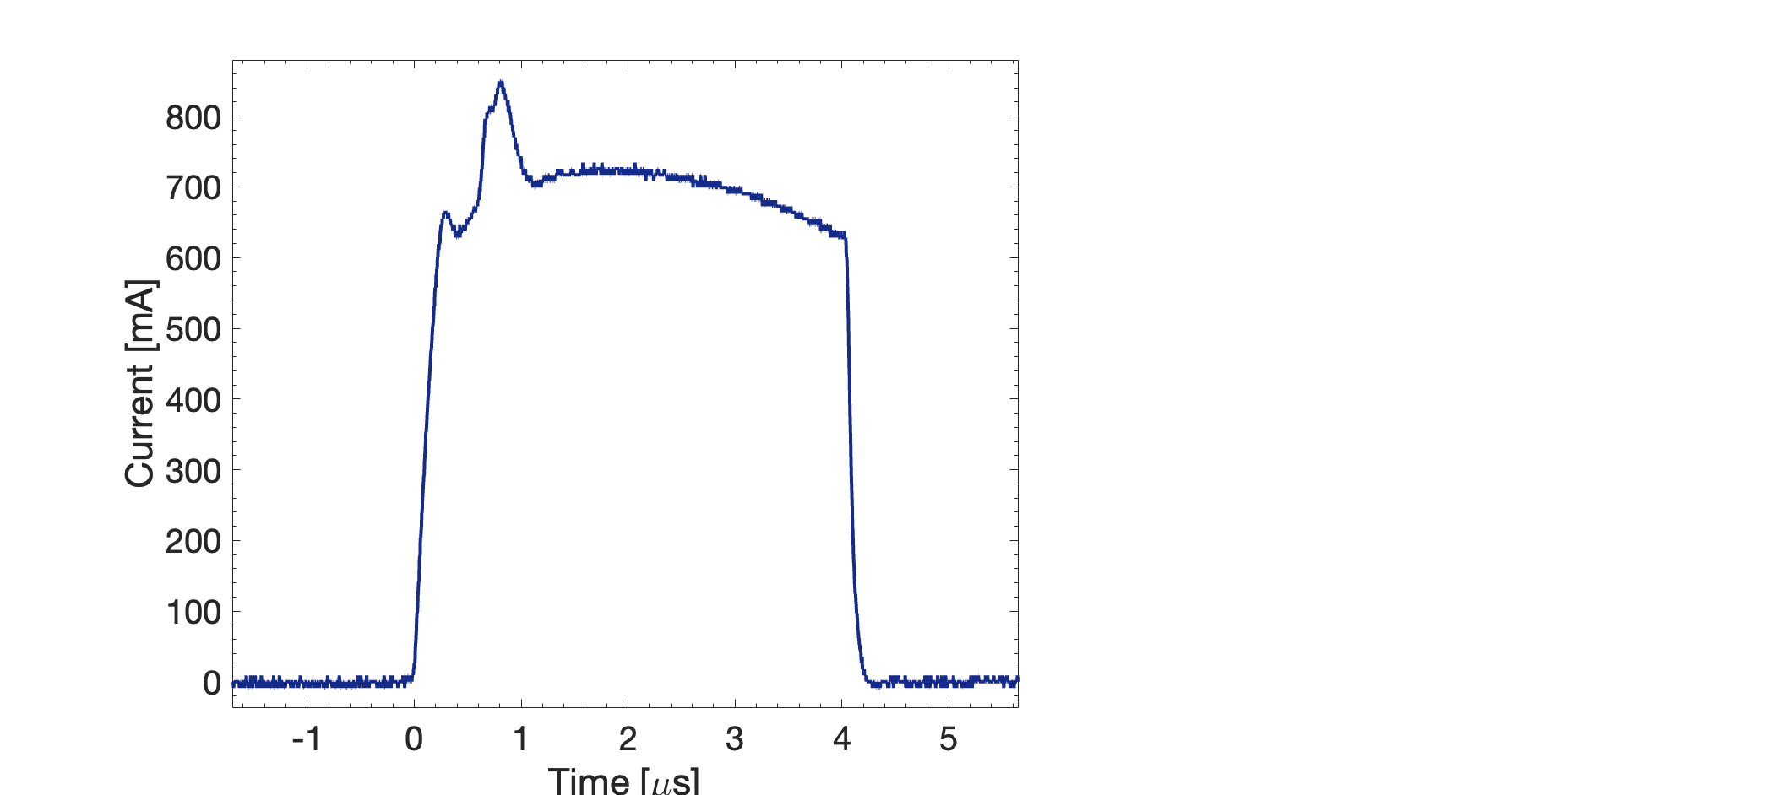
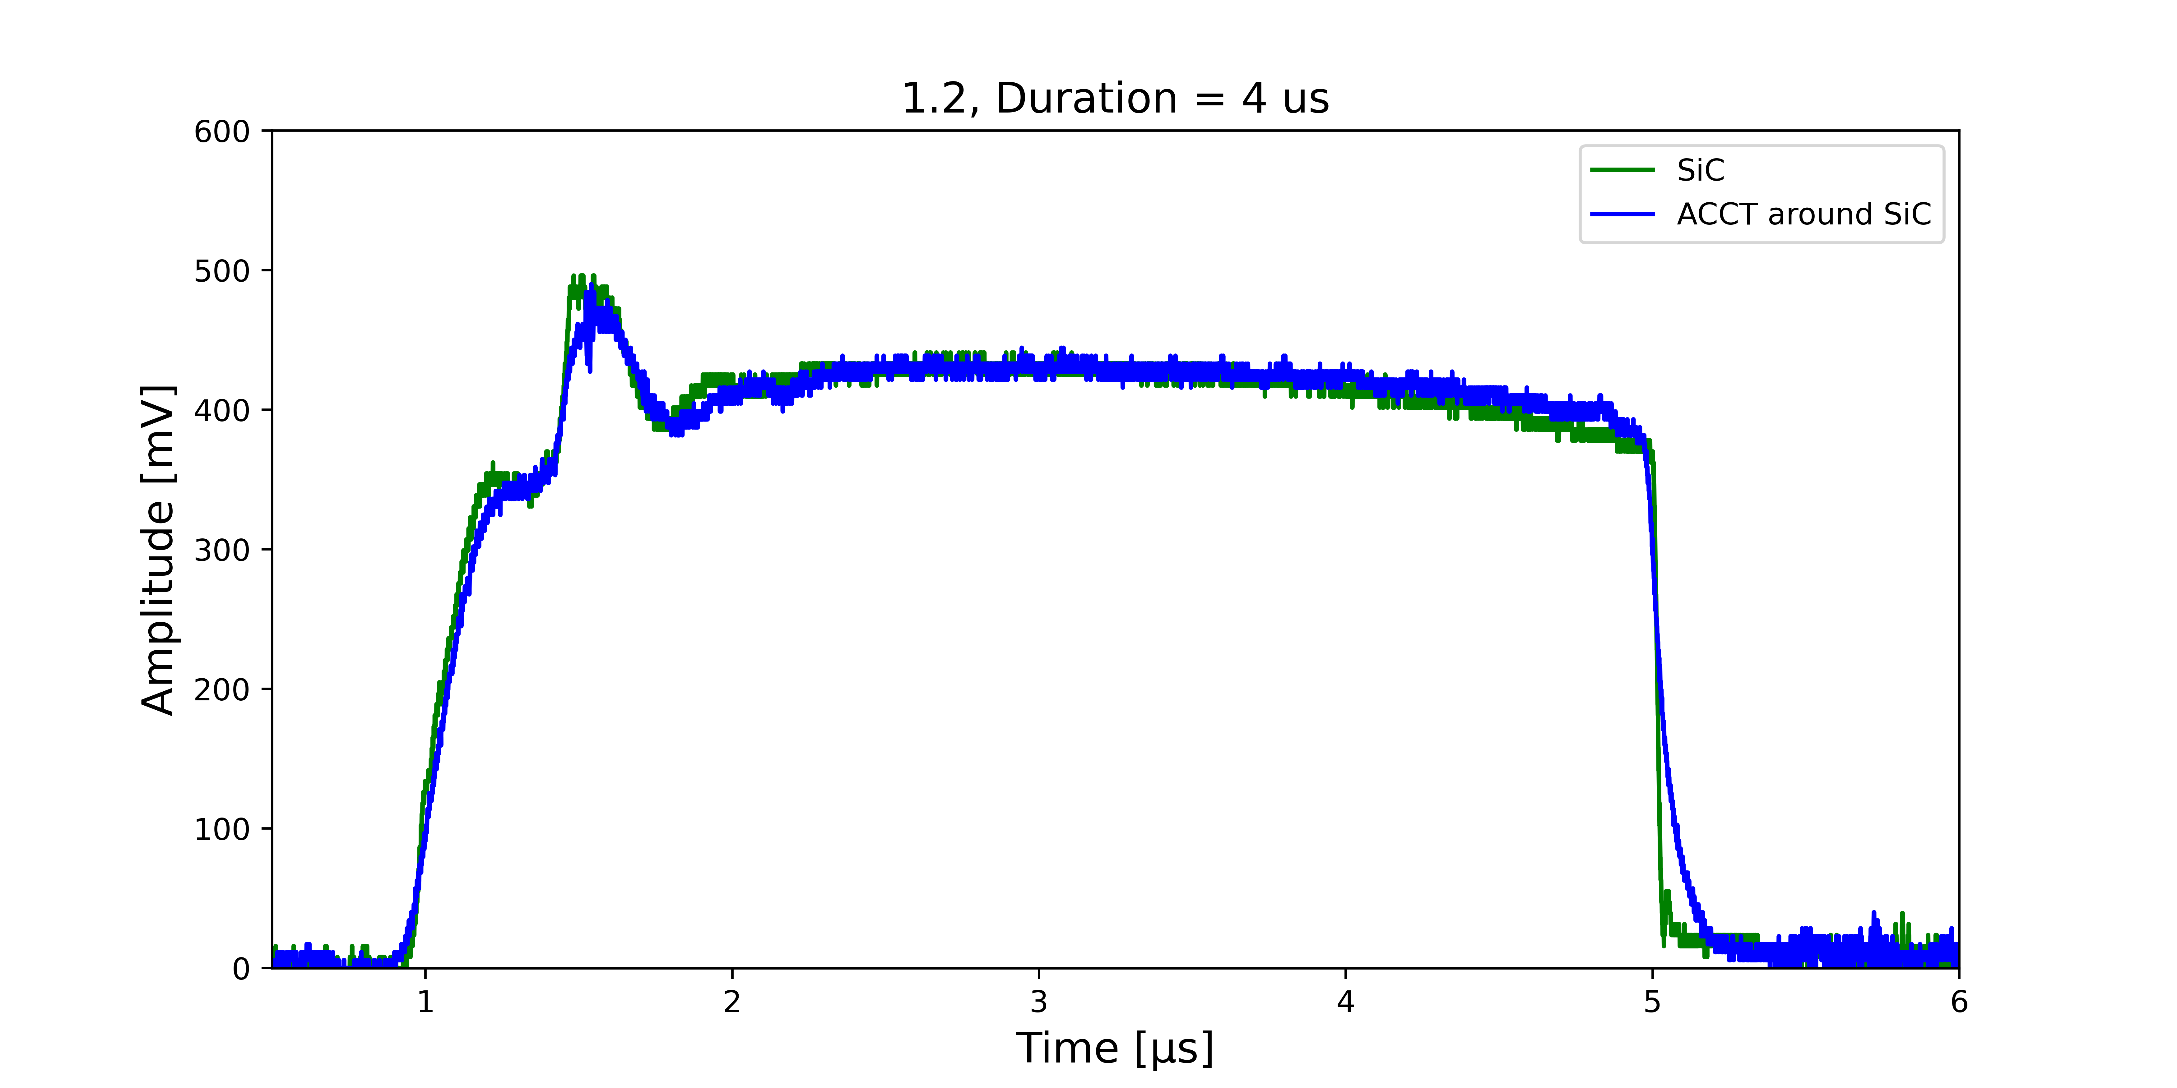
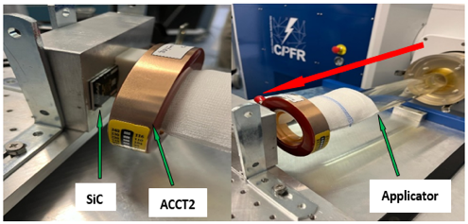


Real time monitoring of the instantaneous dose rate
ACCT
SIC
Keithley 6517A
Voltage
Signal
Applicator
EF
50
ohm
SiC
Oscilloscope
Waveforms → instantaneous dose rate
COMPARISON OF SIC-ACCT WAVEFORMS AT THE SAME POSITION
C. Okpuwe et al., Radiation Research (2025)

Slide 9
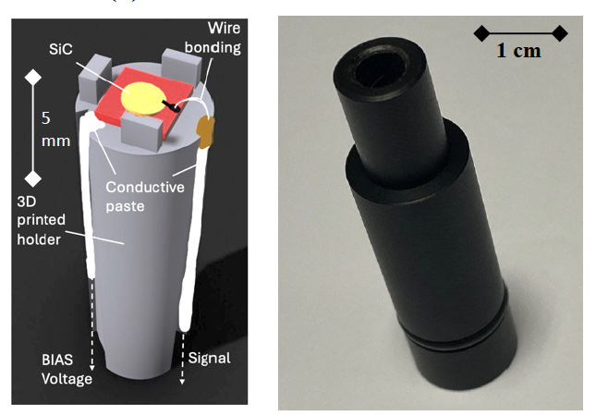
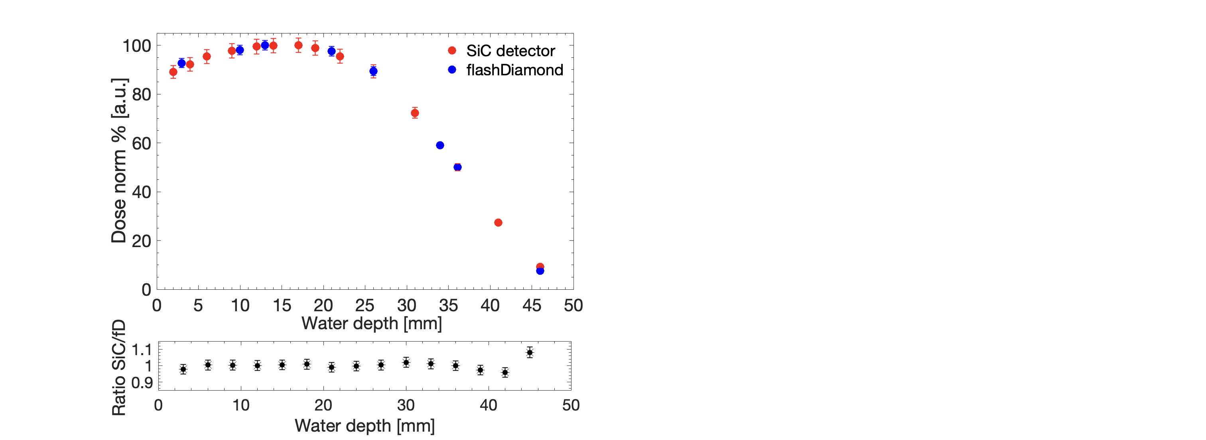
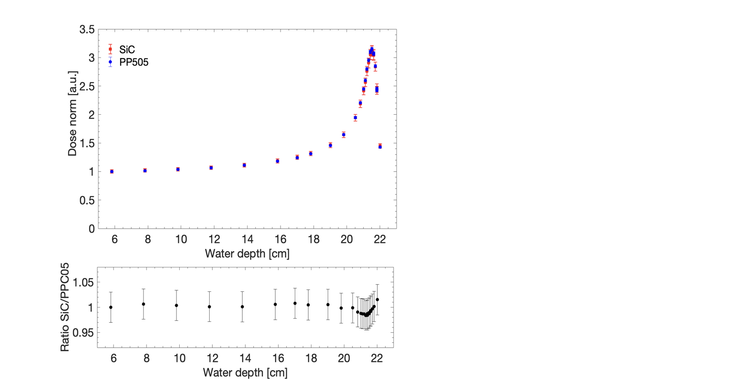
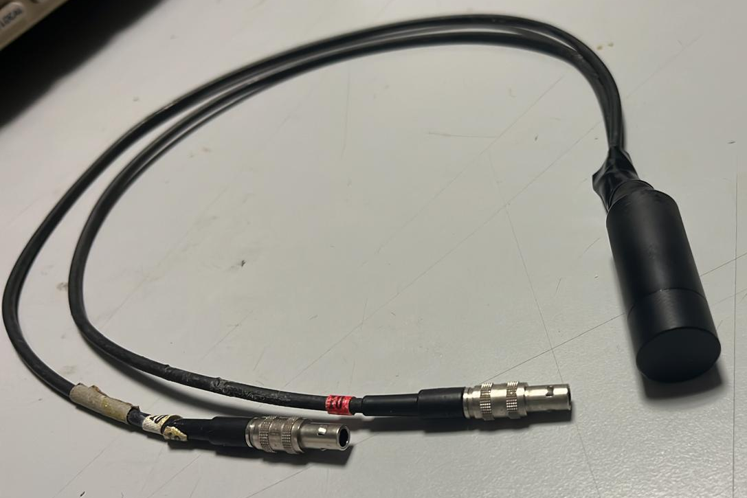
Realization of a first prototype of encapsulated water-proof SiC detector for reference dosimetry
Depth dose distribution with 9 MeV electron beams
Depth dose distribution with 180 MeV proton beams
G. Milluzzo et al., accepted in Physics Medicine and Biology (2025)

Slide 10
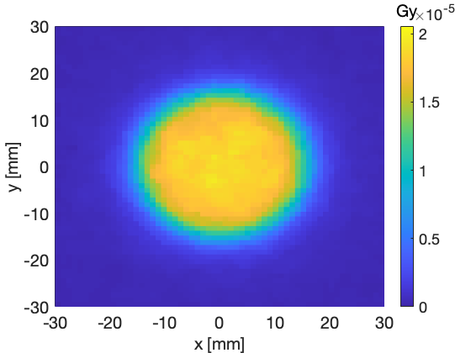
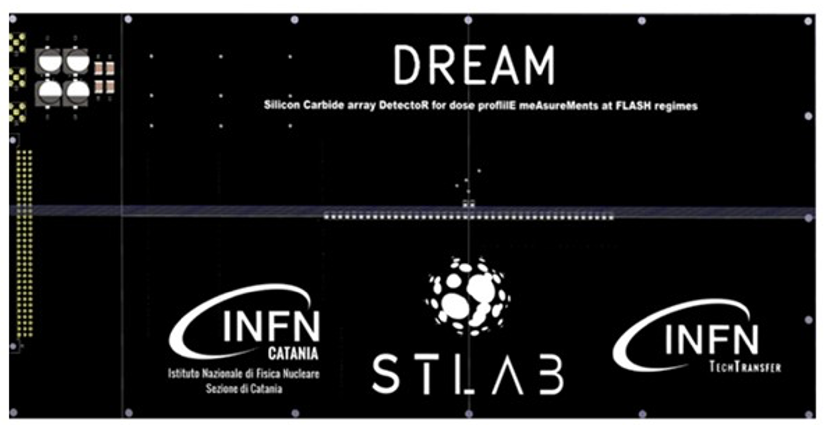
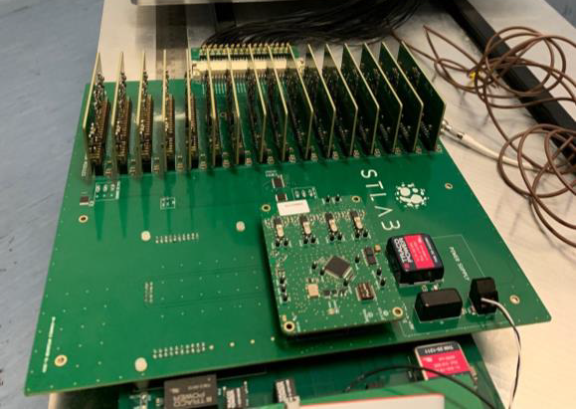
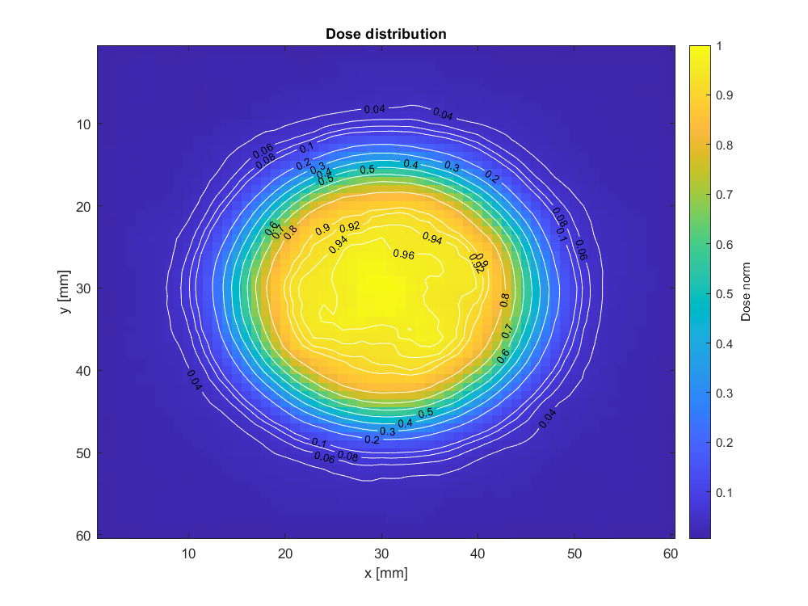

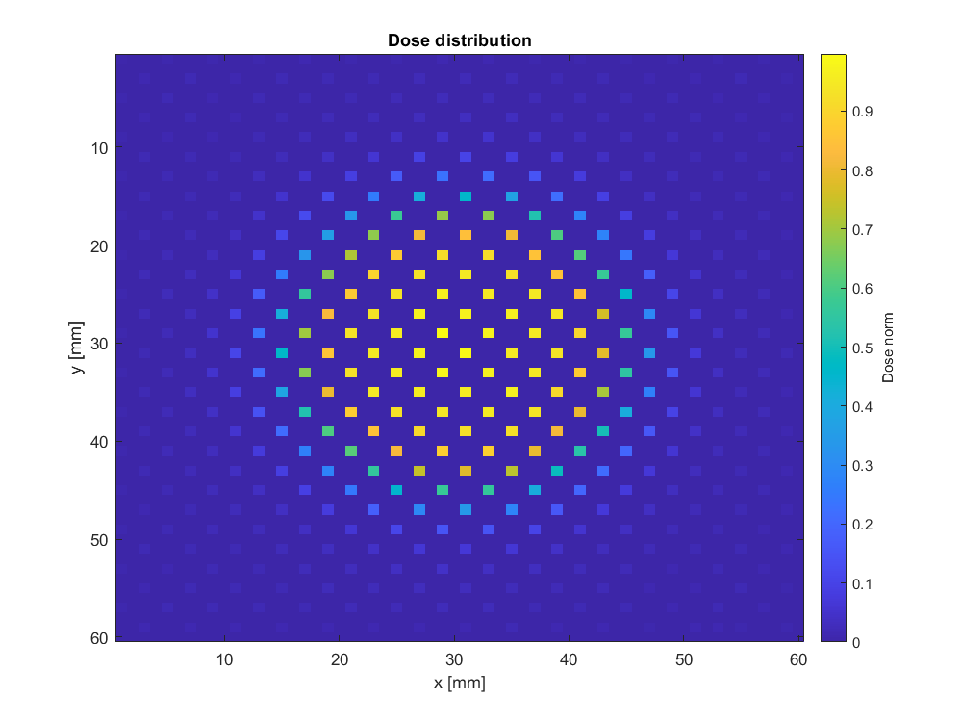

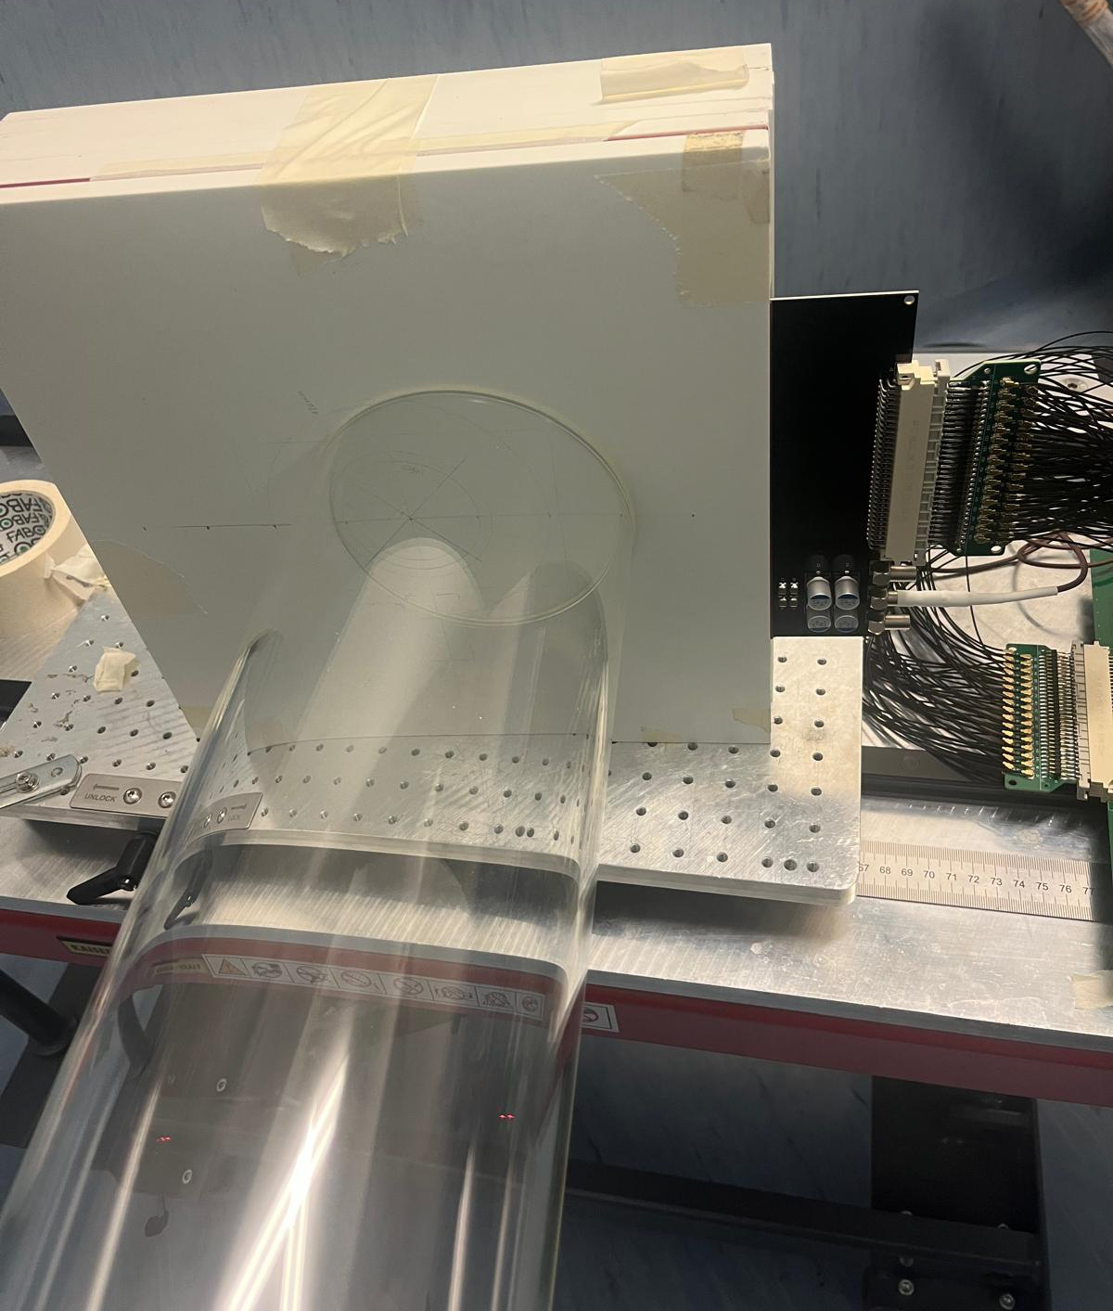
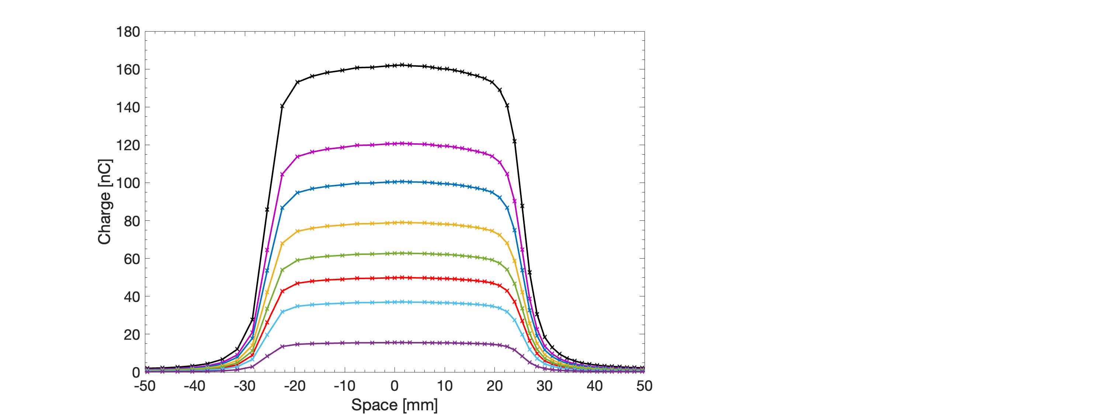


Dose distributions measurements with 1D/2D SiC systems
>60 small size (1 mm) SiC detectors mounted on a PCB
Analogic integrating readout electronics
1D Array: DREAM
Silicon carbide array DetectoR for dose profilE meAsureMents at FLASH regimes
Beam axis
2D matrix → DALI’
Development of Advanced dosimetric techniques for uLtra-hIgh dose rate beams
6 cm
6 cm
First test with UHDR electron beams
APP 50
10 pulses,
100 Hz
3.8 Gy/p
2.8 Gy/p
2.4 Gy/p
1.8 Gy/p
Minimizing the number of detectors and the cost → optimized design and SiC displacement
Support for the future clinical trial with UHDR e- beams @ CPFR
Conv
1.5 Gy/p
1.2 Gy/p
Patent submitted

Slide 11
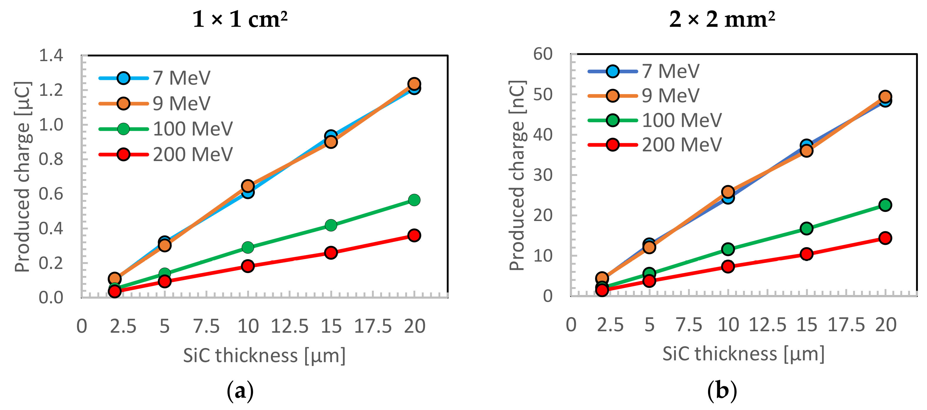
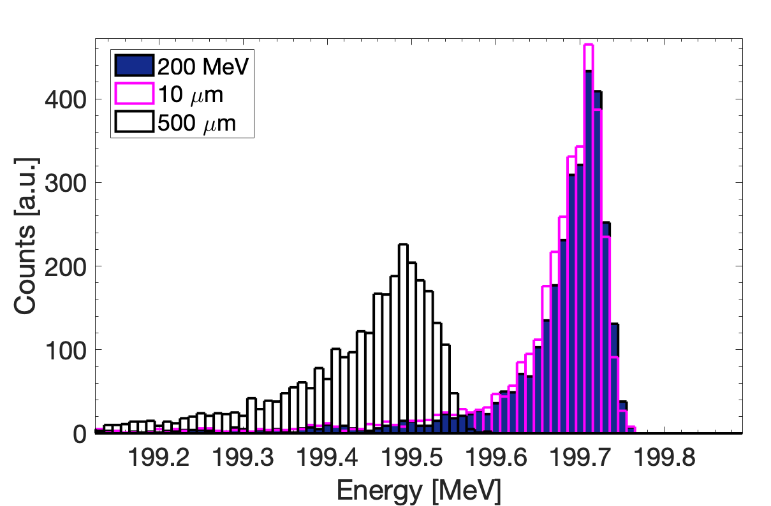
Perspective for VHEE UHDR beams
Requirements for reference dosimetry
Sensitivity to
high energy electrons
Dosimetry of small
size field
Different thickness SiC detectors available
Micrometer and cm² size available
Requirements for beam monitoring
Transparency
Position sensitive
Fast response
free standing membranes
SiC matrix detectors
< ns time resolution
What next?
First test of SiC detectors with high energy electron beams accelerated by laser @ ELI-Beamlines (2026) (Tassielli G.F., Favetta M., Grittani G.M., Lazzarini C.M, Romano F., Milluzzo G.)
Measurements with VHEE and comparison with other technologies

Slide 12
CONTRIBUTORS
Francesco Romano, Giuliana Milluzzo, Chinonso Okpuwe, Gabriele Trovato, Damiano Zitelli
Massimo Camarda, Samuele Moscato
Maurizio Marrale, Andrea Montagno, Giuseppe Valenti, Paola Mantineo, M.C. D’Oca, Alvaro Soares, Elena Corvaia
Francesco Tommasino, Emanuele Scifoni, Enrico Verroi, Stefano Lorentini, Annalisa Trianni
Fabio Di Martino, Andrea Cavalieri, Maria Grazia Celentano, Jake Pensavalle
ACKNOWLEDGEMENTS
INFN CSN5 for funding the activities through the “FRIDA” project
Fondazione Pisa for funding CPFR with the grant "prog. n. 134/2021"
National Plan for NRRP Complementary Investments, project n. PNC0000003 - AdvaNced Technologies for Human-centrEd Medicine (ANTHEM).
Thank you for your attention
giuliana.milluzzo@ct.infn.it

