Slide 1






Diamond detectors for UHDR – VHEE dosimetry
Gianluca Verona Rinati
Dip. Industrial Engineering, University of Rome “Tor Vergata”, Italy
e-mail: gianluca.verona.rinati@uniroma2.it
International Workshop on Very High Energy Electron Radiotherapy (VHEE’25)
STFC, Daresbury Laboratory, 15–17 set 2025

Slide 2
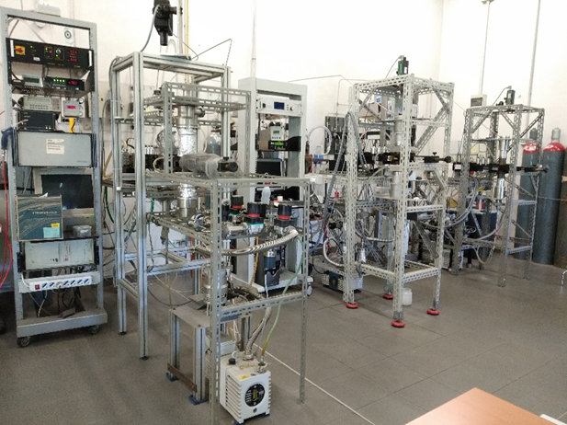
Diamond laboratory at Tor Vergata
Design, development, characterization and production of diamond-based devices
Growth of intrinsic and doped diamond
Microlithographic patterning of diamond structures and contacts
Housing fabrication and wiring
Device characterization
Research
Dosimetry
Microdosimetry
Nuclear fusion diagnostics:
Neutron detectors
VUV / Soft-X ray detectors
TOF detectors for laser-matter interaction experiments
High frequency/High power transistors
Commercial activities
Radiation therapy dosimetry
Diamond detectors for pulse-duration measurements of femto-second lasers

Slide 3
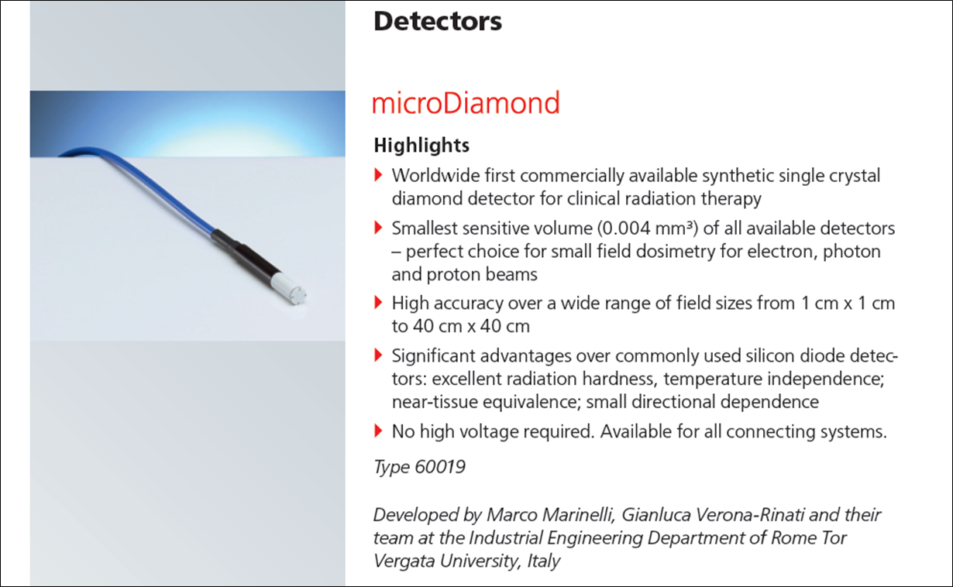
Why diamond
Diamond Key Features
Z = 6 (same as water)
Nearly constant diamond/water stopping power ratios
High bandgap (5.5 eV)
High specific sensibility (∼270 C/Gy·m³)
High electron-hole mobility
Very high displacement energy (∼ 42 eV)
Low energy dependence (photons, electrons, protons, carbon ions…)
Low dark current / noise
Small size, high spatial resolution
Fast response time ( ∼ 1 ns)
Excellent radiation hardness
Specifications
Type No. 60019
Design: waterproof, disk-shaped, sensitive volume perpendicular to detector axis
Measured quantities: absorbed dose to water
Nominal sensitive volume: 0.004 mm³
Reference point: on detector axis, 1 mm from detector tip, marked by ring
Nominal response: 1 nC/Gy
Detector bias: 0 V
Radiation quality: 100 keV ... 25 MV photons (6 ... 25) MeV electrons
Field size: (1 x 1) cm² ... (40 x 40) cm²
PTW-Freiburg leaflet: www.ptw.de

Slide 4
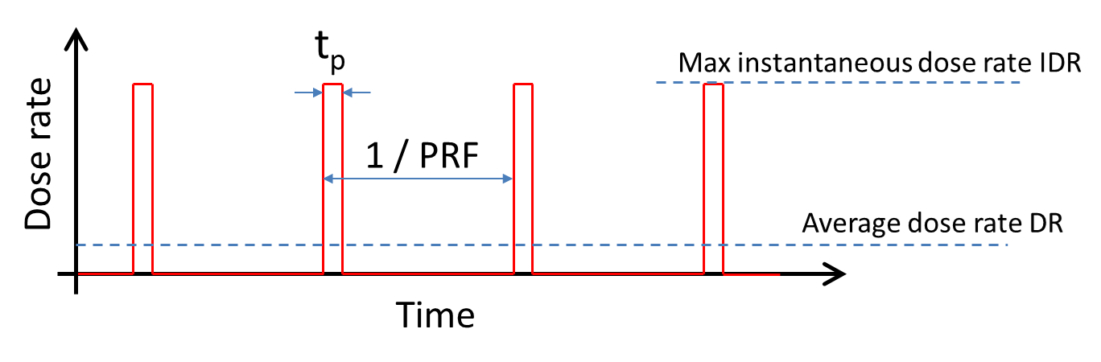
UH-DR and UH-DPP dosimetry
Radiation beams utilized in FLASH-RT are characterized by high dose rates (>40Gy/s)
In many cases they consist of pulsed beams leading to extremely high instantaneous dose rates
Active dosimeters (real time reading) suffer of response nonlinearities and saturation effects in such extreme regimes
Development of a new detectors specifically designed for operation in UH-DPP conditions

Slide 5
microDiamond detector in UH-DPP beams
Synthetic diamond Schottky diode
Self biased (∼1 V built-in potential)
Ionizing radiation
R_{s}
Electrometer
Schottky contact
Output
i
Electrometer
Electric field
A
i
A
CVD slightly B doped
CVD slightly B doped
CVD B+ doped
CVD B+ doped
i
HPHT substrate
HPHT substrate
Example:
DPP = 1Gy
t_{p}= 1µs
Sensitivity = 1 nC/Gy
R_{s} = 1 kΩ
The unavoidable presence of a resistance along the circuit generates a drop voltage opposite to the built-in one (V = Ri)
i = 1 mA
V_{drop} = 1 V
Reduced current (sensitivity)
Reduced resistance
Lower sensitive volume
Higher doping/contact optimizaion

Slide 6

PTW flashDiamond detector
flashDiamond Detector T60025
Linearity
9 MeV electron beam - 4 μs pulses
Synthetic single crystal diamond detector
Specifically designed for UH-DR beams
1.2 mm diameter sensitive volume
Radiation hard
Recommended for electrons, photons and protons
Facility | Beam | Sensitivity (nC/Gy)
PTW | ⁶⁰Co | 0.309 ± 0.005
PTB | UH-DPP - 20 MeV electrons | 0.305 ± 0.002
SIT S.p.A. | 9 MeV electrons - conventional | 0.306 ± 0.005
M. Marinelli et al. Med Phys.2022;49:1902–1910
G. Verona Rinati et al. Med Phys.2022;49:5513–5522

Slide 7
PDDs
Measurements performed in motorized water phantom
“Conventional” beam modality
Comparison among fDs, Markus IC and mD
“UH-DPP” beam modality
Comparison between fD and EBT-XD

Slide 8
Profiles
Measurements performed in motorized water phantom
“Conventional” beam modality
Profiles at D_{max} for all the 7 applicators
“UH-DPP” beam modality
Profiles at D_{max} for all the 7 applicators

Slide 9
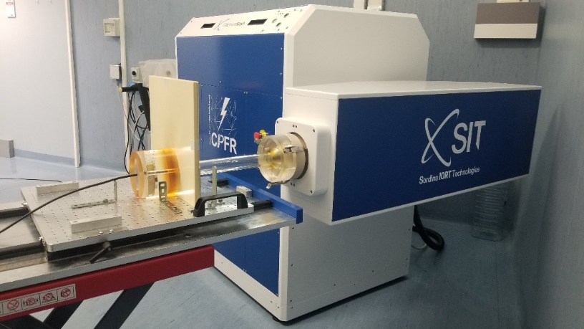
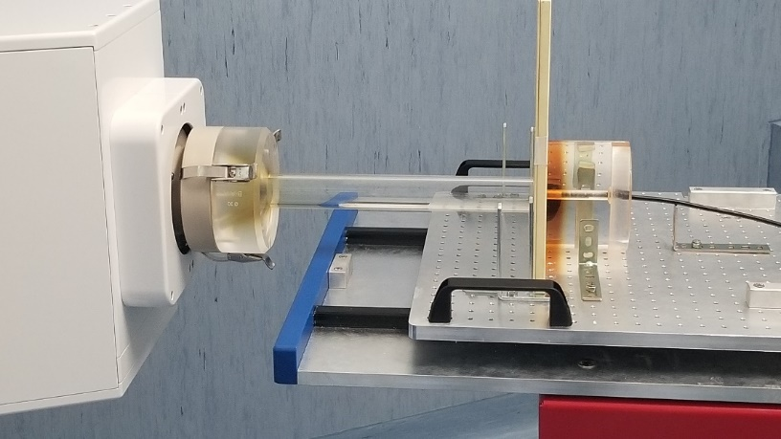
Time resolved measurements: UH-DPP electrons
Test performed at CPFR, Pisa, Italy and SIT S.p.A, Aprilia, Italy
Linac: ElectronFlash (SIT S.p.A.)
9 MeV electrons
Dosimeters:
flashDiamond
Detectors connected to a variable gain transimpedance (FEMTO) amplifier (10³ V/A gain, 10 MHz bandwidth) and a digital oscilloscope (PicoScope)

Slide 10
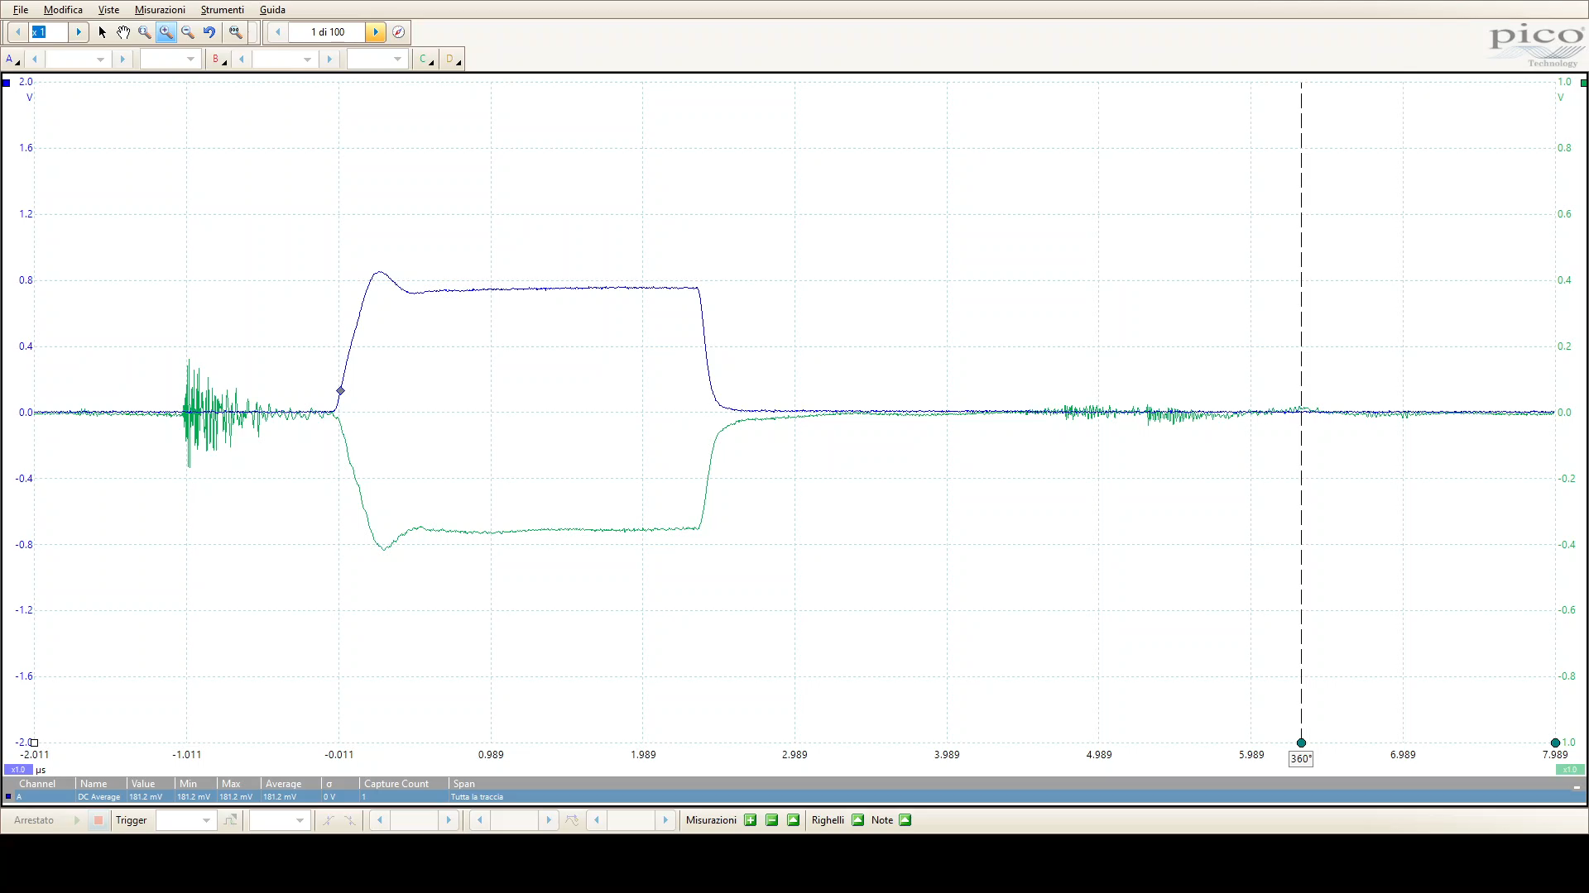
Time resolved measurements: UH-DPP electrons
flashDiamond
ACCT

Slide 11
Dose and I-DR detectors: UH-DPP electrons
Pulse duration scan
I-DR scan

Slide 12
Dose and I-DR detectors: UH-DPP electrons
Charge values from the FEMTO+Pico chain obtained by integrating the current temporal traces
Facility | Electronic chain | Sensitivity (nC/Gy)
PTW (⁶⁰Co) | UNIDOS | 0.465
CPFR (9 MeV electrons) | UNIDOS | 0.470
CPFR (9 MeV electrons) | FEMTO+Pico | 0.471

Slide 13
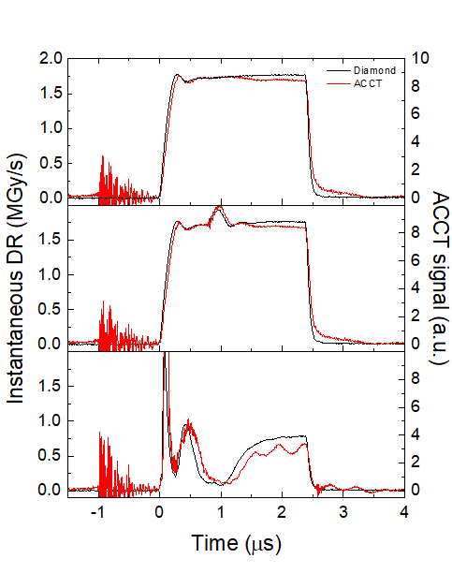
Dose and I-DR detectors: UH-DPP electrons
Comparison between ACCT and flashDiamond prototype signals

Slide 14
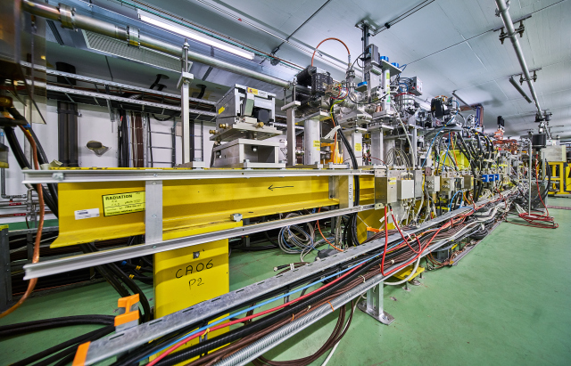
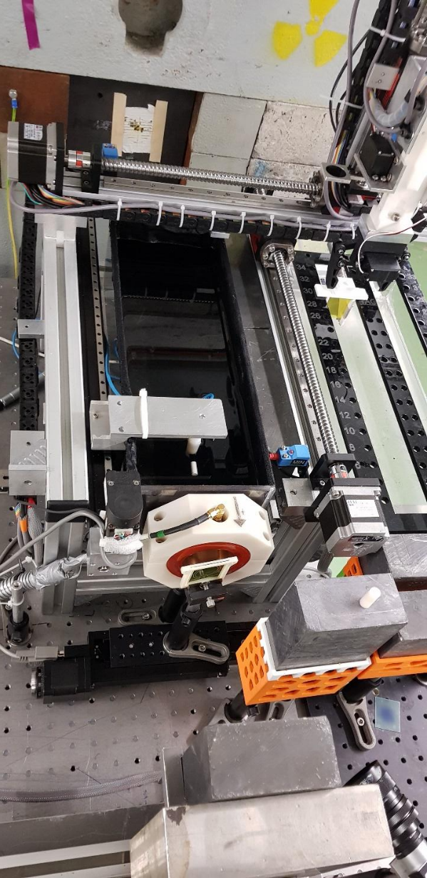

VHEE dosimetry - CLEAR Facility at CERN
Test performed at CERN Linear Electron Accelerator for Research (CLEAR)
Test performed in a motorized water phantom
Positioning of EBT3 films using a robotic device
PARAMETER | VALUE
Beam Energy | 60-220 MeV
Pulse repetition rate | 0.8 - 10 Hz
Bunch length | 0.1–10 ps
Bunch charge | 0.01 – 1.5 nC
Bunch spacing | 666 ps
Max bunches per pulse | 150
Max total charge | 30 nC

Slide 15
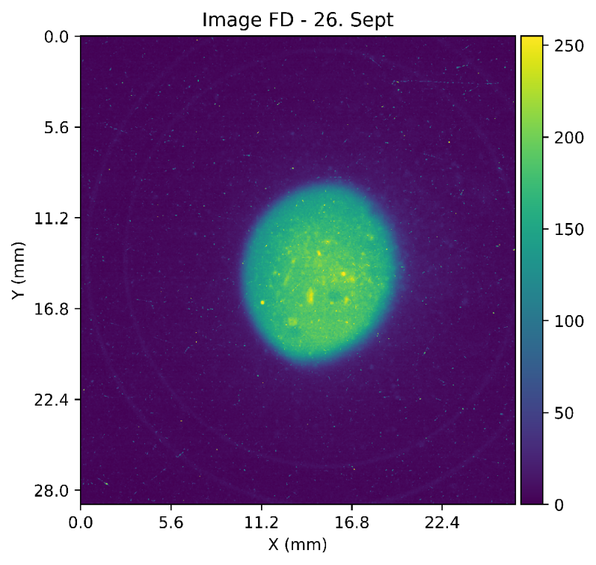
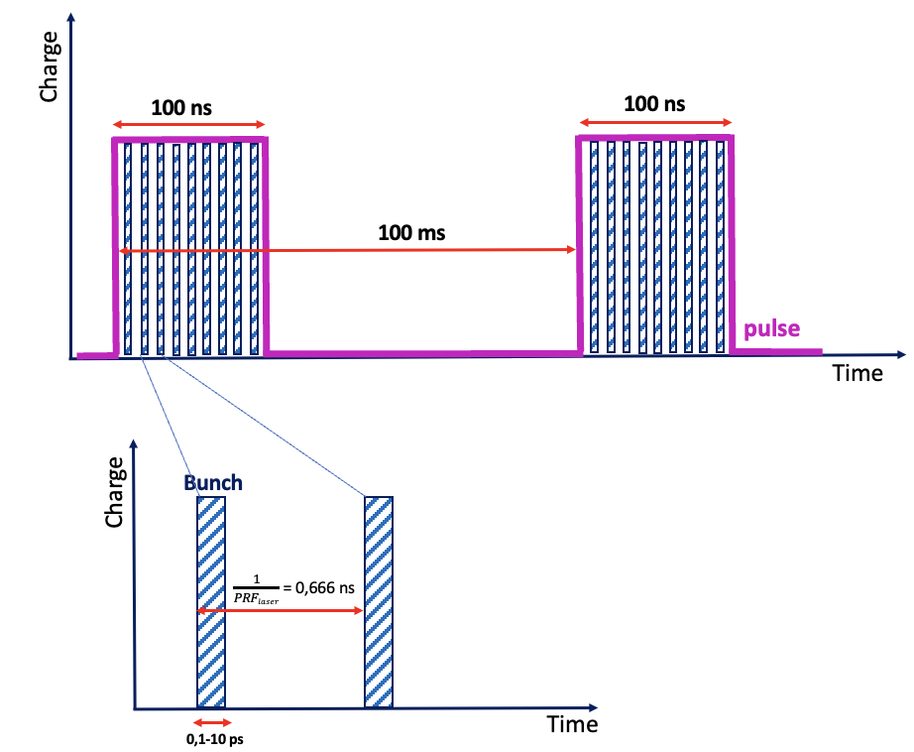
VHEE dosimetry
Beam parameters
Electron energy: 200 MeV
Beam diameter: 1 cm
Bunch charge: 0.1 nC – 0.7 nC
Bunch inerval: 0.666 ns
Number of bunches: 20 - 170
Pulse length: 12 ns – 110 ns
Pulse repetition frequency: 10 Hz

Slide 16
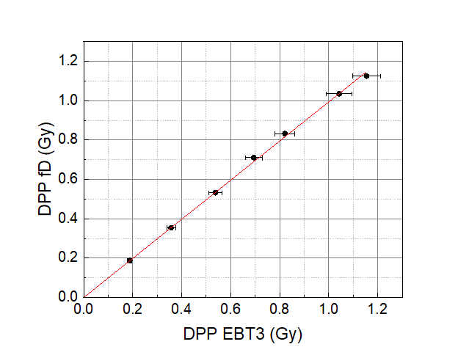
VHEE - Linearity 1
Beam energy 200 MeV
Depth in water 32 mm
Linearity test performed by varying the number of bunches (pulse length from 12 ns to 112 ns)
Dose-per-pulse from 0.19 Gy to 1.15 Gy
Instantaneous dose rate nominally constant at about 10 MGy/s
Detector: fD 8530
Sensitivity (⁶⁰Co reference conditions): 0.154 nC/Gy
Best linear fit slope = 0.99 ± 0.02
Same calibration factor (within exp. uncertainty) as in ⁶⁰Co reference conditions.
No appreciable energy dependence under VHEE beams, indicating suitability for absolute dosimetry

Slide 17
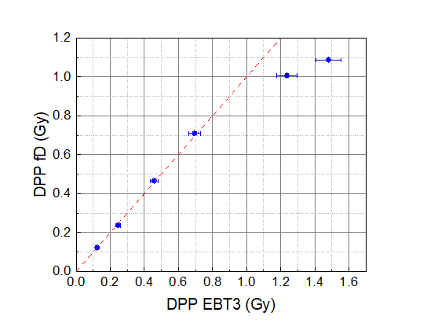
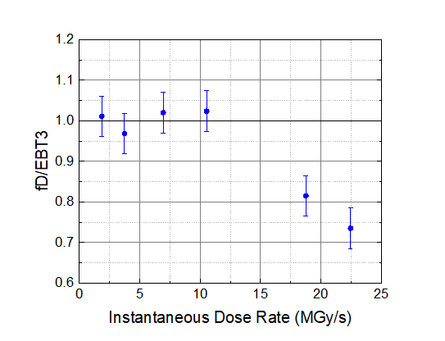
VHEE - Linearity 2
Beam energy 200 MeV
Depth in water 32 mm
Linearity test performed by varying bunches charge
Pulse length constant (66 ns)

Slide 18
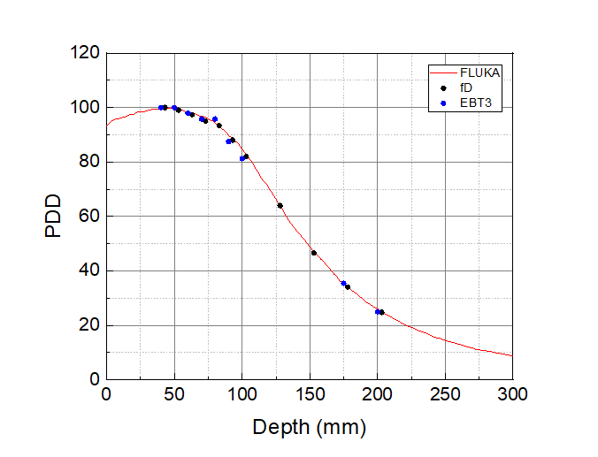
PDDs
PDD curves obtained from the fD detector, EBT3 films and by the Monte Carlo simulation
Charge per bunch: 0.2 nC

Slide 19
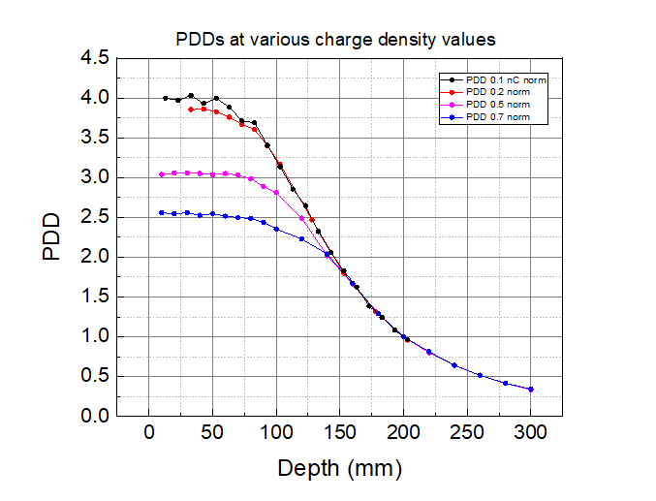
PDDs
PDD curves measured at different values of charge-per-bunch (from 0.1 nC to 0.7 nC)
Curves normalized at 200 mm
IDR ∼ 7 MGy/s
IDR ∼ 3.5 MGy/s
IDR ∼ 18 MGy/s
IDR ∼ 22 MGy/s

Slide 20
Conclusion
The developed flashDiamond detectors was demonstrated to be a suitable tools for a thorough dosimetric characterization of UH-DR and VHEE beams
No variation of the calibration factor in VHEE beams relative to that obtained under ⁶⁰Co reference conditions, indicating possible use of the fD for absolute dosimetry
Linear response up to about 10 MGy/s
Work is in progress to design specific detector for FLASH-VHEE beams with extremely high IDR

Slide 21


Acknowledgments
SIT
Giuseppe Felici
Luigi Giunti
Veronica De Liso
PTW
Rafael Kranzer
URTV
Marco Marinelli
Claudio Verona
Gianluca Verona Rinati
CPFR
Fabio Di Martino
Damiano del Sarto
Jake Harold Pensavalle
CERN - CLEAR
Wilfrid Farabolini
Vilde F. Rieker
Antonio Gilardi
Alexander Malyzhenkov
SAPIENZA
Gaia Franciosini
Lucia Giuliano

Slide 22
Thank you!

