Slide 1
Dosimetry Codes of Practice Are they applicable to VHEE RT?
Hugo Palmans
National Physical Laboratory, Teddington, UK and MedAustron, Wiener Neustadt, Austria

Slide 2
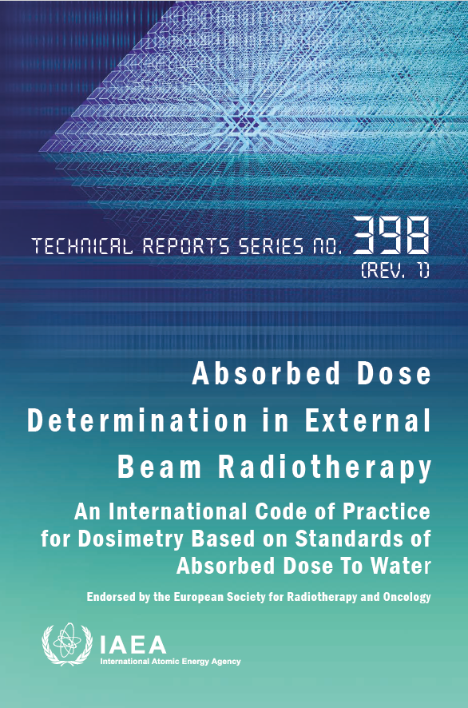
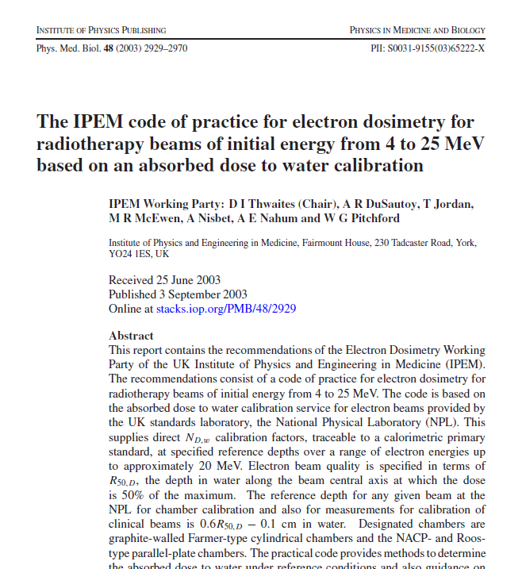

Slide 3
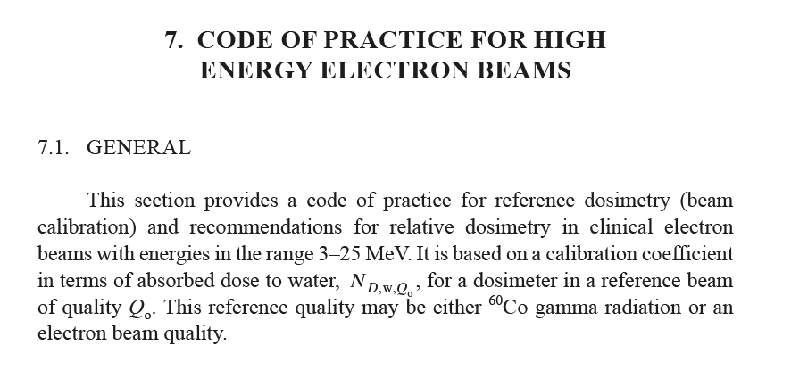
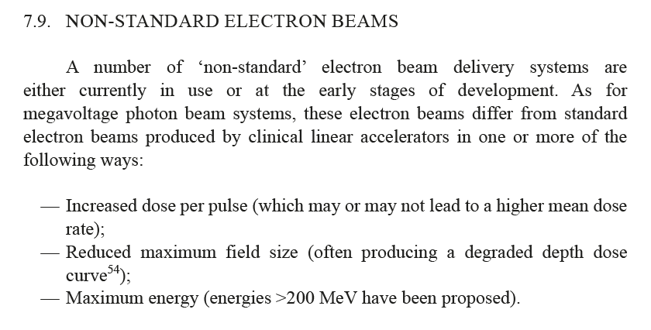
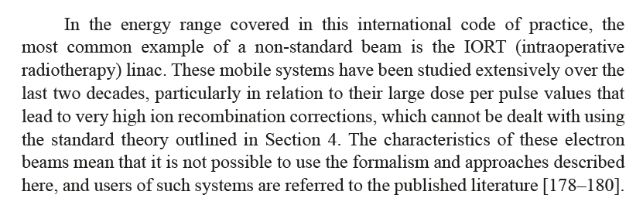
TRS-398 Rev.1:

Slide 4


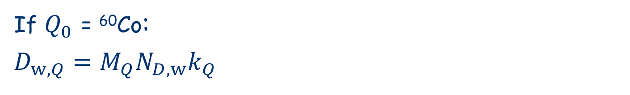
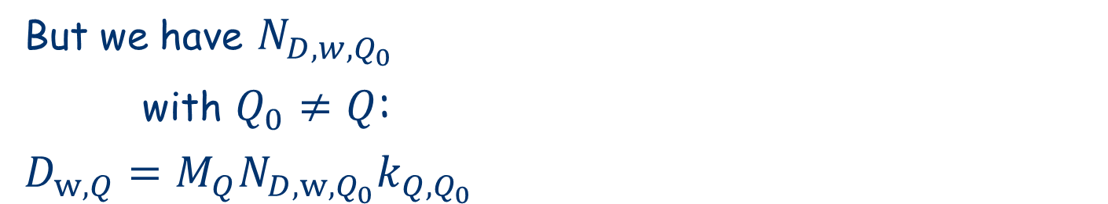

IAEA TRS-398 Rev.1: Framework/ Simple absorbed dose formalism
SI definition of quantity:
* Absorbed dose (to water) in broad beam
$D_{w,Q}=M_{Q}N_{D,w,Q}$
Primary standards:
* Calorimeters, ICs, Fricke
But we have $N_{D,w,Q_{0}}$
with $Q_{0}≠Q$:
$D_{w,Q}=M_{Q}N_{D,w,Q_{0}}k_{Q,Q_{0}}$
Secondary standard:
* Ionization chamber
Quantity at user:
* Reference absorbed dose
* Beam monitor calibration
TRACEABILITY
If $Q_{0}$ = ⁶⁰Co:
$D_{w,Q}=M_{Q}N_{D,w}k_{Q}$
Relative dosimetry in water:
* Output factors
* Profiles 1-2-3D
* TPS

Slide 5

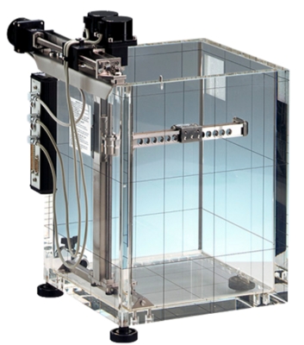
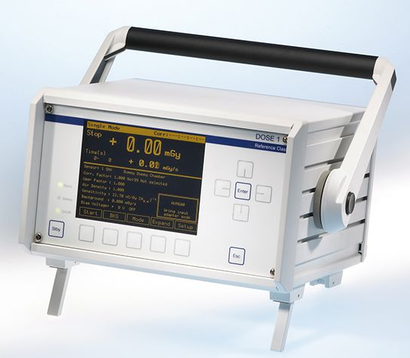
TRS-398 Rev.1: recommendations on equipment

Slide 6
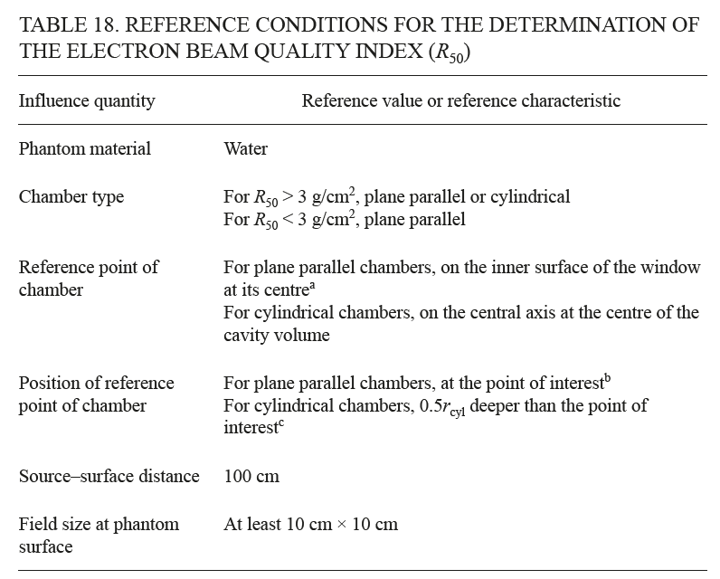
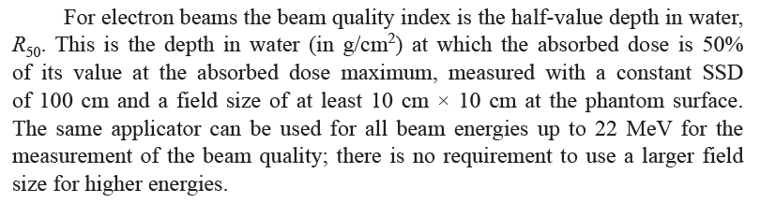

TRS-398 Rev.1: recommendations on beam quality Q

Slide 7
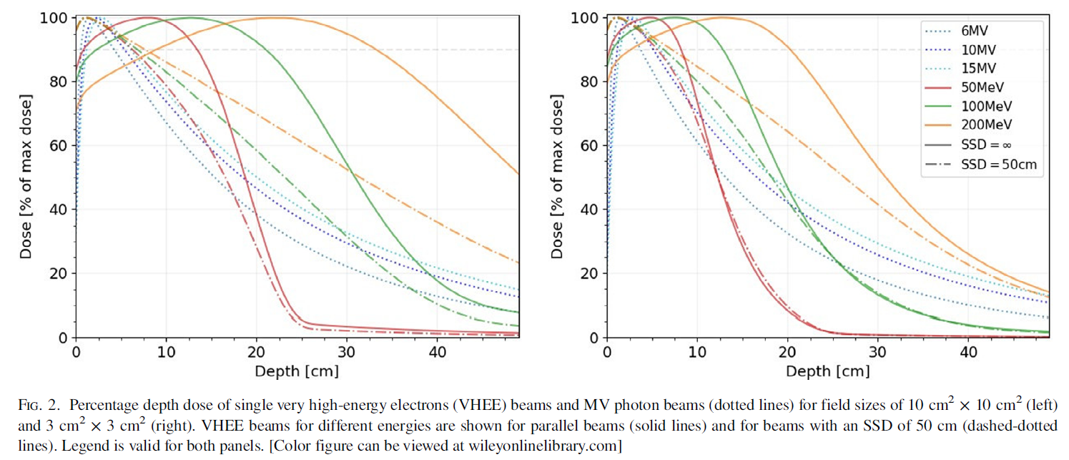
For which field size and how to measure R₅₀ in VHEE beams?
(Böhlen et al 2021 Med Phys 48:3958)

Slide 8
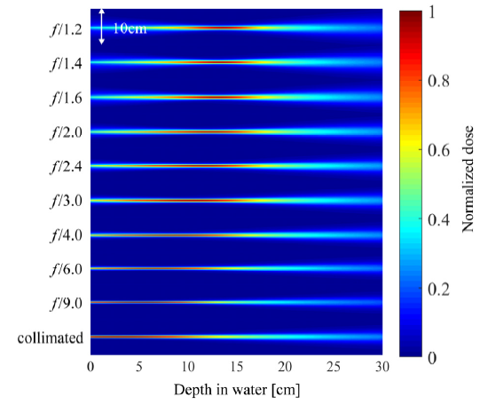
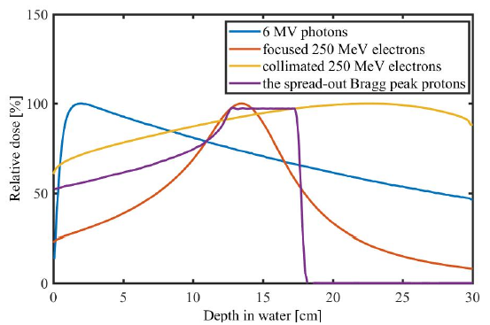
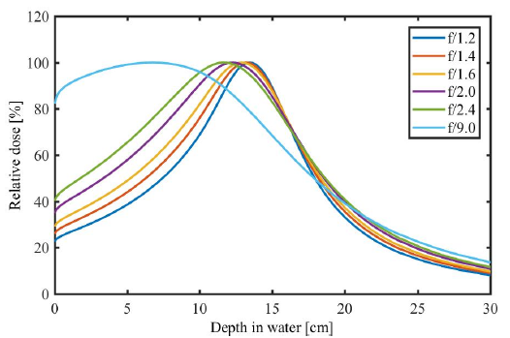
How to measure R₅₀ in focused VHEE beams?
(Fan et al 2023 – IPAC23)

Slide 9
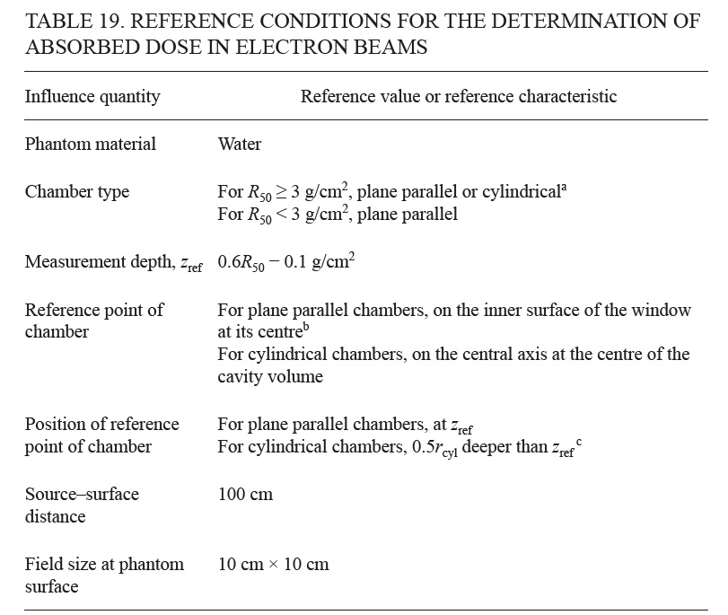
TRS-398 Rev.1: reference conditions for reference dosimetry:

Slide 10
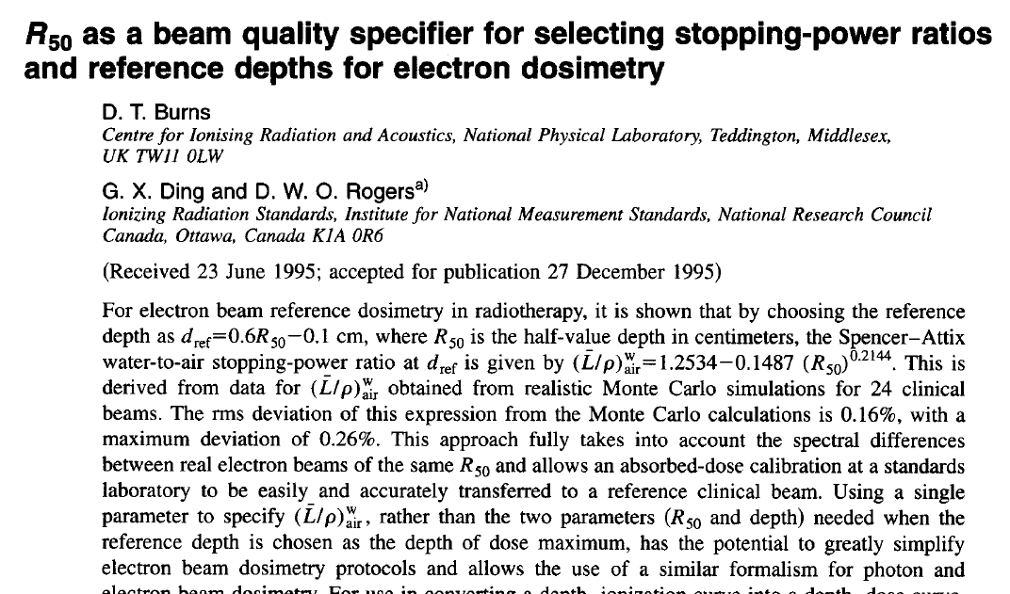
Where does this come from?

Slide 11
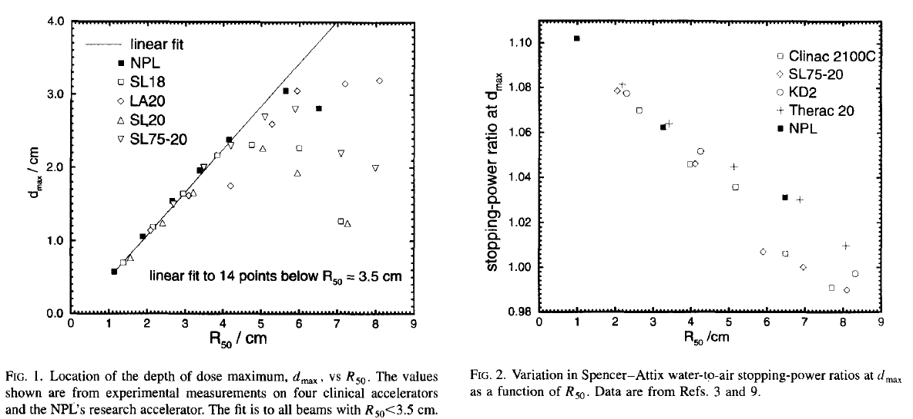
Where does this come from?

Slide 12
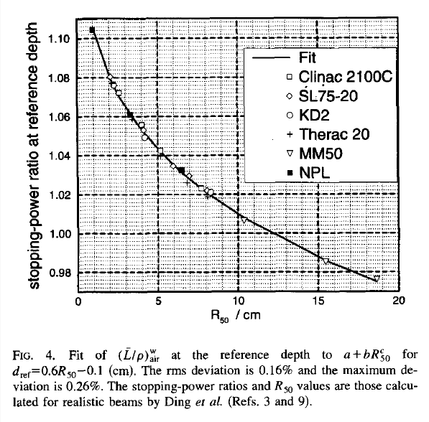
Where does this come from?

Slide 13
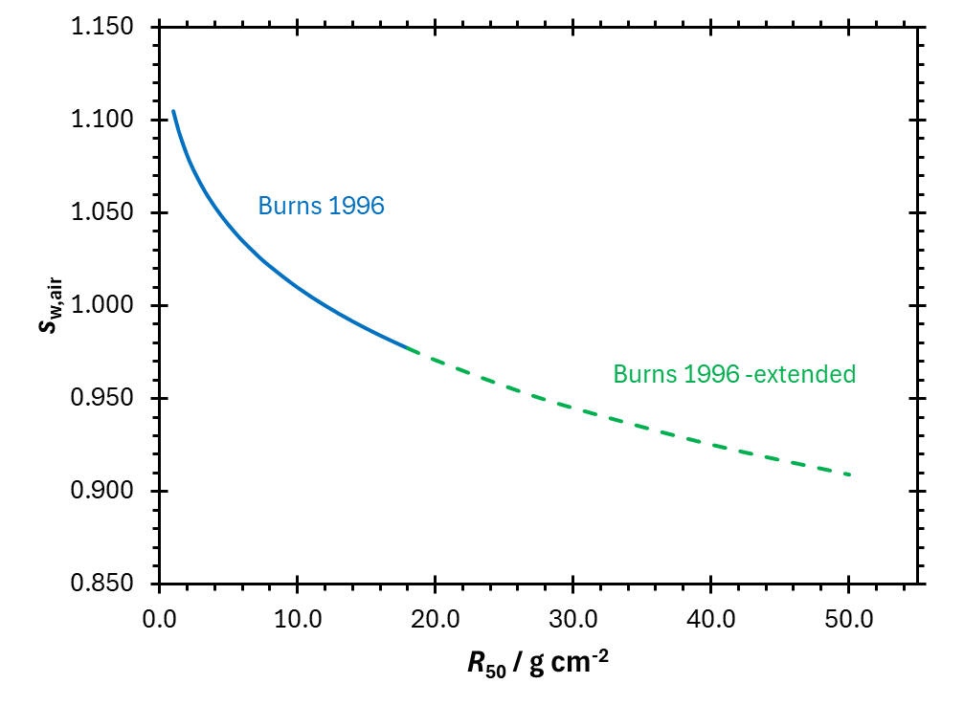
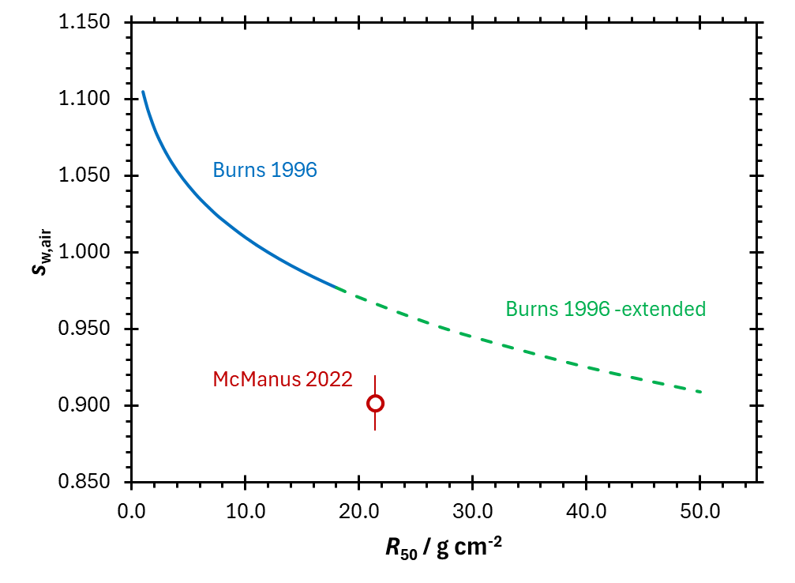
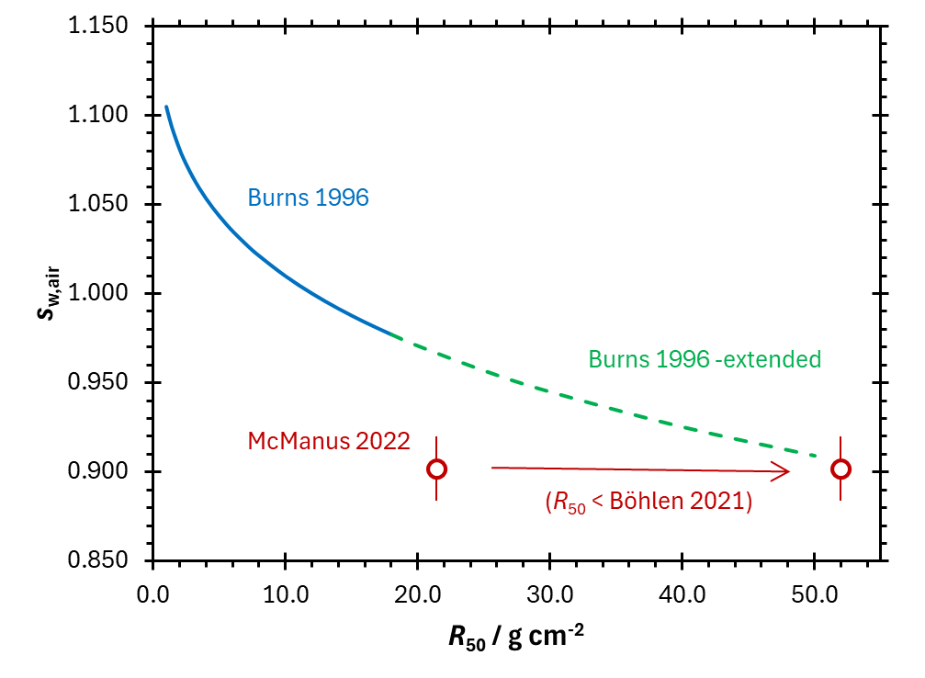
VHEE data compared to Burns
But: that Burns value would be for a reference depth of 30 cm…

Slide 14
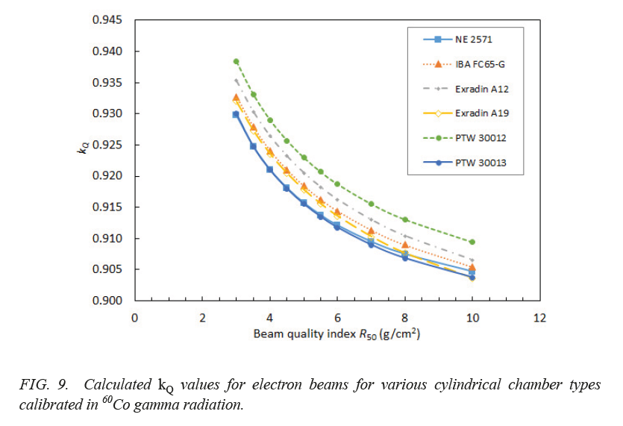
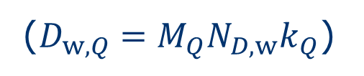
TRS-398 Rev.1: beam quality correction factors k_{Q}
($D_{w,Q}=M_{Q}N_{D,w}k_{Q}$)

Slide 15
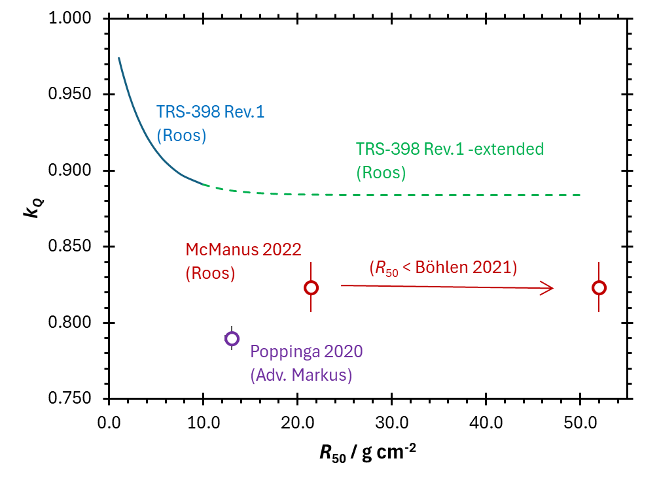
Beam quality correction factors k_{Q}

Slide 16
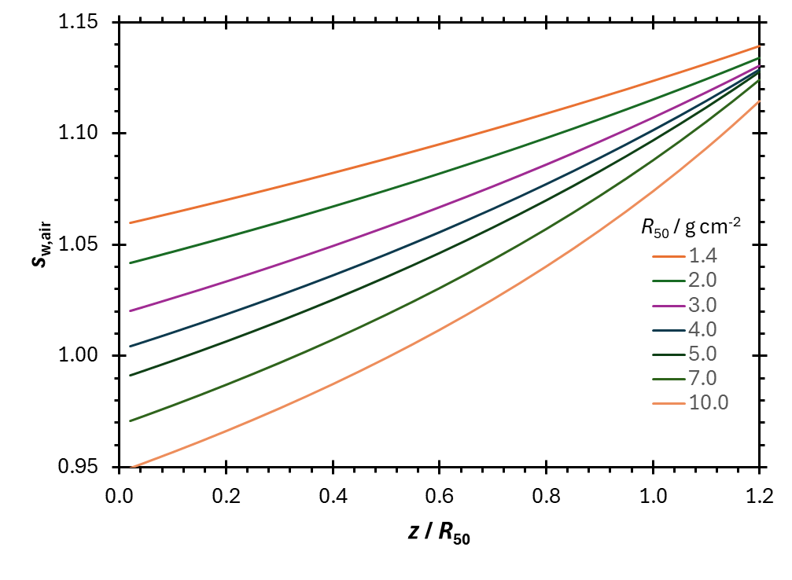
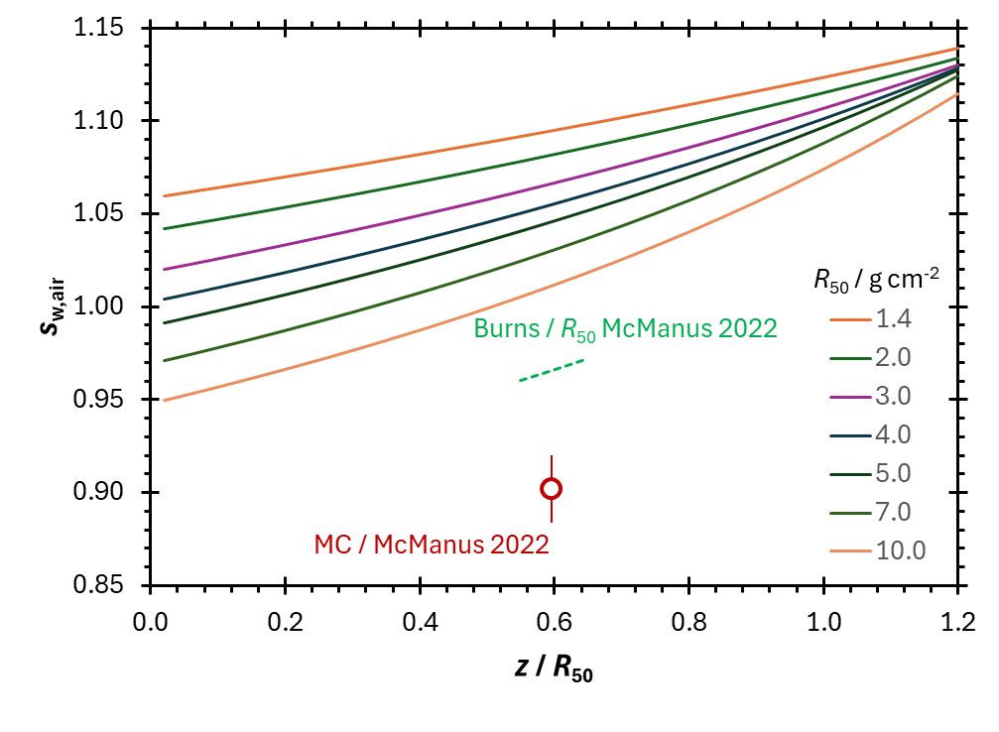
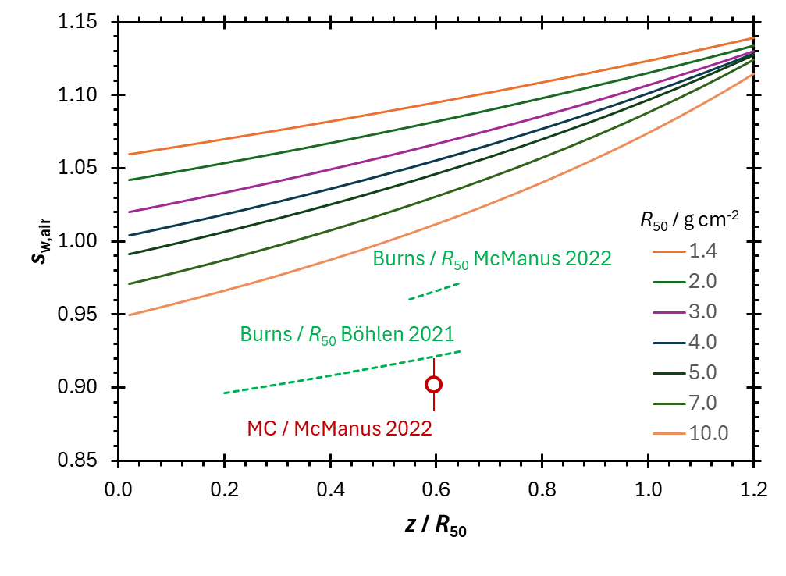
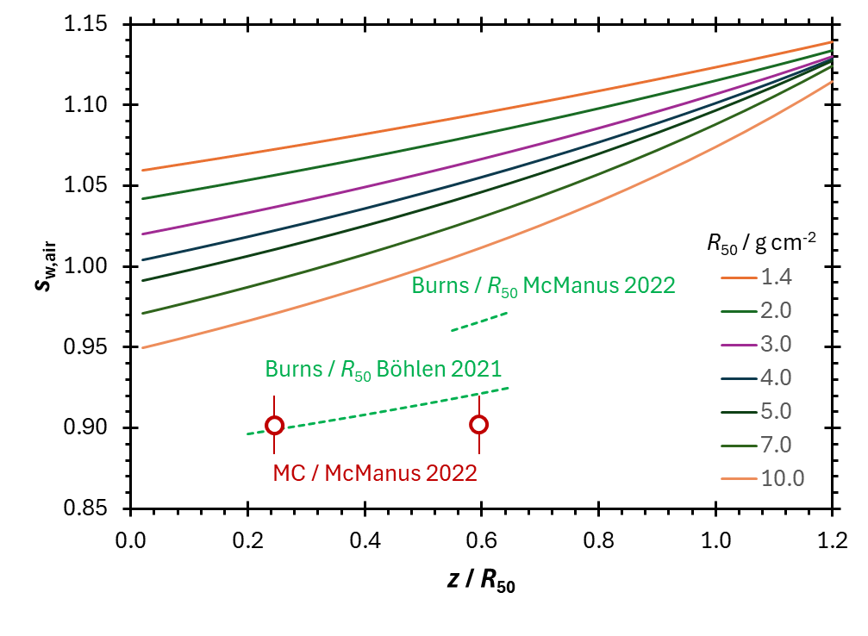
TRS-398 provides recommendations on the measurement of depth-dose distributions, profiles and output factors

Slide 17
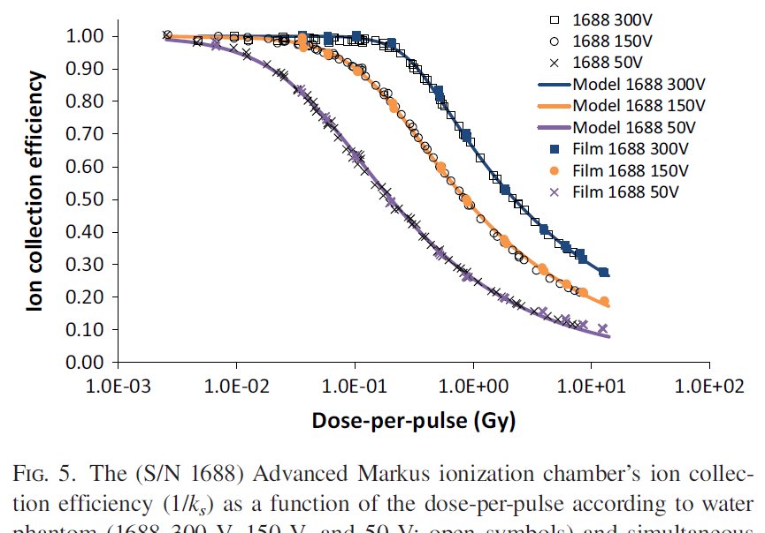
TRS-398 provides recommendations on some other things
Correction of the raw ionization chamber reading for influence quantities
Use of plastic phantoms
Cross calibration of field ionization chambers
(Petersson et al 2017 Med Phys 44:1157)

Slide 18
TRS-398 provides recommendations on some other things
Correction of the raw ionization chamber reading for influence quantities
Use of plastic phantoms
Cross calibration of field ionization chambers

Slide 19
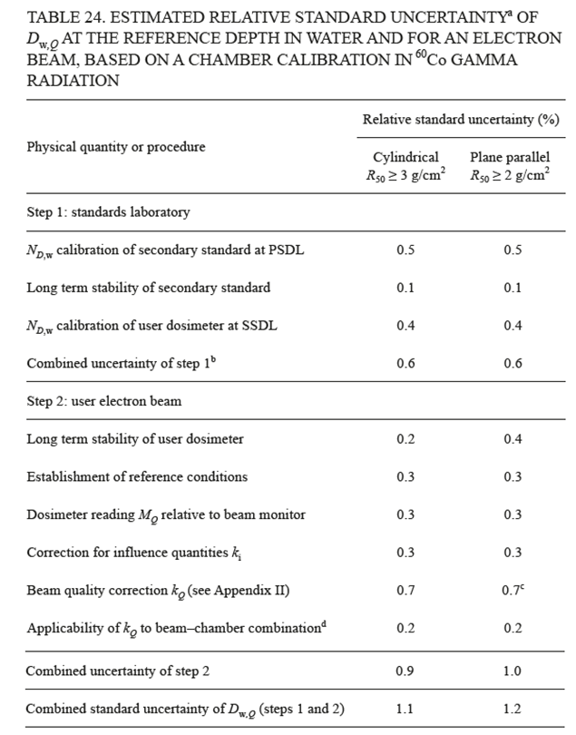
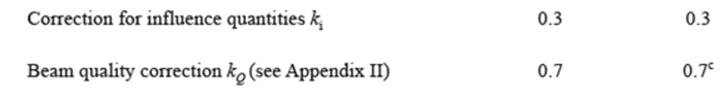
TRS-398 provides example/typical uncertainty budget

Slide 20
So, when new modalities come that deviate from those that led to TRS-398 Rev.1, one has to consider:
Can the same equipment be used?
Are the reference conditions still valid or can they even be achieved?
Is the beam quality specification still relevant and can it be measured in the same way?
Can the same k_{Q} values be used?
Are the recommendations on relative dosimetry still valid?
Is the typical uncertainty budget still valid or are any components much larger?

Slide 21
UHDR proton RT
Can the same equipment be used? √ but some improvements and alternatives
Are the reference conditions still valid or can they even be achieved? √
Is the beam quality specification still relevant and can it be measured in the same way? √
Can the same k_{Q} values be used? √
Are the recommendations on relative dosimetry still valid? √
Is the typical uncertainty budget still valid or are any components much larger? √

Slide 22
(UHDR) VHEE RT
Can the same equipment be used? √ but some improvements and alternatives for UHDR
Are the reference conditions still valid or can they even be achieved? √ to some extent but relevance should be questioned
Is the beam quality specification still relevant and can it be measured in the same way? √ probably yes
Can the same k_{Q} values be used? X maybe with different model, but more data needed
Are the recommendations on relative dosimetry still valid? √ maybe, but more data and extension needed
Is the typical uncertainty budget still valid or are any components much larger? √ but some larger contributions

Slide 23
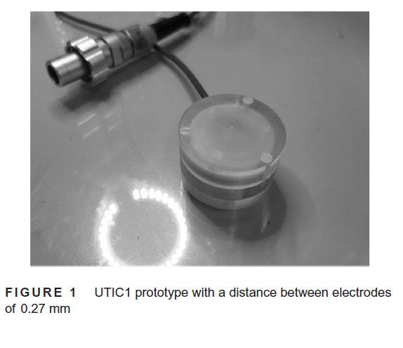
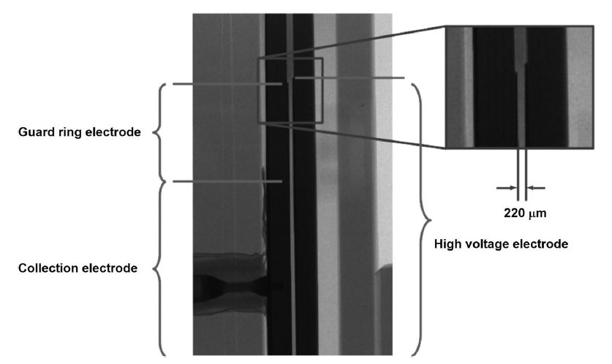
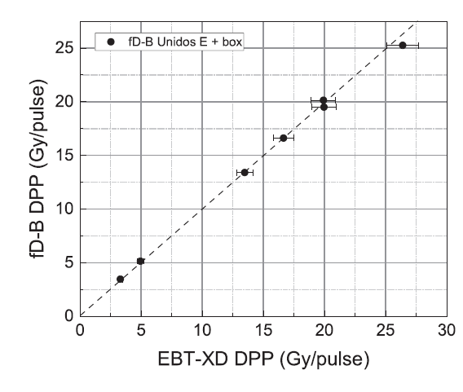
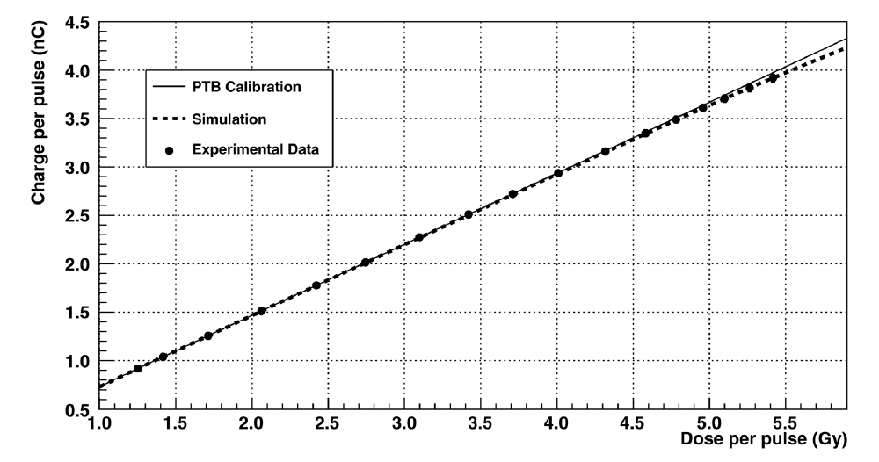
UHDP/R solutions
Ultra-thin PP IC FLASH diamond
Gomez et al 2022, Med Phys 49:4705
Marinelli et al 2022, Med Phys 49:1902

Slide 24
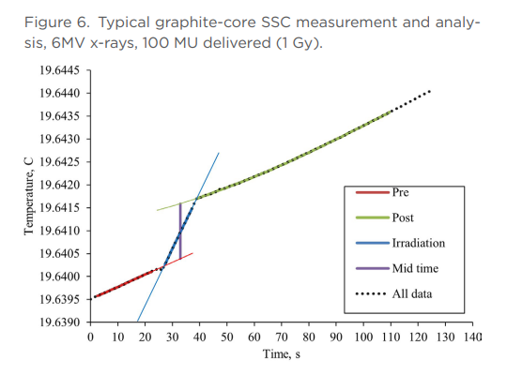
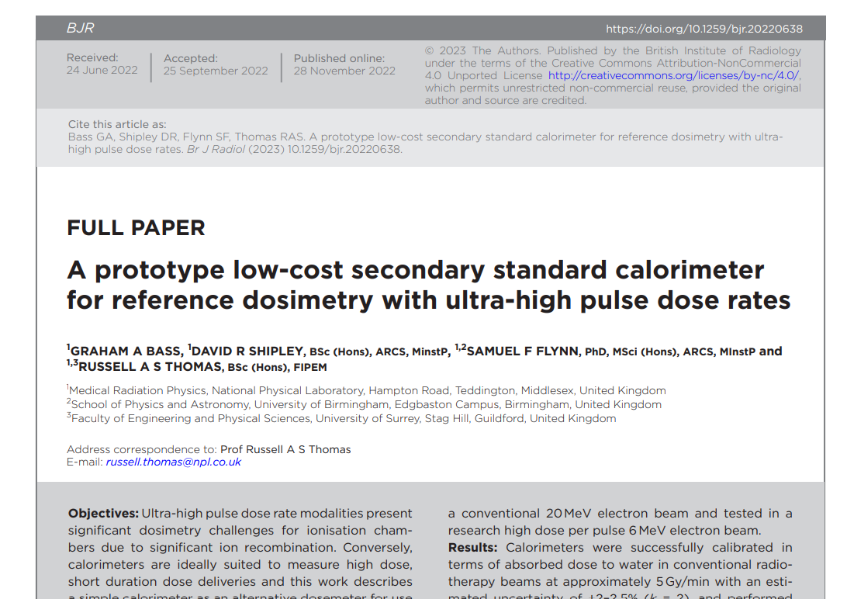
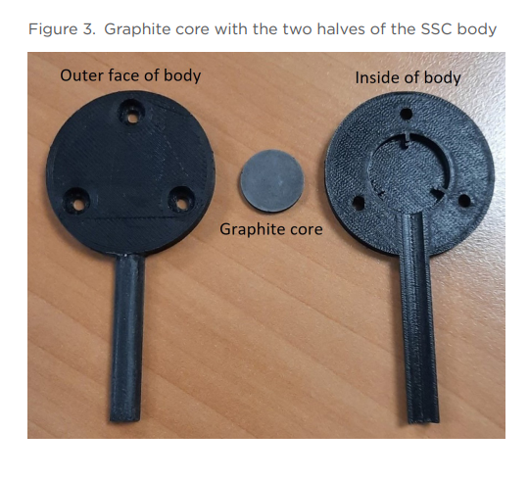
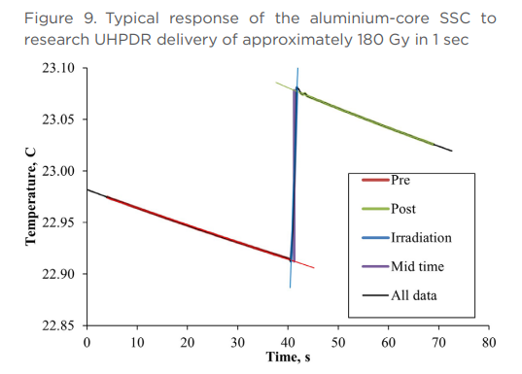
Calorimeters as reference instruments in the clinic for UHDP/R

Slide 25
SFRT VHEE beams
Can the same equipment be used? √ to some extent
Are the reference conditions still valid or can they even be achieved? X
Is the beam quality specification still relevant and can it be measured in the same way? X
Can the same k_{Q} values be used? √ maybe but more data needed
Are the recommendations on relative dosimetry still valid? X
Is the typical uncertainty budget still valid or are any components much larger? X

Slide 26
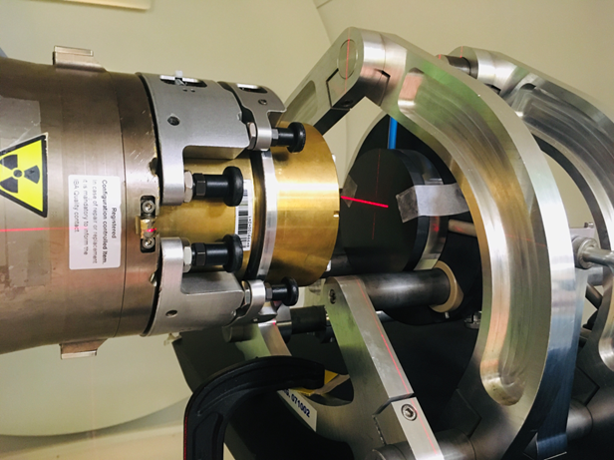
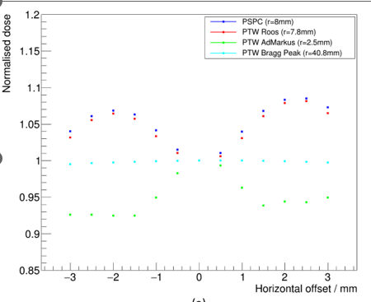
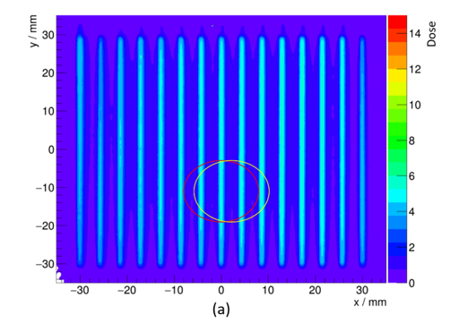
SFRT - average dose measurement
Cotterill et al 2024, submitted to Cancers

Slide 27
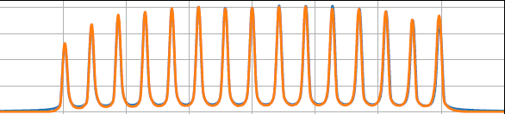
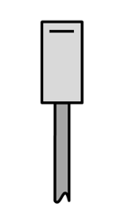
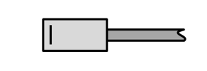
SFRT - peak or valley - detector orientation, e.g. microDiamond
Small field mini beam

Slide 28
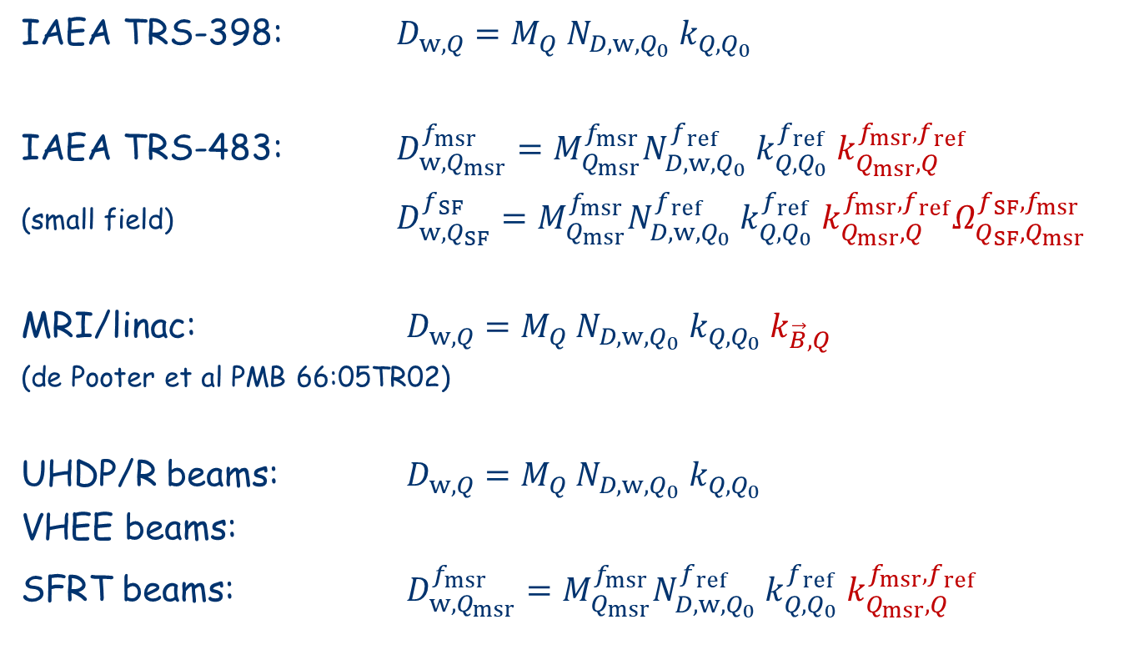
Formalism
IAEA TRS-398: $D_{w,Q}=M_{Q} N_{D,w,Q_{0}} k_{Q,Q_{0}}$
IAEA TRS-483: $D_{w,Q_{msr}}^{f_{msr}}=M_{Q_{msr}}^{f_{msr}}N_{D,w,Q_{0}}^{f_{ref}} k_{Q,Q_{0}}^{f_{ref}}{ k}_{Q_{msr},Q}^{f_{msr},f_{ref}}$
(small field) $D_{w,Q_{SF}}^{f_{SF}}=M_{Q_{msr}}^{f_{msr}}N_{D,w,Q_{0}}^{f_{ref}} k_{Q,Q_{0}}^{f_{ref}}{ k}_{Q_{msr},Q}^{f_{msr},f_{ref}}Ω_{Q_{SF},Q_{msr}}^{f_{SF},f_{msr}}$
MRI/linac: $D_{w,Q}=M_{Q} N_{D,w,Q_{0}} k_{Q,Q_{0}} k_{\vec{B},Q}$
(de Pooter et al PMB 66:05TR02)
UHDP/R beams: $D_{w,Q}=M_{Q} N_{D,w,Q_{0}} k_{Q,Q_{0}}$
VHEE beams:
SFRT beams: $D_{w,Q_{msr}}^{f_{msr}}=M_{Q_{msr}}^{f_{msr}}N_{D,w,Q_{0}}^{f_{ref}} k_{Q,Q_{0}}^{f_{ref}}{ k}_{Q_{msr},Q}^{f_{msr},f_{ref}}$

Slide 29
In conclusion
No recommendations for VHEE beams in existing COPs for reference dosimetry in external beam radiotherapy
Framework and formalism can still be used, but may have to be expanded for SFRT beams
Relevance of beam quality and reference depth for HE electrons is questionable for VHEE
More systematic determination of stopping power ratios and beam quality correction factors are needed
For UHDR VHEE alternative instrumentation is required
For SFRT reference conditions and appropriate quantities need to be better defined and positioning is a larger issue

