Slide 1
Progress Towards 100 Hz Operation of the VHEE Beamline at ILIL
Gabriele Bandini, PhD
gabriele.bandini@ino.cnr.it
15 – 17 set 2025
STFC, Daresbury Laboratory
Notes:
Good morning, first of all I would like to thank the organizers for this opportunity.
My name is Gabriele Bandini, and I work at the National Institute of Optics of the National Research Council in Pisa.
Today I will present the progress and current status of the upgrade of our beamline towards the acceleration of VHEE at 100 Hz.

Slide 2
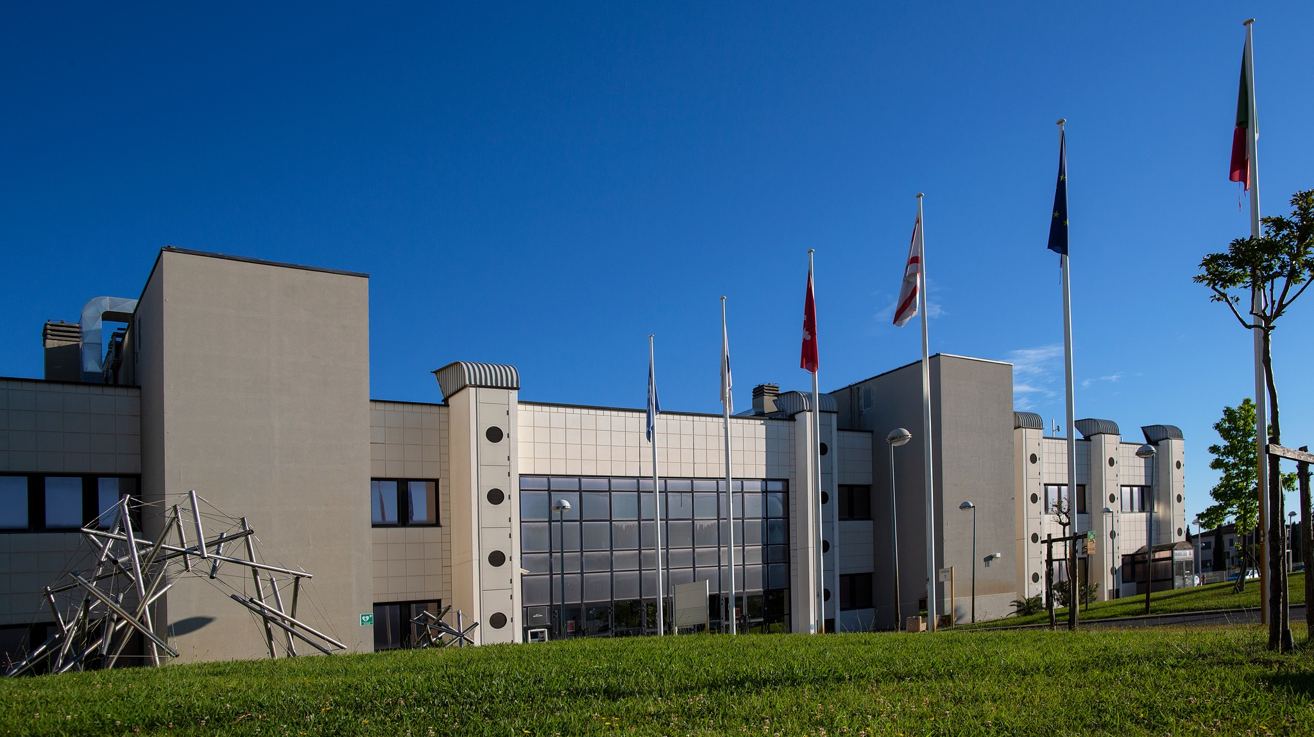

CNR (Consiglio Nazionale delle Ricerche) Campus in Pisa
Notes:
A quick introduction to the institute: this photo shows the main building of the Pisa research area, which was inaugurated in 2000, this year is the 25th anniversary of its foundation.
In addition to several CNR research institutes, the area also hosts research laboratories from both public and private institutions.

Slide 3
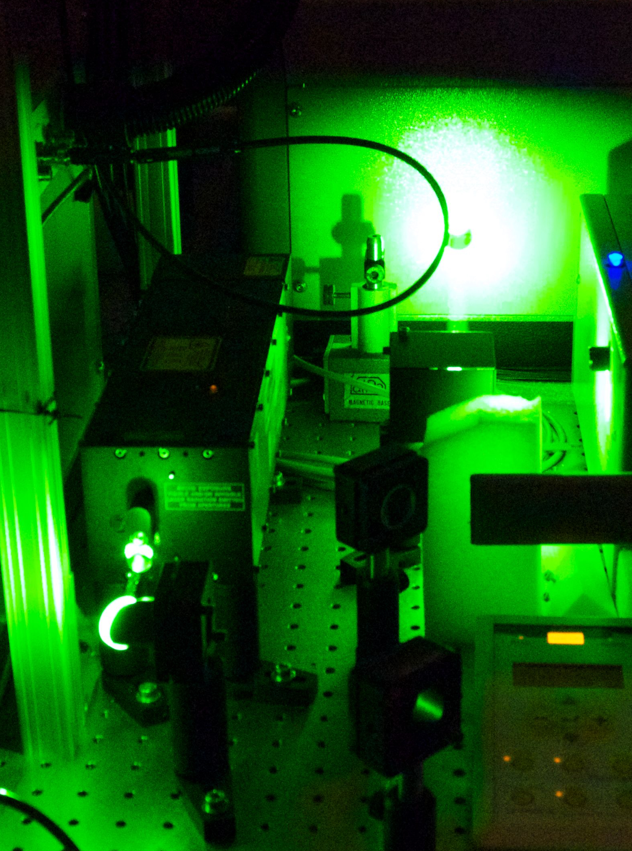
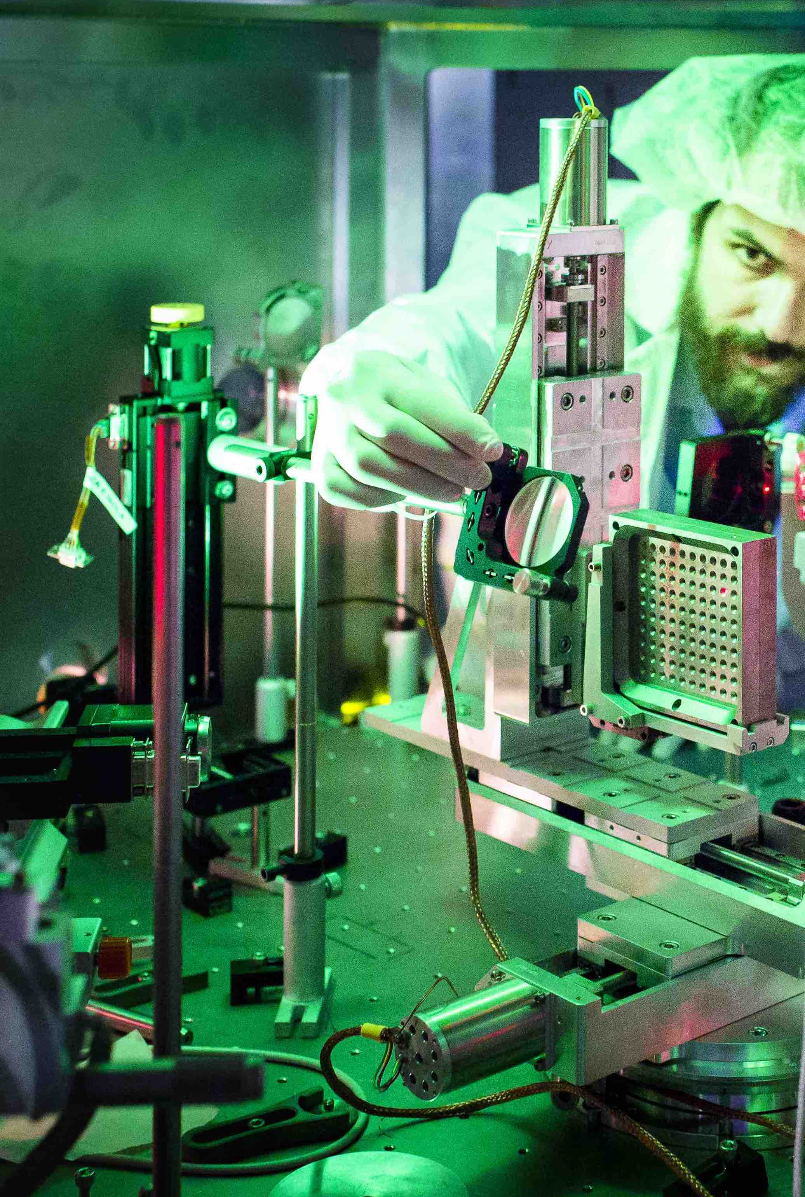
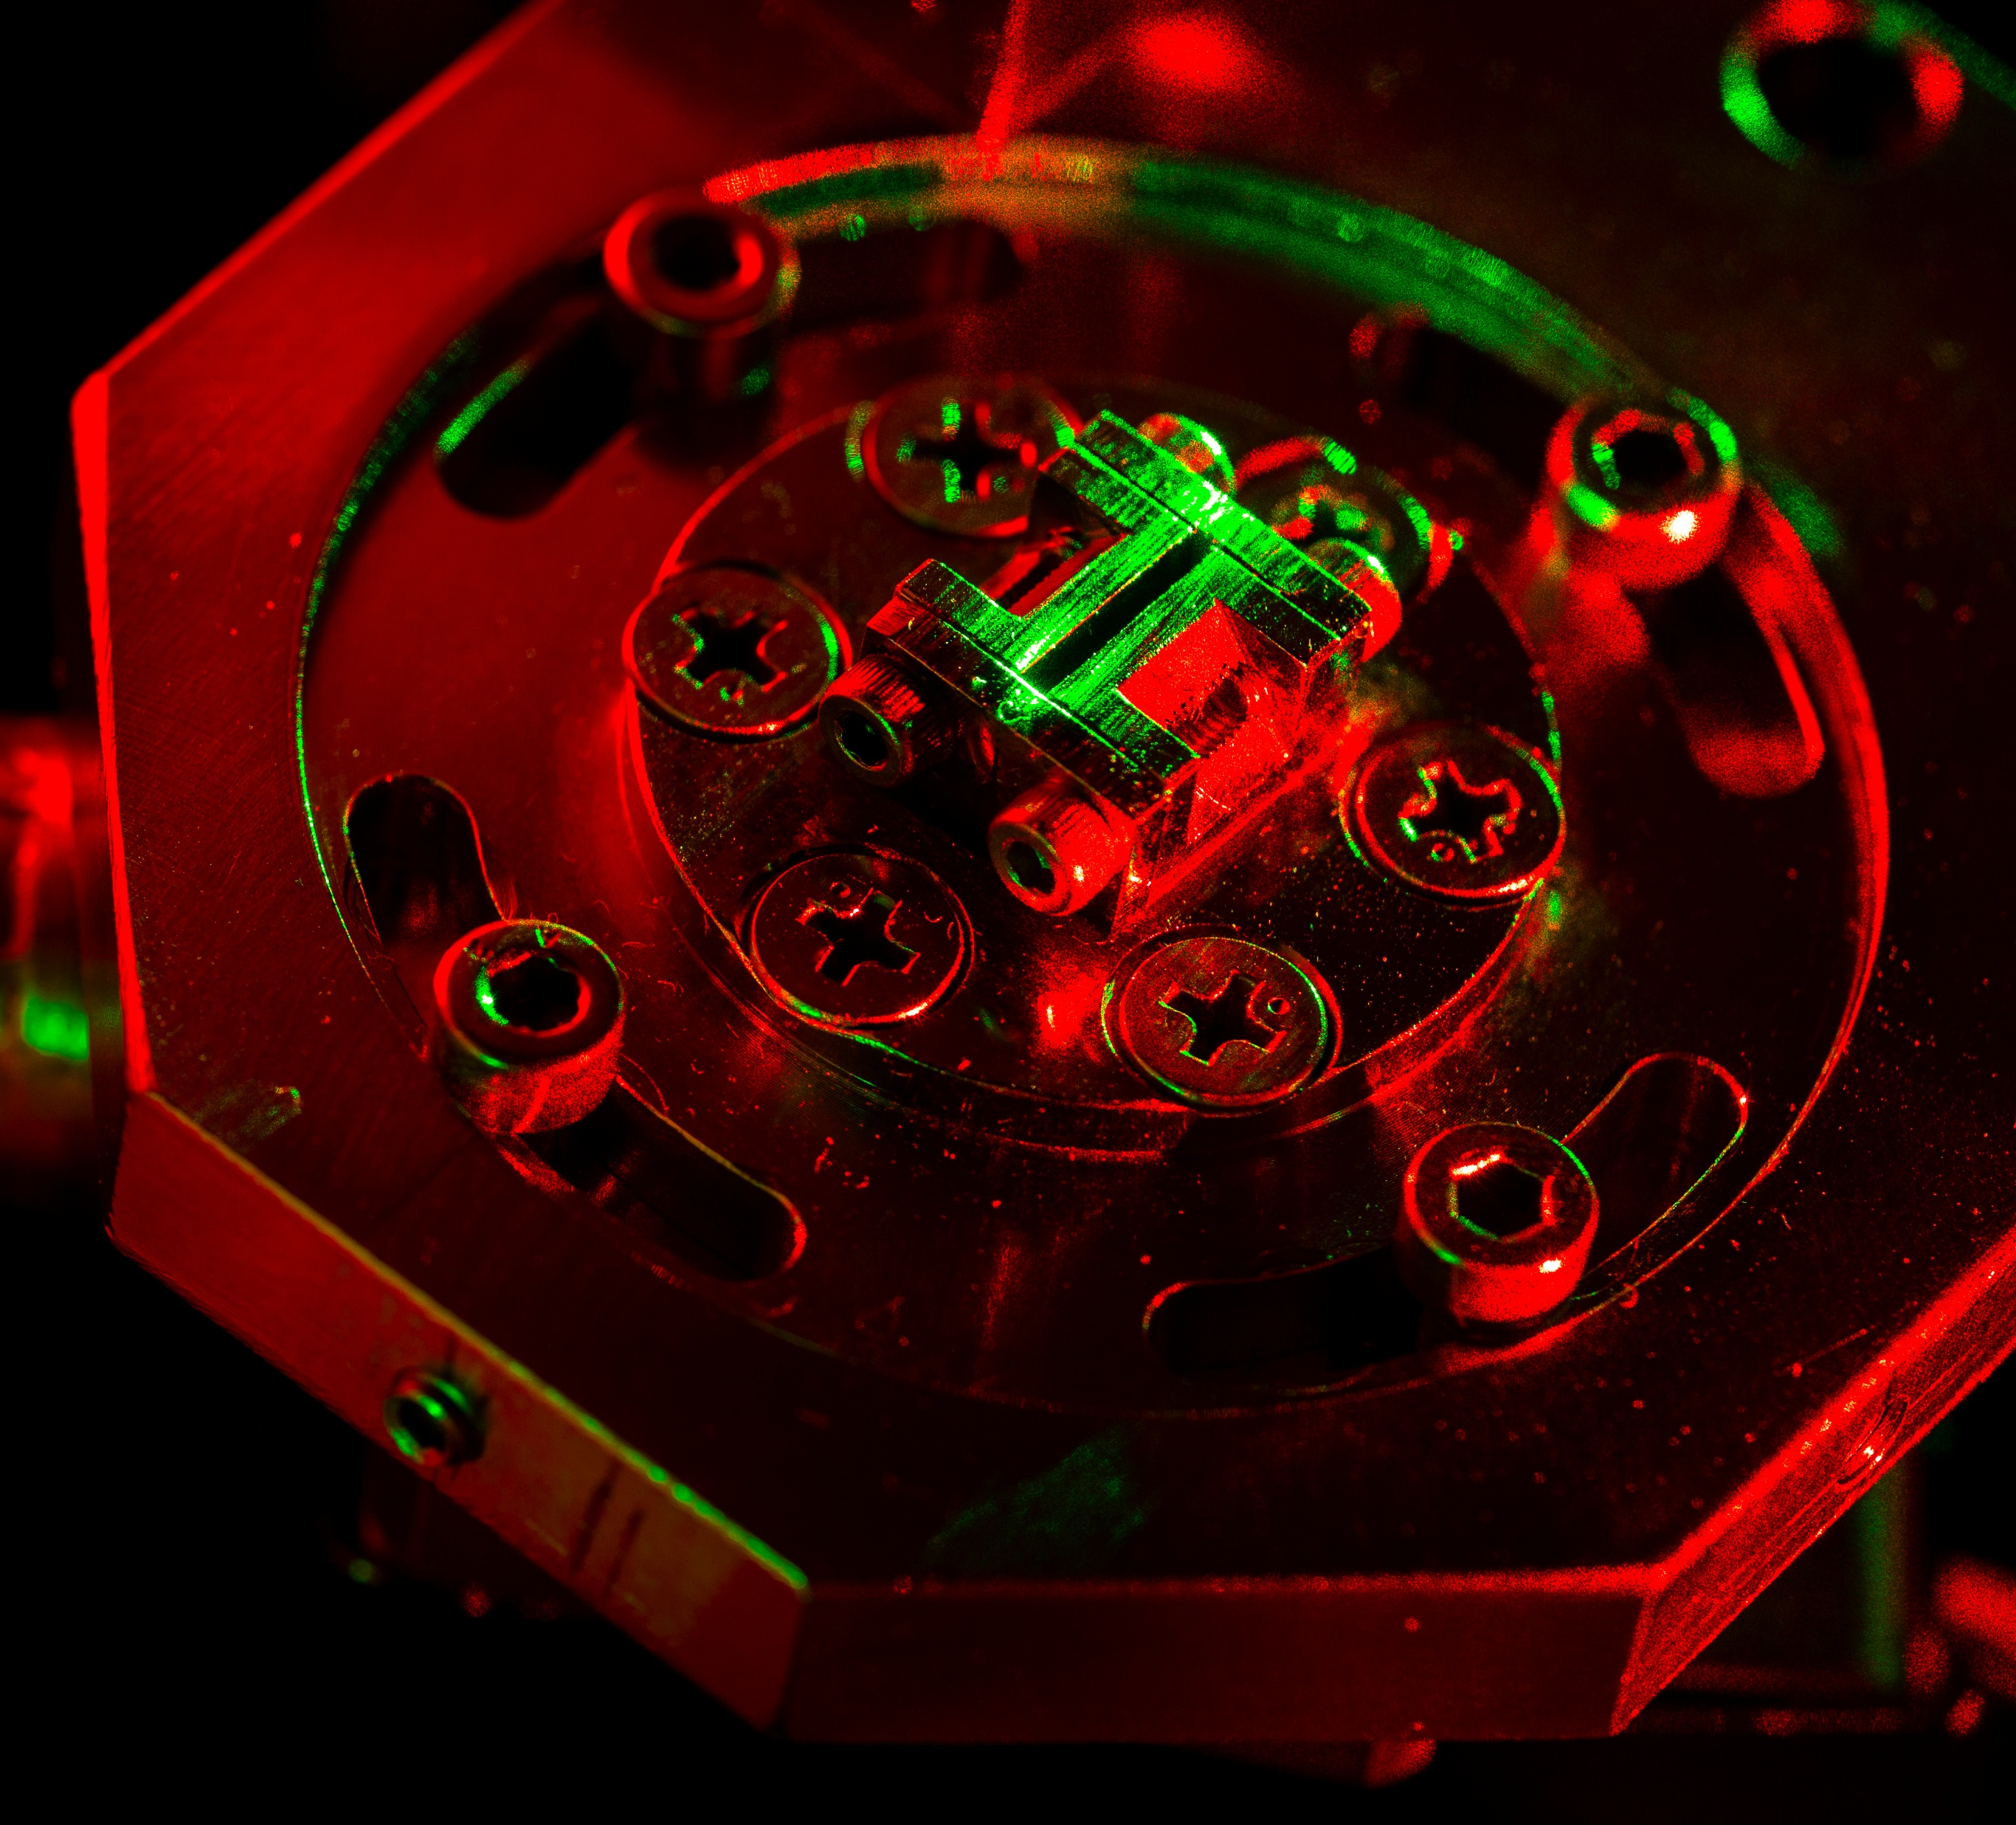
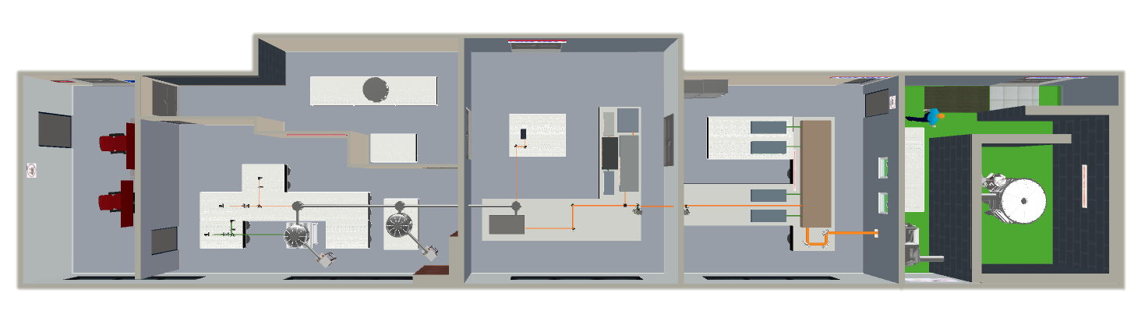
The ILIL Group
PEOPLE
Leonida A. GIZZI (Head)
Fernando BRANDI
Gabriele CRISTOFORETTI
Petra KOESTER
Luca LABATE
Federica BAFFIGI
Lorenzo FULGENTINI
Simona PICCININI
Martina SALVADORI
Alessandro FREGOSI
Daniele PALLA
Gabriele BANDINI
Mohamed EZZAT
Federico AVELLA (PhD)
David GREGOCKI (PhD)
Simon VLACHOS (PhD)
https://ilil.ino.cnr.it/it/il-nostro-laser/
ILIL – INTENSE LASER IRRADIATION LABORATORY
Notes:
Among these institutes, it hosts the National Institute of Optics, where the ILIL group is engaged in LPA research, with a particular focus on medical applications.
So, what are the background and motivations driving this research, not only in our laboratory but in many others around the world?

Slide 4
Background and motivation
Background and Motivation for VHEE-RT
Possibility to treat deep-sited tumors
Reduced scattering and degradation due to heterogeneities in tissues
Possibility of focalization via MQPs (reduced input dose, energy filter, beam manipulation)
Good candidates for FLASH-RT
Background and Motivation for VHEE with Laser-plasma (L-VHEE)
Small footprint (Guo, Z., Liu et al. Nat Commun 16, 1895 (2025))
Simple photons transport with mirrors
Stable, continued operation of LWFA accelerator achieved (A. Maier et al., Phys. Rev. X 10, 031039 (2020))
Electric fields of the order of 10s or more GV/m, compact acceleration cavity (Nature “Dream beam 2004”)
Electron bunch with ps-fs duration, ultra-high instantaneous dose rate (>>10⁵ Gy/s) with effects to be investigated (Zhu, H. et al., Mol Med 31, 79 (2025))
Up to 10 GeV electrons demonstrated (A. J. Gonsalves et al., Phys. Rev Lett. 122, 084801 (2019))
L-VHEE (50-250 MeV) dose per pulse up to ≈ Gy per pulse, pencil beam (Svendsen et al., Sci Rep 11, 5844 (2021))
L-VHEE Multi field and Intensity Modulation proof-of-principle (L. Labate et al., Sci Rep 10, 17307 (2020))
Targeted development at major public and private labs (ELI(CZ, RO, HU), KALDERA(DE), EuPRAXIA (EU/IT), EPAC (UK), TAU Systems (USA), LOA (FR)…)
Notes:
There is previous knowledge and strong motivation to explore VHEE for radiotherapy.
First, the ability to irradiate tumors located deep within the human body.
This characteristic, typical of particle therapies such as VHEE and protons, benefits from reduced scattering and energy degradation when crossing tissue heterogeneities.
Furthermore, since these are charged particles, magnetic fields can be used to manipulate the accelerated beams, focusing them on the PTV and thereby reducing entrance dose, but also to filter out unwanted energy components, for instance when dealing with broad energy spectra such those typical from LPA.
They are also excellent candidates for FLASH radiotherapy, with potential to spare healthy tissue, expand the therapeutic window, and reduce treatment duration.
Having established that VHEEs are a valuable tool we should aim to use in radiotherapy, there are also reasons to consider LPAs in this context.
These systems are now compact, including their laser generation and transport setups; delivering the laser to the interaction point is much simpler than transporting electrons or protons.
The stability of laser–plasma acceleration is steadily improving, and the electric fields sustained in plasma enable extremely small accelerating cavities.
The electron beams thus accelerated have durations on the order of pico- or femtoseconds, resulting in extremely high instantaneous dose rates whose biological effects are currently under study.
High energy and dose per pulse values have been demonstrated with this acceleration technique—though in separate works—and these beams are also suitable for multi-field irradiation and intensity-modulated techniques.
All this explains why there is such strong momentum towards the development of these technologies in many laboratories worldwide.
Within this context, I will introduce some works and projects recently involving our group.

Slide 5
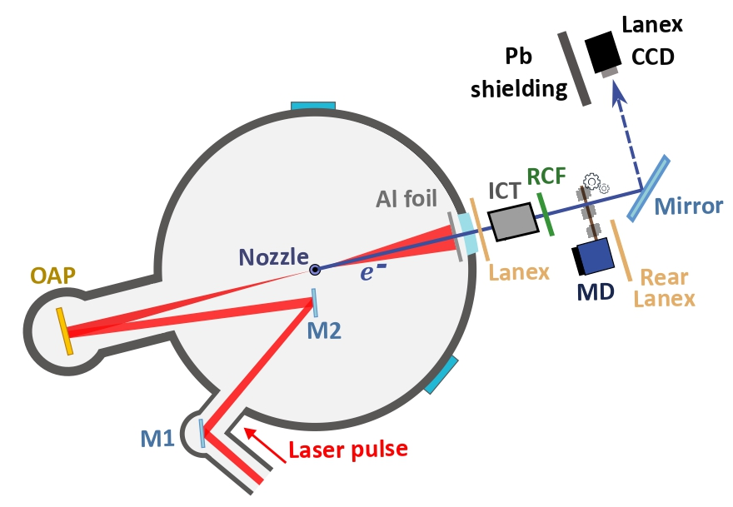
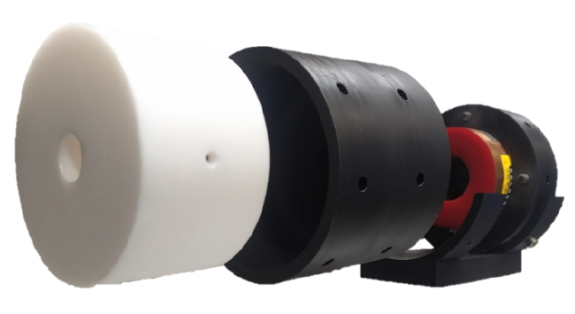
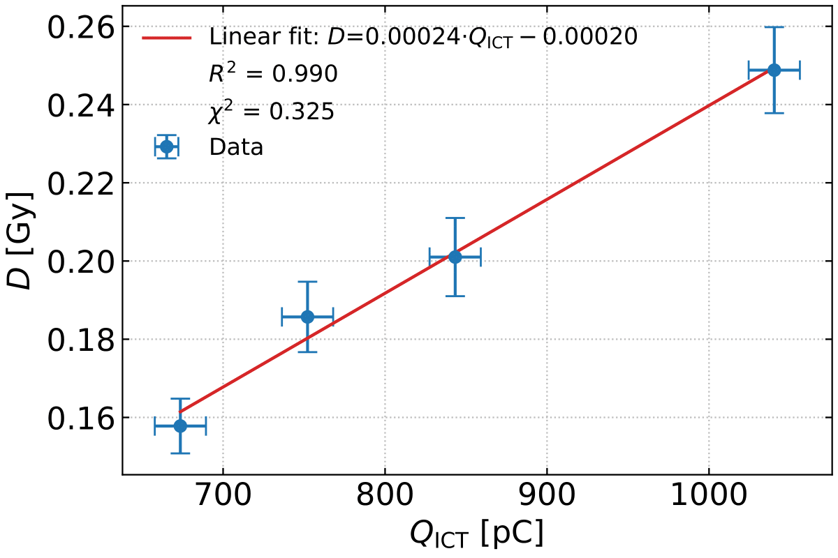
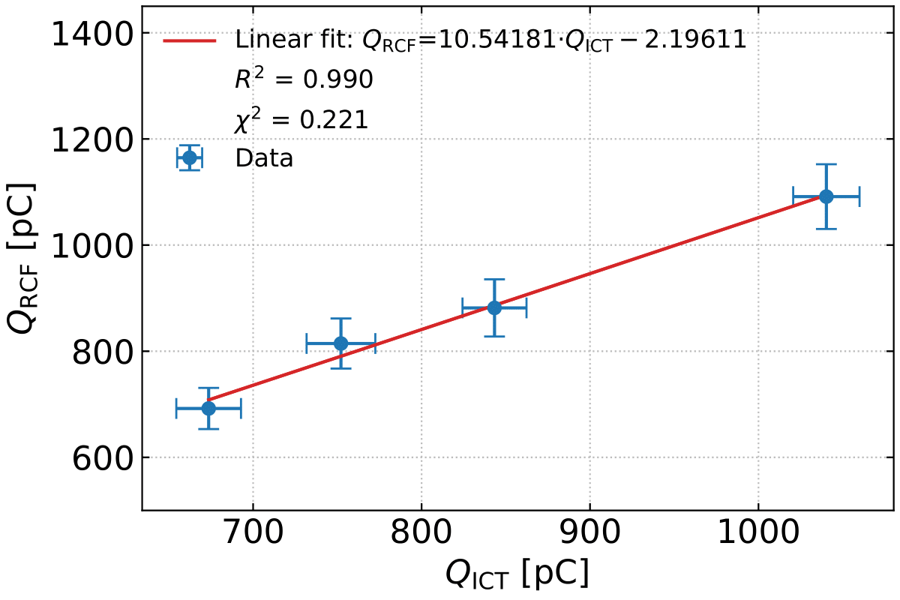
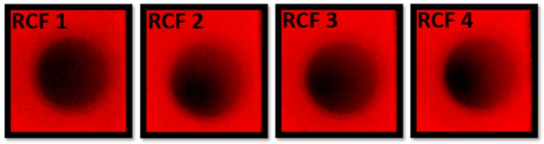
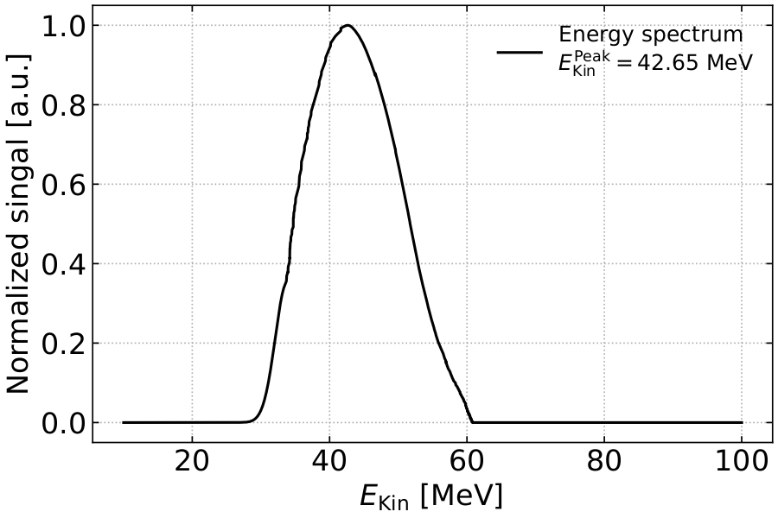

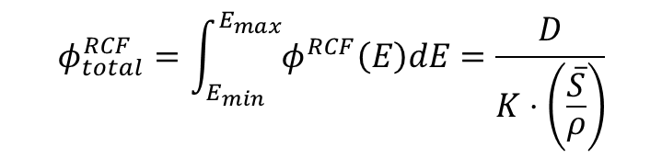
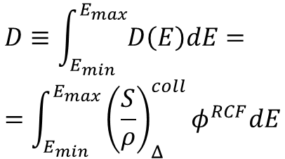
ICT dosimetry
$$D≡\int_{E_{min}}^{E_{max}}{D\left(E\right)dE}==\int_{E_{min}}^{E_{max}}{{\left(\frac{S}{ρ}\right)}_{Δ}^{coll}φ^{RCF}dE}$$
energy-dependent restricted mass collisional stopping power (MeV·cm²·g⁻¹)
electron fluence (cm⁻²)
$$φ_{total}^{RCF}=\int_{E_{min}}^{E_{max}}{φ^{RCF}\left(E\right)dE}=\frac{D}{K⋅\left(\frac{\overline{S}}{ρ}\right)}$$
$$Q_{RCF}=\frac{φ_{total}^{RCF}}{\overline{T}}⋅{\left(\frac{d}{2}\right)}^{2}⋅π⋅e$$
david.gregocki@ino.cnr.it, petra.koester@ino.cnr.it
David Gregocki, Petra Köster et al., “Real-time dose monitoring via non-destructive charge measurement of laser-driven electrons for medical applications”, under submission.
Notes:
First, a study on real-time dosimetry, a crucial aspect for both VHEE and FLASH radiotherapy.
In this work, which is currently under review and it’s from my colleagues and main authors David Gregocki and Petra Koster, an ICT is used to measure the charge of an electron beam and, from this, estimate the dose deposited on an RCF.
At the top you can see the experimental setup: the interaction chamber, the ICT placed just outside the vacuum chamber, and an RCF to measure deposited dose.
There is also a camera for visualizing the beams on Lanex screens and a magnetic dipole inserted for energy spectrum measurements.
Below are images of the four EBT3 RCFs used for dose measurement at different dose levels, and the spectrum measured during the experiment, with a peak energy slightly above 40 MeV.
Even though these energies are somewhat below the VHEE range, the method remains valid.
The idea is that, for deposition in thicknesses smaller than the penetration depth of electrons at a given energy, the dose depends on the restricted mass collisional stopping power and on the electron fluence.
In the first graph on the left, you can see a comparison between the sum of the charges measured over 10 shots per repetition and the dose measured by the RCF placed behind the ICT.
From the dose deposited on the RCF, using the proposed model, the electron fluence can be derived (by applying the weighted average of the restricted mass collisional stopping power over the energy spectrum), and thus the beam charge can be calculated.
A calibration factor can then be obtained, as shown in the graph below, to correlate the charge read by the ICT to the deposited dose, yielding a real-time dose monitoring system.

Slide 6
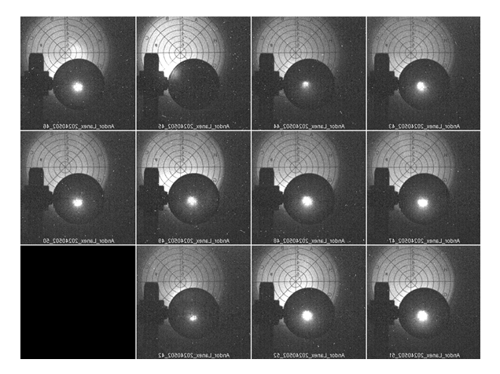

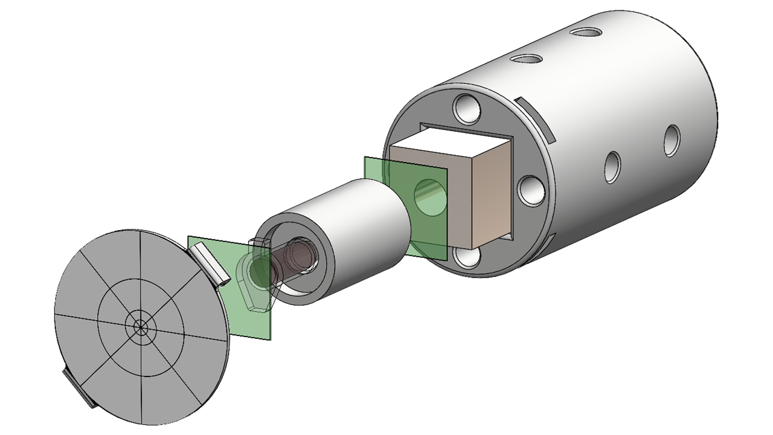
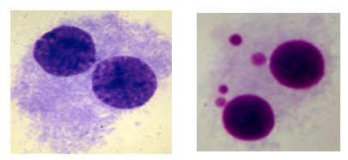
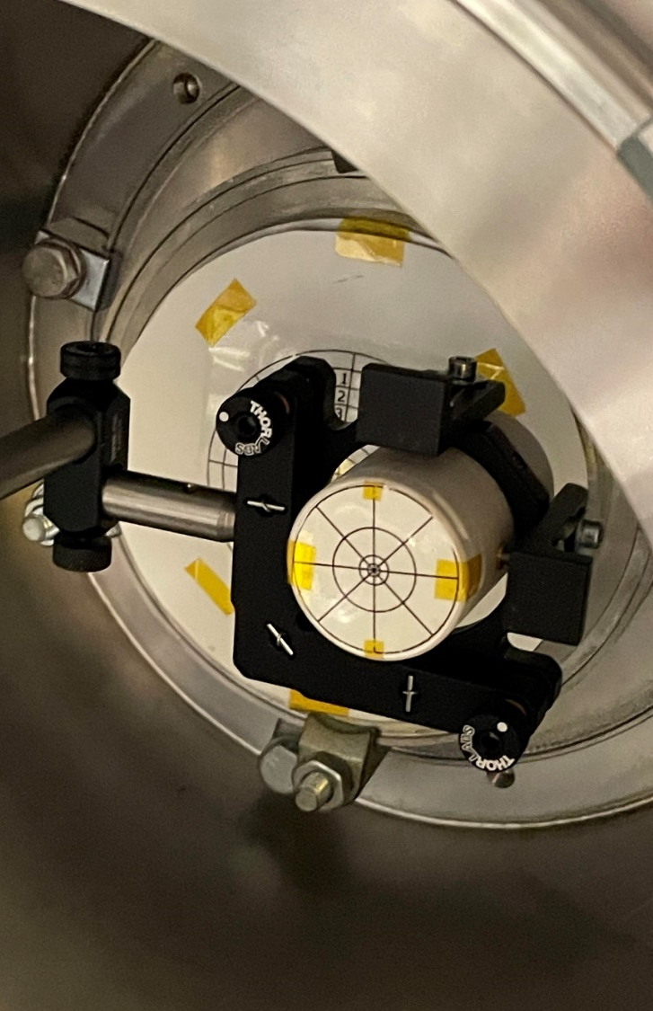
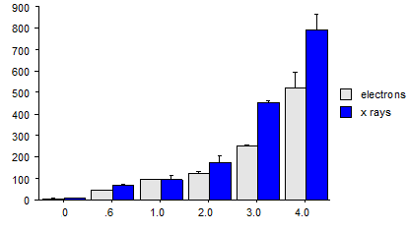
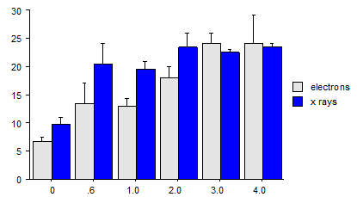
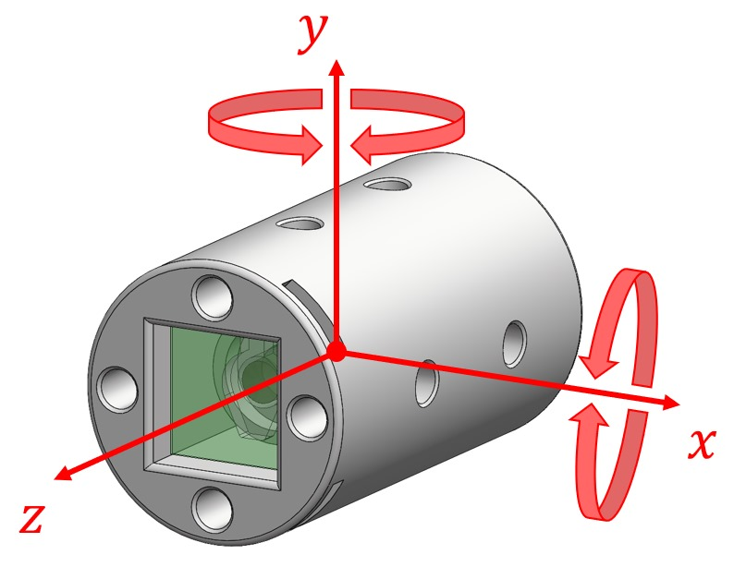
Radiobiology
Micronucleus assay
PRELIMINARY RESULTS
Eppendorf tube
RCFs
e⁻ beam
Lanex target for sample irradiation control
Teflon
adapter
Targeted effect
Bystander effect
yaw
PRELIMINARY
MN total /1000 BN cells
MN total /1000 BN cells
Side view
pitch
Our preliminary findings indicate a radiation dose-response relationship, characterized by telomere shortening and increased chromosomal damage in both targeted and bystander effects. Comparison between VHEE (~75 MeV) and 100 keV photons suggests less damage from VHEE on healthy cells at the same dose administered.
3D printed sample holder with 0.5 ml Eppendorf vial adapter
3 motorized orthogonal translational + 2 angular movements
Nozzle tip
He-N₂ mixture
Notes:
Recently, we also carried out radiobiology experiments, in particular irradiating blood samples.
For the irradiation, a 3D-printed setup was built to host optional collimators, the Teflon adapter with the Eppendorf vial containing the blood sample, RCFs placed in front of and behind the vial to measure deposited dose, and a cap with a Lanex screen target to check alignment of the electron beam with the setup.
To optimize alignment, the structure was mounted with three orthogonal motorized translations and was designed to be inserted into a kinetic mirror mount and aligned with the beam direction.
Here you can see the setup and images from the camera recording several repetitions on the sample under irradiation.
The tests performed on the samples included micronucleus assay and telomere length measurements.
Our preliminary results indicate a dose–response relationship to radiation, characterized by telomere shortening and increased chromosomal damage, both in targeted and bystander effects.
The comparison between VHEE (~75 MeV) and 100 keV photons, now under validation, suggests lower damage from VHEE on healthy cells for the same administered dose.

Slide 7
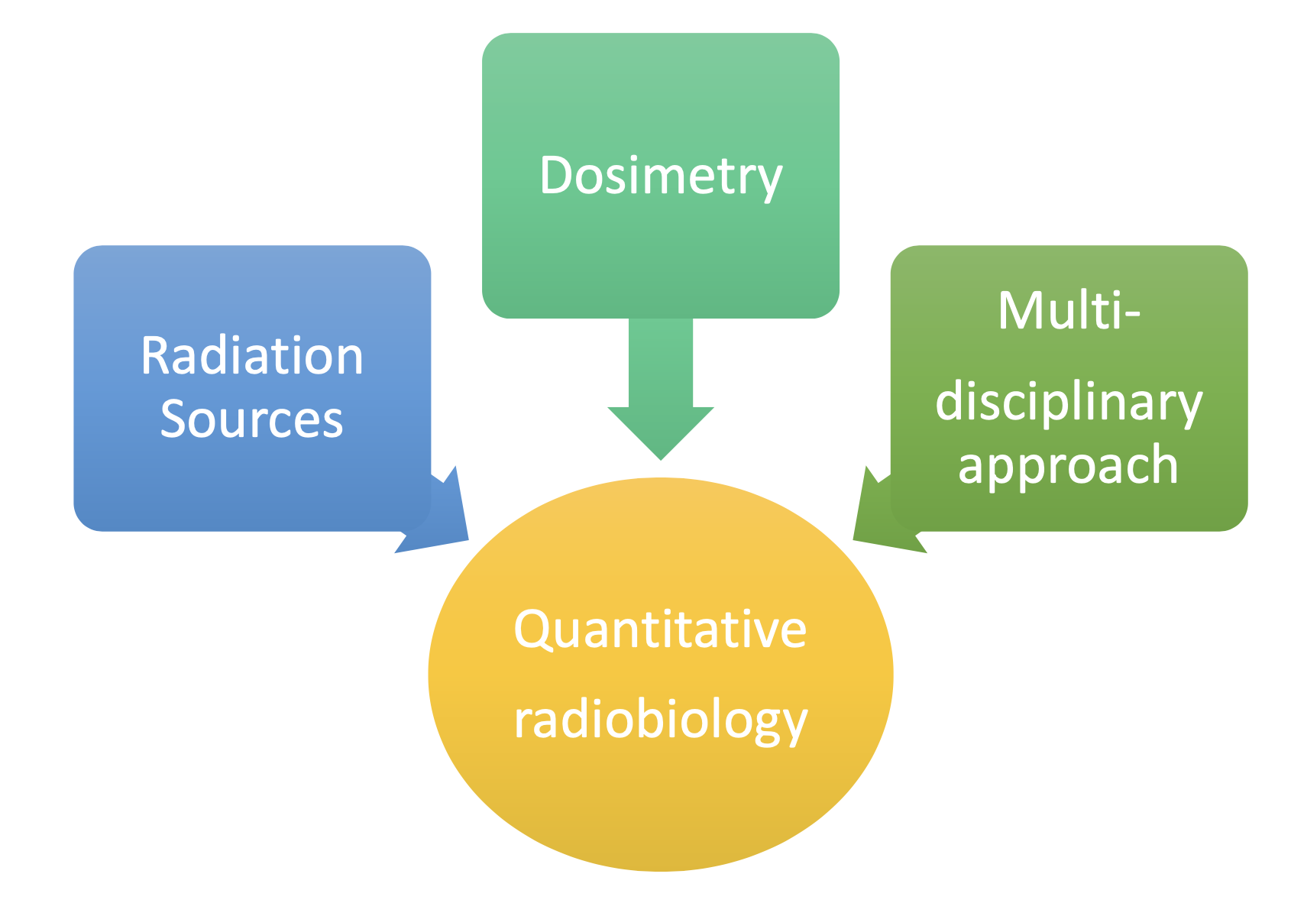
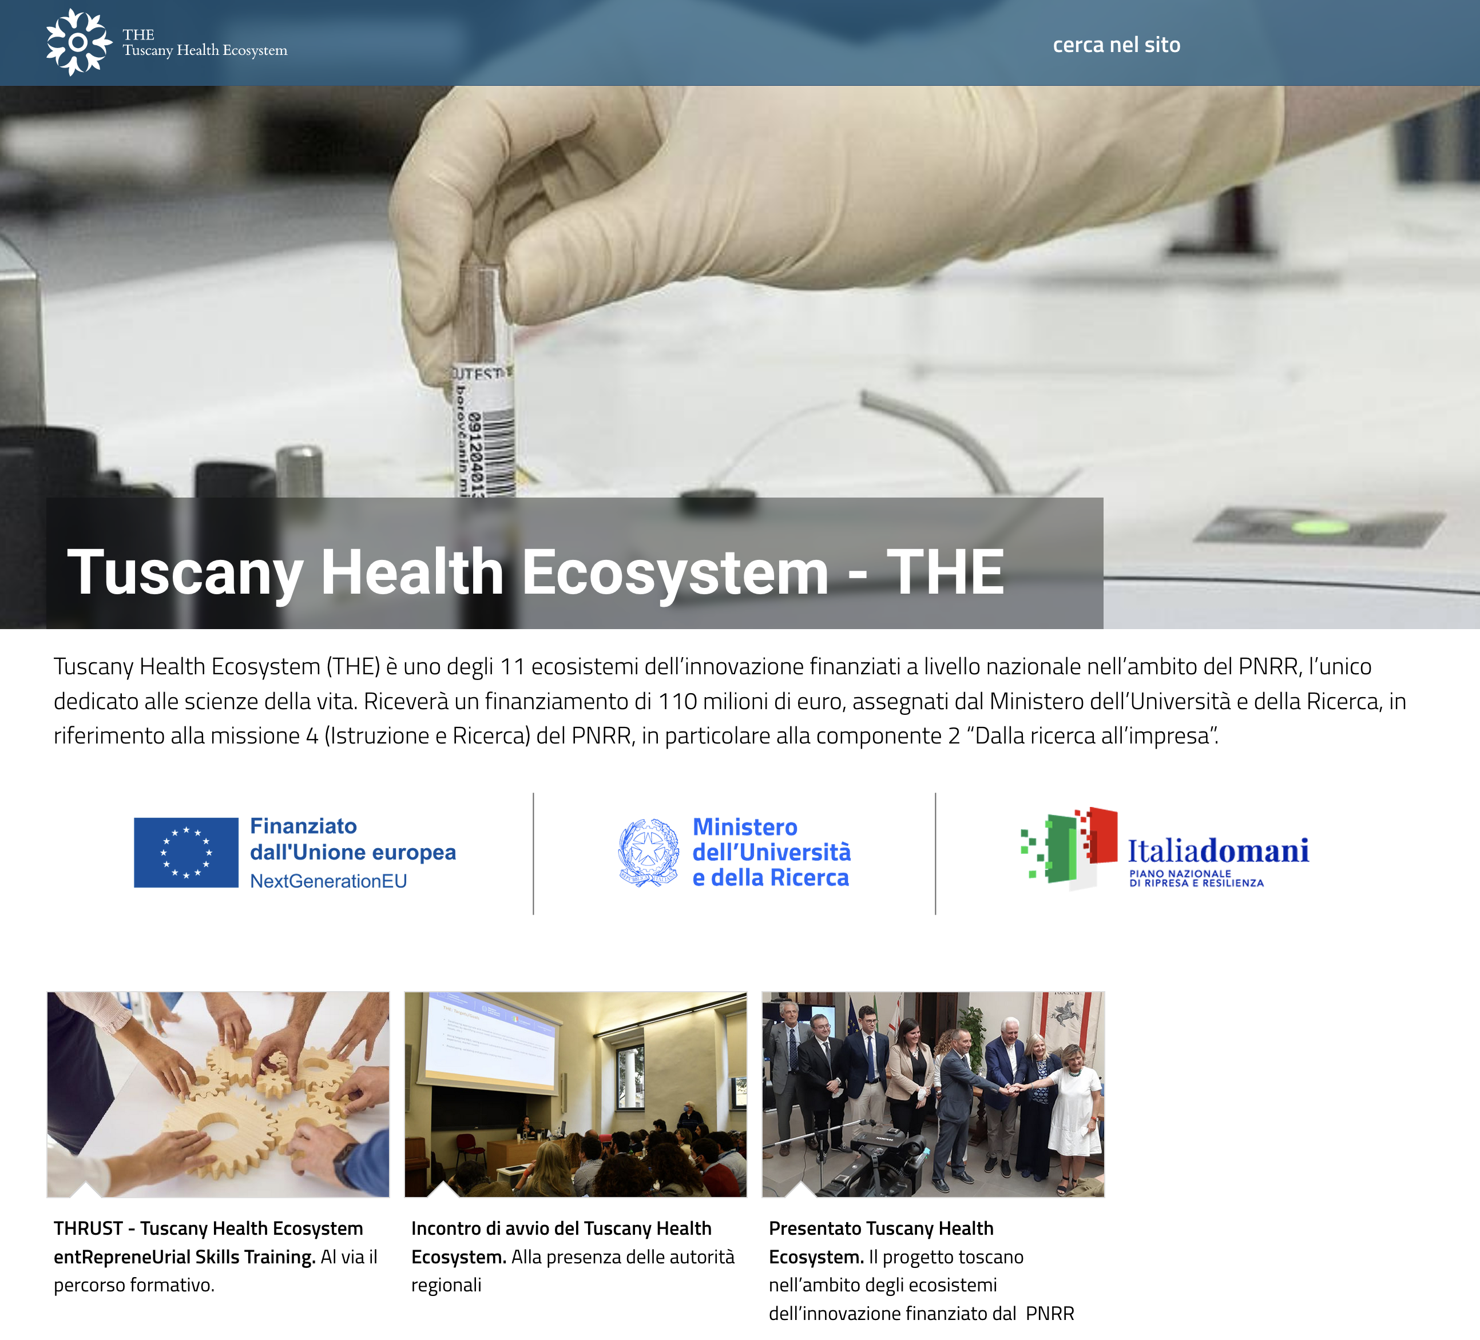
Tuscany Health Ecosystem – THE
In THE: SPOKE1: Advanced Radiotherapies and Diagnostics in Oncology
THE is a funded (110 M€, 2023-2026) innovation ecosystems under the PNRR, fully dedicated to life sciences.
Led by:
With:
Coordinated by:
New accelerator technology for FLASH
New radiobiological effects
New technology for high dose-rate dosimetry
New radiotracers development
Advanced diagnostic approaches
Novel dose deposition control techniques
Synthesis of new radiopharmaceuticals
From radiobiology to clinical application
Preclinical to clinical translation
75 research and tech. STAFF
30 research, techn. and PhD hired
+ 7,6 M€ dedicated budget
http://www.pi.ino.cnr.it/sites/the/
Notes:
One project instead which is worth mentioning in this context is the Tuscany Health Ecosystem, THE, which is going to end in its actual form this year.
THE is a regional initiative with the mission of transforming cutting-edge research in Tuscany into real applications, new enterprises, and innovative technologies for health and well-being.
Funded by the PNRR and NextGenerationEU, it is the only Italian innovation ecosystem entirely dedicated to life sciences.
It brings together all Tuscan universities, research institutes, and many private companies, creating a regional hub to foster innovation and entrepreneurship.
The research, organized into “Spokes”, ranges from diagnostics to therapies, from robotics to nanotechnologies and digital health.
Spoke 1, “Advanced Radiotherapies and Diagnostics in Oncology”, is coordinated by INO, and it is divided into 8 work packages.
The topics of this work packages includes research in areas such as new accelerator technology for FLASH radiotherapy, study of radiobiological effects, technology for high dose-rate dosimetry, which is a very important topic in FLASH-RT, new radiotracers development, advanced diagnostic approaches, novel dose deposition control techniques, synthesis of new radiopharmaceuticals, opening then a path from radiobiology to clinical application.
All this is at the basis and justifies the commitment made to the upgrade of the beamline at the ILIL laboratories.

Slide 8






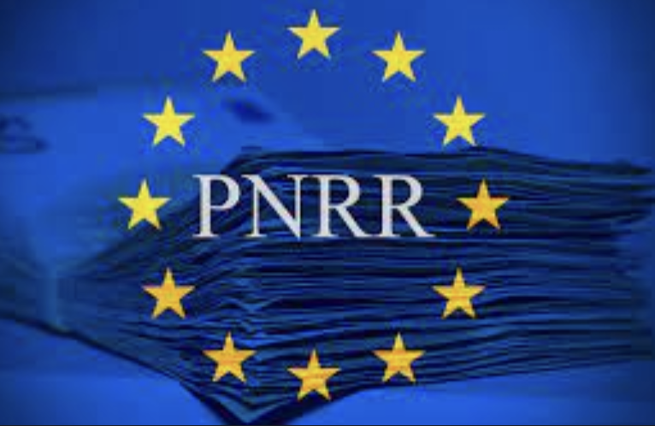
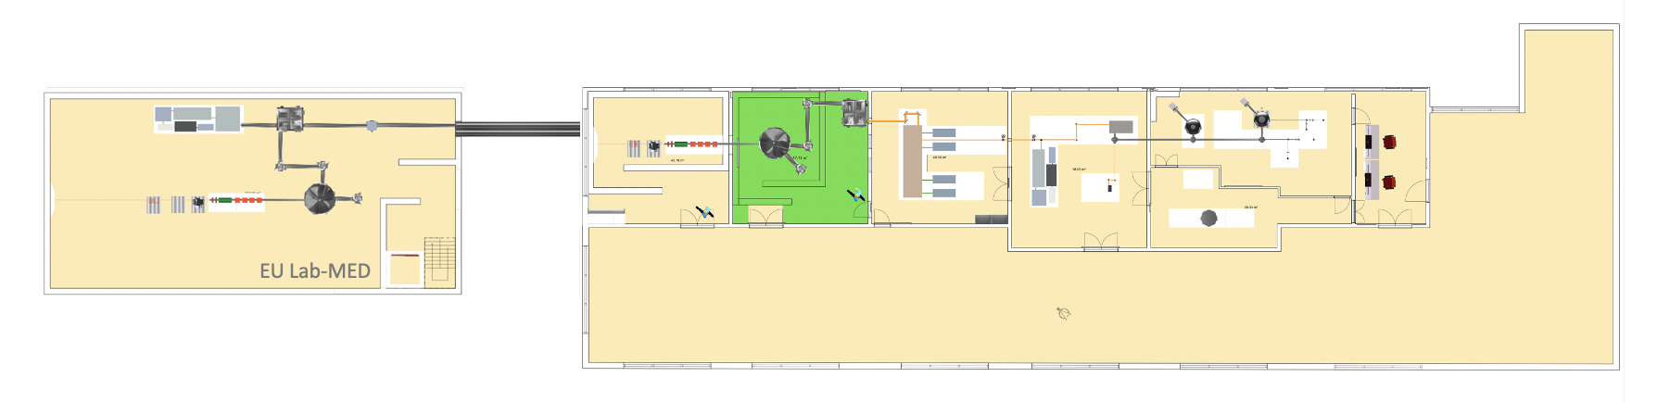
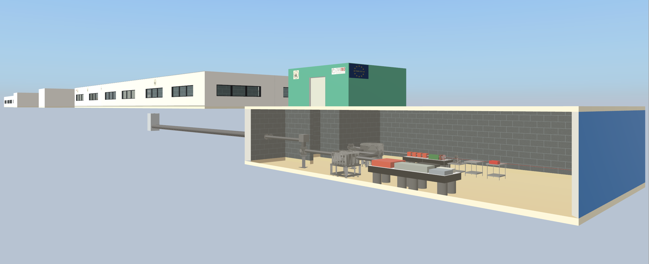

Facility Upgrades
USER
CONTROL ROOM
BEAMLINE for
PRE-CLINICAL
STUDIES
SHIELDED TARGET AREA for PARTICLE ACCELERATION
POWER AMPLIFIER
Up to 220 TW
LASER FRONT END
10 TW, 10 Hz
DIAGNOSTICS DEV. LAB
NEW: planned underground bunker – 1 J, 100 Hz operation
Operating 220 TW Facility
UPGRADE OF ILIL FACILITY FOR:
Upgrade of existing laser system (220 TW) for enhanced stability and control;
New laser systems for high repetition rate operation (100 Hz – 1 J):
High average power compressor
High average power transport to target
High repetition rate target
High repetition rate data collection
New Infrastructure development, including underground bunker for user access to beamlines;
Upgrades funded and in progress – completion expected by 2026.
Notes:
At the top right we see the current infrastructure, characterized by a 10 Hz front-end and a multipass final amplification stage at 1 Hz up to 220 TW.
This is the system currently used for laser–plasma interaction, which takes place in the shielded target area highlighted in green.
At present, the beamline stops there.
The upgrade will first introduce a new 100 Hz front-end, with improved stability and control, both in terms of pointing and energy.
We hope that this upgrade will already lead to improved quality and stability in the accelerated electron beam characteristics.
After that, a brand-new laser system will be set into operation: after the full upgrade of the beamline, it will still be possible to operate the 220 TW, 1 Hz line—up to 7 J before the optical compressor—but it will also be possible to use the laser at 100 Hz and 1 J final output for laser-plasma acceleration.
Of course, this will require a high average power compressor, high average power transport to target, high repetition rate gas target and a data collection system able to sample fast enough.

Slide 9
Facility Upgrades
USER
CONTROL ROOM
BEAMLINE for
PRE-CLINICAL
STUDIES
SHIELDED TARGET AREA for PARTICLE ACCELERATION
POWER AMPLIFIER
Up to 220 TW
LASER FRONT END
10 TW, 10 Hz
DIAGNOSTICS DEV. LAB
NEW: planned underground bunker – 1 J, 100 Hz operation
Operating 220 TW Facility
UPGRADE OF ILIL FACILITY FOR:
Upgrade of existing laser system (220 TW) for enhanced stability and control;
New laser systems for high repetition rate operation (100 Hz – 1 J):
High average power compressor
High average power transport to target
High repetition rate target
High repetition rate data collection
New Infrastructure development, including underground bunker for user access to beamlines;
Upgrades funded and in progress – completion expected by 2026.
Notes:
The acceleration process of this improved beamline will take place into an underground bunker, which will be reached by the laser beam via underground pipes.
All upgrades are funded and in progress.
Work on the front-end upgrade and excavation of the bunker will begin in the coming weeks, and most of the system is expected to be completed by 2026.

Slide 10
SUMMARY
Ongoing research is giving strong boost to the use of laser-plasma accelerators for VHEE radiotherapy, with improvements on stability, reliability, dose rate, dosimetry, beam manipulation.
FLASH modality relies on high repetition rate (≥ 100 Hz). Laser and plasma technologies are available, and we at ILIL are fully committed to the VHEE radiotherapy development programme with laser-plasma accelerators.
Notes:
So, to conclude, the research is giving a strong boost to the use of laser-plasma accelerators for VHEE radiotherapy, pushed also by constant improvements in stability, both as pointing and beam characteristics, reliability, dose per pulse and beam manipulation possibilities.
To enable the use of FLASH radiotherapy the increase of the repetition rate is a key factor, at least up to 100 Hz.
Laser and plasma technologies for such purpose are available, and our lab is committed to the VHEE radiotherapy development programme with laser-plasma accelerators.

Slide 11

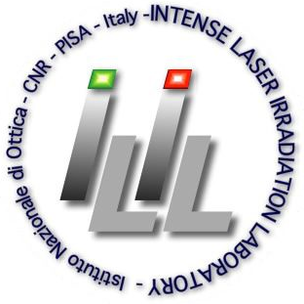
Progress Towards 100 Hz Operation of the VHEE Beamline at ILIL
Gabriele Bandini, PhD
gabriele.bandini@ino.cnr.it
15 – 17 set 2025
STFC, Daresbury Laboratory
Notes:
Thanks for the attention!

