Slide 1



Recent progress on laser-driven Very High Energy Electron radiotherapy
Zhiyuan Guo¹, Bing Zhou¹, Shuang Liu², Bo Guo³, Bo Peng⁴,
Chuanke Li⁴, Jianfei Hua¹, Yang Wan⁴ and Wei Lu^{1,2,3}
^{1. Tsinghua University}
2. Institute of High Energy Physics Chinese Academy of Sciences
3. Beijing Academy of Quantum Information Sciences
^{4. Zhengzhou University}
BAQIS
北京量子信息科学研究院
Colloquia at the International Workshop on Very High Energy Electron Radiotherapy (VHEE’25), Daresbury, UK, September 16 (2025)
Notes:
Good afternoon, everyone. I’m Zhiyuan Guo, representing the collaboration between Tsinghua University, Institute of High Energy Physics Chinese Academy of Sciences， Beijing Academy of Quantum Information Sciences, and Zhengzhou University. Today, I’ll present our recent progress on laser-driven Very High Energy Electron Radiotherapy. Let’s explore how this technology could transform radiotherapy.

Slide 2
Outline
A brief introduction
Recent progress in LWFA-VHEE RT
Main difficulties in clinical translation
Progress in China
Conclusion & Perspectives
Colloquia at the International Workshop on Very High Energy Electron Radiotherapy (VHEE’25), Daresbury, UK, September 16 (2025)
Notes:
My talk has the following key sections:
A brief introduction to VHEE-RT and laser wakefield acceleration;
Recent breakthroughs in laser wakefield acceleration for radiotherapy;
Critical challenges in clinical translation;
Progress from Chinese institutions, including preclinical results.
Finally I’ll conclude with future perspectives.

Slide 3
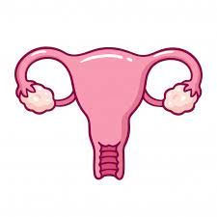

A brief introduction
11,7%
Breast cancer:
2 261 419 new cases
11,4%
Lung cancer:
2 206 771 new cases
46%
Other cancers:
8 879 843 new cases
10%
Colorectal cancer:
1 931 590 new cases
Total
New cases: 19,3 M
Deaths: 10 M
3,1%
Cervix uteri cancer:
604 127 new cases
7,3%
Prostate cancer:
1 414 259 new cases
4,7%
Liver cancer:
905 677 new cases
5,6%
Stomach cancer:
1 089 103 new cases
Estimated number of new cases in 2020, all cancers, both sexes, all ages*
*World Health Organization: press release No 238 (2020)
Notes:
Cancer remains a global crisis. In 2020 alone, 19.3 million new cases and 10 million deaths were recorded. Breast, lung, and colorectal cancers dominate—but current treatments like X-ray radiotherapy have limitations in precision and healthy tissue sparing. This disadvantage need drives our work on VHEE-RT， which has deeper penetration capacity and potential FLASH effect.

Slide 4
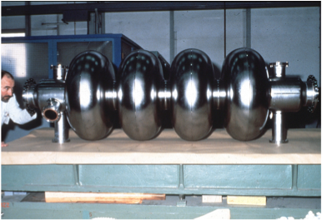
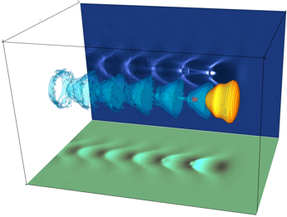
A brief introduction: Linac v.s. Laser acceleration
Linac
Laser Plasma Acceleration
Electric field < 100 MV/m
Electric field > 100 GV/m
1mm => 100 MeV
Accelerating Gradient is limited due to material breakdown
Accelerating Gradient is much higher because a plasma that has already been ionized
V. Malka et al., Science 298, 1596 (2002)
Colloquia at the International Workshop on Very High Energy Electron Radiotherapy (VHEE’25), Daresbury, UK, September 16 (2025)
Notes:
Why lasers? Conventional RF cavities generate electric fields below 100 MV/m, requiring meters-long accelerators. Laser-driven plasma cavities achieve over *100 GV/m*—1,000× stronger fields. As simulated by Pukhov and Malka, this allows VHEE gains in millimeters, not meters.

Slide 5
A brief introduction: Photon v.s. VHEE
100
8 MeV X-rays
50
relative dose deposition
250 MeV electrons
0
0
10
20
30
Depth in tissue (cm)
Due to the build-up effect of X-rays, the depth dose profile (DPP) of X-rays rises rapidly at shallow depths and then decreases exponentially, whereas VHEE exhibits a more uniform distribution. This characteristic allows VHEE to better protect healthy tissues, particularly when treating deep-seated tumors.
Notes:
Depth-dose curves reveal VHEE’s advantage. While 8 MeV X-rays deposit peak dose superficially, 250 MeV electrons penetrate deeper with a more uniform profile. This enables precise targeting of deep-seated tumors while sparing critical organs—a challenge for photons.

Slide 6
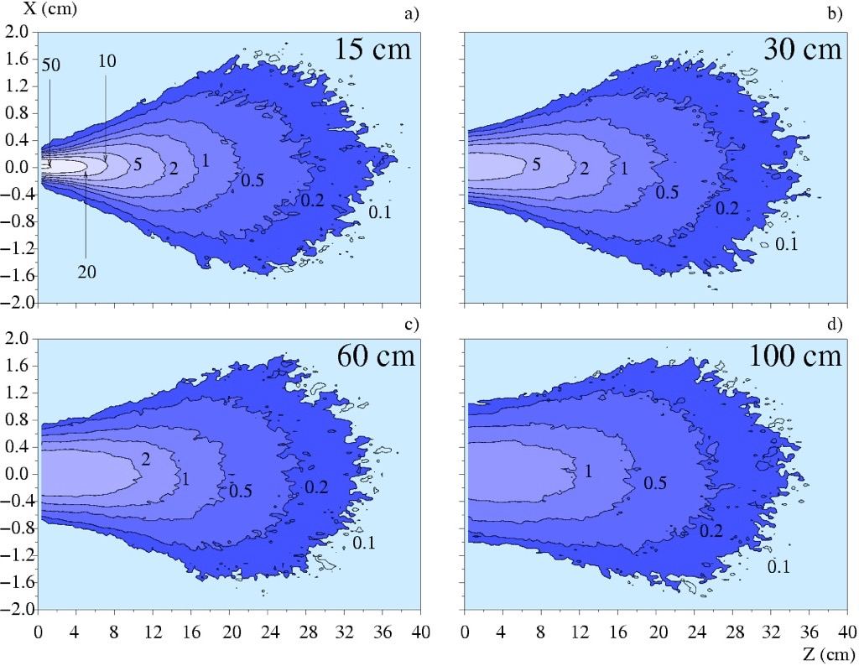
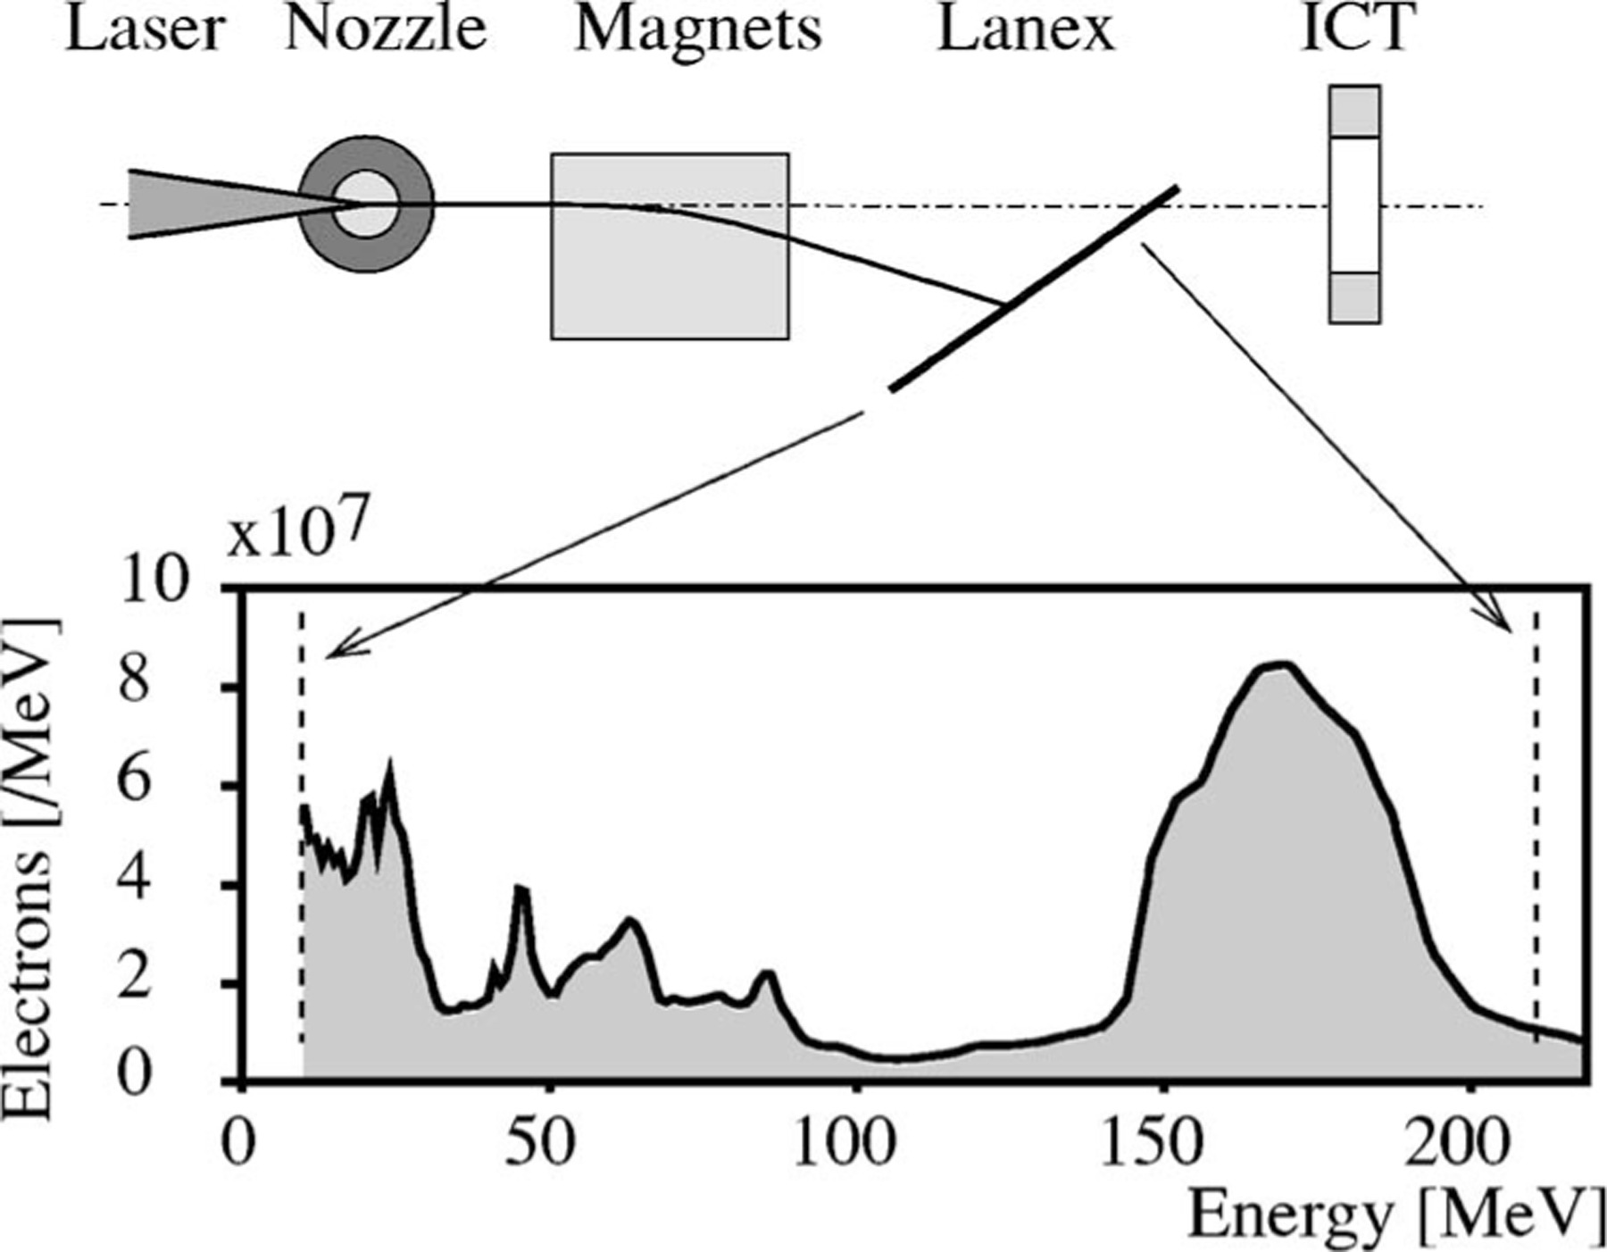
LPA-VHHE dose calculations: a pencil beam
Using magnetic fields to refocus the electron beam inside the water phantom, the transverse penumbra is improved. This electron beam is well suited for delivering a high dose peaked on the propagation axis, a sharp and narrow ranverse penumbra combined with a deep penetration.
Isodose curves for different levels, 0.1, 0.2, 0.5, 1, 2, 5, 10, 20, 50 Gy/nC.
The source to surface distance is a) 15 cm, b) 30 cm, c) 60 cm, d) 100 cm
Y. Glinec et al. Med. Phys. 33, 1, 155-162 (2006)
Notes:
The scientific community pioneered simulation studies on dosimetric properties of laser-accelerated electrons – notably their continuous energy spectrum and point-source nature. These investigations examined dose distributions at varying source-to-surface distances, while simulations of beam transport through quadrupole triplet systems demonstrated dual benefits: filtering out low-energy electrons and achieving satisfying dose distributions，reducing the penumbra significently.

Slide 7
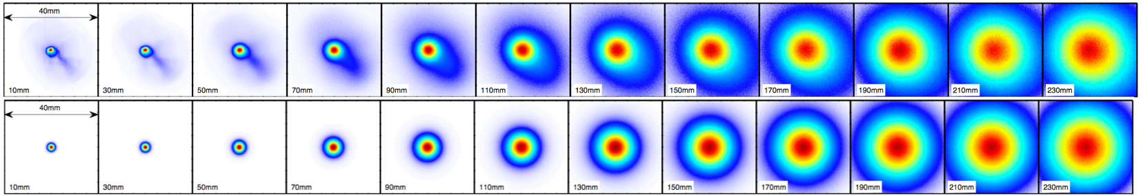
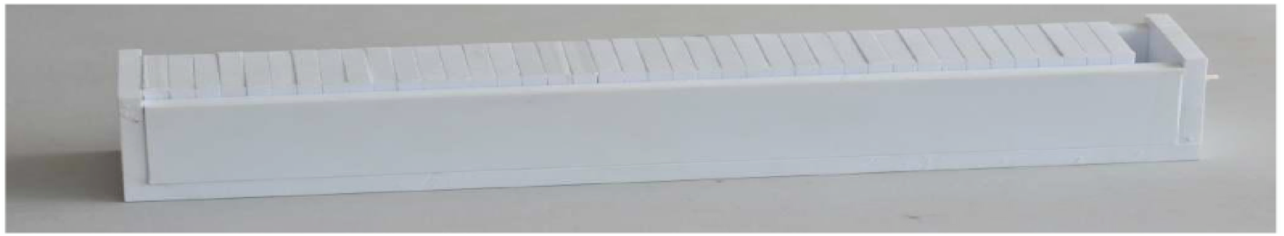
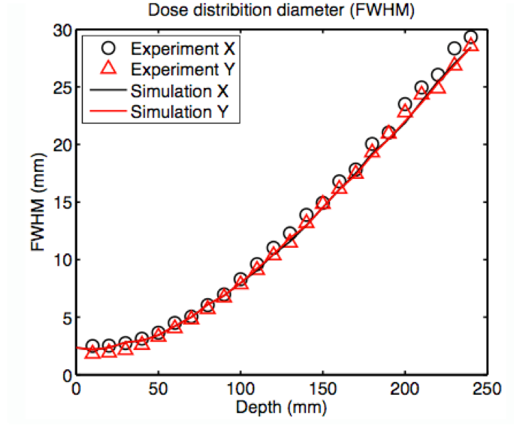
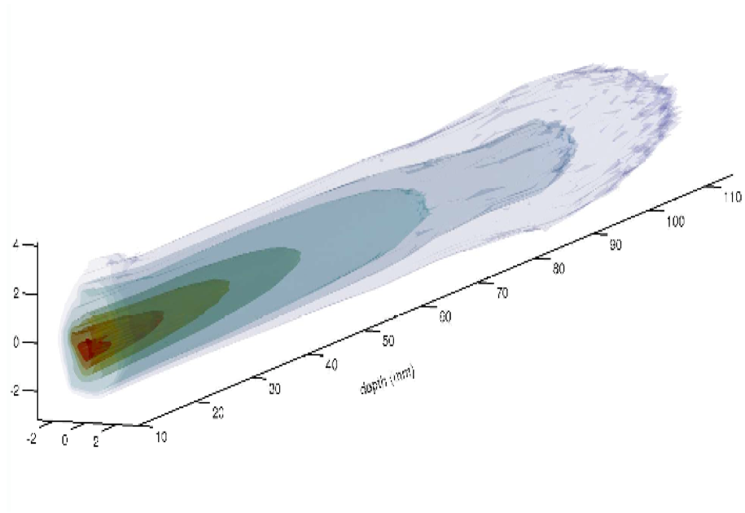
LPA-VHHE dose calculations vs measured result
Epeak=120 MeV
ΔE=20 MeV
Qpeak=30pC
Θ=4.5mrad
Dmax=1Gy/tir
Polystyrene piece (1 cm thick)Fuji Film Detector (40x40 mm²)
Phantom is at 430 mm from the source,
O. Lundh et al., Med. Phys. 39, 6 (2012)
Notes:
The research community has conducted dosimetric studies on an alternative injection scheme. While this approach dramatically reduces electron energy spread, yet causing significant bunch charge reduction. Crucially, simulations and experimental dose measurements show excellent agreement – validating the clinical applicability of this method.

Slide 8
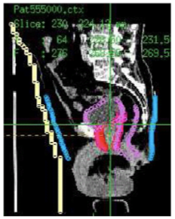
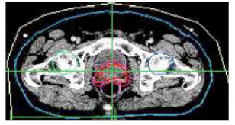
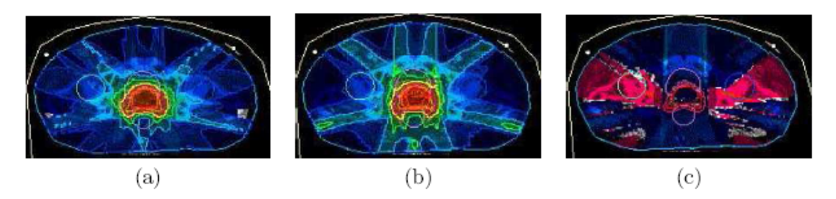
Prostate cancer case
sagittal view
simulations of prostate cancer with 7 irradiation beams
Transversal view
250 MeV electrons
X rays IMRT
Difference
While the target coverage is the same or even slightly better for 250 MeV electrons compared to photons the dose sparing of sensitive structures is improved (up to 19%).
T. Fuchs et al. Phys. Med. Biol. 54, 3315-3328 (2009)
Notes:
scientists using 7-beam VHEE plans for prostate cancer show equivalent target coverage to photon IMRT but reduce doses to healthy structures by up to 19%. This sparing could translate to fewer side effects in therapy.

Slide 9
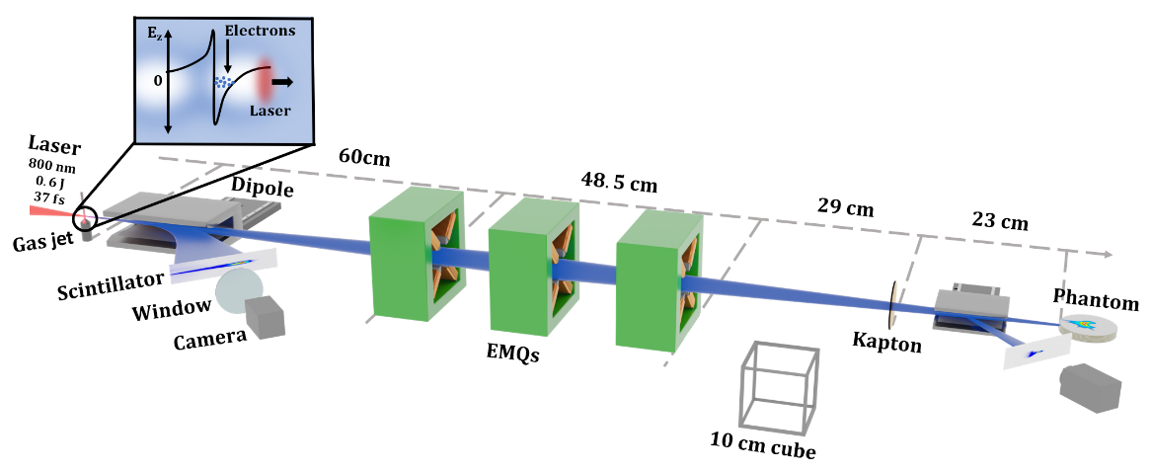
Focused multi-angles VHEE: small intracranial tumor
LLC wakefield accelerator with beam shaping magnets
Focusing the beam at depth
Mitigates lateral spread
Gives more uniform dose
Fluka simulation
EBT3 film stack
Rotation
Focused beam – Multiple irradiation angles – Concave volume
Measurements – 36 angles – 10 pulses/angle
K. Swendson et al., Scientific Reports 11:5844 (2021)
Notes:
Recent work by Swendson confirms clinical viability. Using 36 angles, they delivered 2.72 Gy/fraction

Slide 10
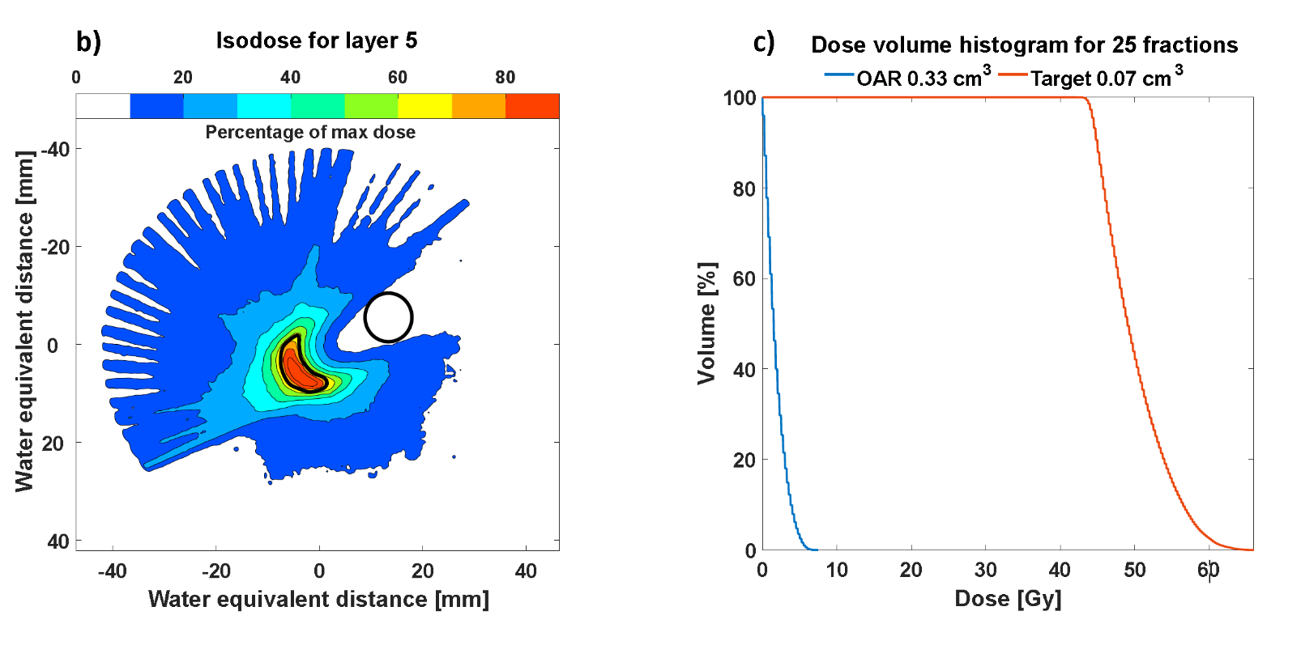

Clinically acceptable focused VHEE-RT
Peak fractional dose delivered was 2.72 Gy which, with a total of 25 fractions, corresponds to a total maximum dose of 65 Gy to the target area while keeping the maximum dose to the OAR below 8 Gy.
Swendson et al., Scientific Reports 11:5844 (2021)
Notes:
as we can see The dose coverage the target while limiting OAR doses to <8 Gy—meeting clinical tolerance criteria.

Slide 11
Main difficulties in clinical translation
Operational Stableness
(From Acceleration to Accelerator)
Preclinical Study
(From cell lines to animal tumor models)
Transport System
(From Prototype to Machine)
Notes:
Three difficulties remain adressing to clinical translation:
Stability: Can lasers operate reliably at clinical demand?
Preclinical Models: Scaling from cells to animal tumors. works need tobe done to assure in vivo effect.
Beam Transport: Designing compact systems to deviler the laser driven VHEE beam.
We have conducted research addressing these key challenges and achieved followed promising progress.

Slide 12
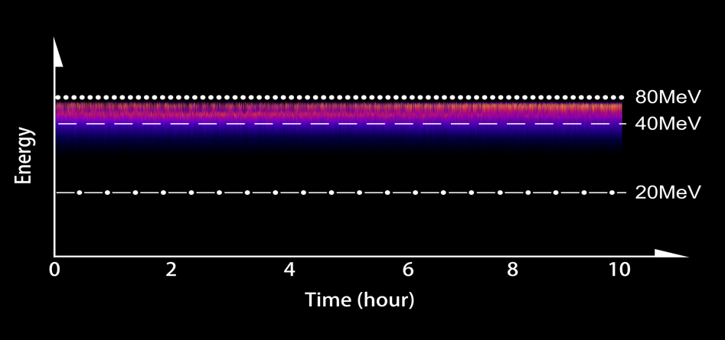
Progress in China: Stableness of the LPA
10 hours stable operation (20TW, 0.3Hz)
Notes:
we achieved *10-hour stable continue operation* at 0.3Hz (left) using self-developed 20 TW laser facility.

Slide 13
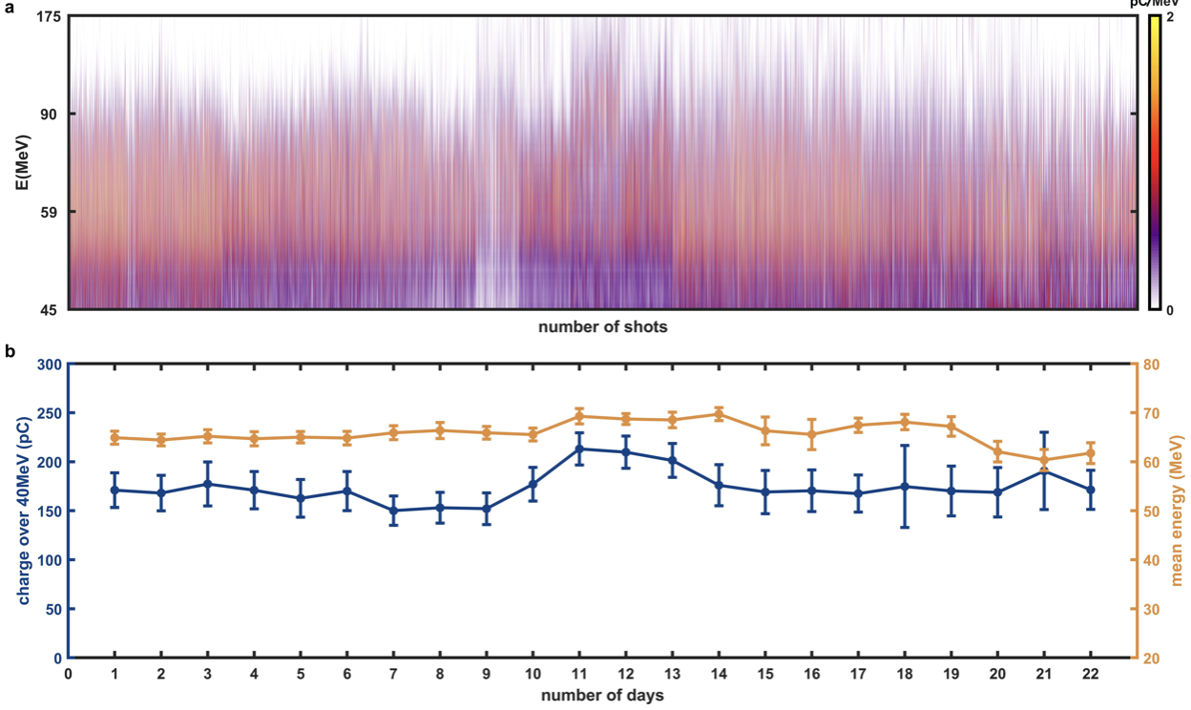
Progress in China: Stableness of the LPA
charge~200pC
average energy~70MeV
one month stable operation (20TW, 1Hz, 2000-3000 shots per day)
Notes:
scaling to 1Hz for a month (right) with 2000–3000 shots/day. Energy spread and charge remain consistent—critical for clinical adoption.

Slide 14
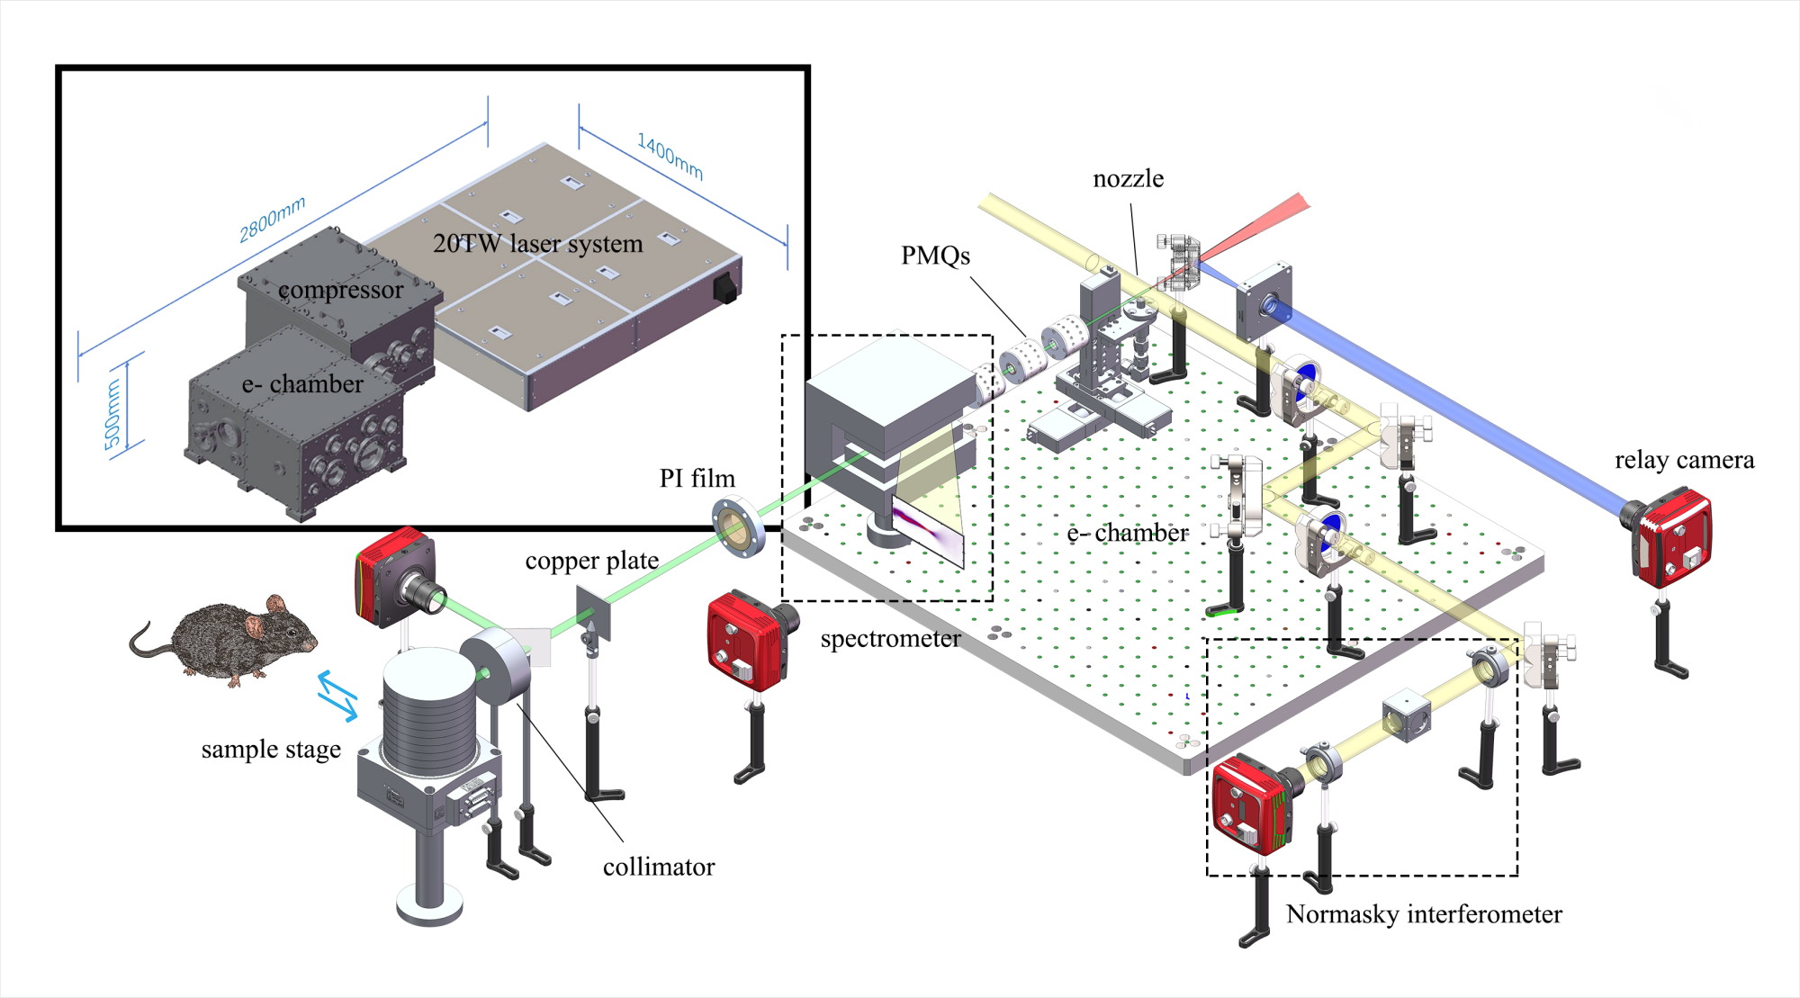
LWFA-VHEE RT prototype
Z. Guo, S. Liu, B. Zhou et al., Nature Comm. 16;1895 (2025)
Notes:
In vivo validation: We started by building a radiotherapy prototype system. By implementing the quadrupole magnet focusing module discussed earlier, we improved beam pointing stability by an order of magnitude. we have conducted dosimetry and in vivo experiment in this prototype.

Slide 15
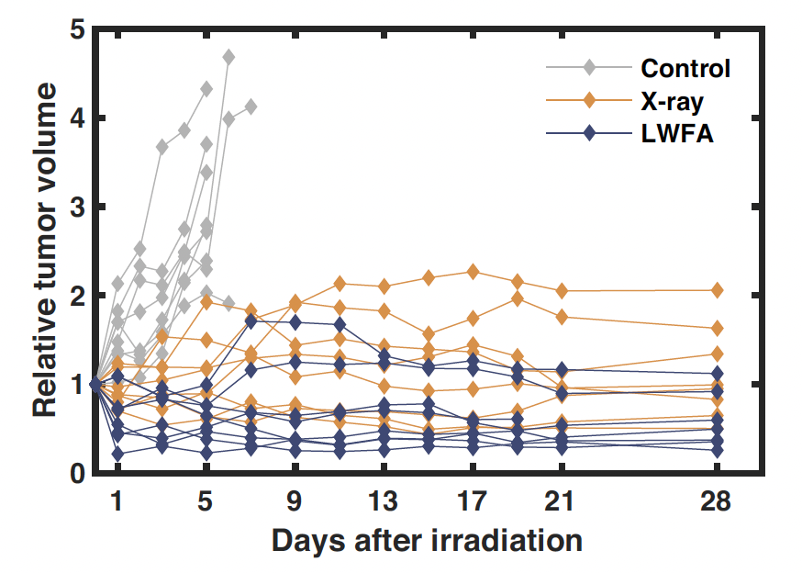
Preclinical Study:
Tumor control in the irradiated mice
The gray line represents the tumor volume changes in the control group mice.
The yellow line represents the tumor volume changes in mice treated with a medical X-ray machine
The blue line represents the tumor volume changes in mice treated with a laser-plasma accelerator.
Z. Guo, S. Liu, B. Zhou et al., Nature Comm. 16;1895 (2025)
Notes:
Mice with implanted tumors received 6 Gy via laser-accelerated electrons (blue) vs. X-rays (yellow). Laser-VHEE controlled tumor growth as effectively as X-rays, proving biological efficacy. The control group (gray) shows rapid progression.

Slide 16
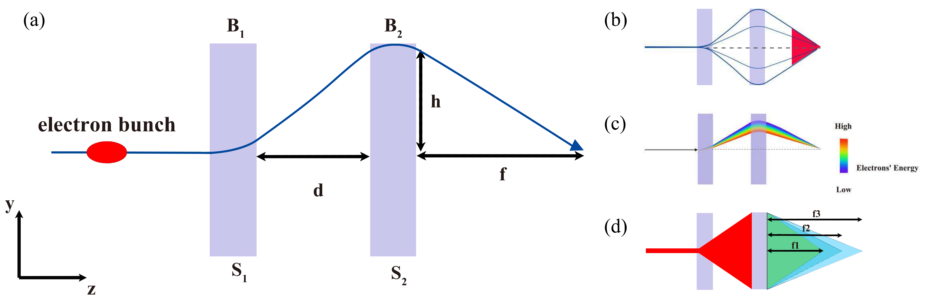
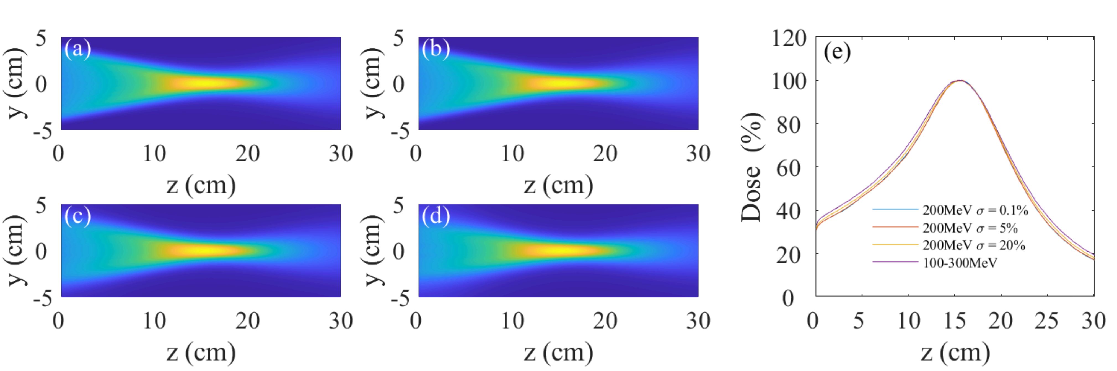
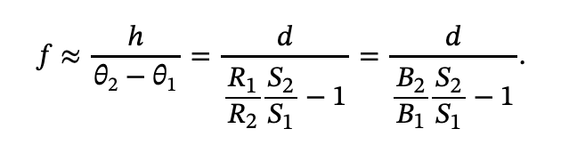
Transport system: compact dose delivery
Focusing via Multiple Beamlets
Adjust Dipole Magnet Strength Ratio to Shift Dose Focus
Essential for LWFA Beam Characteristics (Extremely Large Energy Spread)
B. Zhou et al., https://arxiv.org/abs/2401.01557v2
Notes:
For beam delivery, we developed a compact quadrupole magnet system. By tuning magnet strength ratios, we can easily shift dose focus, lateral and transversial. Additionally this design is essential for handling laser acceleration with large energy spread and divergence.

Slide 17
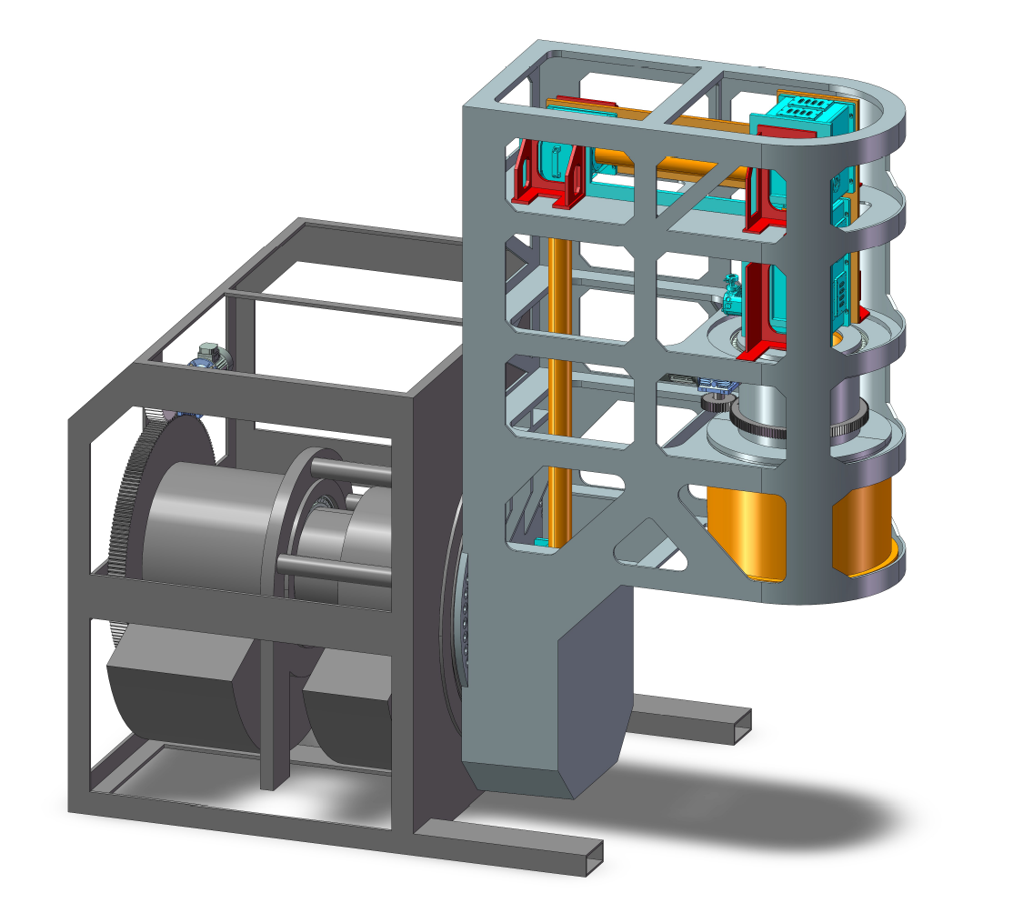
Transport system: machine in design
180 degree rotation
(-90 degree -> +90 degree)
Compact beam transport system (mentioned in last slide)
Notes:
To enable treatment planning with laser-accelerated VHEE beams, we have developed a rotational intensity-modulation therapy system. This compact device is designed for fitting into existing radiotherapy rooms, featuring ±90° gantry rotation and incorporating our in-house compact beam transport magnets – uniquely engineered to handle large-energy-spread electron beams.

Slide 18
Conclusion & Perspectives
Laser acceleration has matured sufficiently over nearly 40 years to meet clinical VHEE radiotherapy requirements.
High-repetition-rate ultrashort ultra-intense lasers: Enabling high dose rates & potential FLASH radiotherapy.
Dose delivery systems require specialized design for laser-accelerated VHEE beams (point-source, large energy spread, high divergence).
Perform further preclinical experiments:
Generate more comprehensive radiation biology data.
Evaluate efficacy in deep-seated tumors using medium-sized animal models.
......
Notes:
In summary:
Laser acceleration is matured enough to meet key requirements for VHEE-RT clinical demand.
High-repetition rate lasers will enable a higher dose rate and even FLASH radiotherapy, reducing treatment times.
Dose delivery systems require specialized design for laser-accelerated VHEE beams (point-source, large energy spread, high divergence).
We has built infrastructure for translational research.
Next steps: Deep-seated tumor trials in larger animals, beamline standardization, and multi-center collaborations. We believe VHEE-RT could enter clinics in the next decade.

Slide 19
Thanks for listening
Prof. Wei Lu: weilu@ihep.ac.cn
Prof. Jianfei Hua: jfhua@tsinghua.edu.cn
Prof. Yang Wan: yangwan23@zzu.edu.cn
BAQIS
北京量子信息科学研究院
Notes:
Thank you! I acknowledge our teams at Tsinghua, BAQIS, IHEP, and Zhengzhou University. Contact us for collaborations. Feel free to discuss if you have any questions

