Slide 1





The I-LUCE laser-based acceleration facility at INFN and its perspectives for electron acceleration in FLASH and VHEE applications
R Catalano, INFN-LNS
GAP Cirrone, S Arjmand, D Oliva, AD Pappalardo, G Petringa, A Sciuto, J Suarez-Vargas
C Altana, A Amato, D Bandieramonte, D Bonanno, A Caruso, G Cuttone, C Manna, GS Mauro, A Miraglia, MS Musumeci, D Rizzo, S Tudisco, F Vinciguerra
International Workshop on Very High Energy Electron Radiotherapy (VHEE 2025)
STFC, Daresbury Laboratory, September 16, 2025

Slide 2
Outline
The upcoming I-LUCE high power laser facility at INFN-LNS
    Laser system characteristics
    Proton/ions and electrons production and acceleration techniques
    Expected beams
    Key features of laser-driven vs conventional VHEE accelerators
    Other applications and concluding remarks

Slide 3
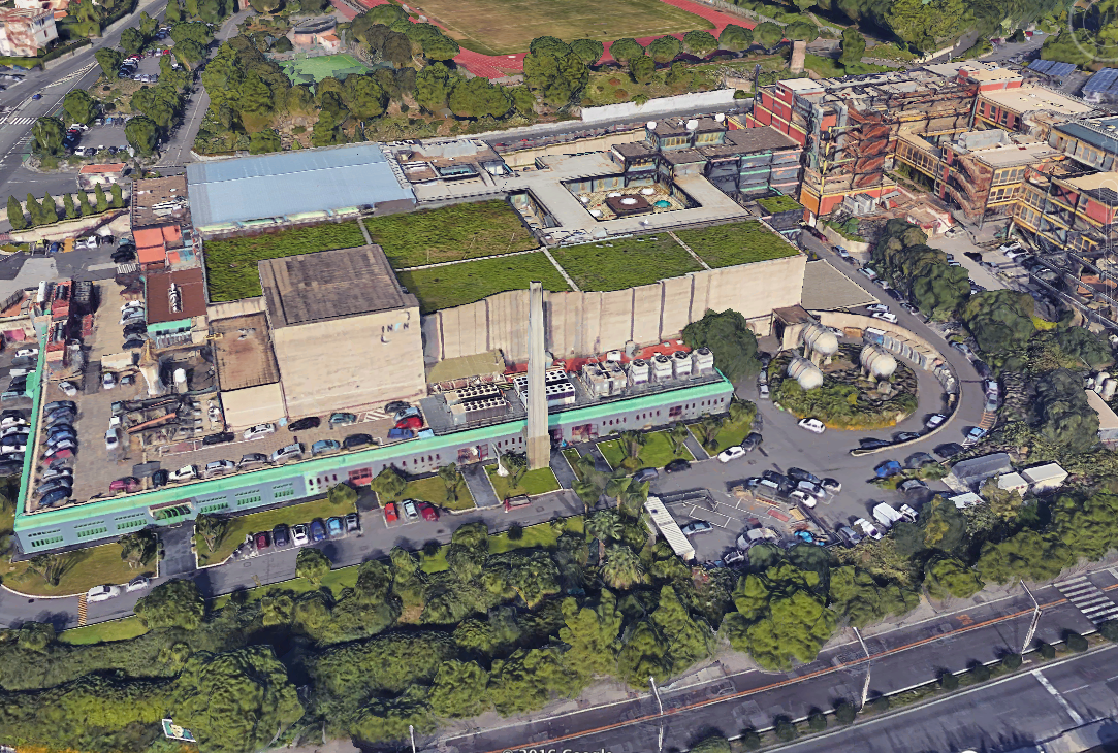
Offices and laboratories
Laser bay
27 AMeV Tandem accelerator
80 AMeV superconducting cyclotron

Slide 4

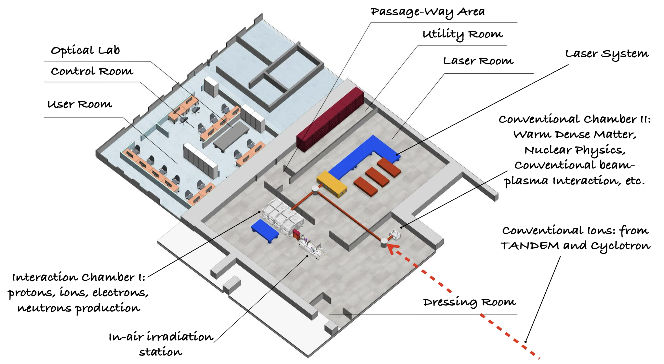

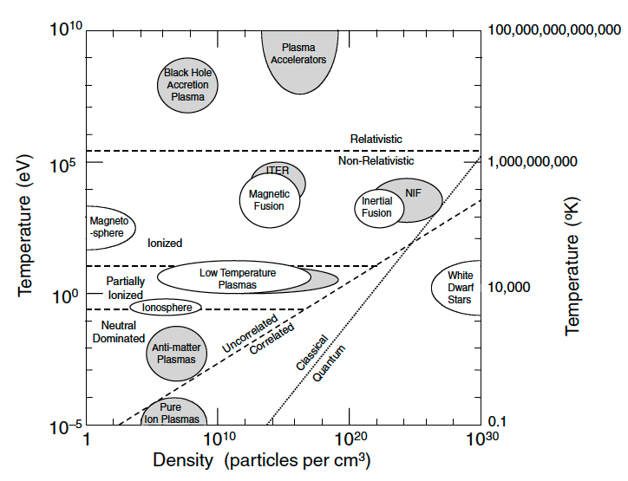

I-LUCE
May 2025
ISO-7 clean room
Two laser systems (L1 and L2)
Three laser outputs
Four experimental stations
(ES1, ES2, ES3 and ES4)
February 2026
L1
ES1
L2
I-LUCE
ES3
ES2
ES4
WDM
Electron temperature [K] | 10¹⁰ – 10¹¹ (MeV range)
Electron density [cm⁻³] | 10²¹ – 10²⁴
Ion temperature [K] | 10⁷ – 10⁹
Compressed matter density [cm⁻³] | Up to 10²⁶
CM

Slide 5
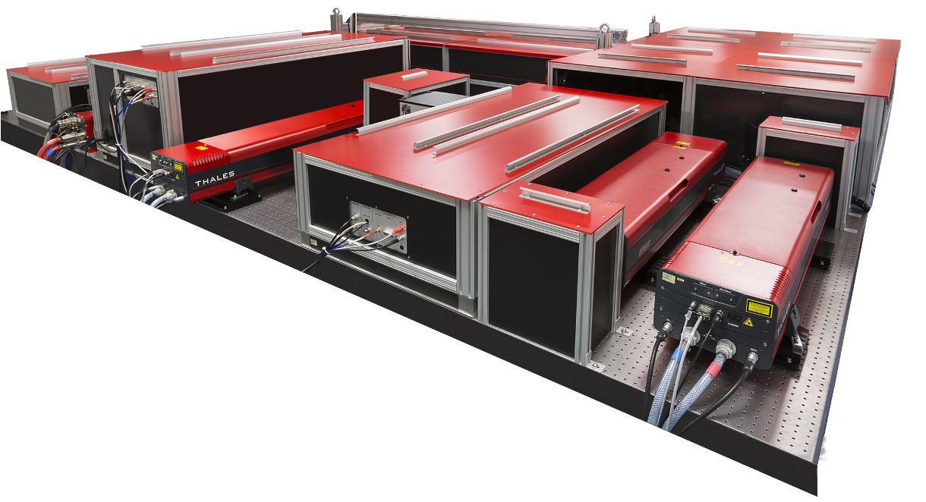

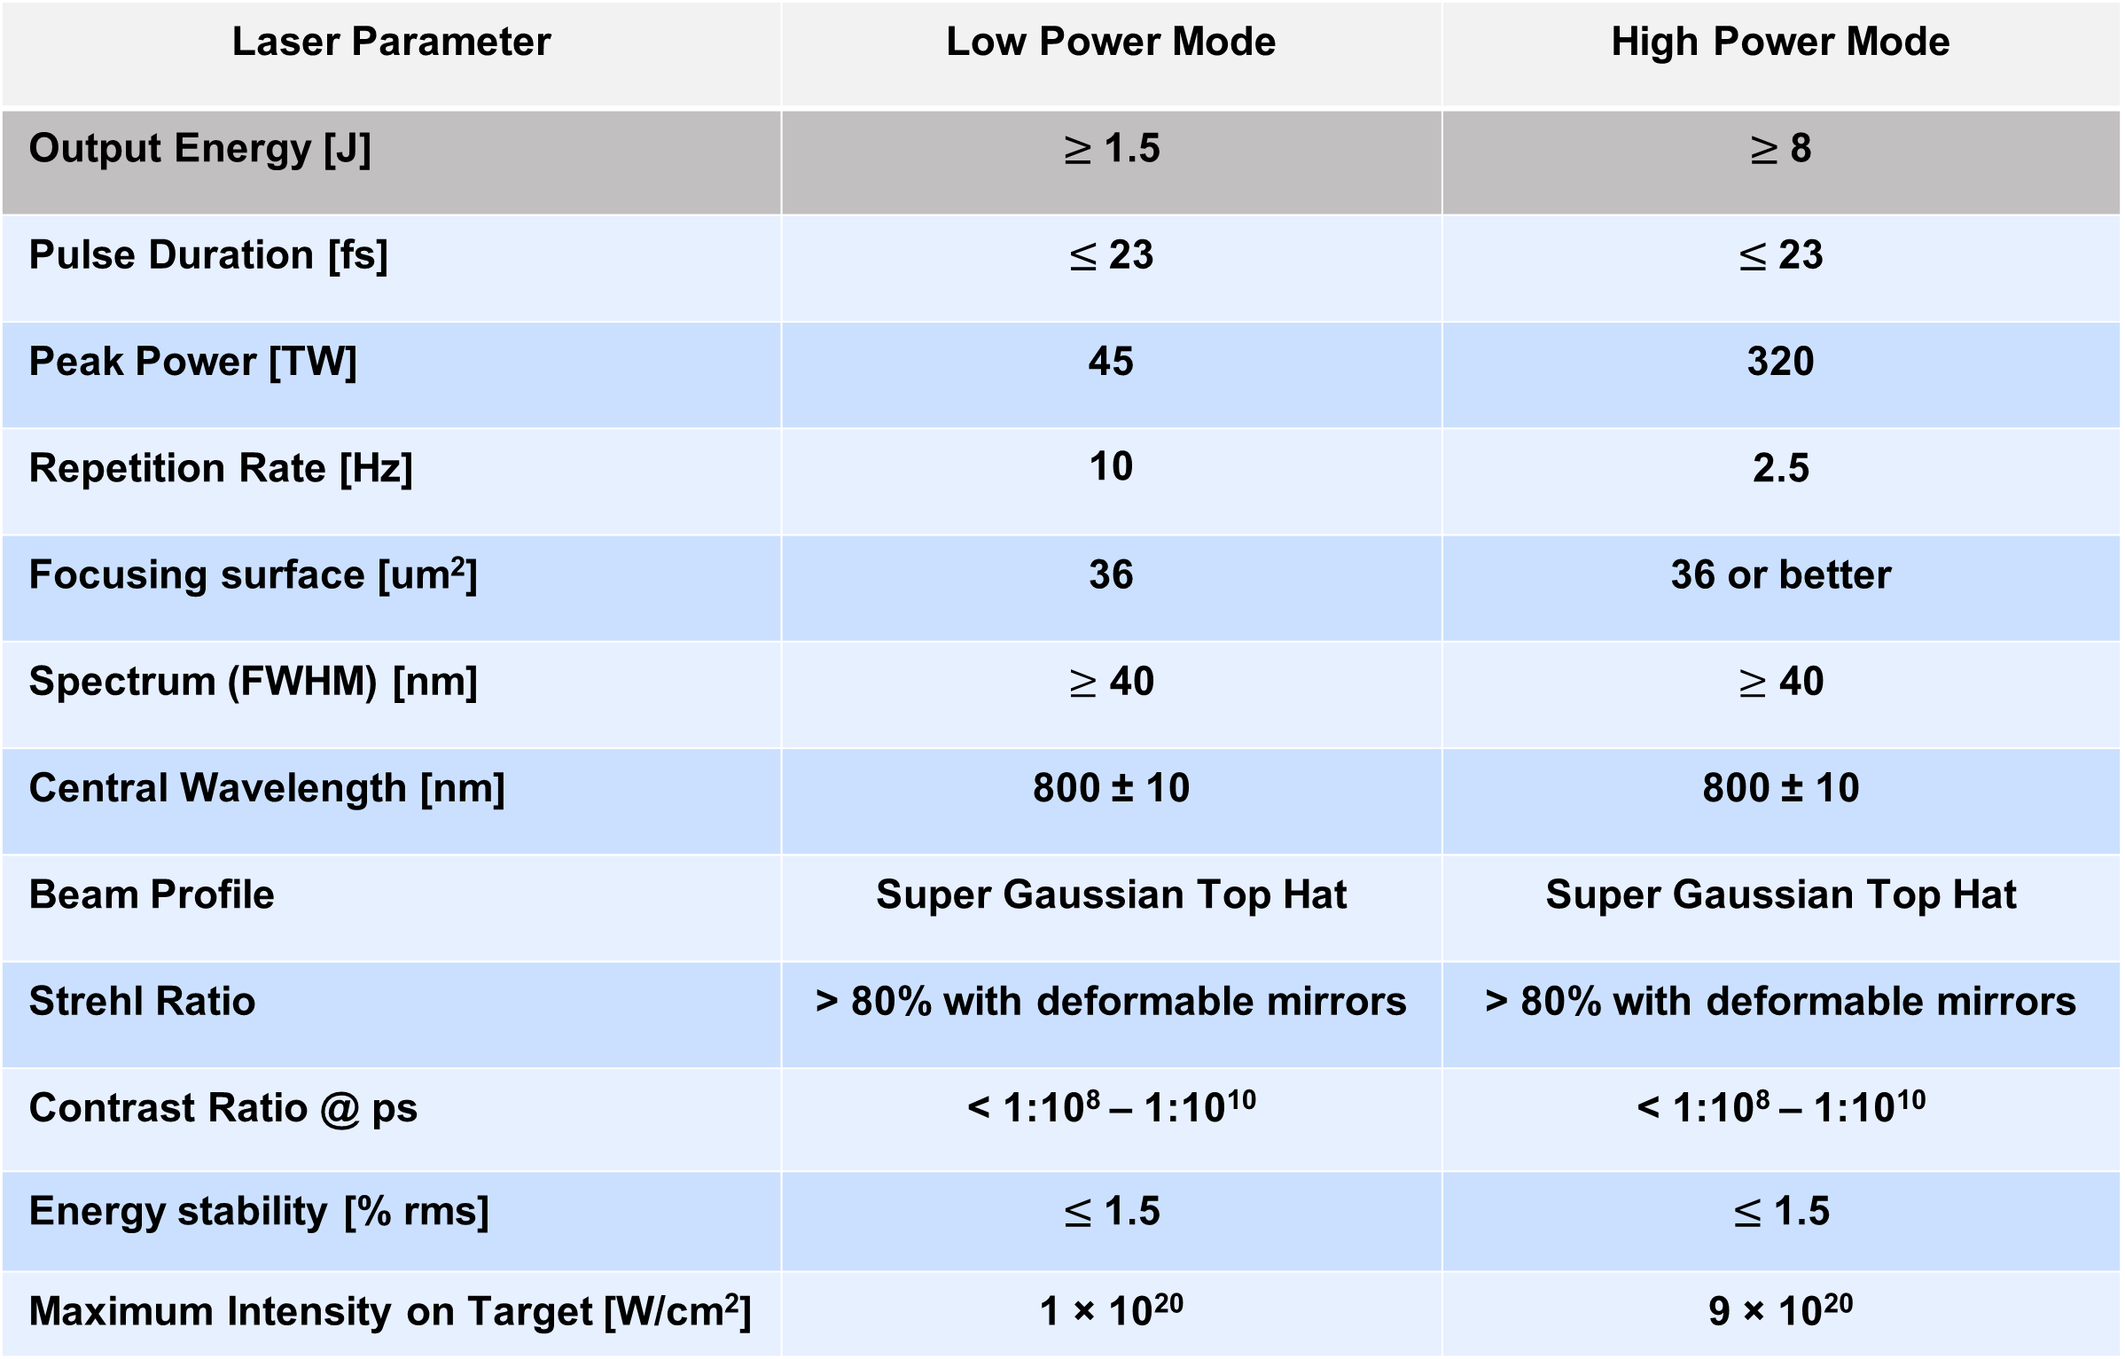
The I-LUCE two laser systems (L2)
Thales Quark System 320 TW
Laser Parameter | Low Power Mode | High Power Mode
Output Energy [J] | ≥ 1.5 | ≥ 8
Pulse Duration [fs] | ≤ 23 | ≤ 23
Peak Power [TW] | 45 | 320
Repetition Rate [Hz] | 10 | 2.5
Focusing surface [um²] | 36 | 36 or better
Spectrum (FWHM) [nm] | $≥$ 40 | $≥$ 40
Central Wavelength [nm] | 800 ± 10 | 800 ± 10
Beam Profile | Super Gaussian Top Hat | Super Gaussian Top Hat
Strehl Ratio | > 80% with deformable mirrors | > 80% with deformable mirrors
Contrast Ratio @ ps | < 1:10⁸ – 1:10¹⁰ | < 1:10⁸ – 1:10¹⁰
Energy stability [% rms] | ≤ 1.5 | ≤ 1.5
Maximum Intensity on Target [W/cm²] | 1 × 10²⁰ | 9 × 10²⁰
Installation within February, 2026
It can operate in two different configurations

Slide 6
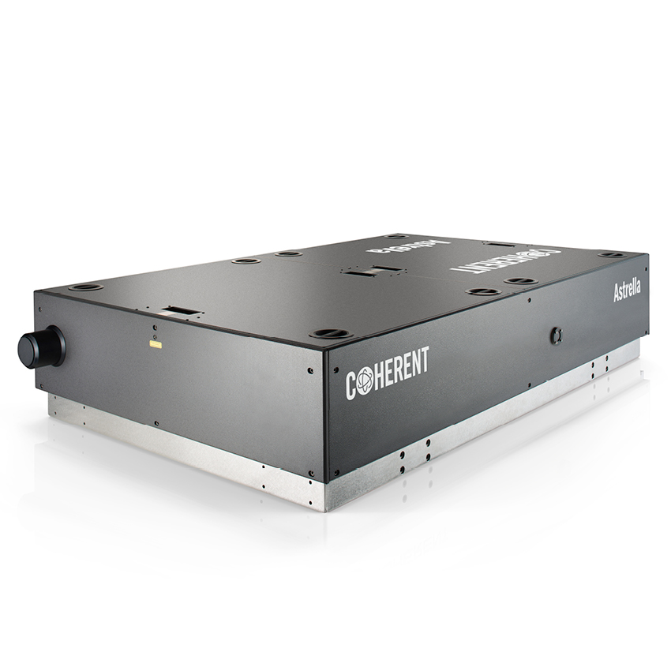
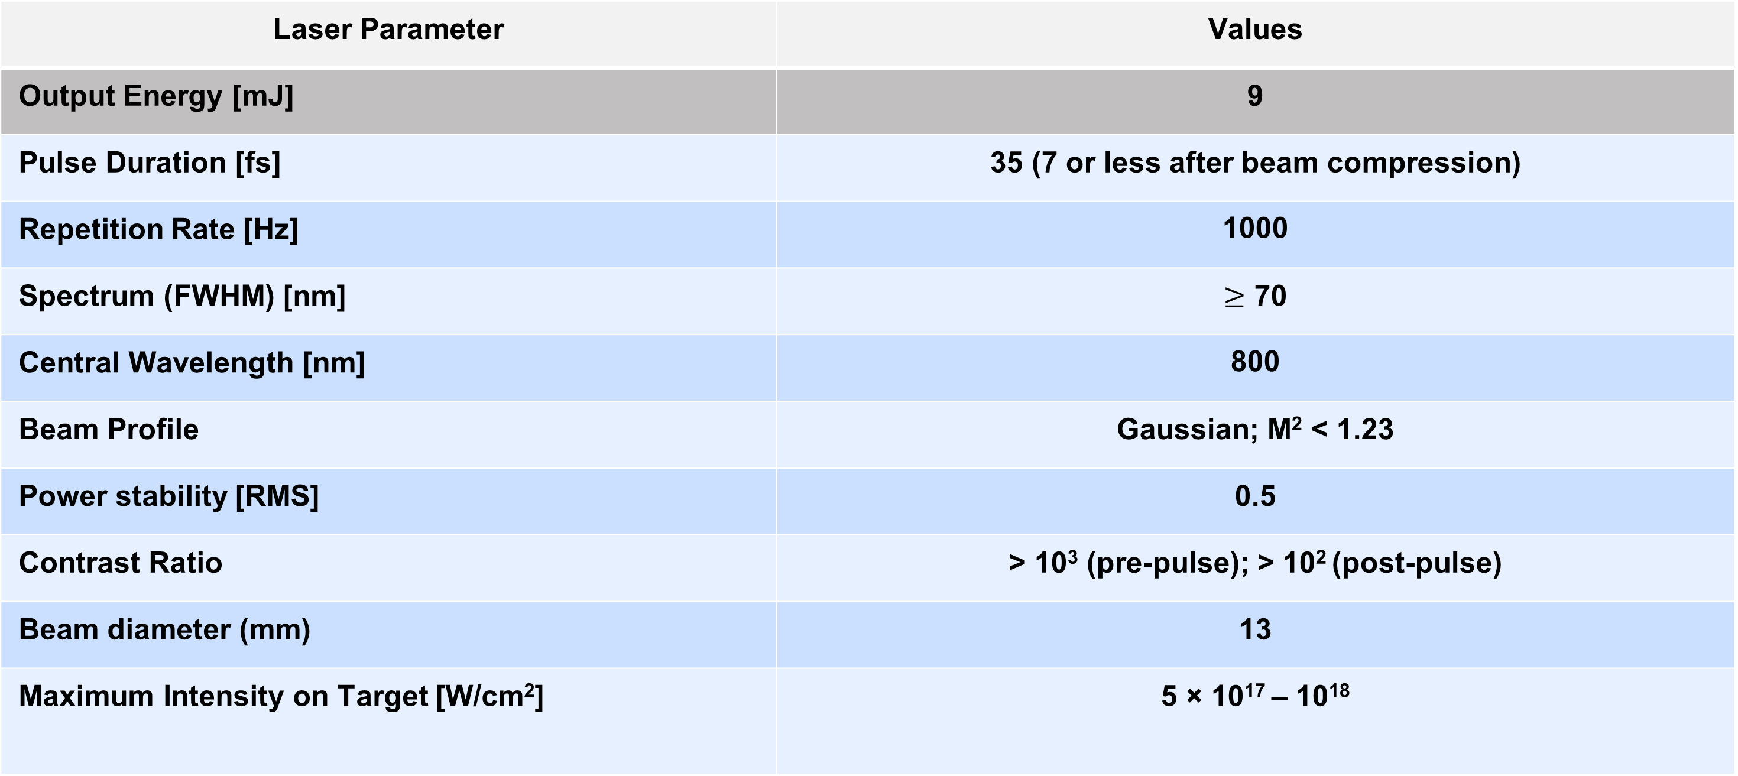
Ancillary femtosecond laser (L1)
Laser Parameter | Values
Output Energy [mJ] | 9
Pulse Duration [fs] | 35 (7 or less after beam compression)
Repetition Rate [Hz] | 1000
Spectrum (FWHM) [nm] | $≥$ 70
Central Wavelength [nm] | 800
Beam Profile | Gaussian; M² < 1.23
Power stability [RMS] | 0.5
Contrast Ratio | > 10³ (pre-pulse); > 10² (post-pulse)
Beam diameter (mm) | 13
Maximum Intensity on Target [W/cm²] | 5 × 10¹⁷ – 10¹⁸
Potential applications:
- test bench for detectors to be employed with the main laser system
- low power laser for high resolution plasma diagnostics of L2
- stand-alone laser system

Slide 7
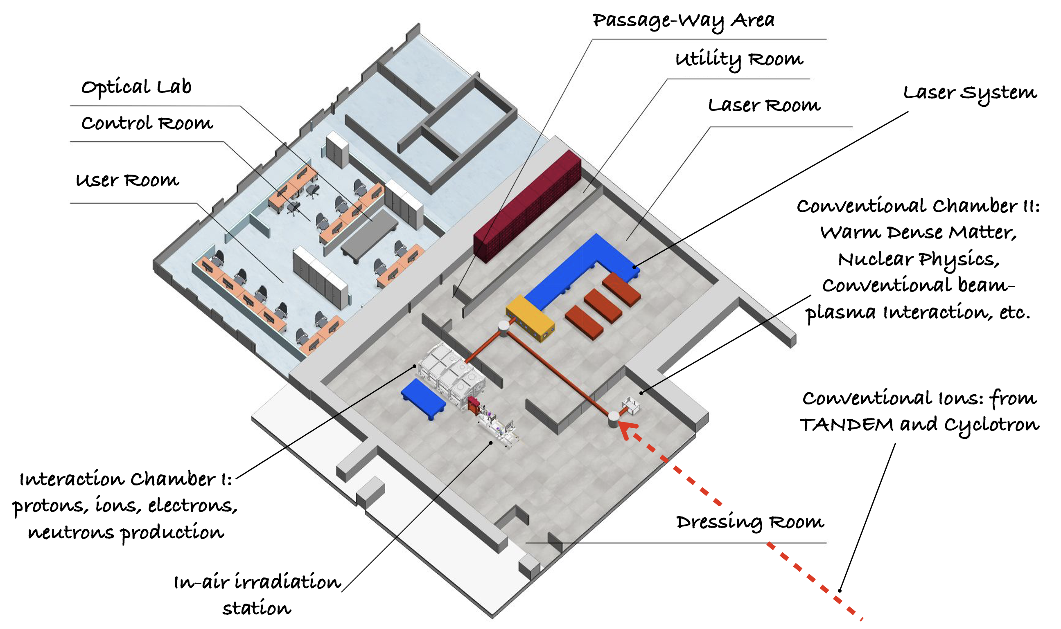
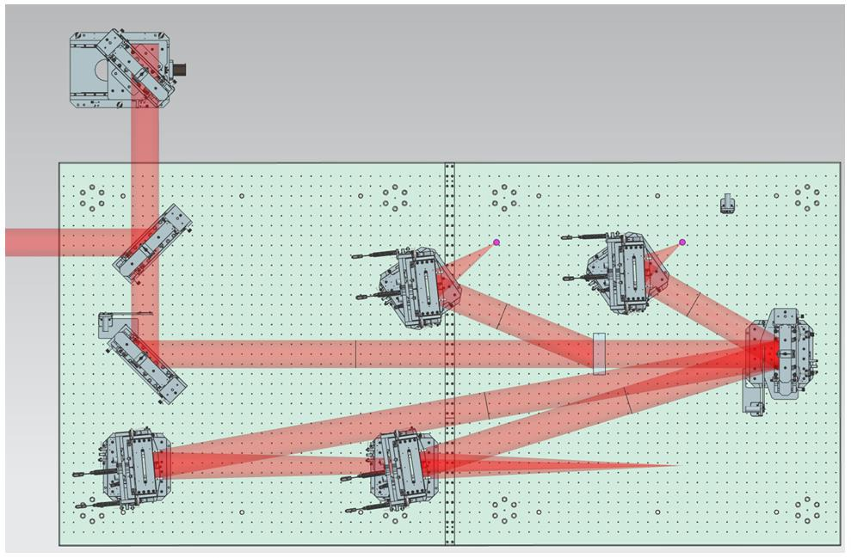

The radiation production interaction chamber
OAP 270 mm
ion acceleration
one interaction chamber for proton/ions and electrons
three different interaction points in the first phase
a partially reflective mirror (beam splitter)
two OAPs for electrons in order to find the best configu-ration to maximize the output
electron acceleration
OAP 2700 mm
OAP 1350 mm

Slide 8
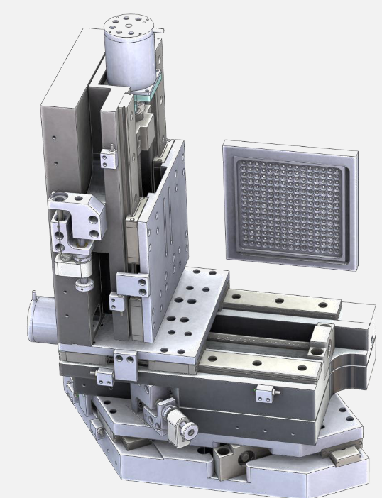
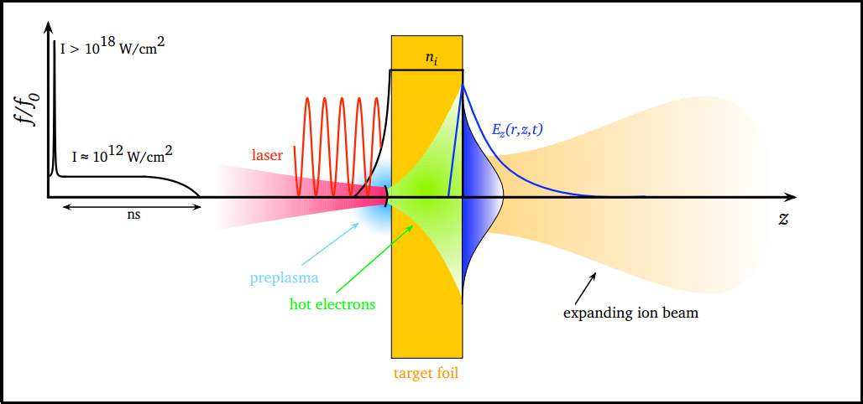
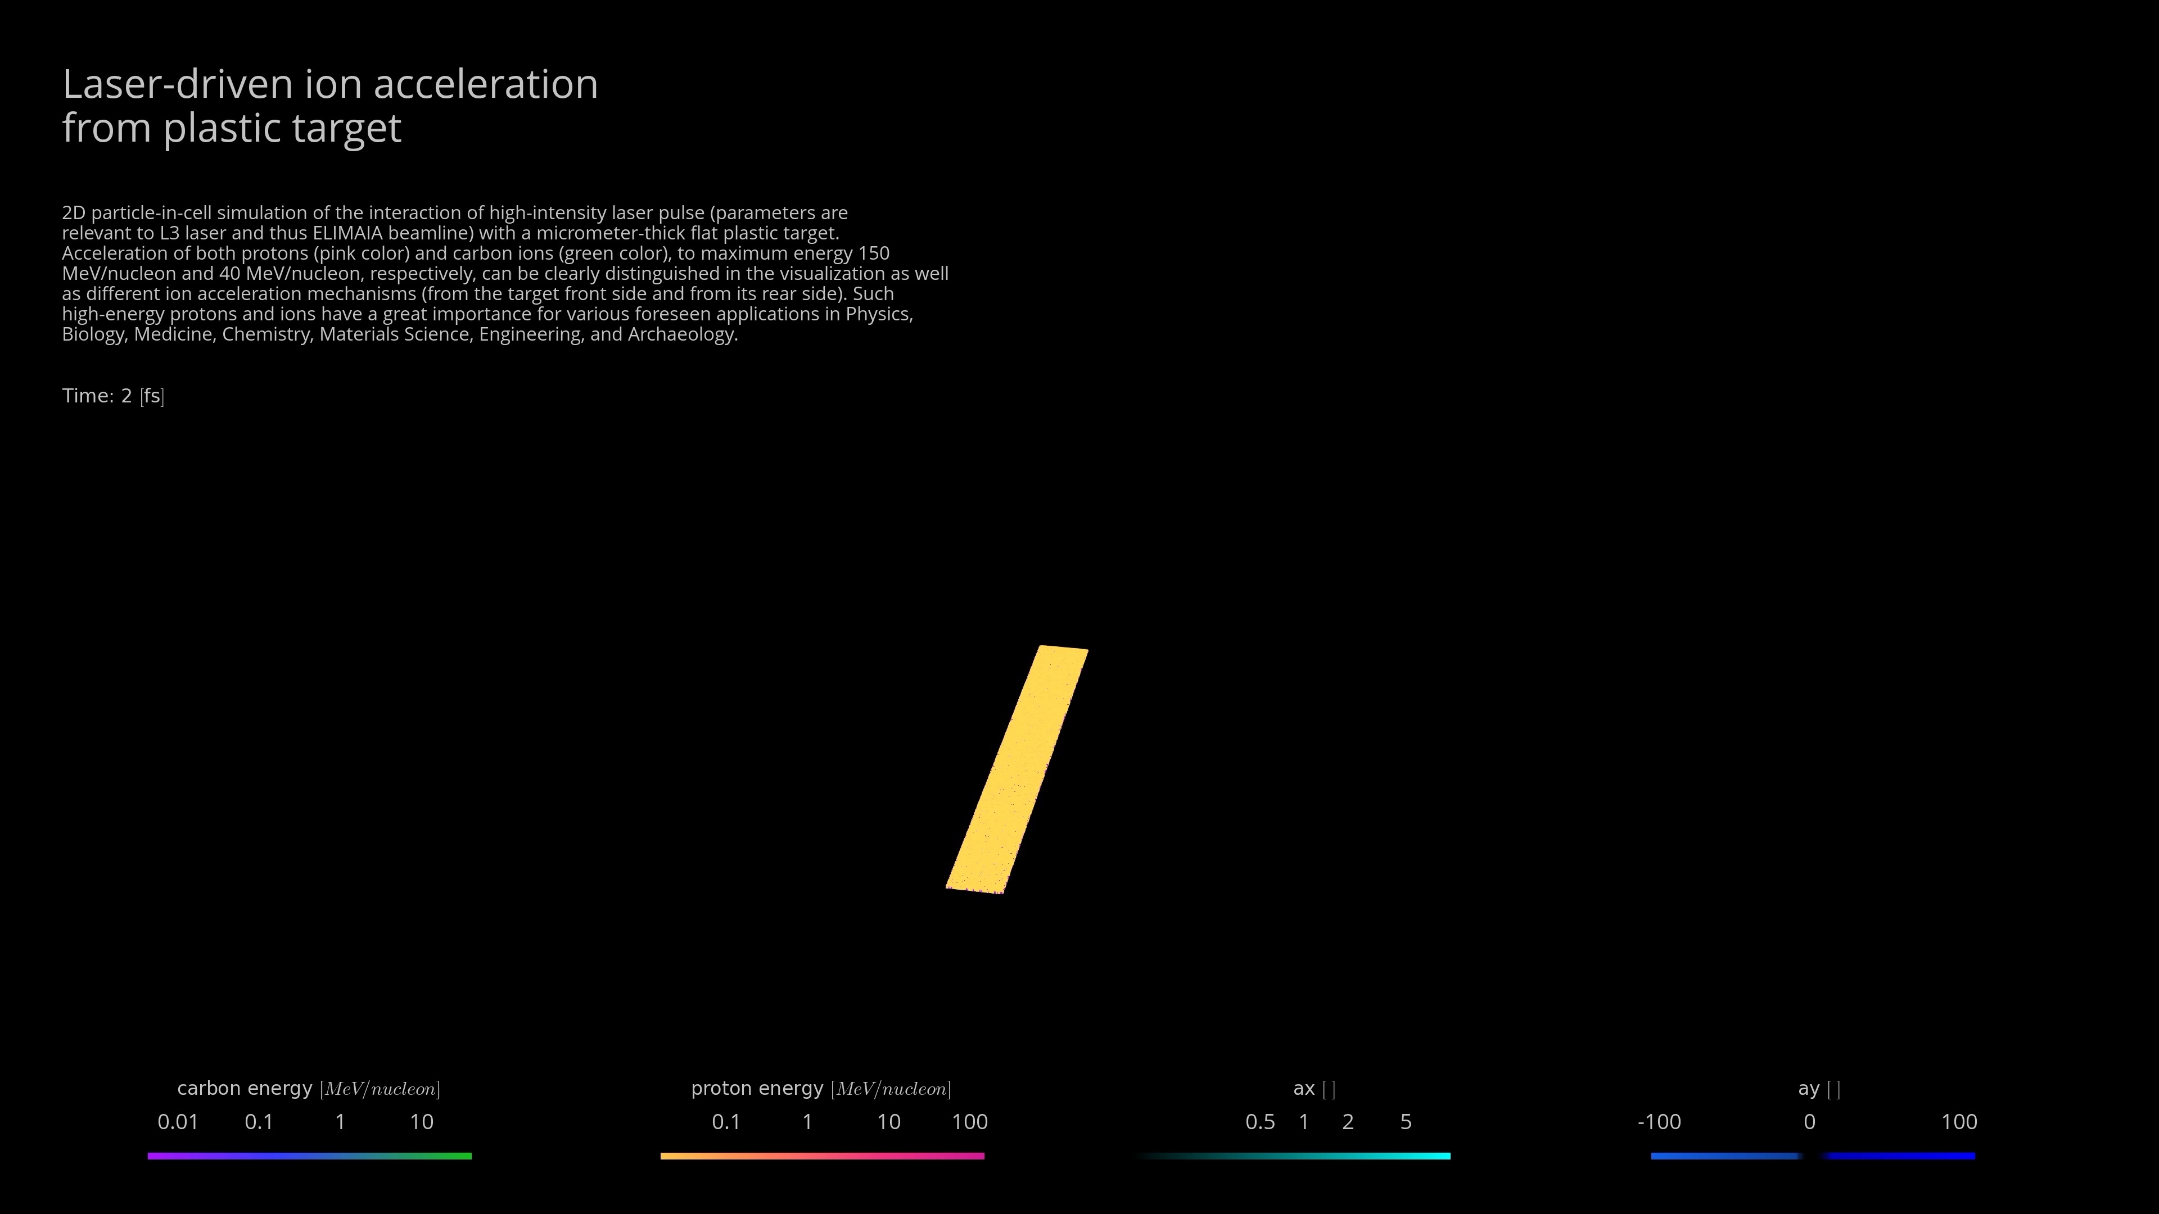

Ion acceleration station
Up to 900 thin solid targets
Max repetition rate: 3 Hz
Five degrees of freedom
XY = 105 mm @10 µm resolution, >20 mm/s
Z = 25 mm @1 µm resolution, < 10 mm/s
Tilt and rotation, ±2° @ 20 µrad resolution
High repeatability and EMP compatibility
TNSA regime
OAP 270 mm
ion acceleration
Micrometric precision and repeatability are requested for the five degrees of freedom
electron acceleration
OAP 2700 mm
OAP 1350 mm
Courtesy of Source LAB

Slide 9
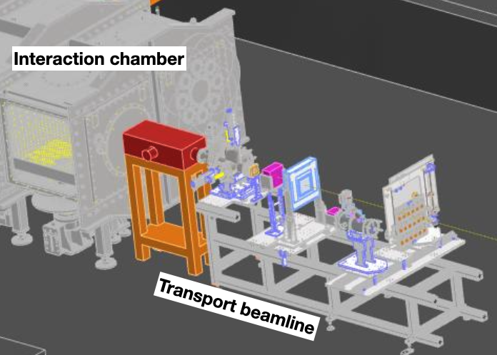
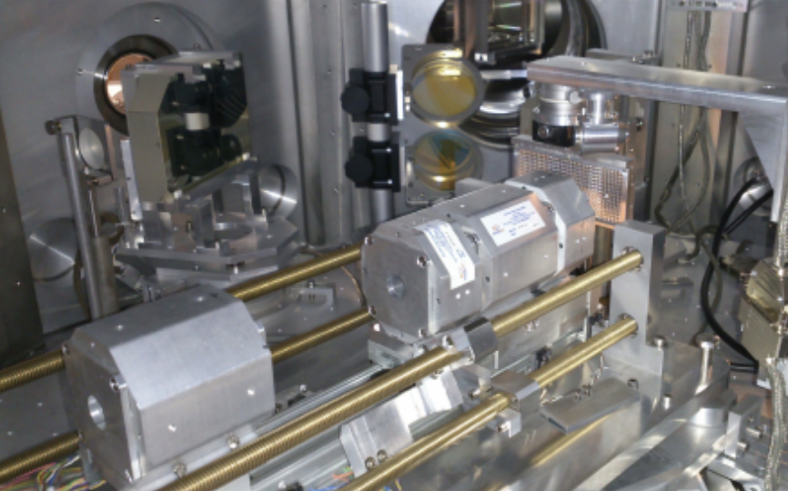
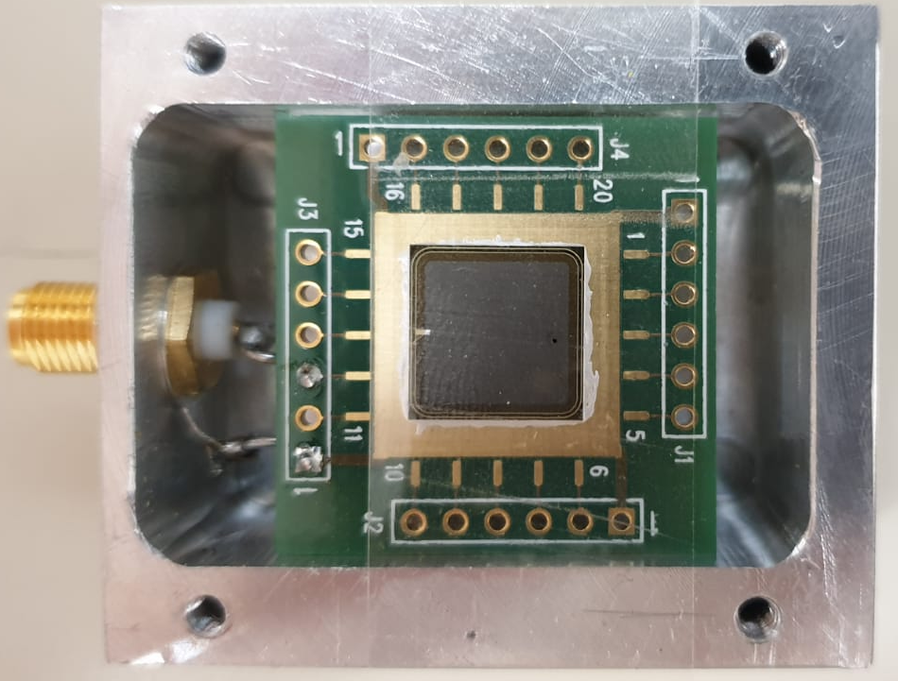


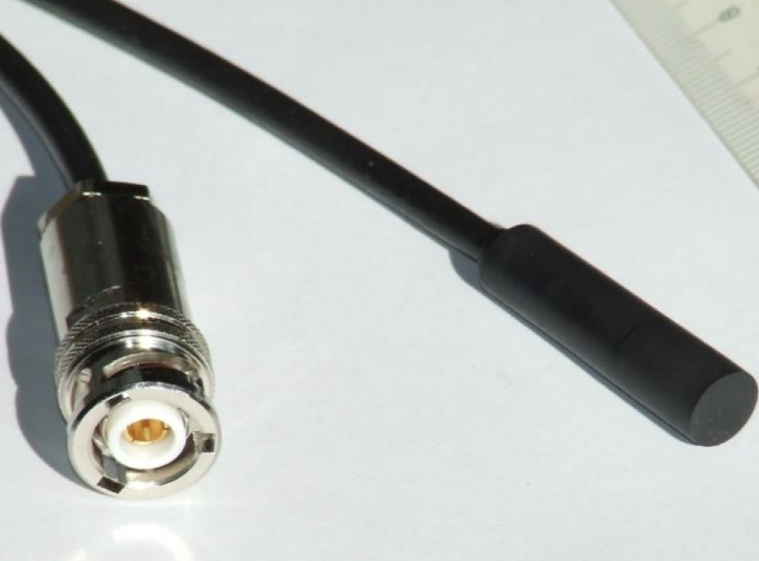
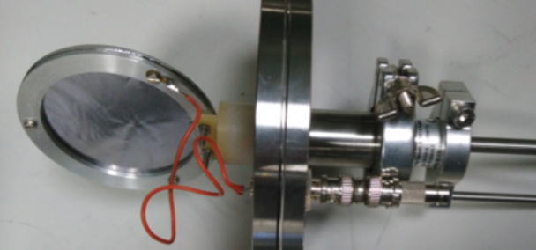
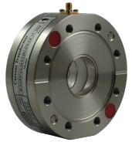
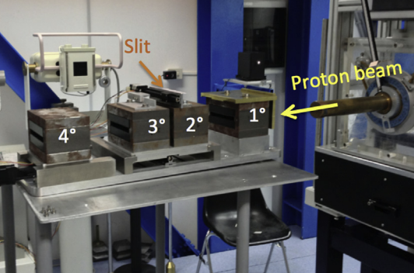
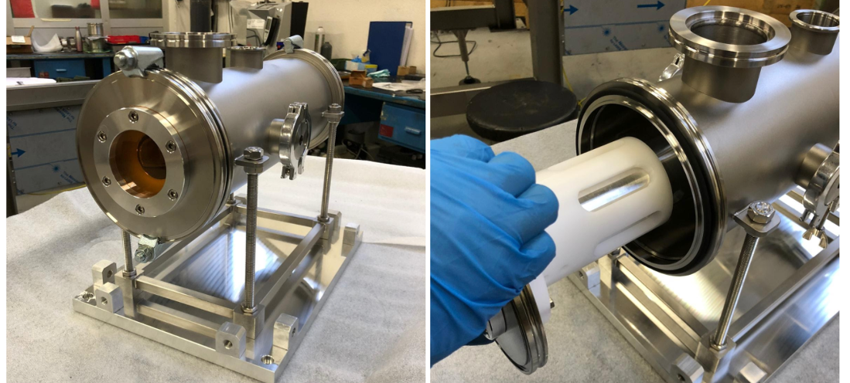
Transport beamline and diagnostic for ion beams
GAP Cirrone et al., Beam delivery methods for laser-driven proton sources, NIMA (2025)
Transport System
Diagnostic System
Permanent Magnet Quadrupoles
Scintillator
SiC & Diamond
High magnetic field gradient to focus the particle beam
Dosimetric System
SEM
ICT
Energy Selection System
Protons /Ions | Max energy | 50 MeV
 | Particle per pulse (at 30 MeV) | 10¹¹ MeV⁻¹ sr⁻¹
Select protons up to 30 MeV with an energy resolution of 5%
Faraday cup
A Thomson Parabola Spectrometer (TPS) is currently under construction

Slide 10
Electrons acceleration station
Two different approaches will be adopted, based on gas sources and LWFA mechanism:
- Plasma Discharge Capillary
- Gas jet system
OAP 270 mm
ion acceleration
electron acceleration
OAP 2700 mm
OAP 1350 mm

Slide 11
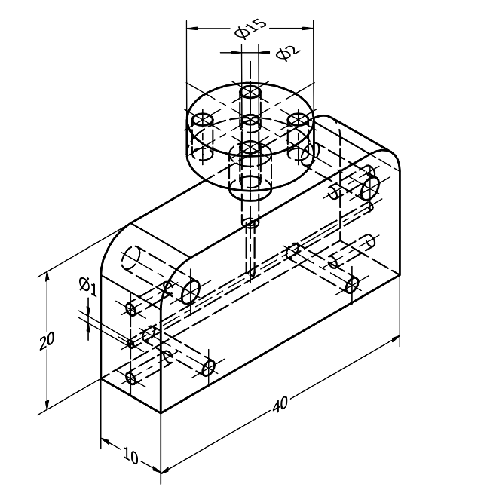
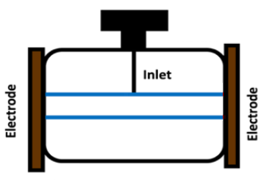
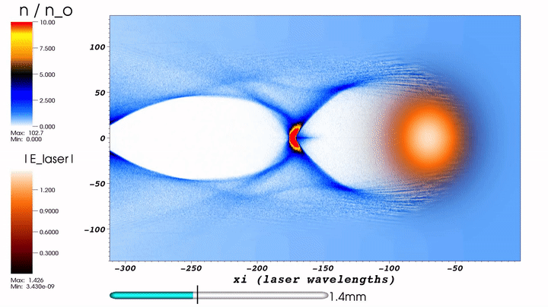
Electrons acceleration station
Two different approaches will be adopted, based on gas sources and LWFA mechanism:
- Plasma Discharge Capillary
- Gas jet system
OAP 270 mm
ion acceleration
a small diameter tube, filled with gas
a HV discharge is applied across the gas-filled capillary forming a plasma with a pa-rabolic transverse density profile
the laser pulse is focused into the plasma channel pushing away electrons from the plasma and creating a region of + ions
this forms a strong electrical longitudinal field (10-100 GV/m)
the electrons are finally accelerated to high energies over just few centimeters
electron acceleration
OAP 2700 mm
OAP 1350 mm
Electrons | Max energy | 3 GeV
 | Particles per pulse | 10⁹

Slide 12
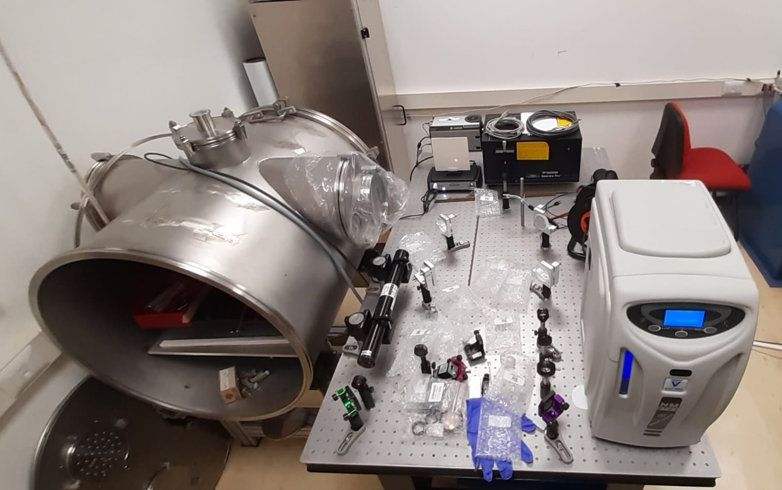
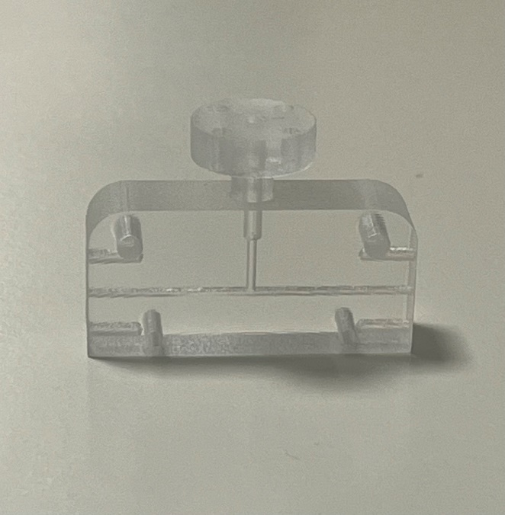
Electrons acceleration station
Two different approaches will be adopted, based on gas sources and LWFA mechanism:
- Plasma Discharge Capillary
- Gas jet system
OAP 270 mm
ion acceleration
Plasma Lab
electron acceleration
OAP 2700 mm
OAP 1350 mm
Electrons | Max energy | 3 GeV
 | Particles per pulse | 10⁹
Capillary prototype

Slide 13
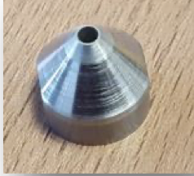
Electrons acceleration station
Two different approaches will be adopted, based on gas sources and LWFA mechanism:
- Plasma Discharge Capillary
- Gas jet system
OAP 270 mm
ion acceleration
supersonic gas-jet injection into a vacuum chamber using a special nozzle (1-2 mm)
the gas, usually He or a mix of He and N₂ with a carefully controlled density, serves as the target that will form the plasma
the high-intensity and ultra-short laser pul-se is focused directly onto the gas-jet, thus stripping electrons from the gas and crea-ting the plasma
the electrical longitudinal field accelerates electrons to high energies
electron acceleration
OAP 2700 mm
OAP 1350 mm
Electrons | Max energy | 3 GeV
 | Particles per pulse | 10⁹

Slide 14
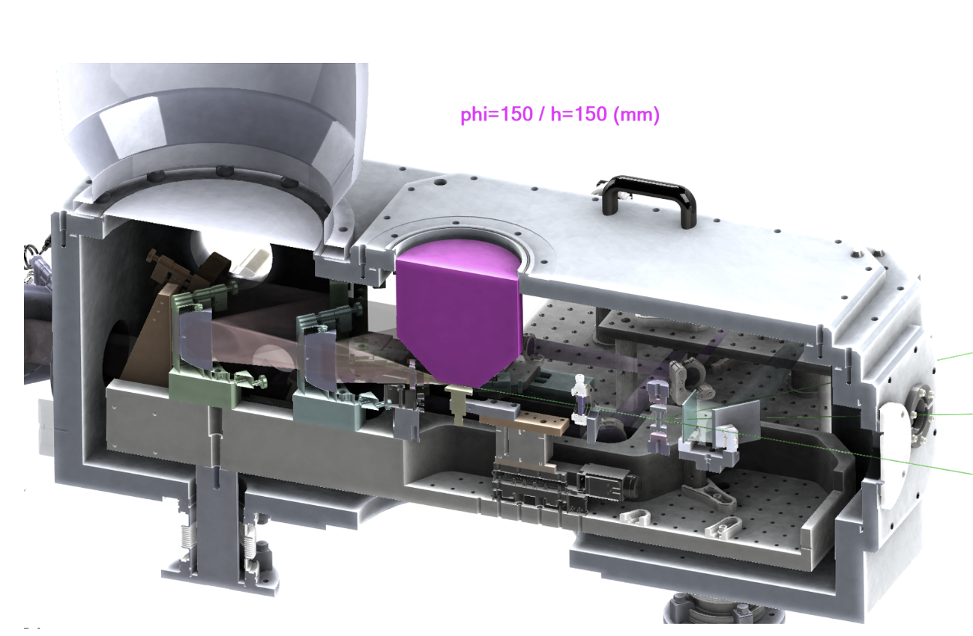
Electrons acceleration station
Two different approaches will be adopted, based on gas sources and LWFA mechanism:
- Plasma Discharge Capillary
- Gas jet system
OAP 270 mm
ion acceleration
electron acceleration
OAP 2700 mm
OAP 1350 mm
Cross-section of e-KAIO Gas-jet Chamber (~900 x ~500 mm)
Under discussion (SOURCE LAB)
Electrons | Max energy | 3 GeV
 | Particles per pulse | 10⁹

Slide 15
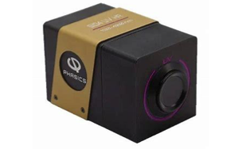
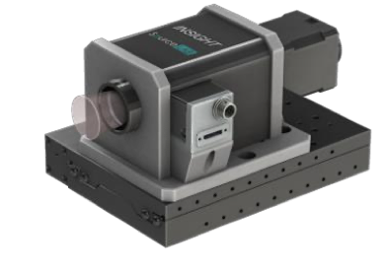
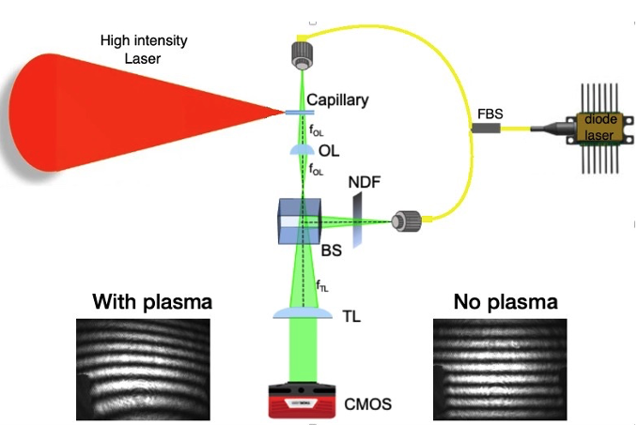
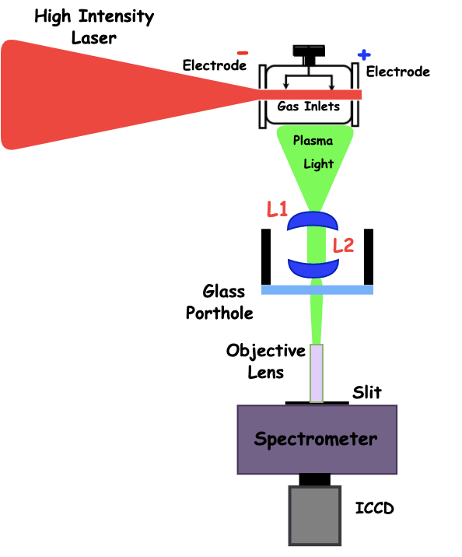
Electrons acceleration station
Diagnostic Systems:
Optical Emission Spectroscopy (OES)
Interferometry (Mach-Zehnder)
Lateral Shearing Interferometer (PHASICS)
Laser Spatio/temporal Characterization (TIPTOE - INSIGHT)
Lateral shearing interferometer (PHASICS)
INSIGHT
Mach Zehnder Interferometer
Spectroscopy system

Slide 16
I-LUCE Laser parameters and expected beams (L2)
Laser Power | 45 TW
Energy per pulse | ≥ 1.5 J
Pulse Duration | ≤ 23 fs
Focusing surface | 36 um²
Max power density (at the target) | 1.21 × 10²⁰
Contrast Ratio @ 100 ps | < 10¹⁰
Repetition rate | 10 Hz
Proton ions | Max energy | 4 MeV
 | Particle per pulse (at 2 MeV) | 10¹¹ MeV⁻¹ sr⁻¹
 | Energy spread | 100%
 | Max beam divergency | ± 20°
Electrons | Max energy | 0.1 GeV
 | Particle per pulse | 10⁹
 | Max beam divergency | ± 20 mrad
Neutrons | Max energy | TBD
Gamma beams | Synchrotron radiation of the e- inside the plasma or bremsstrahlung
 | Max energy | up to 20 MeV
Laser Power | 320 TW
Energy per pulse | ≥ 7 J
Pulse Duration | ≤ 23 fs
Focusing surface | 36 um²
Max power density (at the target) | 8.82 × 10²⁰
Contrast Ratio @ 100 ps | < 10¹⁰
Repetition rate | 2.5 Hz
Proton ions | Max energy | 50 MeV
 | Particle per pulse (at 2 MeV) | 10¹¹ MeV⁻¹ sr⁻¹
 | Energy spread | 100%
 | Max beam divergency | ± 20°
Electrons | Max energy | 3 GeV
 | Particle per pulse | 10⁹
 | Max beam divergency | ± 20 mrad
Neutrons | Max energy | 20
Gamma beams | Synchrotron radiation of the e- inside the plasma or bremsstrahlung
 | Max energy | up to 80 MeV

Slide 17
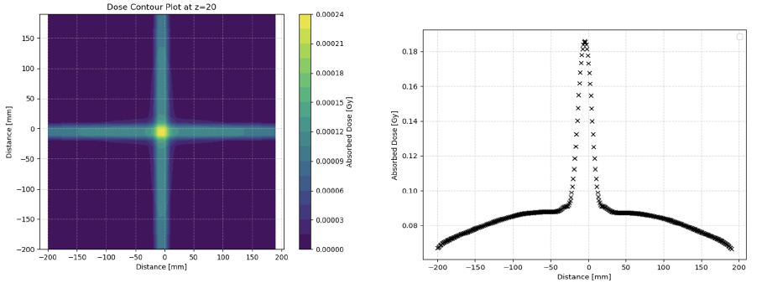
I-LUCE Laser parameters and expected beams (L2)
To perform dedicated dose studies, we developed a custom Geant4-based MC application that simulates dose depo-sition from laser-driven beams in complex geometries.
The input beam parameters (220 MeV, 120 pC, few-fs duration) were based on measurements from a standard capillary setup.
Four electron bunches were simulated entering a 400 × 400 × 400 mm³ water tank from orthogonal directions, with a 40 × 40 × 40 mm³ tumor located at the center.
The 4 beams converge to deliver a uniform 10 × 10 mm- dose profile at FWHM
Geant4-based simulations, scaled to 120 pC per bunch, yield a deposited dose of 0.180 Gy per four bunches.
With kHz-class lasers generating such beams dose rates could reach 42.5 Gy/s - enabling VHEET and FLASH-RT (coll. with INO-CNR)
Arjmand et al., Performed plasma waveguides: Enabling high-energy electron beams for FLASH radiotherapy, NIMA (2025)
Arjmand et al., Parametric study of voltage in plasma-discharge capillary systems: a benchmarking of experimental and simulation data, JINST (2025)
Arjmand et al., Implementing plasma-discharge capillary design for very high energy electron (VHEE) applications at I-LUCE facility, RAD (2024)

Slide 18
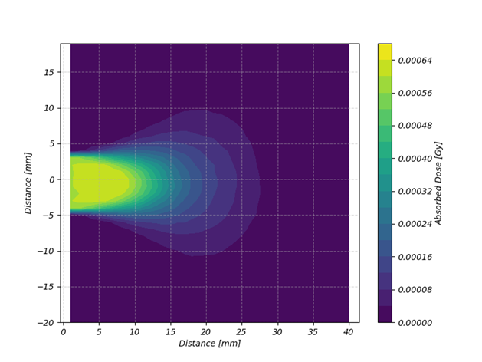
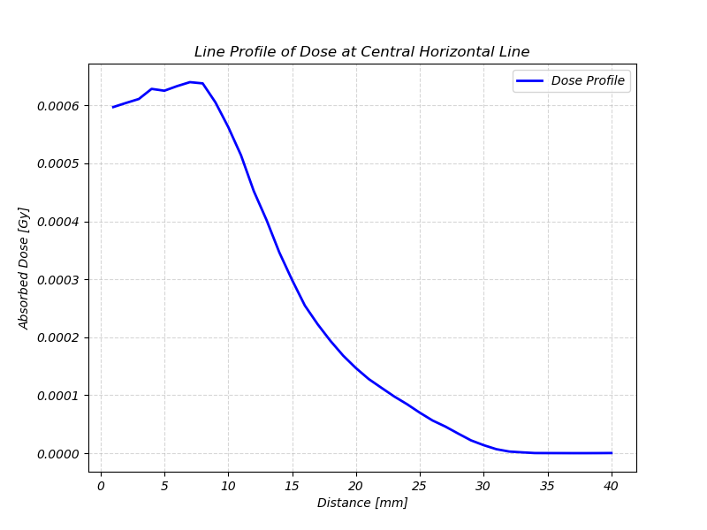
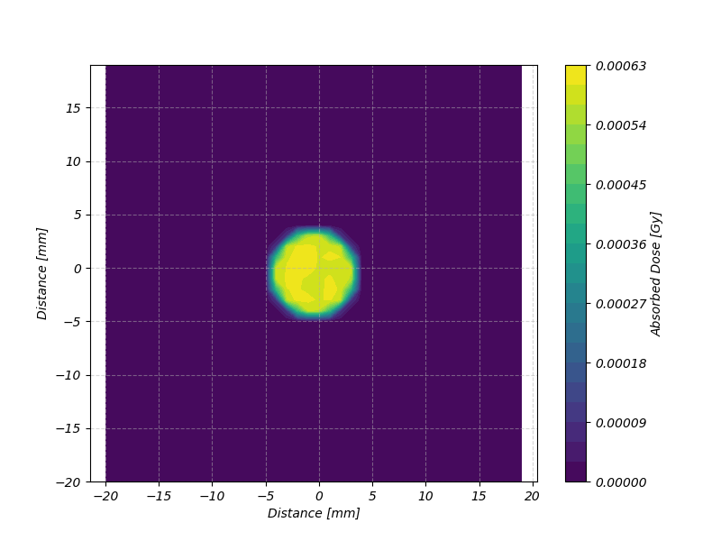
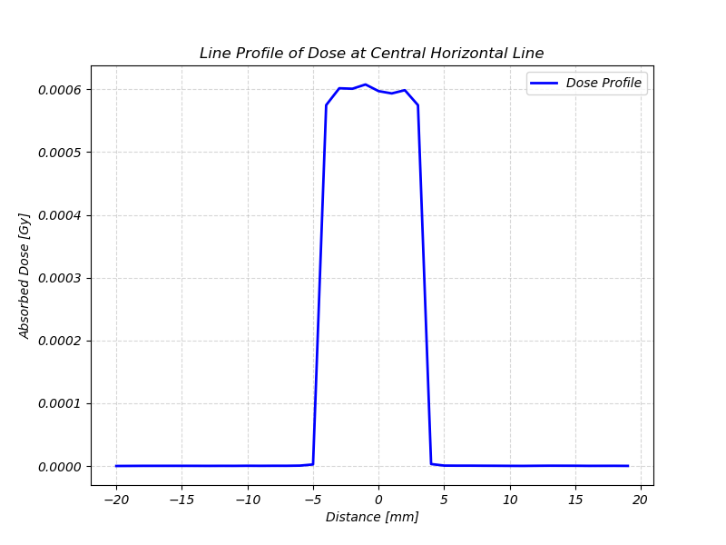
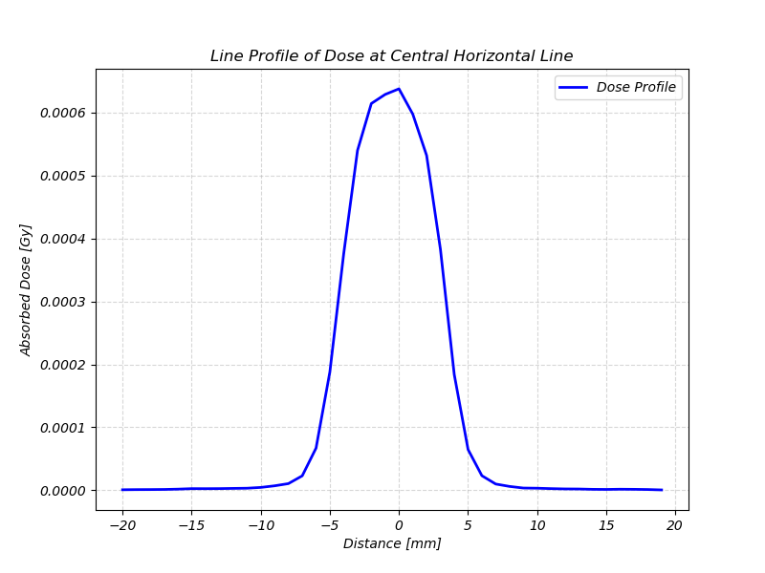
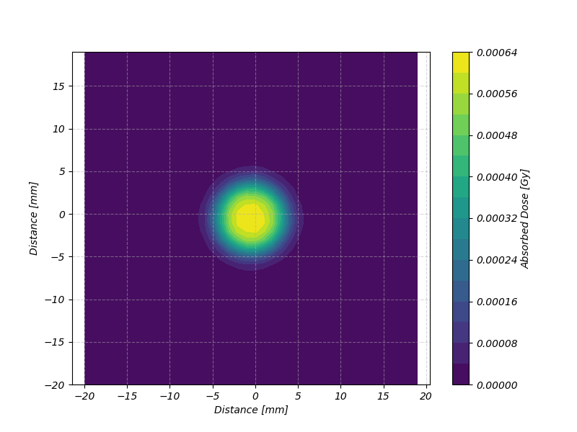
I-LUCE Laser parameters and expected beams (L1)
Depth dose profile
E = 6 ± 0.1 MeV
40 × 40 × 40 mm³ water
Electron bunch charge: 200 pC
Estimated dose: 0.811 Gy/bunch
Estimated dose at 1 kHz: 811 Gy/s
FLASH regime
Beam profile at the entrance position; D_{av} = 0.6 mGy
Beam profile at 7 mm in water; D_{av} = 0.65 mGy

Slide 19
Key features of laser-driven vs conventional VHEE accelerators
Characteristic | Conventional RF Linac | Laser-driven beams
Beam energy range | 50-250 MeV (future designs up to about 400 MeV) | 50-200 MeV demonstrated in stable operation; GeV-scale achieved in experiments (but with large energy spread)
Dose rate capability | Can reach > 40 Gy/s. Continuous beam output, highly stable. | Extremely high peak dose per pulse (fs-scale bursts); naturally suited for FLASH. Repetition rates typically 1-10 Hz.
Beam quality | Quasi-monoenergetic beam (< 1% energy spread) with low divergency, enabling precise magnetic focusing and uniform penetration. | Broad energy spectrum (often 5-20% or more) and large divergency, requiring strong post acceleration focusing and energy selection.
System footprint | Large fixed installation: accelerating structures on order of few meters, plus shielding, RF power sources, and (optionally) a gantry. | Compact acceleration (mm-cm plasma stage) but requires high-power laser apparatus (currently room-sized) and robust beam transport optics.
Key advantages | Mature, proven technology; stable and reproducible beam output. High beam quality allows efficient dose delivery and straightforward treatment planning. | Ultra-high accelerating gradient (10-100 GV/m) → potential for low-footprint accelerators. Ultrashort bunches yield very high instantaneous dose rates ideal for FLASH. No high-Z structures → reduced material activation and possibly simpler radiation shielding.
Key limitations | Significant infrastructure. Also, high energy electrons (> 100 MeV) produce some neutron/X-ray secondary radiation, necessitating shielding and dosimetric precautions. | Beam stability and quality control are major challenges (energy spread, pointing jitter). Low repetition rate and laser reliability limit throughput. Laser systems are expensive and maintenance-intensive.
Clinical readiness | Several prototypes under development. Likely within ~5 years for initial clinical pilot use (in limited settings). | First in vivo tumor irradiation demonstrated in mice (2025), showing proof-of-concept. No human use yet; at least 10+ years away from clinical trial in patients. Technology is still in early research stage, needing R&D and engineering for a clinical-grade device.

Slide 20
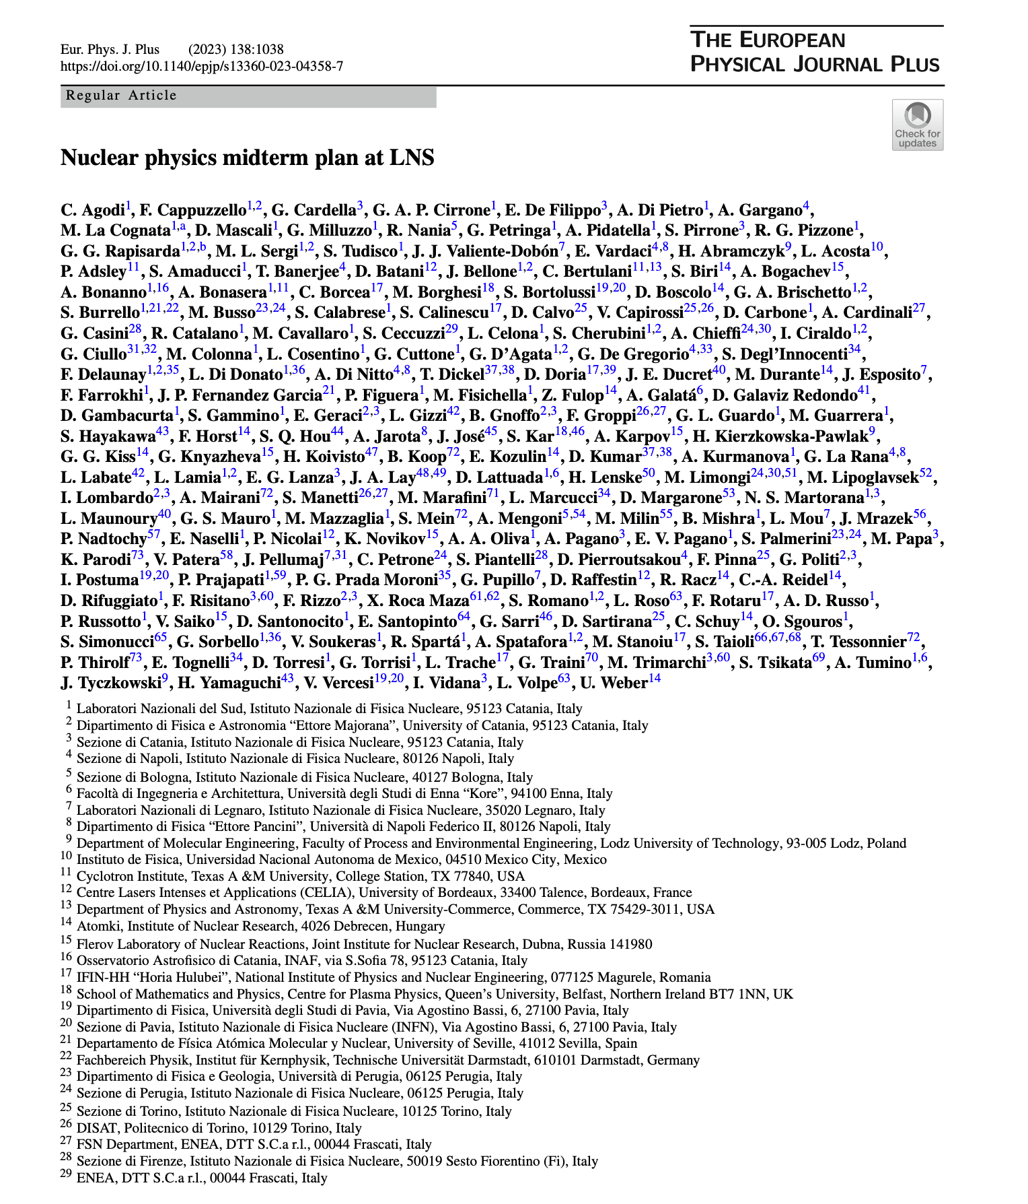
Other applications
Stopping power in plasma
Positrons generation
Radioisotopes production
Nuclear reaction schemes
Hydrogen generation
Conventional ions (4 AMeV – 80 AMeV) – plasma interaction
From fs to ps plasmas
Nuclear beta decay in plasmas of isomeric states on interest in nucleosyntesys
Reaction of astrophysical interest
Inertial fusion studies
Warm Dense Matter studies
Chapter 6.2 Laser applications
Nuclear and nuclear astrophysics station
C Agodi et al., Eur. Phys. J. Plus (2023) 138:1038

Slide 21
Concluding remarks
Protons acceleration up to 50 MeV with solid target
Electrons acceleration up to 3 GeV with capillary and gas-jet system
Neutron beam
Irradiations stations for protons and electrons for medical and multidisciplinary applications
  - Radiobiology
  - VHEE and FLASH radiotherapy applications
  - Material science
Interaction of conventional ion beams with laser-generated plasmas
End of installation: February 2026
End of commissioning: within 2027
Opening of the facility to users: begin 2028
Comparison between conventional and laser-driven electron beams … …

Slide 22
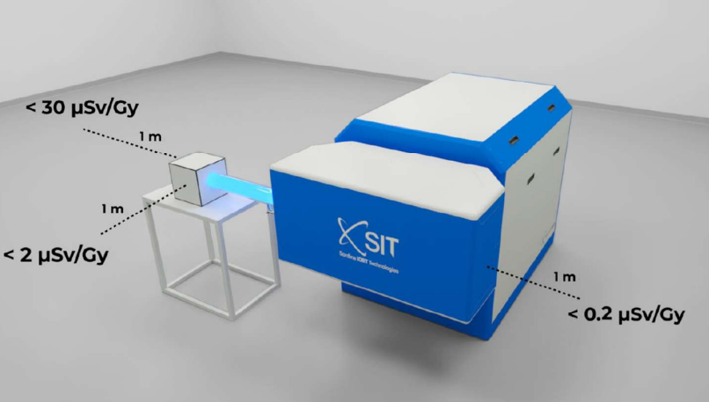


Comparison between conventional and laser-driven beams
A dedicated research accelerator for FLASH radiotherapy will be installed at the CAPiR-UNICT (Center for Ad-vanced Preclinical in vivo Research – University of Catania) – 1 km away from the LNS-INFN
    Real-time energy control between 7 and 9 MeV
    Real-time output monitoring
    Available fields from 1 cm up to 12 cm round fields
    Dose rate available range between 0.005 Gy/sec up to 10,000 Gy/sec
    Pulse duration from 0.2 to 4 us
    Repetition rate between 1 and 250 Hz, with 1 Hz increments
SIT - Sordina IORT Technologies S.p.A. (Italy)

Slide 23
Selected list of recent publications
S. Arjmand et al., Simulation-Based Modeling and Machine Learning Optimization of Plasma Discharge Capillary in LWFA Systems, Laser and Particle Beams, (2025) (Submitted).
S. Arjmand et al., Real-Time Wavelength Calibration and Multi-Technique Plasma Diagnostics in Discharge Capillary, Laser and Particle Beams, (2025) (Accepted).
S. Arjmand et al., Performed plasma waveguides: Enabling high-energy electron beams for FLASH radiotherapy, NIMA (2025)
G.A.P. Cirrone et al., Beam delivery methods for laser-driven proton sources, NIMA (2025)
S. Arjmand et al., Parametric study of voltage in plasma-discharge capillary systems: a benchmarking of experimental and simulation data, Journal of Instrumentation (2025)
M. Scisciò et al., Laser-initiated p-11B fusion reactions in petawatt high-repetition-rate laser facilities, Matter and Radiation at Extremes (2025)
P. Blaha et al., ELIMAIA-ELIMED: a new user platform for radiobiological research utilizing laser-driven protons, Frontiers in Physics (2025)
K. Hideghéty et al., From ultrafast laser-generated radiation to clinical impact: a roadmap for radiobiology and cancer research at the Extreme Light Infrasctructure (ELI), European Physical Journal Plus (2025).
S. Arjmand et al., Implementing plasma-discharge capillary design for very high energy electron (VHEE) applications at I-LUCE facility, RAD Conference Proceedings (2024)
G. Petringa, et al., A comprehensive Beamline for Proton and Ion Beams Accelerated via Laser-plasma Interaction: the Approach Implemented at the I-LUCE Facility, RAD Conference Proceedings (2024).
GAP. Cirrone et al., Laser Driven User Facilities and Status of I-LUCE at Laboratori Nazionali del Sud of INFN (ITALY), RAD Conference Proceedings (2024).

Slide 24

2nd INFN School and Workshop on “High Power Lasers for Fundamental Science and Applications” (HPLA)
https://agenda.infn.it/e/HPLA2025
Istituto Nazionale di Fisica Nucleare
Laboratori Nazionali del Sud (Catania, Italy)
November 17-19, 2025
Publication on The European Physical Journal (EPJ) Web of Conferences (WOC)
Poster session
Best poster Award

Slide 25
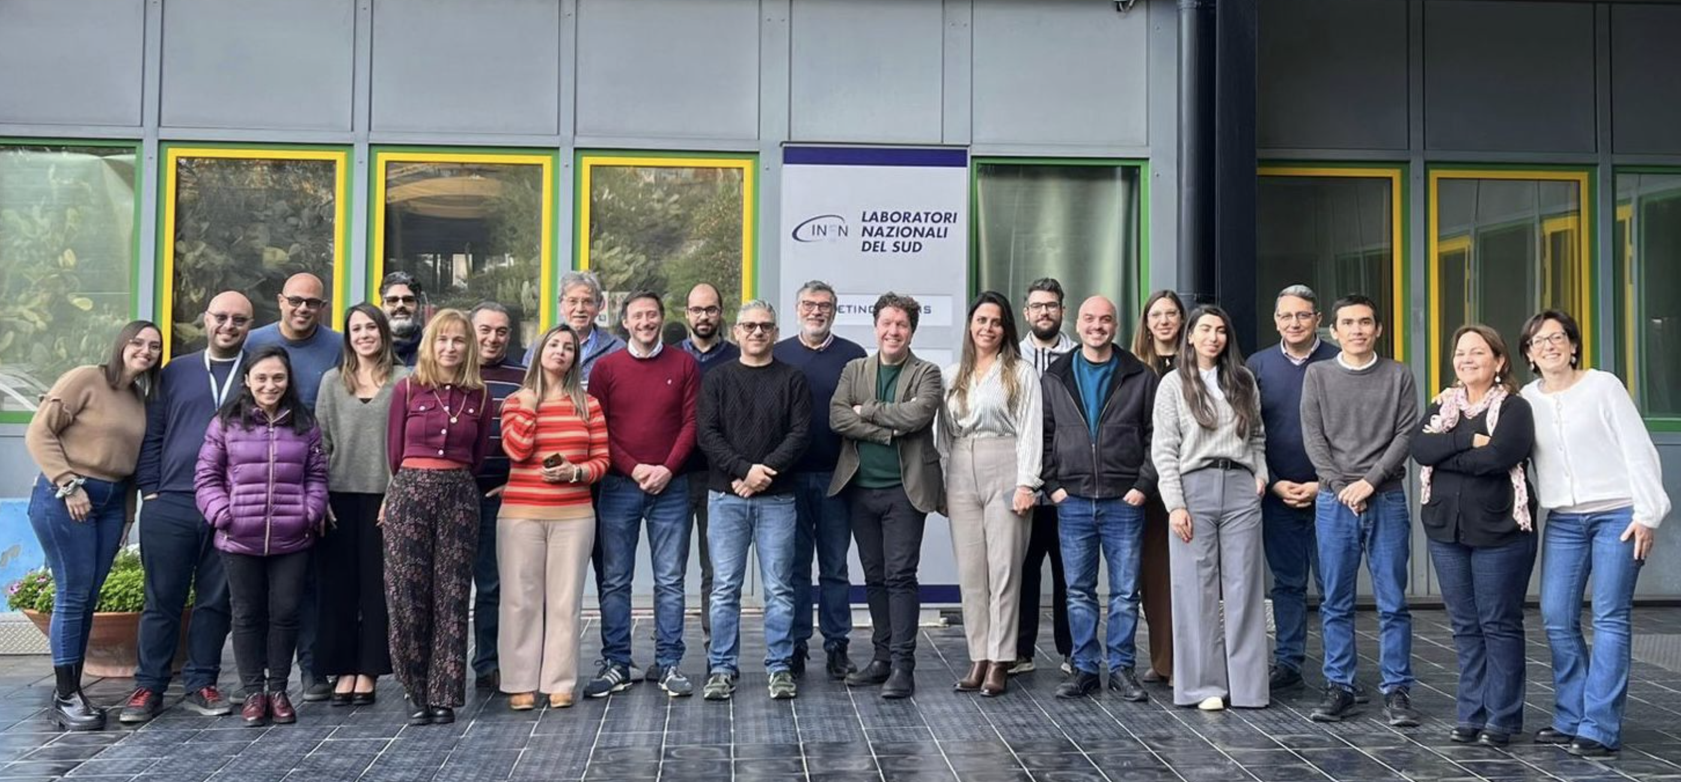
Thank you for your attention

