Slide 1

Beam modelling, dose calculation and potential clinical application of a scanned electron beam with ultra-high dose rate
J Bedford J, M Gross, F Riemer, Z Amirkhanyan,
F Stephan and U Oelfke

Slide 2
Overview
1. VHEE background
2. Electron beam model
Treatment planning with FLASH effect
Potential clinical applications
5. Conclusions

Slide 3
VHEE background
1

Slide 4
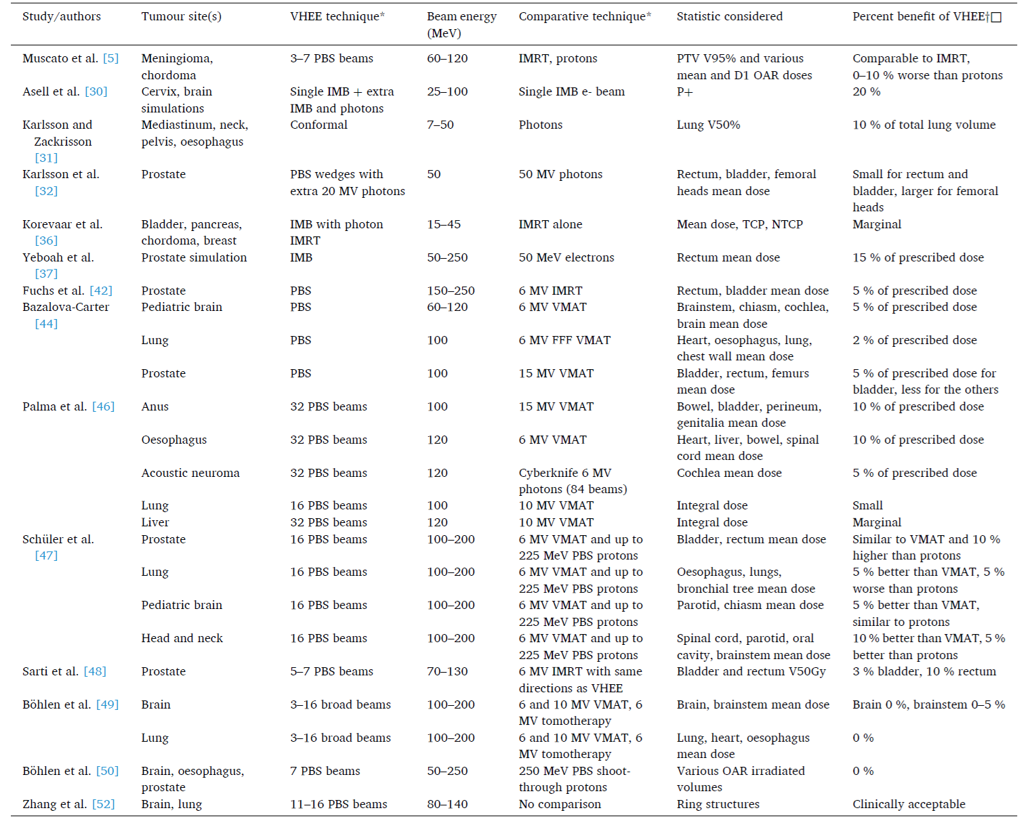
Treatment planning for VHEE: summary
Organ at risk sparing of 0-10%
of prescribed dose
Bedford and Oelfke Phys. Imaging. Radiat. Oncol. 32: 100670 (2024)

Slide 5
Choice of VHEE energy
Depth dose
Lower scatter
Steeper penumbra
Lower scatter
Steeper penumbra
Depth dose
Low energy
High energy
Böhlen et al. Med. Phys. 48: 3958-3967 (2021).

Slide 6
Electron beam model (18 MeV)
2

Slide 7
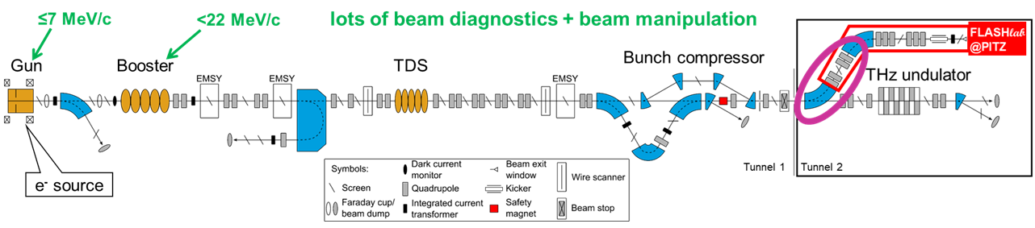




Beam line at PITZ: 18 MeV
30 $ps$
Dose rate (Gy s⁻¹)
Bunch | 4 × 10¹³
Train | 1 × 10⁹
Overall | 1 × 10⁷
$≤1$ ms
$$t$$
0.1-1 s
0.2 $μs$
Stephan et al. Phys. Med. 104: 174–187 (2022).

Slide 8
Experimental measurements at PITZ
50 μm Ti exit window
26 mm
50 μm Ti exit window
10 mm wall
10.85 mm
11.85 mm
Gafchromic films
11.85 mm

Slide 9
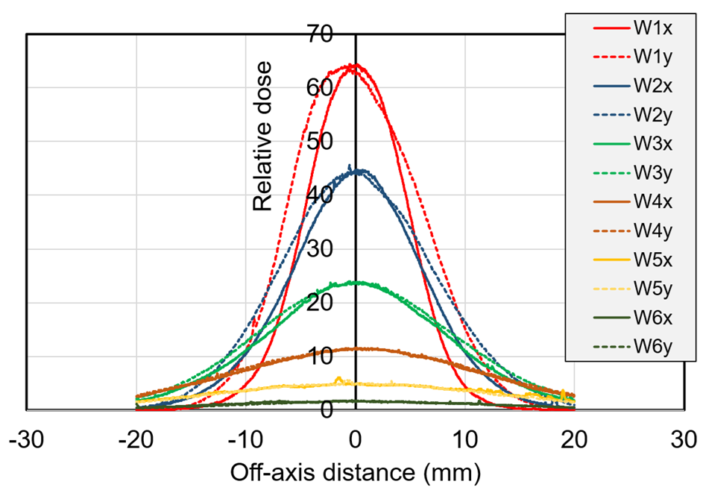
Raw measured data
Aim:
Model with
Gaussian beam model
+ Boltzmann solver

Slide 10
Beam parameters used in modelling
17.5 MeV Gaussian
Parallel beam (10 m source-axis distance)
4.0 mm spot spacing
Elliptical beam profile
4.0 mm × 5.6 mm (spot σ)

Slide 11
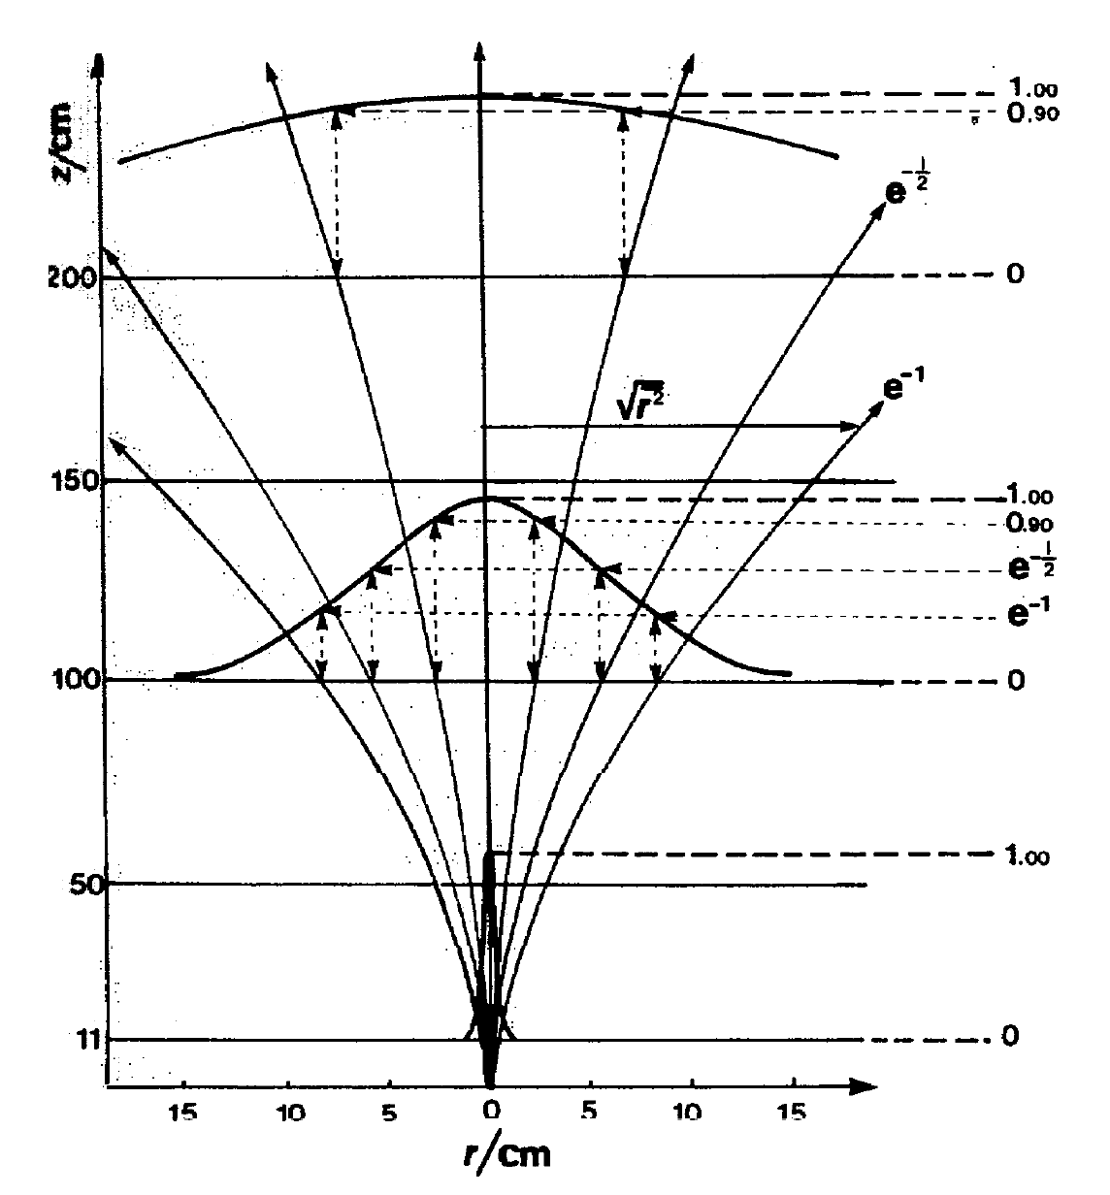
Classic distribution of electron fluence
ICRU 35 (adapted from Brahme 1971)
6 MeV electron beam in air
Gaussian initial distribution
Progressively widening Gaussian distributions of particle position and angle
Based on mass scattering power
ICRU 35: Radiation dosimetry: electron beams between 1 and 50 MeV (1984).

Slide 12
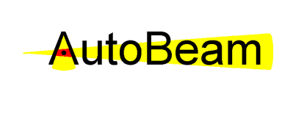
Discrete ordinates Boltzmann solver
2. Scatter calculated by Boltzmann integral
1. Fixed source with continuous slowing down
4. Total fluence = fixed source + multiple scatters
3. Multiple scatters achieved by multiple iterations

Slide 13
Discrete ordinates
1. Quadrature
2. Cross sections
3. Transport sweeps
Incoming fluence
Incoming fluence
Set of energies and directions
14
1
2
10
10
15
16
3
Probability from differential cross section σ(E,θ)
16
3
17
4
11
11
Probability from total cross section σ_{T} (E)
18
5
18
5
19
12
12
6
20
7
20
7
13
13
21
8
22
9
Energy: 1 MeV steps
Directions: simple angular
grid
Outgoing fluence
Outgoing fluence
Bedford JL. Phys. Med. Biol. 68: 185019 (2023).

Slide 14
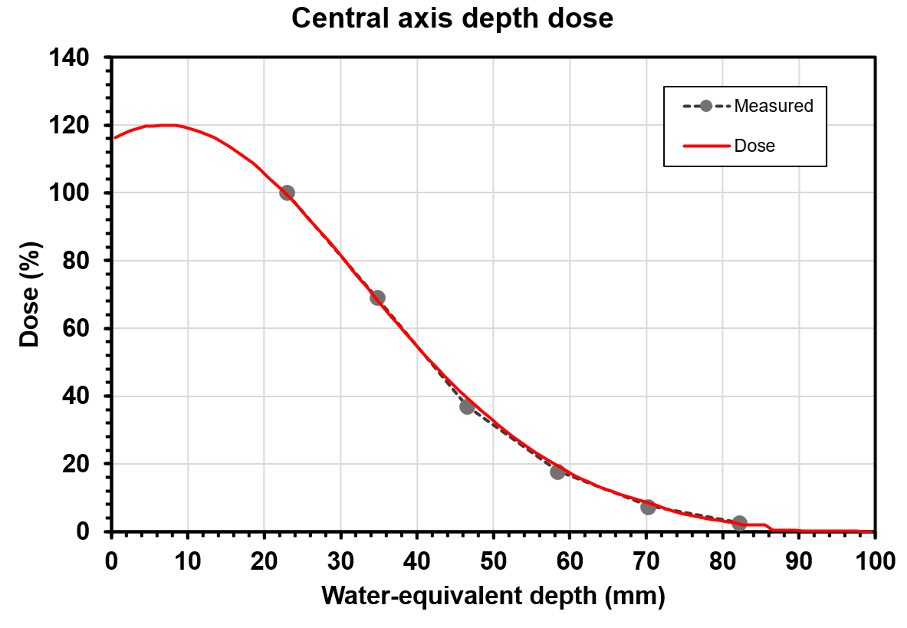
Fitted beam model
R_{50%} (mm) ≈ 2 × E (MeV)
Bedford et al. Phys. Med. 125: S334-S335 (2024).

Slide 15
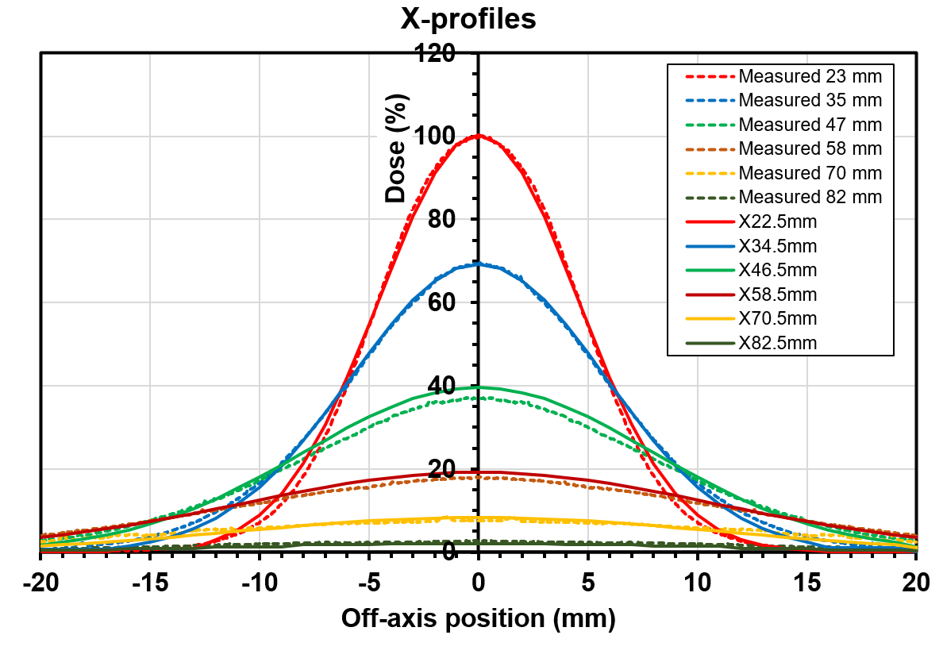
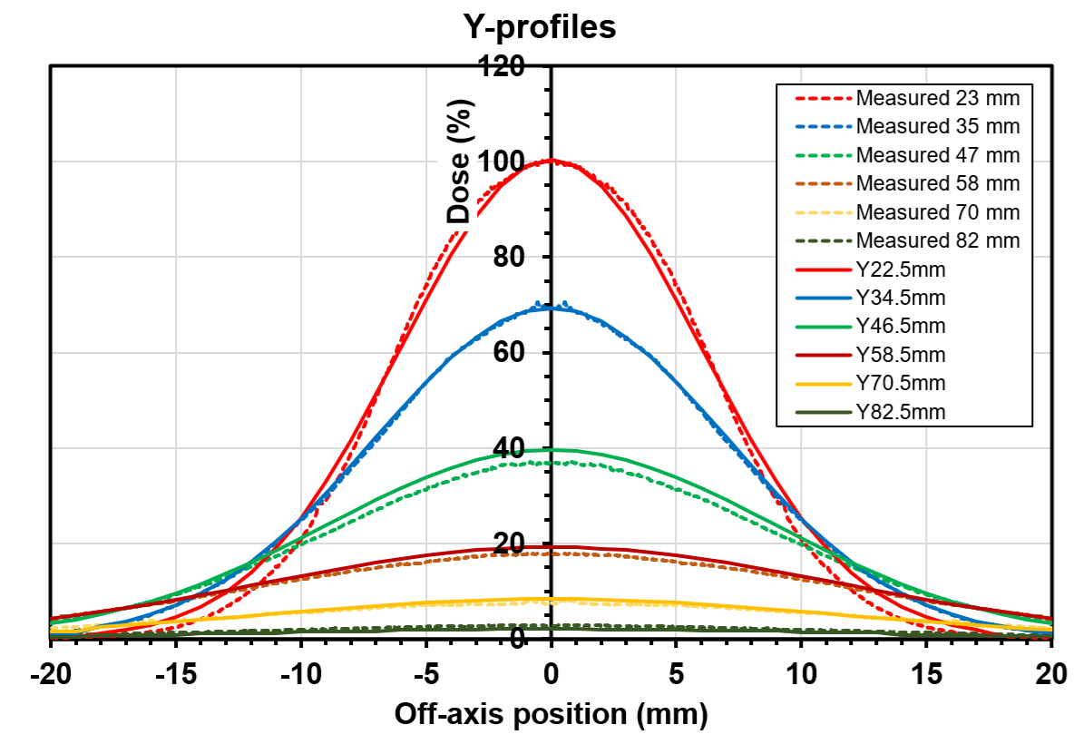
Fitted beam model
Symmetrised beam profiles with calculated fits
Bedford et al. Phys. Med. 125: S334-S335 (2024).

Slide 16
Treatment planning with FLASH effect
3

Slide 17
Treatment planning summary
AutoBeam v6.4 in-house software
New PITZ beam model
Discrete ordinates Boltzmann dose
Pulse-by-pulse model of dose rate
Used in iterative inverse planning scheme
Takes 10 mins at 2 mm dose grid resolution
Bedford JL. Phys. Med. Biol. 69: 035021 (2024)

Slide 18
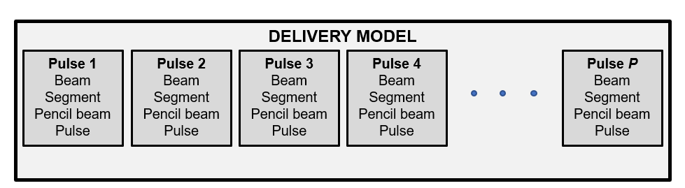
Pulse-by-pulse treatment planning model
Direction
Energy layer
Spot position
Bunch
Beams give distinct directions
Segments give energy layers in “spread-out electron peak”
Pencil beams are spot positions from kicker
Pulses in this context are bunches
Bedford JL. Phys. Med. Biol. 70: 045010 (2025)

Slide 19
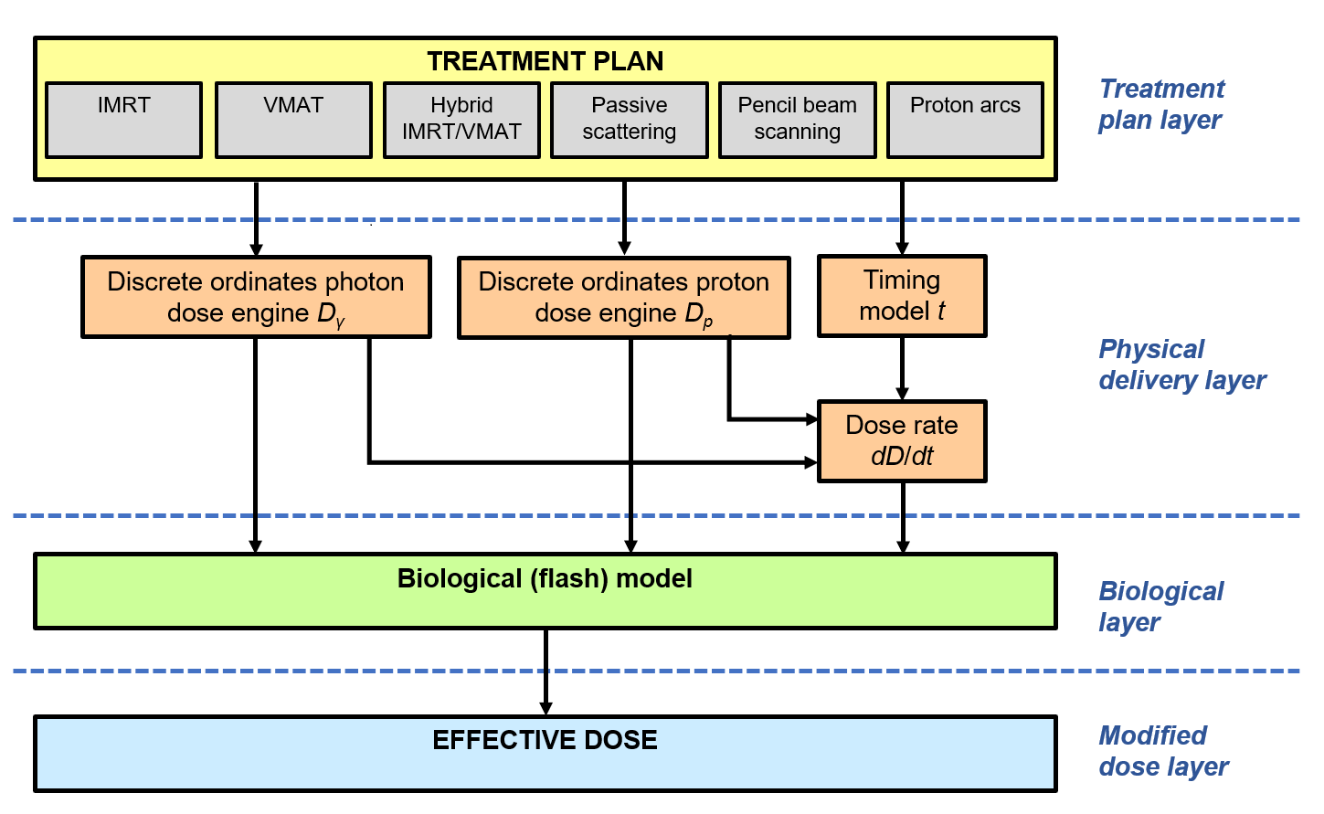
AutoBeam biological layered strategy

Slide 20
Key FLASH parameters
F_{R}
Monitor unit rate 10¹³ MU s⁻¹
(1 MU = 1 cGy to 0.01 m²)
10¹¹ Gy s⁻¹ in target
FLASH threshold
10 Gy dose
40 Gy s⁻¹ dose rate
FLASH mod factor 0.2
0.2
0.0
0
40
100
Dose rate
(Gy s⁻¹)
RBE
1.0
1-F_{R}
0.0
0
10
Dose (Gy)
Böhlen et al. Int. J. Radiat. Oncol. Biol. Phys. 114: 1032−1044 (2022).

Slide 21
Potential clinical applications
4

Slide 22
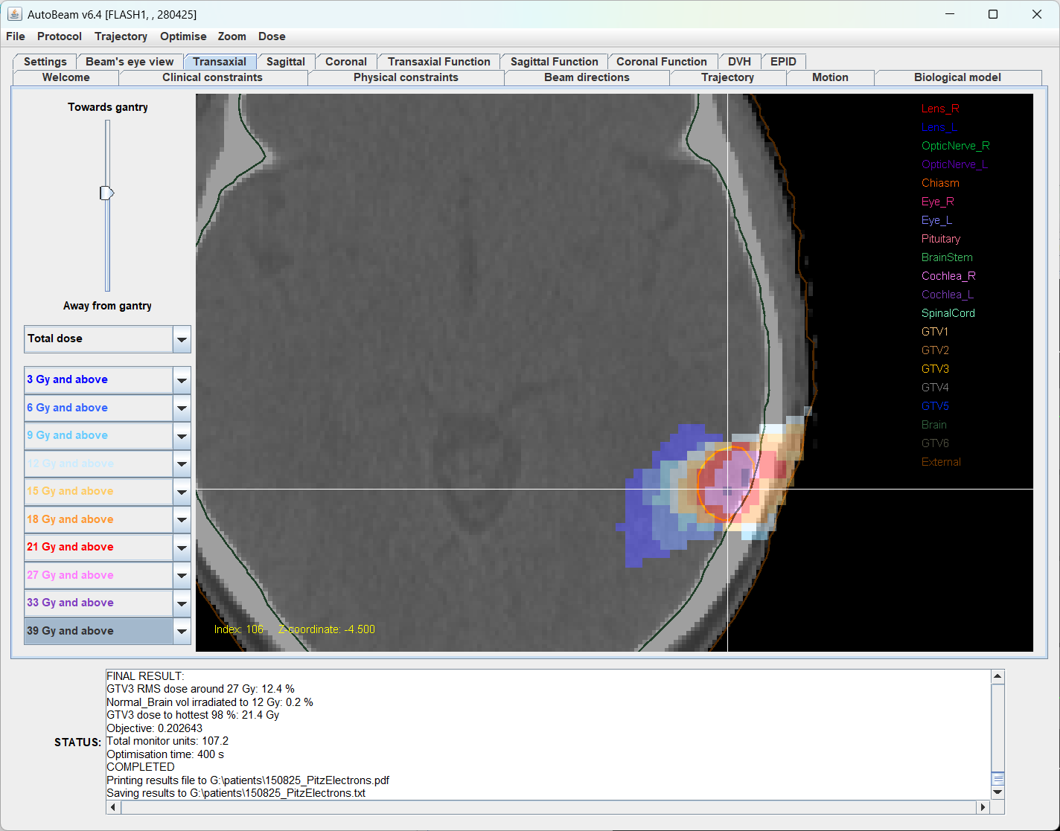
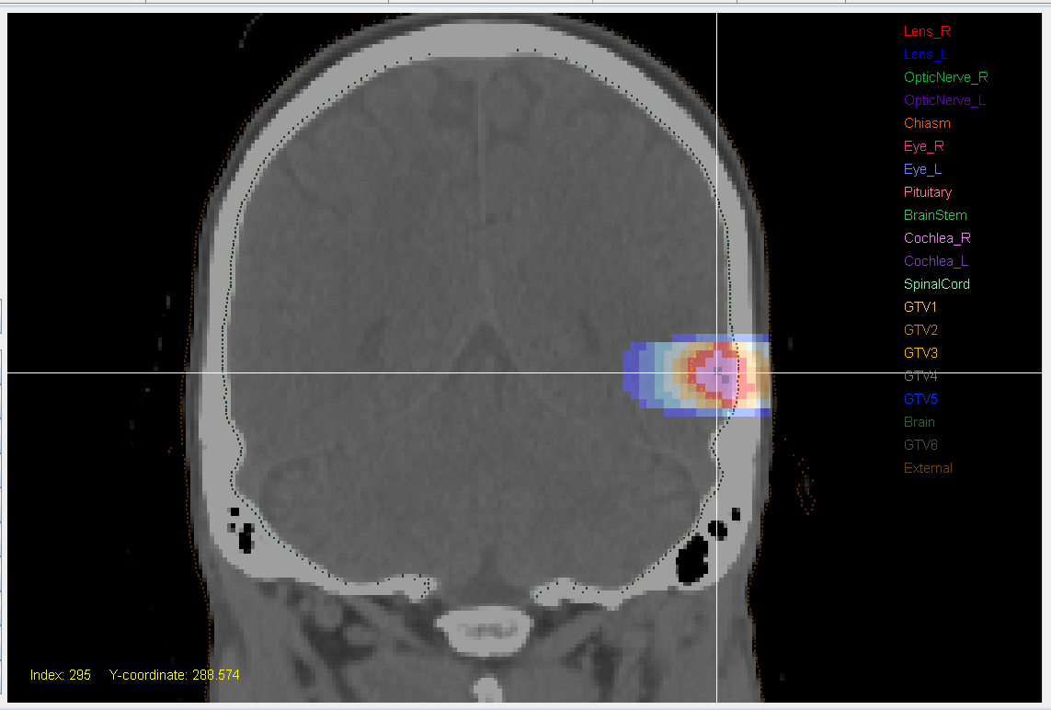
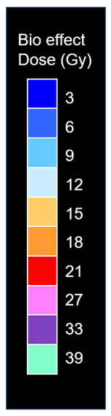
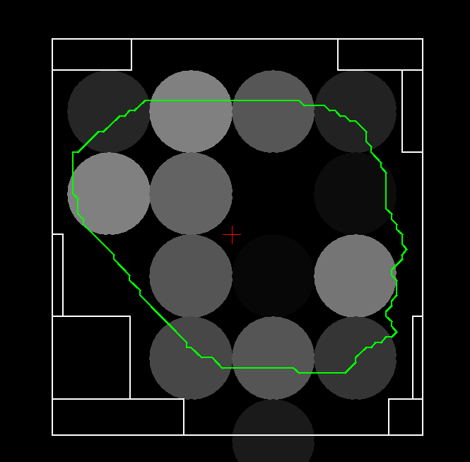
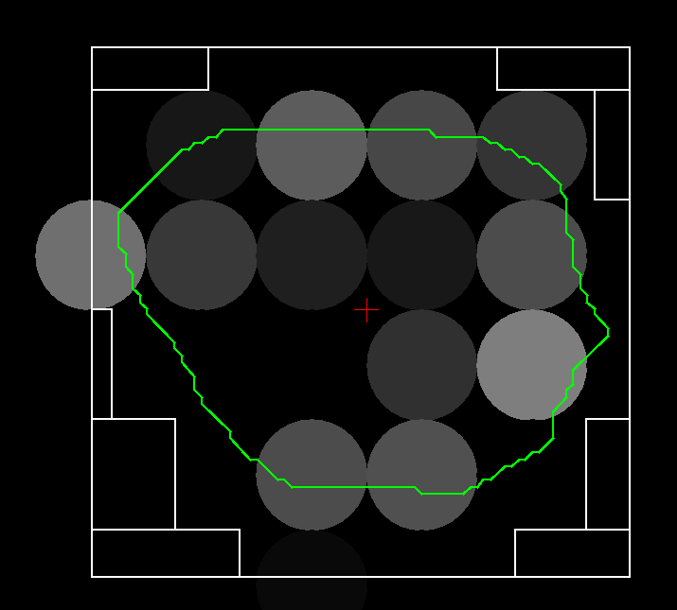
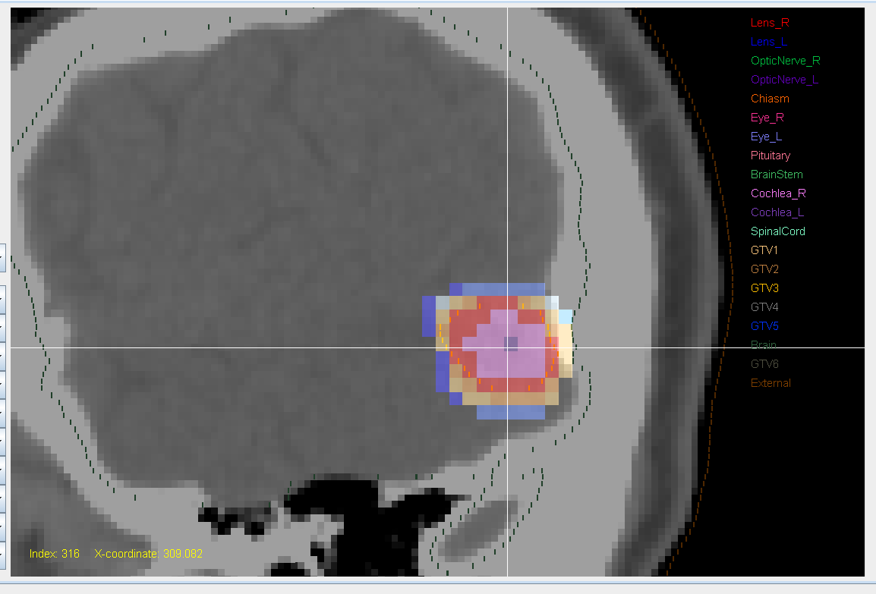
Superficial brain tumour
A
A
S
Gross tumour volume
R
L
R
L
R
L
P
I
S
4 mm
P
A
P
I

Slide 23
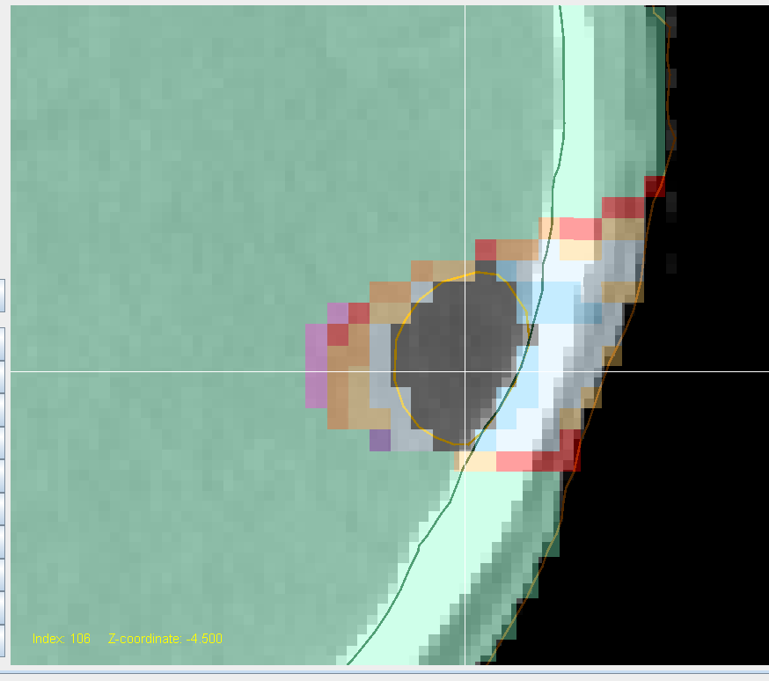
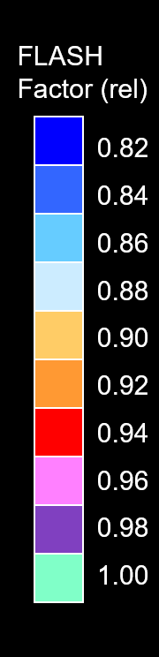
Estimation of FLASH effect
A
A
A
R
L
R
L
P
P

Slide 24
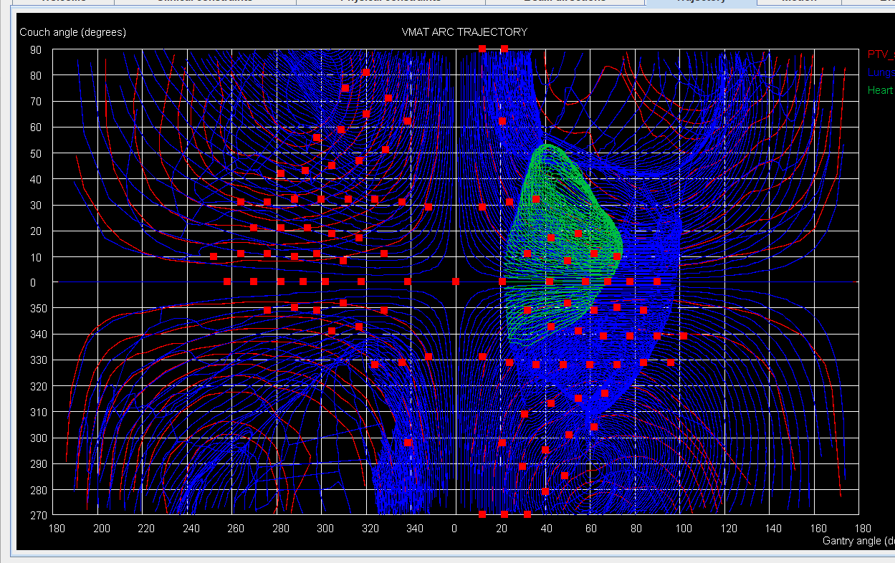
Comparison with Cyberknife: robot paths
C-arm equiv couch angles
C-arm equivalent gantry angles
Bedford et al. Med. Phys. 47: 1533-1544 (2020)

Slide 25
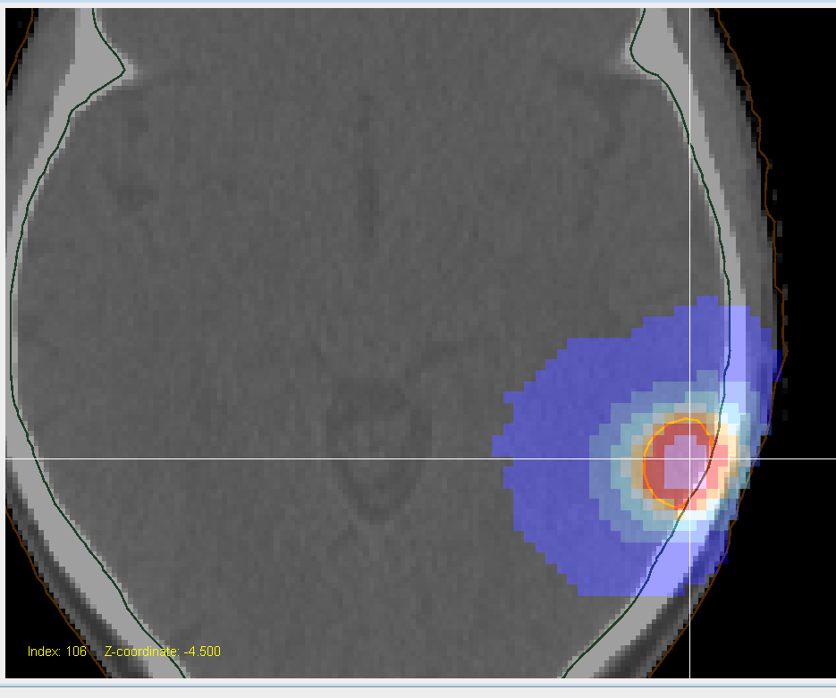
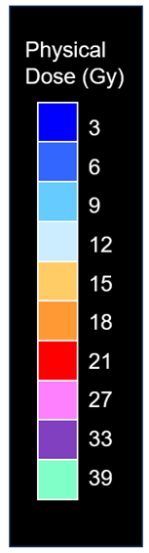
Electrons versus Cyberknife
A
A
R
L
R
L
P
P

Slide 26
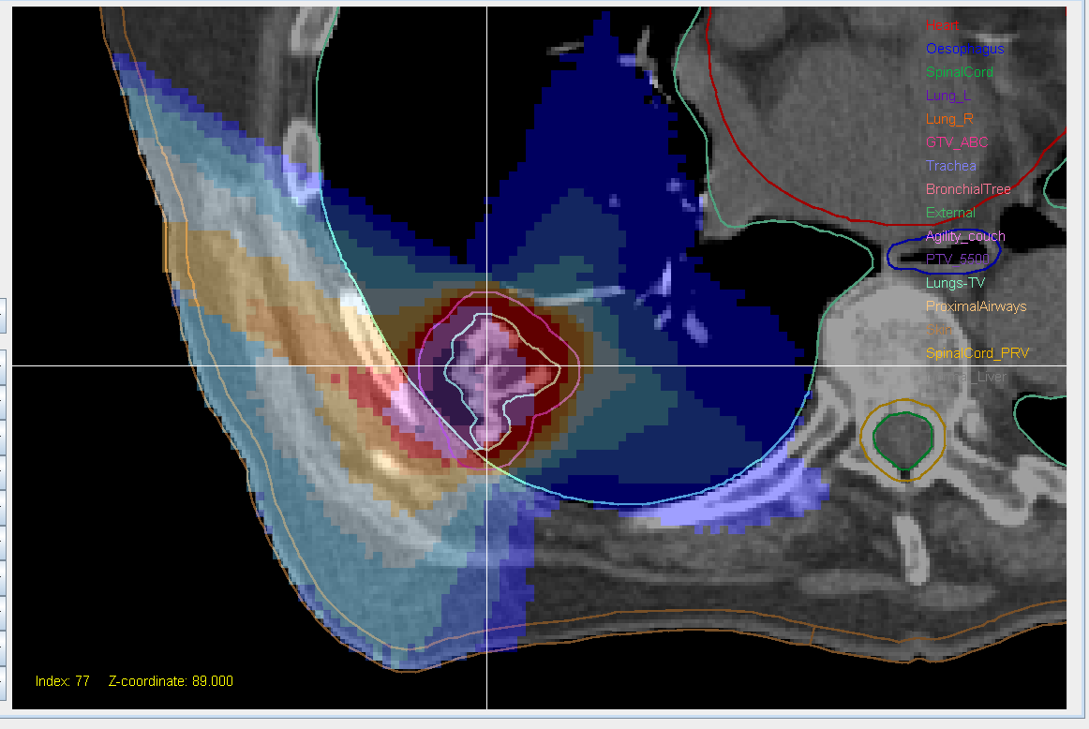
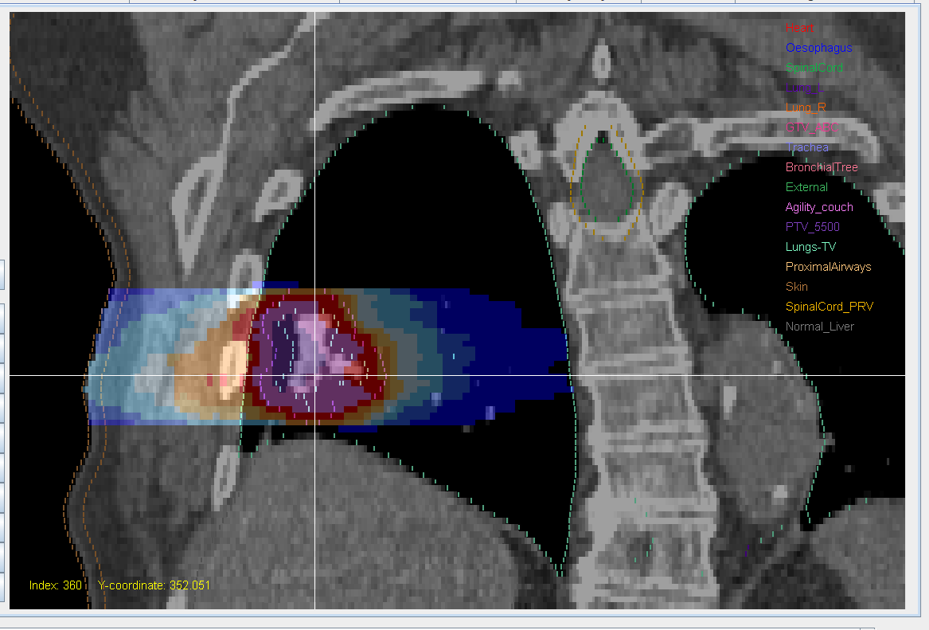
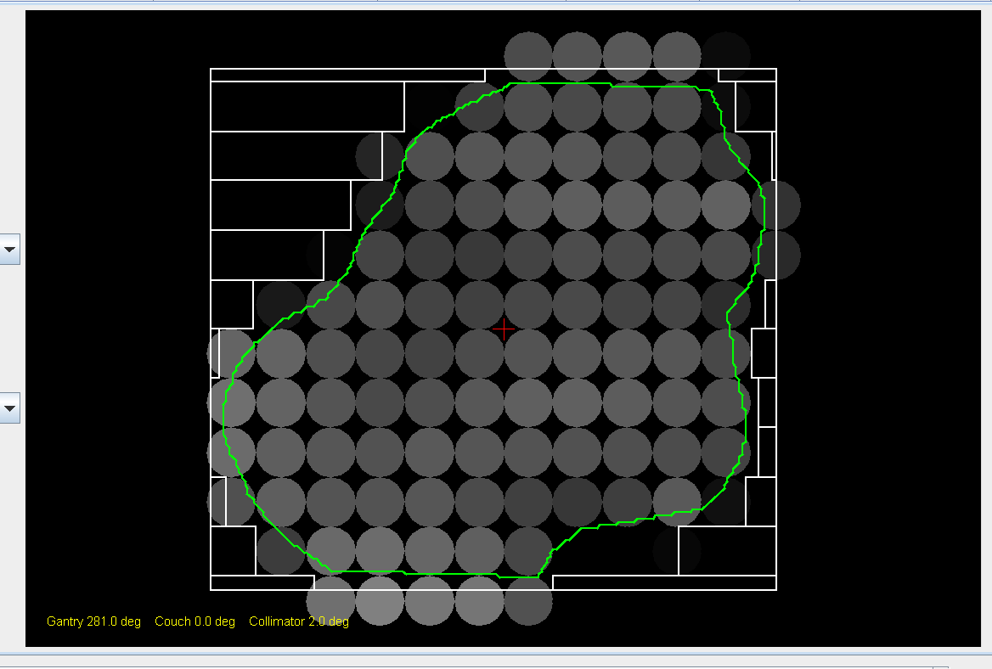
VHEE arc: superficial lung at 180 MeV
S
A
R
L
R
L
I
P
120° arc with 4° control point spacing

Slide 27
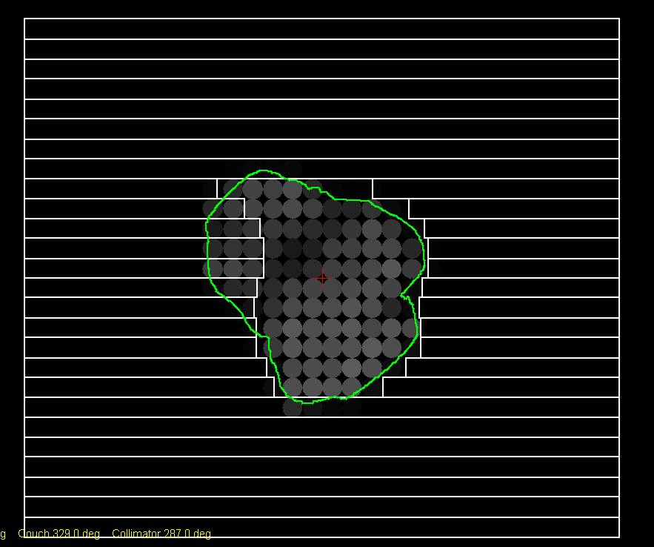
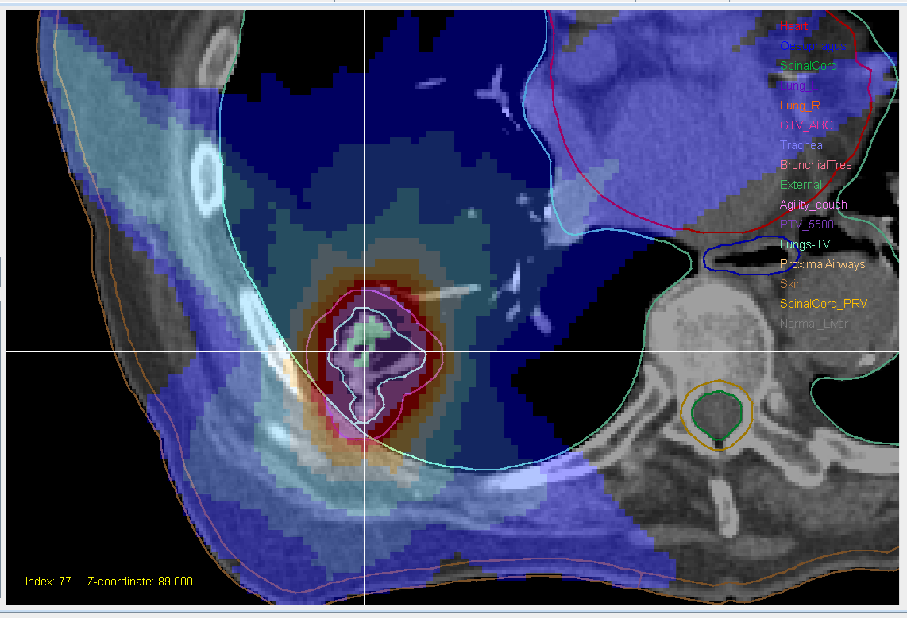
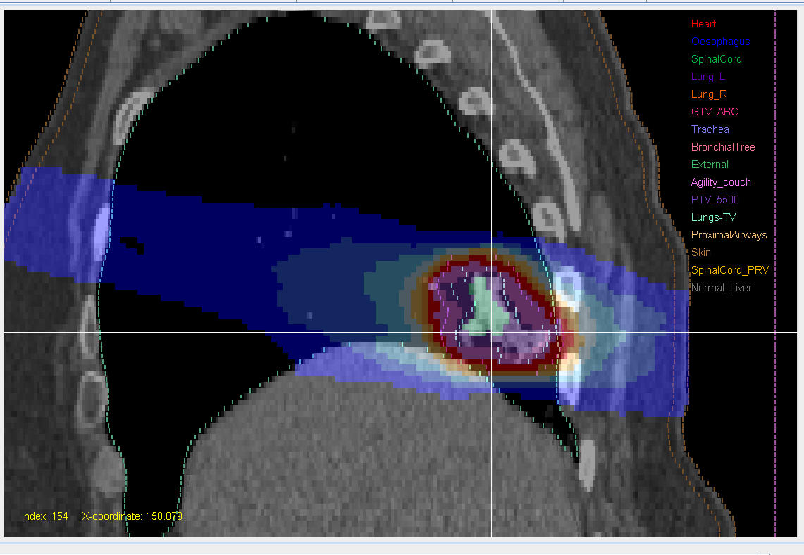
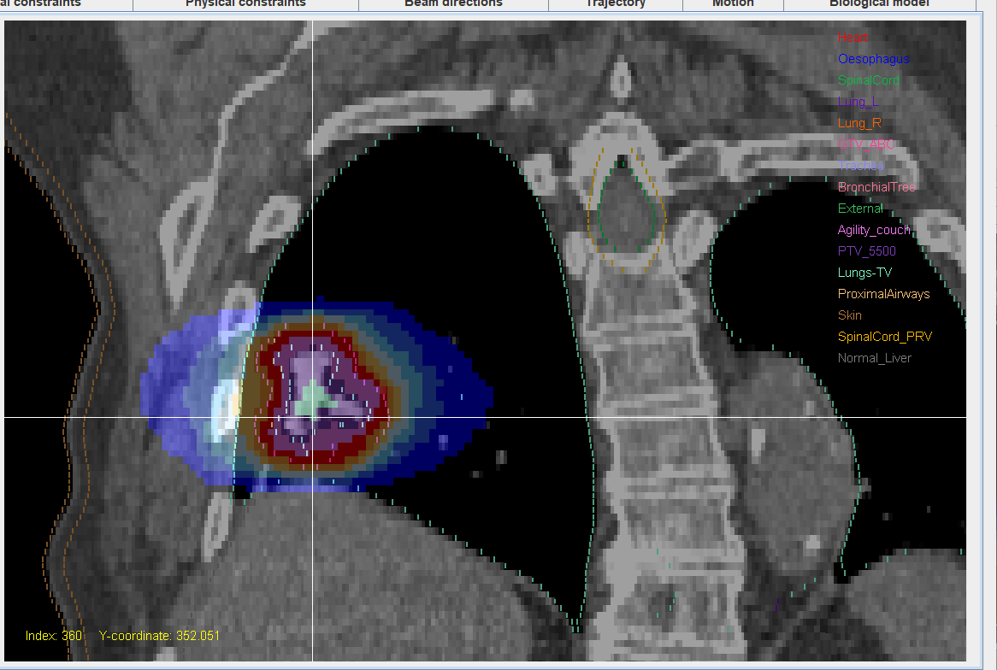
Superficial lung: Cyberknife comparison
A
R
L
P
S
S
A
P
R
L
I
I

Slide 28
Conclusions
5

Slide 29
Discussion and Conclusions
Need to decide on energy: depth dose versus penumbra
VHEE appears beneficial compared to photons
Planning: pulse resolution and overall treatment
Accelerators such as FLASHLAB@PITZ offer potential to exploit FLASH effect
This study uses conservative FLASH factor
The magnitude of the FLASH factor still unknown at such high dose rates
Higher energies may offer VHEE+FLASH benefits
Investigation on cohorts of patients needed

Slide 30

Acknowledgments
National Health Service
Funding to NIHR Biomedical Research Centre at The Royal Marsden and The Institute of Cancer Research
PITZ DESY
FLASHlab@PITZ

