Slide 1
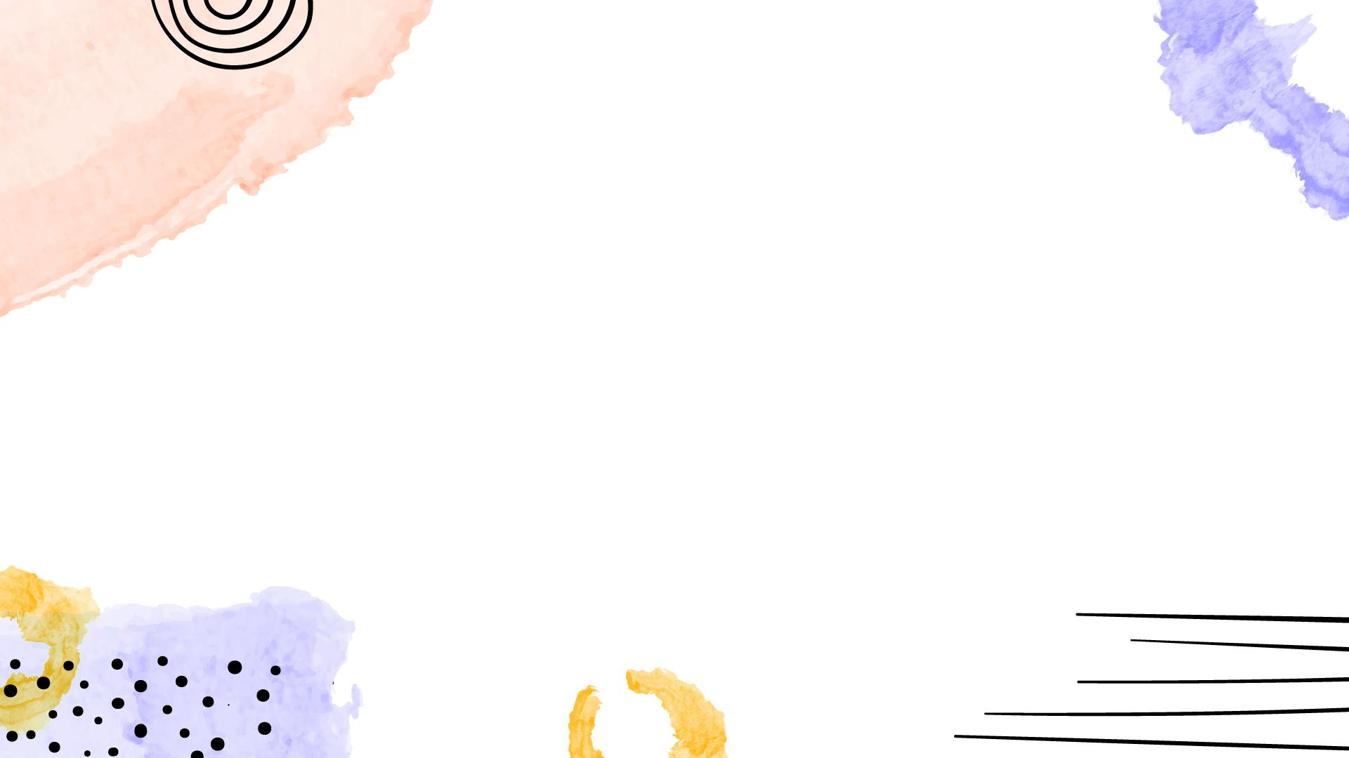
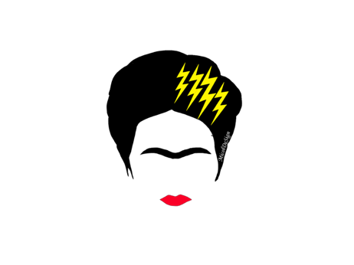



The challenge of VHEE planning: providing robust plans that will ease a FLASH delivery
A. Sarti
International Workshop on Very High Energy Electron Radiotherapy (VHEE’25)
STFC, Daresbury Laboratory

Slide 2
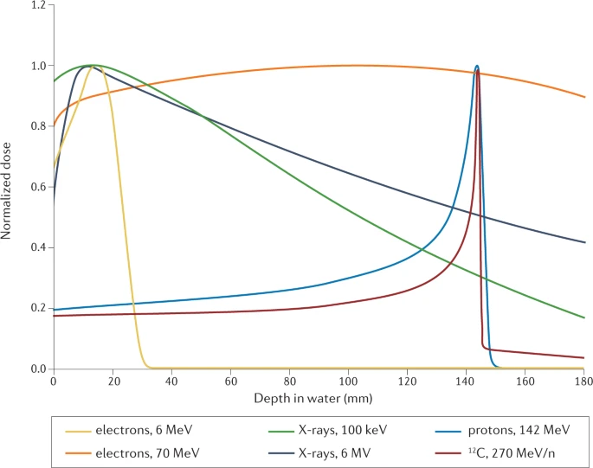
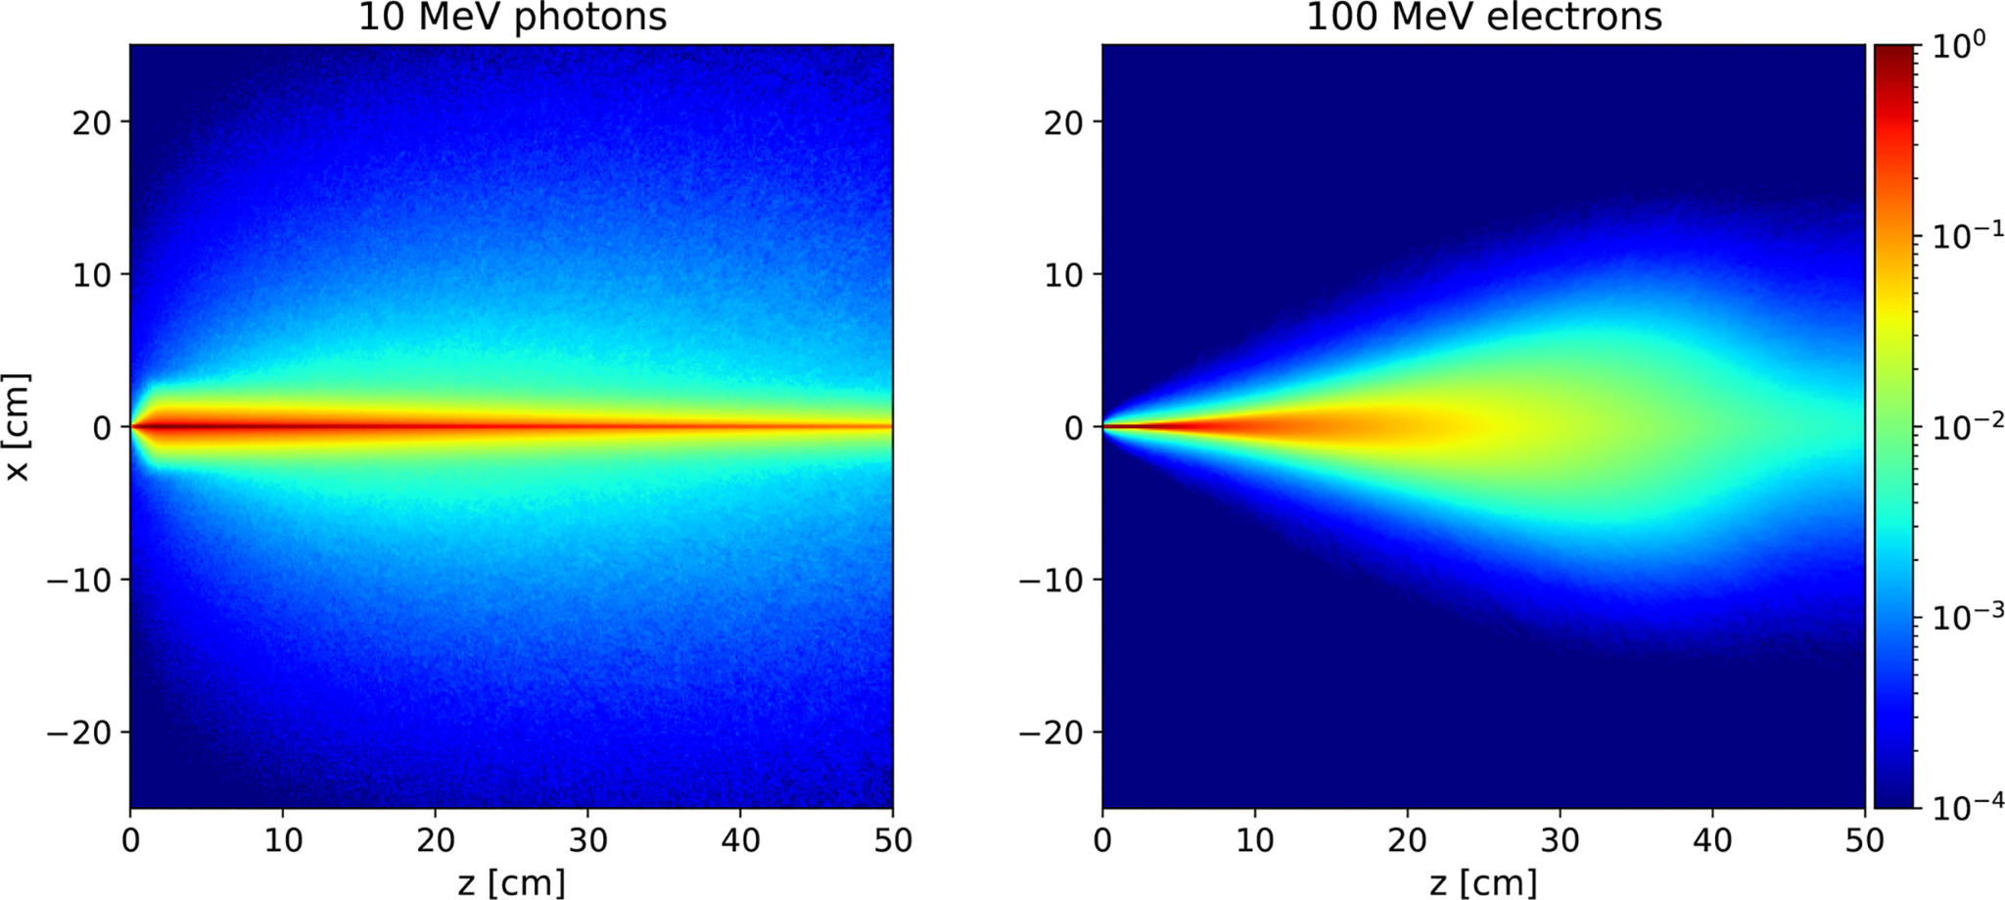
The challenge of VHEE planning
Planning with 𝛾 (earliest) and p / ¹²C (more recent) has a long history… For VHE e- it’s, almost, an unexplored territory (10 y?)..
What are the VHEE characteristics that we can exploit when planning a treatment?
Vozenin, MC., Bourhis, J. & Durante, M. Nat Rev Clin Oncol 19, 791–803 (2022).

Slide 3
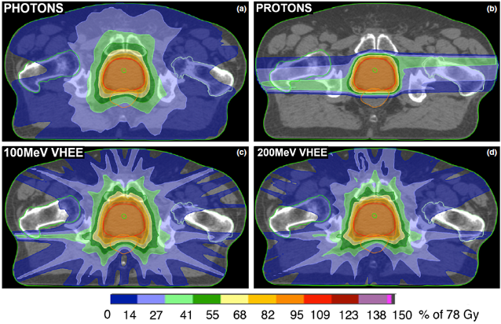
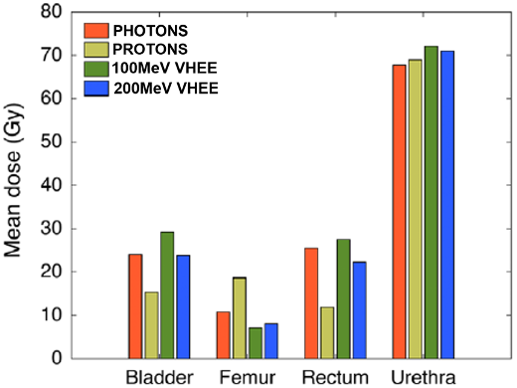

Are VHEE (CONV) suited for RT?
YES! known since, at least, 2014..
But initially with a focus on E>> 100 MeV (dose reduction in entrance channel + better dose conformity)
→ Geometry and beam delivery in first attempts was inherited from IMRT
→ We kept this approach as we are looking towards FLASH: no arc, no need to reduce dose to OARs as FLASH will help us

Slide 4
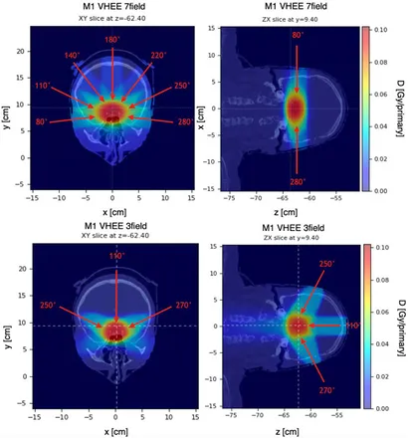
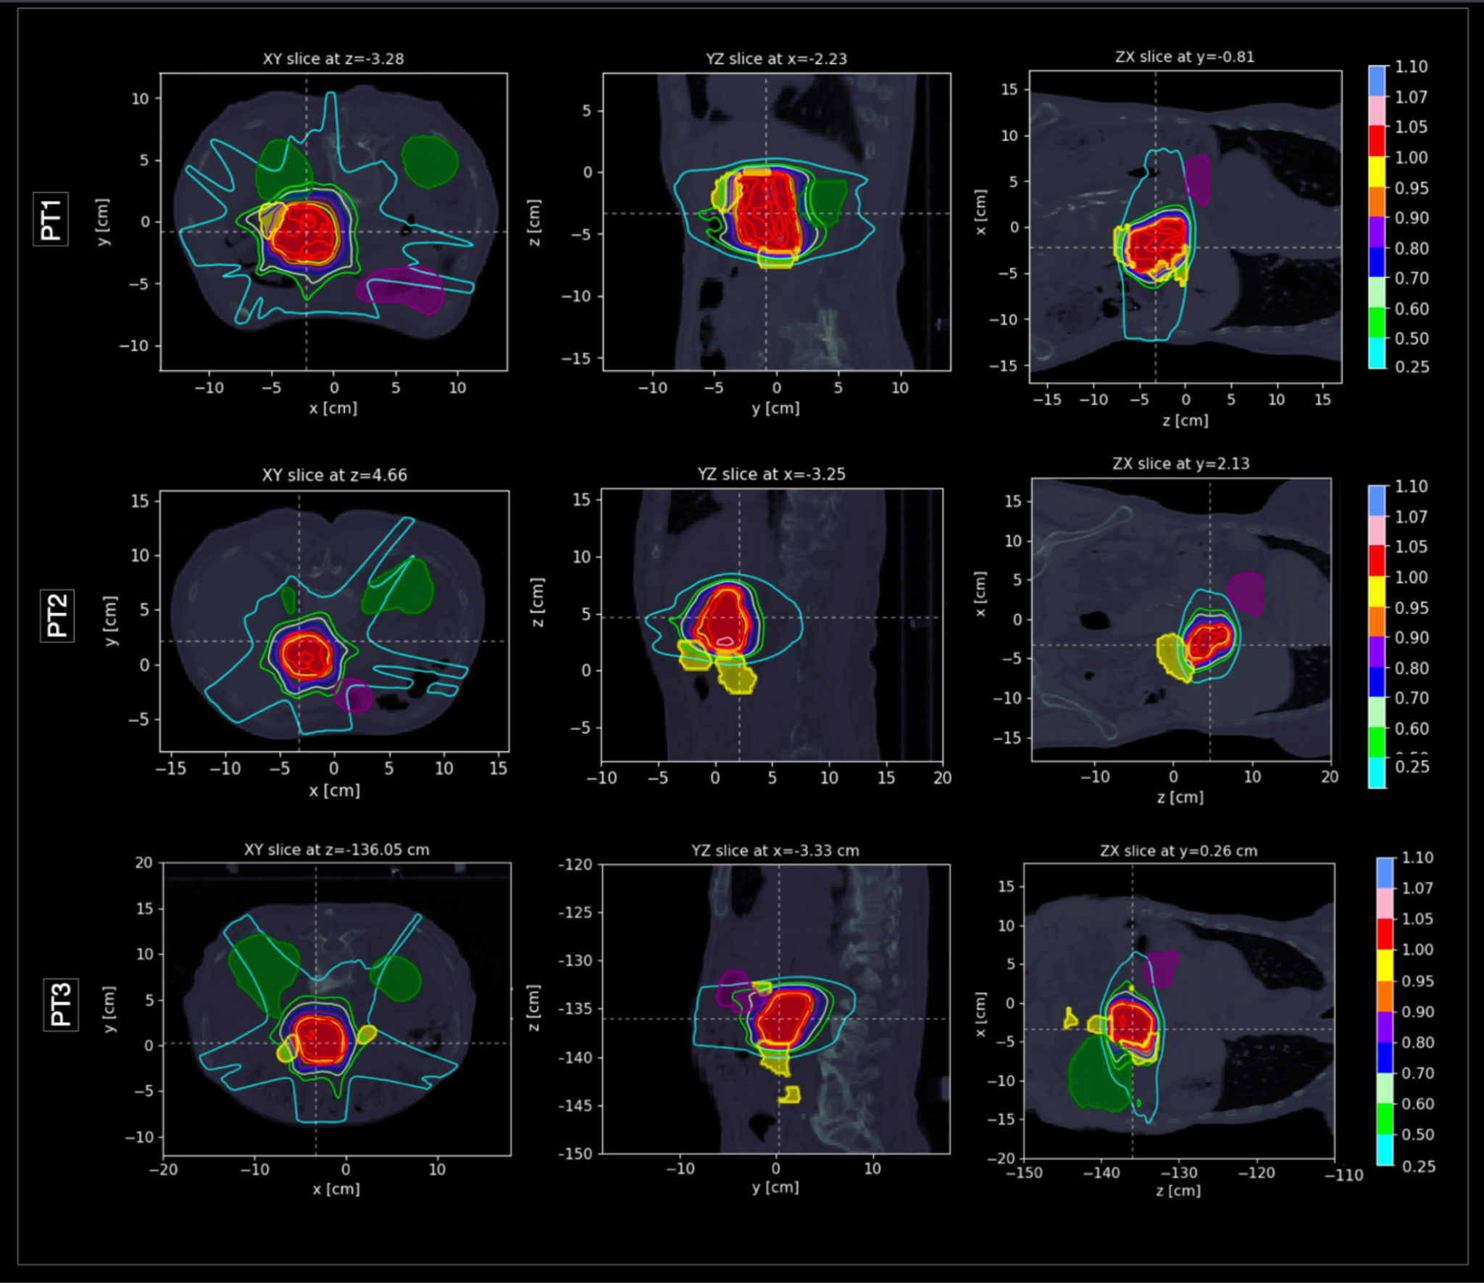
IMRT ok for complex geometries
Intracranial lesions
Pancreatic cancer

Slide 5
To plan → we need a beam model
The exploration of ALL the possible solutions will take some time :)
We started from few (arbitrary) assumptions on a possible road towards FLASH
Compact accelerating solution (small footprint, advantage wrt p) → ‘small’ E [70 - 150 MeV]
Few irradiation fields (IMRT like)
Naturally VHEE from RF are coming in ‘pencil beams’ transverse size @ exit window of ~mm, with small divergence
We had in mind a ‘SAFEST’-like solution [see L. Giuliano talk] for VHEE… Most of the results can be generalised in a straightforward way!
[please be reminded that everything I show in the next slides is MC ☺]

Slide 6
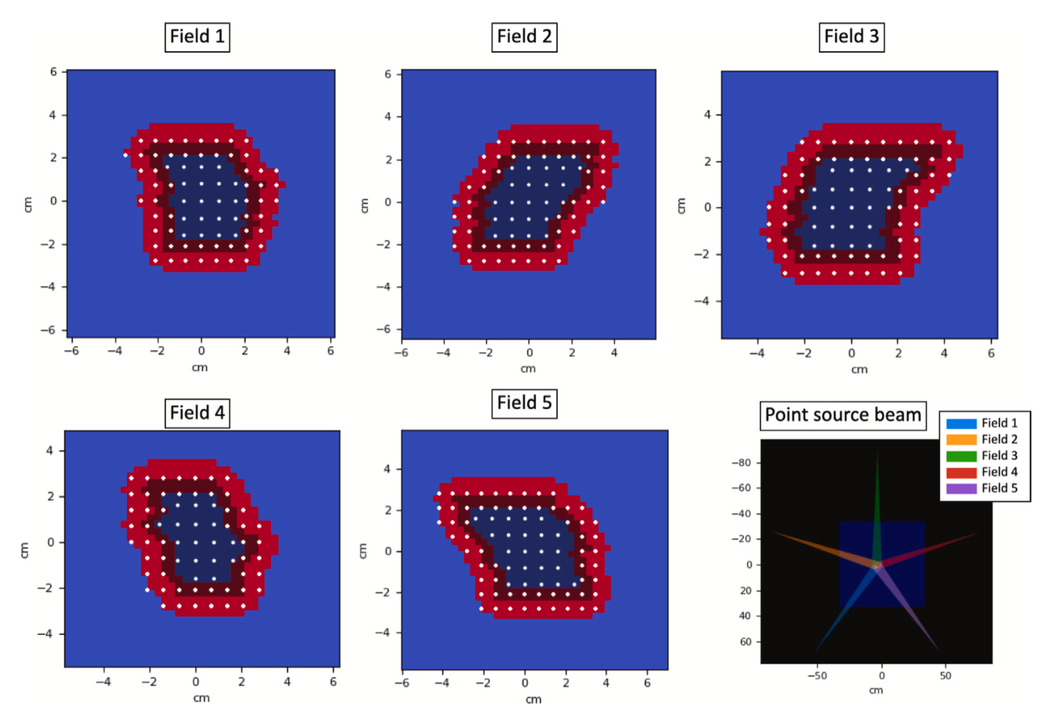
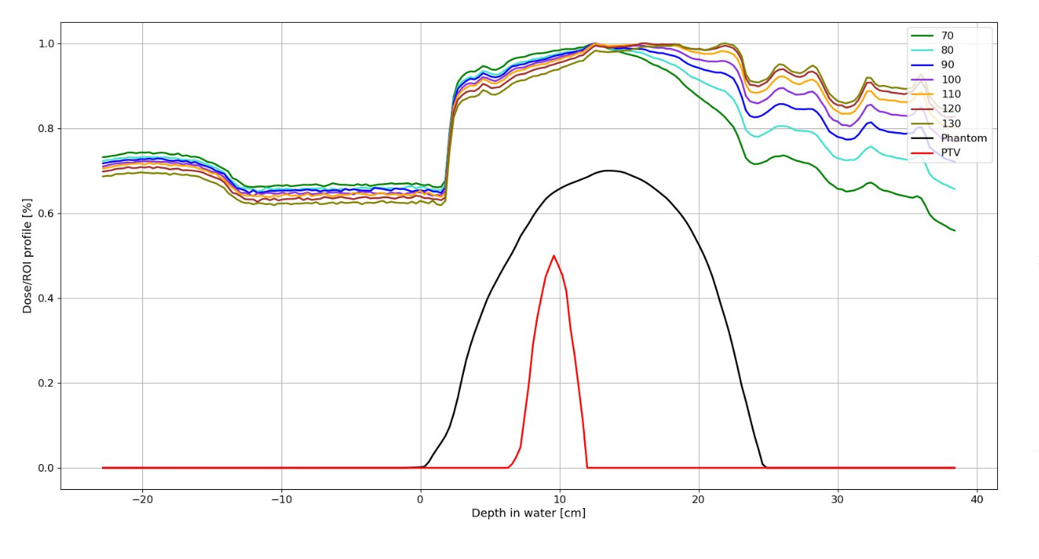
The workflow
Mimic IMRT
3. Define field E
2. Choose APBS pattern
Assumption for FLASH: 1 field <-> 1 E

Slide 7
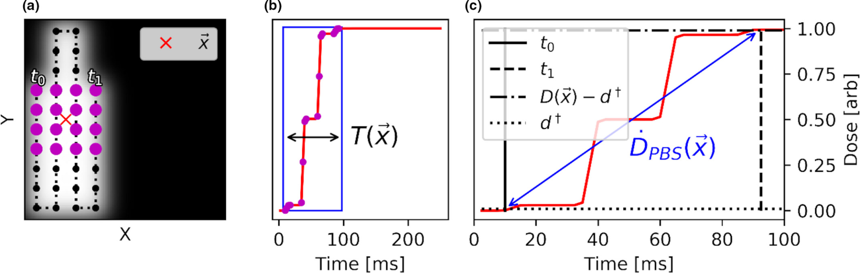
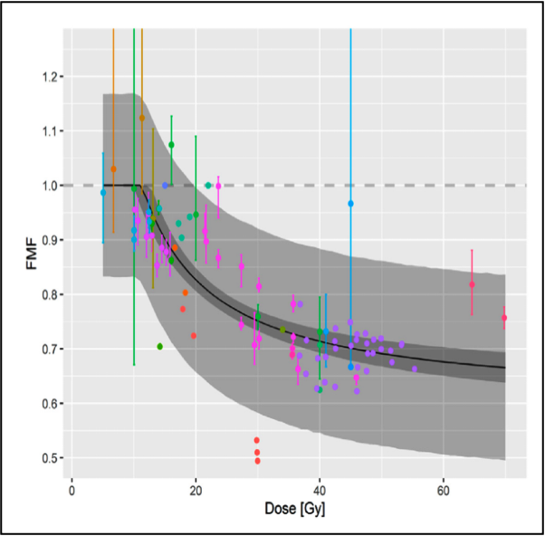
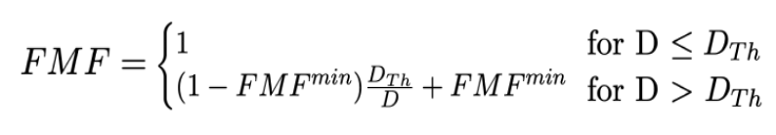
How to include FLASH?
→ DR calculation as in Folkerts, M.M. (2020), Med. Phys., 47: 6396-6404 + Threshold (40 Gy/s)
Little is known yet about dependence on tissue, D and DR of the FMF (FLASH sparing)
→ D modeling as in Bohlen,Int J Radiat Oncol Biol Phys. 2022 Dec 1;114(5):1032-1044.
Robustness comes from varying D_{th}, FMF_{min}, DR threshold AFTER ensuring CONV compatibility

Slide 8
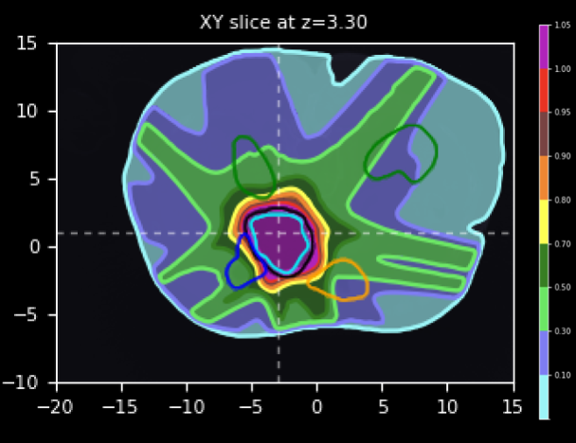
A first exercise: pancreatic cancer
Start with a “simple” exercise:
→ Implement APBS
→ Neglect, on first attempt, the DR dependence: go only for D dependence
duodenum
PTV
Treatment efficacy is limited by induced duodenum toxicity → Can we increase the dose to the PTV while keeping the max dose to the duodenum under control (avoid perforation → patient death)?
Treatment of pancreatic cancer with very high dose per-fraction (e.g. 6 Gy) is likely to profit significantly from the FLASH effect!

Slide 9
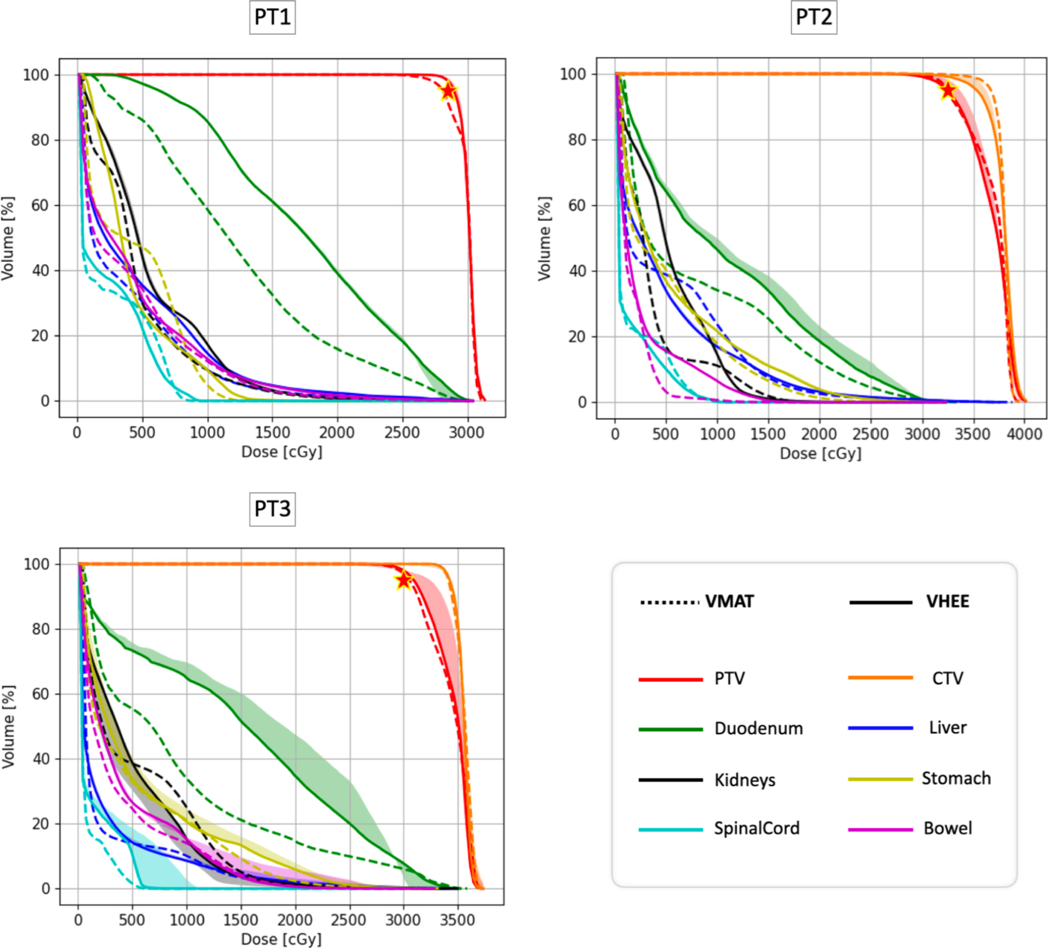
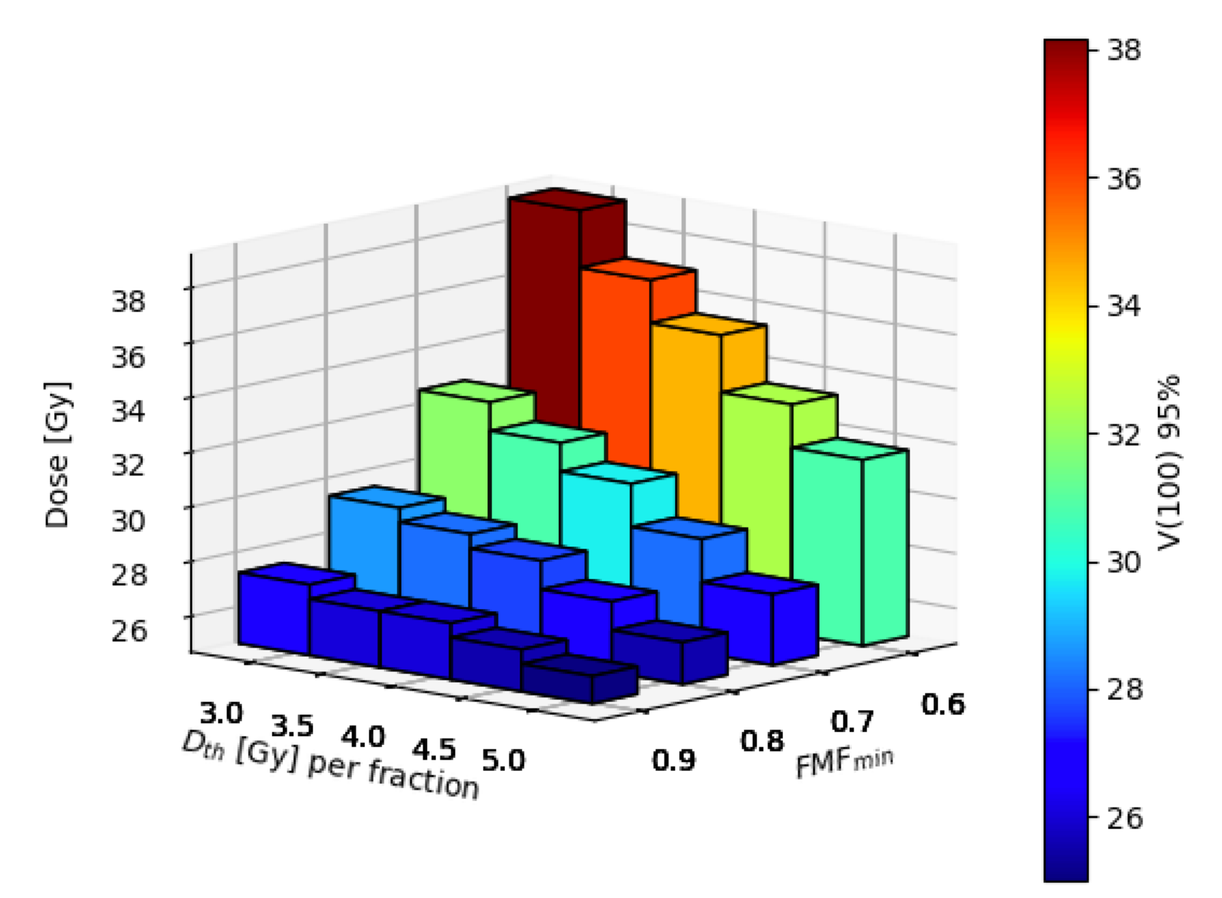
Pancreatic cancer: results
[neglecting DR dependence, assuming FLASH in the whole OAR volume]
Prescribed dose (*0.95) that can be reached in 100% of the target volume
The FLASH effect could allow to significantly increase the D prescriptions!
A. De Gregorio et al., Phys Med 137, 2025, 105076 [10.1016/j.ejmp.2025.105076]

Slide 10
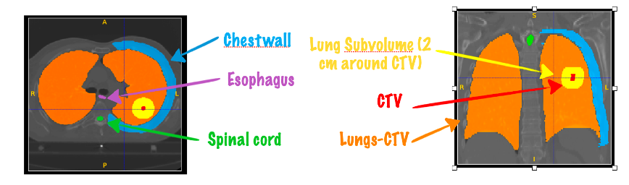
A step forward: including DR
Neglecting the DR dependence can have a HUGE impact on the results: FLASH it’s not “only” about D but mainly about DR
→ We need to include the ‘details’ on how we want to deliver the beam to compute the DR and account for it
The perfect candidate for FLASH studies: treatment of NSCLC with very high doses per fraction, small number of PBs (small volume 4 to 10 cc), promising results from lung toxicity reduction in mice with FLASH!
Lung tumour patients treated at Campus Bio-Medico University Hospital of Rome with high D prescriptions using photons delivered with VMAT technique.

Slide 11
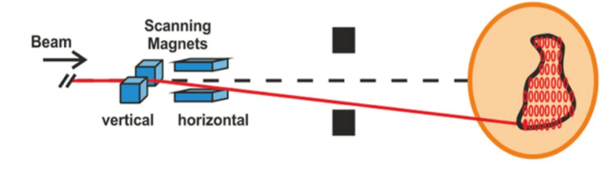
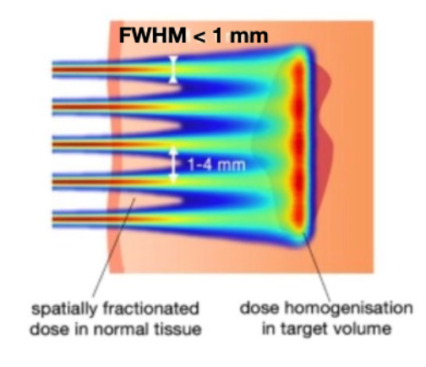
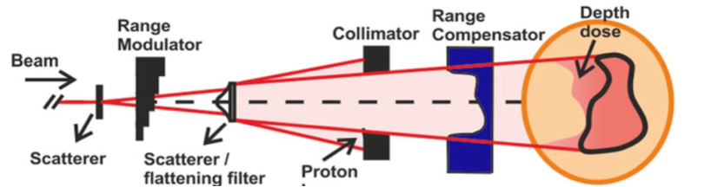
Three examples.. (not exhaustive!)
Active scanning with smallest number of PBs compatible with reasonable dose conformation to the PTV → slower but better PTV coverage
Spatial fractionation (minibeam) → combines advantages of SFRT & FLASH (D and DR increase in entry channel)
‘Flat’ beam with 2D (transverse) D shaping → worse PTV coverage, but highest DR!

Slide 12
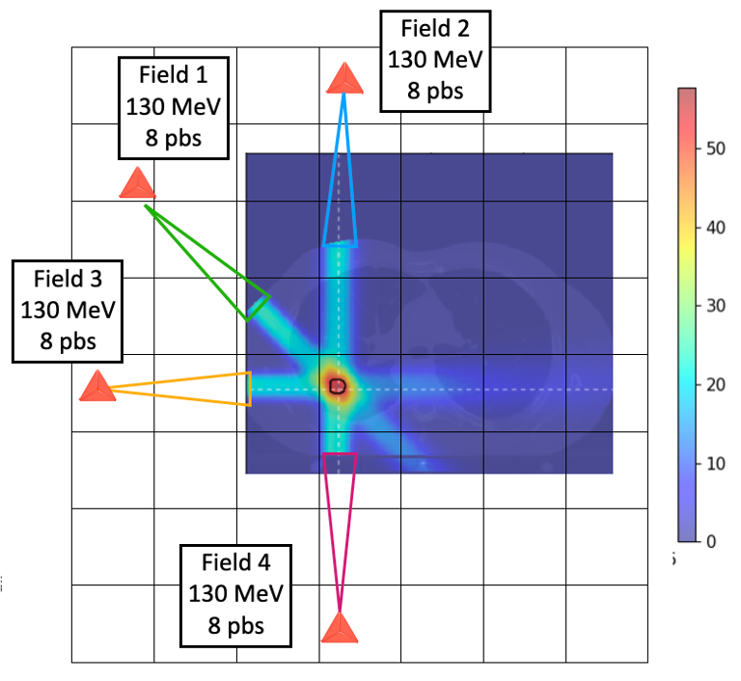
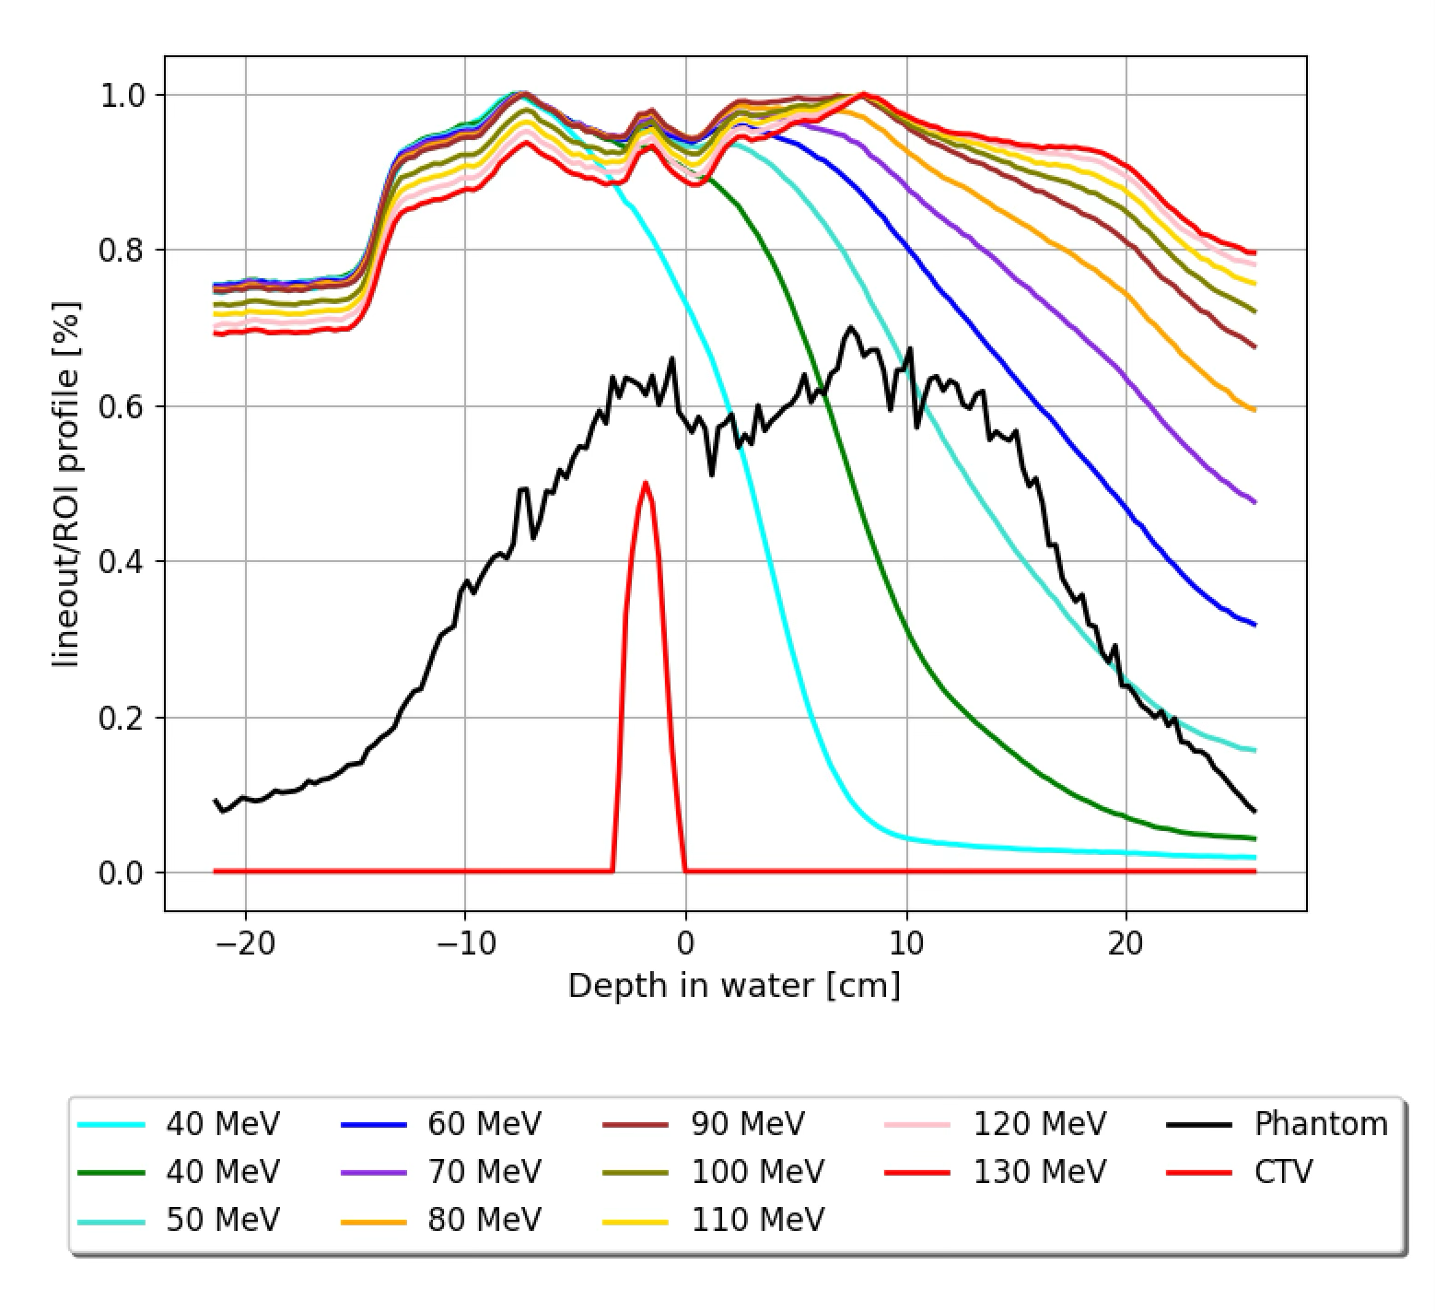
APBS lung treatment
Same 4 fields approach for all the different options (PBS, Flat, SFRT)
PBS: optimised #PB + fixed FWHM (1cm) → looking @ dose conf in CONV mode
FLAT: ‘emulated’ 2D collimation → no real entrance beam shape optimisation → conservative results
SFRT: went for highest PVDR ratio while keeping good uniformity/coverage of PTV
Beam E optimisation
130 MeV are needed to reduce the dose in the entrance channel [chestwall/ribs].. No significant gain in overall plan quality going @ 200 MeV

Slide 13
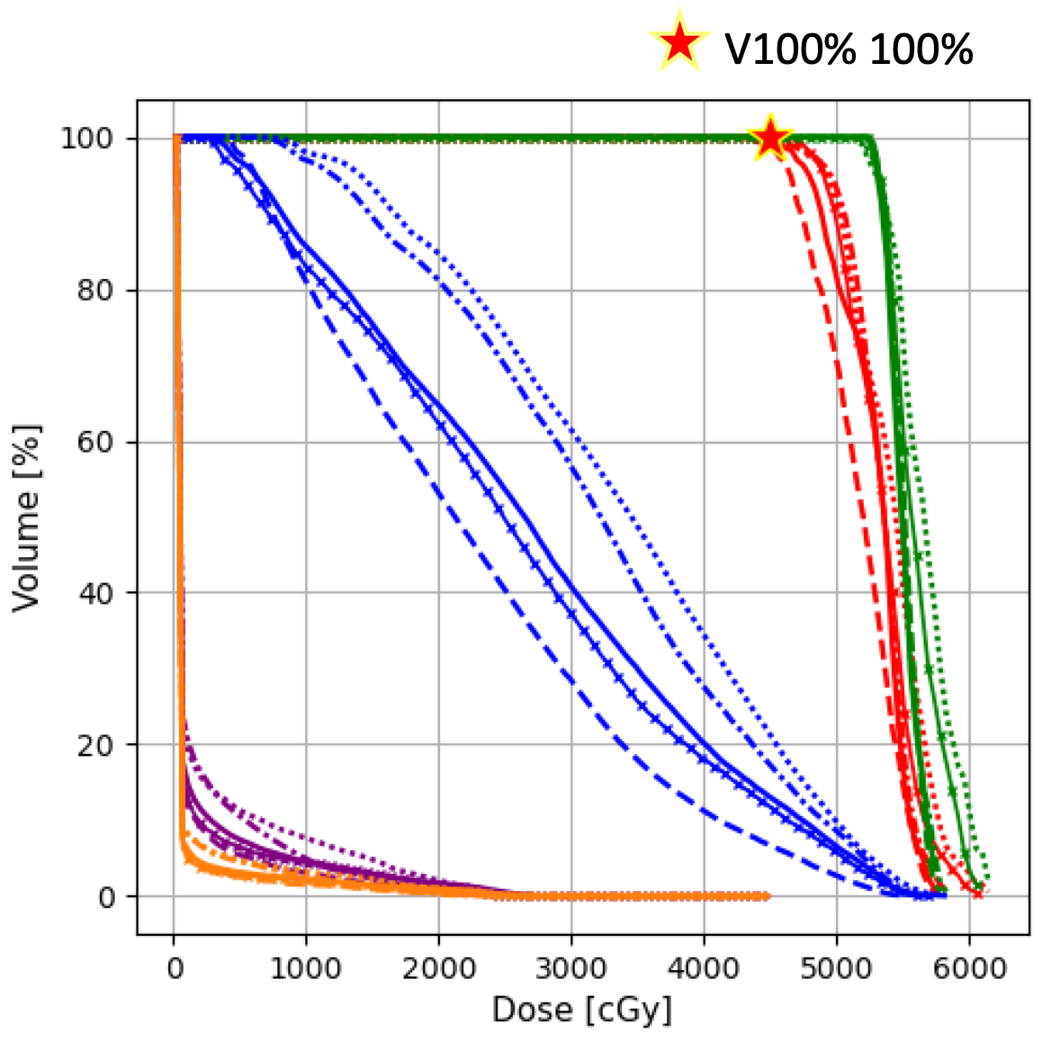
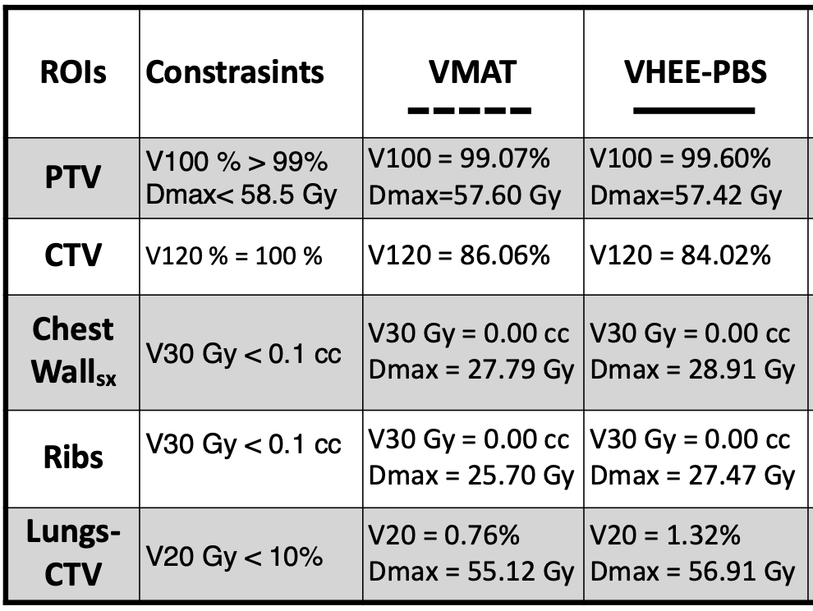
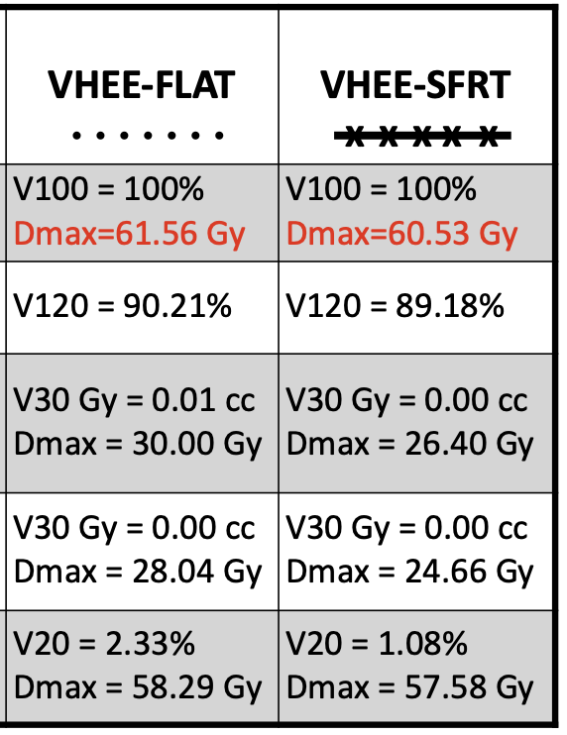
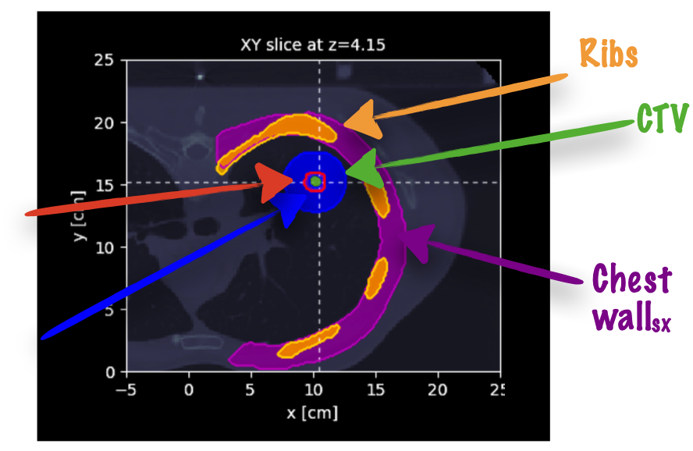
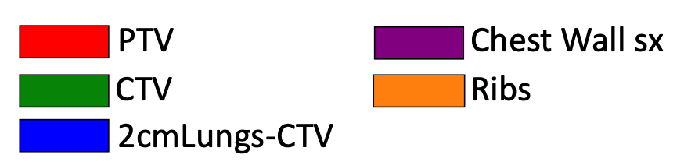
NSCLC results - CONV
PTV
Portion of lung
tissue within 2
cm of the CTV
9

Slide 14
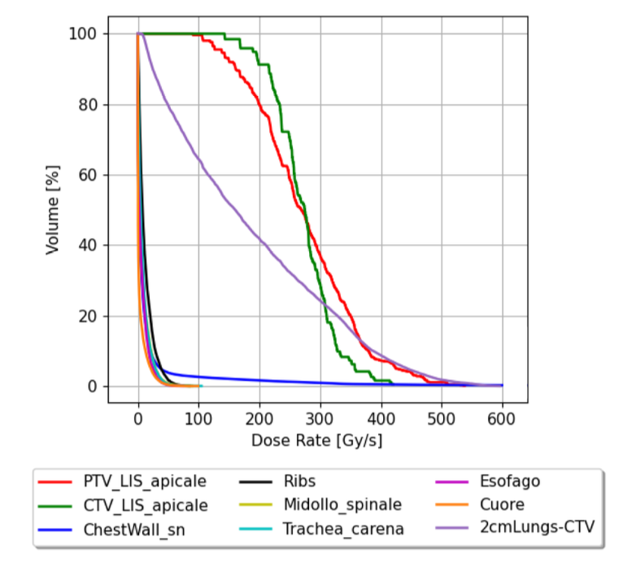
What about the ‘DR’?
PTV
DRVH
CTV
When computing the DR in a multi-field approach we are facing an important challenge: account for the ‘field switching effect’.
2cm lungs -CTV
40 Gy/s
chestwall
For now: computing a ‘per field’ DR and applying the FMF correction if (in each field) D and DR requirements (>40 Gy/s) are met!

Slide 15
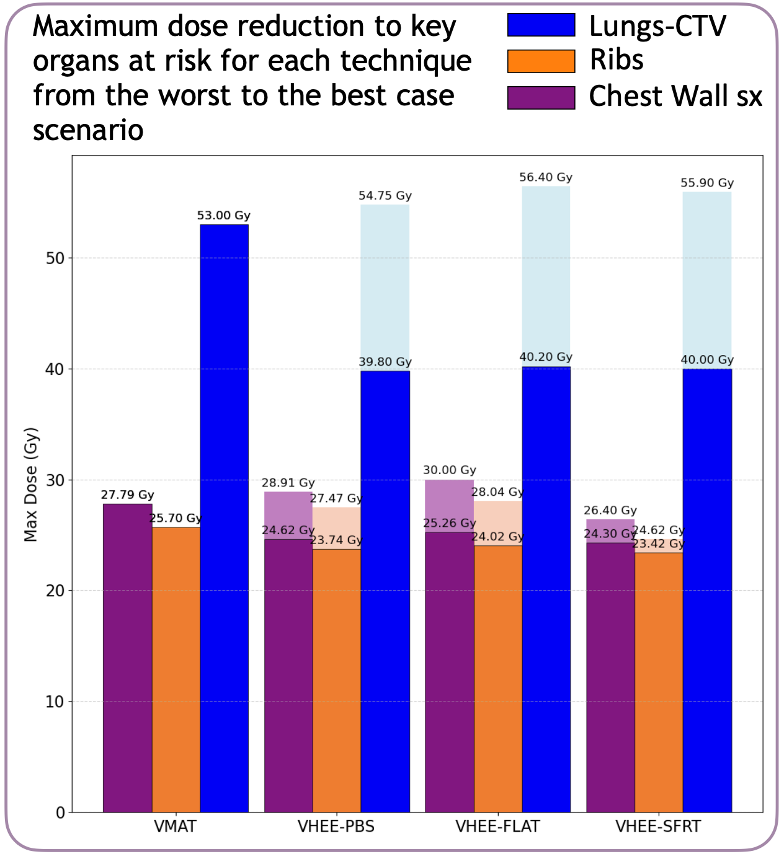
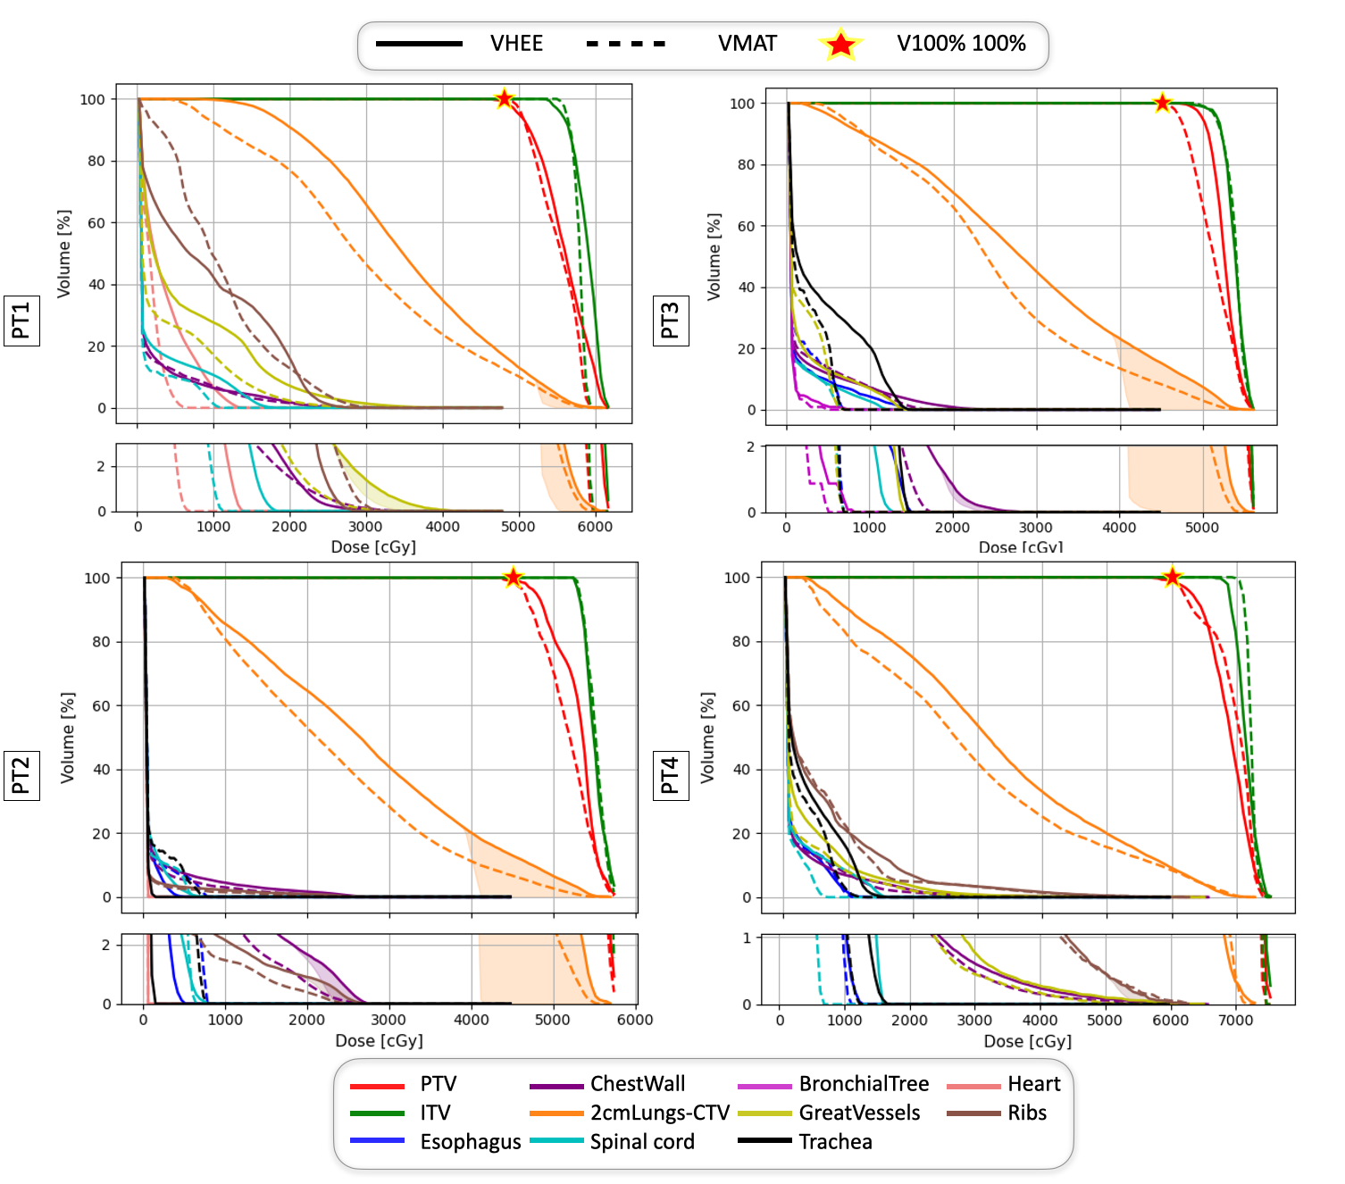
The FLASH potential
 | Lungs | Other OARs
FMF^{min} | 0.12 | 0.6
D_{th} | 6 Gy | 13 Gy
Data | Mouse lung | Zebrafish body

Slide 16
The FLASH potential
The D dependence
PT 1: 4 x 12 Gy
PT 2: 3 x 15 Gy
PT 3: 3 x 15 Gy
PT 4: 8 x 7.5 Gy
Why such a small effect?
D/field outside PTV is small!

Slide 17
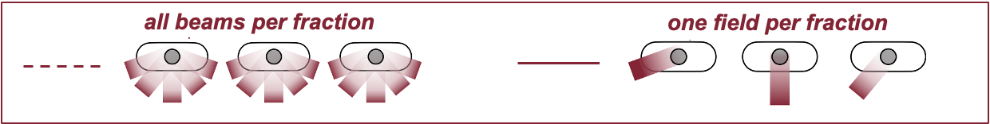
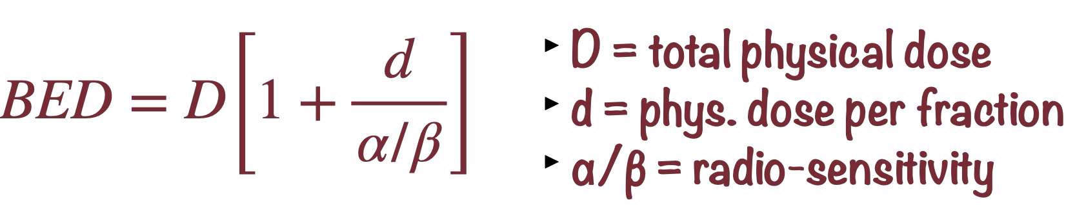
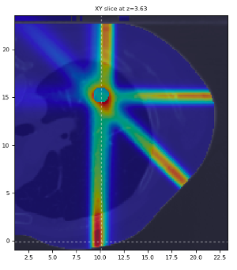
The ‘one field per fraction’ approach
How to increase the FLASH effect? Deliver 1 field x fraction: dose per field/fraction increases! → Switch to BED to account for new fractionation scheme..
In our example: 4 fields? → 4 fractions
What matters are the ⍺/β values:
⍺/β (PTV) : 10 Gy while ⍺/β (OAR) : 3 Gy
Can FLASH balance the huge increase in toxicity for the OARs?

Slide 18
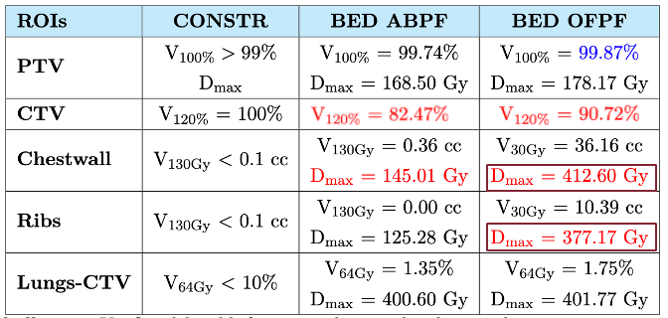
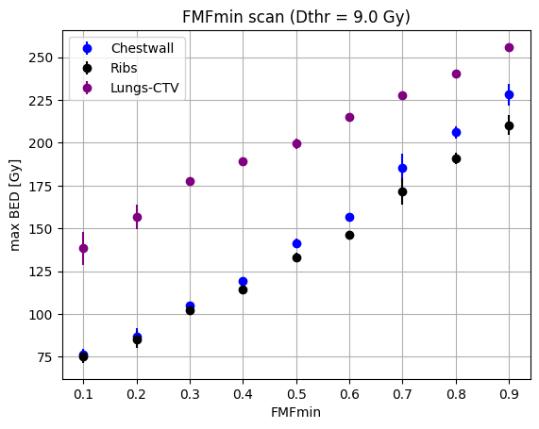
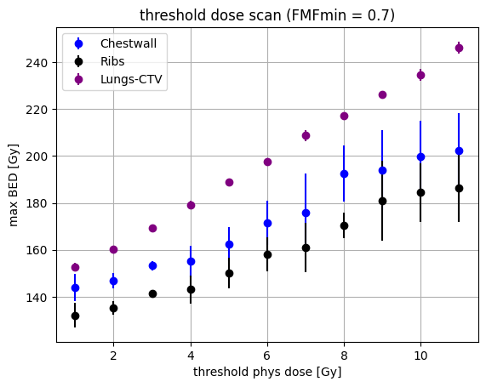
OFPF : results
CONV exposes OARs in entry channel to

Slide 19
Concluding remarks
VHEE (E ≥ 100 MeV) are competitive with state-of-the-art RT and PT → interesting for FLASH applications in view of fixed-E ‘SOBP’ w.r.t p
Still room for ‘optimising tools optimisation’ → conservative results so far!
FLASH evaluation, so far, starts after reaching the CONV conformity and aiming to go beyond exploiting the FLASH sparing
The FLASH planning challenge is to balance two competing requirements: bring D and DR to maximum values while keeping BED and dose conformity at the level of CONV irradiations
Better modelling of D, DR and tissue dependence of FMF is crucial to define the best irradiation scenario → Robustness calls for full FMF^{min}, D_{th}, tissue study for each specific plan..
→ Different fractionation approaches might help to enhance the FLASH effect..

Slide 20
Spare slides

Slide 21
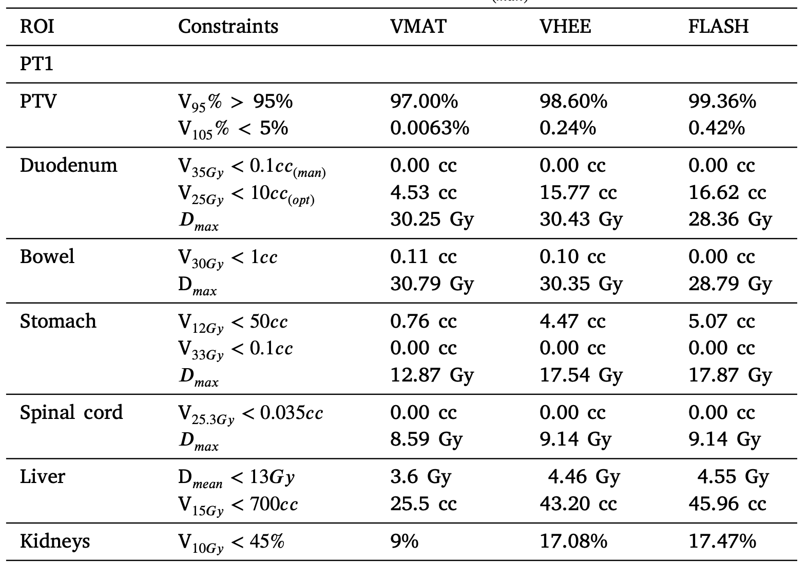
Pancreatic cancer: results

Slide 22
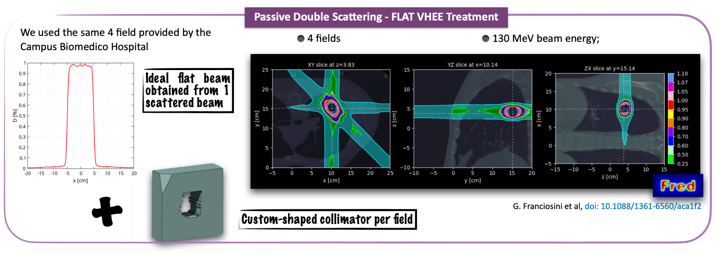

Slide 23
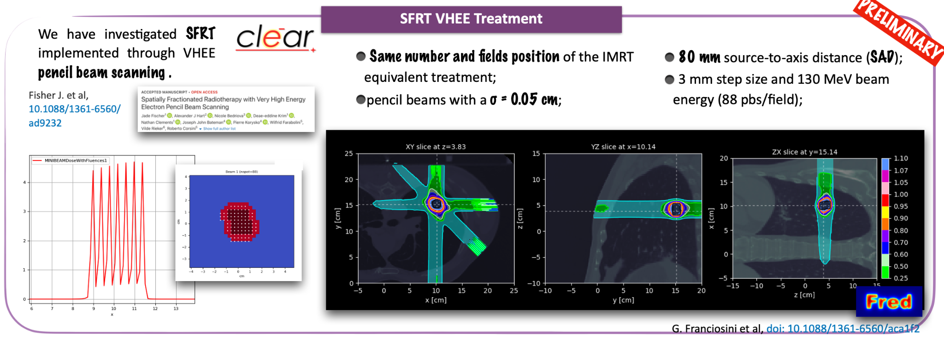

Slide 24
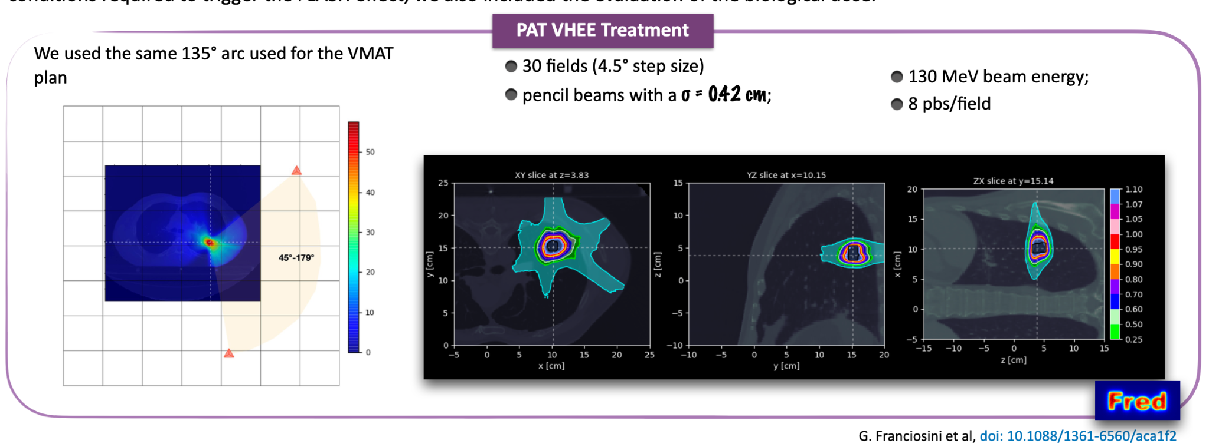
Arc? Yes we can.

