Slide 1

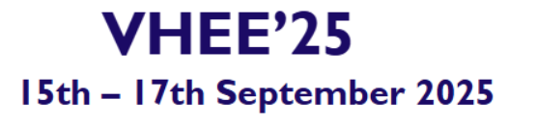




Note
Please feel free to photograph and share these slides on social media.
1/14

Slide 2
Dr. Jake Harold Pensavalle
Sordina IORT Technologies S.p.A. (SIT)
Very High Energy Electrons: Clinical Perspective and Constraints
Technological adaptations and clinical applications with FLASH
2/14

Slide 3
Outline
Introduction – FLASH & the VHEE Opportunity
Low-Energy Electron FLASH Research Platforms
Taking FLASH Deep: Very-High-Energy Electrons (VHEE)
Best Beam Modalities for VHEE-FLASH (Open-Field vs PBS)
Clinical Targets for VHEE-FLASH
Design Requirements for a Clinical VHEE-FLASH Linac
Conclusion & Outlook: VHEE as the Missing Link
3/14

Slide 4
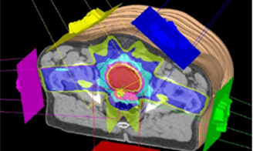
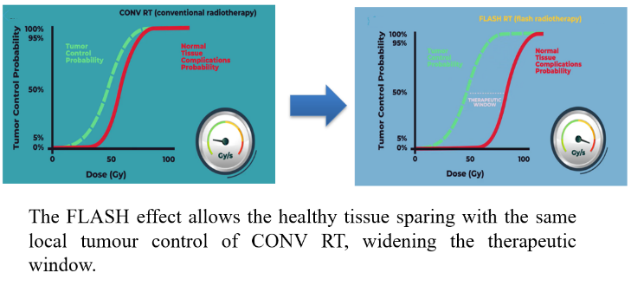
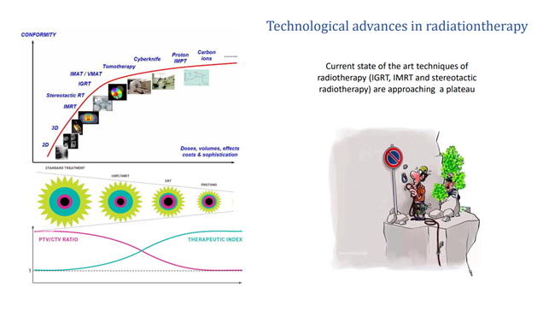
Introduction:
VHEE in the Context of Clinical Machines
- The big revolution in radiotherapy is FLASH therapy: beyond conformality.
- Ultra-high dose rate treatment with promising biological effects.
- Challenge: Extending FLASH to deep-seated tumors.
- Solution: Very High Energy Electrons (VHEE) offer a pathway to achieving this.
Courtesy of Prof. Fabiola Paiar
4/14

Slide 5
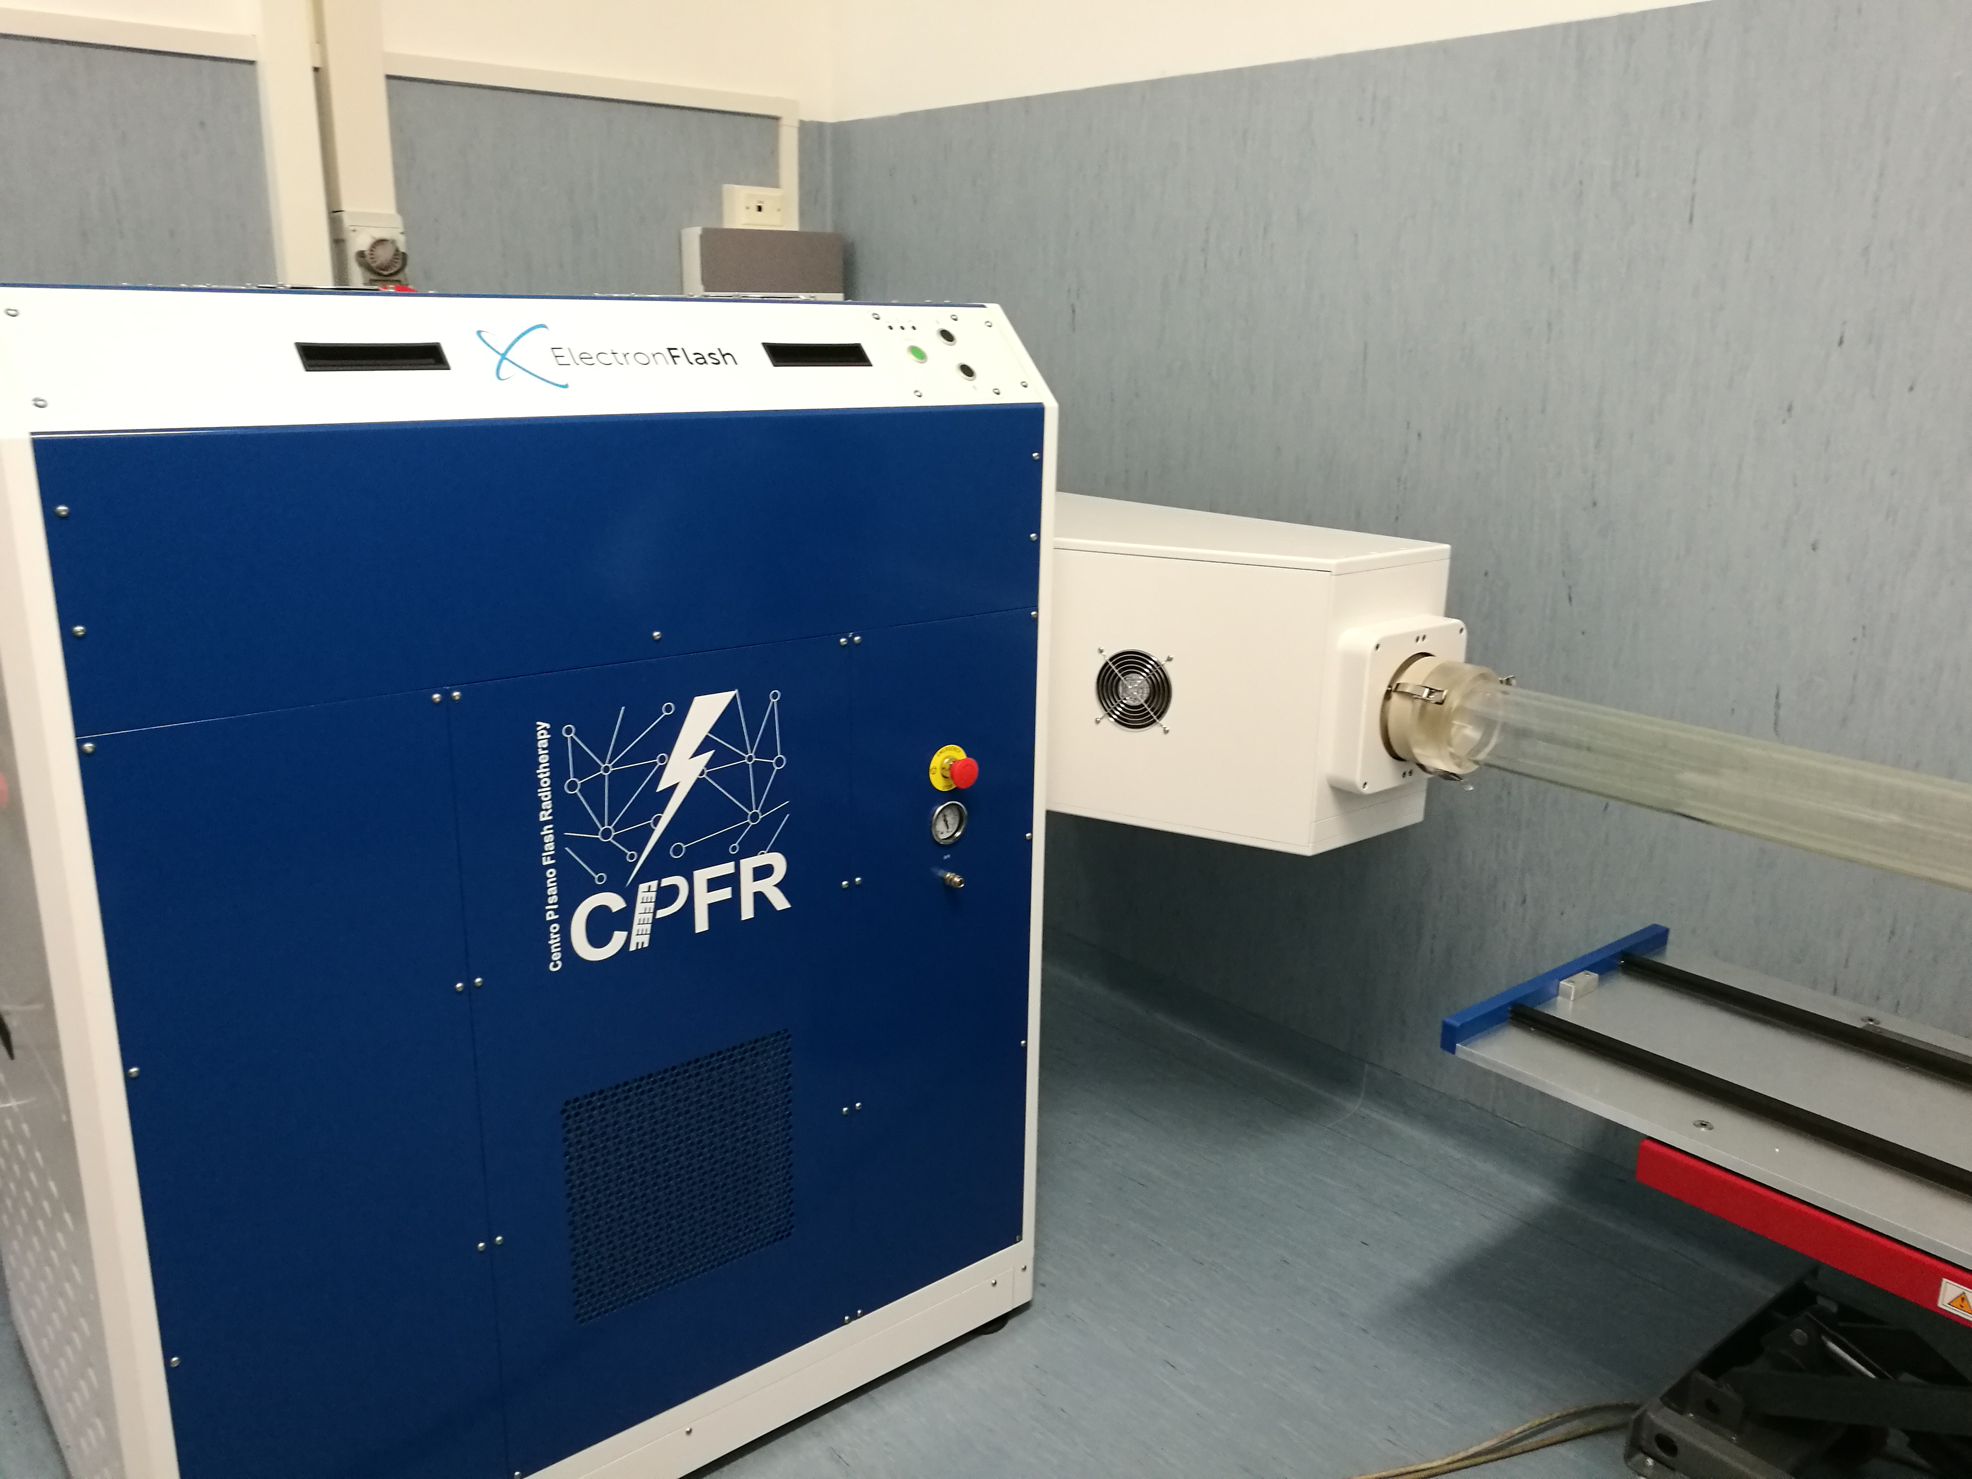
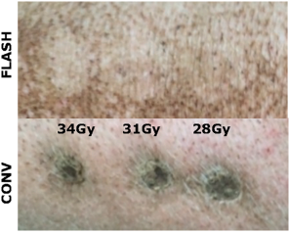
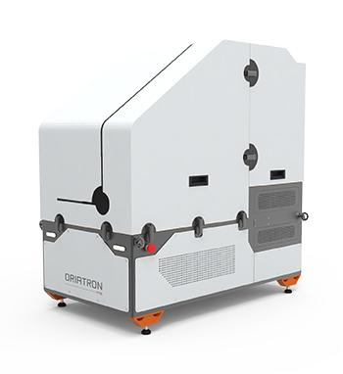
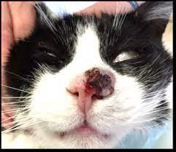
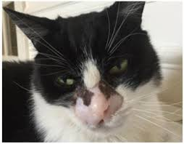
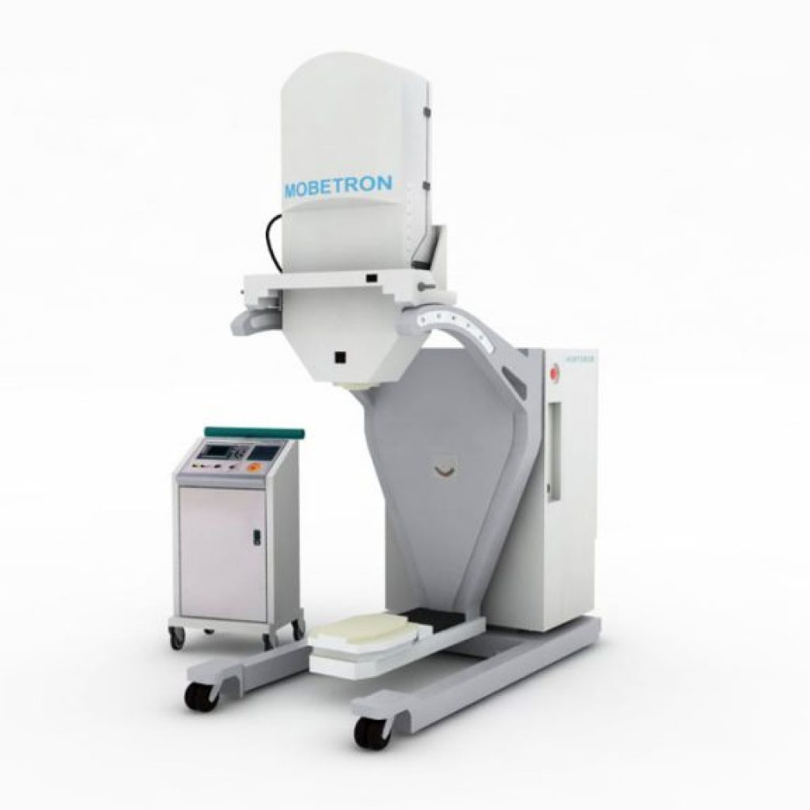
Di Martino, F., et al. "Architecture, flexibility and performance of a special electron linac dedicated to Flash radiotherapy research: electronFlash with a triode gun of the centro pisano flash radiotherapy (CPFR)." Frontiers in Physics 11 (2023): 1268310.
Steppingstone: Low-Energy Electron FLASH
- Why electrons?
  - preclinical data, ease of obtaining a FLASH beam with low impact accelerators.
- Preclinical studies: Exploring FLASH with low-energy electrons (6-10 MeV).
- Clinical relevance: Effective for superficial tumors and intraoperative settings.
- Limitations: Depth penetration restricts applicability for deeper tumors.
Average Dose Rate
≥ 1000 Gy/s
Moeckli, Raphaël, et al. "Commissioning of an ultra‐high dose rate pulsed electron beam medical LINAC for FLASH RT preclinical animal experiments and future clinical human protocols." Medical physics 48.6 (2021): 3134-3142.
Vozenin MC, De Fornel P, Petersson K, Favaudon V, Jaccard M, Germond JF, Petit B, Burki M, Ferrand G, Patin D, Bouchaab H. The advantage of FLASH radiotherapy confirmed in mini-pig and cat-cancer patients. Clinical Cancer Research. 2019
5/14

Slide 6
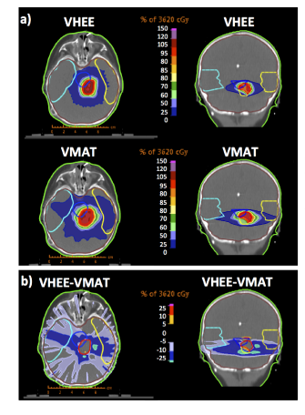
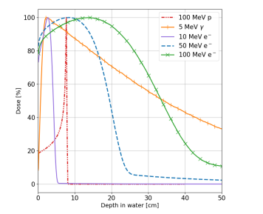
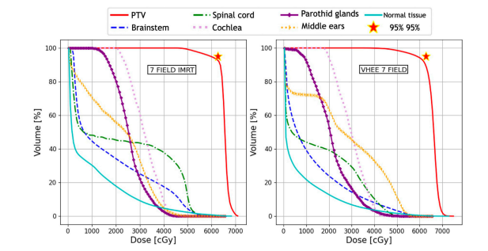
Extending FLASH to Deep-Seated Tumors with VHEE
Bazalova‐Carter, Magdalena, et al. "Treatment planning for radiotherapy with very high‐energy electron beams and comparison of VHEE and VMAT plans." Medical physics 42.5 (2015): 2615-2625.
Giuliano, Lucia, et al. "A compact C-band FLASH electron linear accelerator prototype for the VHEE SAFEST project." Frontiers in Oncology 15 (2025): 1516576.
- Why VHEE?
  - High-energy electrons (50-250 MeV) penetrate deeper than conventional electrons.
  - Studies suggest better dose conformity in comparison to photons.
  -Potential for motion robustness, particularly in lung and abdominal tumors.
  -Combined with FLASH, previously untreatable tumors become possible (pancreas, brain).
- Key research areas:
  - Dosimetry and treatment planning.
  - Dose delivery to use FLASH at its full potential.
Muscato, Annalisa, et al. "Treatment planning of intracranial lesions with VHEE: comparing conventional and FLASH irradiation potential with state-of-the-art photon and proton radiotherapy." Frontiers in Physics 11 (2023): 1185598.
6/14

Slide 7
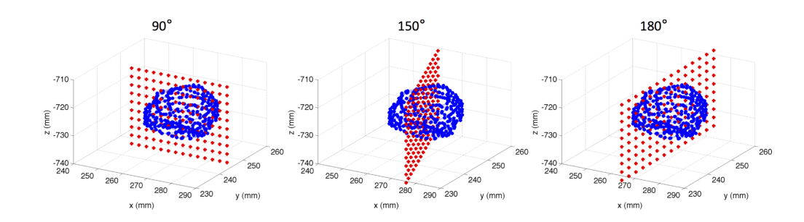
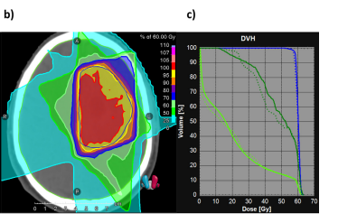
FLASH with VHEE:
Best Beam Modalities
Pencil Beams
Bazalova‐Carter, Magdalena, et al. "Treatment planning for radiotherapy with very high‐energy electron beams and comparison of VHEE and VMAT plans." Medical physics 42.5 (2015): 2615-2625.
- Two major delivery approaches:
  - “Open-field” conformal VHEE: Simple, robust, but less precise in dose shaping, straightforward for FLASH, tricky radiation protection.
  - Pencil beam scanning VHEE: Higher precision, better dose shaping, but technically demanding, FLASH + beamlets? Delay time?
- Comparing modalities for different clinical applications:
  - Open-field: Suitable for large homogenous tumors.
  - Pencil beam scanning: Ideal for complex anatomies and organ sparing.
Open fields
Rahman, Mahbubur, et al. "FLASH radiotherapy treatment planning and models for electron beams." Radiotherapy and Oncology 175 (2022): 210-221.
7/14

Slide 8
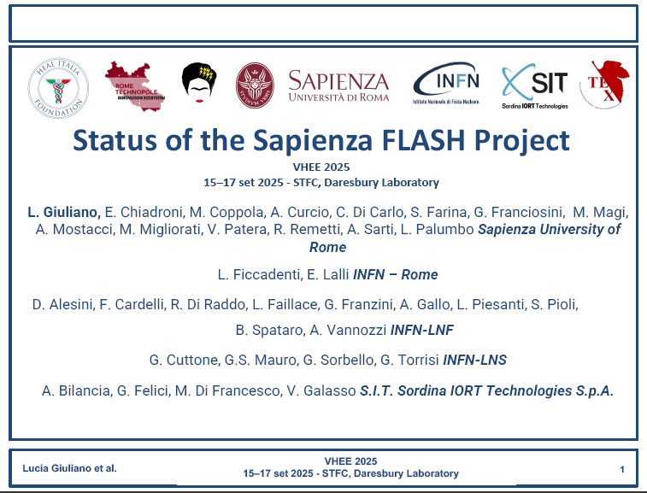
Examples of VHEE research platforms
ARES: Accelerator Research Experiment at SINBAD, DESY, Hamburg, Germany, Operational since 2020
CLARA: Compact Linear Accelerator for Research and Applications, STFC, Daresbury Laboratory, U.K. operational since 2017
CLEAR: The CERN Linear Electron Accelerator for Research, CERN, Geneva, Operational since 2017
SAFEST: Sapienza Flash Electron Source for radiotherapy, Sapienza University and INFN project in development
What would a clinical VHEE medical device need?
Collaboration with SIT
8/14

Slide 9
Clinical Applications of VHEE-FLASH
Brain tumors & multiple metastases – potential for neuro-cognitive sparing → opens door to safe dose-escalation trials.
Locally advanced NSCLC – pre-clinical data show far less pneumonitis/fibrosis, enabling higher curative doses.
Pancreas & other abdomen – FLASH reduces GI toxicity; VHEE could finally allow ablative doses near duodenum/small bowel.
Vertebral metastases – deeper penetration + FLASH may protect spinal cord while boosting vertebral dose; ideal early-phase trial site.
Immuno-oncology synergy – FLASH alters immune milieu and cytokines, promising combination with checkpoint inhibitors.
Pensavalle, J. H., et al. "Standard requirements for clinical very high energy electron and ultra high dose rate medical devices." Frontiers in Physics 12 (2024).
9/14

Slide 10
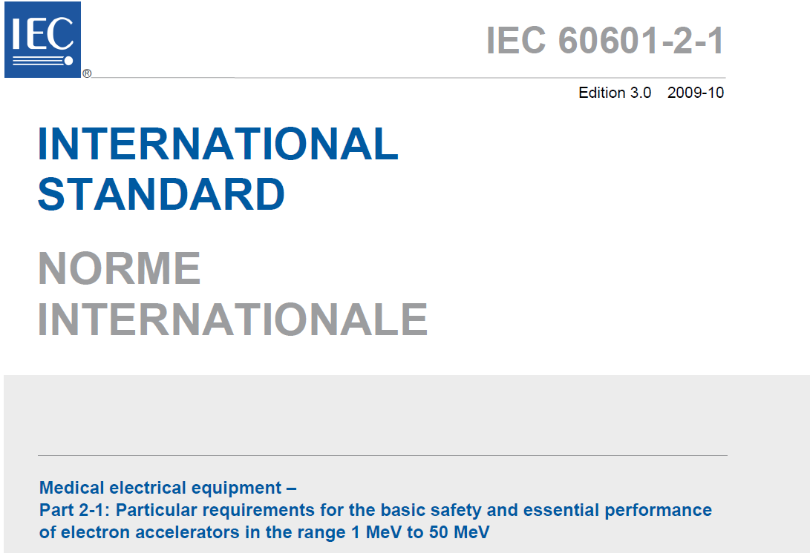
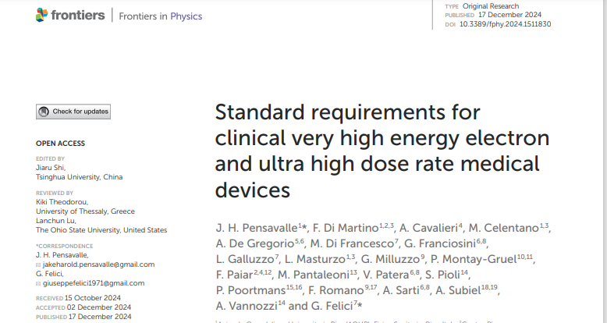
Standard Requirements for a Clinical VHEE FLASH-Capable Linac
Beyond
- Technical specifications:
- Energy range: 50-250 MeV.
- Dose rate: Exceeding FLASH threshold (~40 Gy/s). - Beam control: the UHDR dimension.
- Field size considerations.
-New standards needed for FLASH-specific dose monitoring: beyond IEC60601-2-1.
  -Technology: Multi-gap ion chamber (recombination-corrected); ultrathin Si & SiC fast rad-hard sensors; BCT pulse-charge readout; segmented transmission calorimeter for dose-rate-independent flatness.
- Adaptations in treatment planning systems: Dose Rate Volume Histograms and more.
- Regulatory and clinical adoption challenges:
- Need for standardized protocols.
- Clinical trials to validate efficacy and safety.
10/14

Slide 11
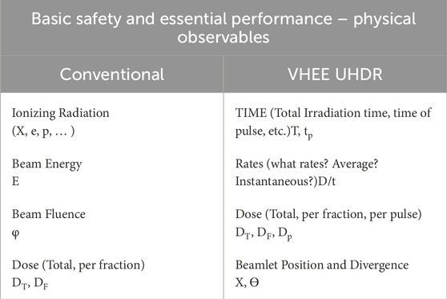
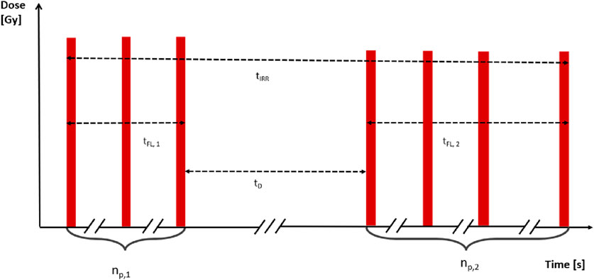
Basic safety and essential performance
-Basic safety and essential performance boils down to identifying and controlling the fundamental variables.
11/14

Slide 12
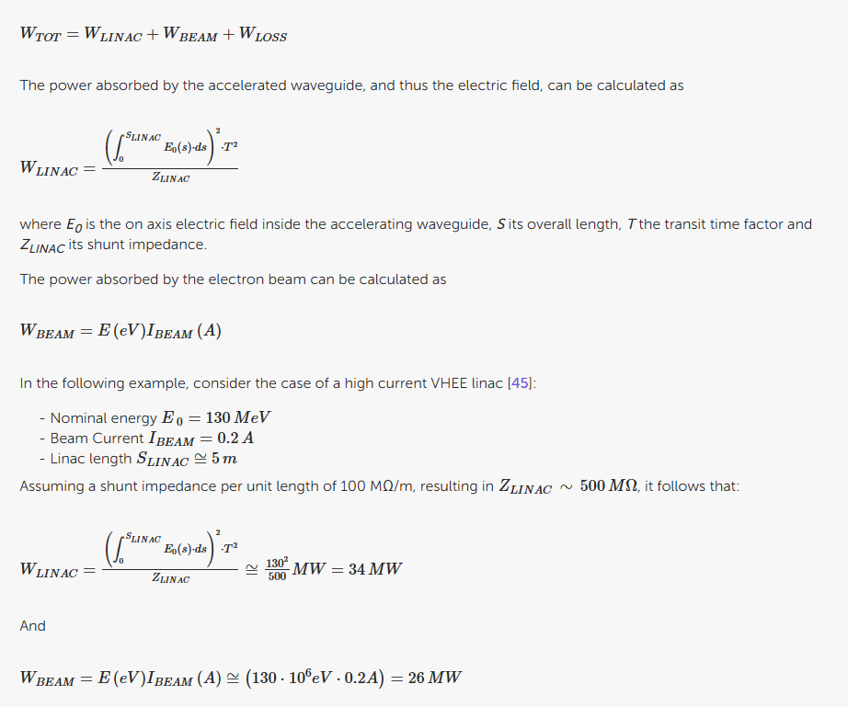
Basic safety and essential performance
In the VHEE-FLASH dimension, even conventionally trivial matters, matter!
Energy variations due to output fluctuations become critical!
12/14

Slide 13
Conclusions: The Future of VHEE in Clinical Radiotherapy
VHEE is key enabler of FLASH therapy for deep-seated tumors.
Bridging research with clinical application: from Low energy to full-scale VHEE-FLASH systems.
Challenges ahead: machine development, clinical trials, and regulatory pathways.
Key Message: VHEE is the missing link to bring FLASH to deep-seated tumors.
13/14

Slide 14
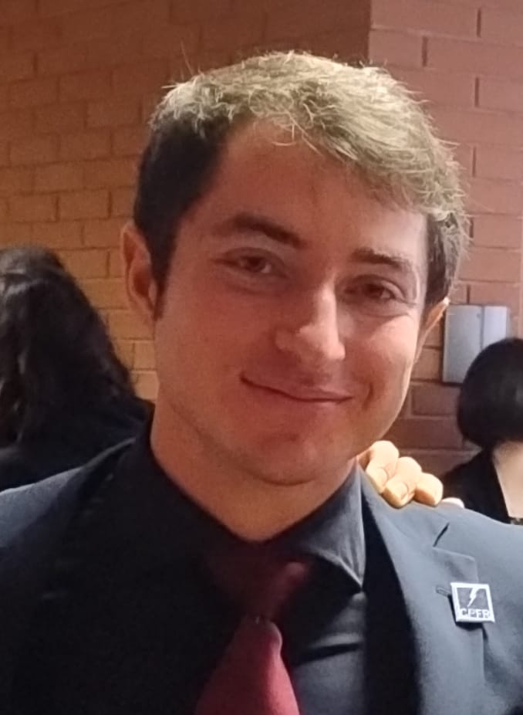
Thank you for your attention!
jake.pensavalle@soiort.com
13/14

