Slide 1


Experimental conditions for the FLASH sparing effect: Systematic in vivo studies
Anouk Sesink, Ph.D.
Dept. Radio-Oncology, CHUV

Slide 2




INTRODUCTION
40 Gy/s
100 ms
Hybrid
Beam scanning
Beam parameters
Dose per fraction
Time fractionation
Split dose delivery

Slide 3
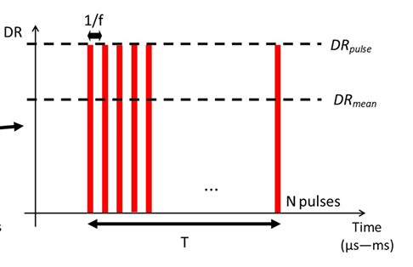
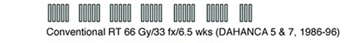
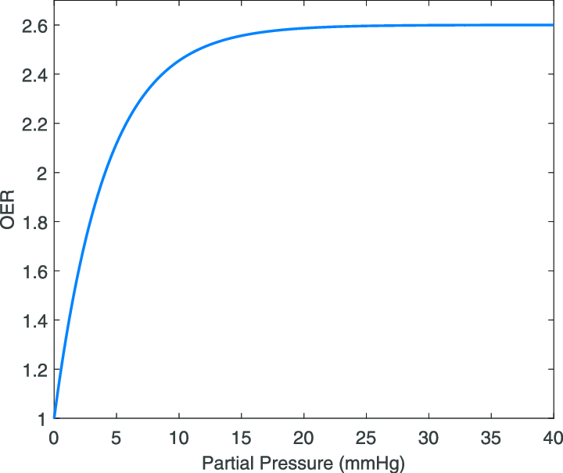
INTRODUCTION
Experimental conditions for the FLASH sparing effect: Systematic in vivo studies
1. AIM
Determining the optimum physical beam parameters
2. AIM
Implementing the fractionation, split dose and beam scanning in FLASH-RT
3. AIM
The role of oxygen in the FLASH effect

Slide 4

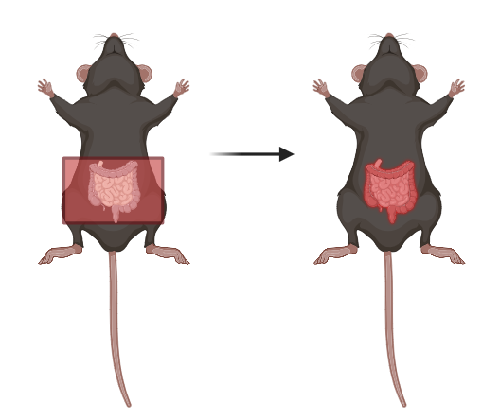
INTRODUCTION
Methods: Radiation induced intestine toxicity, a model of early toxicity
Large numbers of self-renewing crypt-villus units
Rapid turnover (3-5 days)
Radiation-induced toxicity: mainly; loss of stem cells (ISC) in the crypts, loss of crypt renewal, loss of epithelial barrier with inflammation
Late toxicity: chronic inflammation, fibrosis
Mobetron
C57BL6/J mice
Humane endpoint reached during follow up include:
Impairment of mobility
Diarrhoea
Continued weight loss
Notes:
Early epithelial barrier dysfunctions with mucositis symptoms. The mucosal and epithelial breakdown results in severe inflammatory responses, increasing pro-inflammatory cytokines. Its considered an early responding tissue but can also accumulate severe late toxicities where the inflammatory response prevales together with a continuation of stem cell depletion, resulting in ECM changes including fibrosis, loss of function.

Slide 5


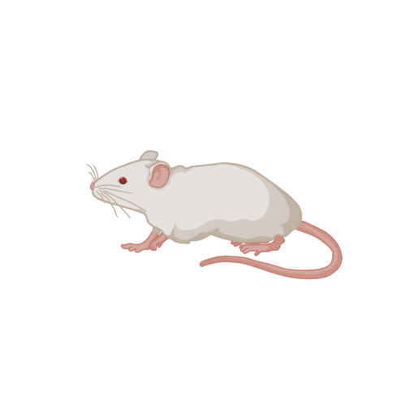
INTRODUCTION
eRT6
Methods: Radiation induced skin injury, a model of early toxicity
Rapid turnover rate (4-8 weeks in human, 2 weeks in mice)
Radiation-induced toxicity: damage to cellular structures, cell death and senescence, immune activation, vasculature disruption and impaired wound healing.
Late toxicity: impaired wound healing, skin fibrosis
Balb/C mice
0 = no skin alterations observed
1 = < 50% alopecia in irradiated volume
2 = > 50% alopecia in irradiated volume
3 = Erosion no depression < 50% of irradiated volume
3.5 = Erosion no depression > 50% of irradiated volume
4 = small ulceration < 3mm2
5 = big ulceration > 3mm2
Luca Soutter
Notes:
Radiotherapy acts through numerous mechanisms to kill cancer cells, including direct damage to cellular structures, cell death and senescence, immune activation, vasculature disruption and impaired wound healing. However, these events also occur in healthy tissues including the skin, contributing to the development of radiation dermatitis (5-9).
Radiation-induced early toxicity progresses into late toxicity, both contributing to alterations in the tissue’s microenvironment. This results in major wound healing complications within the irradiated area observed in up to 35% of post-operative patients (10, 11). It highlights the vast complexity of radiotherapy’s impact on the skin, from the initial ionization of biomolecules within femtosecond time to late toxicities months to years after irradiation.

Slide 6
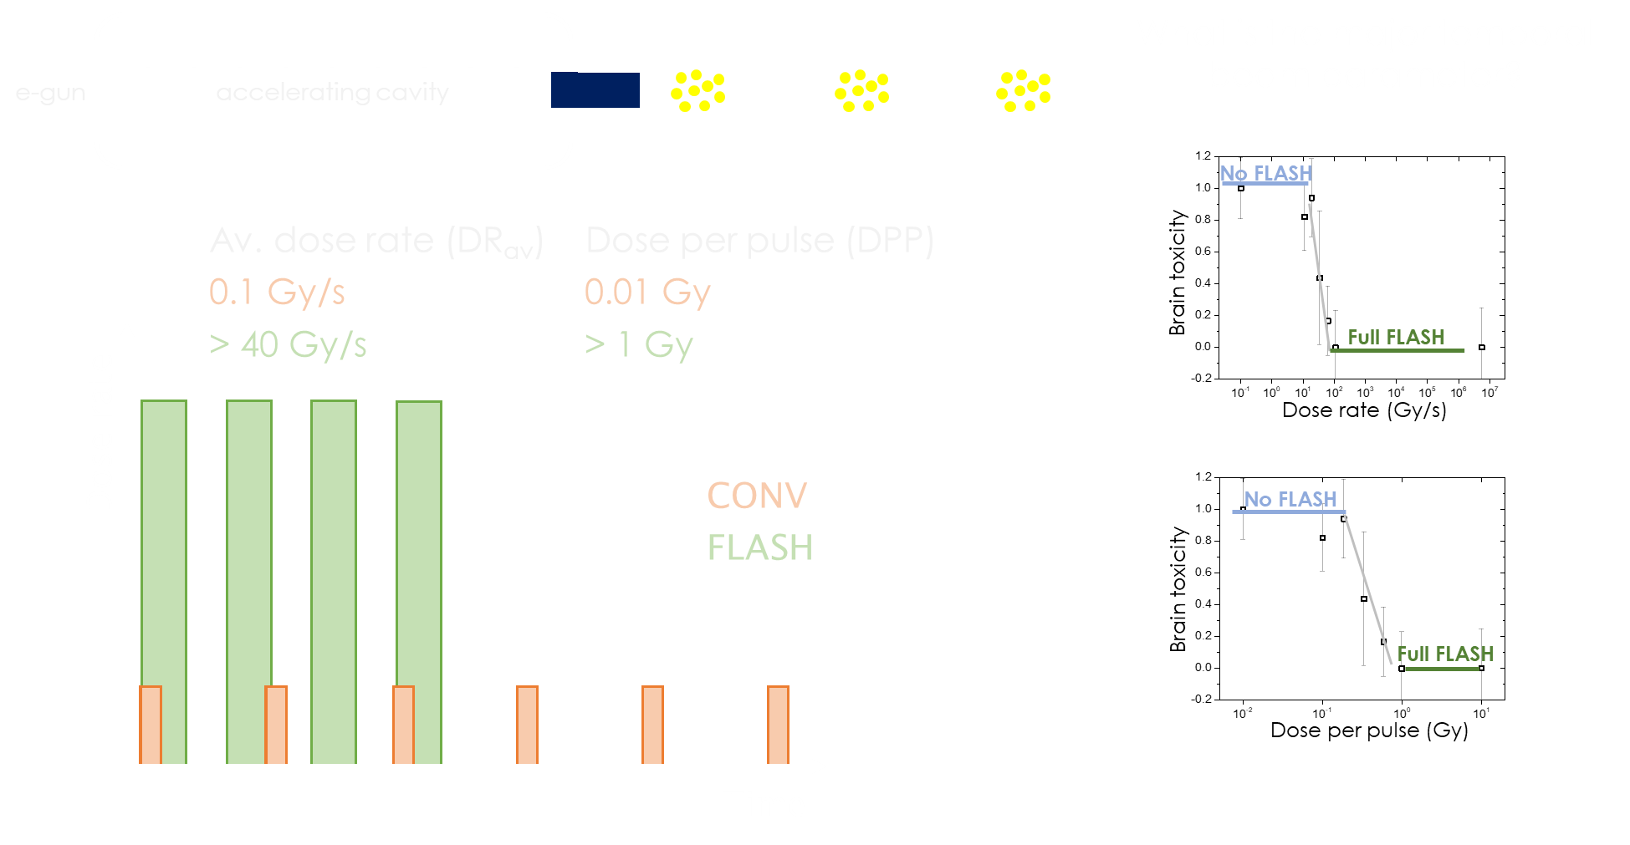
1. Temporal beam parameters
Montay-Gruel et al. Radiotherapy and Oncology 2017

Slide 7
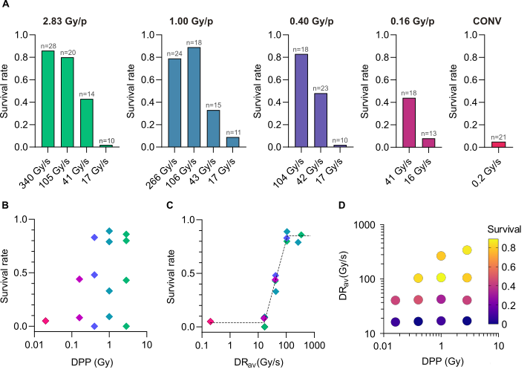
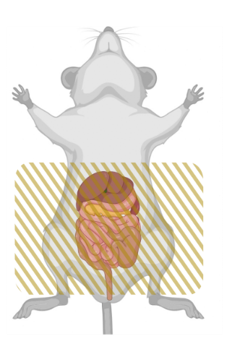
1. Temporal beam parameters
eRT6
Grilj et al. (2025)
17 Gy
This research provides evidence that the average dose rate is the critical beam parameter for reproducing the FLASH normal tissue sparing effect with minimum dose rate of 100 Gy/s.

Slide 8
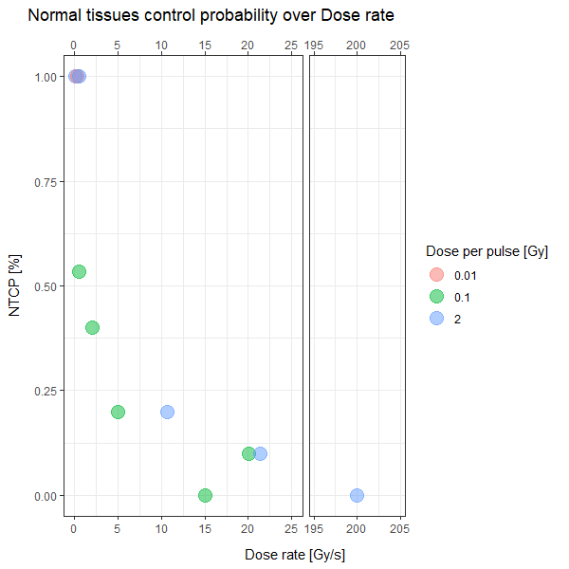
1. Temporal beam parameters
eRT6
N=10
30 Gy
Plots provided by Luca Soutter

Slide 9
1. Temporal beam parameters
eRT6
N=10
30 Gy
In skin, an average dose rate of 5 Gy/s or higher results in survival above 80%. Equal DPP results in equal toxicity.
Plots provided by Luca Soutter

Slide 10
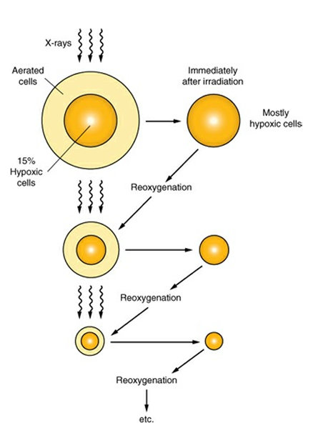
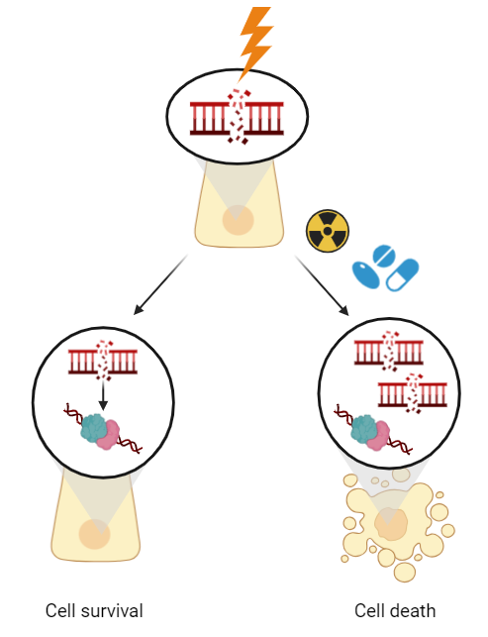
2. Fractionated radiotherapy and the FLASH effect
Tumour reoxygenation
Fractionated radiotherapy is part of the standard of care
Repair of sublethal damage in the normal tissue
Less normal tissue toxicities
Higher total dose delivery
Tumour reoxygenation of hypoxic new outer tumour layer results in better tumour control
sublethal damage repair
Can maintain the FLASH sparing effect in a fractionated setting?
Radiobiology for the radiologist 8th edition

Slide 11
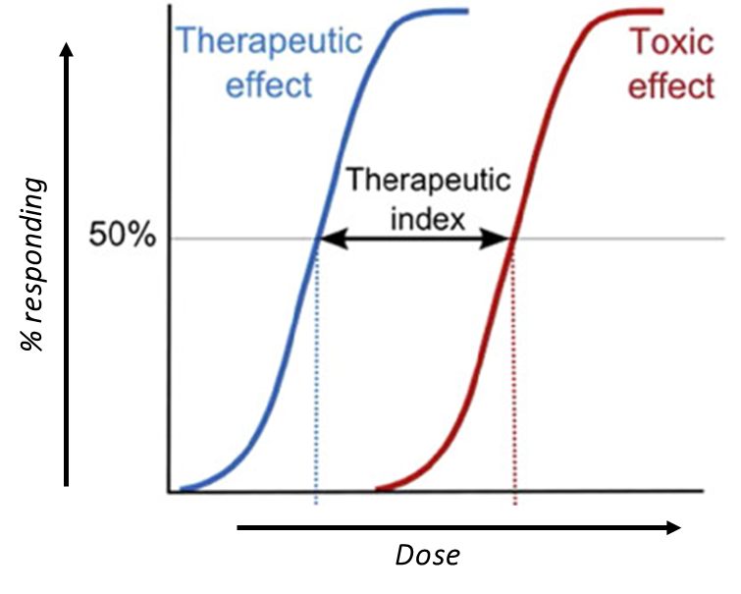
2. Fractionated radiotherapy and the FLASH effect
FLASH Dose Modifying Factor: FDMF
FDMF

Slide 12

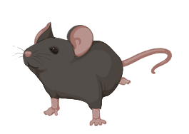
2. Fractionated radiotherapy and the FLASH effect
Methods
Mobetron
Daily observation
SURVIVAL
Follow-up until
Endpoint is reached
CONV:
12, 14, 15, 16, 17 Gy
#1
± 15d
FLASH:
12, 14, 16, 17, 18, 20 Gy
0d
Daily observation
#1
#2
SURVIVAL
Follow-up until
Endpoint is reached
CONV/FLASH
8, 9, 10, 11, 12, 13 Gy
0d
1d
± 15d
Daily observation
#1
#2
#3
#4
#5
#6
#7
#8
#9
#10
SURVIVAL
Follow-up until
Endpoint is reached
CONV/FLASH
5, 5.5, 6, 6.5, 7 Gy
0d
1d
2d
3d
4d
7d
8d
9d
10d
11d
± 25d
Sesink et al. (2025) Submitted

Slide 13
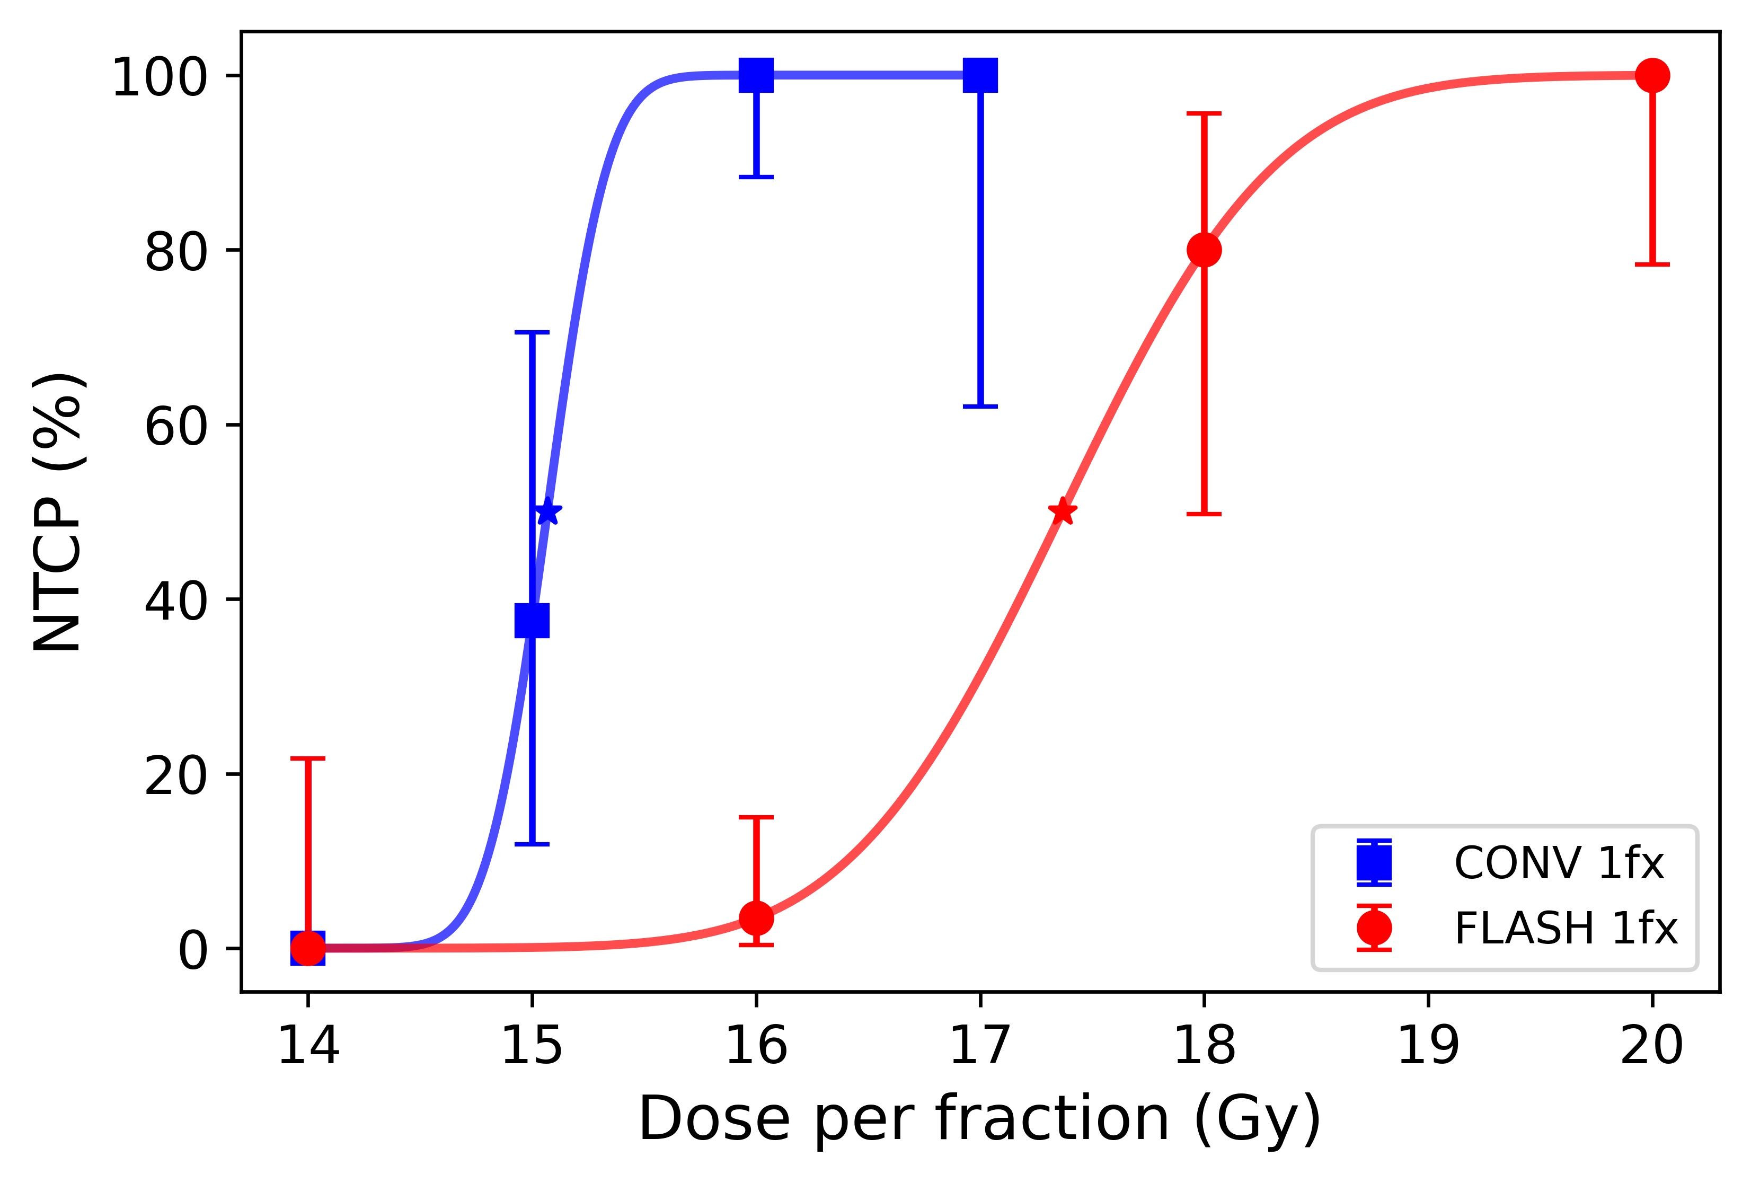
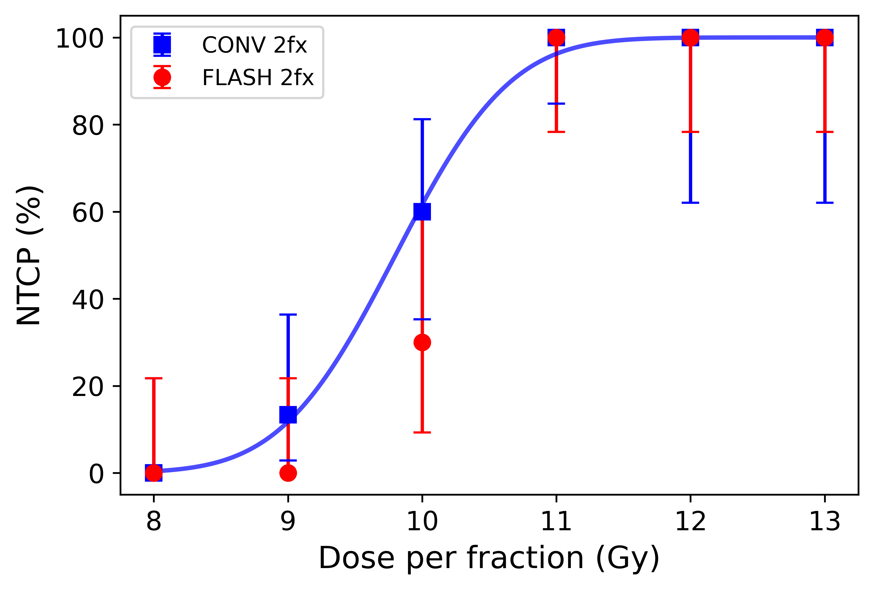
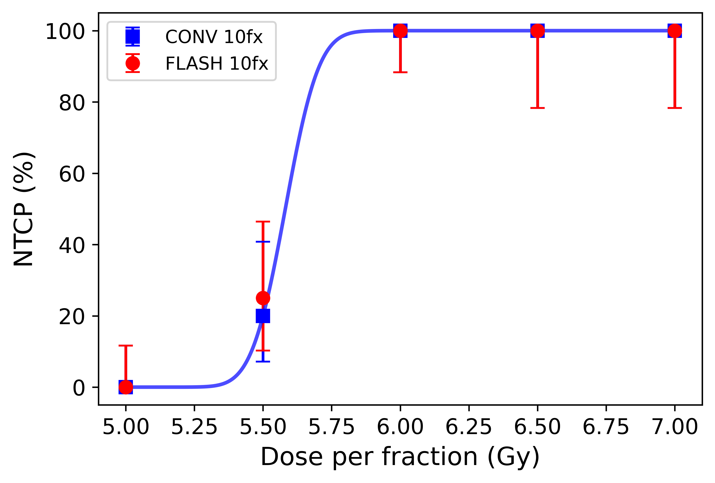
2. Fractionated radiotherapy and the FLASH effect
Results
Mobetron
FDMF: 1.14
FDMF: 1.03
FDMF: 1.00
1 fraction
2 fractions
10 fractions
N = 8-29
N = 5-15
N = 10-20
FDMF: FLASH dose modifying factor
Sesink et al. (2025) Submitted

Slide 14
2. Fractionated radiotherapy and the FLASH effect
Results
Mobetron
FDMF: 1.14
FDMF: 1.03
FDMF: 1.00
1 fraction
2 fractions
10 fractions
N = 8-29
N = 5-15
N = 10-20
Conclusion: The FLASH effect is not maintained with fractionated radiotherapy of the abdominal cavity of C57BL6/J female mice using 10 fractions. Verify in a second model.
Sesink et al. (2025) Submitted

Slide 15
2. Fractionated radiotherapy and the FLASH effect
eRT6
Daily observation
SURVIVAL
Follow-up until
Endpoint is reached
CONV:
18, 21, 24, 27, 30 Gy
#1
FLASH:
21, 28, 30, 32, 34, 36,
38, 40 Gy
0d
± 50d
Daily observation
CONV:
10, 12, 14, 16 Gy
#1
#2
#3
SURVIVAL
Follow-up until
Endpoint is reached
FLASH:
10, 12, 14, 16, 18, 20 Gy
0d
1d
2d
± 50d

Slide 16
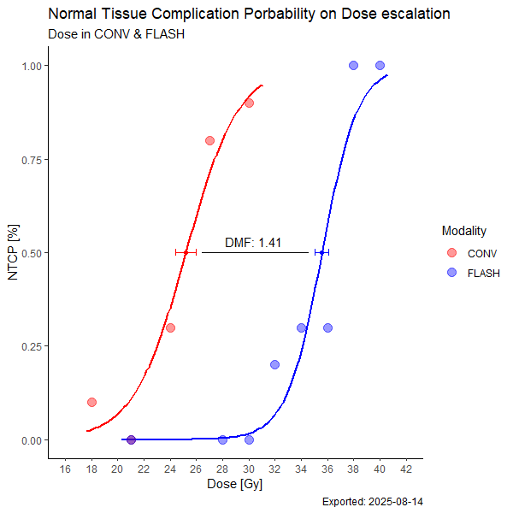
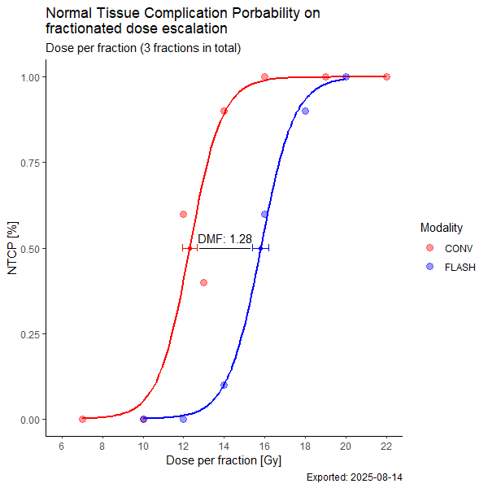
2. Fractionated radiotherapy and the FLASH effect
eRT6
Results
FDMF: 1.41
FDMF: 1.28
1 fraction
3 fractions
N = 10
N = 10
Conclusion: The FLASH effect is maintained with fractionated radiotherapy of BALB/c skin following 3 fractions
Plots provided by Luca Soutter
Sesink, Soutter et al. (2025) in prep.

Slide 17
2. Fractionated radiotherapy and the FLASH effect
eRT6
Results
FDMF: 1.41
FDMF: 1.28
1 fraction
3 fractions
N = 10
N = 10
Conclusion: The FLASH effect is maintained with fractionated radiotherapy of BALB/c skin following 3 fractions
Next: can we maintain the FLASH effect with increased fractions of 5 or 10 fractions and can we replace a fraction with CONV and maintain the FDMF of 1.28?
Plots provided by Luca Soutter
Sesink, Soutter et al. (2025) in prep.

Slide 18
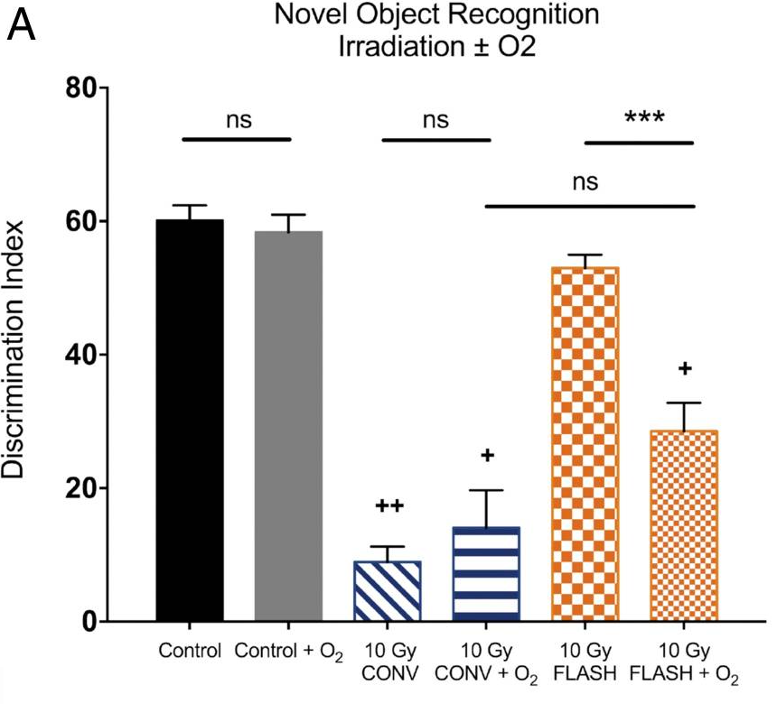
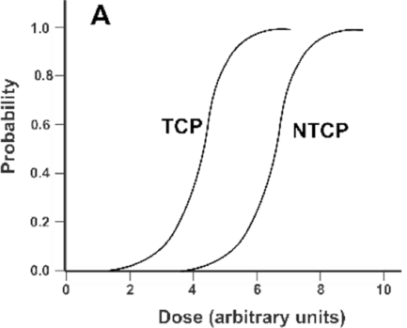
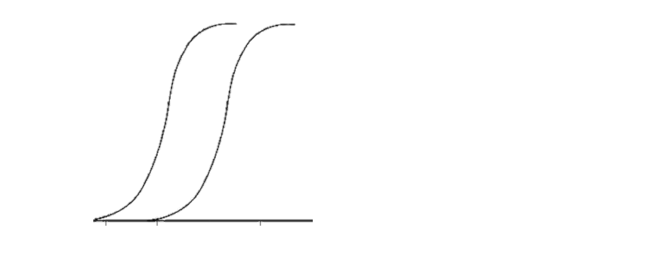
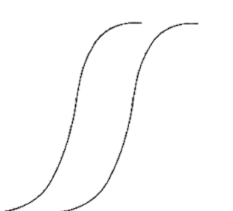
3. Oxygen and the FLASH effect
‘’Increase of Oxygen in tissue results in the loss of the FLASH effect’’
Cognitive impairment
NTCP probability
CONV
FLASH
Montay-Gruel et al. (2019)
Increase concentration of oxygen in the normal tissue resulted in a loss of the FLASH effect
Does oxygen alter the FLASH NTCP or results in overall radio sensitization of the radiotoxicity model?

Slide 19
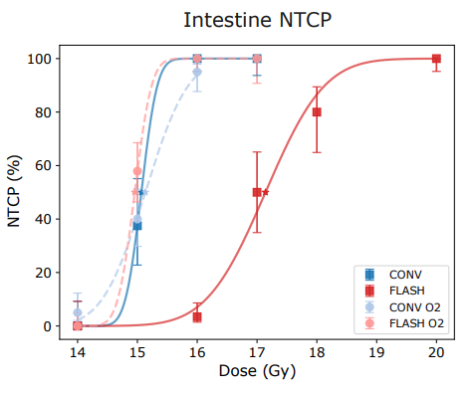
3. Oxygen and the FLASH effect
Results
Mobetron
Air: FDMF: 1.14
Oxygen: FDMF: 1.00
N = 8-29
Sesink, Soutter et al. (2025) submitted

Slide 20
3. Oxygen and the FLASH effect
Results
Mobetron
Air: FDMF: 1.14
Oxygen: FDMF: 1.00
N = 8-29
Conclusion: There is no overall radio sensitization of the model but indeed a loss of the FLASH effect in the abdominal toxicity model
Sesink, Soutter et al. (2025) submitted

Slide 21
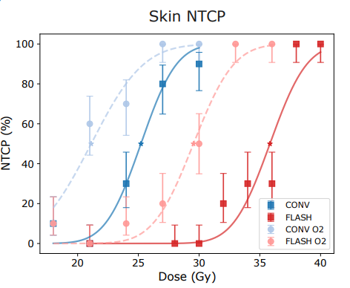
3. Oxygen and the FLASH effect
eRT6
Results
Air: FDMF: 1.41
Oxygen: FDMF: 1.36
Plots provided by Luca Soutter
N = 10
Sesink, Soutter et al. (2025) submitted

Slide 22
3. Oxygen and the FLASH effect
eRT6
Results
Air: FDMF: 1.41
Oxygen: FDMF: 1.36
Conclusion: There is overall radio sensitization of the model with no loss of the FLASH effect
Plots provided by Luca Soutter
N = 10
Sesink, Soutter et al. (2025) submitted

Slide 23
3. Oxygen and the FLASH effect
eRT6
Results
Whats going on?
Plots provided by Till Böhlen
Sesink, Soutter et al. (2025) submitted

Slide 24
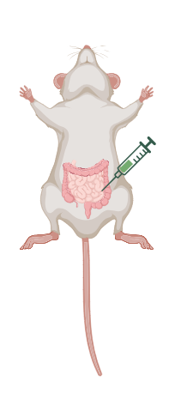
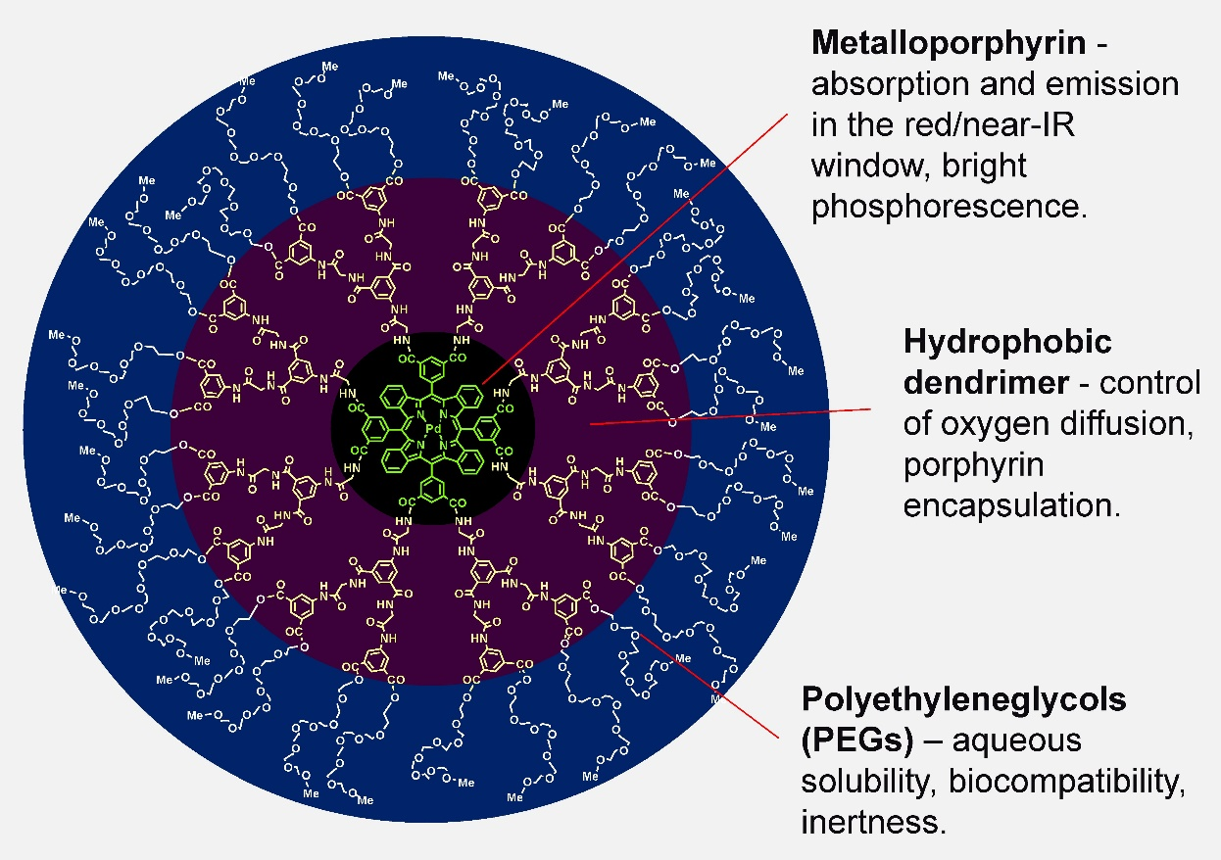
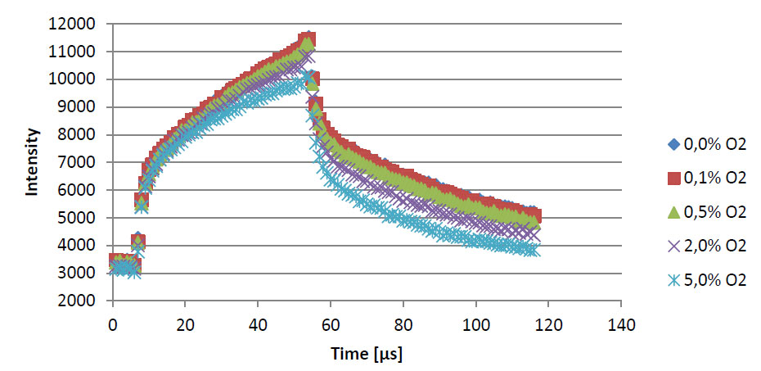
3. Oxygen and the FLASH effect
In vivo oxygen measurements
Methods
Pt phorphyrin enclosed by hydrophobic dendrimers
Dissolved in medium, cannot enter inside the cell
Oxygen quenches phosphorescence and decreases its lifetime
Vinogradov lab UPenn
Oxygen breathing
vs
air breathing
Oxygen concentration
Phosphorescence lifetime
For further info: Esipova et al. (2019)

Slide 25
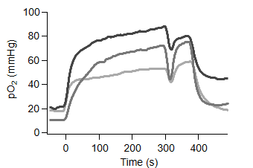
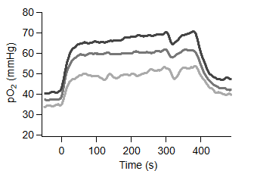
3. Oxygen and the FLASH effect
In vivo oxygen measurements
Removal from box to place in the mask
Start O2
breathing
Time of irradiation
Intestine
Conclusion: oxygen breathing results in a severe rapid increase in oxygen within the intestine and skin
Skin
Sesink, Soutter et al. (2025) submitted

Slide 26
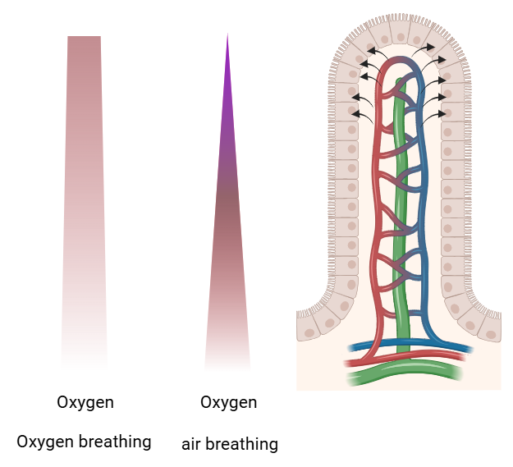
3. Oxygen and the FLASH effect
eRT6
Loss of the FLASH sparing effect
Intestine
Sesink, Soutter et al. (2025) submitted

Slide 27
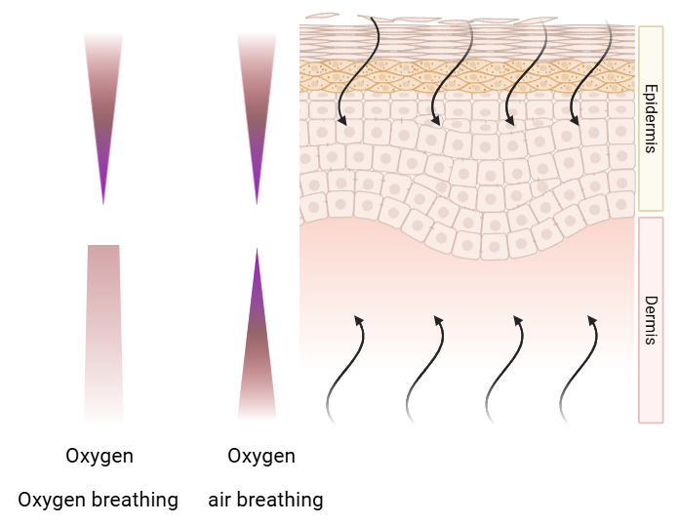
3. Oxygen and the FLASH effect
Sesink, Soutter et al. (2025) submitted
eRT6
FLASH sparing effect is maintained
Skin

Slide 28
3. Oxygen and the FLASH effect
Sesink, Soutter et al. (2025) submitted
eRT6
FLASH sparing effect is maintained
Skin
Conclusion:
Loss of FLASH sparing under oxygen breathing is tissue specific
Important to conduct full dose response studies in FLASH research to avoid drawing wrong conclusions

Slide 29

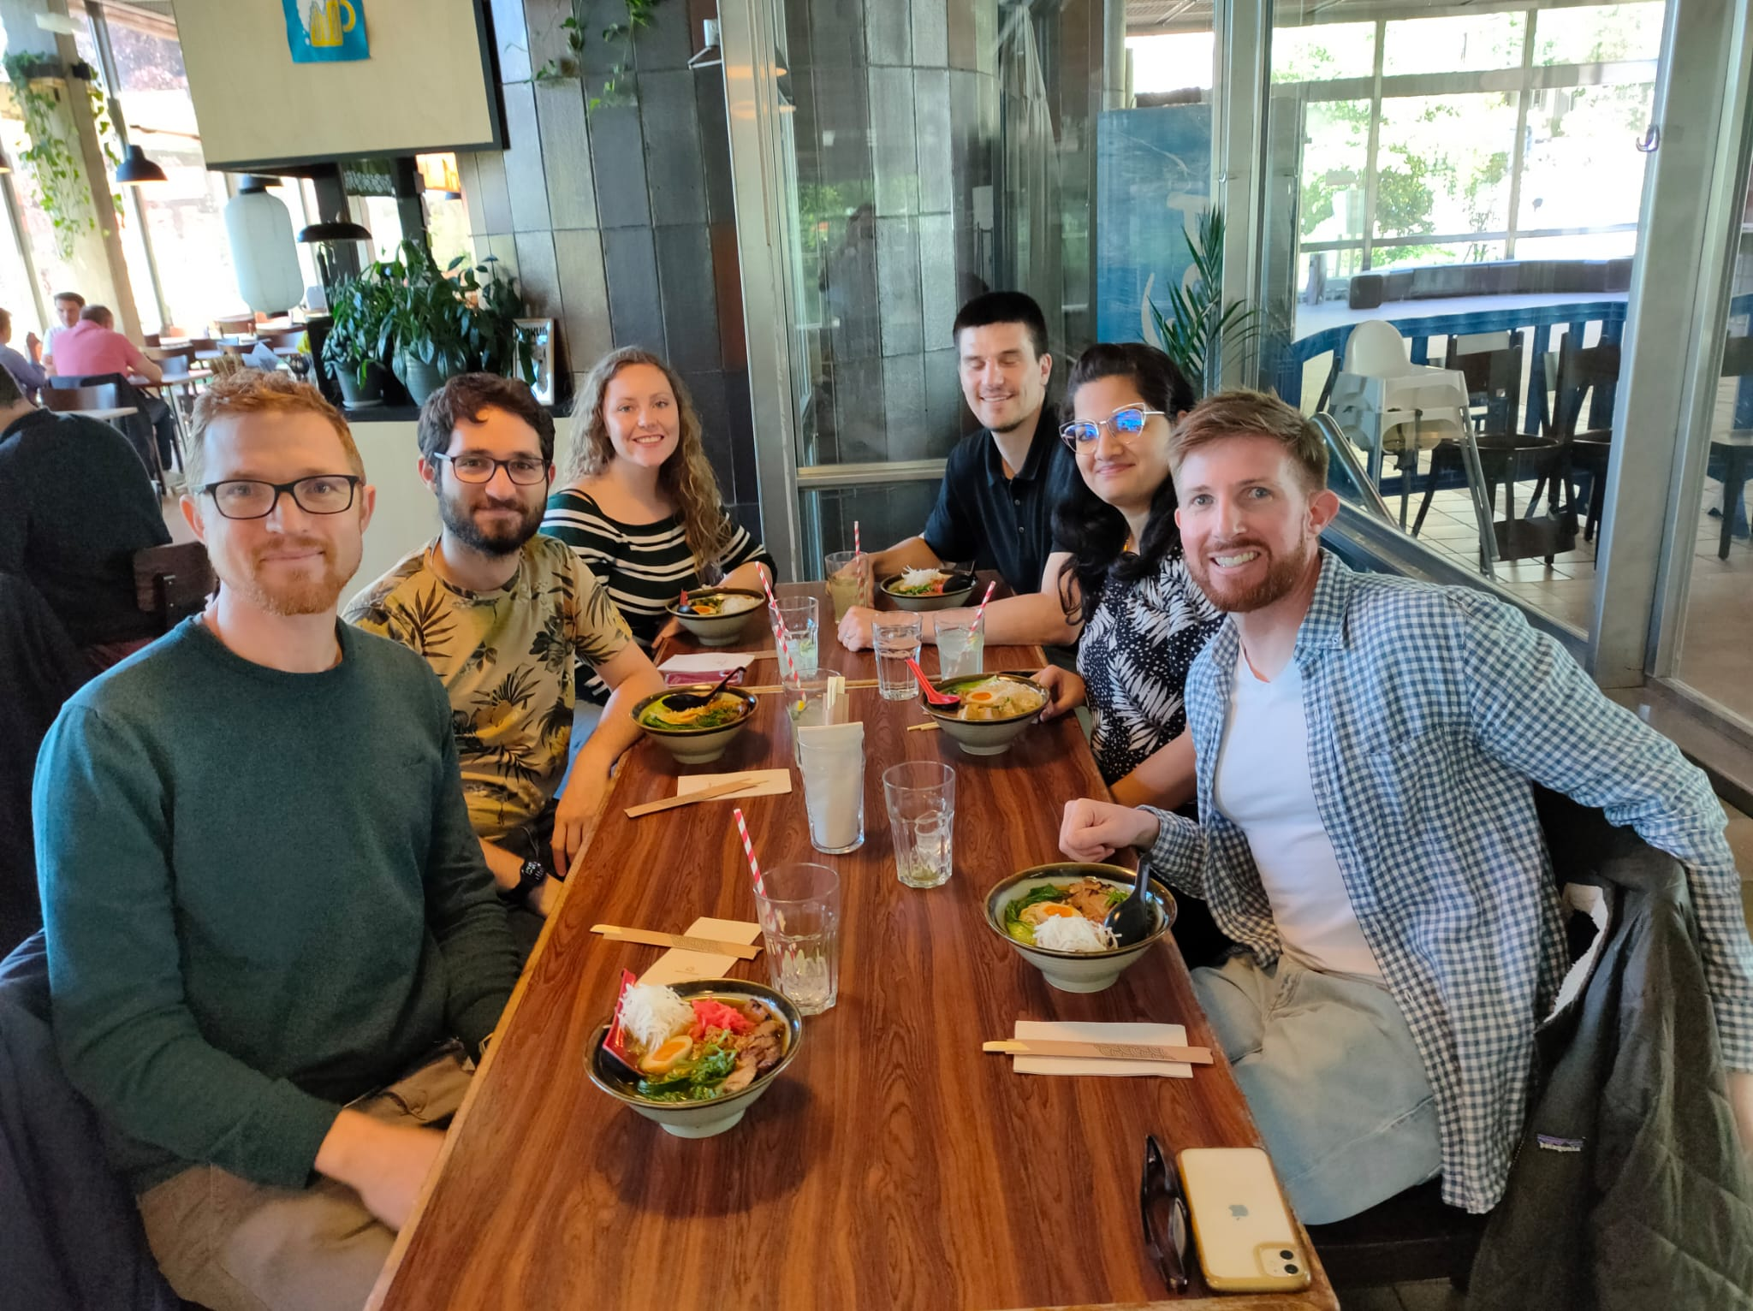
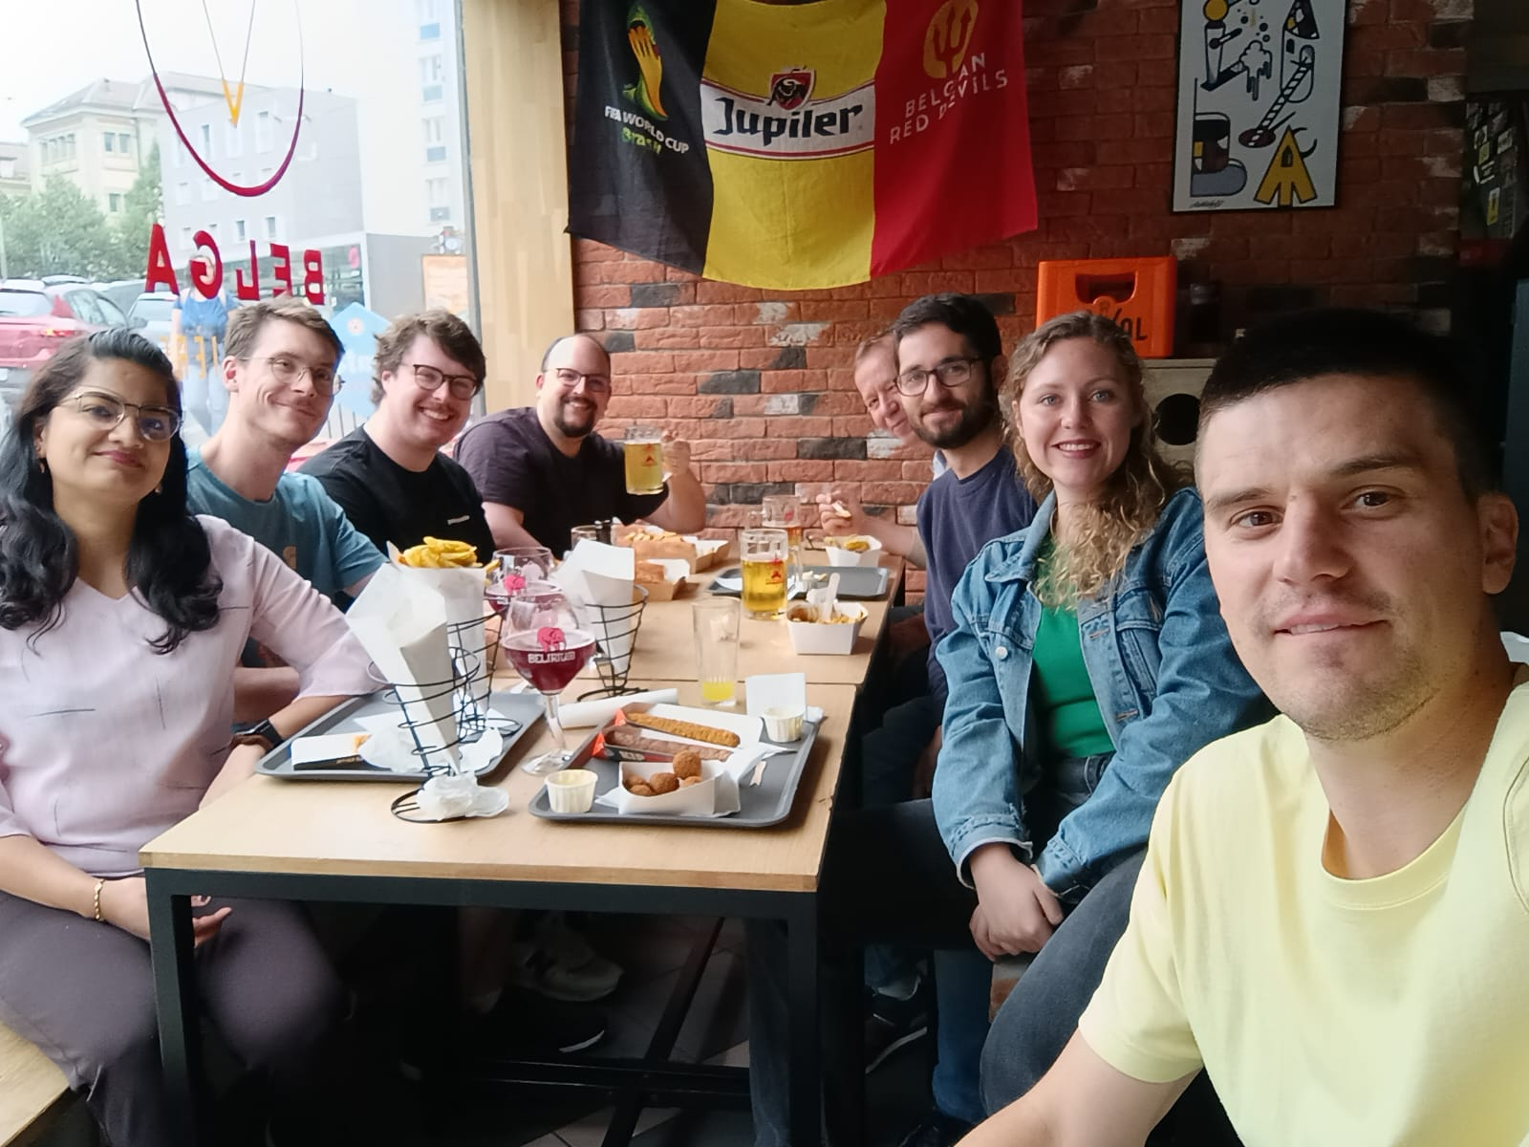
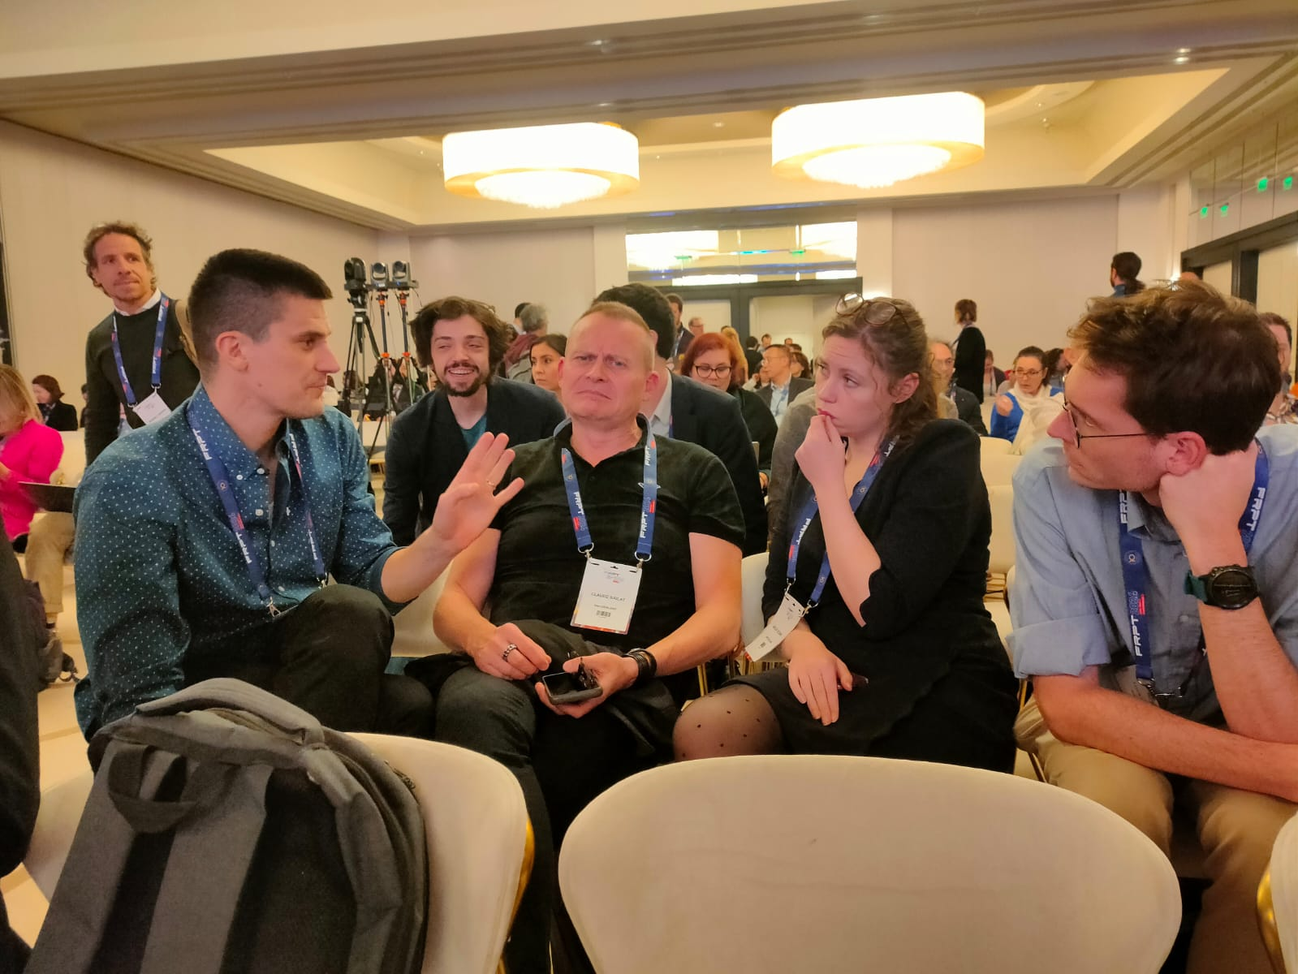
ACKNOWLEDGEMENTS
Dept. Radiation Oncology
Dr. Veljko Grilj
Dr. Preethi Devanand
Anet Valdes Zayas
Prof. Fernanda Herrera
Prof. Jean Bourhis
Prior lab members:
Dr. David Repáraz Pernaut
Dr. Lorela Çiraku
Dr. Katiuska Passelli
Julie Pernot
Institute of Radiation Physics
Luca Soutter
Dr. Reiner Geyer
Dr. Till Böhlen
Prof. Raphaël Moeckli
Dr. Pascal Froidevaux
Dr. Claude Bailat
Animal facilities
CHUV
Dr. David Viertl
Collaborators
Prof. Margret Schottelius
Dr. David Viertl
Dr. Alexandra Litvinenko
And the rest of the team
AGORA
Isabelle Grandjean
Jacques Barraud
EPALINGES
Francis Derouet
Lisa Arlandi

Slide 30
Experimental conditions for the FLASH sparing effect: Systematic in vivo studies
Anouk Sesink, Ph.D.
Dept. Radio-Oncology, CHUV

