Slide 1
The new beamline and biolab at FLASHlab@PITZ
Outline
About PITZ
New beamline and Biolab
Recent experiments
Summary
Xiangkun Li for the PITZ team, DESY
VHEE’25, STFC, Daresbury Laboratory, 15-17.09.2025
Notes:
Self introduction;
Outline

Slide 2
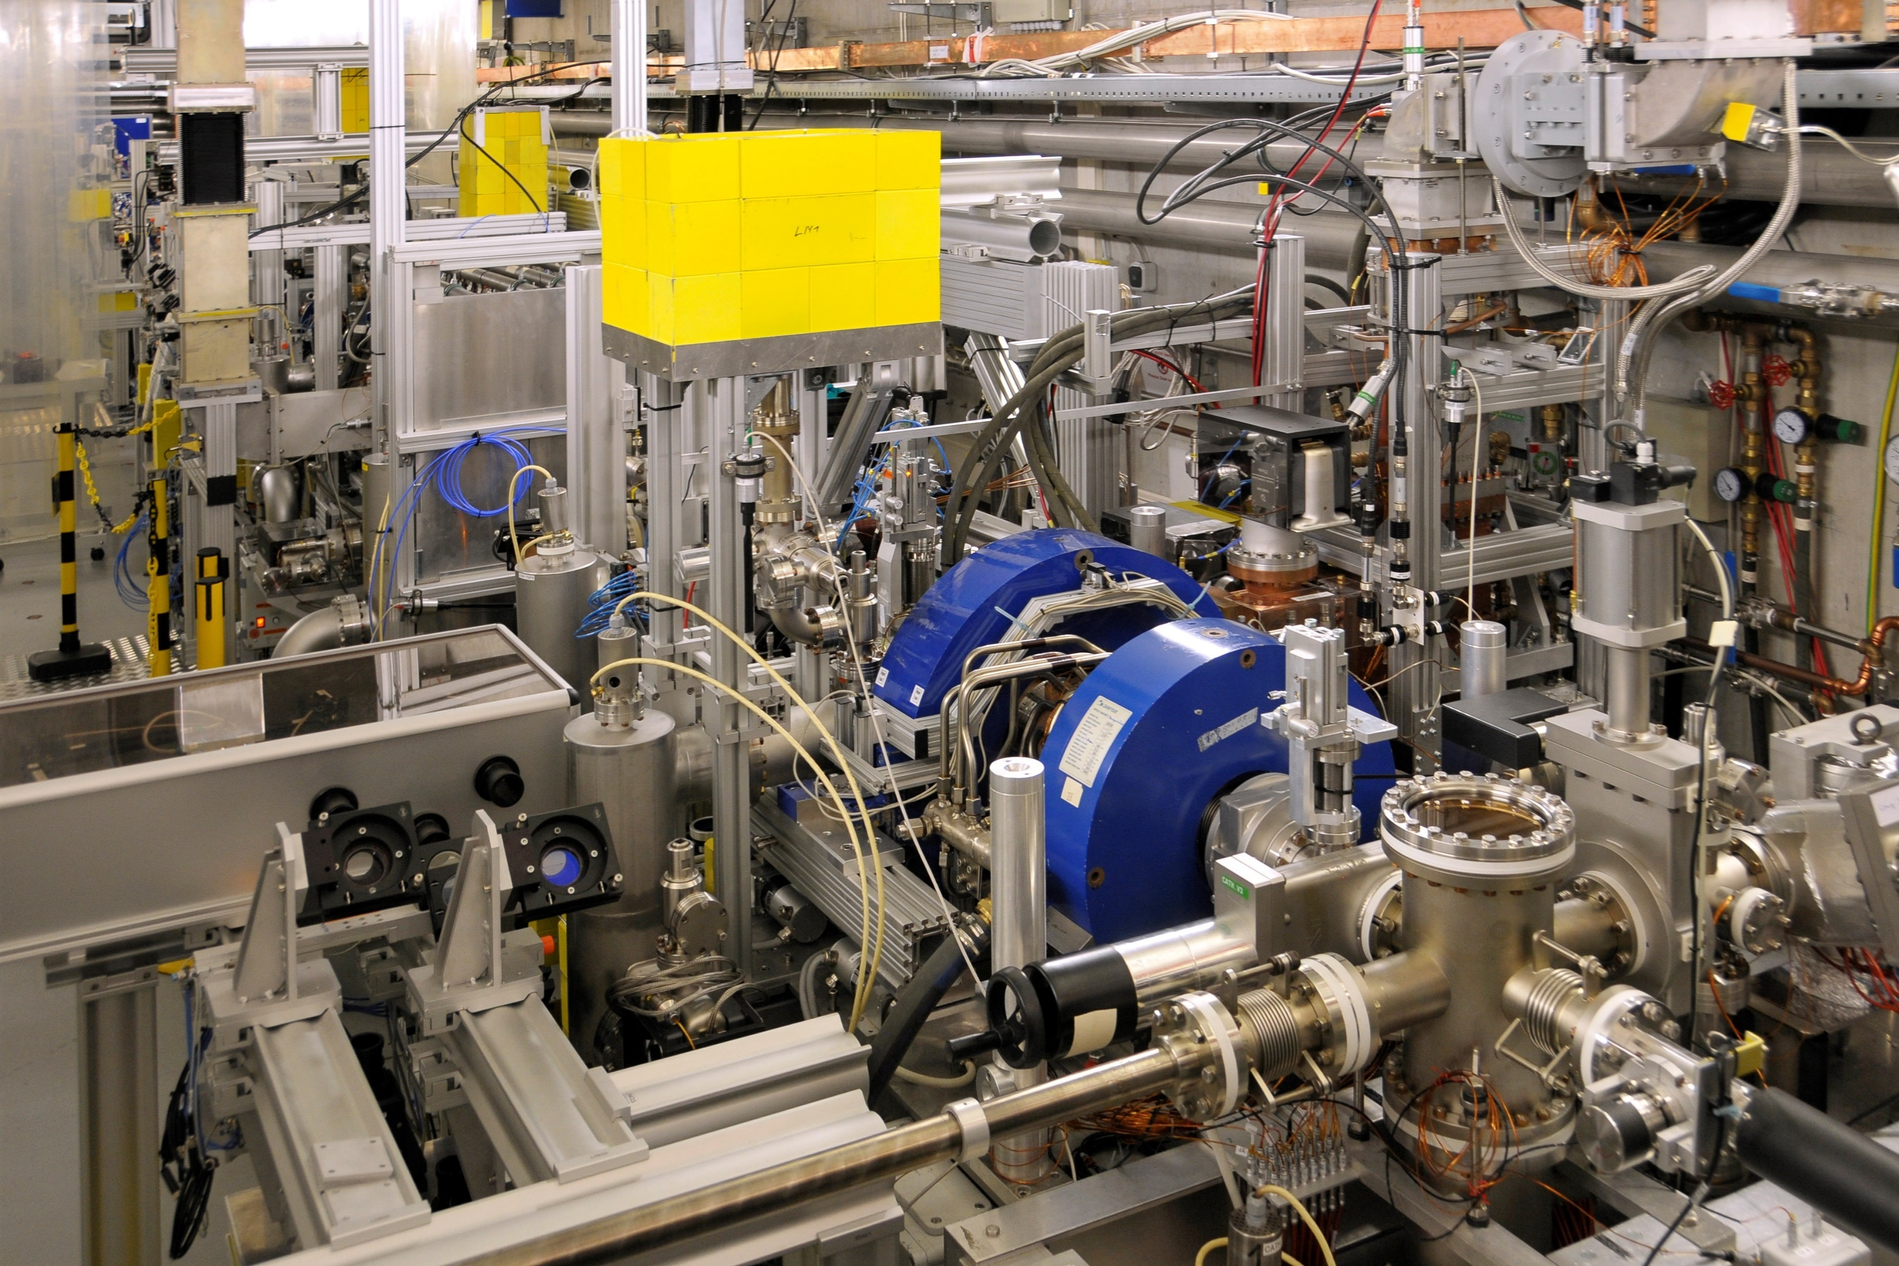
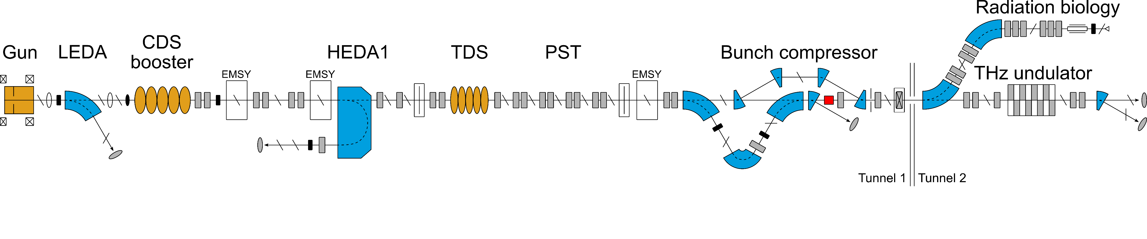
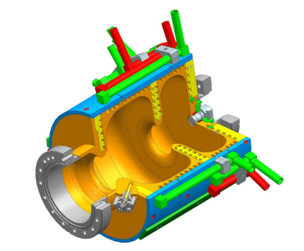
About PITZ
Photo Injector Test facility at DESY in Zeuthen (PITZ)
PITZ develops optimized electron sources (minimized emittance) for short-wavelength Free Electron Laser (FEL) user facilities like the European X-ray Free Electron Lasers in Hamburg
General accelerator R&D and applications of high brightness beam → R&D on electron FLASH radiation therapy (FLASHlab@PITZ)
PITZ cooperates with 26 partners
FLASHlab@PITZ
<7 MeV
<22 MeV
<25 MeV
RF deflector
L-band (1.3 GHz)
e⁻ beam diagnostics (charge, spectrum, emittance, current profile, etc)
60 MV/m
Property | Value
Energy | < 22 MeV
Bunch charge | fC to 5 nC
Duration (FWHM) | 0.1 – 30 ps
Beam size (RMS) | µm – mm
Separate access to Tunnel 2 allows sample exchange while the accelerator is running
Notes:
Introduction to PITZ, refers to FLASHlab@PITZ as an application
then the beamline and beam parameters, comes to FLASHlab@PITZ beamline in the end

Slide 3
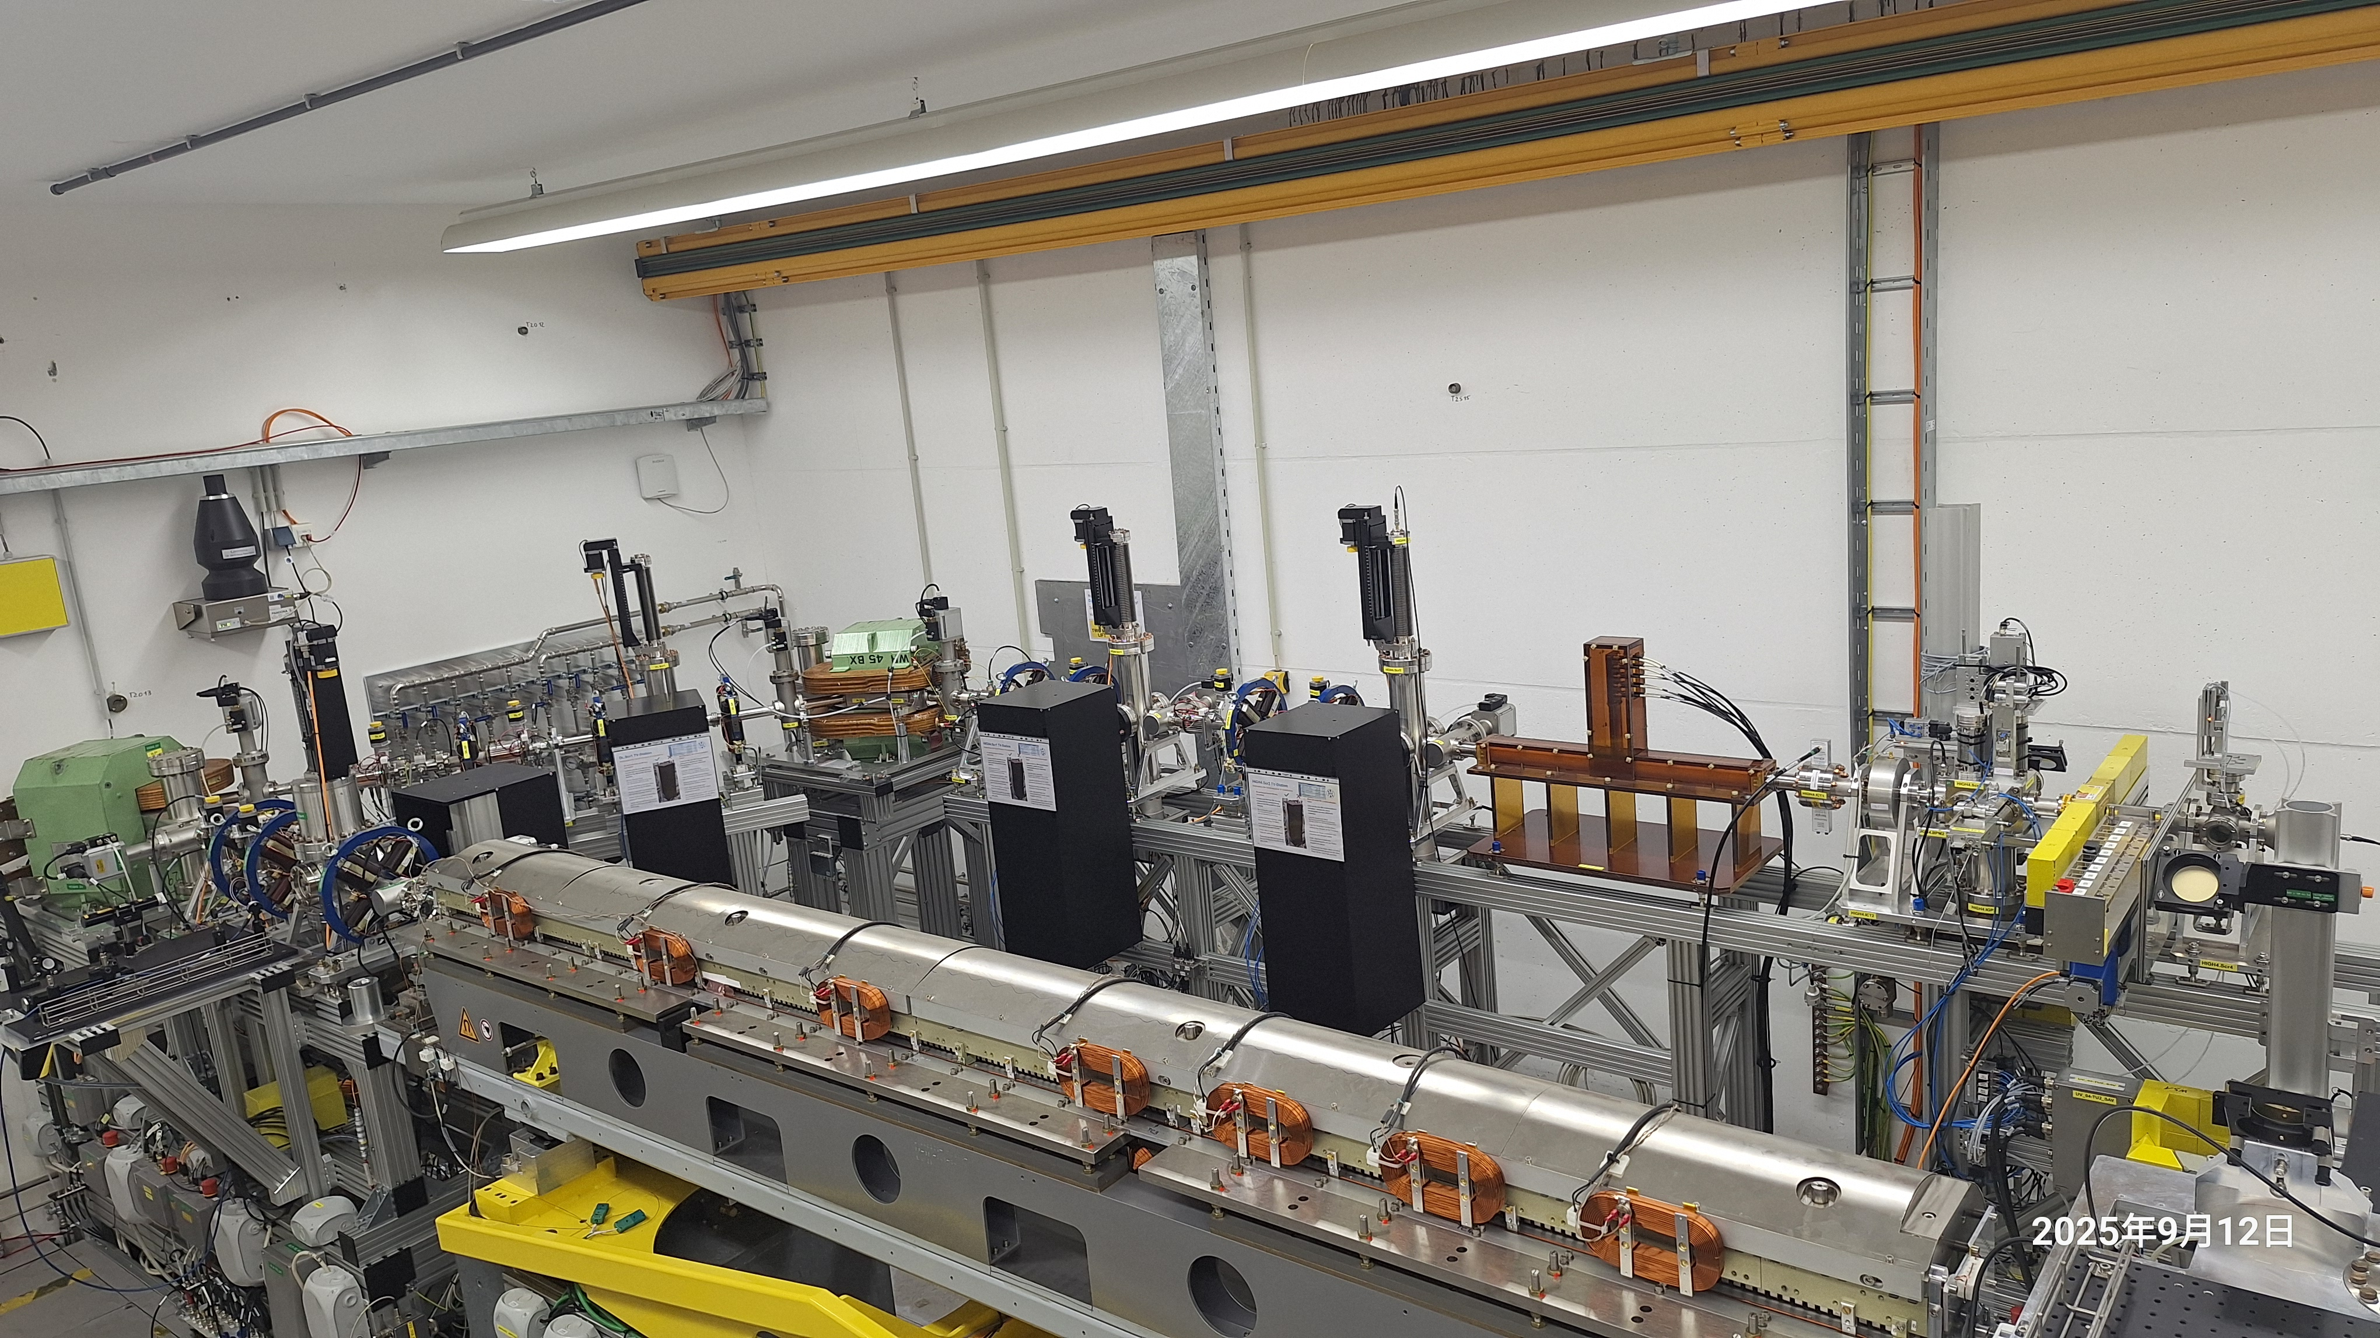
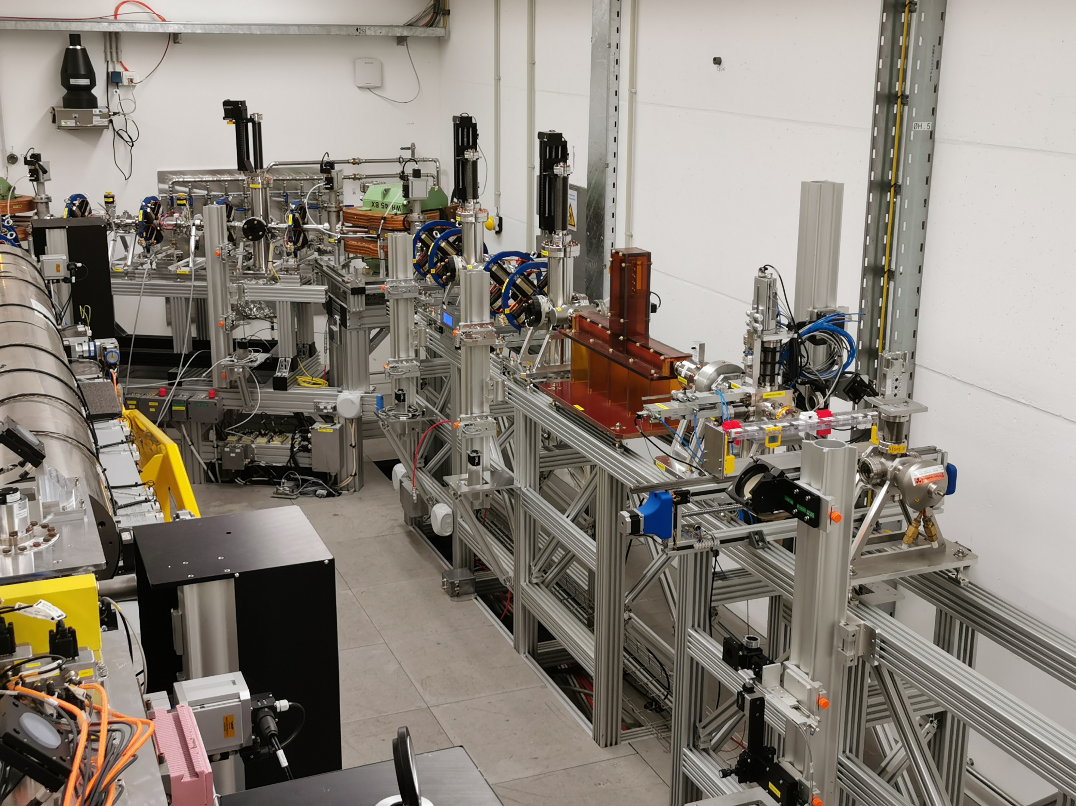
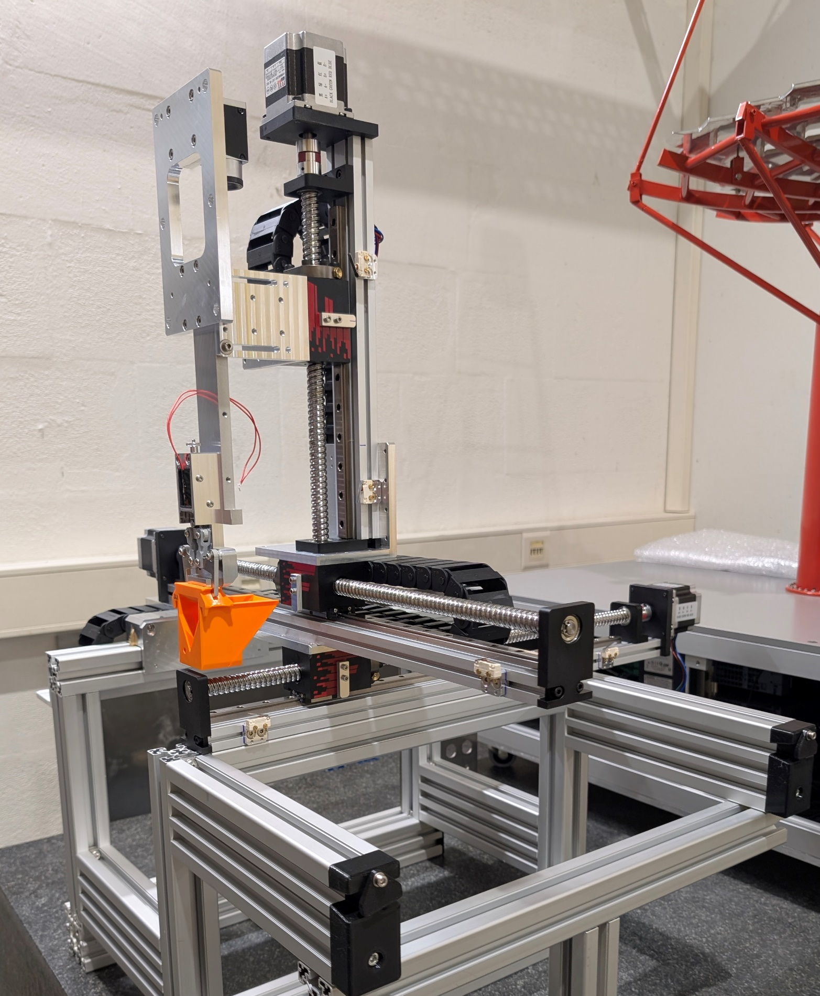
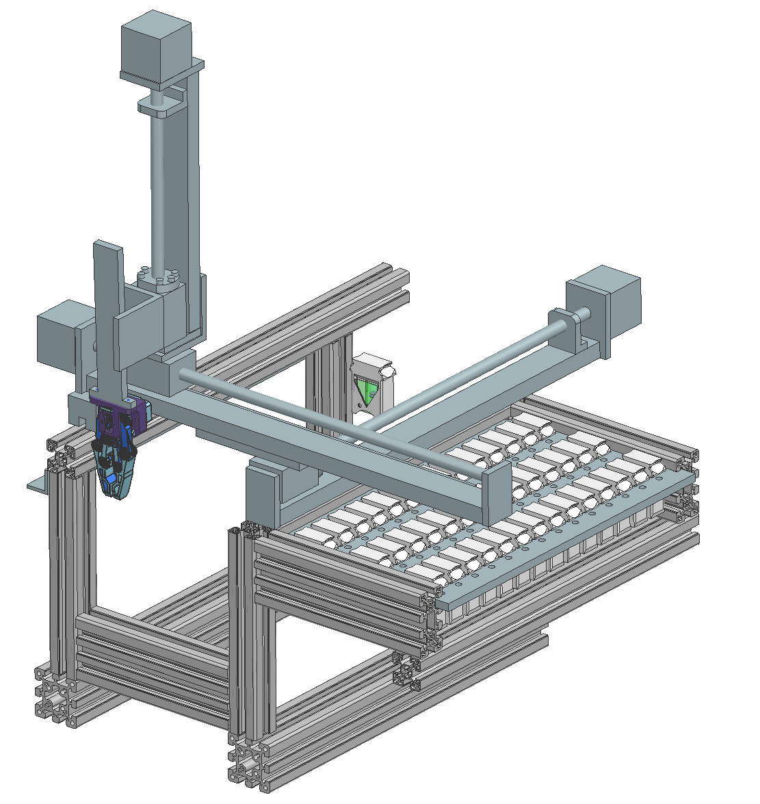
FLASHlab@PITZ
Alu plate
Sample handling
Overview of beamline, in operation in August 2025
Online dosimetry
Dogleg
Shielding
Vertical kicker
e- beam direction
ICT
Ti window
Quadrupoles
Samples
PITZ-robot based on C-Robot from CERN (ongoing)
Beam position monitor
Screen + Faraday cup
Notes:
FLASHlab@PITZ beamline: how the electrons move, the diagnostics and experimental area
Zoomed view of the motor stage, 9 slots for samples and 1 slot for online dosimetry
More flexible PITZ-robot is under preparation
Also mention the vertical kicker

Slide 4
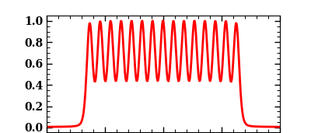
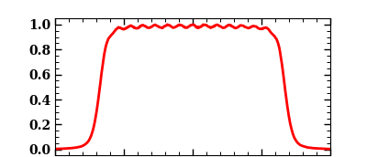
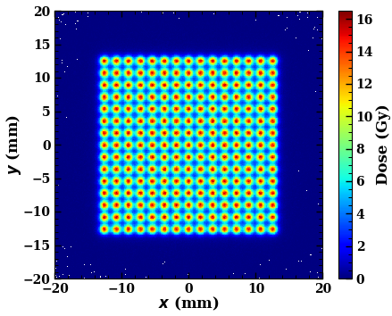
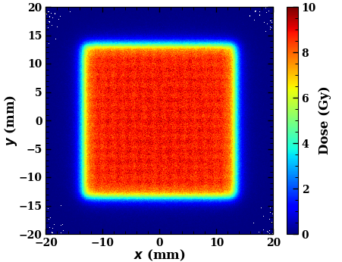
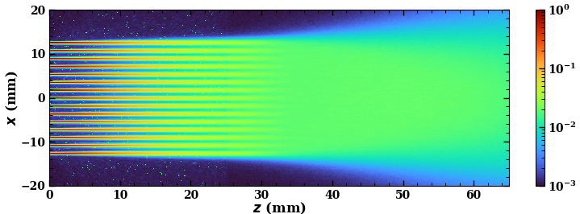

Flexible dose generation (1)
Fluka simulation by Z. Amirkhanyan
PVDR~2.2
Scanning beams
Slow kicker
(a few μs)
Fast kicker
(0.1 μs)
Ti window + air + water
15x15 beams with:
$$σ_{XY}=0.1 mm$$
$$Δ=1.8 mm$$
Slow kicker: installed, to be tested soon
Fast kicker: design ready, production ongoing
Almost 100% usage of electrons
Can be spatially fractionated or uniform
Full 2D scan can be finished within 1 ms
1 cm deep
Allows SFRT in addition to FLASH-RT
Notes:
One unique capability is to generate radiation field with scanning beams;
To do this, we have installed a slow kicker on the beamline, which is to be tested soon
The quick kicker design is finished and the production is ongoing
The benefits of scanning beams includes …
Simulation case: 15x15 electron beams with an RMS size of 0.1 mm and spacing of 1.8 mm; after 2.5 cm in air, maintains a PVDR of 2.2
Became uniform from 1 cm in water

Slide 5
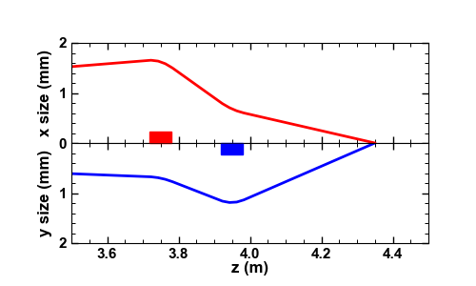
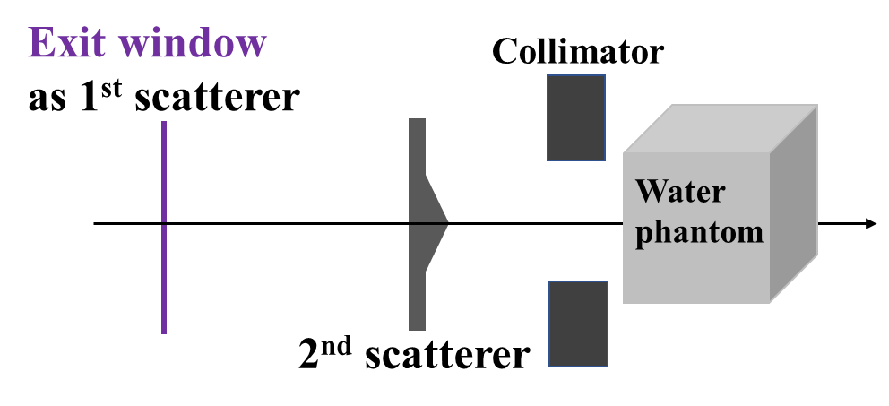


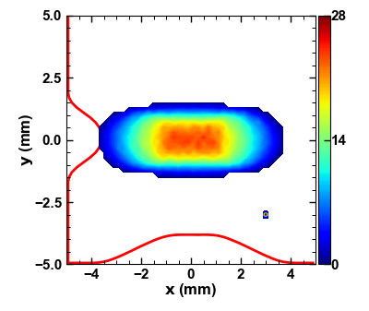
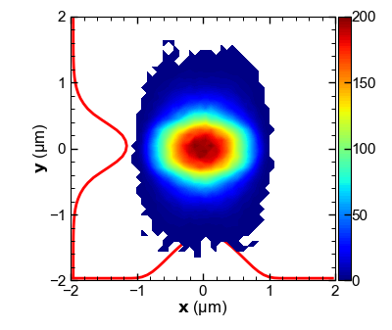
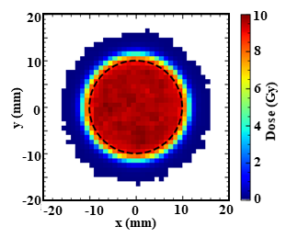
Flexible dose generation (2)
3. Microbeam generation (~1 fC)
Exit window
7.5 μm Kapton
2. Scattering beams
Radially dependent scattering angle
50 μm Ti
Simulation by Ocelot
Dose (Gy)
Dose @1 cm in water
~60% of electrons inside the circle!
Microbeam allows for precise delivery of dose within individual cells → Studies of cell damage and bystander effects
Notes:
Design and test the dual-scatter scheme, which allows to generate broad uniform radiation field inside the target with a good transmission efficiency towards the target;
Exit window as first scatter to expand the beam, a specially design film introduce a radially dependent scatter angle to flatten the beam; After optimization, 60% efficiency
In addition, it is also possible to focus very low charge bunch into sub-micrometer size. In this simulation, two additional quadrupoles are employed to focus the beam by a factor of more than 1000.
Given the very low bunch charge, the local dose can reach up to 200 Gy;
The high dose can be precisely delivered to individual cells, allowing studying cell damage mechanism and by stander effects.

Slide 6
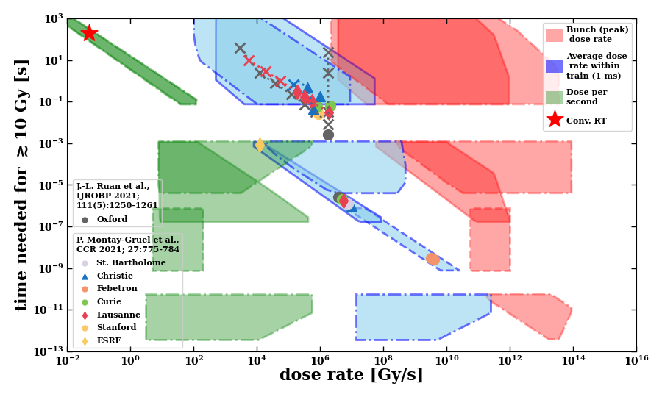
Dose parameter space
Pulse Train Time Structure
up to 1 ms
t
1 cm² uniform dose from scattering beams 0.5-1.5 mm RMS size for scanning beams (uniform and minibeam）
1-10 Hz
NEPAL laser: up to 4.5 MHz
(Arbitrary bunch pattern)
Pharos laser: up to 1 MHz
Scattering, 4.5 MHz (✓)
Measured
Scattering, two-bunch scheme(✓)
Scanning beam
Scanning beams for uniform dose distribution
Scanning beams for spatially fractionated RT:
0.5-1.5 mm² minibeam
Notes:
0.2 Gy per pC within 1mm → 50 bunches for 10 Gy
This slide summarizes our dose parameter space. We considered both the scanning and scattering methods mentioned earlier, as well as the capabilities of our two laser systems.
Our lasers operate in what is called burst mode. The bursts repeat at 10 Hz, and within each burst the laser pulses repeat at a frequency of up to 4.5 MHz — or separated by about 220 ns. When we combine the two lasers, we can reach even shorter pulse separation — down to the RF frequency of 1.3 GHz, or roughly 770 ps.
On this plot, the horizontal axis shows the dose rate, and the vertical axis shows the time required to deliver at least 10 Gy. We have also indicated the regions where FLASH effects have been studied in other laboratories for comparison.
Using the scattering method with a single laser, we can reach dose rates up to about 10⁸ Gy/s. With the two-bunch scheme, this extends by roughly two orders of magnitude.
When we switch to 2D beam scanning, the available parameter space becomes larger with uniform radiation fields, and even more with spatially fractionated radiation fields.
Ref:
Folkerts M, Abel E, Busold S, Perez J, Krishnamurthi V and Ling C 2020 A framework for defining FLASH dose rate for pencil beam scanning Med. Phys. 47 6396–404

Slide 7
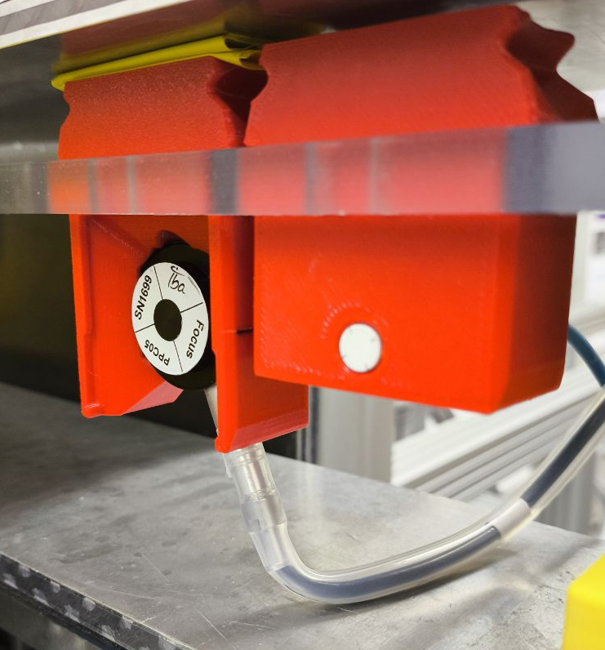
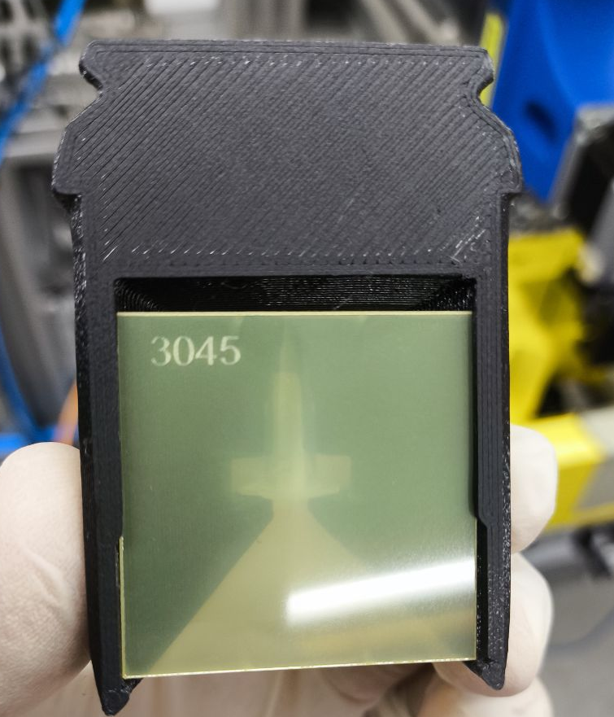
Dosimetry at FLASHlab@PITZ
Courtesy: F. Riemer
PPC05 Ionization chamber (left) & flashDiamond (right)
Dose measurement for bio-chemical experiments:
Online detectors (Ionization chamber for LDR and Diamond for HDR) are used for beam alignment and dose estimation
Gafchromic films are used to measure the delivered dose for each sample → non-destructive measurement
Dosimetry research
Cross-calibration of all detectors using Alanine (analysis by PTB)
TLD/OSLD readout on campus (since July)
Doserate linearity measurements:
flashDiamond detector shows linearity for the full parameter range of PITZ
Gafchromic films show super-linearity
Characterization of detector prototypes (flashDiamond, SiC detector)
Planned: TurboICT and calibrated screen
Sample in tube sandwiched between two Gafchromic films
Dose rate | Online measurement | Offline measurement
Low | IBA PPC05 Ionization chamber | Gafchromic EBT-XD films, TLD-100
High | PTW flashDiamond
Ultra-high | PTW flashDiamond
More details from dedicated talk by O. Stein, “Dosimetry at ultra high dose rate at PITZ and ARES”
Notes:
To better support biochemical experiments, dose measurement has been integrated into radiation experiments on the platform.
To support bio-chemical experiments, we offer online detectors for … and films for …
In addition, we also use the platform for dosimetry studies, such as cross-calibration of all detectors with Alanine, doserate linearities investigation, and characterization of ..
More details on the dosimetry at PITZ can be found from Oliver’s talk tomorrow
Is the super-linearity relevant with dose rate or dose? → Comments from Felix: both
More comments from Flex:
Online detectors for dose estimations: IC and Diamond (as shown in the table). IC for LDR (20pC), Diamond for HDR and UHDR (700pC, 3.5nC) See attached picture for super-linearity of films (old picture). Further investigation is ongoing, but the data from last week is not yet analysed. For the dose rate of the flashDiamond (see also attached picture): Up to 110 Gy/pulse. (418 NoP --> ~93µs --> ~1.2E6 Gy/s)

Slide 8
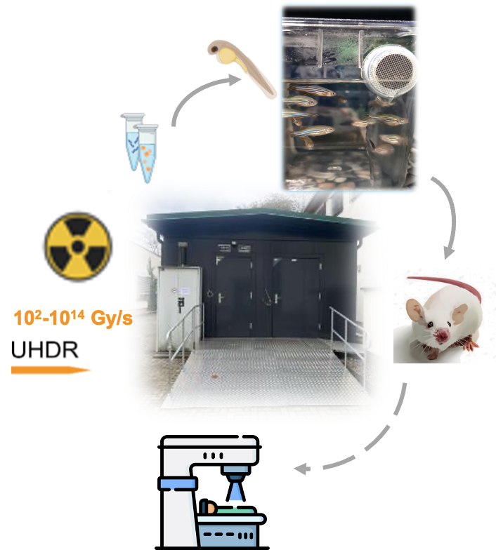


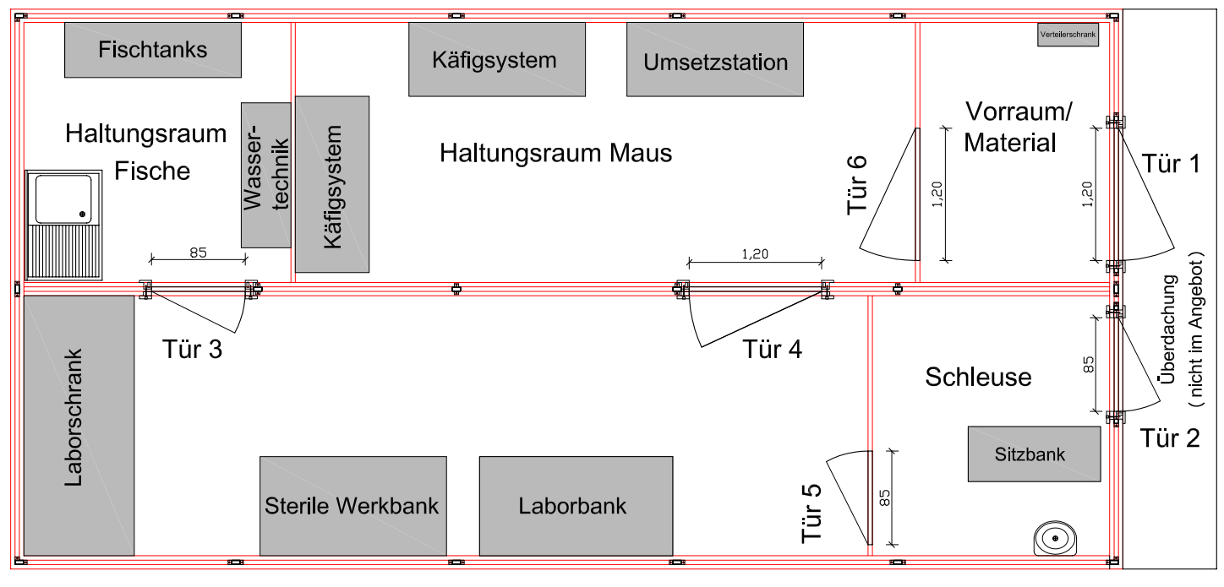
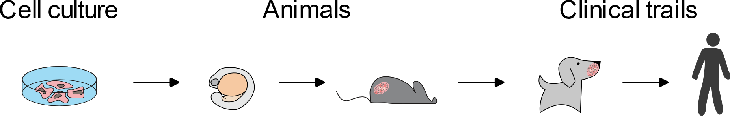

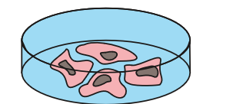
FLASHlab@PITZ : Infrastructure
Courtesy: A. Grebinyk
BioLab for comprehensive preclinical research
Laboratory for biological experiments:
from zebrafish embryos (fast & high-throughput screening model, first studies done)
to mice (bridging preclinical research to radiotherapy)
Mobile Container-Lab Solution: rapid-deploy of container laboratories for agile research directly next to the accelerator facility
Supported by Technical University of Applied Sciences Wildau and Max Delbrück Center for Molecular Medicine (MDC)
All animal experiments are rigorously planned to be conducted in accordance with:
European Directive 2010/63/EU on the protection of animals used for scientific purposes
German Animal Welfare Act (Tierschutzgesetz, TierSchG)
Notes:
To enable preclinical researches, a mobile container-lab has been built next to our accelerator. It allows the housing of zebrafish and mice and preparation for radiation experiments.
Here is the layout of the lab, the entrance, the preparation room, the fish room and the mouse room. It is worth mentioning that all animal experiments are to be conducted following the European and German regulations.

Slide 9
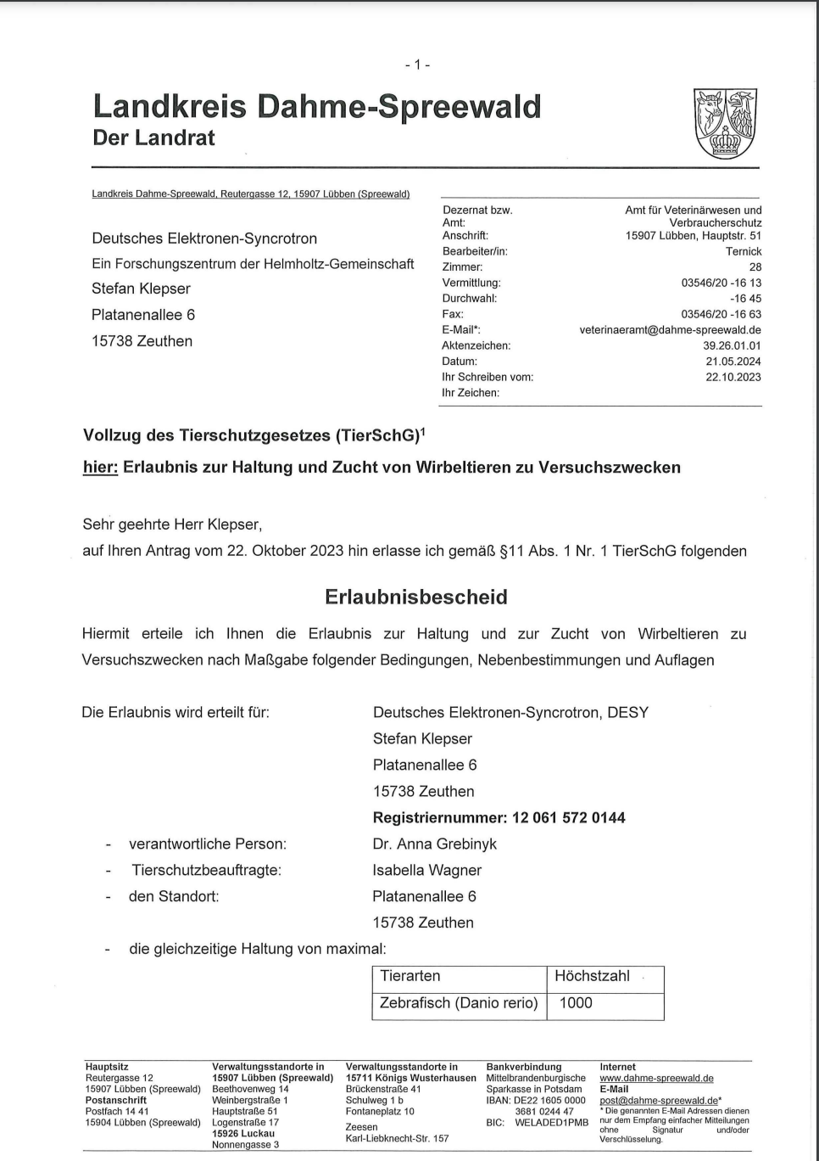
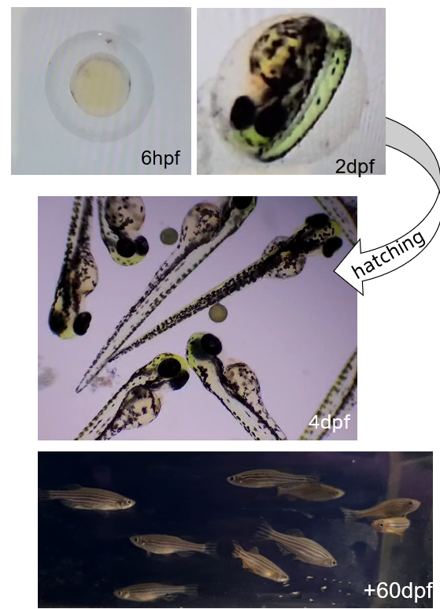

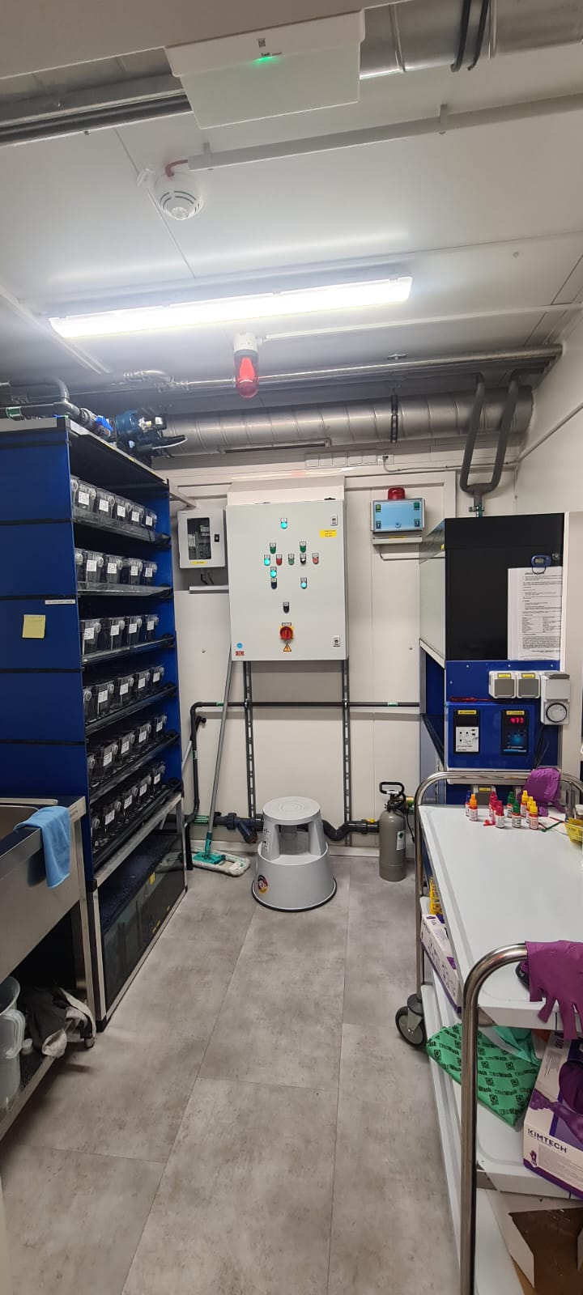
Zebrafish Husbandry
21.05.2024: Authorized by Office for Veterinary Affairs, Consumer Protection and Agriculture (Amt für Veterinärwesen, Verbrauchschutz und Landwirtschaft)
to house 1,000 Zebra Fish annually
to breed 800 Zebra Fish annually
(update from 03.07.2025)
Small system – still much of work
08.08.2024: we have got 367 Zebrafish from MDC
05.09.2025: 316 Zebrafish
Established procedures:
Fish care: pH calibration, Artemia preparation, water quality testing and reporting
To balance pH level build CO₂ generating system
Breeding to maintain heathy adult population
Rehoming of retired animals in TH Wildau Aquarium and private hobby care
Embryo generation: optimization ongoing
First electron irradiation of embryo done in August 2025
Courtesy: A. Grebinyk
Notes:
For Zebrafish, we were granted the permission in May 2024 to house 1000 fishes annually and to breed 800 annually.
We received our first fish from MDC in August last year and now maintain 316, excluding those that have been retired and including those we hatched ourselves.
Procedures have been established for fish care, providing not only a healthy living environment in the laboratory, but also after their retirement.
Currently, we are optimizing embryo generation. First electron irradiation was performed last month, preliminary results will be discussed later.
H, or General Hardness, measures the concentration of minerals such as calcium and magnesium in the water. KH, or Carbonate Hardness, measures the buffering capacity of the water, which is essential to maintain a stable pH level. Low levels of both GH and KH can produce an unfavourable environment for aquatic life.

Slide 10

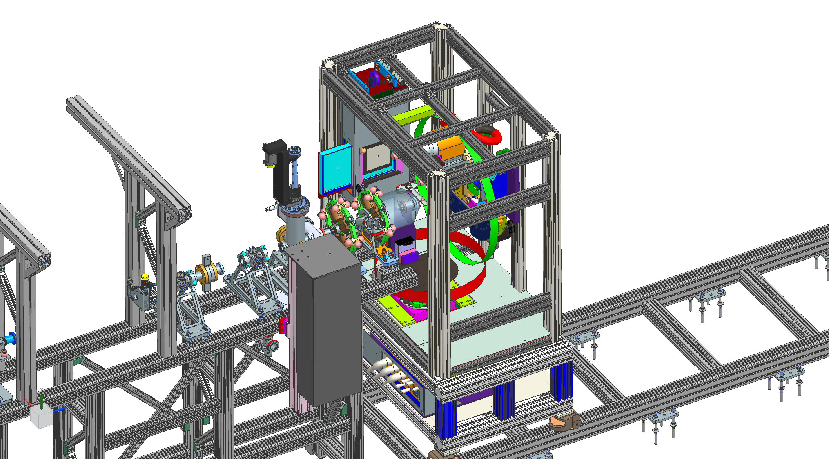
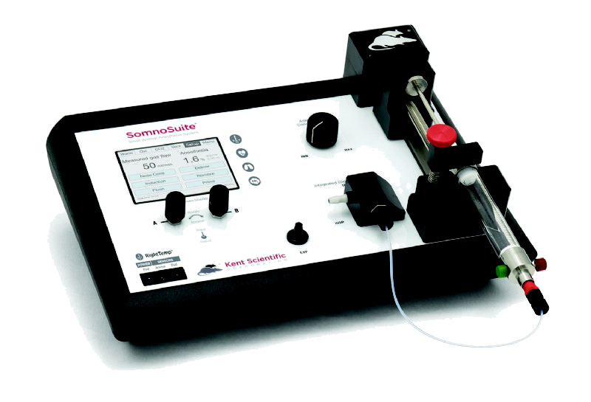
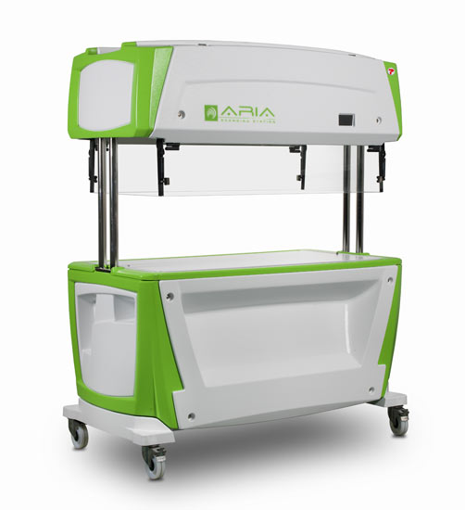
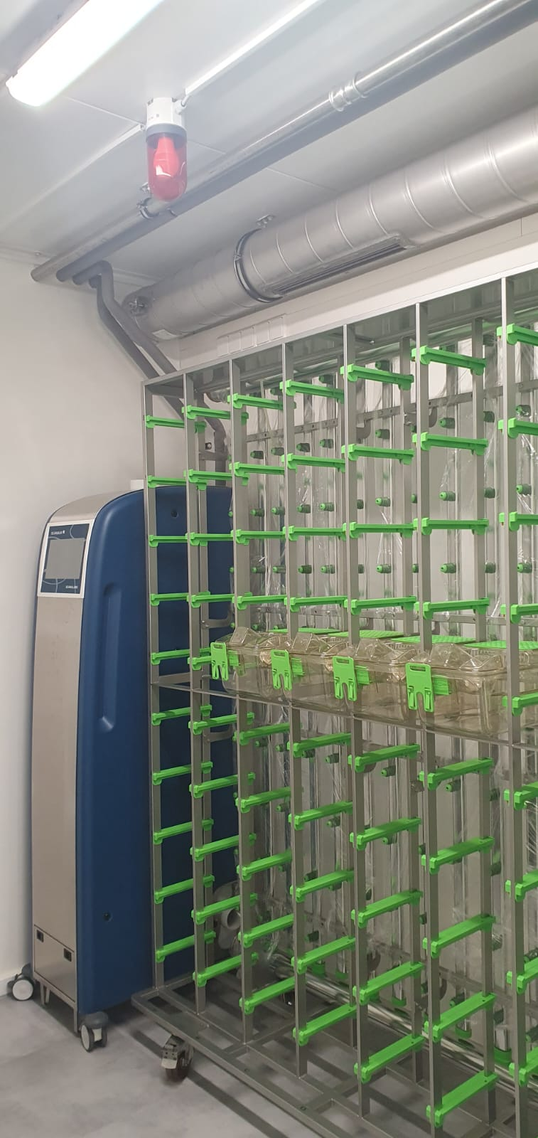
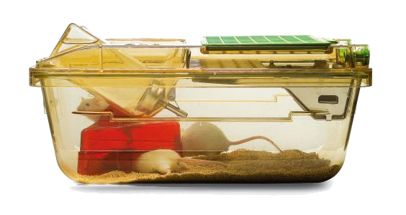
Mice Unit Preparation
Courtesy: A. Grebinyk
Small system – still much of work
03.07.2025: Authorized Husbandry by Office for Veterinary Affairs, Consumer Protection and Agriculture (Amt für Veterinärwesen, Verbrauchschutz und Landwirtschaft)
to house up to 450 mice simultaneously
Operation set with MDC and TH Wildau
Individually ventilated cage (IVC) system
Search for qualified experts for the positions of a second Animal Welfare Officer and an Animal Caretaker
First e⁻ irradiation planned for 2026
Anesthesia system
Small Animal Radiation Research Platform (SARRP) will be delivered this year
Precision of conformal clinical radiotherapy
High-resolution CT imaging
Dynamic couch and gantry movements
Simple and complex arc therapy
IVC
Cleaning Station
Air system and IVC-rack
Notes:
For mice, we obained the permission to house up to 450 mice simultaneously in July 2025.
The mouse room is equipped with air system and rack for individually ventilated cages, cleaning station and anesthesia system.
In addition, we are purchasing a small animal radiation research platform, which will significantly enhance our research capabilities by enabling: Precision conformal radiotherapy – delivering clinically relevant treatment plans with sub-millimeter accuracy.
High-resolution CT imaging – allowing accurate tumor localization and treatment planning.
Dynamic couch and gantry movements – enabling precise beam positioning from multiple angles.
Simple and complex arc therapy – supporting both basic and advanced irradiation protocols for sophisticated experimental designs.
We are searchig for qualified experts as a second animal welfare officer and as an animal caretaker.
First radiation experiments are planned in 2026.

Slide 11
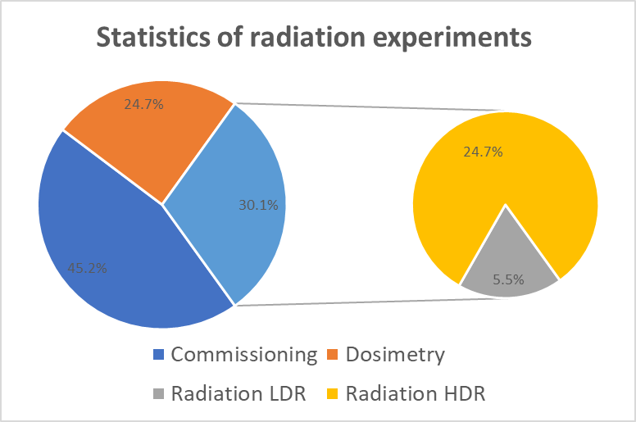
Recent experiments
New beamline in operation in August
 | Targets | # of sessions | # of 8h shifts
Commissioning | - | - | 16.5
Dosimetry | IC, Diamond, Alalin, Mouse phantom, etc | - | 9
Rad. LDR | Fish, Cell, DNA, etc | 11 | 2
Rad. HDR |  | 57 | 9
Sum |  | 68 | 36.5
For each session: 30-40 minutes for dismounting & installation of samples & films, and accelerator recovery
At low dose rate (LDR, 0.05 Gy/s): the radiation takes 30 min. to a few hours, depending on the total dose of all 9 samples
At high dose rate (HDR, 3~6x10⁶ Gy/s): the radiation only takes a few minutes
Notes:
The new beamline has come into operation in August.
Besides commissioning shifts, we have spent 9 shifts on dosimetry and 11 shifts on radiation experiments, which were grouped into 68 sessions in total.
For each session, 30 to 40 minutes are required for dismounting and …
At low dose rate, the radiation takes 30 minutes to a few hours;
At high dose rate, it takes only a few minutes.

Slide 12
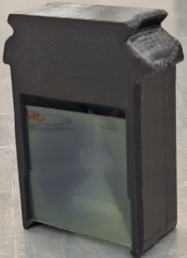
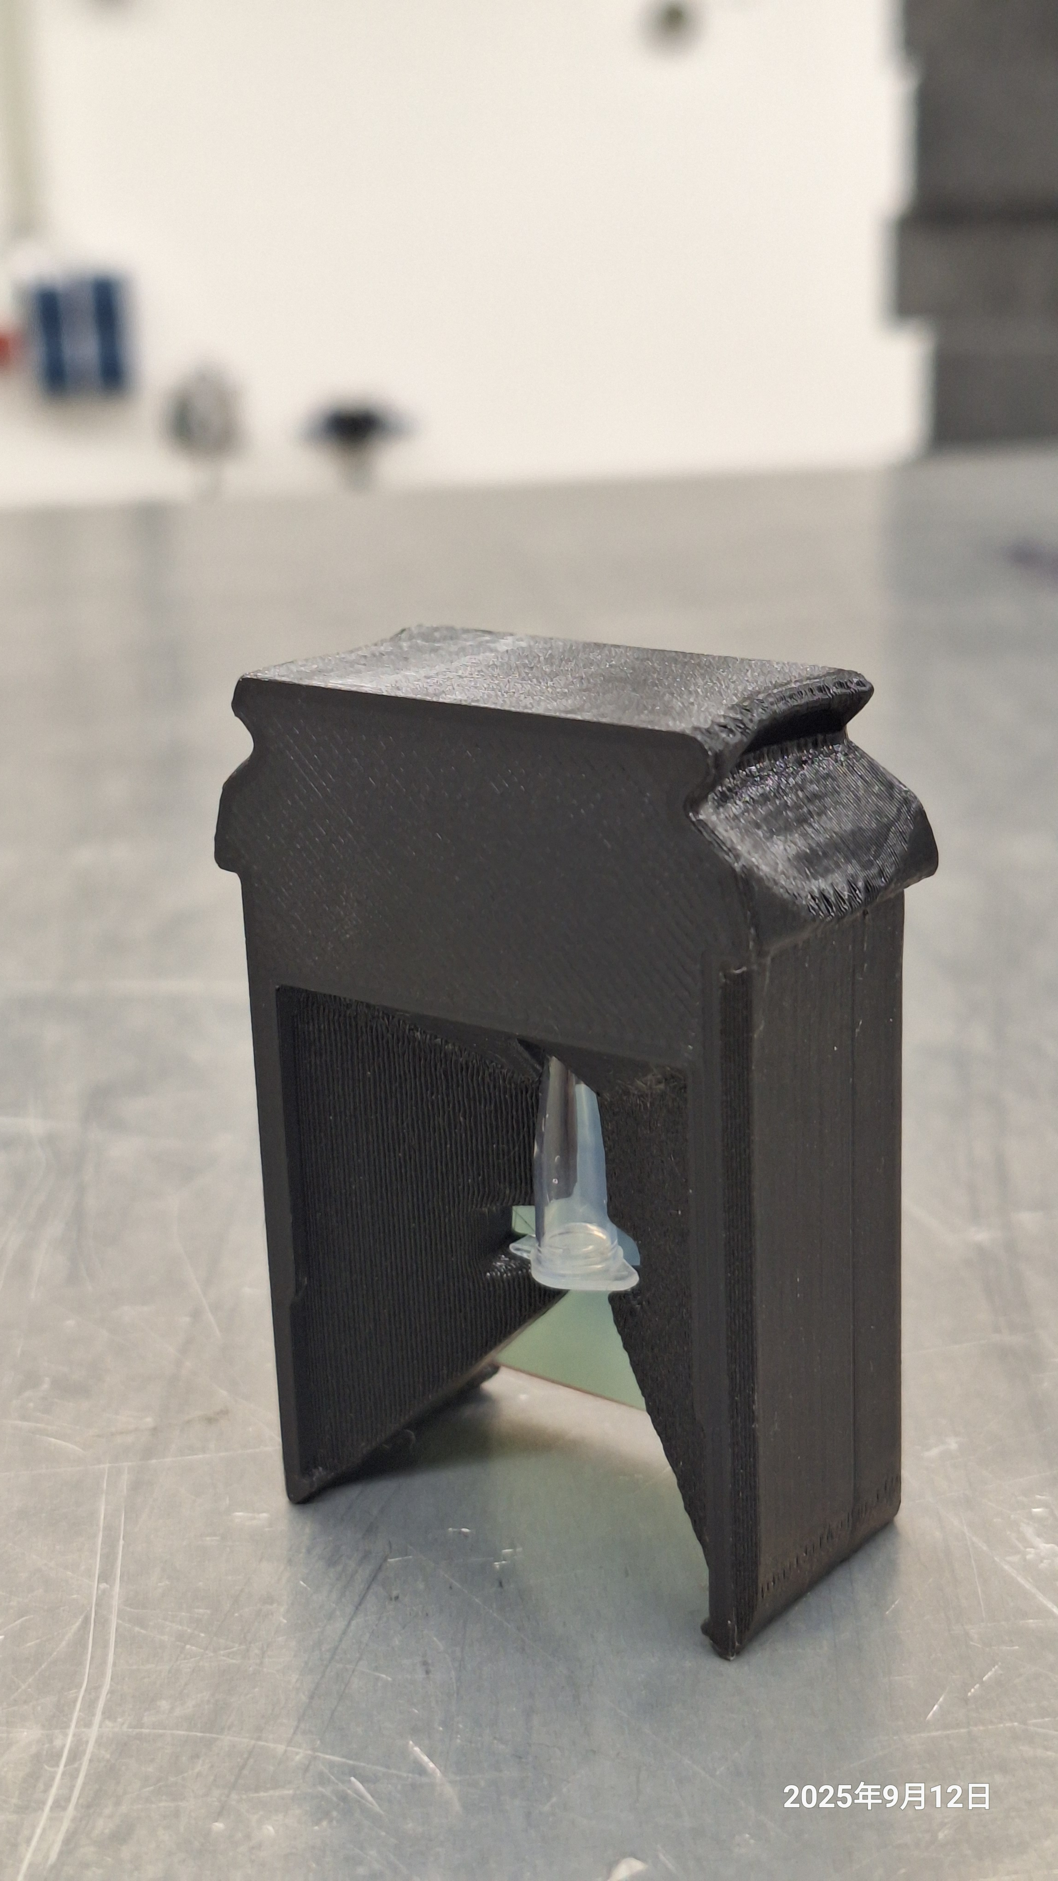
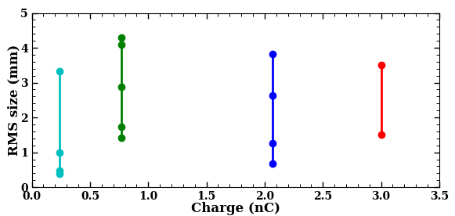
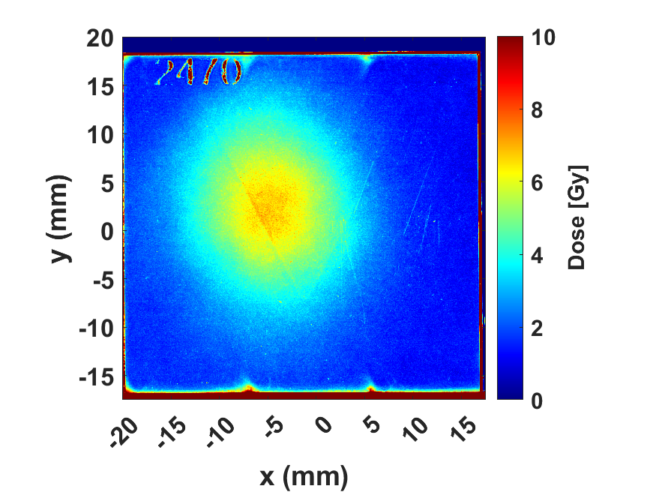
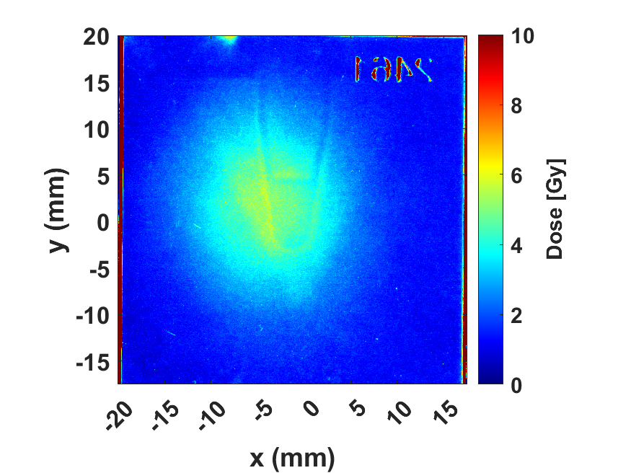
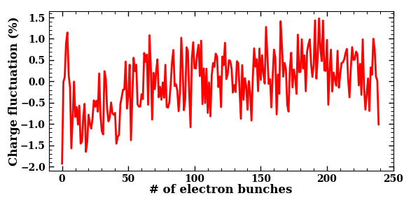
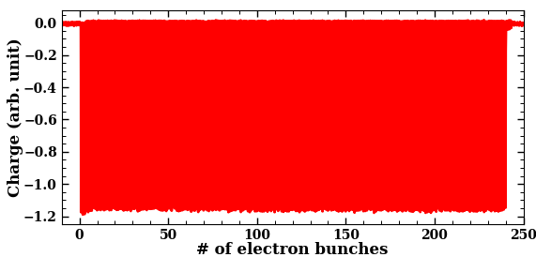
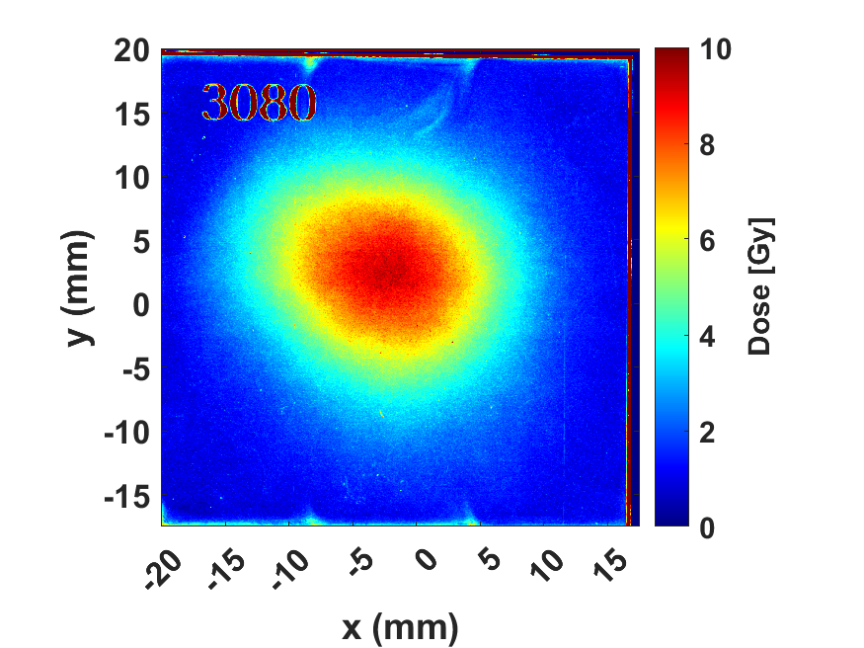
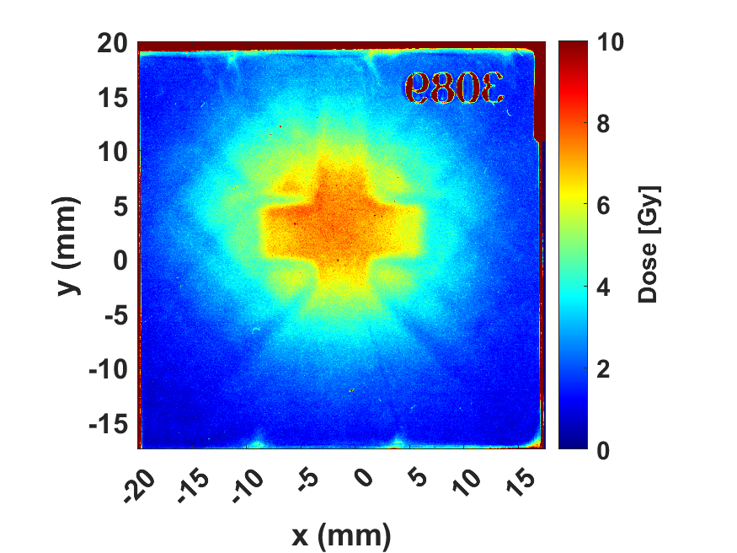
Delivered e⁻ beam and dose
Courtesy: F. Riemer
Variable e⁻ beam charge, size and dose
Tunable beam size at various bunch charges
front
behind
focused
Charge stability along the RF pulse (p2p: $±$1.5%)
defocused
Measured dose distributions under HDR, with uniform field tuned by e⁻ beam size
Notes:
For a large range of bunch charge, electron beams with variable beam size have been transported towards the exit window.
By focusing or defocusing the electron beams, the homogeneous dose area can be adjusted.
On the right side, it shows the measured dose distributions from focused and defocused beams, on the films in front of or behind the samples.
In this case, the shadow shows clearly a uniform dose for the sample.
At the bottom, it shows a uniform charge distribution along the RF pulse, which means a very nice linear dependence of dose on the number of electron bunches.

Slide 13
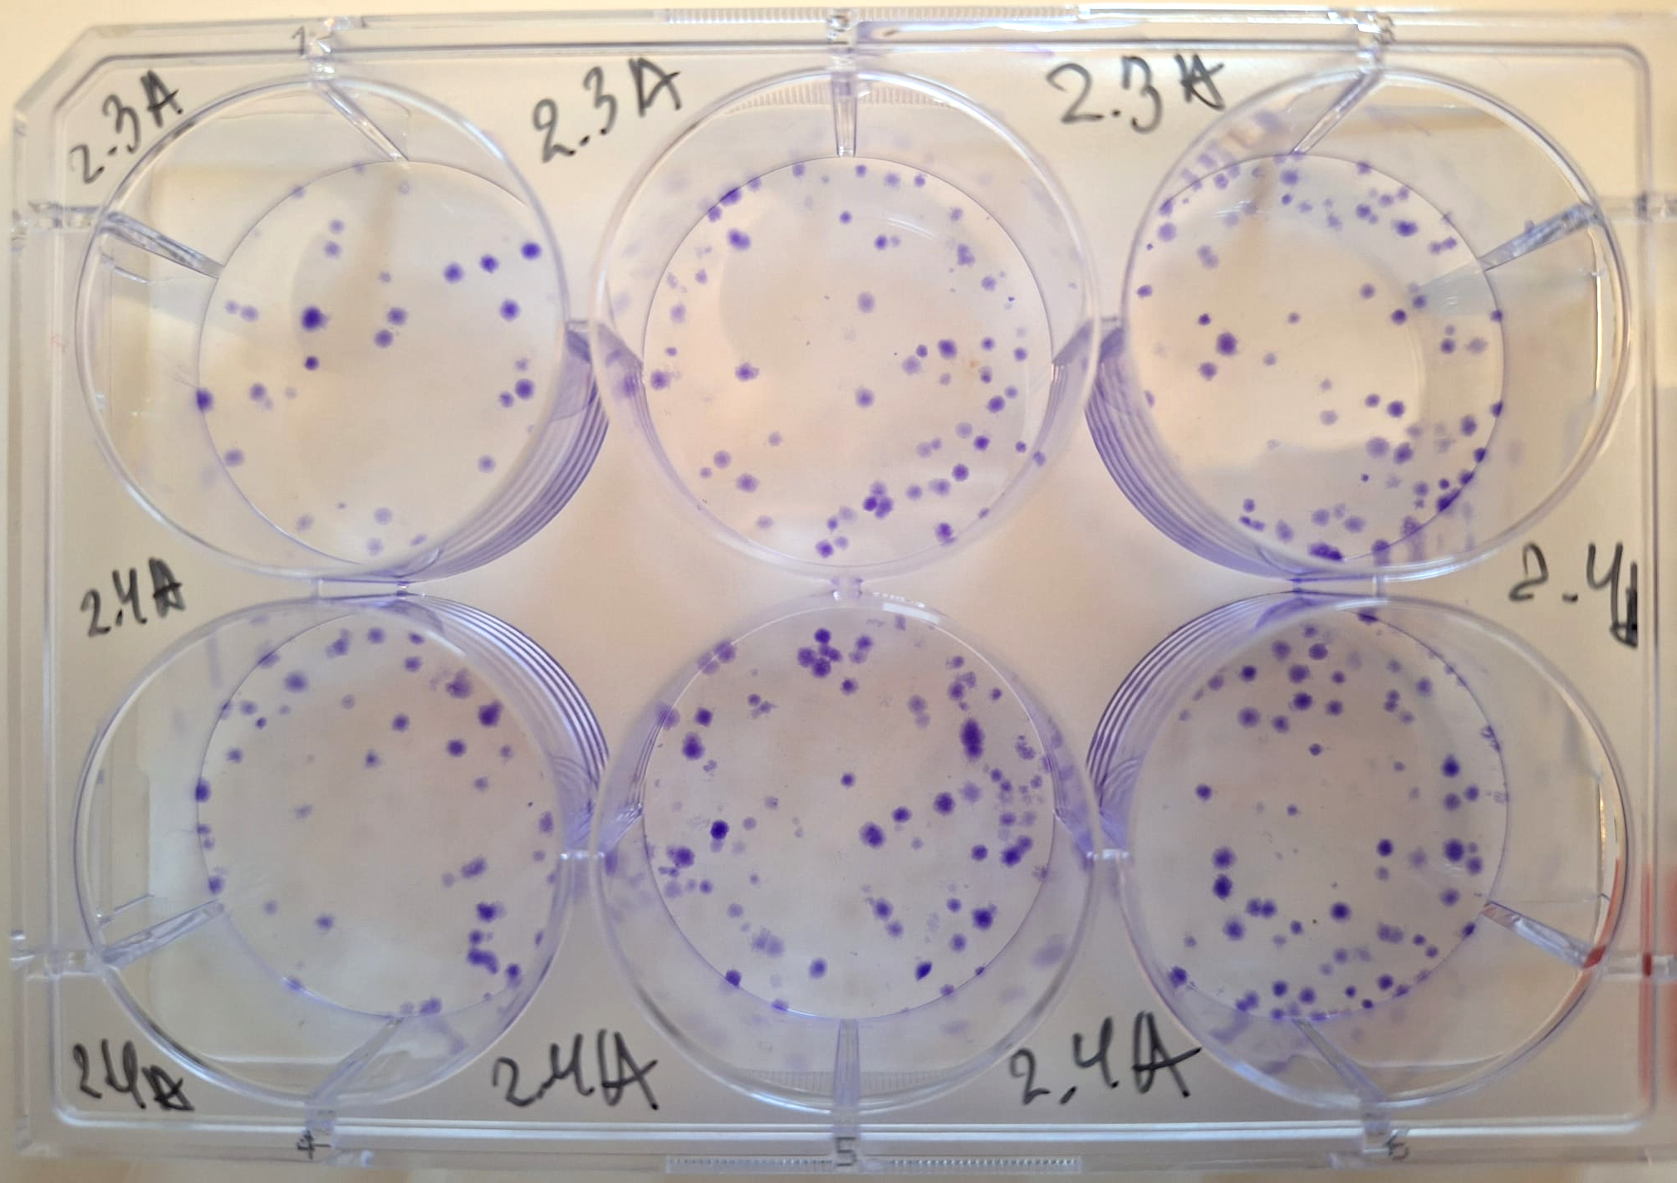
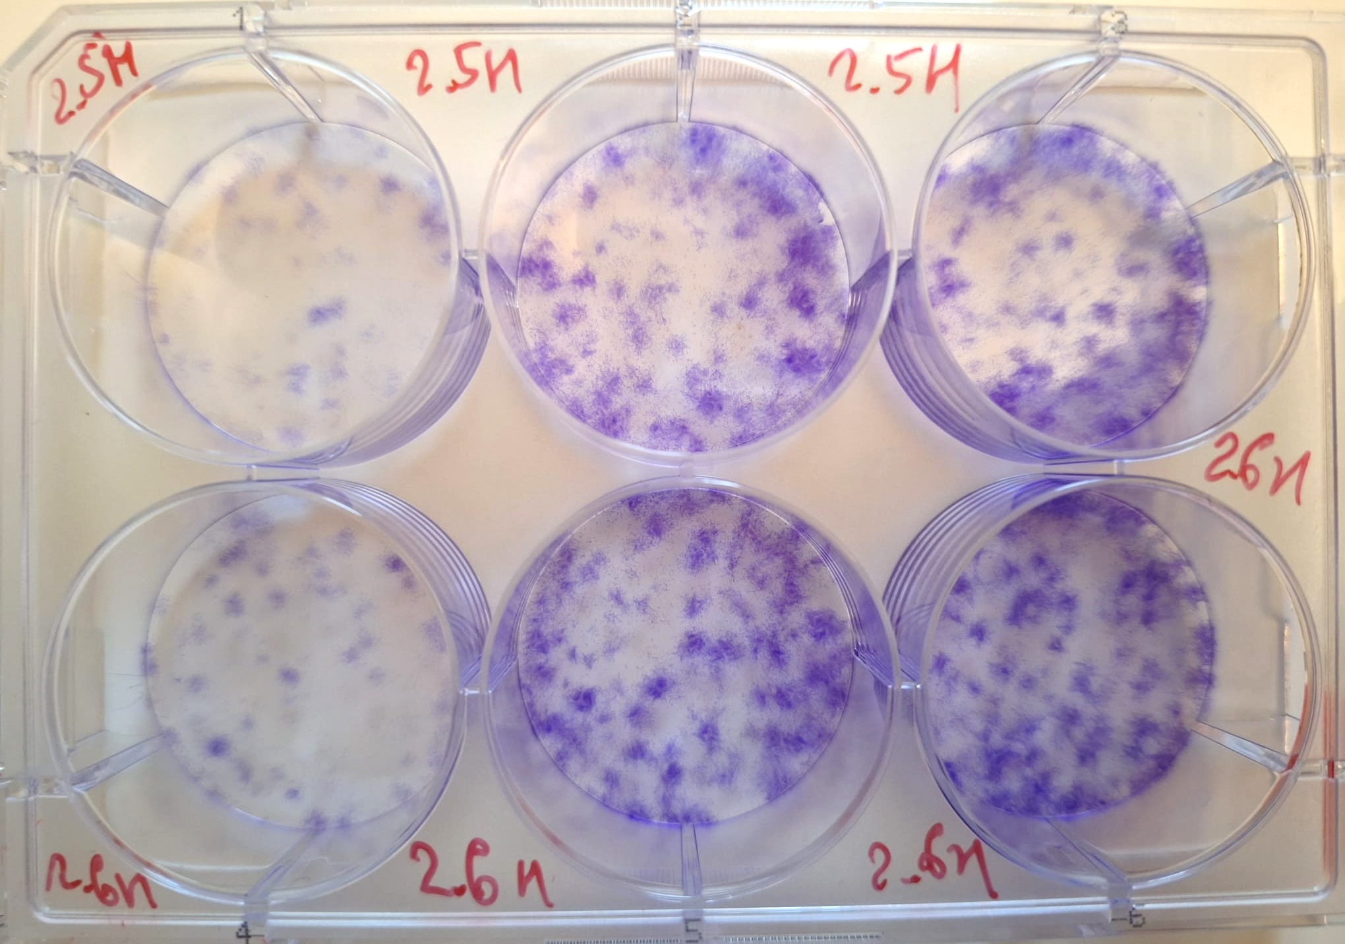
Courtesy: A. Grebynik, et. al.
Cell irradiation
Model: | Assay: | Dose rate, Gy/s: | Charge, pC: | Results:
H₂O | Coumarin | 7.8×10⁵ 4.5×10⁶ | 700 3100
DNA plasmid | pBR322 | 0.05 7.8×10⁵ 4.5×10⁶ | 10 700 3100
Cancer A549 and healthy HEL299 cells | DCFH-DA
 | Clonogenic
 | Comet
Preliminary results: intracellular ROS production
0.05 Gy/s
7.8×10⁵ Gy/s
Human lung adeno-carcinoma A549 cells
are ongoing
0.05 Gy/s
7.8×10⁵ Gy/s
Human fetal lung fibroblast HEL299 cells
A549
HDR 2 Gy
HEL299
HDR 2 Gy
Notes:
In the last two slides, I will show the results from recent radiation experiments.
Due to the short time between the experiments and this talk, the result here is very preliminary.
On this slide, ROS production in the normal and cancer lung cells irradiated at three dose rates are presented.
For both types of cells, it shows a clear difference between low dose rate and high dose rate.
And the difference is more significant for normal cells.
On the bottom, it shows the ongoing Clonogenic assay, a higher survival rate was observed from normal cells irradiated by 2 Gy under HDR.

Slide 14
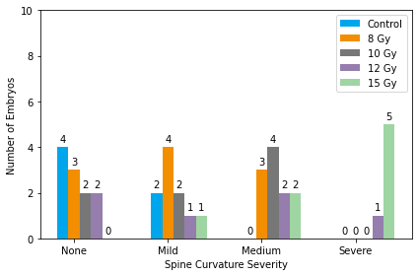
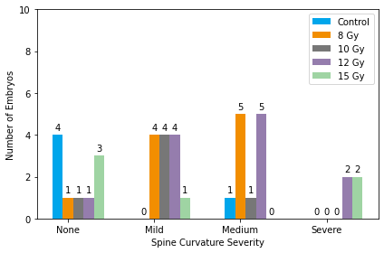
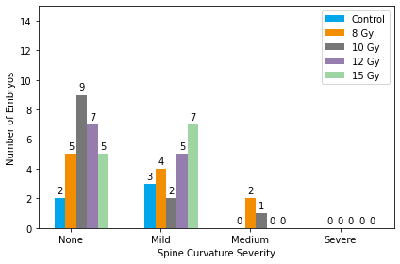
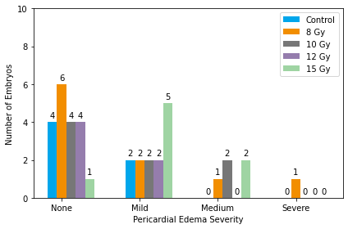
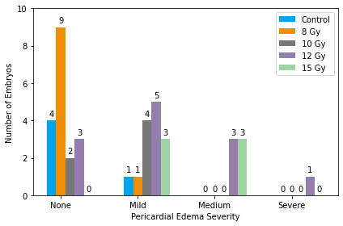

Assessment of Spine Curvature and Pericardial Edema in Zebrafish Embryos 24hpf Irradiation - 5dpf
Pericardial edema
None
X-ray Irradiation
LDR Irradiation
HDR Irradiation
Spinal curvature
Mild
Pericardial edema
Medium
Spinal curvature
None
Mild
Medium
Severe
Severe
Preliminary Data – Courtesy of PITZ Bio group
Notes:
This slide shows the deformity of spine and pericardial edema of zebrafish embryos under radiations of X-rays and electrons.
The radiation was carried out 24 hours post fertilization and the analysis was done 4 days after radiation, or 5 days post fertilization.
For both spinal curvature and pericardial edema, while LDR radiation shows similar medium and sever deformities, we observed no severe deformities and less medium deformities under HDR.

Slide 15
Summary & Outlook
R&D platform FLASHlab@PITZ restarted in August:
Provides improved beam quality and more flexible beam control across a wide range of bunch charges
Produces radiation fields at both LDR and UHDR by scattering a broad electron beam using an aluminum plate
Dosimetry studies continue: e.g., cross-calibration of all detectors with Alanine and characterization of detector prototypes
Preclinical research infrastructure established:
A comprehensive BioLab supports preclinical research, including zebrafish and mouse husbandry as well as preparation for radiation experiments
First zebrafish experiments were conducted in August
Future developments: more flexible sample handling using PITZ-robot, more efficient dose generation through 2D scanning and dual-scattering, and the installation of radiation platform (SARRP)

Slide 16

Thank you
Xiangkun Li
PITZ
xiangkun.li@desy.de
+49 33762 77185

Slide 17
Backup

Slide 18


LDR
HDR
Marc
HDR
HDR
Felix
UHDR
UHDR
UHDR
UHDR
Felix
LDR
Felix
LDR
UHDR
Felix

Slide 19

UHDR
Felix
HDR
Marc

Slide 20




Generating homogeneous dose distribution
Scattering and collimating
Plate scatterer → only 10% of bunch charge remains within the area having at least 90% of the peak dose
Cone-shape scatterer → Introduce more scattering to the electrons near the beam axis, moving faster outwards → ~60% of bunch charge remains within the flattened dose distribution
Dose distribution is usually round
The scattering angle follows approximately gaussian distribution, and thus the beam distribution is gaussian
Gaussian
Flattened
Flattened

Slide 21












Generating homogeneous dose distribution
Scattering and collimating: optimization
The location and geometry of the scatterer is optimized for:
Homogeneous dose distribution and
More charge within a given circle
$θ_{max}$
$$σ_{r}$$
$$θ\left(r\right)=θ_{max}exp(−r^{2}/2σ_{r})$$
Exp.
area
Exit
window
L1
L2

Slide 22



Generating homogeneous dose distribution
5x5 scanning
Scanning beams
A 2D kicker system scans the bunches in the transverse plane
The dose within a voxel comes not only from the bunch which hits it, but also from neighboring bunches → radiation time, dose rate
The bunches at borders are not contributing much to the homogeneous distribution → ratio of useful bunch charge: $1−\frac{4n}{n^{2}}=1−\frac{4}{n}$ → ~80% of bunch charge inside the homogeneous dose area
Can produce arbitrary dose distribution
The number of bunches can be from 5x5 to 67x67
# of bunches
25x25
The relevant bunches for dose rate calculation are those neighbouring bunches which contribute to 5% to 95% of the total dose
It is usually in the order of 2n
The dose is estimated by considering only the local bunch (with RMS size from 0.5 to 1.5 mm)

Slide 23




Flexible dose generation
More option: generating micrometer electron beam (1 fC)
To be added
Adjust the beam size before focusing
Minimize beam size
Existing quads
$$σ_{xy}=0.97 mm$$
$$σ_{xy}=0.3 μm$$
Dose (µGy)
Dose (Gy)
Microbeam allows for precise delivery of dose within individual cells → Study cell damages
→ Bystander effects
$$x100$$
Simulation by Ocelot

Slide 24
FLASHlab@PITZ
Overview of beamline, in operation in August 2025
Notes:
FLASHlab@PITZ beamline: how the electrons move, the diagnostics and experimental area
Zoomed view of the motor stage, 9 slots for samples and 1 slot for online dosimetry
More flexible PITZ-robot is under preparation
Also mention the vertical kicker

Slide 25



Mice Unit Preparetion
Small system – still much of work
03.07.2025: Authorized Husbandry by Office for Veterinary Affairs, Consumer Protection and Agriculture (Amt für Veterinärwesen, Verbrauchschutz und Landwirtschaft)
to house up to 450 mice simultaneously
Search for qualified experts for the positions of a second Animal Welfare Officer and an Animal Caretaker
Operation set with MDC and TH Wildau
Individually ventilated cage (IVC) system
First electron irradiation planned for 2026
Anesthesia system
Air system and IVC-rack
Changing Station
Notes:
H, or General Hardness, measures the concentration of minerals such as calcium and magnesium in the water. KH, or Carbonate Hardness, measures the buffering capacity of the water, which is essential to maintain a stable pH level. Low levels of both GH and KH can produce an unfavourable environment for aquatic life.

Slide 26
SARRP (Small Animal Radiation Research Platform)
Courtesy: Anna Grebinyk / Frieder Müller
Will be bought this year
Dimensions: 2060 mm H x 1480mm W x 1040mm D
Weight: 2590 kg
Ongoing process:
Design work with the manufacturer X-Strahl for optimized PITZ layout
For studying radiobiological effects on:
Normal tissues
Tumor lesions
Precision of conformal clinical radiotherapy
High-resolution CT imaging
Dynamic couch and gantry movements
Simple and complex arc therapy

Slide 27


Bunch charge along the pulse
Peak-to-peak jitter +/- 1.5 %

Slide 28

Super-linearity

Slide 29


Assessment of body length and eye diameter in Zebrafish Embryos 24hpf Irradiation - 5dpf
Body Length
Eye Diameter
Preliminary Data – courtesy of PITZ Bio group

