Slide 1







High Gradient Technology for VHEE Linac in FLASH Radiotherapy
HG2025, Mérida, Yucatán, México
L. Giuliano, E. Chiadroni, A. Curcio, S. Farina, M. Magi, A. Mostacci, M. Migliorati, L. Palumbo Sapienza University of Rome
L. Ficcadenti, E. Lalli INFN – Rome
D. Alesini, F. Cardelli, R. Di Raddo, L. Faillace, B. Spataro INFN-LNF
G.S. Mauro, G. Sorbello, G. Torrisi INFN-LNS
Lucia Giuliano et al.
High Gradient Technology for VHEE Linac in FLASH Radiotherapy
HG2025, Mérida, Yucatán, México

Slide 2
OUTLINE
FLASH therapy in a nutshell
SAFEST project and 24 MeV FLASH linac@Sapienza
Phase 1 – SW structure (2025)
  Durk current estimation
  Mechanical drawing and realization
  Triode gun optimization
Phase 2: TW structure (2026)
  First prototype for low power test and tuning
  Second prototype for high power test
Conclusion
Lucia Giuliano et al.
High Gradient Technology for VHEE Linac in FLASH Radiotherapy
HG2025, Mérida, Yucatán, México

Slide 3
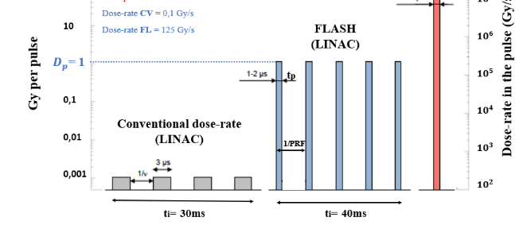
FLASH Therapy IN A NUTSHELL
FLASH irradiation protects healthy tissues from damage and remains as efficient as conventional irradiation in the repression of tumor growth.
Courtesy of V. Faudon
FLASH THERAPY
Dose rate =125 Gy/s
It is a new way to deliver the dose:
- high dose per pulse (>1 Gy) in “very short time” of irradiation (< 100 ms )
- high mean dose rate (>40-100Gy/s)
Dose rate =0,1 Gy/s
Control 17 Gy CONV 17 Gy FLASH
Favaudon et al., Science Translational Medicine 6, 2014
 | Conventional | FLASH
Dose (Gy) | 17 | 17
Mean Dose rate (Gy/s) | 0,03 | 60
Healthy Fibrosis Healthy
Lucia Giuliano et al.
High Gradient Technology for VHEE Linac in FLASH Radiotherapy
HG2025, Mérida, Yucatán, México

Slide 4
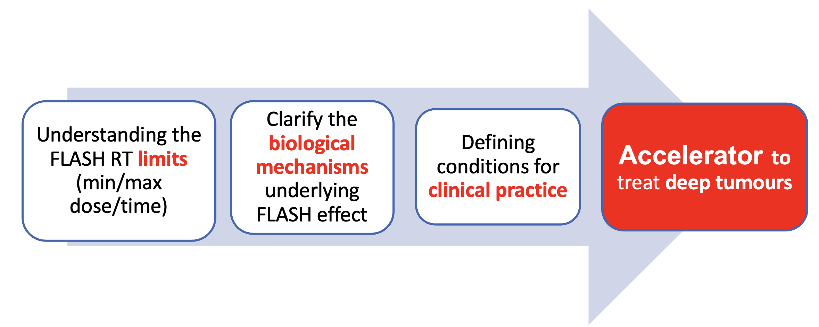
SAFEST PROJECT
VHEEs
Very High Energy Electrons
>100MeV
The choice of operation in C-Band (5.712GHz), by using a compact and modular layout, is an optimal compromise for working with high-charge electron bunches, and still for having more compact accelerating structures
Emerging Research Trends
SAFEST Parameters | Value
Frequency | 5.712 GHz
RF pulse length | 5 μs
RF source Power | 45 MW
LINAC length | ~ 3 m
Nominal beam energy | 100 MeV
Beam pulse current | 100 mA
L. Faillace et al., Perspectives in linear accelerator for FLASH VHEE: Study of a compact C-band system, Phisca Medica, November 2022
Lucia Giuliano et al.
High Gradient Technology for VHEE Linac in FLASH Radiotherapy
HG2025, Mérida, Yucatán, México
Notes:
TRL 5 – Technology Validated in Relevant Environment: The prototype or system is tested in an environment similar to the intended application.

Slide 5
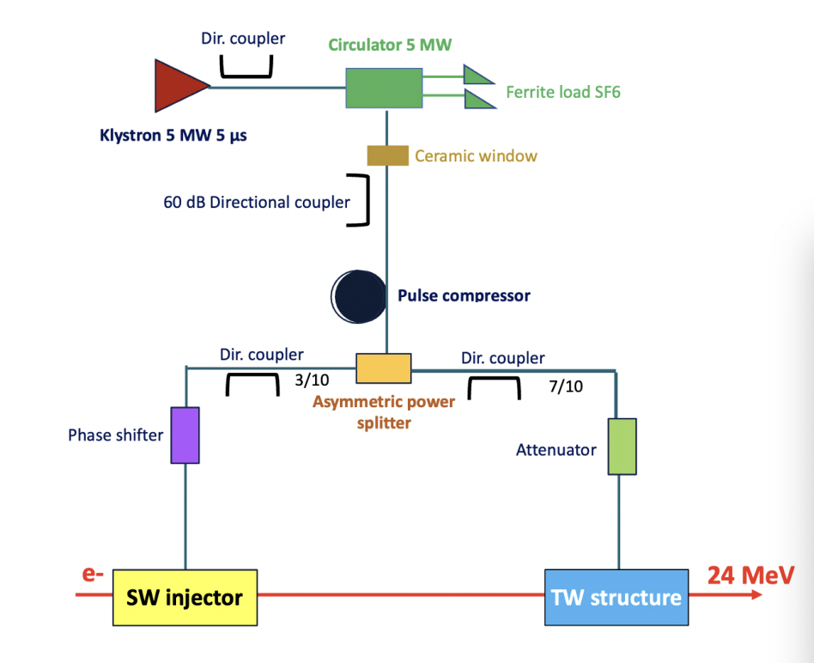
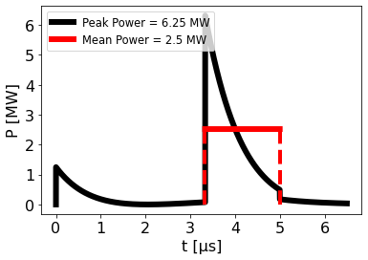
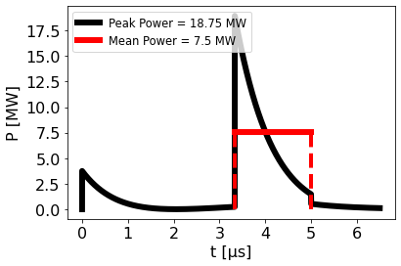
24 Mev Flash linac
A prototype was funded by the PNRR with a budget of 1.6 M€
Parameters | Value
Frequency | 5.712 GHz
RF pulse length | 5 μs
Klystron Power | 5 MW
Peak power with pulse compressor | 24.4 MW (β = 3)
Linac length | ~ 1.5 m
Nominal beam energy | 24 MeV
Beam pulse current | 100 mA
1/4
3/4
Asymmetric power splitter
Scalable to VHEE machines
Lucia Giuliano et al.
High Gradient Technology for VHEE Linac in FLASH Radiotherapy
HG2025, Mérida, Yucatán, México

Slide 6
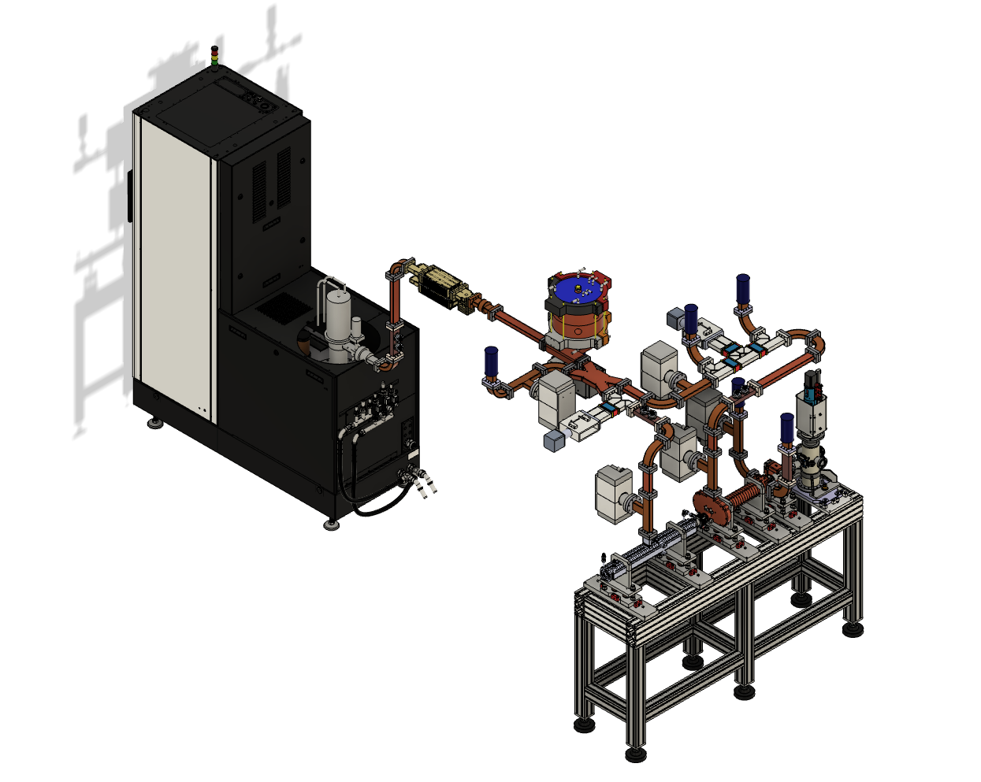
Cad technical design
Modulator
Scandinova k100
Working frequency 5.712GHz (C-band)
RF load
Repetion frequency 200Hz
Klystron
Canon (5MW 200 Hz)
Attenuator
Pulse compressor
(LNS-INFN design)
RF power
distribution network
Electron
beam to users
Phase shifter
Vacuum pump
Flash Electron
Accelerator
Lucia Giuliano et al.
High Gradient Technology for VHEE Linac in FLASH Radiotherapy
HG2025, Mérida, Yucatán, México

Slide 7
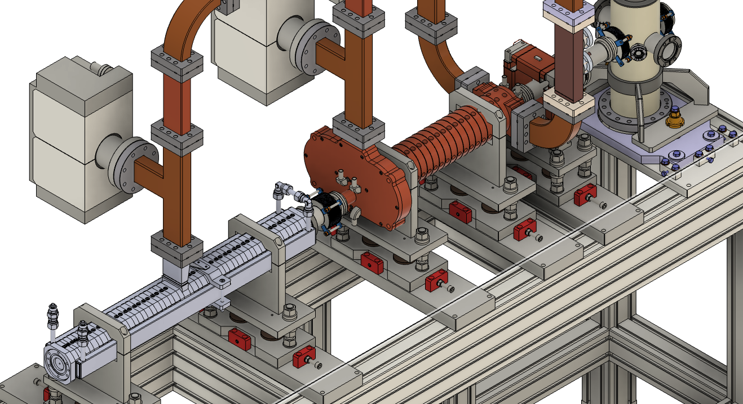
FLASH ELECTRON ACCELERATOR
RF power to loads
Electron
beam
Vacuum pump
RF power
Beam diagnostics
Traveling wave structure
RF power
Standing wave structure
Electron source
L. Giuliano et al., A compact C-band FLASH electron linear accelerator protoype for the VHEE SAFEST project, Frontiers, March 2025
Lucia Giuliano et al.
High Gradient Technology for VHEE Linac in FLASH Radiotherapy
HG2025, Mérida, Yucatán, México

Slide 8
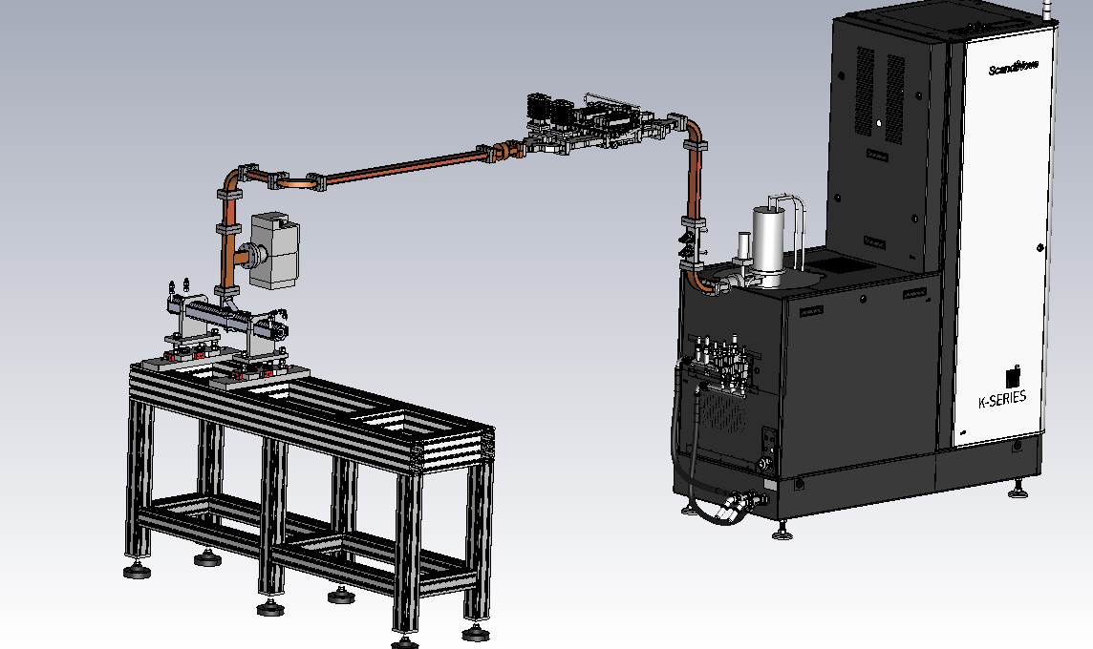
Phase 1 – December 2025
Circulator
Modulator
Scandinova K100
Klystron
Canon (5MW 200 Hz)
SW structure
Electron beam
Lucia Giuliano et al.
High Gradient Technology for VHEE Linac in FLASH Radiotherapy
HG2025, Mérida, Yucatán, México

Slide 9
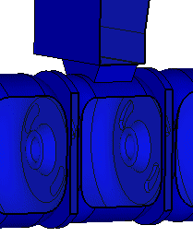
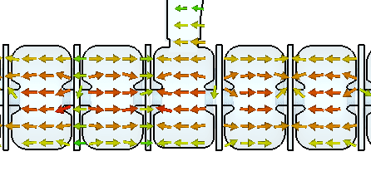
Standing wave structure
beam
Feeding power waveguide
Main cotributors: L. Giuliano, L. Faillace
RF power
Input coupler window
Parameters | Value
Mode of operation | Bi-periodic ; π/2
N of cells | 27
Shunt Impedance | 103 MΩ/m
Quality factor | 10178
Coupling coefficient | 1.58
Beam capture | 35%
Filling Time | 0.220 μs
Average gradient | 17 MV/m
Peak Electric field | 50 MV/m
Beam output energy | 10 MeV
Beam pulse current | 100 mA
Off axis magnetic coupling
Input power
Magnetic field
Electric field
L. Giuliano et al., RF Design and Measurements of a C-Band Prototype Structure for an Ultra-High Dose-Rate Medical Linac, Instruments, February 2024
Lucia Giuliano et al.
High Gradient Technology for VHEE Linac in FLASH Radiotherapy
HG2025, Mérida, Yucatán, México

Slide 10
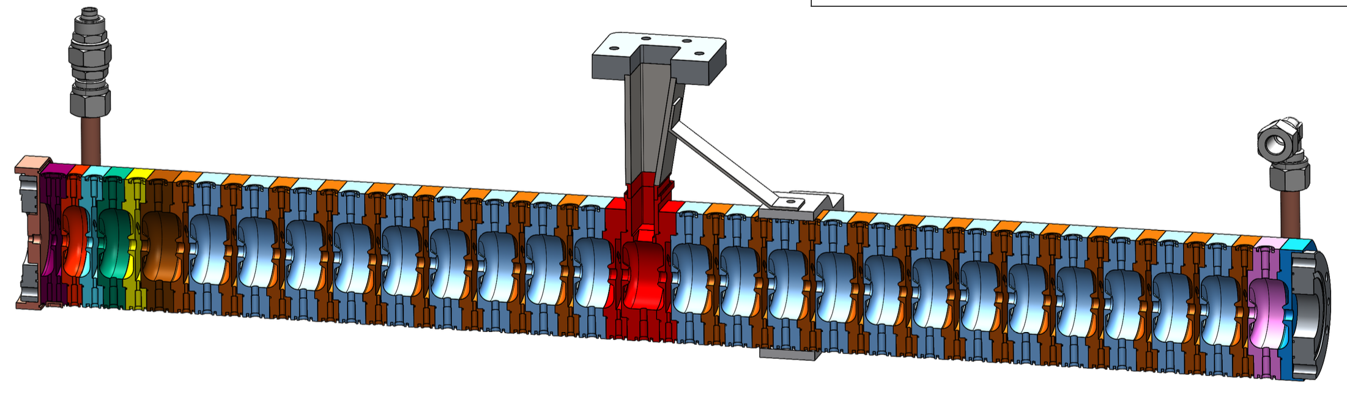
SW mechanical drawing
Water cooling
RF power
Bunching section
69 cm
The final realization will be completed by the end of June 2025
Lucia Giuliano et al.
High Gradient Technology for VHEE Linac in FLASH Radiotherapy
HG2025, Mérida, Yucatán, México

Slide 11
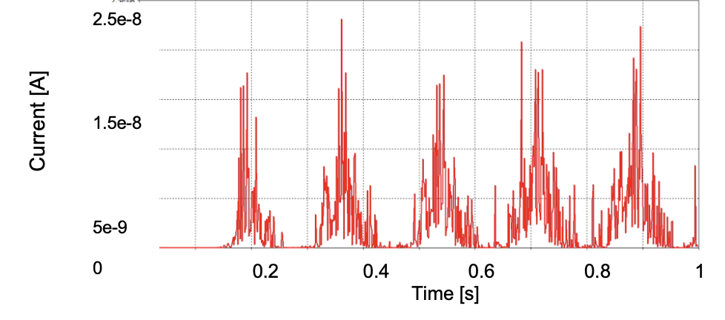
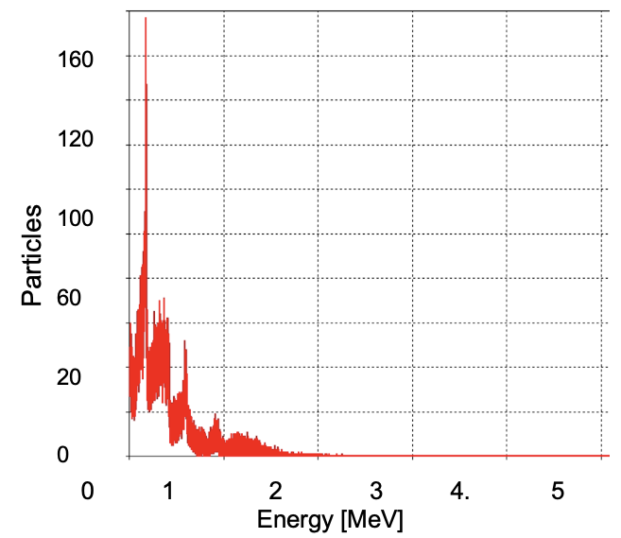

DaRK CURRENT estimation
Main contributions: F. Cardelli, L. Giuliano, M. Migliorati, L. Palumbo
Electron beam axis
Faraday Cup
Energy distribution of the particles detected by the Faraday cup for the entire structure (< 3MeV)
Current detected by the Faraday cup for the entire structure
Fowler-Nordheim formula
Lucia Giuliano et al.
High Gradient Technology for VHEE Linac in FLASH Radiotherapy
HG2025, Mérida, Yucatán, México

Slide 12

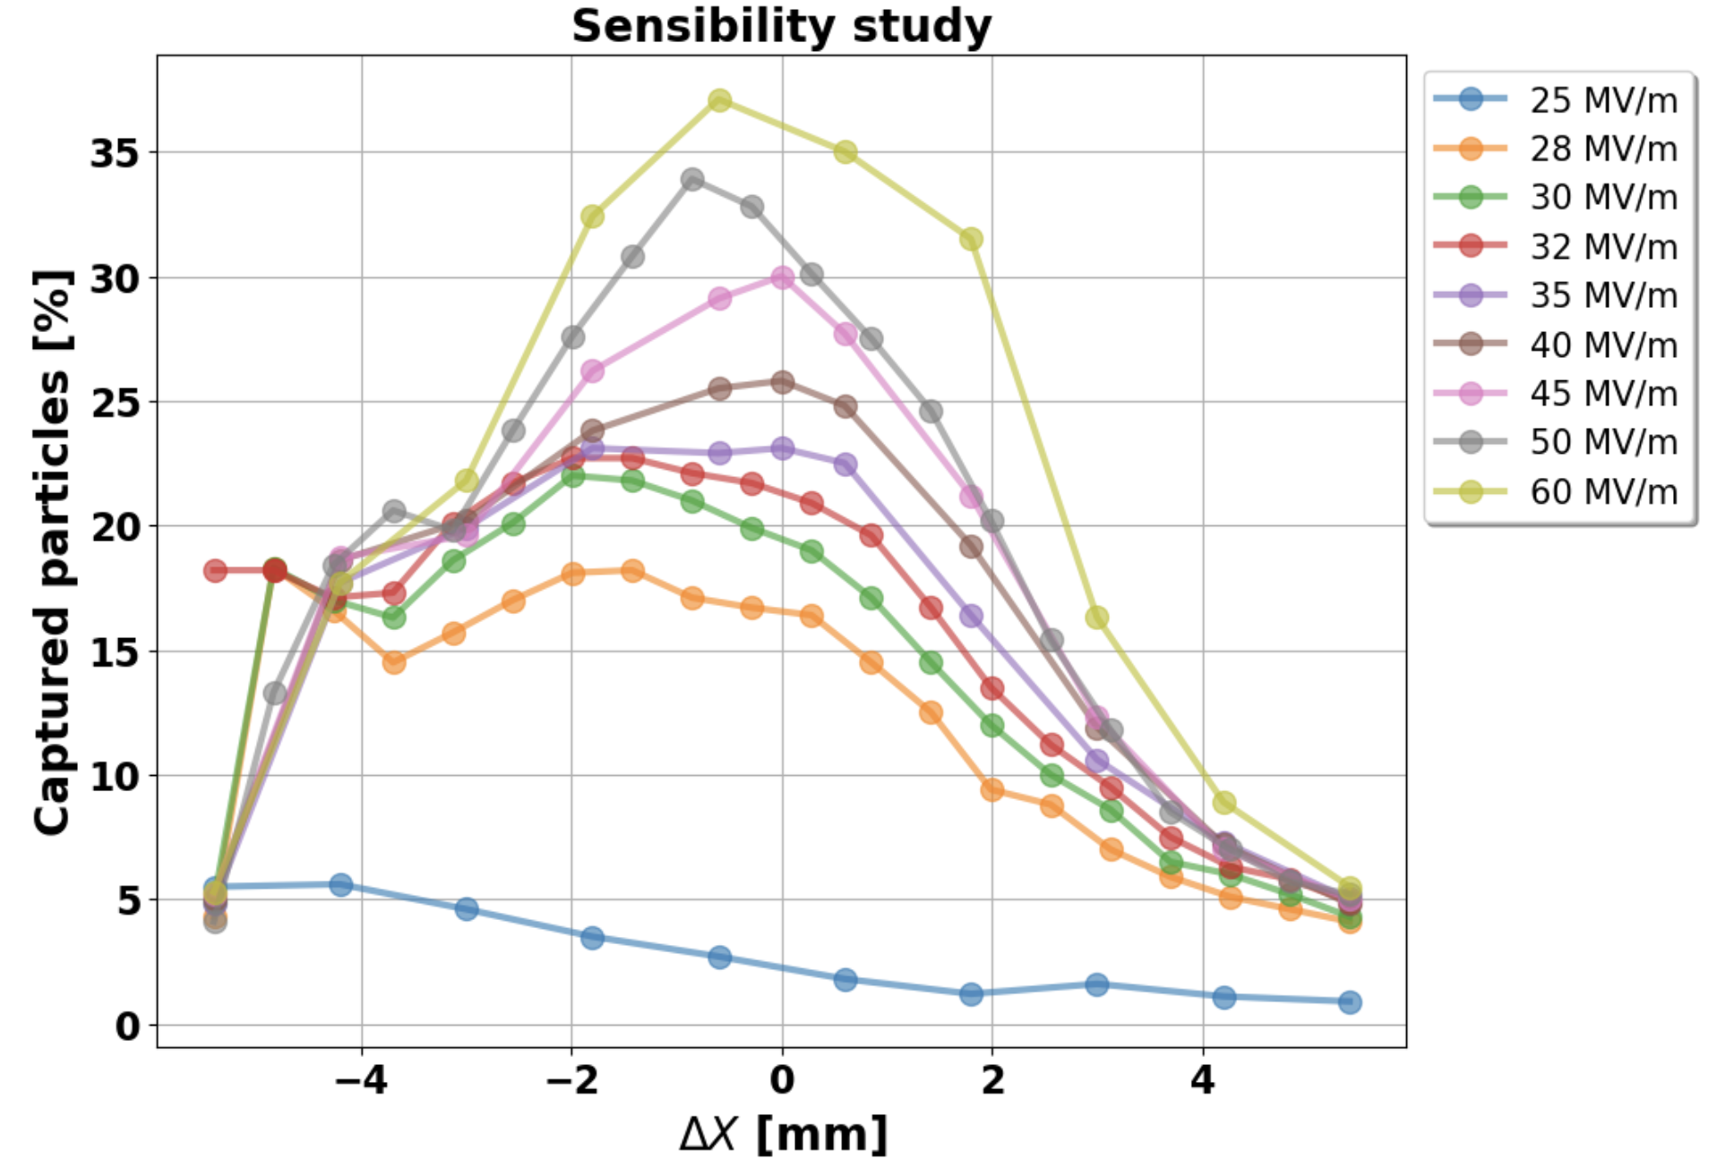
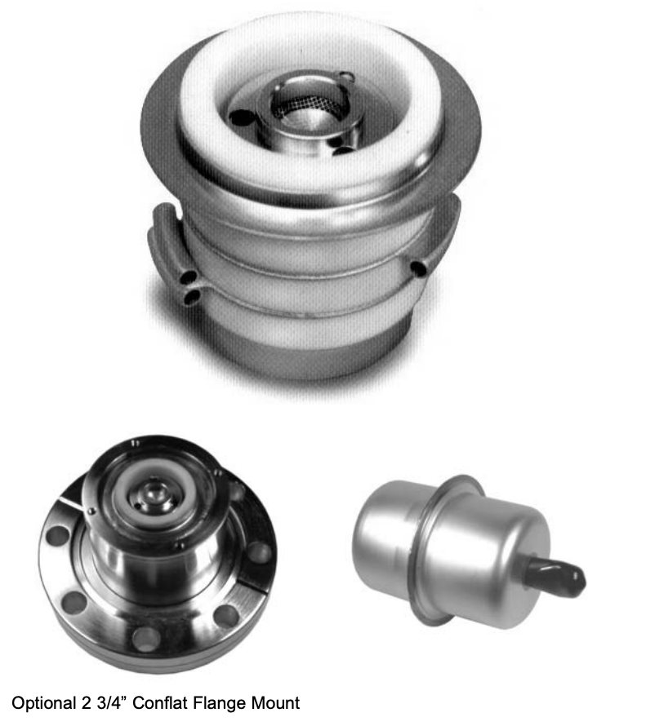
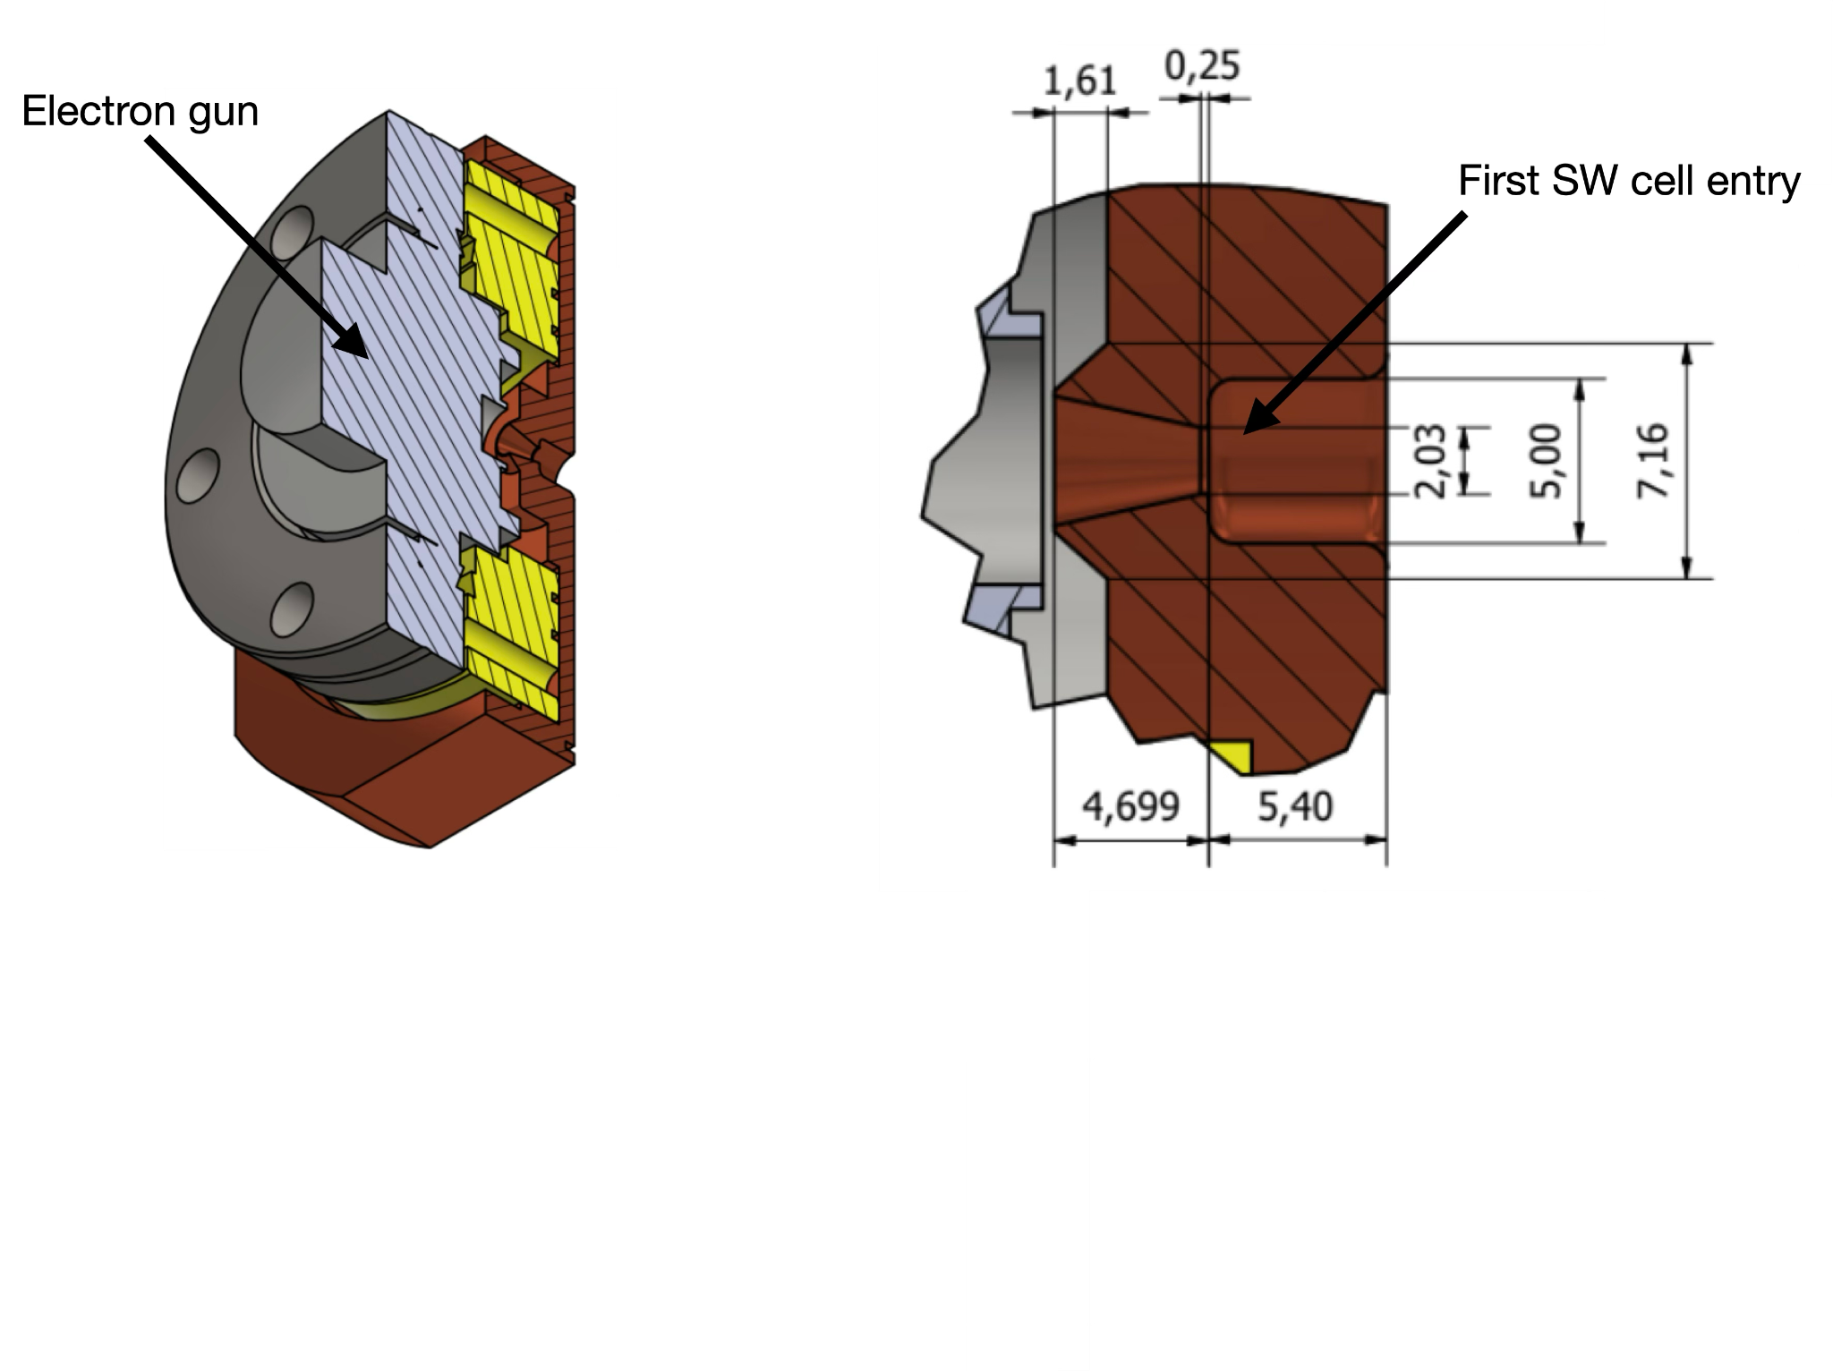
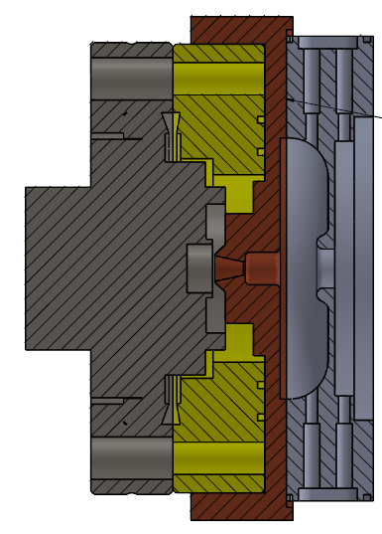
Electron source: thermionic triode gun
Electron gun
Custom flange
ASTRA
Distance cathode - anode [mm]
The first segment of SW replicates the anode industrial configuration
The second part was design by us to maximize the electrons capture
Custom flange designed to maintain the required distance for beam capture optimization
Courtesy of S. Farina
Lucia Giuliano et al.
High Gradient Technology for VHEE Linac in FLASH Radiotherapy
HG2025, Mérida, Yucatán, México

Slide 13
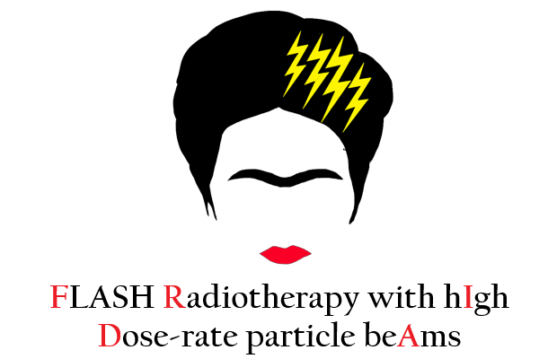
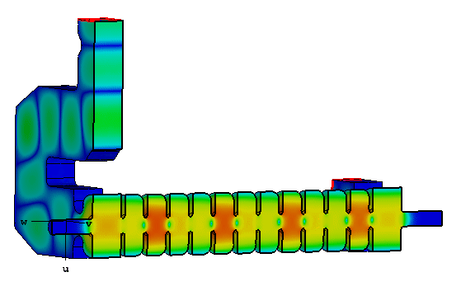
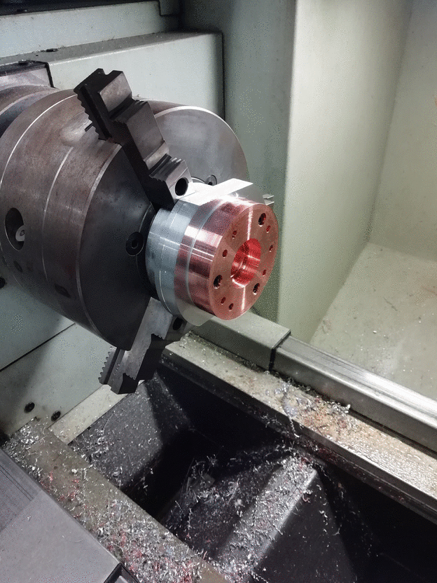
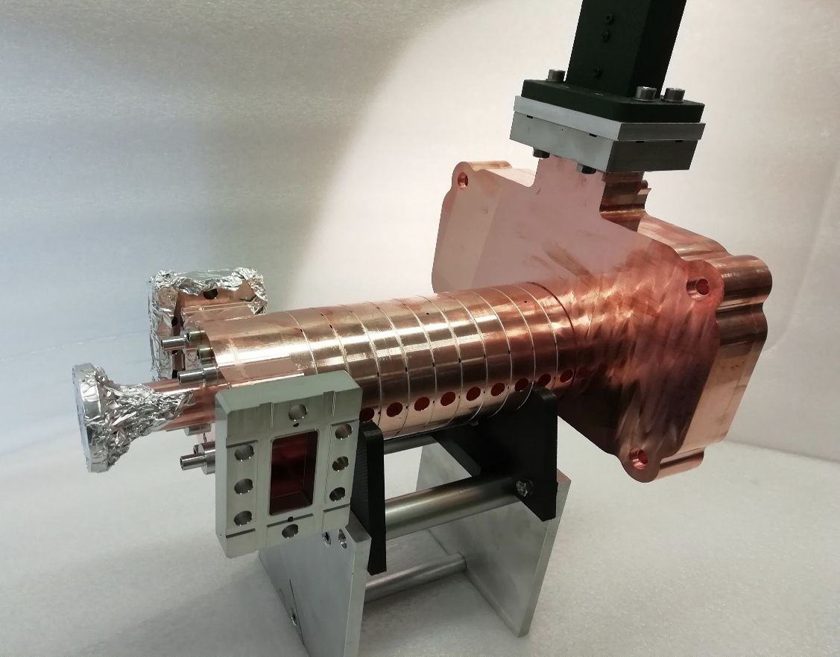
Phase 2: Traveling wave structure (2026)
RF power IN
RF power OUT
beam
Parameters | Value
Structure type | Constant Impedance
Shunt impedance | 107 MΩ/m
Quality factor | 10127
Filling time | 0.143 μs
Group velocity | 0.01c
Mode of operation | 2/3π
Final beam energy | 24 MeV
Beam pulse current | 100 mA
Main contributors D. Alesini, F. Cardelli, A. Curcio, L. Faillace, L. Ficcadenti, L. Giuliano, M. Magi, M. Migliorati
Lucia Giuliano et al.
High Gradient Technology for VHEE Linac in FLASH Radiotherapy
HG2025, Mérida, Yucatán, México

Slide 14
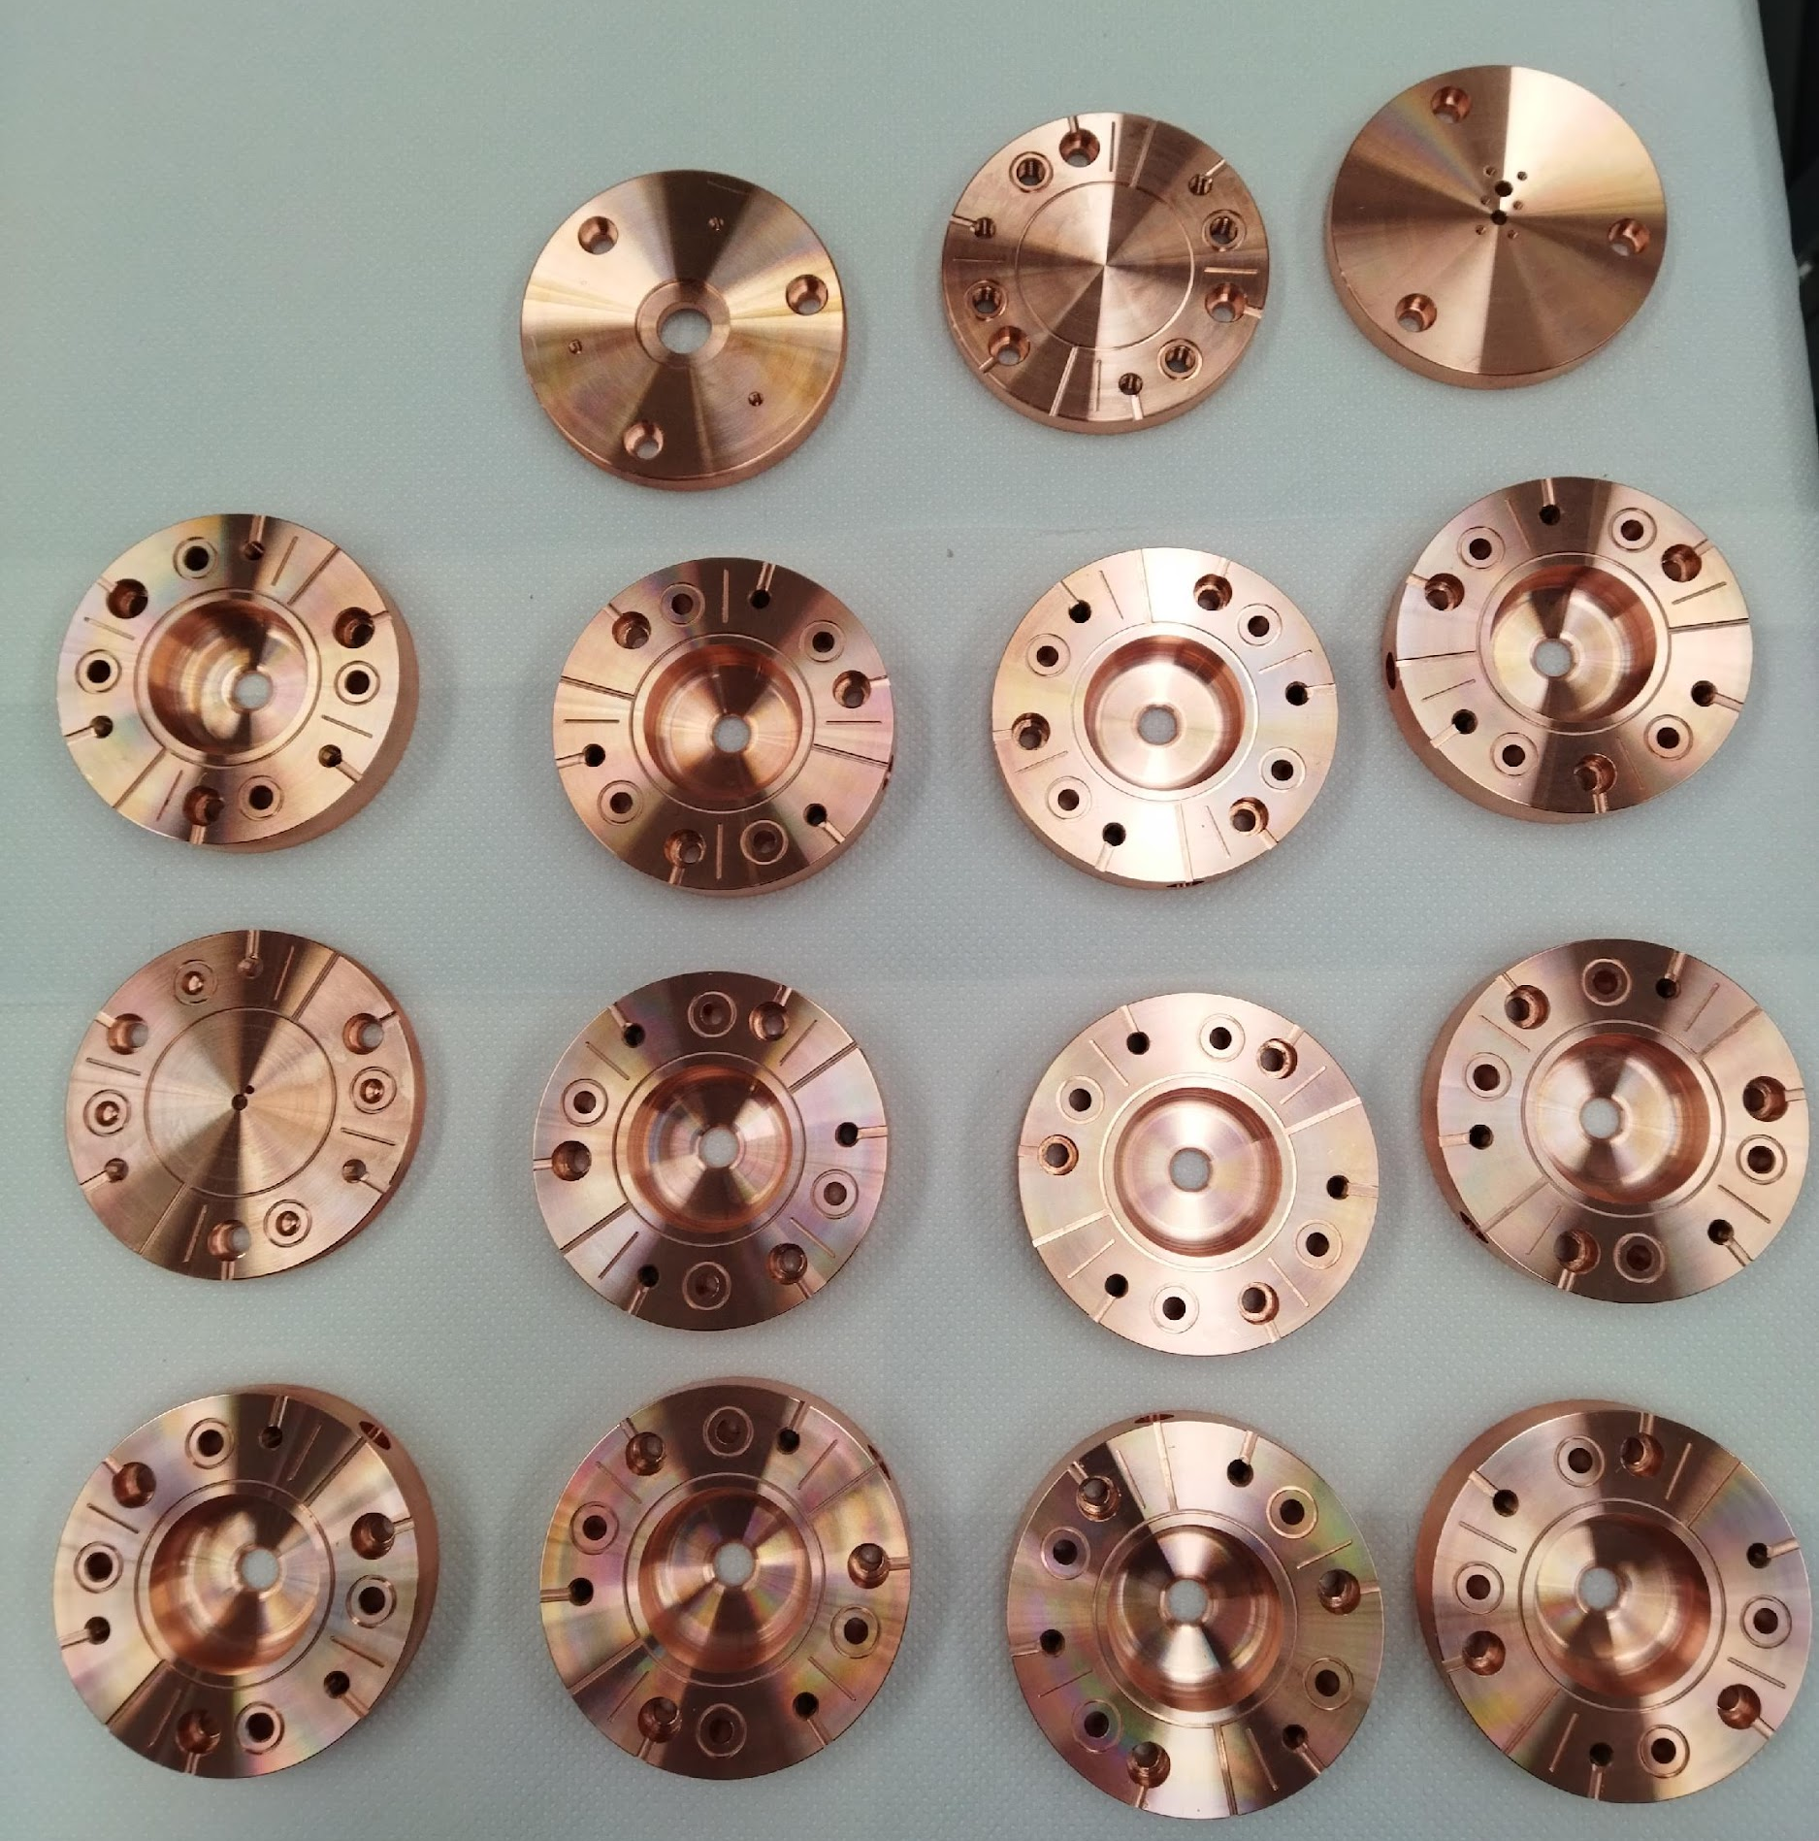
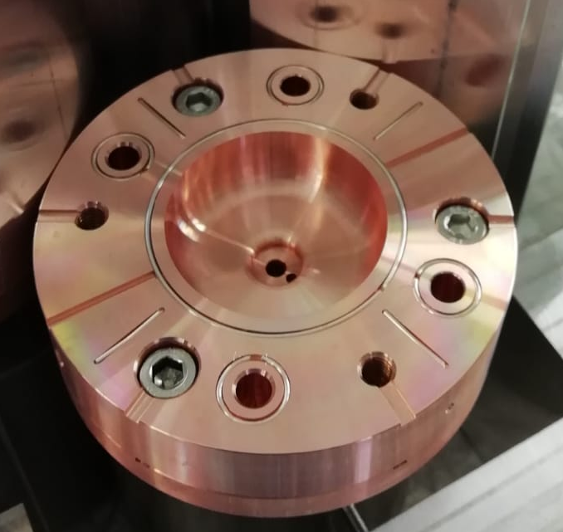


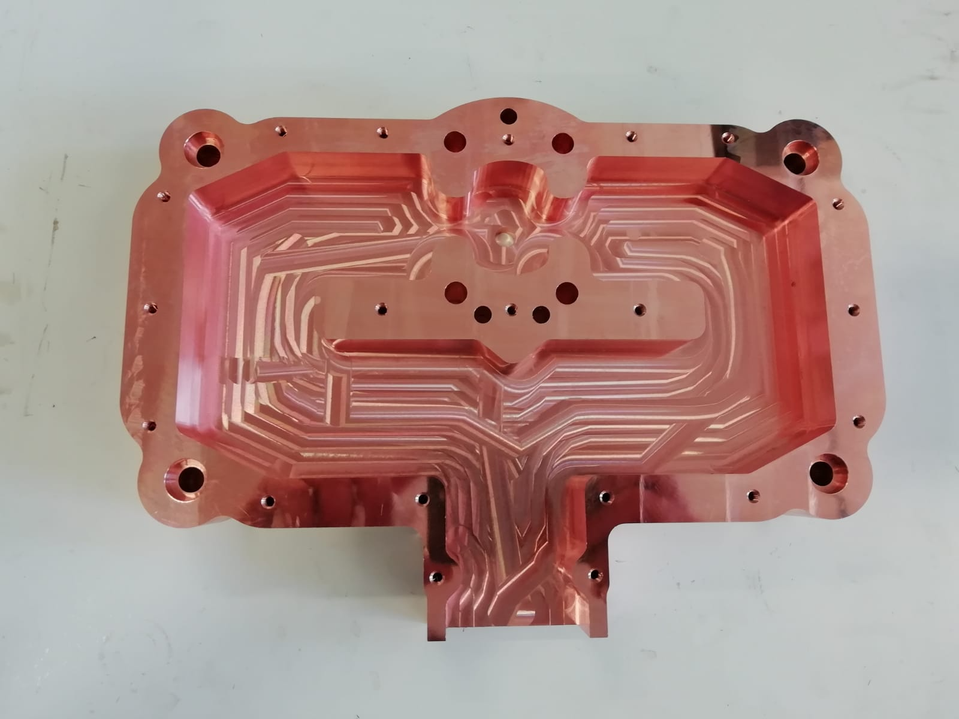
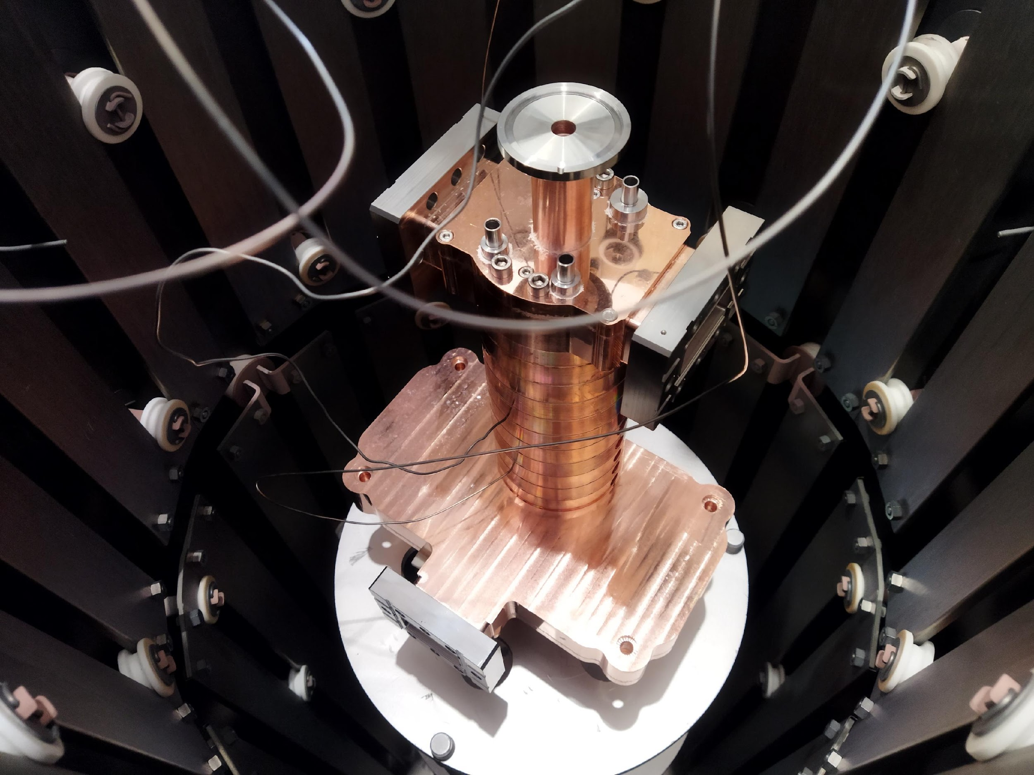
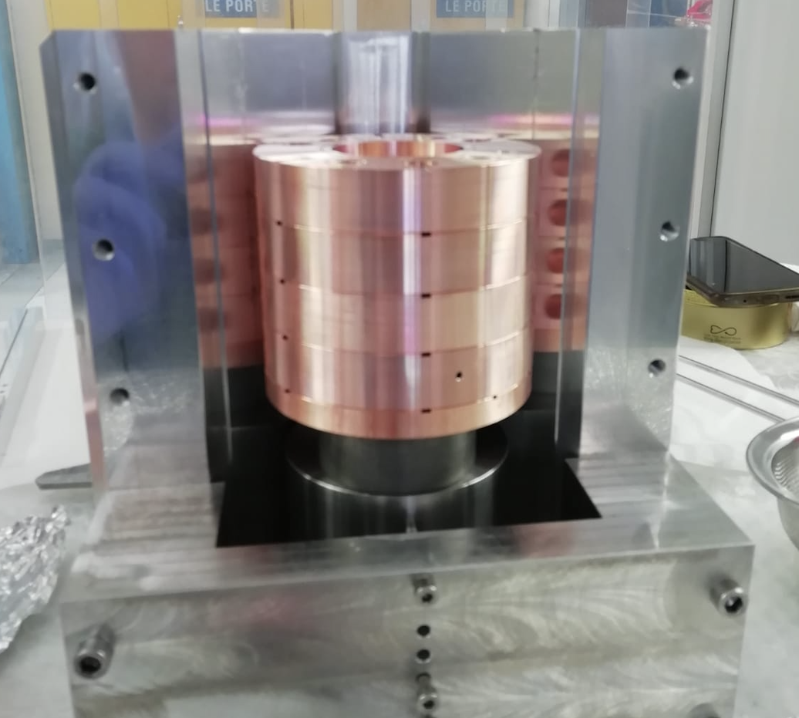
Building the TW structure @ Sapienza
Brazing alloy
Screws: prevent external clamping and ensure alignment and more reliable assembly
Screws to join the cells
In house building of the accelerating structure
Water cooling hole
RF power
Main contributors: D. Alesini, R. Di Raddo, L. Faillace, L. Giuliano, M. Magi, M. Migliorati
Lucia Giuliano et al.
High Gradient Technology for VHEE Linac in FLASH Radiotherapy
HG2025, Mérida, Yucatán, México

Slide 15
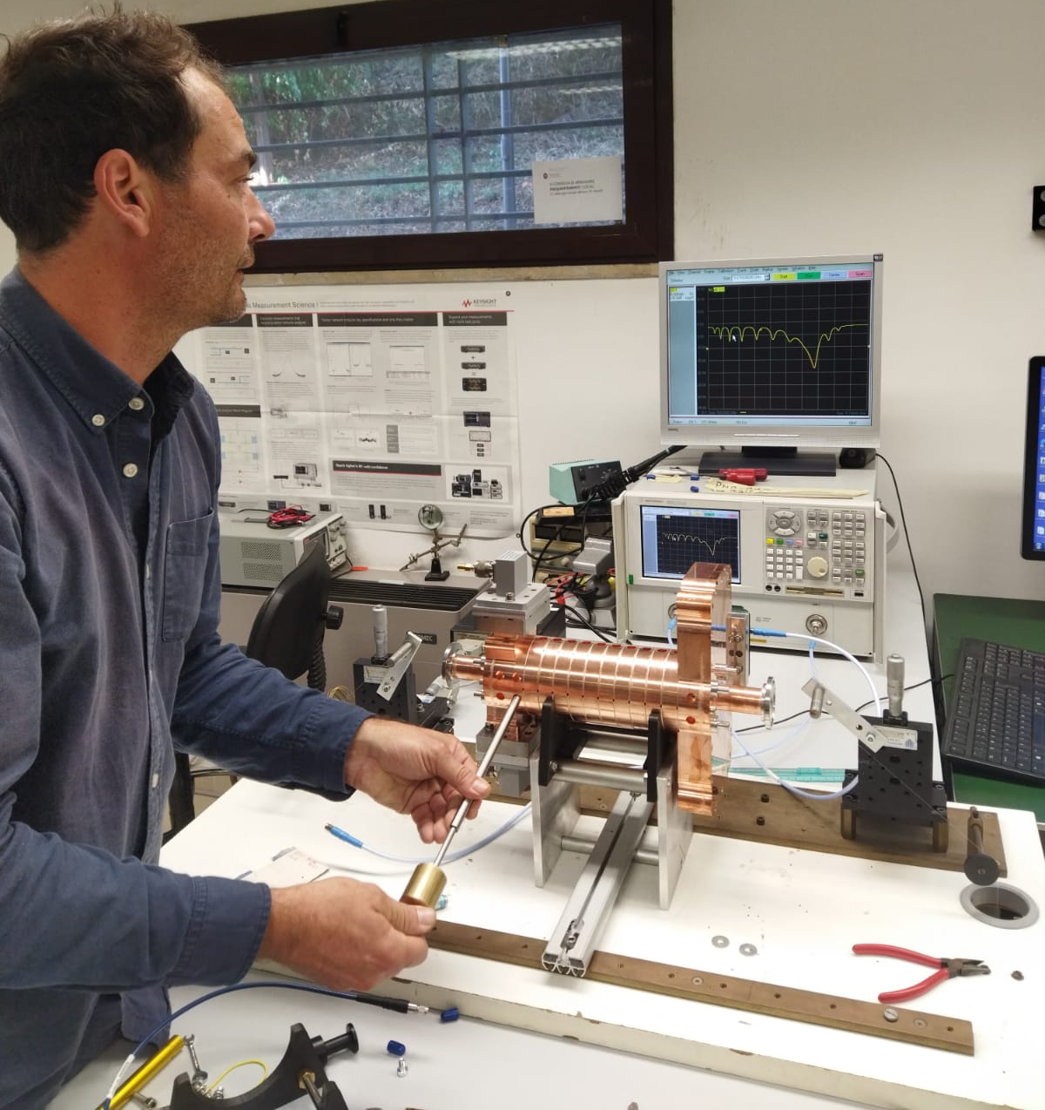
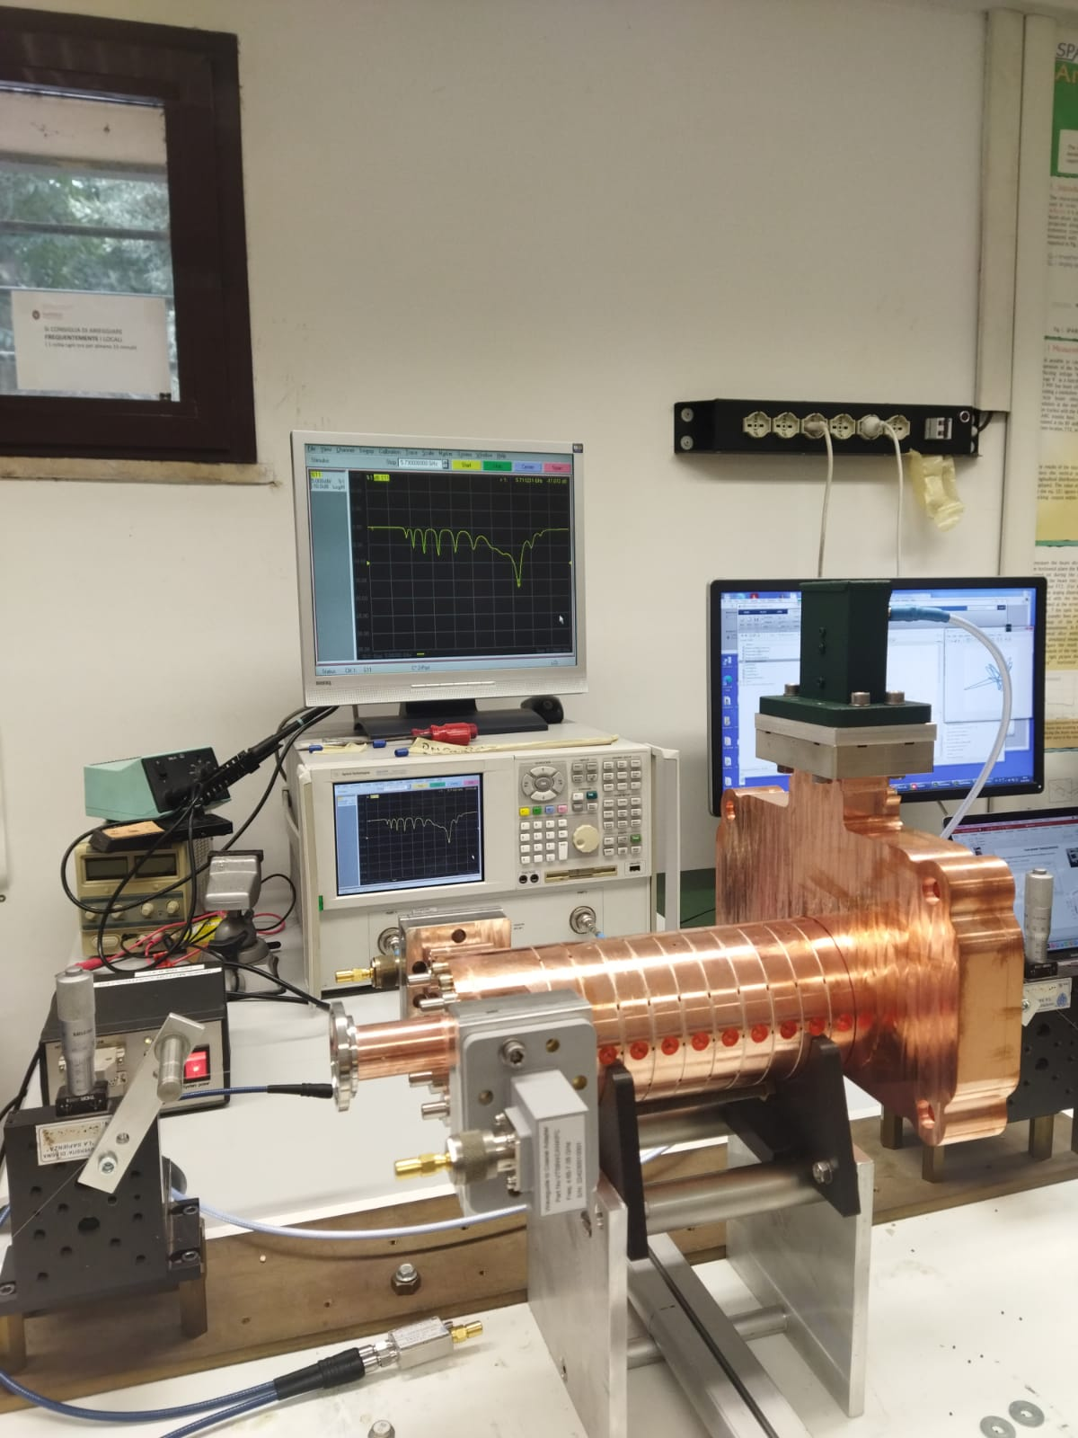
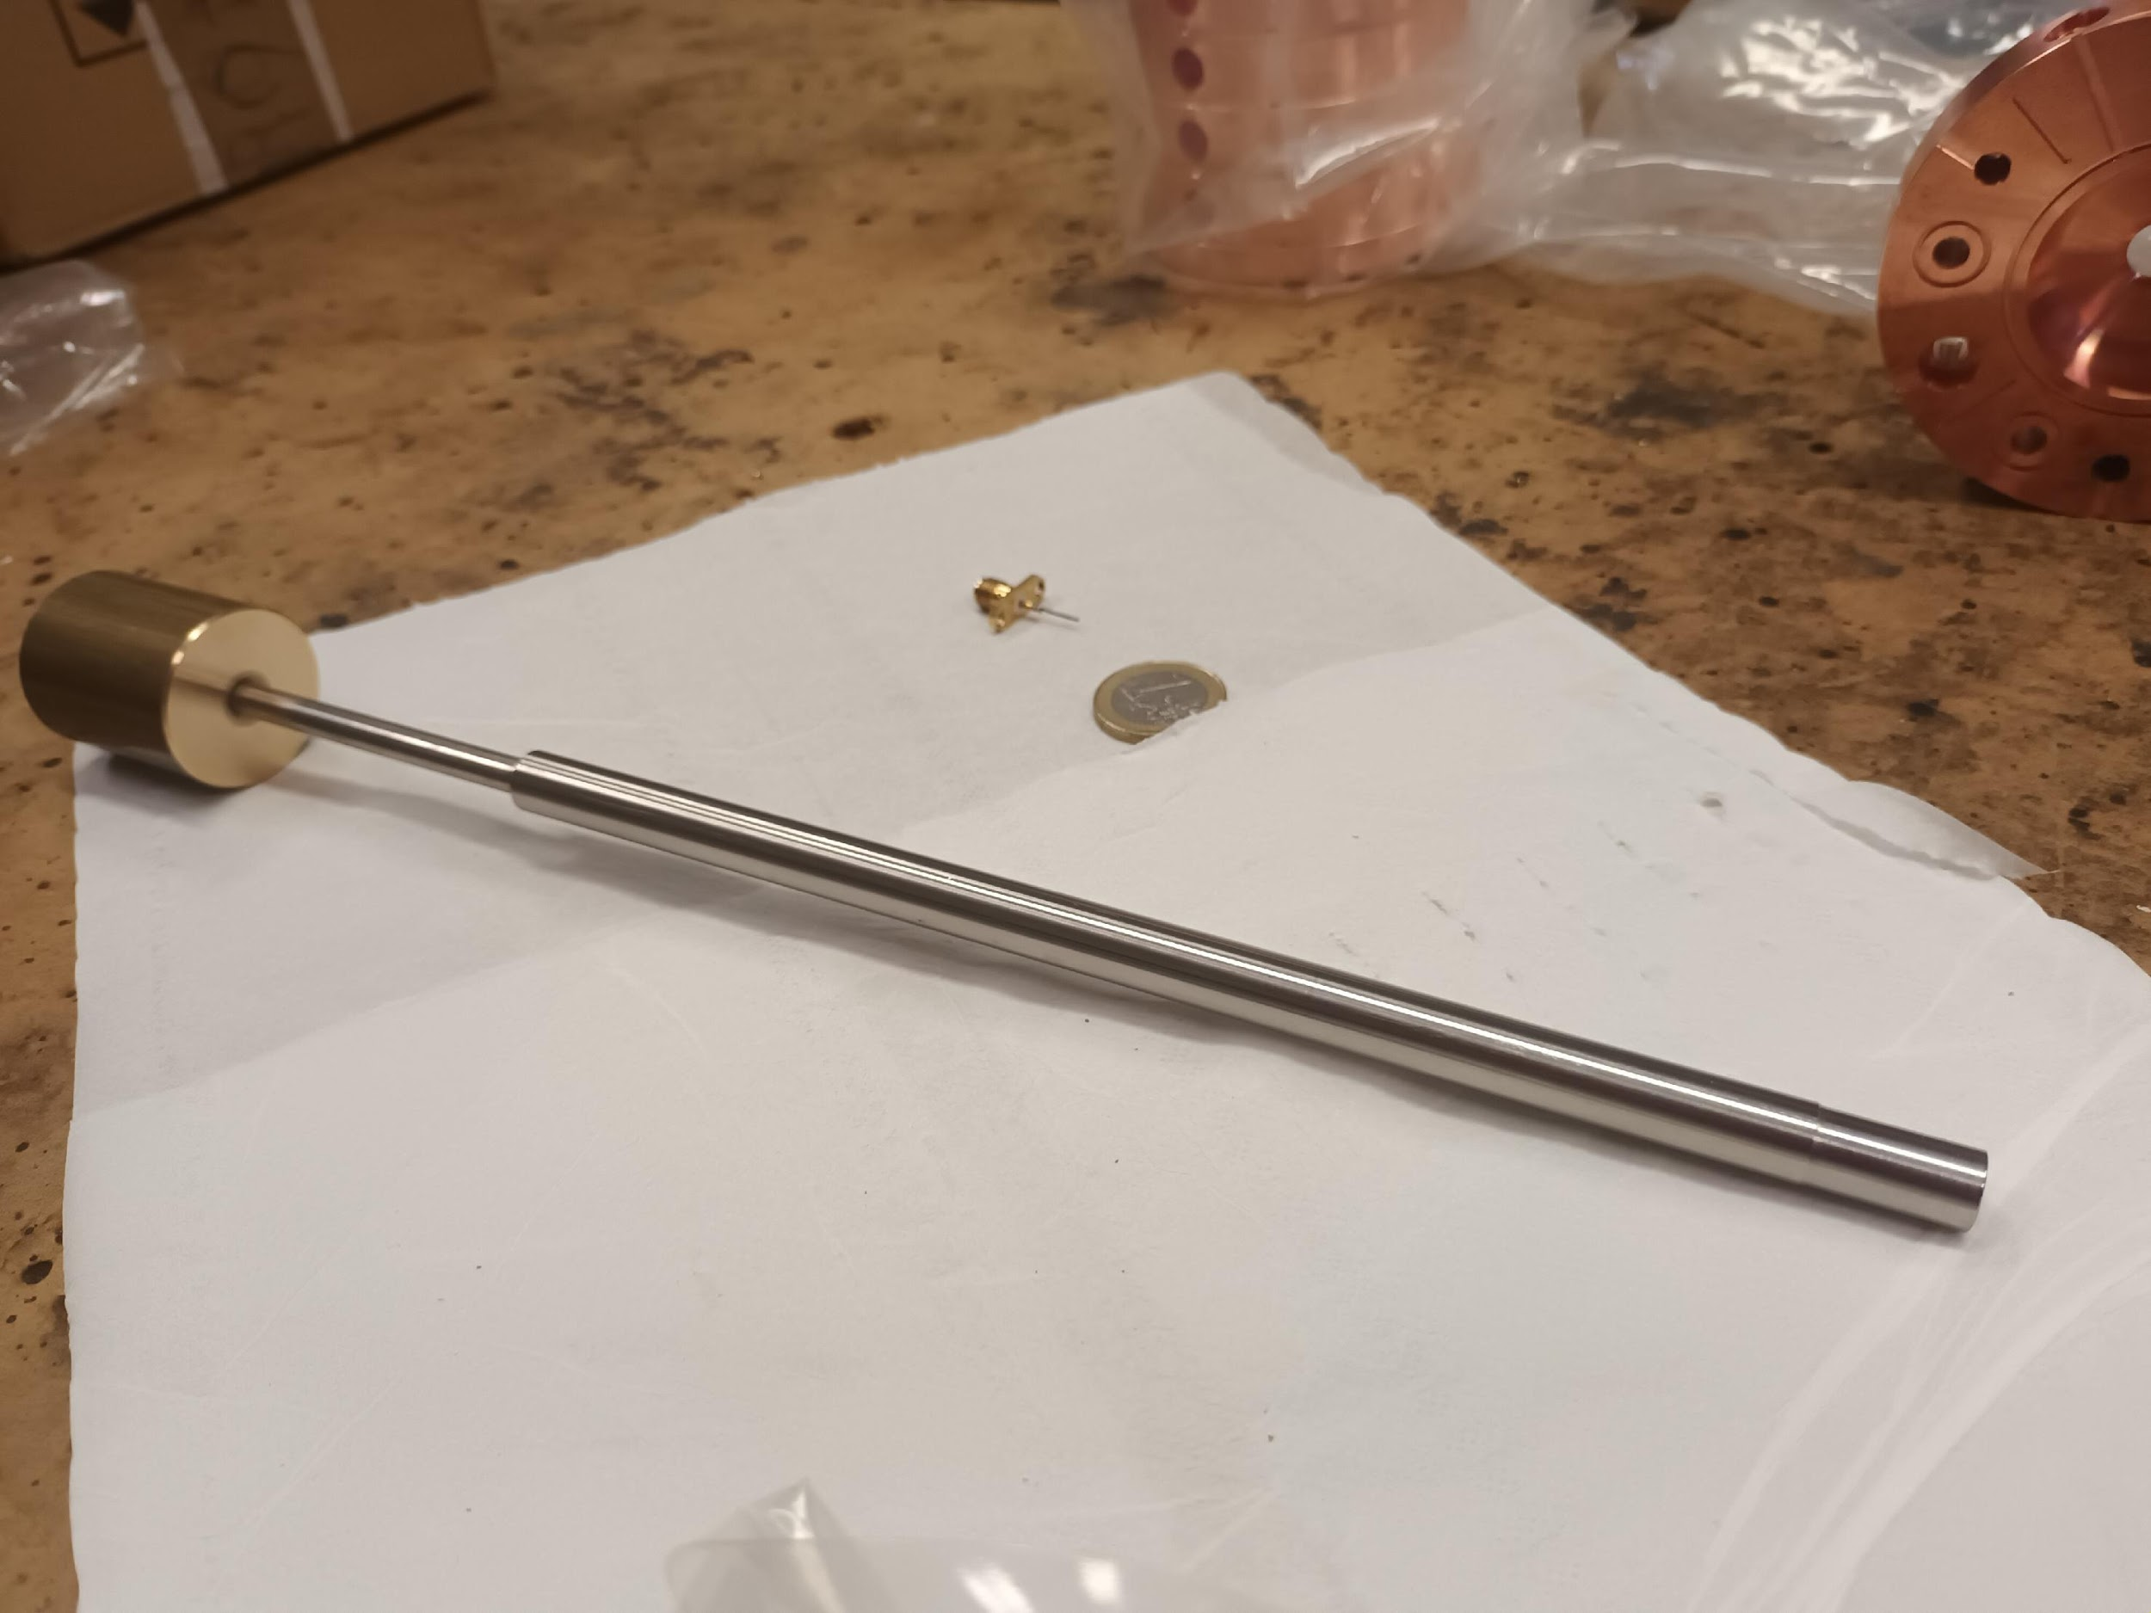
Tuning of TW section at SApienza-LAB
tuners
Tuning by deformation
Main cotributors: A. Curcio, S. Farina, L. Ficcadenti, L. Giuliano
Lucia Giuliano et al.
High Gradient Technology for VHEE Linac in FLASH Radiotherapy
HG2025, Mérida, Yucatán, México

Slide 16
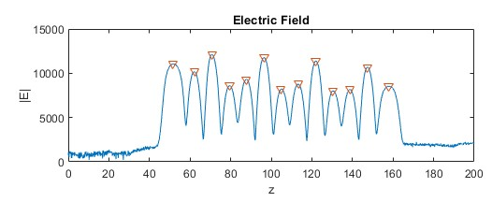
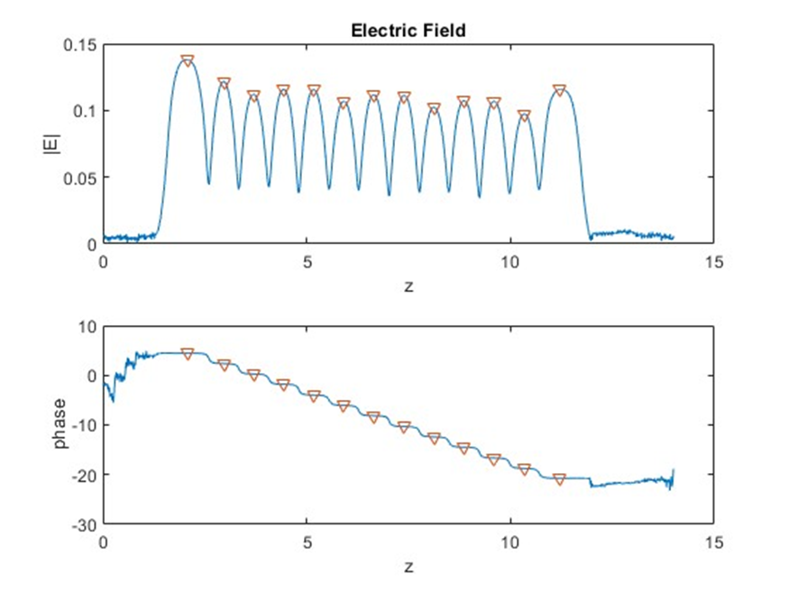
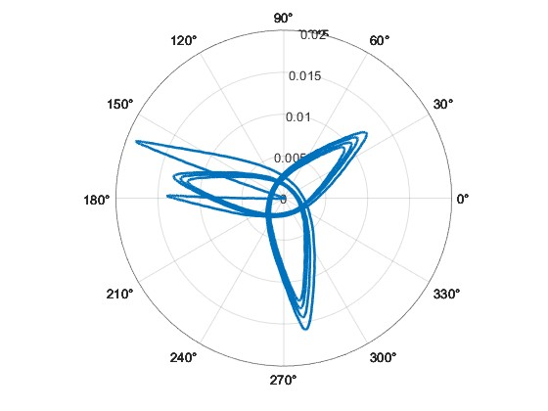
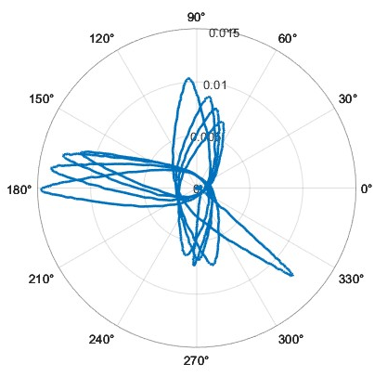
FINAL Tuning of TW section at sapienza-LAB
Electric field before tuning
Electric field after tuning
Phase shift after tuning
Phase shift before tuning
Main cotributors: L. Ficcadenti, L. Giuliano
Lucia Giuliano et al.
High Gradient Technology for VHEE Linac in FLASH Radiotherapy
HG2025, Mérida, Yucatán, México

Slide 17
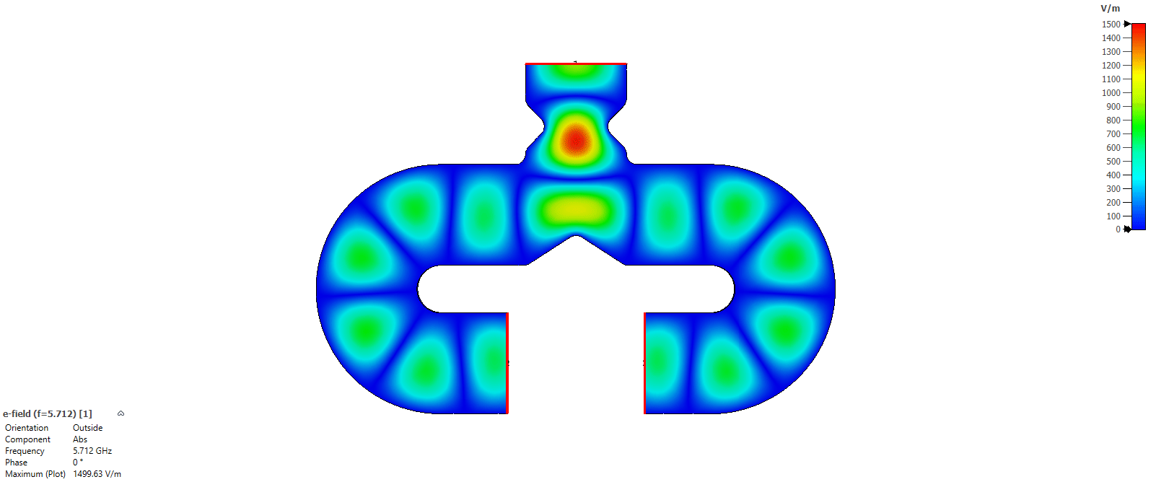
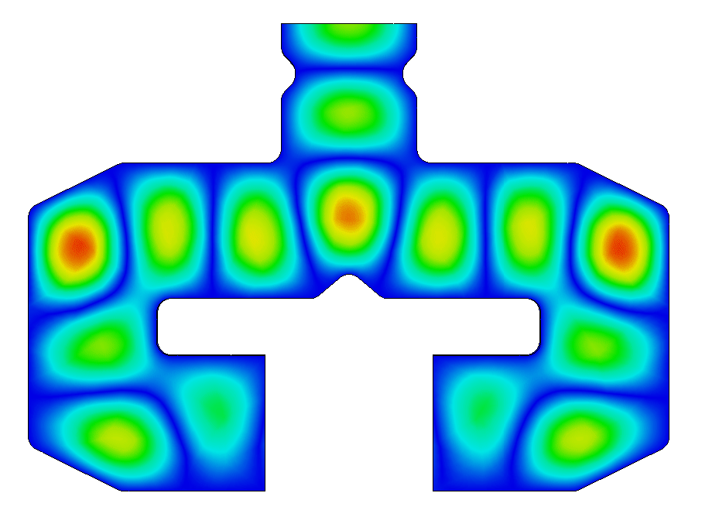
Power splitter optimization
The electric field in the power splitter
before optimization
The electric field in the power splitter
after optimization
High fields at the curves
1 Watt
1 Watt
Constriction that caused higher-order mode excitation
Rounding not suitable for mechanical processing
TE010 mode
Main cotributors: L. Ficcadenti, L. Giuliano
Lucia Giuliano et al.
High Gradient Technology for VHEE Linac in FLASH Radiotherapy
HG2025, Mérida, Yucatán, México

Slide 18
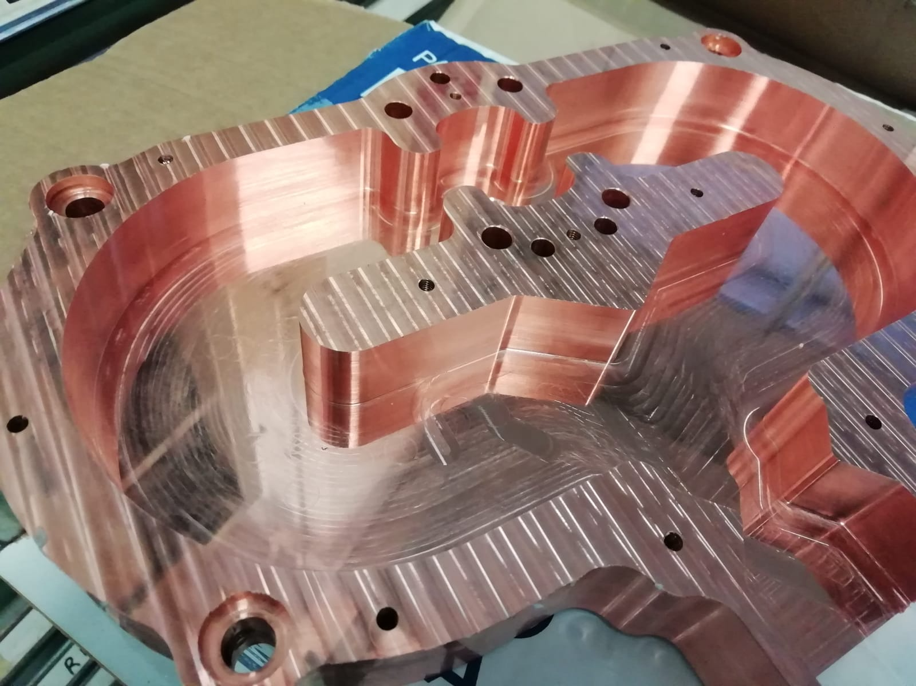
Power splitter optimization
The electric field in the power splitter
after optimization
1 Watt
TE010 mode
Main cotributors: L. Ficcadenti, L. Giuliano, M. Magi
Lucia Giuliano et al.
High Gradient Technology for VHEE Linac in FLASH Radiotherapy
HG2025, Mérida, Yucatán, México

Slide 19
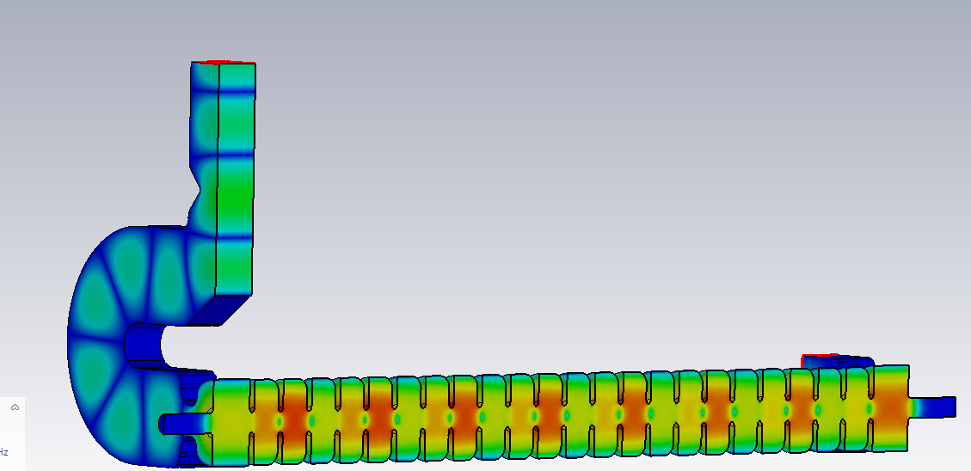
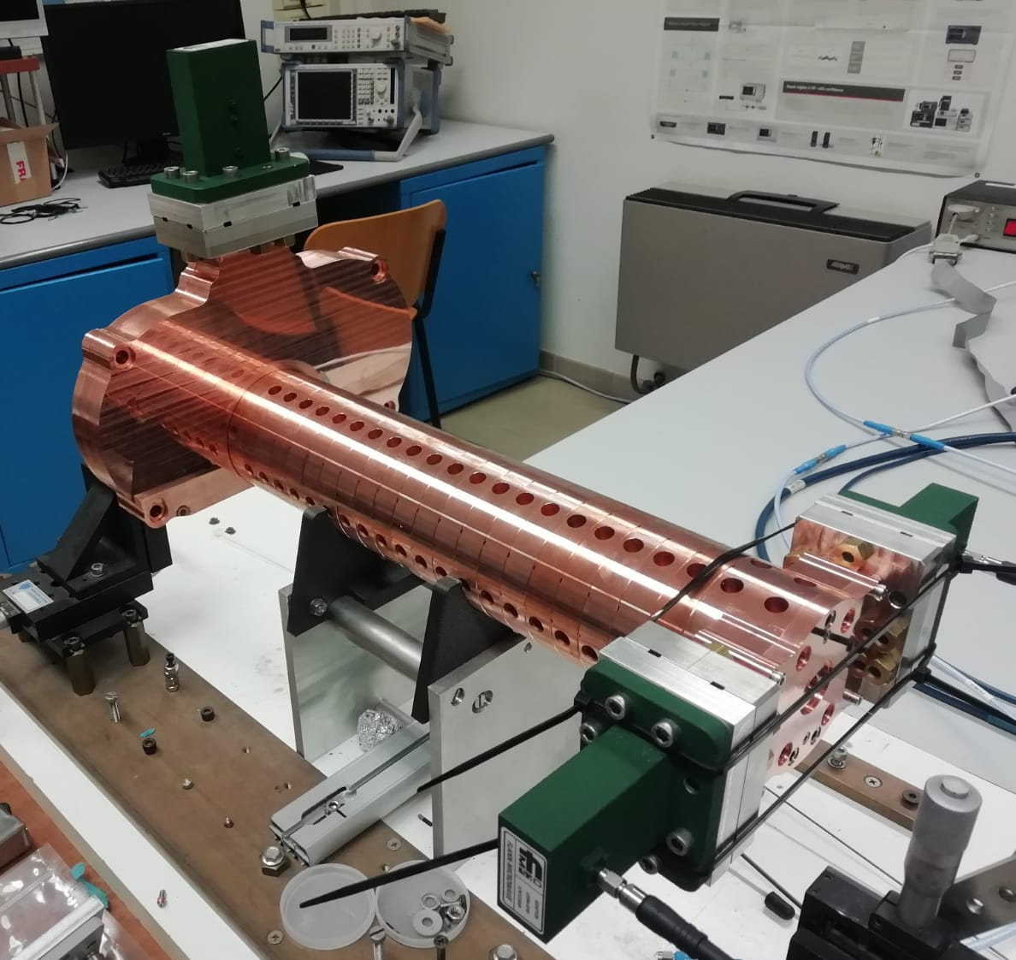
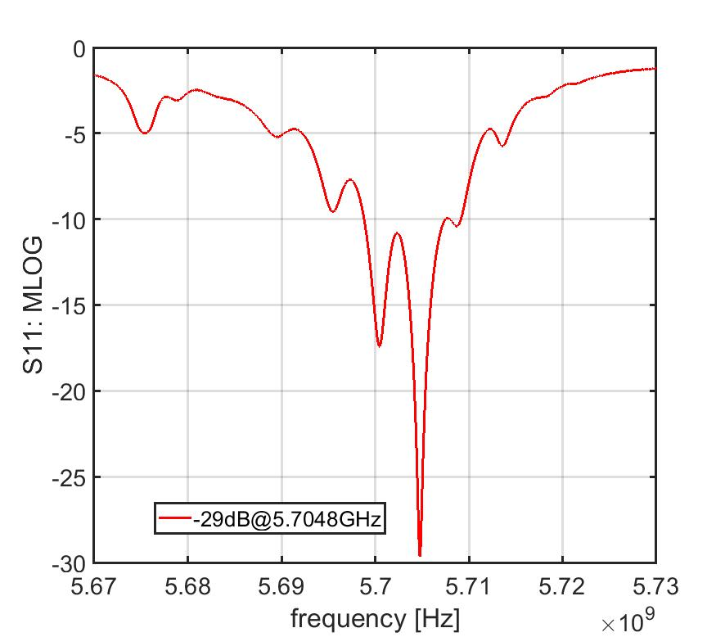
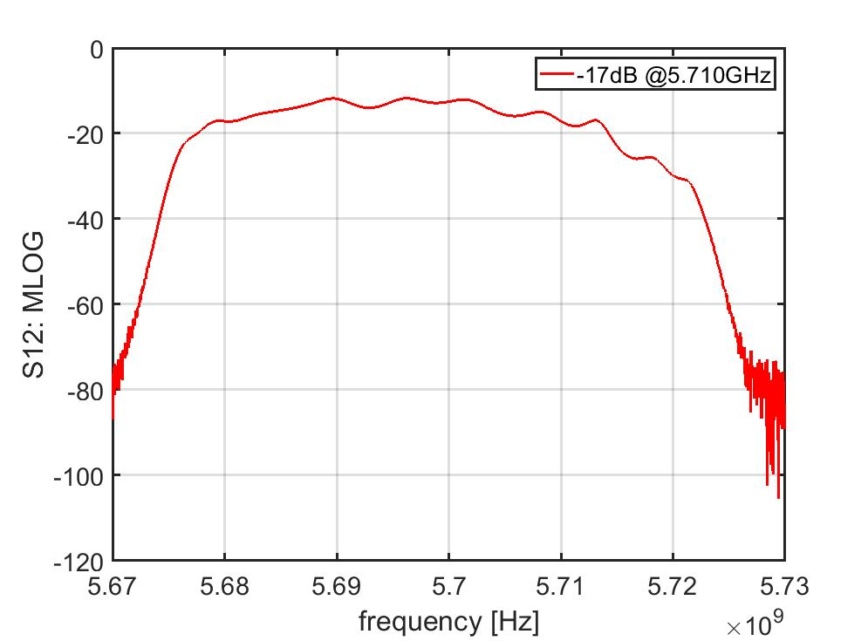
TW realization and low power test
Sim[GHz] | Meas [GHz]
5,7232 | - ?
5,7202 | 5,7217
5,7193 | 5,7197
5,7178 | 5,7178
5,7157 | 5,7149
5,7132 | 5,7120
5,7106 | - NO
5,7075 | 5,7080
5,7044 | 5,7050
5,7013 | 5,7013
5,6977 | 5,6977
5,6941 | 5,6940
5,6908 | 5,6907
5,6874 | 5,6870
5,6842 | 5,6842
5,6816 | 5,6811
5,6789 | 5,6786
5,6773 | - NO
5,6758 | 5,6756
43.23 cm
Measurements without Couplers SW-like:
Peaks match CST simulations ✅
Likely issue: Couplers, not cells
New couplers machinery is ongoing
Main cotributors: D. Alesini, F. Cardelli, A. Curcio, S. Farina, L. Giuliano, M. Magi
Lucia Giuliano et al.
High Gradient Technology for VHEE Linac in FLASH Radiotherapy
HG2025, Mérida, Yucatán, México

Slide 20

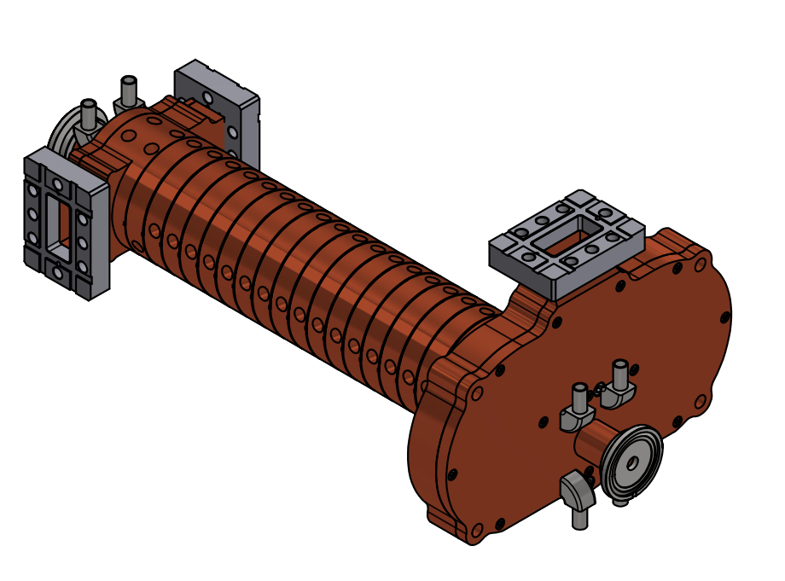
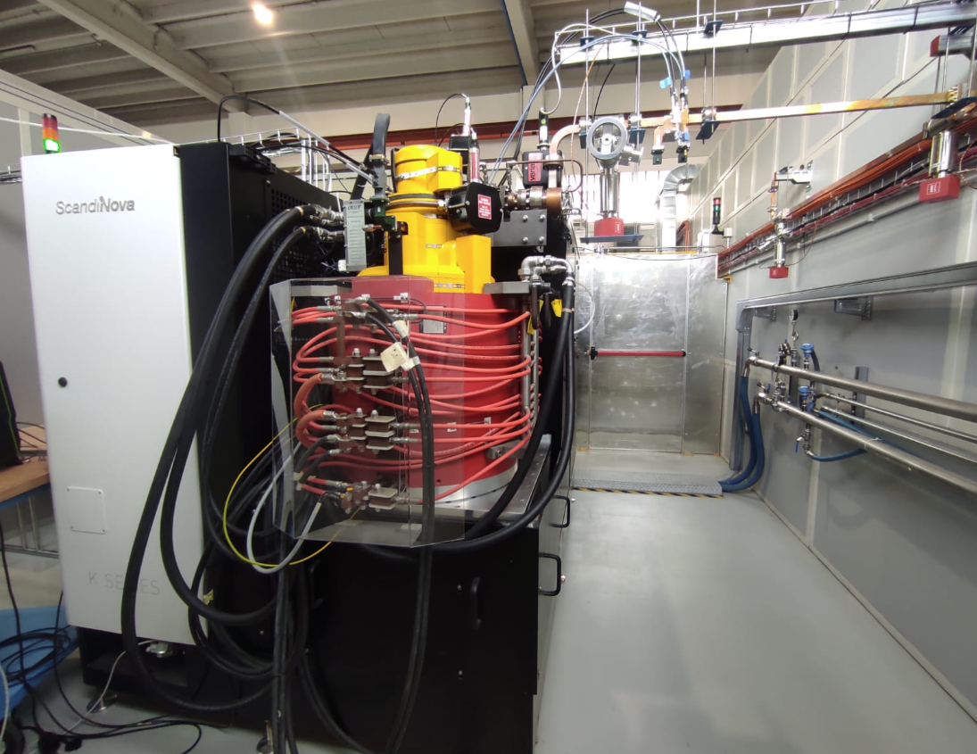
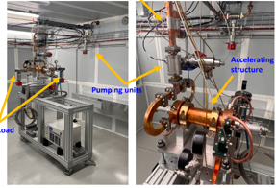
PLANNED high POWER TEST AT LNF
50 cm TW structure
C-band Klystron
High Power Test scheduled in autumn 2025
Lucia Giuliano et al.
High Gradient Technology for VHEE Linac in FLASH Radiotherapy
HG2025, Mérida, Yucatán, México

Slide 21
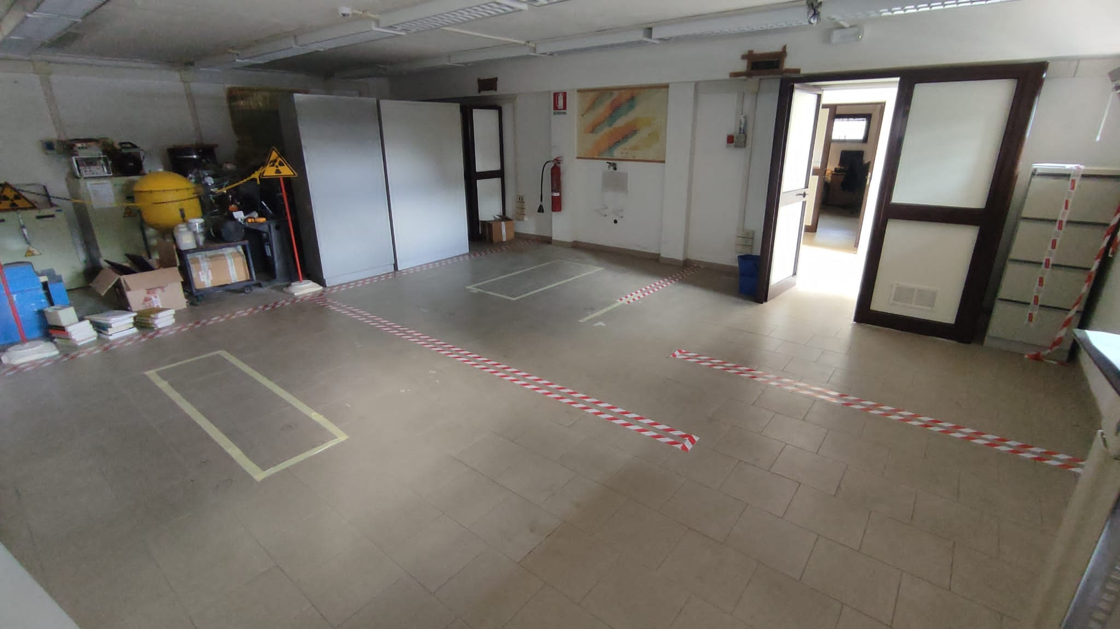
Bunker @ Sapienza University
Modulator & Klystron
Room Service
LINAC
e-
The works of the bunker will be completed in October 2025
Lucia Giuliano et al.
High Gradient Technology for VHEE Linac in FLASH Radiotherapy
HG2025, Mérida, Yucatán, México

Slide 22
CONCLUSION
  24 MeV FLASH Linac is under costruction @Sapienza University
  The procurement of all components is on schedule
  Phase 1: featuring SW 10 MeV, will be completed by the end of 2025
    The SW and gun design has been completed.
    SW structure will be realized by the end of June 2025
  Phase 2: featuring SW and TW 24 MeV, will be completed by the end of 2026
    The TW 50 cm development is in progress
    The high-power test expected to be conducted at Frascati INFN - TEX Laboratory in autumn 2025
Lucia Giuliano et al.
High Gradient Technology for VHEE Linac in FLASH Radiotherapy
HG2025, Mérida, Yucatán, México

Slide 23
Thank you!!!
Lucia Giuliano et al.
High Gradient Technology for VHEE Linac in FLASH Radiotherapy
HG2025, Mérida, Yucatán, México

