Slide 1
ARES @ DESY
Status update
VHEE conference 2025
Florian Burkart
DESY - MIL, injectors and linacs

Slide 2
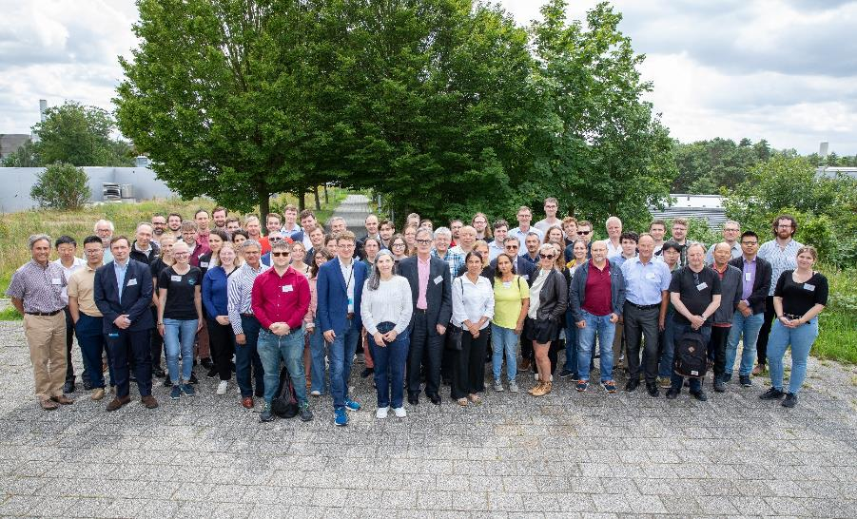
Since last VHEE 2023 … status update!
Very fruitful conference!
Unfortunately, we have a very hard budget crisis at DESY.
Reduction of ARES run-time in 2024 down to 3 month.
Operation team reduced from 5 to 2 Postdocs.
Heavy impact on availability.
2025 looks much better but still reduced availability.

Slide 3
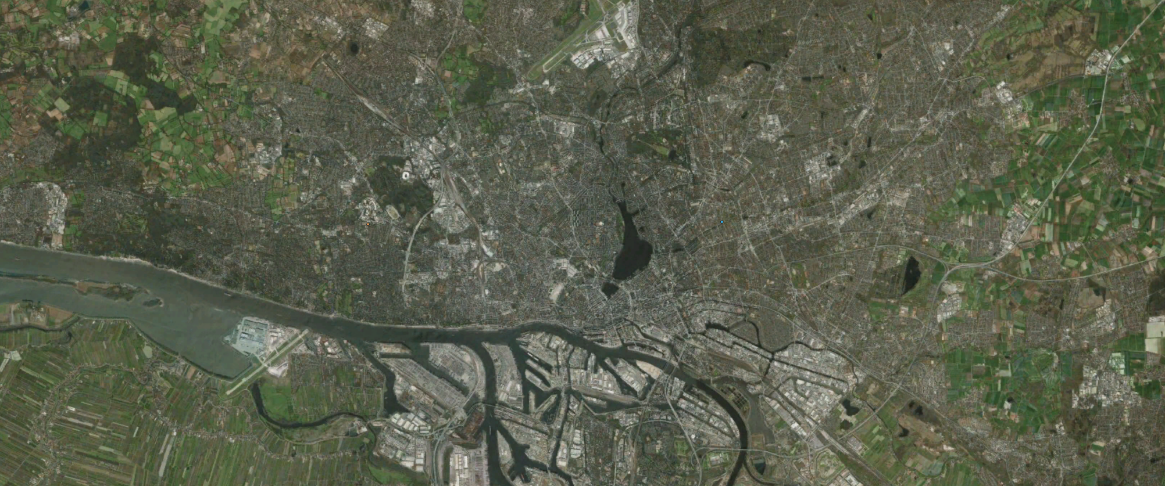
Deutsche Elektronen Synchrotron (DESY)
Campus in Hamburg Bahrenfeld

Slide 4
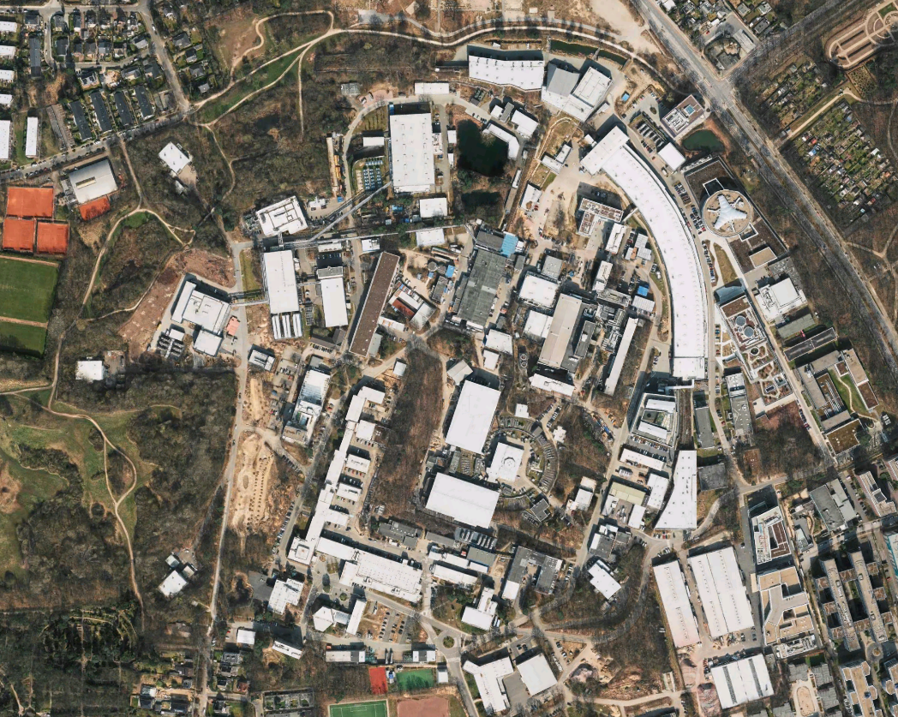
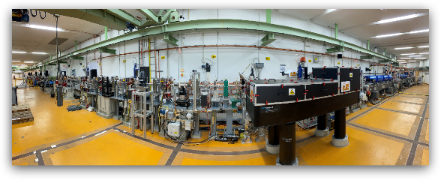
DESYs accelerator landscape
ARES Linac
FLASH II
FLASH
PETRA III
Campus
SINBAD
EuXFEL
DESY II
KALDERA

Slide 5
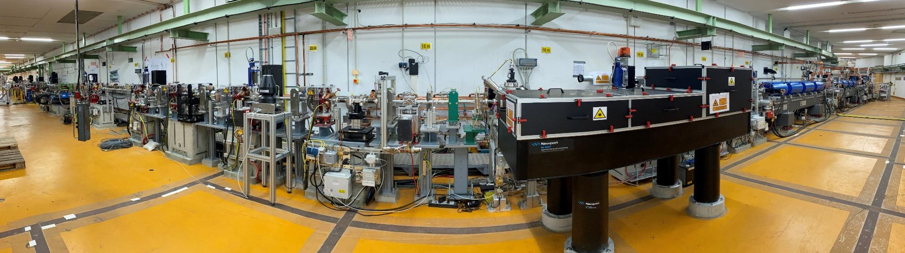
ARES, A Precision Tool for Accelerator Science, Technology and Application Developments
Parameter | Target | Status
Charge | 0.05 - 200 pC | 0.003 - 200 pC
Momentum | 50 - 150 MeV/c | 20 - 160 MeV/c
Momentum Spread | 10⁻⁴ | 10⁻⁴ (res. limited)
Rep rate | 10 Hz | 1 – 50 Hz
Bunch Length (rms) | Sub-fs to ~10 fs | ≈ 2.9 fs
Dose / pulse |  | 2 – 5 Gy
            ARES goals:
Generate and characterize ultrashort e- bunches (fs to sub-fs) with high stability for applications related to accelerator R&D.
Now strong focus on medical applications,VHEE & FLASH, with dedicated experimental area.

Slide 6
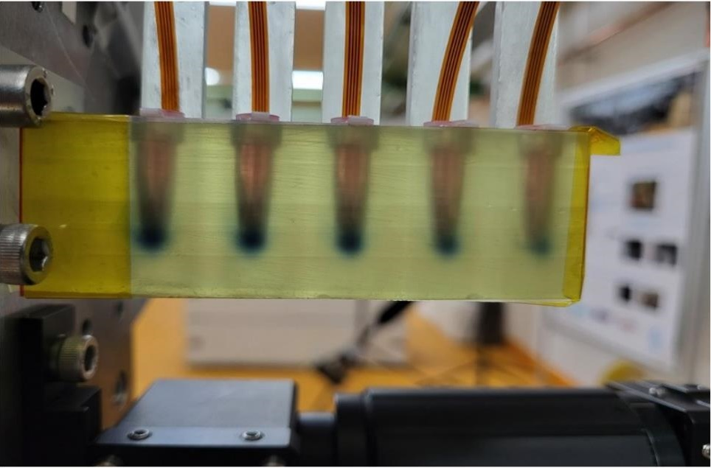
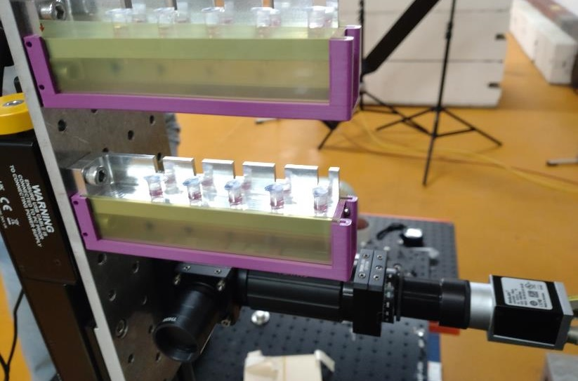
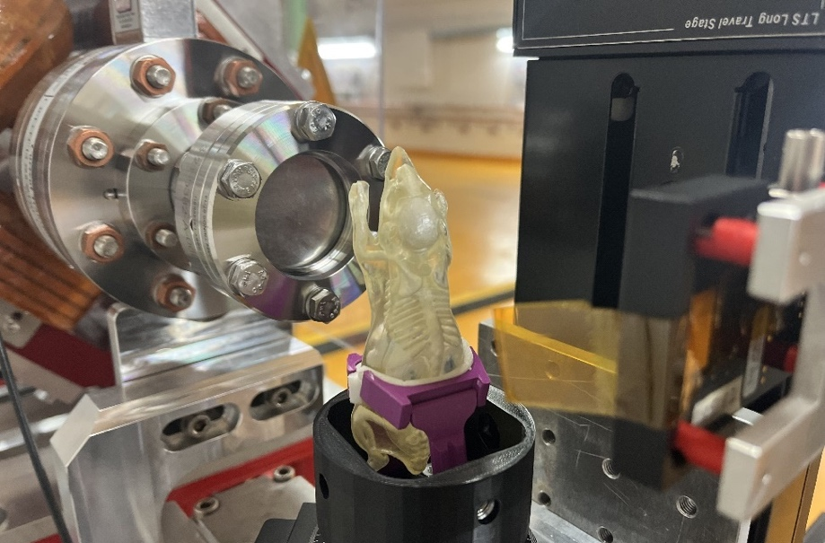
The 3 pillars for medical research
Dosimetry
VHEE & FLASH cell irradiation
Medical Imaging
Strong collaboration to develop and test fast & precise dosimetry.
Starting with cell irradiations,
VHEE / FLASH beam parameters with medical partners.
Medical imaging – the electron CT,
DESY internal collaboration

Slide 7
Infrastructure for medical experiments

Slide 8
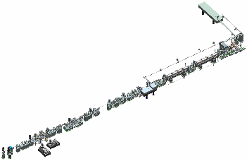
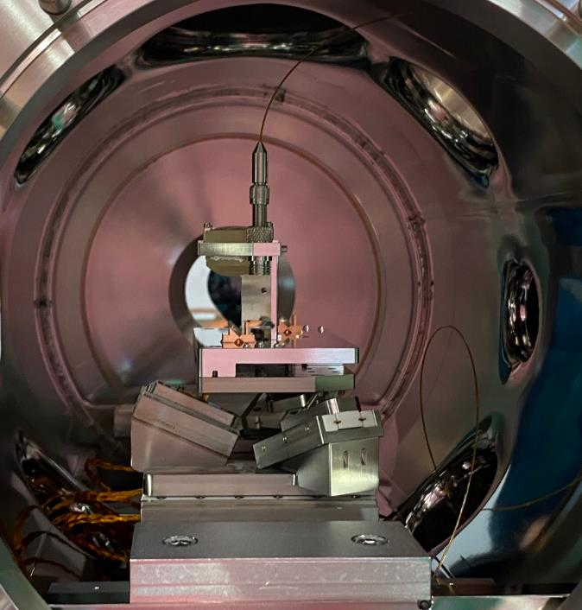
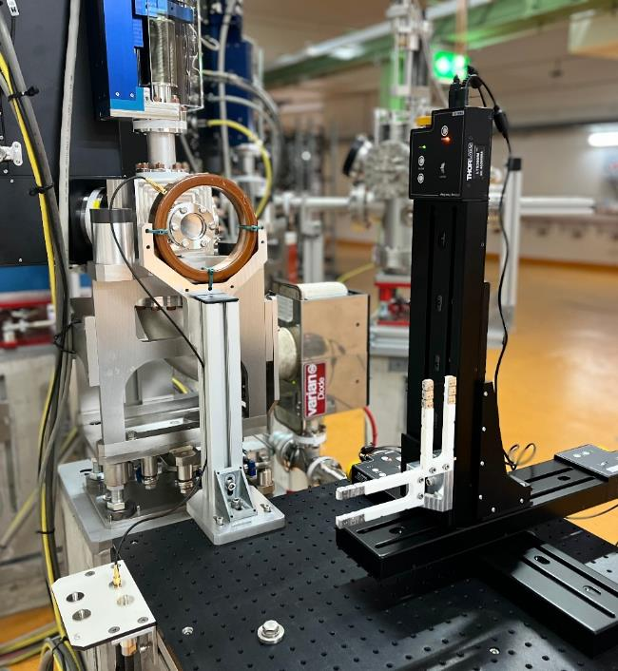
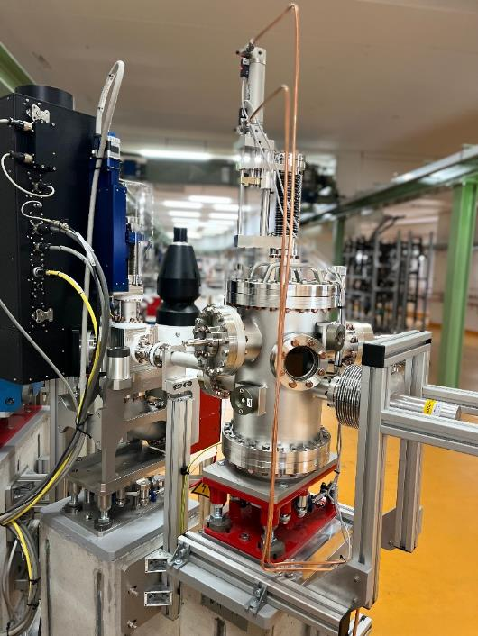
Three Experimental Areas for Users
Full Flexibility
In UHV (~7e-10 mbar), highest precision,
best beam control.
In air, highest flexibility.
In low pressure vacuum, detector test stand.

Slide 9
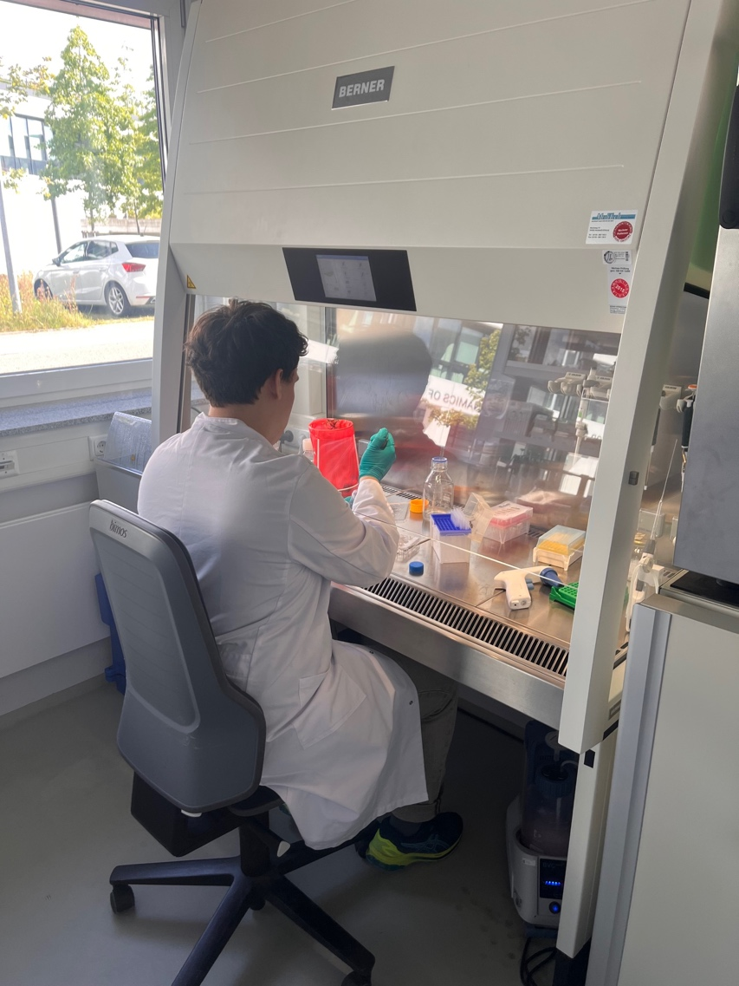
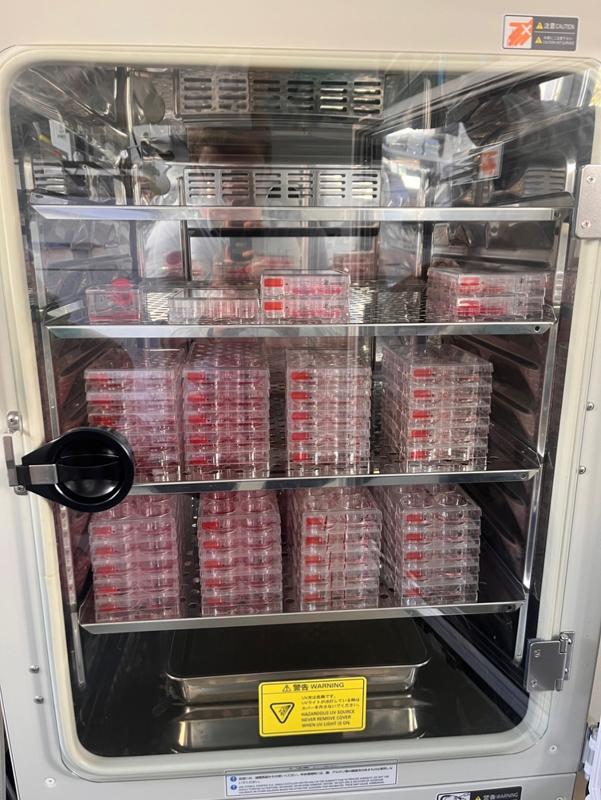
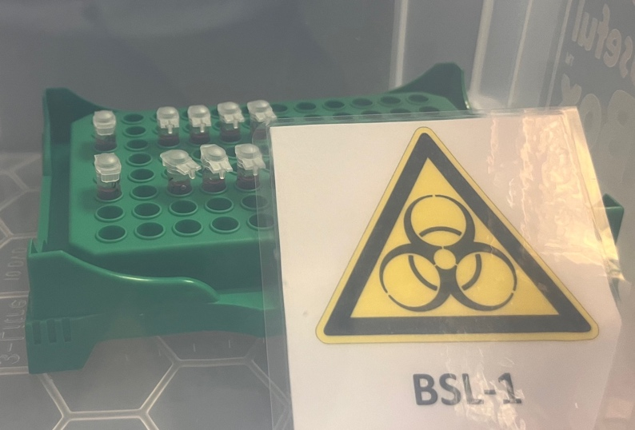
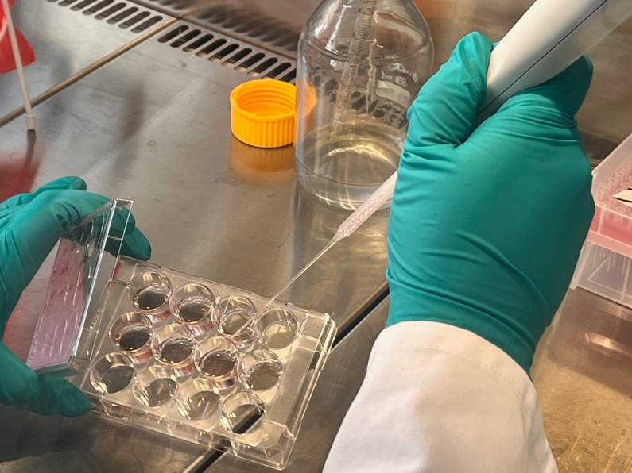
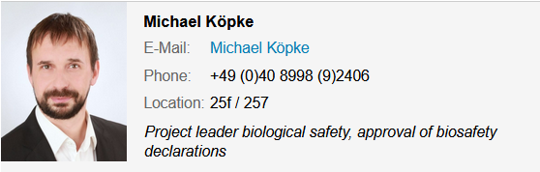
S2 Bio lab
Available for medical experiments at ARES.
BSL2 safety workbench equipped with a mini centrifuge, vortexer, vacuum pump,…
provides all the necessary equipment to cultivate, store, manipulate and analyse biological agents

Slide 10
Dosimetry

Slide 11
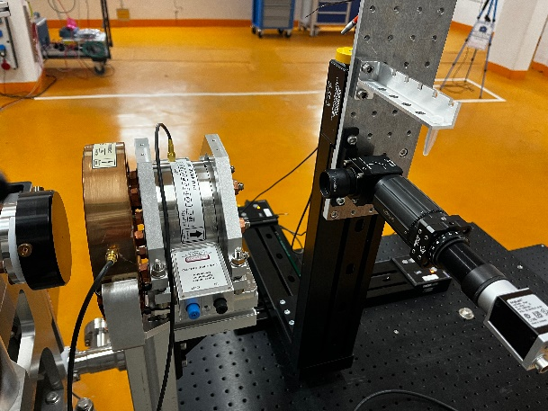
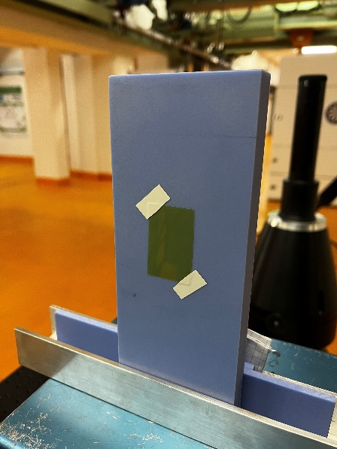

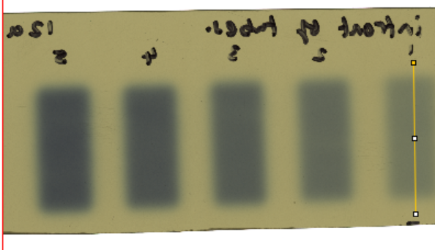
The challenge of „the dose“…
Medical side ~ translator ~ accelerator side
What is the „right“ dose?
  Integrated dose
  Dose rate
  Dose rate/pulse
  How do we measure dose (fast!)
How to translate electrons to dose?

Slide 12
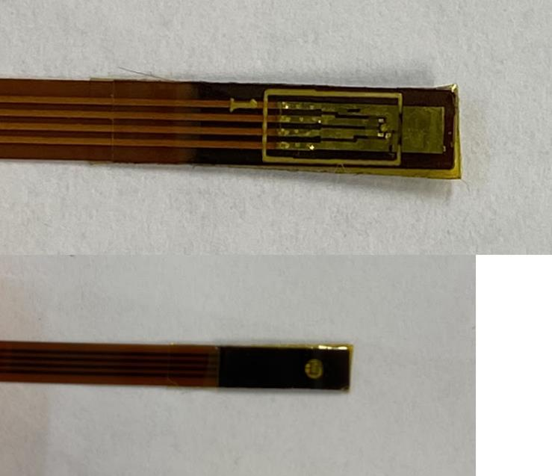



Dosimetry development with the Wollongong university (Australia)
Collaboration with UKE & Woolongong university within the framework of HiACTS (Helmholtz Innovation Platform for Accelerator-based Technologies and Solutions) for the development of an online dosimetry monitor (Moskin)
First beam times to compare Moskin with several other dosimeters (analysis of the results is ongoing). Next beam time in the coming months.
courtesy: James Cayley, Elisabetta Gargioni

Slide 13
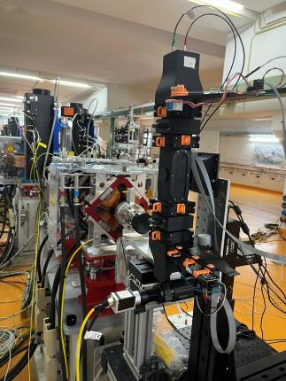
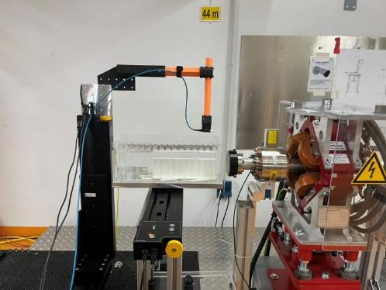
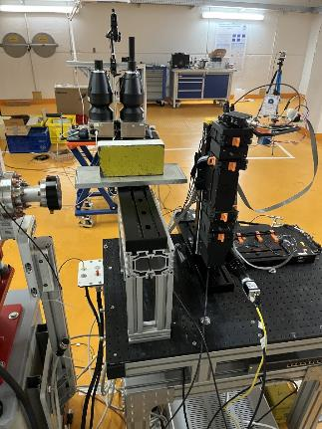
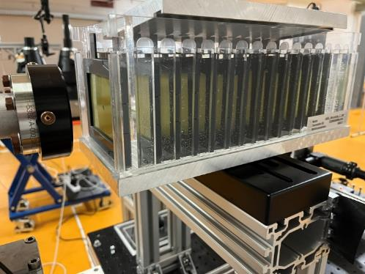
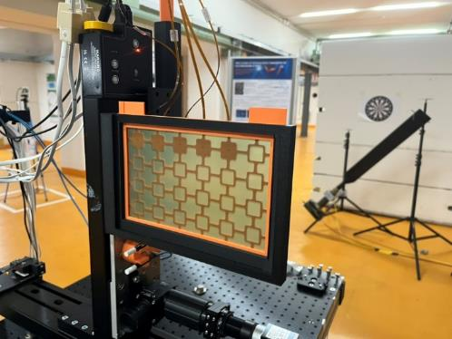
See talks from Oliver Stein
and Florian Beißer
Other detector R&D activities
Dosimetry and radiation detector tests from the DESY radiation protection group
Testing and benchmarking different detector systems (NitroFLASH, diamond, films, PANDORA, etc.)

Slide 14
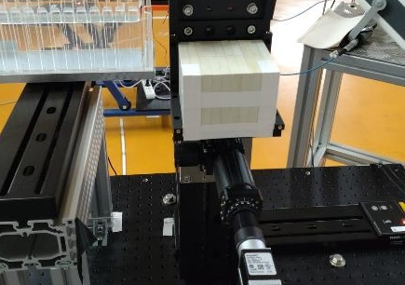
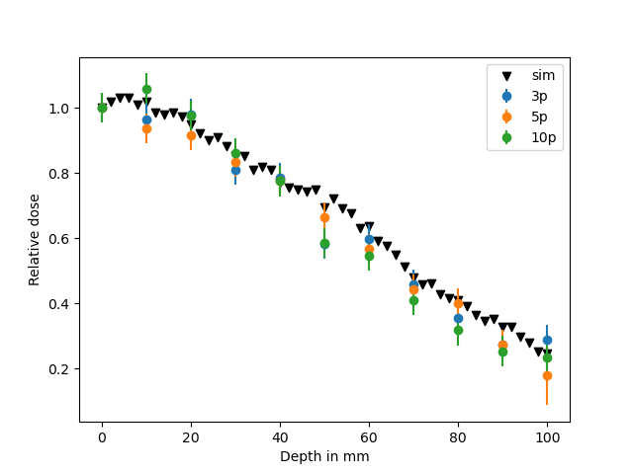
Depth-dose curves in (solid) water
Setting up tools and simulations
Energy = 153 MeV
Beam: approx. Gaussian
FWHM = approx. 2.8 mm (both in x and y) @ phantom surface
About 30 pC per pulse
Dose measured with EBT3-XD films: approx. 0.55 Gy/pulse
Monte Carlo simulation with experimentally-determined beam divergence
Courtesy: Joel Senador, UKE

Slide 15
The results: Beam / Dose structure @ ARES
Single pulses with up to 50 Hz rep. rate
Current Limitations:
Only 250 pC per pulse
→ Small spot size in the order of 10 mm²
O (TGy/s)
Single digit ps
1-5 Gy
1 / 0.1 / 0.02 sec
O (50 – 250 Gy per second)

Slide 16
Cell irradiations

Slide 17
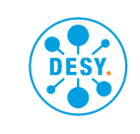
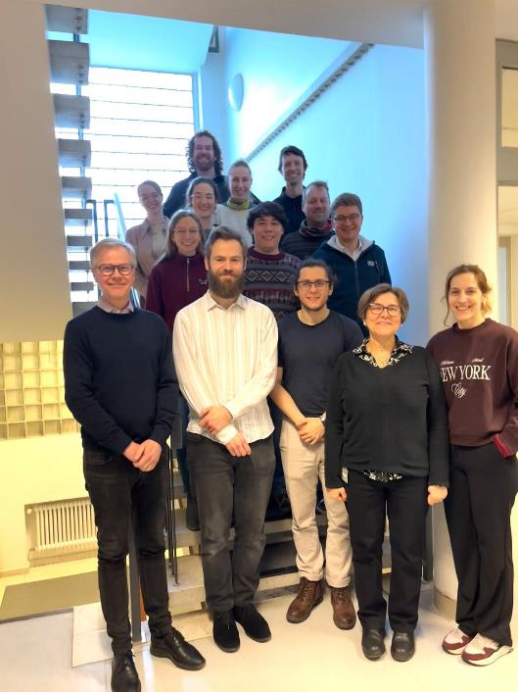
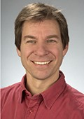


ARES collaboration with UKE
Prof. Dr. K. Rothkamm
+ Dr. N. Struve, Dr. E. Gargioni
+ J. Senador et al.
Very high energy electrons (VHEE) & FLASH treatment
Studies at ARES for Dosimetry
Third party funding received in collaboration with Uni Wollongong (Australia) for online dosimetry development.
Studies concerning treatment of medulloblastoma
Master thesis of Joel Senador (now PhD)
Collaboration meeting with colleagues from UKE, DESY, Uni Lund and Uni Wollongong

Slide 18
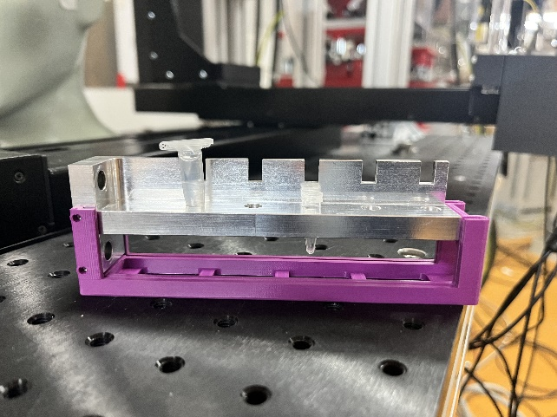
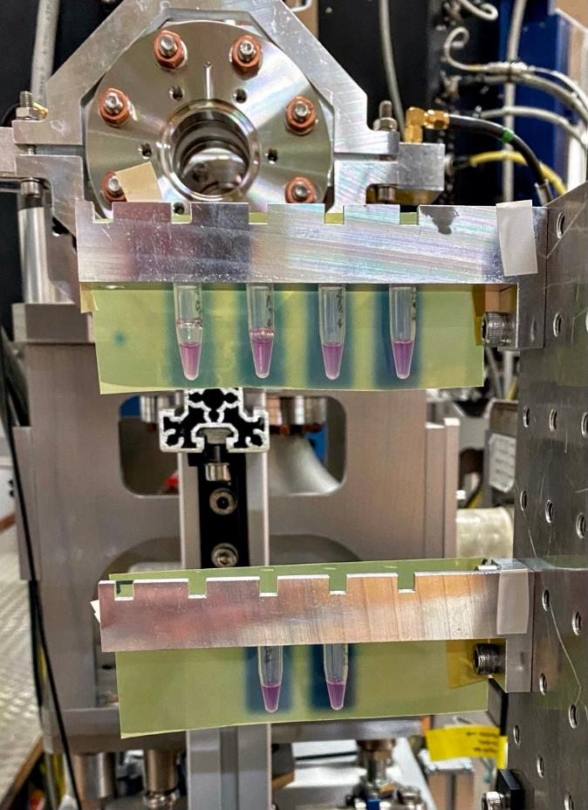
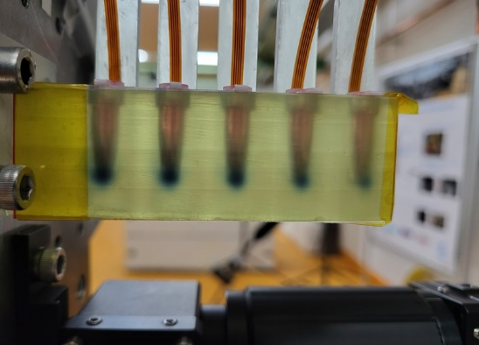
How to hit the cells with small beams?
Part 1
Preparation in the lab and transport to ARES is not an issue.
Bringing the cells in the tunnel is also not a problem (special access mode to keep most of the accelerator parameters).
Eppendorf tubes are not Eppendorf tubes.
Different holder systems from DESY and UKE
Combination with online dosimetry.

Slide 19
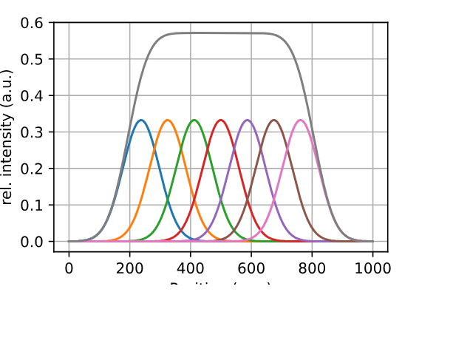
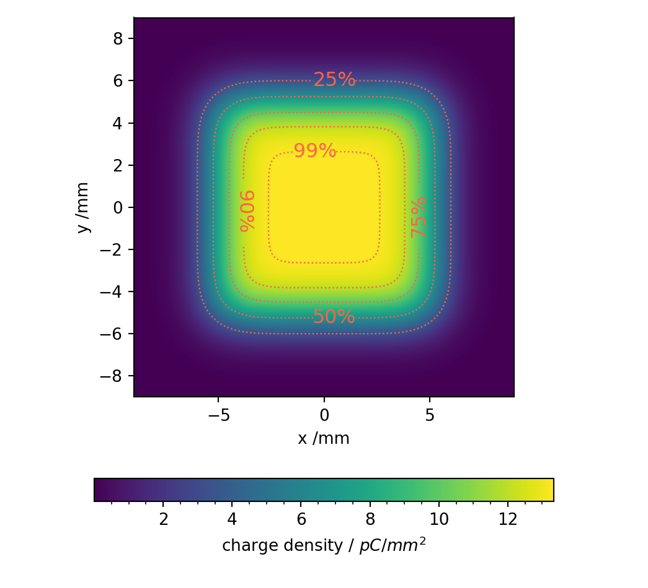
How to hit the cells?
Part 2
ARES is limited in the amount of charge we can produce / transport.
Small spot size, where we can achieve FLASH like beam parameters.
Cells need to be prepared very carefully.
We have to rely on dosimetry!
Still the issue remains: are we sure that we hit the cells with the right dose?
Set-up of different irradiation patterns: Spot (FLASH like parameter) vs. Snake pattern (VHEE parameters, uniform distribution) irradiation

Slide 20
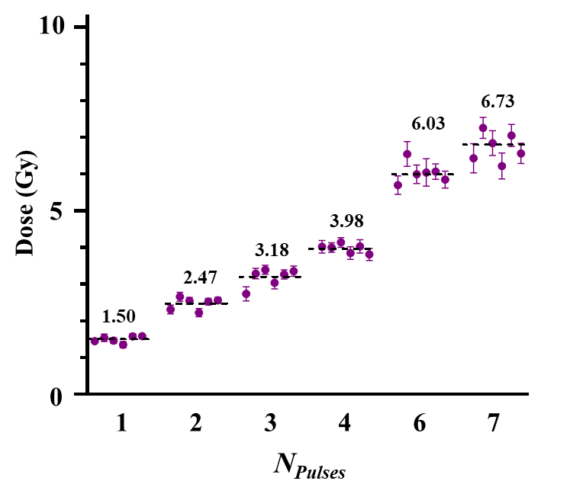
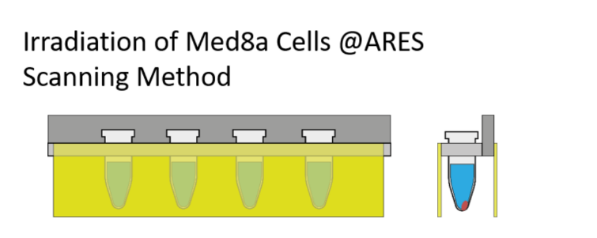
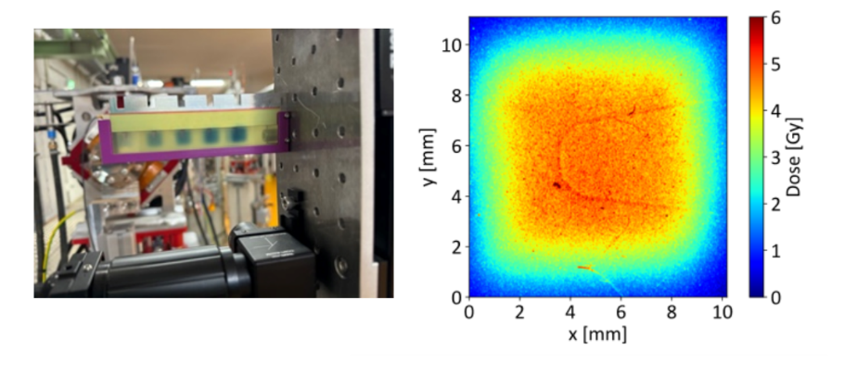
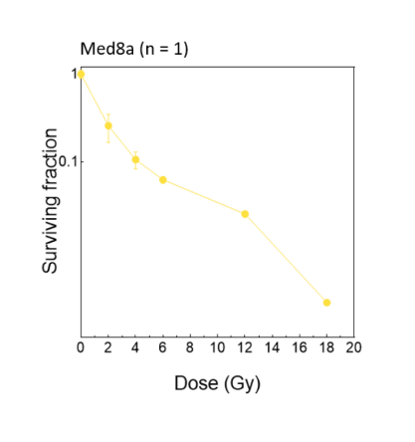
Developing routines and first results
Courtesy: H. Wanstall, R. Jones
Analysis ongoing, publication in preparation
First in vitro measurement of VHEE relative biological effectiveness (RBE) in lung and prostate cancer cells using the ARES linac at DESY
Experimental setup, cells in Eppendorf tubes
Dose analysis after irradiation
Last 2 weeks: increase charge/dose, statistics for cell irradiations.
Survival rate of Med8a cells

Slide 21
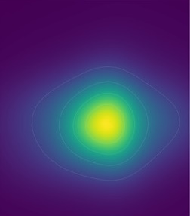
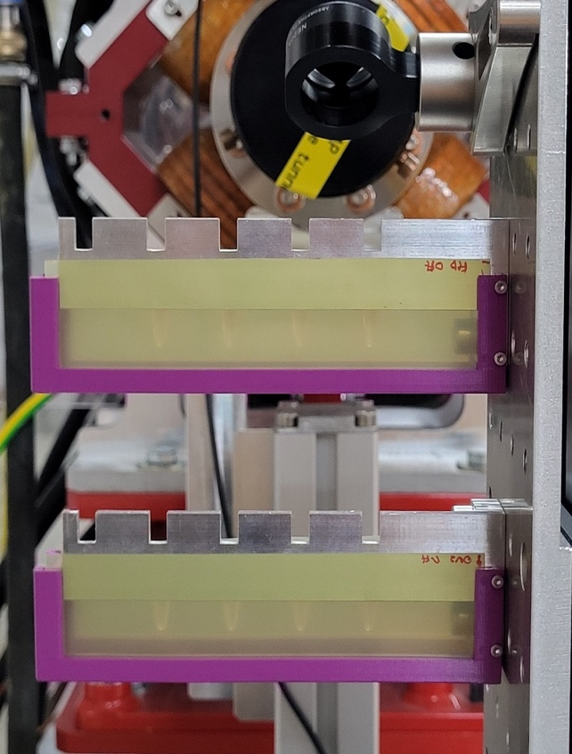
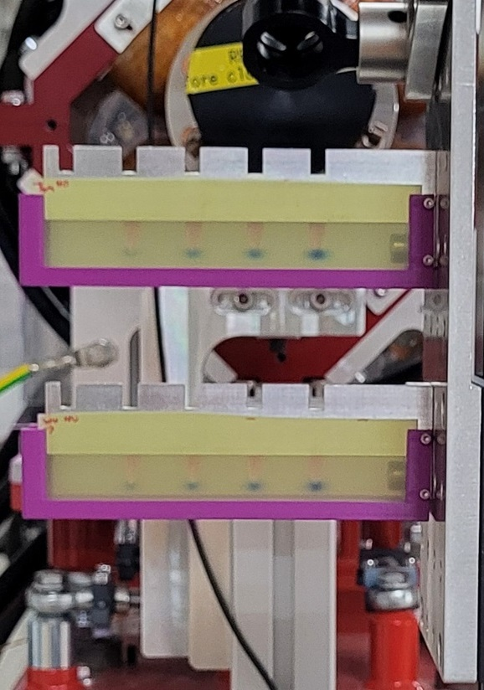
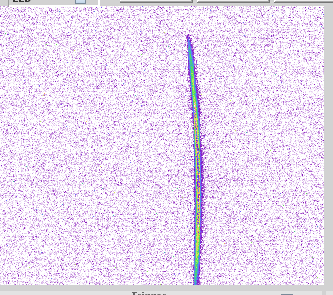
Regular beam times with UKE, tumor cell irradiations
Working on statistics
Irradiation of different cell lines with 2 – 10 Gy
Beam studies (bunch length, optimization of charge density)
Preparation for publications

Slide 22

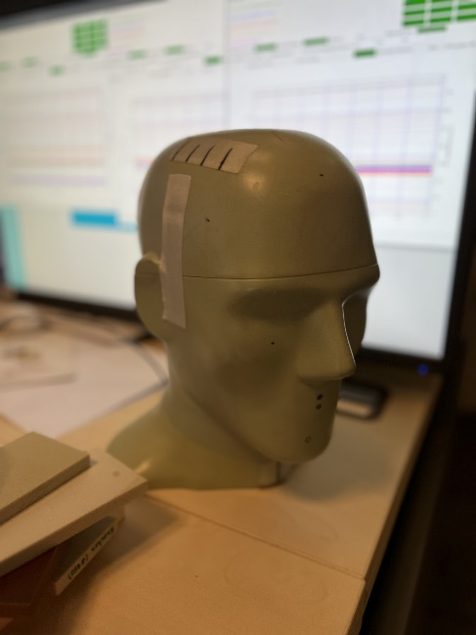
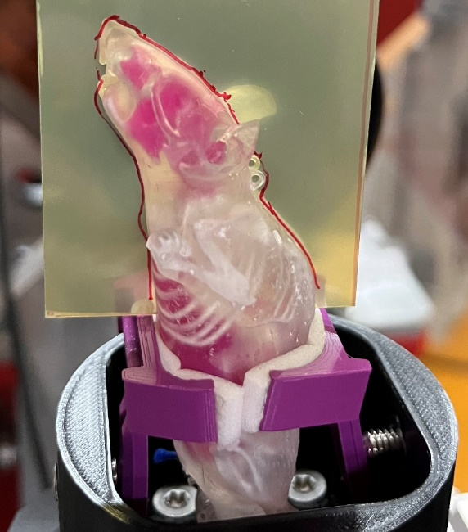
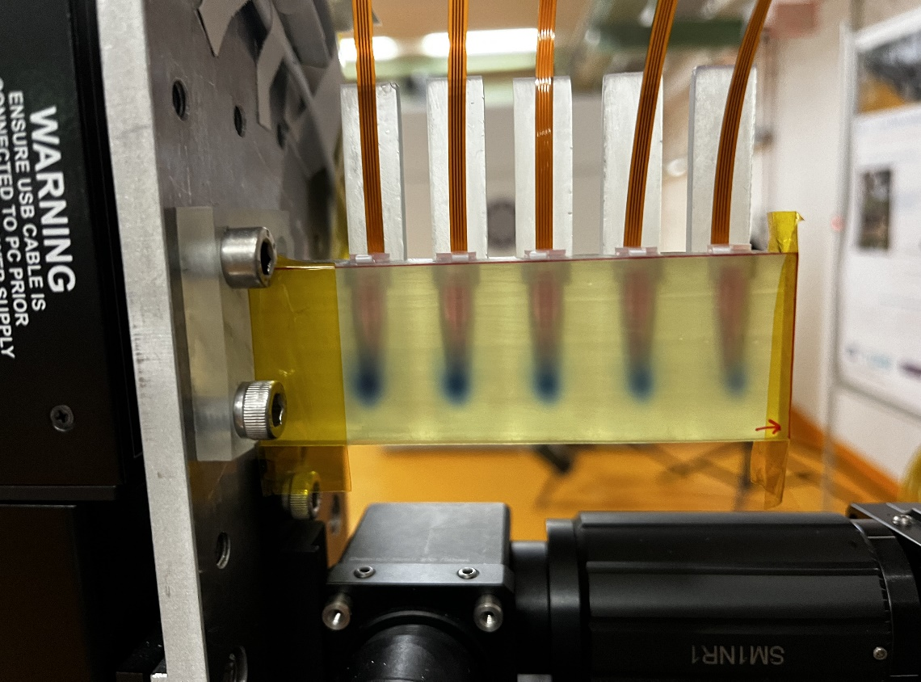
Studies with different types of samples
Studies for tumor treatment with high energetic electrons and FLASH parameters.
Mosfet detectors from Uni Wollongong as online dosimetry.
Animal and skull phantoms and living tumor cells.
Preparation for egg experiments.

Slide 23
Medical imaging

Slide 24
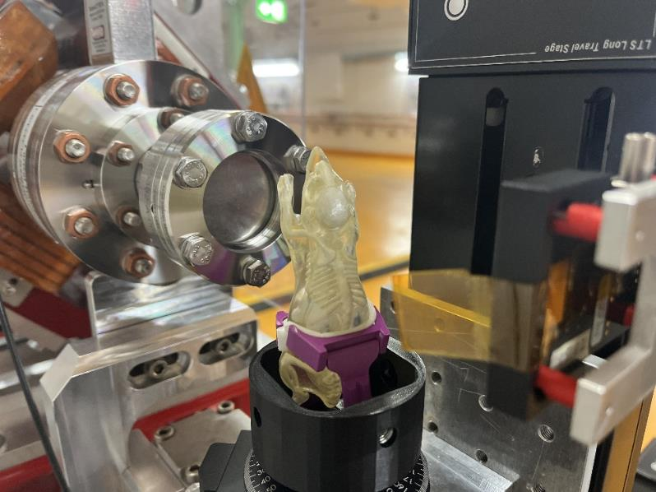
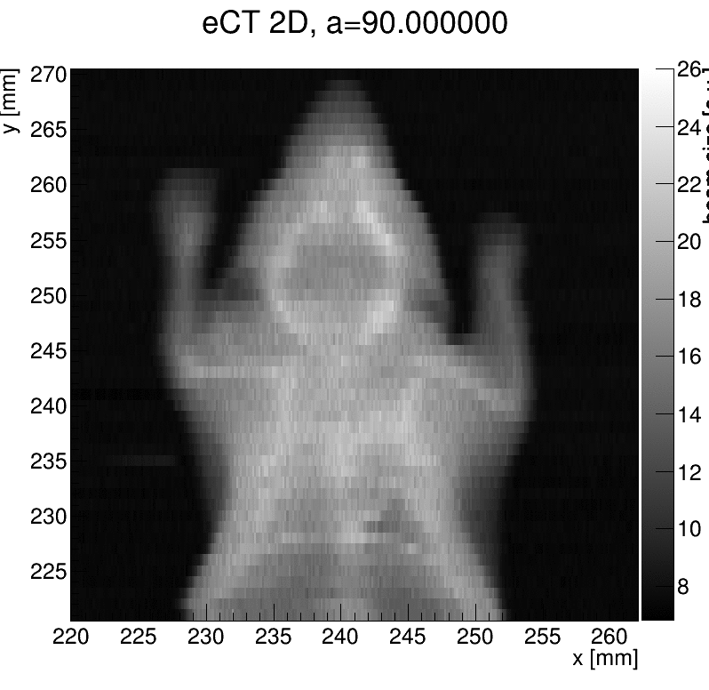
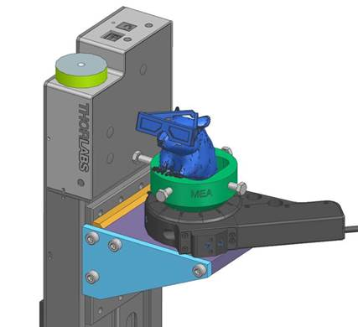

eCT - Medical imaging and treatment with one accelerator
DESY cross-divisional research project
Mouse phantom
Timepix3 detector
First proof-of-principle tomography successful
Next steps:
Tests with more phantoms from University Hospital UKE
What can we detect?
Improve data acquisition system and reduce measurement time.
ElectronCT – an inmaging technique using very-high energy electrons, P. Schuetze et al.,
Front. Phys., Sec. Medical Physics and Imaging, Volume 12 - 2024 | https://doi.org/10.3389/fphy.2024.1454854
courtesy: Paul Schuetze

Slide 25
Summary

Slide 26
ARES - summary
ARES – A state of the art normal conducting linac with highest stability and reproducibility.
Testbed for internal and external Accelerator R&D – full flexibility with three different experimental stations
Rich portfolio of completed, ongoing, and planned R&D activities
Unique opportunities for medical applications
Towards one accelerator for imaging and treatment with VHEE and FLASH radiotherapy beam parameters.
Platform for dosimetry detectors developments.
Ramping up activities again in the second half 2025.

Slide 27
Thank you!
Florian Burkart
DESY - MIL (injectors and linacs)
florian.burkart@desy.de
+49 40 8998 3039
Notkestr. 85, 22607 Hamburg

