Slide 1
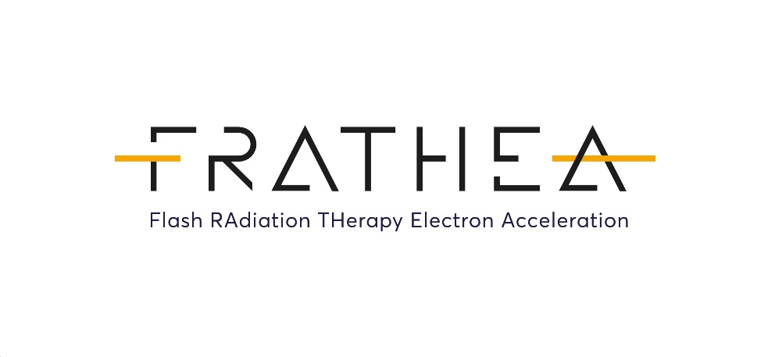
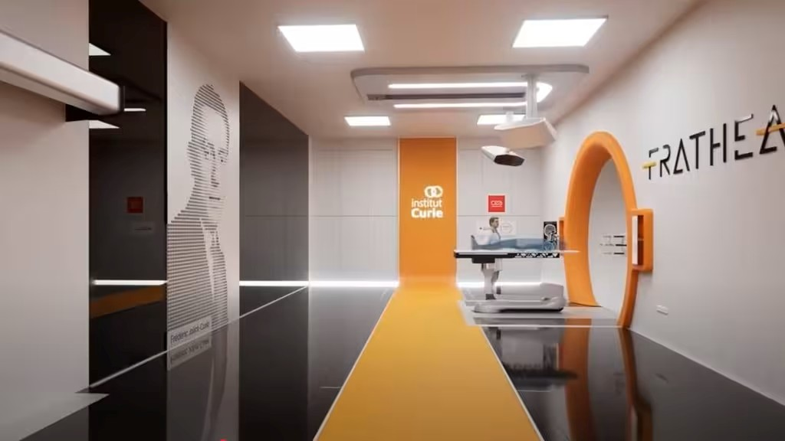
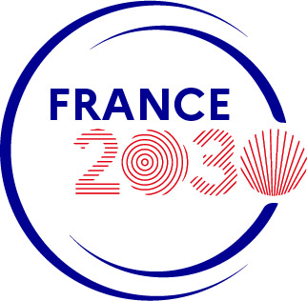


Prof Gilles Créhange, MD, PhD
Institut Curie, Paris
STFC, Daresbury Laboratory
VHEE’25
15 Sept 2025
Clinical perspectives with VHEE
ANR-24-FRAT-0001

Slide 2
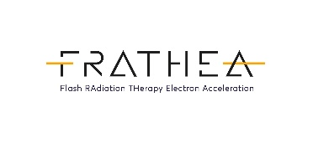
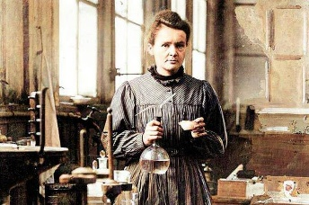
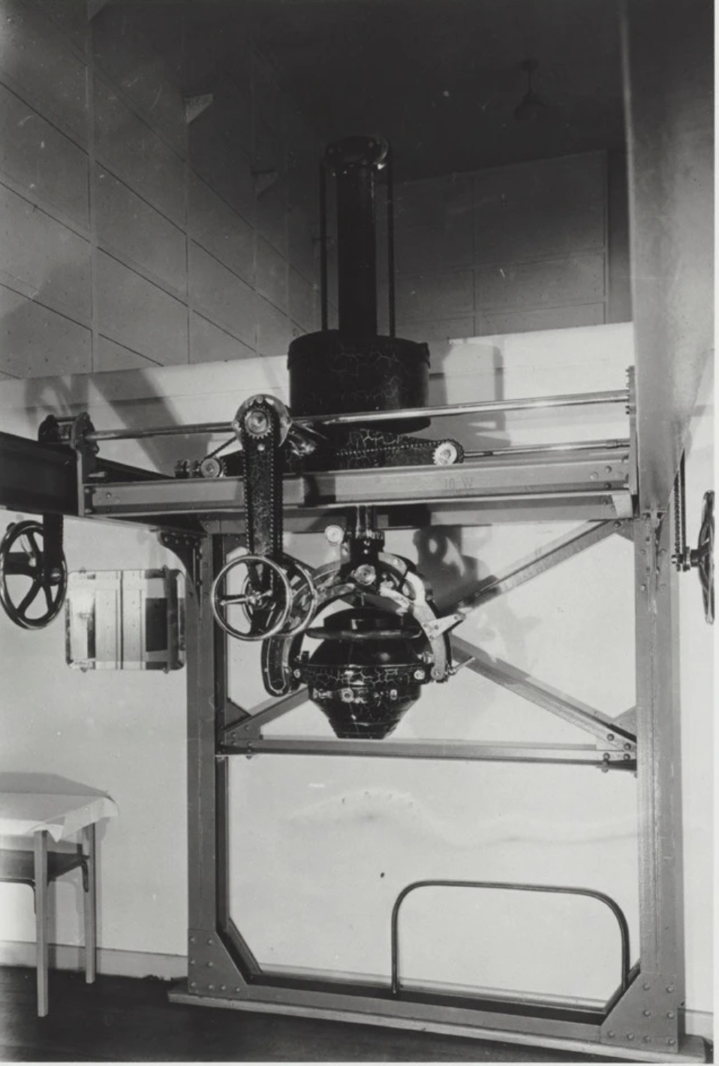
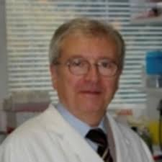
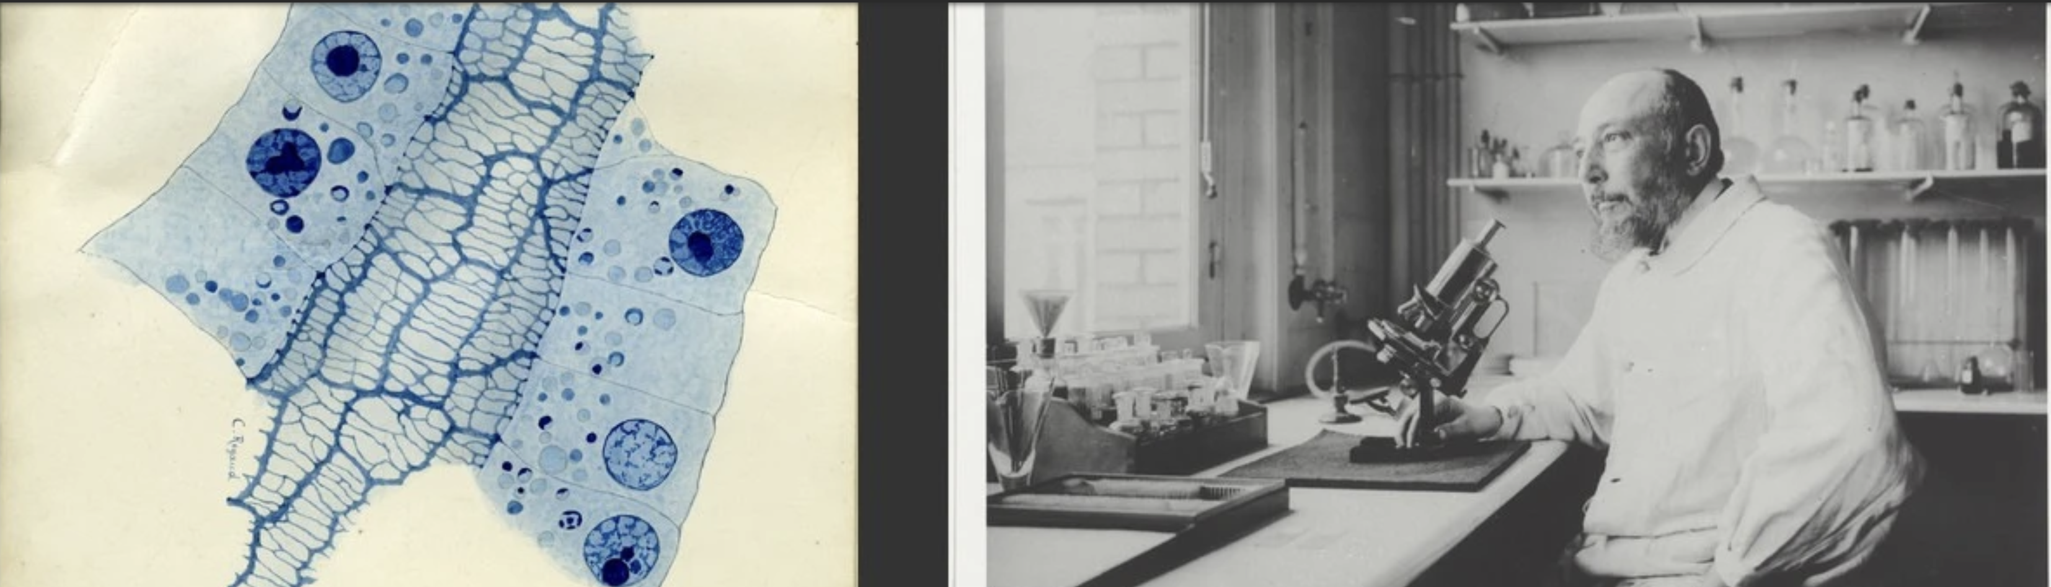
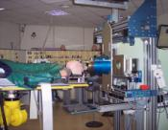
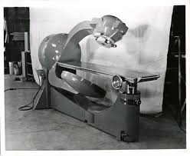
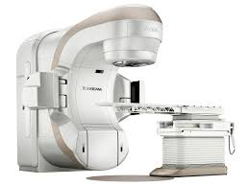
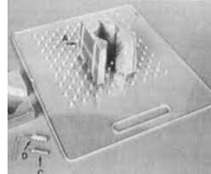
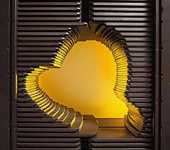
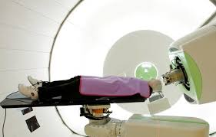
Back to the future of Institut Curie : From bench to bedside
20 years…
100 years…
20 years?
First french proton center
3DRT
IMRT
IGRT
SBRT
« W » effect
1903
1911
1925
2011
2028?
1970
1991
2000
2014
2018
« Flash » effect
LiNACs
2DRT
First proton gantry
First Flash proton set up
Cobalt
FRATHEA
Flash VHEE
Normo or hyperfractionation (15-40)
Hypofractionation (1-5)
Notes:
Since Marie Curie discovered the anti-cancer properties of radioactivity at the Radium Institute and Claudius Regaud discovered the effects of fractionation in limiting toxicity, “clinical” radiotherapy has been able to develop thanks to the first radium bomb nearly 20 years later. Of note, the initial clinical results were not very convincing... Which just illustrates that you should never give up and hope!
Over this century, various technological developments involving cobalt bombs and then Linacs made it possible to go beyond the protection of healthy tissue through physical, geometric protection of healthy tissue by better distributing doses to healthy tissue. This made it possible to begin revisiting the principles of fractionation and concentrating radiotherapy sessions.
At the same time, in the early 2000s, Vincent Favaudon described the “W” effect. Ten years later, his experiments on ultra-high dose rates revealed the protective effect of flash radiotherapy on healthy lung tissue in mice. Today, proton. facilities. are the only option available for treating all deep tumors with external beams in humans, but their cost and accessibility likely limit the development of proton FLASH.
In this context, the Institut Curie has developed a research program to develop a prototype accelerator that generates very high-energy electrons in order to respond to this need.

Slide 3
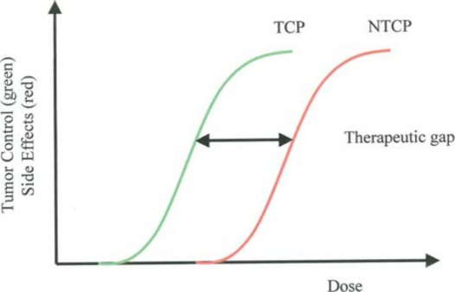
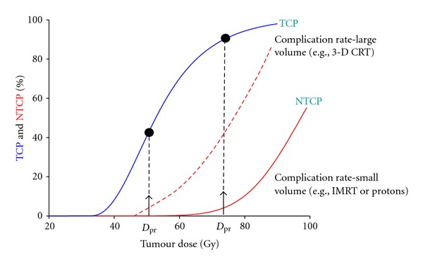
State of the art of conventional radiotherapy
  A 30% increase in cancer cases forecast in France by 2040
  Elder and frail (less compliant) cancer patients with comorbidities should increase in parallel
  Under-use of radiotherapy, even though it is a less costly and more controlled treatment (5% on average of healthcare expenses for cancer treatment)
  Photon treatment cost : 3 to 15k€ per patient
  A treatment lasts between 5 and 6 weeks with an average of 25 fractions
FLASH protons, VHEE
Flash : Large volume?
  Main limitations : healthy tissue tolerance
  Major therapeutic issue: side effects control, especially in children, locally advanced disease, radioresistant disease
Crucial need for an innovative radiotherapy
Notes:
As previously described, advances in conventional radiotherapy have broadened the therapeutic window, significantly reducing toxicity while allowing biologically escalated doses to be delivered to more resistant tumors, thanks to IG-IMRT, proton therapy, brachytherapy, and stereotactic radiotherapy. Nevertheless, in the case of locally advanced tumors with a greater exposure of healthy tissue or organs at risk to radiation, a high probability of tumor control remains but correlated with a higher probability of complications.
Furthermore, the need for radiotherapy will increase with the aging of the population, among other factors, and it will be important to improve tolerance in aggressive cancers, but also to increase access to radiotherapy and improve compliance among elderly and frail patients, as well as to be able to re-irradiate recurrent tumors that are inaccessible to other techniques.

Slide 4

Différentes machines, différents débts de dose :
Dose rate and accelerators :
Motion management and Uncertainties
Cyberknife
Tracking
Longer fraction duration
Linac
Interfraction motion
And/or intrafraction motion
3D soft tissue visualization
Linac based FFF
Air breathing control
Lower risk of motion
FLASH
Free breathing
Better OAR sparing?
10Gy
10Gy
10Gy
10Gy
Tx time
45mn
Tx time
20mn
Tx time
<10mn
Tx time
<1s
≈ 1 Gy/min
Dose rate
Times 3 to 6
> 100 Gy/s
Dose rateX1000
Motion less at risk?
Positioning accuracy = of paramount importance!
Better clinical results?
Different on board technologies to compensate for uncertainties of each technology
Clinical results = Same!
Notes:
A bunch of in vitro studies have demonstrated a better antitumor effect of radiation delivered at an increasing dose rate.
We know that conventional radiotherapy using a low or high dose rate produces essentially the same clinical results regardless of the type of technology used. Although the irradiation time differs from one technology to another, each technology has ways of managing the various uncertainties associated with irradiation of Humans (inter- and intra-fraction movements).
Since flash radiotherapy has been shown to provide better protection of healthy tissue from a biological standpoint, issues related to patient positioning and patient movement at a given moment will need to be studied to determine whether this type of radiotherapy in humans will produce equivalent or better results, which is what we hope.

Slide 5
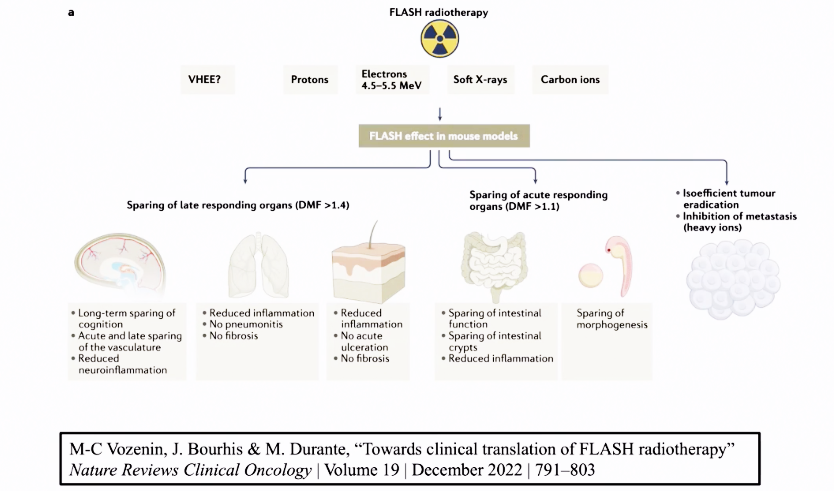
FLASH : Protection mechanisms in healthy tissue
Notes:
In in vitro models or in small or large animals, a growing body of literature has studied the Flash effect with different particles in a reproducible manner in terms of gains in brain tissue, digestive mucosa, skin tissue, lung tissue, and morphogenesis.

Slide 6
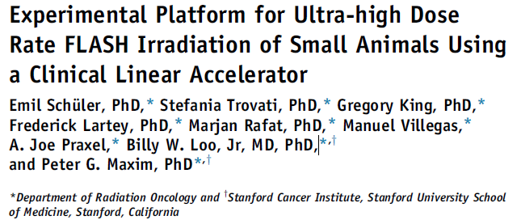
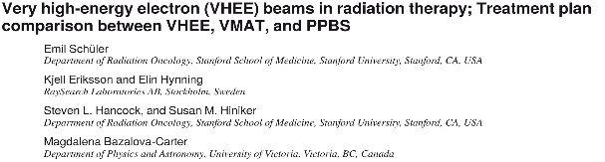
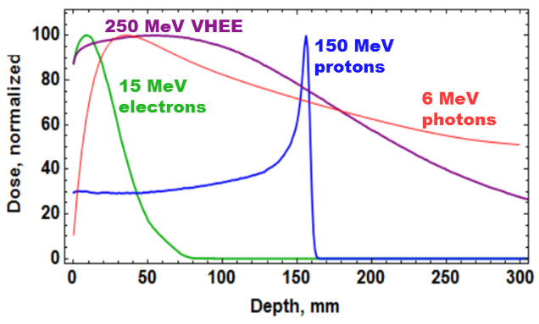
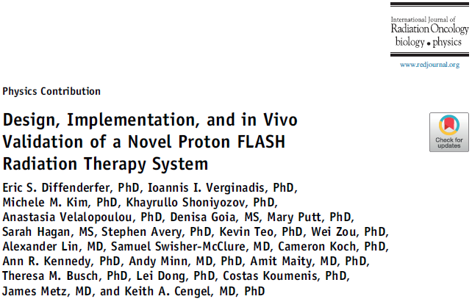
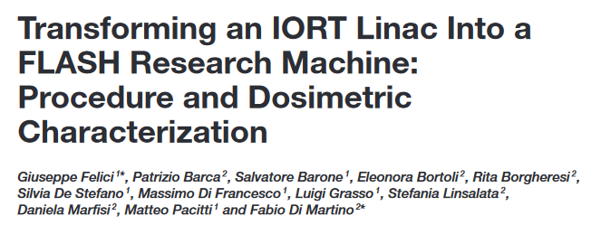
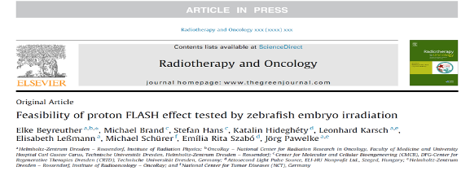
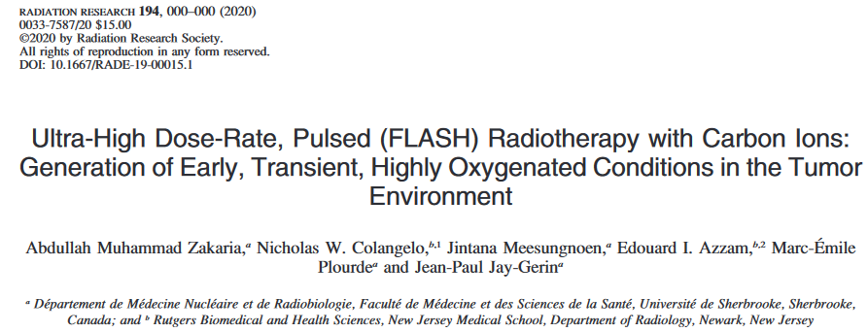
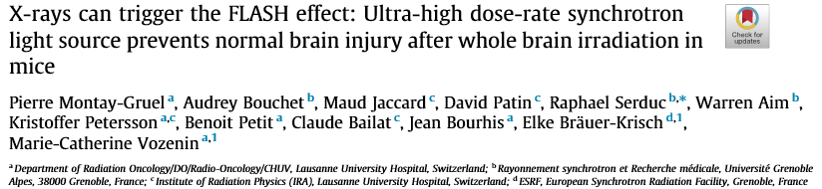
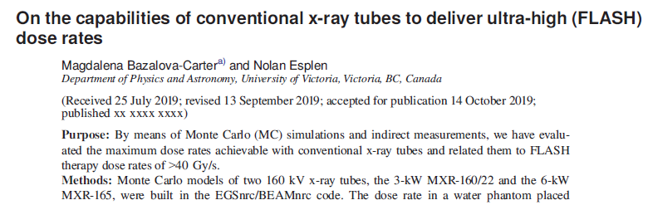
FLASH: A race for developments
Highly expected
More compact
Less costly?
LINACS w/ middle energy electrons
Very high energy electrons (VHEE)
Stanford, Varian, Sweden, …
CERN, Stanford,
Italy, France…
Protons
Protons
LINACS (Intraop electrons)
Varian, IBA,
Curie, PSI,
Upenn, …
SIT, Theryq, ...
Carbon ions (High LET particles)
X Rays(synchrotron or RX tubes)
GSI Heidelberg
CHUV, Lausanne
TRIUMF, Canada
Notes:
Various research programs have been developed over the past 10 years using different technologies. Only low-energy electrons or protons could be used in humans. Low-energy electrons, such as intraoperative RT, suffers from limited development capabilities due to the need for multidisciplinary human resources in an operating room and the greater heterogeneity of published clinical results, reflecting greater uncertainties about this technique in terms of quality, as it is more operator-dependent.
Protons could be used to treat all tumors, but the facilities remain very expensive and few in number, with already limited access for tumors in validated indications. Furthermore, protons are more sensitive to heterogeneity and movement than electrons.

Slide 7
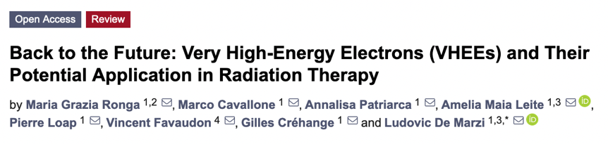
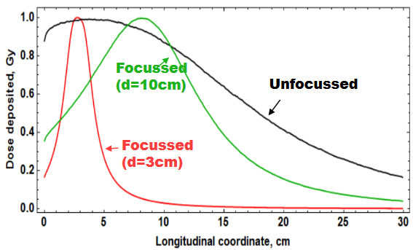
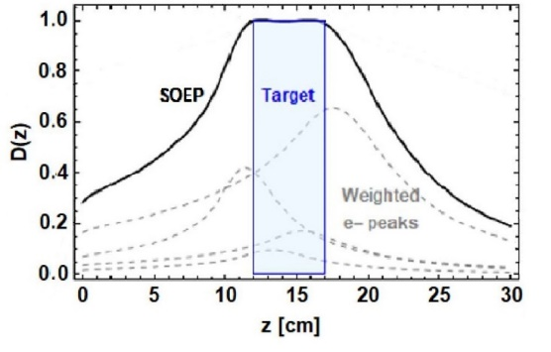
Why Very High Energy Electrons?
Physical dose distribution
VHEE in RT were originally proposed by DesRosiers et al. at Indiana University in 2000
50-250
MeV
Deeper penetration
Sharp transverse penumbra
Compact technology
Easily focused
FLASH dose rates + FLASH context (p+,e-, ν)
« Low sensitivity » to heterogeneities
Dynamic Scanning and IMRT possible
VHEE percent depth doses for three focusing positions in water.
Relative depth dose distributions of photons, electrons and protons.
Notes:
In addition to their depth penetration characteristics, with a profile closer to that of photons, very high-energy electrons have interesting characteristics compared to protons, offering the prospect of more compact installations. Electrons are robust for FLASH irradiation, are easily focused, and are less sensitive to heterogeneities. Furthermore, dynamic scanning and IMRT are possible.

Slide 8
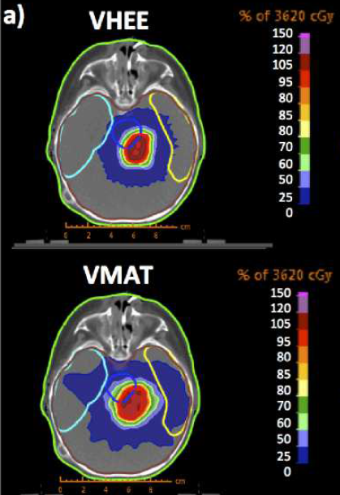
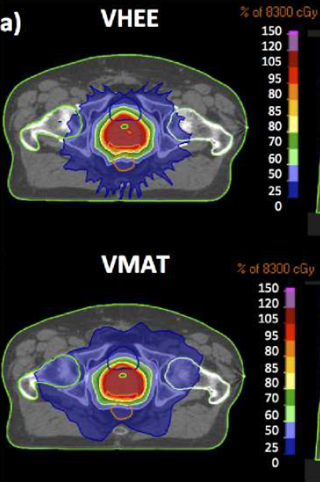
FLASH parameters for optimal dosimetry with VHEE
Physical/ballistic properties:
When theoretical VHEE+VMAT are used, favorable 3D dose distributions compared to photons (integral dose, conformity, cheaper, compact).
If FLASH constraints are taken into account:
No improvement compared to VMAT unless
DMF < 0.8
Beam number > 7
and/or E> 70 MeV
Notes:
In addition, VHEE combined with VMAT produce very favorable 3D dose distributions compared to photons in terms of integral dose and conformity, for example.
The minimum parameters for VMAT irradiation in FLASH mode are beginning to be established.

Slide 9
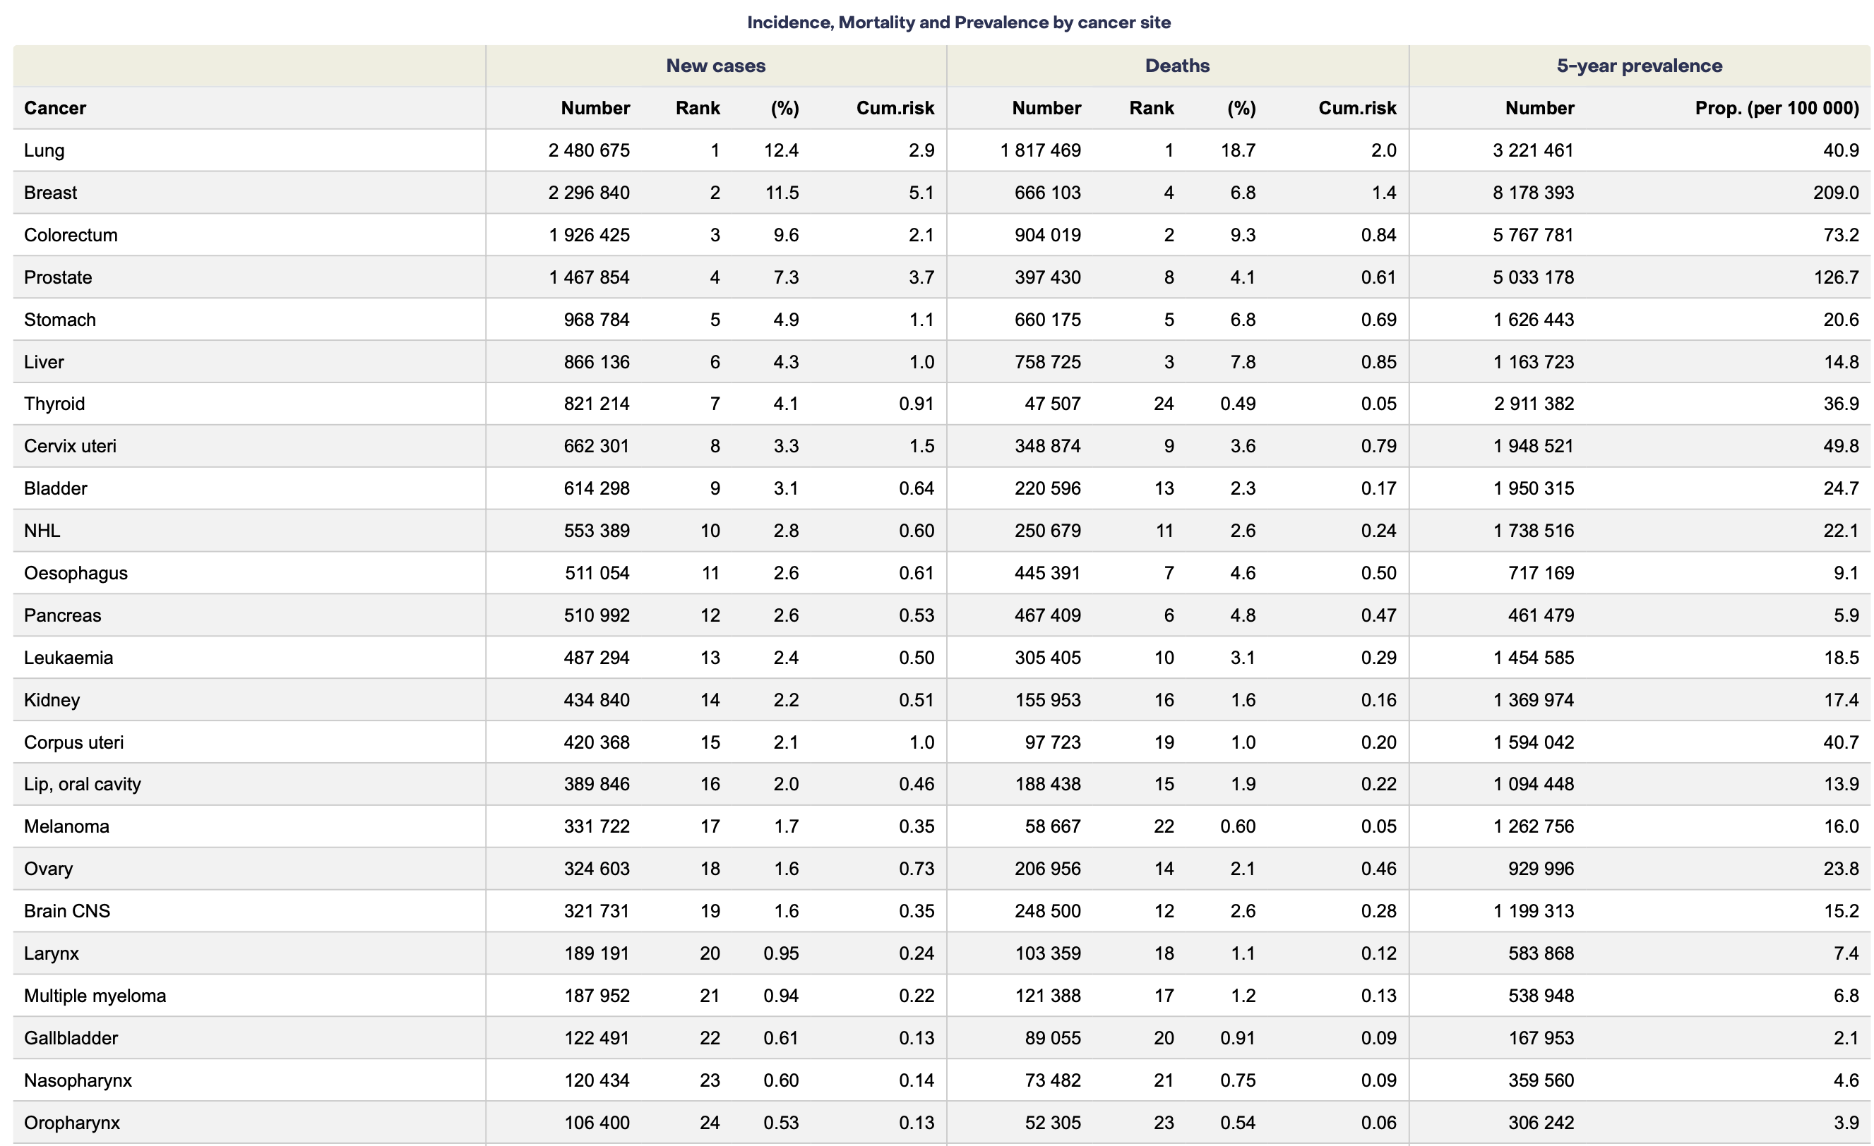
Which « deep » cancers do we want to target in FRATHEA?
Deaths from operated and non operated cancers
Radiotherapy needed for curative intent
Tumours cured with radiotherapy only +/- drugs
Aim #1
Decrease toxicity
Improve QoL
Aim#2
Increase therapeutic ratio
(Efficacy/Morbidity)
https://gco.iarc.who.int
Notes:
Radiotherapy is needed in almost all cancers!
We currently have three options for studying FLASH in humans:
1- Preoperatively, with the advantage of having the pathological specimen available to study the short-term effects on tissues (e.g., rectum, esophagus, pancreas)
2- Postoperatively, with the disadvantage of often having larger irradiation volumes than in models of tumors treated preoperatively, thus exposing much more healthy tissue in some cases (breast, prostate, uterus).
3- For tumors in place: for which the risk/benefit balance remains suboptimal, given the movements of the affected organ or the presence of critical organs at risk that cannot tolerate curative doses (esophagus, pancreas, lung, brain).
Furthermore, the mortality rate for certain cancers remains high, and long-term morbidity and mortality in cured patients remains a problem for several cancers.

Slide 10
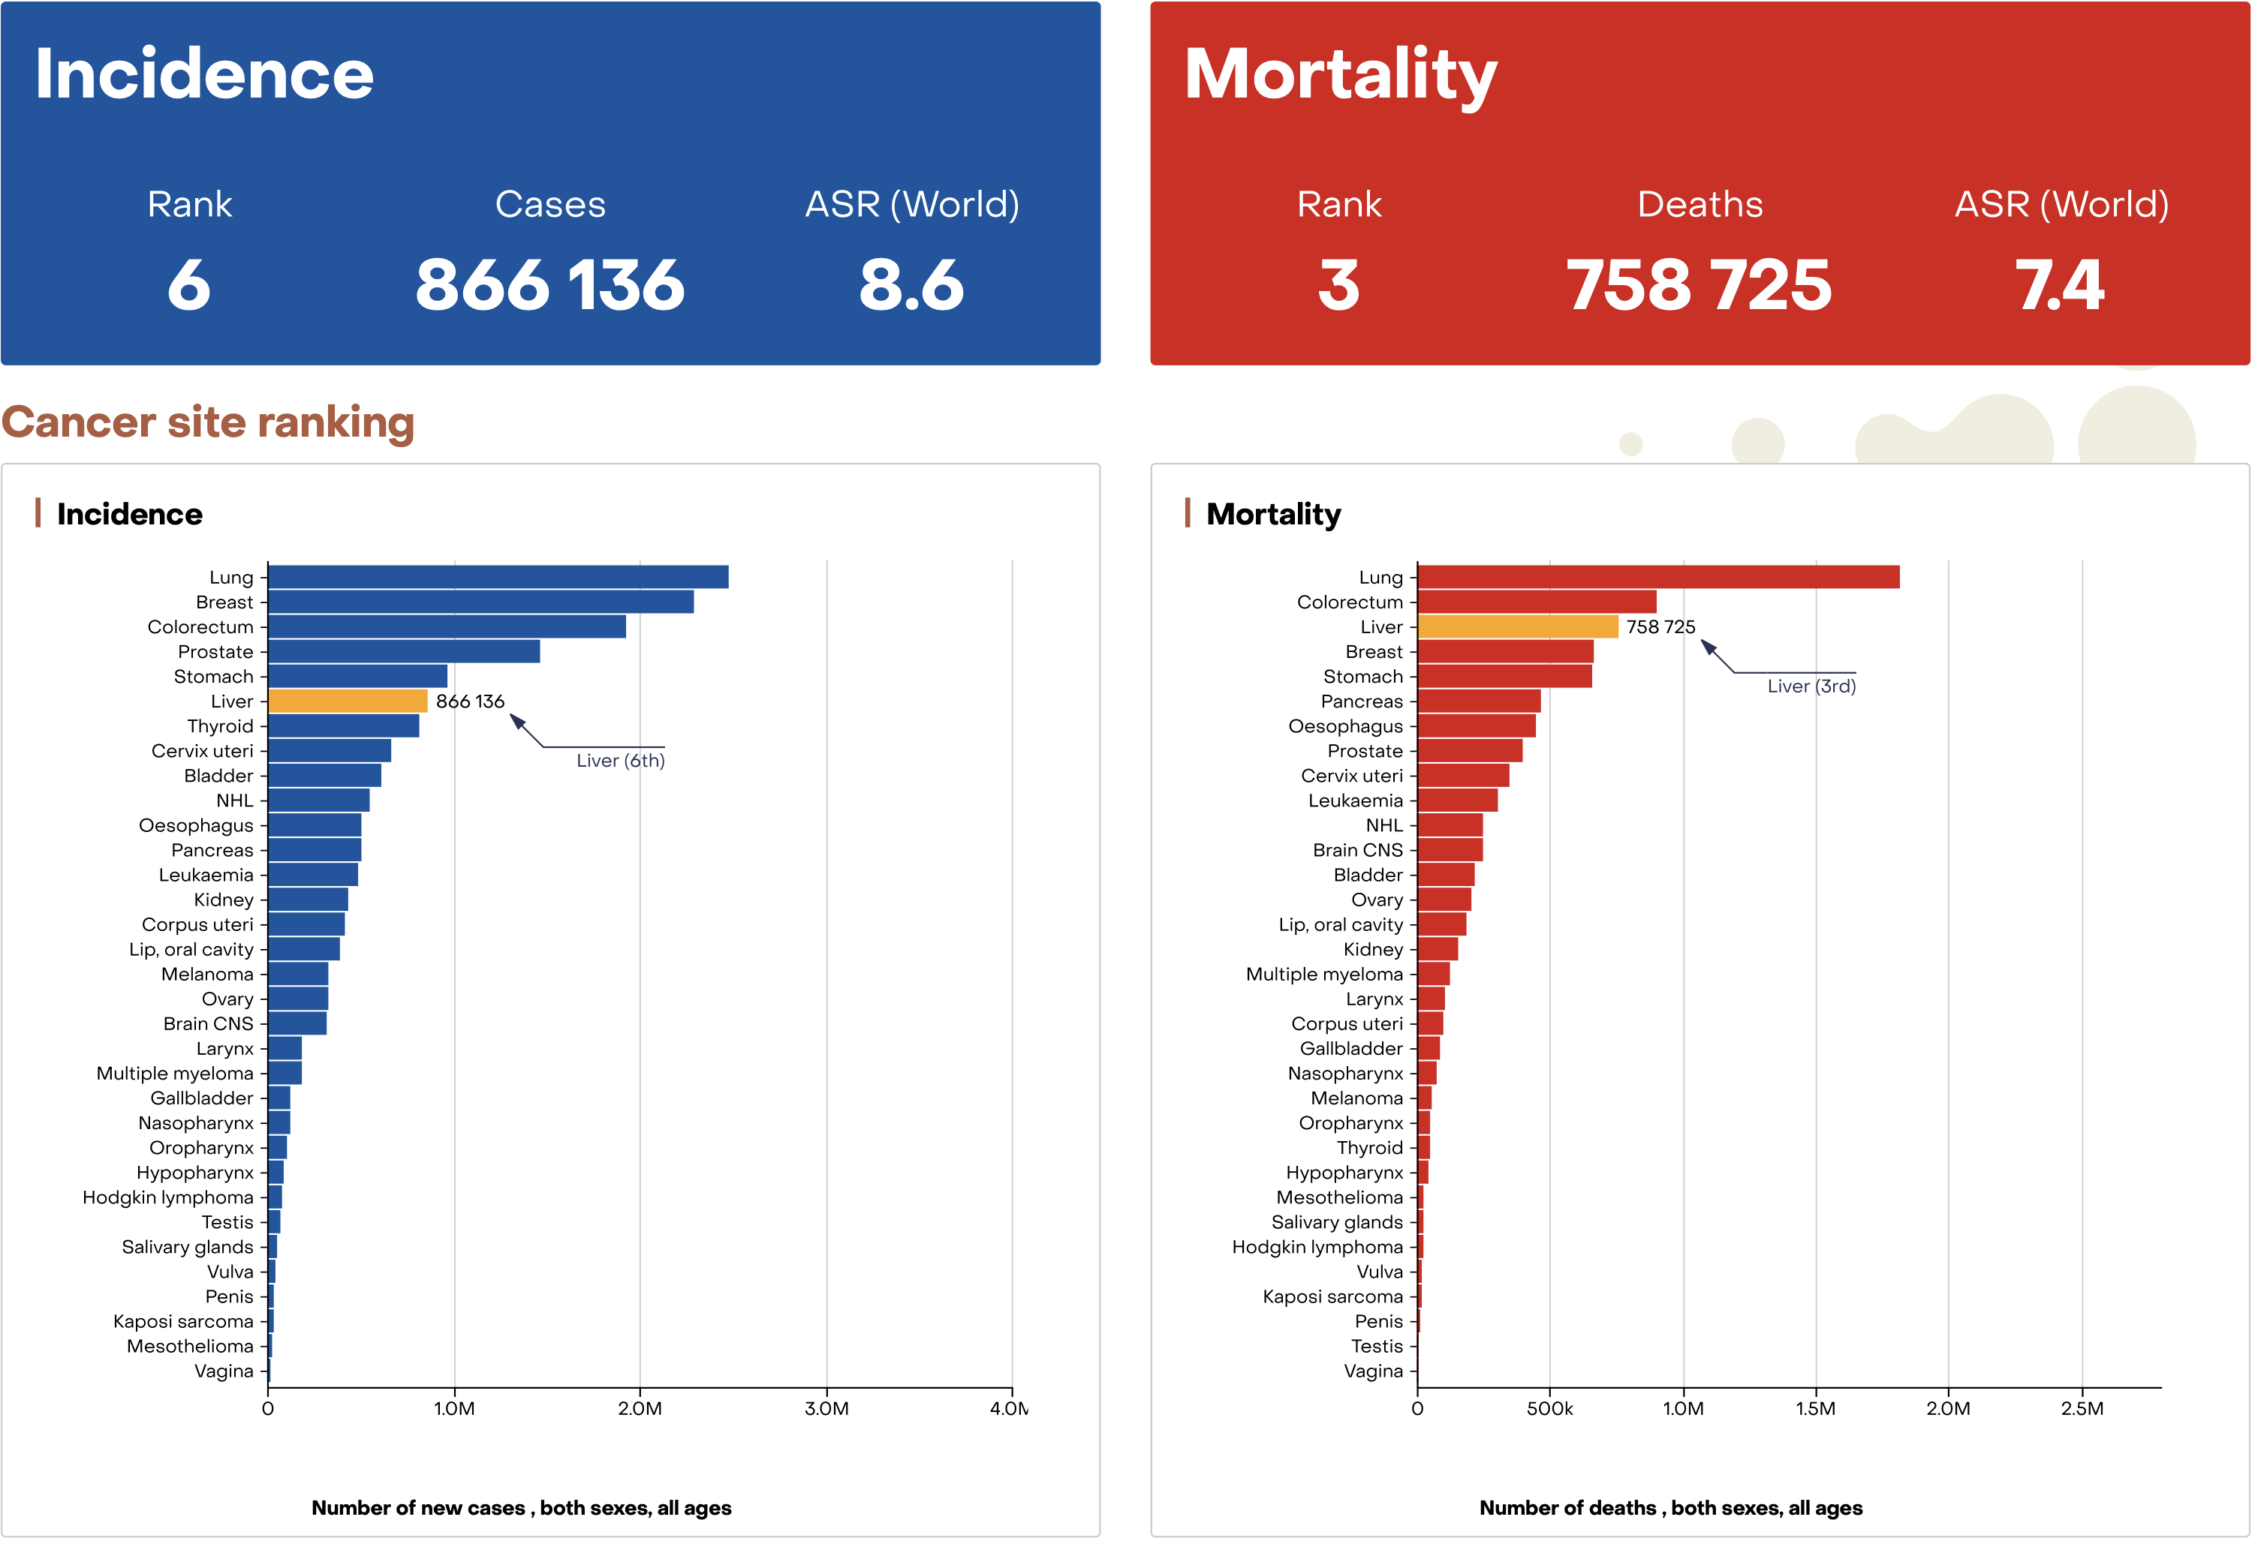
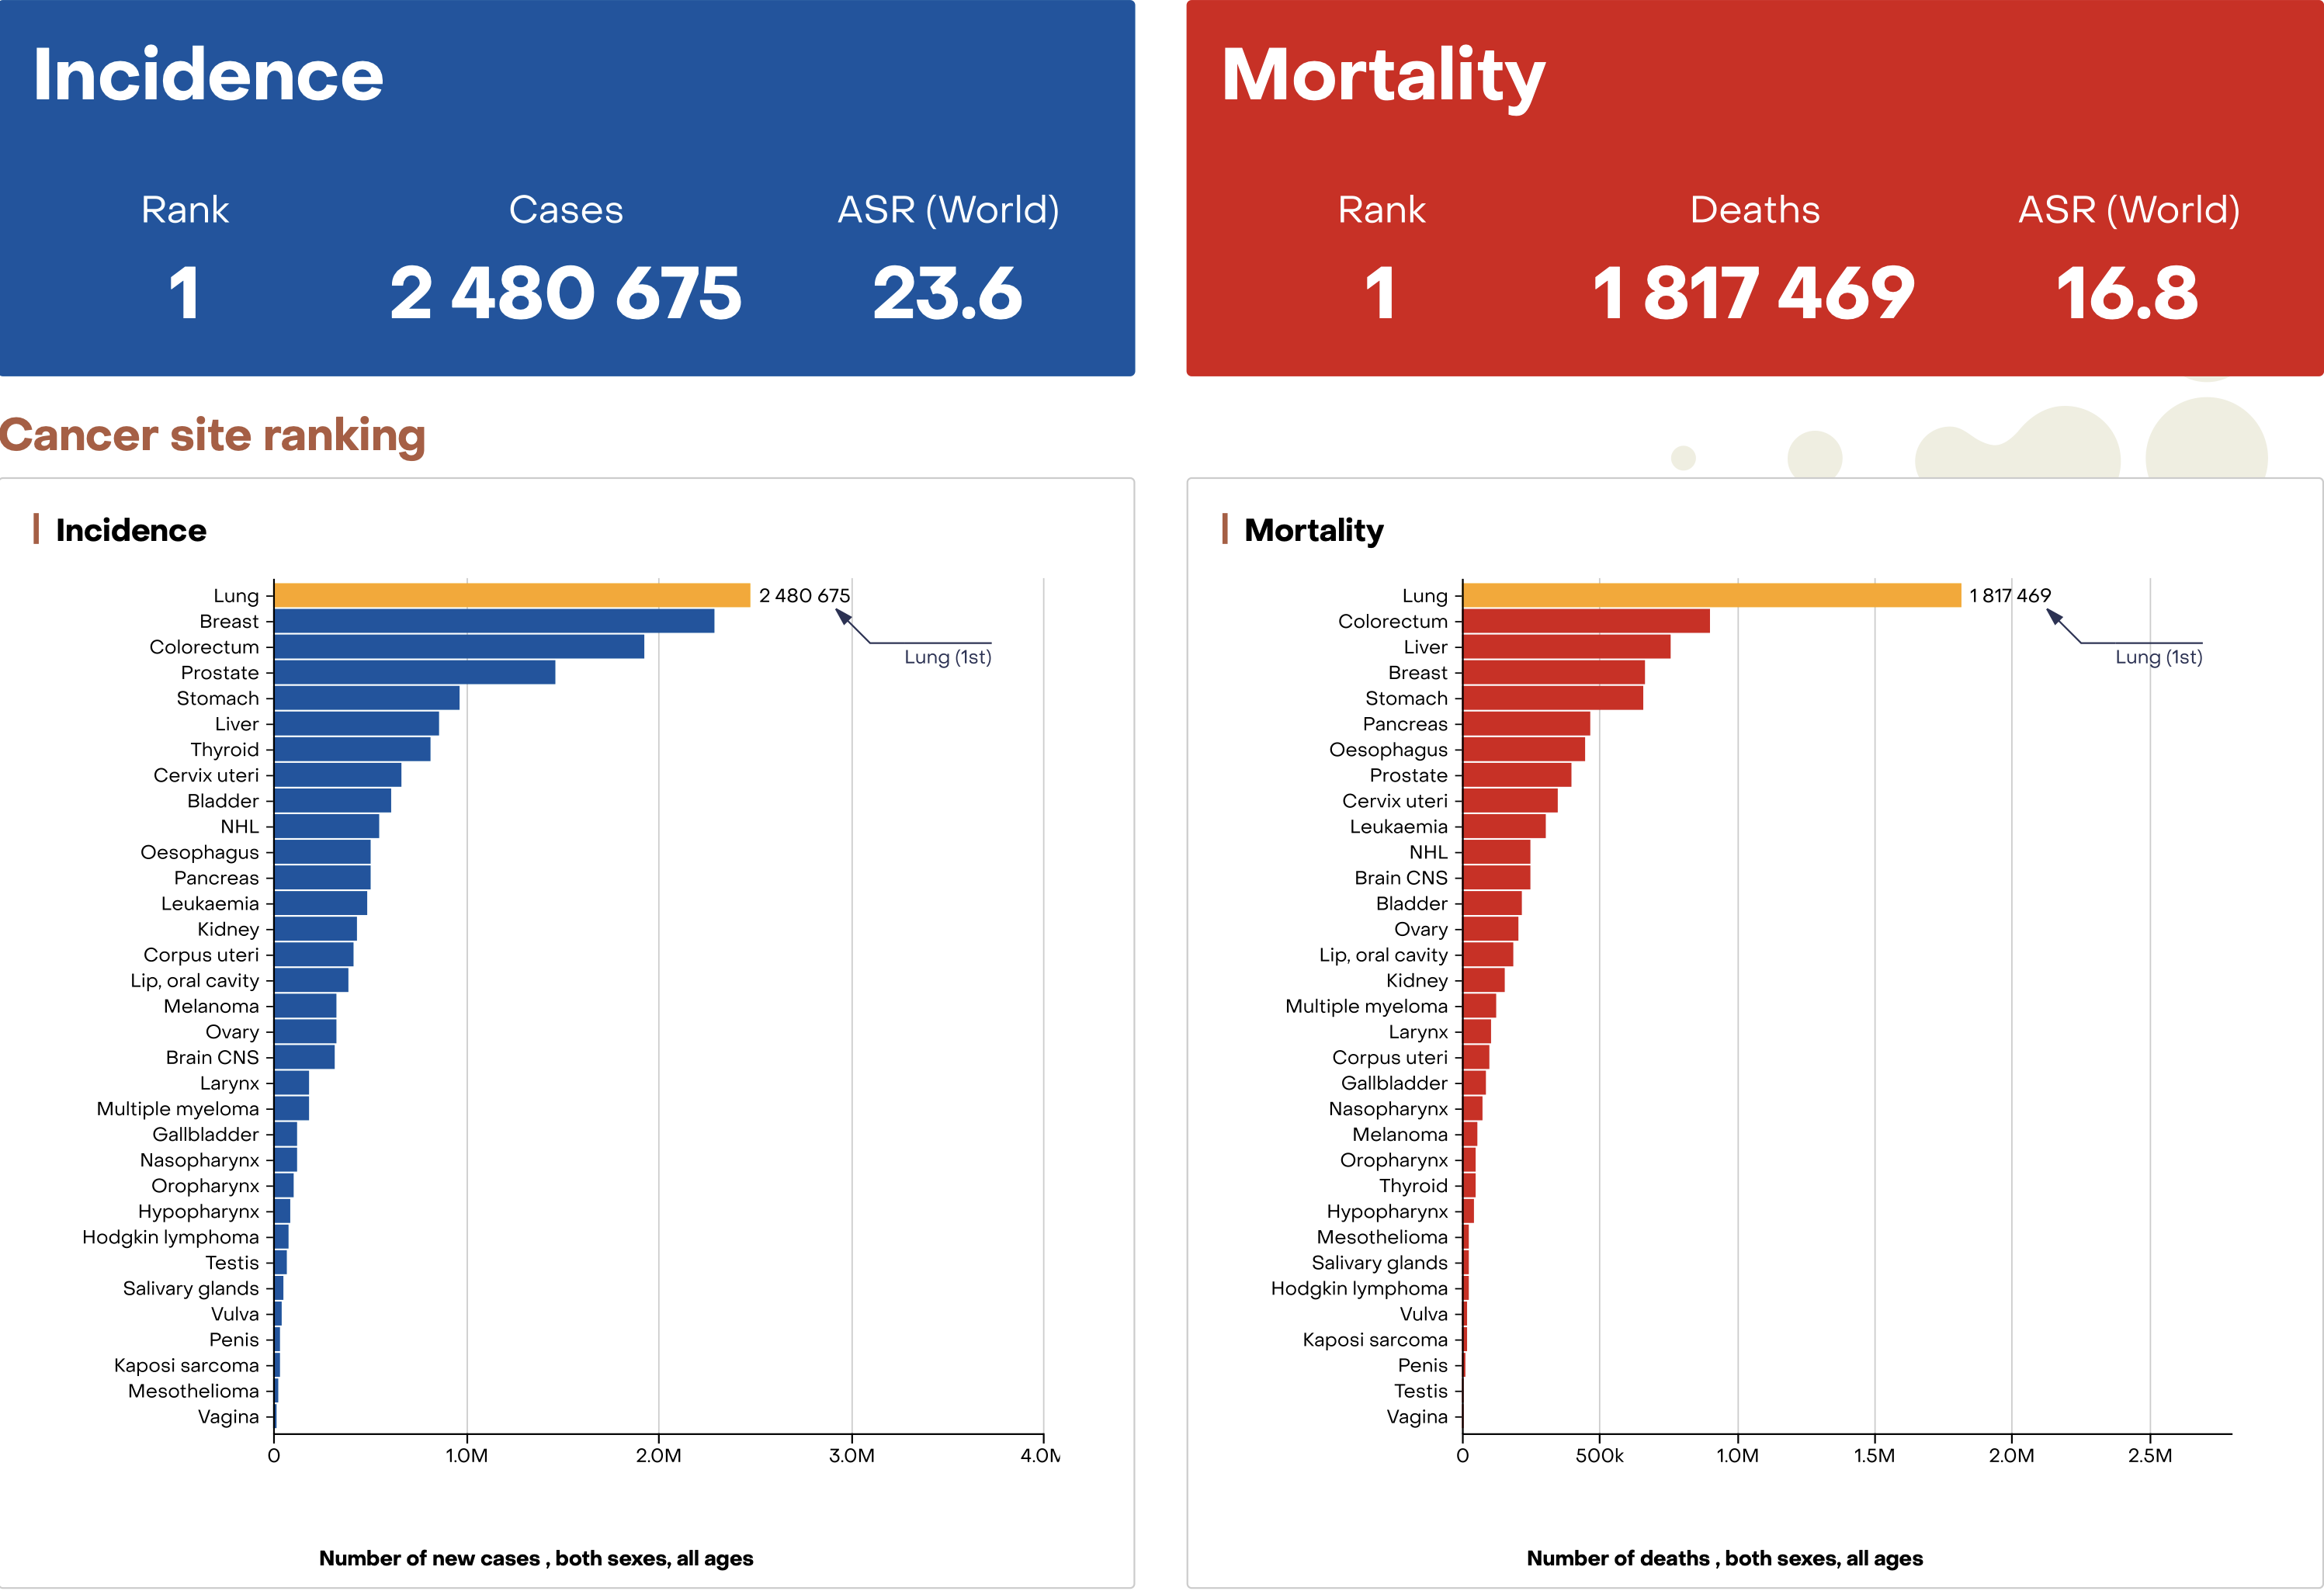
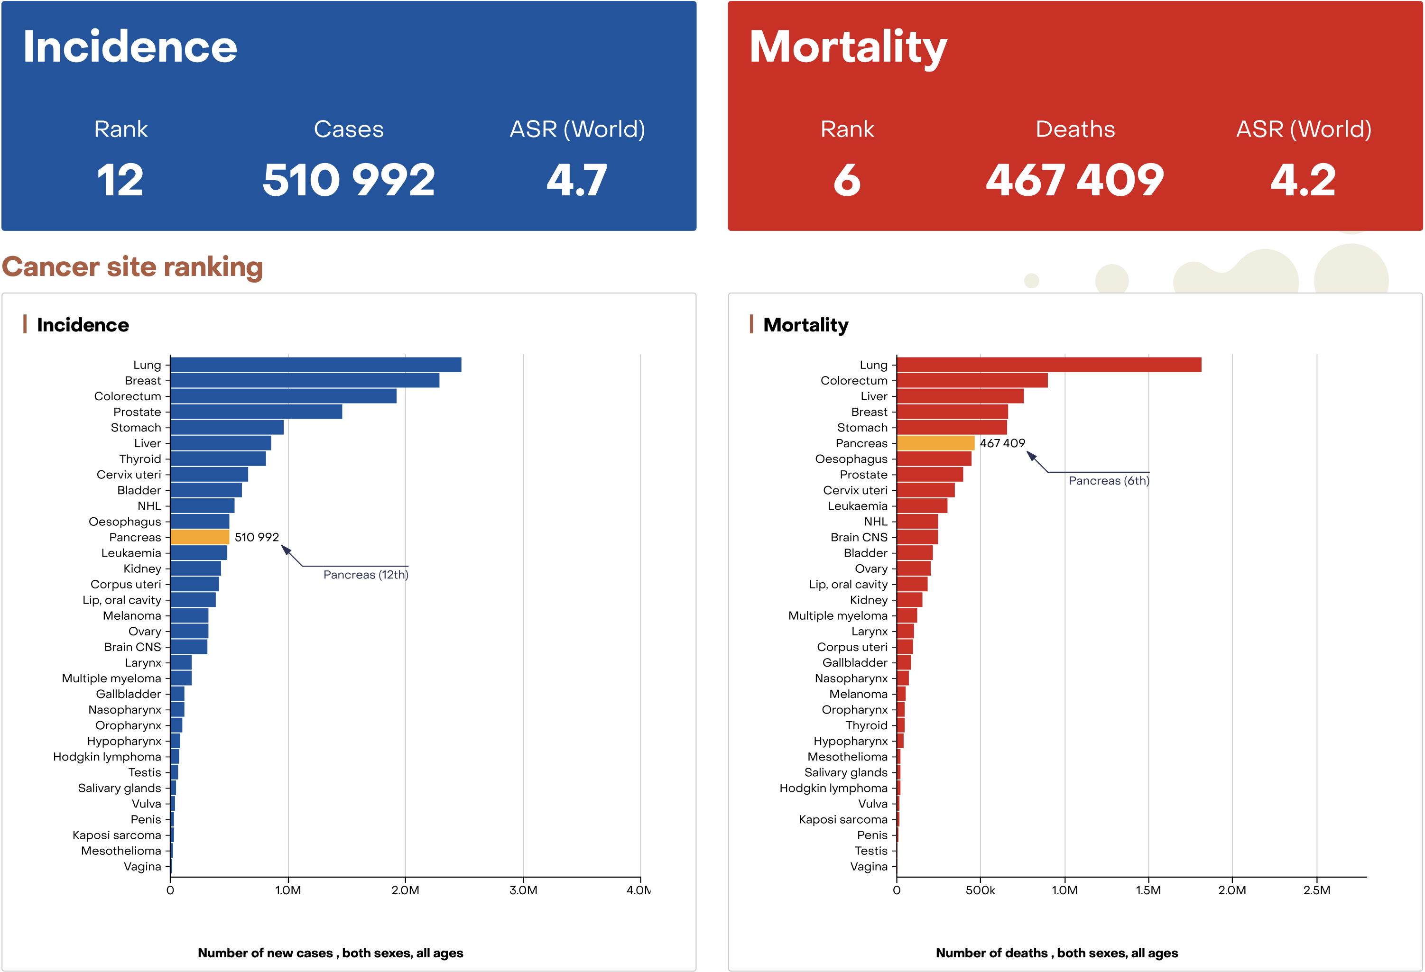
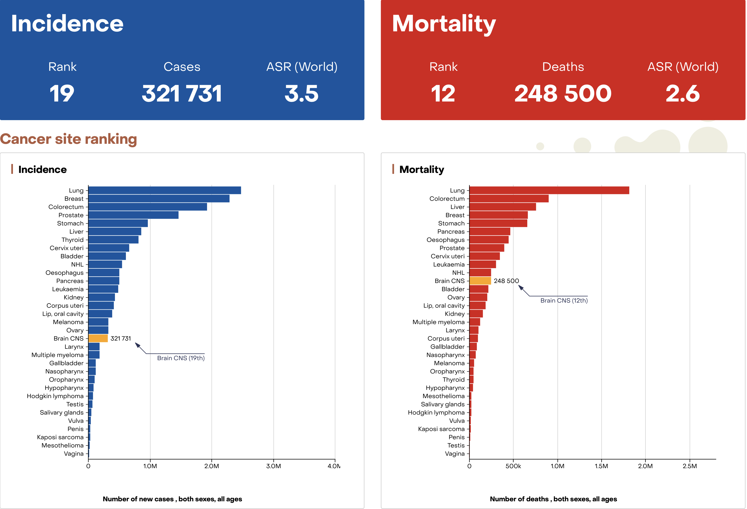
Our target : Cancers at high risk of morbidity and mortality
Notes:
We have chosen to focus on locally advanced tumors in situ or in the preoperative setting, for which the toxicities of radiotherapy remain significant, with possible long-term sequelae in long-term survivors, if any.
Namely, brain tumors which is ranked 12th in the number of deaths worldwide, but if you take GBM only, the this number is far worse.
Pancreatic cancer , a radioresistant cancer with high chemoradiation related adverse events. This cancer is expected to increase by more than 30% in 2030.

Slide 11

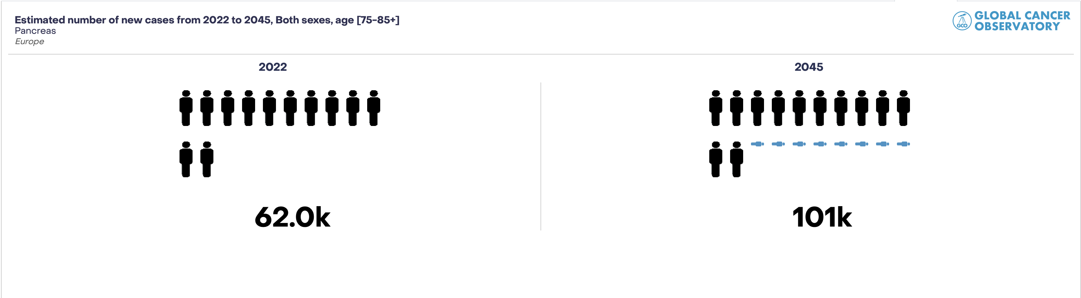
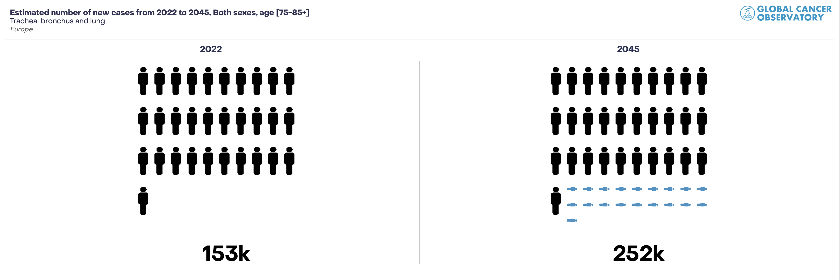
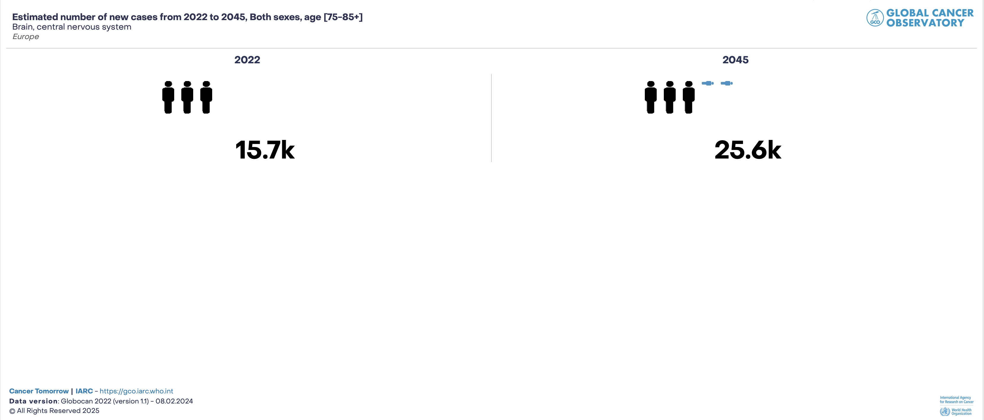
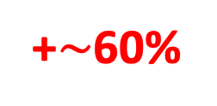
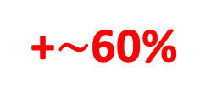

Expecting number of cancer in 75+y old patients in Europe by 2045
PANCREAS
+$\sim$60%
LUNG
BRAIN
+$\sim$60%
+$\sim$60%

Slide 12
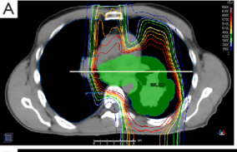
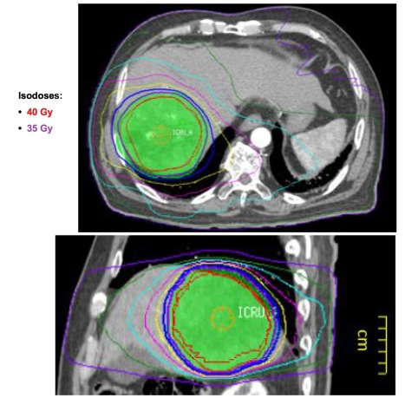
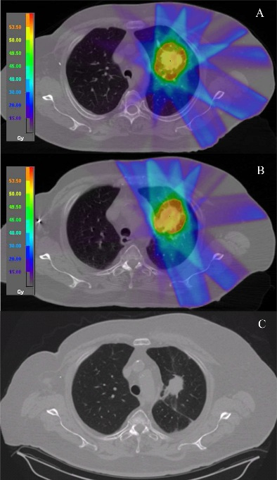
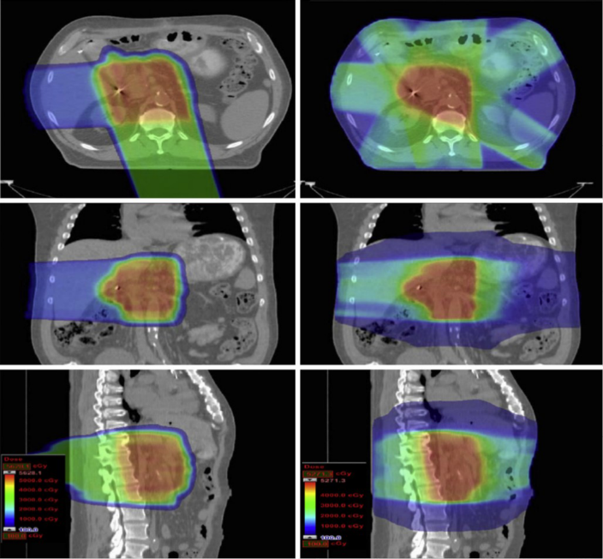
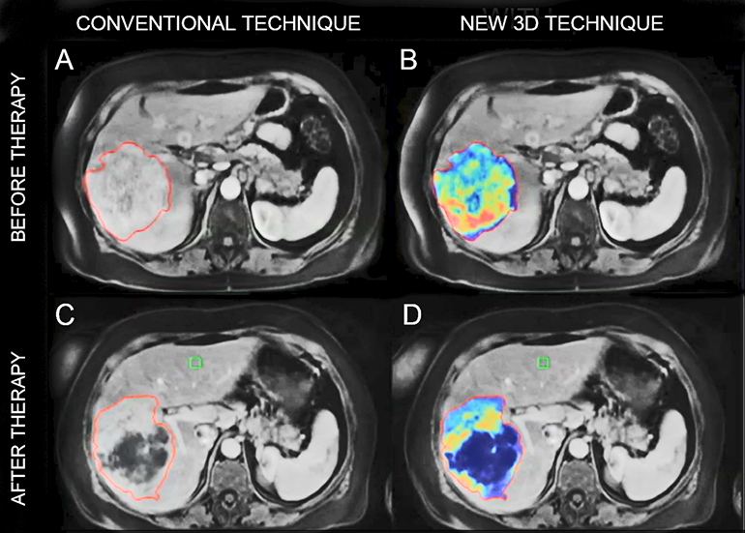
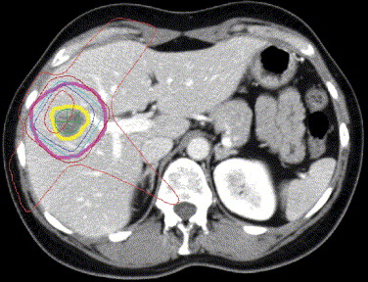
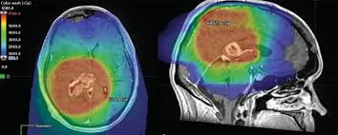
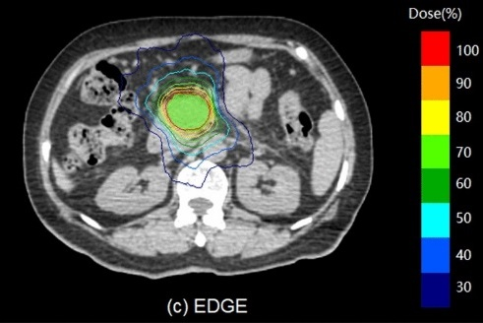
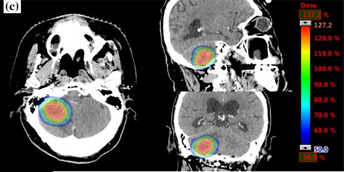

Deep tumors to be treated with FLASH protons / VHEE
>90% Local control
<10% acute and late toxicities
<70% Local control
>10-20% Acute and late toxicities
Protons
Image guided IMRT or SBRT
Protracted EBRT or moderate hypofractionation
+/- Chemo
15-35 fr
Protons
Image guided IMRT or SBRT
Extreme hypofractionation
1-5 fr
Brain
Lung
Pancreas
Liver
Localised cancer
Stages I/II
Locally advanced cancer
Stages III
Notes:
For these different types of cancer, at localized stages, proton therapy and modern conventional radiotherapy under stereotactic conditions offer a very good therapeutic index, with over 90% local control and less than 10% severe toxicity.
However, for locally advanced stage III tumors, where treatments must still be fractionated and often combined with a radiopotentiating drug, the results are not as good.

Slide 13
Survival hampered by harmful toxicities with conventional modern radiotherapy for « large volume » cancers in phase III trials
Chemoradiotherapy for stage III NSC Lung cancer (60Gy vs 74Gy) :
First cause of death : Cancer (75%)
Second cause of death : Cardiopulmonary complications
Local failure : 16.3 vs 24.8% (No impact on survival)
G3-5 Radiation oesophagitis : 7% vs 21%
G3-5 Cardiac complications 3% vs 9%
G3-5 Late pneumonitis 0% vs 2%
Chemoradiotherapy for Locally advanced pancreatic cancer :
First failure : Local 34% vs Met 12%
G3-4 toxicity 23%
Chemoradiotherapy for brain cancer (GBM):
Local failure with only 24% amenable to salvage surgery or salvage RT (5%)
54% salvage chemo
10-25% G3-5 toxicity due to radionecrosis.
RTOG 0617
Bradley JD, Lancet Oncol 2015
LAP 07
Hammel P, JAMA 2016
EORTC-NCIC
Stupp R , lancet Oncol 2009
Notes:
We know from evidence based medicine from phase III trials in such cancers that even if the first cause of death is cancer, survivors may suffer from severe toxicity or even sequelae with local failure which occur mostly, often before metastatic disease which brings questions on the efficacy of conventional radiotherapy at such range of doses.

Slide 14




Other topics to be explored: Pediatric cancers and reirradiation
Growth
Endocrine dz
Cardiac dz
Cognition
Second cancers?
…
Yang K et al., BMC Pediatrics 2024
Noel G et al., Cancer Radioth 2024
Notes:
Children with cancer also suffer from significant side effects related to radiotherapy, such as growth disorders, which become disharmonious, endocrine or mental development disorders, as well as the risk of secondary cancers for long-term survivors.
Re-irradiation also remains an area of exploration for flash radiotherapy, which must be investigated in the various cancers mentioned above.

Slide 15



A funded collaborative platform
Selected industrial
Particle accelerator solution provider
Irradiator system development
System integrator
VHEE et FLASH specific imaging
Each consortium member contributes an essential buidling block to the system
Beam shaping
to target treatment area
OIS
Positioning
Patient aligment
Medical physics
TPS
Conformation faisceau
Radioprotection ASN/IRSN
Flash Radiobiology
Flash Radiophysics
Particle Sources
TPS
Radioprotection studies
Dosimetry equipment development
Support and expertises
Imaging
Dosimetry
Quality contorl
Key suppliers
Conventional imaging components and systems
Positioning control solution
Control software
FRATHEA PROJECT funded by France’s major investment plan « France 2030 » and Région Ile de France for 37m€
48 months, project start date: July 1st 2024
Notes:
To this end, we received €37 million in funding from the French government and the Île-de-France region, enabling us to set up a consortium between the Institut Curie, the French Atomic Energy Commission, and an industrial partner.

Slide 16
FRATHEA’s project objectives
Building of a new platform with an innovative demonstrator to study and demonstrate the cancer treatment efficacy
using FLASH radiotherapy with ultra-high energy electrons
Provide safe and effective treatment with FLASH-VHEE
Provide methods to demonstrate that this equipment is as safe and effective as conventional devices
Promote the development of tools (to understand regulatory needs, develop rigorous clinical trials, consider future radiotherapy applications with FLASH-VHEE
Develop and industrialize new dosimetry instrumentation
Optimize treatments regimens
Benefits for the healthcare system: faster, less harmful treatment with shorter trial times and hospital stays
THERAPEUTIC objectives: Studying and demonstrating the use of FLASH radiotherapy with ultra-high energy electrons in lung, brain tumor and pancreas
Notes:
The aim was to develop a prototype linear particle accelerator delivering ultra-high-energy electrons and demonstrate that this equipment is safe and effective.

Slide 17




Project Organization
Executive Board
GTWP1: Coordination
Research Center
+
Hospital Group
Steering Committee: Gilles Créhange (Coordinator)
GTWP4: Radioprotection evaluation
Delphine Lazaro
GTWP2
Demonstrator development
Ludovic De Marzi
GTWP3
Premises fitting
Samuel Meyroneinc
GTWP8
Regulatory activities
Jérome Verdonck
GTWP5: Development of dosimetry instrumentation
Delphine Lazaro
GTWP6: Radiobiology studies
Charles Fouillade
GTWP7: Medical Physics and clinical trial preparation
Ludovic de Marzi
GTWP9: Clinical studies
Régis Ferrand, Annalisa Patriarca, Gilles Créhange
Notes:
The whole project has been set up as followed around 9 worckpackages.
First WP is aimed to coordonate the whole project and to scale and to follow the tasks’ schedule of each WP as well as hirings, and budget control
WG2 3 and 8 on demonstrator development, premises fitting and regulatory activities have been initiated at the beginning of the project to ensure reaching the milestones of the project.
Other WG have been initiated in a second step and are currently organising their activities and schedule.

Slide 18






Platform model: an efficient and operational approach
An incubator for:
  An fast-track approach for faster and more effective access to therapeutic needs
  A parallel approach (radiobiology/ medicine/industry) to develop technologies and validate clinical treatment plan
Proton Therapy Center in Orsay, in the heart of Université Paris-Saclay
  The bunker Room S already available
  A planning that meets the need of efficiencey and rapidity to converge towards the definition of the new VHEE Flash therapeutic modality
Notes:
This prototype will probably be installed in 2027, as we are six months behind schedule due to the administrative rules governing French public procurement at our proton therapy center in Orsay, south of Paris.
Why there?
The first reason is that we have a large empty bunker available.
The second reason is that low-energy electron and flash proton experiments are carried out there, with all the animal facilities and research laboratories nearby.

Slide 19




WPG2 : coordinated by Ludovic de Marzi
Medical physics studies
Design studies of the FLASH-VHEE system
Dose calculation models
(machine, beam, TPS)
linear accelerator (~10m) with one beamline.
« universal » nozzle with DS and PBS.
robot for positioning (preclinical or clinical).
imaging system (Xrays, 2D or 3D).
research treatment planning system.
TCS control/command of the accelerator.
Modelling for the FLASH effect : optimization algorithms
Modelling
FLASH-VHEE
Radiotherapy
Secondary radiation in FLASH-VHEE RT
Notes:
Work package 2, coordinated by Ludo, who is here today, designed the technical specifications required by the manufacturer.

Slide 20





WPG 2/4/5/8 : Medical physics studies
Possible solution for FLASH-VHEE integration into clinics
Study to compacify the system and bring it into line with classic bunkers
Evolution of the beam delivery system (multi directional, online imaging and QA, adaptive RT etc)
Clinical trials studies
PhD Phys, Eng
Nuclear safety regulations: bunker design and radioprotection studies.
Dosimetrical studies.
Quality assurance, online monitoring studies.
Modelling the secondary dose to the workers and patients.
Integration into conventional bunkers, or into PT bunkers
Online QA possible?
Notes:
Broadly speaking, the other work packages will ensure compliance with the regulatory standards of the French nuclear safety authority, carry out dosimetric studies and quality assurance of the irradiation beam, and model the risks of secondary irradiation for workers and patients.

Slide 21








WPG 6 : Coordinated by Charles Fouillade
First planned preclinical studies comparing e-, p+ and VHEE
Lung
Whole thorax
RT
Question 1 : What is the minimum interval between irradiations ?
Question 2 : What is the optimal fractionation for re-irradiation ?
Part 1. In vivo evaluation of FLASH radiotherapy protocols for primary pulmonary irradiation and re-irradiation
Part 2. Investigation of the immune microenvironment after fractionated FLASH irradiation in the lung and of the impact of association with immunotherapy
RT 1 CONV
Test a : 1 x 10 Gy
Test b : Fractionnated
RT 2 FLASH e- / CONV
Single dose 1 x 10 Gy
Fractionnated : 3 x 6 >> 8 / 10 Gy ? (cf Axe 1a)
Kim Cao, MD, PhD stud
LITO Lab
ATOMIC Team
Healthy lung tissue
Interval RT1-RT2
Test 1 : 8 weeks
± Test 2 : 12 weeks
D1 – D4-8 ? (Axe 1a)
Organotypic sections
Single cell
M5
Pulmonary fibrosis
(micro-CT)
→ Follow-up >M11-12
Survival without toxicity
Heart
FLASH radiotherapy could better preserve the microarchitecture and function of the conduction system
→ Orthotopic tumours
Brain
Pierre Loap, MD, PhD stud
LITO Lab
ATOMIC Team
2 types of brain organoids: in collab. with Laboratory of RadioPathology, CEA [Raguin J, BioRxiv 2024]
Healthy brain organoids
Glioblastoma-like brain organoids
VHEE-Flash-RT
(ultra-high dose rate ≥ 40 Gy/s)
Assessment of different radiosensibility biomarkers (SF2, IF-γH2AX, IF-pATM …) [Le Reun E, Int J Mol Sci 2022]
Eymeric Le Reun, MD, PhD
LITO Lab
ATOMIC Team
VHEE-conventional-RT
(≤ 0.03 Gy/s)
Notes:
Charles Fouillâde coordinates WP6 and has begun to consider various preclinical studies on healthy and tumorous lungs, both in primary irradiation and reirradiation.
Work with the CEA on brain tissue and pediatric brain tumors will also be explored and compared in different irradiation modalities.
Finally, cardiotoxicity and sequences involving multiple drugs will be studied, as well as the impact of flash irradiation on the tumor microenvironment.
This will pave the way for the final WP9 which, if the WP6 studies are conclusive, will designate the methodology for clinical trials to be conducted in humans for the following types of cancer: brain, lung, pancreas, liver, and childhood cancers.

Slide 22
Questions yet to be answered in Humans…
For humans, the amount of healthy tissue preserved by a collimator is more often larger than in animal models
Can we still expect to observe a significant FLASH effect with conformal RT (Collimator, Rotational arctherapy, intensity modulation…)?
Could we benefit from some chemo- or immune-related interactions (e.g. radiosensitizing)….and which sequences?
Flash delivery is expected to be <500ms
→ Should it be delivered under sedation or general anesthesia?
→ How patients should be imaged?
→QA of FLASH delivery needs a real time motion monitoring (electromagnetic transponders in mobile tumor?)
FLASH effect depends on delivery time :
Are delivery parameters used in animals for a FLASH effect the same than that needed in Humans (Field size and dose rate related parameters)?
Can we loose or decrease the FLASH effect in PBS mode?

Slide 23







Acknowledgments
Steering Committee,
Gilles Créhange, MD, PhD
Anne Claire De Reboul​
Amaury Martin, PhD
Nadine El Tannir, PhD, PMO
Research Center
Vincent Favaudon
Irène Buvat, PhD
Ludovic De Marzi, PhD
Régis Ferrand, Eng, Phys
Charles Fouillade,PhD
Thomas Gauliard, Biomed Eng
Delphine Lazaro (CEA)
Samuel Meyroneinc, Biomed Eng
Annalisa Patriarca, PhD
Jérôme Verdonck, RPC
​
Fundings
WPG1
WPG6
WPG2-7
WPG3
WPG8
WPG4-5
Hospital
Kim Cao
Eymeric Le Reun
Pierre Loap

