Slide 1



Investigating the biological effects of beam parameters to guide technological developments for clinical applications of FLASH
Prof MC Vozenin
marie-catherine.vozenin@hug.ch

Slide 2
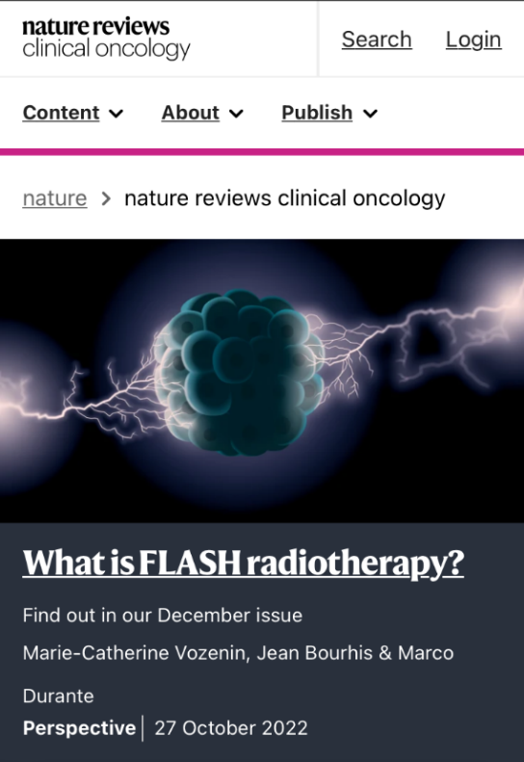
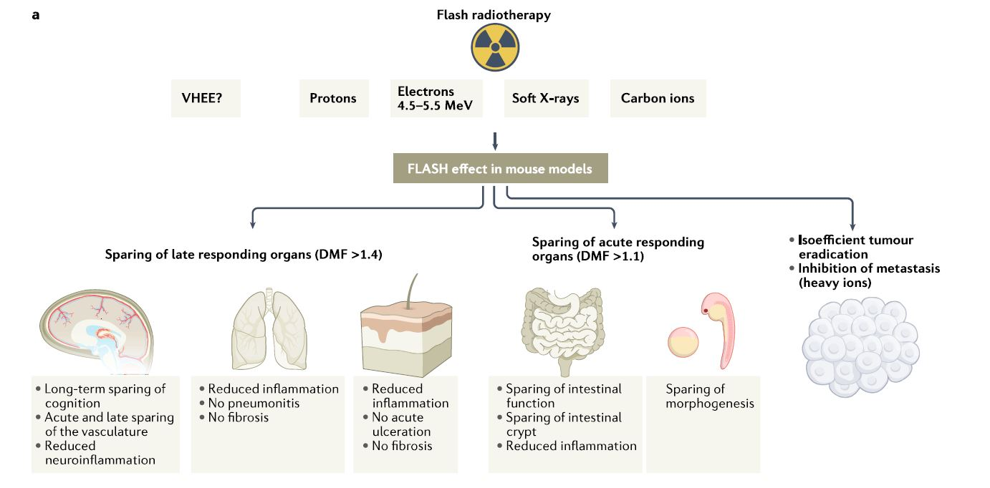
Preclinical results
Long-term sparing
of vasculature
No fibrosis

Slide 3

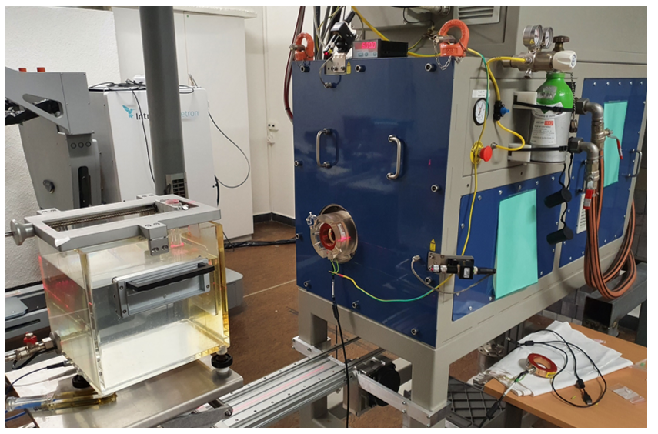

5.5 MeV
> 40 bio publications
...
10 Gy at eRT6
Dose per bunch of 4.6ps
1 pulse of
5500 bunches
Dose per bunch of 4.6ps
330ps
4.6ps
1800 ns
1.8mGy
0.005 mGy
...
x3000
58.4s
10ms
(100 Hz)
700 pulse of 3000 bunches each
1000ns
0.005mGy
Standard RT: Dose is delivered in several minutes- 1 Gy/min
FLASH: Dose delivered in milliseconds- 100 Gy/s
Micro-sec- MegaGy/s

Slide 4
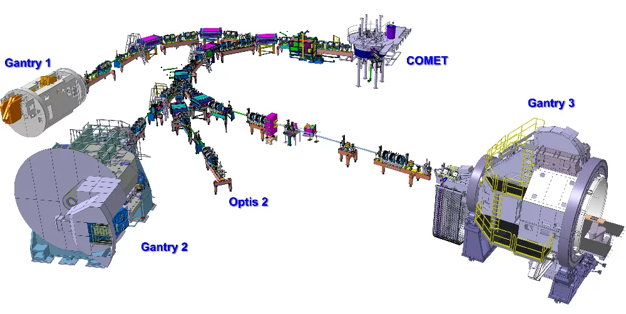

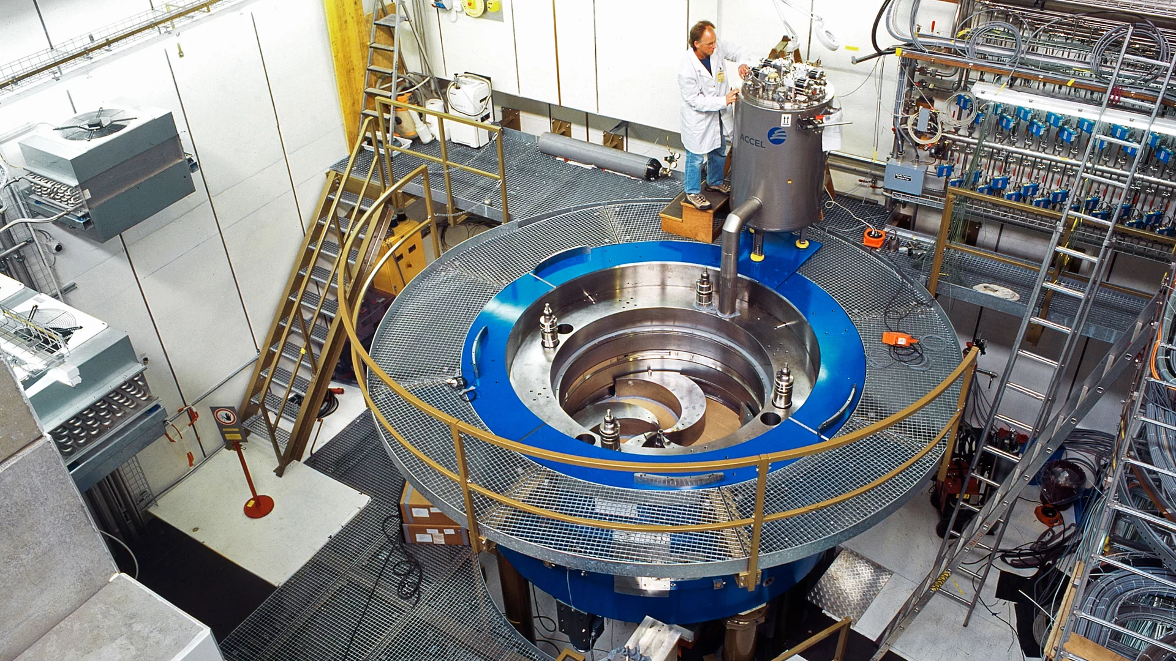


235 MeV
> 20 bio publications
...
10 Gy at PSI
Dose per bunch of 800ps
560’200 bunches
0.018mGy
800ps
13.7ns
10s
728’500’000 bunches
...
0.0000014mGy
13.7ns
800ps
...
Time
Standard RT: Dose is delivered in several minutes- 1 Gy/min
FLASH: Dose delivered in milliseconds- 100 Gy/s
Varian

Slide 5
Almeida et al., R&O, 2023, doi.org/10.1016/j.radonc.2023.109953

Slide 6

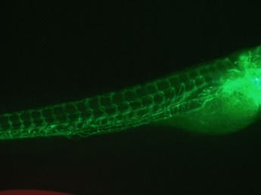
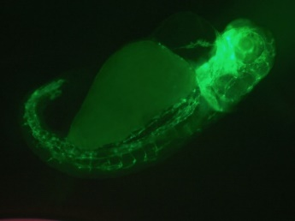
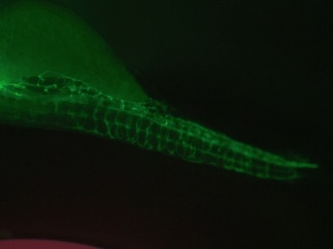

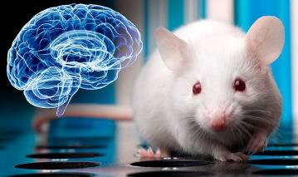
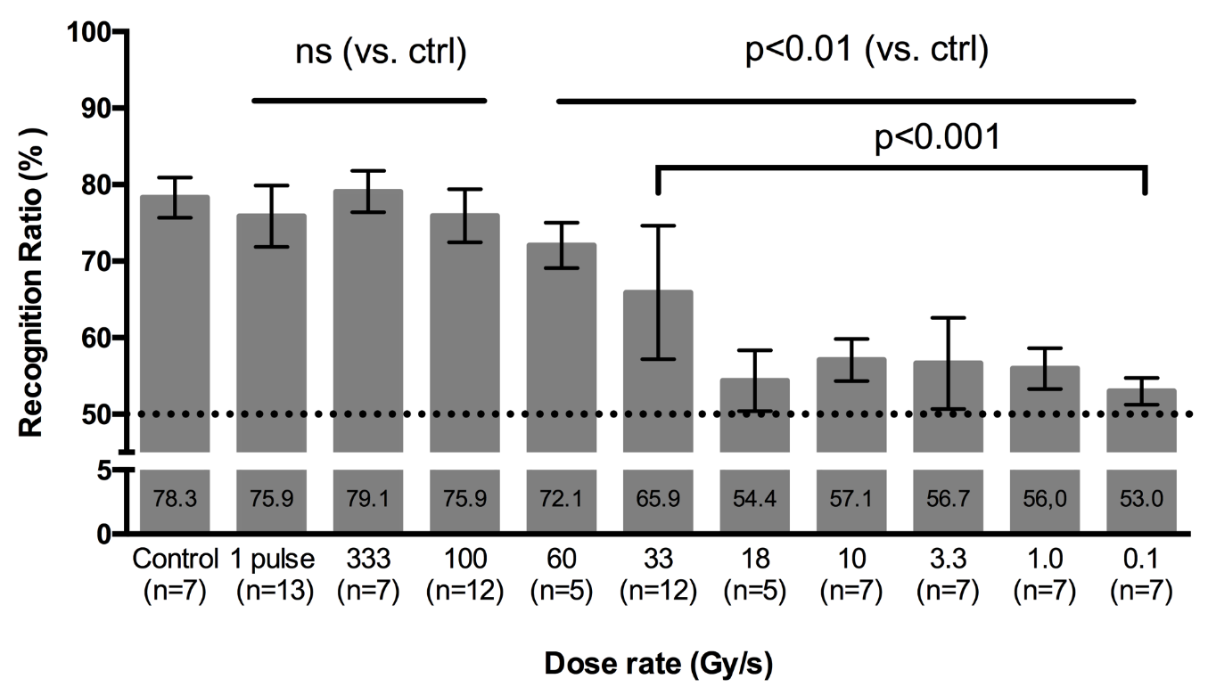
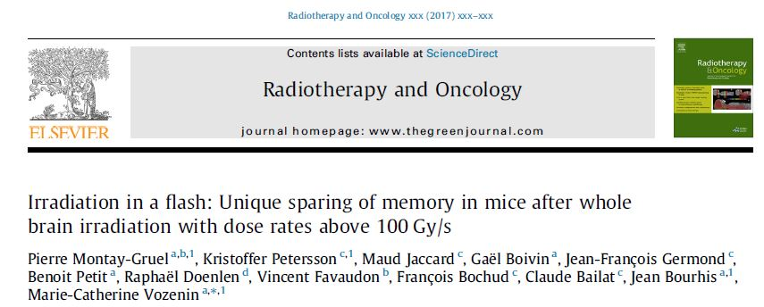
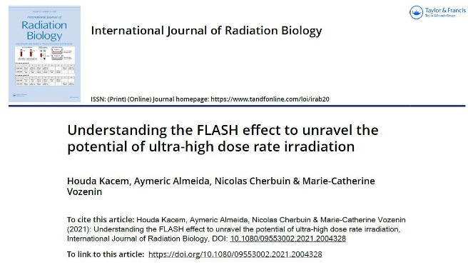
P Montay-Gruel
H Kacem
10 Gy per pulse
1 Gy per pulse

Slide 7
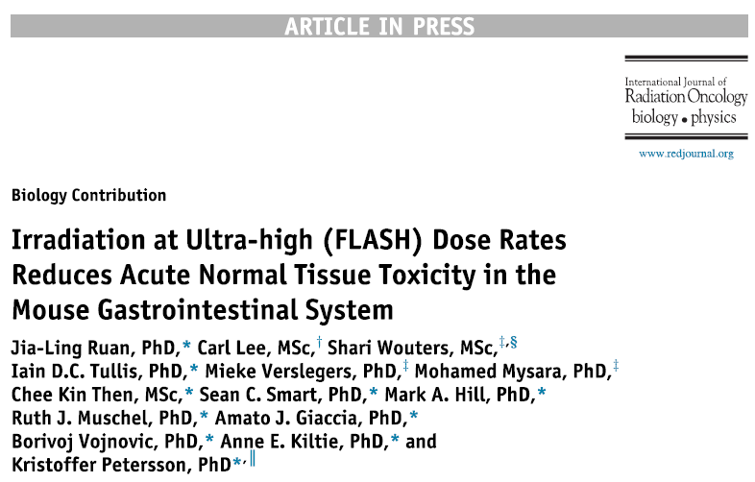

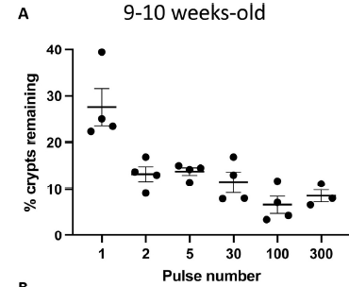

Slide 8
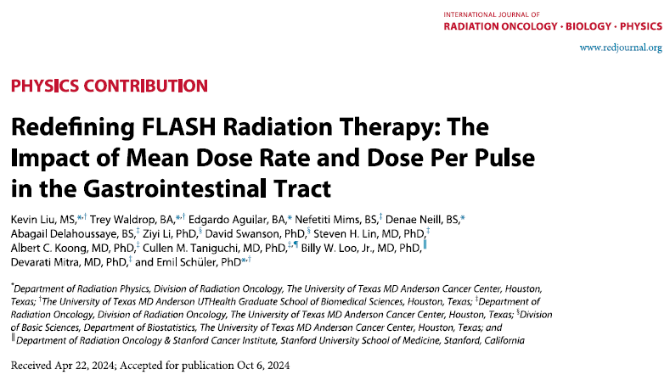

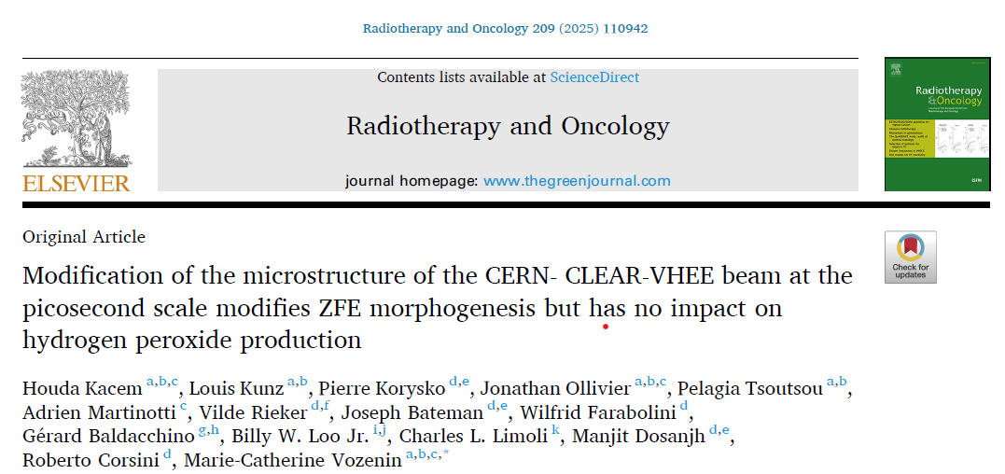
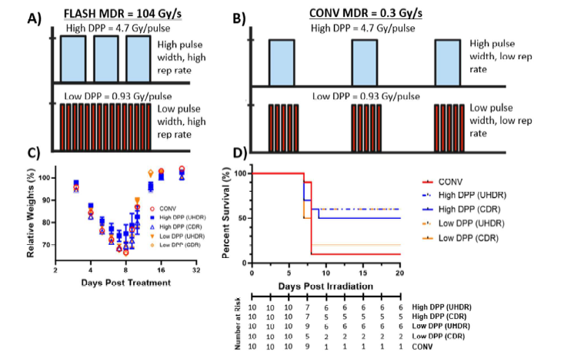
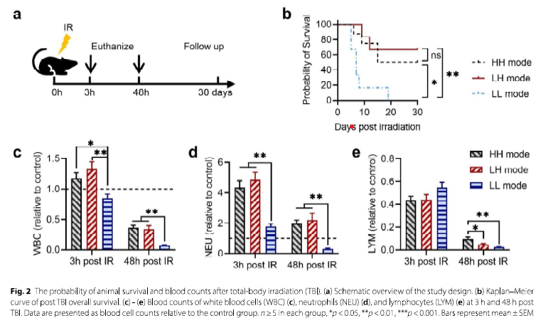
At high dose per pulse, normal tissue sparing is driven by the dose per pulse
Not by the time of dose delivery

Slide 9
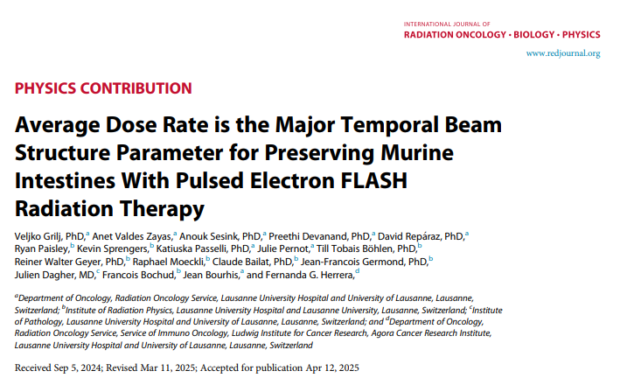
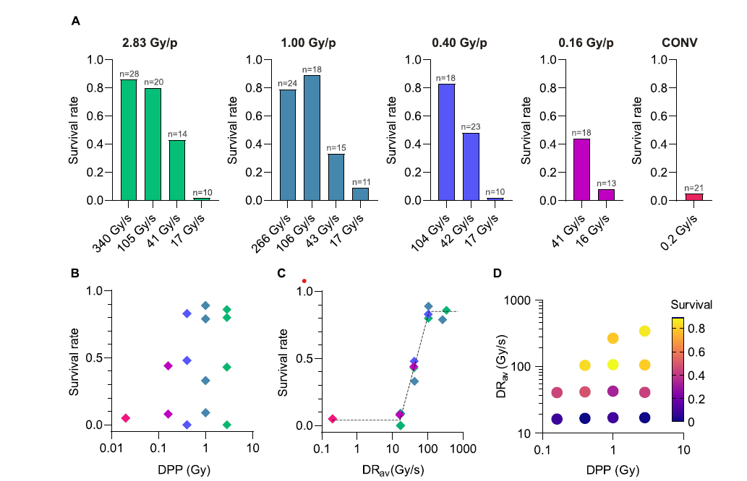
At lower dose per pulse, the time of dose delivery does matter

Slide 10



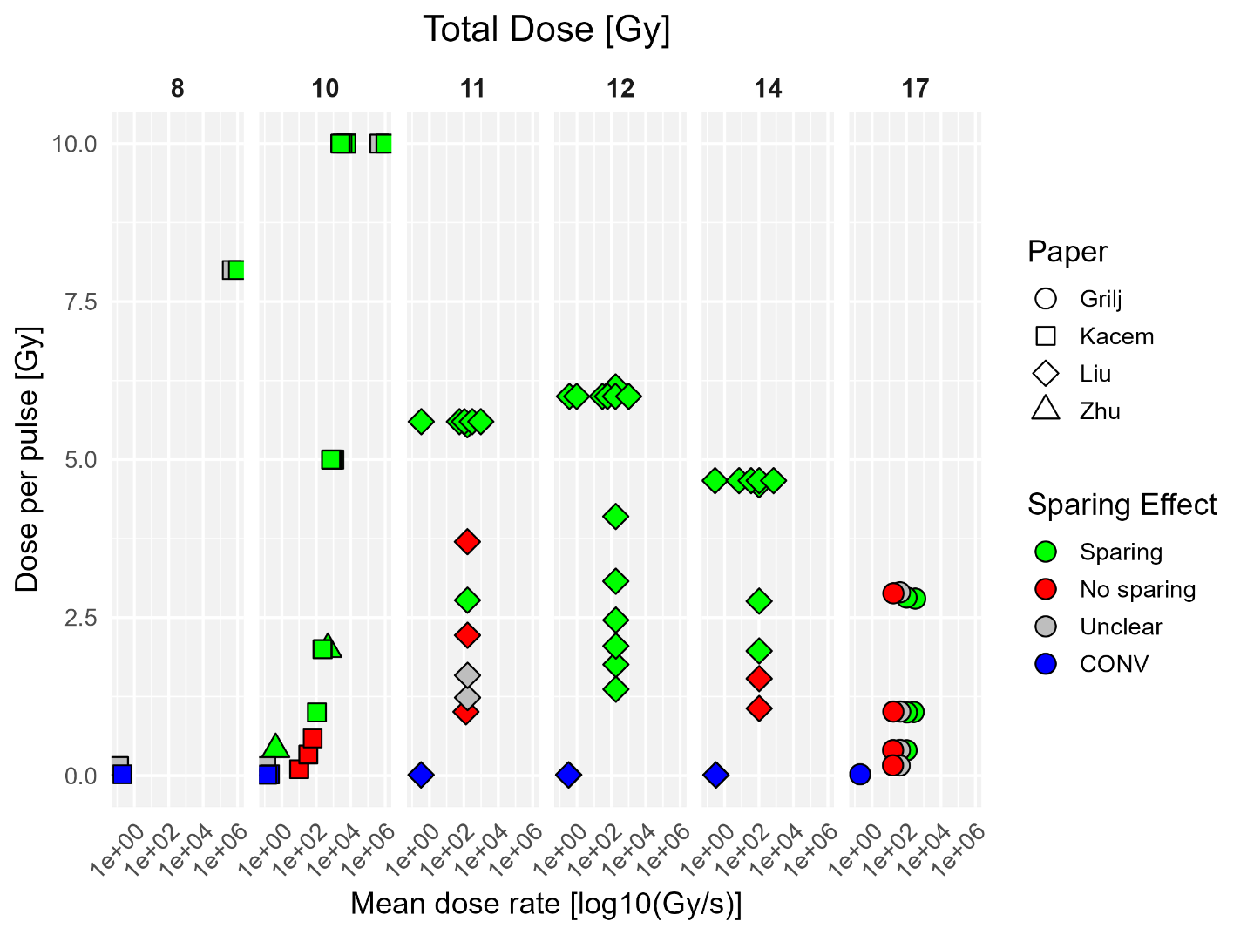
M Knol
L Kunz
J Ollivier
At doses <14 Gy and high dose per pulse, normal tissue sparing is driven by the dose per pulse
At higher dose and lower dose per pulse, the time of dose delivery does matter

Slide 11

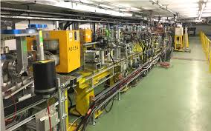
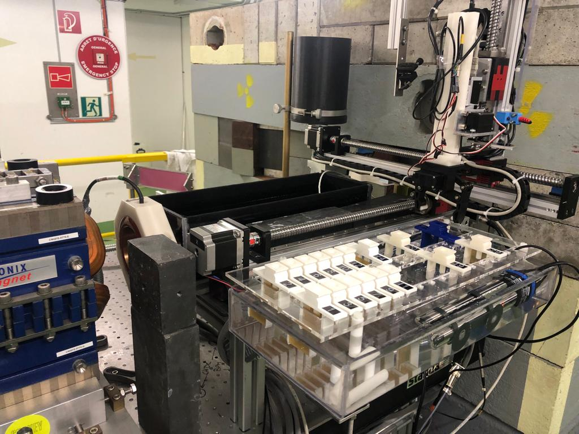
190-210 MeV
Standard RT: Dose is delivered in several minutes- 1 Gy/min
Pico-sec

Slide 12
H Kacem
L Kunz
J Ollivier
150 mGy
330ps
3ps
10 Gy at CLEAR
...
x67
x67
Dose per bunch of 3ps
Time
79.2s
1 train
of 67 bunches
1200ms
(0.83Hz)
3ps
67 trains
of 1 bunch
150mGy
22ns
...
Time
Dose per bunch of 3ps
9ns
336mGy
1 train
of 30 bunches
50s
100ms
(10Hz)
500 trains
of 1 bunch
3ps
Time
20mGy
...

Slide 13
H Kacem
L Kunz
J Ollivier
150 mGy
330ps
3ps
10 Gy at CLEAR
...
x67
x67
Dose per bunch of 3ps
Time
79.2s
1 train
of 67 bunches
1200ms
(0.83Hz)
3ps
67 trains
of 1 bunch
150mGy
22ns
...
Time
Dose per bunch of 3ps
9ns
336mGy
1 train
of 30 bunches
50s
100ms
(10Hz)
500 trains
of 1 bunch
3ps
Time
20mGy
...

Slide 14
Spacing time between bunches
Total time RT:
- 666ps: ~15-20 ns
- 0.625: ~ 15sec
- 1.2s: ~ 30sec
- 4s: 2min 20sec

Slide 15
Spacing time between bunches
Total time RT:
- 666ps: ~15-20 ns
- 0.625: ~ 15sec
- 1.2s: ~ 30sec
- 4s: 2min 20sec

Slide 16
VHEE beams
To investigate the FLASH parameters
To treat most tumor sites
in a FLASH

Slide 17



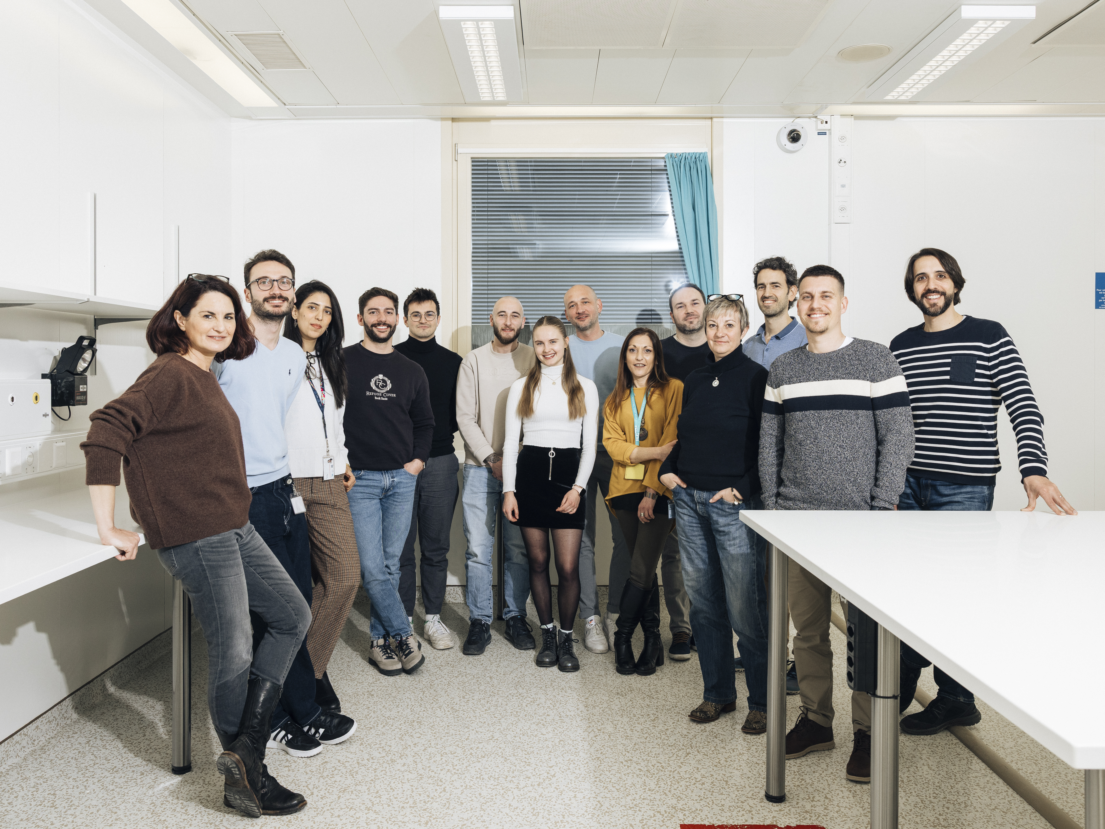





Swiss FLASH «dream» team
Physics and clinical team PSI
D C Weber
S Psoroulas
T Lomax
M Togno
M David
S Sairos
R Schafer
I Collizi
Biology team
B Petit
J Ollivier
H Kacem
A Almeida
L Kunz
M Knol
A Job
J Franco-Perez
P Ballesteros-Zebadua
A Martinotti
C Romero
C Godfroid
R Leavitt
J Jansen
Clinical team
P Tsoutsou
A Durham
N Koutsouvelis
P Jorge
F De Souza
S Fortunato
Veterinary school Zurich
C Rohrer-Bley and team
CLEAR facility
R Corsini
P Korysko
W Farabolini
A Gilardi
Charles Limoli and Team
M Acharya
P Montay-Gruel
J Baulch
B Allen
Y Alaghband
SPIRIT
P01/R01
Peter Maxim
Varian
Billy Loo and Team

Slide 18
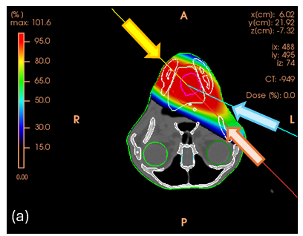
Companion Animal Trials
Species model type and size
Spontaneous tumors → clinical conditions
Hard- & Software → parameter refinement
Spontaneous tumors, genetically heterogeneous
Intact immune system and same environment
Companion animals are routinely irradiated (hypofx)
Intermediate life span → curative trials still with appropriate outcome assessment

Slide 19

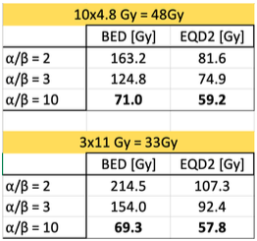




FEATHER: Phase 2/3 trial on feline oral squamous cell carcinoma
2 proton arms with comparable BED (for CONV)
Arm 1: 3x11Gy CONV
Arm 2: 3x11Gy FLASH
Transmission beams (RBE = 1)
Avoid energy-switching deadtime
Avoid range and LET uncertainties
Smaller beams = higher dose rate
Primary endpoint: acute toxicity
Secondary endpoint: anti-tumor efficacy
KFS 5639-08-2022, PI: C. Rohrer Bley, UZH
S. Psoroulas, UZH / DC Weber, PSI / MCVozenin, HUG

Slide 20
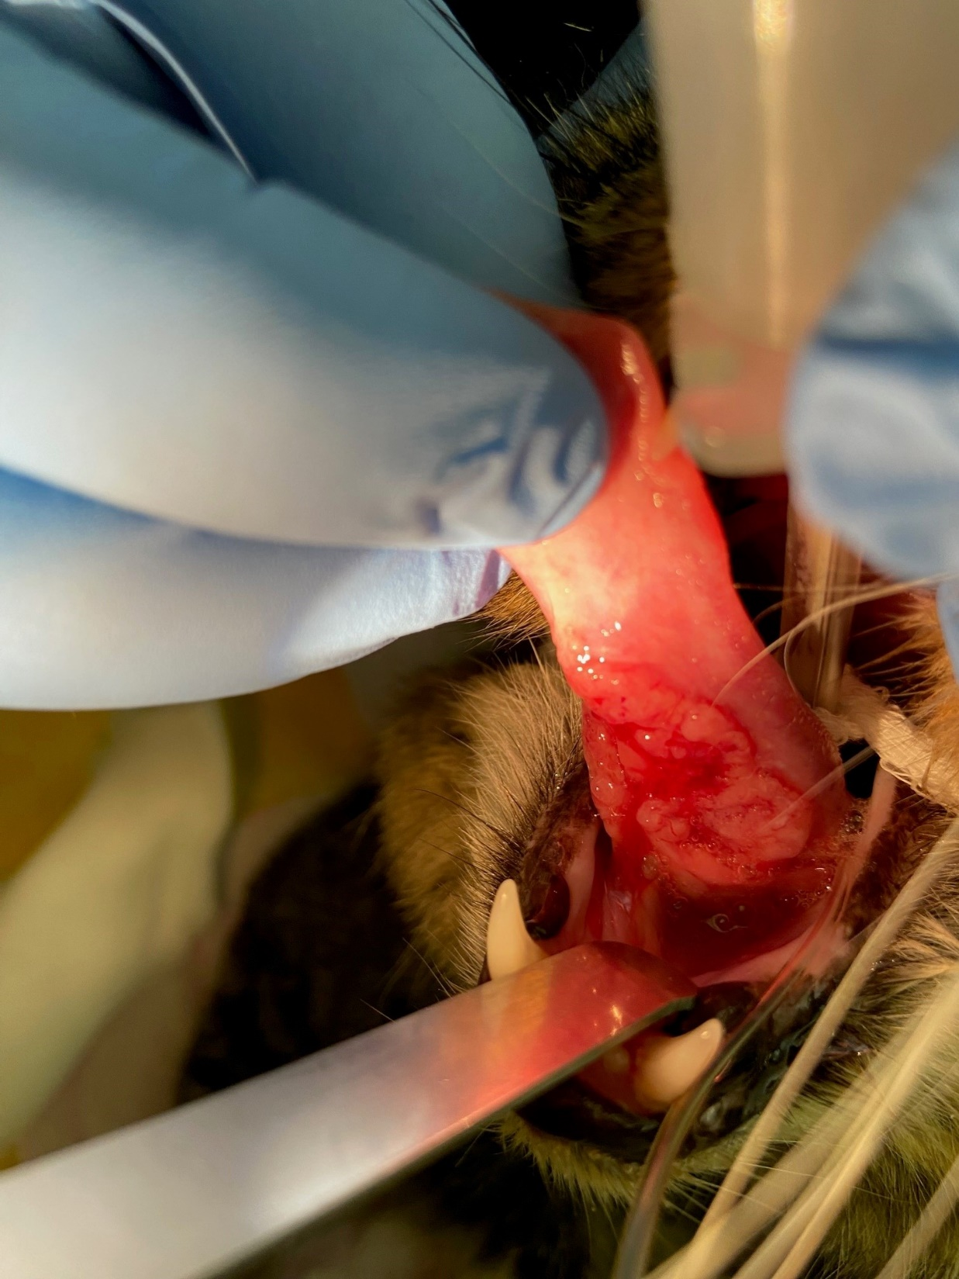
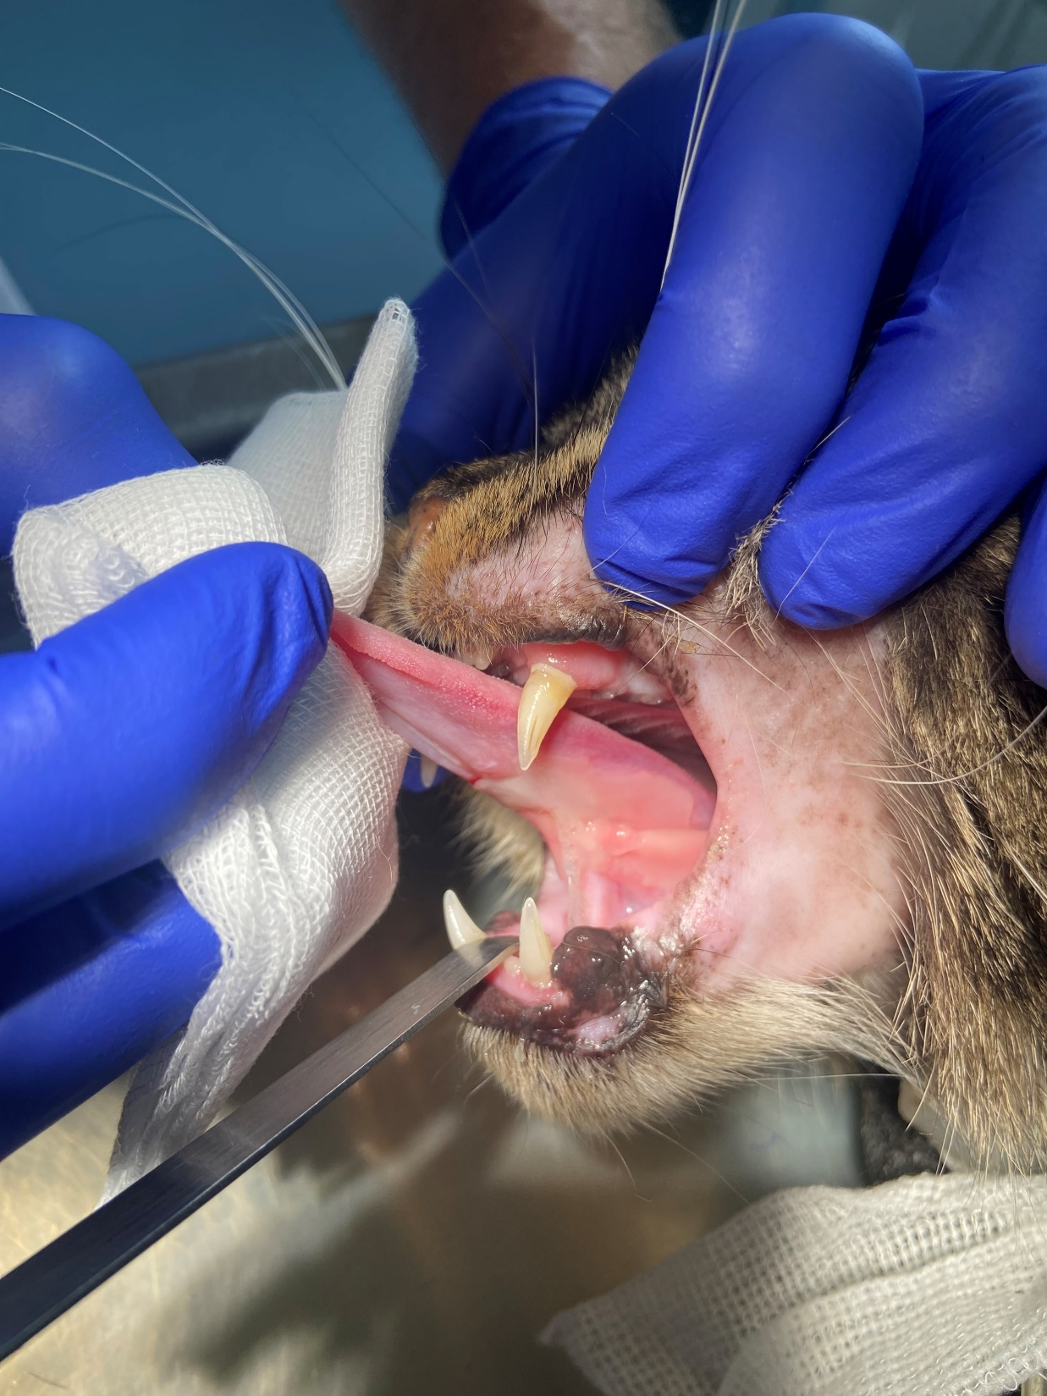
Notes:
Bubi: before 1st treatment, and at 4 weeks (still some mucositis and hair loss, but no tumor visible)

Slide 21
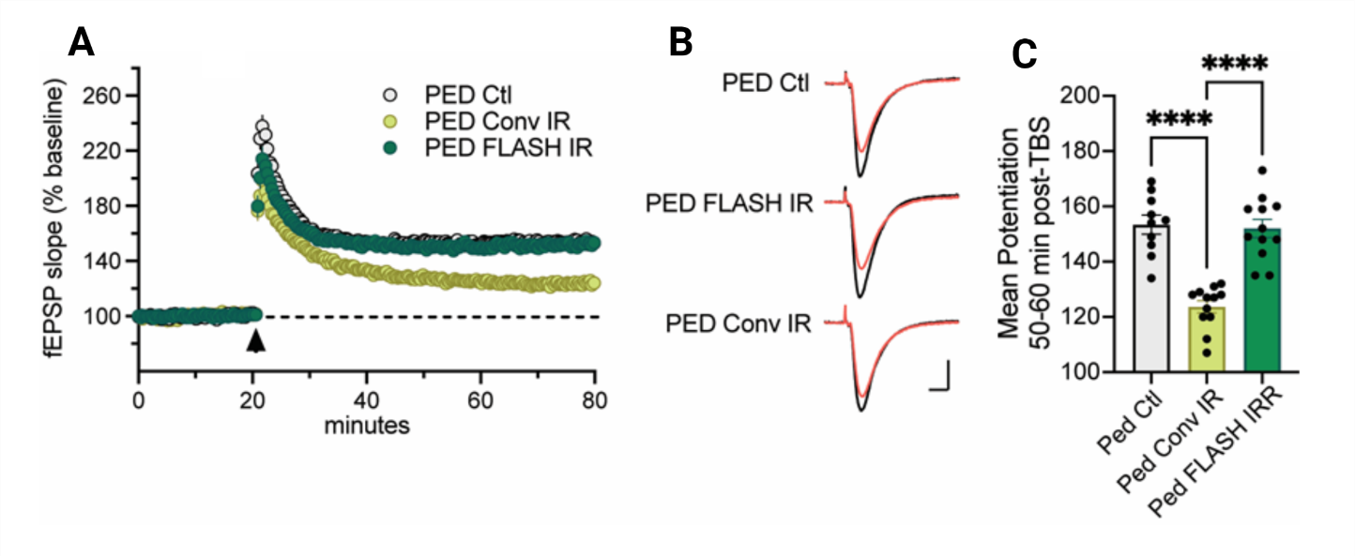
10 Gy Single pulse WB FLASH irradiation
Brain function
Pediatrics
Adults
Montay-Gruel et al. 2017
Montay-Gruel et al. 2018
Montay-Gruel et al. 2019
Simmons et al. 2019
Alaghband et al. 2020
Alaghband et al. 2023
Allen et al, 2023
Almeida et al, 2024
10 Gy

Slide 23
Dose per bunch escalation

