Slide 1
Concluding Remarks
Deepa Angal-Kalinin
VHEE25, 15-17th September 2025
Daresbury Laboratory

Slide 2
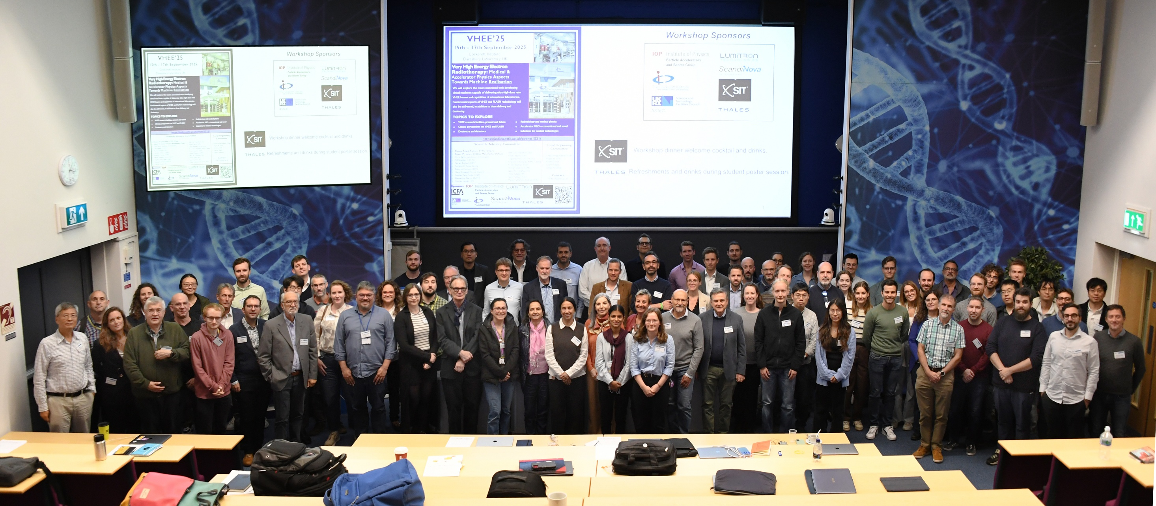

Slide 3
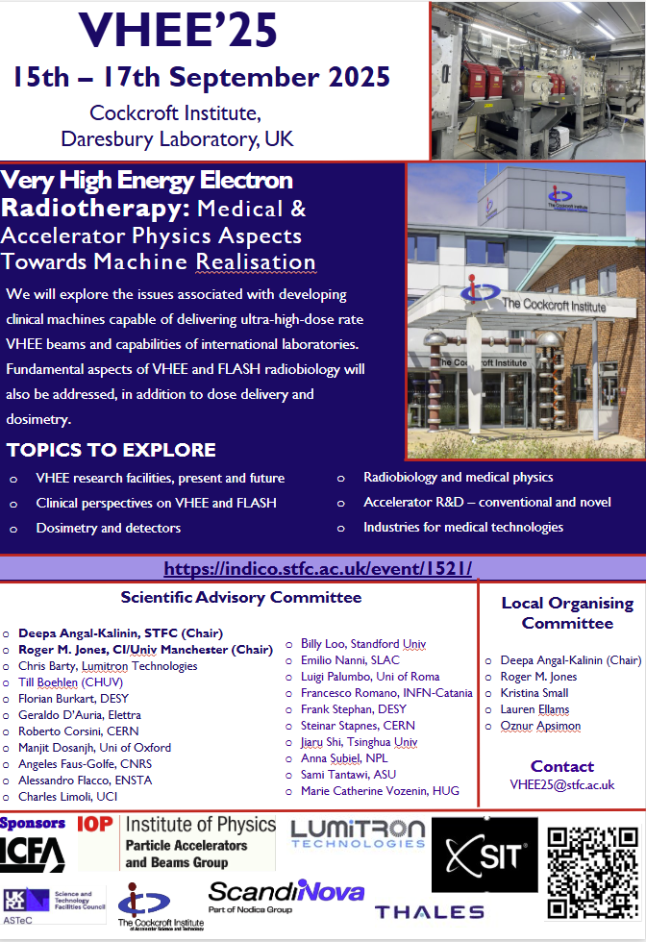







Workshop Sponsors
Workshop dinner welcome cocktail and drinks.
Refreshments and drinks during student poster session.

Slide 4

Special Issue on VHEE!
Timely! Motivated by Rapid & Exciting Developments in field!!
Physica Medica: European Journal of Medical Physics
Focus Issue containing invited papers selected from the presentations at the International Workshop on Very High Energy Electron Radiotherapy (VHEE’25).
The Focus Issue will be coordinated by the Guest Editors. The submissions will be peer-reviewed according to the evaluation rules of EJMP. Invitation letters will be sent by the Guest Editors to presenters via email soon after the workshop.
Guest Editors (GEs): Luigi Palumbo and Roger Jones.
  Deadline for authors to express interest in submitting 10th of October 2025
  Submission deadline: 1st of December 2026

Slide 5
Talks will be uploaded on Indico in next couple of days. Please let me know if you would not like to upload your talk by end of this week the latest.
  If you use a MAC or your own PC, please share a link or send your presentation to me by email (vhee25@stfc.ac.uk)
Workshop photos will be uploaded or link shared with the participants. If you do not want to give your consent, please let us know.

Slide 6
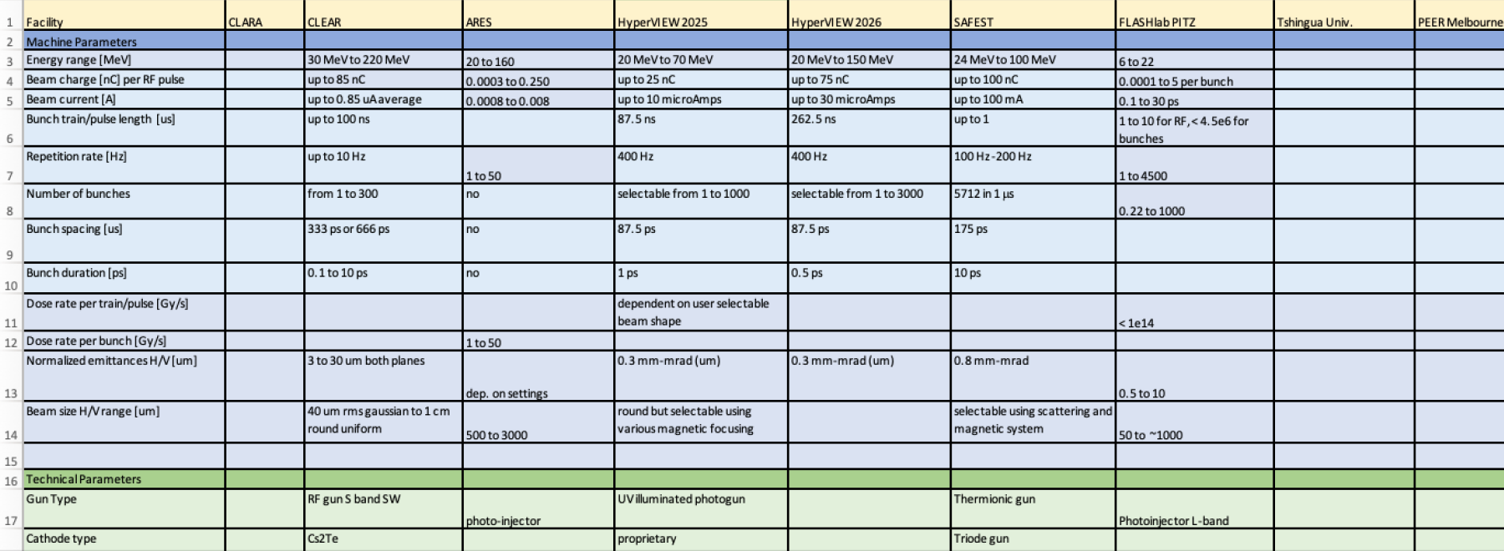
Angeles is co-ordinating collation of parameters of all conventional VHEE+FLASH facilities. Industry is also invited to contribute.
  Please contact fausgolf@ijclab.in2p3.fr

Slide 7
Similar co-ordination for LWFA based facilities will be done by Alessandro Flacco.
For both data bases, SPC will agree on the platform, timeline and how updates will be managed and will be touch with facility lead contact.

Slide 8
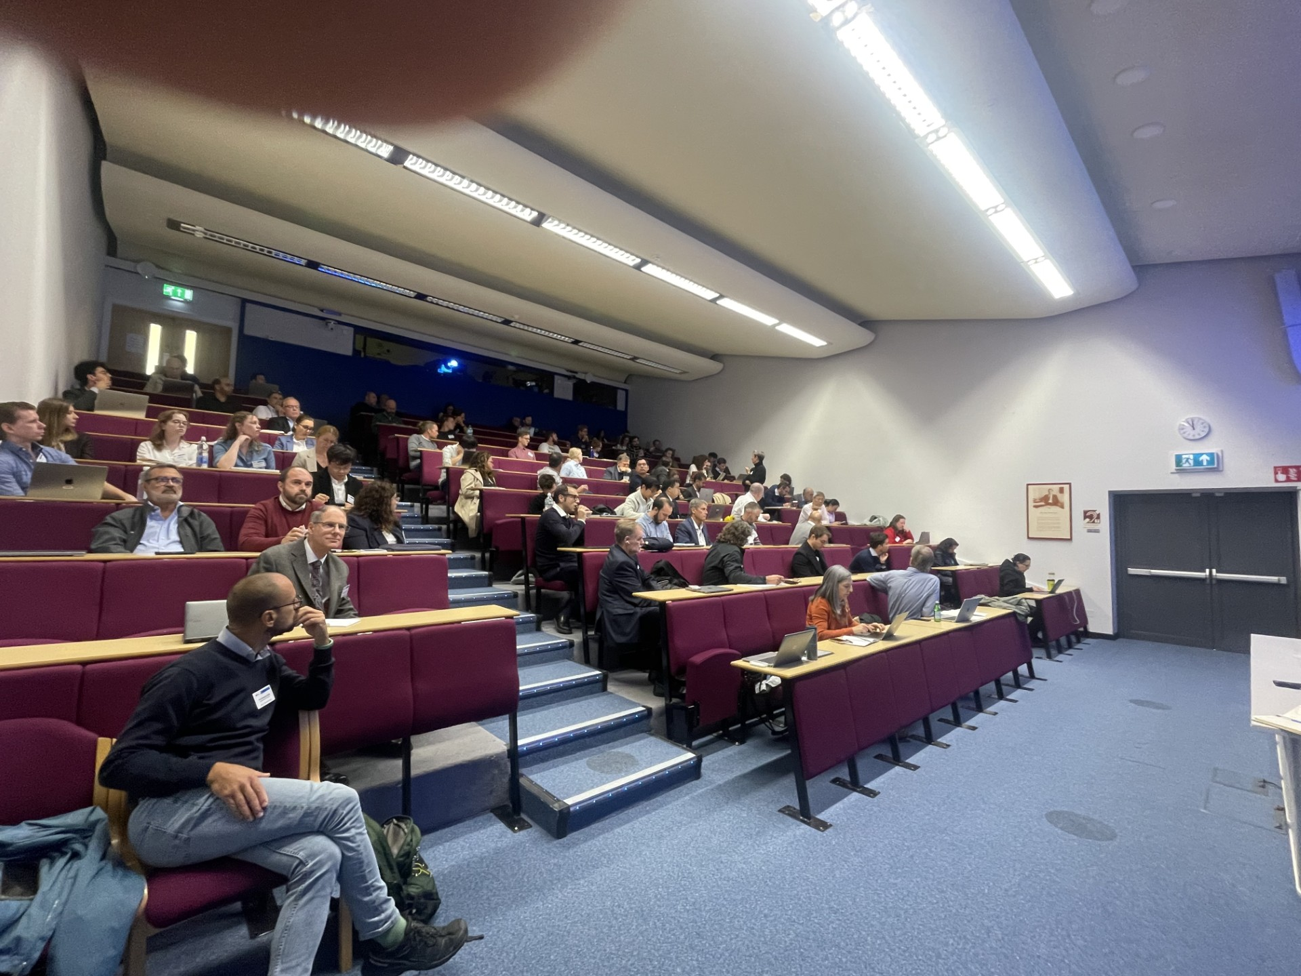
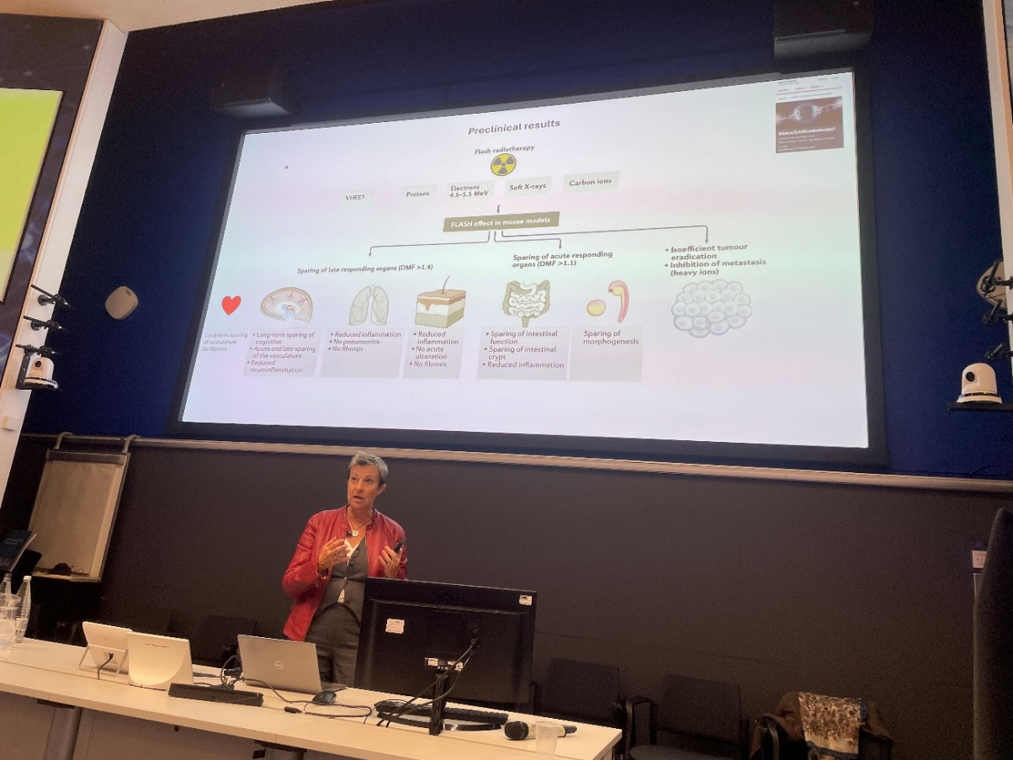
Many challenges still to address! Collaboration is the key towards making progress to clinical VHEE/FLASH a reality!
Thank you all for fantastic workshop.
Safe Travels!

Slide 9


