Slide 1
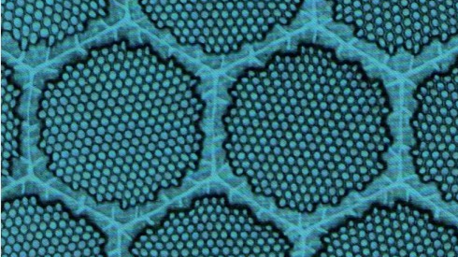
DNA of Superconducting magnets: Rutherford Cable
The development of superconducting filamentary composites, Rutherford Cable and their modern impact.

Slide 2
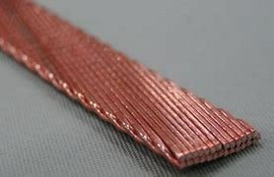
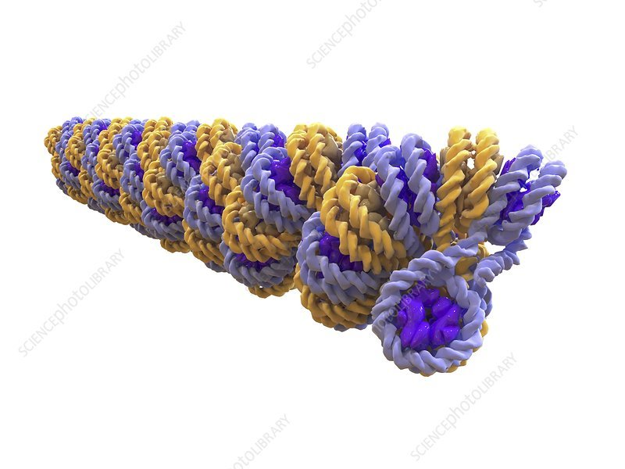
Introduction
RAL has had a long history of scientific contribution and technological innovation.
Superconducting filamentary composites and Rutherford Cable are an outstanding example
Basis of all magnets in major accelerator thereafter. Through to the HL-LHC
Given my biology background, I think of them as the DNA of superconducting magnets.
To first understand their origin and development, we require some context
Section: History and Context
Slide No:1

Slide 3
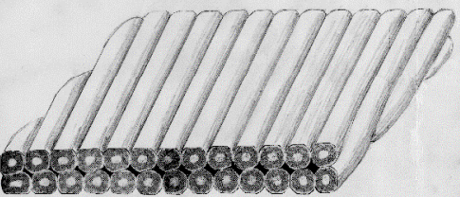
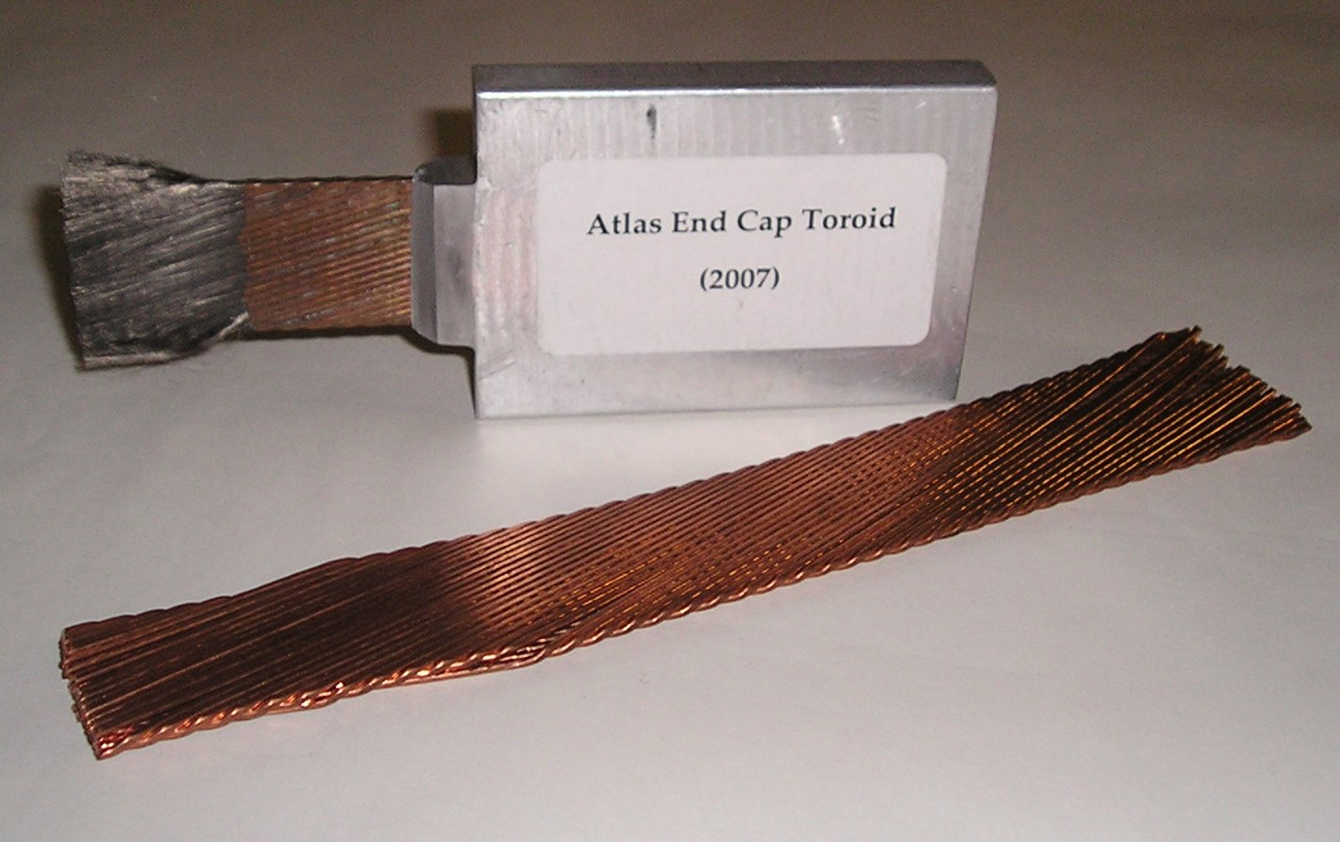
What is Rutherford Cable
Rutherford Cable are a compact collection of superconducting wires – they constitute up superconducting magnets used within synchrotrons.
They have a specific geometric orientation and various features, that mitigate sources of loss.
Can carry 30,000 Amps at 4k!
This presentation aims to inform you of
History and Context
Rutherford cables development
Cable manufacture
Rutherford Cable HEP application
Fermilab
RAL
Rutherford Cable application: Beyond HEP
Fusion
Medicine
Section: History and Context
Slide No: 2

Slide 4
What is superconductivity?
Discovered by Heike Kamerlingh Onnes in 1911.
He found that it would only occur below a specific temperature threshold.
"Thus the mercury at 4.2K has entered a new state which, owing to its particular electrical properties, can be called the state of superconductivity”
Nobel Prize (1913)
Physicists were excited to apply superconductivity to magnets:
“Obtaining a field of 100,000 Gauss (equivalent to 10T) could then be obtained by a coil of say 30 cm in diameter... with relatively modest financial support.”
(Third International Congress on Refrigeration at Washington and Chicago, 1913)
However, superconductivity would only persist at very low fields.
Section: History and Context
Slide No:3

Slide 5
Perfect Diamagnetism
In the 1930s, theoretical understanding improved thanks to German physicists, Walther Meissner and Robert Oschenfeld.
Measured the magnetic field from superconducting tin crystals, they observed a sudden expulsion of the field from the material at a certain magnetic field strength.
They found this process was reversible as the field would re-enter the material above the critical temperature.
Called Perfect Diamagnetism (also the Meissner effect)
⇌
Section: History and Context
Slide No:4

Slide 6
London Penetration Depth
Building on this concept, brothers F and L London found the magnetic field is a pivotal property of superconductivity.
They measured the magnetic flux at the materials surface and defined the London Penetration depth
Distance from the surface where magnetic flux decreased by 1/e (37%) and decreases exponentially thereafter.
London Penetration depth: several micrometres for most materials.
Current yielded from this magnetic flux within the superconductor is known as "surface currents".
Theory built upon by Ginzburg and Landau
Section: History and Context
Slide No:5

Slide 7
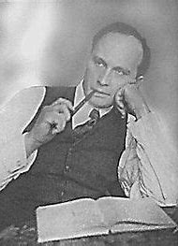
Critical Field
L.V Shubnikov investigated superconductivity.
Perfect diamagnetism was exhibited in pure Tin / lead but not metal alloys
Observation of Meissner effect to a certain threshold.
Above this threshold, observed a 'mixed' state.
Mixed state held until reaching a higher magnetic field strength
This threshold is termed the upper critical field / critical field and is denoted as H_{c2}.
L.V Shubnikov: Credited with the discovery of Type II superconductors, based on his observation of the mixed state (interval between two distinct critical fields)
Work largely went unrecognised in the West following its publication.
Executed during the Great Purge.
H_{c1}
Complete
Mixed
Superconductive state
H_{c2}
Normal state
Section: History and Context
Slide No:6
Notes:
Mnetion he was a colleague or Karlingeh Onnes – he was the first scientist to determine the distinction between Type I and II superconductivity.
Alloys behaved differenty than pure metals
Perfect diamagnetism – Exhibited prior to a magnetic field strength threshold, beyond this threshold it would enter a 'mixed state'. Here flux lines would enter the material at discrete points.
F. London was the first to hypothesise that these were quanta of flux.

Slide 8
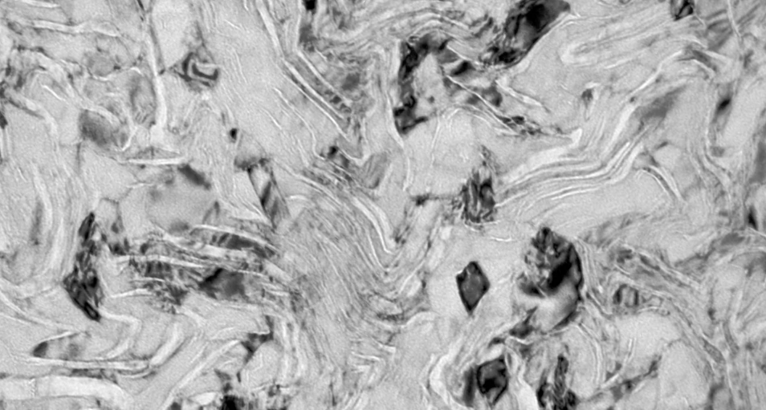
Type I / Type II Superconductors
L.V Shubnikov altered alloy composition to yield lower H_{c1} and greater H_{c2}
These superconductors were later designated as Type II superconductors
Type II superconductors have preferable characteristics for magnets
NbTi alloy: Transmission electron microscope image of a NbTi filament.
Areas of lighter contrast indicate the presence of precipitates of Titanium known as α-Ti.
Section: History and Context
Slide No:7

Slide 9
Fluxoids
Type II superconductors exist within a mixed state – whereby tiny normal 'cores' coexist the superconducting state.
Fluxoids are tiny magnetic flux lines (2 x 10⁻⁵ Wb / 20µT) that penetrate Type II superconductors in their mixed state - H_{c1} < H > H_{c2}
Generate their own circulating currents – termed screening currents. (they oppose bulk current flow within the superconductor)
Orange area represents normal core (area with resistivity)
Blue area represents superconducting state
Black arrows indicate external magnetic field.
H_{c1}
H_{c2}
Section: History and Context
Slide No:8
Notes:
Mixed as normal cores coexist with superconducting state.
Tiny flux lines that enter at discrete points

Slide 10
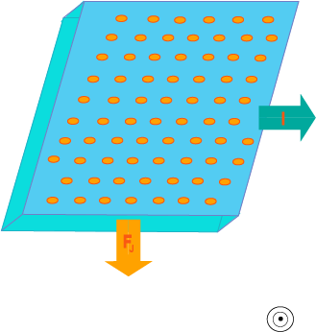
Flux Flow and Pinning
Fluxoids are evenly distributed
Uniform magnetic flux density – Zero field gradient
Lorentz force applied within an external magnetic field
This force causes the fluxoids to move freely - dissipative process called Flux flow
Section: History and Context
Slide No:9
Notes:
Faradays law of induction states that the electric fields generated by circulating magnetic fields generate an E.M.
Here is a superconducting material within a magnetic field (coming out from the screen), a flowing bulk current and a force applied (I'll go on to explain). Orange represents superconductivity whereas blue represents superconductivity.
Fluxoids adopt an even distribution among the superconducting material – their mutual repulsion means the most energetically favourable configuration is an even distribution.
Uniform flux distribution = uniform flux density meaning there is no field gradient
Lorentz force is applied to the fluxoids within an external magnetic field.
They move freely without the influence of other external forces.
Redistribution of fluxoids due to this Lorentz force – flux flow – deposits energy.

Slide 11
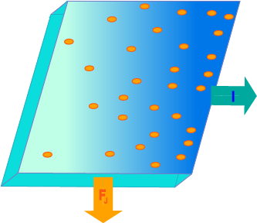
Flux Pinning
Metal impurities / lattice imperfections serve as 'pinning centres.
Non uniform magnetic flux density = Field gradient
This field gradient imposes bulk currents (according to Faraday's law)
Pinning centres impose a pinning force (Fp)
Section: History and Context
Slide No: 10
Notes:
Fluxoid anchors – immobilise fluxoids. They are known as Pinning centres.
Non uniform array of fluxoids implies a field gradient and therefore a current – these are as bulk currents.
Pinning centres change the distribution of screening currents and apply a force to flux lines known as Pinning force
Pinning force exceeds the Lorentz force applied then flux flow (dissipative process) cannot occur.
By increasing this pinning force, you can increase the Lorentz force required to stop current flow therefore increase the current flow through the superconducting material

Slide 12
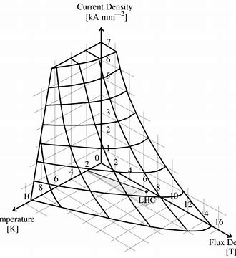
Critical Surface
Critical current density – Maximum current flow through a material
In values beyond: Lorentz force (incurred by current flow) EXCEEDS Pinning force (incurred by pinning centres)
Dependence of Critical surface parameters –
3 Major thresholds that need to be maintained for superconductivity to remain.
Critical field (Hc), critical temperature (Tc) and critical current density (Jc).
3D threshold of Superconductivity and Resistivity.
Factors are dependent on one another
Section: History and Context
Slide No:11
Notes:
Diagram is showing their dependance on one another
If you are to increase the Jc then the critical temperature decreases. Eg: If you increase flux density to 10T at 4.2K the current density becomes too low for magnet applications. HOWEVER if you operate at 9T at 4.2K the critical current density is much more manageable.
I would just like to emphasis that Jc is dependant on temperature (Z and Y axis ) this becomes important later.

Slide 13
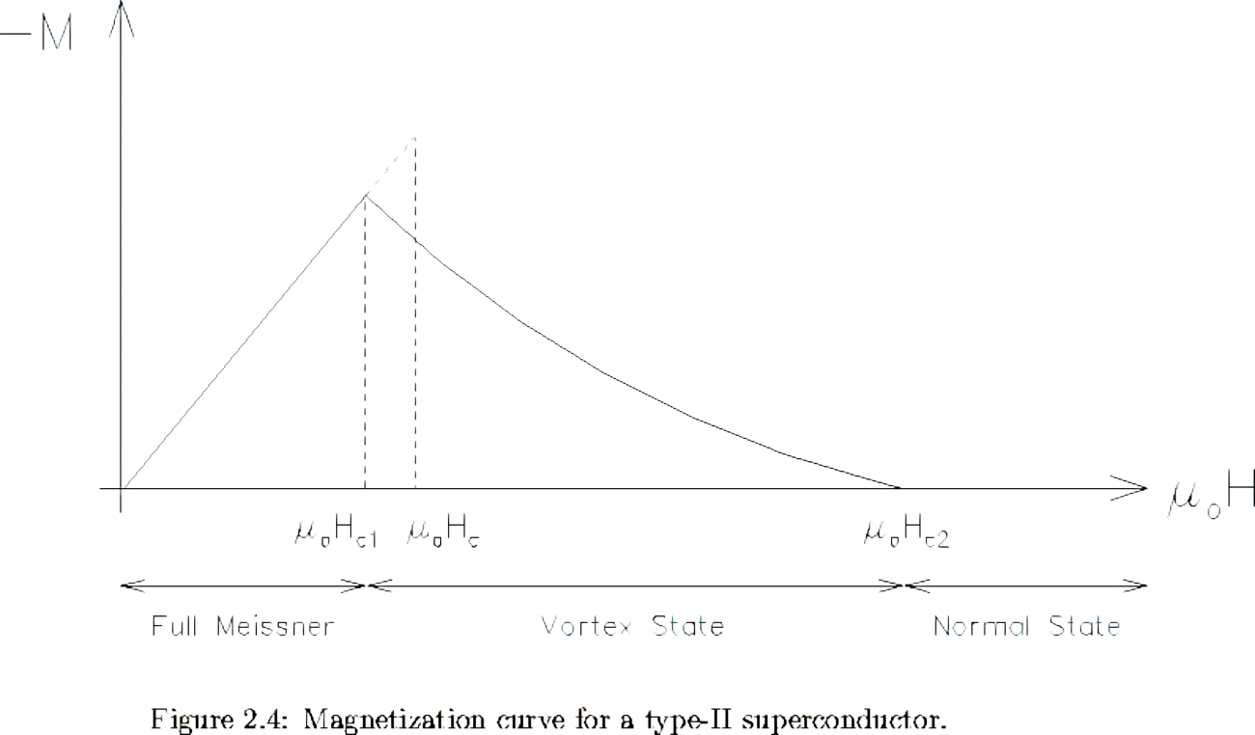
Electromagnetic instability
AC losses: Interaction between the pinning force and the magnetic flux allows for bulk current flow it also allows for AC loss.
Pinning force remains in a constant direction. Lorentz force is variable
Magnetization losses: Superconductors follow a magnetisation curve in changing magnetic fields – persistent currents are established.
Coupling losses: Coupling currents form large loops between wires and strands
Eddy currents
Section: History and Context
Slide No: 12
Notes:
For coupling losses: Electric field is generated between filaments. Current is producd from the induced couplings of this field. Filaments couple via their periphery to yield coupling currents. Within changing fields.
Magnetisation curve: Flow flow and flux pinning results in a net energy loss when subject to a field cycle (when the magnetic field changes direction)Below HC1 the superconductor is in the Meissner state with no flux penetration dH / dT corresponds to magnetic energy storage.
Within the Shubnikov state, area enclosed by the B(H) (flux density - strength) curve encompasses energy loss above HC1. Decreases exponentially as magnetic field increases – though these currents are persistent. (No resistivity)
Limiting flux penetration – Lower frequency/ lower magnetic field strength variation OR Limiting flux movement – Confining it to a smaller area.

Slide 14
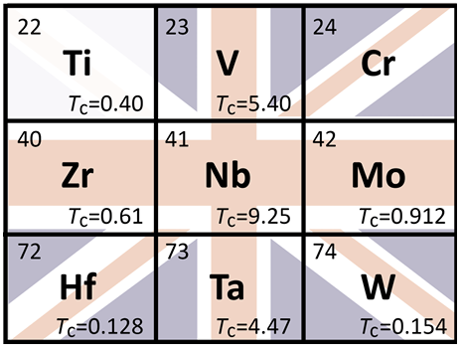
‘Woodstock’ of Superconductivity
Revelatory announcements came in 1961 at the First International Conference on High Magnetic Fields at MIT.
Viable materials such as NbZr superconductors announced to have critical fields of up to 20T!
Coils were commercially available shortly following the conference.
Conference was attended by Audrey and Martin Wood, founders of Oxford Instruments
Used NbZr to build Europe's first superconducting magnet.
God save the Queen
Westinghouse Laboratory in Chicago was at the forefront of superconducting alloy R&D.
They had identified critical surface parameters of V-Nb, Nb-Ta, V-Cr, V-Mo, Nb-Cr, Nb-Mo, Nb-W, Nb-Hf, and Nb-Zr.
British Physicist, John Hulm, expressed a desire to investigate Nb-Ti as ‘God Save the Queen, we’ll have the union Jack’
Section: History and Context
Slide No:13
Notes:
Nb-Ti was considered the workhorse of superconductivity in the 1970s. Favourable mechanic and electric properties.
Whilst it had a lower critical field than Niobium Tin, it was ductile and could be drawn into wire. John Hulm is creditted with the discovery of many superconducting materials. It is known as the Workhorse of superconductivity as it has been used throughout industry.

Slide 15
Flux jumps
Optimism regarding this revelatory announcement quickly diminished as small coil prototypes would fall far below expectations.
With the manufacturing methods used at the time, NbZr superconductors would degrade over time leading to a lower critical current density.
Even after the magnet was trained, they would return to their normal state prematurely, before any thresholds exceeded the critical surface.
This subpar performance was found to be caused by an instability called flux jumping
R&D was directed at limiting this problem particularly at Fermilab, Argonne, Brookhaven and RAL.
Section: History and Context
Slide No:14
Notes:
Prototypes would show subpar performance – quenching far before nearing any of their critical parameters.
Even despite training – incrementally increasing their operating conditions. Each time this happens a quench occurs, though next time the operating currents can go much higher.

Slide 16
Flux jumps
Non uniform fluxoid distribution causes a screening current field gradient
This field gradient of screening currents contributes to the pinning force.
Positive feedback loop
Sudden temperature perturbation
(ΔQ)
Rise in local temperature (ΔT)
Specific heat capacity
Heat conduction
Lowered current density (Δ Jc)
Jc - Temperature dependence
Reversion to normal state
Fl > New Fp – Flux flow
Fluxoids adopt new position in SC material
Lowered Pinning force (Δ Fp)
Lowered current density lowers field gradient
Section: History and Context
Slide No:15
Notes:
Rise in local temperature – Specific heat capacity of a material is 2 / 3 orders of magnitude lower at 4K than it is for 273K.
In the case of copper for example, it is 2000x higher. This means that smaller amounts of energy are needed to raise the temperature of a given mass.

Slide 17
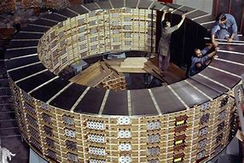
Cryostabilisation
Method of flux jump tolerance was developed in 1965 by Stekly and Zar working at Avco-Everett Research Laboratory in Boston.
They conducted measurements of conductivity and resistivity in superconducting alloys (NbTi) and pure metals (Cu).
NORMAL STATE NbTi alloy had higher resisitivity and lower thermal conductivity than Copper
A great example is the BEBC
Big European Bubble chamber : Use cryostabilised superconducting coils to generate magnetic fields of up to 3.5T. Largest at the time, boasting a 3m diameter
Section: History and Context
References:
Slide No: 16
Notes:
D_{M} is how quickly a magnetic field can diffuse through a material.
Describing how fast heat movers through a material.
The superconductor in its normal is generally a worse thermal conductor AND has higher resistivity than Copper.
By immersing it within copper, current flow would be redirected to the less resistive copper. Heat generated within the normal superconductor, due to ohmic generation would be conducted by the copper rather than the superconductor.

Slide 18
Cryostabilisation mechanism
Liquid Helium coolant
Superconducting NbTi wire
Current flow
Copper matrix
Normal state: Liquid Helium coolant surrounds the copper conductor; the superconducting filament is kept below its critical temperature.
Fault state: Local normal state reversion
Current flow diversion. Ohmic generation becomes localised to the copper
Heat is transferred to surrounding coolant. Allowing NbTi to recovers and regains superconductivity.
Section: History and Context
Slide No:17

Slide 19
Founding of the Superconductor Applications Group
Cryostabilisation offered flux jump tolerance though had significant drawbacks
Low current density
Susceptibility to AC losses and Eddy currents
High refrigeration losses
Whilst not applicable for accelerators
First use of reliable superconductive magnet (to critical current density)
Copper annealing to NbTi
Demonstrated use of effective cryogenic systems - refrigerant circulation
Superconducting applications group (SAG)
Engineers at RALs Applied sciences division took notice.
Peter Smith aimed to develop a coil design that minimized flux jumps and kept refrigeration losses to acceptable limits, within a 1 second rise time (time taken to reach design field).
Alongside physicist, Martin Wilson, they would found the superconducting applications group in 1961.
Section: History and Context
Slide No: 18
Notes:
Eddy currents are produced according to Lenz’s law. The circulating loops of current are dissipative and produce magnetic field distortions which are undesirable
Low current density – Extrinsic factor that needs to be maximised – typically limiting factor in producing high field magnets. Thick films of copper were needed to surround the filaments, to withstand the heat generation brought about by flux jumps.
Copper to superconductor ratio was 1.4: 1.
High refrigeration losses – Energy is needed to rectify the temperature increase within the helium coolant: Termed refrigeration loss
Susceptibility to electromagentic loss –For instance, particular suscpetible to Eddy currents due to the large volume of copper conductor. Eg: Argonne 12 foot bubble chamber at the Zero Gradient Synchrotron (ZGS) had a time constant on the order of an entire day.
High refrigeration losses – Large amounts of energy were needed to rectify heat transfer.

Slide 20
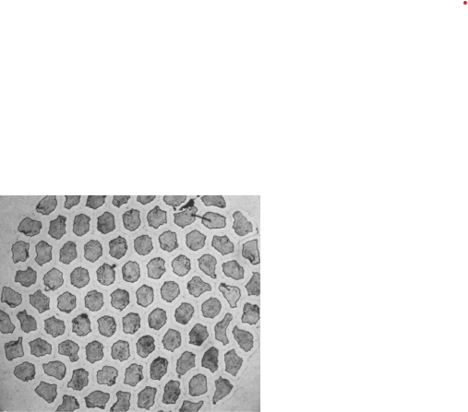
Adiabatic Stability Criterion
Adiabtic stability criterion is a set of equations – describing conditions required for flux jumps.
SAG used this criteria during theoretical work from 1961 – 1965
Thinner filaments – smaller cross section of the superconductor
Smaller filaments confine fluxoid motion to a smaller volume (provided filaments are uncoupled).
Used this criteria to establish flux jumps as tolerable at 50 micrometers
AC losses were tolerable at 5 micrometers.
RAL was not the first to identify this threshold...
100 Micrometer NbTi filaments embedded within a copper Matrix.
Manufacturing techniques were applied to NbTi within a copper matrix but to no success. Image courtesy of NASA 1964
Section: History and Context
Slide No: 19
Notes:
Theoretical work conducted at RAL by the SAG from 1961 – 1965 was able to derive the mechanism. To prevent this positive feedback loop, they developed features that targeted sections of this chain.
Adiabatic stability criterion developed by Bean and London, produced an equation which defined the maximum wire diameter under which flux jumps did not occur. By having very thin filaments, the cross section of the superconductor was smaller thus reducing fluxoid density. Consequently, screening currents are smaller per filament and even if flux flow is to occur then it is across a smaller distance and less heat is dissipated.
Cross section is smaller – fluxoid density is lower
Lower fluxoid density means screening currents are smaller per filament
If flux flow, then DOES occur it is confined to a smaller area therefore limiting heat dissipation.
By confining fluxoid motion to a smaller volume, AC losses AND EDDY CURRENTS are also reduced. PS and MW recognised that this would be ‘tolerable’ at a diameter of 5 to 10 micrometers and worked closely with IMI to reduce the diameter of these filaments.

Slide 21
Filament twisting
SAG pioneered wire twisting. Adjusting the Twist pitch to reduce self-field effects such as coupling losses
Coupling current loops form between wires and within the conductors
Coupling currents are dissipative – ohmic generation within copper matrix
Twisting decouples inner and outer loops.
Loops are still present within both layers.
Self-field effects are limited to the inner and outermost filaments when twisted
Section: History and Context
Slide No:20

Slide 22
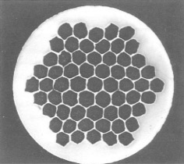
Superconducting filamentary composites
Peter Smith negotiated with Imperial Metal Industries (IMI) to produce a prototype coil of exacting specifications:
NbTi filaments with diameters of 50 Micrometres
Immersed within a fine copper conductive matrix.
This conductive matrix follows the same principles as above with cryostabilisation. Redirecting current flow and conducting heat.
SAG determined minimum volume of conductor to ensure stability
Less coating was needed
Superconductor to matrix ratio was close to 1:1 as opposed to 1: 1.4.
Initially termed Smith-Wilson composites – now Superconducting filamentary composites
Prototype coil manufactured in 1967 by the IMI and RAL collaboration. This singular strand consisted of 61 50µm filaments (black polygons) within a conductive matrix (white surroundings).
This entire assembly is referred to as a strands. A series of strands constitutes a cable
Section: History and Context
Slide No:21
Notes:
Lower ratio meant that – higher critical current density (fit more current carrying filaments within a given space) + higher field generation per coil.

Slide 23
Recap: History and Context
Theory
Critical current density is a crucial metric of superconducting materials – an extrinsic property to the material
Higher critical current density is desired.
Electromagnetic criteria include Flux jumps, Magnetisation losses, Self field losses
Superconducting filamentary composites
RAL was not the only team researching this, with groups at Fermilab and Brookhaven dedicated to SC research
RAL developed Superconducting filamentary composites.
By 1970, AC losses are still far from ‘tolerable’ and coupling currents still persist.
Reduce refrigeration losses within a 1 second rise time to tolerable levels.
Section: History and Context
Slide No: 22

Slide 24
Motivation for Rutherford Cable
What is the purpose of magnets within a synchrotron? (ARM)
Why is a cable needed?
Magnetic field homogeneity achieved by connecting magnets in series
Physicists desire a high magnetic inductance for quench protection.
For a high inductance and minimal voltage– magnets in series (kA) operate with high currents. L ∝ 1 / I²
High current single coils are not practical – sensitive to flux jumps
Cables are also mechanically stable – Reducing frictional heating (more on this later)
The solution is to compact 20 – 50 flattened strands of superconducting filamentary composites into cables.
Section: Rutherford Cable development
Slide No:23
Notes:
(Key message here is that inductance is inversely proportional to current L ∝ 1/ I) AND that inductance + high operating current methods of energy extraction are preferable to those that involve a high voltage.

Slide 25
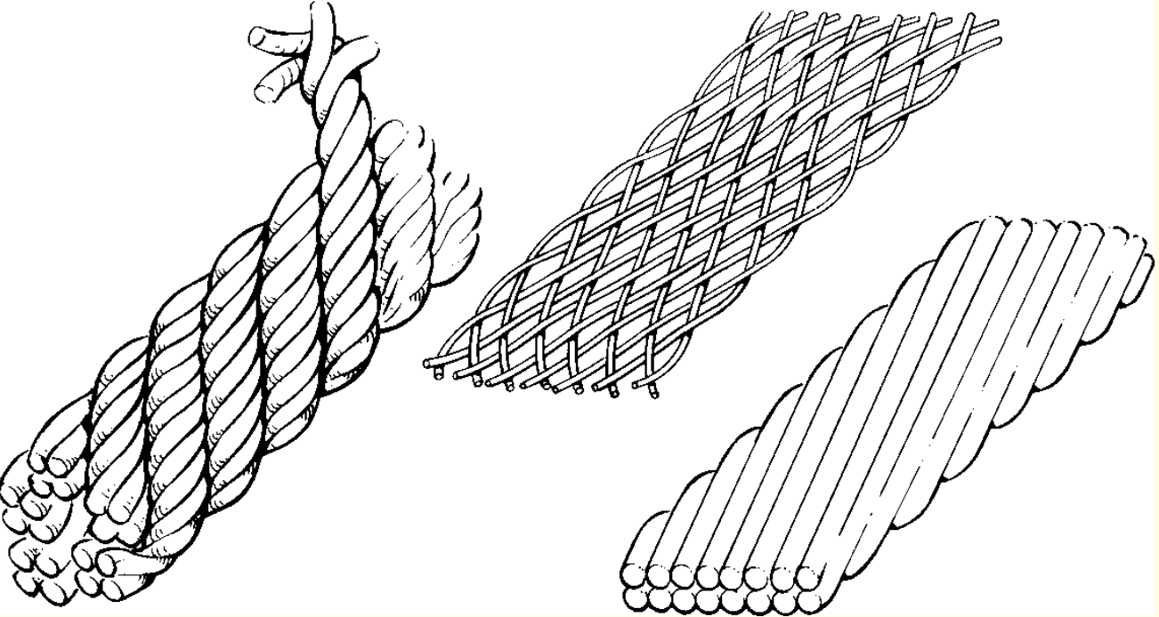
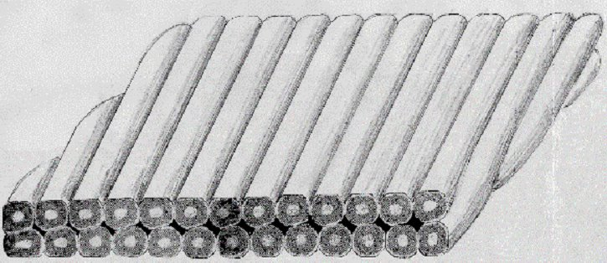
Transposition
Reminder: Filaments generate self-fields and flux linkage occurs between the inner and outer filaments.
To limit this change, physicists implemented wire transposition.
This allows for equal current distribution and limits self-field losses during ramping.
Rope, Braid and Rutherford (as it would later be known)
Maximum stable packing factor is desired for highest possible critical current density
Section: Rutherford Cable development
Slide No:24
Notes:
(Key message here is that inductance is inversely proportional to current L ∝ 1/ I) AND that inductance + high operating current methods of energy extraction are preferable to those that involve a high voltage.

Slide 26
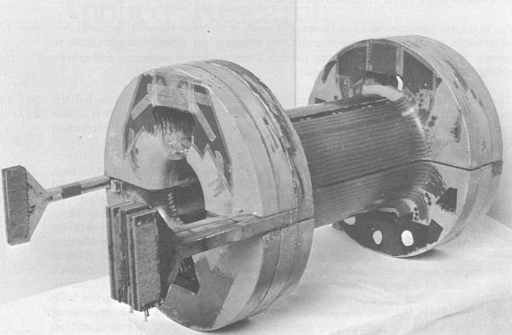
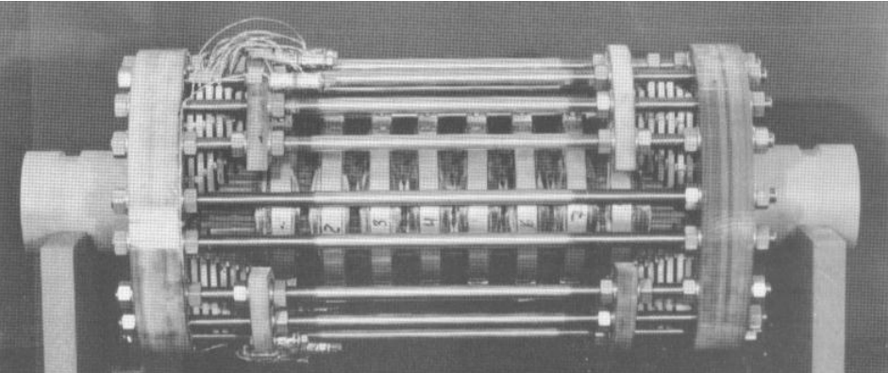
GESSS Collaboration
Groups at RAL, Saclay and Karlsruhe formed the Group for European Superconducting Synchrotron Studies (GESSS)
These laboratories each possessed their own cabling facilities.
They sought to outfit CERN's proposed 300 GeV proton synchrotron (later the SPS) with superconducting magnets.
GESSS design working group stated that if installed from the outset, they could increase beam acceleration to 800 GeV and then further to 1000 GeV
GESSS aimed to demonstrate their feasibility.
AC3 Magnet prototype produced by RAL (1971)
D1 magnet prototype produced by Karlsruhe Laboratory (1973)
Section: Rutherford Cable development
Slide No:25

Slide 27
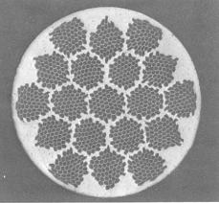
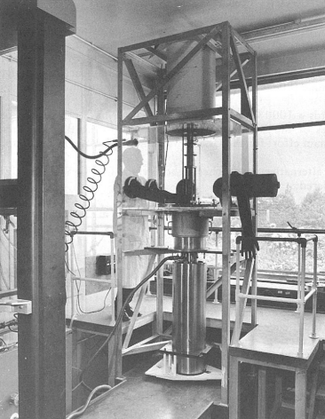
Refining design
Coil Impregnation
Coil impregnation – insert a small volume of material to resist mechanical movement.
Specific properties were desired. At cryogenic temperatures it needed
High YM
Similar thermal contraction rate
RAL conducted a materials search campaign from a dedicated cryogenic facility in R52.
Culminated in selection of Epoxy Resin – still not ideal!
Addition of a copper oxide coating to strands
A copper oxide layer was deposited onto the strands to decrease interstrand coupling
Strand produced by IMI and used by RAL in 1971
Section: Rutherford Cable development
Slide No:26
Notes:
High young's modulus – to prevent plastic deformation and return to its original position
Similar thermal contraction rate to the matrix – otherwise cracking would occur.
Copper oxide layer was deposited – served as a resisitive barrier between the strands

Slide 28
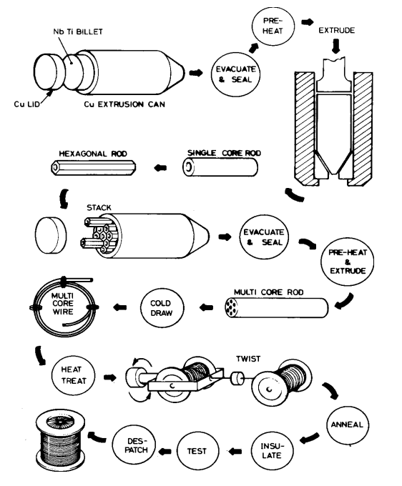
Cable manufacture
Interplay between maximising the packing factor but ensuring mechanical stability of NbTi filaments
Subject to several rounds of extrusion, drawing, twisting and compaction
– promote degradation (quantised by the degradation factor) or even rupture!
IMI enabled the monofilament and multifilament wire production.
Billet – Hexagonal rod – Multi-core rod – twisted filamentary composites
Section: Rutherford Cable manufacture
Slide No:27

Slide 29
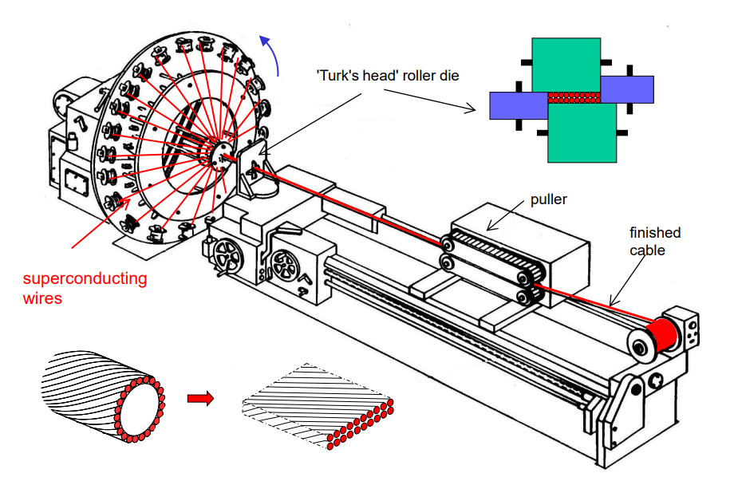
Cable manufacture
Twisted wire was inserted into rotating spools
Rotating mandrel induces wire transposition.
Turks Head Roller compacts and flattens the strands into the desired shape.
RAL played an important role in coil layout
Main control parameters are
Twist pitch
Strand tension
Strand width
Window
Section: Rutherford Cable manufacture
Slide No:28
Notes:
Maximun compaction not implemented – room remains for impregantion and oxide layer deposit

Slide 31
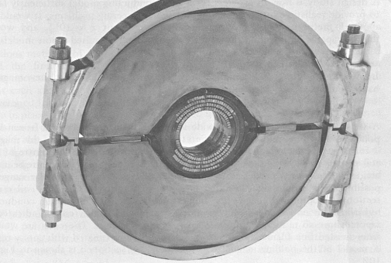
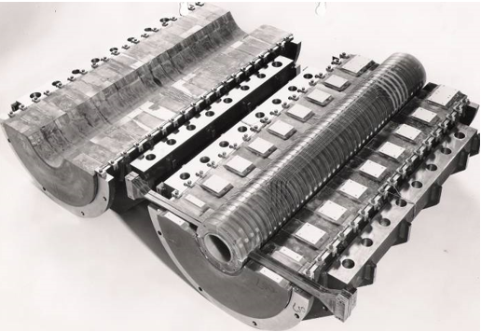
Rutherford Cable - AC4
Rutherford cable chosen above other configurations due to high packing factor – providing greater current density.
Performed better than other prototypes, using rope transposition.
AC4 developed in 1973 was the first magnet to use Rutherford cable within its magnetic windings.
After some training, it operated at its design current density!
Slide No:27
Section: Rutherford Cable manufacture - Prototypes
Slide No:30
Notes:
High compaction factor of 88 – 94%
An iron yoke iron shielding was important in producign a high quality and uniform field.

Slide 32
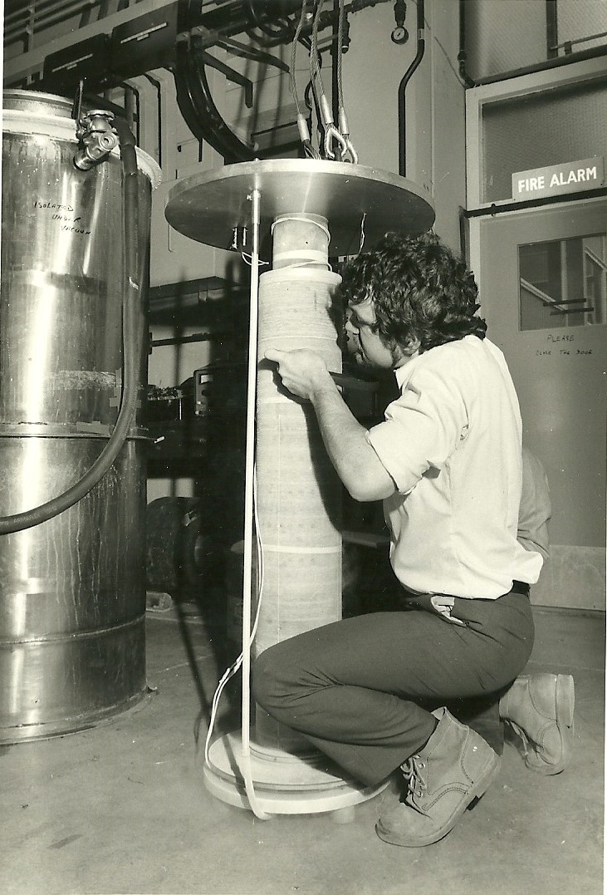
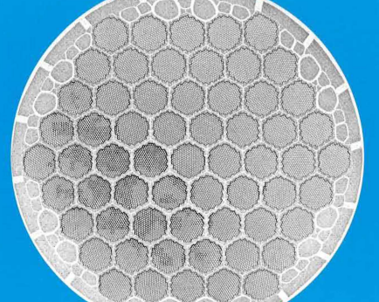
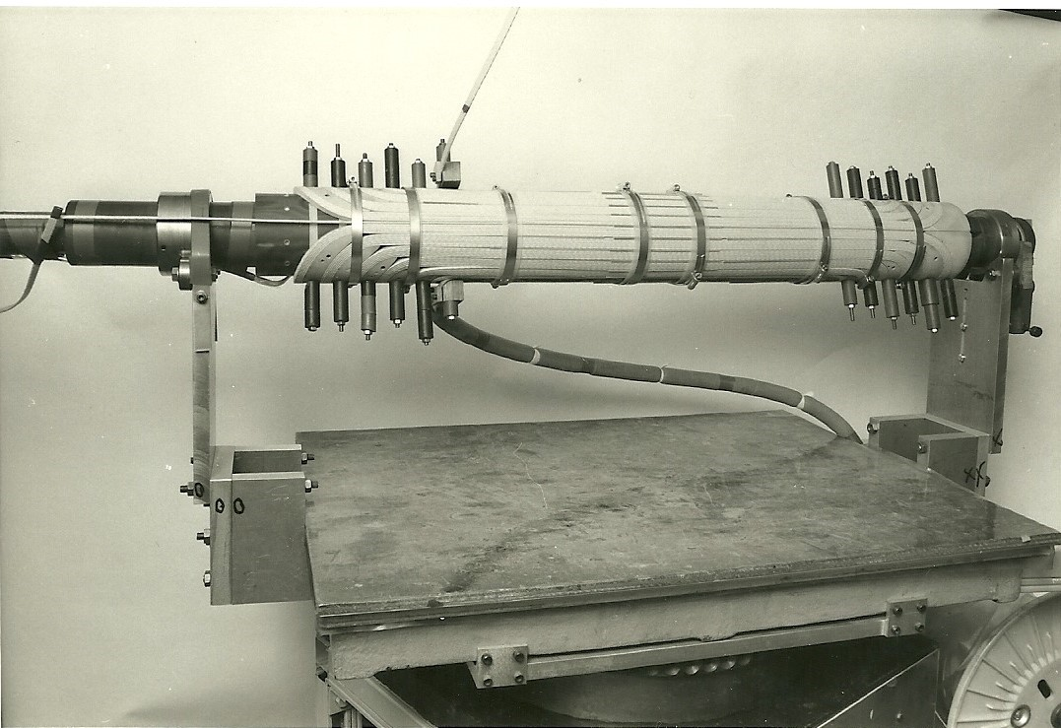
Rutherford Cable - AC5
AC5 was the final prototype developed at RAL
Increased packing density further by
Flattening the strands (P. G. Gallagher)
Adopting a rectangular window
Fit the bill for the SPS – falling just short of ideal specs.
Packed 10,000 – 20,000 filaments within each strand.
Each filament was only 5 micrometers.
This 15 strand Rutherford Cable was named 'Flat 15'.
Section: Rutherford Cable manufacture: Prototypes
Slide No:31

Slide 33
Flat 15
15 wires per cable
Rectangular window
Slight distortions at the edges
Oxide layer between wires
Section: Rutherford Cable manufacture: Prototypes
Slide No:32
Notes:
Oxide layer between wires – to prevent coupling currents between them
Rectangular window – Compact and great for stacking in straight sections
Minor distortions at the edges – Required for magnet manufacture
15 wires per cable
Cabling principles dictated a central core was needed

Slide 34
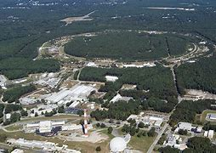
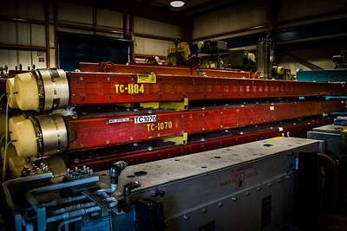
Over to the Tevatron
CERN did not opt for Rutherford Cable for their magnets.
Reinforced by RAL Metallurgist, David Larbaleister, commented that
‘Superconducting magnets were an exotic option'
Robert Wilson, desired installation of superconducting synchrotron magnets to upgrade Fermilab's 400 GeV proton – proton synchrotron.
Allowing for a significant increase to particle collision energy and effectively HALVING power consumption
RHIC (2011): The tunnel seen here was originally intended for the ISABELLE project. Although the team successfully developed prototype superconducting magnets, the project was ultimately hindered by persistent technical challenges. Image credit - BNL
Tevatron Dipole in storage (2013):
First particle accelerator to make use of Rutherford Cable within their superconducting magnets. Image credit – Steve Krave Flickr
Section: Rutherford Cable HEP application : Tevatron
Slide No:33
Notes:
Few suppliers of NbTi in Europe and fewer companies still that had the infrastructure capable of constructing Rutherford Cable.

Slide 35
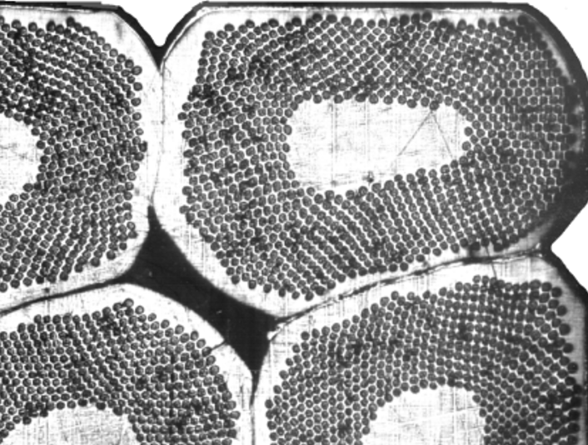
Innovation at Fermilab
They selected a rectangular window, flat, twisted 23 strand Rutherford Cable.
This was termed 'Zebra' cable as the coated strands formed a stripy pattern.
Keystone angling
Kapton insulation
Effective cryogenics
Compaction to align with the magnet design
Section: Rutherford Cable HEP application : Tevatron
Image credit: Charlie Sanabria
Slide No:34
Notes:
Fermilab instituted a few modifications to its design.
Keystone angling – Referring to a thick and thin edge. Key stone angle measures the angle perpendicular to the thin edge that would reach the thick edge.
These layers acted as insulators and limit eddy currents between the adjoining wires.

Slide 36
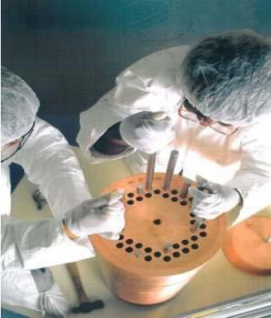
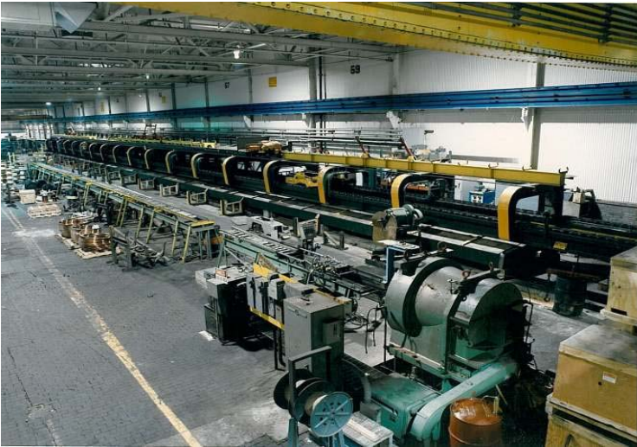
Mass production
Limited market and few sources
Fermilab aided industrial partners
NbTi acquisition / Expertise / Equipment provision
Wire is sent to Fermilab for Quality assurance and cabling
Close collaboration facilitated mass production
Contention between commerce and Fermilab
Being open with the scientific community
By 1974,
Production lines were more efficient and capable of mass assembly of NbTi.
Greater competition
Consistent performance
NbTi rod insertion into copper billet at Intermagnetics General Corp Image credit: IGC
Section: Rutherford Cable HEP application : Tevatron
Slide No:35
Notes:
Initially varied significantly within performance – finding it difficult to manufacture it to Fermilab's specifications.
Significant degradation factors of 3% were sent back. Few manufacturers initially – 3 / 4 major suppliers.
Carrot of incentive bonuses + stick of having wire sent back – Efficient assembly lines and mass production of NbTi.
Close collaboration with companies, Fermilab had consultants and technicians guide the manufacturers. Robert WIlson himself would visit!
Contention arose as Fermilab shared much of their data on wiring specifications and manufacturing techniques – commerce did not want to have other countries learn about this.
By 1974, production lines were more efficient and capable of mass assembly. More companies were able to contribute to the supply chain.
Rather than varying in performance – increased regulation and understanding meant that they were consistent. Rarely exceeding threshold degradation factor.

Slide 37
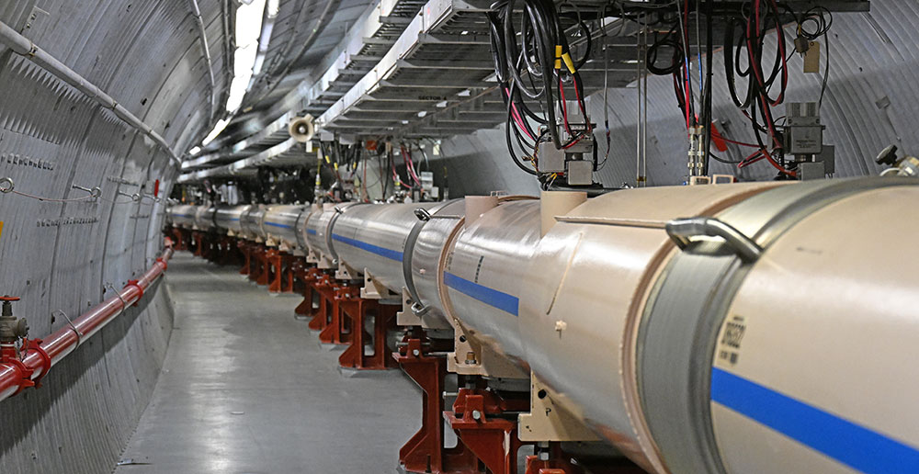
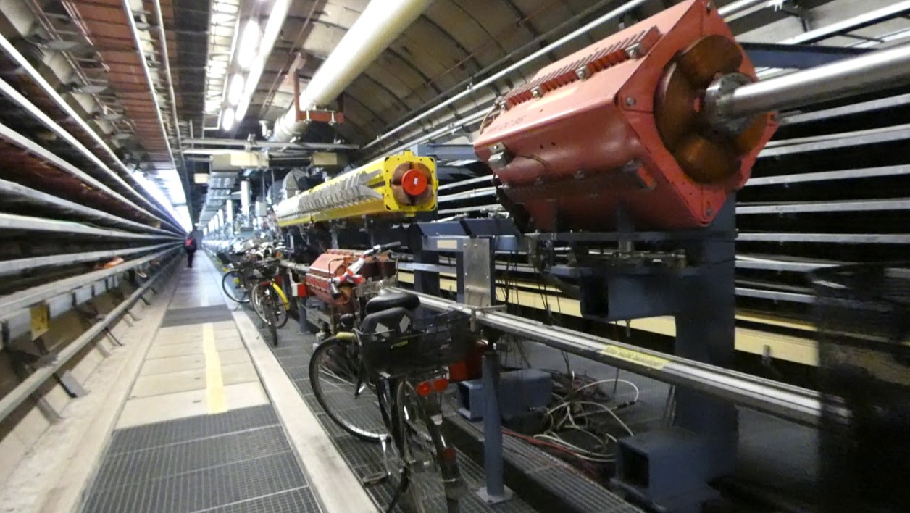
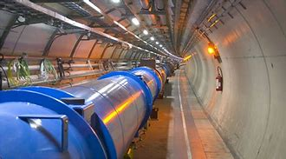
Realistic Heavy Ion collider (BNL)
HERA (DESY)
Large Hadron Collider (CERN)
High Luminosity-LHC (CERN)

Slide 38
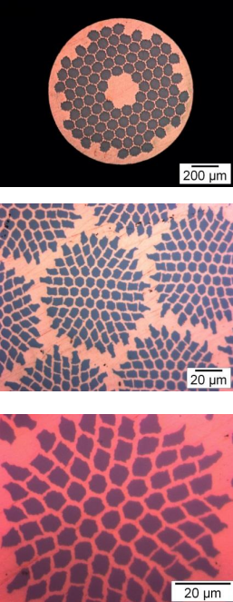
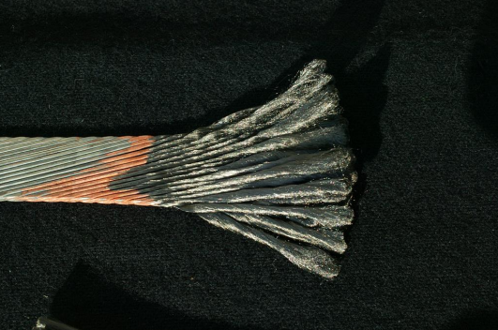
Rutherford Cable at the HL-LHC
With the HL-LHC generating an unprecedented magnetic field strength of 12 Tesla, the higher critical field of Nb₃Sn is required.
5 different types of Rutherford Cable are being produced for the HL-LHC.
3 NbTi and 2 Nb₃Sn strands
NbTi has been the dominant superconductor, but its reign may be coming to an end...
First series of cable production has been complete!
Section: Rutherford Cable HEP application
Slide No:37
Notes:
High temperature superconductors are vying for its position!
Several Kilometers have been wound as of 2023.
New technology that is capable of analysing structrual defects / lattice imperfections

Slide 39
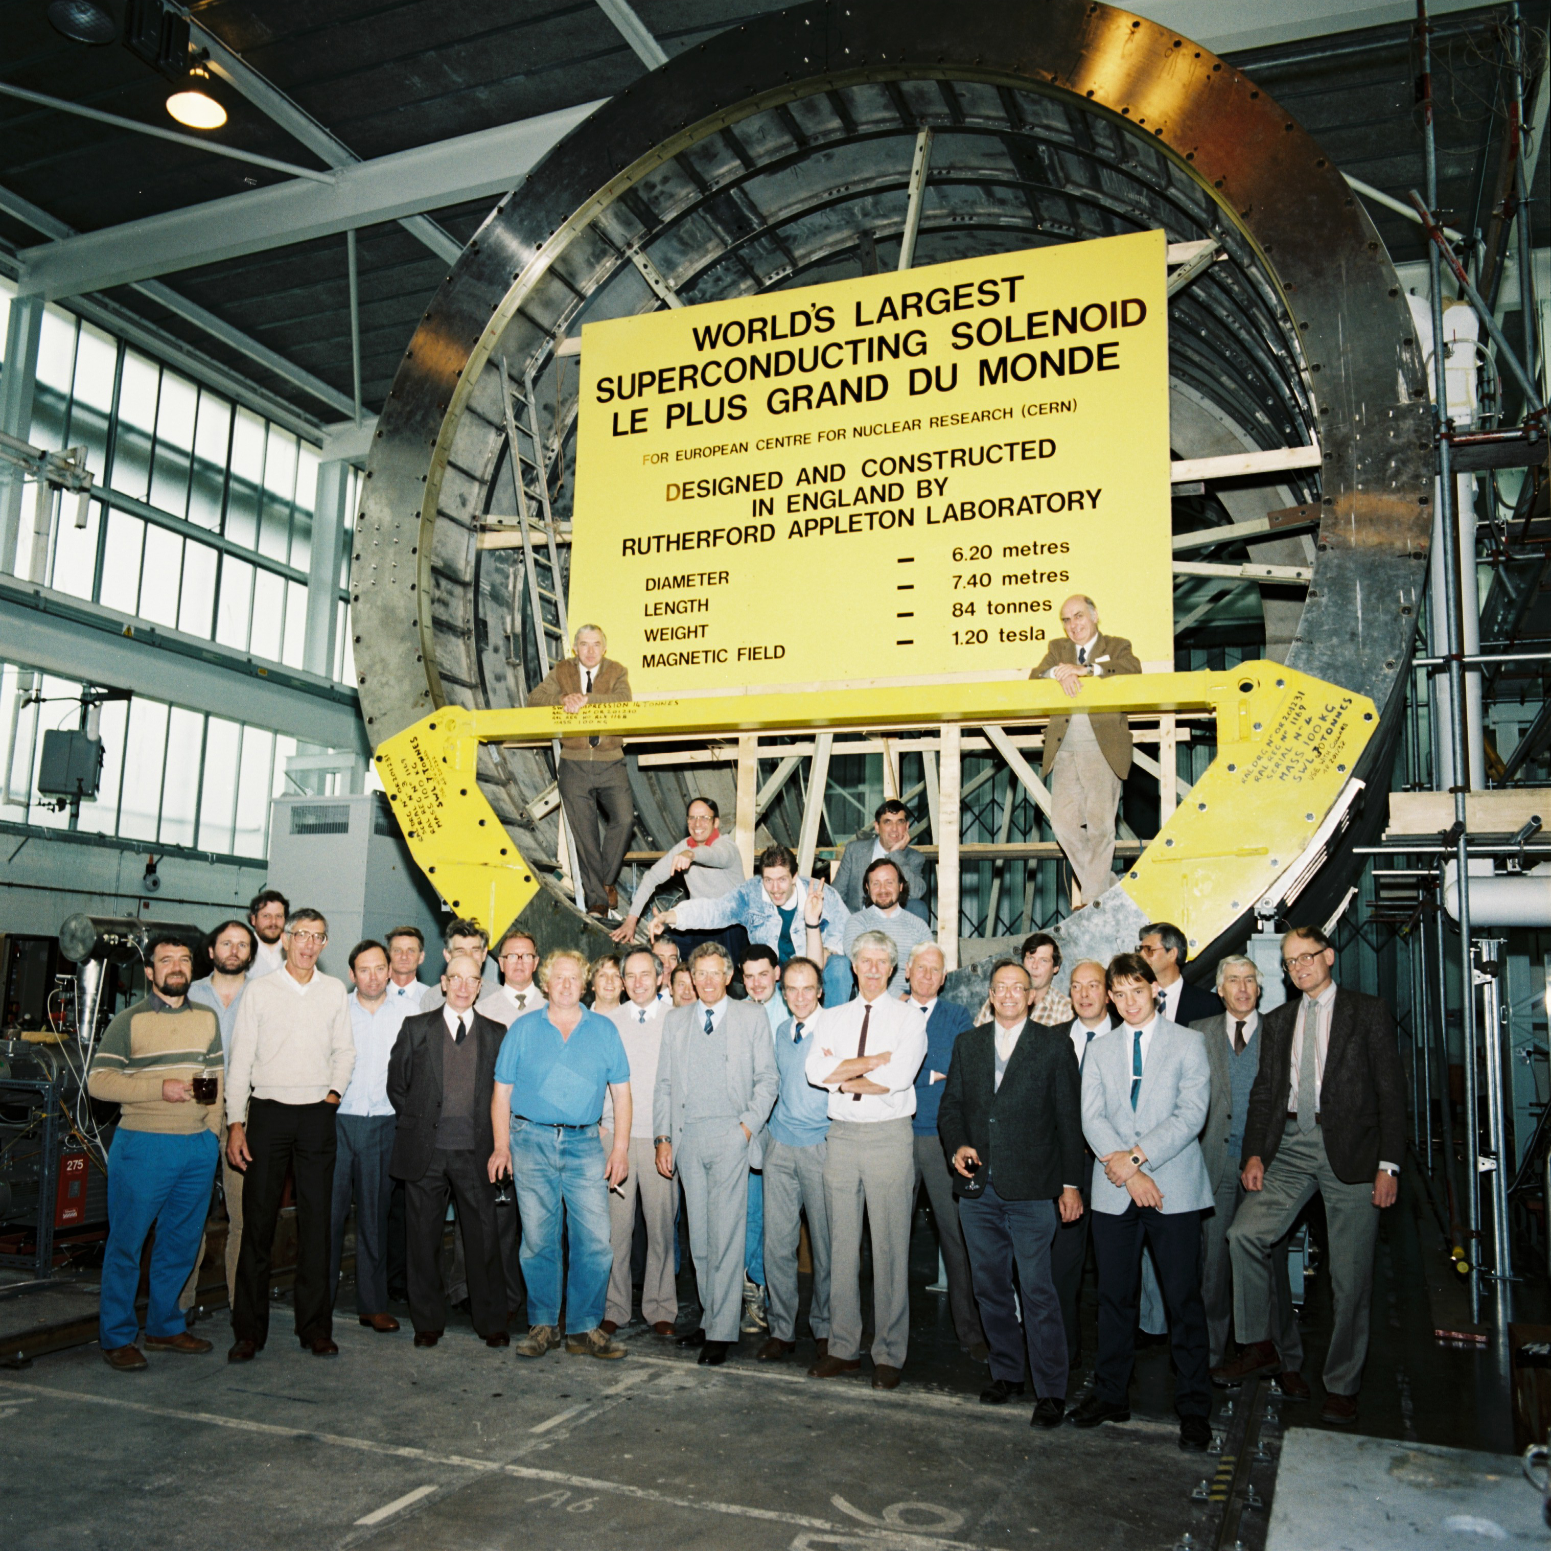
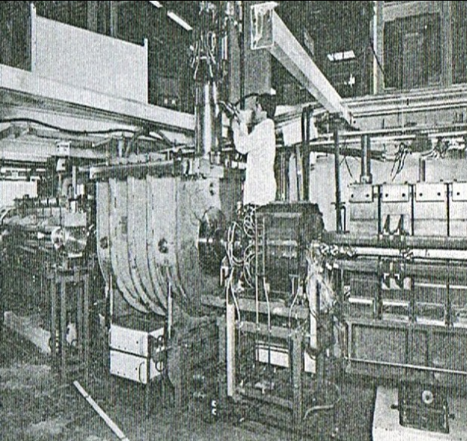
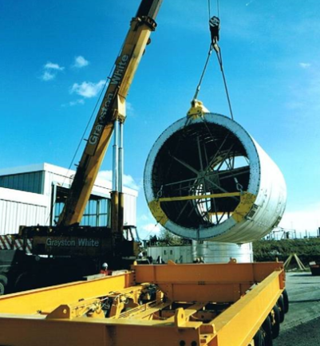
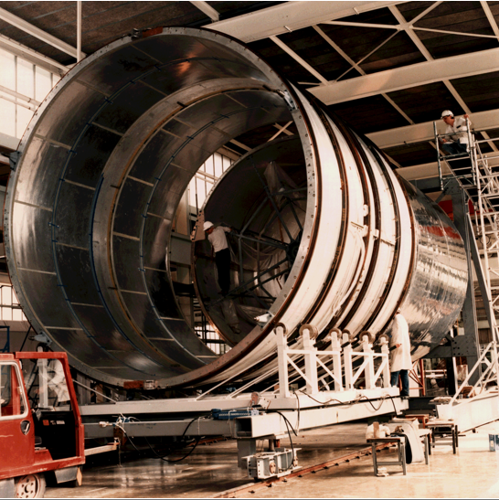
Rutherford Cable at RAL
Helical Undulator for polarised positron source
ILC prototype (2007)
5T Wiggler magnet for the Daresbury Synchrotron Radiation Source (1978)
Superconducting coils for the DELPHI solenoid at LEP (1983)
H1 coils at HERA -
22km of Rutherford Cable
Internal Winding (Inside of Cylinder) (1986)
Section: Rutherford Cable HEP application: RAL
Slide No:38
Notes:
Despite disappointment in '74, RAL continued to leverage its expertise and manufacturing capabilities to manufacture vast lengths of Rutherford Cable.
Developed a new technique termed internal winding of Rutherford Cable – essentially increased rate at which it could be assembled within the magnet.
Develoepd the cryogenics – cryogenics control box allowed for precise control of the coolant circulation.
Our focus was primarily towards detector solenoids.

Slide 40
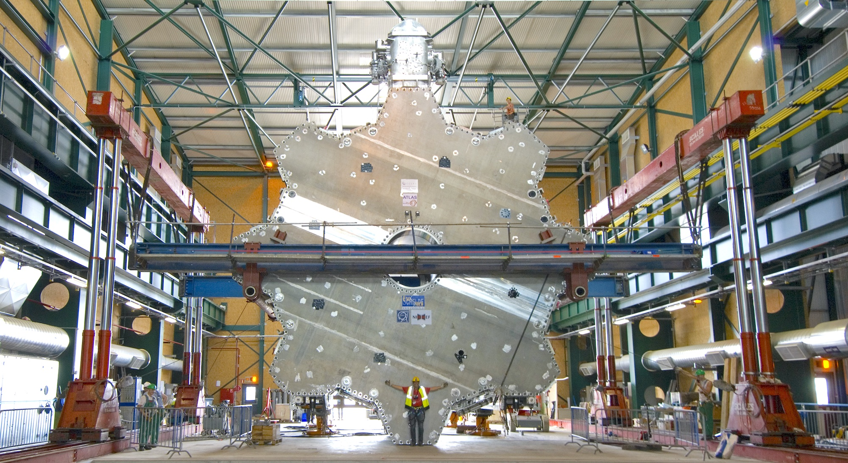
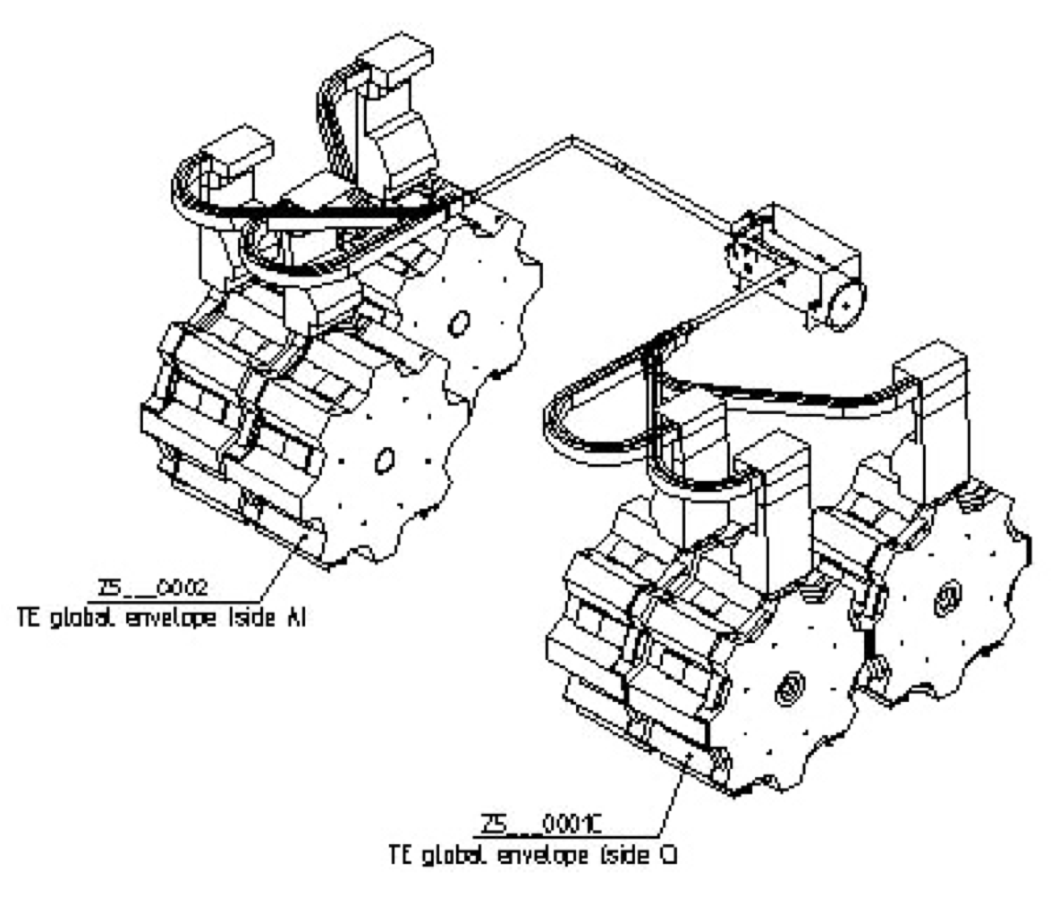
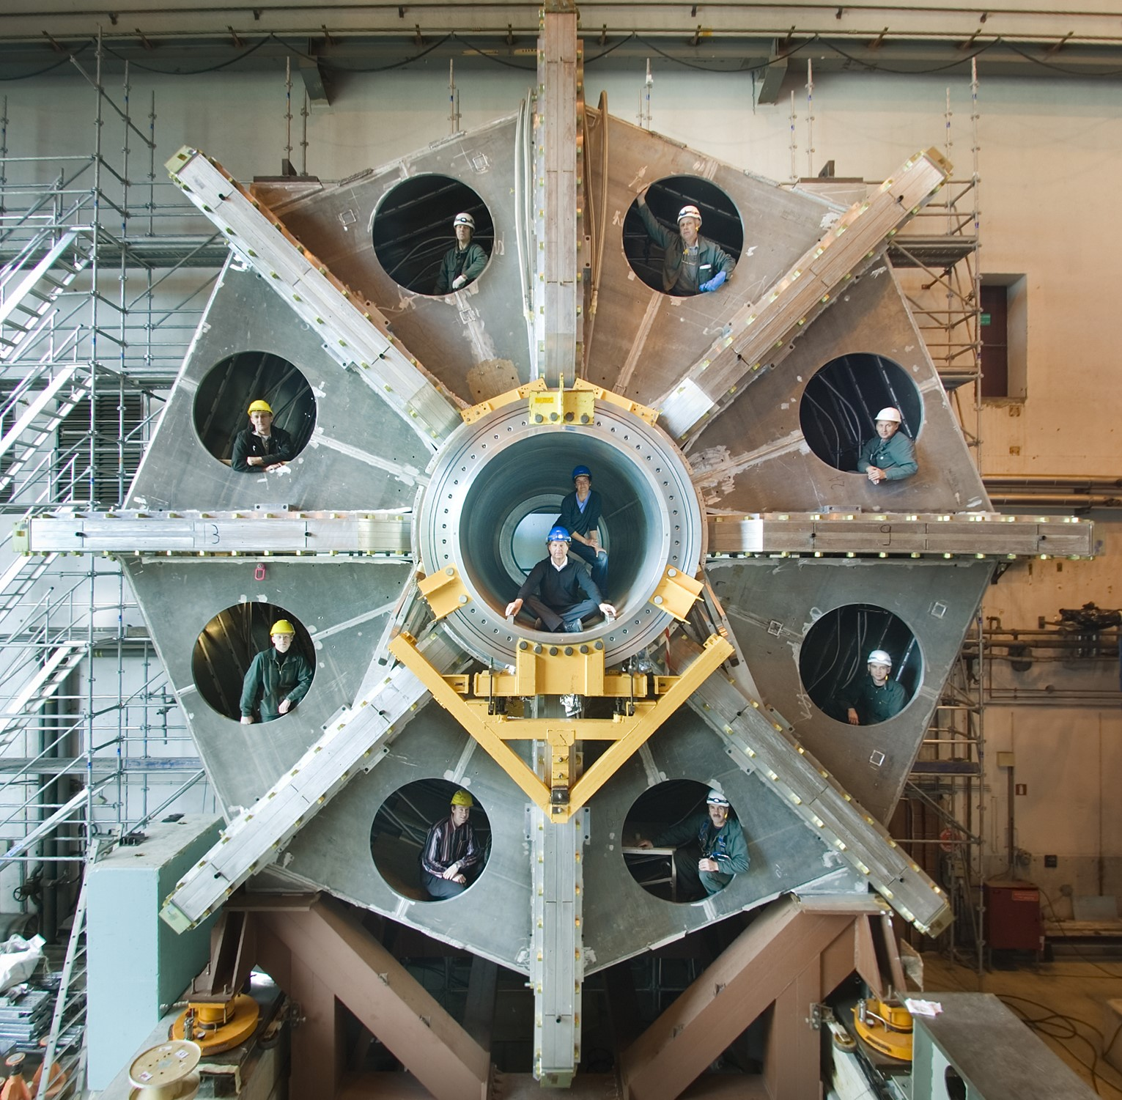
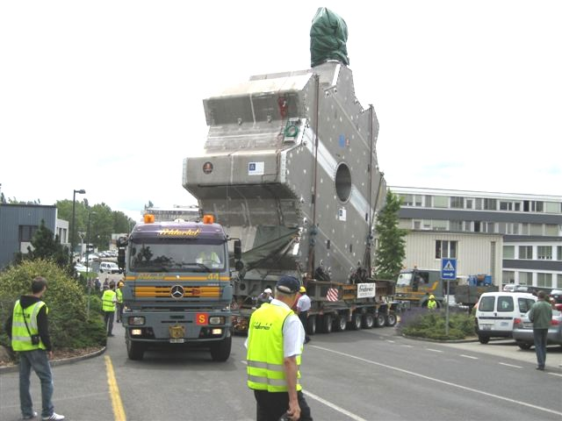
ATLAS End cap toroid
Engineering design and management for the ATLAS end cap toroid (1996 - 2007)
10m in diameter
120 tonnes of cold mass
Stores 250 MJ of energy
Aluminium matrix
Magnet heaters
Dynamic lines
Section: Rutherford Cable HEP application: RAL
Slide No:38
Notes:
LARGE COLD MASS STRUCTURE SUPPORTED BY 8 TOROIDS.
30km of Rutherford cable coils.
Emphasise here that we JUST DESIGNED it
High purity aluminum substituted the use of a copper matrix – high thermal and electrical conductivity.
Magnet heaters were present. 2 EC magnets have a combined energy storage of 400 MJ – kinetic of a energy freight train going at 100KPH. To limit the damage incurred during a quench, heaters were distributed throughout. They would fire if sensors surpassed a specific temperature threshold – distributing the energy evenly among all the coils. This would ensure the temperature never exceeded 100K
Dynamic lines – carried vacuum, electronics, cryogenics for both end caps. Allowed for them to adopt two positions when active and when being installed.
It took days to cool the 100s of Tonnes to cryogenic temperatures

Slide 41
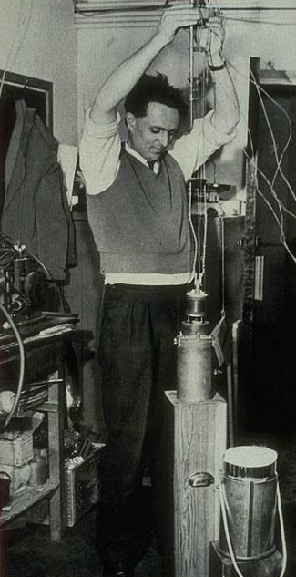
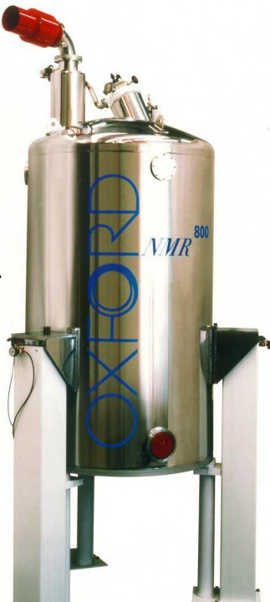
Beyond HEP applications
Oxford Instruments, in conjunction with Oxford University, developed superconducting joints, a pivotal part of NMR and MRI technology.
Oxford Instruments constructed magnets primarily for research purposes with their first product delivered in 1966.
First superconducting magnet for a NMR spectrometer
Nuclear Magnetic Resonance (NMR) is a technique very useful to biology and chemistry.
Superconducting magnets increased the precision and sensitivity
Martin Wood with prototype magnet in Clarendon Laboratory (1962)
Image courtesy of Oxford Instruments
NMR spectrometer (1979)
​
Image courtesy of Oxford Instruments
Section: Rutherford Cable application: Beyond HEP
Slide No:40
Notes:
Select applications to discuss.
Analysing precession frequency of nuclei within a magnetic field to help determine detailed information about the surrounding molecule.

Slide 42
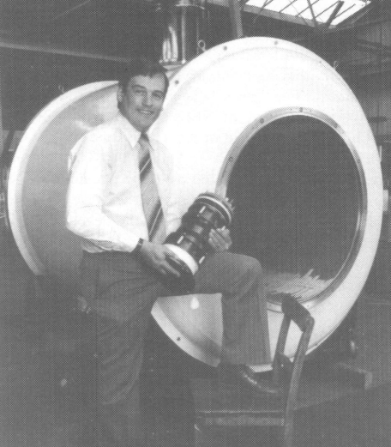
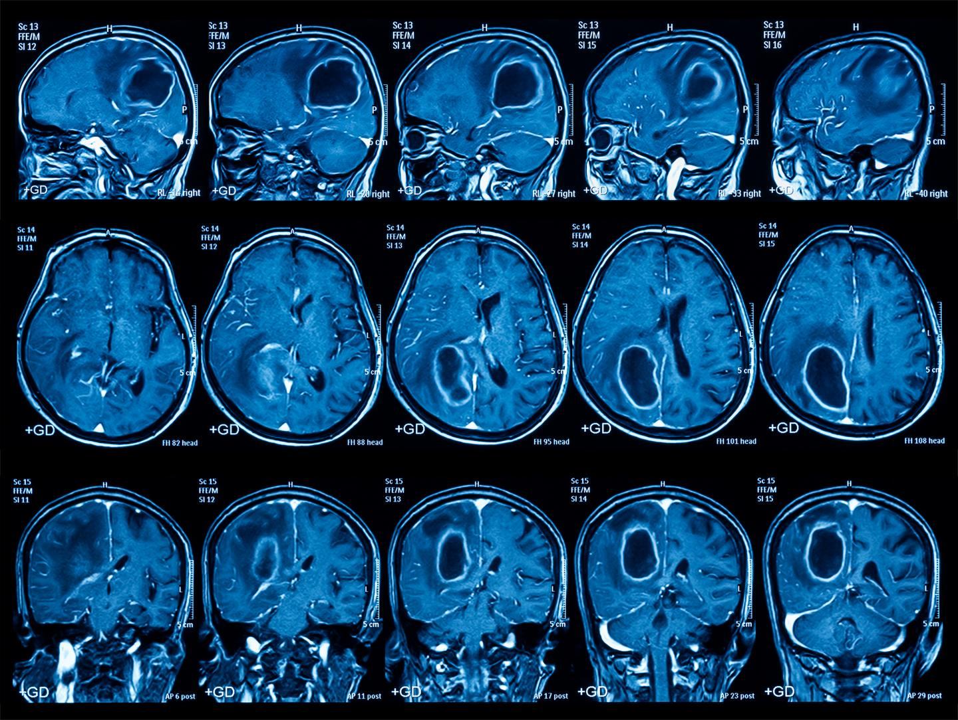
Beyond HEP applications: Medicine
Magnetic Resonance Imaging (MRI)
Used routinely in medical diagnostics.
Development of a superconducting joint
Decreasing power consumption and compact size.
First prototype was manufactured in 1979. Many MRI magnets now use Superconducting joints.
Accelerator based radiotherapy.
Accelerators accelerate the beam to specific energies and direct it at patients.
Targeting the tumour requires large costly infrastructure to attain correct energies and position the beam correctly.
Typical gantries are very large.
Superconducting magnets have been proposed for synchrotron gantries – involving Rutherford Cable.
First superconducting joint prototype
MRI imaging – Routinely used in medicine
Section: Rutherford Cable application: Beyond HEP
Slide No:41

Slide 43
To summarise
Superconducting filamentary composites and Rutherford Cable were first manufactured at RAL.
20 – 50 strands were compacted and transposed to operate within high currents.
RAL developed first prototype and constructed the Rutherford Cable for detector solenoids.
Few other innovations have left such an enduring legacy, not only has this technology providing great strides in superconducting technology, but it has also been used within every large-scale collider since.
For the foreseeable future, Rutherford Cable will serve as the DNA of superconducting magnets.

Slide 44
References
RAL Annual reports (Used from 1962 – 1972) Context dependent. Link
Professor Peter F Smith Brief history of applied superconductivity development at RAL 1960-76
M.N Wilson Superconductivity and its applications. 1979. Rutherford Appleton Laboratory. Digitised version found under technology and engineering section – Link
M.N Wilson A century of superconducting technology 2012, AIP Conference Proceedings, 1435, 11 – 35
M.N Wilson Personal Communication (2024)
Superconductors accelerate progress, Link
J. D. Lewin, P. F. Smith, A. H. Spurway, C. R. Walters, and M. N. Wilson, Experimental and Theoretical Studies of Filamentary Superconducting Composites (1969) RAL preprint
P.F Smith The superconducting program at the Rutherford Laboratory (1967) Conference Proceedings: MT-2 Oxford, England 670711 543 – 546
P.J Lee, B Strauss, M.N Wilson, B. Marancik, E. Gregory, J. Ekin, A Greene Nb-Ti From beginning to perfection (2011)
M.N Wilson Superconducting Magnets for Accelerators Presentation – Indico (Slides 15 - 34)
G. Bronca, P. Genevy, F. Kircher, J. Perot, J.P Pouillange, G. Prost Pulsed Superconducting magnets (1972) Conference Proceedings 4th International Conference on Magnet Technology, BNL, 203 – Link
G. Gallagher Daggit SUPERCONDUCTING CABLES FOR PULSED DIPOLE MAGNETS (1975) Report number: RHEL-M-A25
J.B Thomas Superconducting magnets: Proceedings of the 9th International conference for high energy accelerators (1974) Stanford Pg 185 - 190
Elwyn Baynham. Personal communication (2024)
Superconducting Magnets, Proceedings of the CERN–Accelerator–School course: Introduction to Accelerator Physics, Gijs de Rijk (2021)
Judy Jackson ‘Down to the Wire’ Article within Beam Line periodical (Spring 1993) 23, 1, 14 - Link
IEEE honors game-changing Tevatron technology (fnal.gov)
Various issues of Bulletin. Found via this link - Bulletin Issues from Spring 1972 and 1989
General references
Explanation of BCS and GLAG theory (explanation is not present in article though helps understand the content). Videos from - 75th Anniversary of the Discovery of Superconductivity | IEEE Council on Superconductivity (ieeecsc.org)
Frontiers | Accelerators, Gantries, Magnets and Imaging Systems for Particle Beam Therapy: Recent Status and Prospects for Improvement
Asner, Fred M, High Field Superconducting Magnets (Oxford, 1999; online edn, Oxford Academic, 31 Oct. 2023), https://doi.org/10.1093/oso/9780198517641.001.0001,

