Slide 1
The Development of the Compact Cherenkov Detector HEPI - the High Energy Proton Instrument for Satellite Missions
Dr Joseph O'Neill
IOP Nuclear Physics Conference 2025
23-25 April | Manchester

Slide 2
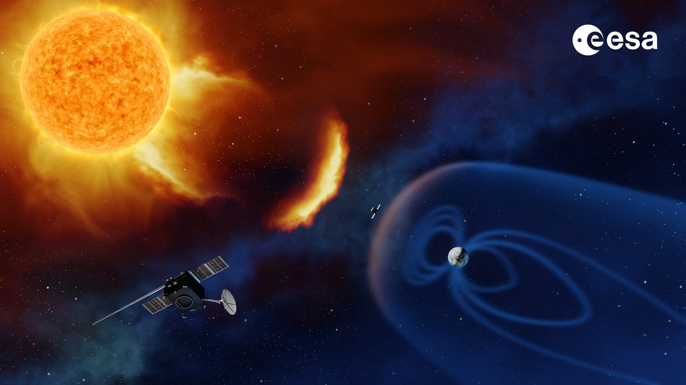
Overview
What is Space Weather, and what are SPEs?
How do Cherenkov detectors work?
HEPI's design
Lab benchmark tests
Beam test investigations
Future work and missions
From ESA website

Slide 3
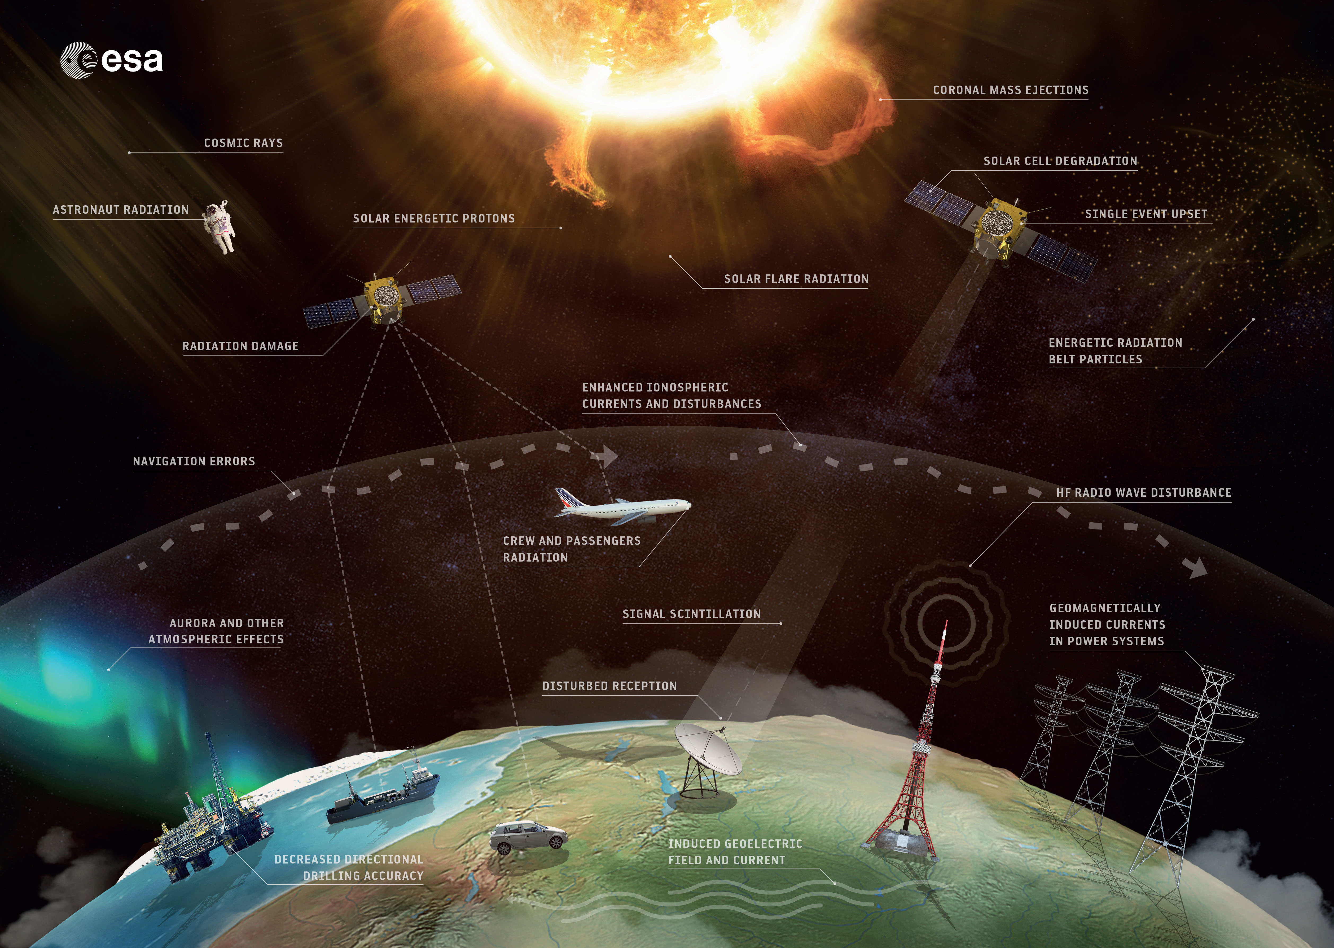
Motivation – What Is "Space Weather"?
Space weather describes the environment of near-Earth space
Space – satellite degradation, astronaut received dose, lunar base impacts
Air – cabin crew and passenger dose, instrumentation
Land – impact on satellite reception, power infrastructure
From ESA website

Slide 4
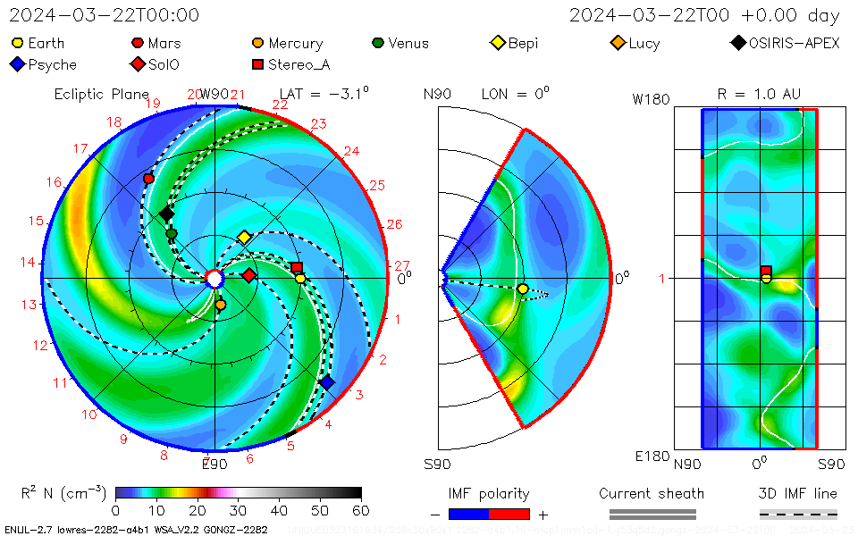
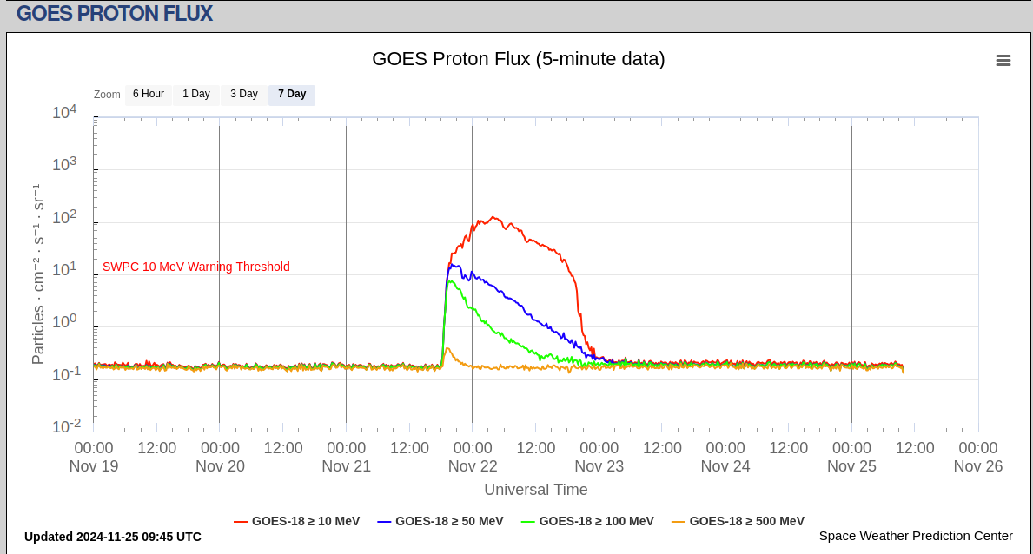
Motivation – What Are SPEs?
Protons emitted in Solar Particle Events (flares, coronal mass ejections) can be accelerated to GeV levels
Few instruments are monitoring the near-Earth space weather environment
A constellation of Cherenkov >300 MeV proton detectors would aid the understanding of the environment, and provide information during SPEs -> ESA’s HEPI project!
Taken from spaceweather website
Taken from Space Weather Prediction Center website

Slide 5
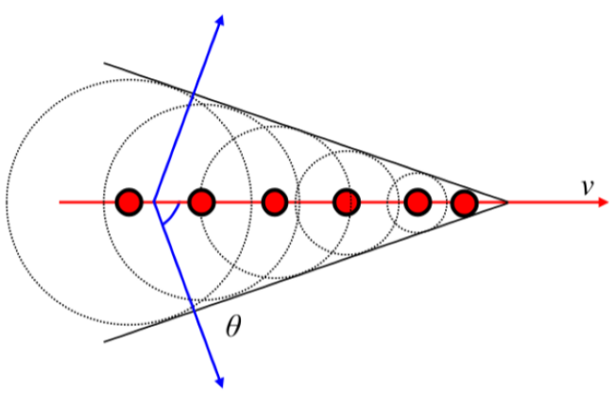
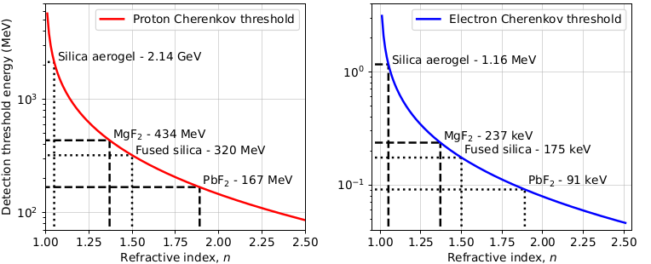
Mechanism – How Do Cherenkov detectors Work?
Cherenkov radiation is emitted by charged particles travelling faster than the speed of light in a dielectric medium
Each particle species will have an inherent Cherenkov threshold energy, dependent on the refractive index of the medium
Previous missions have used large volume Perspex, quartz and PbF₂ radiators to monitor heavy GCRs, proton and electron fluxes

Slide 6
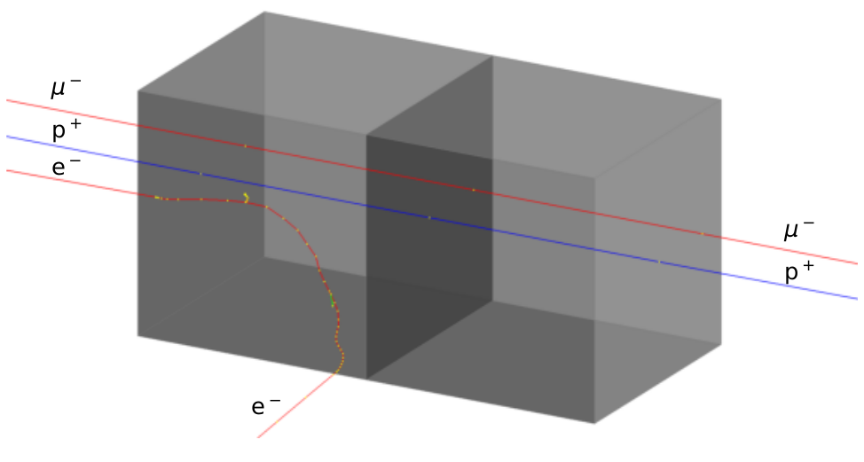
HEPI – Detector Design
The High-Energy Proton Instrument (HEPI) consists of two Cherenkov modules – each consisting of a 10x10x10 mm radiator coupled to a 6x6 mm SiPM
Several materials with Cherenkov thresholds ~300 MeV for protons were chosen to investigate – fused silica, MgF₂, PbF₂, Perspex
Two radiators are used to provide particle species discrimination between protons and electrons in the energy ranges expected in LEO

Slide 7
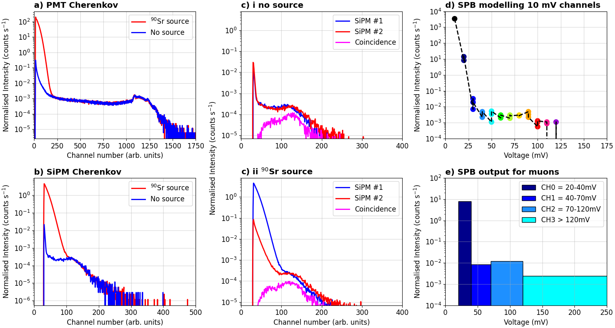
HEPI – Benchtop Measurements
Benchtop measurements using beta sources and muons to stand in for protons
Muon coincidence can be seen to remove electrons and noise
SPB output can be used , with gates set to distinguish between electron edge and the muon signals

Slide 8
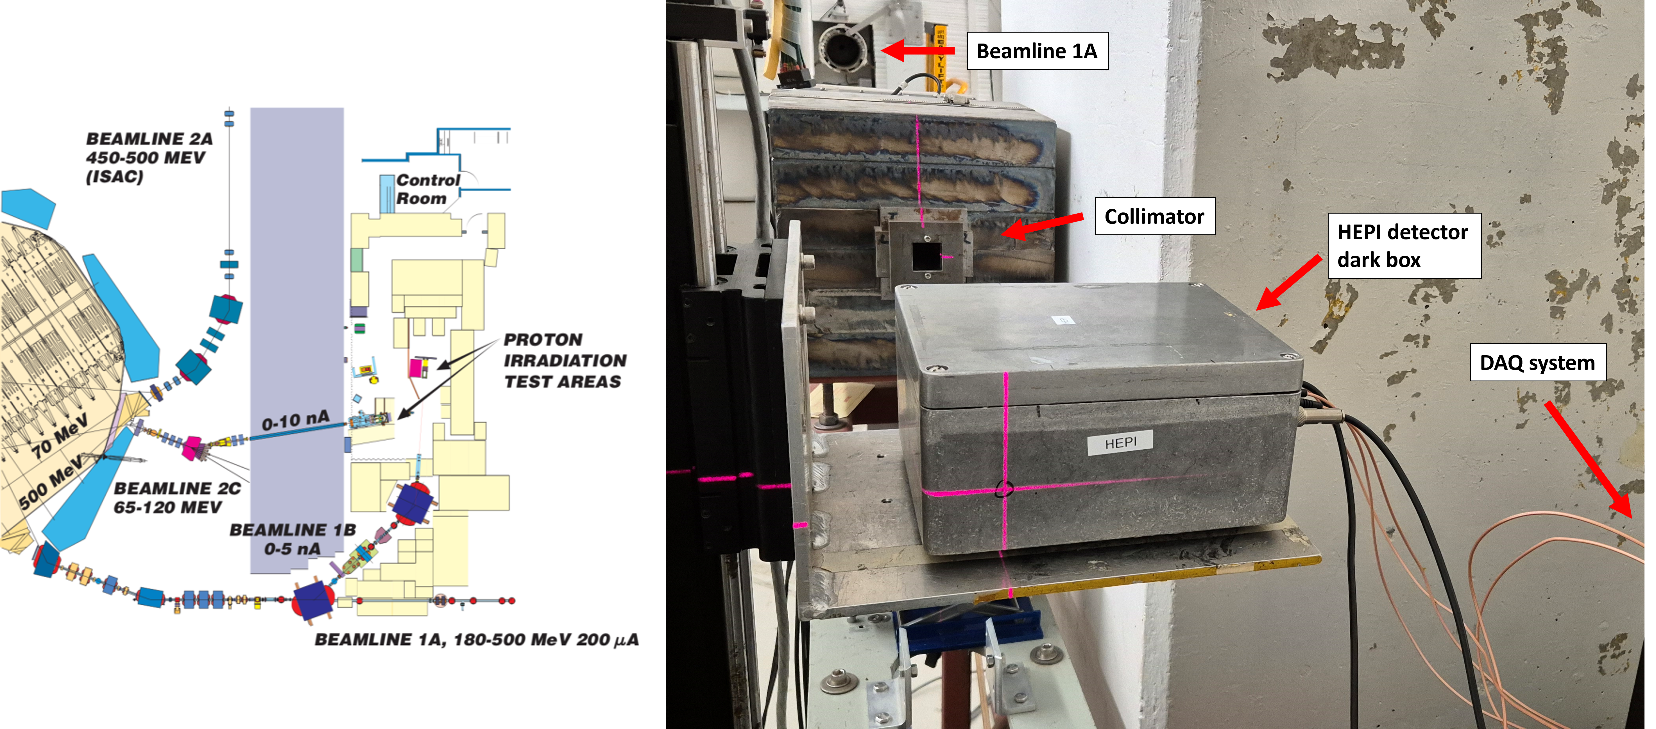
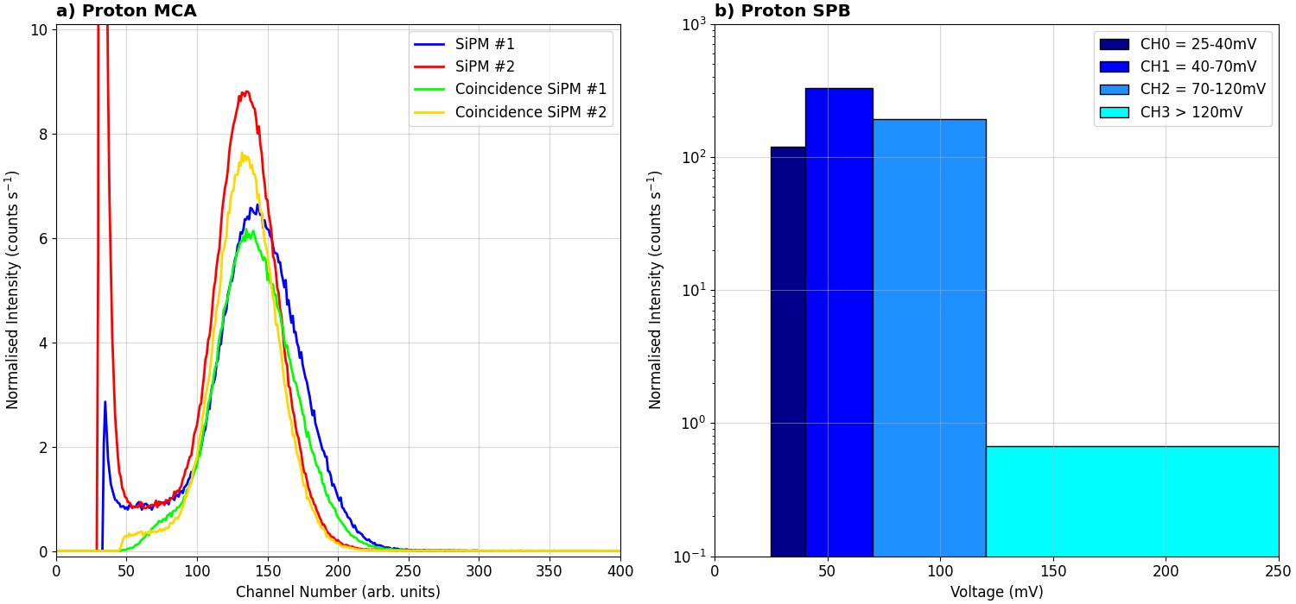
HEPI – Beam Measurements
Beam test performed at TRIUMF in July 2024, with 355 and 480 MeV proton beams
44 measurements with 10 detectors investigated over 3 shifts
Main studies: proton response, SPB performance, energy response, flux response
Development manuscript under review at JSWSC

Slide 9
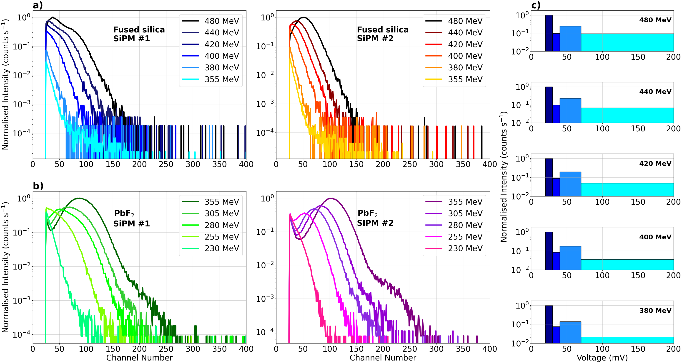
HEPI – Beam Measurements Energy Study
Beam energy decreased using steel attenuators : 480-380 MeV and 355-230 MeV
Measurements taken such that the energy approaches each radiator's Cherenkov threshold: F.S. = 320 MeV, PbF₂ = 167 MeV
Can be seen that as the energy approaches the threshold, the light yield decreases
This corresponds to protons losing energy as they pass through the radiator crossing the threshold

Slide 10
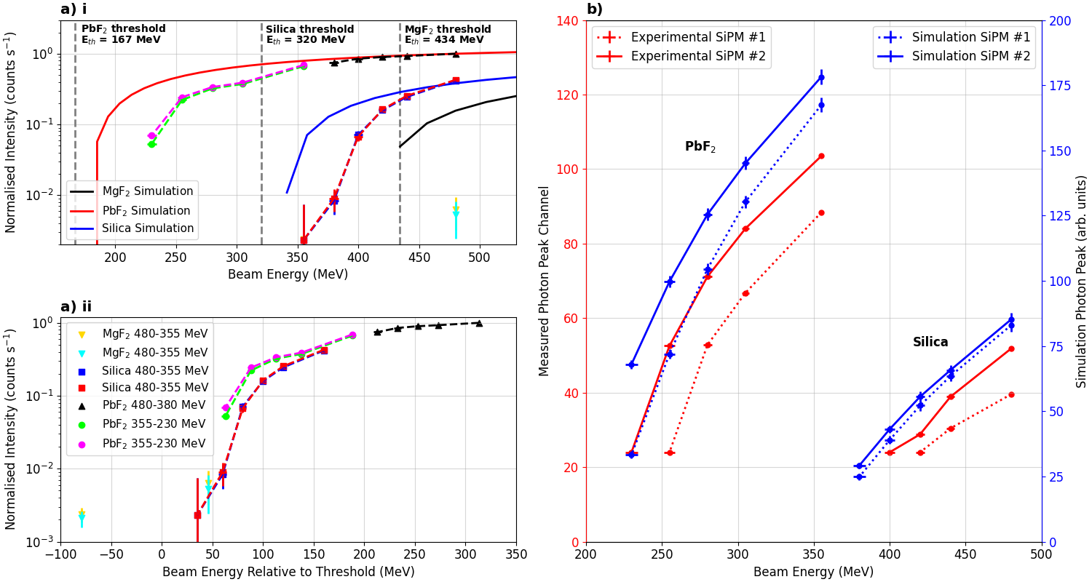
HEPI – Beam Measurements Energy Study
The “true” threshold for HEPI using each material can be determined by comparing energies relative to the threshold
The detector system has a blind spot within ~50 MeV of the theoretical threshold
The impact of the direction of the emitted Cherenkov photons relative to the SiPM can be seen
Threshold study manuscript accepted at NIM A on 10th April

Slide 11
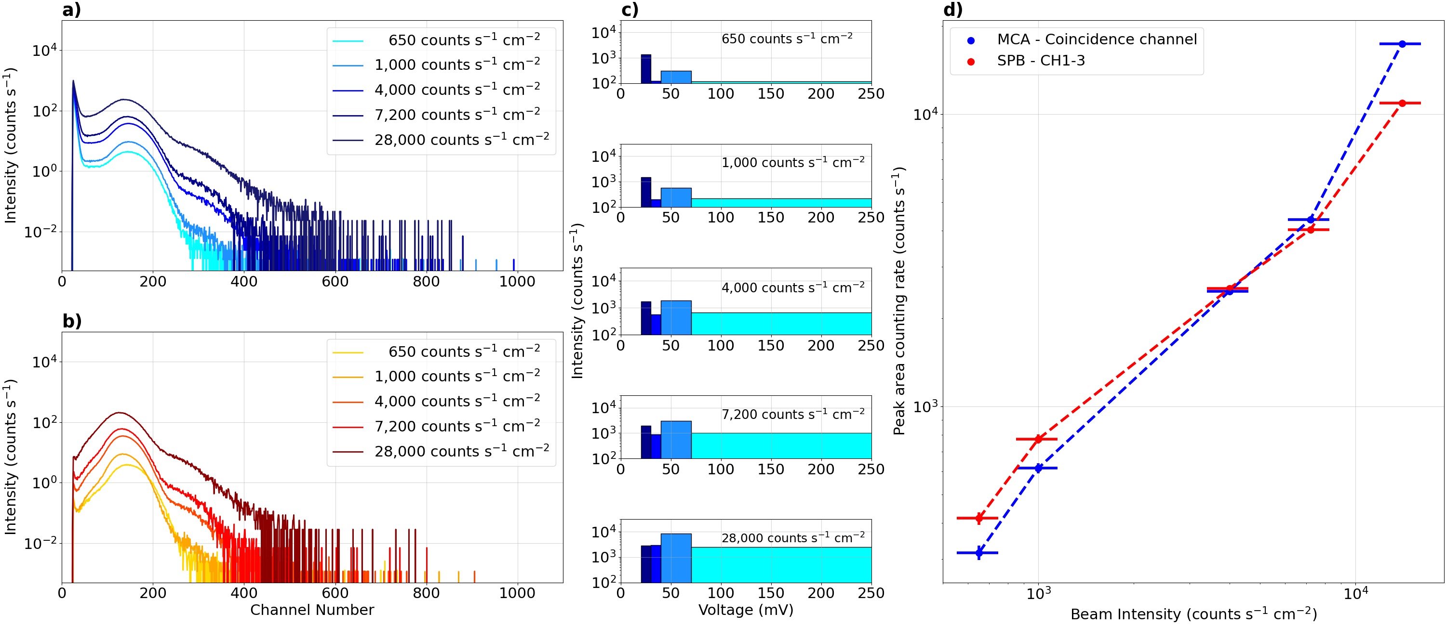
HEPI – Beam Measurements Flux Study
Measurements taken at 480 MeV with varying beam flux 10²-10⁵ counts s⁻¹ cm⁻²
Noticeable displacement damage in the SiPM observed in the dark currents of the detectors at higher fluxes
Systematic offset in the reported beam flux

Slide 12
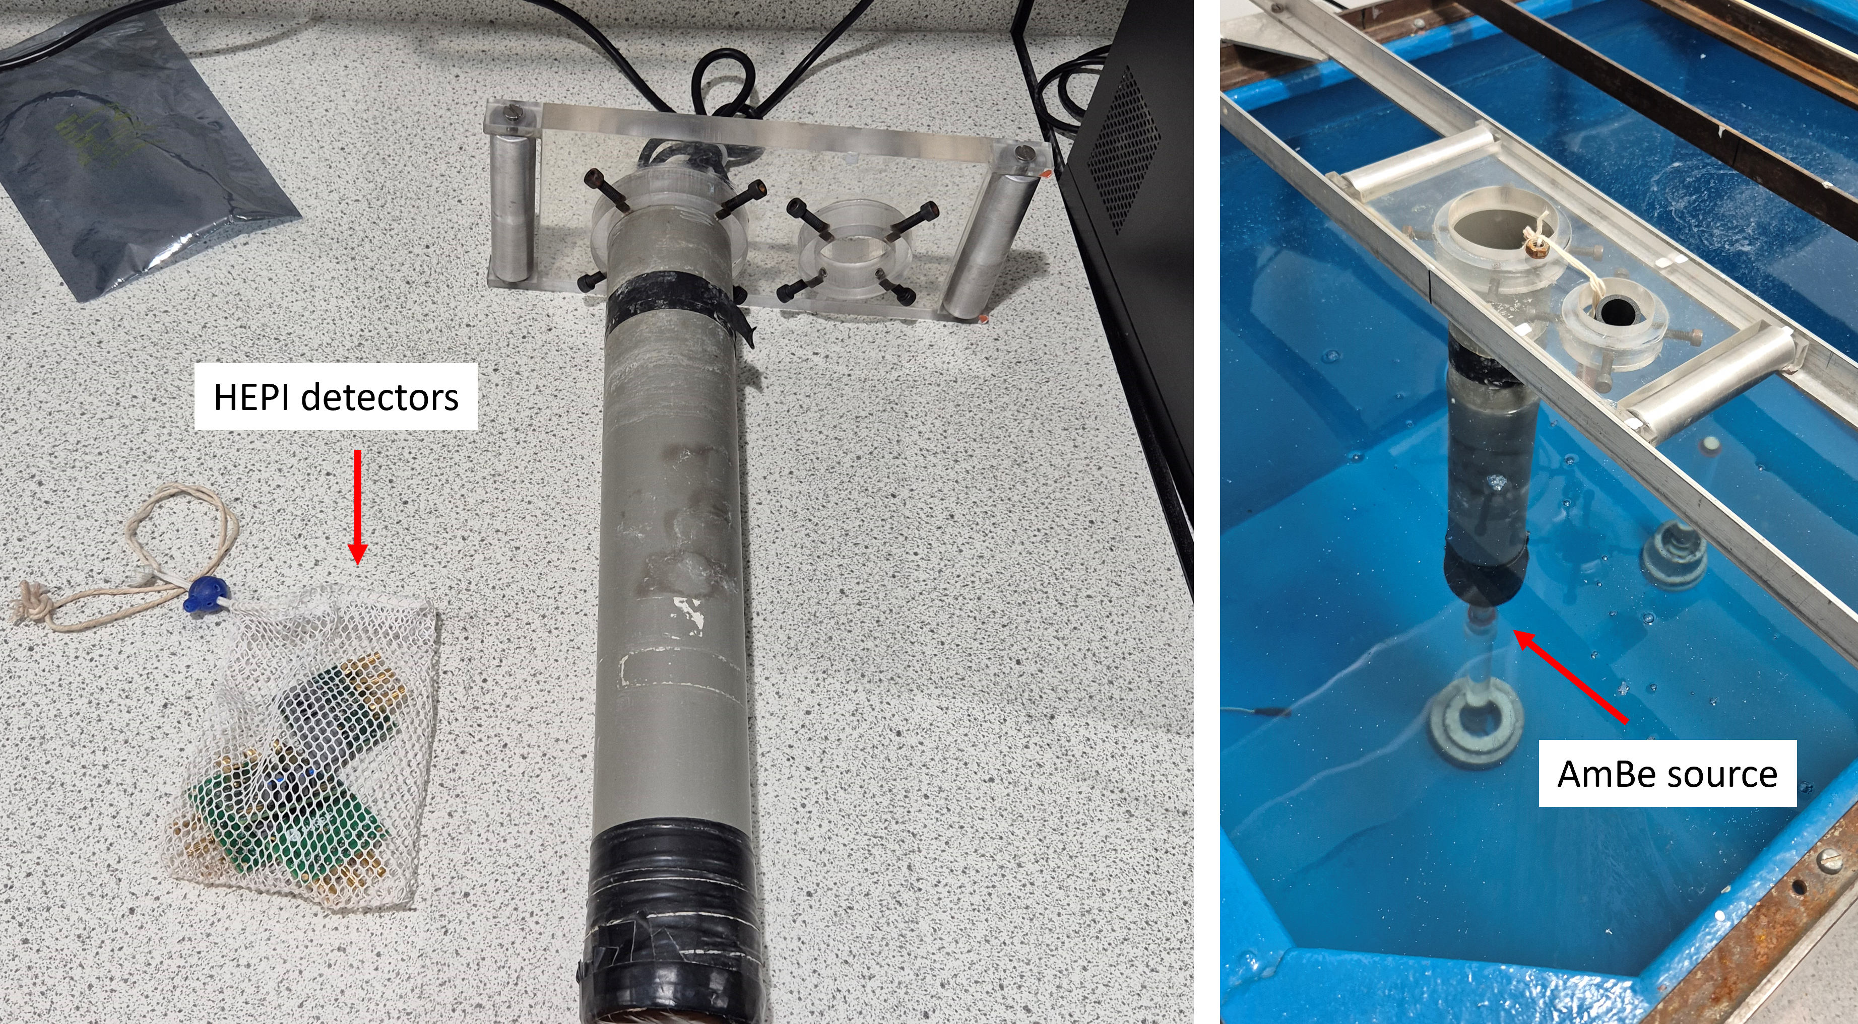
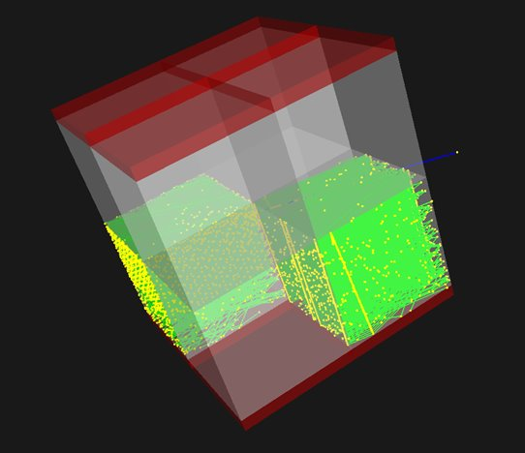
HEPI – Next Steps
Ongoing studies
Radiation damage study – electrons, neutrons, protons
Simulation package in Geant4
Future work
Further beam tests investigating telescope capability
Expanding geometry – Cherenkov telescope!
Radiators with different energy thresholds
Preparations for CubeSat integration for launch next year, looking towards ISS and lunar missions!
From BBC website

Slide 13
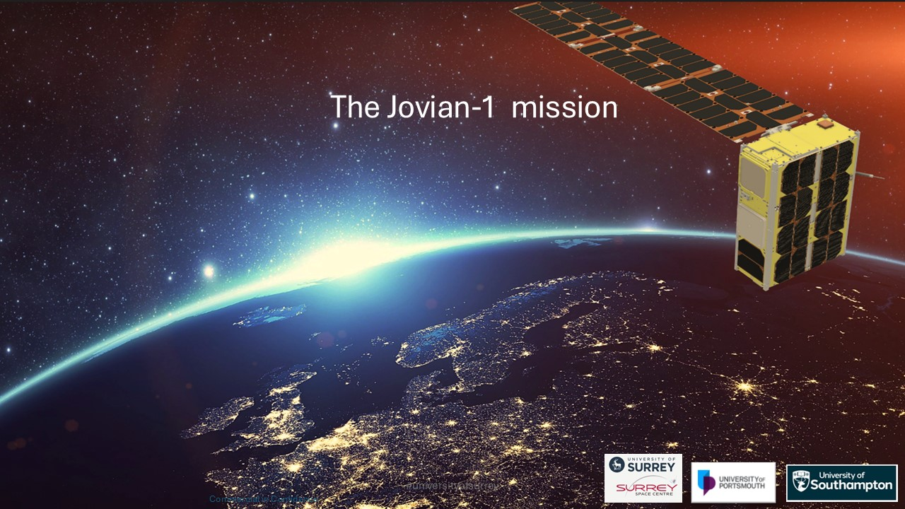
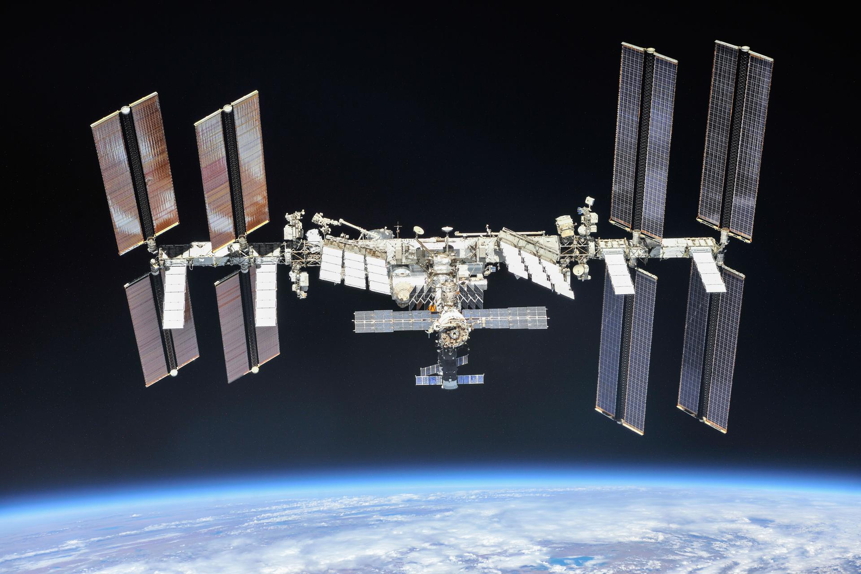
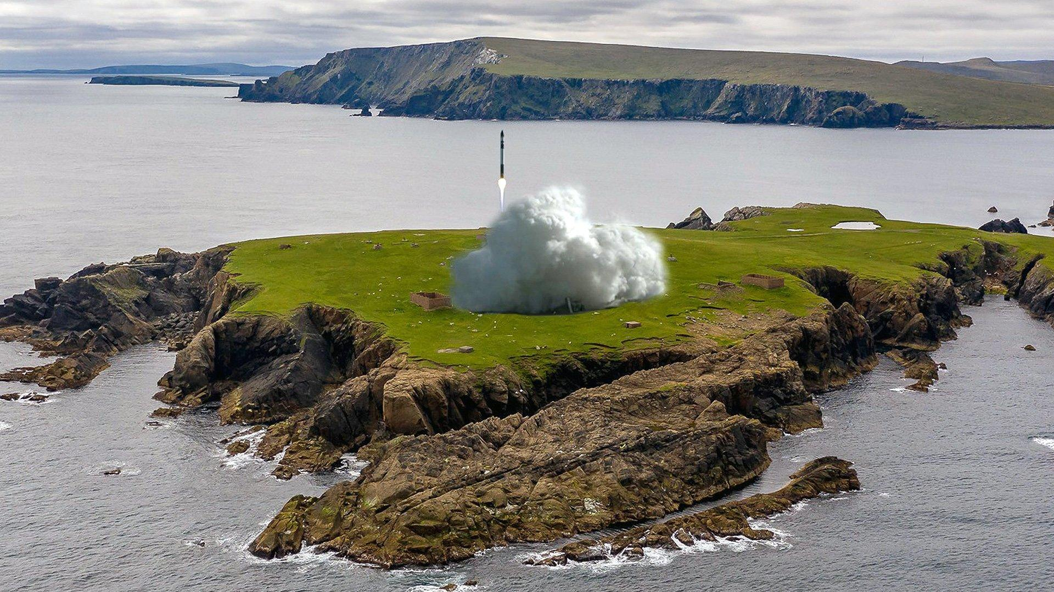
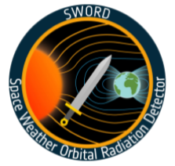
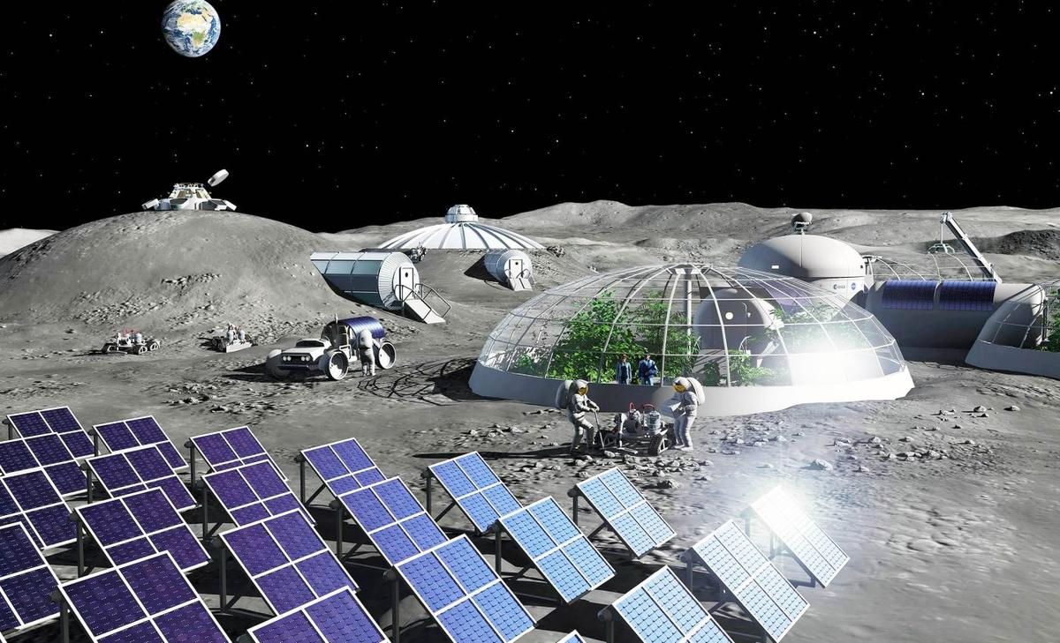
HEPI – Missions!
Scheduled
Potential/Aspirational
From NASA website
From NASA website
From BBC website
From ESA missions update
From NASA website

Slide 14
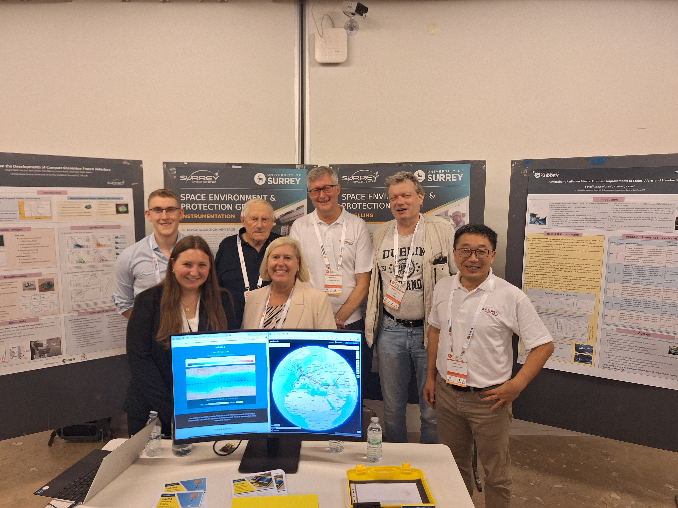
Acknowledgements
My thanks to my colleagues on this work:
Fraser Baird, Ben Clewer, Clive Dyer, Fan Lei, Paul Morris, Keith Ryden, Paul Sellin, Melanie Heil, Piers Jiggens, Giovanni Santin

Slide 15
Any questions?

Slide 16
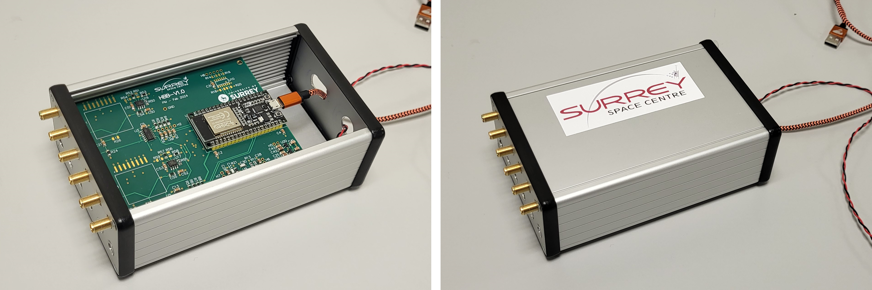
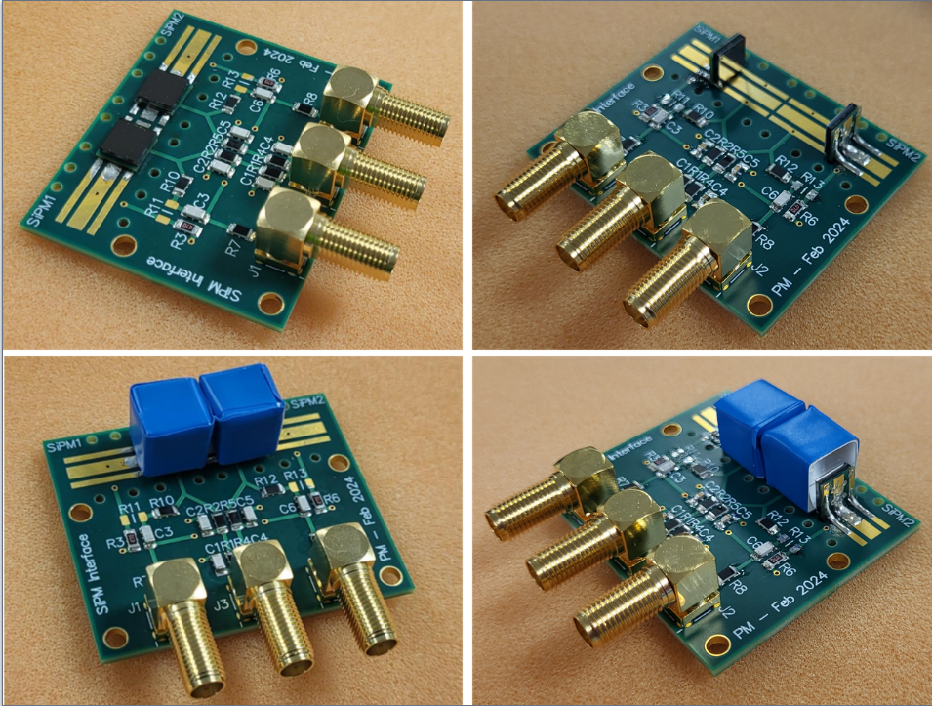
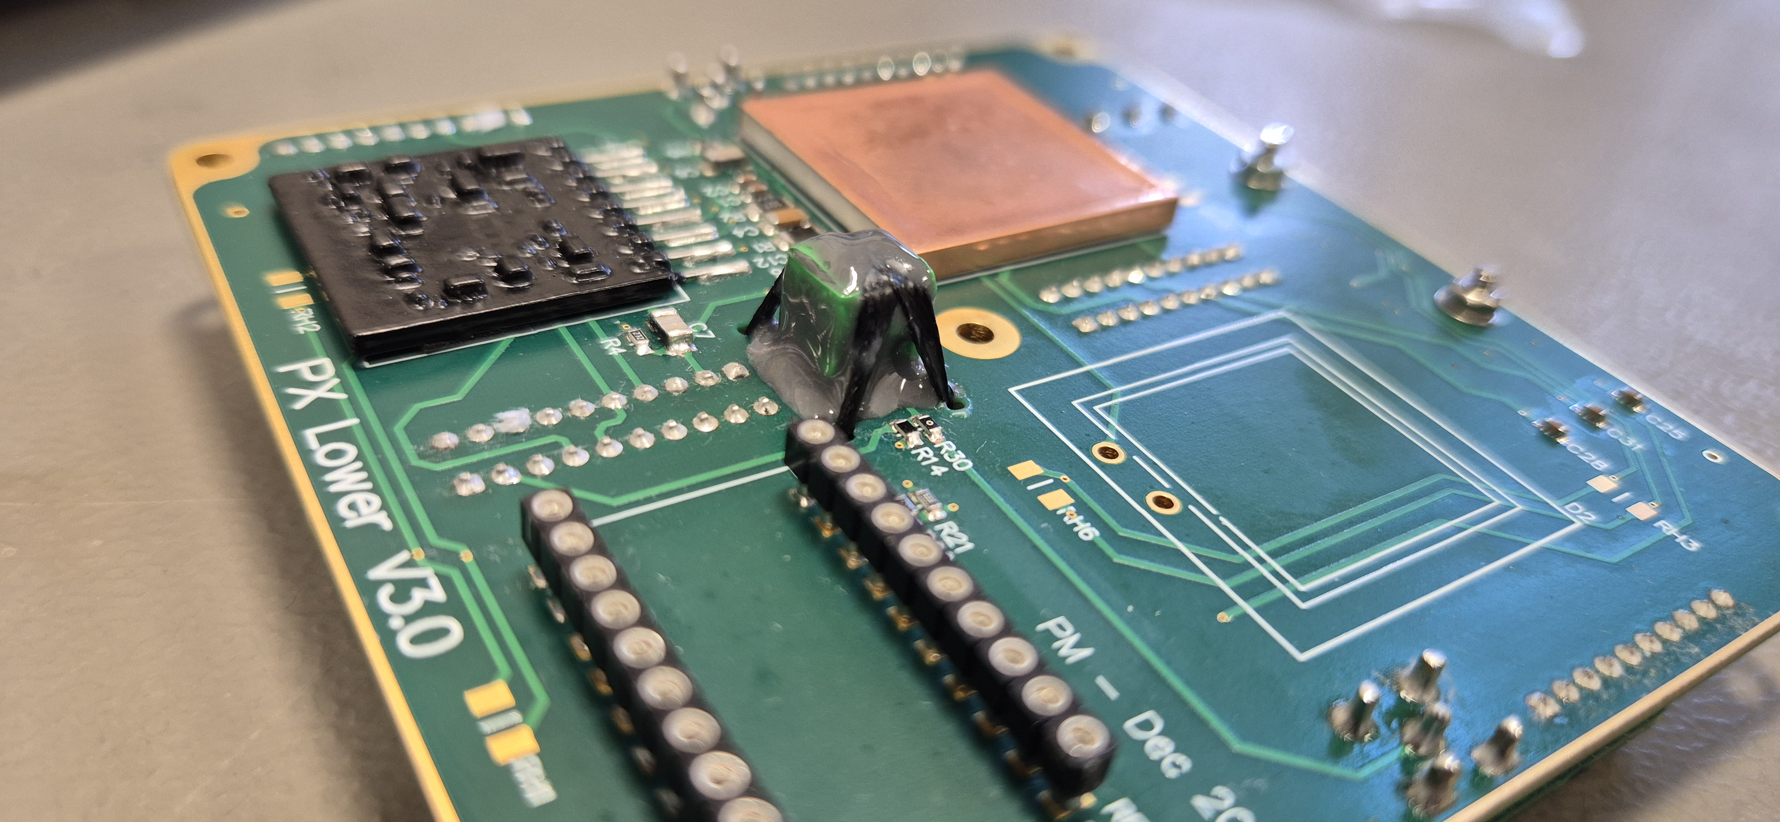
Extra Photos

Slide 17
Design specifics/beam energies

Slide 18
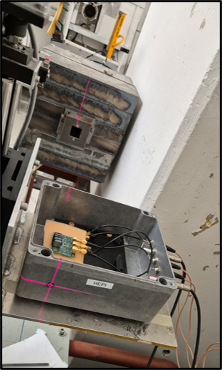
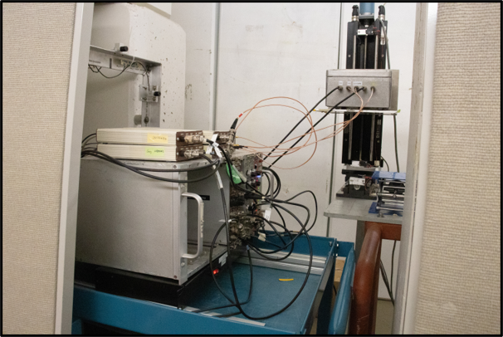
Extra Beam Test Photos

Slide 19
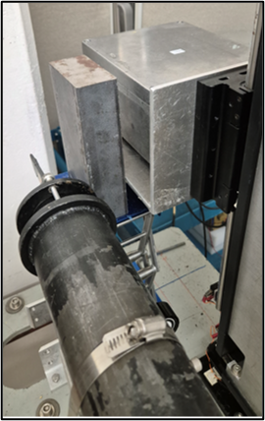
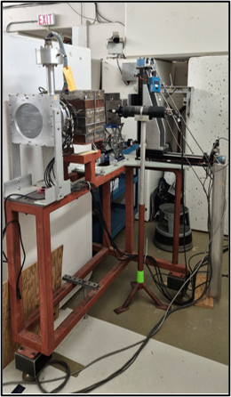
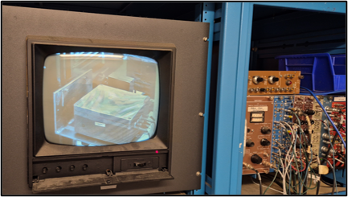
Extra Beam Test Photos

Slide 20
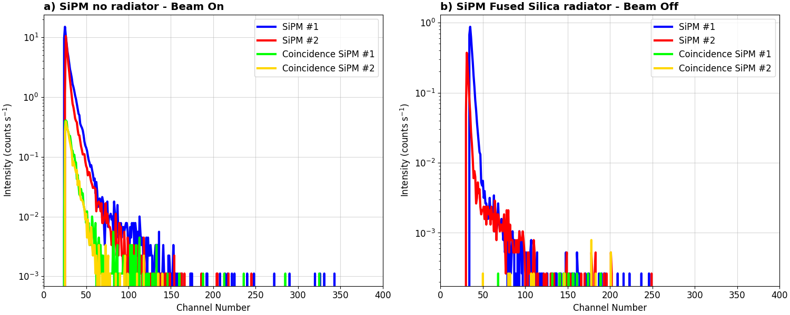
Beam Test backgrounds

Slide 21
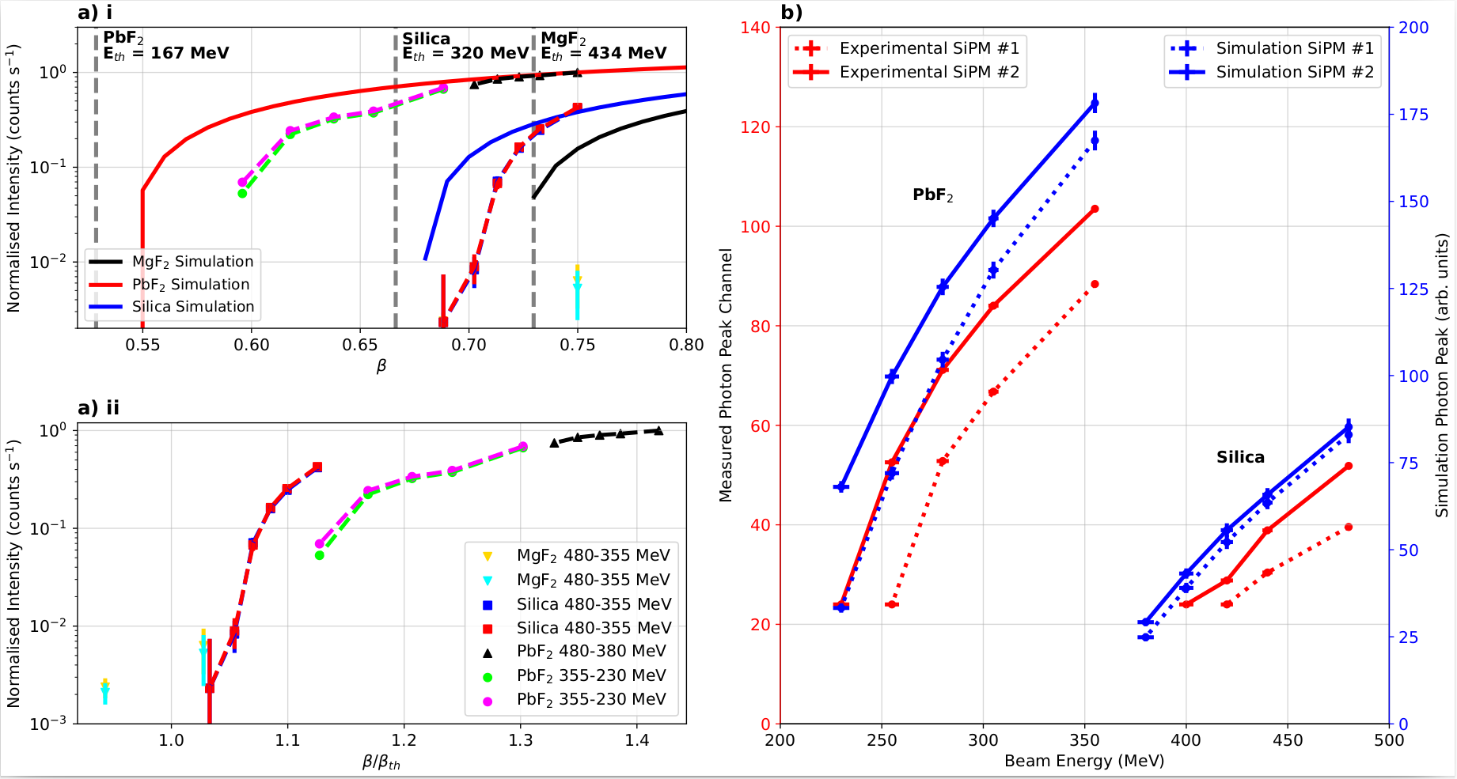
Thresholds beta frame

Slide 22
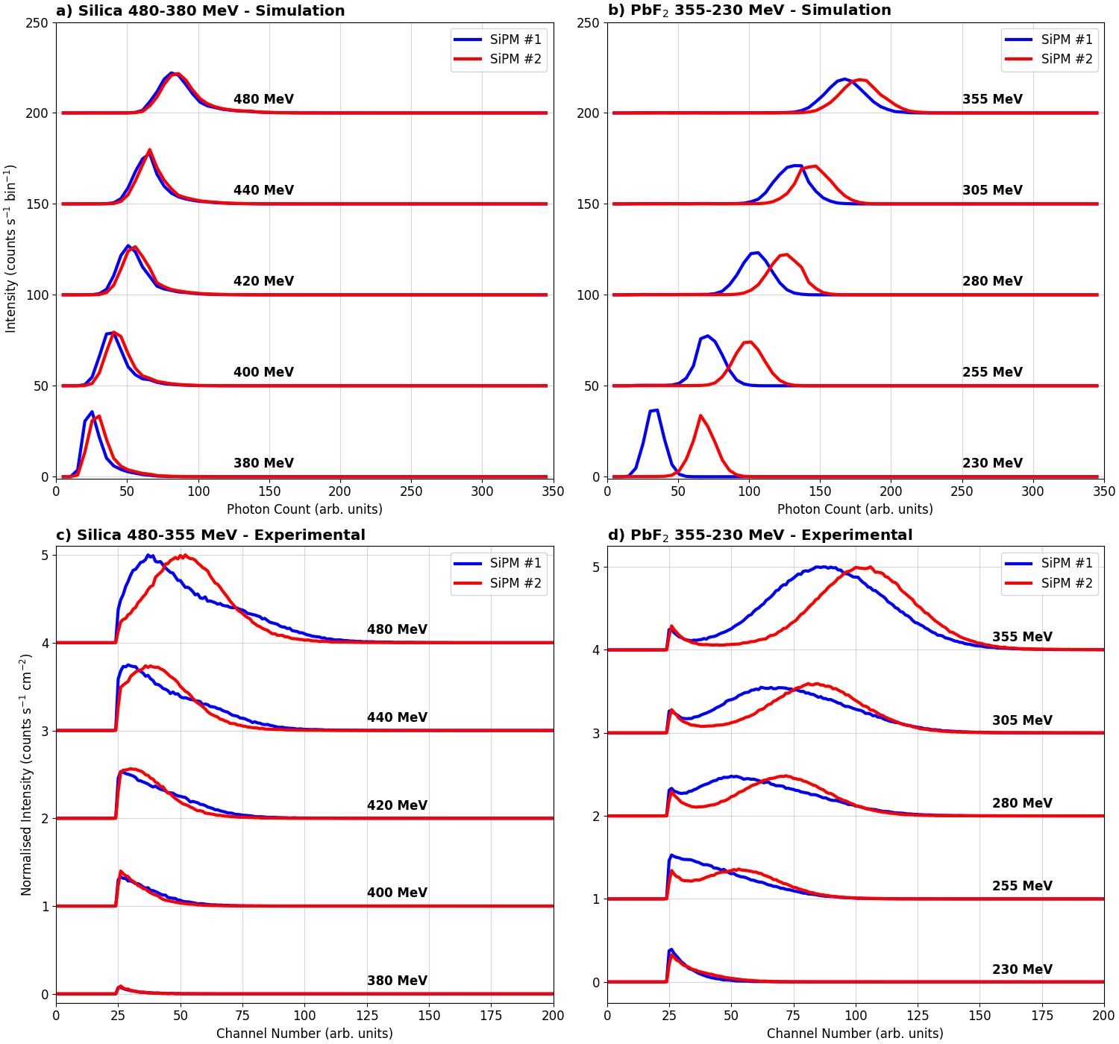
Energy simulations

Slide 23
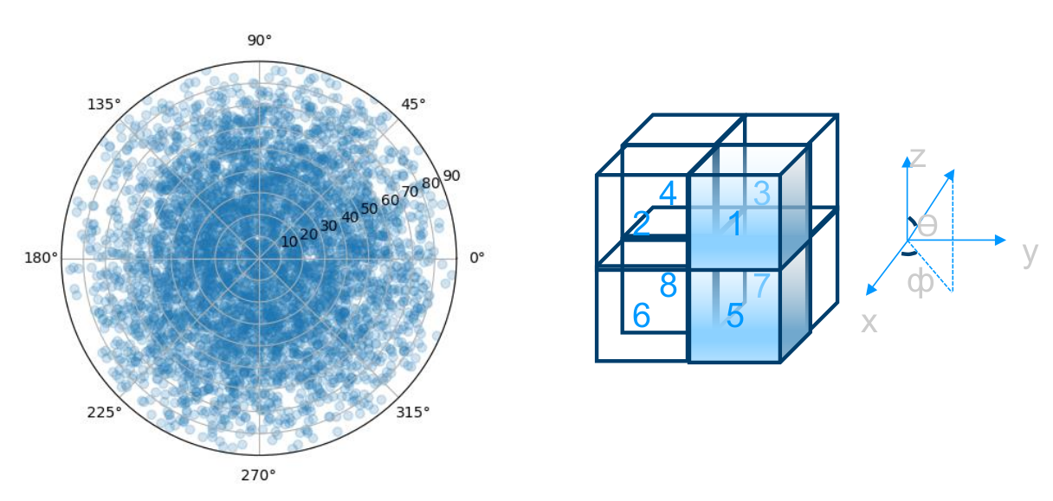
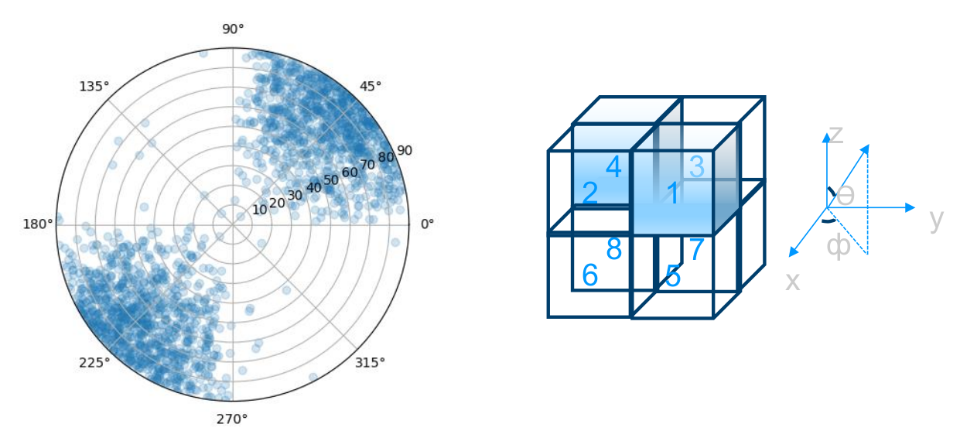
Telescope Simulations

Slide 24
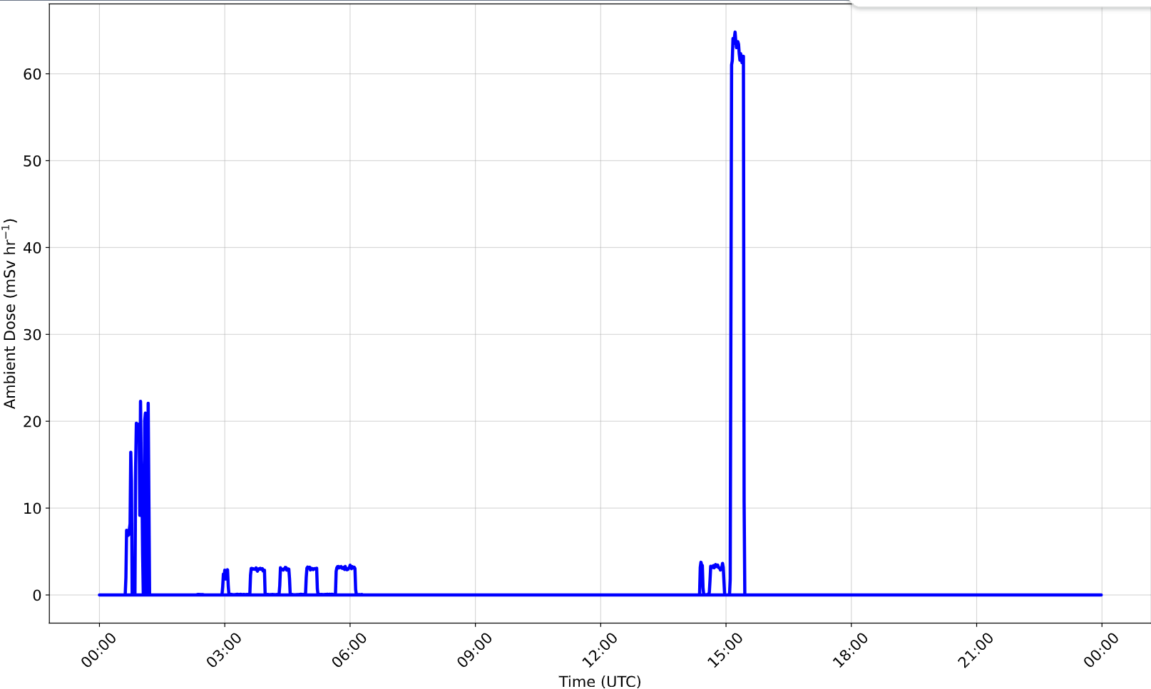
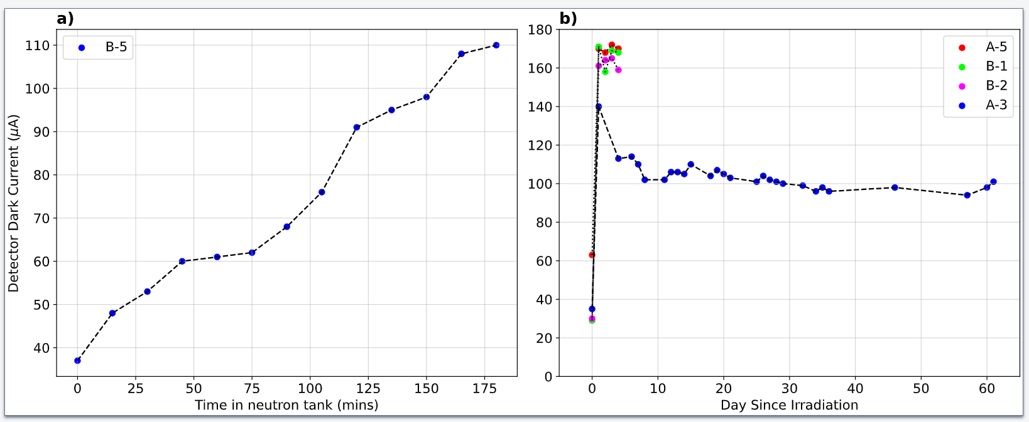
SiPM Damage Studies

