Slide 1

Thermal Effects in the dynamic simulation of the neutron capture reaction in ¹⁸⁸Os
By: Nick Lightfoot
Supervisors: Alexis Diaz-Torres, Paul Stevenson
1

Slide 2
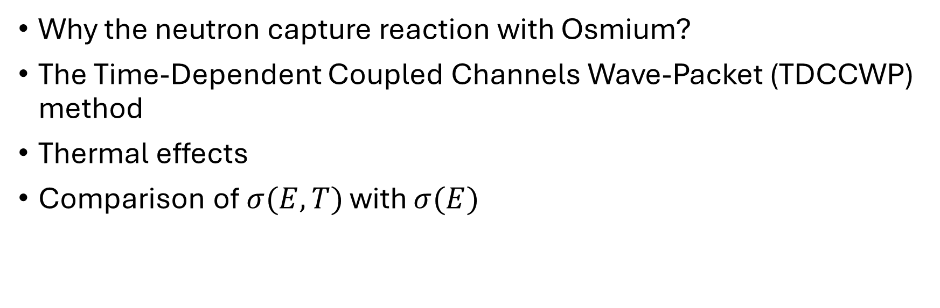
Introduction
Structure
Why the neutron capture reaction with Osmium?
The Time-Dependent Coupled Channels Wave-Packet (TDCCWP) method
Thermal effects
Comparison of $σ(E,T)$ with $σ(E)$
2

Slide 3
Introduction
Why Osmium?
Low lying energy levels
  Obvious observations of thermal effects
The slow neutron capture process is dominant
  Reduces the thermal energy scale to lower energies
  Process found in stellar nucleosynthesis
Useful reaction in the Re-Os clock
Warner LB, Sheline RK. Levels of Os188. Nuclear Physics. 1962 Jun 1;36:207-27.
3

Slide 4
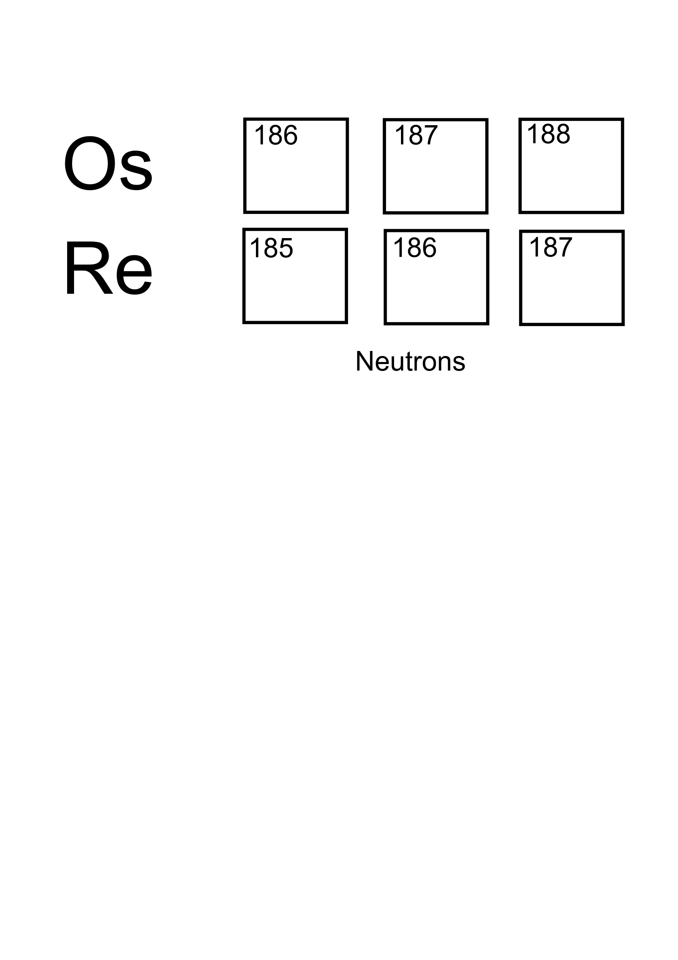
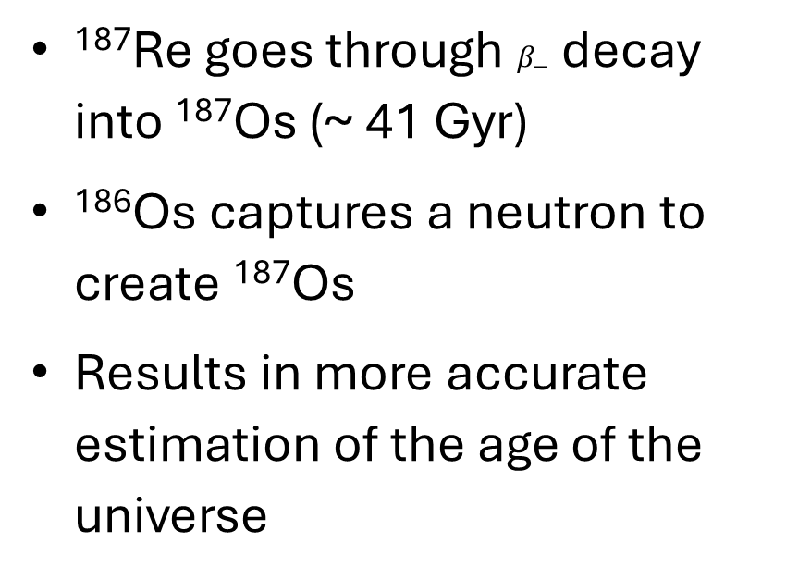
Introduction
The Re-Os Clock
¹⁸⁷Re goes through $β_{−}$ decay into ¹⁸⁷Os (~ 41 Gyr)
¹⁸⁶Os captures a neutron to create ¹⁸⁷Os
Results in more accurate estimation of the age of the universe
Mosconi M, et al, J. Neutron physics of the Re/Os clock. I. Measurement of the (n, γ) cross sections of Os 186, 187, 188 at the CERN n_TOF facility. Physical Review C—Nuclear Physics. 2010 Jul;82(1):015802.
4

Slide 5
The TDCCWP Method
Static vs Dynamic Methods
Static:
Initialise the system
Solves a set of coupled Time-Independent Schrӧdinger equations
Extracts final state transmission coefficients
Quick process, low computational time
Initial conditions restrain the energy range to values above the first excited state.
5

Slide 6
The TDCCWP Method
Static vs Dynamic Methods
Dynamic:
Initialise the system wave-packet
Advance through time using the time evolution operator
Slower process
Intermediate data
No restriction on energy values
Thermal effects can be included
6

Slide 7
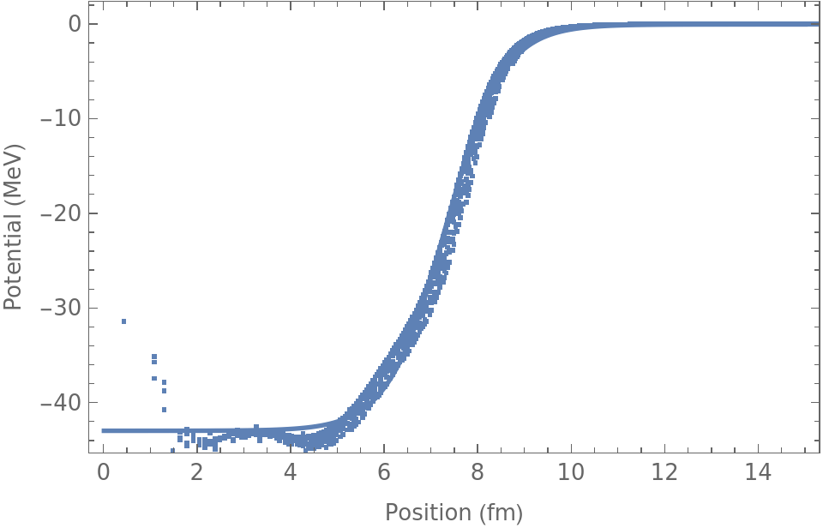
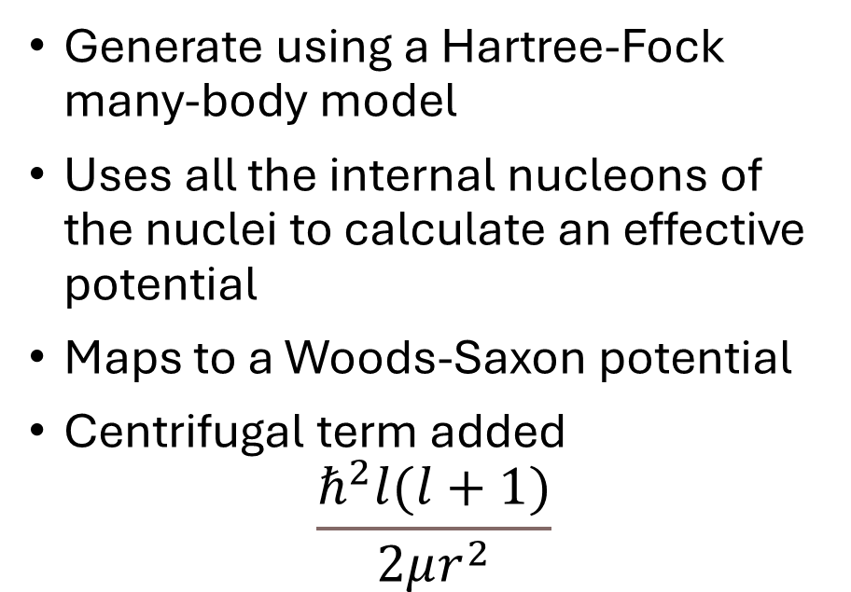
The TDCCWP Method
Nuclear Potential
Generate using a Hartree-Fock many-body model
Uses all the internal nucleons of the nuclei to calculate an effective potential
Maps to a Woods-Saxon potential
Centrifugal term added
$$\frac{ℏ^{2}l(l+1)}{2μr^{2}}$$
7

Slide 8
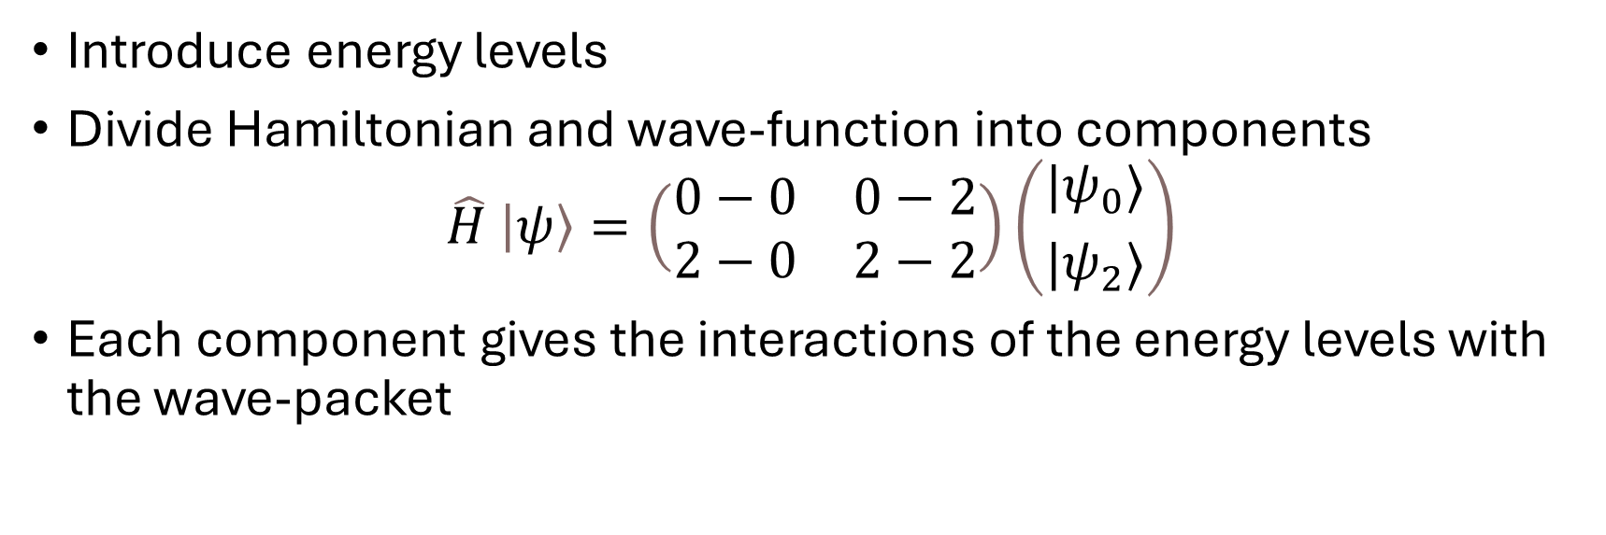
The TDCCWP Method
Coupled Channels
Introduce energy levels
Divide Hamiltonian and wave-function into components
$$\hat{H} \left|ψ\right\rangle =\left(\begin{matrix}0−0 & 0−2 \\ 2−0 & 2−2\end{matrix}\right)\left({{|ψ}_{0}⟩ \atop |ψ_{2}⟩}\right)$$
Each component gives the interactions of the energy levels with the wave-packet
8

Slide 9
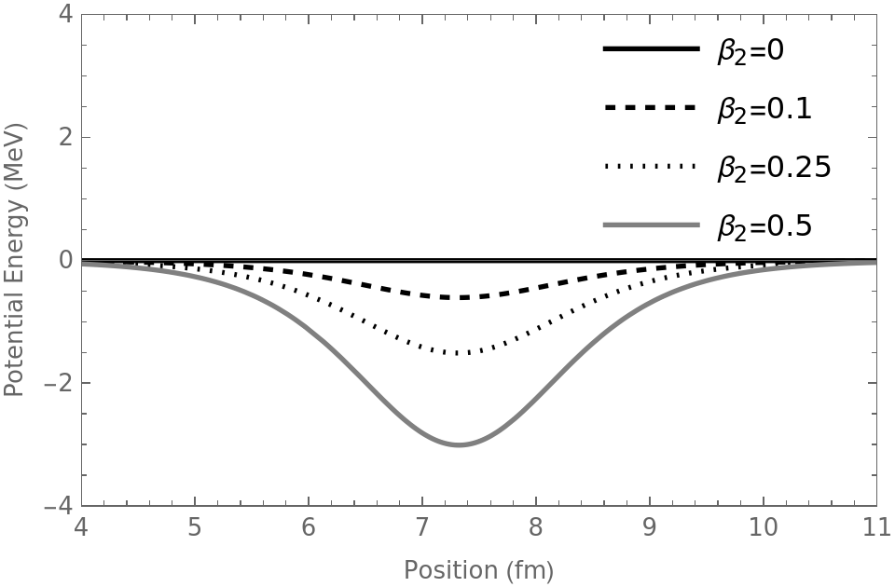
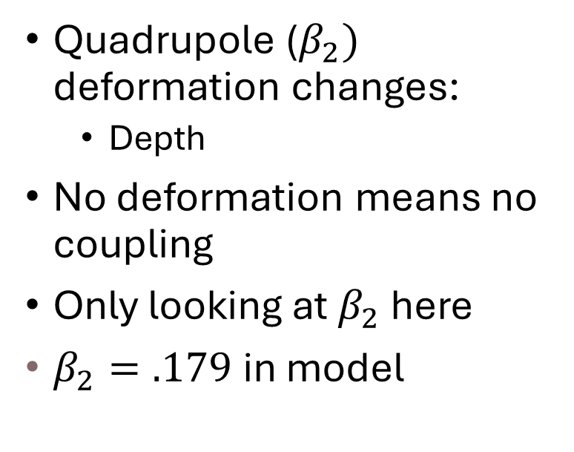
The TDCCWP Method
Coupled Channels: Varying quadrupole deformation
Quadrupole ($β_{2})$ deformation changes:
  Depth
No deformation means no coupling
Only looking at $β_{2}$ here
$β_{2}=.179$ in model
9

Slide 10
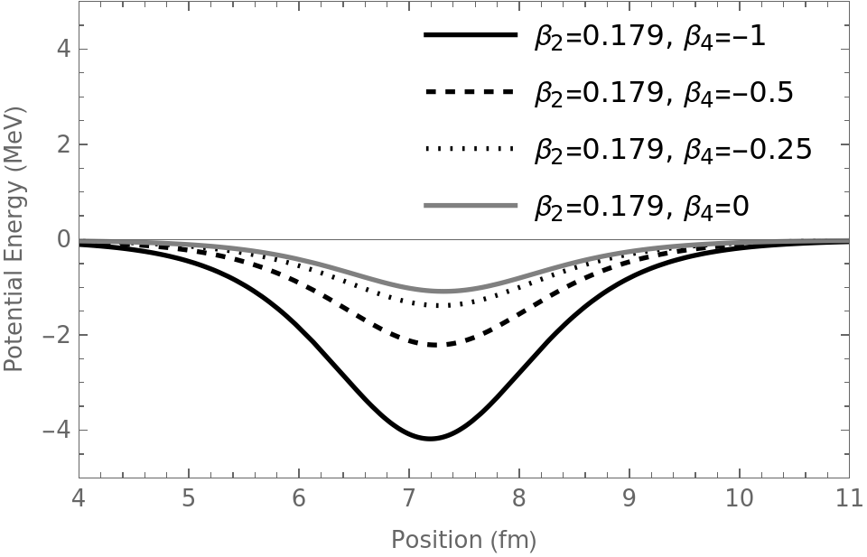
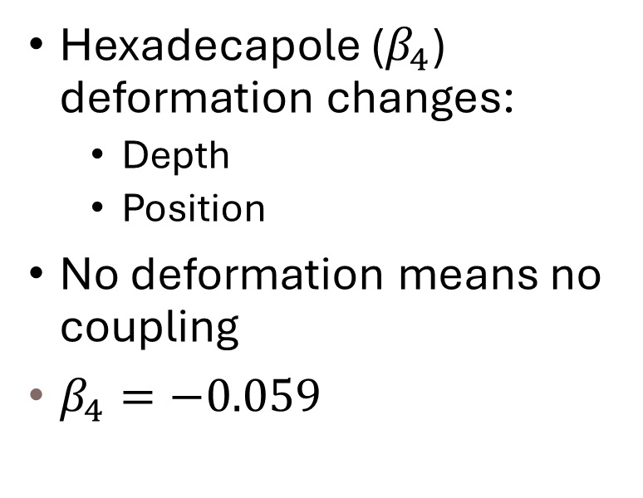
The TDCCWP Method
Coupled Channels: Varying hexadecapole deformation
Hexadecapole ($β_{4}$) deformation changes:
  Depth
  Position
No deformation means no coupling
$β_{4}=−0.059$
10

Slide 11
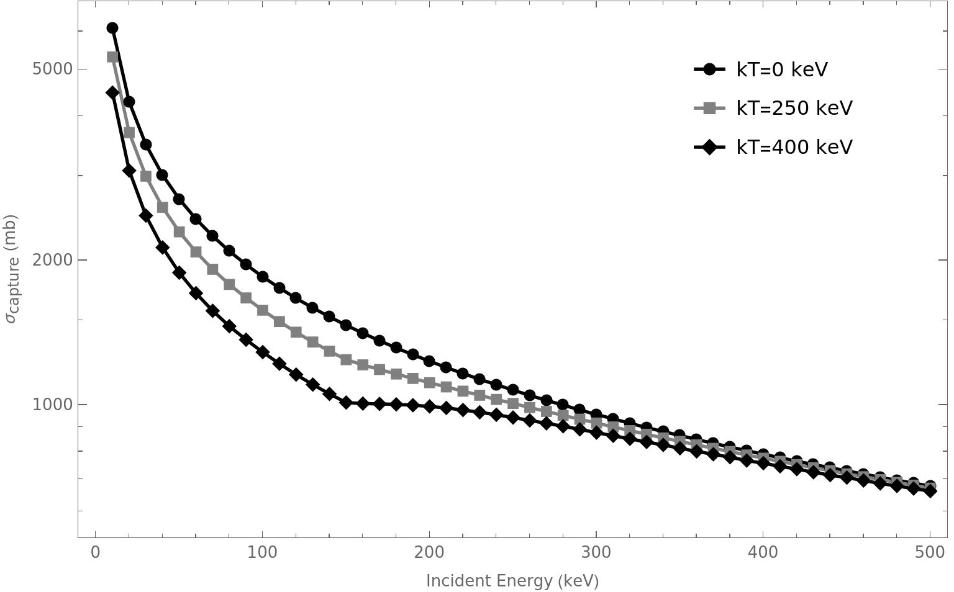
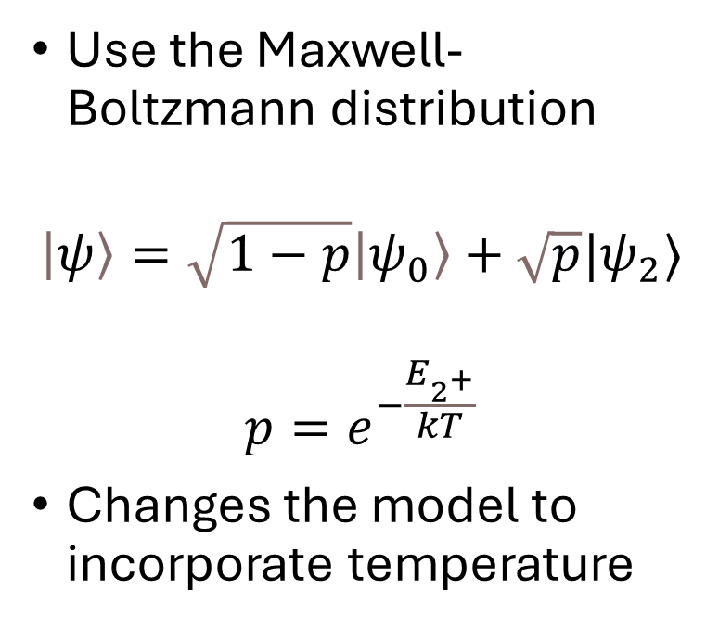
The TDCCWP Method
Temperature Dependent Cross Sections
Use the Maxwell-Boltzmann distribution
$$\left|ψ\right\rangle =\sqrt{1−p}\left|ψ_{0}\right\rangle +\sqrt{p}|ψ_{2}⟩$$
$$p=e^{−\frac{E_{2^{+}}}{kT}}$$
Changes the model to incorporate temperature
11

Slide 12
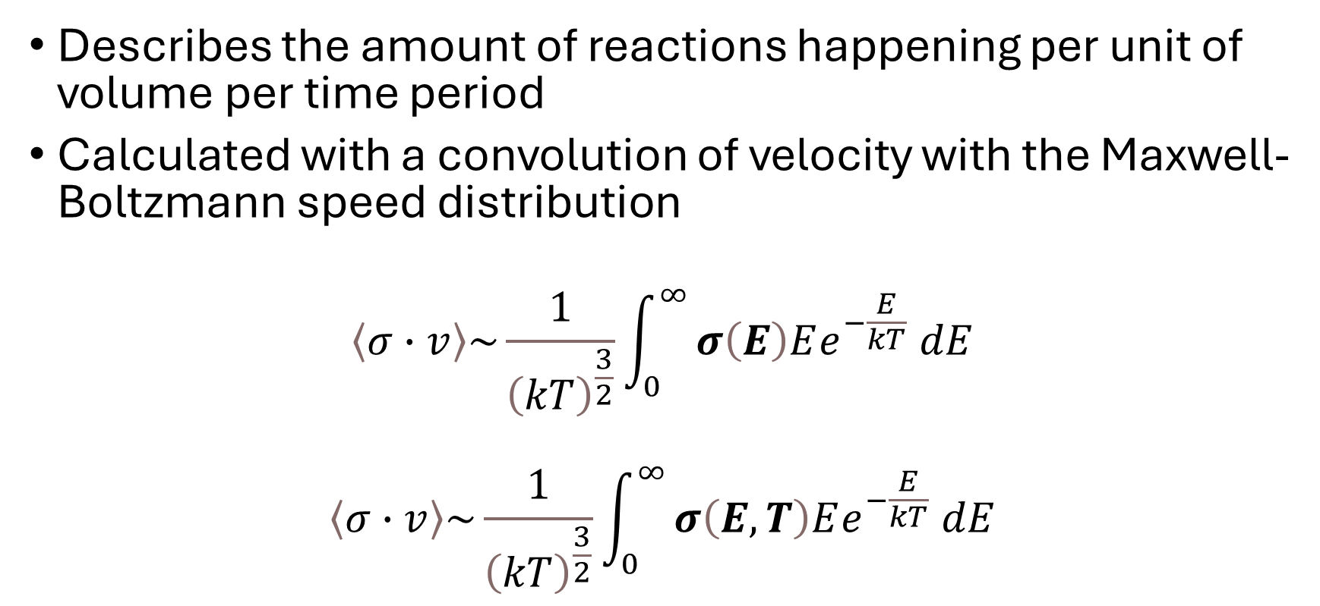
The TDCCWP Method
Reaction Rates
Describes the amount of reactions happening per unit of volume per time period
Calculated with a convolution of velocity with the Maxwell-Boltzmann speed distribution
$$\left\langle σ∙v\right\rangle \sim \frac{1}{{\left(kT\right)}^{\frac{3}{2}}}\int_{0}^{∞}{σ\left(E\right)Ee^{−\frac{E}{kT}} dE}$$
$$\left\langle σ∙v\right\rangle \sim \frac{1}{{\left(kT\right)}^{\frac{3}{2}}}\int_{0}^{∞}{σ\left(E,T\right)Ee^{−\frac{E}{kT}} dE}$$
12

Slide 13
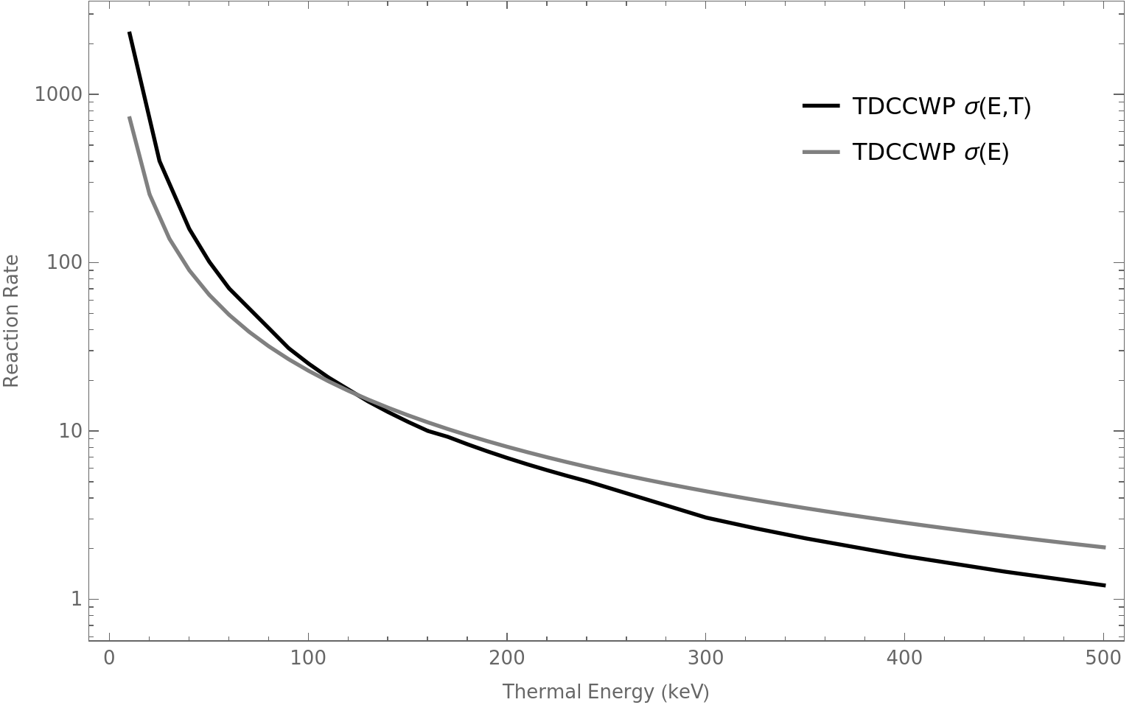
Results
The difference temperature makes
TDCCWP with and without temperature
Temperature dependence deviates around the first excited state, 155 keV
Shows the dominance of small thermal energies.
13

Slide 14
Conclusion
Future Ideas
Look at the neutron capture of ¹⁸⁶Os specifically which looks directly at the isotope in the Re-Os clock
Explore other isotopes
  ⁹⁹Zr to look at nuclear waste transmutation
  ¹⁵¹Eu as a reactor control material
Isotopes near abundance peaks
  A=80,130,138,195,208
14

Slide 15
Conclusion
Recap
The Re-Os Clock
The underlying model of the TDCCWP
How a dynamic model works
The importance of including thermal effects
15

Slide 16
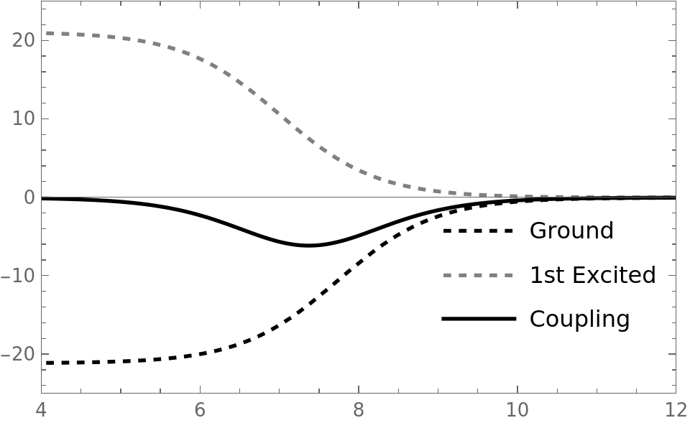
The TDCCWP Method
Coupled Channels: Coupling Potentials
Sum the ground state and 1st excited state contributions.
The first excited state is now positive.
Requires energy jump to go into this state.
Dependent on deformation from spherical.
When it is spherical the coupling potential is flat.
16

Slide 17
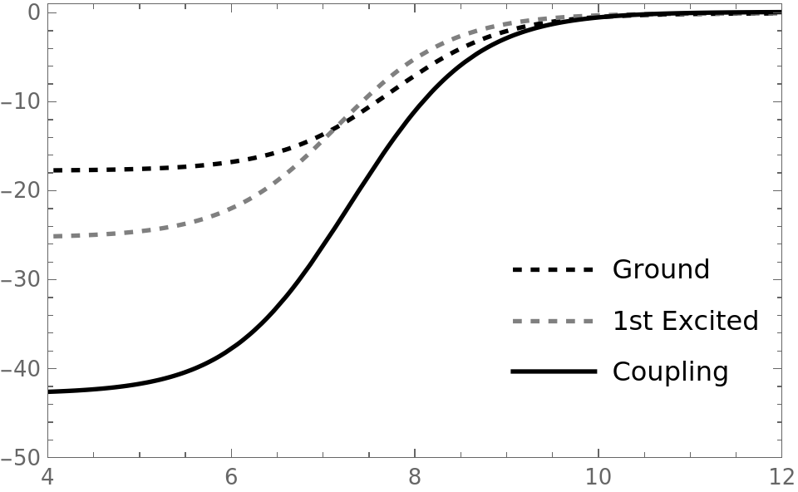
The TDCCWP Method
Coupled Channels: Same Level Potential
The entries correlating to the ground or one of the excited states sums without any cancelation.
These potentials depend only on the deformation of the system.
Integrating over the contributions from these states which correlate to intrinsic angular momenta.
17

Slide 18
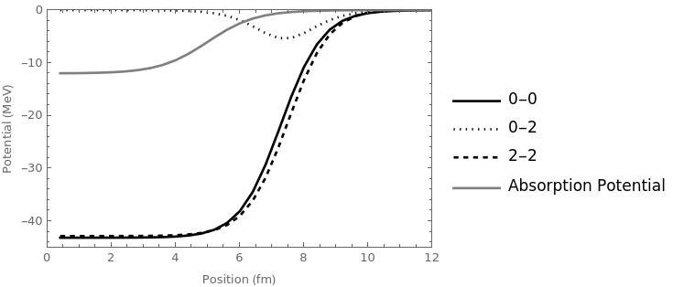
The TDCCWP Method
Absorption Potential
The absorption potential acts as a vacuum
This only applies to the part of the wave-packet that is:
  Not reflected
Parameters chosen to maximize absorption
18

Slide 19
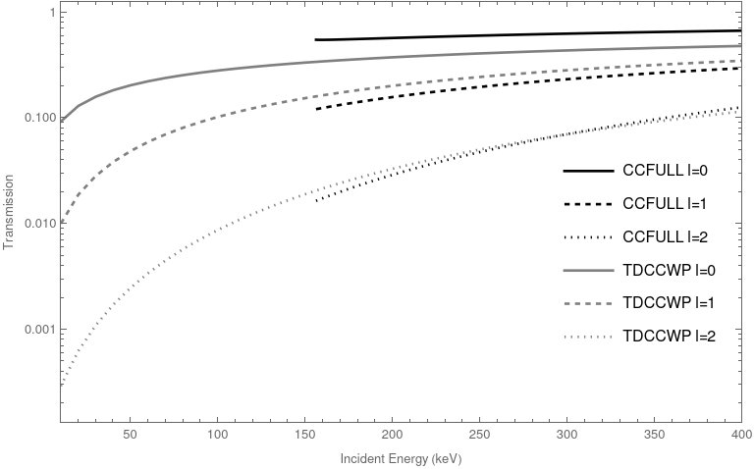
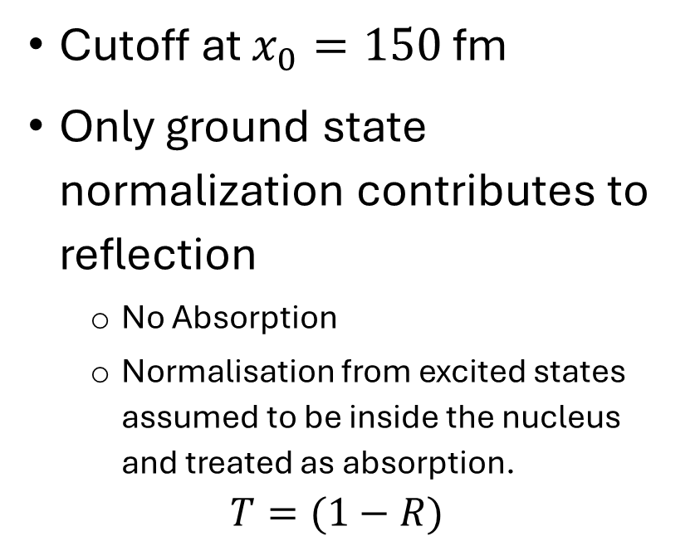
The TDCCWP Method
Reflection Coefficients
Cutoff at $x_{0}=150$ fm
Only ground state normalization contributes to reflection
  No Absorption
  Normalisation from excited states assumed to be inside the nucleus and treated as absorption.
  $$T=(1−R)$$
19

Slide 20
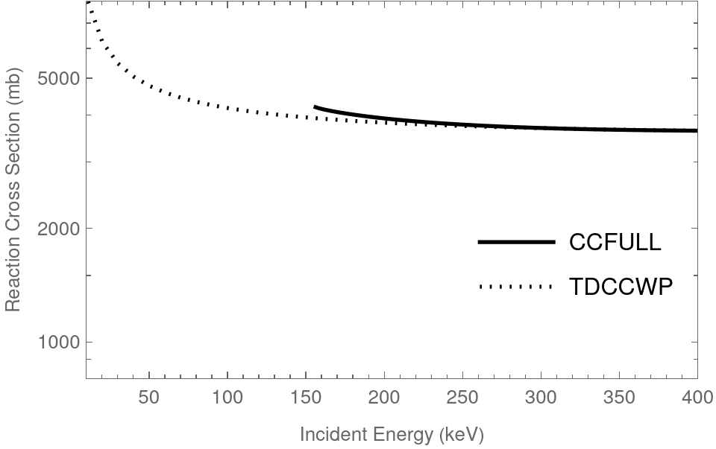

The TDCCWP Method
Transmission Coefficients
$$σ(E)=\frac{π ℏ^{2}}{2μE}\sum_{l=0}{(2l+1)T(E)}$$
20

Slide 21
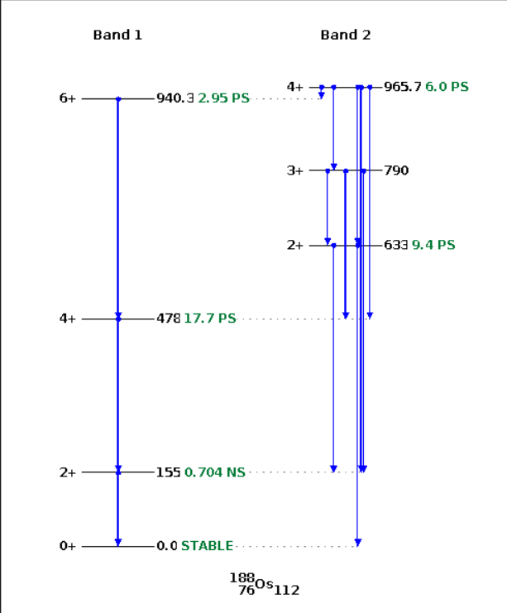
Introduction
Energy Levels for Os188
Low lying energy levels
  Obvious observations of thermal effects
The slow neutron capture process is dominant
  Reduces the thermal energy scale to lower energies
  Process found in stellar nucleosynthesis
Useful reaction in the Re-Os clock
Warner LB, Sheline RK. Levels of Os188. Nuclear Physics. 1962 Jun 1;36:207-27.
21

