Slide 1
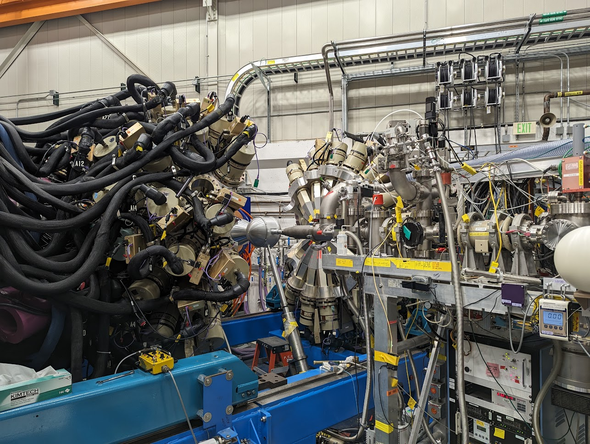
Exploring unphysical quadrupole triaxiality of 200 & 202Hg using Coulomb excitation
Greg Willmott
I

Slide 2
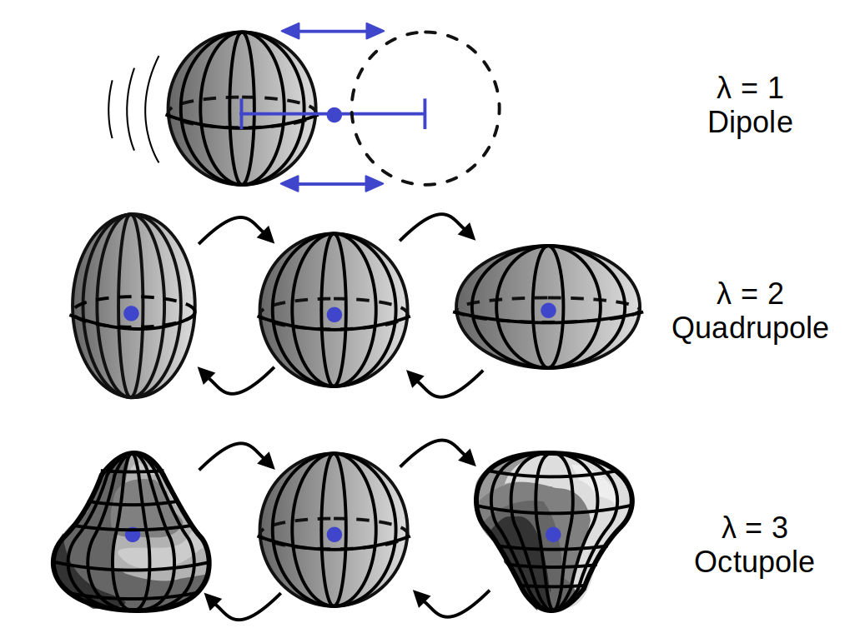
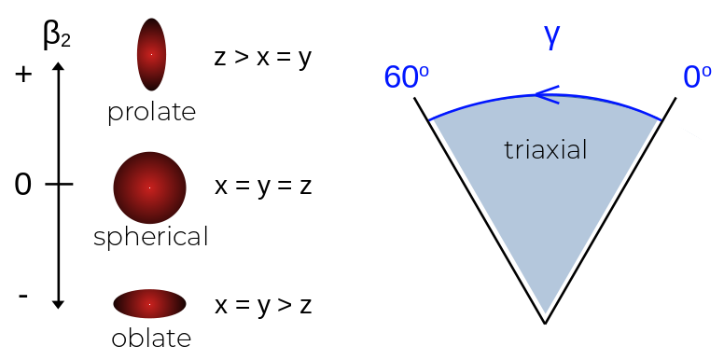
Shape & Deformation
Rigid rotor (collective) model. Phonons induce vibrations to exhibit excitation
(Quadrupole) Deformation parameters of interest
β ≈ amount of deformation
γ ≈ changes form of deformation
{β, γ} are analogous to the model independent Kumar-Cline {Q, δ}.
Greg Willmott gw00431@surrey.ac.uk 2

Slide 3
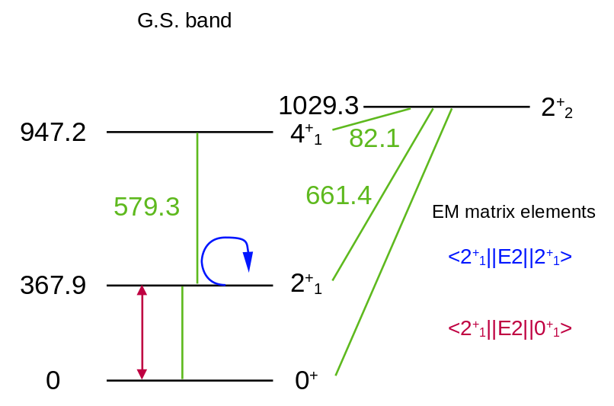
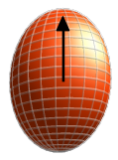
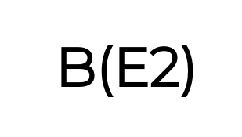
Moments & matrix elements
Rigid rotor model
Deformation results in (quadrupole) moment
Transitions between excited states occur at different rates
(reduced transition probabilities)
Level scheme of 200Hg. Data from NNDC
Inferred from experimental (Coulomb excitation) data
Greg Willmott gw00431@surrey.ac.uk 3

Slide 4
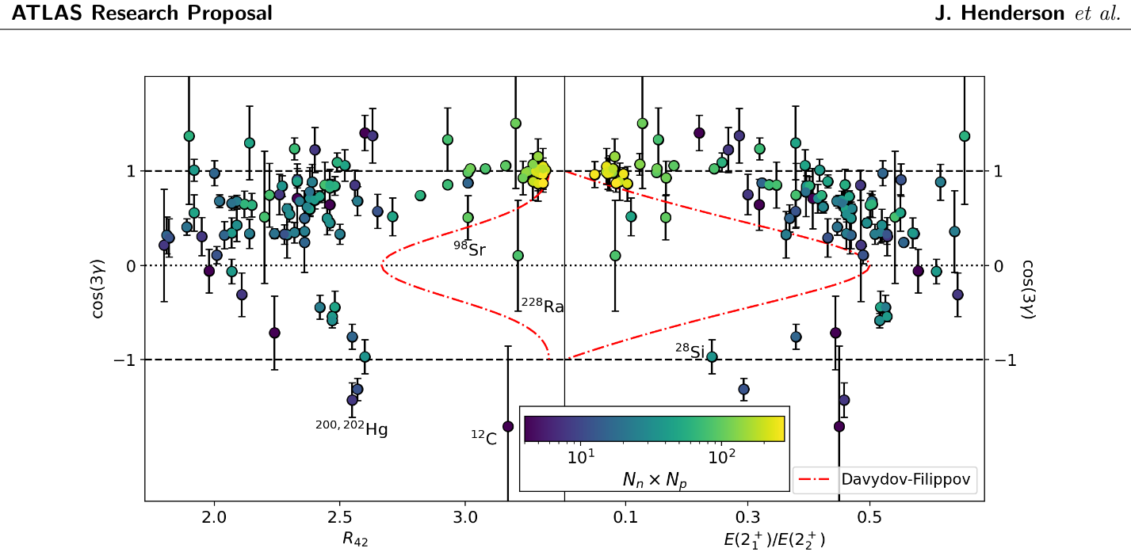
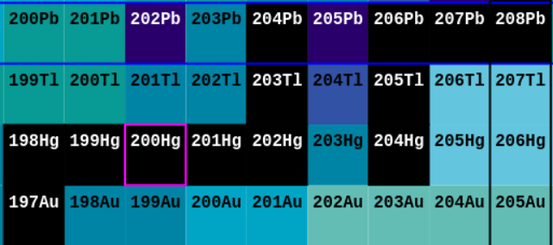
200 & 202Hg
Not resolved by error
| Cos(3γ) | > 1
E(4+) / E(2+):
2.0 - single particle limit
3.3 - rigid rotor limit
Triaxiality or just needs remeasuring?
Greg Willmott gw00431@surrey.ac.uk 4

Slide 5
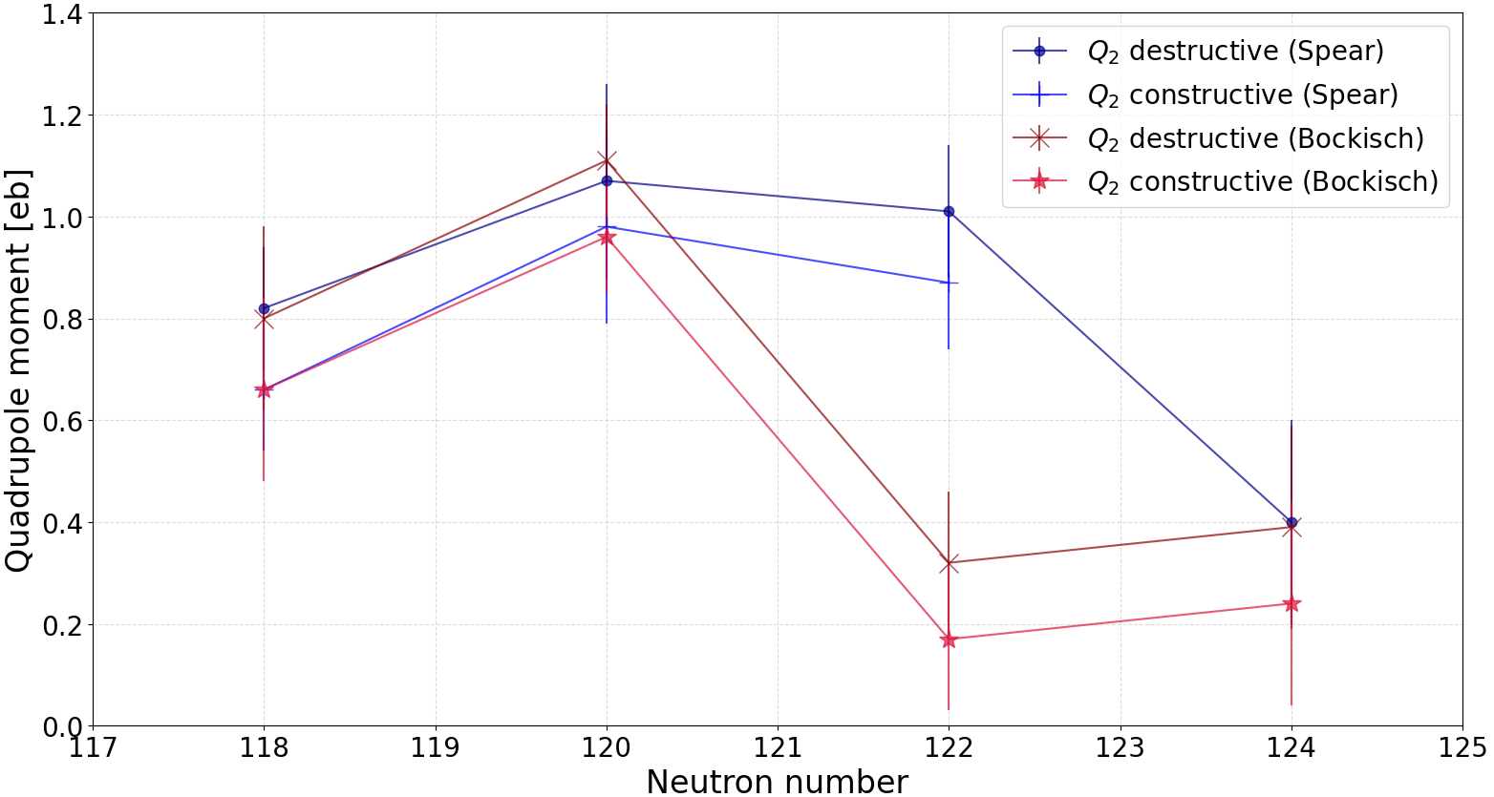
200 & 202Hg
Systematics
202Hg
200Hg
[1] A. Bockisch, et al, “Reorientation effect measurements of even mercury isotopes,” Zeitschrift fr Physik A: Atoms and Nuclei, vol. 291, pp. 245–254, 9 1979.
[2] R. Spear, et al, “Static quadrupole moments of the first excited states of 200hg and 202hg,” Nuclear Physics A, vol. 345, pp. 252–262, 8 1980.
Greg Willmott gw00431@surrey.ac.uk 5

Slide 6
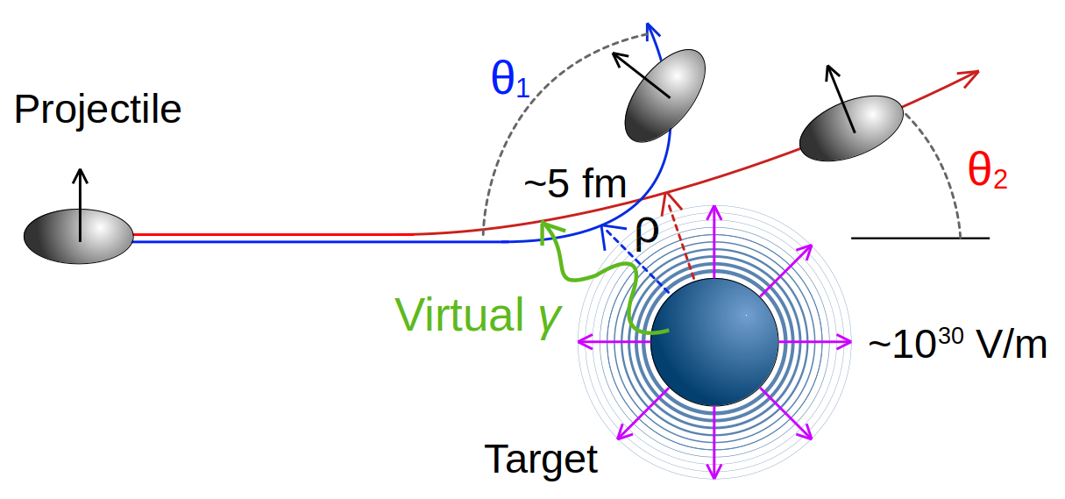
Coulomb Excitation
'Safe' Coulex
Cline criterion
Purely EM process
Mutual excitation
Target choice is important
Reorientation effect
E transitions dominate
Inverse kinematics
Ang. mom. Influenced by the quadrupole moment
Suited for low-lying states in even-evens
Heavy beam, light target
S. M. Lenzi, D. Cortina-Gil, M. Zielinska. The Euroschool on Exotic Beams, Vol VI, Chapter 2, 2022, Springer, 1005, https://doi.org/10.1007/978-3-031-10751-1
Greg Willmott gw00431@surrey.ac.uk 6

Slide 7
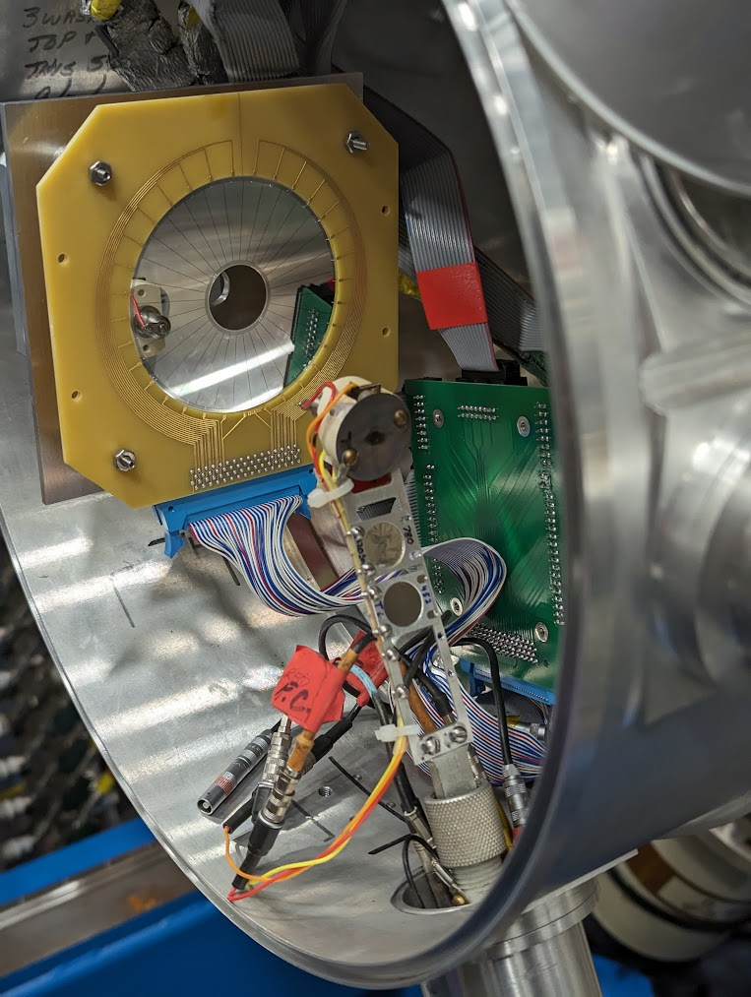
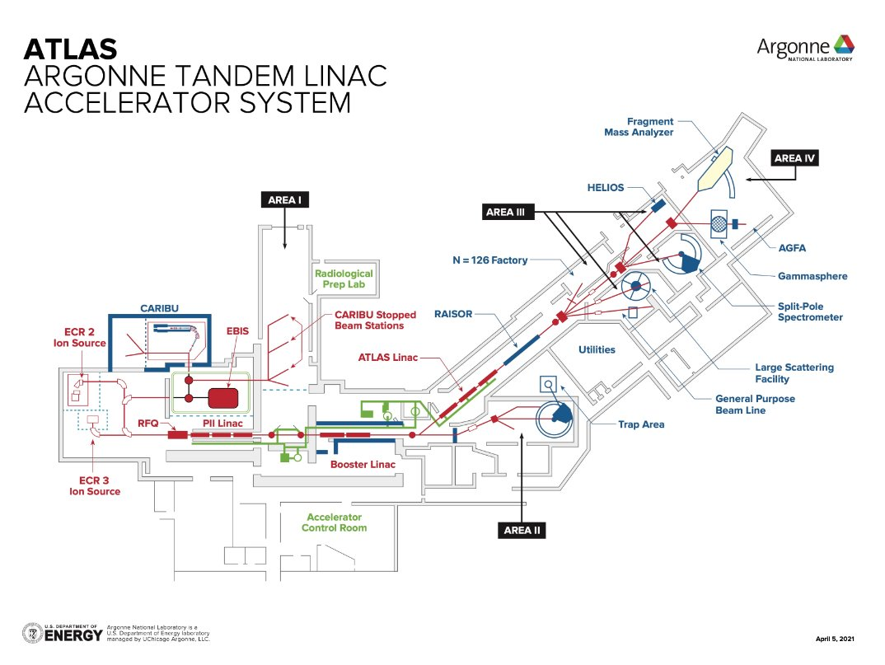
The Setup
Beams x2
Targets x2
Time frame
200, 202Hg @
780 MeV, ~2E6 pps
Natural (48)Ti, 452 mg/cm2
120Sn, 780 mg/cm2
Between 11 and 19 hours per combination
DSSD
Breakout board
Beam
Chamber
Target ladder
Greg Willmott gw00431@surrey.ac.uk 7

Slide 8
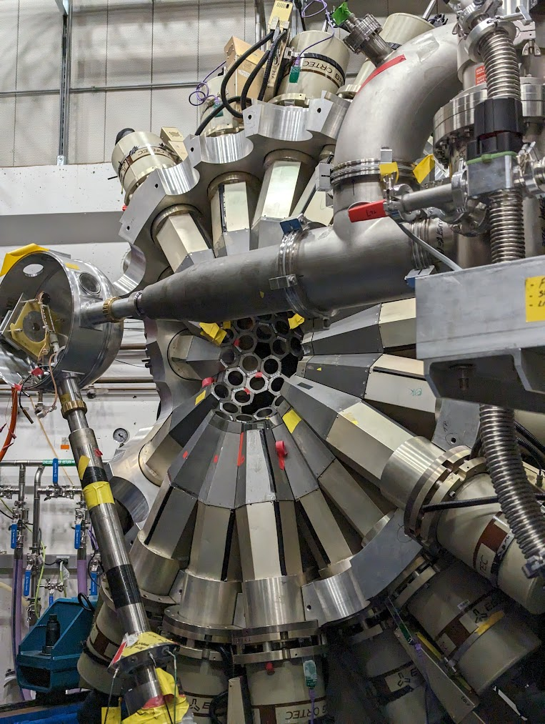
The Data
DSSD
Per event:
Sector, ring IDs
Timestamp
Energy (uncalibrated)
GEBSort
Gate on kinematic loci, multiplicity, E to isolate Coulex events
Beam
Gammasphere
Per event:
Module ID i.e. (θ,φ)
Timestamp
Energy
Yields
Level scheme
Geometry
Matrix elements
Q, B(E2)s
Greg Willmott gw00431@surrey.ac.uk 8

Slide 9
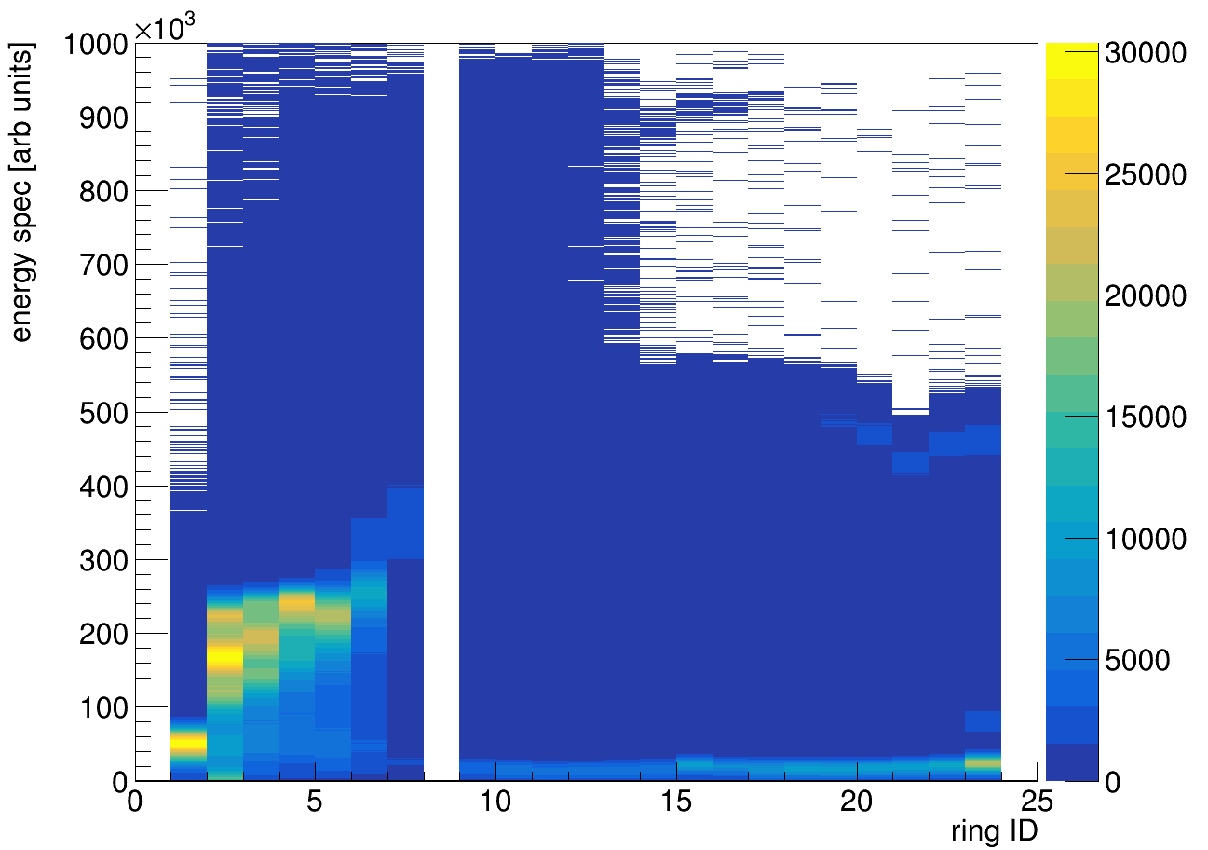
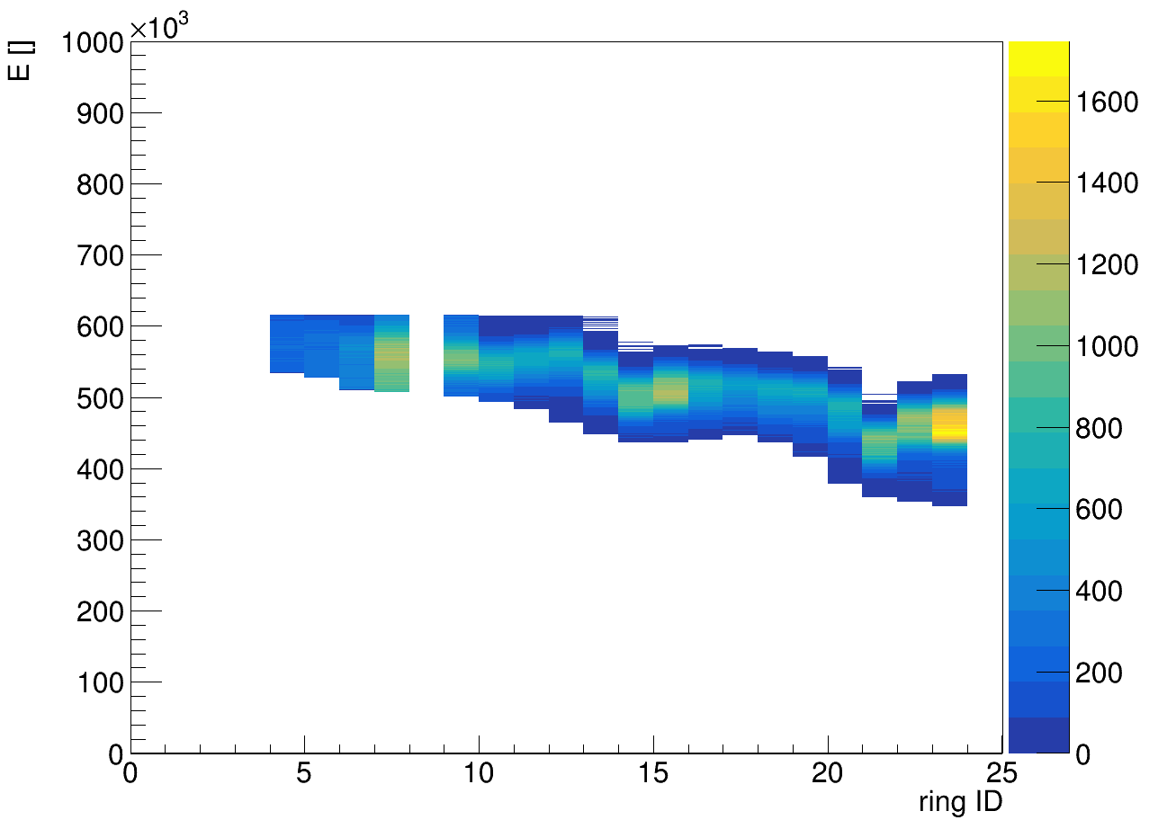
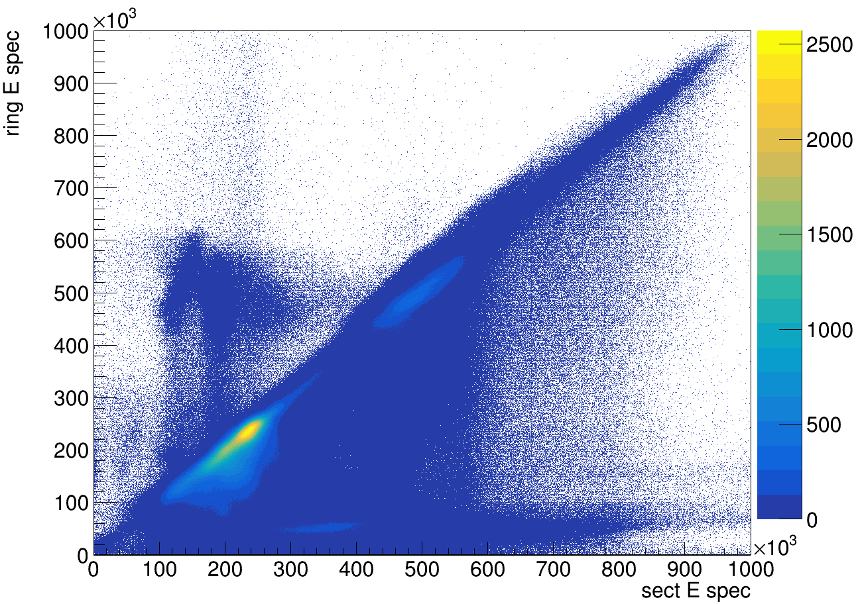
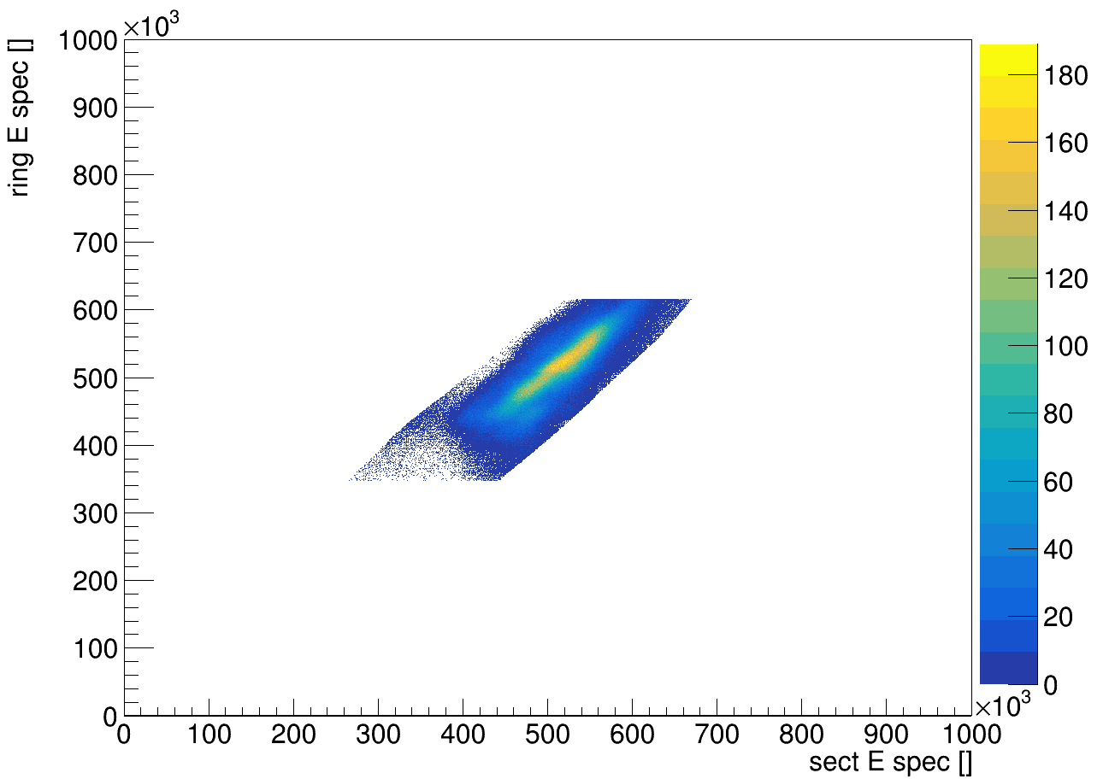
Preliminary Analysis
Particle ID plot
Ring energy [ ]
Ring energy [ ]
Hg
PID GCut
Ti
Ti
Particle ID plot
Ring #
Energy GCut
Ring #
Raw events
Coulex events
Energy vs Energy
Energy vs Energy
Front-back dT
Ti
Ring energy [ ]
Ring energy [ ]
Ti
Loci are resolvable
Hg
Sector energy [ ]
Sector energy [ ]
Greg Willmott gw00431@surrey.ac.uk 9

Slide 10
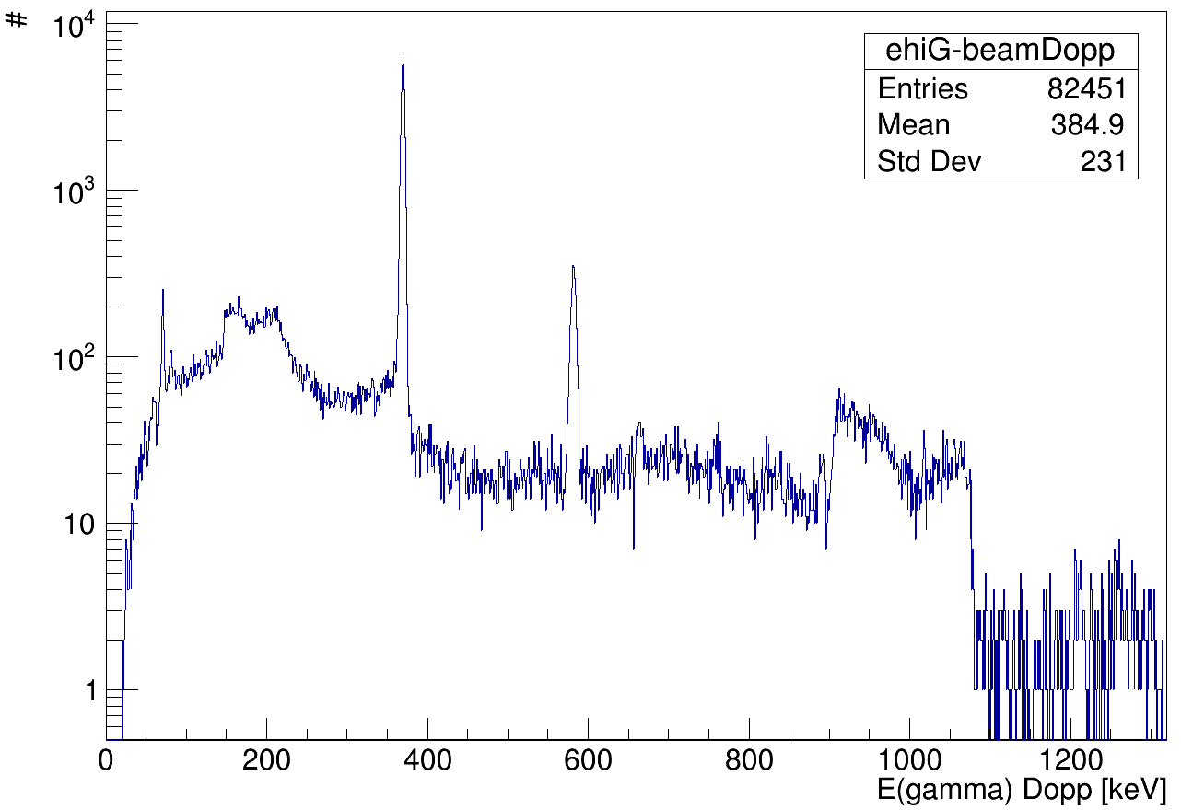
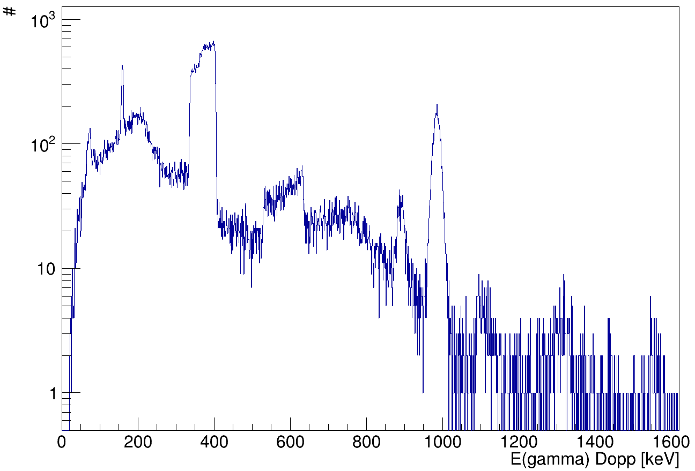
Analysis (gammas)
Sum of all 200Hg + nat Ti data
Doppler corrected on beam kinematic solution
Doppler corrected on target kinematic solution
βTi
βHg
48Ti 2+
200Hg 2+
200Hg 4+
46Ti 2+
2+1 -> 0+1 367.9 keV
4+1 -> 2+1 579.3 keV
F.G. Kondev Nucl. Data Sheets 192, 1 (2023)
2+1 -> 0+1 889.3 keV 46Ti
2+1 -> 0+1 983.5 keV 48Ti
J. Chen Nucl. Data Sheets 179, 1 (2022)
Gosia
Greg Willmott gw00431@surrey.ac.uk 10

Slide 11
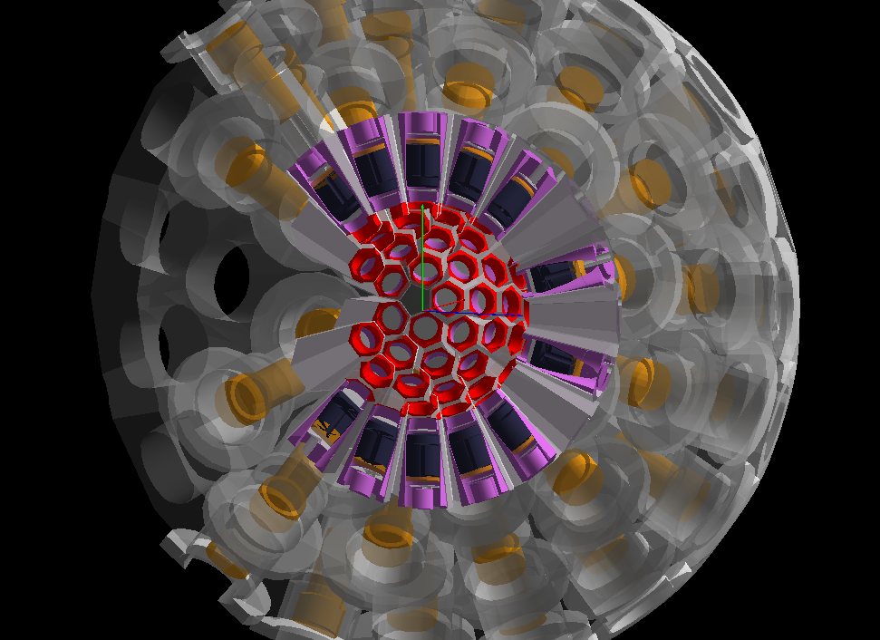
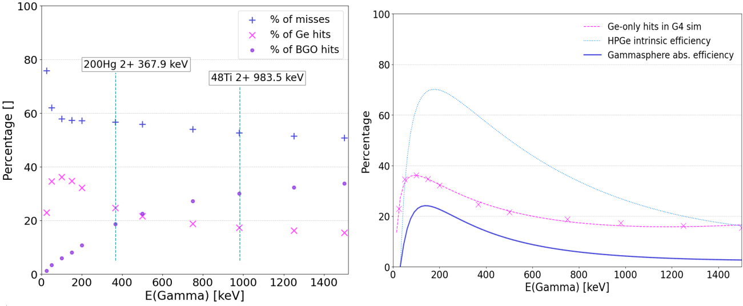
Geant4 (Gammasphere)
Compton suppression modelling
Efficiency curves
Isotropic γ source (11 set energies)
E deposited
Multiply by intrinsic eff [1]
Screen captures from G4 GUI
[1] A. Parmentier et al. “Absolute efficiency calibration of a coaxial hpge detector for quantitative pgaa and t-pgaa,” Journal of Physics: Conference Series, vol. 1055, p. 012010, 7 2018.
Greg Willmott gw00431@surrey.ac.uk 11

Slide 12
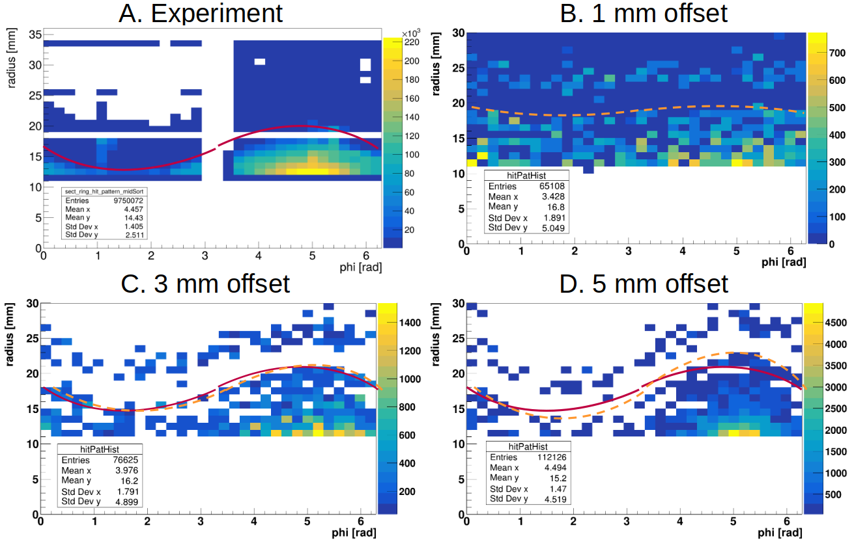
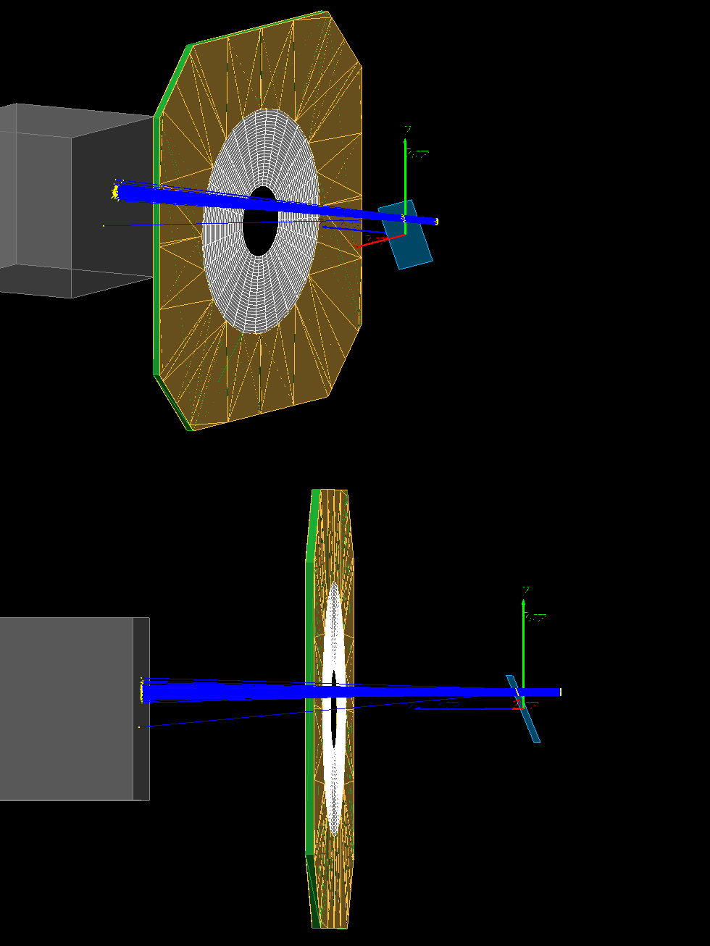
Geant4 (S3 DSSD)
DSSD
Guideline
Hg
Ti
Too little
Trial and error to match offset
Too much
φ
φ of the offset vector matched to data
Greg Willmott gw00431@surrey.ac.uk 12

Slide 13
Conclusions
Analysis to date shows there are sufficient statistics
Beam and target peaks are obvious in gamma spectra. Can search for higher lying transitions
Project is ongoing. Next steps: Gosia input, calculate deformation parameters, repeat for 202Hg
Geant4 is well suited to answer questions that arise during analysis:
What is the beam offset?
How efficient is the gamma detection?
Greg Willmott gw00431@surrey.ac.uk 13

Slide 14
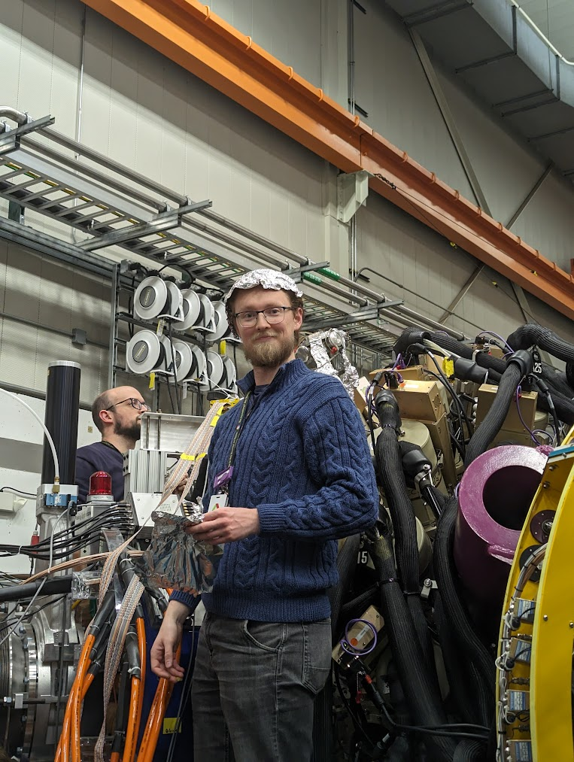
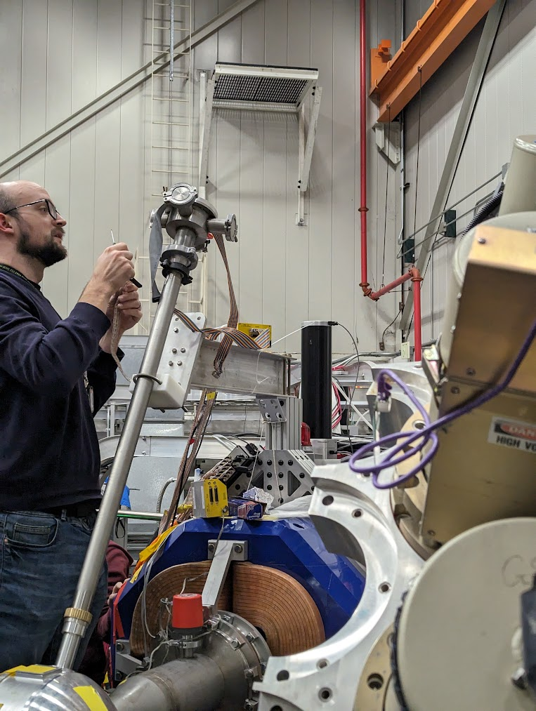
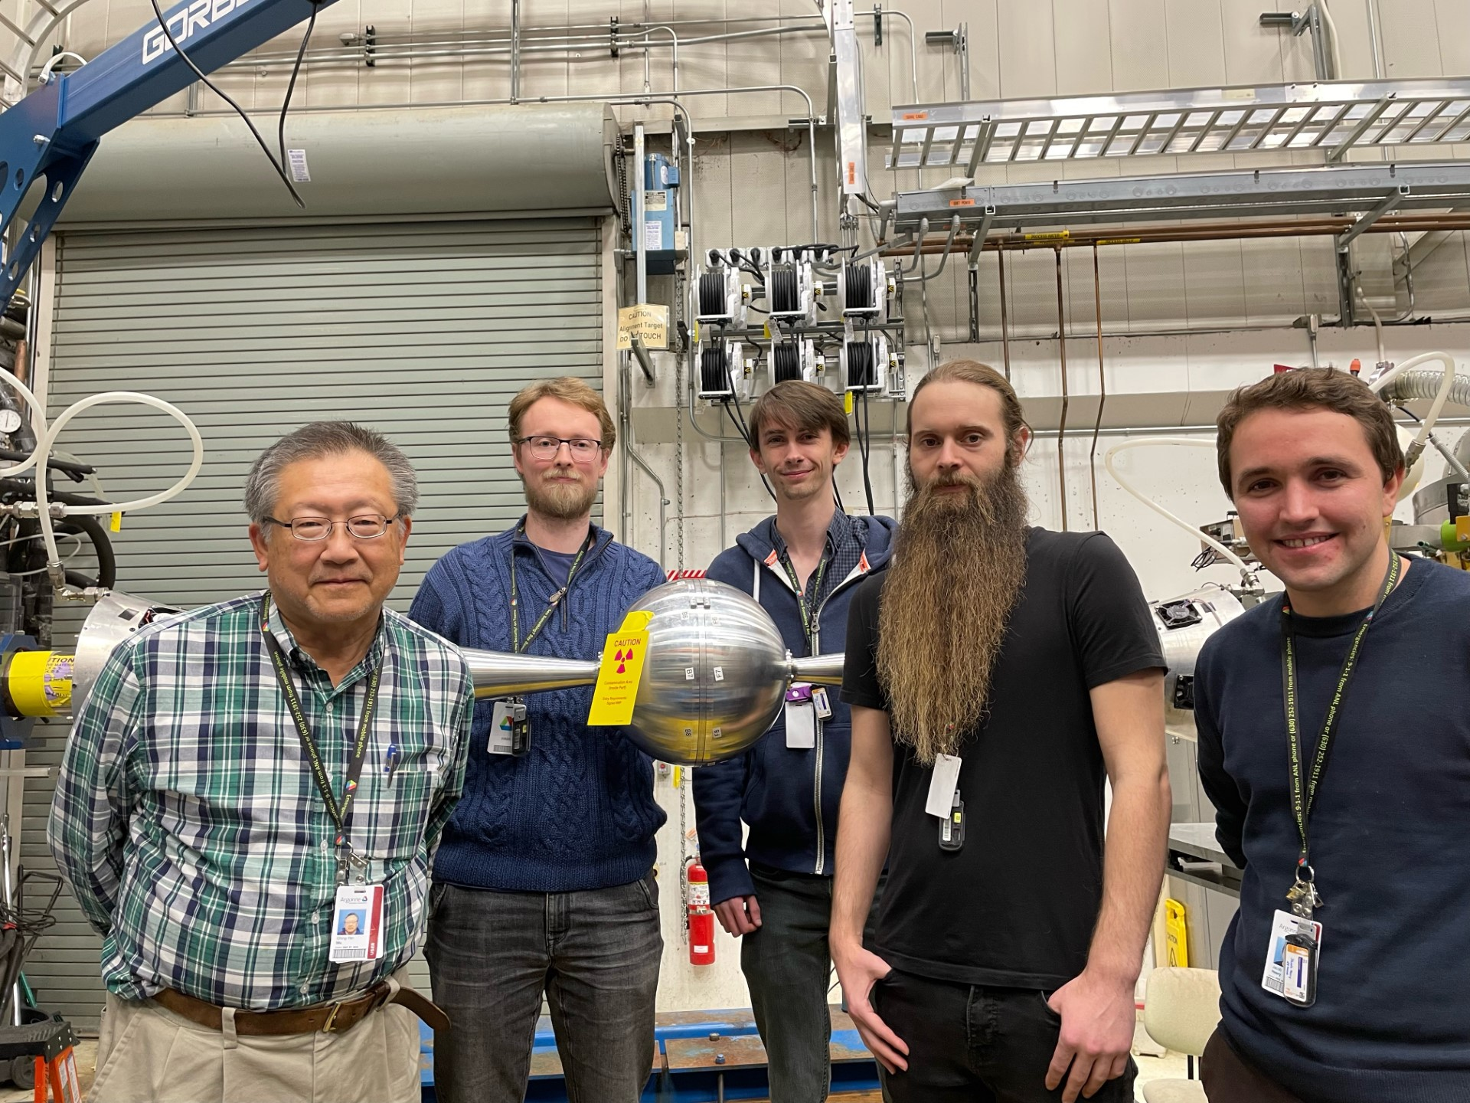
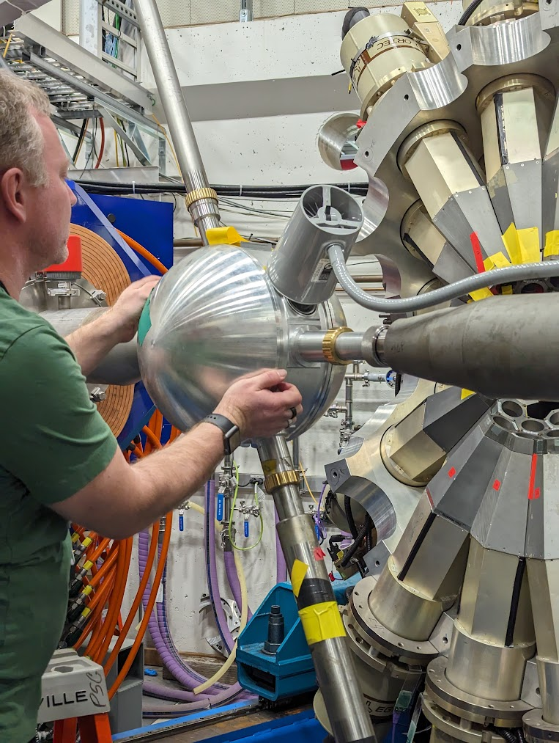
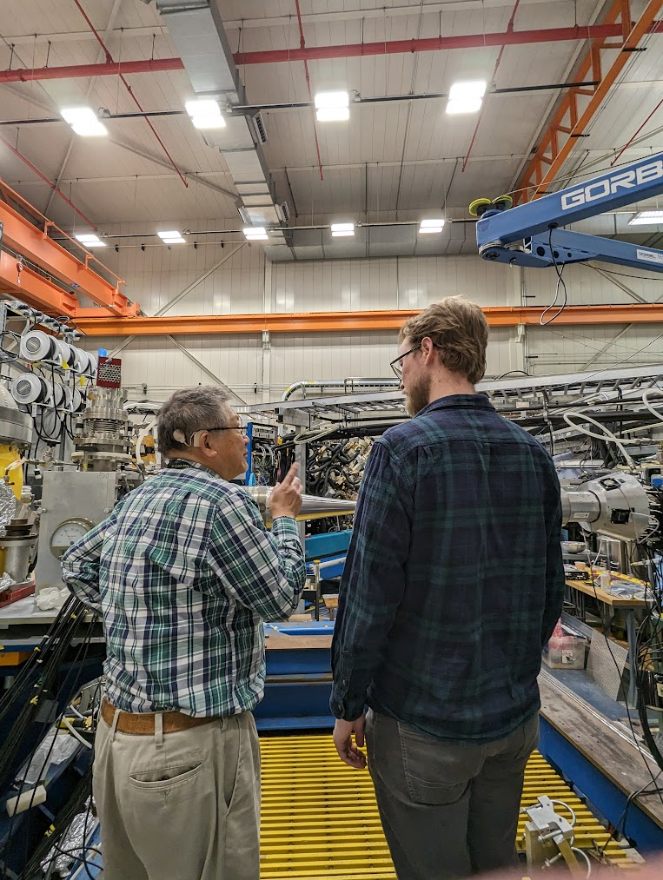
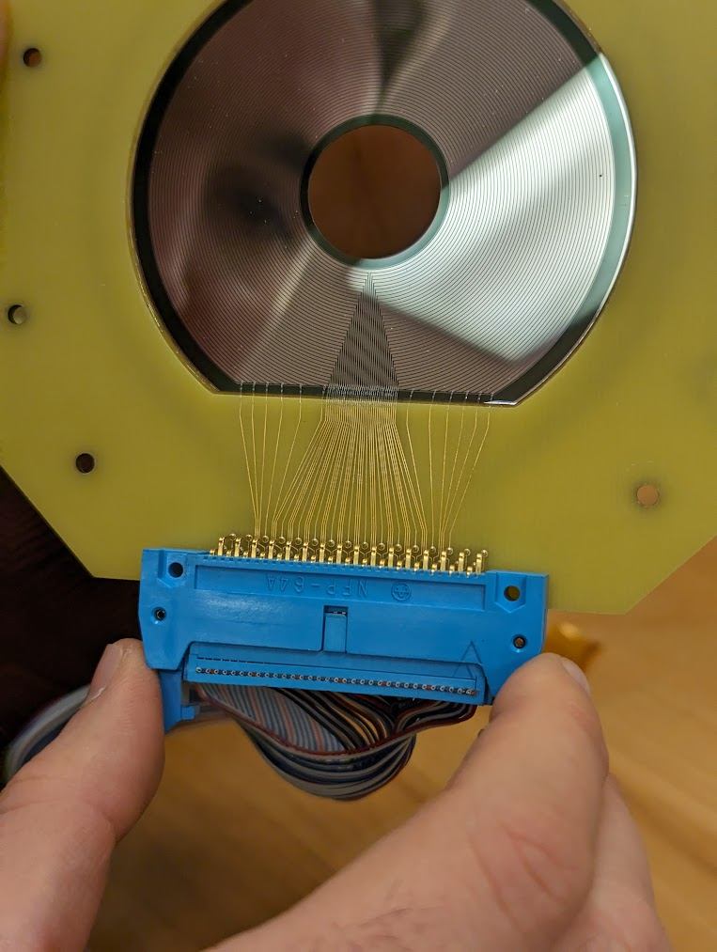
[1]
Thank you to my collaborators
[2]
[3]
[4]
J. Henderson 1, J. Heery 1, D. T. Doherty 1, A. Ertoprak 2, B. Kay 2, C. Müller-Gatermann 2, C. O'Shea 1, P. H. Regan 1,4, W. Reviol 2, D. Rhodes 3,6, R. Russell 1, N. Sensharma 2, D. Seweryniak 2, M. Siciliano 2, R. S. Sidhu 1,5, I. Tolstukhin 2, C. Y. Wu 3
[5]
[6]
Greg Willmott gw00431@surrey.ac.uk 14

Slide 15
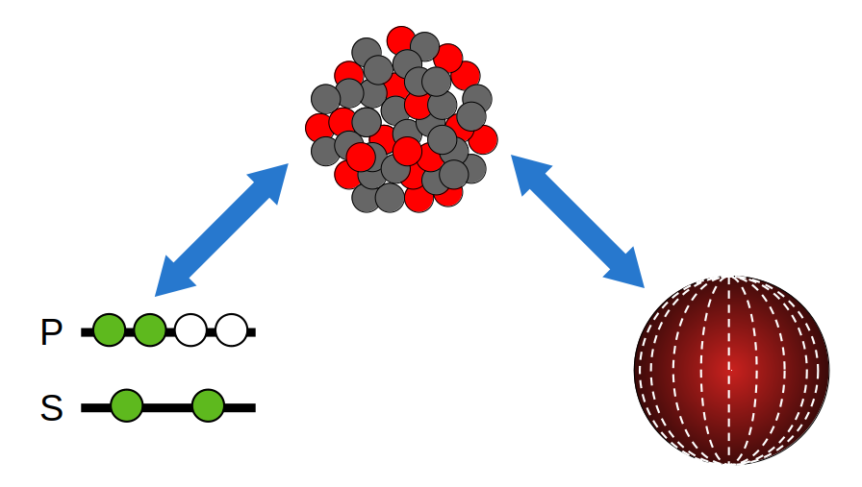
Nuclear structure
Single particle (shell model) vs Collective (liquid drop)
Models needed as strong force is still not fully understood
Rigid rotor (collective) model. Phonons induce vibrations to exhibit excitation
Greg Willmott gw00431@surrey.ac.uk 1

