Slide 1
Measurements of Fission Fragment Masses and Proton Numbers at ILL and n_TOF, CERN
N.V. Sosnin^{1*}, A. G. Smith¹, T. Wright¹, U. Köster², Z. Eleme³, A. Sekhar¹, A. D’Ottavi¹, M. Wlodarczyk¹, C. Lederer-Woods⁴, M. Diakaki⁵, V. Michalopoulou⁵, N. Patronis^{3,6}, M. Bacak⁷
1 - University of Manchester, UK
2 - Institut Laue-Langevin, France
3 - University of Ioannina, Greece
4 - University of Edinburgh, UK
5 - National Technical University of Athens, Greece
6 - CERN
7 - TU Wien, Austria
Nikolay Sosnin IOP 2025 24 April 2025

Slide 2
Structure
Nuclear Fission
Bragg Detectors and Fragment Measurements
Institut Laue Langevin
n_TOF
Conclusion
Nikolay Sosnin IOP 2025 24 April 2025

Slide 3
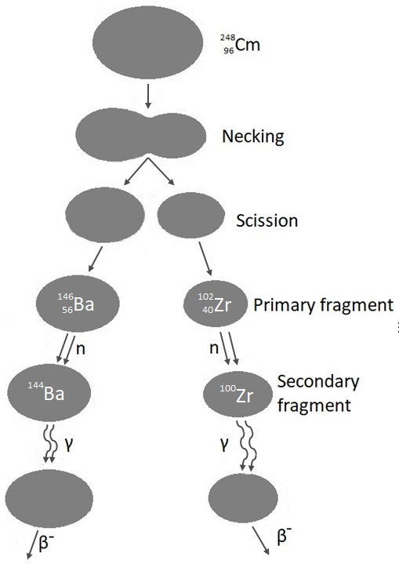
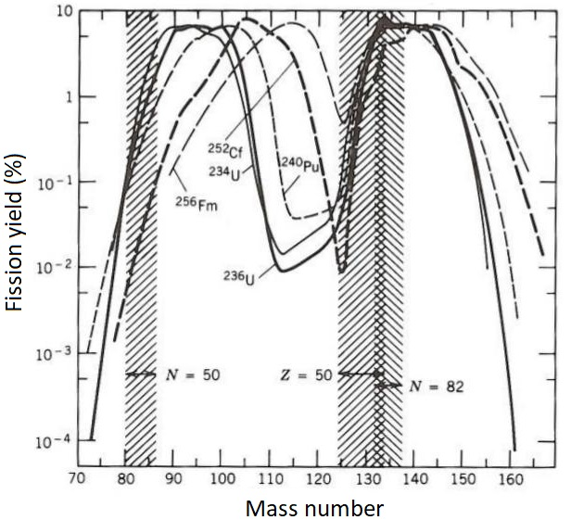
Nuclear Fission
Binary fission mostly produces FF with different mass
Double-magic Z=50 N=82 (132Sn) shell closure very strong and defines the heavier fragment
Left-over matter forms a lighter fragment
I. Ahmad and W.R. Phillips, Reports on Progress in Physics 58, 1417 (1995).
K.F. Flynn et al., Phys. Rev. C 5, 1725 (1972).
Nikolay Sosnin 77Se(n,𝛾) Measurement 25 Nov 2021
Nikolay Sosnin IOP 2025 24 April 2025

Slide 4
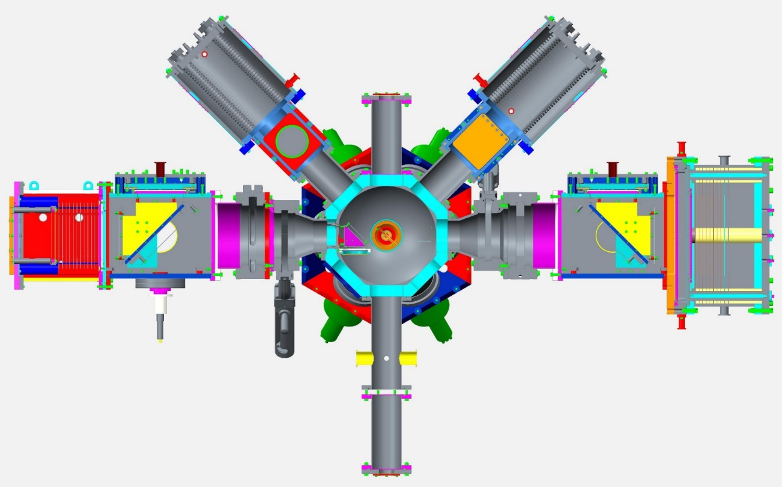
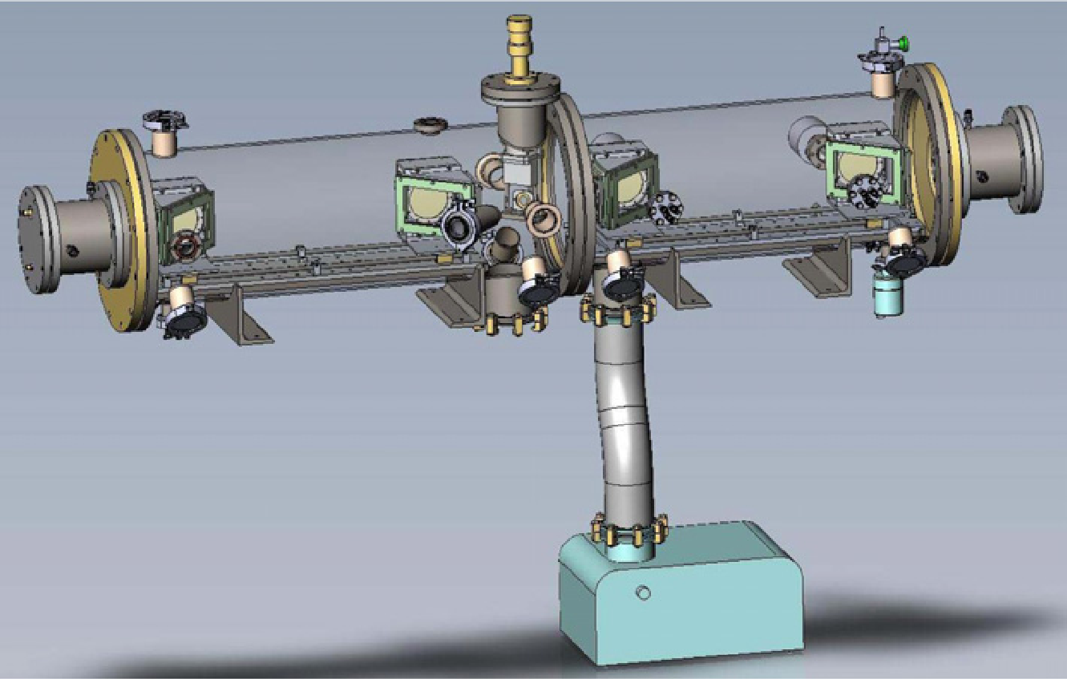
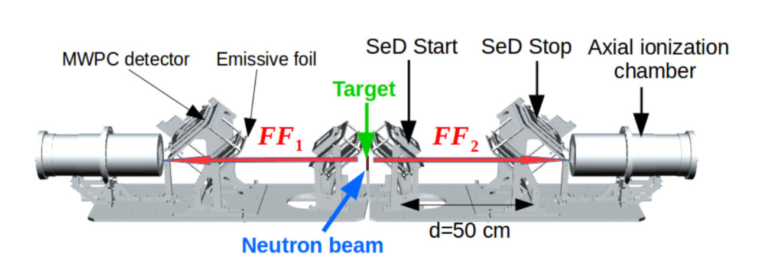
Fission Experiments
STEFF (Manchester, UK)
USEFUL OBSERVABLES
FF A,N,Z, KE → Frequently use Bragg Detectors
Prompt neutron/gamma energies, multiplicities, angular distributions
Typically, correlated measurements of fission observables needed, requiring large arrays
BD
BD
BD
BD
SPIDER (Los Alamos, USA)
BD
BD
BD
BD
FALSTAFF (CEA, France)
Nikolay Sosnin IOP 2025 24 April 2025

Slide 5
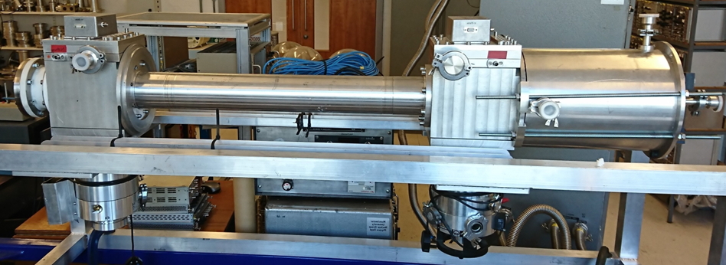
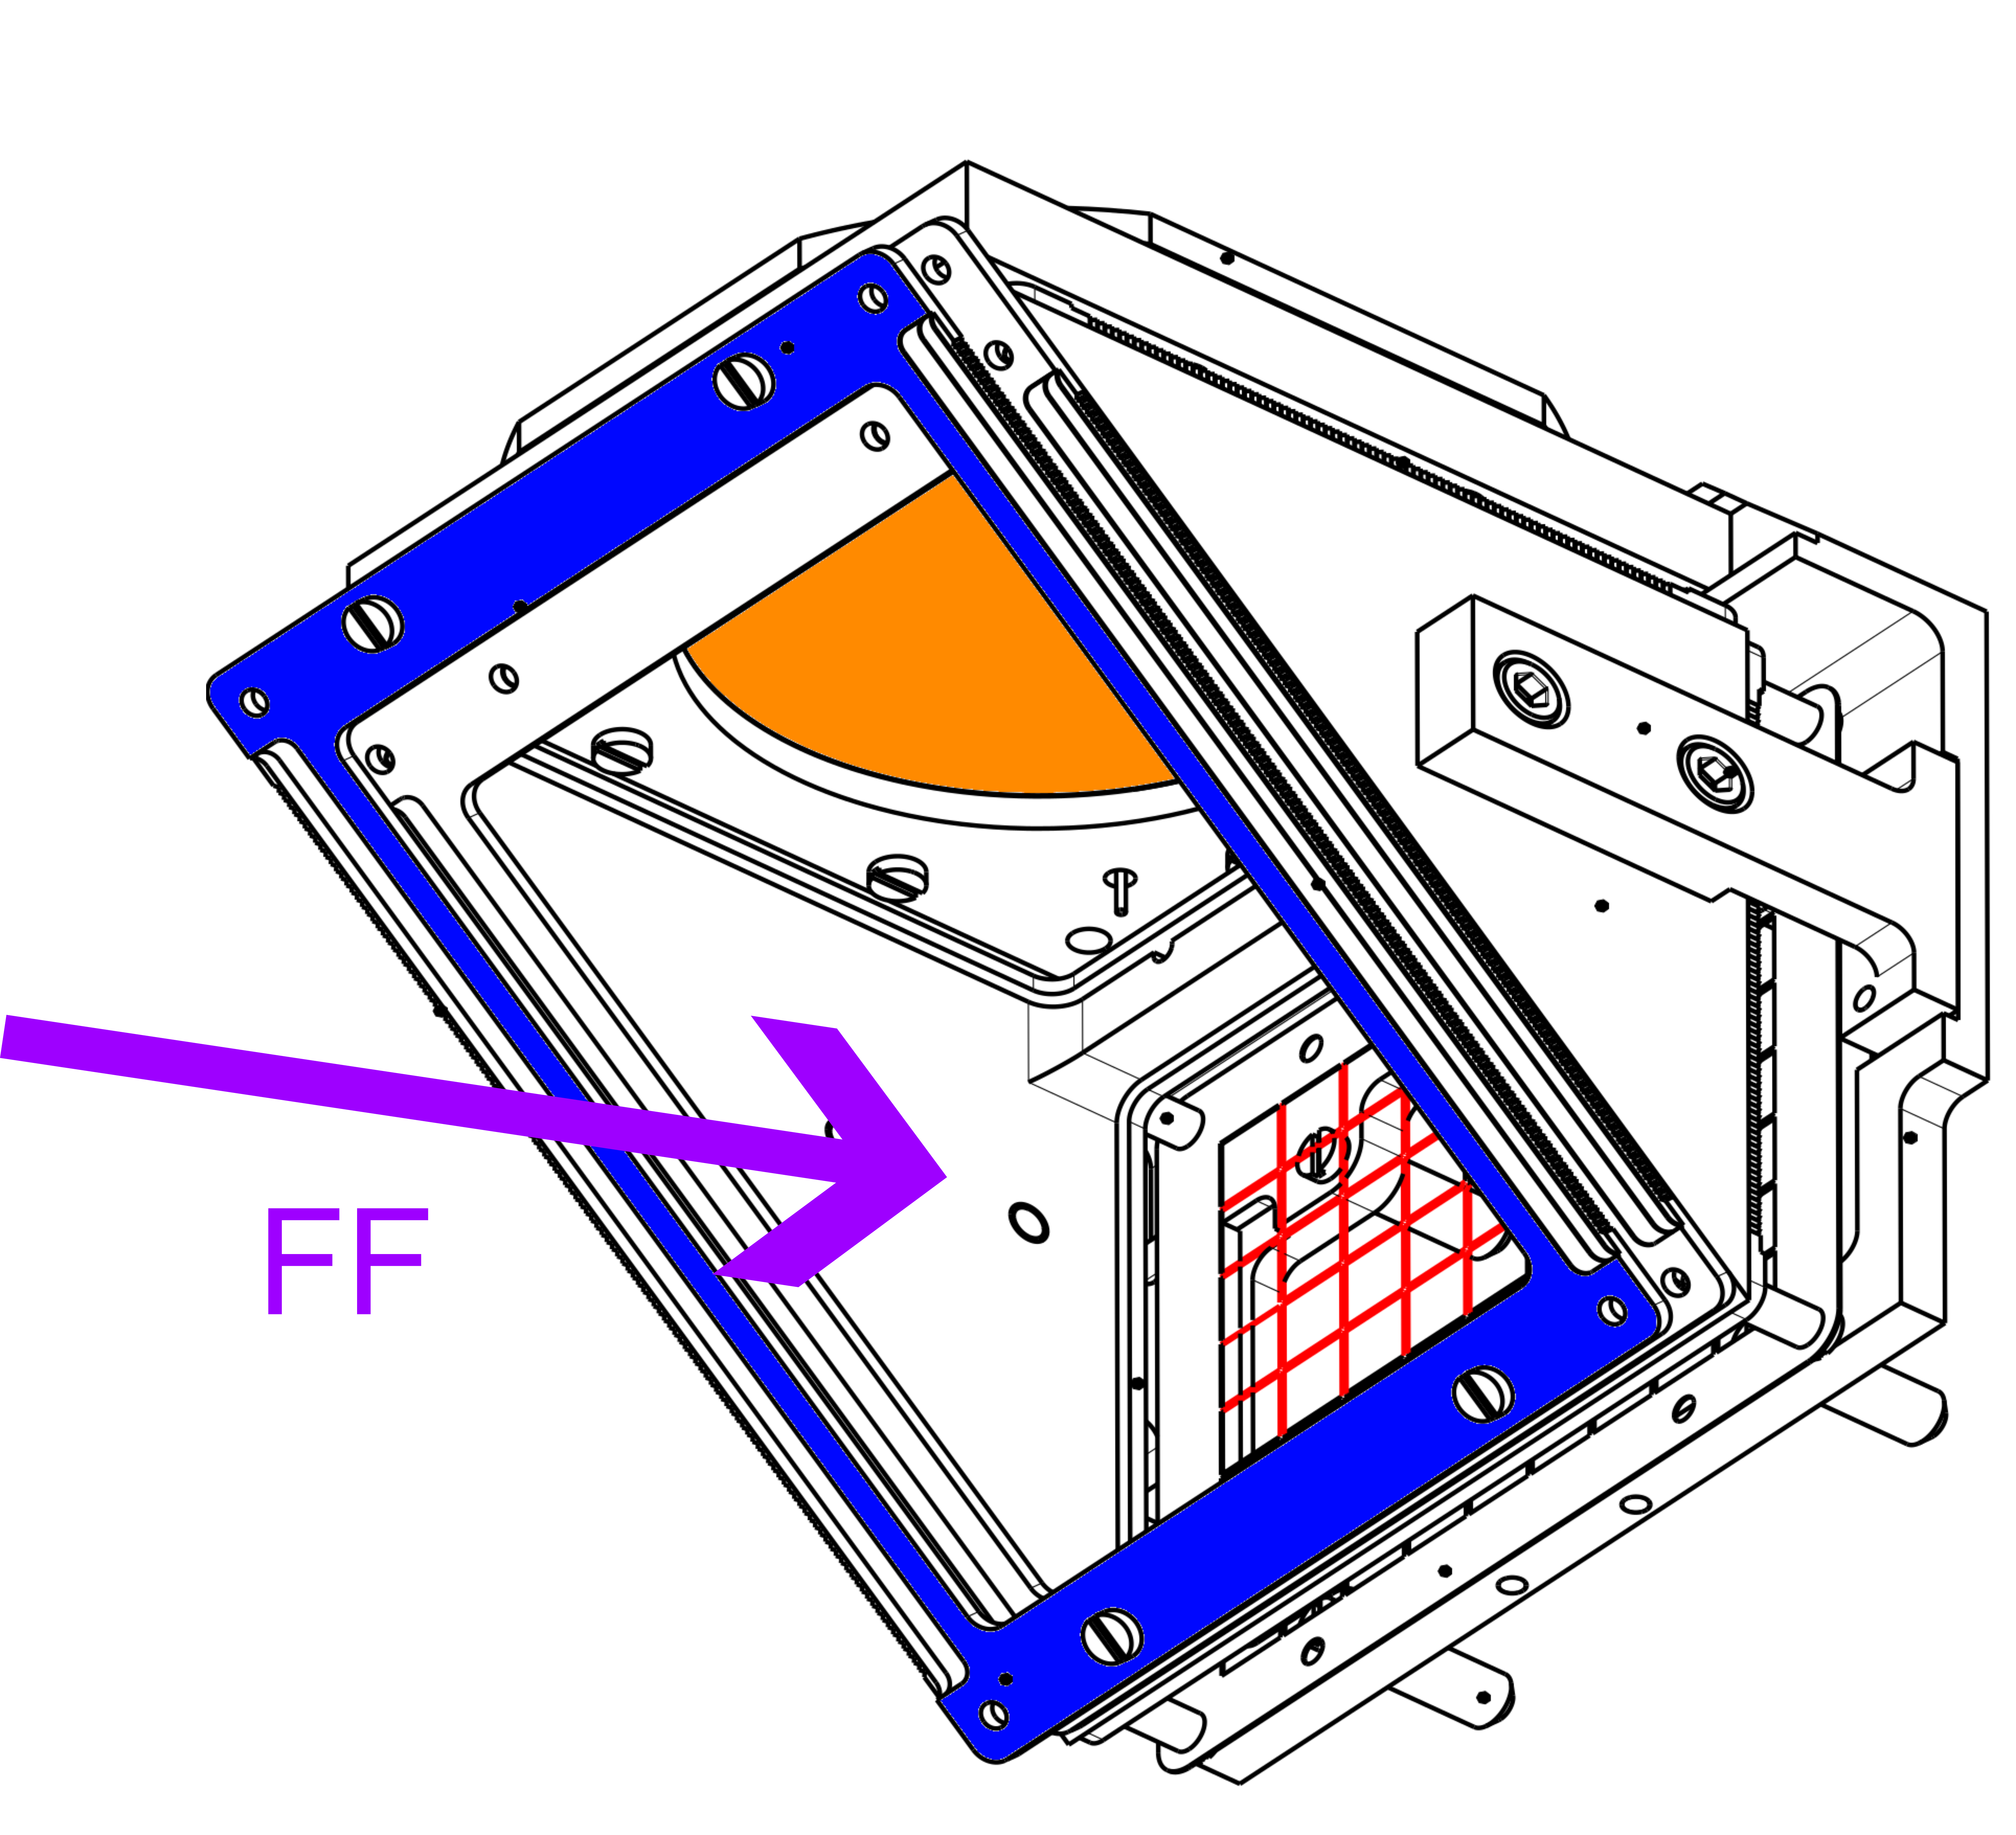
Bragg Detectors and Fragment Measurements
Bragg Detector
FF
gas
Anode
Grid
Bragg detector is a coaxial ionization chamber
Typical gasses CF4, argon, isobutane (iC4H10)
Kinetic energy resolution 0.5 MeV
Grid ensures linear response, blocks +ve ions
1-meter flightpath
~100 nm formvar+Al foils
700 ps TOF resolution
Nikolay Sosnin IOP 2025 24 April 2025

Slide 6
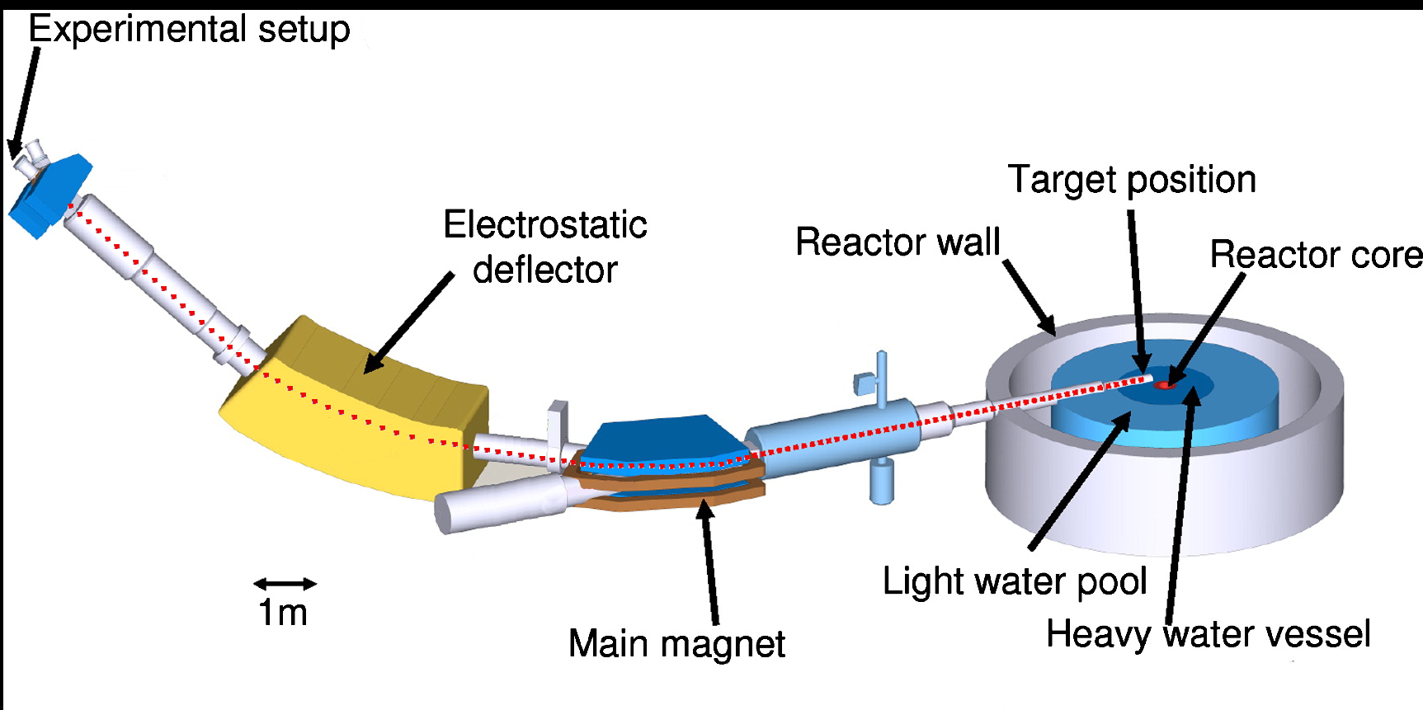
FiFI at Lohengrin
Fission Fragment Identification (FiFI) arm used at Lohengrin for two weeks measurement in June 2021
²³⁹Pu target
Lohengrin separates by A/q and E/q
Aim is investigating ionization signal traces for any variations correlated to fragment Z
Nikolay Sosnin 77Se(n,𝛾) Measurement 25 Nov 2021
Nikolay Sosnin IOP 2025 24 April 2025
Nikolay Sosnin Fission Studies 23 May 2022

Slide 7
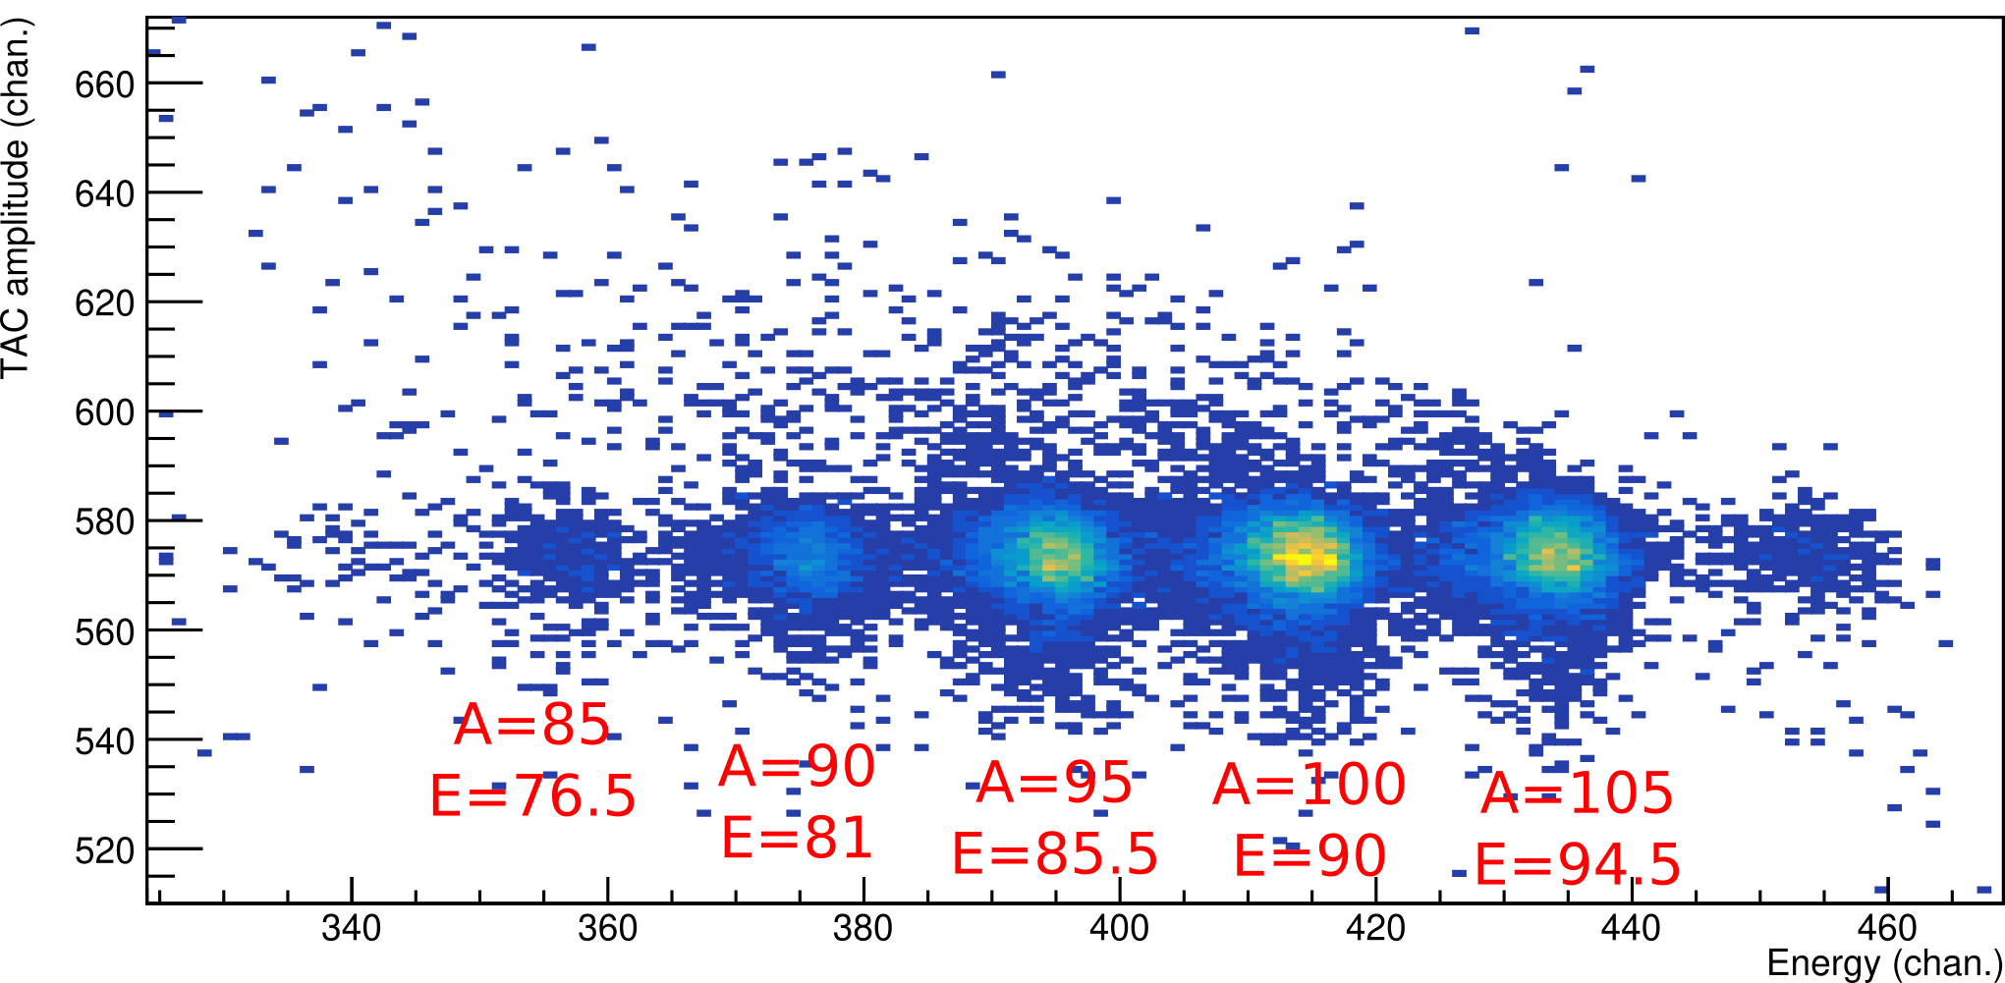
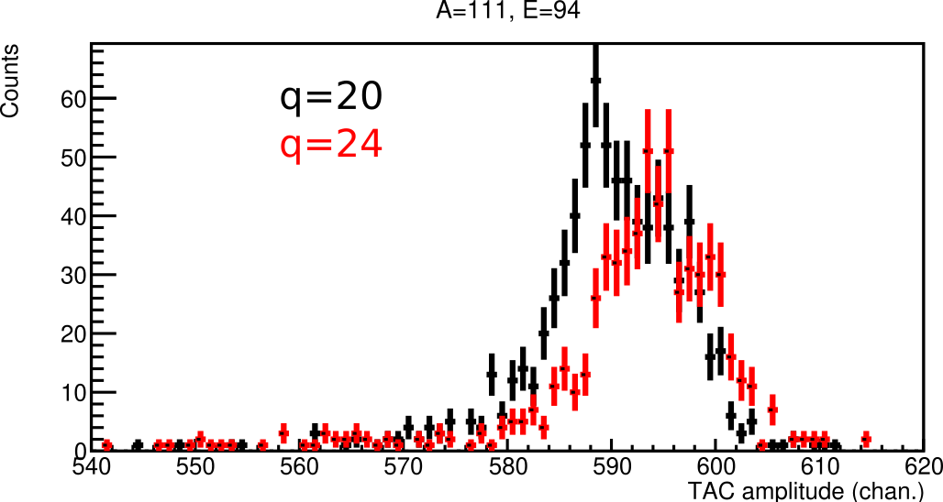
A Little Preview of Results
Lohengrin separates by A/q and E/q
For each q state of all FF produced in target, only one mass and energy will satisfy both ratios
Each peak corresponds to a single ionic charge state
Each mass contains a mix of Z
All FF have the same velocity
Bias Z yield with q gate
Beam setting: A/q = 5, E/q = 4.5
TOF (chan.)
KE (arb.)
TOF (chan.)
Nikolay Sosnin 77Se(n,𝛾) Measurement 25 Nov 2021
Nikolay Sosnin IOP 2025 24 April 2025
Nikolay Sosnin Fission Studies 23 May 2022

Slide 8
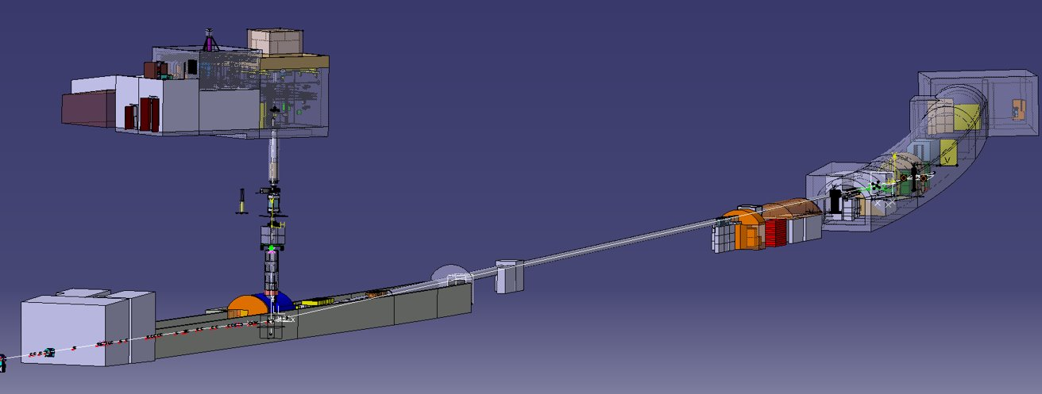
n_TOF, CERN
Bragg detector
0.8% geometric efficiency → Need high flux at EAR2
Higher gamma flash
2 beam collimators: ⌀6cm and ⌀2cm
FiFI TOF section shortened from 1 m to 0.5 m to improve statistics
Use ⌀6cm 235U target for testing
Use fast neutrons (0.5-10 MeV) to measure fission mass yields
Plans for ²⁴³Am and ²³⁰Th for nuclear waste in fast reactors and thorium fuel cycle
Neutrons
^{EAR2}
^{EAR1}
Timing detectors
^{20 m beamline}
^{185 m beamline}
²³⁵U
Nikolay Sosnin IOP 2025 24 April 2025

Slide 9
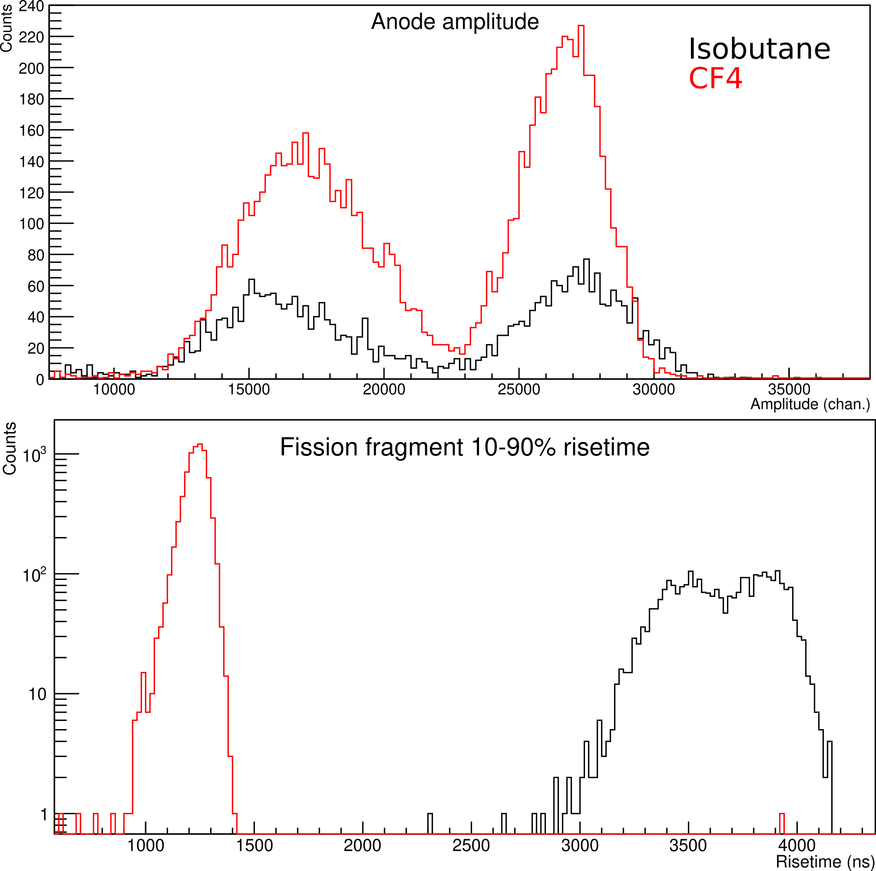
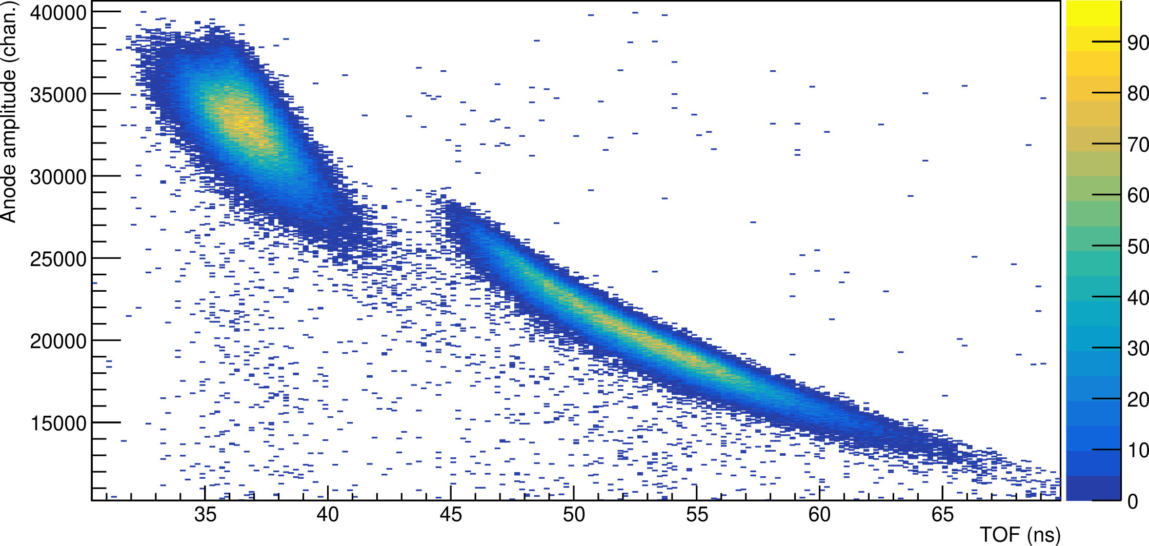
Test results
Thermal neutrons
KE (arb.)
TOF (ns)
Nikolay Sosnin IOP 2025 24 April 2025

Slide 10
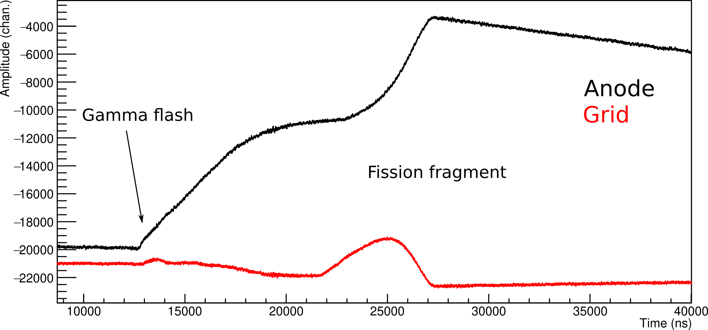
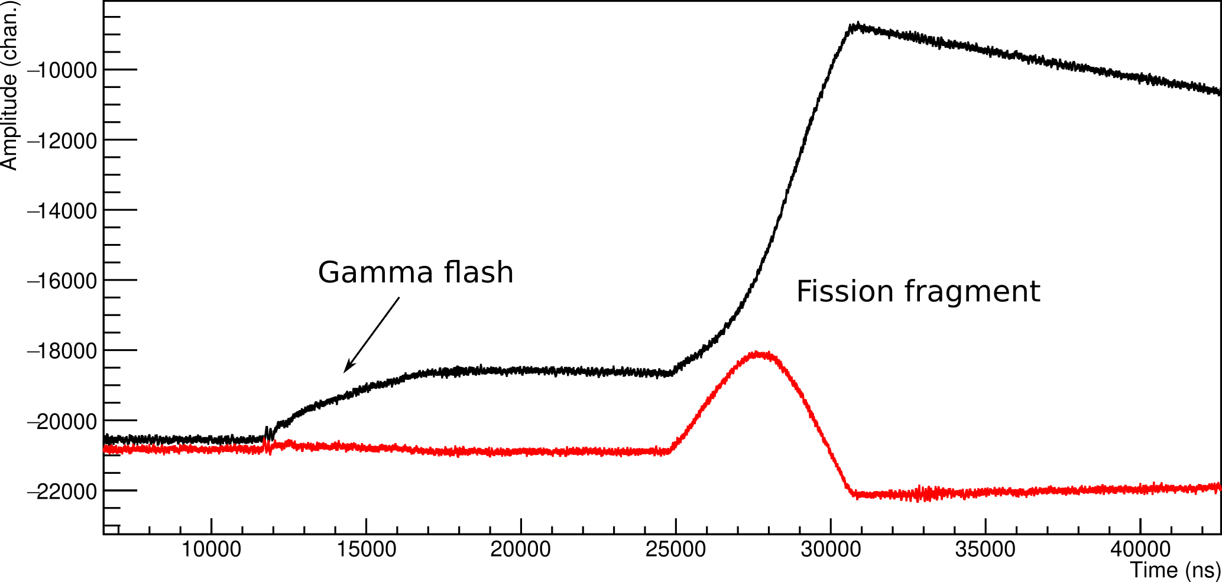
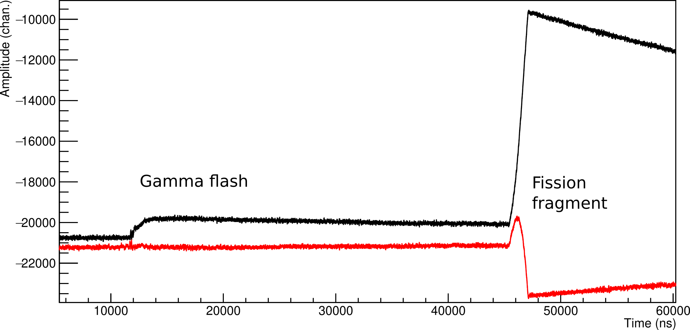
⌀6cm collimator isobutane
⌀2cm collimator isobutane
⌀2cm collimator CF4
Nikolay Sosnin IOP 2025 24 April 2025

Slide 11
Conclusion
ILL analysis ongoing
Calibration is completed
Use such data to identify Z-dependent variations
n_TOF analysis ongoing
Investigated fill gases and collimation
Tests with silicon and scintillators planned
Campaigns for measuring mass yields of ²⁴³Am and ²³⁰Th in the future?
THANK YOU
Nikolay Sosnin 77Se(n,𝛾) Measurement 25 Nov 2021
Nikolay Sosnin IOP 2025 24 April 2025
Nikolay Sosnin Fission Studies 23 May 2022

