Slide 1
GEn-RP: Neutron Electric Form Factor Measurement at 4.5 GeV² via Charge-Exchange Recoil Polarimetry
Co-spokespersons: Bogdan Wojtsekhowski, Michael Kohl, David Hamilton, Andrew Puckett, William Tireman
Students: Andrew Cheyne, Saru Dhital, Bhasitha Dharmasena
IoP Nuclear conference 2025
Andrew Cheyne
a.cheyne.1@research.gla.ac.uk
updated 22/04/2025
Notes:
Or title like, pushing the form factor to high Q2

Slide 2
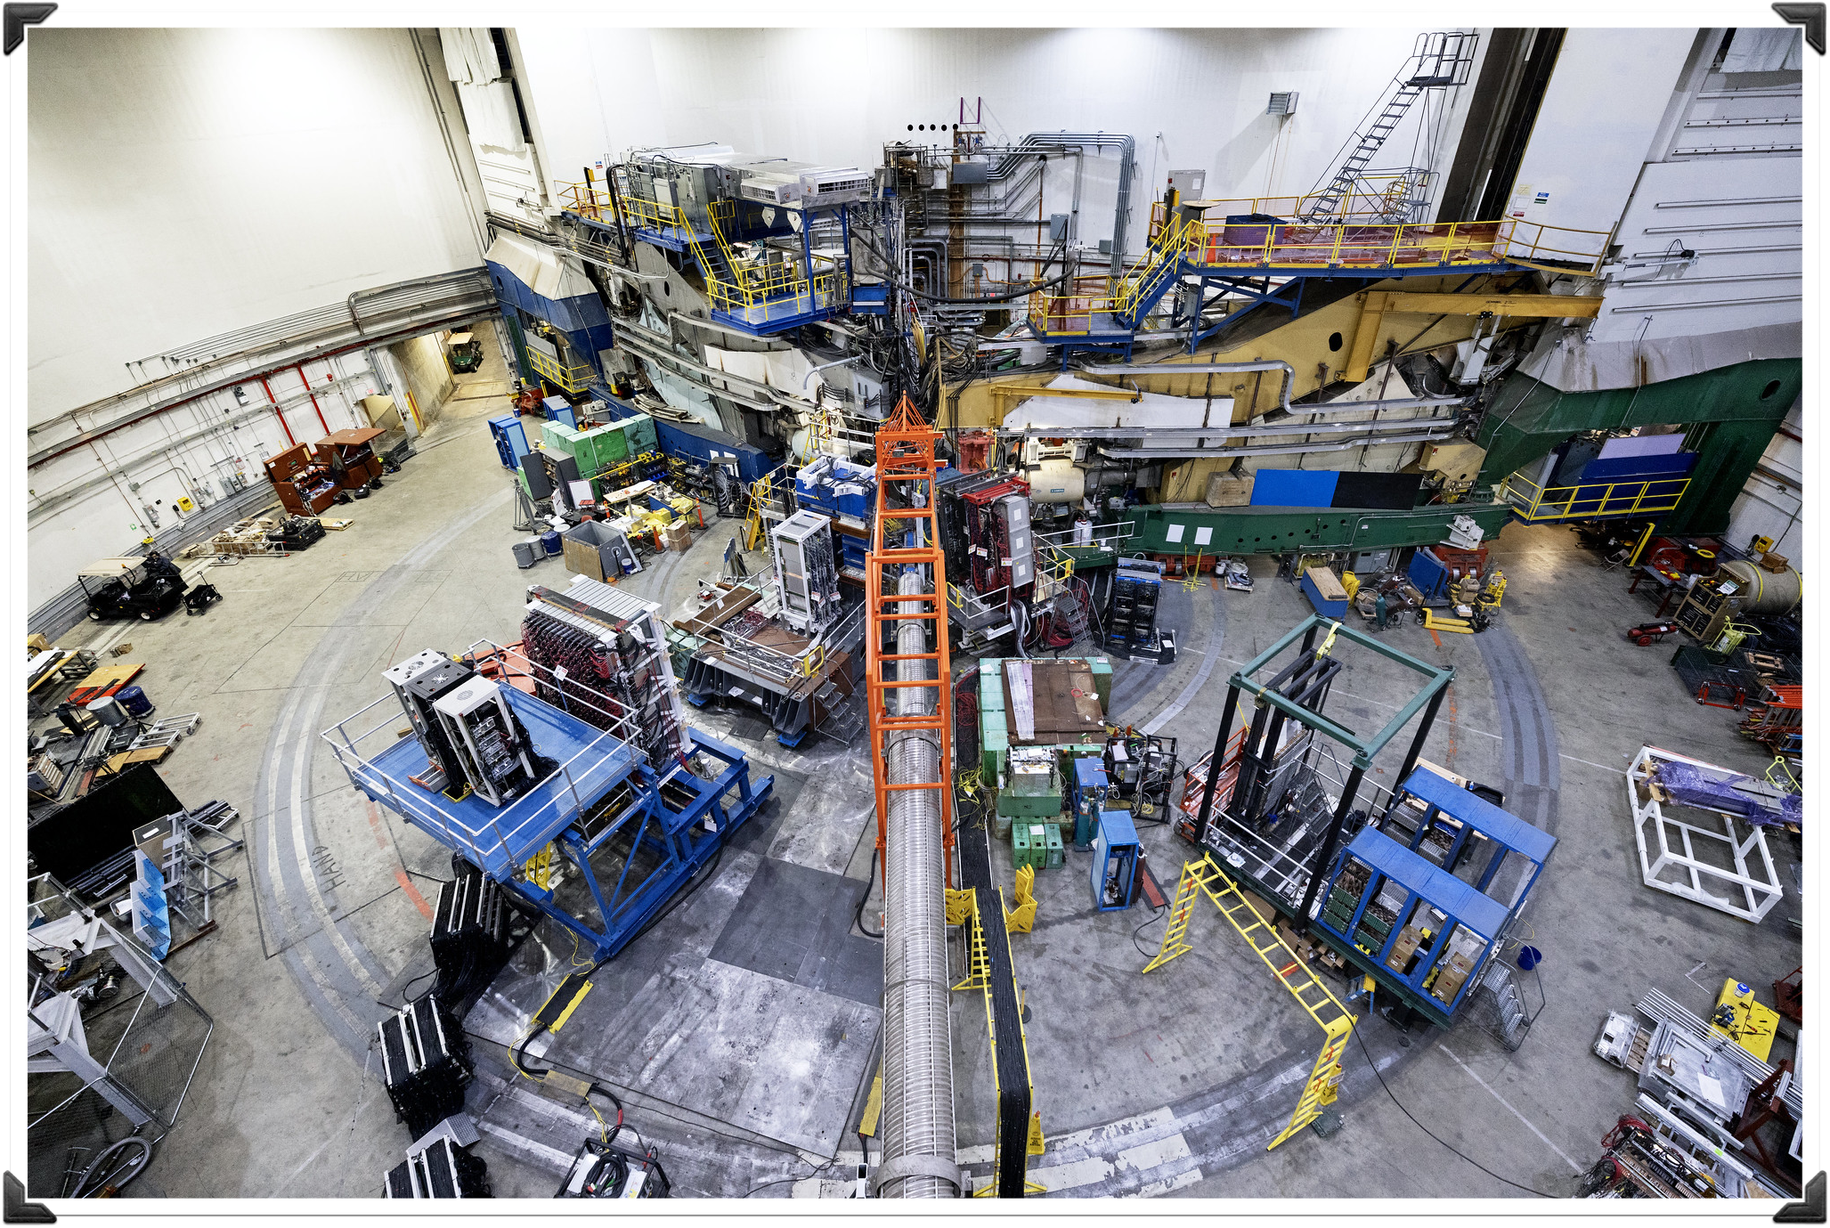
Outline
GEn-RP:
Neutron Electric Form Factor Measurement at 4.5 GeV² via
Charge-Exchange Recoil Polarimetry
Motivation
Hadron structure landscape
SBS-program at Jefferson Lab
Double Polarisation method
The GEn-RP experiment
Jefferson Lab
Experimental setup
Recoil Polarimetry analysis
Current Status
Asymmetry
Future

Slide 3
Motivation
Form Factors and the SBS program at Jefferson Lab

Slide 4
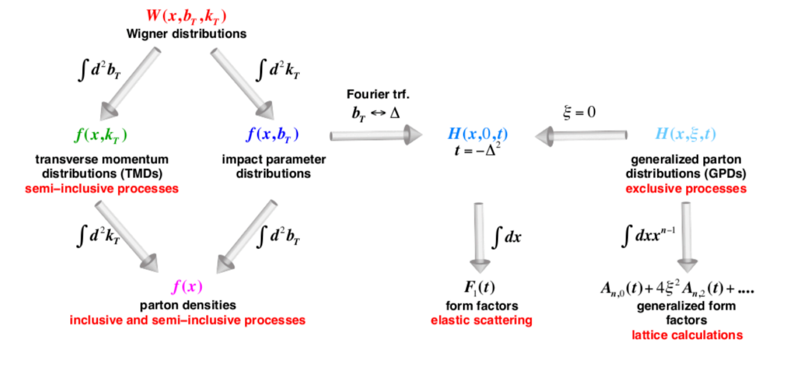
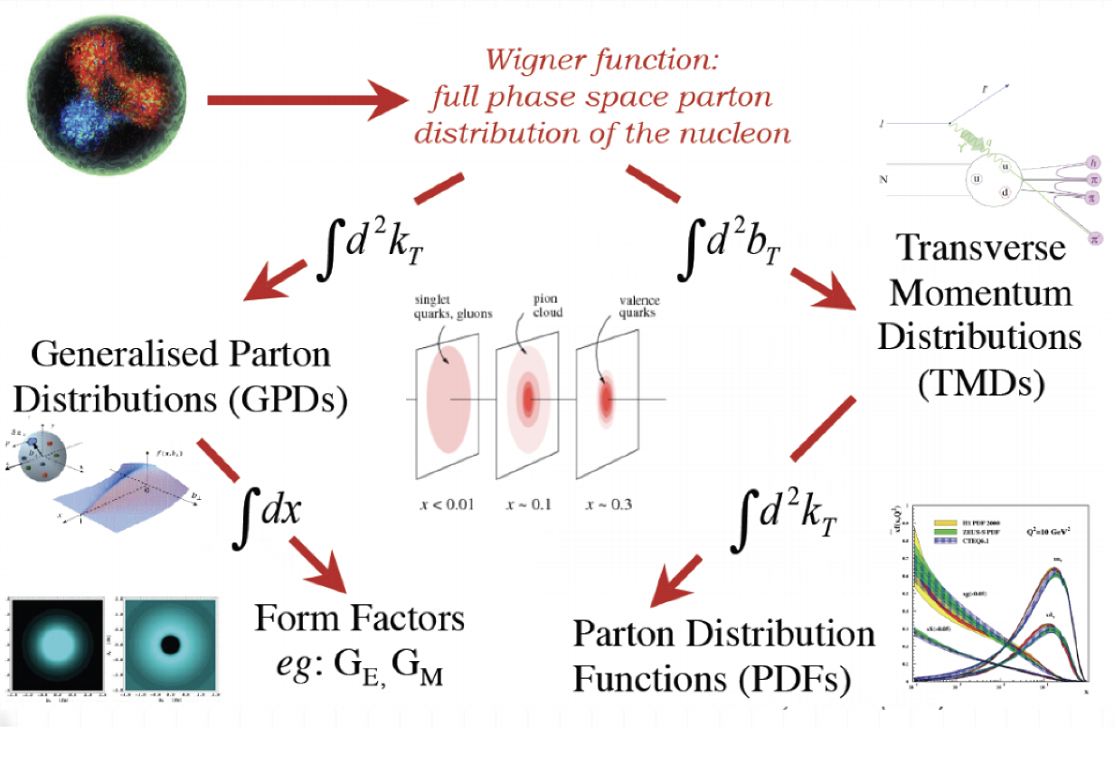
Motivation: Form Factors
Form factors place in the hadron landscape
A full description of the nucleon stands on two measurement pillars:
Inelastic measurements → TMDs/PDFs(momentum,kt)
Elastic measurements → Form Factors (spatial,bt)
Form Factor measurements not as well studied
One common parameterisation of Form Factors are GE and GM.
They describe electric and magnetic distribution inside the nucleon as a function of q².
Notes:
Full 5D phase space
Relativstic so (x, bt, kt)
PDFs accessed via inclusive scattering (gives 1d x distribution of partons inside)
TMD via semi-inclusive (gives transverse as fn of x)
F1 and F2 encode the structure of the hadron
In the background

Slide 5
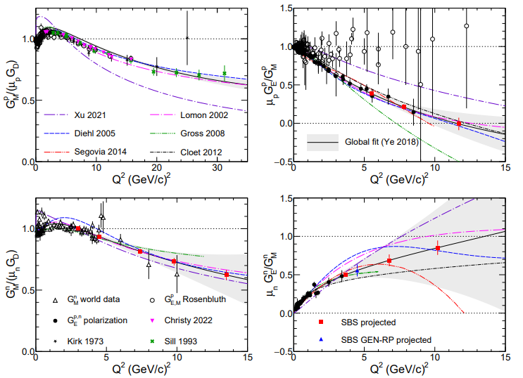
Motivation: Form Factors world data
Explanation of
Super BigBite Spectrometer (SBS) at Jefferson Lab
GM
GE
Suite of experiments aiming to measure GMn, GEn, and GEp at high 4-momentum transfer (Q²)
A range of techniques for form factor extraction:
GMn - cross section ratio measurement (run completed)
GEn-II - double polarisation (polarised target) (run completed)
GEn-RP - double polarisation (charge-exchange channel) (run completed)
GEp-V - double polarisation (running now)
Proton
Neutron
Current world Form Factor data. Red/Blue points marks SBS predicted.
Credit: Andrew Puckett
Notes:
NEED to do:
Explanation about y-axis scales
Other experiments
nTPE
Why was GMn a cross section measurement?

Slide 6
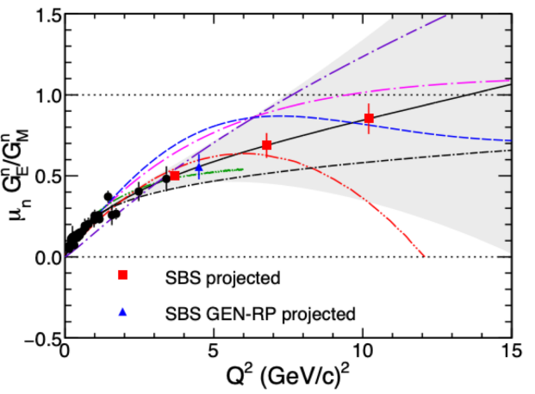
Motivation: Form Factors world data
Explanation of
Super BigBite Spectrometer (SBS) at Jefferson Lab
Suite of experiments aiming to measure GMn, GEn, and GEp at high 4-momentum transfer (Q²)
A range of techniques for form factor extraction:
GMn - cross section ratio measurement (run completed)
GEn-II - double polarisation (polarised target) (run completed)
GEn-RP - double polarisation (charge-exchange channel) (run completed)
GEp-V - double polarisation (running now)
GE
Neutron
Lack of GEn information at higher Q2
Notes:
NEED to do:
Explanation about y-axis scales
Other experiments
NTPE (neutron two photon exchange)
No RP above 1.5 GEV2

Slide 7
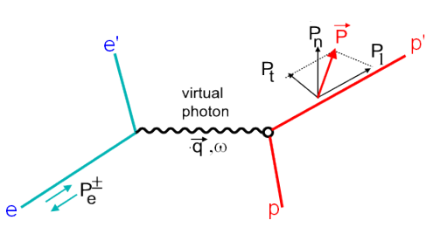
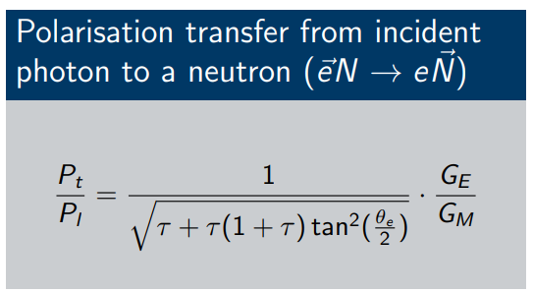
Motivation: Double polarisation
Extraction GE through beam(target) polarisation
Measuring the transverse and longitudinal polarisations gives direct access to the FF ratio GE/GM
N'
N
Polarisation transfer from a polarised electron to an unpolarised nucleon. Recoiling nucleon then has polarisation components Pt and Pl.
$$\frac{P_{t}}{P_{l}}=\frac{1}{\sqrt{τ+τ(1+τ)\tan^{2}(\frac{θ_{e}}{2})}}\frac{G_{E}}{G_{M}}$$
Notes:
Advancements in polarised beam and targets allowed for a polarisation experiments.
Double polarisation method
2017 Bonner prize Perdrisat experiment
Nucleon-nucleon interaction is polarisation dependent.
Modern polarised beam and target advancements made it possible
By measuring Pt and Pl you can take the ratio and extract GE
Cancelling many of the systematics
Tau = q^2 /4M^2
Less sensitive to two-photon contributions than Rosenbluth separation method

Slide 8
The GEn-RP experiment
Experiment setup, and recoil polarimetry analysis

Slide 9
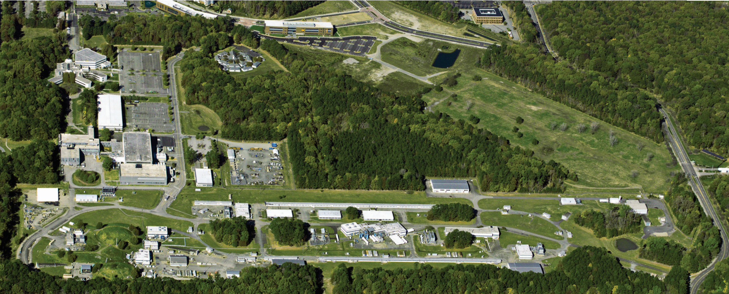
Jefferson Lab
Continuous Electron Beam Accelerator Facility (CEBAF) and experimental halls
Res Fac
CEBAF
LINAC
Hall D
Hall A
Hall B
LINAC
Hall C
Aerial Image of Jefferson Lab
Notes:
Continuous electron-beam accelerator facility (CEBAF)
Capable to highly polarised (80%+) electron beams up to 12 GeV.
4 Experimental halls with beam bunches able to be sent to each hall independently.
Continuous Electron Beam Accelerator Facility (CEBAF)
Injector: photocathode gun creates continuous waveform (CW) bunches of electrons that are injected into the “racetrack” accelerator.
Two Linear Accelerators (LINAC) utilize superconducting radio frequency (SRF) niobium cavities.
Arc magnets allow for beam recirculation.
Up to 11 GeV Beam Energy (12.5 GeV to Hall D).
Hall A
High Current, High Luminosity (60 uA, L = 10^38 e/cm^2/s
User-Driven, Open-Floor experiments
SBS program focuses on probing the nucleus by resolving the electromagnetic form factors of nucleons using the SBS spectrometer.

Slide 10
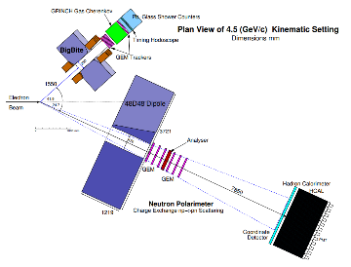
Jefferson Lab
CEBAF and Halls A-D
Continuous electron-beam accelerator facility (CEBAF)
Capable to highly polarised (80%+) electron beams up to 12 GeV.
4 Experimental halls with beam bunches able to be sent to each hall independently.
CEBAF
Hall A
Aerial Image of Jefferson Lab

Slide 11
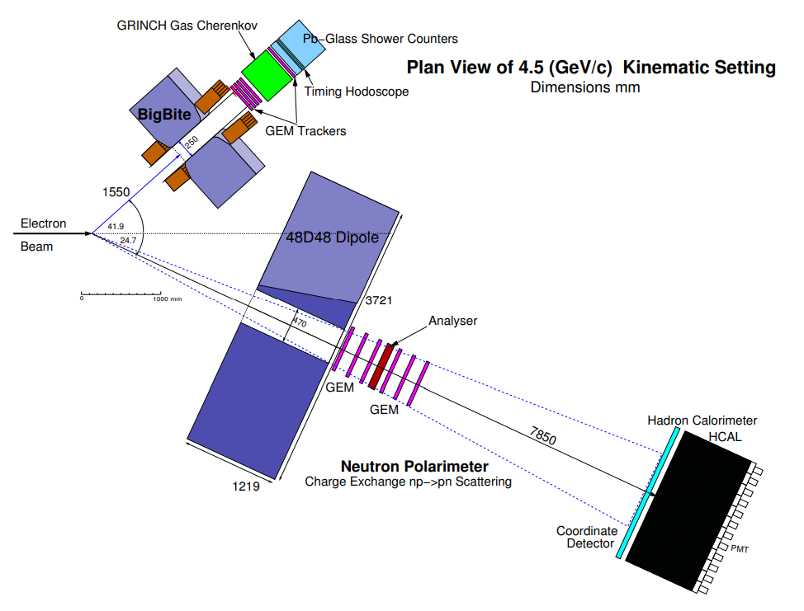
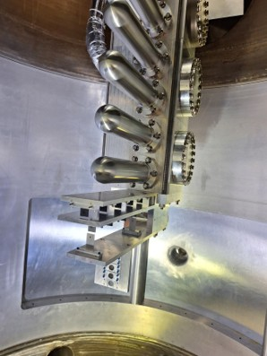
GEn-RP in Hall A
Experiment Aim
Measure the ratio GEn/GMn at Q² 4.4 (GeV/c)² using two recoil polarimetry techniques:
charge-exchange (np→pn)
conventional (np→np) wide-angle scattering
Beam Energy (GeV) | Beam Current (µA) | Electron arm angle (°) | Electron Calorimeter dist. (m) | Q2 (GeV/C)² | Hadron arm angle (°) | Hadron Calorimter dist (m)
4.3 | 10-12 | 42.5 | ~1.5 | 4.4 | 24.7 | 9.0
Experiment schematic for GEn-RP
(charge exchange only)
View inside the target chamber.
Incoming beamline hole can be seen in the background.
Notes:
Double check these energy/q2 values
Measure GEn/GMn at Q2 = 4.4 (GeV/c)2 using charge-exchange recoil neutron polarimetry
Beam:
4.3 GeV/c Energy, Pbeam ~80%
30µA on a 15cm LD2 target
Compare F.O.M. for charge-exchange (np→ pn) scattering and the more standard (np→ np)
Demonstrate the feasibility of detecting low-energy recoil protons from an active analyser at large angles in an unshielded environment
Originally proposed to “piggy-back” on the GMn experiment at the 4.5 (GeV/c)2 kinematic

Slide 12
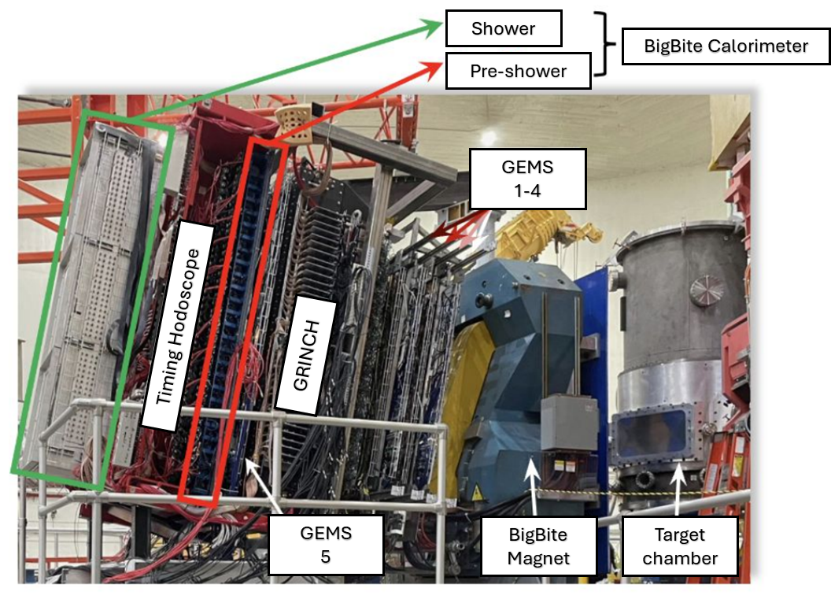
Experimental systems:
Target chamber
For GEn-RP
Moveable cryogenic target cells allows us to use multiple targets
No free neutron target -> liquid deuterium
Also liquid Hydrogen (LH2),
other targets for calibration purposes.
Electron arm
Hadron arm
View inside the target chamber.
Incoming beamline hole can be seen in the background.

Slide 13
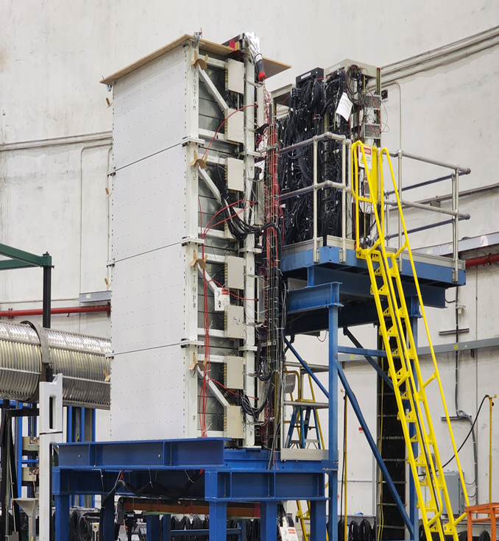
Experimental systems:
Electron arm
BigBite spectrometer - kinematic and vertex reconstruction
BigBite magnet - deflects charged particle
5 layers of GEM trackers - track/momentum reconstruction
GRINCH - particle identification (PID)
Timing hodoscope - precision timing
BBCal (shower and pre-shower calorimeters) - energy
Electron arm
Hadron arm
Notes:
90-1 bars in hodo L/R pmt on each
bbcal: 241 PMTs
shower 27rows*7 col lead glass (8.5*8.5*34cm)
preshower 26*2col (9*9*29.5cm) rad hard lead glass

Slide 14
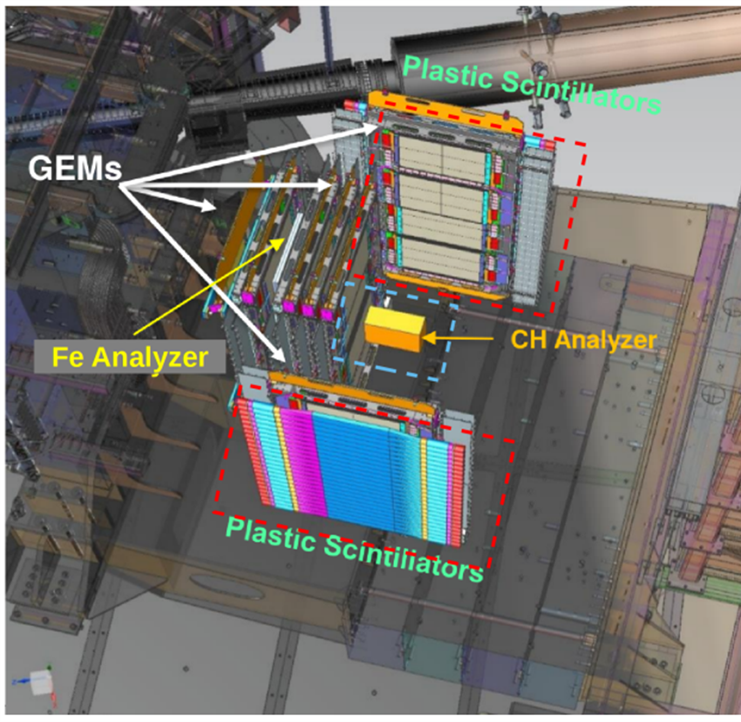
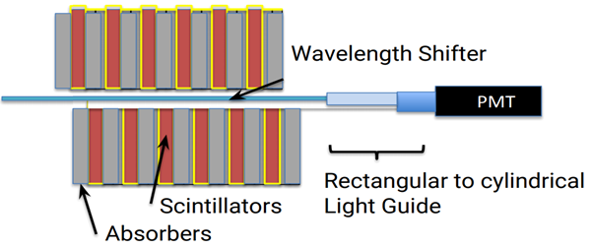
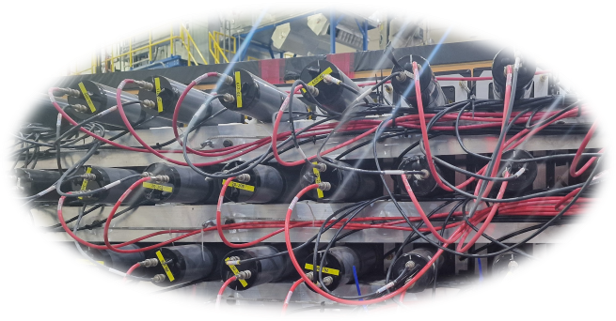
Experimental systems:
Hadron arm
Hadron Calorimeter (HCal)
288 blocks of steel/scintillator in a 12col*24row grid.
Hadron energy and position reconstruction, and timing.
Electron arm
Diagram showing layering inside a single block
Hadron arm
Notes:
each module is 40 layers
goes into wavelength shifter at the center of each module
lightguide -> PMT
Hcal block and detector sizes:
Scint material?
Expectation​:
Time resolution ~1 ns​
Energy resolution ~30%​
Position resolution ~ 4cm​

Slide 15
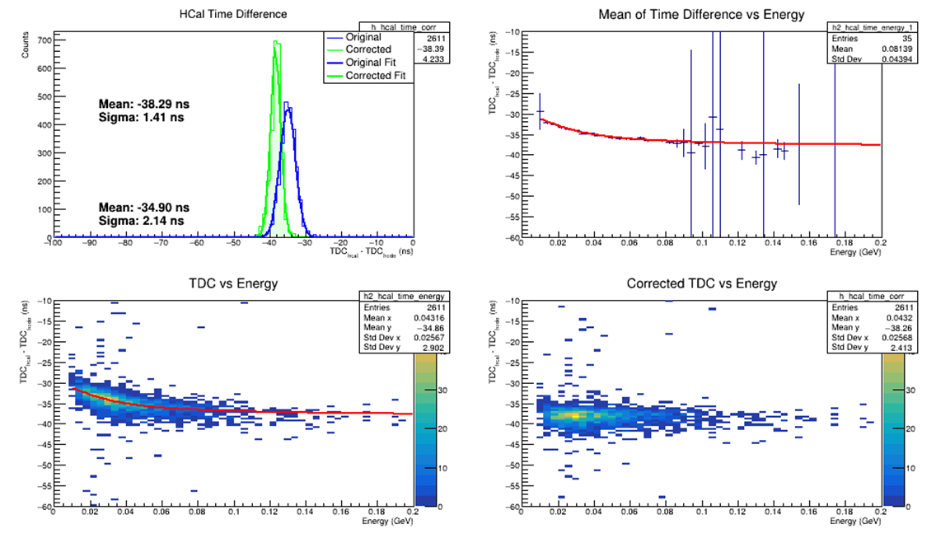
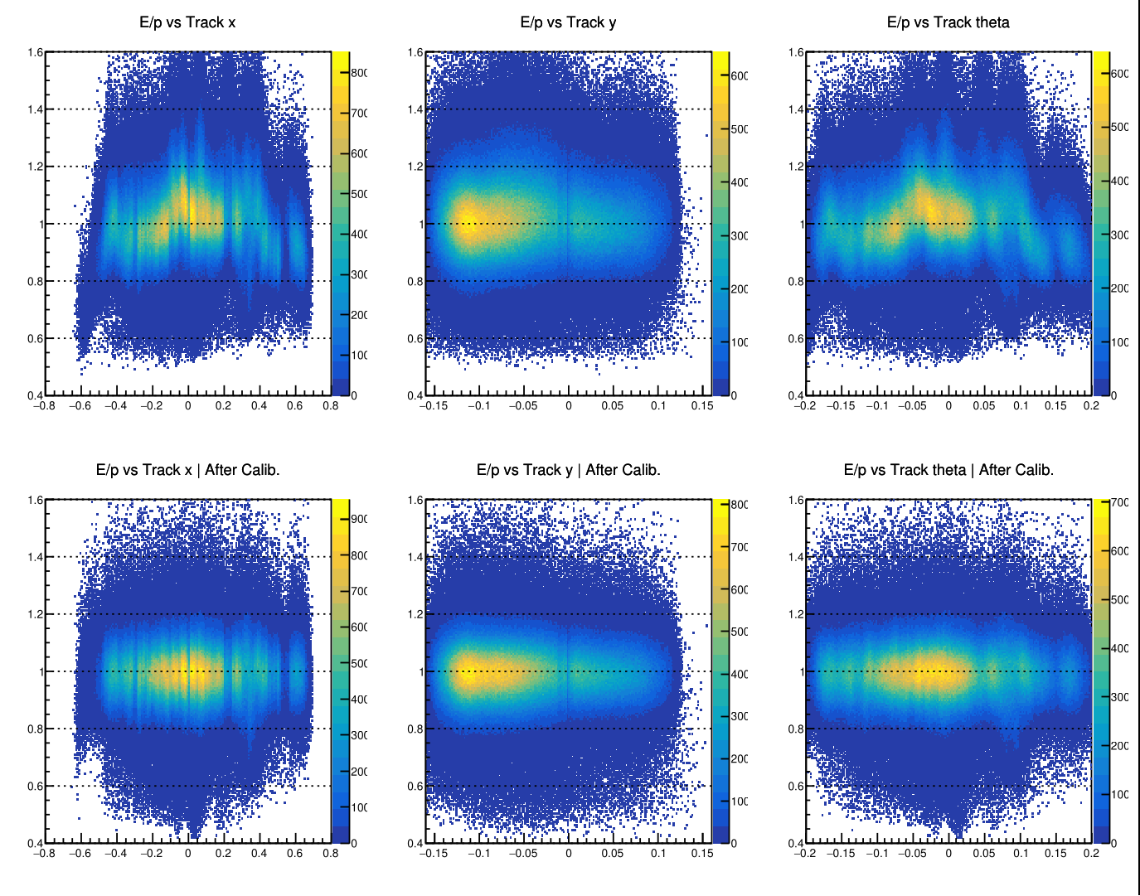
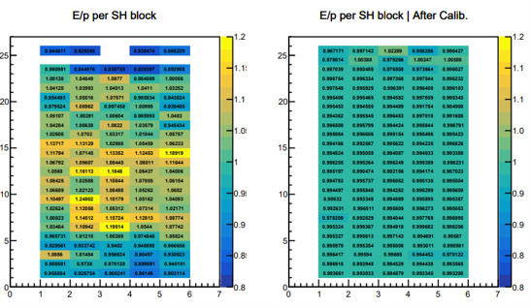
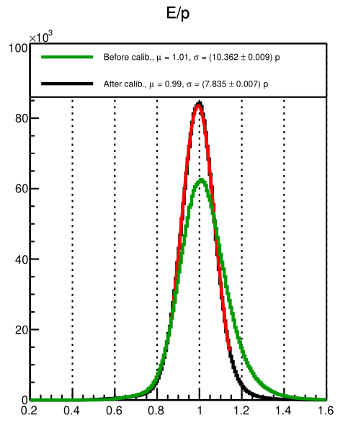
Detector Calibrations
Both arms need kinematic specific calibrations
Timing Calibrations
Energy calibrations
Remove timewalk and alignment effects due to difference in individual detector components (e.g. cable length, scintillation speed)
PMT-gain matched against reconstructed particle momentum
Example Bigbite E/p resolution improved by ~10% -> ~7% across all runs
Map of average block E/p for preshower showing more uniform distribution after calibrations
Example of timewalk correction for an individual PMT of the hadron arm calorimeter.
Notes:
Looking to ensure uniformity across the detector and track variable.

Slide 16
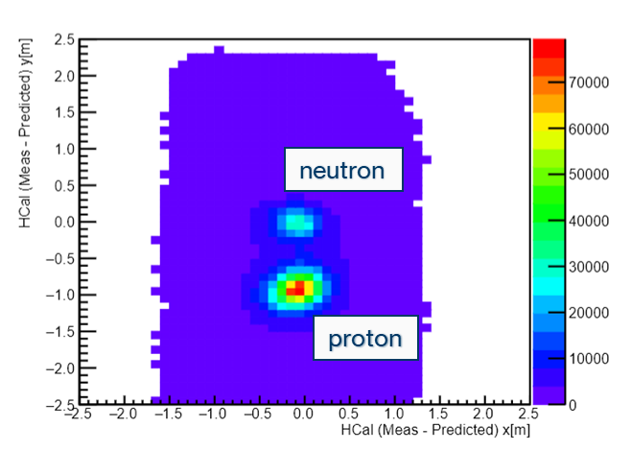
Experimental systems:
Analysis
2 Arm analysis
Information from both arms used for analysis
E.g. – proton/neutron event selection.
Electron arm
Hadron arm
Example of proton-neutron separation from Gen-RP
Notes:
each module is 40 layers
goes into wavelength shifter at the center of each module
lightguide -> PMT
Expectation​:
Time resolution ~1 ns​
Energy resolution ~30%​
Position resolution ~ 4cm​

Slide 17
Experimental systems:
Hadron arm polarimeter
Polarimeter (GEn-RP)
Charge Exchange analyser
Removable steel plate sandwiched between 8 layers of GEM charged particle trackers
Wide-angle np→np scattering.
Active CH Analyser and side plane hodoscope
Not used
Electron arm
Hadron arm
The polarimeter for GEn-RP with both charge-exchange and wide-angle components..

Slide 18
Recoil Polarimetry
Producing an asymmetry
N-N interaction in the analyser causes a spin-dependent deflection in secondary scattering distribution
Electron arm
Hadron arm

Slide 19
Recoil Polarimetry
Producing an asymmetry
N-N interaction in the analyser causes a spin-dependent deflection in secondary scattering distribution
Electron arm
Hadron arm
$$F_{LS}=−\overset{^}{r} \frac{dU_{LS}\left(r\right)}{dr}r ∙\left(p ×S \right) − U_{LS}\left(r\right) p×S$$
$$f(p,θ,φ)=\frac{ε(p,θ)}{2π}(1+A_{y}(p,θ)S_{y}cos(φ)−A_{y}(p,θ)S_{x}(sin(φ))$$

Slide 20
Recoil Polarimetry
Producing an asymmetry
N-N interaction in the analyser causes a spin-dependent deflection in secondary scattering distribution
S_{y}
S_{x}
y
θ
x
Φ
z
Electron arm
(p, θ, Φ)
Hadron arm
$$f(p,θ,φ)=\frac{ε(p,θ)}{2π}(1+A_{y}(p,θ)S_{y}cos(φ)−A_{y}(p,θ)S_{x}(sin(φ))$$

Slide 21
Recoil Polarimetry
Producing an asymmetry
Scattered particle distribution be described as x/y sinusoidal terms in Φ
Results in a spin dependent asymmetry in Φ
Electron arm
Hadron arm
$$f(p,θ,φ)=\frac{ε(p,θ)}{2π}(1+A_{y}(p,θ)S_{y}cos(φ)−A_{y}(p,θ)S_{x}(sin(φ))$$

Slide 22
The GEn-RP Polarimeter
Charge-exchange
HCal
Passive analyser sandwiched between layers of GEM charged particle trackers
Look for events where you have neutron into the analyser that undergoes charge exchange
y
Neutron
x
Φ
Electron arm
Analyser
Proton
Hadron arm

Slide 23
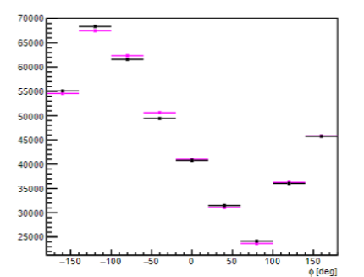
The GEn-RP Polarimeter
Charge-exchange
HCal
Passive analyser sandwiched between layers of GEM charged particle trackers
Look for events where you have neutron into the analyser that undergoes charge exchange
Plot counts vs Φ angle
y
Neutron
x
Φ
Electron arm
Analyser
Proton
Hadron arm

Slide 24
Charge Exchange Polarimeter
Polarimeter
HCal
Passive analyser sandwiched between layers of GEM charged particle trackers
Look for events where you have neutron into the analyser that undergoes charge exchange
y
Neutron
x
Analyser
Proton

Slide 25
Charge Exchange Polarimeter
Polarimeter
HCal
Passive analyser sandwiched between layers of GEM charged particle trackers
Look for events where you have neutron into the analyser that undergoes charge exchange
Plot counts vs Φ angle
y
Neutron
x
Analyser
Proton

Slide 26
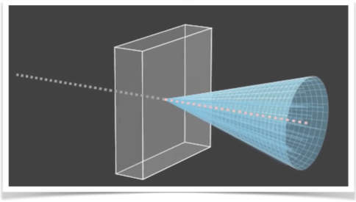
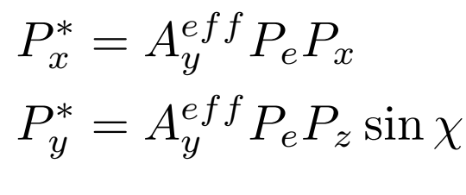
Obtaining polarisation components
From the asymmetry
e⁻
e⁻
We measure both +/- beam helicity and take their difference to remove many false asymmetry contributions
Then the polarisation in x*,y* can be extracted
$$A = \frac{f^{+}−f^{−}}{f^{+}+f^{−}}={hA}_{y}{(P}_{x}^{∗} \sin{θ}−P_{y}^{∗}\cos{θ})$$
$$f(p,θ,φ)=\frac{ε(p,θ)}{2π}(1+A_{y}(p,θ)S_{y}cos(φ)−A_{y}(p,θ)S_{x}(sin(φ))$$

Slide 27
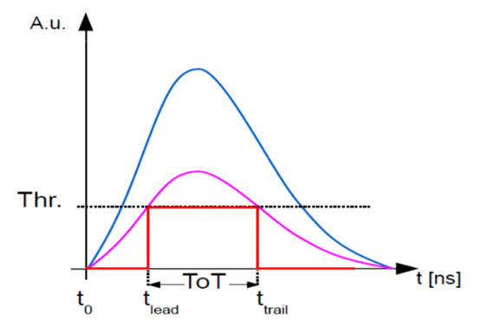
Calibrations: Timing
Timewalk corrections
Both the Hadron and Electron arms have a significant timewalk in their that needs corrections
Image from J. Hu, et al. Time Walk Measurements. CERN. https://indico.cern.ch/event/143033/contributions/

Slide 28
Current status
Calibrations, preliminary results, and future work

Slide 29
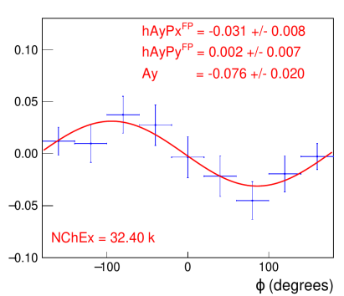
Asymmetry from the Data
First look at the asymmetry
Plotting the difference in counts between +/- helicity states vs azimuthal angle.
fit with:
$f_{diff}(φ)=\frac{hA_{y}}{π}(P_{x}^{fpp}cos(φ)−P_{y}^{fpp}sin(φ))$
Analysis done during the experiment on the first ~70% of data shown on the right.
Charge-exchange channel shows the expected asymmetry in azimuthal distribution.
Plotting the difference in counts between +/- helicity states vs azimuthal angle.
fit with:
Analysis done during the experiment on the first ~70% of data shown on the right.
Charge-exchange channel shows the expected asymmetry in azimuthal distribution.
$$A = \frac{f^{+}−f^{−}}{f^{+}+f^{−}}={hA}_{y}{(P}_{x}^{∗} \sin{θ}−P_{y}^{∗}\cos{θ})$$
Preliminary
Plot credit to David Hamilton.
Notes:
• Neutron transverse polarization component Pt = 0.13 • Neutron longitudinal polarization component Pl = 0.79
Expected Analysing power used in simulations was 0.07

Slide 30
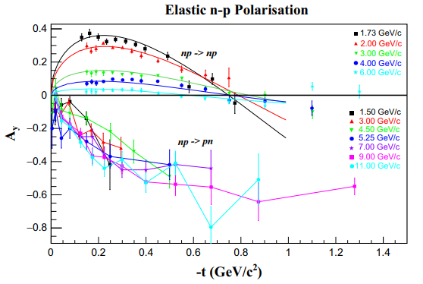
Why is this result important?
Charge-Exchange channel
Standard recoil-polarimetry becomes less effective at higher energies
Charge-exchange channel look to be the only viable method at larger energies.
This experiment aims to be the first measurement of GEn using charge-exchange recoil polarimetry, opening the door to higher energy measurements.
Analysing power of recoil polarlimetry of the neutron. Credit: JINR Dubna
$$\frac{P_{t}}{P_{l}}=\frac{1}{\sqrt{τ+τ(1+τ)\tan^{2}(\frac{θ_{e}}{2})}}\frac{G_{E}}{G_{M}}$$
Notes:
One problem for recoil polarimetry is that as you increase the energy (different coloured data points)
The analysing power Ay (a measure of the ability for a polarimeter to seperate spin states) goes towards 0 for traditional np->np scattering
If we instead look at Charge-exchange np->pn scattering (where we measure a neutron in and proton out of our polarimeter) the analysing power seems to not show this drop off.

Slide 31
Summary
Charge-Exchange channel
The SBS: GEn-RP successfully took data in April-May 2024
First experiment to measure GEn using recoil polarimetry at high Q²
Charge-Exchange channel has been the main focus
Initial plots show asymmetry without specific calibrations
Calibrations are well underway with 1st full data replay expected soon
$$\frac{P_{t}}{P_{l}}=\frac{1}{\sqrt{τ+τ(1+τ)\tan^{2}(\frac{θ_{e}}{2})}}\frac{G_{E}}{G_{M}}$$
Notes:
One problem for recoil polarimetry is that as you increase the energy (different coloured data points)
The analysing power Ay (a measure of the ability for a polarimeter to seperate spin states) goes towards 0 for traditional np->np scattering
If we instead look at Charge-exchange np->pn scattering (where we measure a neutron in and proton out of our polarimeter) the analysing power seems to not show this drop off.

Slide 32
Summary
Subtitle

Slide 33
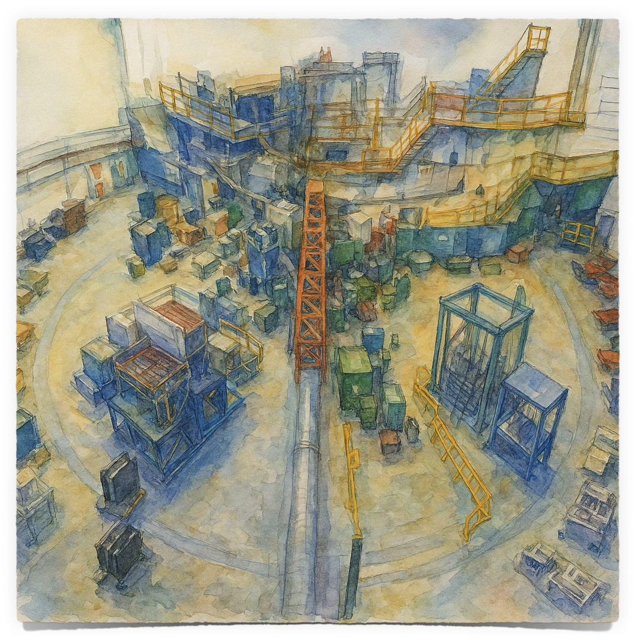
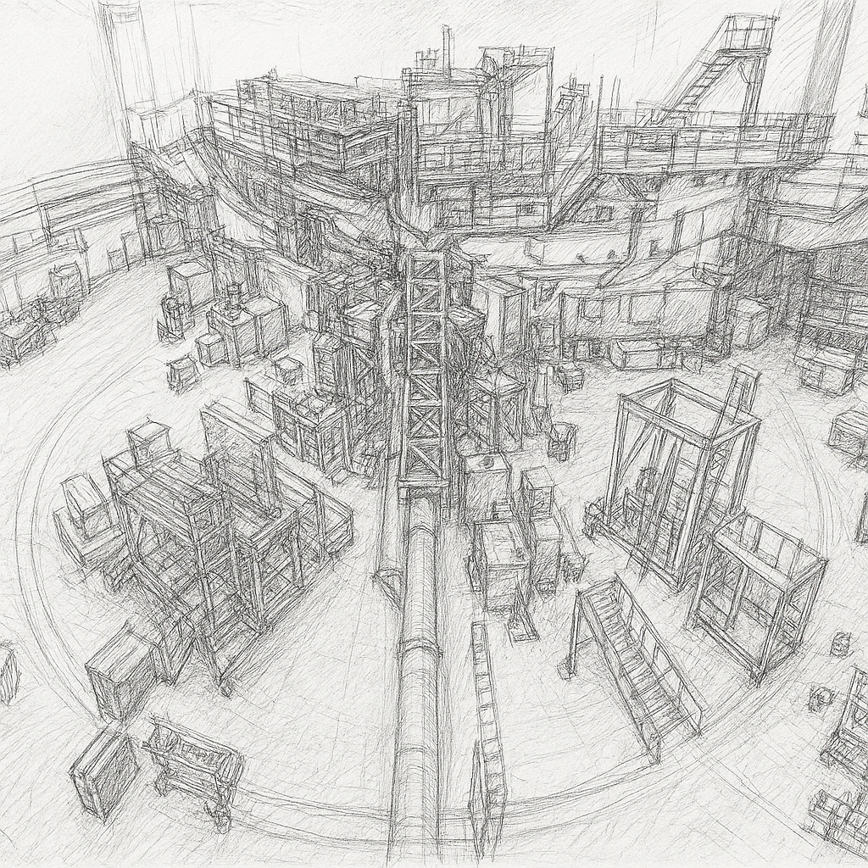
GEn-RP Summary
SBS program
SBS taking many new FF measurements in the high Q2 range
Particularly needed for the Neutron
The GEn-RP experiment
Successfully took data April-May 2025
Calibrations well underway
Asymmetry is showing but needs work
Future
Hope to show charge-exchange double polarisation is the method for future form factor measurements

Slide 34
Thank you
Any questions?

Slide 35
Backups
Other things

Slide 36
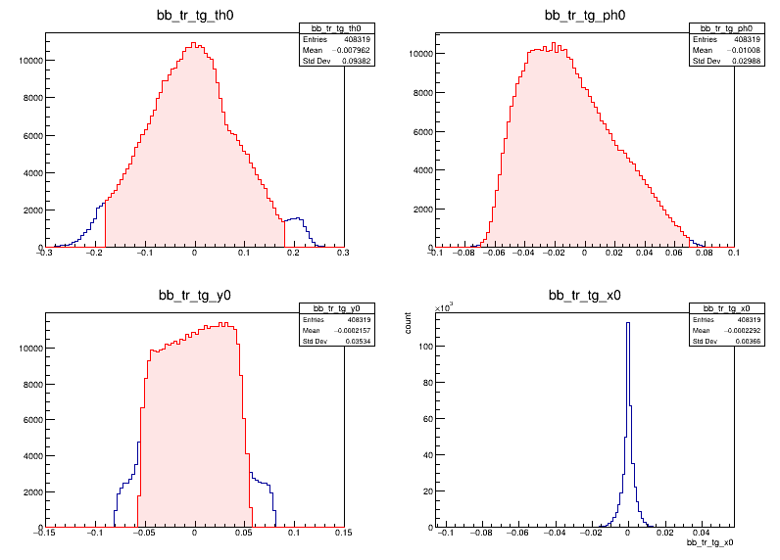
Event selection
Fiducial cuts
Fiducial cuts
Quasi-elastic cuts
Δy/Δx
Track veto
Pion cuts

Slide 37
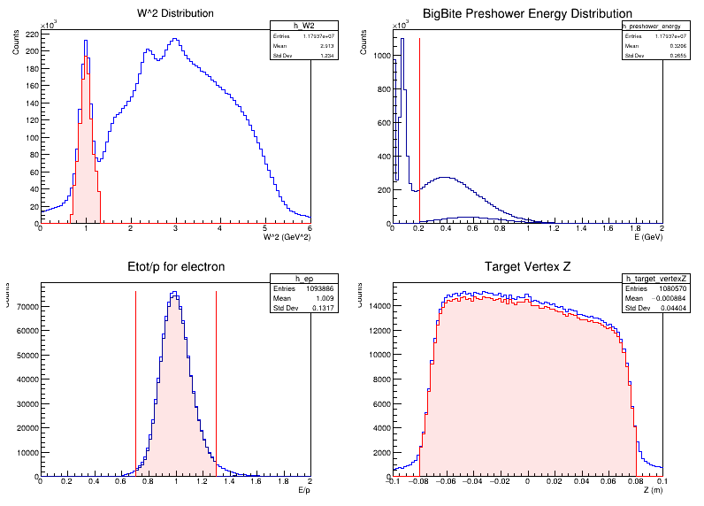
Event Selection
Quasi-elastic cuts
Fiducial cuts
Quasi-elastic cuts
Δy/Δx
Track veto
Pion cuts

Slide 38
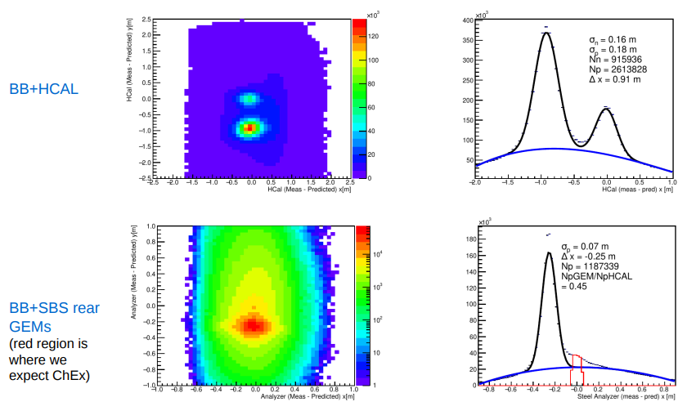
Event Selection
Δy/Δx
Fiducial cuts
Quasi-elastic cuts
Δy/Δx
Track veto
Pion cuts

Slide 39
Event Selection
Track Veto
Fiducial cuts
Quasi-elastic cuts
Δy/Δx
Track veto
Pion cuts

Slide 40
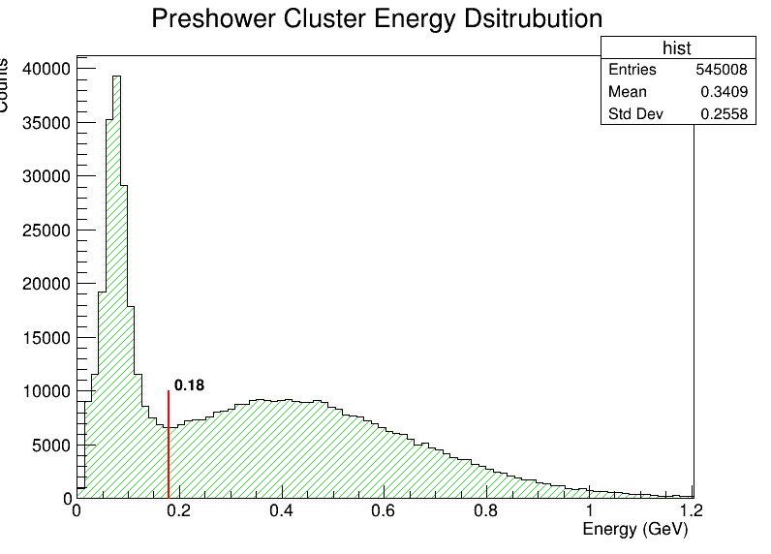
Event Selection
Pion cut (preshower)
Fiducial cuts
Quasi-elastic cuts
Δy/Δx
Track veto
Pion cuts

Slide 41
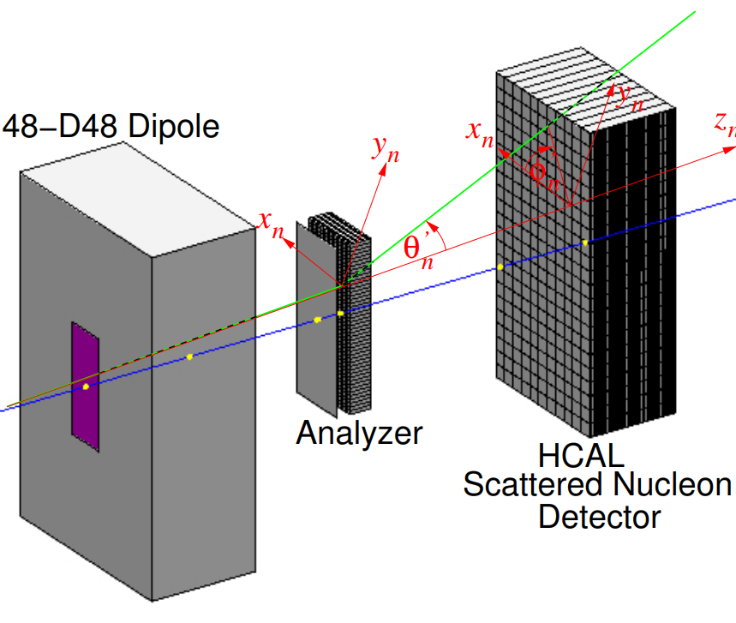
Hadron arm
Analysis
HCal dy/dx
Nucleon-nucleon interaction in the analyser causes a deflection
The azimuthal distribution of outgoing nucleon is then asymmetric due to this spin dependent deflection

Slide 42
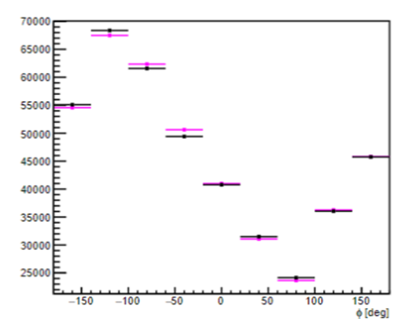
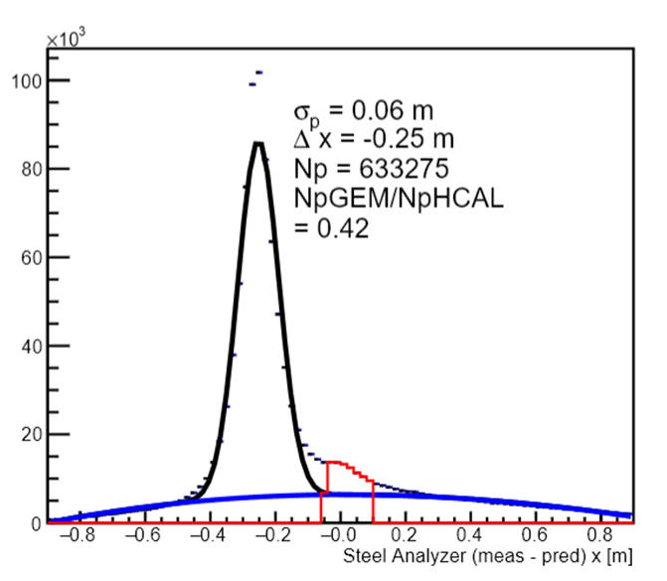
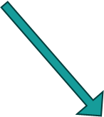
Preliminary Checks

Slide 43
Recoil asymmetry
$$F_{LS}=−\overset{^}{r} \frac{dU_{LS}\left(r\right)}{dr}r ∙\left(p ×S \right) − U_{LS}\left(r\right) p×S$$
The deflecting force arising from the spin-orbit potential gives rise to an azimuthal asymmetry
Andrew Cheyne - GEn-RP seminar

Slide 45
Recoil asymmetry
$$F_{LS}=−\overset{^}{r} \frac{dU_{LS}\left(r\right)}{dr}r ∙\left(p ×S \right) − U_{LS}\left(r\right) p×S$$
1st term is always directed radially but magnitude scaled by projection onto p x S
2nd term always reinforces this
Andrew Cheyne - GEn-RP seminar

Slide 46
Recoil asymmetry
$$F_{LS}=−\overset{^}{r} \frac{dU_{LS}\left(r\right)}{dr}r ∙\left(p ×S \right) − U_{LS}\left(r\right) p×S$$
Now looking at opposite spin and contribution of 2nd term.
Andrew Cheyne - GEn-RP seminar

Slide 47
Spin Asymmetry
Andrew Cheyne - GEn-RP seminar

Slide 48
Hadron arm
Terminology
Blue line: reconstructed path from electron arm
Red: deflected path due to magnet (defined as z_n)
Green: Deflected path due to interaction in analyser
Theta is the deflection from z_n
Phi is the angle in the x-y plane

Slide 49
HCal facts
Both ADC and TDC are used to record HCAL data (2 cable lines from front-end to back-end)​
Front-End (HCal upper platform) ​
10 x amplifier, fADC patch panel, TDC split panel​
TDC discriminator ​
Summing modules (4x4 and then 8x8), Sum trigger discriminator​
Back-End (DAQ bunker)​
fADC patch panel, fADC 250 in VXS crate​
TDC discriminator, f1TDC in VXS crate​

Slide 50
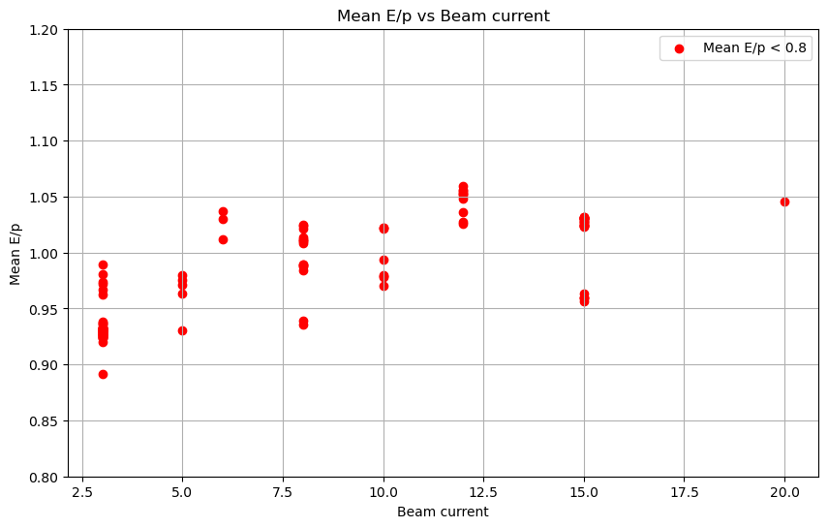
BBCal energy
The change in calorimeter threshold during running can be seen in the E/p vs run number
Run groups separated at these dates
There also appears to be large changes when no changes are made
This appears to be a beam current effect due to misaligned GEMs and other detectors.

Slide 51
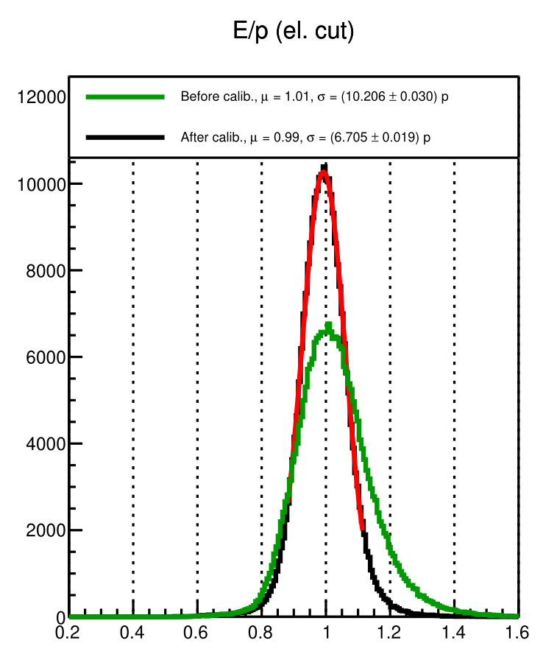
BBCal energy calibrations results
Without optics calibration parameters, the improvement to E/p resolution is from around 10->7.5 %
Values similar for all run groupings
Similar to what was seen in previous experiments

Slide 52
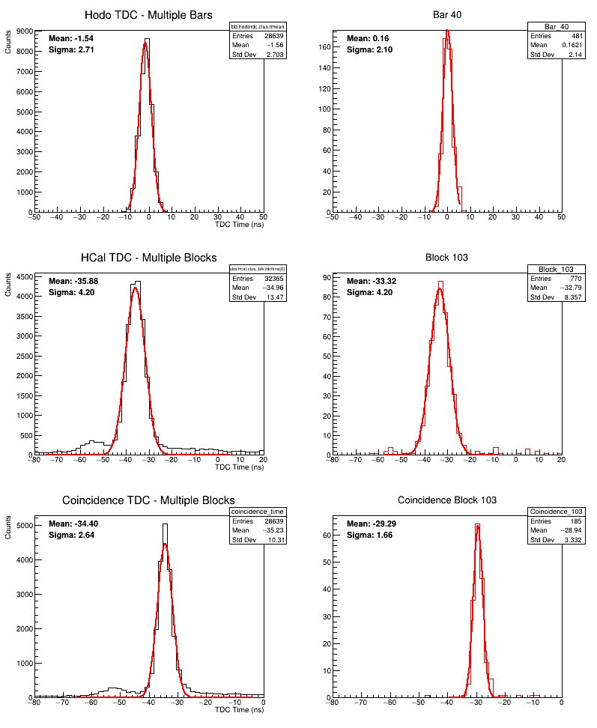
TDC timing
Both arms have TDC timing information
Ultimate goal is to do the full global minimisation of all parameters as discussed previously and shown here: (https://sbs.jlab.org/DocDB/0005/000540/001/PucketGENweekly_Mar14_2024.pdf)
Implemention described this week (ongoing):
https://sbs.jlab.org/DocDB/0006/000670/001/hodonotes.pdf

Slide 53
TDC timing problems
1. Missing HCAL tdc information
2. Trigger resolution
Previous SBS experiments had a large number of missing TDC information (-1000 above)
This was due to a TDC threshold being too high
Poor resolution trigger widens timing distribution when looking at a single time variable
If you subtract two (shown above for horoscope bars) you subtract the wide reference and resolution improves to expected

Slide 54
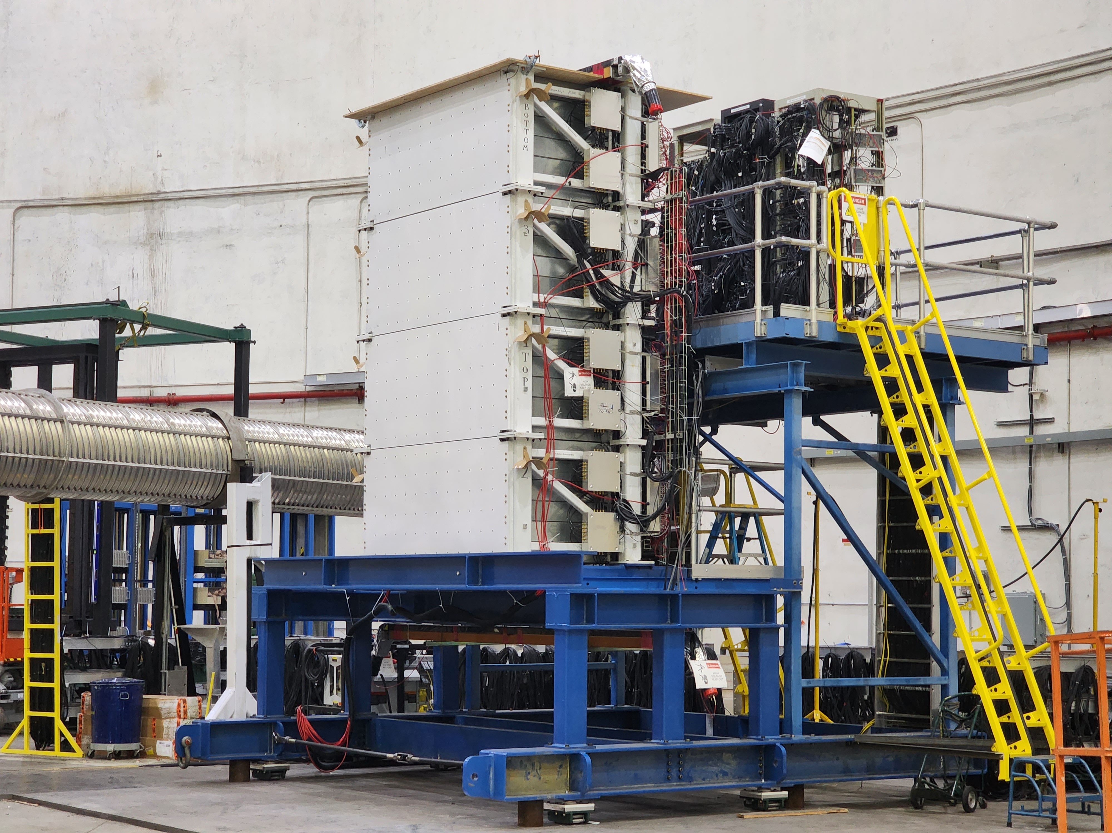
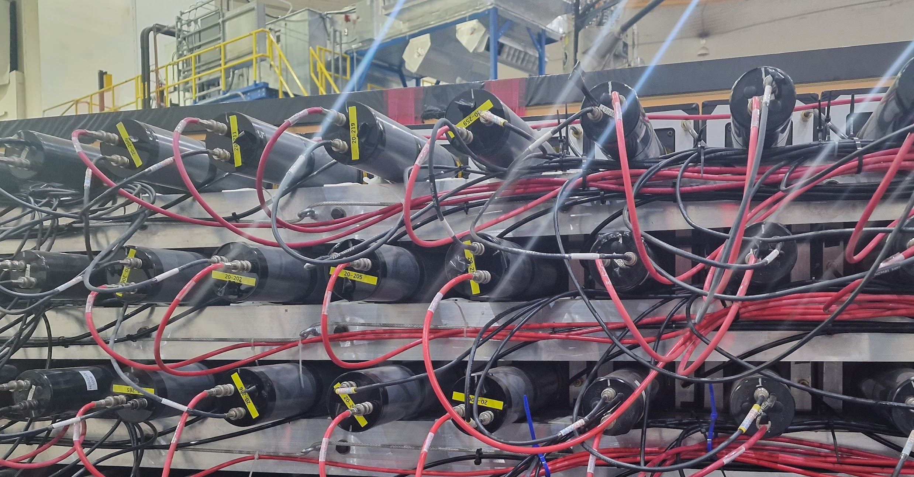
Hadron arm timing
Both ADC and TDC are used to record HCAL data (2 cable lines from front-end to back-end)​
Front-End (hcal upper platform) ​
10 x amplifier, fADC patch panel, TDC split panel​
TDC discriminator ​
Summing modules (4x4 and then 8x8), Sum trigger discriminator​
Back-End (DAQ bunker)​
fADC patch panel, fADC 250 in VXS crate​
TDC discriminator, f1TDC in VXS crate​
Expectation​
Time resolution ~1 ns​
Energy resolution ~30%​
Position resolution ~ 4cm​

Slide 55
TDC timing problems

Slide 56
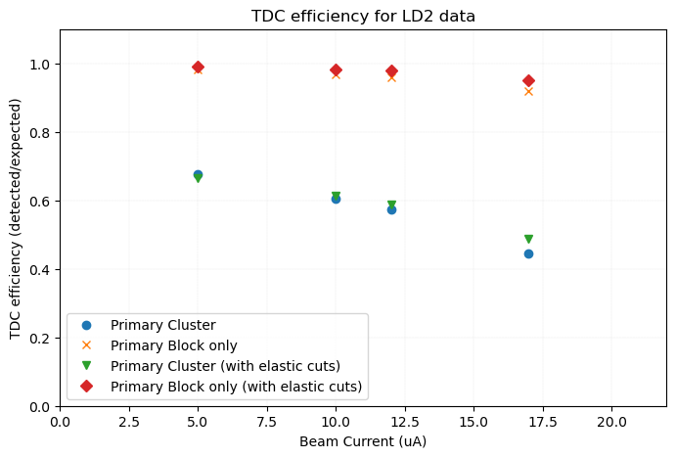
Hadron arm timing – LH2 (elastic cuts)

Slide 57
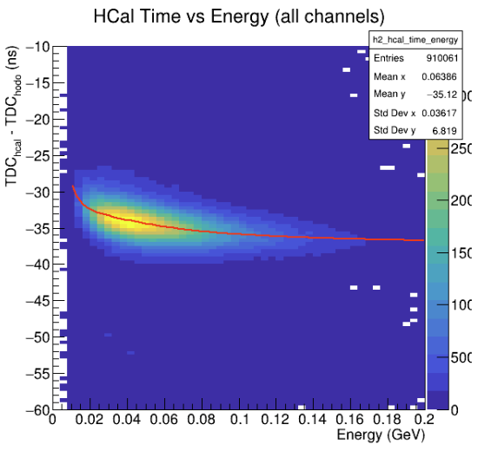
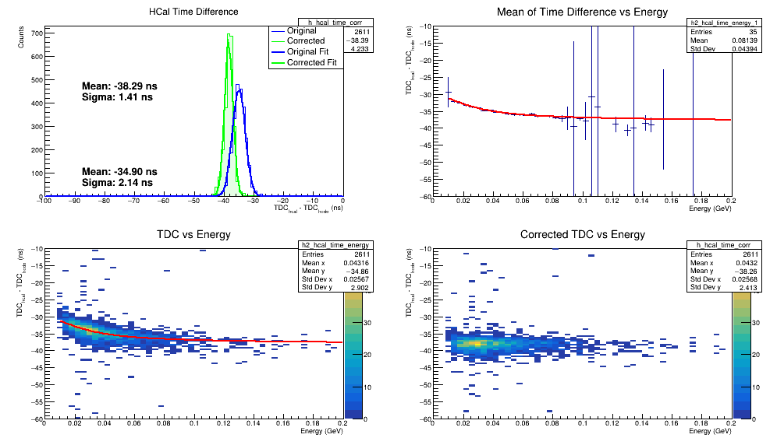
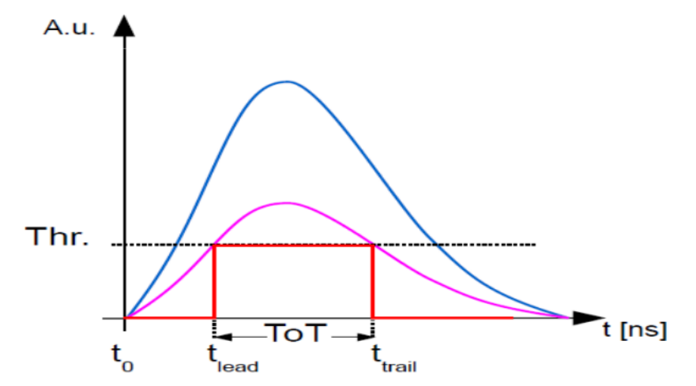
Timewalk in HCal
Significant walk effect in Hcal
Filter for a single channel, extract fit parameters and correct
Image from J. Hu, et al. Time Walk Measurements. CERN. https://indico.cern.ch/event/143033/contributions/

Slide 58
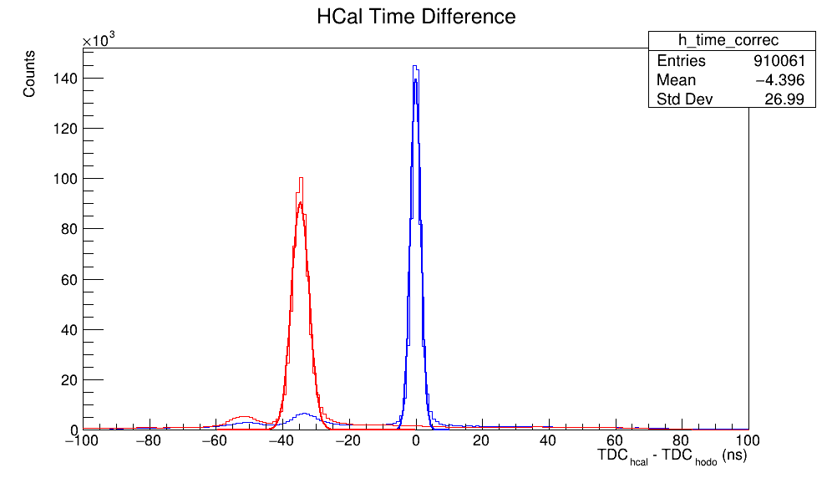
Timewalk in HCal
2.58 -> 1.4 ns resolution after timewalk on coincidence time
HCal expected resolution ~1 ns
Unexplained bump at -40 ns
Not a rigorous treatment, just to understand the timwalk contribution

Slide 59
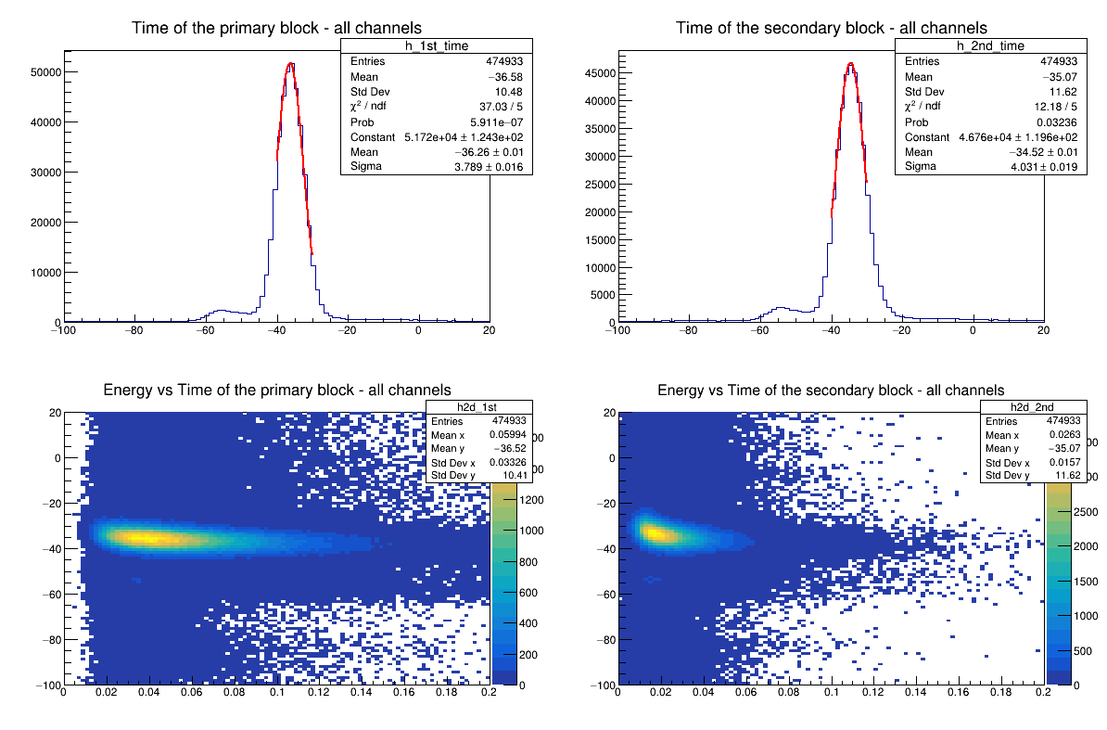
HCal TDC calibrations
hcal_clus_size2 > 1: pass=713149 all=844438 -- eff=84.45 % cumulative eff=7.30 %
Time cut_1: pass=677507 all=713149 -- eff=95.00 % cumulative eff=6.94 %
Time cut_2: pass=474933 all=677507 -- eff=70.10 % cumulative eff=4.86 %

Slide 60
HCal TDC calibrations

Slide 61
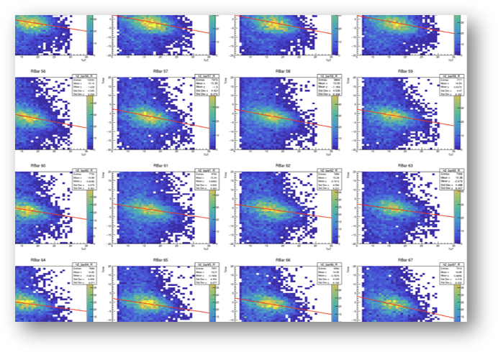
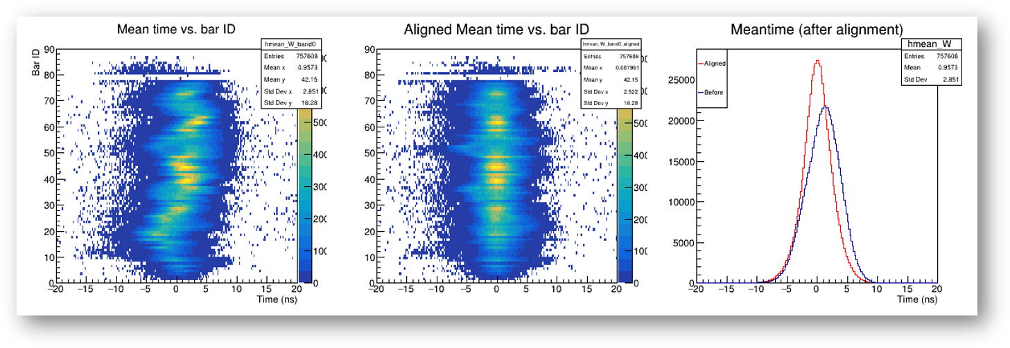
Electron arm timing
Timing hodoscope calibration procedure:
Timewalk
Meantime align
GEM track match
Scintillation speed correction
Time of Flight corrections

Slide 62
Electron arm timing
As mentioned there is a significant effect of the poor trigger resolution on the hodoscope
Andrew Puckett P & Gary Penman showed for GMn and GEn it is possible to observe the beam RF structure in the hodoscope
Could be used instead of trigger

Slide 63
RF beam structure in GEn-RP
Fold this over by 2.004ns
Adjust bar meantime to align all peaks at the same time
All bars mod(2.004)
Vs bar id
Bar 53 mod(2.004)

Slide 64
Instead of modulus folding I tried fitting the whole distribution
Where:
Gaussian​ part
[0] = amplitude, [1] = mean/center, [2] = sigma/width​
Modulation​ part
[3] = modulation amplitude, [4] = phase shift, [5] = modulation sigma/width

Slide 65
These offsets align the RF structure well
It is unclear what to do with these rf offsets at present (work ongoing)

Slide 66
Two independent methods of looking at hodoscope resolution without reference time contribution.
Both show around 570ps resolution.

Slide 67
Expected resolution
500 ps resolution is as expected for Gen-RP kinematics
Figure credit: Ralph Marinaro Thesis

Slide 68
Proton data using Polarisation Transfer disagrees with Rosenbluth separation method
Rosenbluth relies on a one photon approximation
Radiative corrections do not account for hard two-photon-exchange

Slide 69
Colleagues

