Slide 1
Lifetime measurements in ¹⁴⁶Ba and ^{146,148}Ce using the fast-timing technique
Faye Rowntree

Slide 2
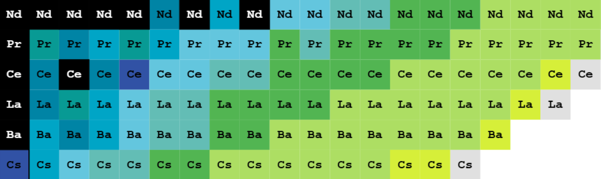
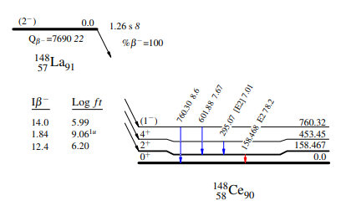
The Lanthanides
National Nuclear Data Centre (NNDC)
Z=55
N=82
¹⁵⁰Cs → ¹⁵⁰Ba → ¹⁵⁰La → ¹⁵⁰Ce → ¹⁵⁰Pr
80.8ms 258ms 0.51s 6.05s 6.19s
¹⁴⁸Cs → ¹⁴⁸Ba → ¹⁴⁸La → ¹⁴⁸Ce → ¹⁴⁸Pr
151ms 619ms 1.411s 56.8s 2.29m
¹⁴⁸Cs → ¹⁴⁶Ba → ¹⁴⁶La → ¹⁴⁶Ce
322ms 2.16s 6.1s 13.22m
Notes:
Start more vague: lanthanides
Start from purpose/goal

Slide 3
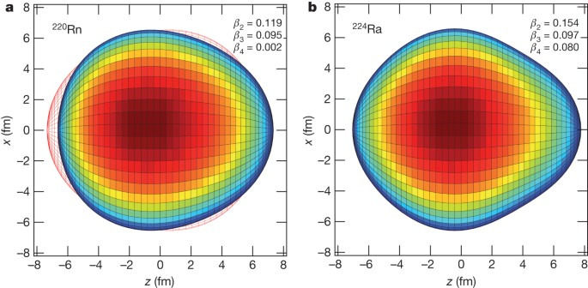
Octupole Deformation
-previously seen in the neutron-rich actinides
-separation of centre of mass and centre of charge
-creates an enhanced dipole moment
Gaffney, L., Butler, P., Scheck, M. et al, Nature 497, 199–204 (2013)

Slide 4
Octupole Deformation
GRIFFIN (TRIUMF)
Miniball (CERN)
electric quadrupole moment (Q₀)
electric octupole moment (Q₃)
electric dipole moment (D₀)

Slide 5
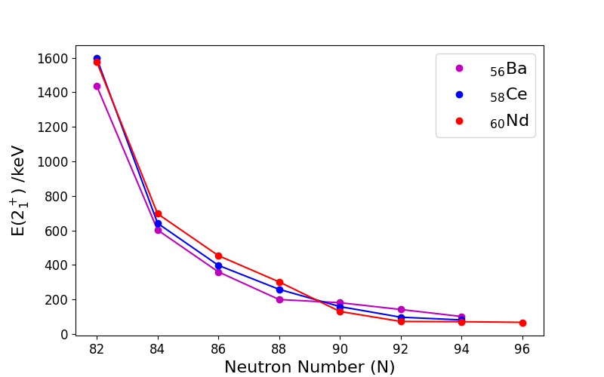
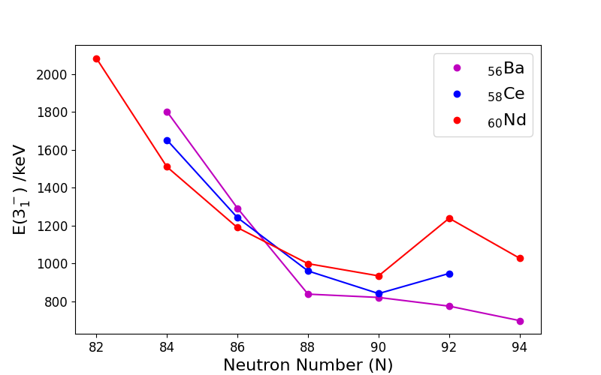
Octupole Deformation
R. Lica et al, Phys. Rev. C 97, 024305 (2018)
M. M. Satrazani, Thesis (2024)
National Nuclear Data Centre (NNDC)
Notes:
Add label for 146ba and 148ce
Make text bigger on plots

Slide 6
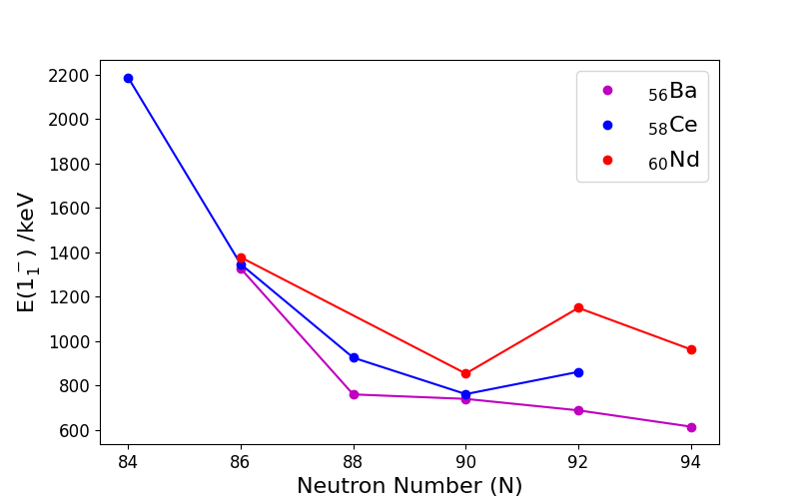
Electric Dipole Moment
M. M. Satrazani, Thesis (2024)
R. Lica et al, Phys. Rev. C 97, 024305 (2018)
Nucleus | D₀^{shell} /efm | D₀^{macro} /efm | D₀ /efm
¹⁴⁰Ba | 0.11 | 0.01 | 0.12
¹⁴²Ba | 0.11 | 0.01 | 0.13
¹⁴⁴Ba | 0.08 | 0.02 | 0.09
¹⁴⁶Ba | 0.02 | 0.02 | 0.04
¹⁴⁸Ba | -0.04 | 0.02 | 0.02
¹⁵⁰Ba | -0.08 | 0.02 | -0.06
¹⁴⁴Ce | 0.15 | 0.02 | 0.17
¹⁴⁶Ce | 0.15 | 0.03 | 0.18
¹⁴⁸Ce | 0.13 | 0.03 | 0.15
¹⁴⁶Nd | 0.14 | 0.02 | 0.16
¹⁴⁶Ba
¹⁴⁸Ce
National Nuclear Data Centre (NNDC)
P. A. Butler and W. Nazarewicz, Nuc. Phys. A 533 (1991)
Notes:
Add lifetime equation

Slide 7
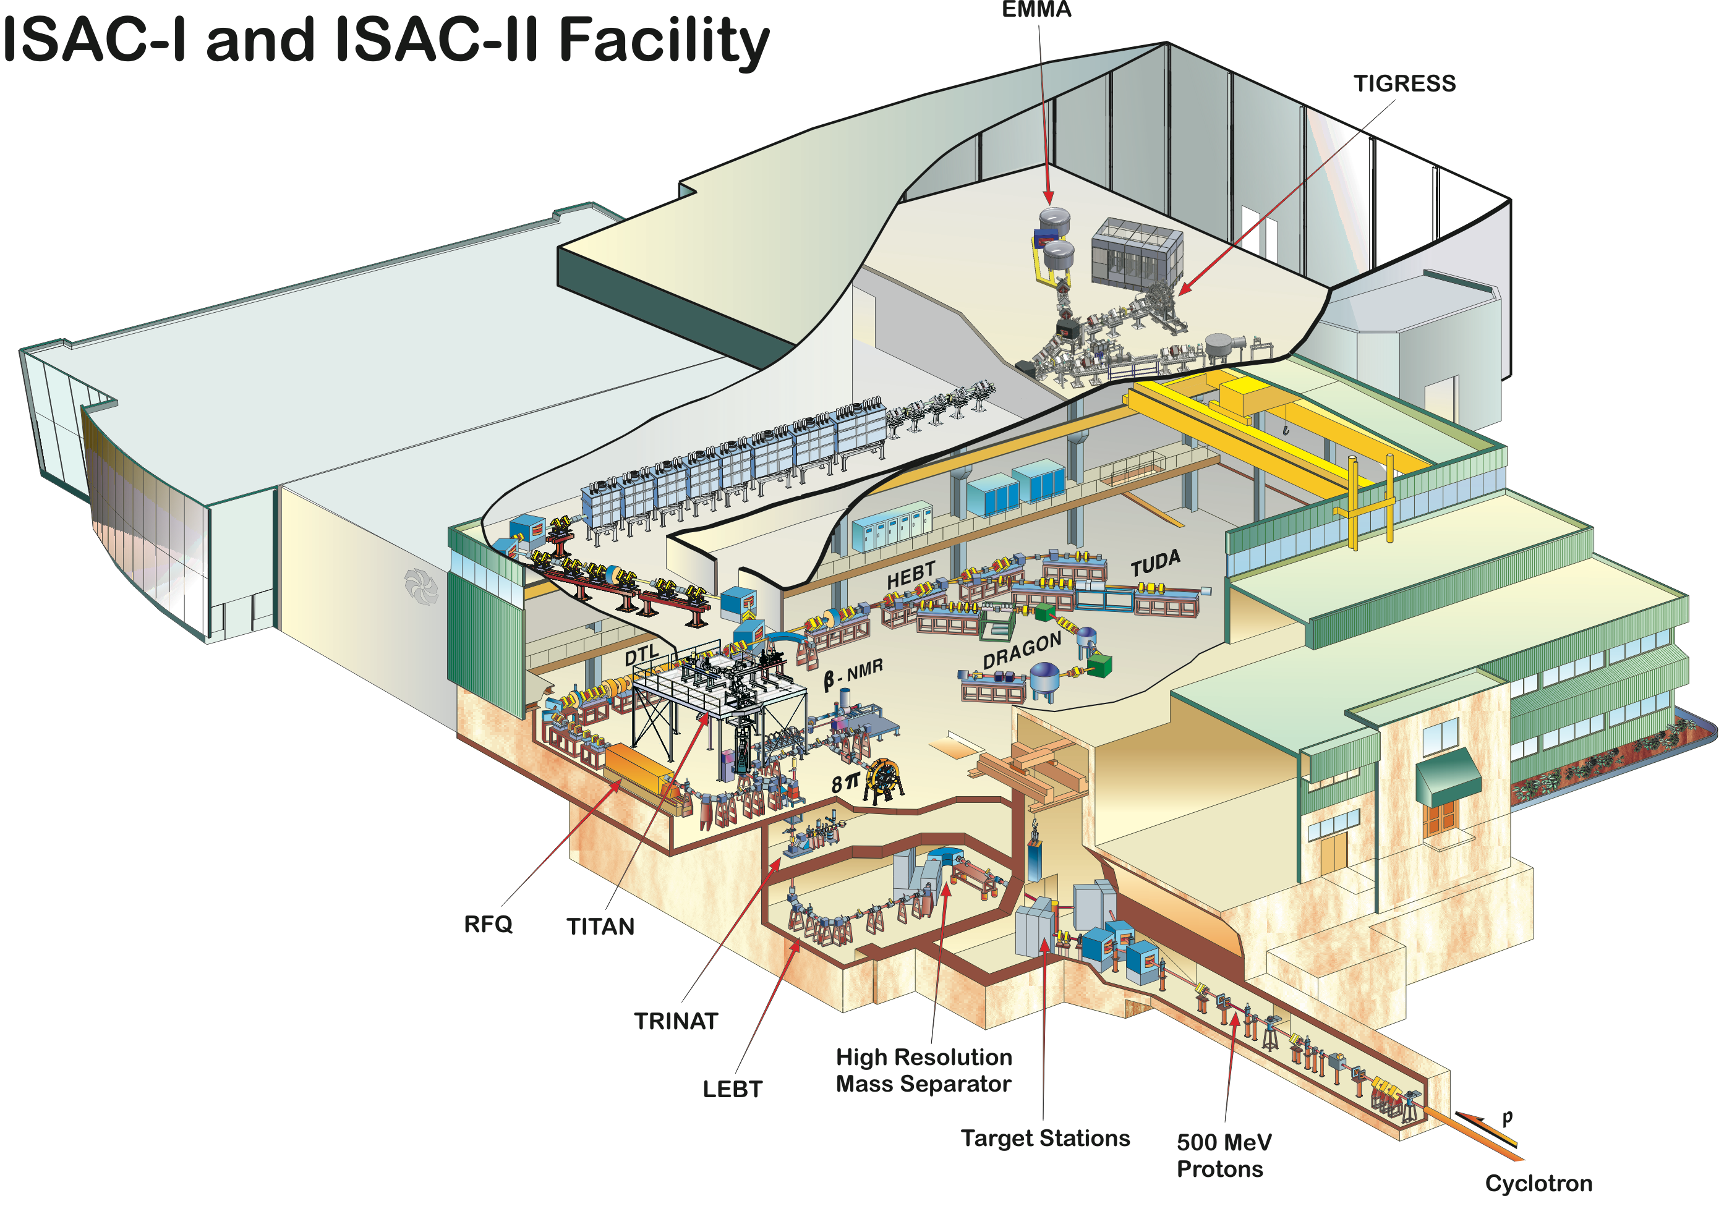
ISAC-I
RIB produced via isotope separation on-line (ISOL) technique
Protons hit UC target
Ions separated by mass
RIB sent to low energy beam transport (LEBT), then to switchboard
RIB delivered to GRIFFIN

Slide 8
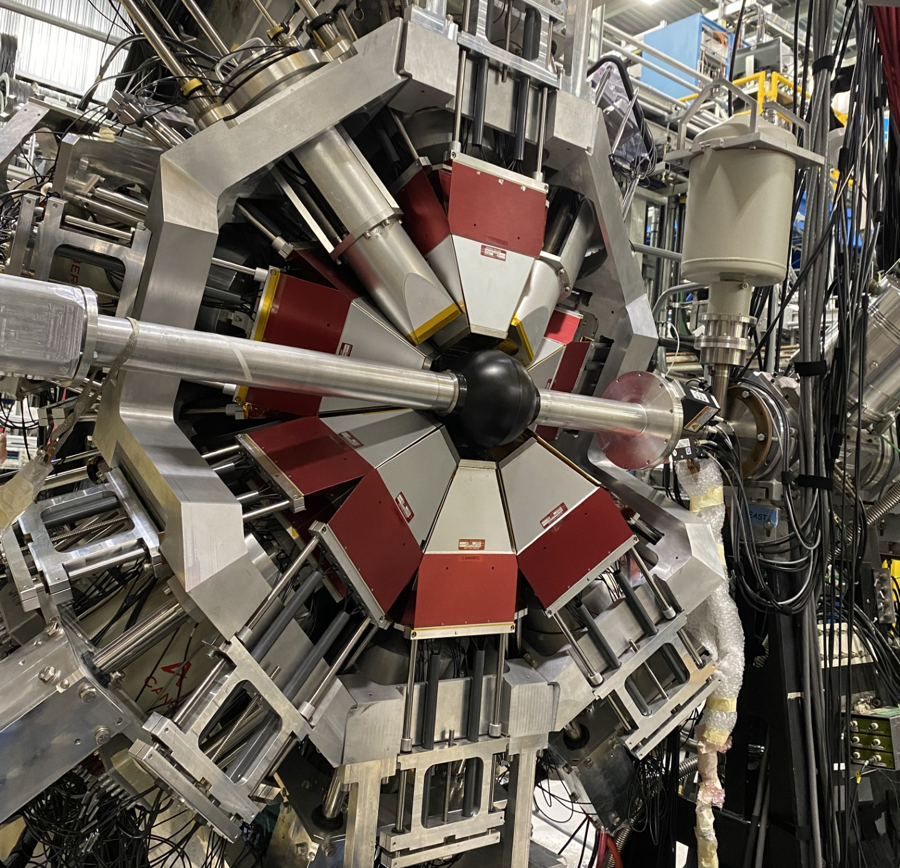
GRIFFIN
LaBr₃(Ce)
ZDS (usually)
RIB hits tape…
…tape removes decay products
HPGe
Tape

Slide 9
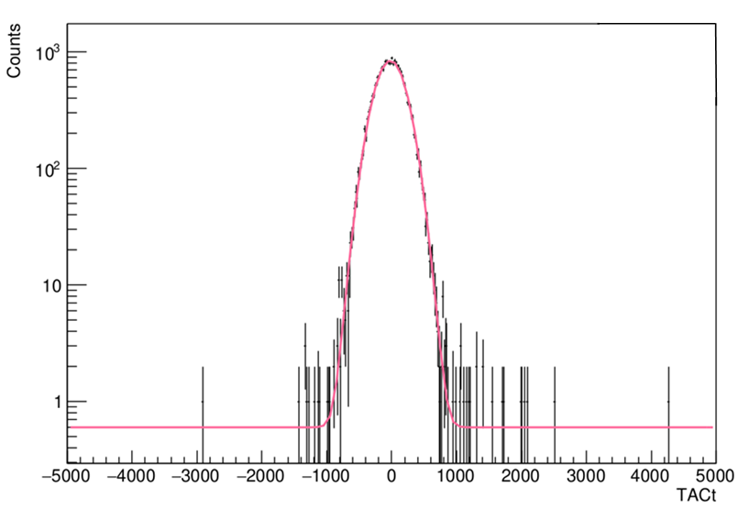
Fast Timing
β_{feeder}
γ_{feeder}
State of interest
2 signals – start and stop
Intermediate state of interest
TAC spectrum gives information about lifetime
γ_{decay}
γ_{decay}
Detector 1 (start)
TAC
delay
Detector 2 (stop)
Time /ps
Notes:
Explain tac

Slide 10
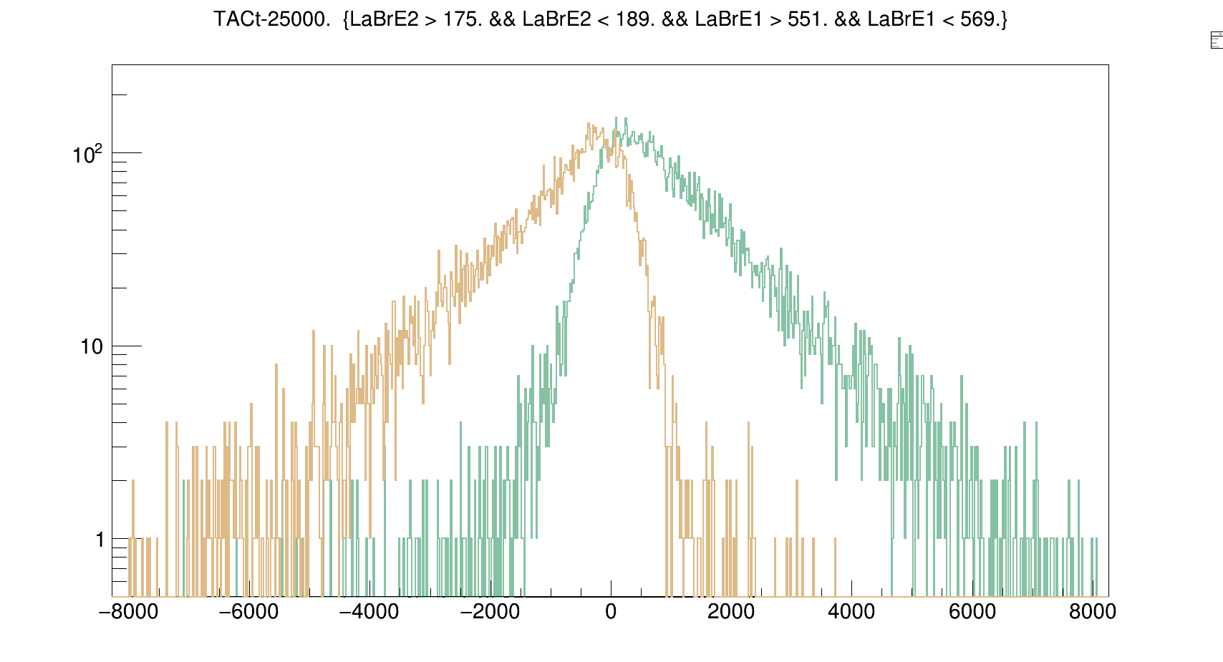
Fast Timing
β_{feeder}
γ_{feeder}
State of interest
γ_{decay}
γ_{decay}
feeder
Detector 1 (start)
Counts
TAC
decay
Detector 2 (stop)
delay
antidelayed
delayed
decay
Detector 1 (start)
TAC
feeder
Detector 2 (stop)
delay
Time /ps
Notes:
Show different g-feed and g-decay hitting different detectors and antidelayed tac config
Add labels to axes and label delayed/antidelayed

Slide 11
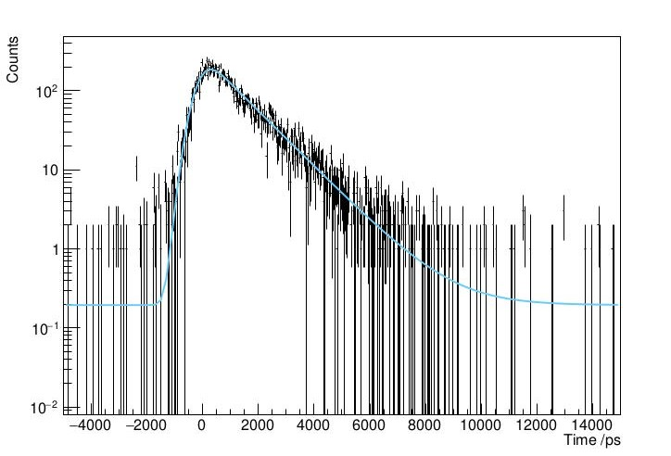
Convolution Method
gaussian
decay constant
γ-ray energy
exponential
centroid
background count
Notes:
Add equals sign

Slide 12
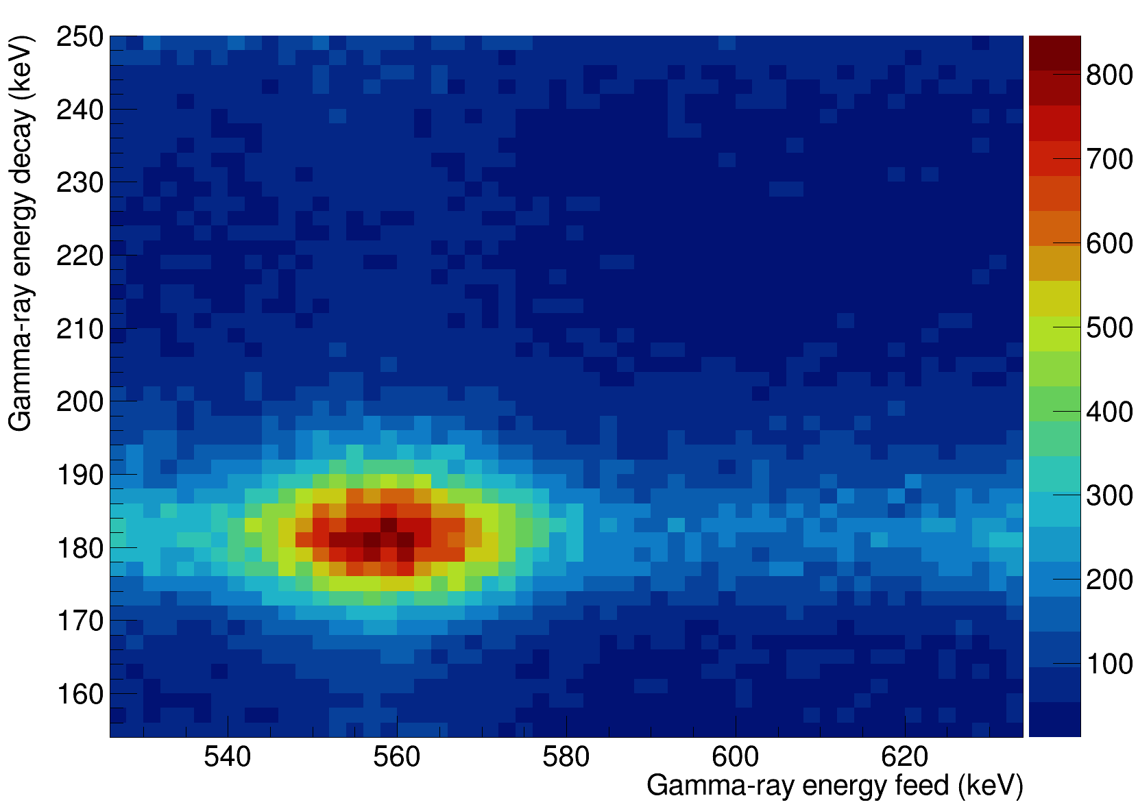
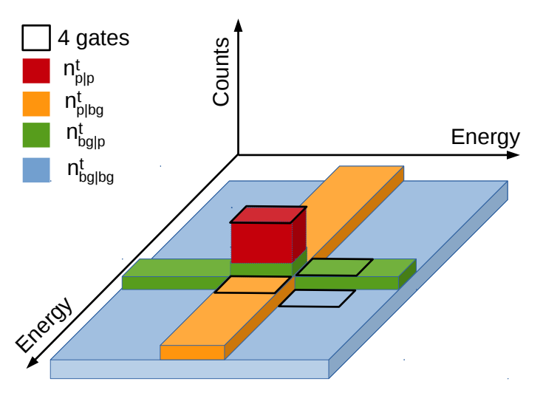
Background Subtraction
p|bg
bg|bg
p|p
bg|p
E. Gamba, Thesis (2019)
Notes:
Highlight its my data,
Explain energy matrix

Slide 13
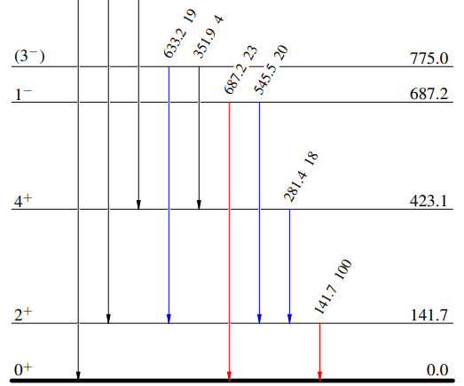
¹⁴⁸Ba 2⁺ half-life
Delayed configuration:
λ = (4.05+/-0.07) 10⁻⁴ s⁻¹
τ = 2469 +/- 43 ps
t_{1/2} = 1711 +/- 30 ps
Χ²/NDF = 2.47
delayed
t_{1/2} = 1733(22) ps
From literature: 1510(20) ps
R. Lica et al, Phys. Rev. C 97, 024305 (2018)
4⁺ → 2⁺, 2⁺ → 0⁺
Antidelayed configuration:
λ = (3.95+/-0.07) 10⁻⁴ s⁻¹
τ = 2534 +/- 45 ps
t_{1/2} = 1756 +/- 31 ps
Χ²/NDF = 2.52
antidelayed
NNDC
Notes:
Be positive!
Talk about quadrupole deformation first – validation of method
Add activity/tape cycle?

Slide 14
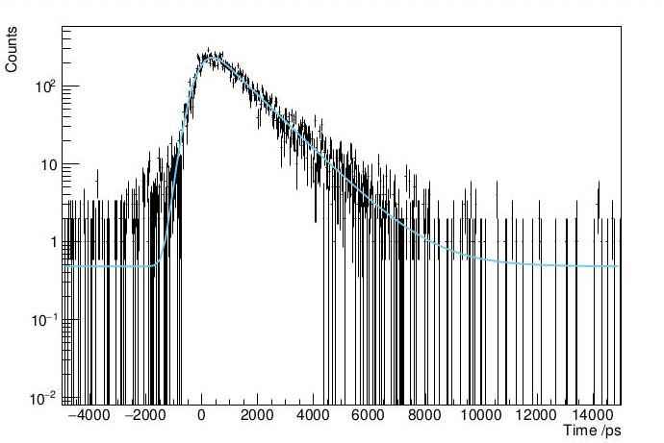
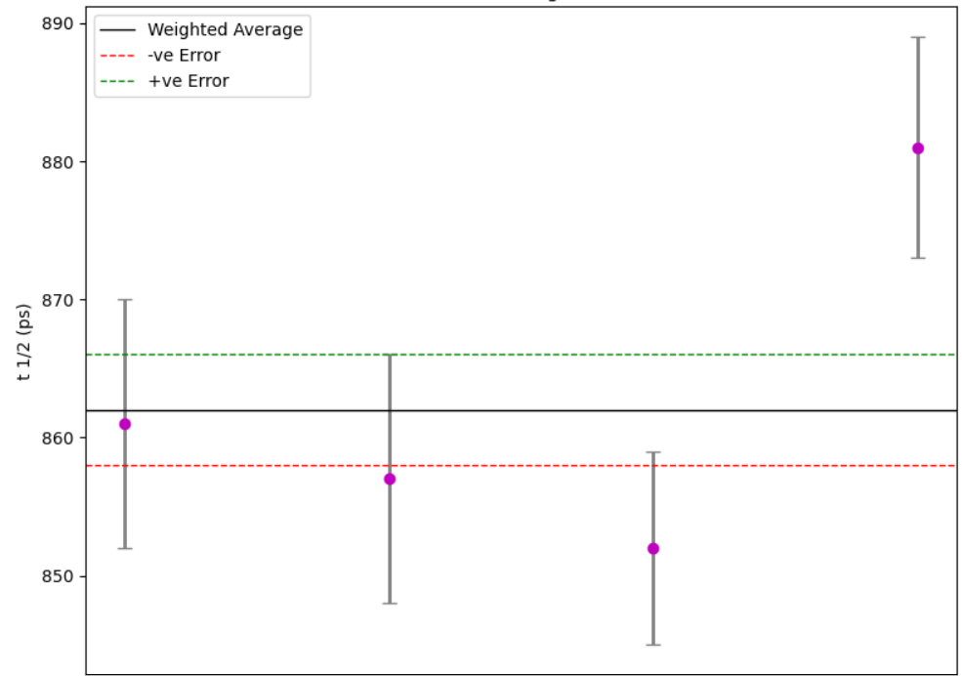
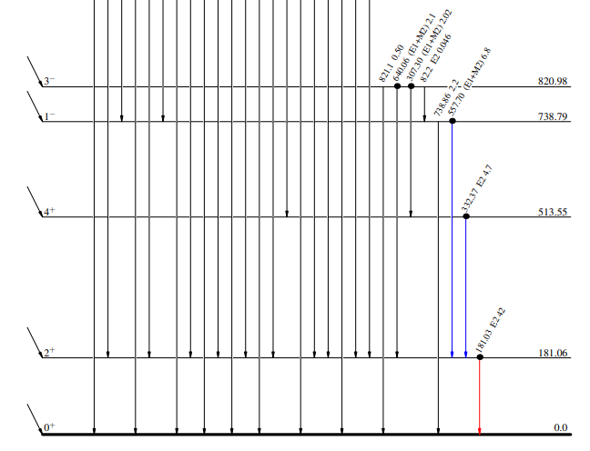
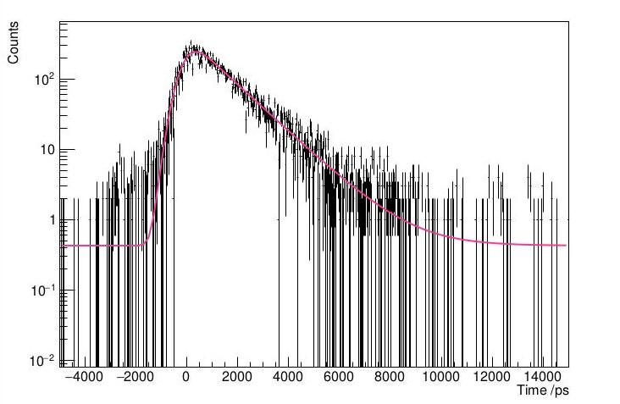
¹⁴⁶Ba 2⁺ half-life
1⁻ → 2⁺, 2⁺ → 0⁺
4⁺ → 2⁺, 2⁺ → 0⁺
1⁻ → 2⁺, 2⁺ → 0⁺
t_{1/2} = 862(4) ps
4⁺ → 2⁺, 2⁺ → 0⁺
From literature: 859(29) ps
H. Mach et al, Phys. Rev. C 41 R2469 (1990)
NNDC

Slide 15
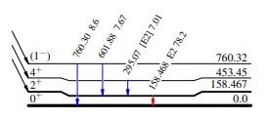
¹⁴⁸Ce 2⁺ half-life
4⁺ → 2⁺, 2⁺ → 0⁺
t_{1/2} = 1050 +/- 9 ps
1⁻ → 2⁺, 2⁺ → 0⁺
NNDC
From literature: 1010 +/- 60 ps
R. L. Gill et. al, Phys. Rev. C 33, 1030 (1986)

Slide 16
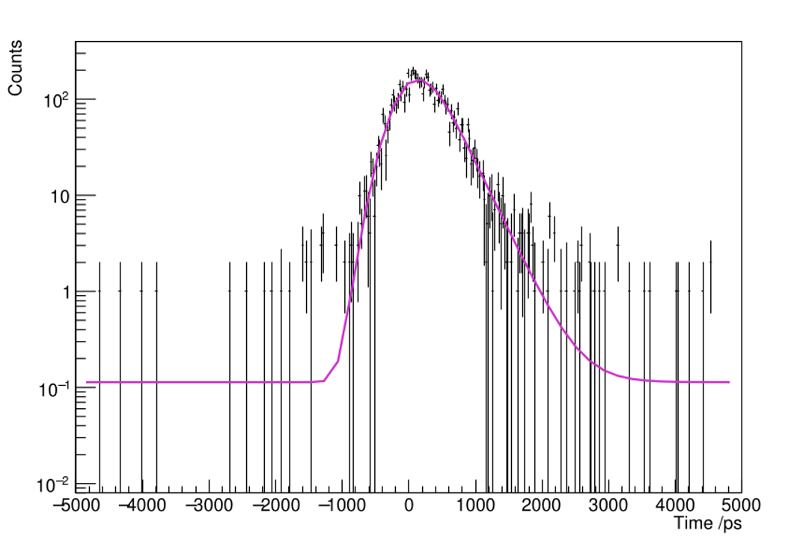
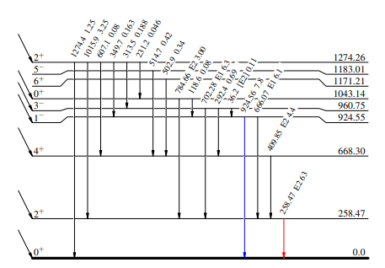
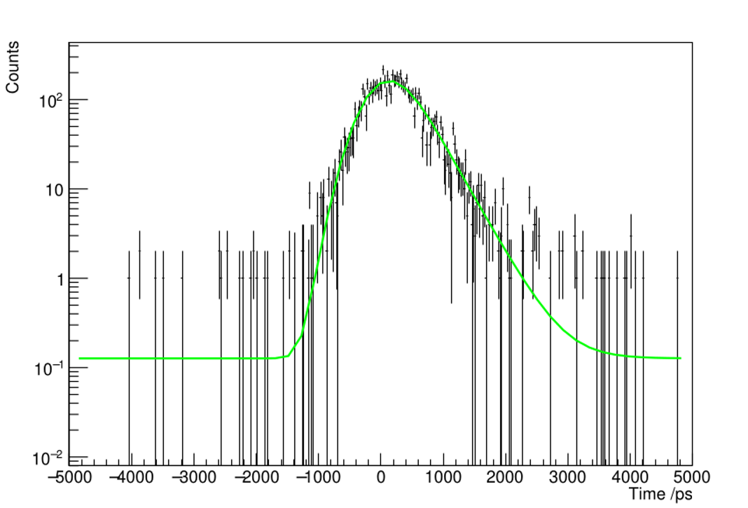
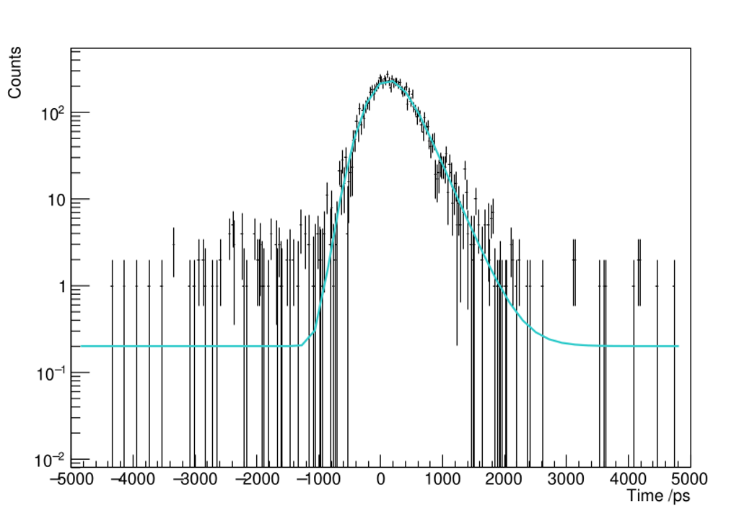
¹⁴⁶Ce 2⁺ half-life
3⁻ → 2⁺, 2⁺ → 0⁺
t_{1/2} = 204(3) ps
4⁺ → 2⁺, 2⁺ → 0⁺
NNDC
1⁻ → 2⁺, 2⁺ → 0⁺
From literature:
189(10) ps
H. Mach et. al, Nuclear Instruments and Methods in Phys A 280 (1989)

Slide 17
Summary of B(E2)s
Nuclide | Half-life /ps | Lifetime /ps | B(E2) /e²fm⁴
¹⁴⁶Ba | 862(4) | 1244(6) | 3386(17)
¹⁴⁶Ce | 204(3) | 294(3) | 2417(25)
¹⁴⁸Ce | 1057(10) | 1526(14) | 5375(50)
Notes:
Validation of technique, these are the B(E2)s corresponding to lifetimes measured
Add liams equation
Change units

Slide 18
Future Work: 1⁻ and 3⁻ Lifetimes
ZDS (start)
TAC
β_{feeder}
γ_{feeder}
delay
State of interest
LaBr₃(Ce) (stop)
γ_{decay}
γ_{decay}
+
γ
HPGe

Slide 19
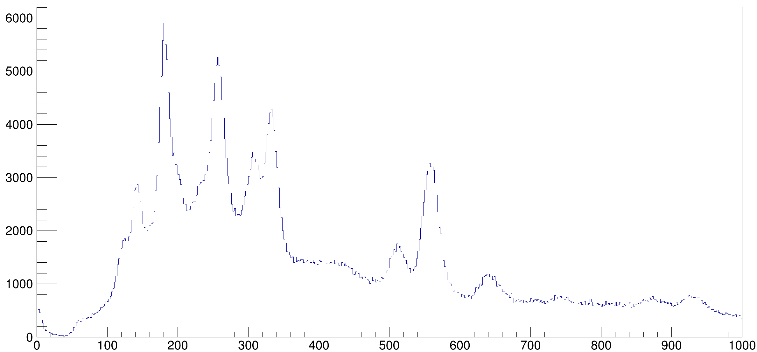
Future Work: ¹⁴⁶Ba
Counts
307 keV, 3⁻ → 4⁺
332 keV, 4⁺ → 2⁺
557 keV, 1⁻ → 2⁺
640 keV, 3⁻ → 2⁺
Energy /keV

Slide 20
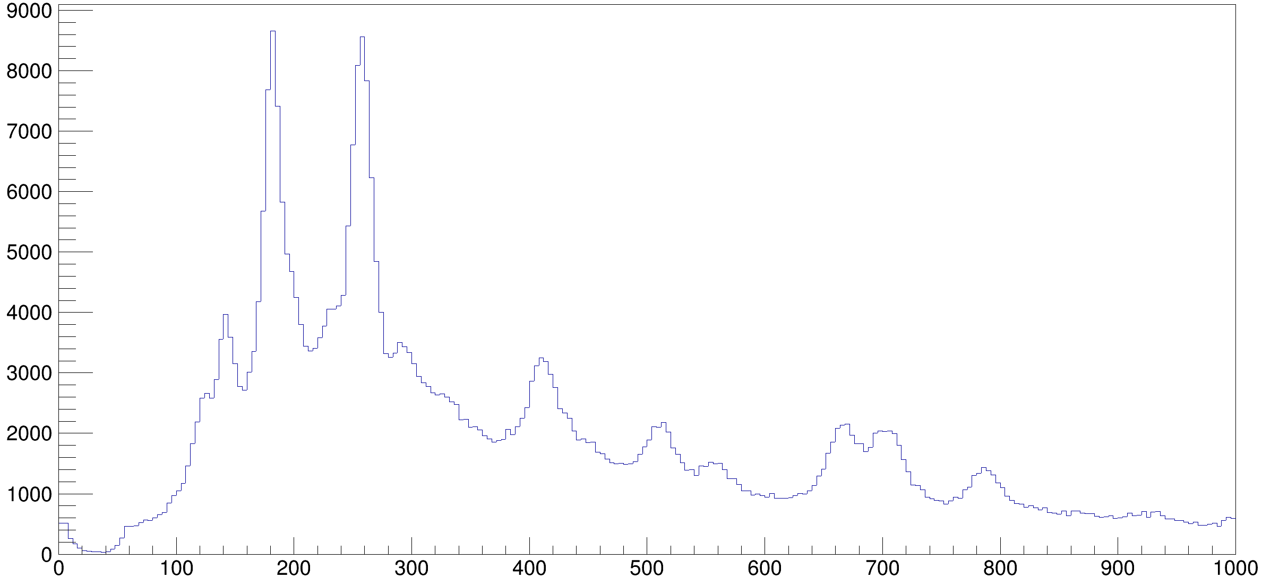
Future Work: ¹⁴⁶Ce
Counts
292 keV, 3⁻ → 4⁺
410 keV, 4⁺ → 2⁺
666 keV, 1⁻ → 2⁺
640 keV, 3⁻ → 2⁺
Energy /keV

Slide 21
Thank you to my collaborators
L. Gaffney¹
J. Ojala¹
M. M. Satrazani¹
P. Spagnoletti¹
F. Ali²
C. Andreoiu³
N. Bernier^{4,5}
M. Bowry⁴
S. S. Bhattacharjee⁴
R. Cabellero-Folch⁴
R. Coleman²
A. Diaz Varela²
F. H. Garcia³
A. B. Garnsworthy⁴
G. Grinyer⁶
M. P. Hladun⁶
J. Keatings⁷
R. Lefleur²
B. K. Luna⁸
K. Mashtakov⁷
J. L. Mitchell⁶
B. C. Olaizola Mampaso⁴
C. Petrache⁹
A. J. Radich²
M. M. Rajabali⁸
Y. Saito^{4,5}
L. Sexton^{4,10}
J. P. Siuryte^{4,10}
J. Smallcombe⁴
J. F. Smith⁷
C. Svensson²
E. Timakova⁴
K. Whitmore³
D. Yates^{4,5}
1 University of Liverpool, Liverpool, UK
2 University of Guelph, Guelph, Canada
3 Simon Fraser University, Vancouver, Canada
4 TRIUMF, University of British Columbia, Vancouver, Canada
5 University of British Columbia, Vancouver, Canada
6 University of Regina, Regina, Canada
7 University of the West of Scotland, Glasgow, UK
8 Tennessee Technological University, Cookeville, Tennessee, USA
9 Paris-Saclay University, Paris, France
10 University of Surrey, Guildford, UK

