Slide 1
Nuclear Data and medical radioisotope production activities at UKNNL
IOP Nuclear Physics conference, Manchester 2025
Luigi Capponi
Not protectively marked

Slide 2
Nuclear data for beginners
Computational modelling is dependent on data that describes the physical parameters of nuclides and their nuclear reactions
Tens of thousands of measurements have been made experimentally throughout the years to determine such physics data
Processed through the nuclear data lifecycle and international collaborative projects these have been used to build nuclear data libraries, such as:
JEFF-4.4 ENDF/B-VIII.0 TENDL-2023
JEFF Nuclear Data Library - NEA https://www.oecd-nea.org/dbdata/jeff/jeff40/t4/
ENDF/B-VIII.0 Evaluated Nuclear Data Library https://www.nndc.bnl.gov/endf-b8.0/
TENDL-2023 nuclear data library https://tendl.web.psi.ch/tendl_2023/tendl2023.html
Not protectively marked

Slide 3
Nuclear data for beginners
Evaluation (mostly volunteer) projects:
JEF/JEFF Western Europe + South Korea collaboration Joint Evaluated File/Joint Fission Fusion File
ENDF USA Evaluated Nuclear Data File
JENDL Japan Japanese Evaluated Nuclear Data Library
FENDL IAEA, Fusion Evaluated Nuclear Data File
CENDL China, Chinese Evaluated Nuclear Data Library
Former Eastern bloc files e.g. BROND and RUSFOND.
Note contributors produce component parts with project directing aims to solve their specific needs, compilation of “complete” files from parts or parameter sets and drive testing.
The projects don’t fund work but act as forums when users and specialists can collaborate.
Projects tend to be very open and encourage collaboration within their areas.
Different projects have a different focus on applications needing to be simulated.
Not protectively marked

Slide 4
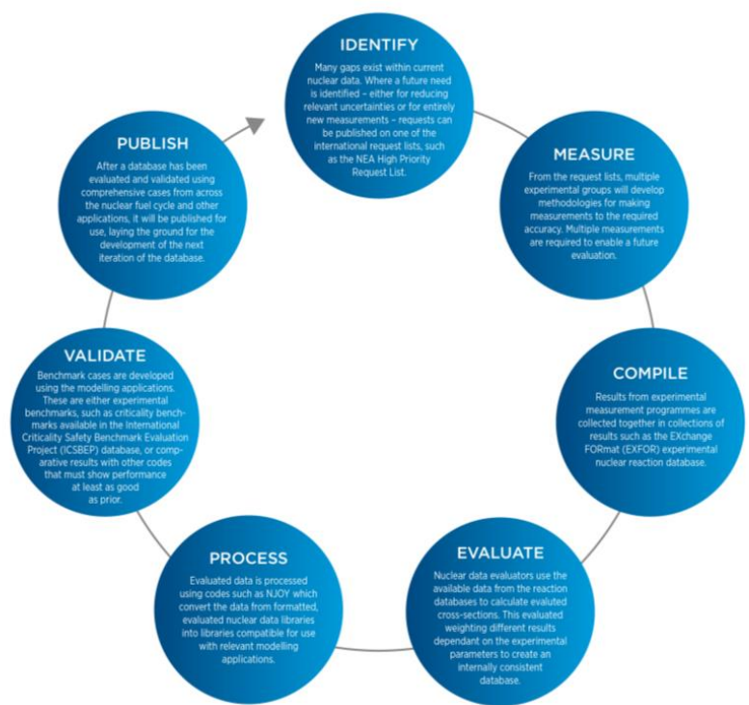
Nuclear data for beginners
Not protectively marked

Slide 5
Nuclear data for beginners An overview on the JEFF file
Trends
1960-1985 Initialise and produce complete libraries
1985-2000 Improve agreement with benchmarks
2000-now
Improve understanding of uncertainties and their covariances for uncertainty quantification.
Not protectively marked

Slide 6
Nuclear data for beginners The High Priority Request List from the Working Party on International Nuclear Data Evaluation Co-operation (WPEC)
WPEC Expert Group on the High Priority Request List (EGHPRL) for Nuclear Data
Purpose
Maintains and periodically reviews list of high priority nuclear data requests.
Stringent criteria are applied for entries based on need, available data and methods.
Request types are:
A high priority request, which is justified by strong need, quantitative sensitivity studies (or the equivalent), achievable measurement solution and must be well documented.
A general request is well motivated for a specific quantity on a specific nucleus and is documented but lacks a detailed backing by a sensitivity analysis or impact study.
A special-purpose request in a well-defined category is of interest to a recognised important subfield of applied nuclear science for which it is essential to stimulate new activity. Such a request may not satisfy the criteria as in the cases above.
Not protectively marked

Slide 7
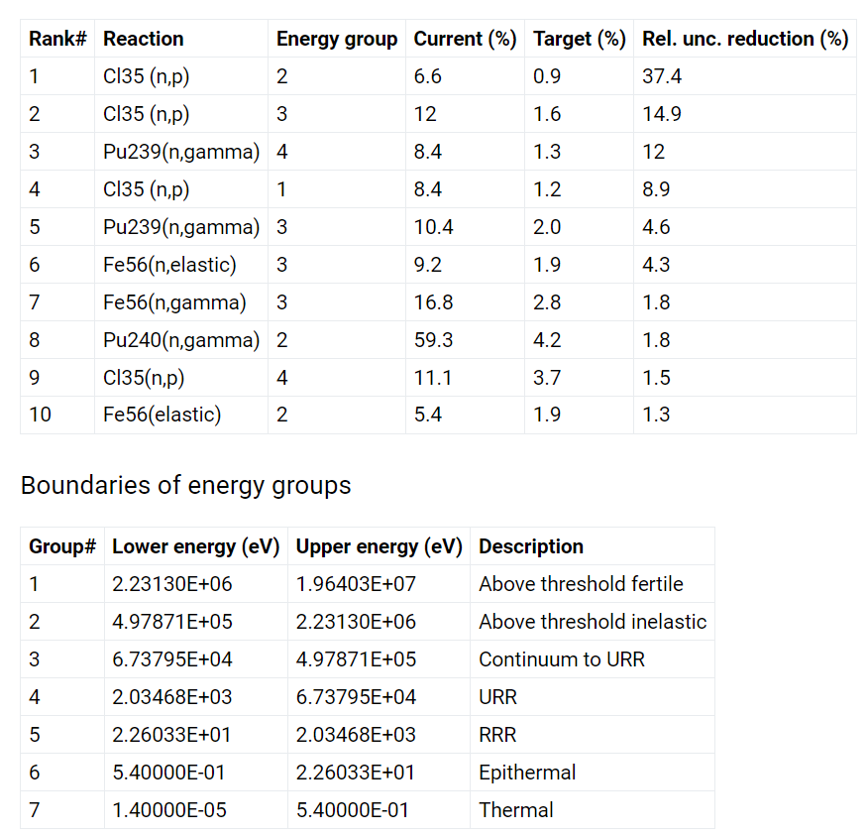
Nuclear data for beginners The High Priority Request List: an example
³⁵Cl (n,p) reaction in chloride molten salt fast reactors
There is currently large uncertainty in reactivity for chloride fast reactors, due mainly to the uncertainty in the Cl-35 (n,p) cross section at high energies.
This is a difficulty for chloride fast reactor design because the required fissile loading has a large uncertainty, and this uncertainty also propagates to other parameters important to safety, such as reactivity coefficients.
Production of S-35 via this reaction is also important for corrosion.
In progress entry is in HPRL.
To bring uncertainty < 300pcm need significant reduction in uncertainties
Not protectively marked

Slide 8
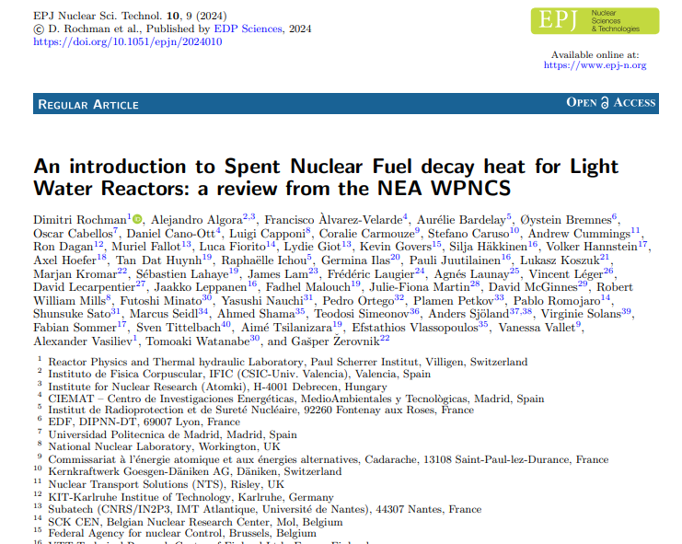
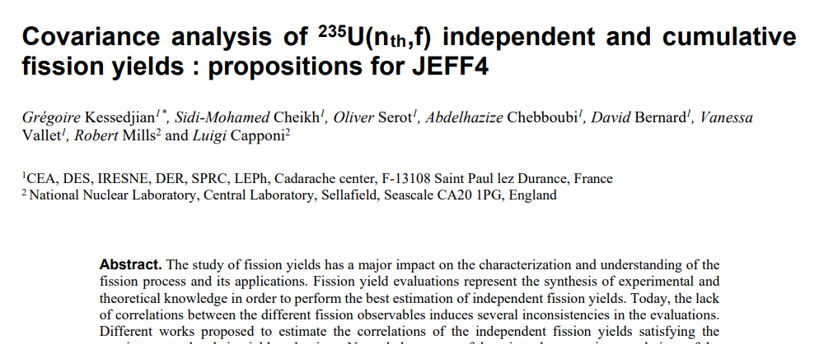
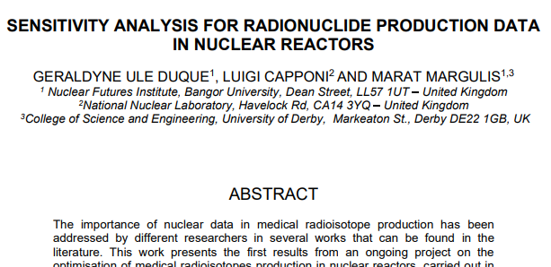
Nuclear data for beginners The UKNNL recent pubblications
Not protectively marked

Slide 9
Neutron irradiations: an experimental work Producing nuclear data for medical applications
Experimental work has been performed with several purposes:
Building and upskilling UKNNL capabilities in neutron irradiation experimental work and gamma spectrometry measurements.
Validation of the CARP simulation code through dedicated experimental irradiations.
Verifying the feasibility of accelerator based medical radioisotope production (from the nuclear physics point of view) and measuring the relative cross sections.
Upskilling the group capabilities in mass spectroscopy post irradiation measurements.
Not protectively marked

Slide 10
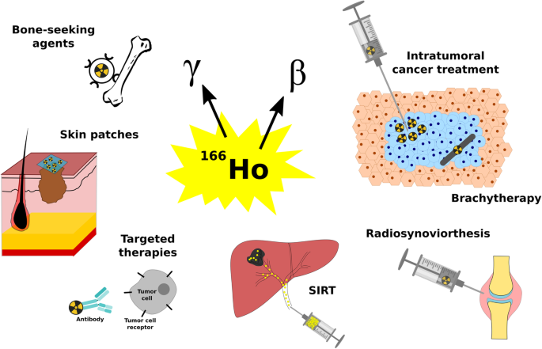
The Birmingham irradiation: ¹⁶⁶Ho production
Ho-166 is a neutron rich radioisotope which beta decays, with a half-life of ~27 hours, to stable Er-166.
This decay process leaves Er-166 in an excited state, whose subsequent nuclear de-excitation emits among others a measurable 80.57 keV gamma ray.
The beta decay followed by a distinctive gamma radiation make Ho-166 an ideal candidate for radiotherapy and imaging.
Not protectively marked

Slide 11
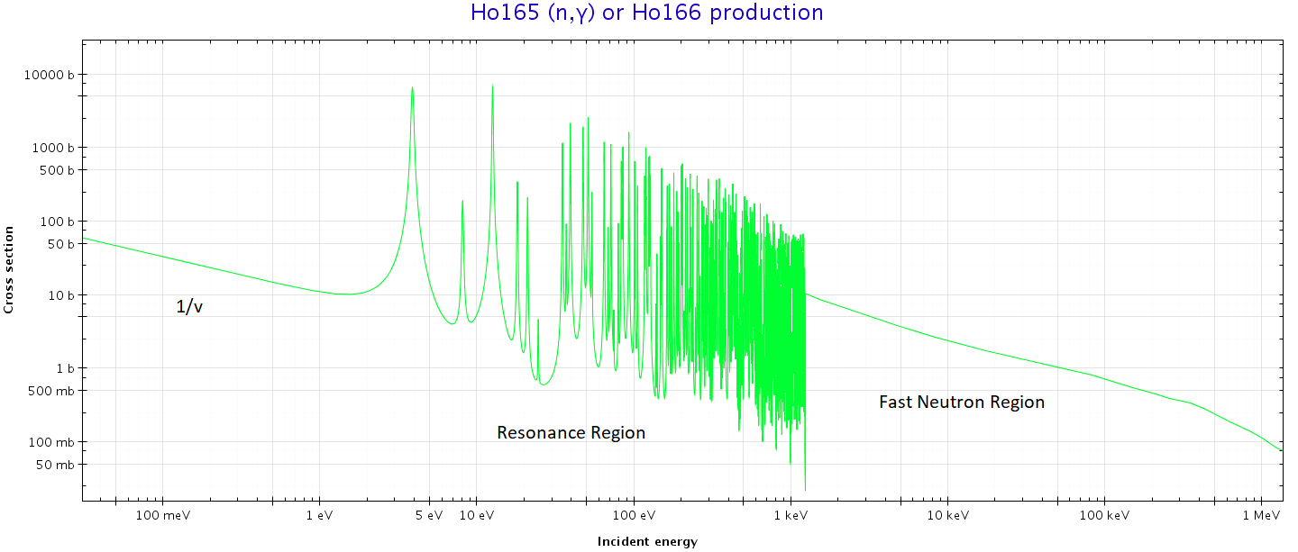
The Birmingham irradiation: ¹⁶⁶Ho production
The first production method explored was the direct irradiation of a ¹⁶⁵Ho metallic foil.
Nice and clean method leading to a single isotope reaction, but it is difficult to separate chemically afterwards ¹⁶⁵Ho (the carrier), from the ¹⁶⁶Ho.
While the chemical separation is not part of this work it should be taken in account when considering production approaches for applications.
Not protectively marked

Slide 12
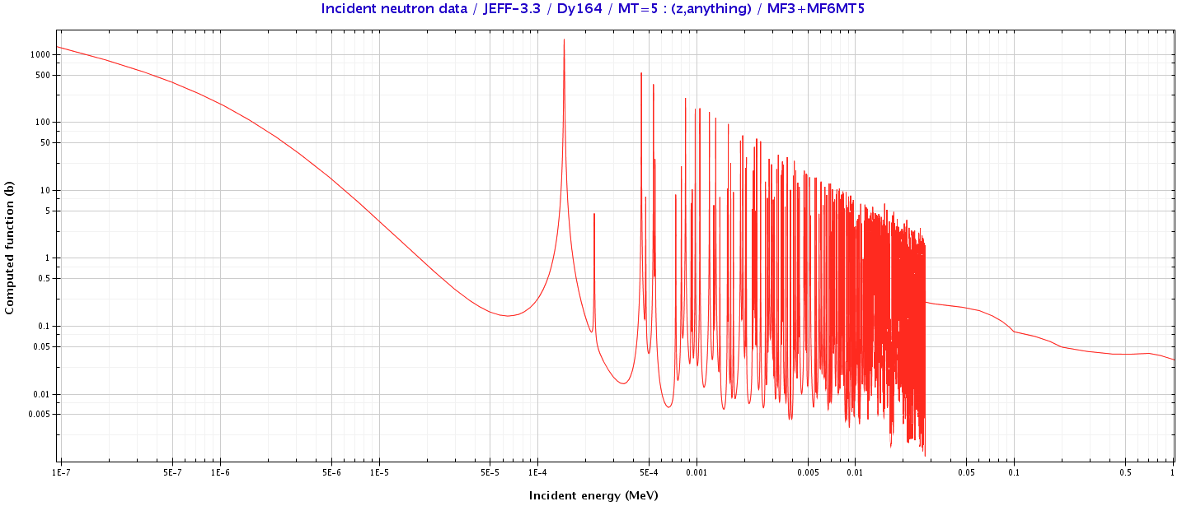
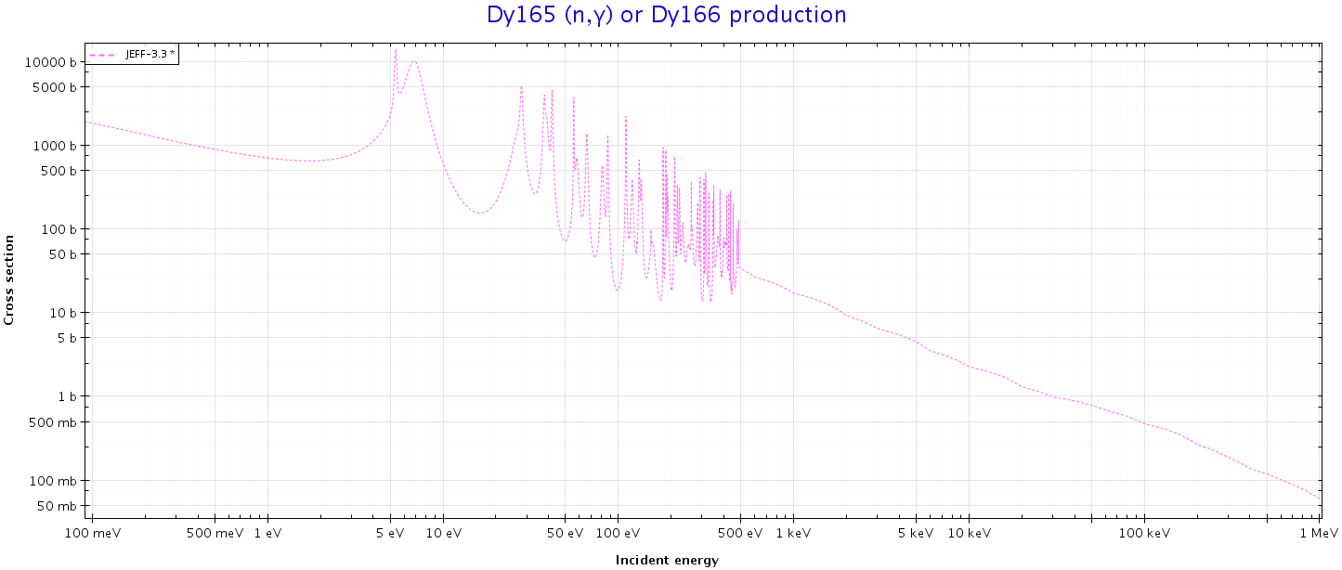
The Birmingham irradiation: ¹⁶⁶Ho production
Alternatively, ¹⁶⁶Ho can be produced irradiating a ^{nat}Dy metallic foil.
This is a two-step process. The heaviest Dy isotope is ¹⁶⁴Dy, two neutron captures are needed to get to ¹⁶⁶Dy, which then decays to ¹⁶⁶Ho.
This method is slower and the two-step reaction happens with a reduced probability, but it is easy to separate chemically afterwards the ^{NAT}Dy (the carrier) from the required ¹⁶⁶Ho.
Both production methods have been investigated in this work.
Not protectively marked

Slide 13
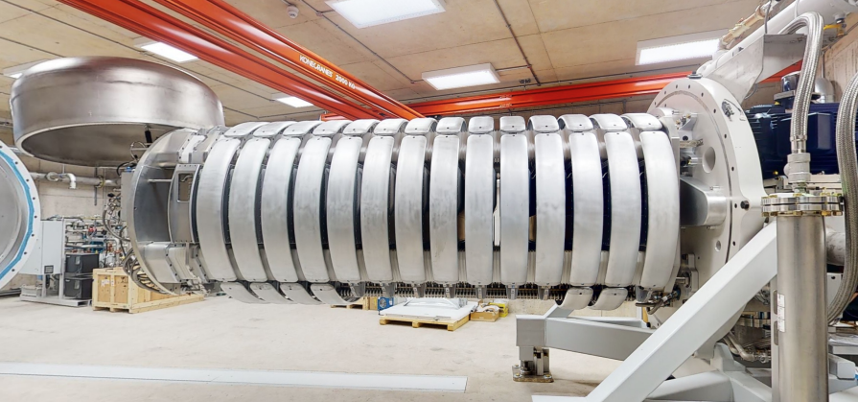
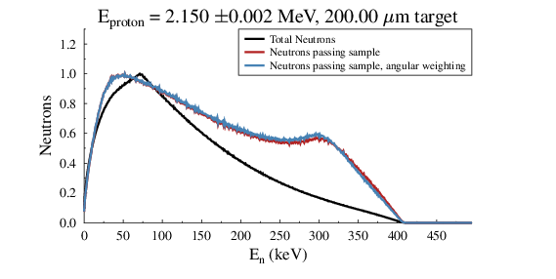
The Birmingham neutron source (HF-ADNeF)
Neutrons are produced by bombarding a 0.2mm thick spinning ⁷Li target with protons.
A beam of neutrons is produced via the ⁷Li(p,n)⁷Be reaction.
The maximum energy of the neutron beam is equal to the energy difference between the proton beam and the Q-value of the ⁷Li(p,n) reaction, which is 1.88 MeV.
Not protectively marked

Slide 14
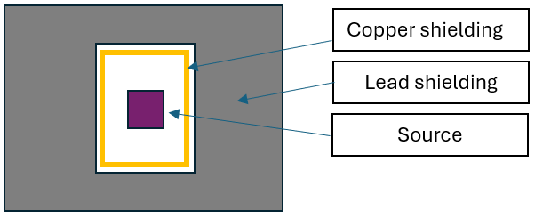
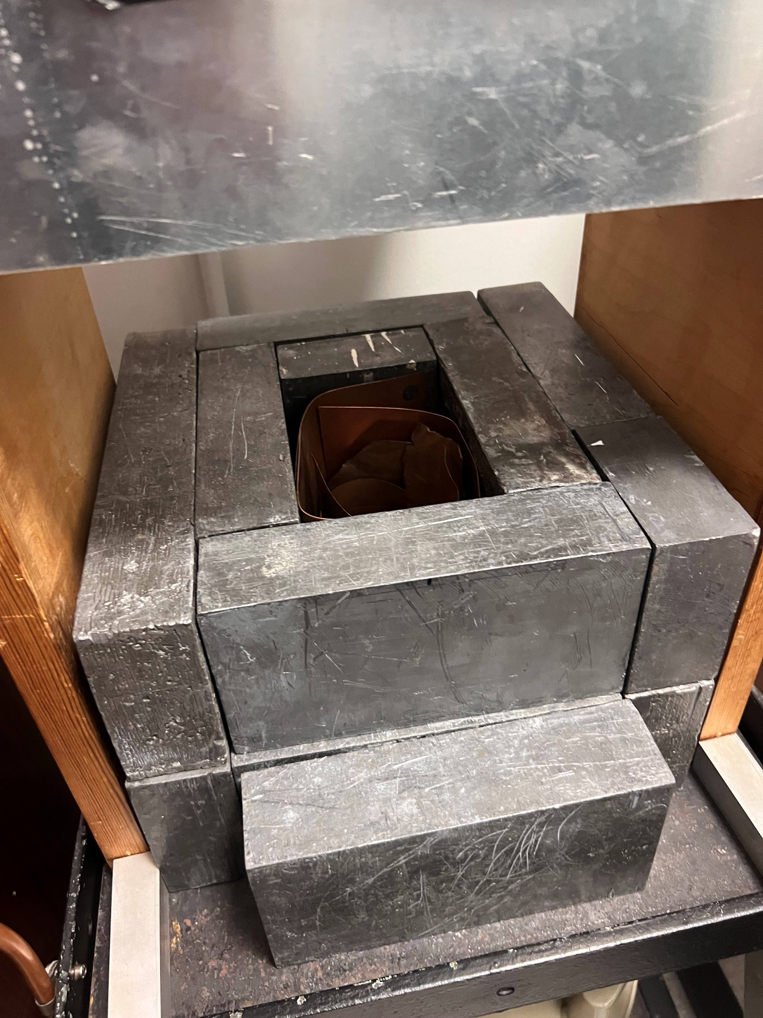
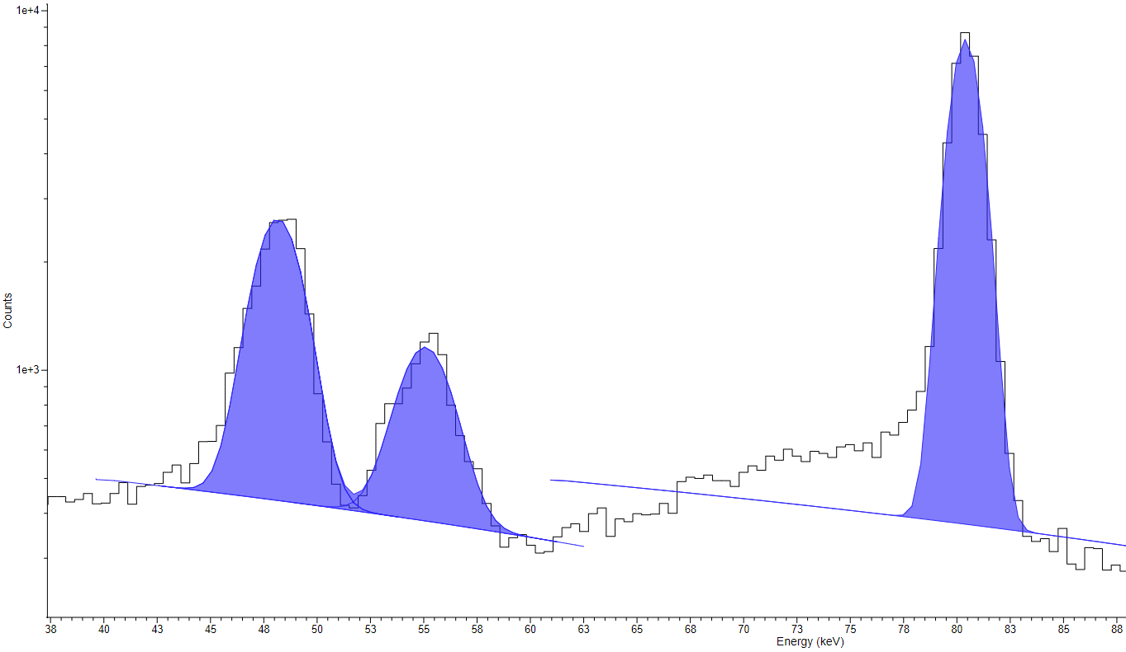
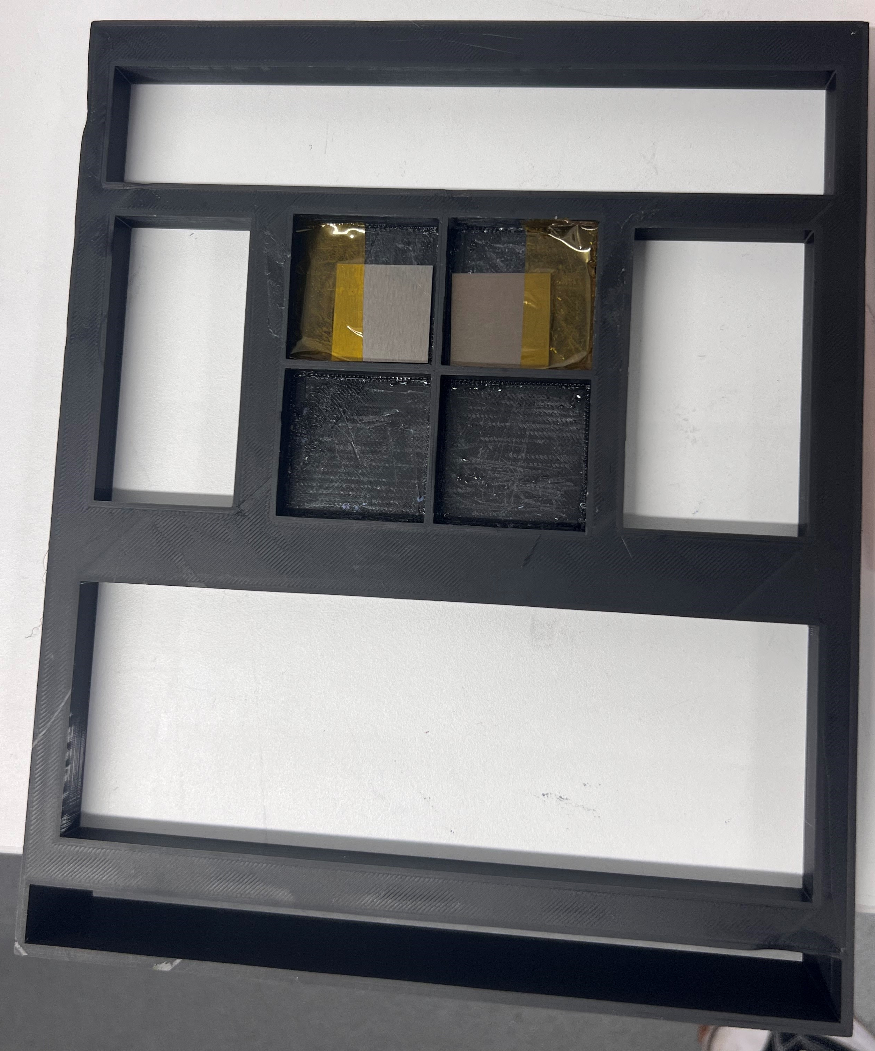
The experimental setup
The gamma detector setup
The Interspec peak fitting software
The target holder
Not protectively marked

Slide 15
Analysis results
¹⁶⁵Ho(n,γ)¹⁶⁶Ho reaction
¹⁶⁴Dy(n,γ)¹⁶⁵Dy -> ¹⁶⁵Dy(n,γ)¹⁶⁶Dy -> ¹⁶⁶Ho reaction
File | Sample | No. of Ho-166 Atoms | Uncertainty (%)
Ho-3hr-200-keV-2cm | 1 | $$9.13×10^{11}$$ | 7.39
Ho-3hr-200-keV-6cm | 1 | $$5.05×10^{11}$$ | 7.44
Ho-3hr-800-keV-6cm | 2 | $$2.91×10^{12}$$ | 7.42
Ho-3hr-800-keV-Mid | 2 | $$3.17×10^{12}$$ | 7.43
Ho-6hr-400-keV-Mid | 3 | $$2.52×10^{12}$$ | 7.43
File | Sample | No. of Ho-166 Atoms | Uncertainty (%)
Dy-3hr-200-keV-6cm-2nd | 1 | $$3.98×10^{8}$$ | 33.96
Dy-3hr-200-keV-2cm-3rd | 1 | $$7.03×10^{8}$$ | 26.32
Dy-3hr-200-keV-2cm-4th | 1 | $$5.89×10^{8}$$ | 11.15
Dy-3hr-200-keV-2cm-5th-Overnight | 1 | $$5.46×10^{8}$$ | 8.50
Dy-3hr-800-keV-2cm | 2 | $$4.02×10^{9}$$ | 7.76
Dy-6hr-400-keV-2cm | 3 | $$2.88×10^{9}$$ | 7.98
CARP predictions: $1.913×10^{11}$ (800keV)
$4.381×10^{10}$ (200keV)
CARP prediction: $none (working in progress)$
Not protectively marked

Slide 16
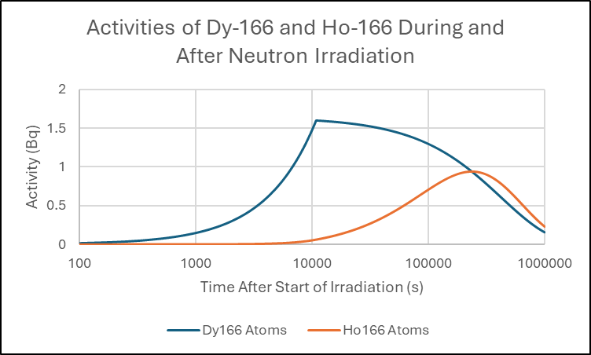
Analysis results
¹⁶⁴Dy(n,γ)¹⁶⁵Dy -> ¹⁶⁵Dy(n,γ)¹⁶⁶Dy -> ¹⁶⁶Ho reaction
File | Sample | No. of Ho-166 Atoms | Uncertainty (%)
Dy-3hr-200-keV-6cm-2nd | 1 | $$3.98×10^{8}$$ | 33.96
Dy-3hr-200-keV-2cm-3rd | 1 | $$7.03×10^{8}$$ | 26.32
Dy-3hr-200-keV-2cm-4th | 1 | $$5.89×10^{8}$$ | 11.15
Dy-3hr-200-keV-2cm-5th-Overnight | 1 | $$5.46×10^{8}$$ | 8.50
Dy-3hr-800-keV-2cm | 2 | $$4.02×10^{9}$$ | 7.76
Dy-6hr-400-keV-2cm | 3 | $$2.88×10^{9}$$ | 7.98
Not protectively marked

Slide 17
General comments
The experiment was successfully performed, and the gamma-ray measurement results are consistent with the expected gamma rays.
The CARP predictions for ¹⁶⁶Ho production are one order of magnitude lower than what was measured. This could be due to a poor estimation of the lower energy tail of the spectrum.
The Dy production path produced consistently more ¹⁶⁶Ho than expected.
It could be a measurement error or considerable larger than expected Dy neutron absorption cross sections.
Not protectively marked

Slide 18
Thank you

