Slide 1
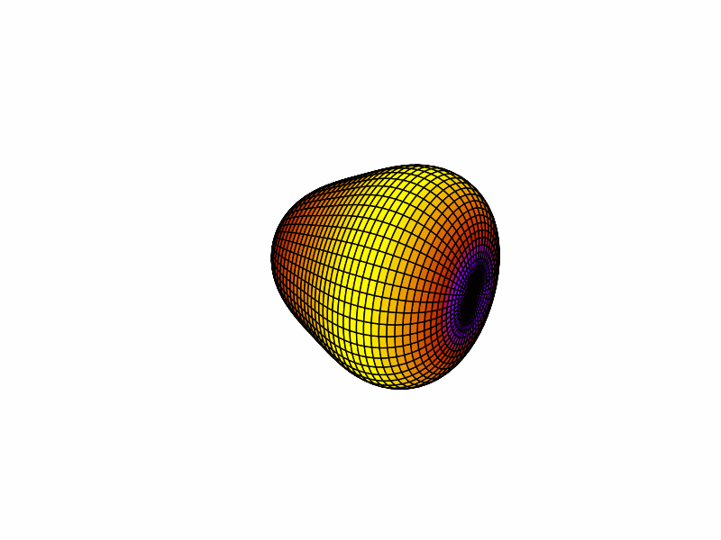
Measurements of octupole collectivity in ¹⁴⁴Ba
Ben Jones
University of Liverpool

Slide 2
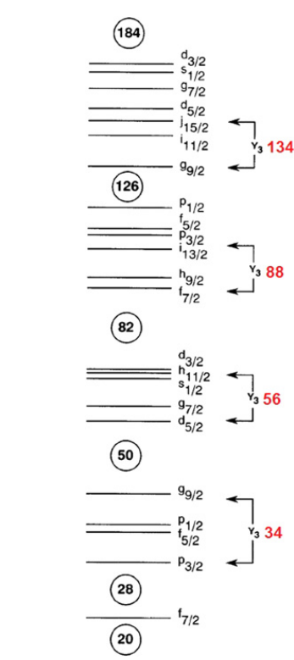
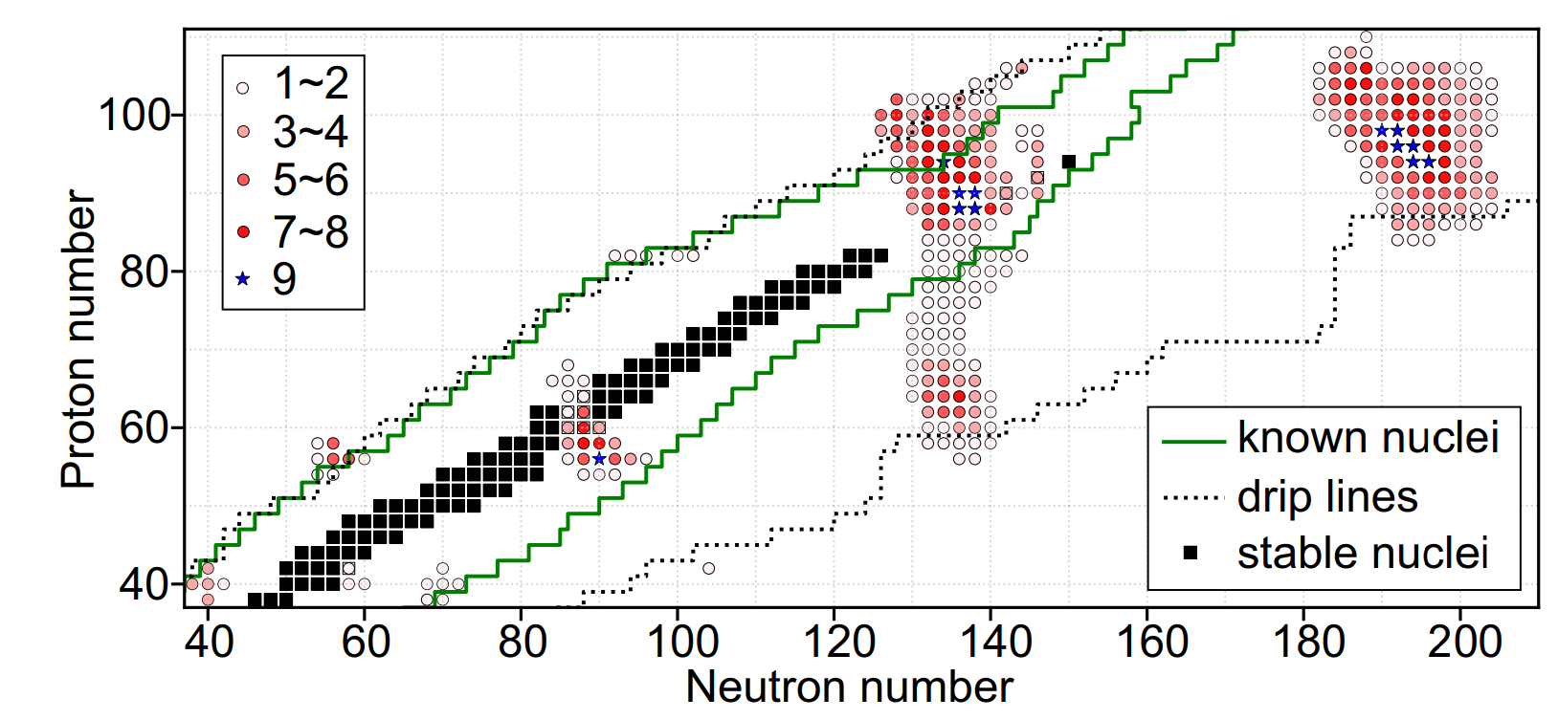
Origins of octupole correlations in nuclei
Octupole deformations can be traced back to particle-hole interactions with intruder orbitals of opposite parity with $∆j, ∆l=3,$coupled by the octupole interaction.
Octupole magic numbers: 34, 56, 88, 134.
Octupole deformation is greatest when both proton and neutron numbers are near these octupole magic numbers.
Intruder orbitals
Lanthanides
Actinides
[1] Y.Cao et al., Phys Rev C 102 (2020)

Slide 3
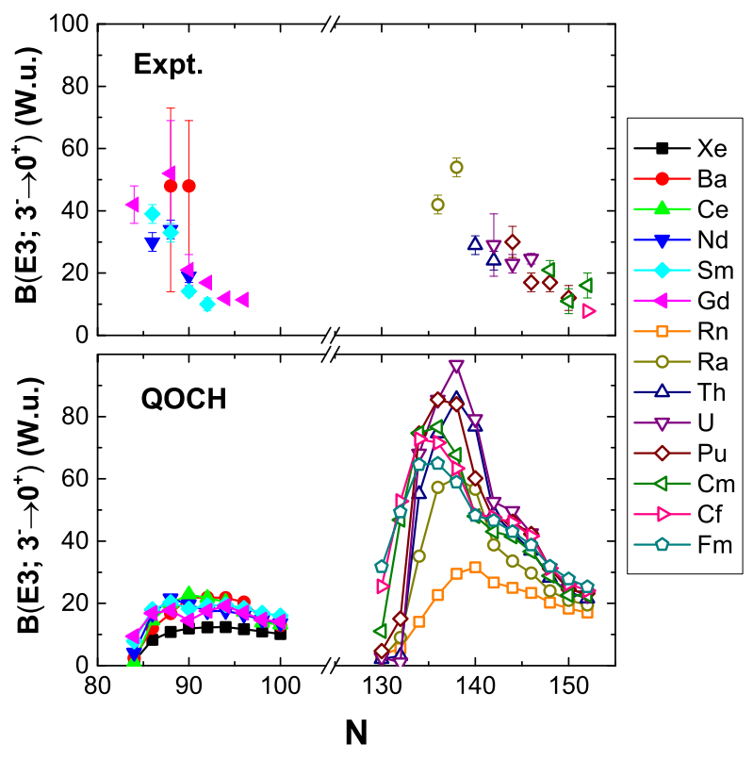
Experiment vs theory
Several Rn isotopes are shown to behave as octupole vibrators [1], and ^{222,224,226}Ra exhibit static octupole deformation in their ground state [2].
Very little experimental data of the $B(E3)$ exists for isotopes in the Lanthanide region.
Previous measurement of the $B(E3)$ for ¹⁴⁴Ba near by Bucher et al., ANL [3] is significantly enhanced over theory and has a large associated uncertainty.
[1] P. A. Butler et al., Nat Commun. 2019 Jun 6;10(1):2473
[2] P. A. Butler et al., Phys. Rev. Lett. 124, 042503 – Published 31 January, 2020
[3] B. Bucher et al., Phys. Rev. Lett. 116, 112503 – Published 17 March, 2016
[4] S. Y. Xia et al., Phys Rev C 97. 054303 (2017)

Slide 4
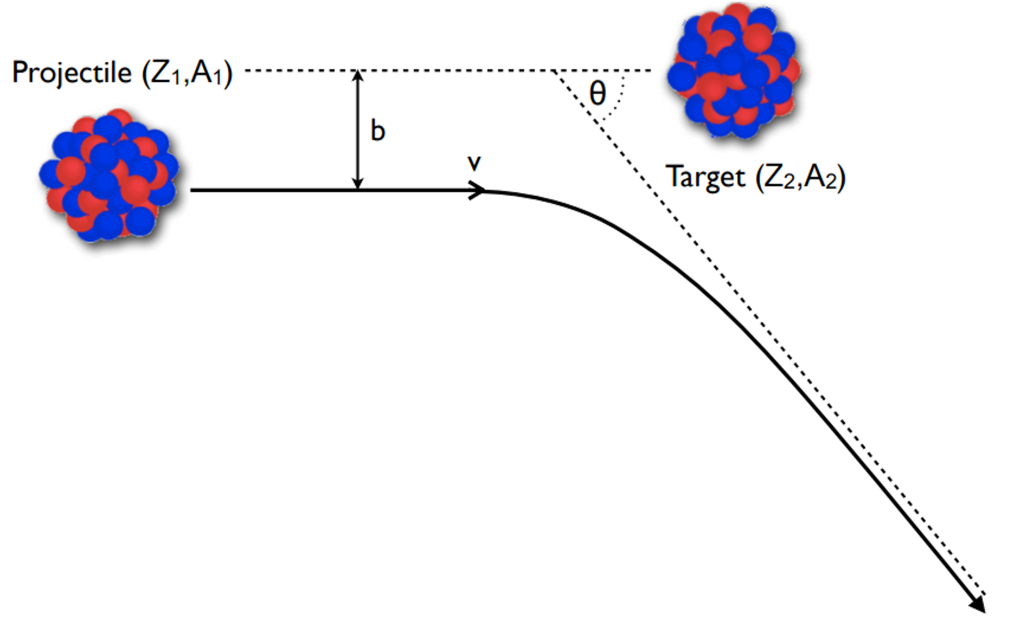
Coulomb excitation
Projectile and target nuclei excite one another via the Coulomb interaction while following hyperbolic trajectories – process can be modelled semi-classically
While in each others EM-field both nuclei have a chance to excite via single step, or a series of multi-step transitions
Direct probe for EM (E1, E2, E3, M1…) M.E.’s coupling states in a nucleus

Slide 5
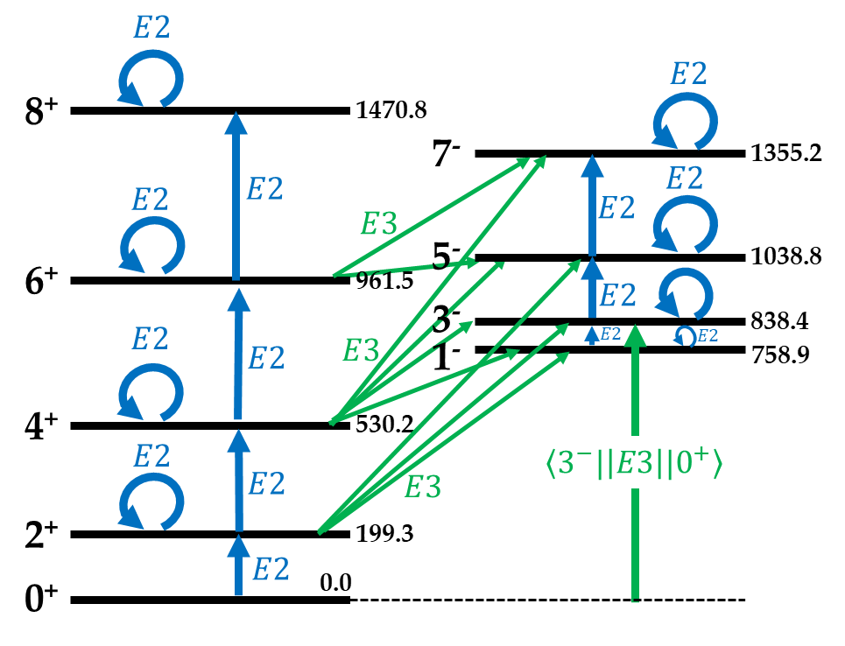
¹⁴⁴Ba – Excitation
$E2$ and $E3$ transitions dominate the excitation process
Magnitude of the $\left\langle 3^{−}|\left|E3\right||0^{+}\right\rangle$ M.E. is an unambiguous measure of octupole collectivity
$$B\left(E3;3^{−}→0^{+}\right)= \frac{{\left\langle 3^{−}|\left|E3\right||0^{+}\right\rangle }^{2}}{7}$$

Slide 6
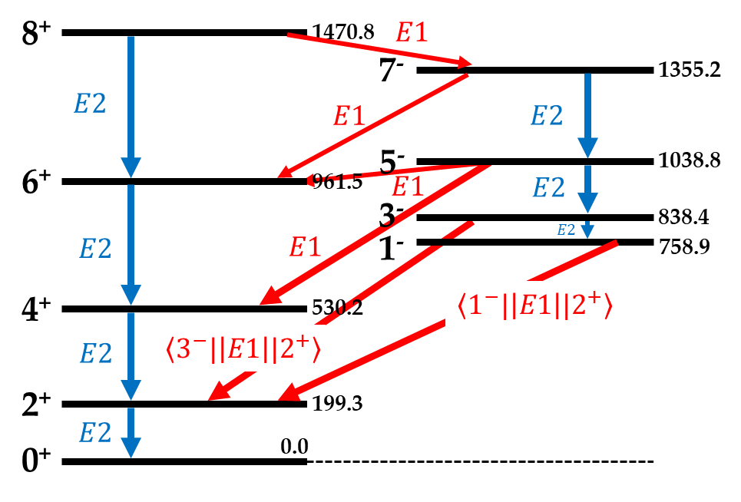
¹⁴⁴Ba – De-excitation
$E2$ and $E1$ transitions dominate the de-excitation process i.e. the observed γ-rays
$3^{−}→2^{+}$ γ-ray yield experimental observable used to probe occupation of the 3- state

Slide 7
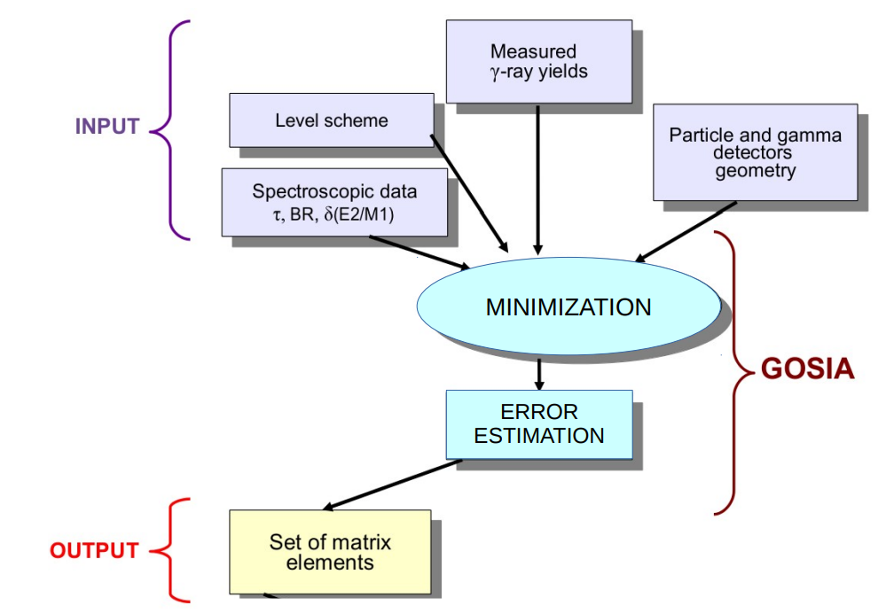
GOSIA
Used to model both excitation and de-excitation process
Integrates over target thickness and scattering angles, considering the geometry and efficiency of the detector setup
Fits the matrix elements to the experimental particle-gated γ-ray yields and additional spectroscopic data
$$dφ$$
$$dr$$
$$dθ$$
$$\frac{dE}{dx}$$

Slide 8
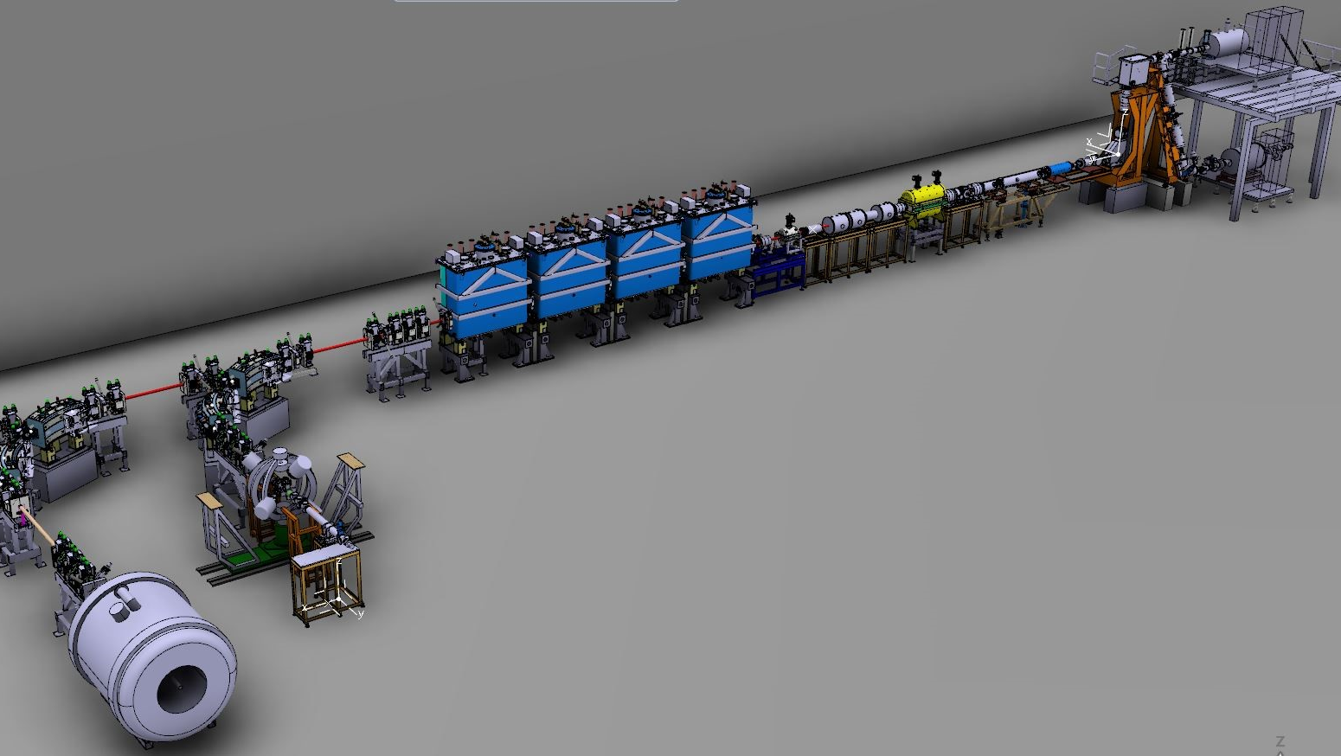
HIE-ISOLDE
1.4 GeV proton beam directed into thick primary targets yielding a variety of atomic fragments
Separators used to extract nuclei of specific mass
RIB re-accelerated up to 10 MeV/u and delivered to experiments
MINIBALL
ISS

Slide 9
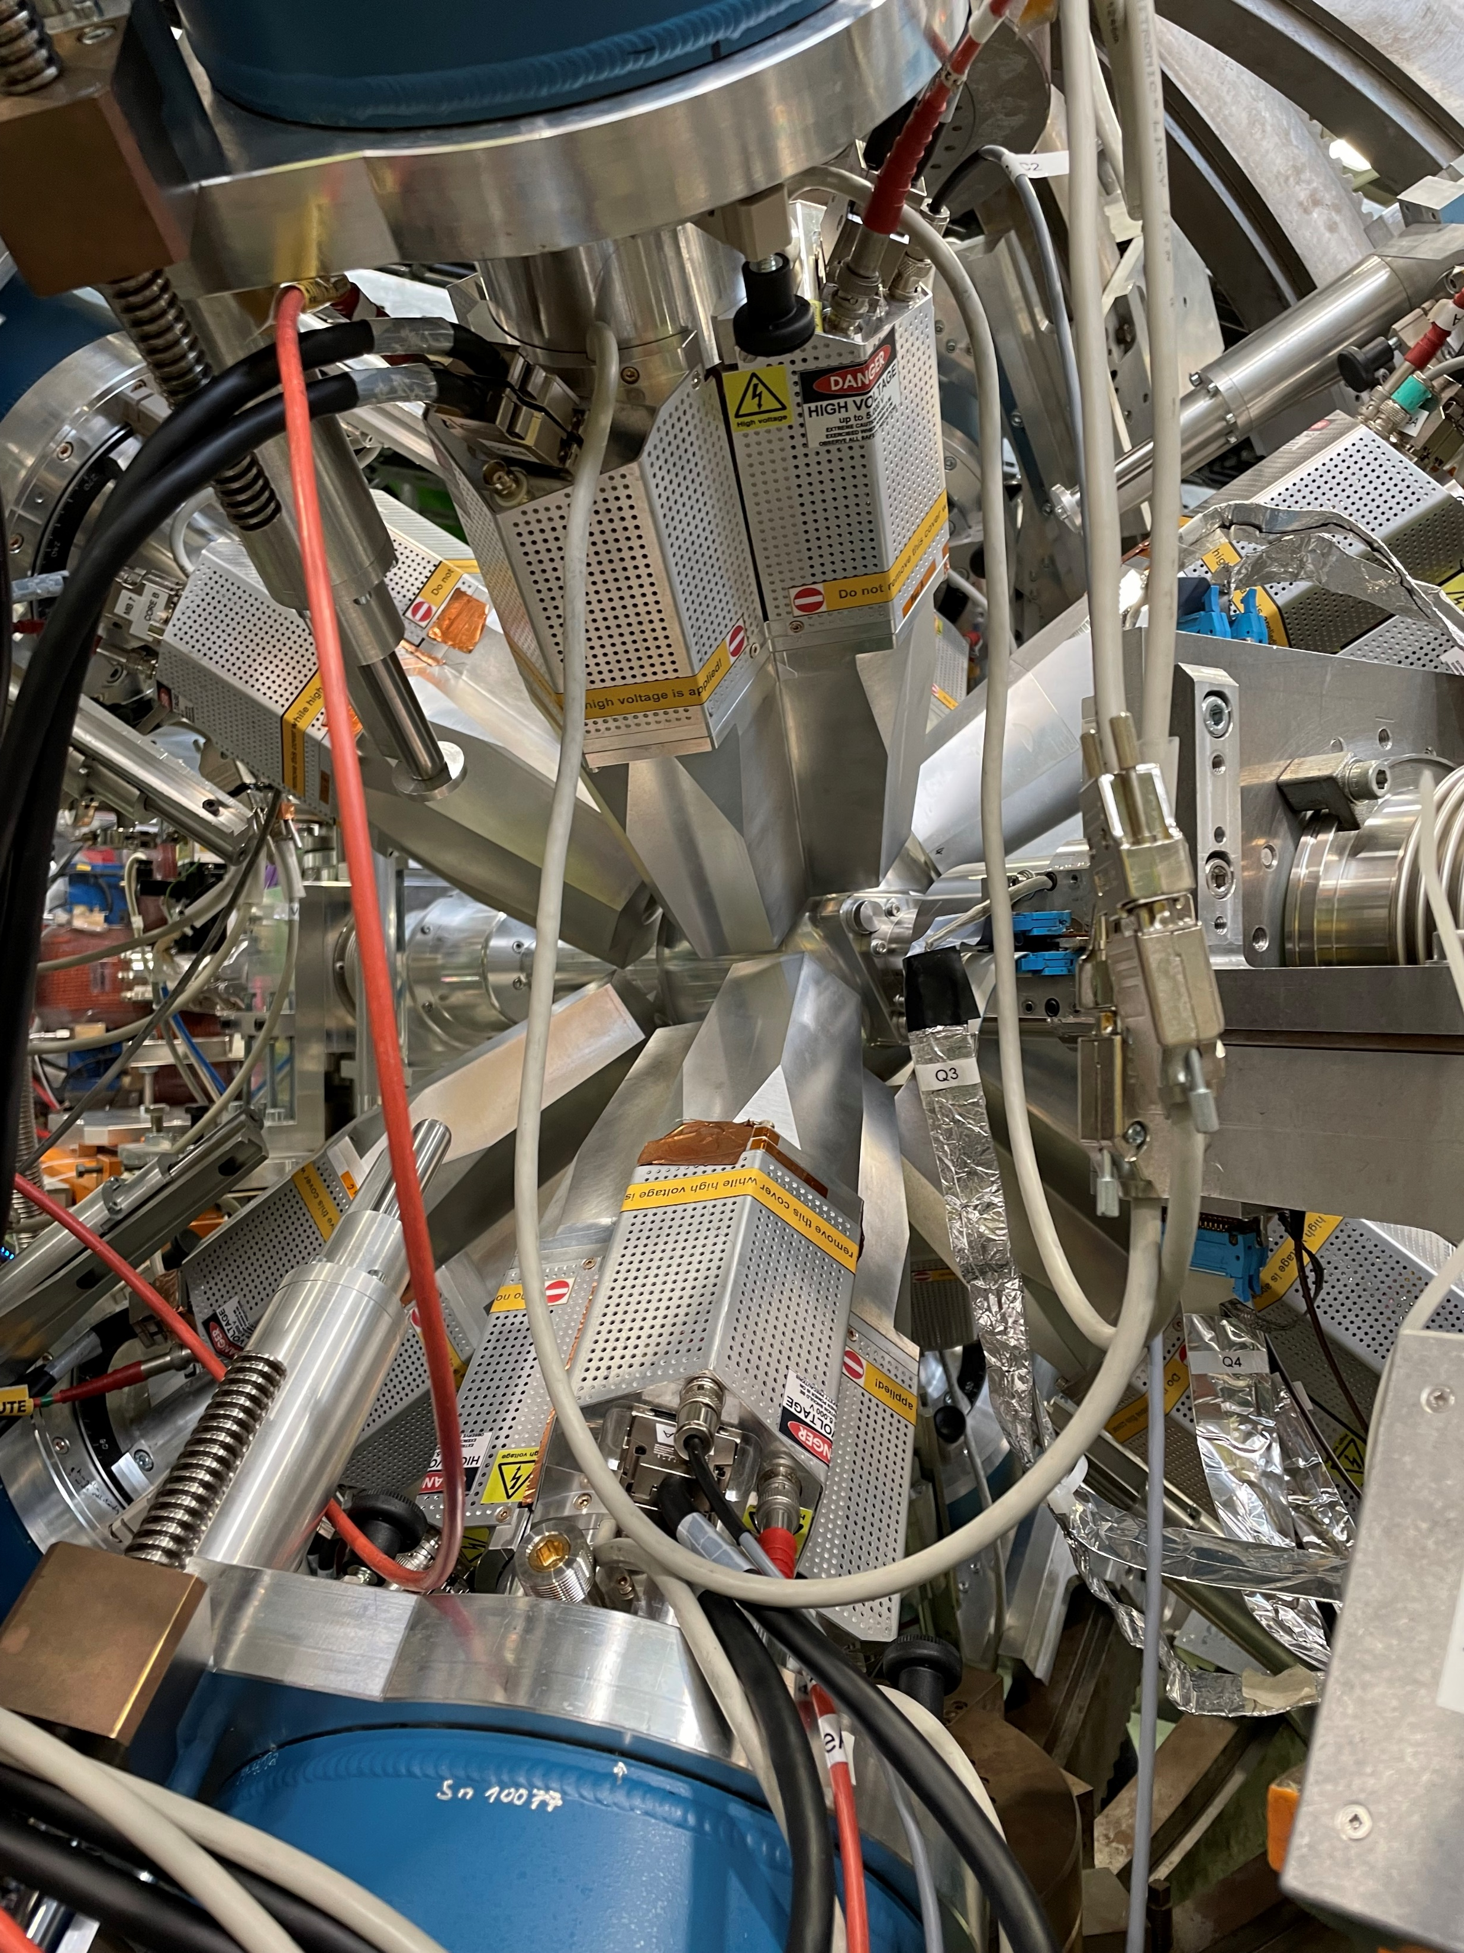
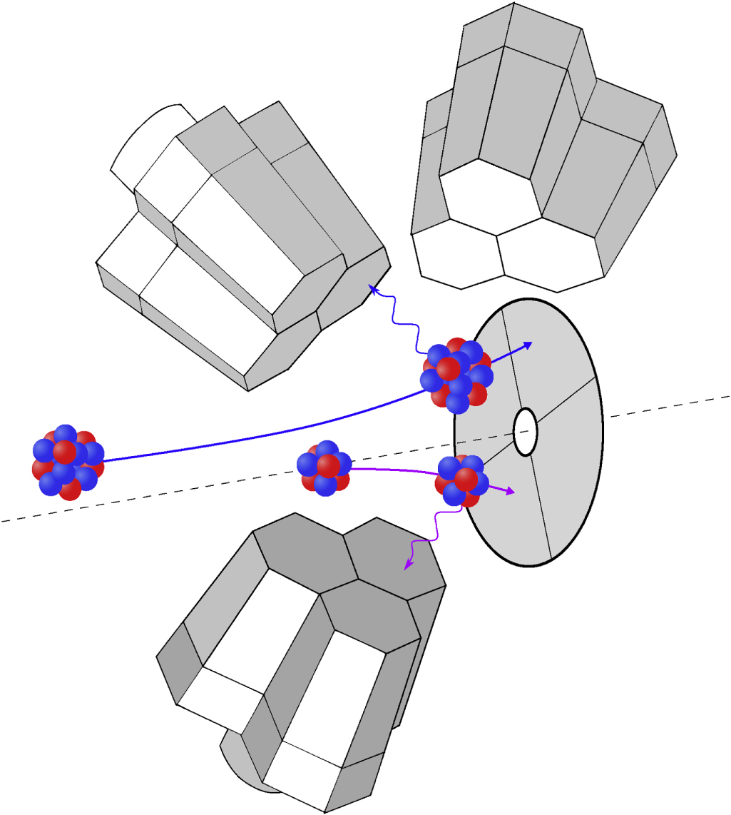
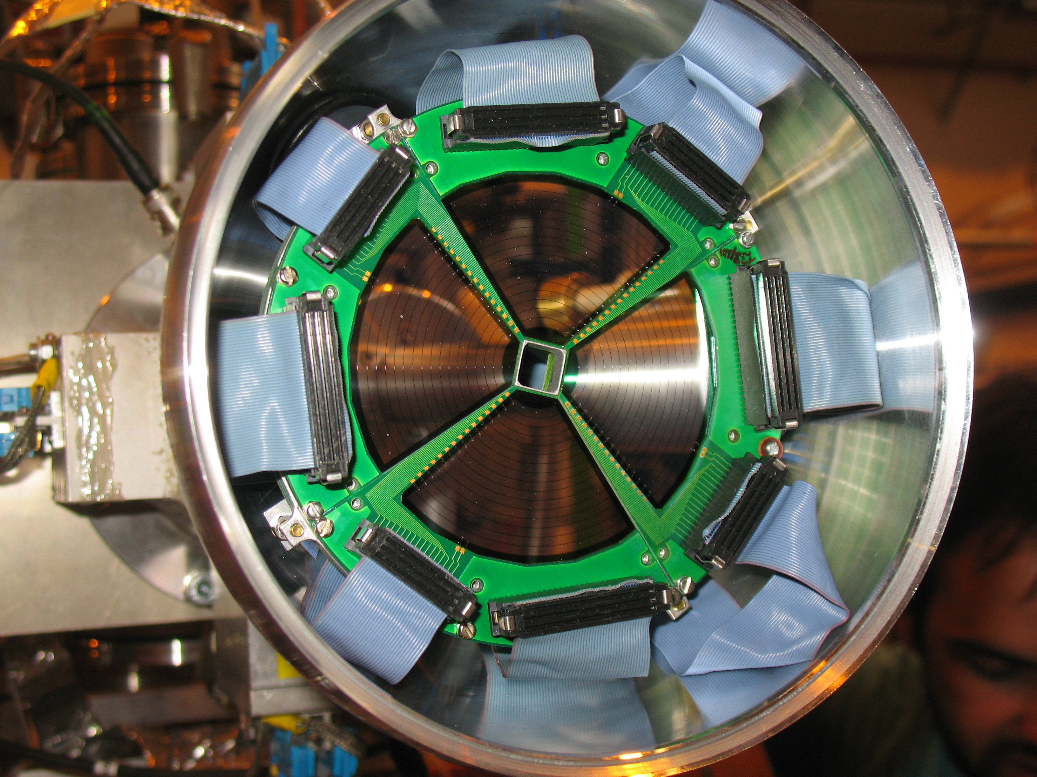
MINIBALL
HPGe clusters centred around the target position, plus a position sensitive silicon CD detector placed downstream of the target

Slide 10
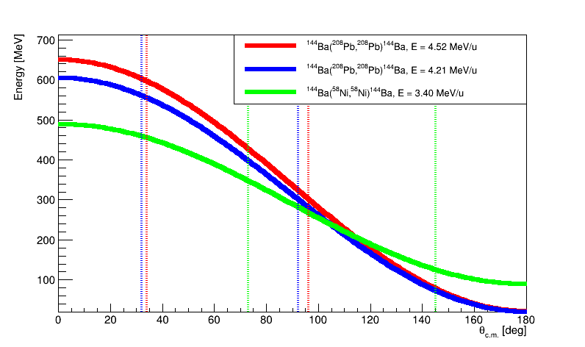
Experimental data
Three experiments performed on ¹⁴⁴Ba over 2017 and 2024 with a mix of beam energies and target isotope to cover a greater centre-of-mass scattering angle, gaining sensitivity to the angular distributions of the excitation:
Beam E = 4.21 MeV/u, Target : ²⁰⁸Pb
Beam E = 4.52 MeV/u, Target : ²⁰⁸Pb
Beam E = 3.40 MeV/u, Target : ⁵⁸Ni

Slide 11
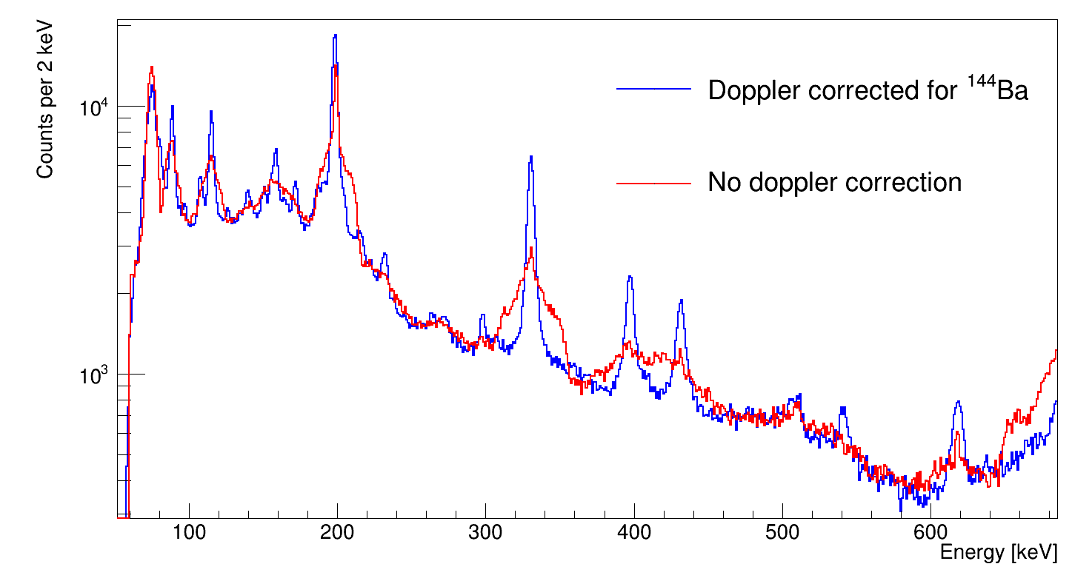
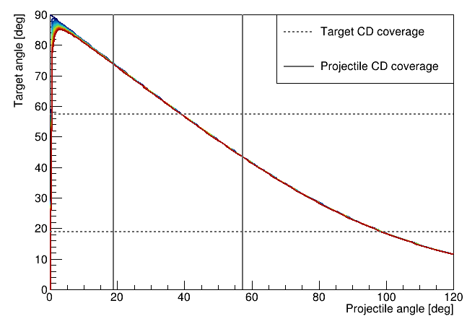
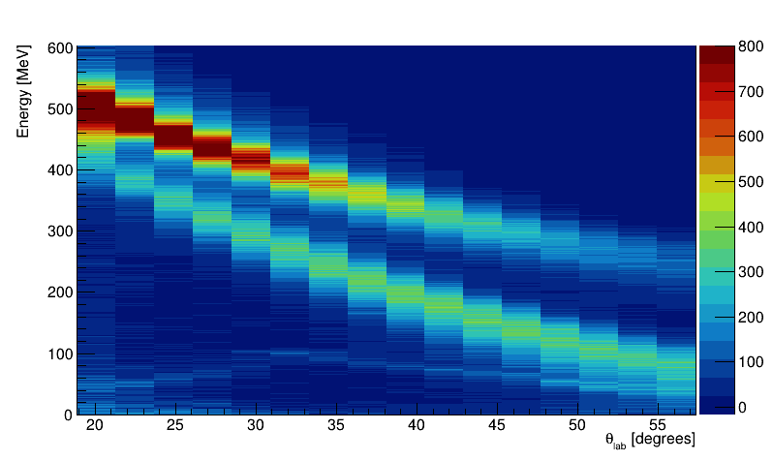
Particle gating
γ-rays are doppler corrected for the coincident projectile/target nucleus
Gating on both the projectile and target effectively increases the lab angle coverage of the CD detector
¹⁴⁴Ba
²⁰⁸Pb

Slide 12
Particle gated spectra
$$2^{+}→0^{+}$$
$$4^{+}→2^{+}$$
$$6^{+}→4^{+}$$
$$8^{+}→6^{+}$$
$$5^{−}→4^{+}$$
$$1^{−}→2^{+}$$
$$3^{−}→2^{+}$$
$${10}^{+}→8^{+}$$
Singles and γ-γ yields checked for consistency for low yield peaks
²⁰⁸Pb target favours multistep excitation and has higher Coulomb excitation cross section
⁵⁸Ni target favours single step excitation and has fewer counts, but cleaner spectrum
$$2^{+}→0^{+}$$
$$4^{+}→2^{+}$$
$$6^{+}→4^{+}$$
$$5^{−}→4^{+}$$
$$1^{−}→2^{+}$$
$$3^{−}→2^{+}$$

Slide 13
GOSIA – $χ^{2}$minimisation
PRELIMINARY
Data normalised to known lifetime of the $4^{+}→2^{+}$ in ¹⁴⁴Ba
$χ^{2}$scan of $\left\langle 3^{−}|\left|E3\right||0^{+}\right\rangle$, all other M.E.’s are allowed to vary during the minimisation
$$B\left(E3;3^{−}→0^{+}\right)= \frac{{\left\langle 3^{−}|\left|E3\right||0^{+}\right\rangle }^{2}}{7}$$

Slide 14
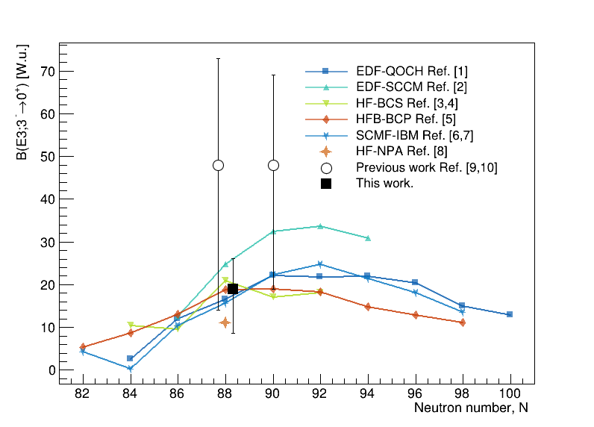
Measured $B\left(E3;3^{−}→0^{+}\right)$
Extracted B(E3) consistent with current theory
Systematic errors yet to be included (Beam energy, target thickness etc.)
PRELIMINARY
References:
[1] S. Y. Xia et al., Phys. Rev. C 96, 054303 (2017)
[2] R. N. Bernard, L. M. Robledo and T. R. Rodríguez, Phys. Rev. C 93, 061302 (2016)
[3] J. Egido and L.M. Robledo, Nucl. Phys. A 518, 475 (1990)
[4] J. Egido and L.M. Robledo, Nucl. Phys. A 545, 589 (1992)
[5] L. M. Robledo, M. Baldo, P Schuk, and T. R. Rodríguez, Phys. Rev. C 81, 034315 (2010)
[6] K. Nomura, D. Vretenar, T. Nikšić and Bing-Nan Lu, Phys. Rev. C 89, 024312 (2014)
[7] K. Nomura, T. Nikšić and D. Vretenar, Phys. Rev. C 97 024317 (2014)
[8] X. Yin, M. Q. Lin, C. Ma, and Y. M. Zhao, Phys. Rev. C 111, 044310 (2025)
[9] B. Bucher et al., Phys. Rev. Lett. 116. 112503 (2016)
[10] B. Bucher et al., Phys. Rev. Lett. 118. 152504 (2017)

Slide 15
Outlook
Complementary analysis of the $2^{+}→0^{+}$ lifetime from this dataset – compare ratio of doppler shifted and unshifted γ($2^{+}→0^{+}$) yield
GOSIA analysis of isobaric contaminants in the beam (¹⁴⁴Sm and ¹⁴⁴Nd) will provide consistency check with previous B(E2) and B(E3) measurements
Data from ¹⁴⁴Ba(d,d’) measurement at ISS to extract deformation lengths, $β_{γ}$, currently being analysed will hopefully provide an independent measurement B(E3)

Slide 16
Thanks for listening and thanks to all the collaborators!

Slide 17
Backup slides

Slide 18
Doppler shifted and unshifted γ($2^{+}→0^{+}$)
$$λ=λ_{0}\frac{(1−βcos{(θ}_{pγ}))}{\sqrt{1−β^{2}}}$$
$$\frac{N(t)}{N_{0}}=\frac{{\text{γ}(2^{+}→0^{+})}_{shifted}}{{\text{γ}(2^{+}→0^{+})}_{shifted}+{\text{γ}(2^{+}→0^{+})}_{unshifted}}=e^{{−t}/{τ(2^{+}→0^{+})}}$$

Slide 19
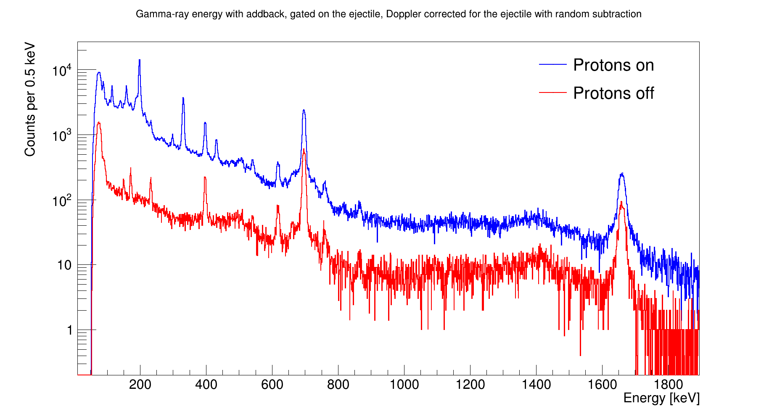
Isobaric contaminants
¹⁴⁴Ba($2^{+}→0^{+}$)
¹⁴⁴Nd($2^{+}→0^{+}$)
¹⁴⁴Sm($2^{+}→0^{+}$)

Slide 20
ISS
Setup
ISS silicon array placed in the downstream position (for the first time)
Target: 200 μg/cm², CD₂
Beam Energy: 8.38 MeV/u
Magnetic field: 2.5 T
Faraday cup for beam tuning
CD2 target
Faraday
cup

Slide 21
ISS data
Different charge states of ¹²C elastically scattering
Elastically scattered protons
Elastically scattered deuterons

Slide 22
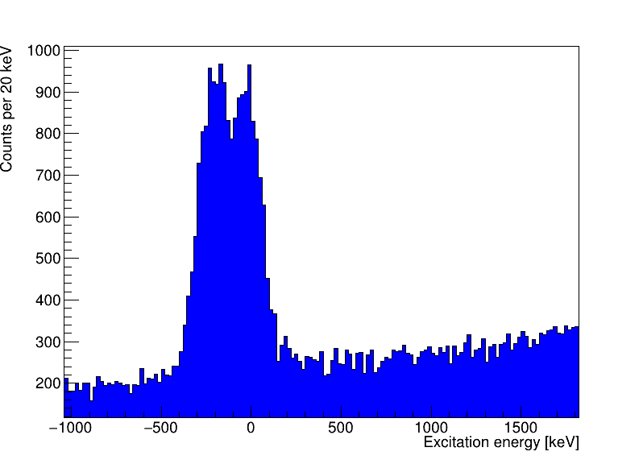
Excitation energy reconstructed from the kinematics
2⁺
199 keV
Slice of events from 570 mm to 684 mm
¹⁴⁴Ba
E2
0⁺
0 keV
¹⁴⁴Ba(d,d’)¹⁴⁴Ba(2⁺): E = 199 keV
The 2⁺ is only visible on the last row due to the resolution and size of the elastic peak.
Elastically scattered protons
Elastically scattered deuterons

Slide 23
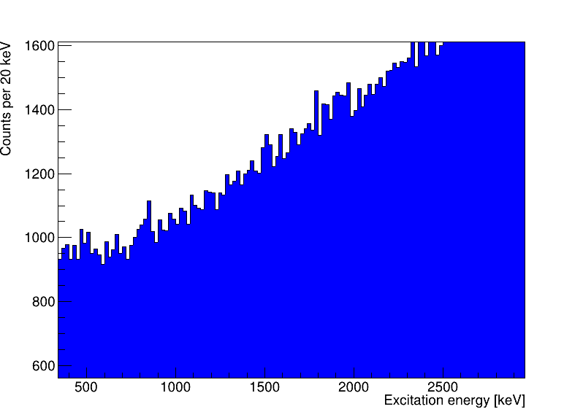
3⁻
838 keV
1⁻
759 keV
4⁺
530 keV
¹⁴⁴Ba
2⁺
199 keV
E3
Slice of events from 312 mm to 684 mm
0⁺
0 keV
¹⁴⁴Ba(d,d’)¹⁴⁴Ba(3⁻): 838 keV
Almost the entire detector can be used to see the 3⁻ since its far enough away from the rutherford scattering peak.

