Slide 1
Quasi-Free Scattering Studies In
and Around the Ca Mass Region
Luke Rose, Ryo Taniuchi,
Stefanos Paschalis and Marina Petri
University of York
For the s467 experiment of the R³B Collaboration
Date: 23/04/2025
The results presented here are based on the experiment s467, which was performed at the target station FRS-HTC at the GSI Helmholtzzentrum für Schwerionenforschung, Darmstadt (Germany) in the frame of FAIR Phase-0.

Slide 2
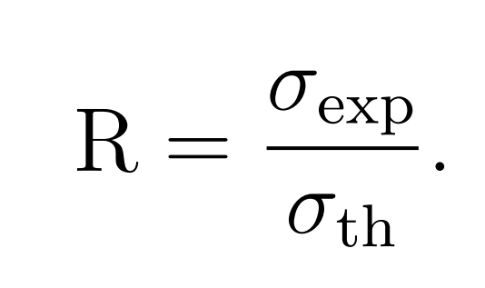
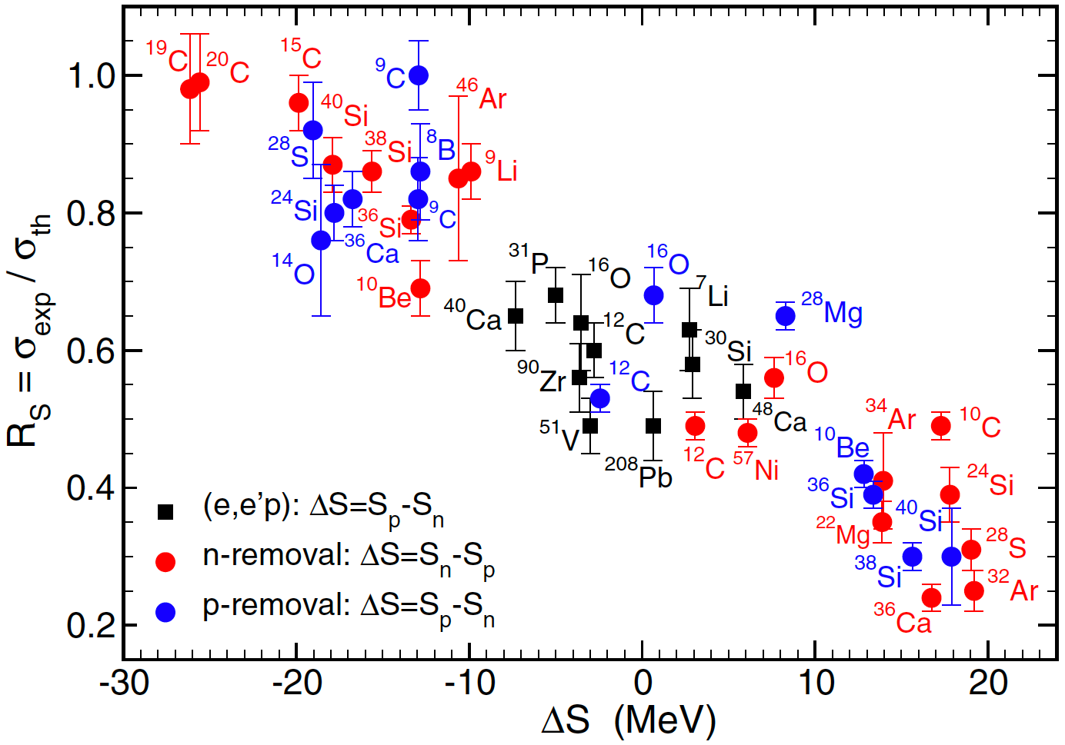
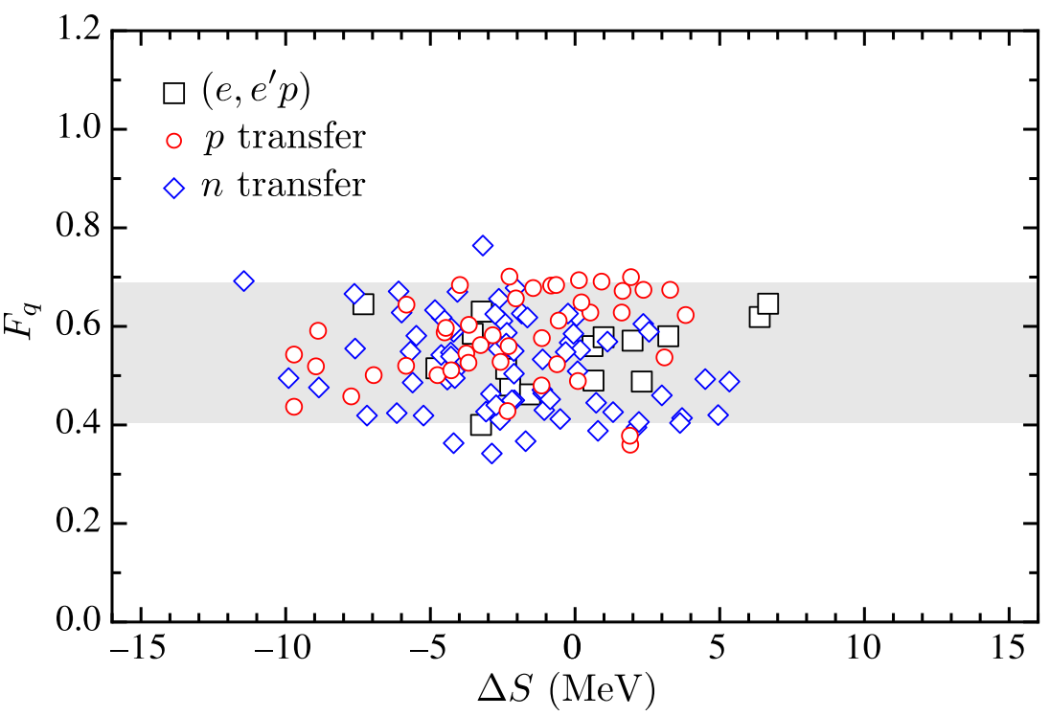
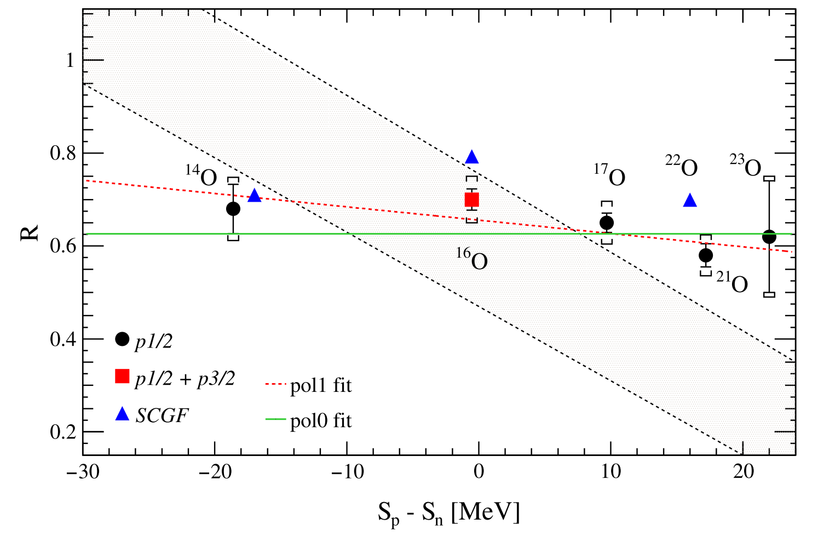
Experimental Motivation
Quasi-free scattering (QFS) and transfer reactions show small isospin dependencies. Knockout reactions with nuclear targets would be affected by reaction mechanisms. QFS is a clean reaction and can access wider isospin regions.
Knockout reactions
Transfer reactions
(p,2p) Quasi-free scatterings
J. A. Tostevin and A. Gade, PRC 90, 057602 (2014)
B. P. Kay et al., PRL 111, 042502 (2013)
L. Atar et al., PRL 120, 052501 (2018)

Slide 3
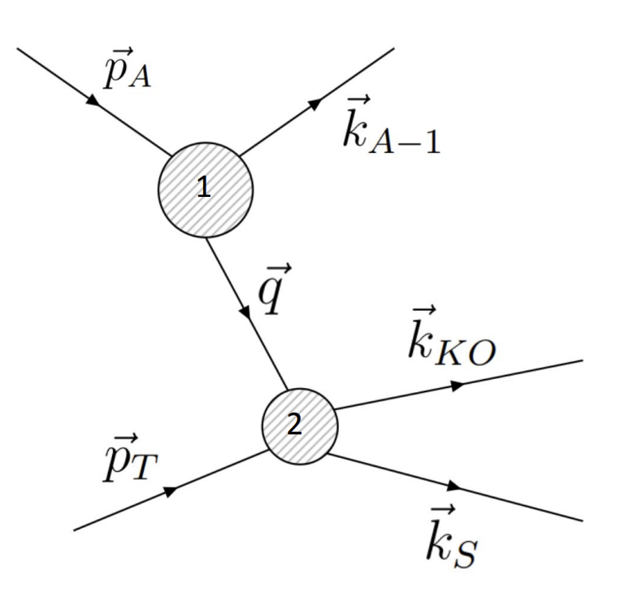
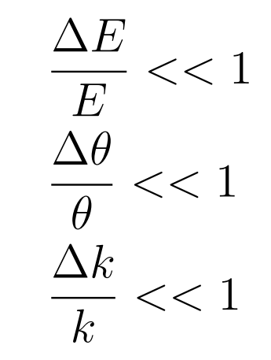
QFS mechanism
Approximations:
Mediated by virtual Pion exchange.
Reactions with beam energy 100-1000 AMeV.
Small energy transfer.
Small angular scattering.
Small momentum exchange
Both sudden approximation and eikonal approximations are used in the calculation of QFS cross sections.

Slide 4
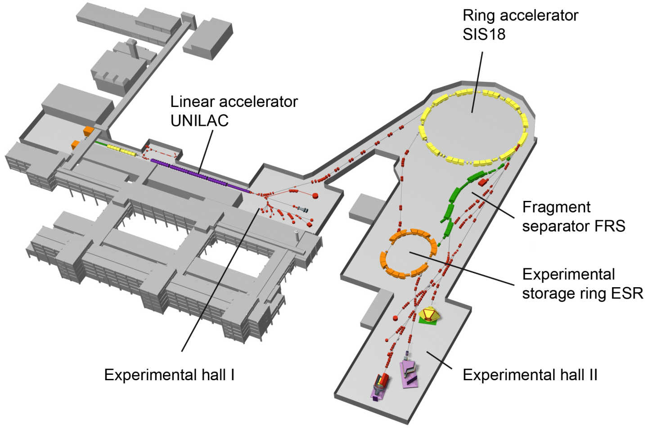
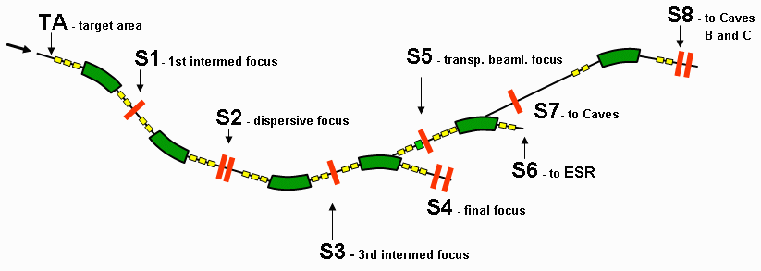
GSI-Beam production
GSI Facility Darmstadt, Germany.
Ions accelerated in UNILAC.
Further accelerated and fully stripped primary beam in SIS18.
Extracted and secondary beam production in FRS.
R³B setup
⁸⁶Kr 580 AMeV
Cocktail beams to experimental hall
https://www-win.gsi.de/frs-setup/

Slide 5
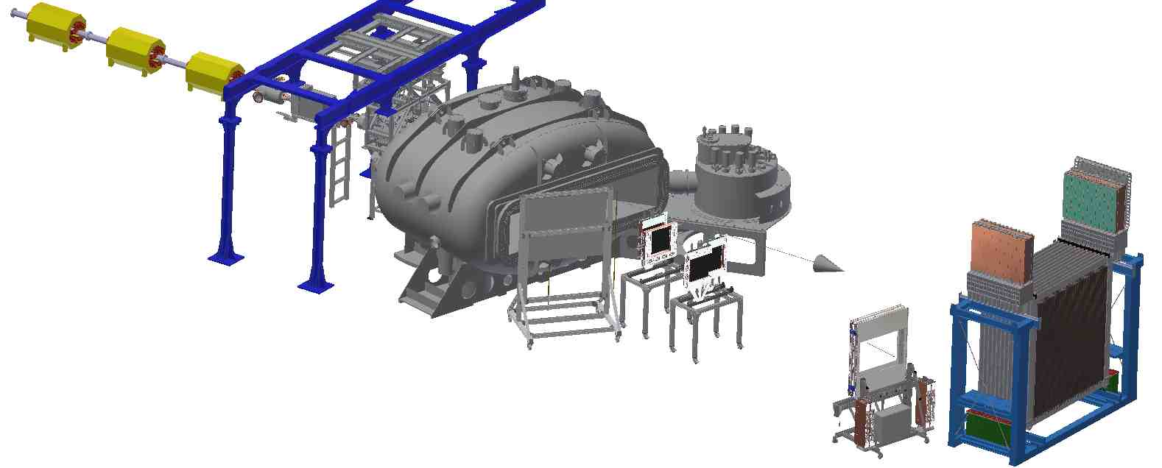
Experimental setup-Cave C
Secondary beam ToF measured by plastics and directed to Focal plane at Cave C.
Gas detectors for Z measurement.
Multi wires for in beam tracking.
Plastics for ToF and veto.
CALIFA to tag QFS reactions.
NeuLAND for neutron ToF.
GLAD
Target area
ToFw
Targets: C, CH₂, Empty

Slide 6
PID-Particle IDentification
PID plots for CH₂ target.
Before target gate on isotope of interest.
Reaction PID gate on reaction channel of interest.

Slide 7
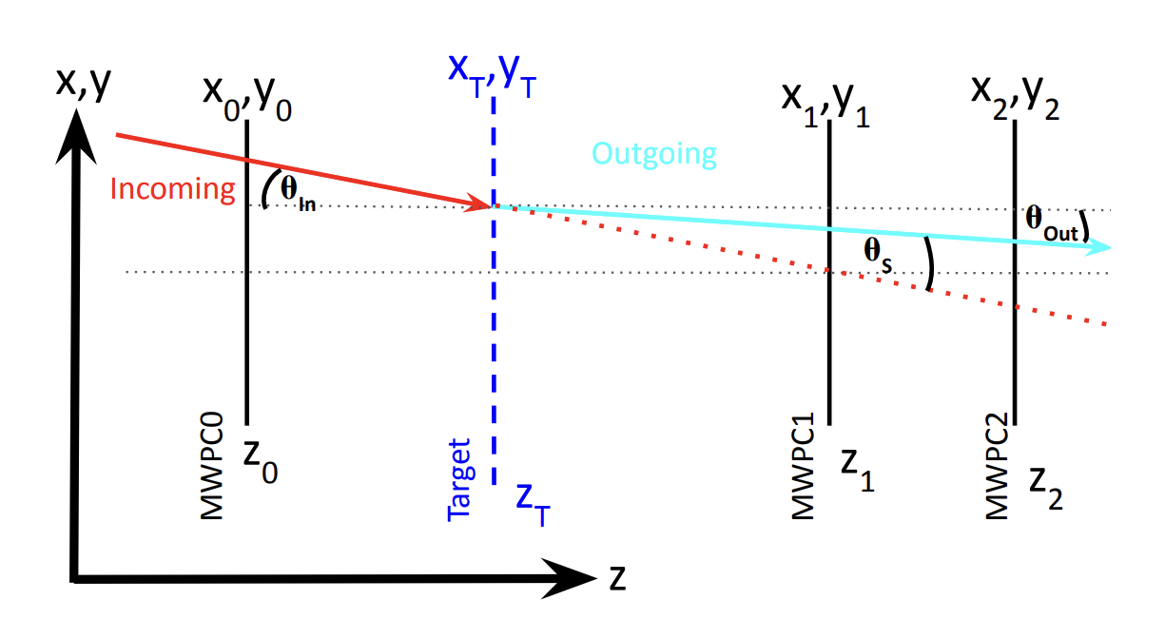
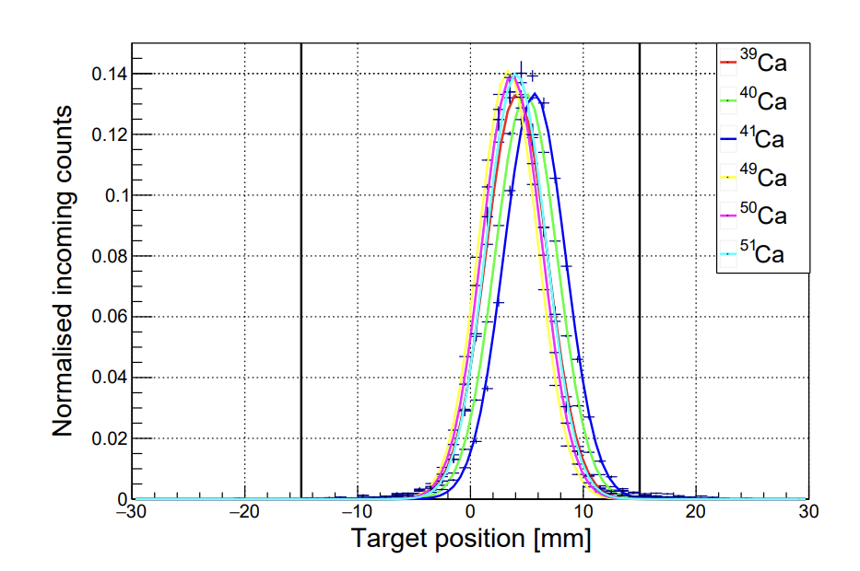
In Beam Tracking
Target position reconstruction for Ca isotopes in target runs using unreacted beam cuts
Ion tracking through upstream MWPC detectors to calculate angle of track to be used in momentum reconstruction of ions.

Slide 8
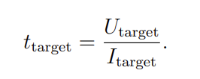
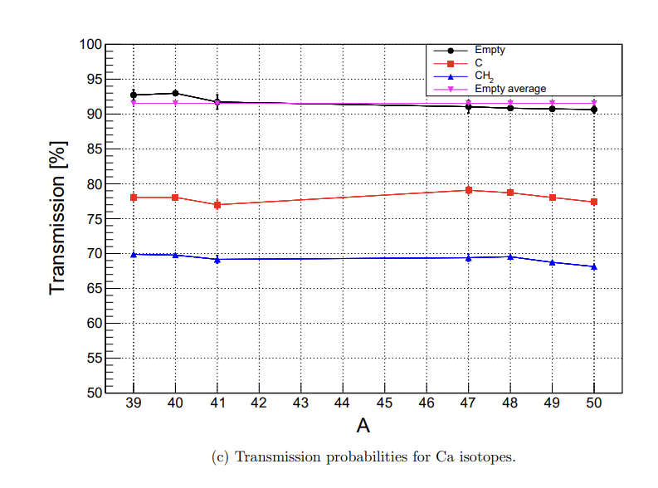
Ion Transmission
Transmissions probabilities for each isotope for each target setting is calculated.
An average empty target efficiency is also calculated.

Slide 9
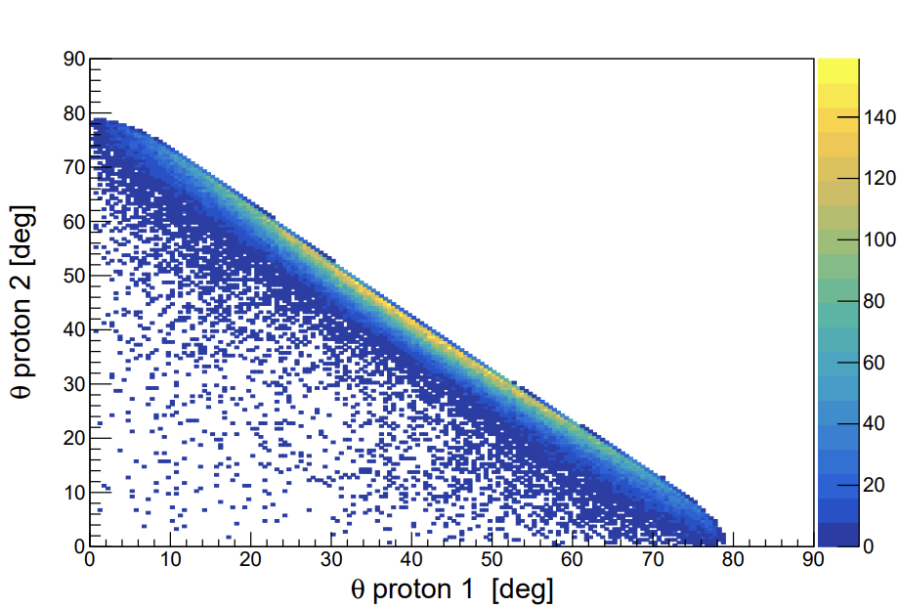
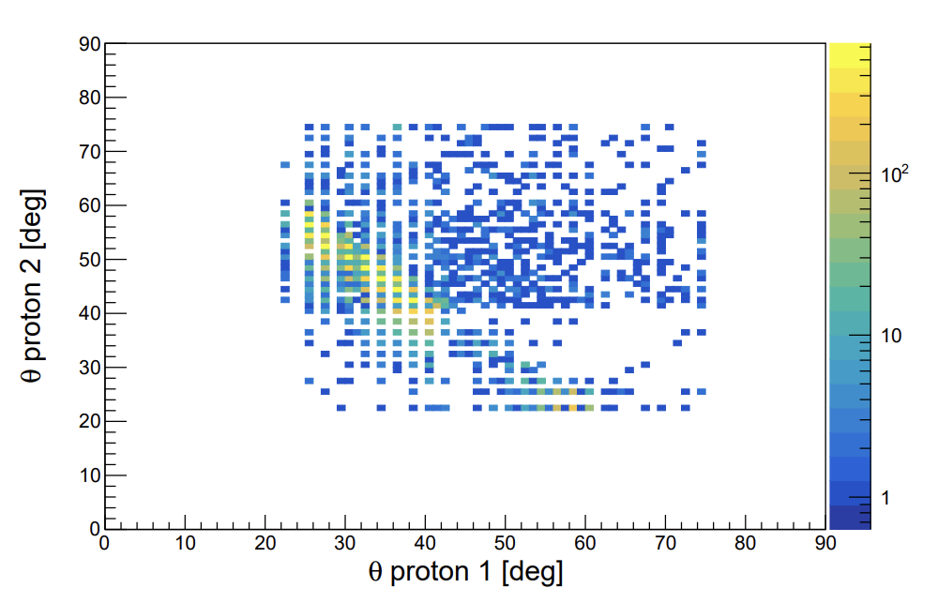
(p,2p) event tagging-simulations
(p,2p) angular correlations
Proton 2
Proton 1
Califa Geometry:
CsI(Tl)
Highly segmented
Optimised for detection of protons and gamma rays.

Slide 10
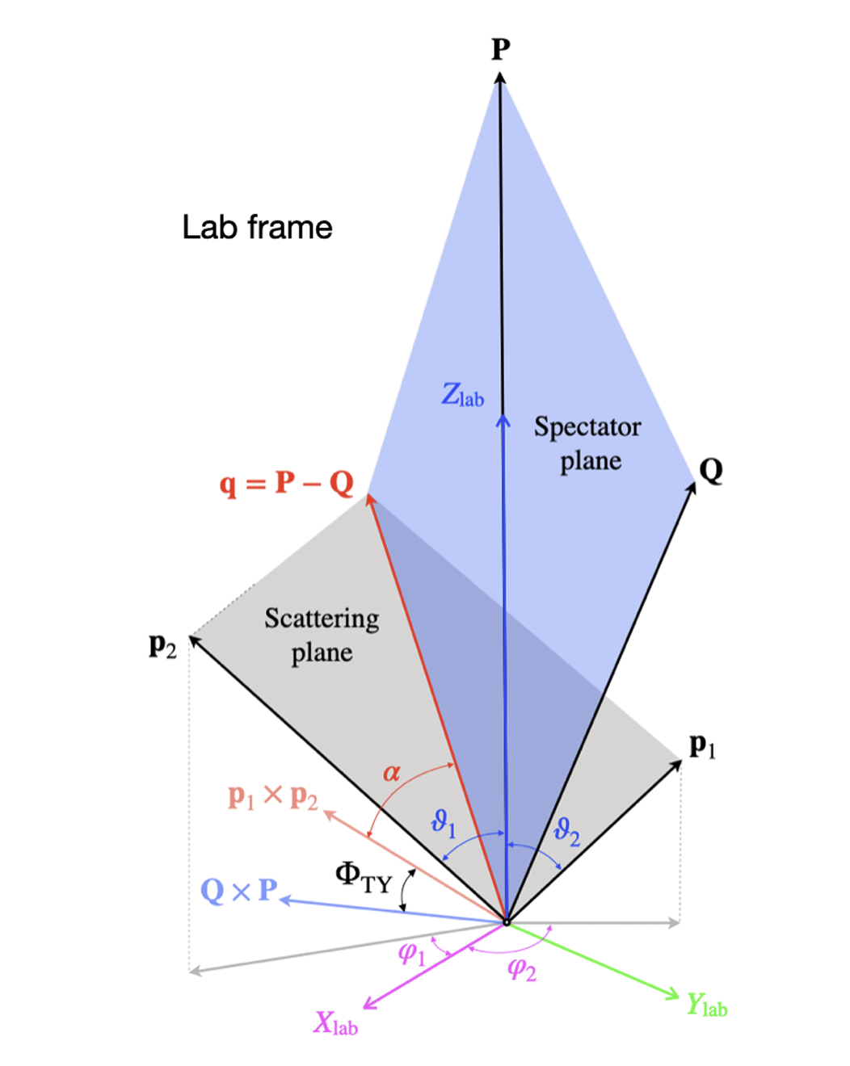
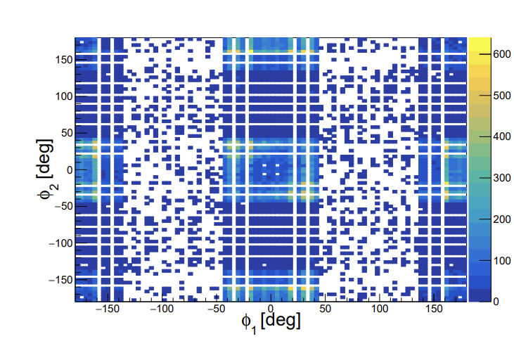
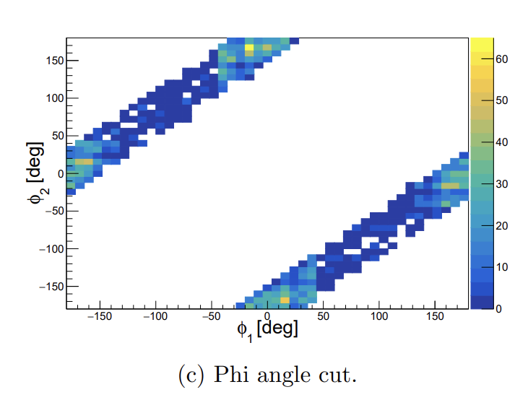
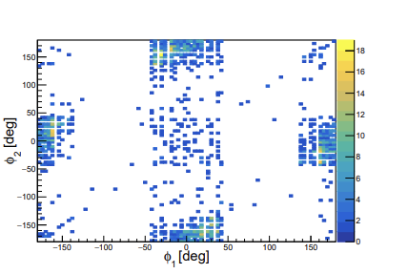
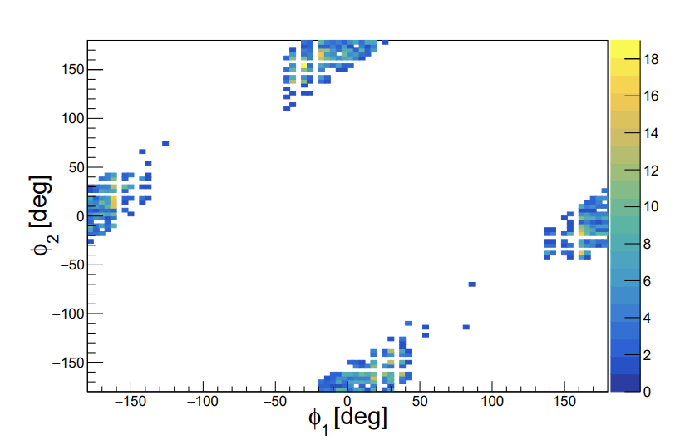
QFS – Event Tagging With CALIFA (Experimental Data)
a)20 MeV Clusters
b)
c) Coplanar cut
a)+b)+ c)

Slide 11
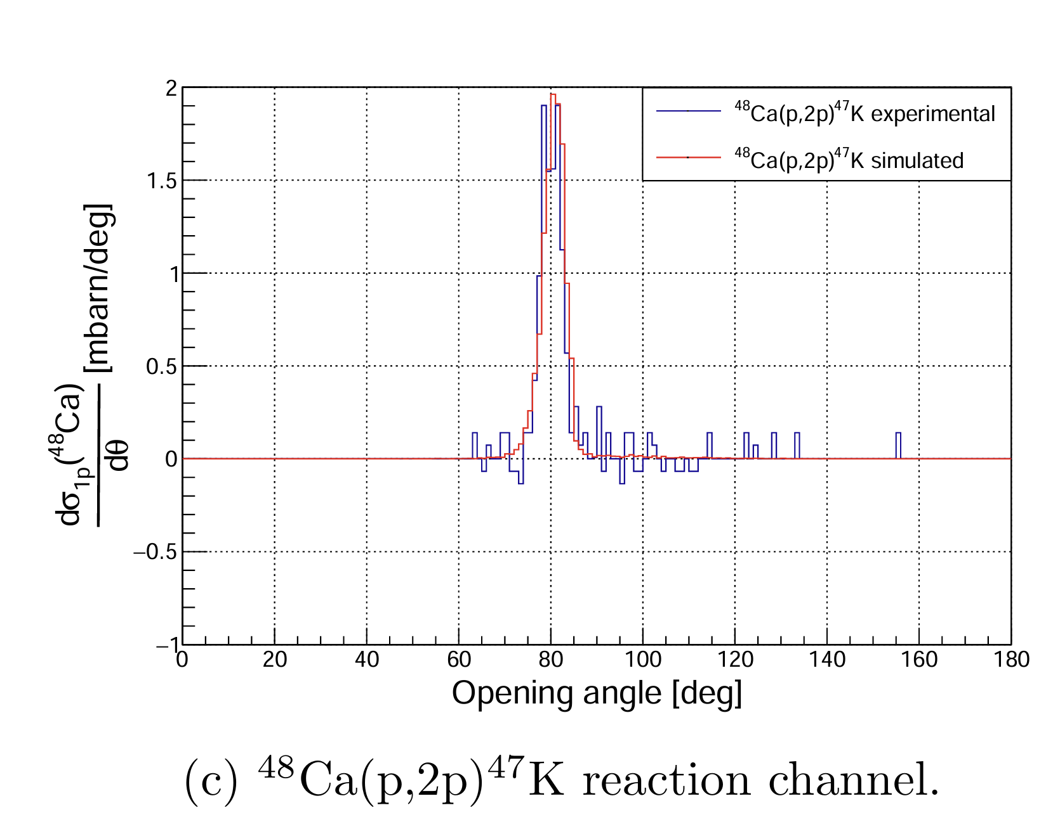
QFS – (p,2p) Opening Angle Distributions
Carbon contributions are subtracted from CH₂ target runs and then scaled by the geometrical efficiency.
Differential cross sections are then plotted and overlaid are the corresponding simulations scaled by the experimental cross section.

Slide 12
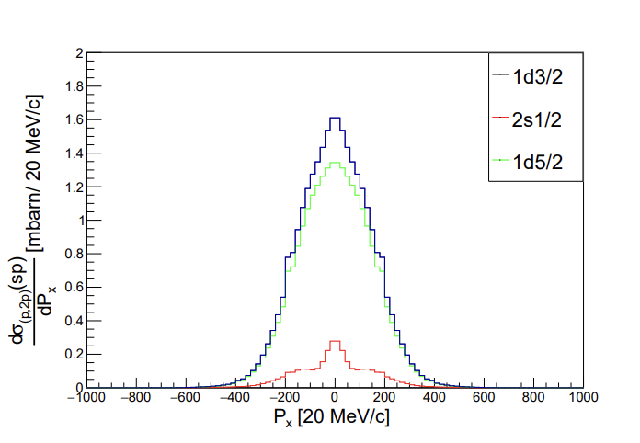
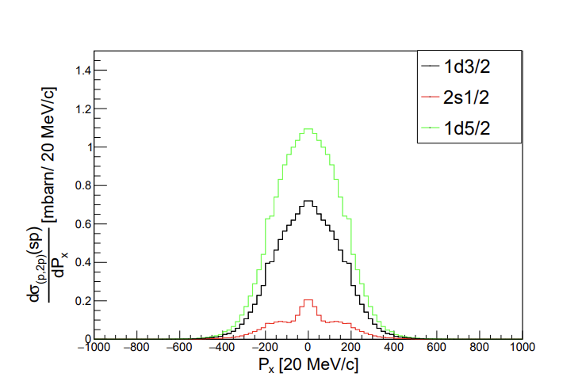
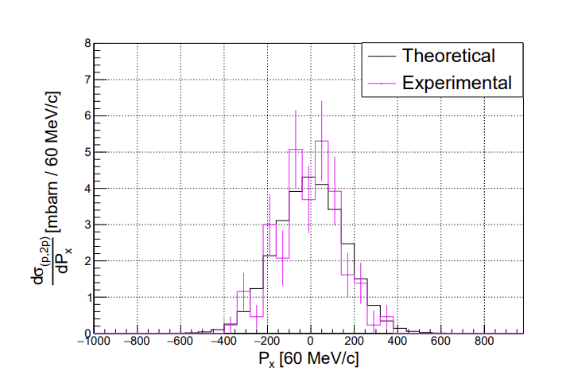
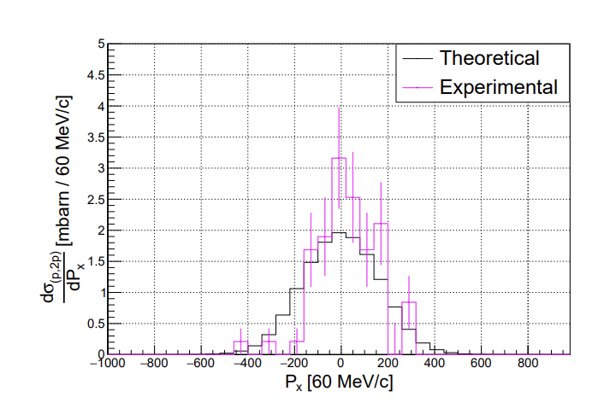
QFS (p,2p) momentum distributions
SP momentum distributions summed using occupancies from IPM.
40Ca case overlaps nicly,
⁴⁸Ca experimental distributions is narrower than theory.
x-component transverse momentum distributions

Slide 13
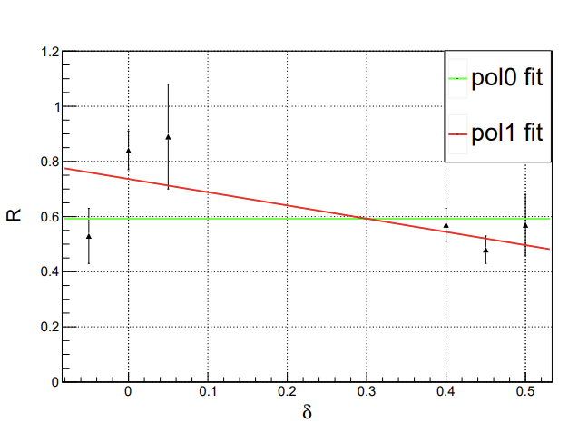
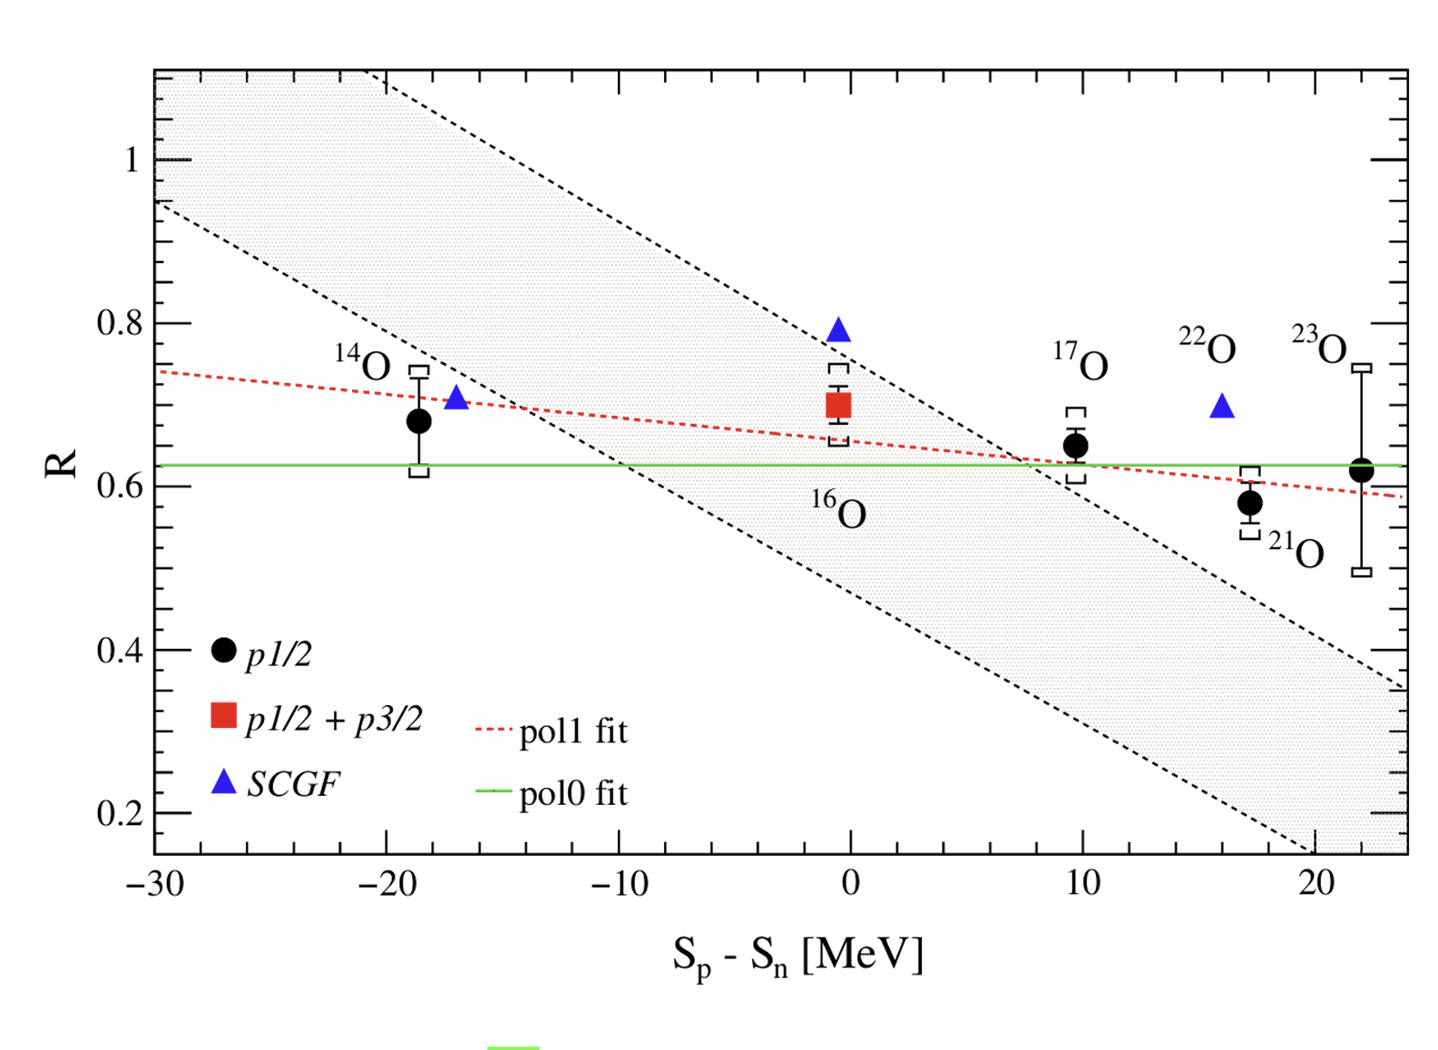
QFS Ca (p,2p) Reduction factors
Previously calculated R for ^{A}O(p,2p)^{A-1}N
Reduction factors for ^{A}Ca(p,2p)^{A-1}K
Shows very weak correlation with nuclear asymmetry.
R=Reduction factor:

Slide 14
Conclusion and outlook
Systematic study of cross sections along the calcium isotopes at ~500 MeV/u.
Agreement with Oxygen (p,2p) study by R3B
A Very weak dependence on asymmetry is found.
Tagging (p,2p) events was successful using CALIFA
Thank you for your attention
Acknowledgement for the collaboration of the s467 experiment of R³B at GSI/FAIR!

