Slide 1
Alpha-particle condensation in diluted ${}_{ }^{16}O$ at finite temperature
Miriam Davies
With: Esra Yüskel, Jean-Paul Ebran, Elias Khan, Paul Stevenson

Slide 2
Clustering and localisation
Extreme non-homogeneous distribution of nucleons within nucleus
Often associated with very large nuclear deformation values, $β_{λμ}$
Frequently found in light nuclei
Localisation is dependent on depth of confining potential [1]
Most well known (alpha) cluster state is the $0_{2}^{+}$state in ${}_{ }^{12}C$ - the Hoyle state [2][3]
${}_{ }^{20}{Ne}$
RHB (DD-ME2)
[1] J.-P. Ebran, E. Khan, T. Nikšić, and D. Vretenar, Nature 487, 341 (2012).
[2] F. Hoyle, Astrophys. J. Suppl. Ser. 1, 121 (1954)
[3] A. Tohsaki, H. Horiuchi, P. Schuck, and G. Röpke, Rev.Mod. Phys. 89, 011002 (2017).

Slide 3
Low density nuclear matter
As the density of the nucleus is decreased, transitions from homogeneous to clustered state: Mott transition
Nucleon-nucleon Cooper pairs are favoured at densities above the saturation density ($ρ>ρ_{0}$)
α-clustered states favoured at densities below the saturation density ($ρ<ρ_{0}$)
Low density matter occurs in:
Outer regions of heavy nuclei
Halo nuclei
Expanding hot matter from heavy ion collisions
Envelope of core-collapse supernovae
Low density isomers, for example ${}_{ }^{12}C$ Hoyle state ($r_{rms−Hoyle}\sim 1.5 r_{rms−gs}$)

Slide 4
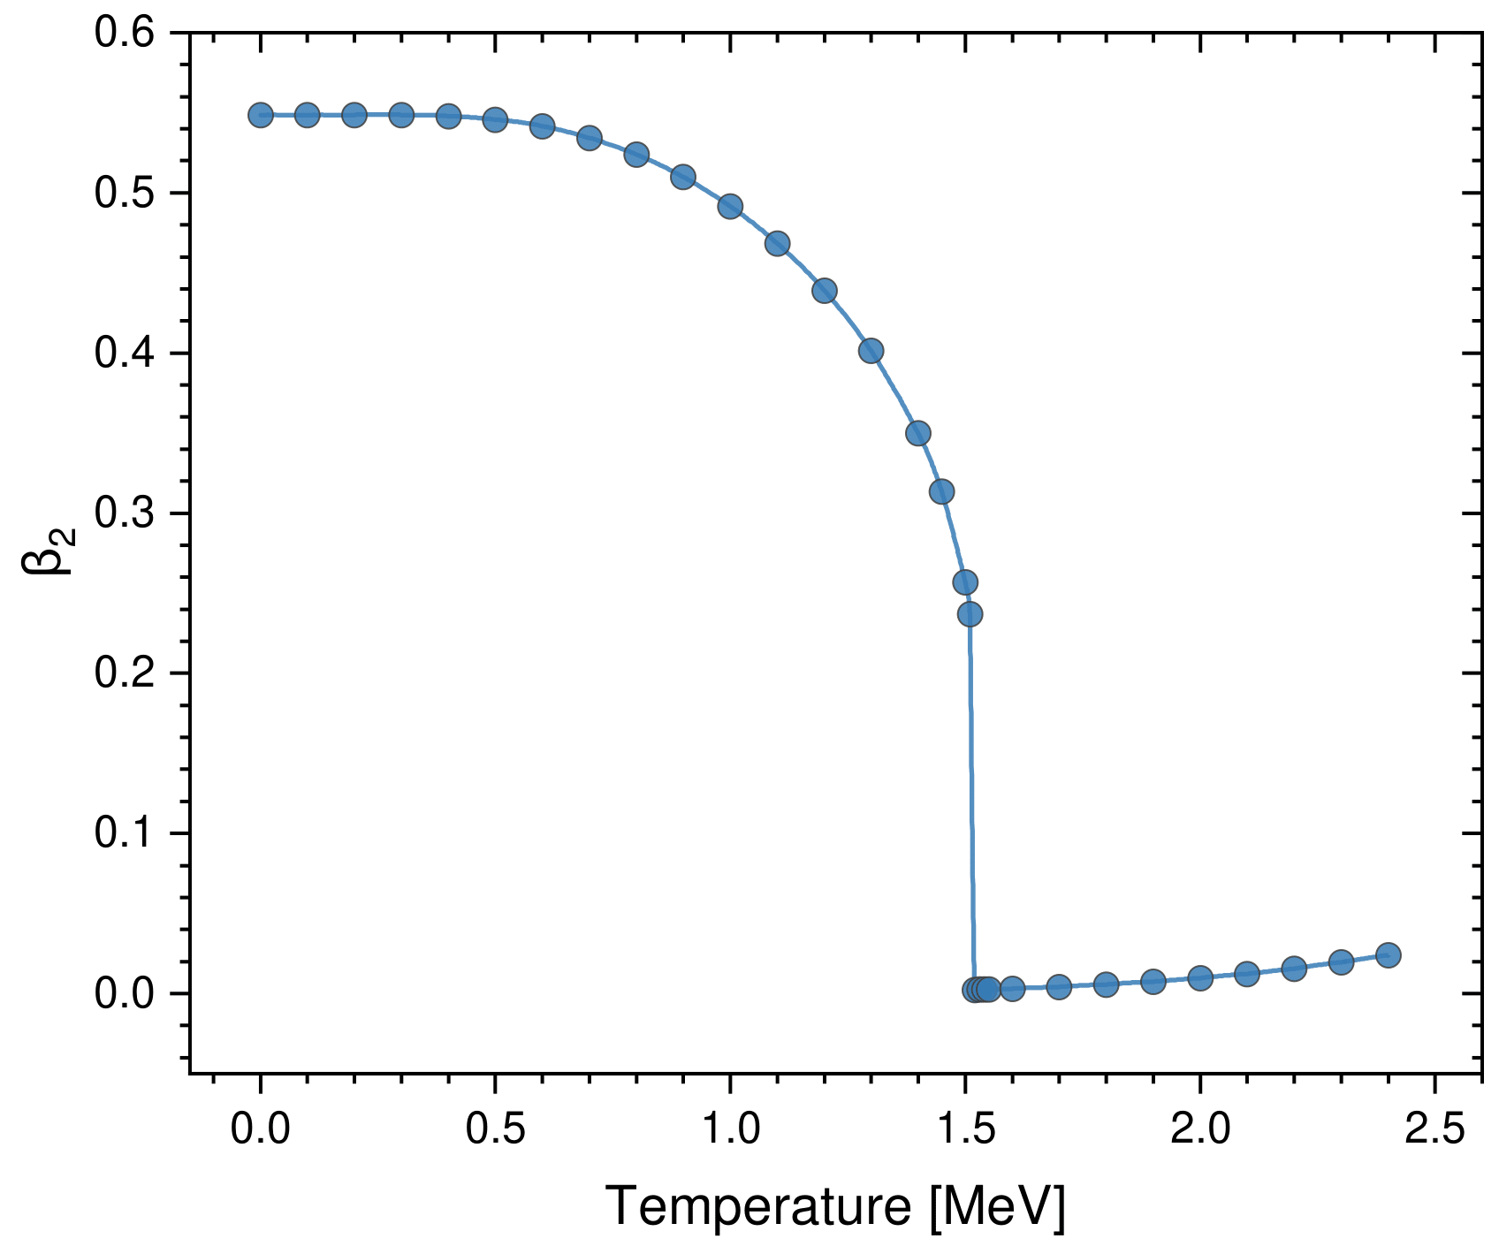
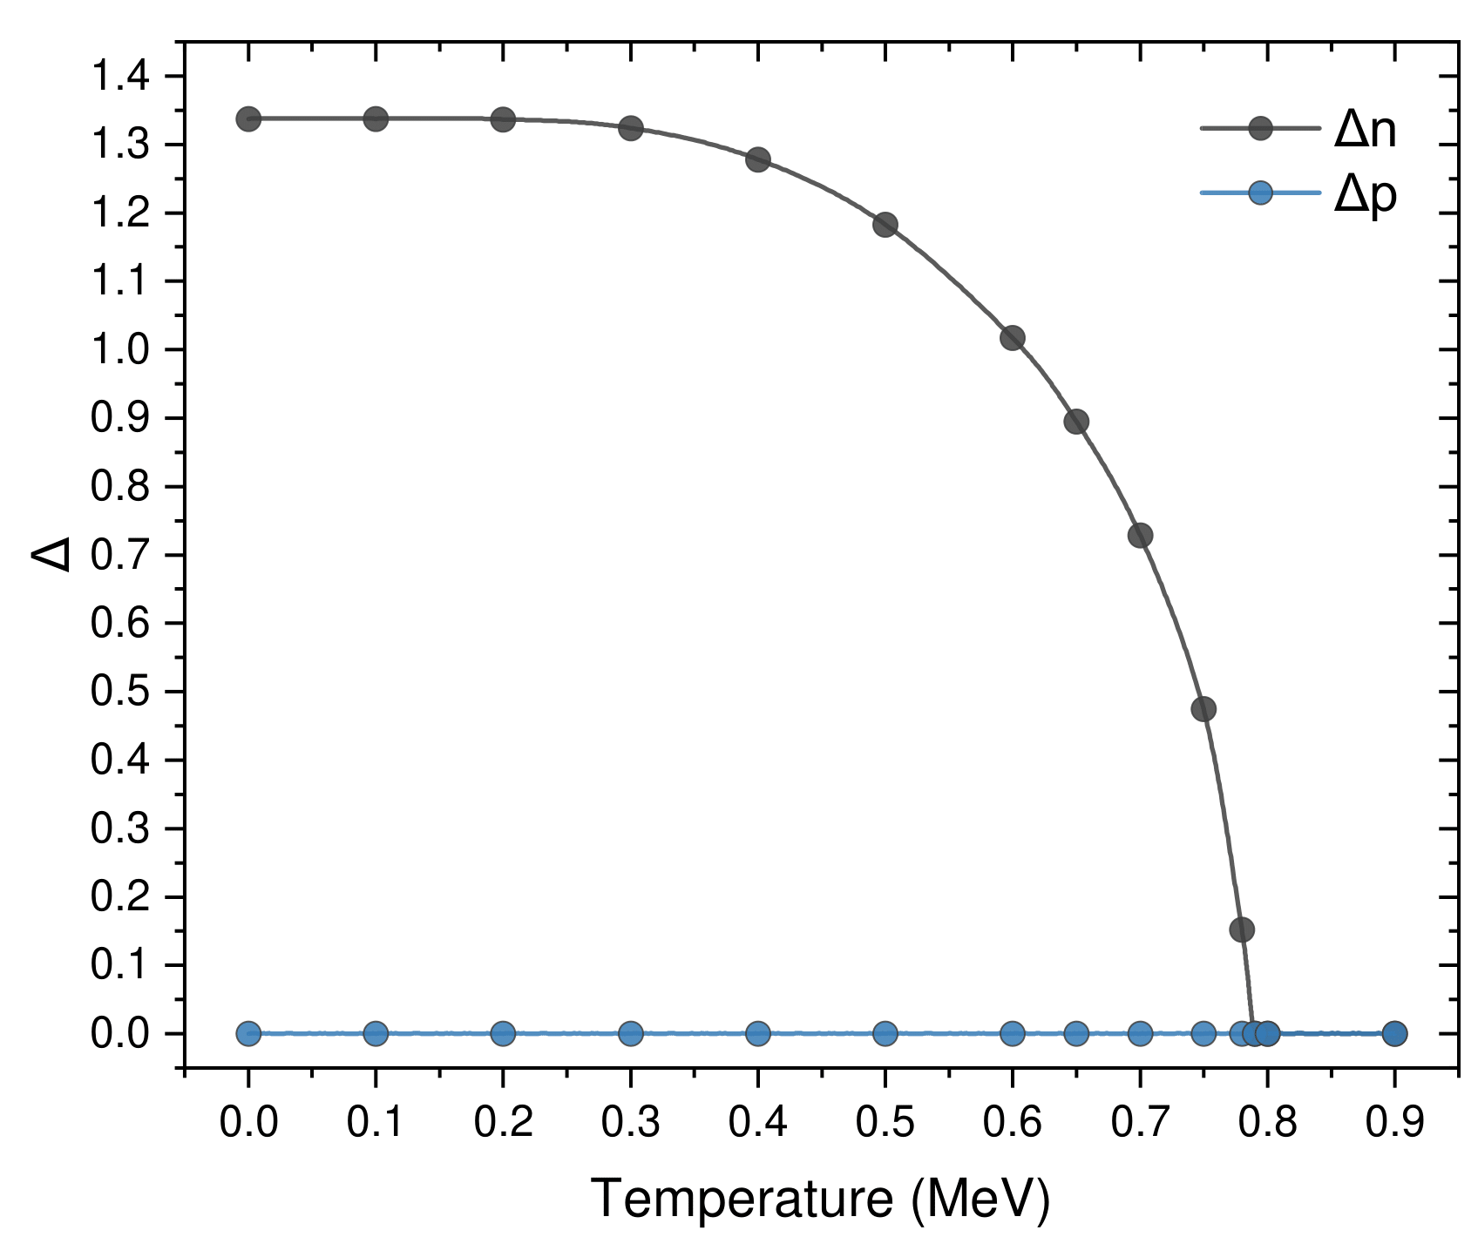
Framework
Nuclear self-consistent mean field models map the many-body problem onto a one-body problem
Exact energy density functional is approximated by simple functionals of powers and gradients of ground-state nucleon densities and currents
Finite temperature relativistic Hartree-Bogoliubov theory with DD-ME2 interaction:
Includes pairing correlations well (normal density & pairing tensor coupled)
(FT-)RHB equation: $\left(\begin{matrix}{\hat{h}}_{D}−m−λ & \hat{Δ} \\ −{\hat{Δ}}^{∗} & −{{\hat{h}}^{∗}}_{D}+m+λ\end{matrix}\right)\left(\begin{matrix}U_{k} \\ V_{k}\end{matrix}\right)=E_{k}\left(\begin{matrix}U_{k} \\ V_{k}\end{matrix}\right)$
Key difference for finite temperature is in the densities: non-zero occupation probability: $f_{k}=\frac{1}{1+e^{βE_{k}}}$
Minimise (free) energy: $F=E−TS$
Finite temperature decreases nuclear deformation due to thermal quenching
${}_{ }^{20}{Ne}$
DD-PC1
${}_{ }^{120}{Sn}$
DD-PC1

Slide 5
Framework
FT-MCRHB code developed can constrain $β_{20},β_{22},$ $β_{30},$ $β_{32}, (β_{10})$, the rms radius, and the temperature
Modified version of [4]
Quantum phase transition (QPT) to an α-clustered state established in low density ${}_{ }^{16}O$ at $T=0.0 MeV$ ($ρ\sim ρ_{0}/3$)[5][6]
Interested in the competition between cluster formation due to dilution, and loss of deformation due to increasing temperature within ${}_{ }^{16}O$
[4] T. Nikšić, N. Paar, D. Vretenar, P. Ring. Computer Physics Communications, 185(6), 2014.
[5] M. Girod, P. Schuck. Phys. Rev. Lett., 111:132503, 2013.
[6] J.-P. Ebran, M. Girod, E. Khan, R.D. Lasseri, P. Schuck. Phys. Rev. C, 102:014305, 2020.

Slide 6
${}_{ }^{16}O$: Radial Expansion
Nuclear radial density for ${}_{ }^{16}O$for $T=0.0, 2.0 MeV$ with$β_{λμ}=0$ from $r=2.60−5.00 fm$ with step size $Δr=0.10 fm$ using MC-FTRHB and DD-ME2
Ensure parameters give us physical solutions as we go to lower densities: require a smooth decrease in density
Isotropic expansion ($β_{2μ}=0$) throughout calculations

Slide 7
${}_{ }^{16}O$: Free Energy
Free energy minimised as nucleus undergoes isotropic expansion ($β_{2μ}=0$) for different temperatures
Observe QPT in nucleus
Pairing (not observed), non-axial ($β_{32}$) and axial ($β_{30}$) octupole deformation free to develop:

Slide 8
${}_{ }^{16}O$: Phase Diagram
Regions of clustering & homogeneity
Axial octupole deformation region
Doesn’t induce localisation
Small overlap for $T=3.0 MeV$
Find a critical temperature above which clustering no longer emerges: $T=4.1 MeV$

Slide 9
Alpha-particle condensation in ${}_{ }^{16}O$ at finite temperature
SUMMARY:
α-condensation occurs during isotropic inflation of the nucleus at low densities
Mott density for α-particle condensation decreases with increasing temperature
There is a critical temperature we find clustering no longer emerges
QUESTIONS?

