Slide 1
Direct Measurements of Astrophysical Reactions with Radioactive Beams
Matthew Williams
STFC Ernest Rutherford Fellow

Slide 2
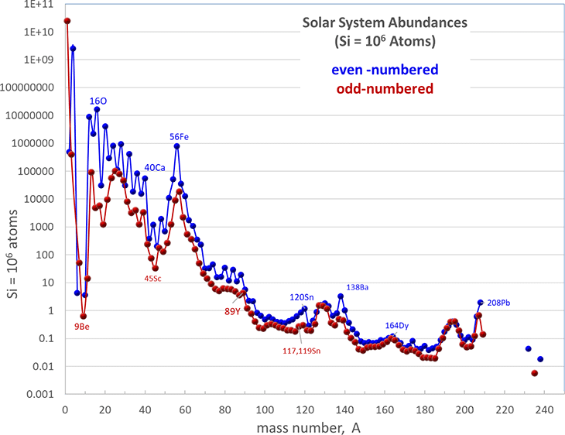
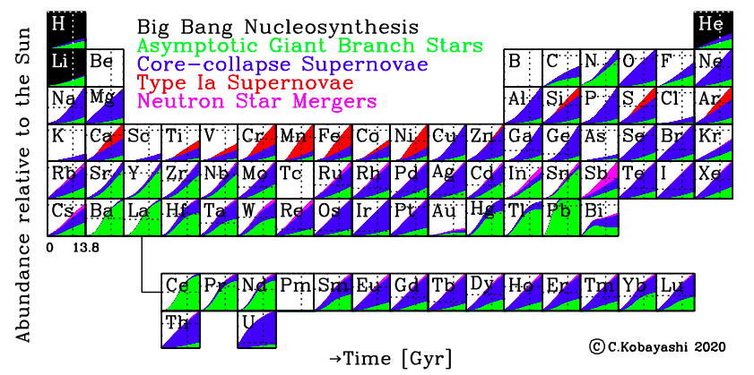
Nuclear Properties and Origin of the Elements
Chart of Solar Abundances
Most tightly bound nuclei
Peaks at neutron magic numbers
C. Kobayashi et al., ApJ 900 179 (2020)

Slide 3
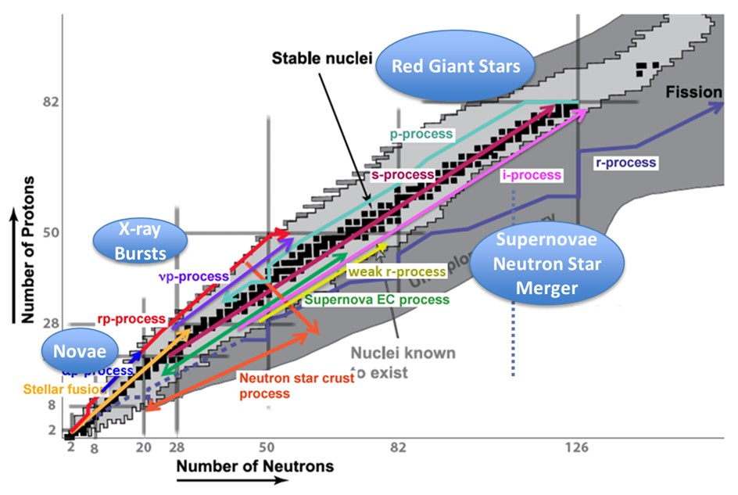
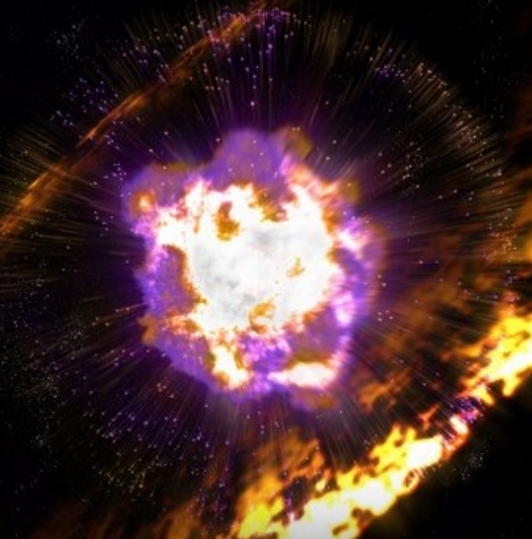
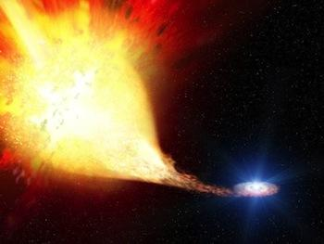

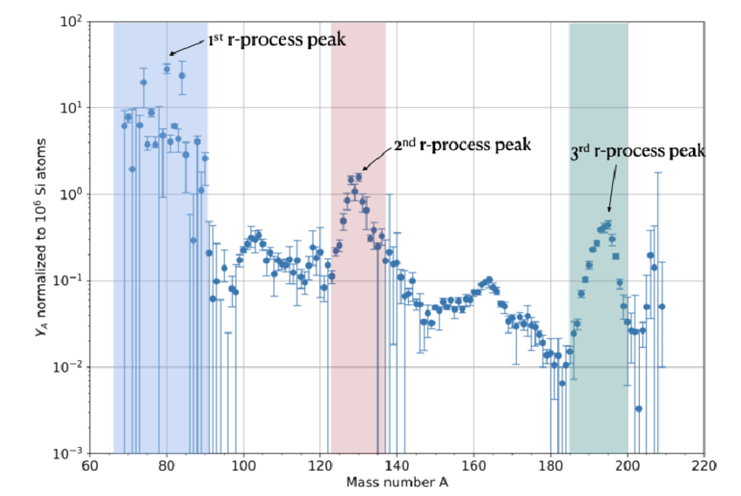
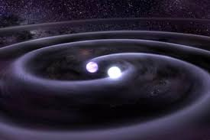
Nucleosynthesis across the nuclear landscape
Contributions to Heavy Elements
Involving radioactive nuclei
Main r-process
Weak r-process
p-process
i-process
r-process residual pattern

Slide 4
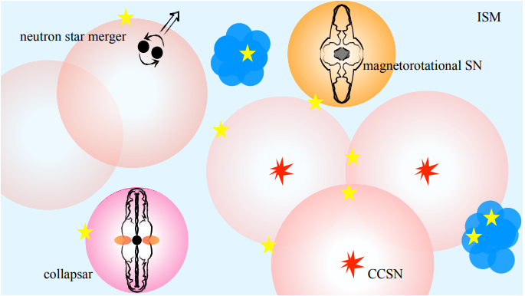
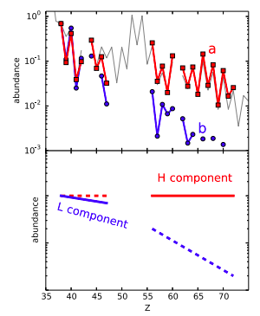
Observations from Metal-Poor Stars
Stars preserve heavy element signatures of the ISM in which they formed.
For metal poor stars perhaps only one or few rare r-process events contributed.
Standard r-process
Other process?
Many metal-poor stars show abundances that deviate from the “main” r-process pattern.
Not yet clear what other process produce this pattern let alone which sites are responsible
K. Farouqi et al. A&A 663, A70 (2022)
C. J. Hansen, F. Montes, and A. Arcones, ApJ 797, 123 (2014).

Slide 5
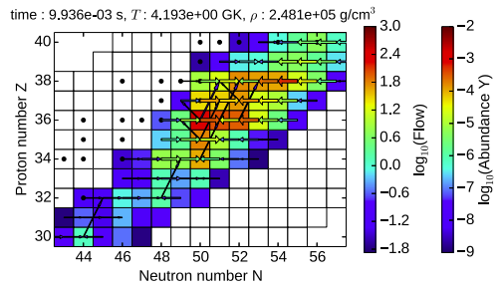
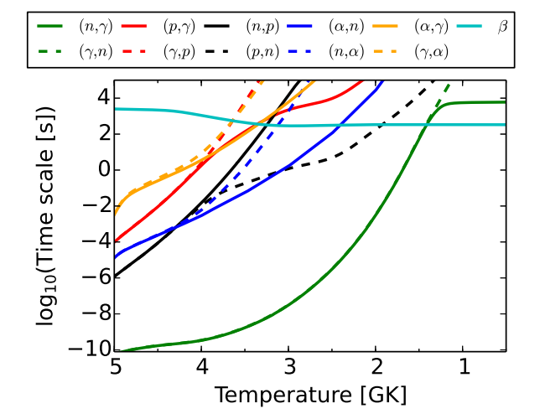
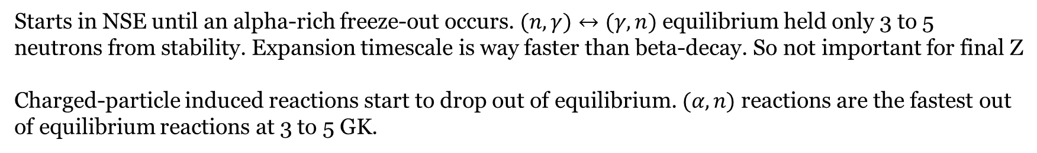
The weak r-process
Characterised by moderately neutron-rich conditions: $0.4<Y_{e}<0.49$
Candidate site in neutrino-driven winds of supernovae but may also occur in parts of NSM ejecta.
Starts in NSE until an alpha-rich freeze-out occurs. $(n,γ)↔(γ,n)$ equilibrium held only 3 to 5 neutrons from stability. Expansion timescale is way faster than beta-decay. So not important for final Z
Charged-particle induced reactions start to drop out of equilibrium. $(α,n)$ reactions are the fastest out of equilibrium reactions at 3 to 5 GK.
J. Bliss et al., J. Phys. G: Nucl. Part. Phys. 44 (2017) 054003

Slide 6
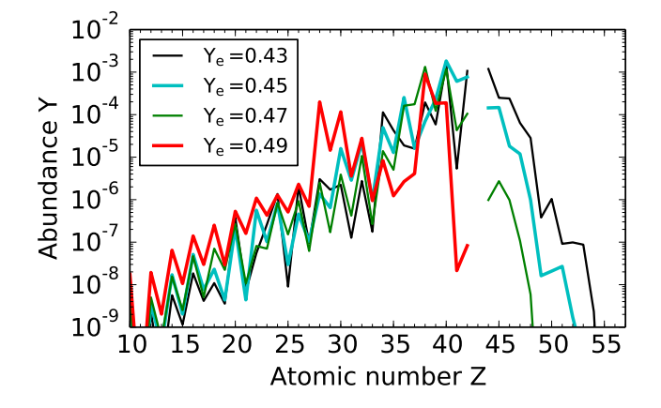
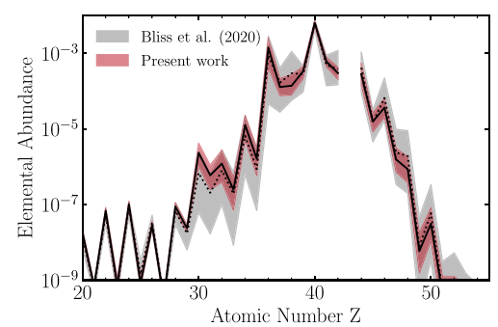
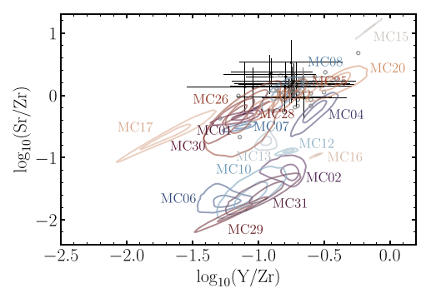
Uncertain conditions and uncertain reaction rates
Uncertainties in both the conditions in the wind and nuclear reaction rates impact final abundances
Effect on abundances is of similar order to observational uncertainties.
By constraining the nuclear reactions, observations can be used to find the matching conditions.
J. Bliss et al., J. Phys. G: Nucl. Part. Phys. 44 (2017) 054003
A. Psaltis, et al., ApJ, 935:27 11, (2022)

Slide 7
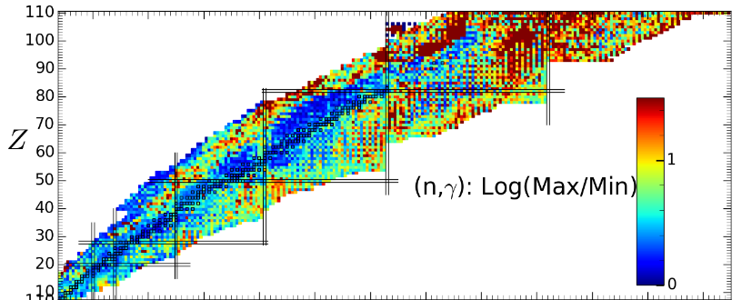
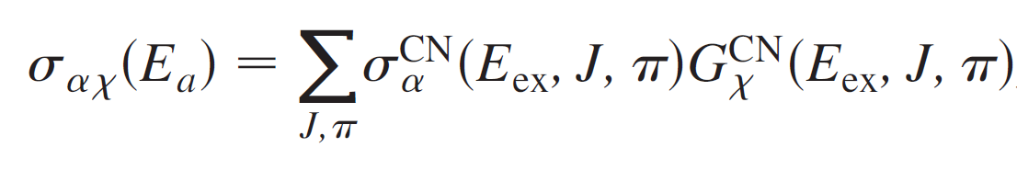
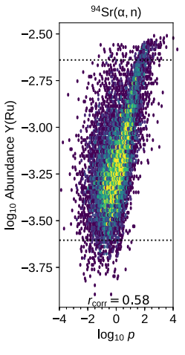
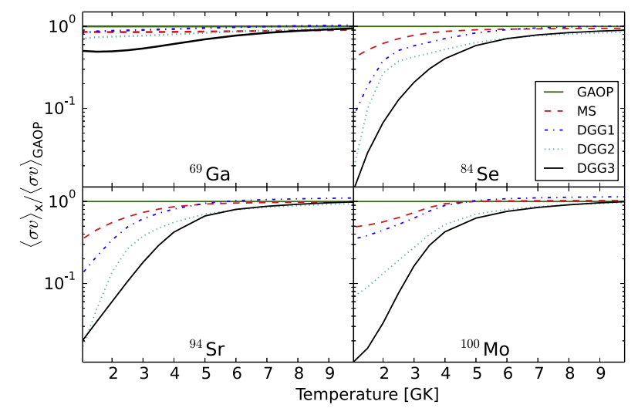
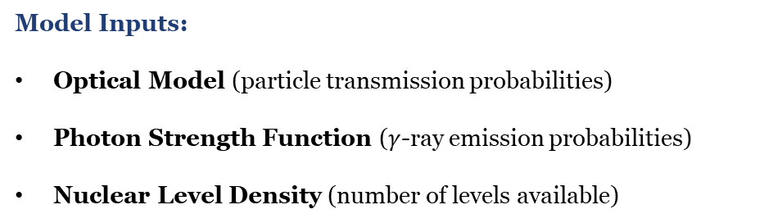
Nuclear reaction rates for heavy element synthesis
Hauser-Feshbach Model
Treat formation and decay as independent processes and represent parameters as averaged properties across many states.
Compound Nuclear (CN) Formation cross-section
CN Decay branching ratio
Model Inputs:
Optical Model (particle transmission probabilities)
Photon Strength Function ($γ$-ray emission probabilities)
Nuclear Level Density (number of levels available)
Nucleosynthesis calculations have shown that key weak r-process markers are correlated strongly with changes in reaction rates

Slide 8
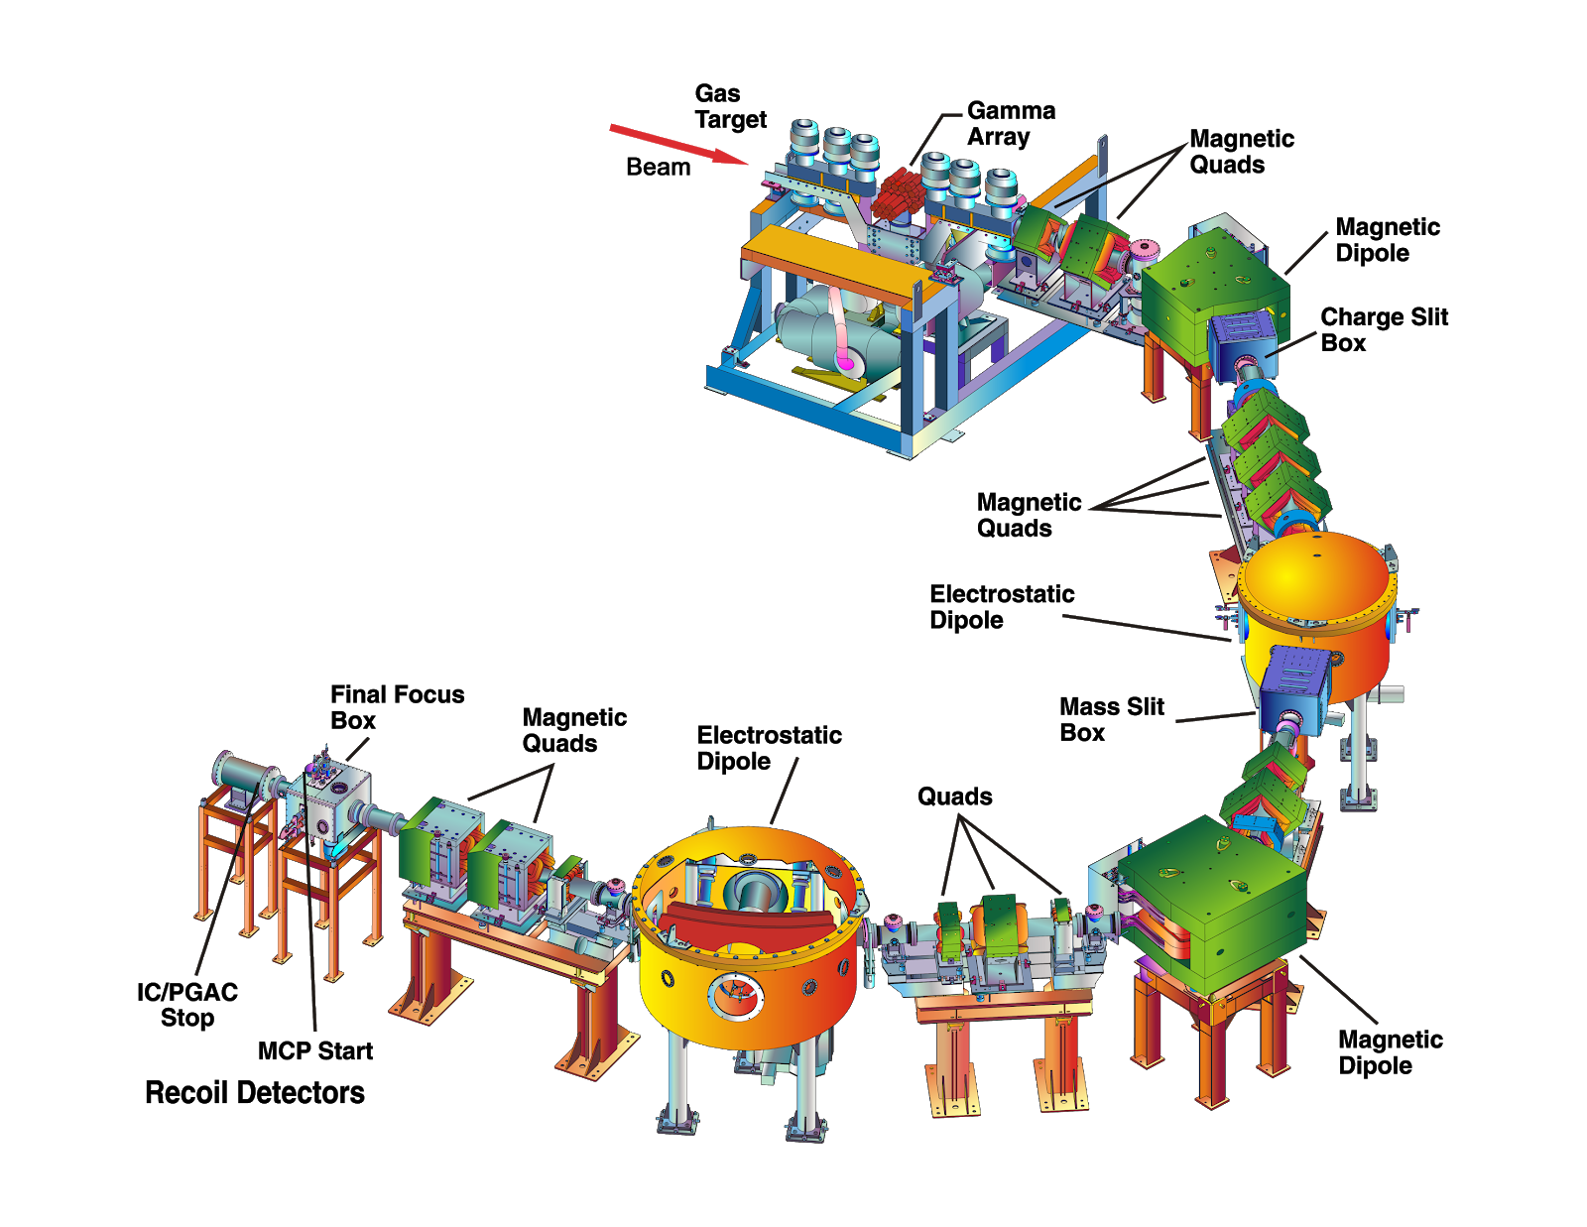
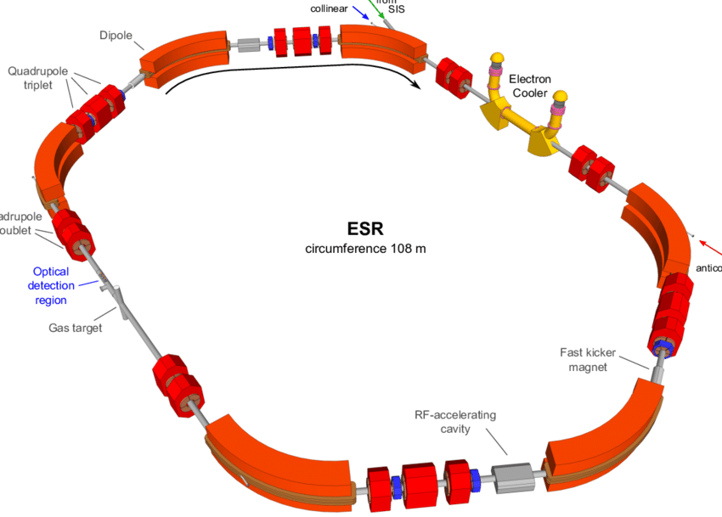
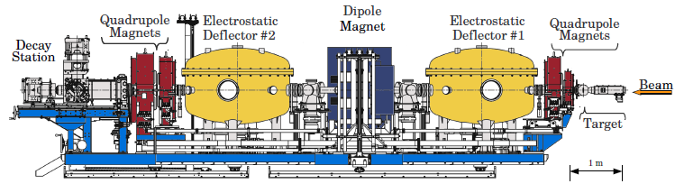
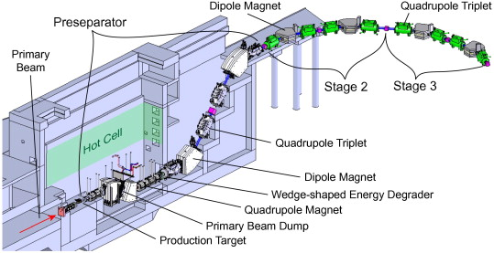
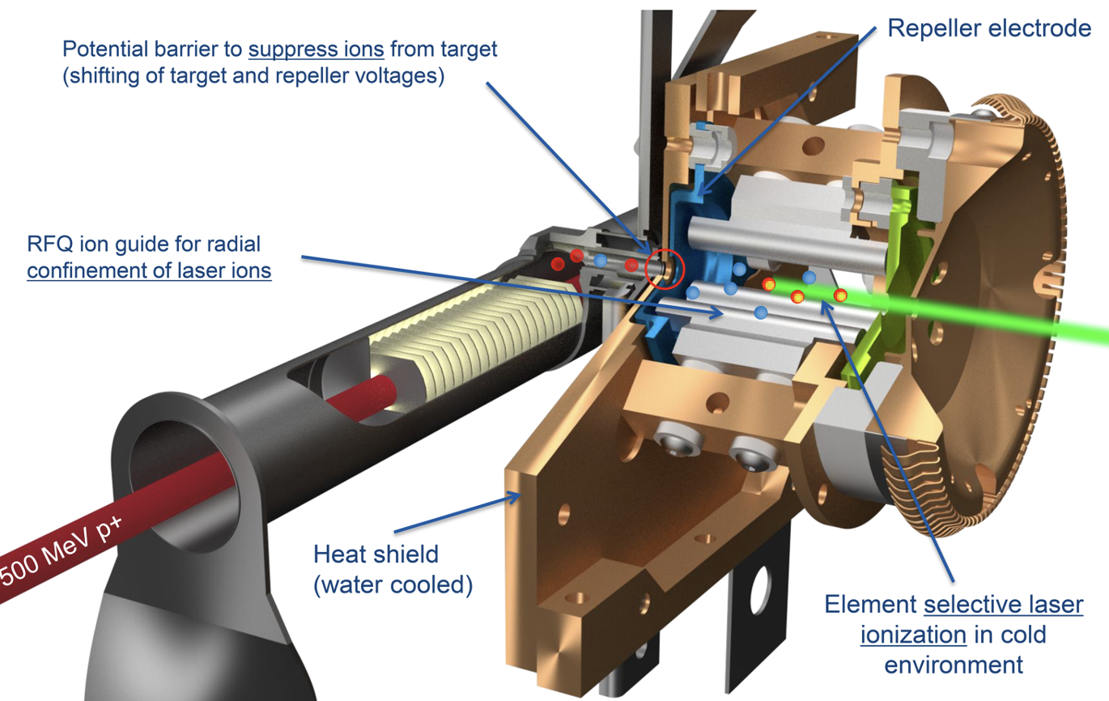
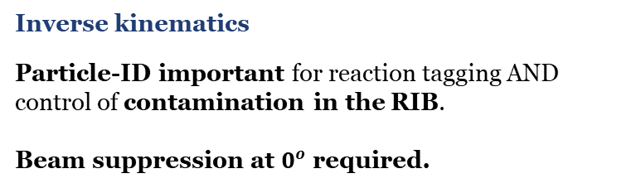
Experimental Challenges
Inverse kinematics
Particle-ID important for reaction tagging AND control of contamination in the RIB.
Beam suppression at $0^{o}$ required.
RIB Production
ISOL
ISOL can deliver intense beams (chemistry dependent)
Post-acceleration techniques are well-established to access required energy range of 1.5 to 3 MeV/u
Fragmentation
Difficult to access required energy range with high enough beam intensity
RIB Beam Production Methods
Direct Measurements with Radioactive beams A>60:
3
Two of which published this year!

Slide 9

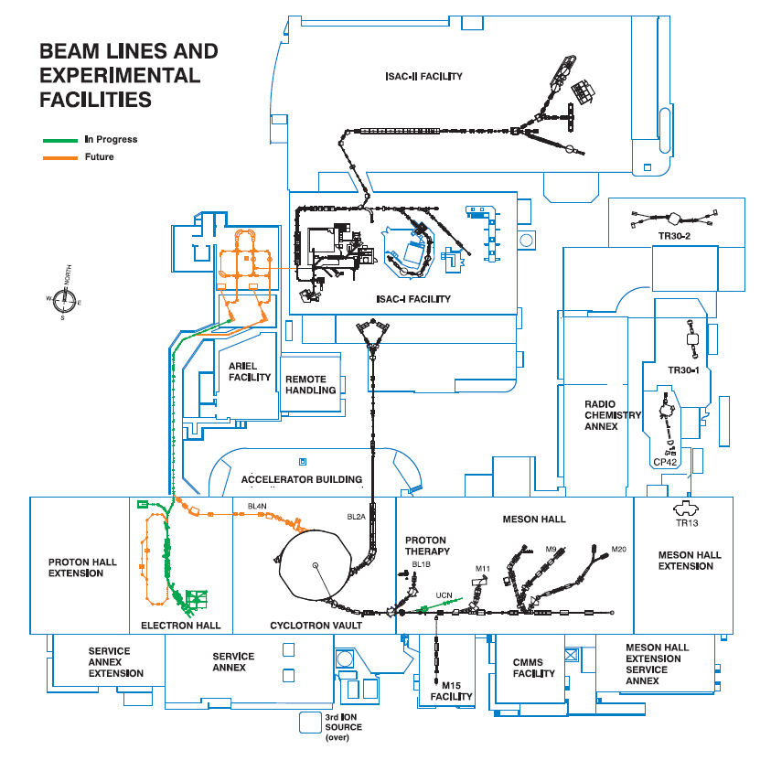
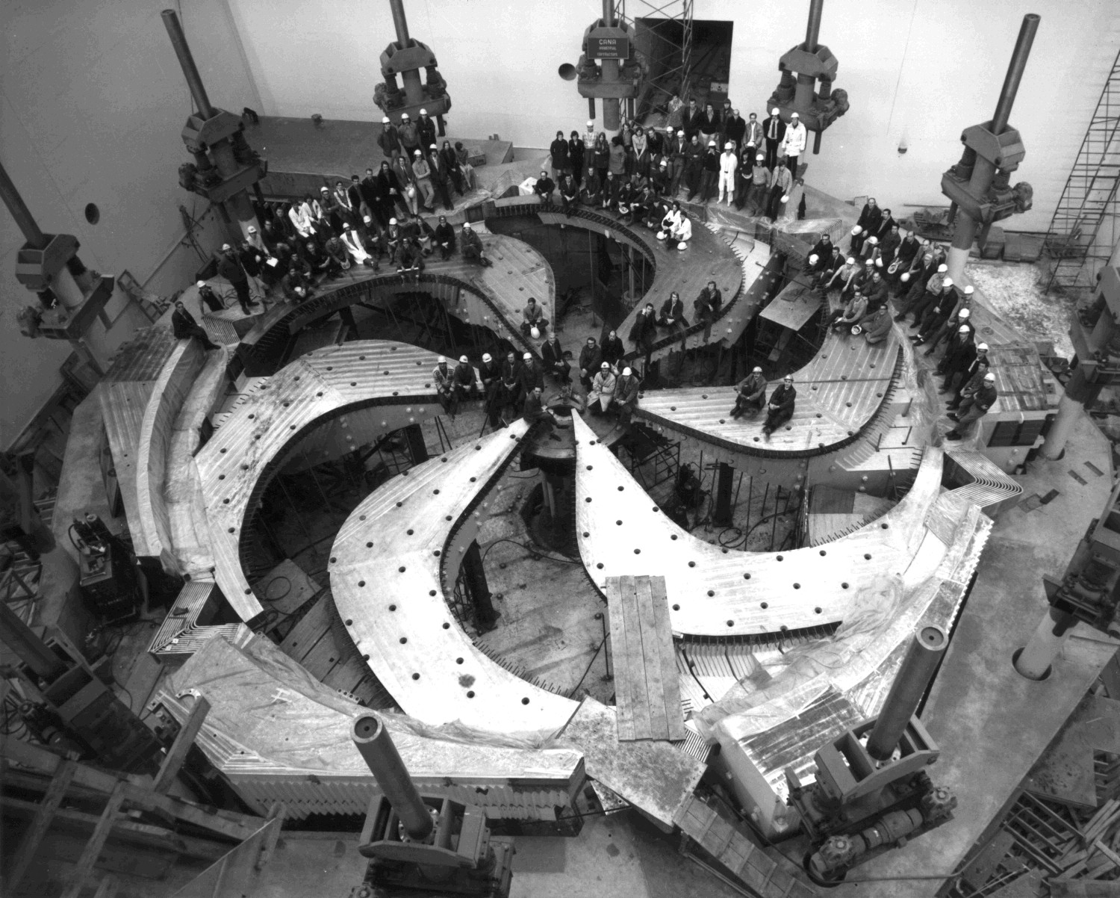


The TRIUMF Laboratory
University of British Columbia
TRIUMF

Slide 10
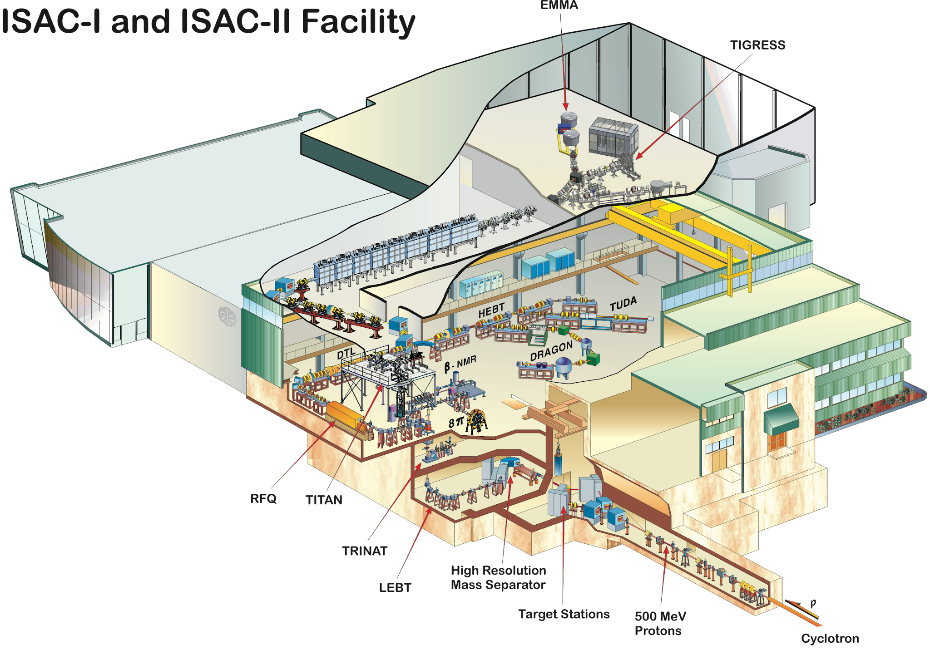
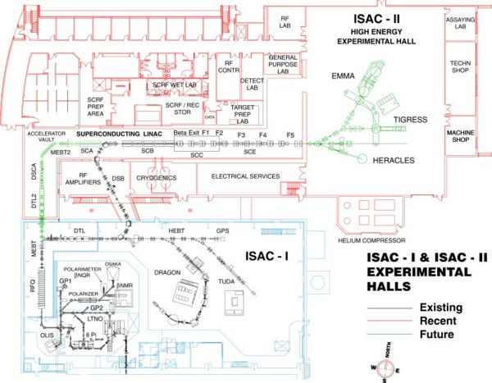
The Isotope Separator and Accelerator (ISAC) Facility

Slide 11
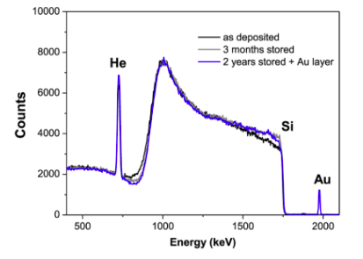
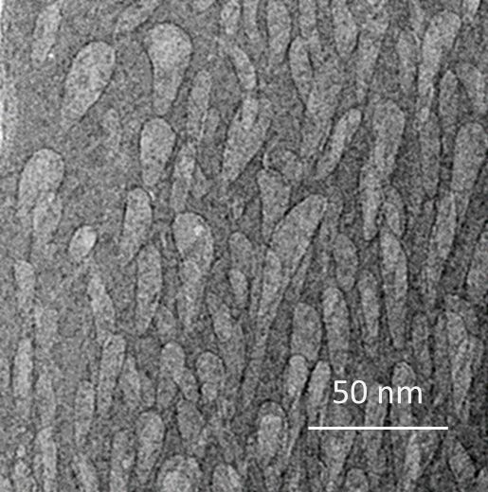
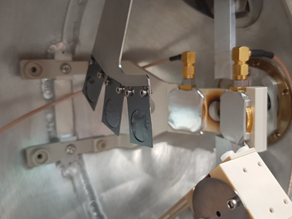
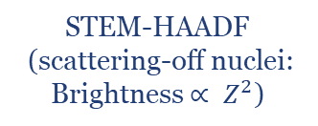
New Target Material to Measure $α$-induced Reactions
Using a radioactive beam means we need to use helium (a noble gas) as a target.
Gas Targets: Require windows and/or large pumping infrastructure. Limits space for detectors. Not compact.
He-implanted Metallic Foils: Low number density, not very uniform, known to lose He-content quickly with beam exposure.
Novel Si:He Nanomaterial Targets:
Silicon thin-films grown via sputtering technique using helium as the processing gas. Helium collects in nanoscale pores that permeate the whole target. We found that using a thin aluminium backing foil improved mechanical stability.
High helium content up-to 7 x 10¹⁸ atoms/cm²
Uniform target content.
Retains He content while in storage.
STEM-HAADF
(scattering-off nuclei: Brightness $∝ Z^{2}$)
Characterised by proton elastic backscattering
Traditional TEM
V. Godinho, et al., ACS Omega 2016, 1, 1229−1238
Asuncion Fernandez, Private Communication

Slide 12
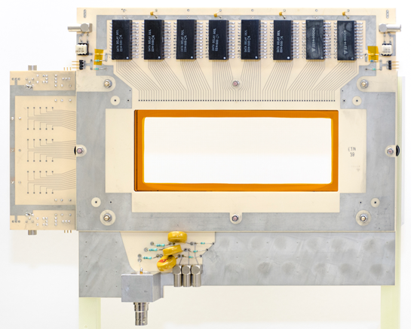
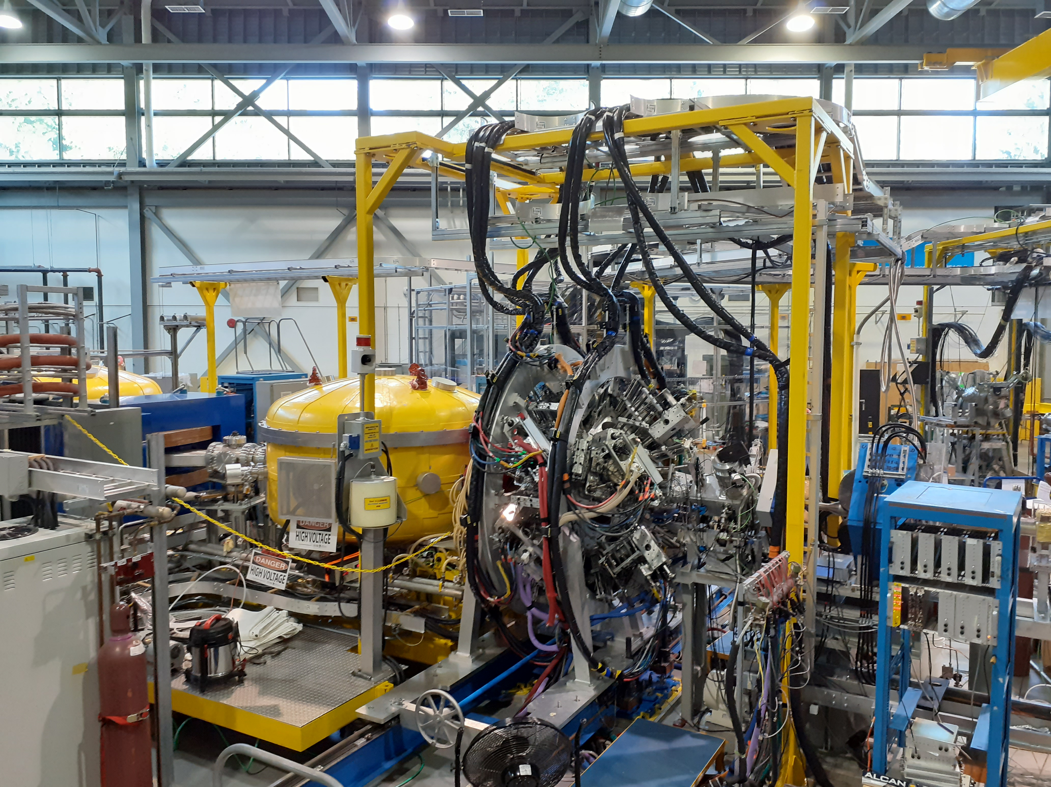
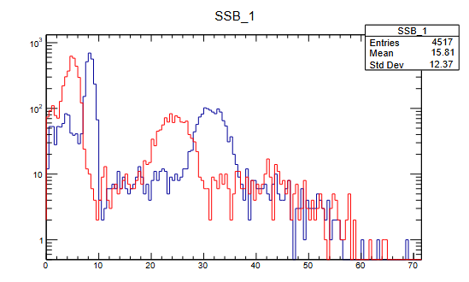
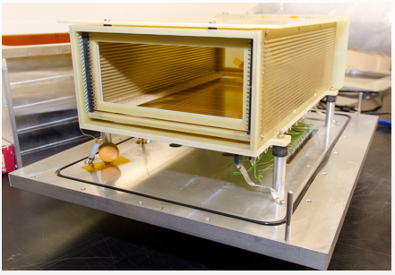
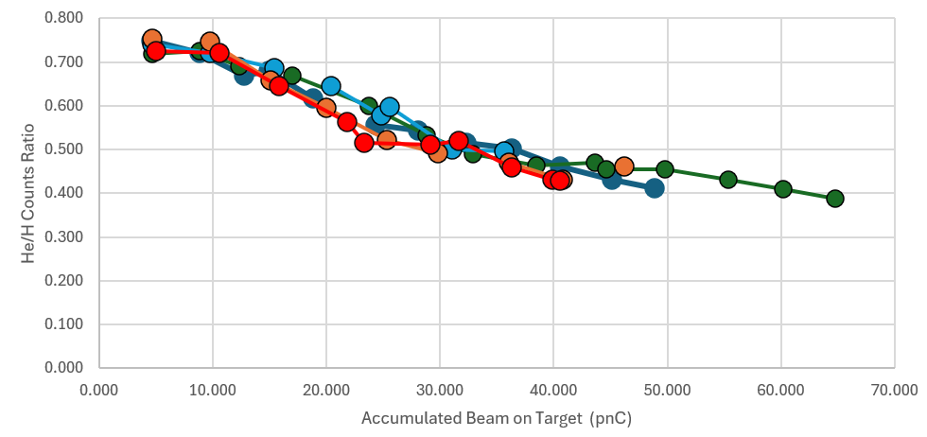


The EMMA+TIGRESS Set-up
PGAC
Use EMMA to suppress unreacted beam at zero degrees
TIGRESS searches for coincident $γ$-rays in the final nucleus of interest
Ion Chamber
Helium in each SSB
Ion-implanted Silicon
Monitor target content by detecting scattered helium with two SSB detectors at 20 degrees.
Helium content decreased with accumulated charge. But returned to same value when illuminating a fresh spot.
Indicates uniform content – as expected!
B. Davids, M. Williams, et al., NIMA 930 (2019) 191–195
G. Hackman, C. Svensson. Hyperfine Interact (2014) 225:241–251

Slide 13
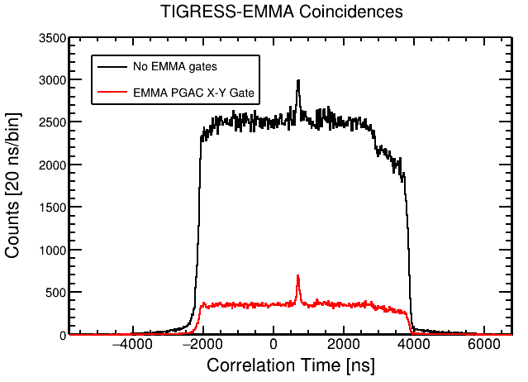
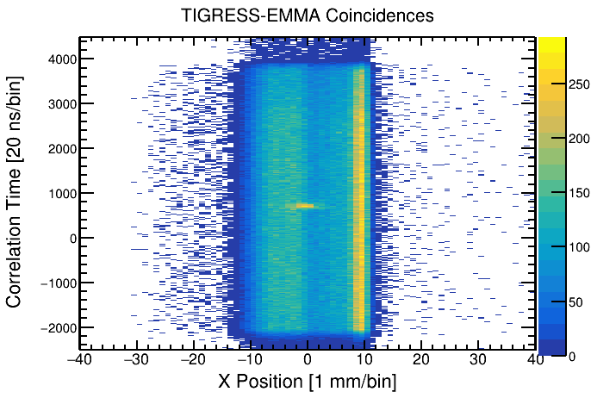
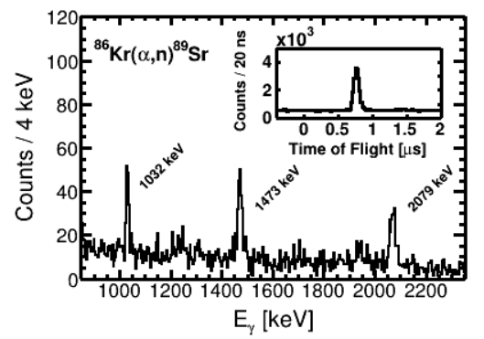
Test Measurement of ⁸⁶Kr(α,n)⁸⁹Sr
Measured the ⁸⁶Kr(α,n)⁸⁹Sr reaction at two energies: 10.4 and 8.3 MeV in centre of mass.
Correspond to the centre of the (classical) Gamow window at ~5 GK and ~4 GK.
TIGRESS-EMMA ToF peak clearly seen. Signal to background improved by gating on central X-position.
Several prominent γ-rays in ⁸⁹Sr are observed, from which partial cross-sections can be easily extracted.
M. Williams, et al., Phys. Rev. Lett. 134, 112701 (2025)

Slide 14
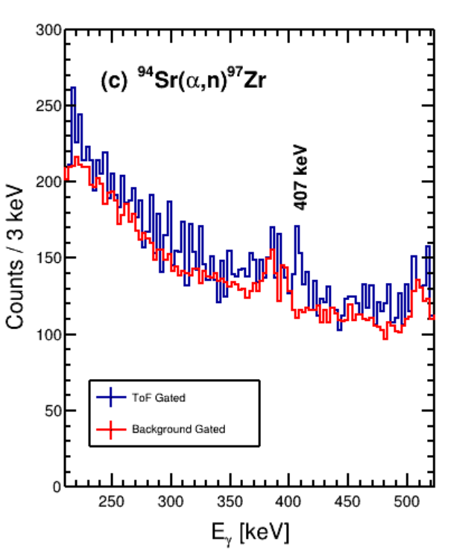
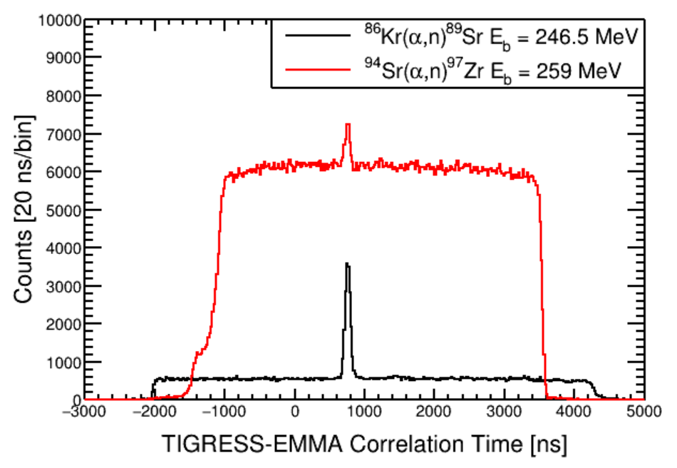
Study of ⁹⁴Sr(α,n)⁹⁷Zr using EMMA+TIGRESS
Higher background in RIB due to random coincidence with decays from scattered beam deposited in target chamber. Doppler-shifted stopped lines then obscure many ⁹⁷Zr transitions.
Nonetheless, able to see the 407-keV transition in ⁹⁷Zr. Allows partial cross-section measurement
M. Williams, et al., Phys. Rev. Lett. 134, 112701 (2025)

Slide 15
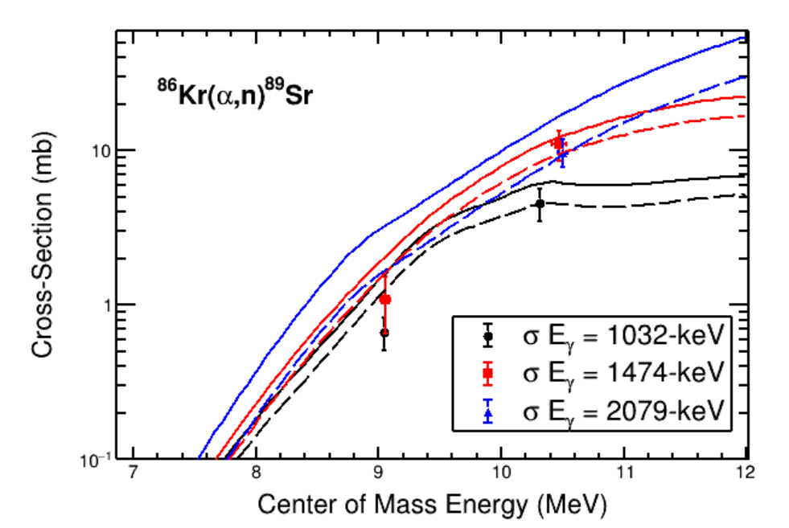
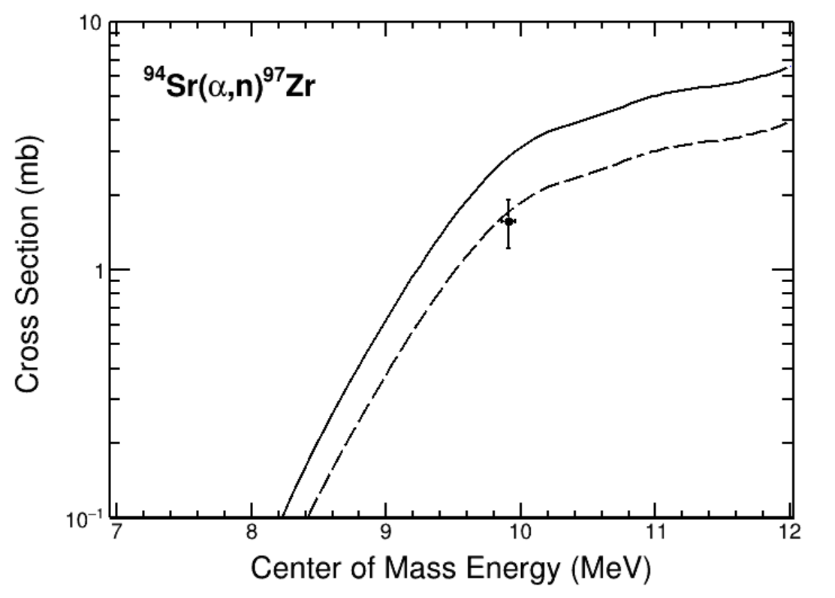
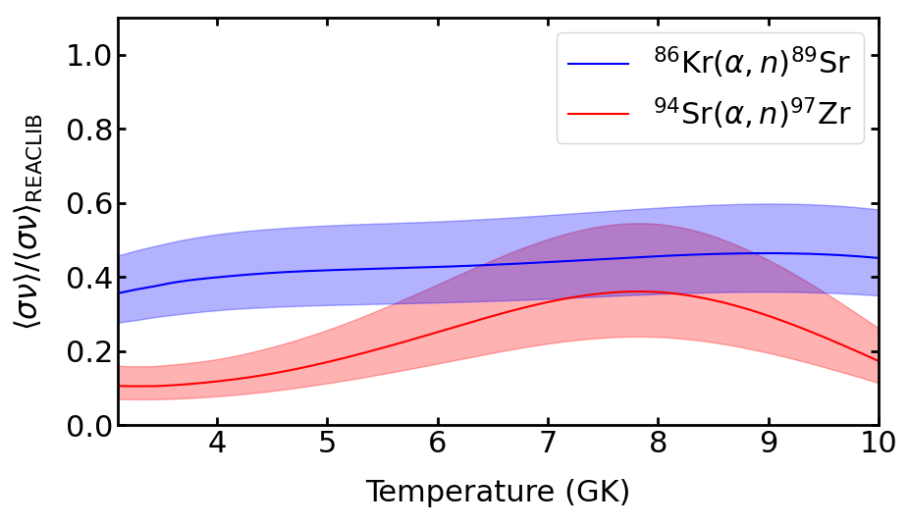
First measurement of a weak r-process reaction with radioactive beam.
⁸⁶Kr(α,n) & ⁹⁴Sr(α,n) – ~60 % of default TALYS
Both ⁸⁶Kr(α,n) and ⁹⁴Sr(α,n) are lower than prediction assuming default TALYS v2.0
⁹⁴Sr(α,n) rate is a factor 5 to 10 lower than REACLIB at weak r-process temperatures.
This will reduce the abundance of ruthenium, which has been identified as a key marker for the weak r-process.
First measurement of a weak r-process reaction with RIB and demonstration of Si:He targets
Opens-up more possibilities for the future!
M. Williams et al., Physical Review Letters (Accepted)
J. Bliss et al., Phys. Rev. C 101, 055807 (2020).

Slide 16
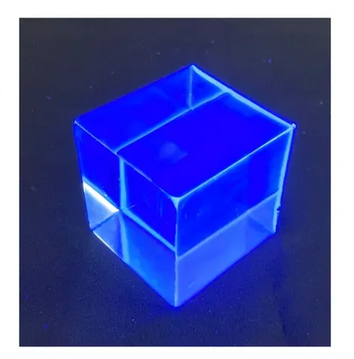
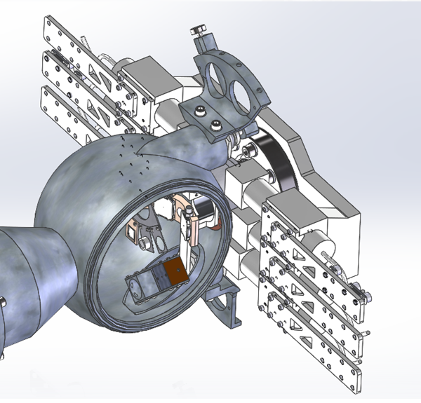
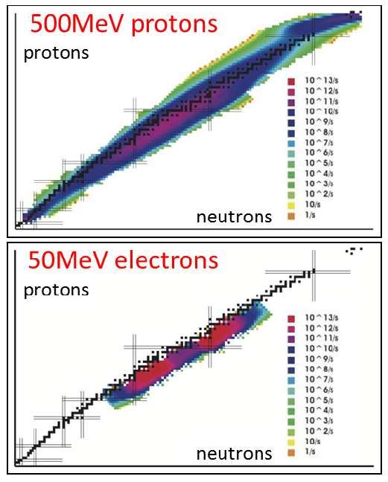

What next? Neutron Detectors & ARIEL (Advanced Rare Isotope Laboratory)
Organic Glass Scintillators
ARIEL
Electron Linac to induce photofission of uranium
Peak production rates in neutron-rich region of interest for weak r-process.

Slide 17



Direct Measurements with radioactive beams at FRIB
Astrophysical Energies in ReA3 Hall
FRIB beams are stopped in a gas catcher, extracted, charge-bred, and then reaccelerated through a superconducting linac.
Maximum extraction intensity is on the low-end for direct measurements (<10⁷) – especially for radiative capture. Efficiency worse for low Z
In the future there will be a solid stopper and ion source that will allow higher intensities to be reached.

Slide 18



The SECAR Facility at FRIB
JENSA Gas-Jet
Extended Gas Target

Slide 19






p-process studies with SECAR
~30 stable isotopes cannot be produced by neutron capture processes.
Light p-nuclei sensitive to $(p,γ)$ rates on radioactive nuclei.
Only one measurement of a $(p,γ)$ on a radioactive nucleus involved in the p-process.
Measured using EMMA+TIGRESS
Efficiency very low and EMMA not ideal separator for beam suppression
Observed abundances from pre-solar grains
First approved direct measurement with RIB at SECAR to measure light p-process reactions
G. Lotay, S. Gillespie, M. Williams, et al., Phys. Rev. Lett. 127, 112701
M. Williams, et al., Phys. Rev. C 107, 035803 (2023).
E23054 FRIB PAC2 PI: M. Williams

Slide 20
Summary
Direct measurements with radioactive beams heavier than iron are scarce with the first measurements of weak r-process and p-process reactions using radioactive beams made only in the last few years.
New facilities (ARIEL, FRIB, SECAR, Storage rings) and equipment (Nanomaterial Targets, New neutron detectors) are now able to overcome these past challenges.
Further studies are being planned to provide the required nuclear data to understanding nucleosynthesis in extreme environments including how the heavy elements emerged.

Slide 21















Slide 22




Recent Experimental Efforts
Significant experimental work on $(α,n)$ reactions have been pursued by the ATOMKI group (not just motivated by the weak r-process) to test and refine the $α$ optical model.
Most work at ATOMKI follows the activation technique after bombardment of targets with alpha beams.
Experiments in inverse kinematics have also been carried out instead using inverse kinematics. MUSIC ion chamber can identify total $(α,xn)$ reactions.
No radioactive beam experiments yet published!
G. G. Kiss et al., ApJ 908 202 (2021)
C. Fougeres, et al., Phys. Rev. C 109, 065805 (2024)
W-J. Ong, et al., Phys. Rev. C 105, 055803

Slide 23



Astrophysical impact of ⁸³Rb$(p,γ)$⁸⁴Sr measurement
Impact investigated for both Type II and Type Ia supernovae explosions
Lower ⁸³Rb$(p,γ)$⁸⁴Sr cross-section leads to less efficient destruction of the ⁸⁴Sr p-nucleus in supernovae, raising its production factor.
The total uncertainty in ⁸⁴Sr production is reduced by a factor of 2 from previous sensitivity study.
Uncertainties represent the combined effect of all reaction rates variations – not just ⁸³Rb$(p,γ)$⁸⁴Sr.
Abundance enhancement not sufficient to explain enhanced ⁸⁴Sr seen in Allende Meteorite but could relieve tension – full GCE simulations required!
15 $M_{⊙}$ CCSNe = +30 %
25 $M_{⊙}$ CCSNe = +12 %
Type 1a SNe = +32 %
M. Williams, et al., Phys. Rev. C 107, 035803 (2023).
Astrophysical modeling by N. Nishimura

