Slide 1
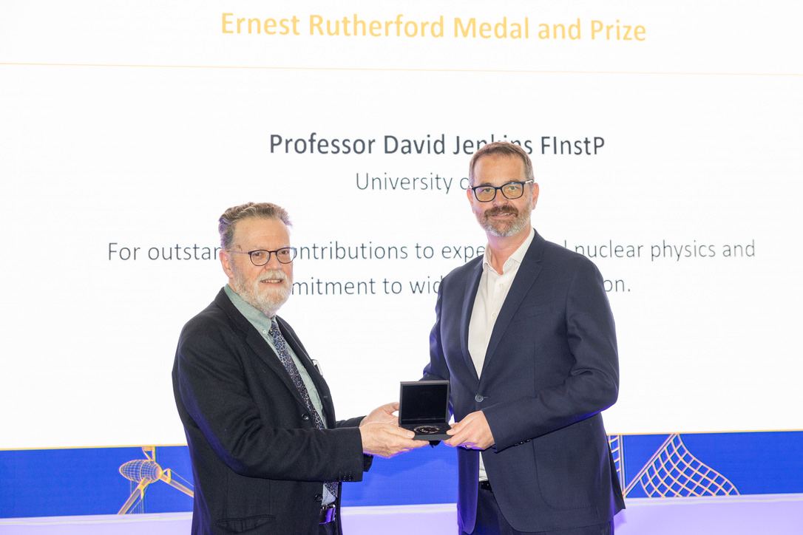



Data driven approaches to learning about nuclear structure
David Jenkins

Slide 2
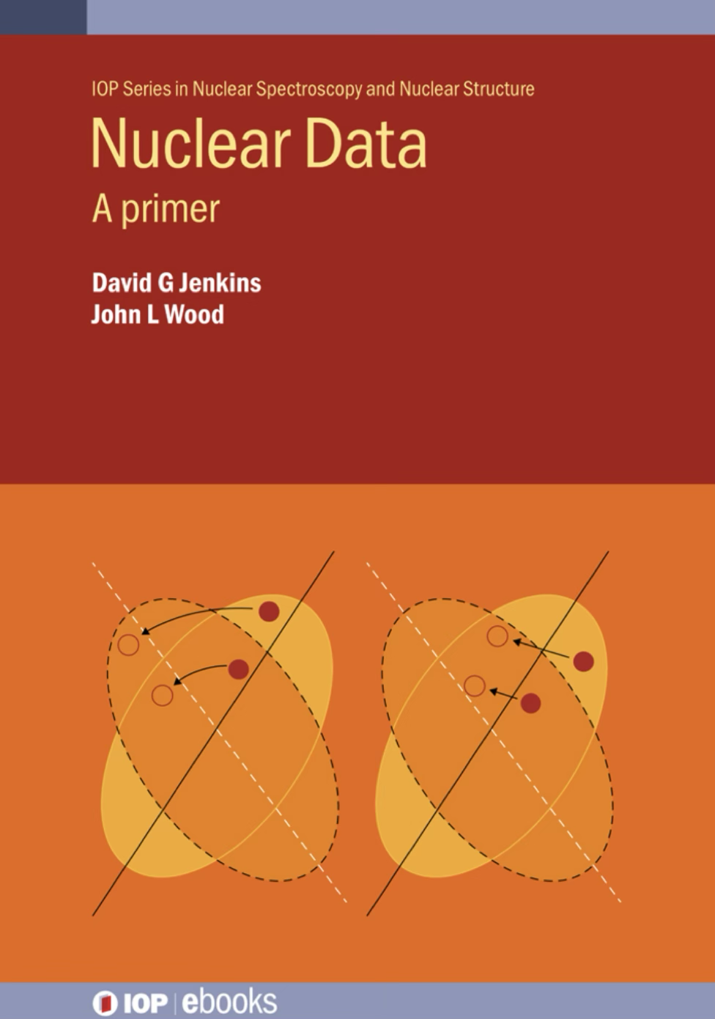
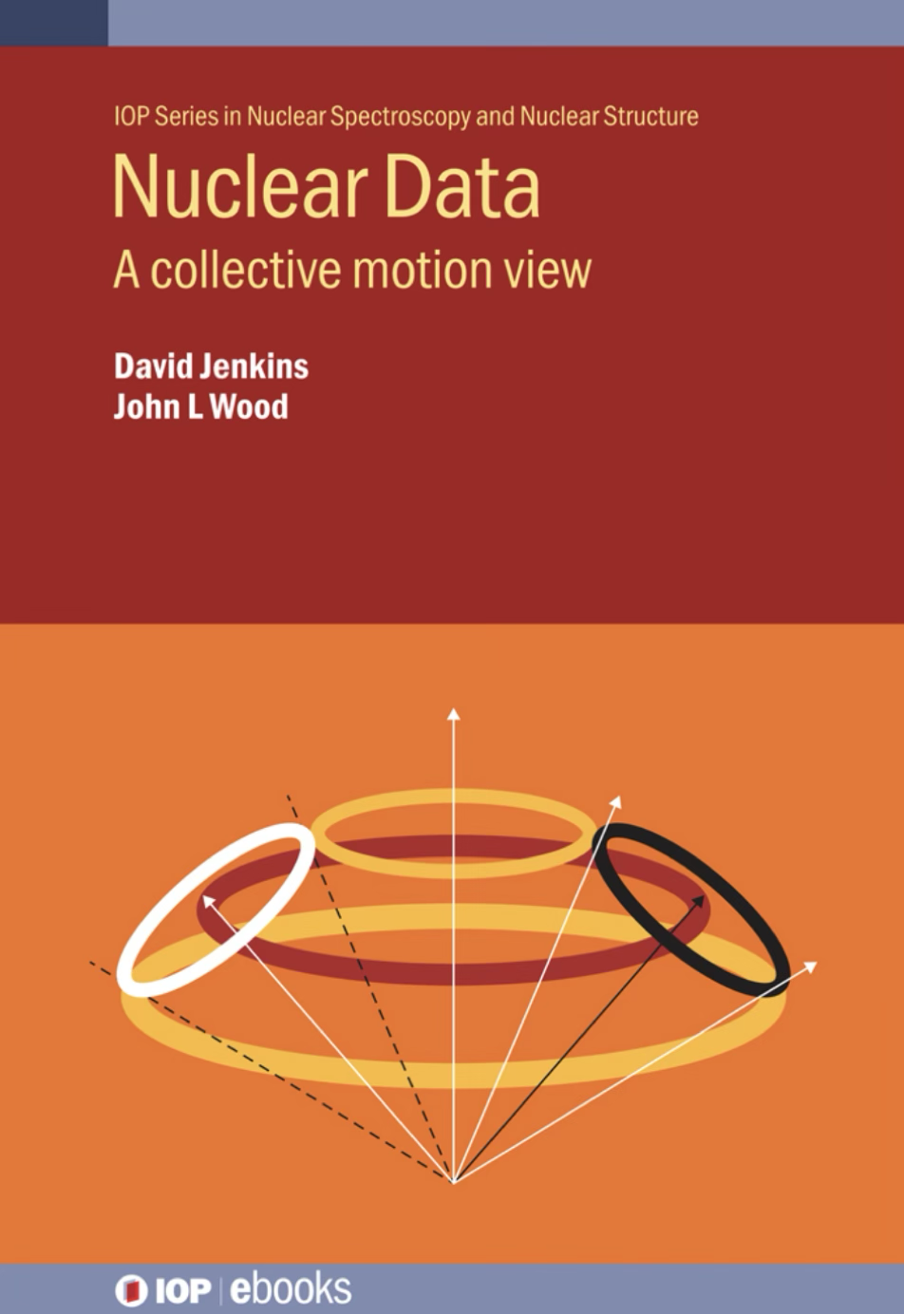
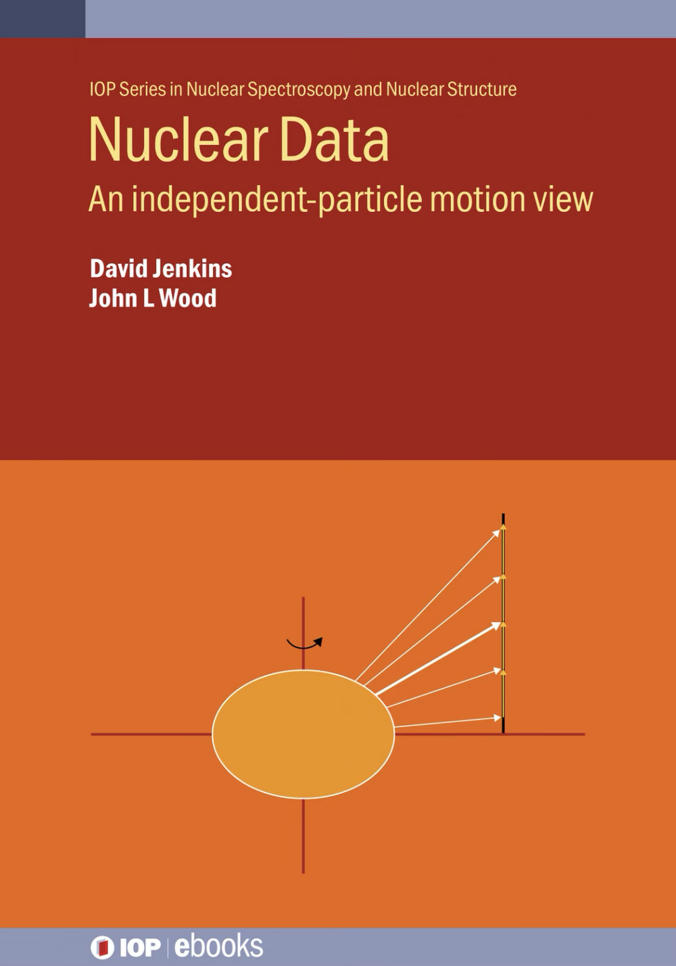

Slide 3
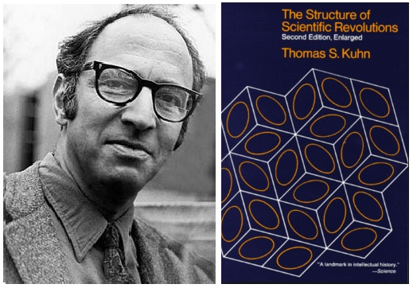
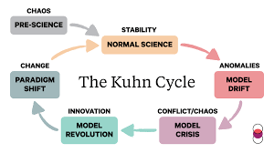

Slide 4
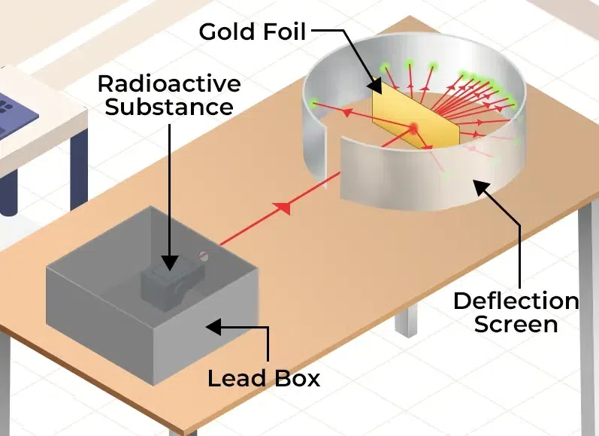

Paradigm Shift Number 1: Rutherford Scattering

Slide 7
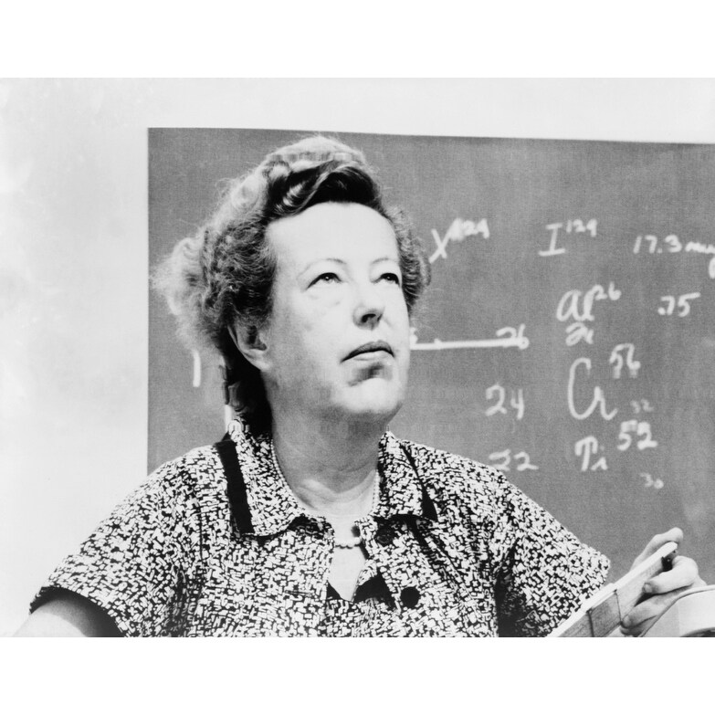
Paradigm Shift Number 2: Shell structure and spin-orbit interaction
Notes:
Plot of two neutron separation energy, S_2n, as a function of atomic mass, A for the calcium isotopes (Z=20). The discontinuities at A=40 and A=48, reflect the shell closures for N=20 and N=28.

Slide 10
Paradigm Shift Number 3: Superdeformation
Notes:
Even more spectacular case of rotation. A superdeformed band in 152Dy with a highly regular I(I+1) structure – here seen from the gamma-ray spectrum.

Slide 11
How well defined are rotations in nuclei?

Slide 12
NB Q is only defined for states with
Notes:
Examples of quadrupole moments across the nuclear chart: note these are normalized by ZR²

Slide 14
Notes:
Reminder of the pattern of excitation expected in a rotational nucleus. The ratio of 4+ to 2+ excitation energies is a key parameter.

Slide 15
R₄ = E(4⁺)/E(2⁺)
Notes:
Let us look at the R_42 ratios. We can see many nuclei get very close but not quite touching 3.33. However, something of a mystery is the smooth evolution away from the maximum so we see a smooth trend towards the vibrational limit of R_42 =2.0.

Slide 16
Notes:
These are some of the best cases of rotational nuclei known. These plutonium nuclei have R_42 closest to the 3.33 prediction and have a highly regular I(I+1) spacing until a backbend around spin 26 hbar

Slide 18
1 cm⁻¹ = 1.24 x 10⁻⁴ eV

Slide 21
Notes:
We expect B(E2) transition strengths to be very large in deformed nuclei representing contribution from the whole nuclear system. We see that, notably in heavy actinide region. Again, what we see is a smooth evolution of B(E2) not a phase transition.

Slide 24
Notes:
Quadrupole moments for various Yb isotopes. We see various observations. Quadrupole moments are large and positive. Note Q_0 is not defined for I=0. They are essentially flat as a function of angular momentum again supporting a rigid nuclear shape.

Slide 26
Notes:
Let’s start with 16O and 40Ca which we widely consider as definitive doubly-magic nuclei but even in these the low-lying structure is dominated by excited rotational bands.

Slide 27
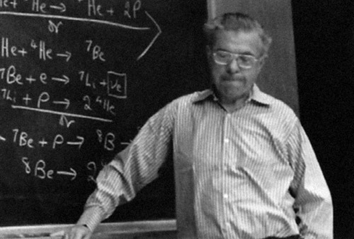
2⁺
3.03 MeV
Γ = 1.51 MeV
0⁺
Γ = 5.57 eV
= 1.2 x 10⁻¹⁶ s
Sir Fred Hoyle (1915-2001)
2α -0.09 MeV
⁸Be
Helium fusion in stars
F. Hoyle, Astrophysical J. Suppl.
Ser. 1 121 1954
3α 7.37 MeV
I(I + 1)
Notes:
I leave you with a spectacular speculation. The Hoyle state so important to astrophysics could be the bandhead of a highly deformed structure.

Slide 28
A few parting questions….
Do we need more data?
If so, what kind of data do we need?
Are we doing enough with the data we have?

Slide 29
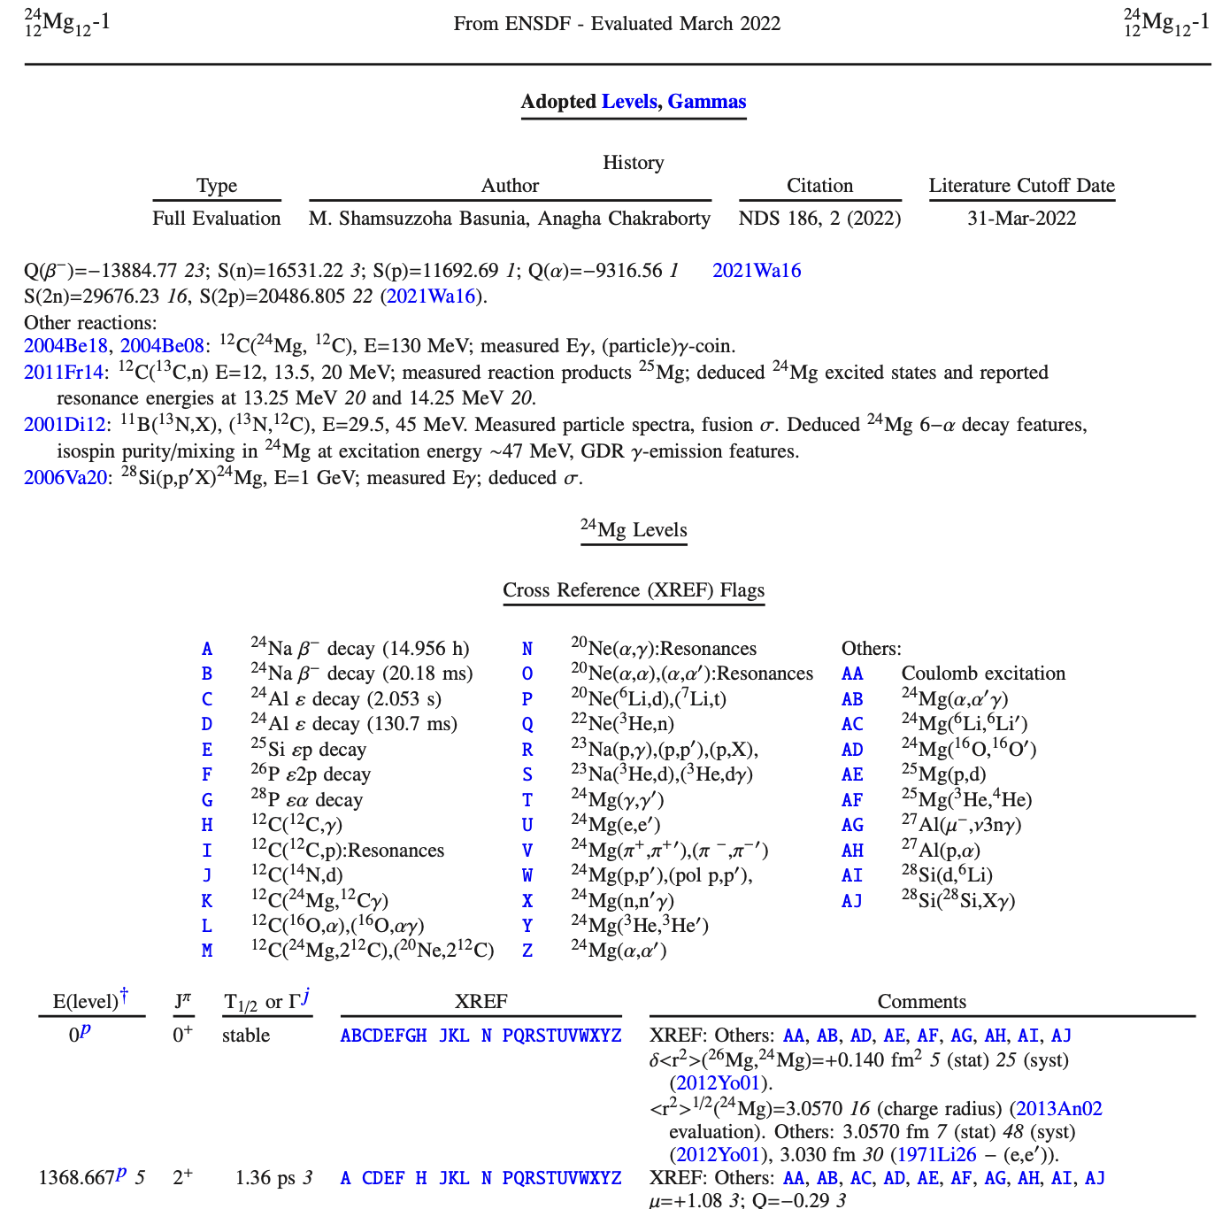

How to use the amazing resources on NNDC?

Slide 30
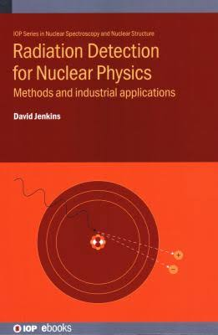

Slide 31
Finis
Notes:
Let’s look at whether we do have ”good vibrations”

