Slide 2
IOP Nuclear Physics Group Committee
Who are we?
Committee is diverse with members from academia and industry both in the UK and internationally.
Dr Jack Henderson – Chair
Dr Kara Lynch – Secretary
Dr Stefanos Paschalis – Treasurer
Dr Liam Gaffney – Member
Dr David Lee – Member
Dr Andrew Petts – Member
Dr Rachel Montgomery – Member
Dr Lee Packer - Member
Dr Philippos Papadakis – Member
Dr Daniel Pittman-Weymouth - Member
Miss Bethany Slingsby– Member
Miss Hannah Gill – Early Career Physicist
Five committee positions up for election in 2025:
1x Treasurer
4x Ordinary members

Slide 3
Event Funding
What does the IOP Nuclear Physics Group Committee Do?
Supports conferences and workshops organised by group members – this year’s budget (April onwards) being developed.
Events organised by a single group:
Half-day event £500
One-day event* £1000
Multi-day conference £1000 for the first day, plus £500 for each additional day
Joint events organised by more than one group:
Half-day event £750
One-day event* £1500
Multi-day conference £1500 for the first day, plus £750 for each additional day
Supports early career researchers through the awards of ECR prize, thesis prize and student conference prizes.
IOP has small pots of money for ECRs to attend conferences, do outreach etc.
Have a look here https://www.iop.org/about/support-grants#gref

Slide 4
Funding for events
Half-day event £500 (£750)
One-day event* £1000 (£1500)
Multi-day conference £1000 (£1500) for the first day, plus £500 (£750) for each additional day
Contact jack.henderson@surrey.ac.uk and Stefanos Paschalis stefanos.paschalis@york.ac.uk
2024 sponsored events (~£19k):
IOP Joint NP, HEPP, APP conference – Liverpool
Nuclear Physics Summer School
R-Matrix school – Edinburgh
NSTAR meeting – York
Anapole Moments mini-workshop – York
UK-EIC meeting – York
BridgeCE - Surrey
ECR event (January 2025) – Edinburgh
2025 (~£25k):
ECR Forum
Nuclear Physics in Plasma Environments
R3B Meeting
BridgeCE
Plunger meeting
HYPATIA Science workshop
FAUST science workshop
Perspectives in nuclear data
AI in nuclear physics and applications
WOSMIPX
UK Nuclear Science Forum
IoP Nuclear Physics Conference*

Slide 5
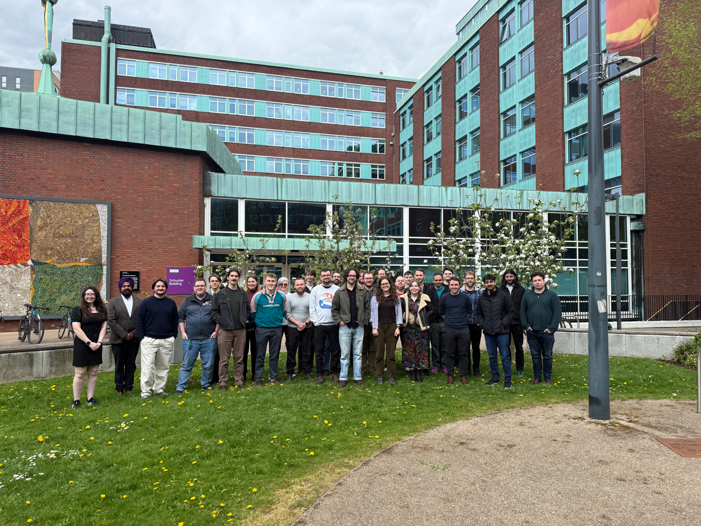
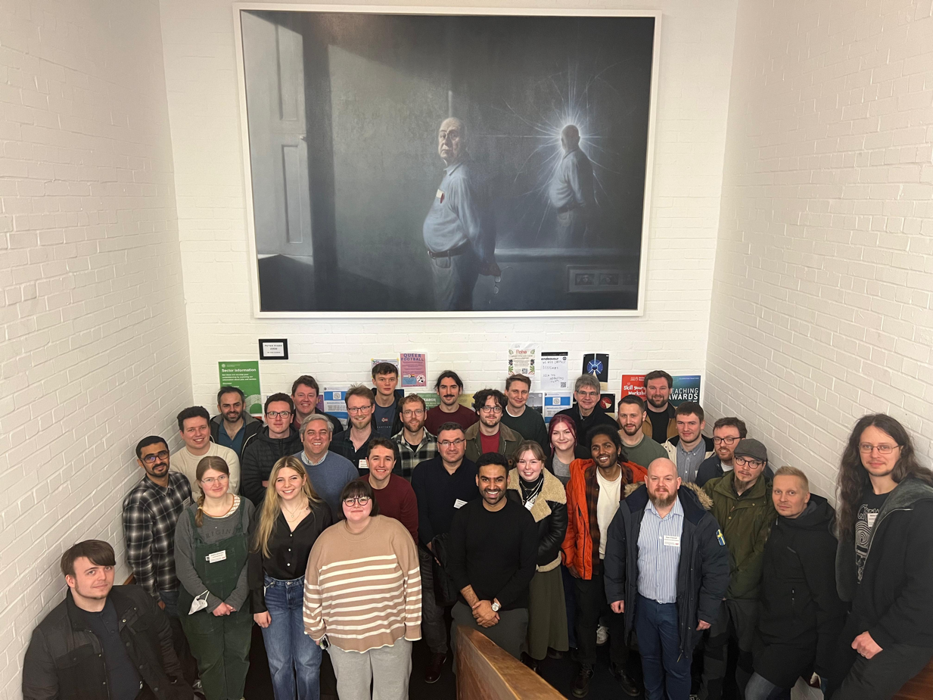
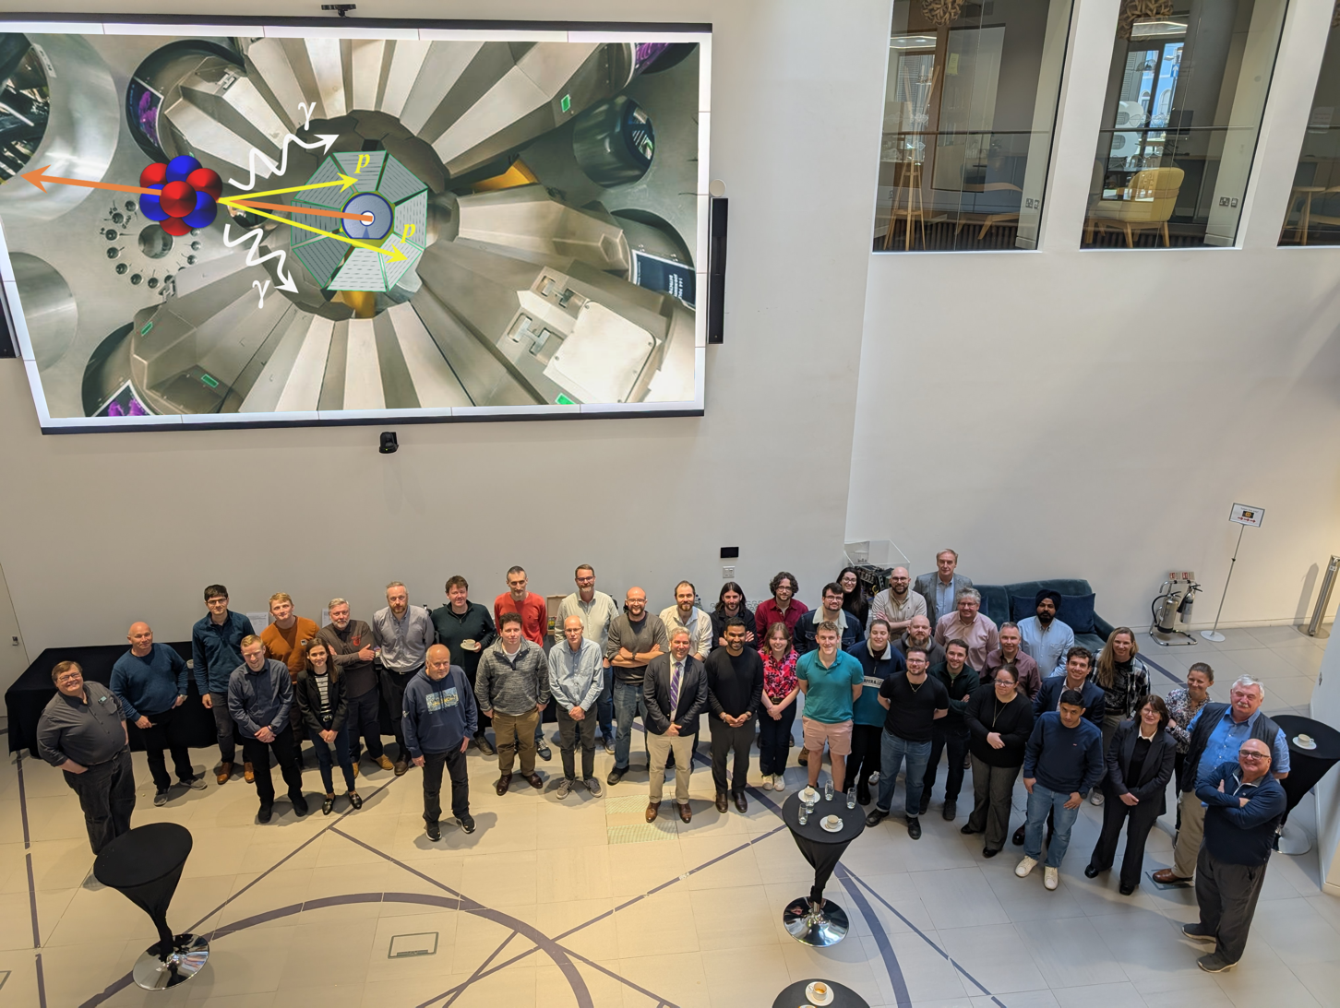
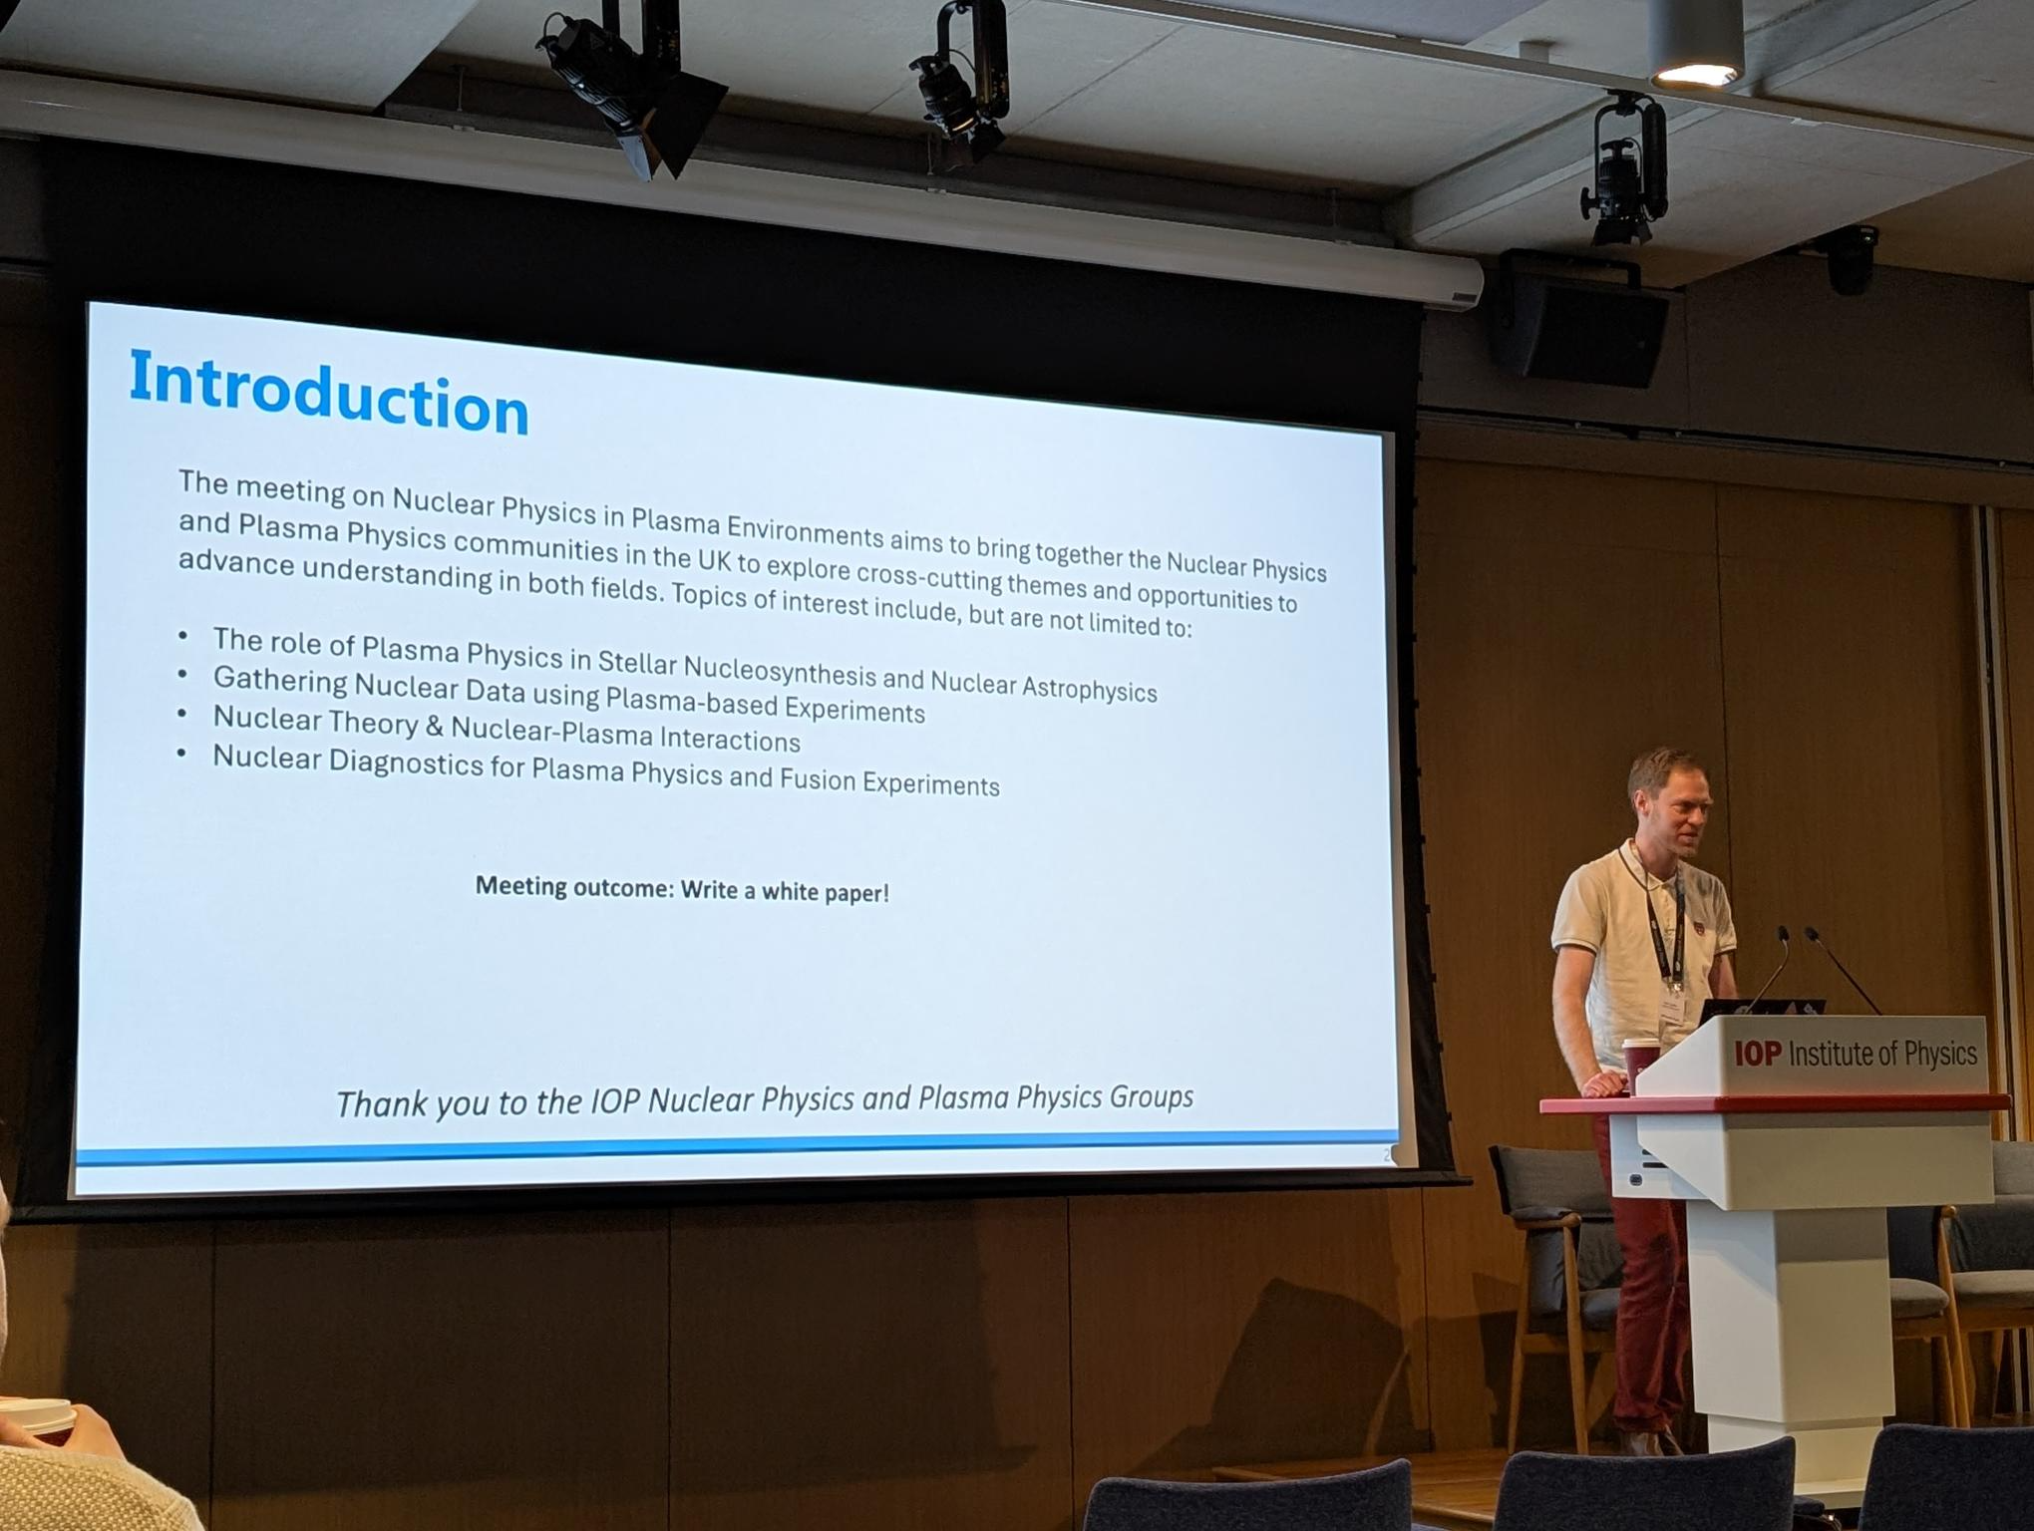
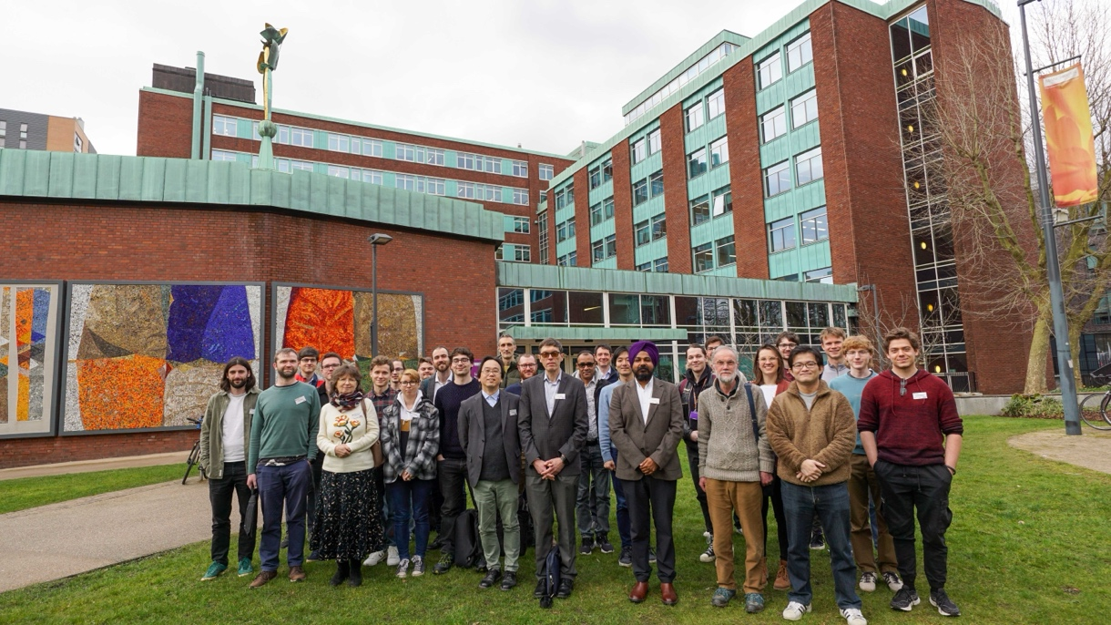
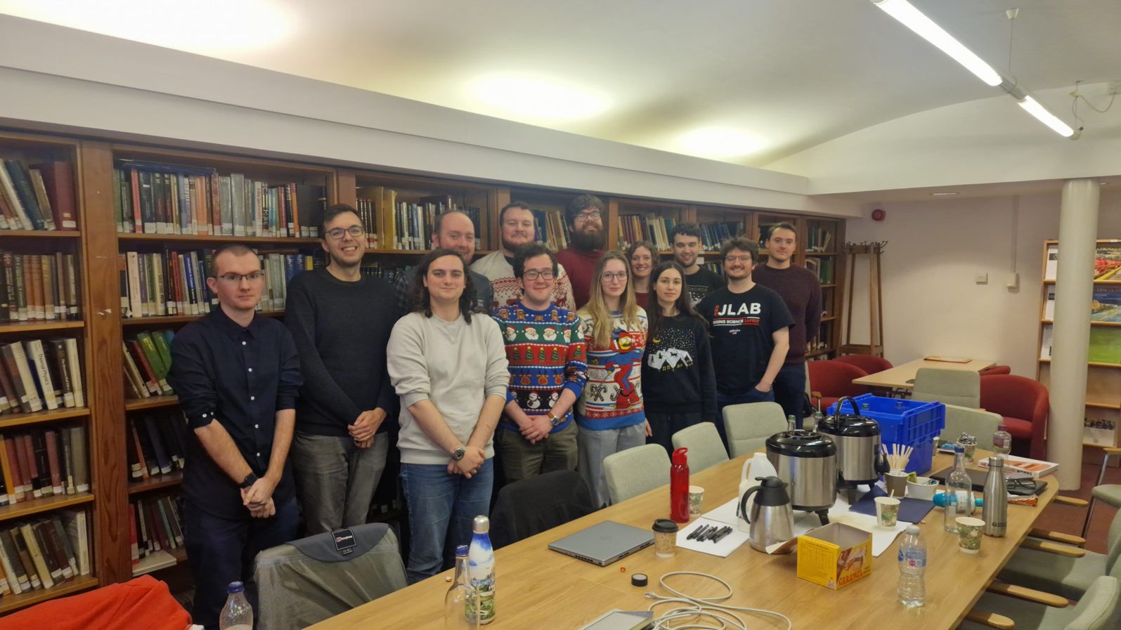
Funding for events
ECR Forum (Manchester)
ECR event (Edinburgh)
FAUST Workshop (IoP)
Nuclear & Plasma Physics (IoP)
Hadron ECR event (Glasgow)
Nuclear Reactions (Manchester)

Slide 6
Budget
The IoP has been going through a re-evaluation of its budget envelopes due to changes in the funding environment
Still keen to support events through the special interest groups and local branches
But:
In future we will have to be stricter on balance between “group events” and “external events”
For small events with no fee, the distinction is minor (group events should use IoP conference services, and must be accessible to all IoP members)
For group events with a fee (i.e., this conference) the group can no longer offer support from its budget – PhD students and ECRs are strongly encouraged to use the IoP support/grants programme (https://www.iop.org/about/support-grants)
When communicating your event, please indicate as early as possible whether it might be suitable as a group event

Slide 7
Early career researcher prize
Deadline November
Open to researchers in experimental or theoretical nuclear physics in fundamental or applied areas.
<6 years post doctoral experience or 10 years since start of first employment.
Nomination form and supporting statement from referee.
https://www.iop.org/physics-community/special-interest-groups/nuclear-physics-group/early-career-researcher-prize

Slide 8
Early career researcher prize
2025 Winner – Ragandeep Singh Sidhu (University of Surrey)
For his outstanding contributions to innovative experiments at storage rings for the advancement of nuclear astrophysics research
https://www.iop.org/physics-community/special-interest-groups/nuclear-physics-group/early-career-researcher-prize

Slide 9
Thesis prize
Deadline November
Open to individuals who have received their PhD in the 12-month period prior to the deadline (exceptions can be made at the group’s discretion).
Nominations for physicists work in applied or industrial nuclear physics welcome.
Nomination and supporting statement from referee.
https://www.iop.org/physics-community/special-interest-groups/nuclear-physics-group/early-career-researcher-prize

Slide 10
Thesis prize
2025 Winner – Magda Satrazani (University of Liverpool)
Gamma-ray spectroscopy of neutron-rich cerium isotopes following beta-decay of mass-separated caesium ions
Supervisor: Dr. Liam Gaffney
https://www.iop.org/physics-community/special-interest-groups/nuclear-physics-group/early-career-researcher-prize

Slide 11
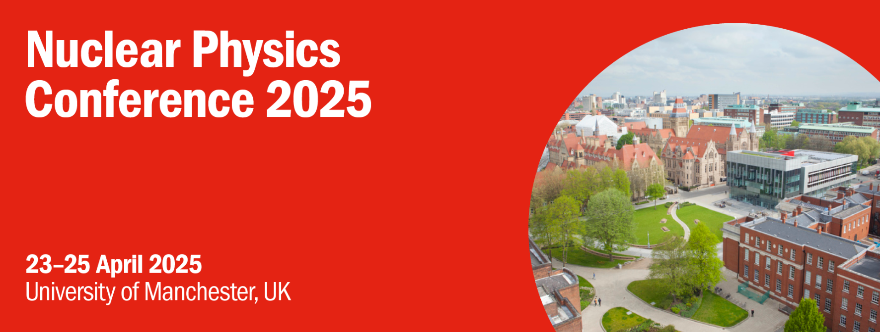
IoP Conferences
2026: University of Brighton – Week of the 13th of April 2026, Chair: Alison Bruce
Future order (tentative):
2027: University of Birmingham
2028: University of Glasgow (Joint HEPP/APP)
2029: University of the West of Scotland
2030: University of Edinburgh

Slide 12
Future initiative? Nuclear Data
Initial discussions with Energy and Nuclear Industry groups regarding a joint workshop on nuclear data
Aim to improve interactions between communities and potentially develop new routes to funding sources
Likely first event to occur in 2026 – potential for IoP written report on the importance of nuclear data to energy and security
Interested parties, please get in touch

Slide 13
Future initiative? Next Generation
What opportunities might exist in 10+ years time? How can they be used to support (or be supported by) nuclear physics?
Examples: Vulcan, STEP, etc.
Are there routes for nuclear physics to develop using next generation facilities outside of traditional accelerator laboratories?
Can nuclear physics help bridge the gap between new facilities and other national challenges (nuclear data, nuclear medicine)?
Can we develop a white-paper describing the opportunities?

Slide 14
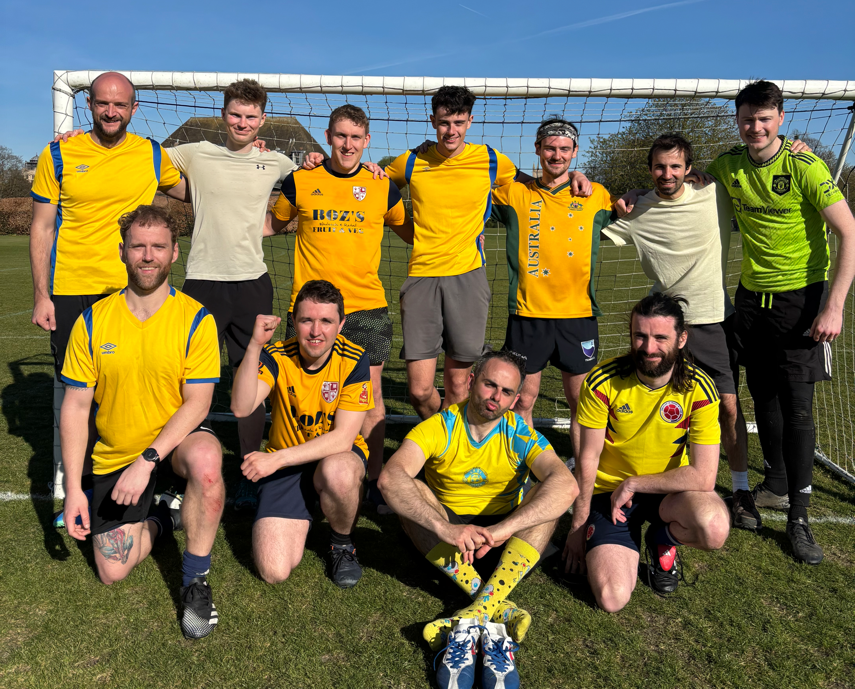
Bubble Chamber Cup
Nuclear Physics (+ UCL) team entered the HEPP bubble chamber cup
Won the tournament (without conceding)
Don’t expect to be invited back…

Slide 15
Bubble Chamber Cup
Nuclear Physics (+ UCL) team entered the HEPP bubble chamber cup
Won the tournament (without conceding)
Don’t expect to be invited back…

Slide 16
Bubble Chamber Cup
Nuclear Physics (+ UCL) team entered the HEPP bubble chamber cup
Won the tournament (without conceding)
Don’t expect to be invited back…

Slide 17
Thank you!

