Slide 1
STFC Update
NP Town Hall
Michele Dougherty & Grahame Blair
Executive Chair Exec Director Programmes
23rd April 2025
Notes:
The abstract pattern can be removed or repositioned if required. Be careful to ‘Send to Back’ so that it does not obscure any important information.

Slide 2
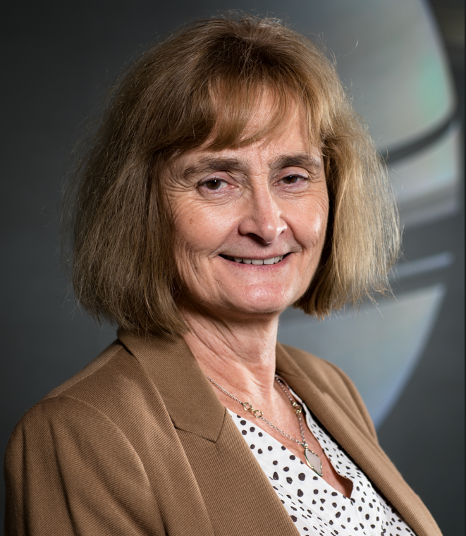
UKRI Executive
STFC Executive Chair
In January, I started as STFC’s Exec Chair
Part of UKRI's Executive Committee
UKRI’s champion for Infrastructure and Space
UK representative on CERN Council and SKAO Council
I have a 35 yr career as a Space Physicist including:
PI for Cassini (Saturn) and Jupiter Icy Moons Explorer (JUICE)
In addition, I am Institute of Physics President-Elect and President from October 2025
Former roles include:
Head of Department of Physics at Imperial College
STFC Council member

Slide 3
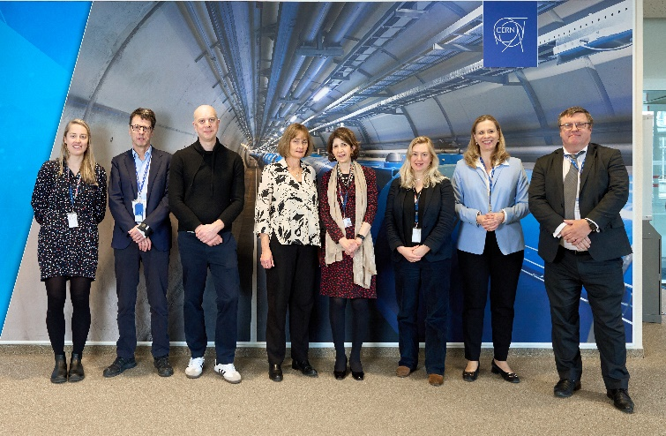
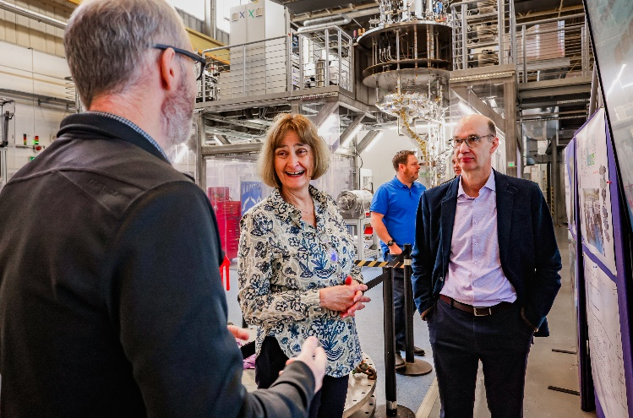
First 3 months
Since 02 January (my first day)
Visit to CERN and my first CERN Council meeting
Impressed by span of UK contributions – critical contributions across breath of CERN activities
Visit Jodrell Bank and my first SKAO Council meeting
Strategic meetings with local Universities including Physics department updates
University of Manchester
University of Liverpool & Liverpool City Region Mayor
University of Oxford
Visit to Daresbury including the update on research into sustainable accelerators and LBNF-DUNE project

Slide 4
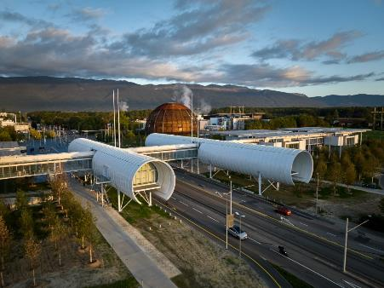
CERN: Strategy and Governance
General updates:
Michele Dougherty is the new UK CERN Council delegate alongside Shabana Haque (DSIT)
Mark Thomson to become CERN DG in January 2026 – STFC is preparing to engage with new CERN management
Eight underground CERN visits delivered including DSIT Science, Innovation and Technology committee on 3rd March
UK Strategy for Engagement with CERN 2025 activities include:
Coordinating activities related to engineering and CERN across the UK
Promoting CERN training opportunities to UK technical audiences (with CERN HR)
Improving the value proposition for engaging UK industry in commercial opportunities
Align CERN engagement to new government priorities and ambitions
Landscape analysis of CERN-related outreach and public engagement in the UK
Contact the STFC CERN team at: ukatcern@stfc.ukri.org

Slide 5
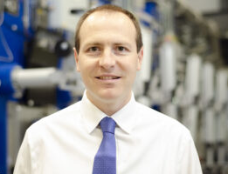
UKRI Executive
CEO UKRI
Prof Sir Ian Chapman will start as UKRI’s CEO in August 2025
Ian is currently CEO of the UK Atomic Energy Authority (UKAEA) and a UKRI Board member
He is distinguished physicist:
Knight Bachelor in the New Year Honours List 2023 for his services to global fusion energy
Fellow of the Royal Academy of Engineering and a Fellow of the Royal Society.
His research has been recognised with a number of international awards
Upon appointment, he said: “Research and innovation must be central to the prosperity of our society and our economy, so we have the great privilege of shaping the future of the country.”

Slide 6
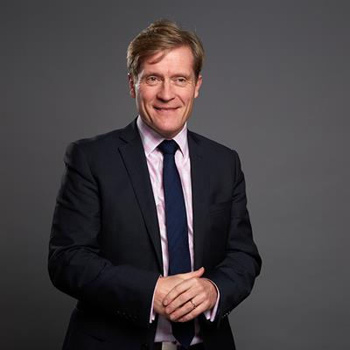
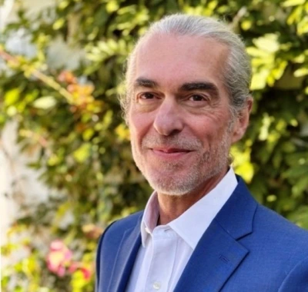
STFC Executive
Executive Director National Labs Large Scale Facilities
Prof Roger Eccleston was appointed Executive Director with effect from 9 December 2024
He was formerly:
Director of ISIS Neutron & Muon Source
Deputy Vice-Chancellor (Academic) at Sheffield Hallam University
Chief Operating Officer
Keith Zimmerman has been appointed at COO and started 31 March
He was formerly:
Director of a transformation programme at King’s College
Chief Operating Officer at the University of Bath,

Slide 7
STFC Council Appointments
New Council members
This month, we welcomed 4 new Council members:
Prof David Charlton, Poynting Professor of Physics at University of Birmingham. He is an experienced Particle Physicist and was previously on Science Board (PPAN)
Prof Stan Bentvelsen, Professor at University of Amsterdam and former director of Nikhef. He is a scientific lead on Einstein Telescope (Gravitational Waves)
Prof Jayne Lawrence, Director of University of Manchester @ Harwell. She is a long term user of STFC facilities and a former chair of Science Board
Prof Andrew Pontzen, Professor of Cosmology Durham University. His research interests are the interfaces of astrophysics, high energy physics, cosmology and computation
We would like to encourage more under-represented groups to apply to all of our advisory bodies and will be issuing calls for new members of Science Board and other boards and panels later this month

Slide 8
Spending Review

Slide 9
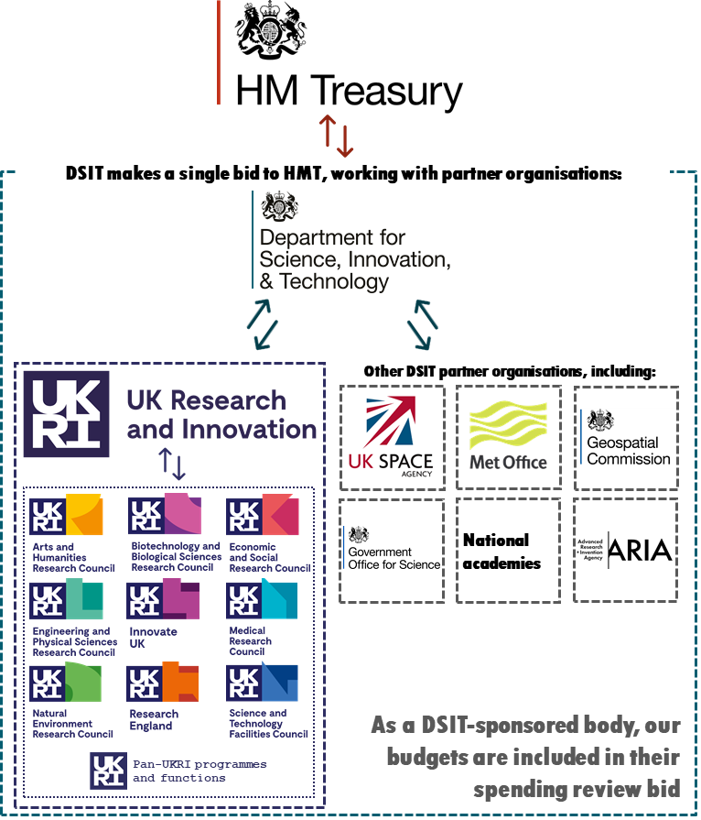
Spending Review
Spending Review process in a nutshell
Spending Reviews (SRs) are led by HM Treasury
STFC and the other research councils feed priorities into UKRI, who submits a collective bid into DSIT, along with other public bodies, e.g. the Met Office
DSIT makes its bid into HMT, which set the department budgets and the allocation process then flows in reverse
This Spending Review is in 2-phases:
Phase 1 – budgets for 2025/26
Phase 2 – budgets for 2026/27-2029/30

Slide 10
Spending Review – Phase 1
Headlines for 2025/26 :
DSIT has announced almost £14 billion of R&D funding, with £8.8 billion budget for UKRI
We welcome the protection of R&D budgets, particularly as the government is having to make difficult choices to prioritise its spending in the face of more challenging time with constrained budgets across the public sector
The case for research and innovation is strong given its central role in driving economic growth and improving productivity in the economy and public services
As we enter a period of tighter budgets, UKRI is working collectively to ensure its portfolio as a whole is balanced to deliver the best outcomes now and in the future
There are parts of the R&D system that will be disappointed that their ambitions have not been met

Slide 11
Spending Review – Phase 1
Implications for STFC Funding in 2025/26:
There are significant pressures and calls on STFC’s budget:
Inflation has been significant over recent years (over 10% p.a. at times), which has not been matched by increased funding for construction/lab infrastructure
Salaries, University overheads and student stipends have all increased
Delays (including Covid) and technical challenges have led to increased costs
STFC has long-term international commitments backed by MoUs and agreements
We have had to make some difficult choices to reach a balanced budget:
Reduced % success rate for the 2024 Astronomy and Particle Physics grants rounds – with priority given to preserving people, resulting to reductions in capital investments
Some projects have not been renewed or are being paused
We are committed to reducing STFC’s fixed costs including operations national facilities at a reduced rate in 2025 and reducing staff numbers

Slide 12
Spending Review – Phase 2
Status:
Phase 2 is currently underway with an initial announcement expected this summer
Recognising the tight fiscal position across the whole of the public sector, UKRI has submitted a realistic flat-real bid, focused on 3 priority areas:
£17bn on new discoveries from curiosity driven research
£10bn on scaling and growing innovation; and
£9bn on citizen outcomes/public services
However, flat-real will involve some hard choices about what to close, stop or scale back across the UKRI portfolio
The impacts will be felt across all Research Councils and our communities

Slide 13
Spending Review – Phase 2
We are committed to ensuring a sustainable future for our research communities
We cannot continue with everything that we currently fund, but what we do fund must be at a viable level, delivering world class research and technology
We are currently engaging our Science Boards and Council in a prioritisation exercise to assess the scientific impacts across all our portfolio:
Joint meeting of STFC Council & Science Board in March
11 &15 April and 1 May extraordinary Science Board Prioritisation meetings
14 May Council Review
This will feed into discussions with incoming UKRI CEO and DSIT
The prioritisation builds upon the recent PPAN roadmap activity – a big thank you to everyone in the community who has contributed to this extensive process​

Slide 14
NP Programme Update

Slide 15
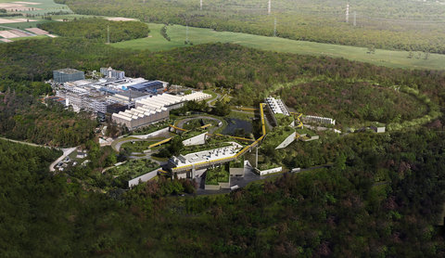
STFC Nuclear Physics
NP Consolidated Grant
Projects
FAUST
γRIBF
FAIR R3B Silicon Tracker
Electron Ion Collider (EIC) UKRI Infrastructure Fund
Subscriptions/M&O
FAIR (NuSTAR and HISPECC/DESPEC)
ISOLDE@ CERN
MINIBALL
EXOGAM
AGATA
ALICE
ECT*
Notes:
Nuclear Physics Advisory Panel Roadmap Published in December 2024, significant updates from the previous version published in 2019. Thanks to the effort of the Advisory Panel and those involved.

Slide 16
Nuclear Physics Consolidated Grants 2023
(October 2024 – September 2027) - Exploitation from PD Core - ~£19m
The NP Consolidated Grants (CG) provides funding that underpins both the nuclear physics programme, including both experiment and theory in nuclear structure, hadronic physics and nuclear astrophysics.
Who? 11 Institutes:
University of Birmingham
Sheffield Hallam University
University of Edinburgh
University of Glasgow
University of Liverpool
University of Derby
STFC Daresbury Laboratory
University of Manchester
University of Surrey
University of the West of Scotland
University of York
Measure | 2020 | 2023
Number of proposals | 8 | 8
Number of institutes | 12 | 11
Number of scientific themes | 33 | 29
Academics – Number (Requested) | 66 | 63
Academics - Average FTE | 6% | 4.5%
Academics – Total FTE per year | 2.8 | 2.9
PDRA – Number | 23 | 34
PDRA - Total FTE per year | 19 | 25
Core Posts – Number | 9 | 12
Core Posts - Total FTE per year | 6.5 | 9.4
Cross Community - Number | 13 | 13
Cross Community - Total FTE per year | 10 | 11.8
Number of Studentships | 2 | 3
Technician - Total FTE per year | 3.9 | 5.2
Total Number of FTE per year | 44.3 | 54.3

Slide 17
Nuclear Physics CG 2026 Round
STFC has moved to 4-year consolidated grants. This provides benefits to the community in terms of longer-term planning and commitment and is easier for the office to administer. ​
The 2026 Nuclear Physics CG round will use the new Funding Service (TFS).
New NP Panel members will be recruited in 2025 to support the consolidated grant round.
In line with the awarding of the recent PP and Astronomy grants, it is anticipated that the 2026 NP CG will be constrained to a similar level reflecting the pressures on the research budget. The detail of this will be established through the on-going PPAN prioritisation exercise and outcome of the SR2.
Rough Timeline:
Autumn 2025 – Call information published
November 2025 – Call Opens
February 2026 – Call Closes
Notes:
PPGP will meet earl October to finalise the call guidance

Slide 18
Nuclear Physics Advisory Panel and Nuclear Physics Grant Panel Membership call
Advisory Panel: Four new members with specific research interests
Grant Panel: Six new members including a new Chair, expertise in hadronic physics, nuclear structure and theory.
CCC: Three new members required.
Please see the website for the main call’s page: Call for applications to STFC advisory bodies and peer review panels – UKRI
Call opened in April 2025 and will close on 18 May 2025. This aligns with recruitment across other STFC panels.
Any questions please speak to a member of the team.

Slide 19
Computing and e-Infrastructure
DiRAC - DiRAC-4 science case has recently been externally peer reviewed. Resource Allocation Committee - peer review of RAC17 proposals is complete, computing allocations to start April 2025. RAC18 to be launched in due course.
GridPP - funding constraints have meant restrictions on hardware procurement. We may fall below the UK pledge in future years but are working actively with the collaboration to mitigate where possible.
SWIFT-HEP - supports software development for the HL-LHC era however it is not possible to support the second phase of the project going forward.
AIRR (AI Research Resource) - £7.5m has been allocated from the UKRI DRI fund for the new AI Research Resource (Dawn) at Cambridge for operations from April 2024 - March 2028. Isambard-AI (£243.5m) will also be coming online line in 2025.
A call for expressions of interest to get access to AIRR is now open: https://engagementhub.ukri.org/ukri-infrastructure/airr-eoi/
New Computing Advisory Panel (CAP) - is being set up to replace the STFC e-Infrastructure Advisory Group (SEAG). The recruitment process is underway.
Notes:
GridPP7 – Due to a reduction in funding, STFC may face challenge in fulfilling the UK's future pledge. However STFC has been working diligently to mitigate these risks, with strong emphasis on prioritising the funding of staff resource. We will discuss with the wLCG as we approach the April Resource Review Boards.

Slide 20
Quantum Technologies for Fundamental Physics (QTFP)
A programme funded by the UKRI Strategic Priorities Fund (SPF), run jointly with EPSRC.
Applies the latest advances in quantum science and technology to explore and answer long-standing research questions about the universe and its evolution. The first programme entailed:
£32m for 7 large consortia over 5 years
£6.3m for 17 small projects over 2 years
Programme is currently bridged to Sept 2025 only, from STFC core funding.
Awaiting outcome of SR Phase 2 for Quantum Technologies. If favourable a call for large consortia awards to start on 1 April 2026 will be issued.
If no dedicated funding from SR phase 2 then, like all other programme areas, QTFP is under consideration within the prioritisation exercise.

Slide 21
Doctoral Studentships and Stipends
Update
UKRI has announced uplifts to the minimum PhD stipend level, (the latest increase from October 2025 is an increase by 8% to £20,780 per year) and has updated our terms and conditions in response to the New Deal work.
STFC response
STFC has maintained landscape (DTP) numbers for 2025 starts but given these increases and our overall financial position we may need to reassess our numbers going forwards.
We are working with our ETCC advisory group to develop a new algorithm for landscape (DTP) students to allow the changes for astronomy grants to be incorporated and reduce bureaucracy
Notes:
STFC is appointing a sub group of ETCC to develop the approach to the algorithmn

Slide 22
Fellowship Programmes
The main fellowship programmes for STFC community are:
Ernest Rutherford Fellowships (STFC):
A large number of applications received (again) this year (168 applications). Panels took place at the end of March and interviews will take place at the end of April. Many thanks to colleagues for their help in peer review.
UKRI Future Leaders Fellowship
Round 9 applications received and sifted. Interviews will take place in May.
Round 10 has opened with a closing date in June.
Discussions are taking place on a more common fellowships framework across UKRI

Slide 23
Outlook

Slide 24
Outlook
The environment is currently uncertain on many levels but:
The PPAN programme remains strong and world leading:
Strong scientific leadership across the PPAN Area.
Excellent community with high quality ECRs and students.
We are well prepared to weather the current uncertainty
Strengthened Science Boards now up and running for over a year.
Over a year of background preparation in developing a prioritised Roadmap.
Strong input from Advisory Panels as basis of up-to-date portfolio analysis.
New planning tools in place based on a well-structured 10-year plan.
Strong community participation in international activities, e.g. NuPECC 2024 LRP.
Great opportunities for joint evolution of our programme, together with our international colleagues.

Slide 25
Notes:
The abstract pattern can be removed or repositioned if required. Be careful to ‘Send to Back’ so that it does not obscure any important information.

