Slide 1
News from Accelerator Physics inputs
Professor Stewart Boogert (Prof Phil Burrows, Dr Chris Rogers)
28th April 2025
RAL

Slide 2
Introduction
Presentation focused on plan-B getting to 10 TeV pCM energy
  Plan-B is predicated on plan A vision
Stages of infrastructure or facilities or R&D to reach that goal
Checked all inputs to the ESPPU (😩)
Looked for updates or interesting points associated with each project or R&D
Focus on FCC-ee/hh, LC, MC, LHeC, LEP3
Spoiler: Nothing radical to report to the community
Did not focus on timeline, costs as these often suffer from optimism-bias
  Chris R did revew all projects for key parameters and could augment with these details

Slide 3
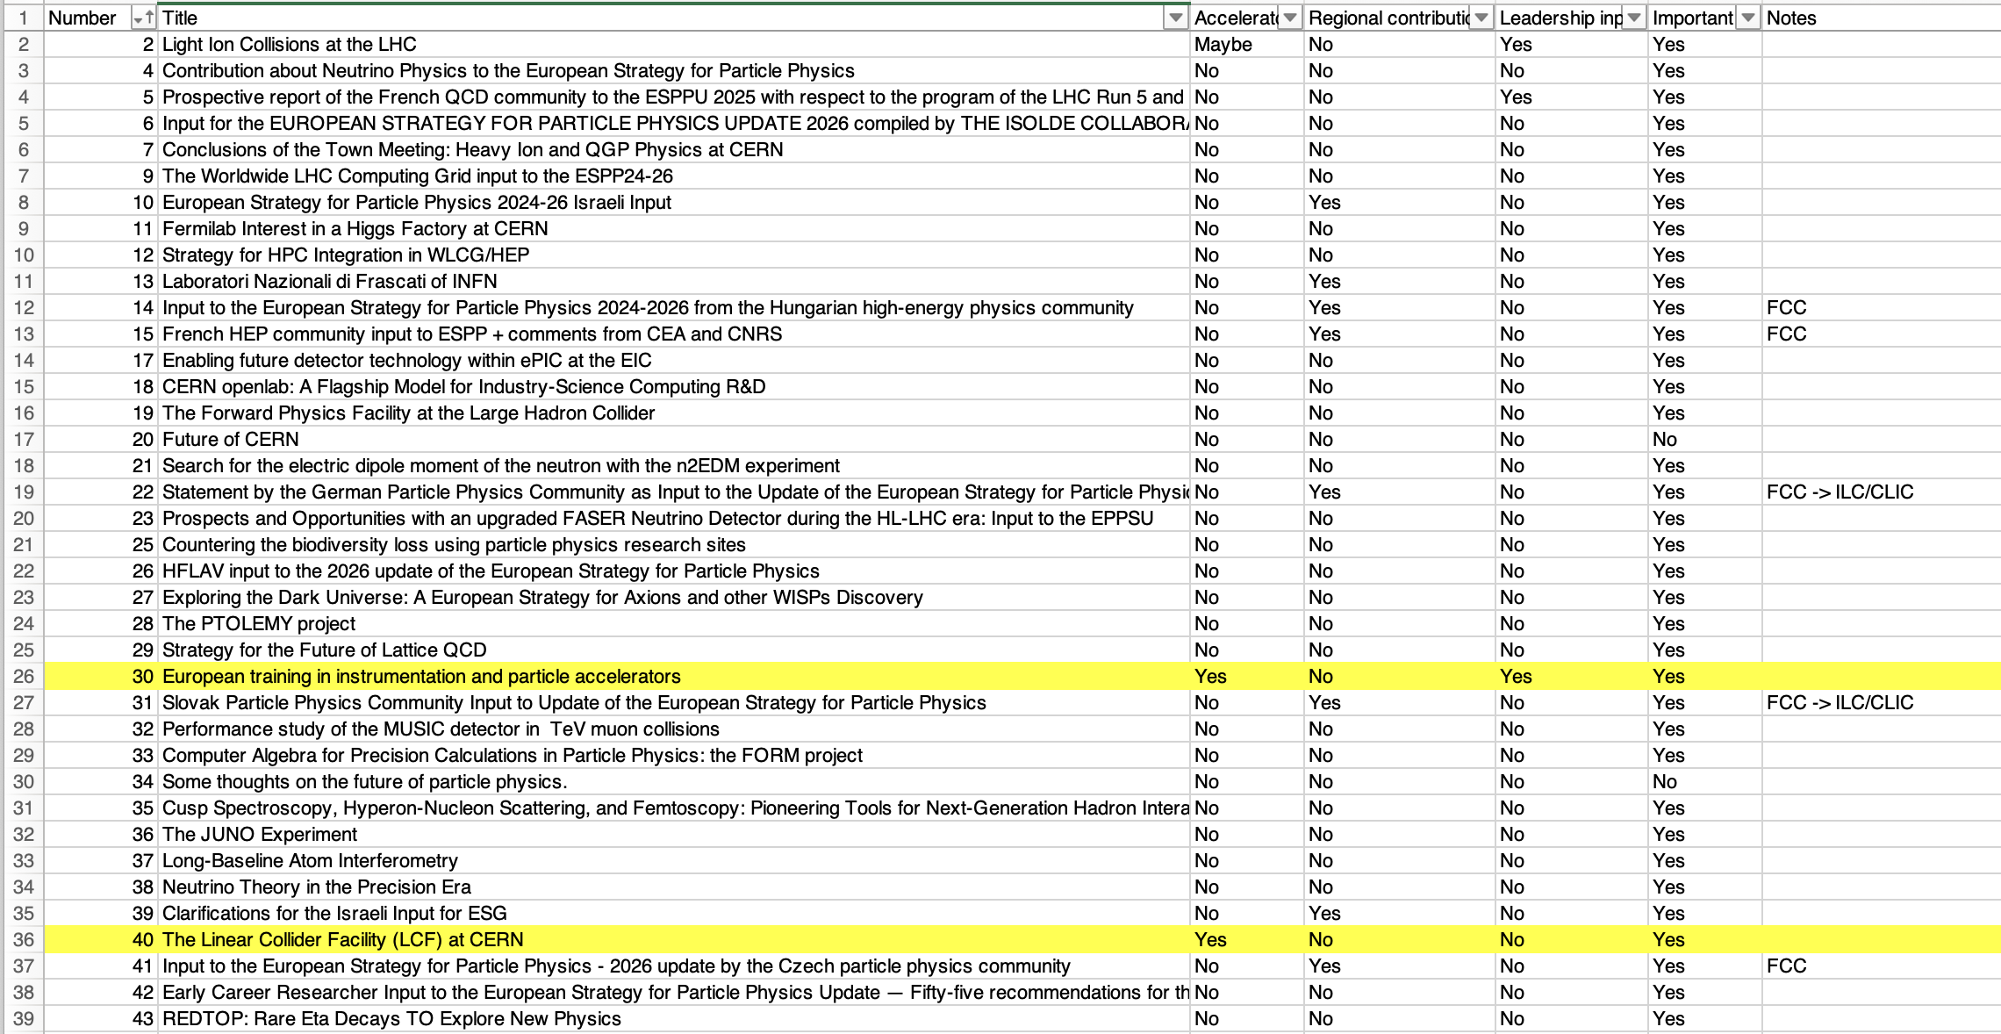
Accelerator inputs to ESPPU

Slide 4
Accelerator inputs to ESPPU
Total number of submissions 263
  Categorised into accelerator/non-accelerator/maybe?-accelerator
  Accelerator inputs : 40
  Maybe accelerator inputs : 7
National inputs
  Country community (or national lab e.g. INFN and PSI) : 42
  Quick review of these inputs does reveal a consistent stance on accelerator R&D
  Strong support for FCC-ee as a step towards FCC-hh, with back of LC Higgs factory
Lots of overlap in submissions e.g.
  Linear collider (C3, ILC@CERN, ILC@Japan)
  National Lab contribution and projects
No time to present
  ESSnuSB (151), Proton-Driven Plasma Wakefield Acceleration for Future HEP Colliders (210), Super Tau Charm Facility (231),

Slide 5
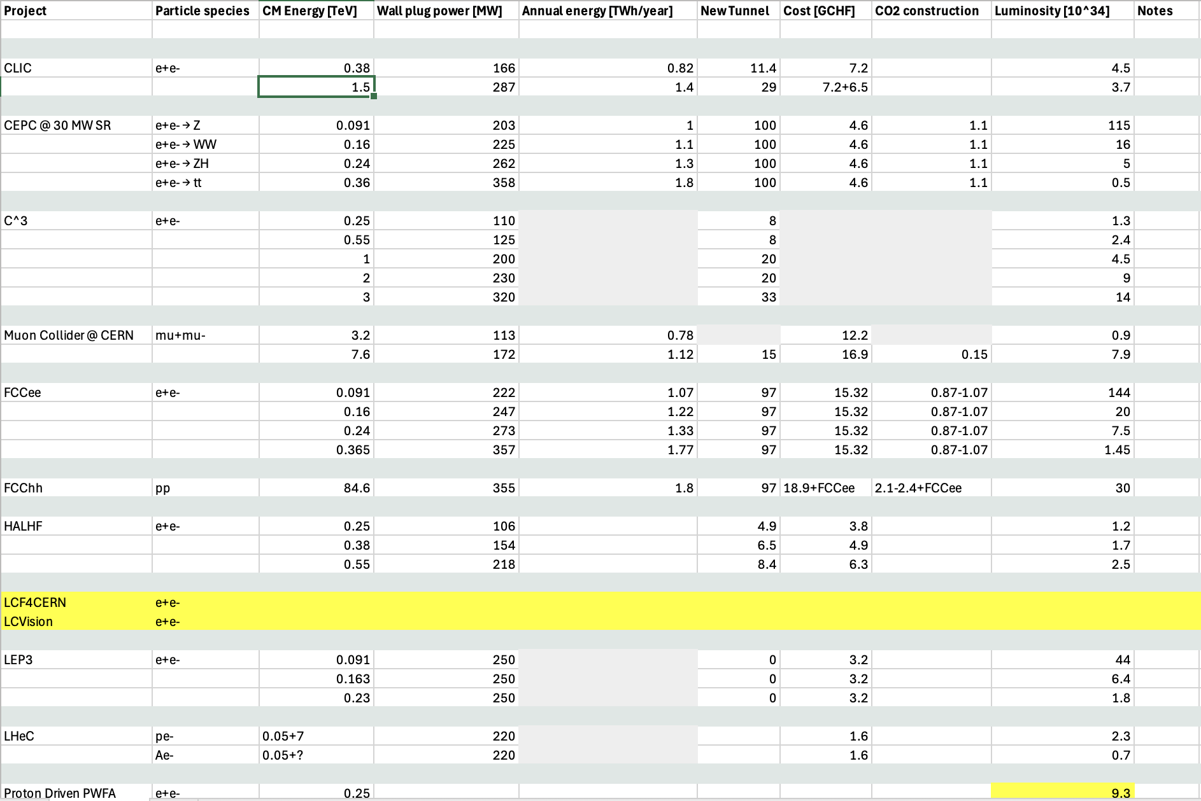
Project spreadsheet

Slide 6
Projects
FCC/CEPC, LC, LHeC, LEP3, MC, Advanced acceleration

Slide 7
FCC / CEPC
FCC-hh baseline field of 14 T
153: The Circular Electron Positron Collider (CEPC)
233: FCC Integrated Programme Stage 1: The FCC-ee
247: FCC Integrated Programme Stage 2: The FCC-hh

Slide 8
Linear Collider
Plan for LCF after ESPPU
  Phase 1
    Final placement of the collider complex
    Optimisation of LCF design
    35 MCHF material and 180 FTEy of personnel effort
  Phase 2
    Would require a decision to go ahead
    SCRF industrialization
    Cryo and industrialization
    120 MCHF for pre-series production and 420 FTEy personnel
40: The Linear Collider Facility (LCF) at CERN
78: The Compact Linear ee Collider (CLIC)
97: C3 within the "Linear Collider Vision”
140: A Linear Collider Vision for the Future of Particle Physics
275: Status of the International Linear Collider

Slide 9
LHeC (Energy recovery linacs)
56: PERLE : an ERL facility for future sustainable colliders (LHeC, FCC)
174: Phase-One LHeC
214: The Large Hadron electron Collider (LHeC) as a bridge project for CERN

Slide 10
LEP3
The LEP3 physics programme would have three phases,
  near or on the Z peak (91.2 GeV), over 5 years,
  near the WW threshold (163 GeV), over 4 years and
  near the ZH threshold (at 230 GeV), over 6 years.
165: A Possible Future Use of the LHC Tunnel
188: LEP3: A High-Luminosity e+e− Higgs & Electroweak Factory in the LHC Tunnel

Slide 11
Muon collider
105: Magnet R&D for the Muon Collider
152: United States Muon Collider Community White Paper for the European Strategy for Particle Physics Update
207: The Muon Collider

Slide 12
Advanced acceleration
Coherent community mainly in US working towards 10 TeV pCM Wakefield collider
Unique challenges
  staging of plasma modules
  and positron acceleration
  Sub-nanometre focus beam sizes
  Other options need to be investigated e⁻e⁻ and ɣɣ
57: HALHF: a hybrid, asymmetric, linear Higgs factory using plasma- and RF-based acceleration
98: Design Initiative for a 10 TeV pCM Wakefield Collider
159: Contribution of ALEGRO to the Update of the European Strategy on Particle Physics
172: AWAKE - Input to the European Strategy for Particle Physics Update on behalf of the AWAKE Collaboration
210: Proton-Driven Plasma Wakefield Acceleration for Future HEP Colliders
220: Advanced Accelerator and HEP Developments through Networking between the Large Particle Physics Laboratories and CERN

Slide 13
Technologies
High temperature superconducting magnets, High gradient RF
Community : lab contributions and other

Slide 14
High-field and/or HTS Magnets
49: High Performance and Cost Effective Superconducting Accelerator Magnet R&D at IHEP
104: HTS Potential and Needs for Future Accelerator Magnets
105: Magnet R&D for the Muon Collider
243: High Field Magnet Programme – European Strategy Input
256: Superconductivity Global Alliance (ScGA) European Strategy Input

Slide 15
High gradient Radio Frequency (RF)
Areas of activity
  Bulk-Nb, thin films (LCF)
  Fundamental and HOM Couplers (FCC, ILC and the MC)
  Normal Conducting High-Gradient structures (C^3)
  RF power sources, and LLR
  Machine Learning and Artificial Intelligence
Good progress in all areas
219: RF developments for future colliders

Slide 16
“Community”
Broad agreement on important topics
  High field magnets (MC, FCC-hh)
  SCRF (FCC-ee, LC)
  Advanced plasma based high gradient acceleration
  Energy recovery linacs
  High brightness muon beams
Generally, reflects the proposed projects
Quote from 90: “Sustained funding and strategic investment for accelerator R&D”
Project costs of many B£, R&D phase costs of 5% would be £250M
  Would convert challenges to realities. HTS superconducting magnets which are industrialisable
30: European training in instrumentation and particle accelerators
65: Accelerator R&D proposals by INFN
90: Strategic Imperative: Investing in Accelerator R&D and Technologies for the Future of Particle Physics and Societal Impact
120: European Contributions to Fermilab Accelerator Upgrades and Facilities for the DUNE Experiment
134: PSI European Strategy Input
154: Midterm Review of the European Accelerator R&D Roadmap
162: Sustainability Assessment of Future Accelerators
255: A Flexible Strategy for the Future of Particle Physics at CERN

Slide 17
Potential futures
2025
100s GeV pCM
2040s
20XX
10 TeV pCM
FCC-ee
FCC-hh
3.0 TeV (CLIC,
C3, HELEN,
Nb3Sn )
10 TeV PWFA,
SWFA, PWFA
SCRF or conv. LC (550 GeV)
Muon beams
(nuStorm)
Muon collider
HL-LHC
FCC-ee or FCC-hh
LEP3
FCC-ee or FCC-hh
LHeC

Slide 18
Summary
Main contender projects FCC, LC and Muon colliders all have a “path-way” to realise 10 TeV pCM energy
Some projects are envisioned as a brigde to the FCC future (LHeC and LEP3)
Ordered in increasing technical (not financial) risk
  FCC-hh
  1.5 TeV lepton
  Muon
  10 TeV lepton or gamma
All futures require significant investment in accelerator R&D or project development, e.g. SC magnets, SC RF, project development
  £250M distributed over 10 partners would be national programmes at £25M. Levels not seen in UK since LCABD

