Slide 1
Education, EDI and outreach Cockcroft SAC
Stewart Boogert
21th February 2025

Slide 2
Introduction
Education, EDI and outreach should be presented at every SAC (opposed to the 2-year cycle of research topics)
Lots to discuss this year, so short update just from me
..but wanted to remind SAC it is not forgotten about
Regarding outreach and communications
Absolutely world leading activity in this area from Liverpool
Issues obtaining contributions from University colleagues (all except communications and outreach at Liverpool)
Challenge is to raise all partners to same level

Slide 3
Education
Invested significant time understanding our students, in preparation for our core grant submission but also to inform our eduation strategy

Slide 4
Understanding our PhD students
For the core grant significant effort has been put into understanding our student cohort
Try to gather as much information as possible about our former members, including destination data
6 students per annum funded by the STFC quota (allocation based on number of academics)
Other 6-10 students from other funding sources
Cost per student for 3.5 years O(100k)
 | Head count
Total number of students over last 20 years | 316
Currently studying or writing up | 81
Average number of PhD students per annum | 12 – 16
Withdrawn or “unknown” rate | <10%

Slide 5
Students per Cockcroft partner
Partner | Head count
Lancaster | 73
Liverpool | 96
Manchester | 96
Strathclyde | 40
ASTEC | 16

Slide 6
Students in different research areas

Slide 7
Skills survey
CI lecture courses are high quality but there is need to adapt to changing requirements
Performed a skills survey of all Cockcroft members (PhD – Prof)
Confirms expectations
Need to provide education and training in AI/ML

Slide 8
Education initiatives
Organise skills training in
Artificial intelligence, Machine Learning
Git and version control
Data acquisition (probably EPICS focused)
Start with practical and skills focused offering (2-3 hours in a practical session)
Group project a la John Adams Institute
Students to present project to SAC?
Need to get this off the ground
Needs space in the second semester, needs a leader, needs a project
Accelerator physics and engineering taught masters?
Raise profile of accelerators in the University partners
How about something like https://www.ip-paris.fr/en/education/masters/physics-program/master-year-2-large-facilities
Centre for Doctoral training or Doctoral training Hub?

Slide 9
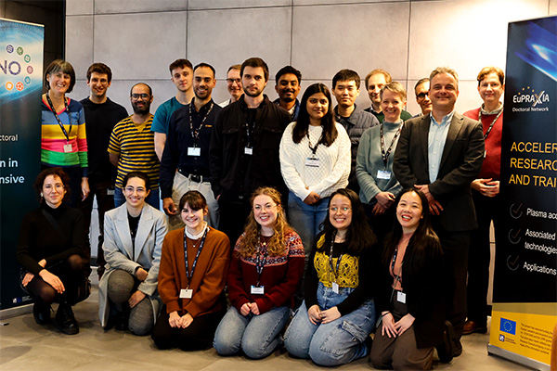
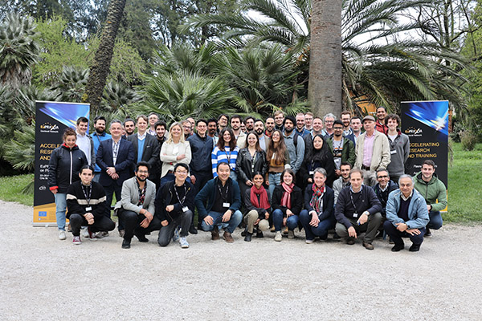
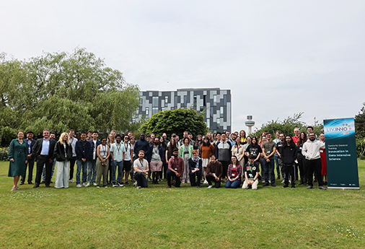
Training activities (Liverpool)
Liverpool Virtual Seminar Series on Data Intensive Science
University of Liverpool’s LIV.INNO CDT Student Seminar Series
LIV.INNO and EuPRAXIA-DN researcher training in Liverpool (November 2023)
Media Training for EuPRAXIA-DN Fellows (November 2023)
EuPRAXIA-DN School on Plasma Accelerators in Rome (May 2024)
STFC Data Science Summer School in Liverpool (July 2024)

Slide 10
2024 Post-graduate conference

Slide 11
Equality, diversity and inclusion

Slide 12
Base line data
Getting historical data on EDI data for the PhD students and PDRAs impossible task.
Can determine base line gender balance over the last 20 years
Conclude that other characteristics are impossible to determine
Cockcroft academics can monitor, but low statistics and therefore noisy
Lauren has produced a ”copy” of the IoP EDI survey, so we can at least bench mark the Cockcroft against wider UK physics
Similar data does not exist for the IET (discussions with Graeme and other IET members)

Slide 13
Key baseline statistics
Institute of Physics report
Female fraction stable at 25% in physics throughout education
Physics at 17% non-white at UG decreasing to 14%
0% for PhD black or British black vs higher proportion of the local population (wider problem for physics)
13% with disabilities
Data for different socio-economic backgrounds not in report (universities will have this)

Slide 14
Cockcroft EDI strategy
Build an inclusive and supportive ‘Cockcroft community’.
Improve diversity of PhD students and PDRAs, increasing the representation of women, Black, and underrepresented ethnic minorities PDRAs and students.
Ensure CI public outreach activities and events encourage participation from a wide range of communities, in particular, under-represented groups.
To have CI EDI champions (at least one from each CI Partner) to act as point of contact for CI staff and students. These EDI representatives will offer advice and signpost services and support available within the CI partner organisations.
To promote and encourage best practice in EDI within partner organisations.
Take action to further understand and improve the experience of CI staff and students through yearly staff surveys.

Slide 15
1. Cockcroft community
Near term actions:
Create spaces and events for PhD students to interact, formally and informally, including coffee before CI lecture, PG conference.
Update the PG handbook to include a statement of expectations around behaviour and professionalism.
Review current induction programme for staff and identify areas of improvement
Expand CI Awards recognizing research excellence and outstanding research contributions to also recognize outstanding contributions in: public outreach/engagement and developing EDI initiatives, as well as a best supervisor award. These awards are designed to encourage and celebrate behaviour the CI would like to foster.
Improved shared office space

Slide 16
2. PhD student diversity
Near term actions:
Establish a clear process for reviewing and shortlisting PhD applications that embeds good recruitment practices and ensure that this process is well communicated to CI supervisors. This action includes investigating the possibility of creating a new PhD application portal, with the option of voluntarily submitting EDI data.
Review​​ job advertisements for inclusive wording (by autumn) and a diversity statement.
​Establish a central list of student societies contacts at a wider range of UK universities for targeting PhD recruitment (This includes non-Russell group universities).
￼Advertise more widely and offer more summer internships. Investigate 10,000 Black Interns programme, with the view to offering an internship through the programme.
Linking PhD student allocation to transparency around application processes and shortlistig
Done for academic hires, but is it for PDRA?
Summer student web page updated
10,000 Black interns almost impossible to engage with as the Cockcroft

Slide 17
3. CI public outreach activities and events
Near term actions:
We will identify the barriers to participation in public engagement activities faced by specific underrepresented audiences (E.g. the visually impaired, Deaf and hard of hearing, mobility impairment such as wheelchair users).
Identify critical areas of Widening Participation and Access which can be targeted as a priority for engagement (engagement with economic deprived communities, for example).
Review CI public events and communication for accessibility, inclusive language, and broad representation of CI staff members and students.

Slide 18
4. CI EDI champions
Near term actions:
Create a dedicated CI web page for EDI, which includes names of the EDI representatives and their role.
​Promote the role of EDI representatives to all CI staff to ensure they know who to contact if needed, through CI Away Day talk and email communication to all CI staff and students.
Draft web page created. In addition, with wellbeing and whistleblowing

Slide 19
5. promote and encourage best practice in EDI within partner organisations
​​Near term actions include: ￼​
Establish connection (where there is not already one) between CI EDI committee members and their employing institution’s EDI team.
​Keep abreast of what is EDI ‘best practice’ through engaging with material published by organisations such as AdvanceHE and Mental Health First Aid England (MHFA).
Survey CI partner EDI policies and strategies to measure against EDI best practice, and promote change in areas of deficiency. ​￼​This includes reviewing what training is offered relating to unconscious bias and good recruitment practice.
CI EDI committee members will encourage CI University partners to sign up the UK Government pledge on the non-use of NDAs in cases of workplace harassment.
Formed new group of partner EDI representatives but still not complete

Slide 20
6. CI staff and student surveys
Quantitative data:
To create initial benchmarks against which to set objectives and targets. Future surveys will also measure progress and impact and adjust targets upwards over time (E.g. % of Black PhD students).
Understand patterns of application/success/outcomes for PhD students, to enable strategy and actions to be focused on key areas of attrition, and to report to STFC these data as required.
Qualitative data:
To understand and benchmark attitudes and beliefs among current staff and students, to set priorities for future work around culture change.
To measure the success of race equality initiatives in delivering culture change, through changes over time in attitudes and beliefs.
To understand experiences among disabled, female, LGBTQ+, and BAME staff and students, including instances of exclusion and micro-inequities to understand where this is happening and identity how to best address it.
To understand the experiences of part-time staff, prevailing attitudes, and micro-inequities that impact inclusion and sense of belonging.
To measure progress over time in reducing incidents of harassment/micro-aggressions.

Slide 21
Outreach and communications

Slide 22
National post-doc appreciation week

Slide 23
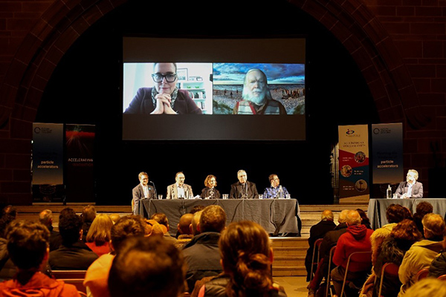
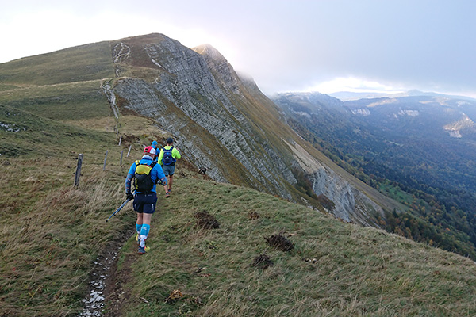
Outreach and public engagement activities
Ri Christmas lecture livestream from University of Liverpool (December 2023)
Beyond Boundaries: A Dialogue on Science and Faith at Liverpool Cathedral (March 2024)
‘Artificial Intelligence and Aliens’ – public talk as part of STFC Data Science summer school (July 2024)
Launch of Code of the Universe AR app with CERN (September 2024)
Run the Length of the Future Circular Collider (October 2024)
Screening of FCC documentary “Way Beyond” (October 2024)
Physics of Star Wars identified as best practice in outreach globally at APS March meeting; invitations to speak at many additional events; talk on Hollywood Physics also increasingly successful.

Slide 24
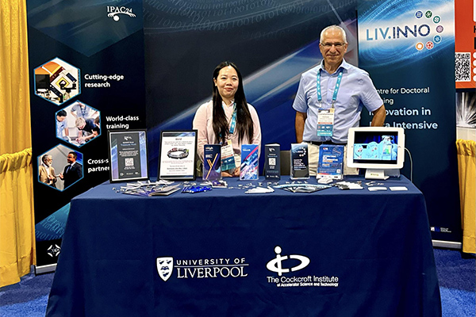
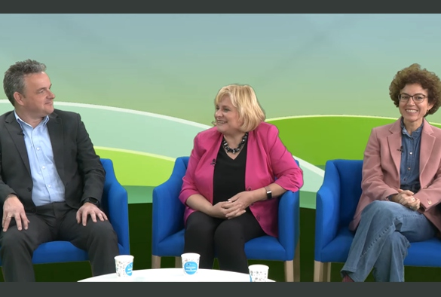
Events showcasing research and training initiatives (examples)
Quantum Helium Atom Microscope project presented at UK National Quantum Technologies Showcase 2023 (November 2023)
CPW invited to speak by EU about best practice in PGR training (November 2023)
CPW contributes to EDI panel at THE Campus Live UK & IE, Liverpool (December 2023)
Industry booth at industry exhibition @IPAC, Nashville (May 2024)
CPW invited to speak on knowledge valorisation at 2024 KoWi Annual Conference, Munich (June 2024)
LIV.INNO industry showcase event, Liverpool (September 2024)
EuPRAXIA Satellite Meeting hosted during BSBF 2024, Trieste (October 2024)

Slide 25
New Manchester president visit to Cockcroft

Slide 26
Director’s ambition in outreach
Have a Cockcroft identity in outreach
Develop initiatives which are co-created and developed by all Cockcroft members
Examples might include
Shared resources (e.g., talks) explaining accelerators and our work, engaging with specific age groups (14-16)
Singular set of Cockcroft demos and activities which all Cockcroft partners (e.g., post-docs and students) can contribute to
Multiple interventions (lab tour, school talk) over 4-6 period is shown to have the best outcomes
Individual academics take responsibility for a school or set of schools

Slide 27
Summary
Deep understanding of Cockcroft PGR students
How to develop the alumni community
Develop this method of working for EDI and outreach
Trying to track the impact is a challenge
Progress is slow and difficult as we do not all work in the same organisation
Poor balance between CI partners in outreach and communications
Liverpool’s output dwarfs all other partners combined
Individual academics have outreach activities which are personal or focused on a particular interest

