Slide 1
HL-LHC activities at Cockcroft
Prof Graeme Burt
(thanks to Carsten Welsch, Nik Templeton and Rob Appleby for slides)

Slide 2
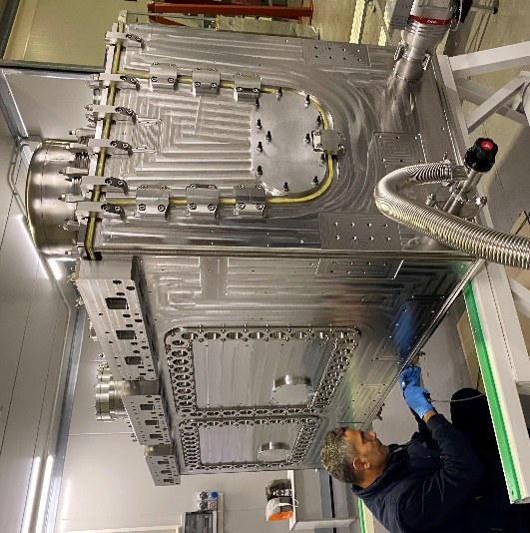
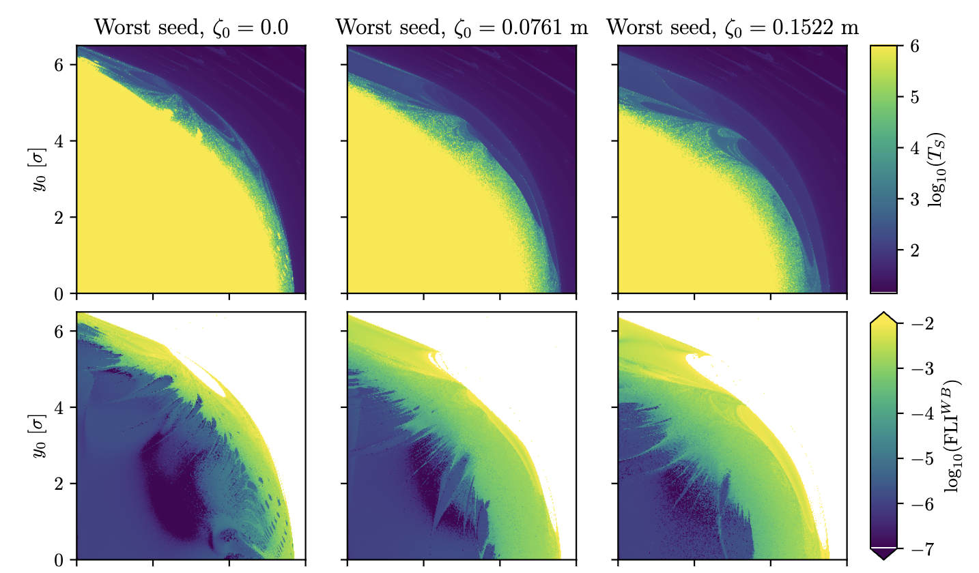
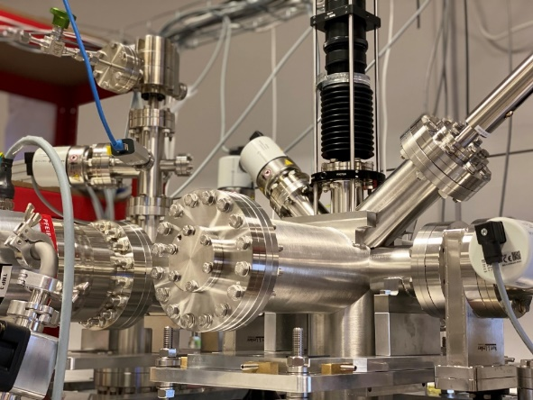
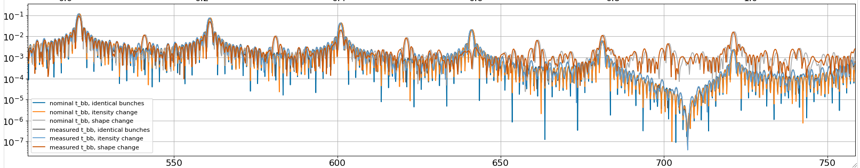



Cockcroft HL-LHC activities
Beam Gas Curtain
Crab cavity construction and beam dynamics
Jk (arb. Units)
Frequency (MHz)

Slide 3
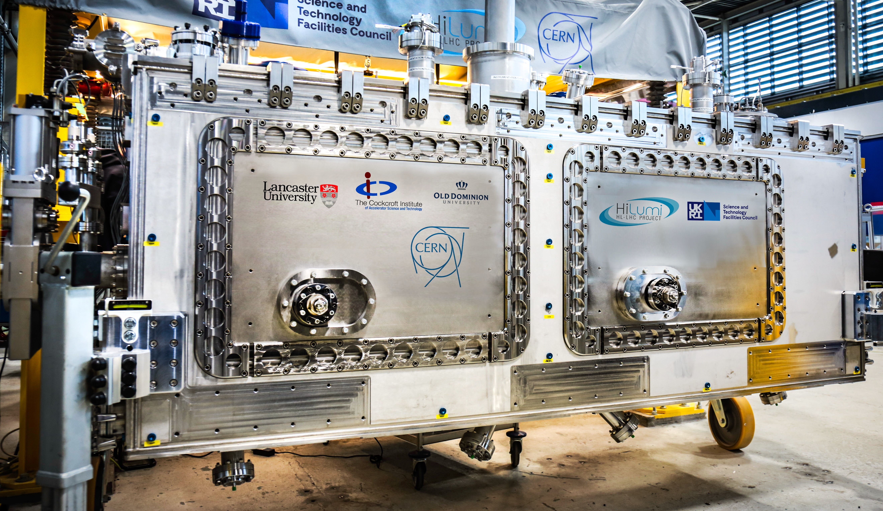
SPS RFD crab cavity

Slide 4
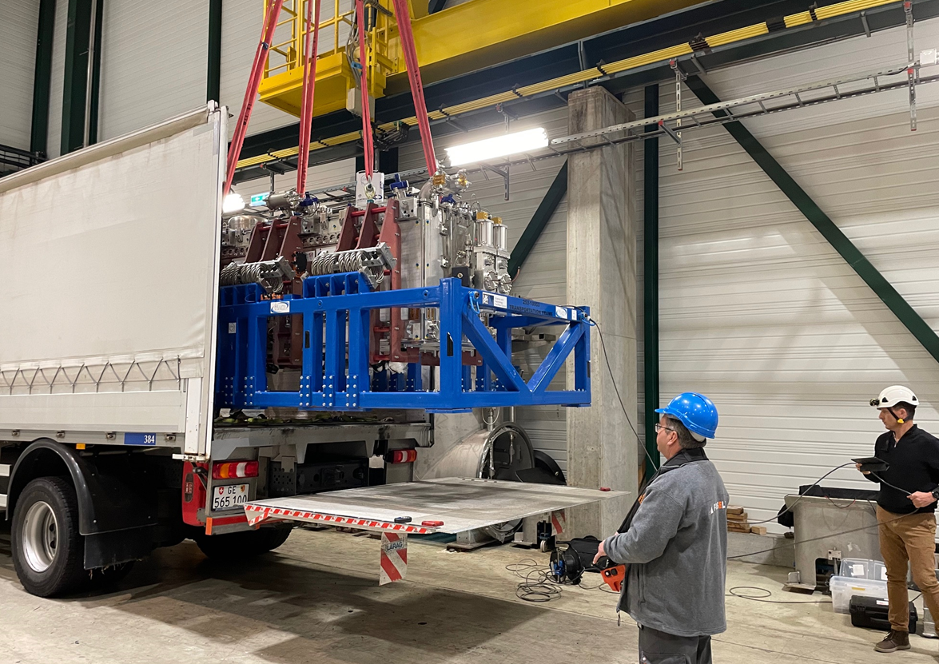
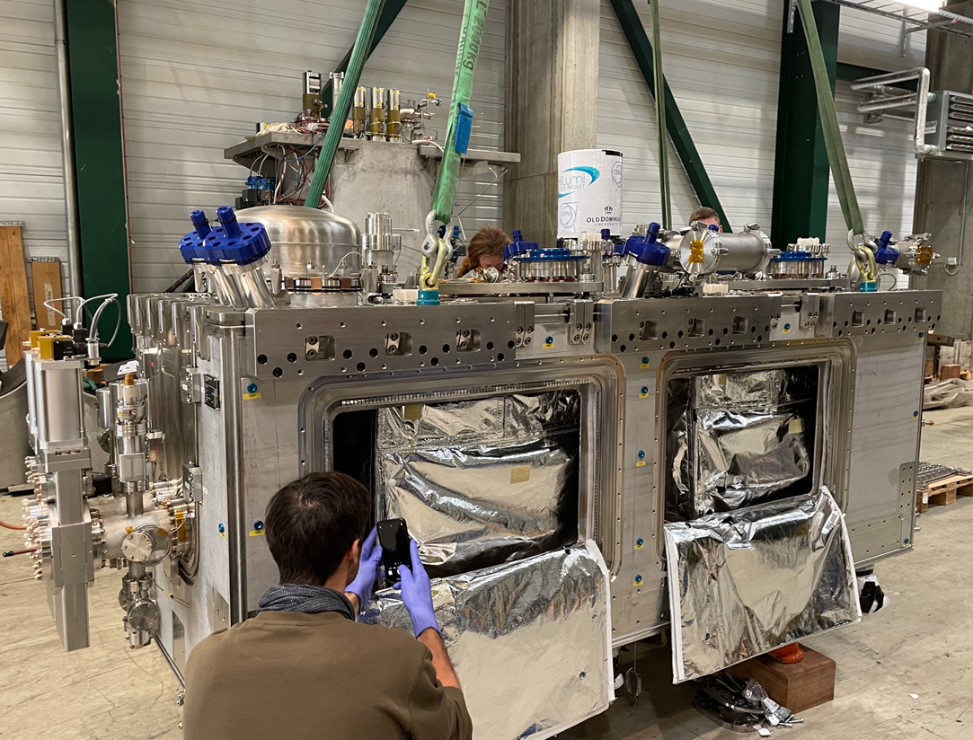
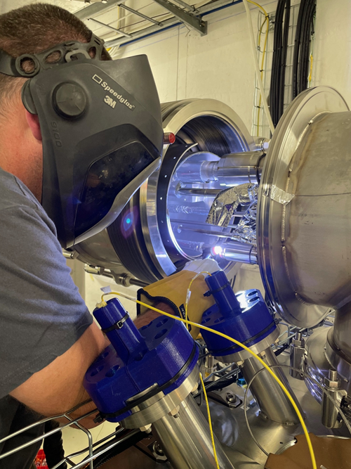
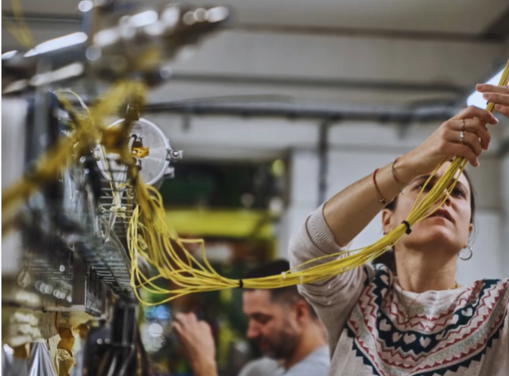
RFD cryomodule in SM18
Arrival in SMS18 (23rd Oct 23)
1st inspection (23rd Oct 23)
Intensive testing program implemented in SM18 bunker to allow full verification of RFD CM.
Validation of the cryomodule at 2K required before the installation in the SPS.
Welding of lines + NDT (7th Nov 23)
Alignment and CRG (10th Nov 23)

Slide 5
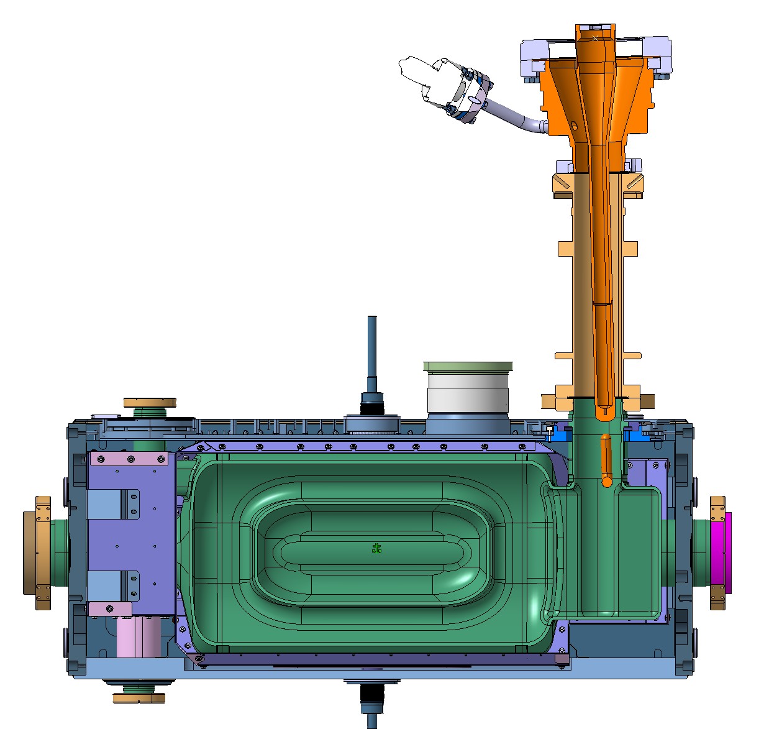
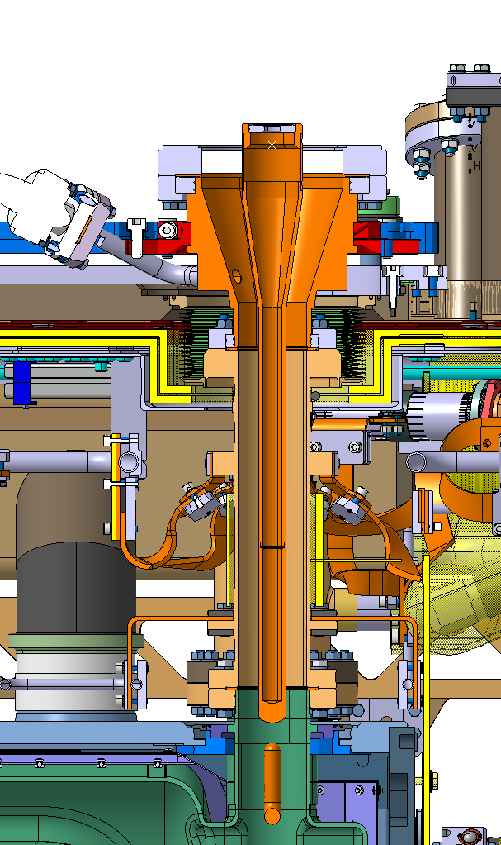
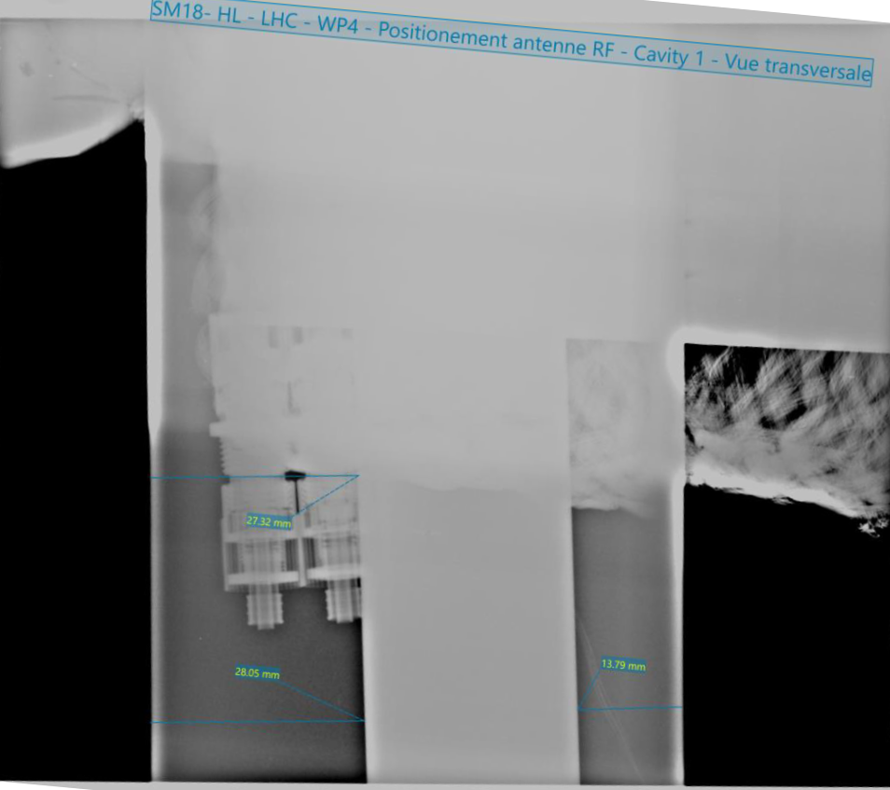
Issues on initial testing
2 critical NCRs postponing the installation at SPS (YETS 24-25).
  Tilt of the FPC on CAV 1 – short circuit.
  Tilt & Vacuum leak on the FPC of CAV 2.
Cavity 2, FPC
Vacuum leak
Cavity 1, FPC short circuit
X-ray
NCR: EDMS 2995980
NCR: EDMS 2995891

Slide 6
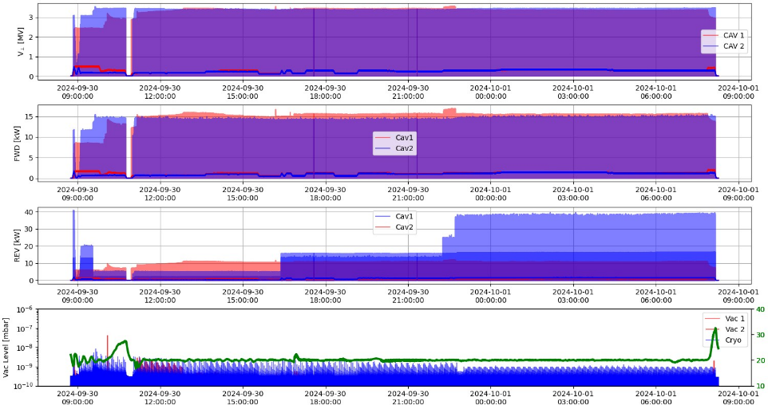
RF Conditioning and Voltage ramp-up
2nd RF conditioning of CAV 2 completed much faster than 1st time (~2 weeks).
Both cavities reached 3.4MV in pulse mode ( ~100ms), next step CW.

Slide 7
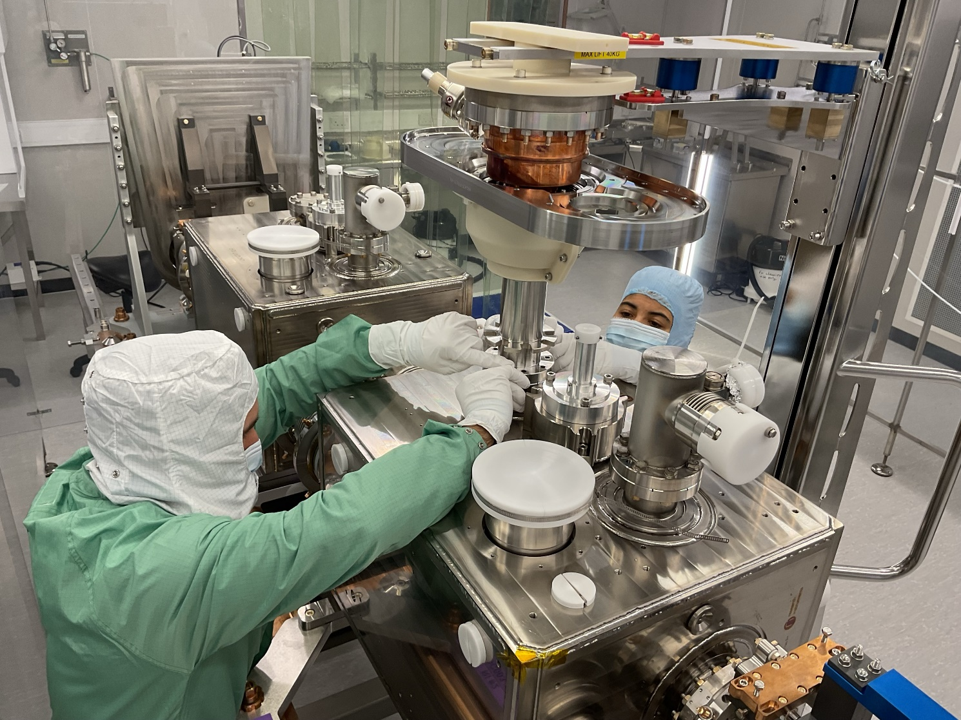
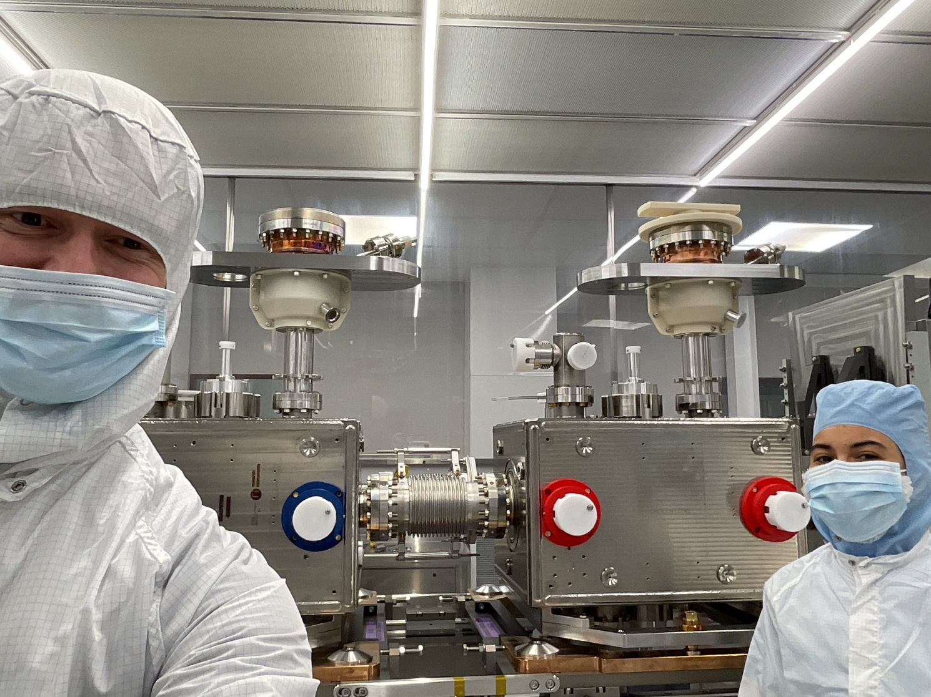
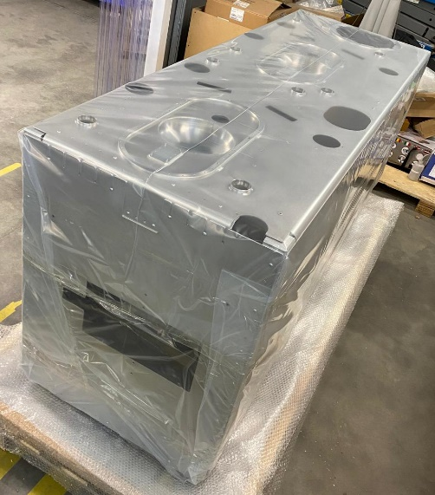
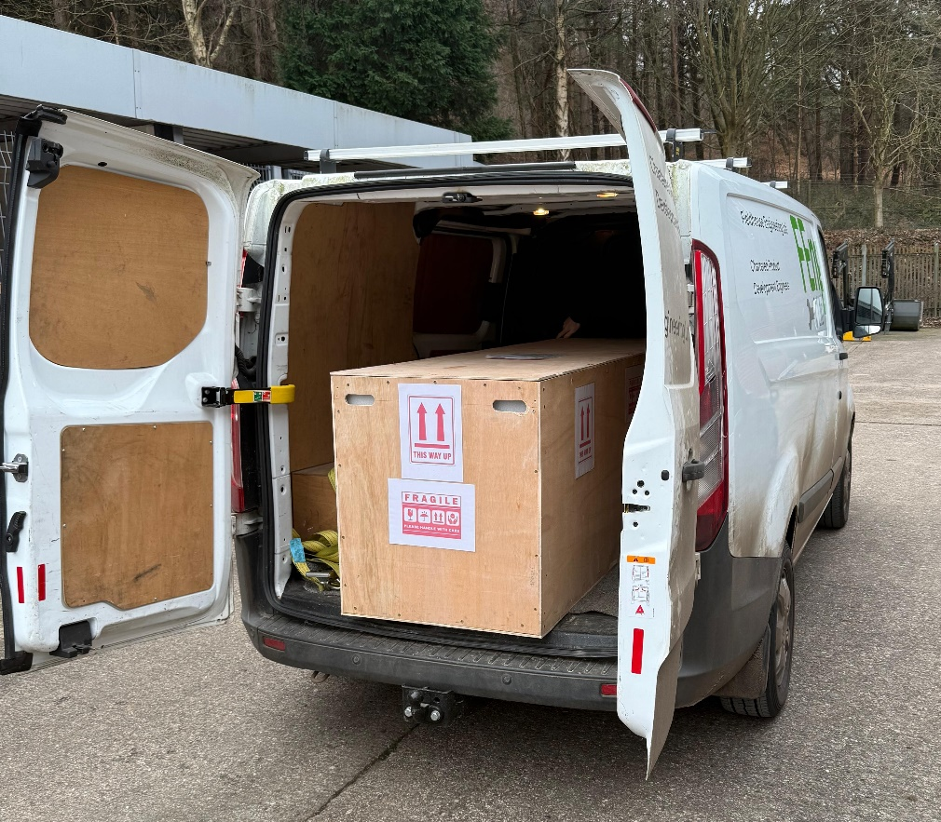
HL-LHC-UK Crab Cryomodule Status
Steps1 & 2 – ISO4 string assembly complete
  Ready for final beamline leak test & RGA
OVC delivered 30th Jan
  Incoming leak test passed, fiducialisation next
Thermal screen delivered 23rd Jan
1st batch (7/13) non-biphase cryolines delivered

Slide 8
Crab Cryomodule Summary and Outlook
RFD prototype has now had the coupler non-conformity corrected and both cavities have reached design gradient in pulsed mode
One cavity needs more conditioning to reach the design gradient CW but there is no known showstoppers it just needs time
The DQW series procurement is almost complete, we have the first set of most components and the remaining sets are well advanced
Clean room string assembly is now complete for the 1st series cryomodule, and we move to the next step in assembly

Slide 9
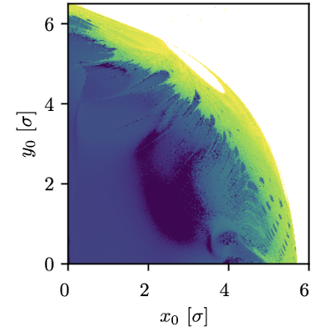
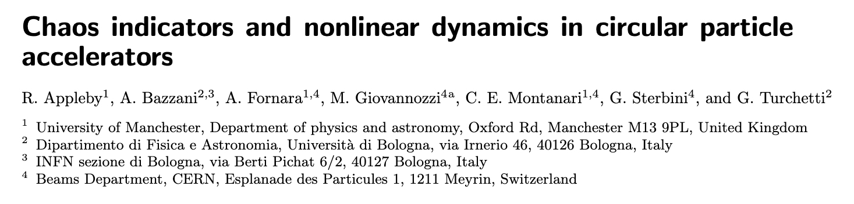
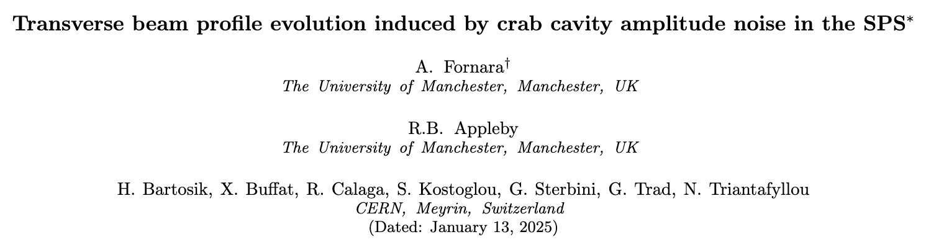
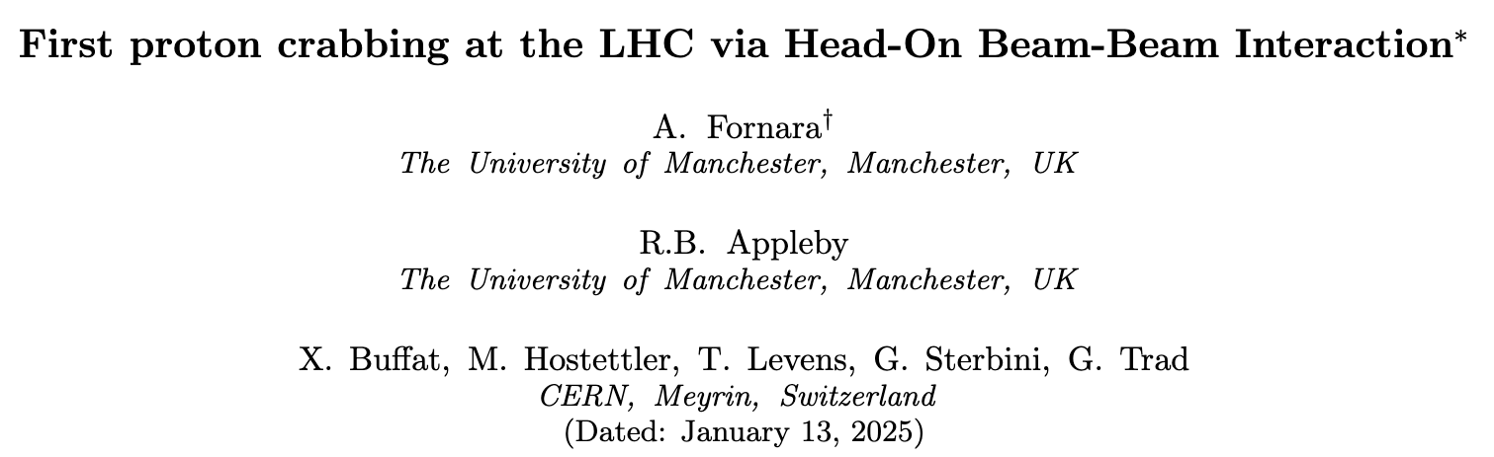

Nonlinear Dynamics and Chaos
Beam Beam Crabbing
Crab Cavities and noise
Transverse-Longitudinal coupling, Crab Cavities, Beam Beam effects, Dynamic Aperture, Chaos.
LHC experiment/simulations on crabbing induced via Head-On Beam Beam interaction.
Crab Impedance
SPS experiment/simulations on Emittance Growth, Tail Population Evolution.
Jk
Frequency (MHz)

Slide 10

Chaos and Nonlinear Dynamics
In the context of non-linear dynamics LHC is complicated.
This problem raised some questions:​
How does chaos affect this complex 6D motion?​
How does the parameter space affect stability?
The three planes (x,y,z) can be coupled together;
Sextupoles and Octupoles are present, together with strongly non-linear Beam Beam [1] effects;
~O(10) hours of collisions (${>10}^{8}$ turns) → useful to look for precursors of chaos [2].
The HL-LHC [3] luminosity upgrade will push LHC to its own limits: ​
The intensity increase to ~2.3×10^11;​
Introduction of Crab Cavities (CC) [4];​
Circular stable region present (and dependent on z);
Stability time and Lyapunov time could be correlated;

Slide 11
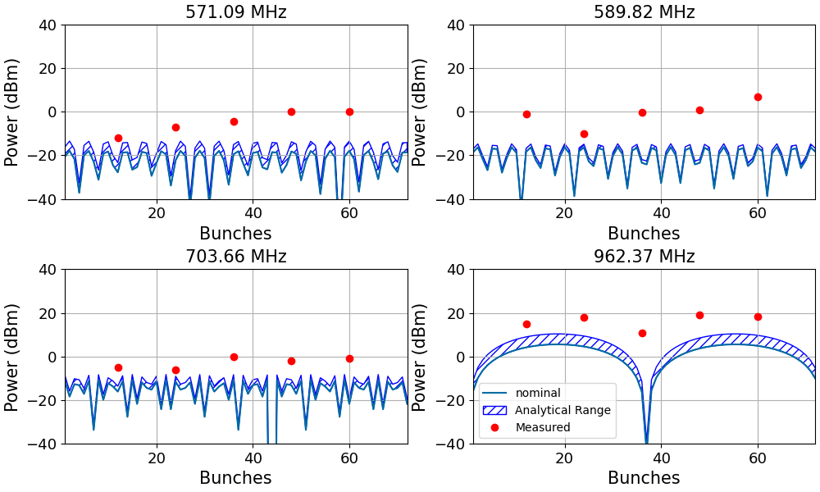
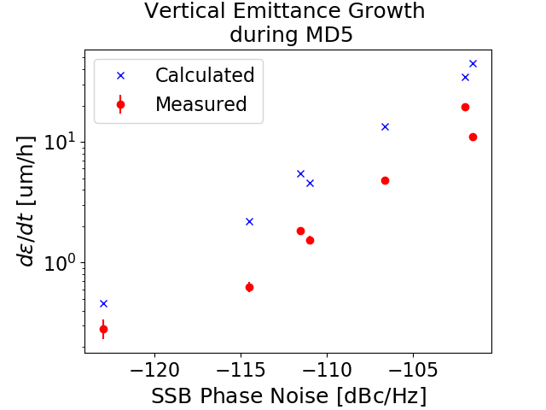
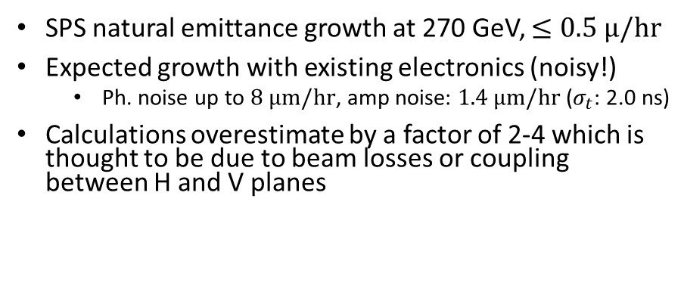
Resolving discrepancies in the SPS crab runs
Power excited into the HOMs is 1-2 orders of magnitude higher than predictions for some modes.
We also don’t see expected dependence on number of bunches, bunch length, or bunch spacing
SPS natural emittance growth at 270 GeV, $≤0.5 μ/hr$
Expected growth with existing electronics (noisy!)
  Ph. noise up to $8 μm/hr$, amp noise: $1.4 μm/hr$ ($σ_{t}$: 2.0 ns)
Calculations overestimate by a factor of 2-4 which is thought to be due to beam losses or coupling between H and V planes

Slide 12
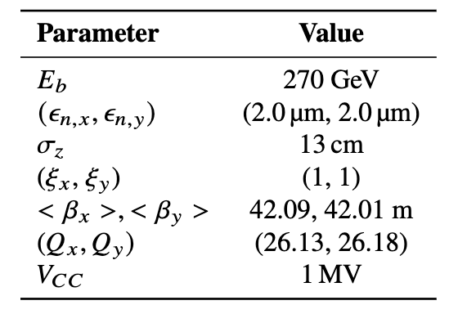
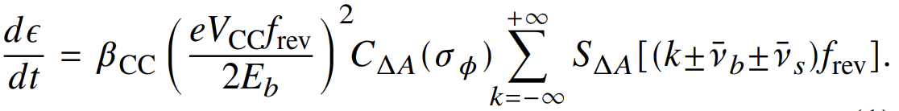
Crab Cavities and Noise
Emittance Growth Rate (E.G.R.) is one of the main concerns for the Crab Cavity (CC) operation in the HL-LHC scenario.
Tight budget : 2%/h [9].
This made the case for a series of studies that started in 2018 and ended in 2023 for what concerns the vertical kicking DQWs CCs in the SPS Accelerator [10] .
Theoretical “Zero Coupling” Model:
Linear Emittance Growth Expected [9].
The experiment took place in the SPS where the Theoretical Model was put to test (and failed due to the complexity of the real world…).

Slide 13
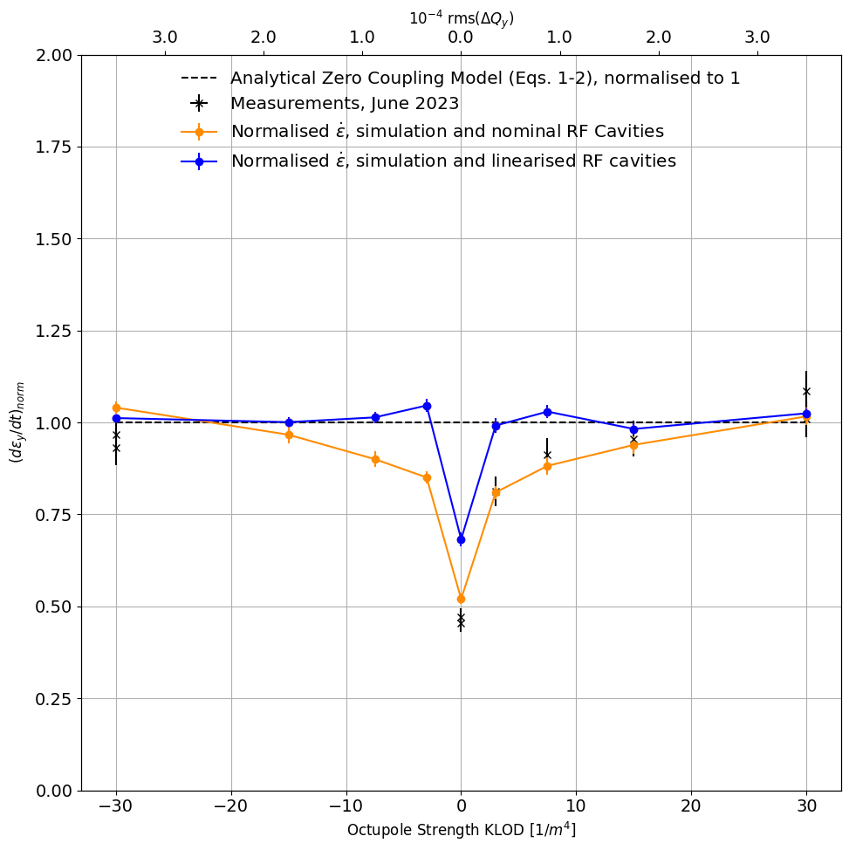
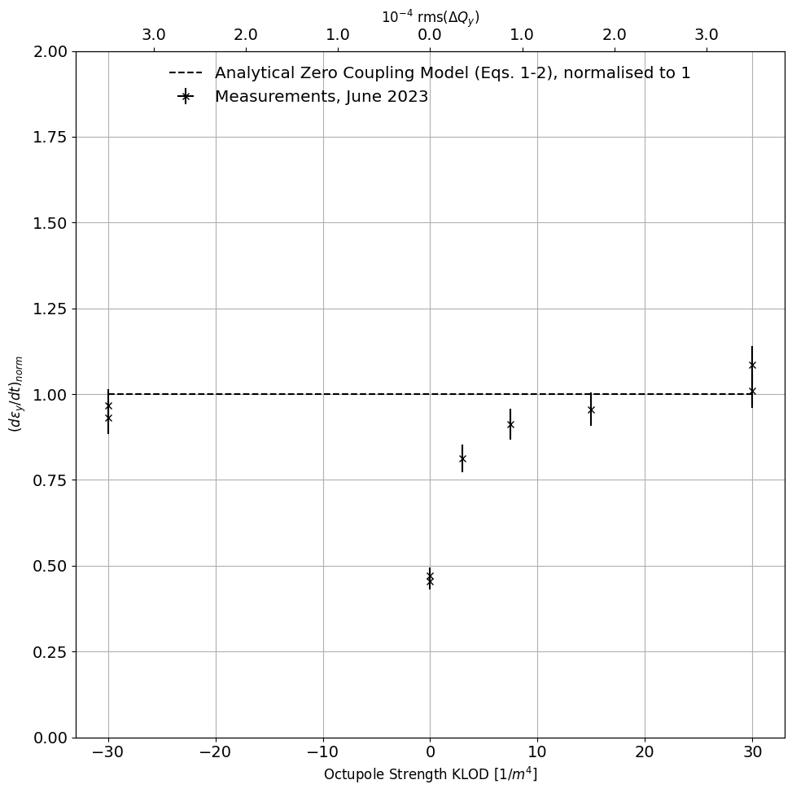
Crab Cavities and Noise
There is a dependence on detuning.
This dependence was NOT predicted by PyHEADTAIL [10].
For high octupole detuning the zero coupling model is restored.
New simulation with Xsuite (full lattice map: nonlinear longitudinal bucket + complete impedance model).
The dependence is perfectly reproduced.

Slide 14
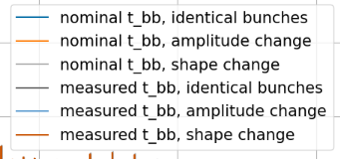
Bunch Shape and Spacing Jitter
Different Bunch Shapes
Analytical
“Brute Force”
Use Beam and RF parameters and work exclusively in freq domain
Derivation assumes infinite unchanging beam → adding jitter isn’t appropriate
Fit Bunch profile data
Generate time domain signal
Perform FFT
20 MHz lines when bunch shape is changed
Jk (arb. Units)
Bunch harmonics (40MHz apart)
Identical Bunch Shapes
Frequency (MHz)

Slide 15
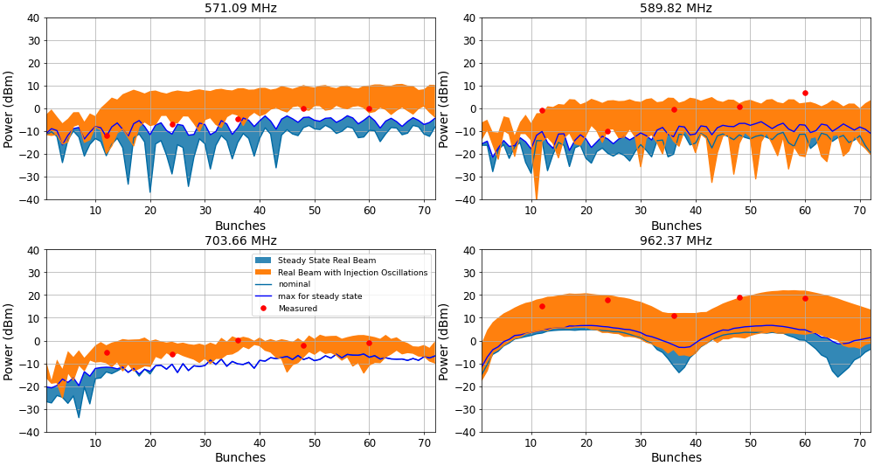
Adding Charge Distribution Jitter
With Real Profiles (1e11 protons per bunch)

Slide 16
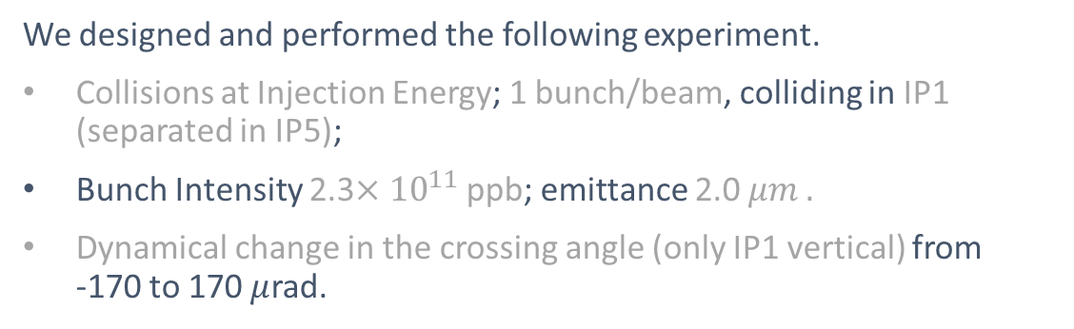
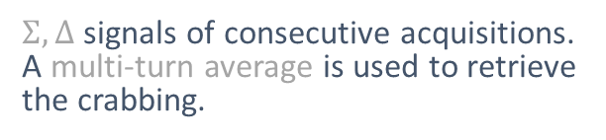
Beam Beam Experiment
We designed and performed the following experiment.
Collisions at Injection Energy; 1 bunch/beam, colliding in IP1 (separated in IP5);
Bunch Intensity 2.3$×{10}^{11}$ ppb; emittance 2.0 $μm .$
Dynamical change in the crossing angle (only IP1 vertical) from
-170 to 170 $μ$rad.
Measured crabbing at the HT monitor location for B1.
The simulation is in perfect agreement with the data.
Head-Tail Monitor [14]
$Σ, Δ$ signals of consecutive acquisitions. A multi-turn average is used to retrieve the crabbing.

Slide 17
Crab Dynamics Summary and Outlook
All crab SPS measurement discrepancies have been fully understood
The emittance growth was a coupling of impedance and noise through octupoles
The impedance was due to the SPS having significant beam transients and harmonics
The work on applying Chaos theory to beam dynamics is proving to be a very powerful technique allowing us to model far more turns than the brute force approach
First crabbing measurement has been done in LHC and will inform how we approach commissioning the crab cavities

Slide 18
Beam Gas Curtain: Motivation
It is essential to be able to measure beam size within accelerators to determine emittance and luminosity.
Current transverse profile diagnostics for the LHC include wire-scanners and the BSRT, both of which have limitations.
The High-Luminosity upgrade will introduce new challenges for existing diagnostics.
The Beam Gas Curtain (BGC) is a non-invasive beam profile monitor that works for all stages of acceleration on the LHC.
  It is the only instrument able to acquire lead ion beam size measurements at injection energy.
  It is the only instrument able to acquire proton and ion beam size measurement through the acceleration cycle.

Slide 19
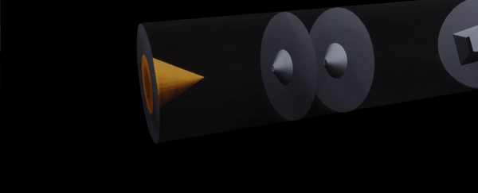
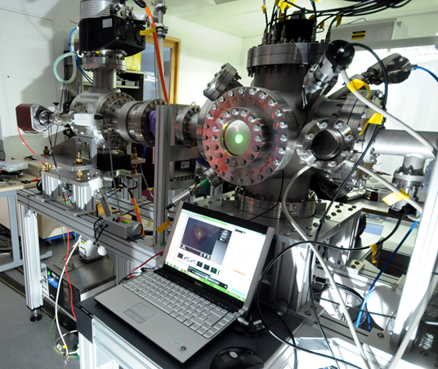
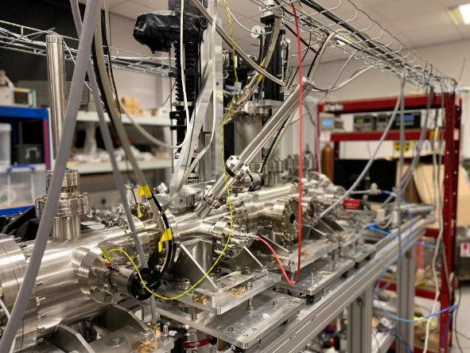
Gas Curtain Generation
Accelerate gas to supersonic speeds.
Collimate the profile using skimmers to a 45 degrees thin curtain.
Credit: Bethany Spear
18 years of research on gas jet technology.
Version 1
Version 2
Version 3

Slide 20
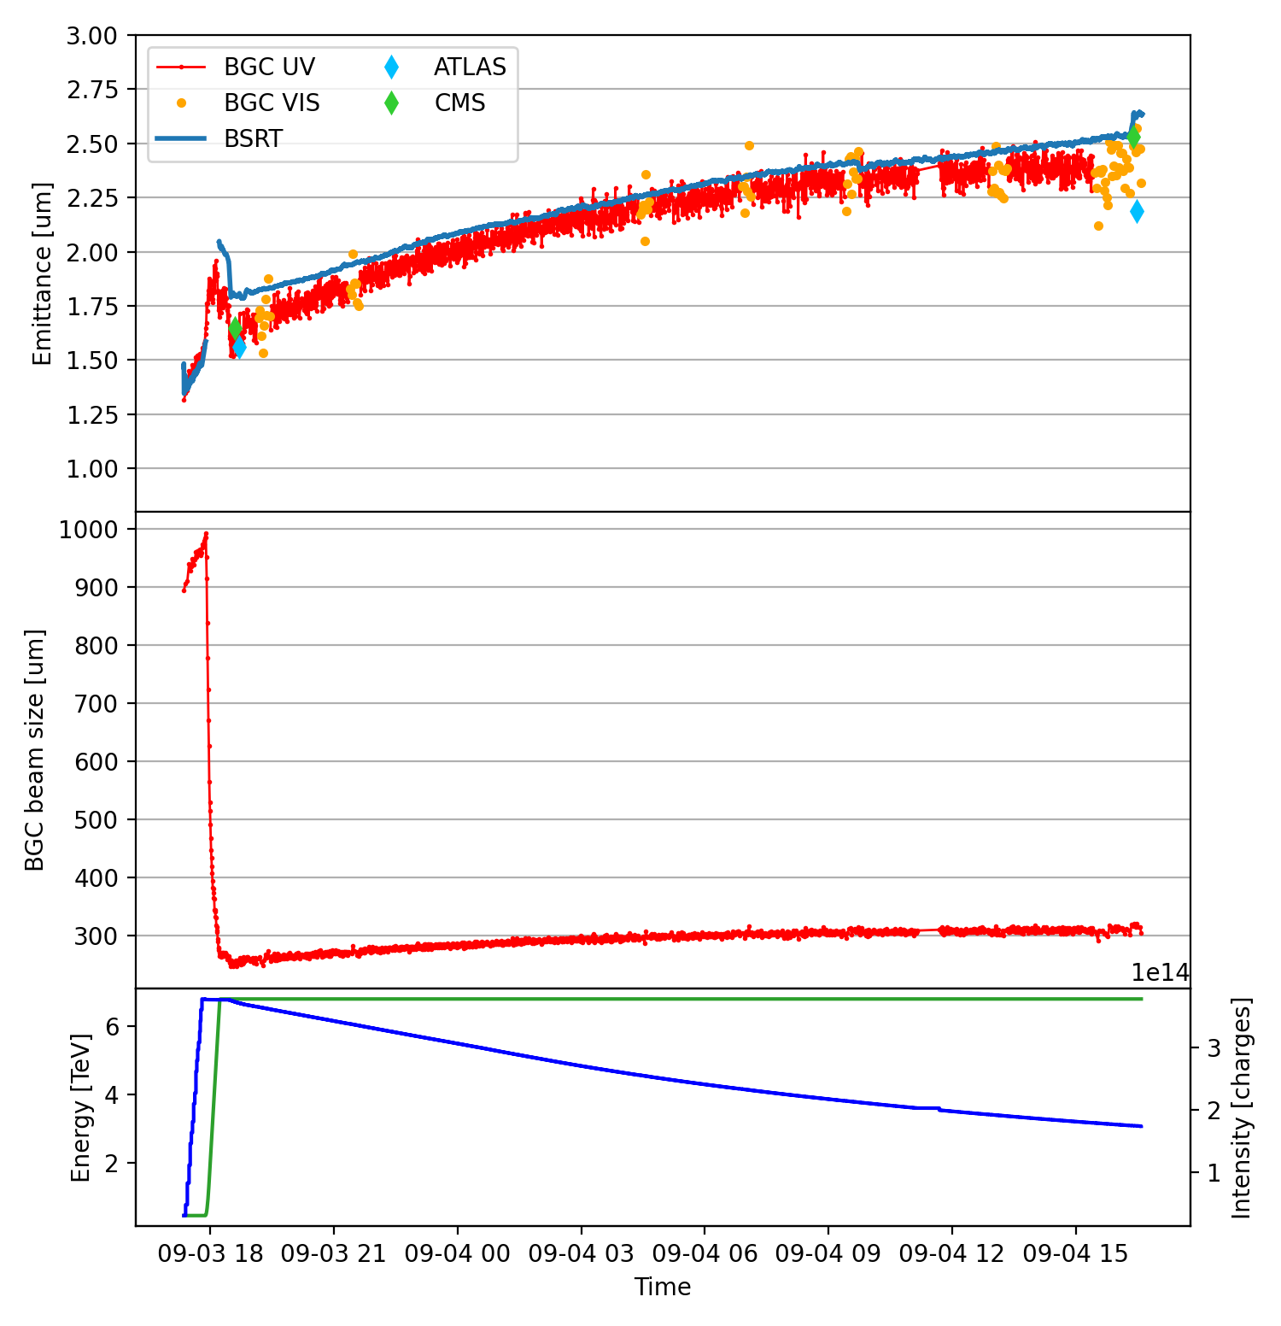
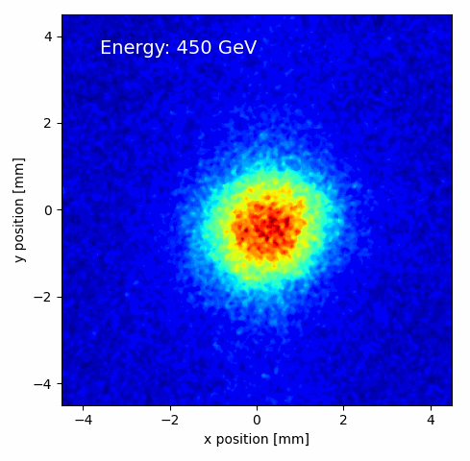




UV and Visible Fluorescence
Proton Physics
Combining UV and visible measurements allows accurate measurements every 40 seconds.
Fluctuations within ±5% in emittance.
#10084
Absolute values still compatible with experiment emittance scans.
>22h SB due to injectors unavailability
Courtesy of D. Butti

Slide 21
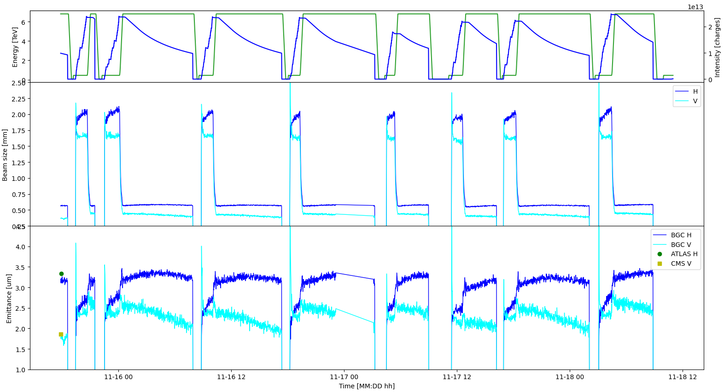
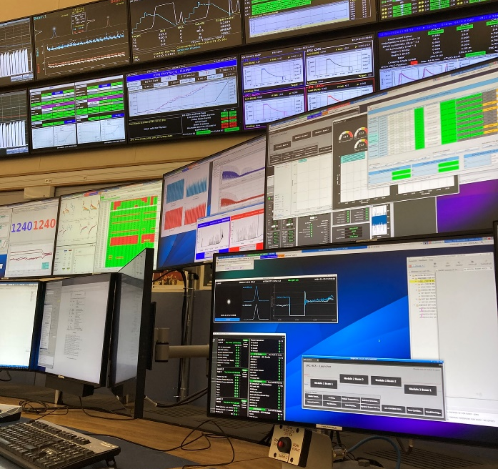
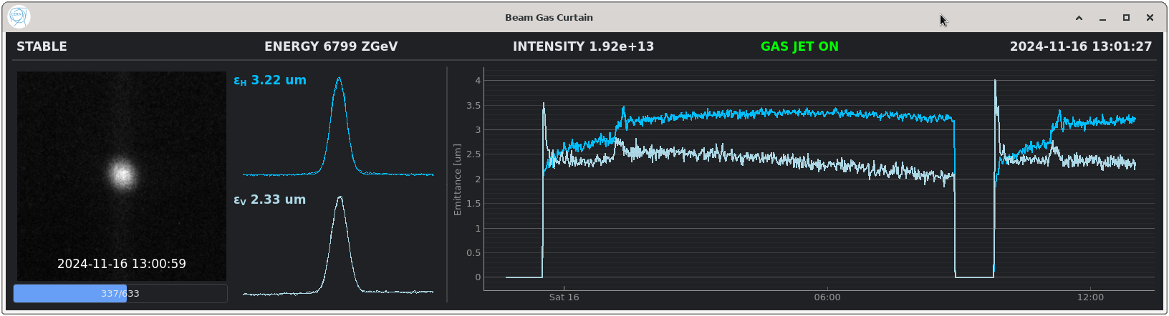
Highlights from 2024 Ion Run
Ion Physics
BGC continuously running throughout ion run, close to operational instrument.
Online average emittance measurements.
Courtesy of D. Butti
Notes:
Larger cross-section and lower SR, even easier than Protons.

Slide 22
BGC: Summary and Outlook
BGC performance as emittance monitor thoroughly assessed in 2024; talks e.g. at IPAC’24, IBIC 2024 and IPAC’25.
Achievements with proton beams.
  Accurate + reproducible measurements for horizontal direction in stable beams.
  Combined UV-visible operation provides the best option for the entire fill.
Achievements with ion beams.
  Stronger fluorescence and larger sizes simplifies BGC operation.
  Effective online emittance monitoring during ion physics production.
Excellent basis for healthcare applications (£340k JetDose award)
Next:
  Install second BGC monitor for Beam 2 during LS3.
  Very high interested to use BGC to optimize machine performance, measure cross sections, and for advanced applications such as halo imaging and control.

Slide 23
HL-LHC-UK Conclusions
HL-LHC-UK at Cockcroft has continued to make critical contributions to the HL-LHC project at CERN.
RFD Crab prototype now installed in SPS, and 1st DQW series is being assembled
We have understood and can replicate all crab SPS test results
BGC has had a very successful run in LHC showing the power of this critical tool.
Have been asked to prepare a bid to STFC this year to focus on benefit realization, to capitalize on what we have delivered for HL-LHC-UK
Will fund UK staff to take part in commissioning of UK equipment on HL-LHC

