Slide 1







(Relativistic Ultrafast Electron Diffraction & Imaging)
Julian McKenzie
Cockcroft Institute SAC
20th February 2025

Slide 2
Contents
RUEDI Recap
Project Status + Timescales
Design updates:
  Beamline split
  Sub-systems
Digital Twin
Environmental Sustainability
Potential CI collaborations

Slide 3
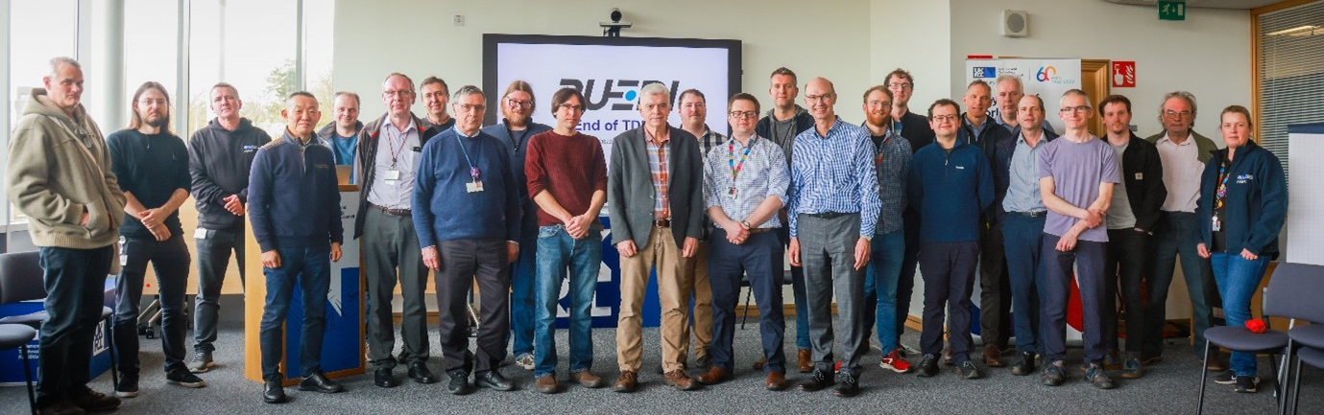
The RUEDI Facility
Relativistic Ultrafast Electron Diffraction and Imaging
Funding announced at end of March 2024
£124.4 million from UKRI Infrastructure Fund from ~2026
https://www.astec.stfc.ac.uk/Pages/RUEDI,-the-World%E2%80%99s-fastest-electron-microscope-and-diffraction-facility.aspx

Slide 4

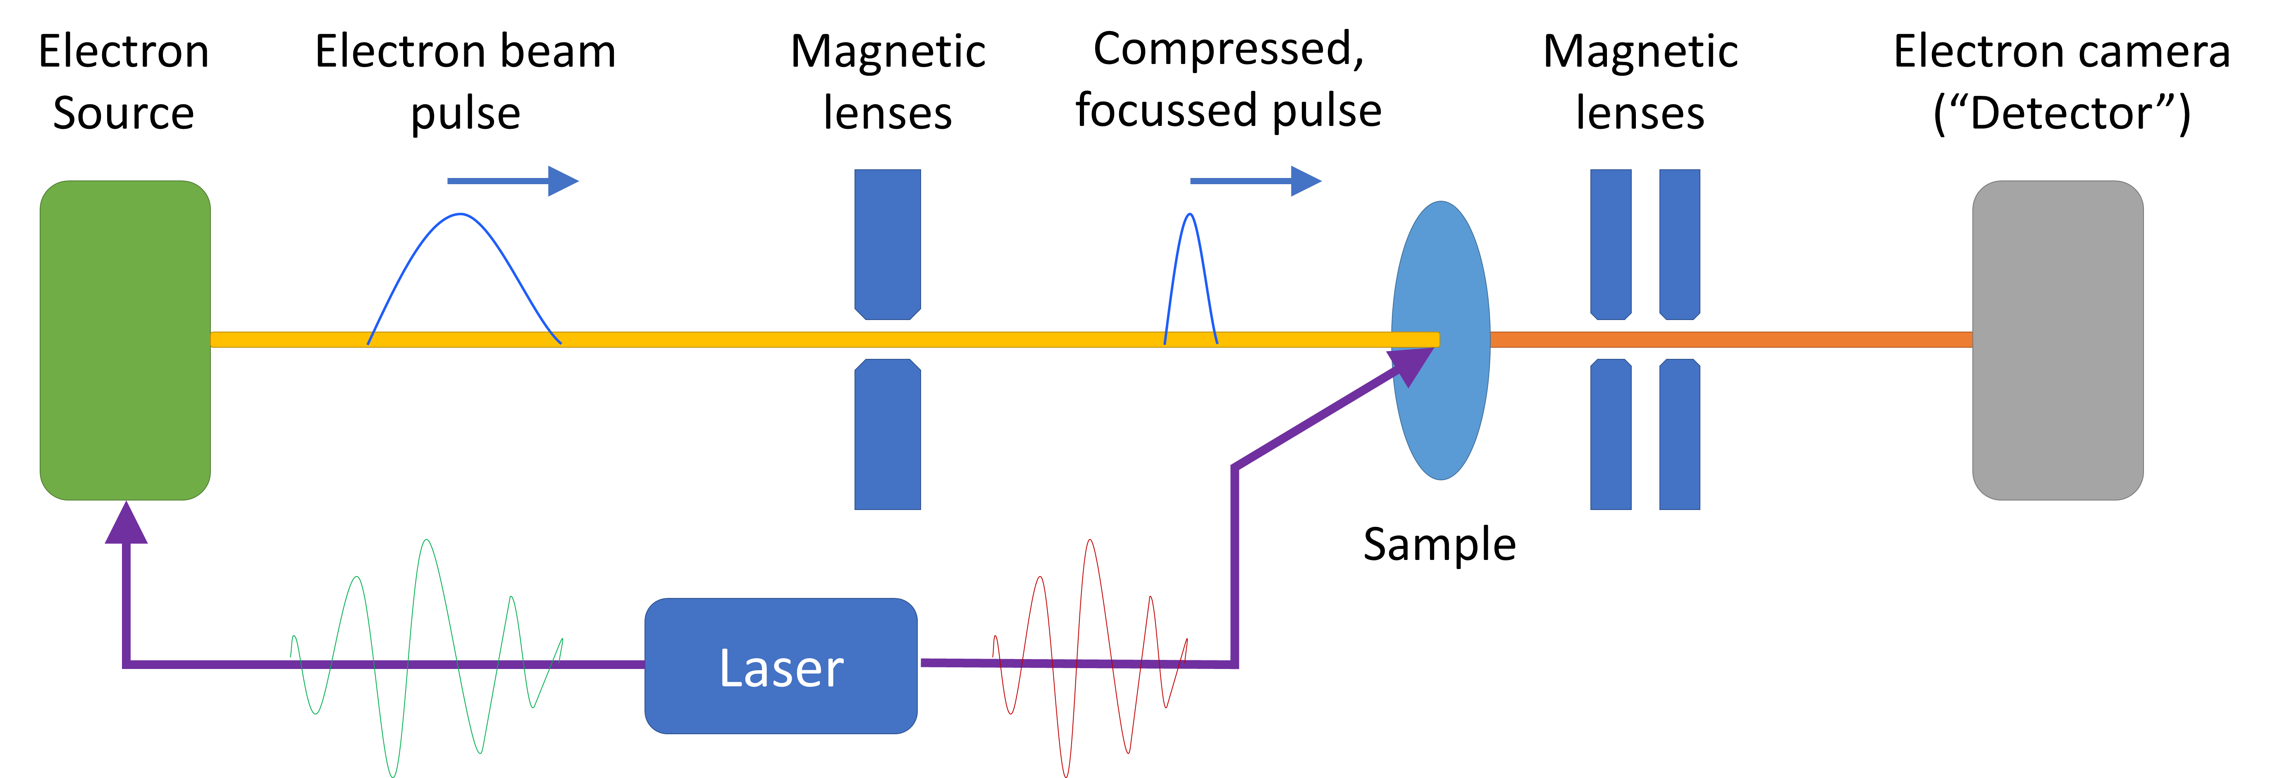
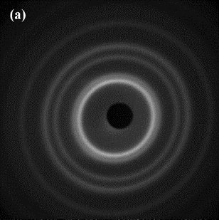
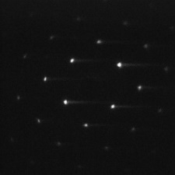
The RUEDI Facility Proposal
A future UK National User Facility
Relativistic Ultrafast Electron Diffraction & Imaging (RUEDI)
Time-resolved pump-probe experiments
With a large variety of:
  Pumps
    Wide range of laser wavelengths, THz, (TW, keV ion source - maybe)
  Sample environments
    Solid, liquid cells, liquid/gas jets, plasmas, cryogenic (down to mK level)
To enable a large range of science
UED | UEM
Ultrafast Electron Diffraction | Ultrafast Electron Microscopy
Reciprocal space | Real space imaging
Structural determination | Direct observation

Slide 5
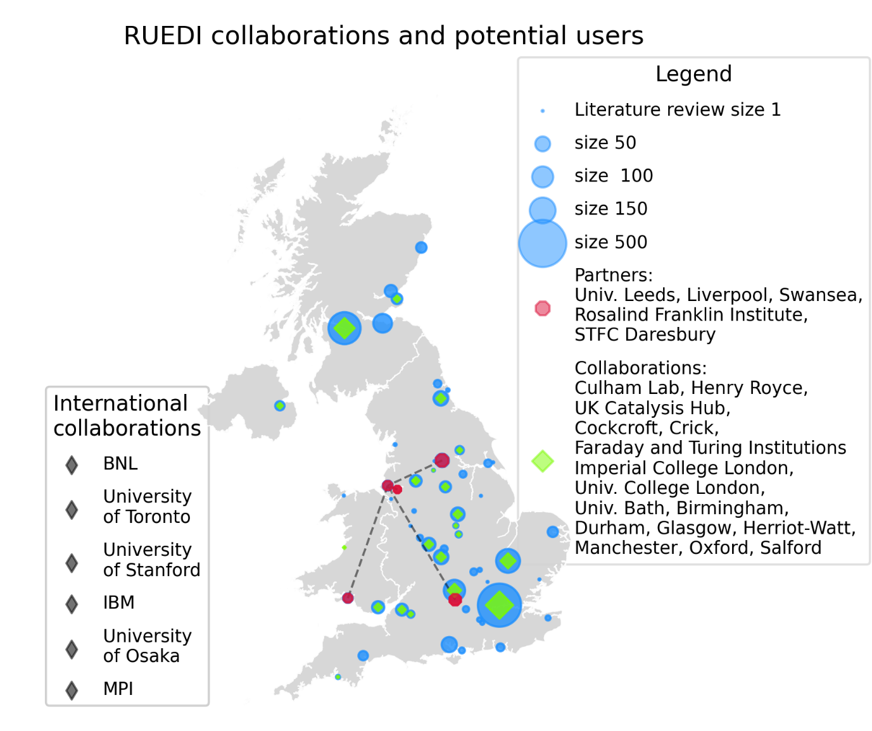




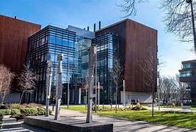
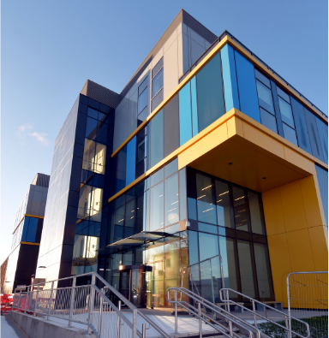
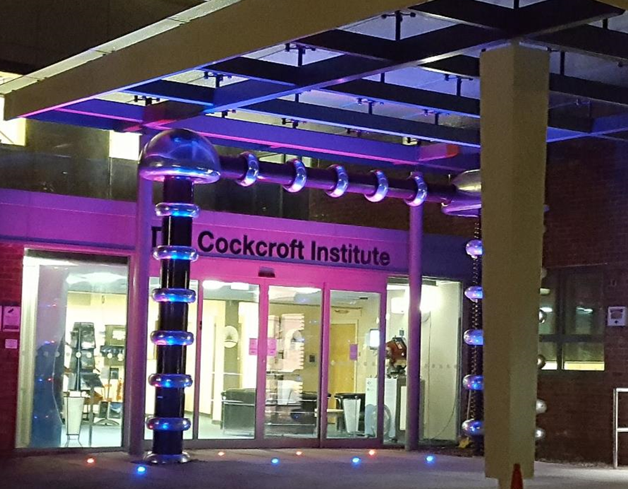


The RUEDI Project
UKRI project through EPSRC -
UK Infrastructure Fund:
And main partners:
Science Team:
Imaging line:
Diffraction line:
The Materials Innovation Factory
Harwell Campus Hub
Cockcroft Institute
Machine will be hosted at Daresbury Lab
Other science theme leads:

Slide 6





RUEDI science
Dynamics of Chemical Change
Quantum Materials & Processes
Biosciences
Materials In Extremes
Energy Generation, Conversion and Storage
Ultrafast low-energy optical switching
Magnetic textures & skyrmions
Topological superconductors
Thermoelectric energy harvesting
Photosynthesis & energy transfer
Cardiac disease related dynamics
Virology & infection
Biological self-assembly/toxicity
Photocatalysis & induced electro-chemistry
Defect kinetics in solar cells
Ion solvation kinetics in batteries
Kinetics of glasses
Chemical complexity across scales
Hydrogen bonding
Pulse radiolysis
Heterogenous catalysis
Astrophysics & warm dense matter
Advanced manufacturing
Nuclear fission/fusion/space
Response to shocks
Wide array of sample environments and triggers
Stroboscopic diffraction
<10fs to 100fs resolution
Cryogenic, mK temperatures
Stroboscopic diffraction
THz & wide optical triggers
<10fs to 100fs resolution
Live cells, liquid environment
Single-shot imaging
0.8nm resolution
<1μs resolution
TW laser >10¹⁸ W.cm²
Single shot imaging
10-100nm
1-100ps
Wide array of laser pumps
NIR to UV
Single-shot / stroboscopic
1nm resolution
<1μs
First round of town halls in 2022
Further town halls 2025: April - September
Week long RUEDI science workshop in September 2025
Key to continue close alignment between science priorities and machine design

Slide 7
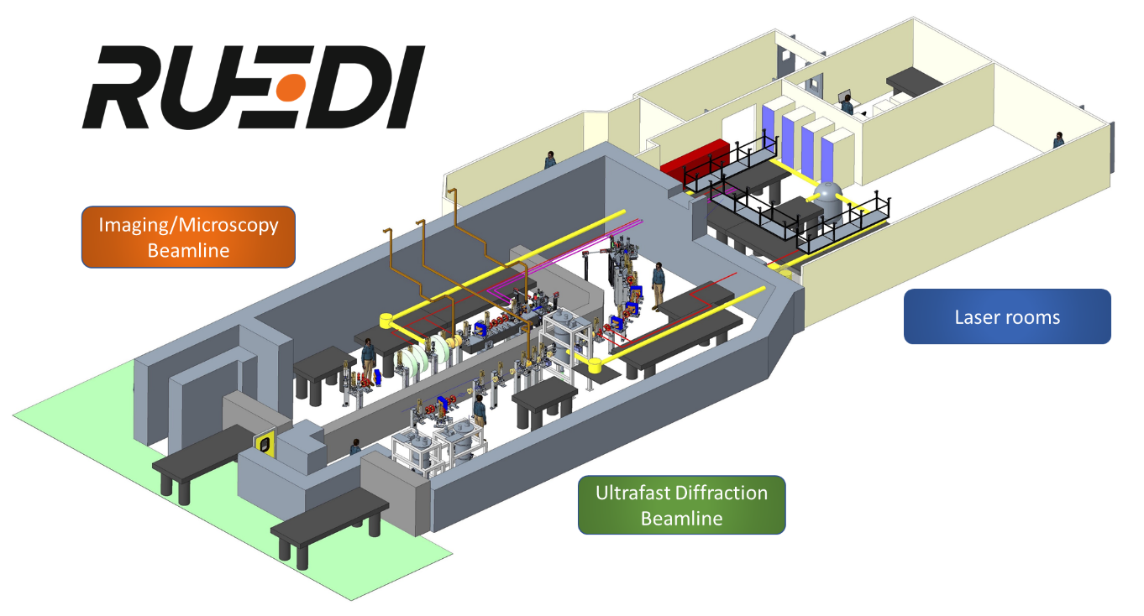
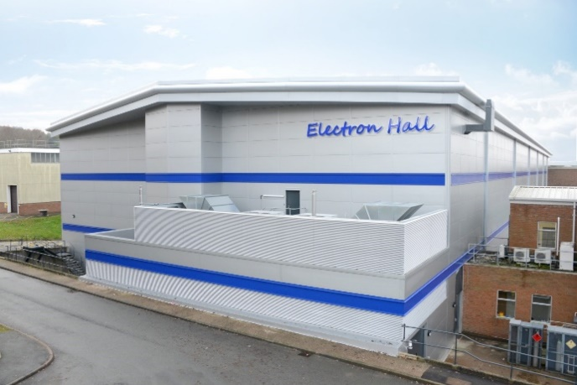

Project status
Technical Design Report completed at end of March 2024
Full project approval announced on 27 March 2024
https://www.ukri.org/news/major-research-and-innovation-infrastructure-investment-announced/
£124.4 million from UKRI Infrastructure Fund from ~2026 for 6 years construction and commissioning
  Subject to full business case approval
  Then handover to user facility
To be sited at Daresbury Laboratory in the Electron Hall, next to existing CLARA facility (S-band photoinjector, 250 MeV linac, 120 TW laser)
7

Slide 8
Timeline
TODAY
Calendar years
2025
2026
2027
2028
2029
2030
2031
2022
2024
2023
2032
+…
Initial funding
Bridging 1
Bridging 2
Capital funding
Ops
Bid
OBC + FBC
Science case
Funding decision 1
UKRI IF award
Funding decision 2
UK IPA Gateway 3
CDR
TDR
Final design
Construction
Users
Currently preparing Outline Business Case
Assumption is for Capital funding release 2026, tbc
5-6 yr procurement, assembly, commissioning
Start Of User Programme c. 2032
After commissioning, 5-year user programme & upgrade cycles; two 5-year cycles guaranteed!
Commissioning

Slide 9
Funding Status
UKRI IF awarded funding, subject to UK IPA Gateway 2 (OBC) and Gateway 3 (FBC) reviews
  OBC submission March 2025, review June 2025
  FBC submission TBC, current assumption Oct 2025, review Feb 2026
Earliest possible capital funding Oct 2026, subject to FBC approval
Currently ~1yr limited bridging funding provided until June 2025
  reduced staff from IF period from ~14 FTE to ~9 FTE
Asking for further bridging funding from June 2025 → capital start
Construction budget includes 26 FTE from Oct 2026 to Oct 2032

Slide 10
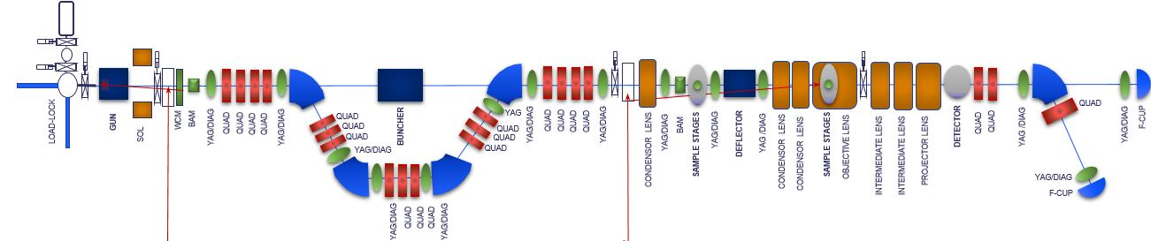
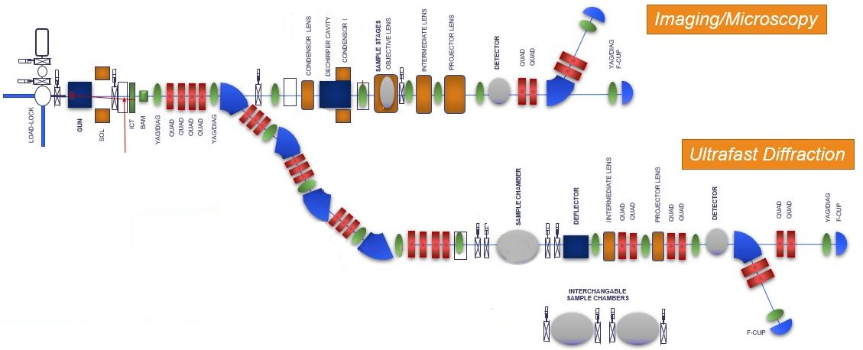
Instrument Design – Evolution 1
Initial concept: 1 beamline for both UED/UEM
Magnetic or RF bunch compression
Two sample / beam interaction points
Issue: different sample locations, beam parameters, and bunch compression on target
CDR - 1 gun to 2 beamlines
Magnetic compressor geometry modified to give separation between beamlines
More space for interchangeable sample chambers
Still compromises performance, especially of imaging line
Photoinjector optimisation for two different beam modes

Slide 11
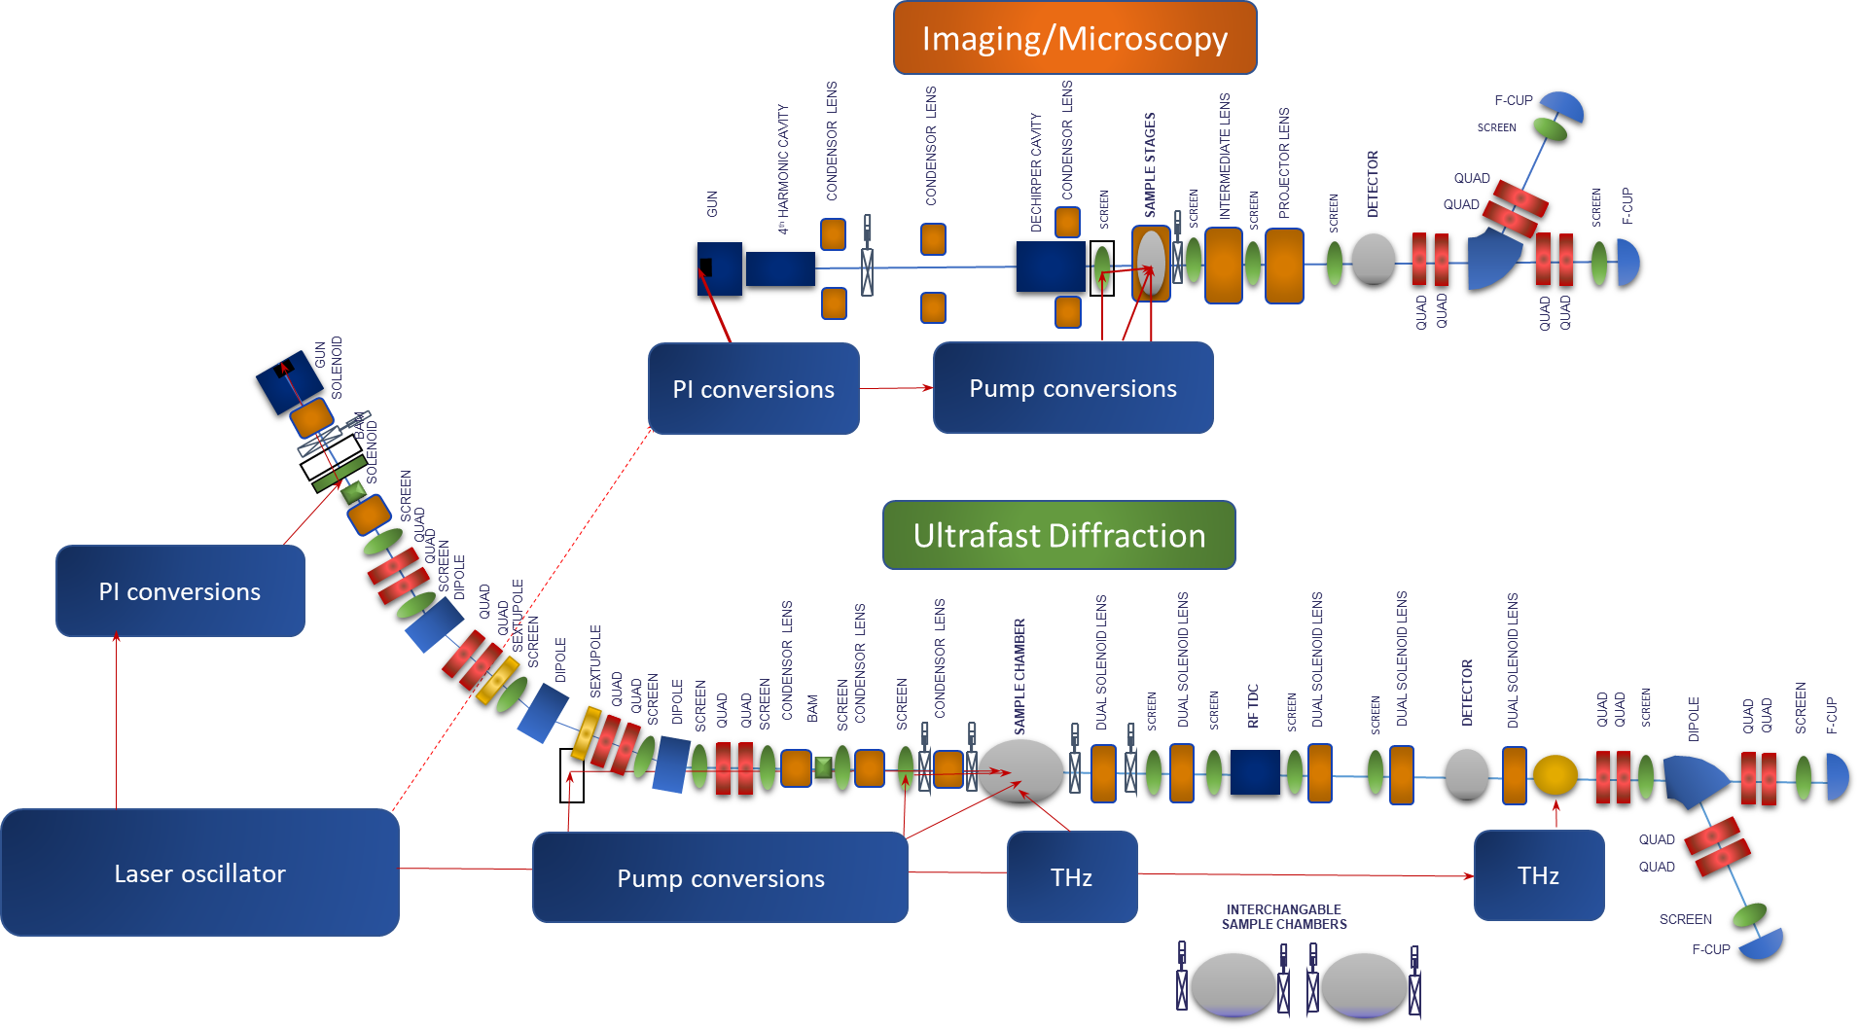
Instrument Design – Evolution 2
TDR
  2 fully separate beamlines, separately shielded
  2 options for Imaging line
    RF option
      3xRF cavity
      Photoinjector (S-band)
      lossless monochromation (X-band)
      dechirp/decelerate (S-band)
    DC option
      Fully DC gun (1-2 MeV), fast chopper
  Redesigned diffraction line
Post-TDR
  Imaging line
    RFI responsible
    DC option favoured
  Diffraction line
    STFC responsible
    Iterations of photoinjector + arc
    Diffraction optics simplification

Slide 12

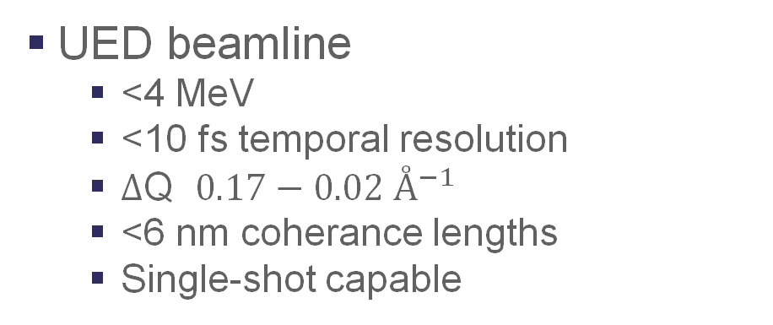
RUEDI Capabilities
UED beamline
  <4 MeV
  <10 fs temporal resolution
  $Δ$Q ${0.17−0.02 Å}^{−1}$
  <6 nm coherance lengths
  Single-shot capable
UEM beamline
  <2 MeV
  μs-scale temporal resolution
  0.8 - 10 nm spatial resolution
  Single-shot capable
Laser pumps
  UV-IR-THz wavelengths
  High intensity TW (>10¹⁸ W.cm⁻²)
  HCF for <10 fs pulse lengths

Slide 13
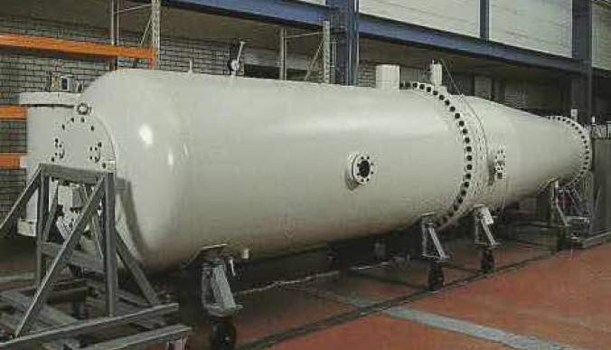
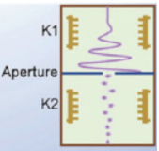
Imaging Source – DC option
We previously looked into a design with an S-band RF gun and X-band lineariser - but DC is now the preferred option
Scale up from proven keV microscopes
DC accelerator + fast chopper
Limited manufacturers of MeV-scale DC accelerators
  Extremely large systems!
  Excellent energy stability
RF-based chopper to form short bunches:
  Good for ms and us-scale
  Potentially down to ps
  Cannot reach fs
  Needs design effort to work at MeV
Source current not high enough to reach single-shot bunch charges at smaller timescales

Slide 14
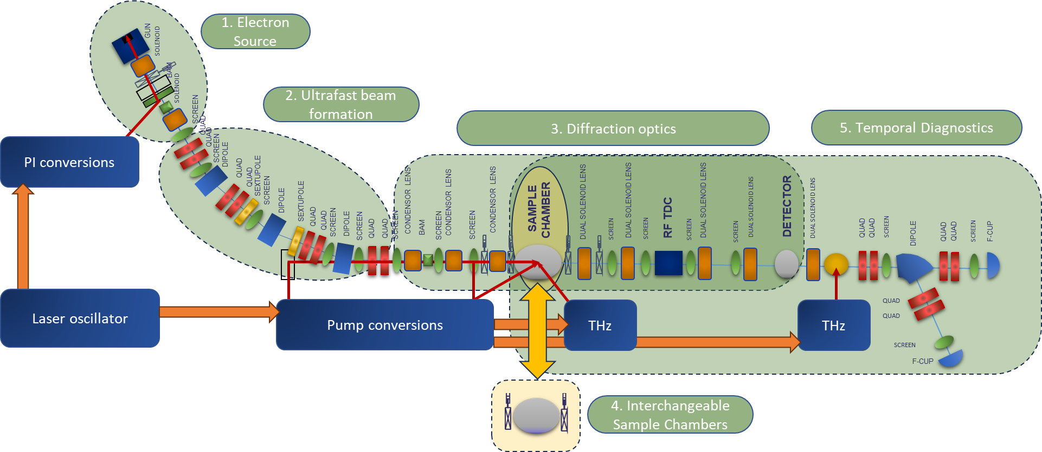
Ultrafast Diffraction Line
2. Ultrafast beam formation
  Simultaneously compresses bunch length and reduces jitter for overall time resolution <10fs single shot
Electron source
  S-band RF photoinjector
  Creates high brightness, short pulse beams
3. Diffraction optics
  Variable magnification + camera length
  Direct electron detector
4. Chambers
  Solid, liquid and gas samples
  mK low temperature chamber
5. Temporal diagnostics
  Shot-by-shot arrival time and fs bunch length measurements
6. Lasers
  Feeds photoinjector, THz diagnostics and pump samples

Slide 15
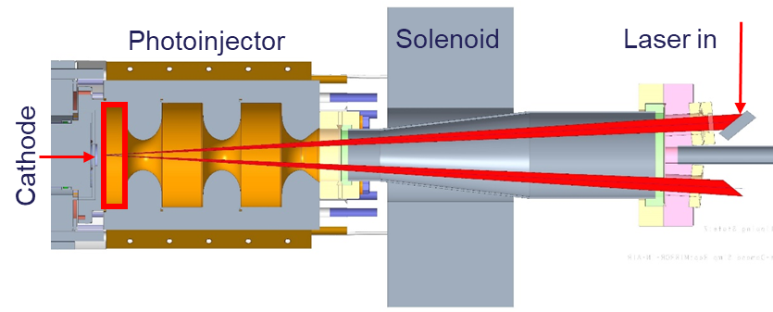
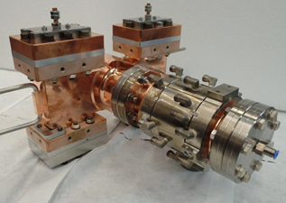
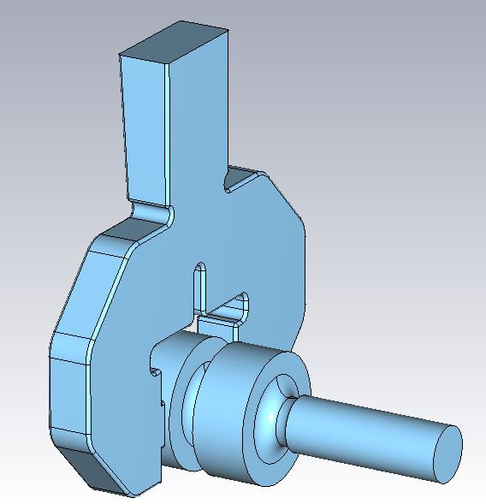
Electron gun overview
Normal conducting S-band RF gun, 4 MeV, <0.5pC
Designed for low dark current
2.X cells
  Cell lengths: 0.45-0.9-1.0
Photoinjector laser
  Front laser injection
  Out of vacuum final laser mirror
  Blow-out regime – short: ~60 fs pulse duration
  Variable laser spot size: 100 um – 400 um diameter
Cathode
  Copper – backwall of electron gun
Side coupled RF
Cooling similar to 400 Hz gun designed for CLARA
1 kHz repetition rate, over-coupled RF for short pulse lengths (~1us)
CST sims with coupler and all 3D elements complete, GPT beam sims, thermal analysis to do
Above: CLARA 400 Hz 1.5 cell
Right: RUEDI 1 kHz 2.4cell
 | 1.4 Cell | 2.4 Cell
RMS bunch length [fs] | 148 | 232
RMS transverse emittance [nm rad] | 36 | 37
Max field on cathode [MV/m] | 115 | 69

Slide 16
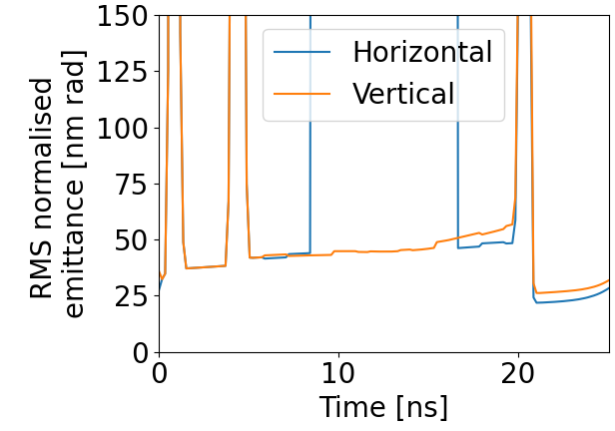
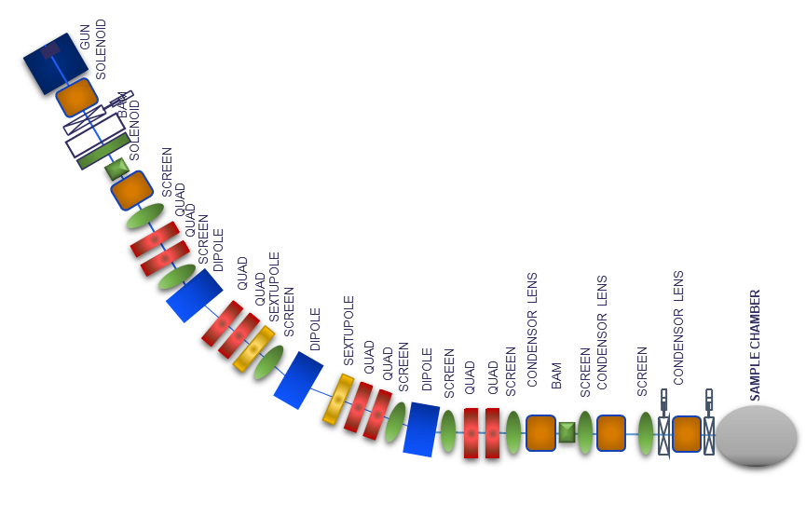
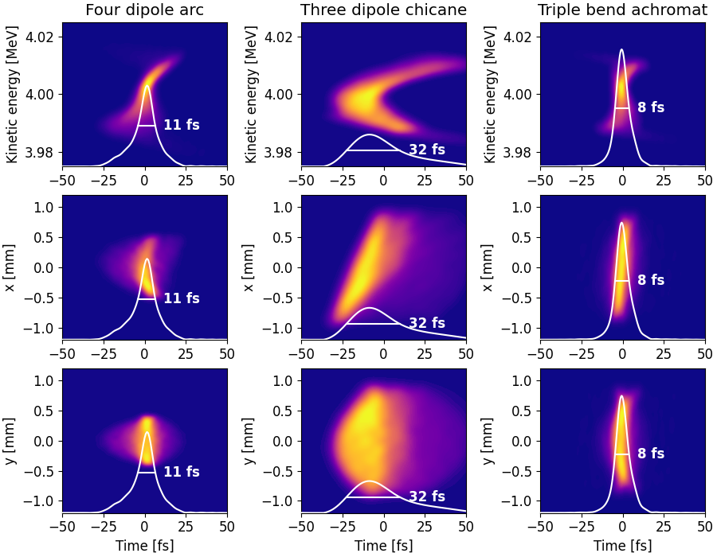
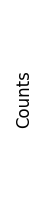
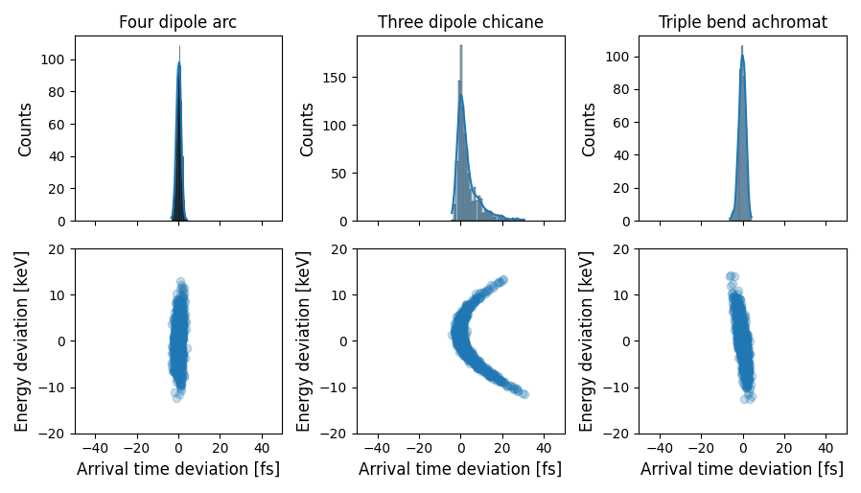
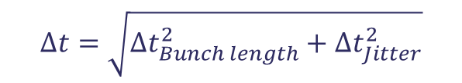
Beam transport arc
TDR compared no compression, RF compression and range of different magnetic compressors
Magnetic main advantage is it removes photoinjector jitter whilst simultaneously compressing the bunch*
TBA chosen - flexible R56 tuning
Sextupoles to correct the T566
Supress space-charge residual dispersion through minimising the spot size in the central dipole
Separates DC from gun to samples, and gases/liquids etc in sample chamber from gun
Aperture
Longitudinal phase space
Time of arrival histogram
4 fs
$$∆t=\sqrt{{∆t}_{Bunch length}^{2}+{∆t}_{Jitter}^{2}}$$
*H.W. Kim et al, Nature Photonics 14, p245–249 (2020)
https://doi.org/10.1038/s41566-019-0566-4
F. Qi et al, Phys. Rev. Lett. 124, 134803 (2020)
https://doi.org/10.1103/PhysRevLett.124.134803

Slide 17
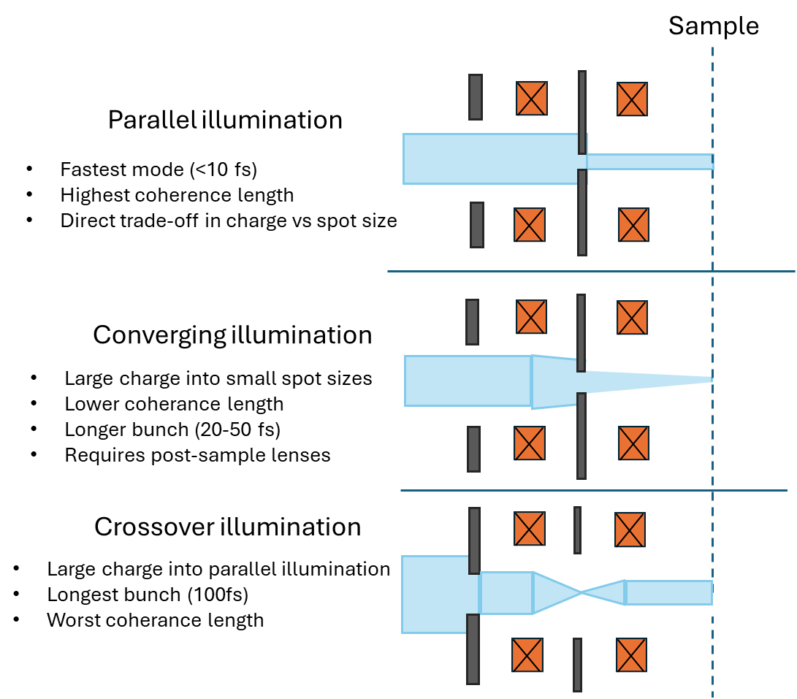
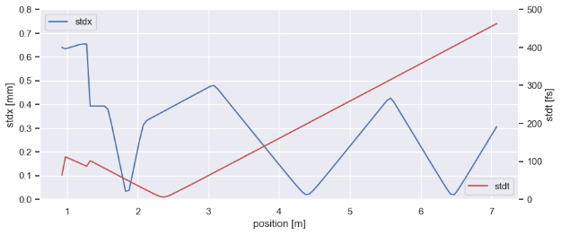
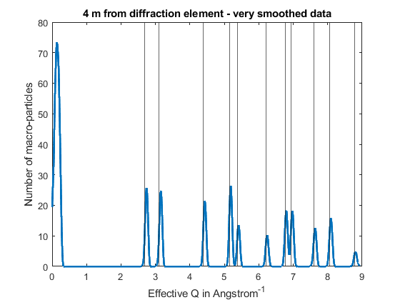

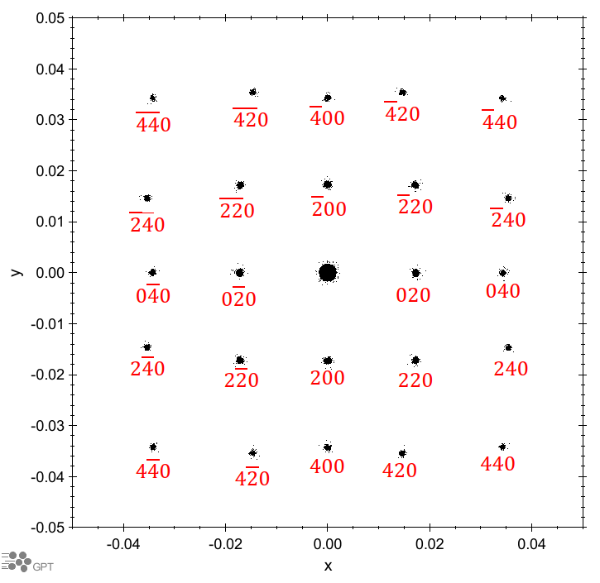
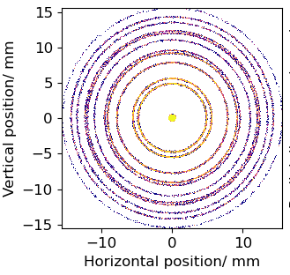

Diffraction Optics
$$L_{c}=\frac{λσ_{x}}{2πε}$$
Gun, arc, PI laser all fixed for all operational modes
2 condensor lens, 2 aperture system pre-sample for flexible illumination
  Trade-off charge, spot size, coherance length, pulse length
2 projector lenses for varying de/magnification onto range of potential detectors
  Tuneable camera length 0.05 – 30 m
Detector:
  Direct electron
    Hybrid pixel: 25-100um pixel size, 0.1 - 4 MP resolution
    MAPS: <15um pixel size, 4-16 MP resolution
  Backup scintillator + camera
GPT tracking:
  with space-charge
  simplistic scattering model for single-, and poly-crystalline materials
Sample
Detector

Slide 18
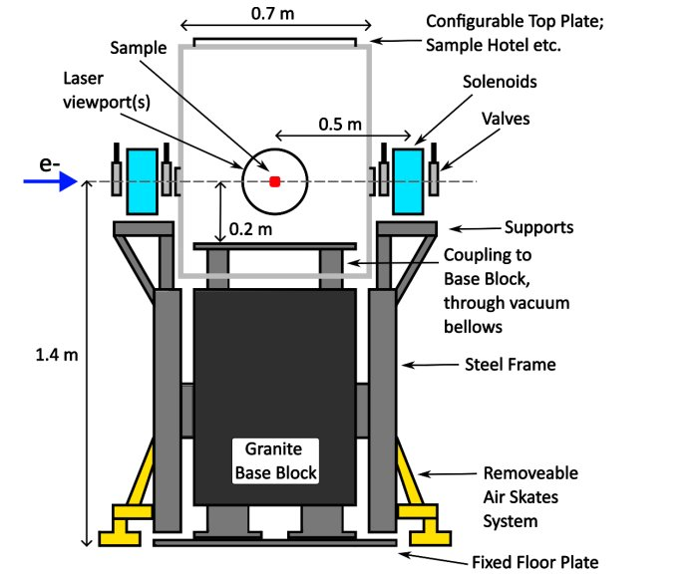
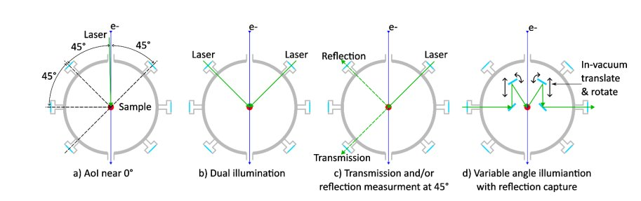
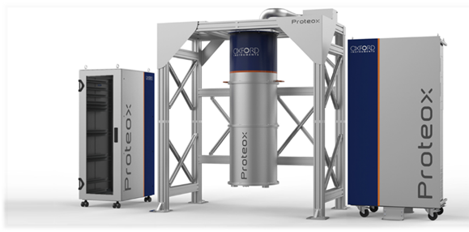
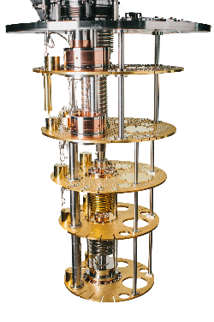
Sample chambers
Interchangeable sample chambers for different environments – eg/ solid samples, liquid jets, gas phase, cryogenic
In conversation with science team about requirements for sample control (position, rotation, temperature), laser injection, and diagnostics needed etc
Aiming to be compatible with mK dilution fridge for quantum materials experiments
Actively seeking collaborators with knowledge/experience of the different environments

Slide 19
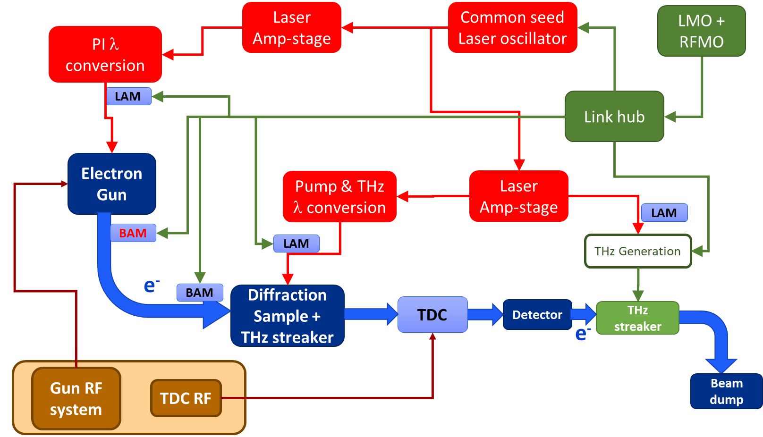
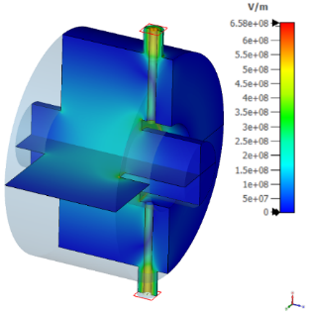
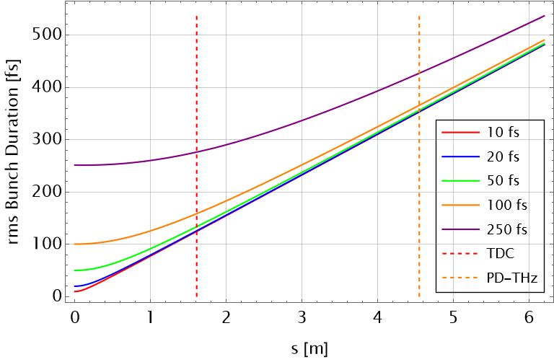

Synchronisation + Longitudinal Diagnostics
Temporal properties:
  Time of arrival
  Bunch length
Diagnostic suite:
  RF Beam Arrival Monitors
  RF TDC
  THz at sample position
  THz post-detector
  Spectrometer
CST sims of TDC/BAM/THz largely complete
Beam dynamic simulations first pass
RF TDC limited to ~100fs, sample THz key diagnostic, post-sample THz for time-tagging

Slide 20
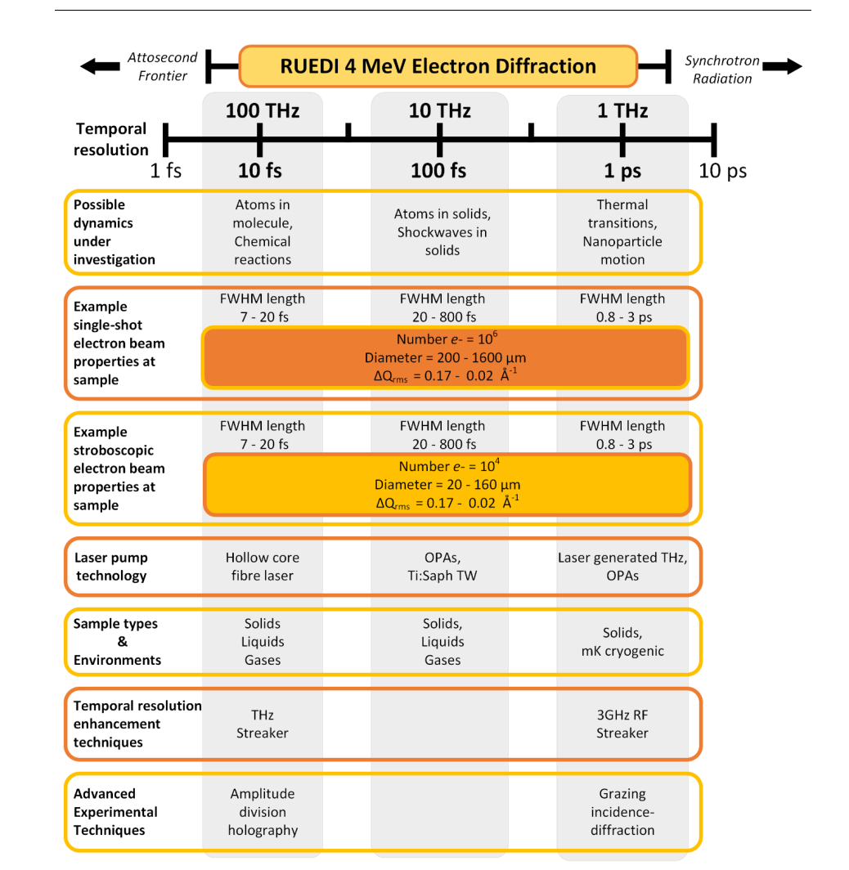
Ultrafast Diffraction Line Performance
The RUEDI diffraction line has:
  4 MeV
  400 fC produced at the gun
  1.6-160 fC charge at the sample after collimation
  Few fs time of arrival jitter at the sample
  < 10 fs bunch length
  Up to 6 nm coherence lengths
  Emittance 2-50 nm rad level
S2E simulations:
  GPT tracking with space-charge
  RF cavity designs in CST
  Magnet designs in Opera

Slide 21
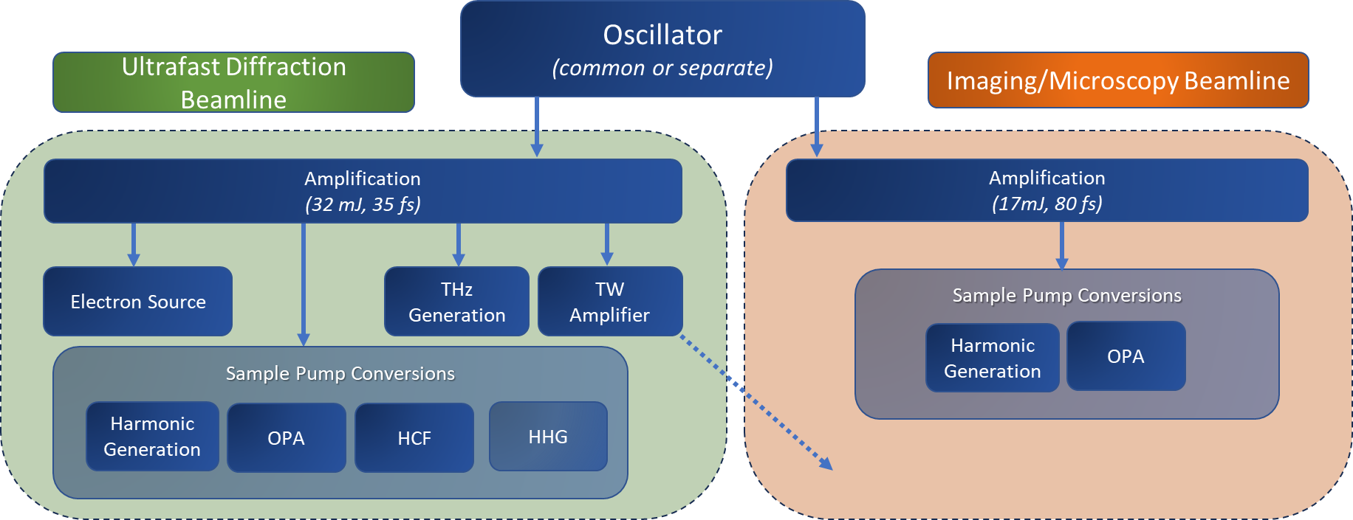
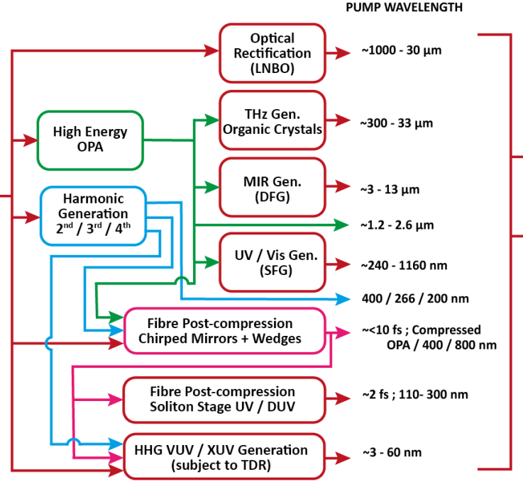
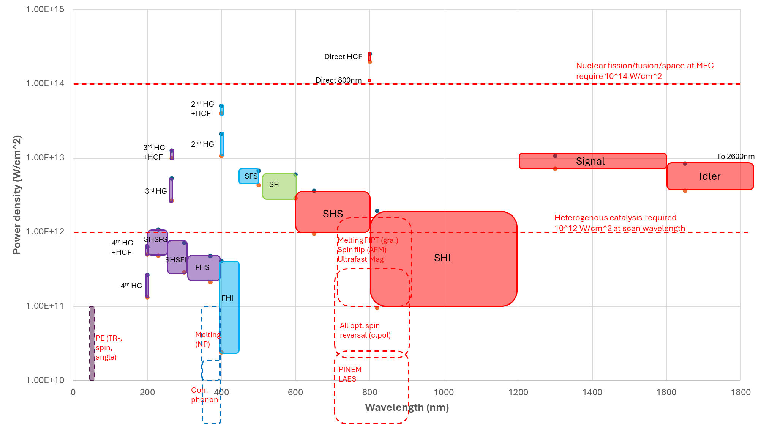
Laser Systems
Lasers feed:
  Electron source(s)
  Sample pumps
  fs diagnostics
Laser pumps:
  UV-IR-THz
    200nm - 5um
    OPAs + harmonic generation
  High intensity TW (>10¹⁸ W.cm⁻²)
  HCF for <10 fs
  Potential HHG + others
Intensity
Wavelength (nm)
21

Slide 22
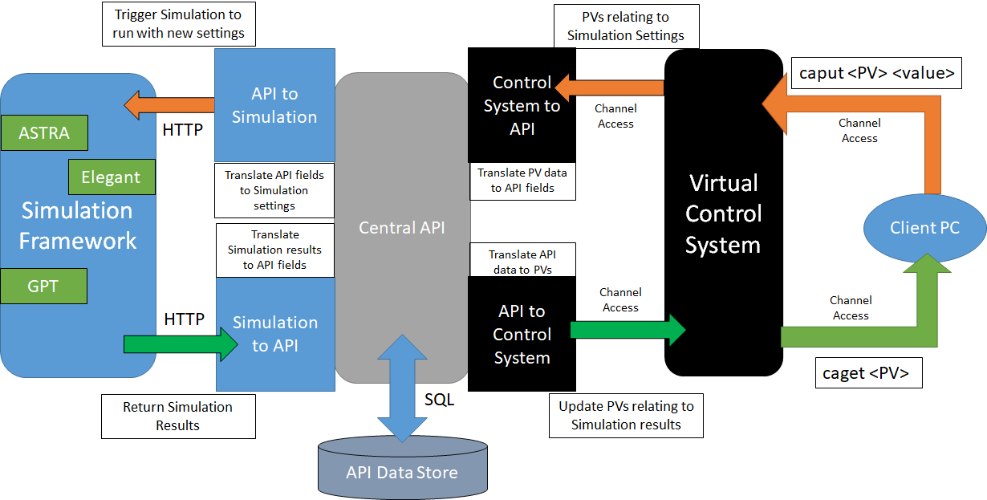

Digital Twin
Interface with virtual machine identically to physical machine via EPICS
Simulation outputs in identical formats to real diagnostics, with artificial noise/jitter
Builds on developments on CLARA at Daresbury
Benefits
Control room software development
Machine setup characterisation and optimisation
Operator training
Virtual Diagnostics
End goal - virtual user experiments

Slide 23
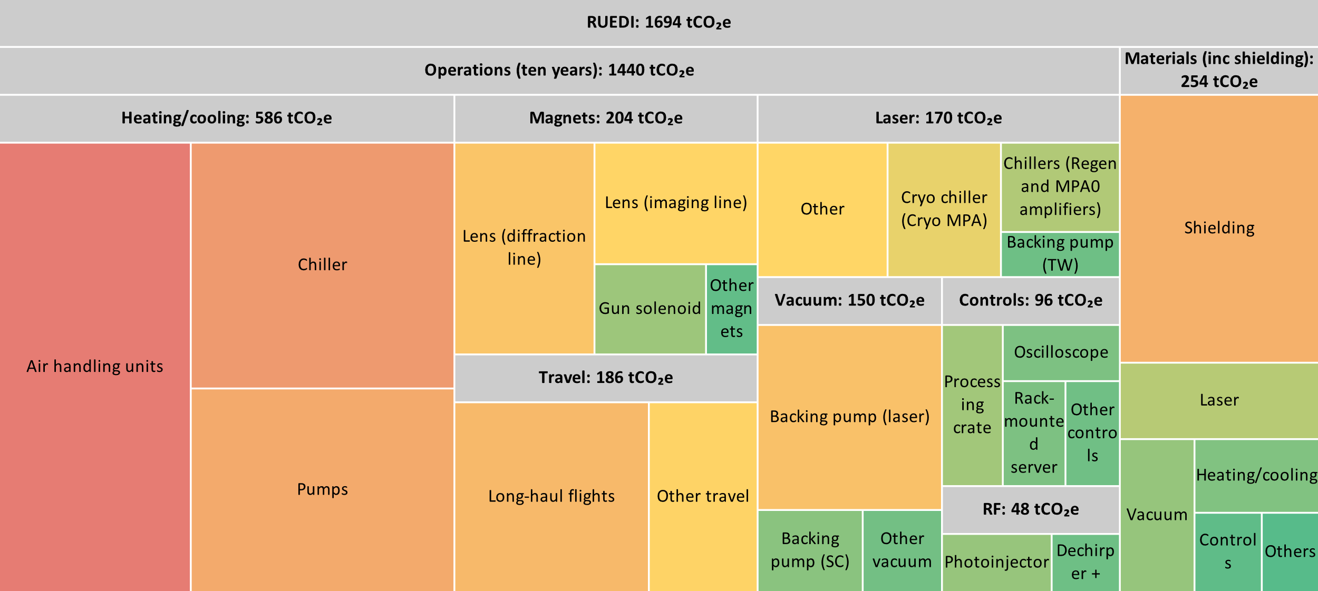
Environmental Sustainability
Lifecycle emissions assessment
Calculated carbon emissions for manufacture and operations
10 year operations
Investigating options to reduce large contributors
Published report Feb 2024
https://www.astec.stfc.ac.uk/Pages/Sustainable-Accelerators-Task-Force-Report-.aspx

Slide 24
What could CI academics contribute?
Diagnostics
  THz
  BPM (low-charge)
  BAM (low-charge)
  Emittance measurements
  Time-stamping
Future Novel Optics
  Novel diffraction modes
  Holography
  Ptychography
  Higher order correctors
  Aberration correction and link to standard accelerators
  Low aberration lenses
  Realistic diffraction models
  Stochastic effects
AI/ML
  Virtual diagnostics
  Digital Twin
  Online optimisation
  Online feedback
  Emittance measurements, tomography
  Anomaly removal
Chambers
  Liquid jets
  Gas jets
  mK temperatures
  Other novelties?
Lasers
  <10fs pulse length
  NOPA
  HHG XUV
  DUV soliton
RF
  SF6-free vacuum circulator
  Multi-kHz operation

Slide 25
What could CI academics contribute?
THz
Diagnostics
  THz
  BPM
  BAM
  Emittance measurements
  Time-stamping
Future Novel Optics
  Novel diffraction modes
  Holography
  Ptychography
  Higher order correctors
  Aberration correction and link to standard accelerators
  Low aberration lenses
  Realistic diffraction models
  Stochastic effects
AI/ML
  Virtual diagnostics
  Digital Twin
  Online optimisation
  Online feedback
  Emittance measurements, tomography
  Anomaly removal
Chambers
  Liquid jets
  Gas jets
  mK temperatures
  Other novelties?
Lasers
  <10fs pulse length
  NOPA
  HHG XUV
  DUV soliton
RF
  SF6-free vacuum circulator
  Multi-kHz operation

Slide 26
Summary
UKRI Infrastructure Fund initial approval £125M for full facility at Daresbury Laboratory
Going through gateway process for business case, earliest approval Feb 2026 for funding release Oct 2026
Physics design largely complete
  Diffraction line <10fs temporal resolution
Need final engineering design and funding/staff to complete design
Once gateway passed will need ~double current staff levels
Looking to raise CI academic engagement in project on timescales, both for commissioning (ML useful) and future upgrades

Slide 27
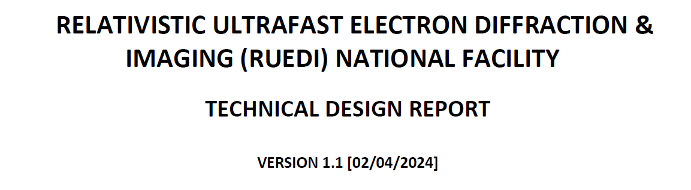
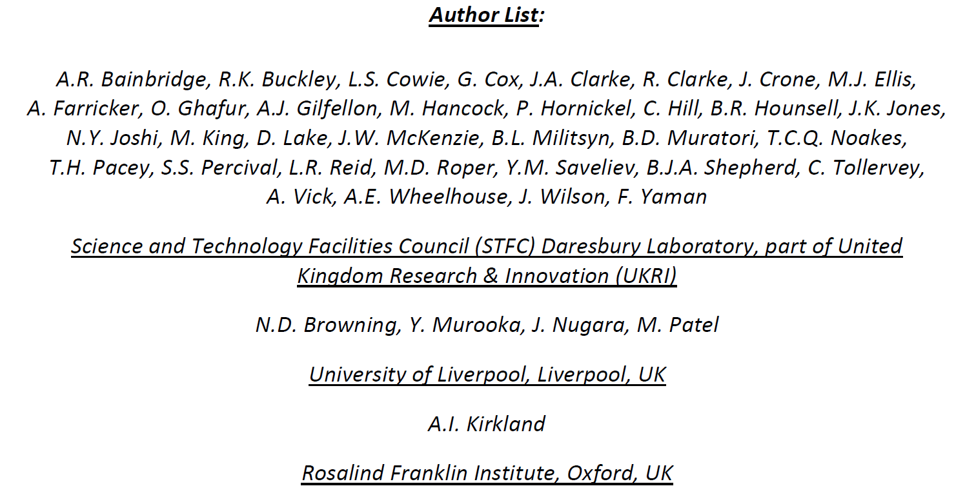
Acknowledgements
Science Team:
N. Browning (Liverpool) – Lead
W. Bryan (Swansea) – Quantum Materials
R. Fleck (Kings) – Biosciences
S. Maskell (Liverpool) – AI
B.L. Mehdi (Liverpool) – Energy
M. Patel (Liverpool) - Nuclear
S. Schroeder (Leeds) – Chemistry
C. Welsch (Liverpool) - Materials in Extremes
EPSRC/UKRI:
L. Blackwell
K. Blaney
T. Chapman
J. Gorman
J. Nicholson
A. Sawko
S.J. Spencer
A. Wilcox
G. Marshall, S. Griffiths, J. Ouyang, E. Snedden
STFC Daresbury Laboratory

