Slide 1










CI at AWAKE
J. Wolfenden on behalf of the AWAKE-UK collaboration
The Cockcroft Institute Scientific Advisory Committee 2025
20/02/2025

Slide 2


Overview
AWAKE Run 2
AWAKE-UK
The Cockcroft Institute and AWAKE
Summary
J. Wolfenden (joseph.wolfenden@cockcroft.ac.uk)
CI at AWAKE 20/02/2025
1

Slide 3
AWAKE Run 2

Slide 4
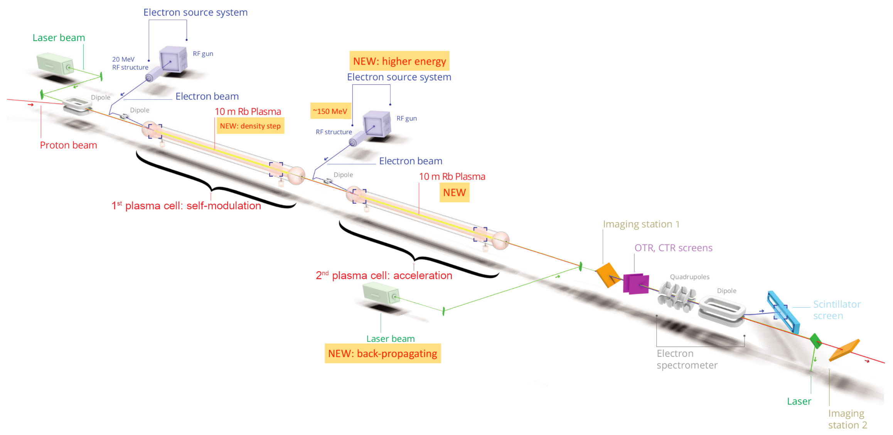
AWAKE Run 2 Overview
Goal:
Demonstrate the possibility to use AWAKE scheme for
high energy physics applications in mid-term future.
Objectives:
Accelerate electron bunches to high energy
(0.5-1 GV/m)
Control electron bunch quality
(emittance ~10 μm)
Demonstrate scalable plasma source technology
(Helicon and Discharge)
J. Wolfenden (joseph.wolfenden@cockcroft.ac.uk)
CI at AWAKE 20/02/2025
3

Slide 5
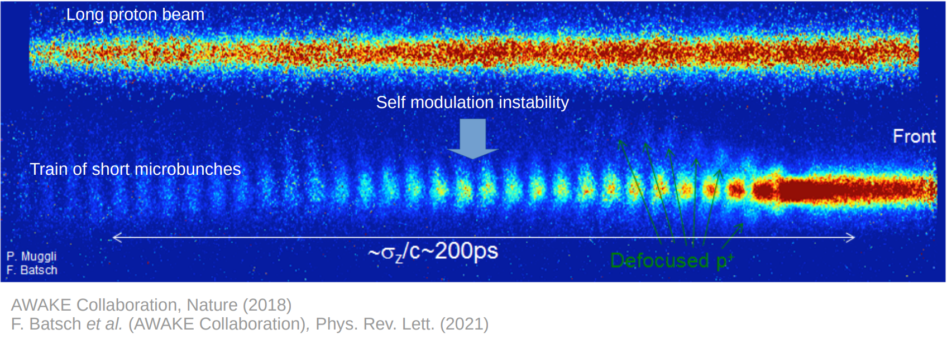
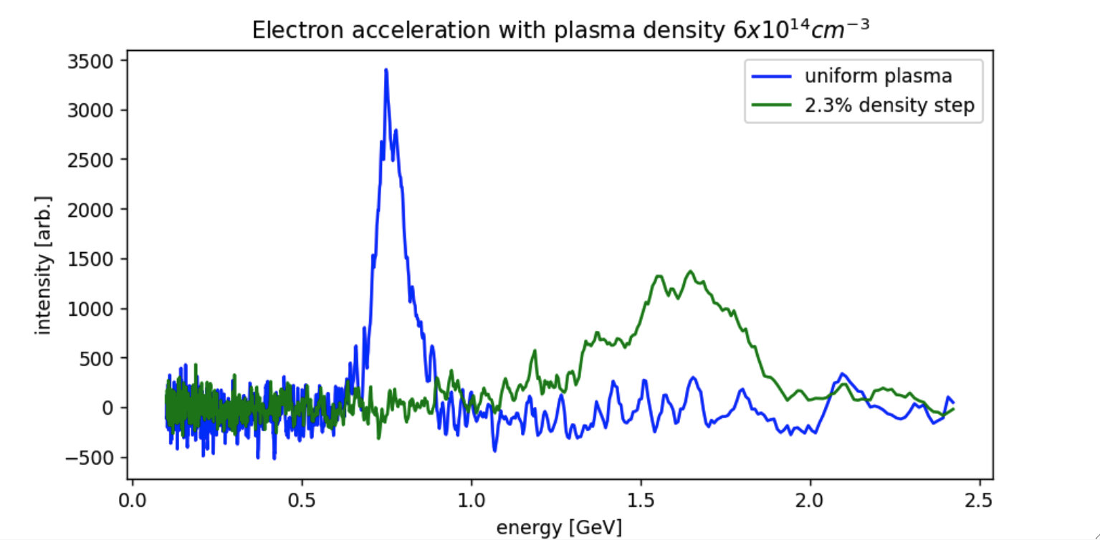
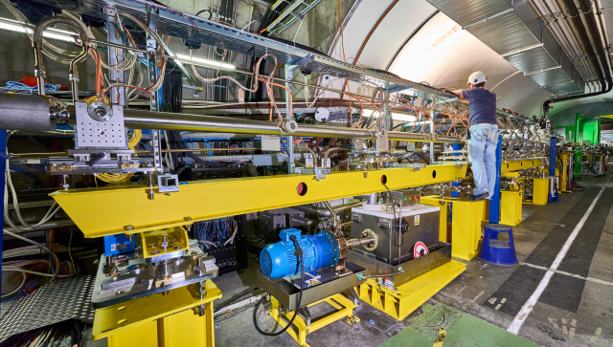
The AWAKE Run 2 Programme – Current/Past
Run 2a (2021-22):
Demonstrate electron seeding of
self-modulation. Done!
Run 2b (2023-25):
Demonstrate stabilisation of micro-bunches with a density step. Ongoing!
(Image credit: UCL/F. Pannell)
(Image credit: CERN/M. Cavazza)
J. Wolfenden (joseph.wolfenden@cockcroft.ac.uk)
CI at AWAKE 20/02/2025
4

Slide 6
AWAKE Run 2 Successes So Far
Part of the roadmap for the European Strategy for Particle Physics
Working groups looking at applications (e.g. PEEP) as input to the ESPP Update
> 70 journal articles related to AWAKE in high-level journals
  Including several Editors Choice selections
> 90 conference proceedings and papers
> 28 PhD students and > 11 Masters students
  Including 4 prestigious thesis prizes
> 20 PDRAs
  Including 2 prestigious ECR prizes
Many AWAKE focussed courses and seminars
  Including USPAS, JUAS, and CAS
Several outreach activities including news articles, TEDx, and many others
J. Wolfenden (joseph.wolfenden@cockcroft.ac.uk)
CI at AWAKE 20/02/2025
5

Slide 7
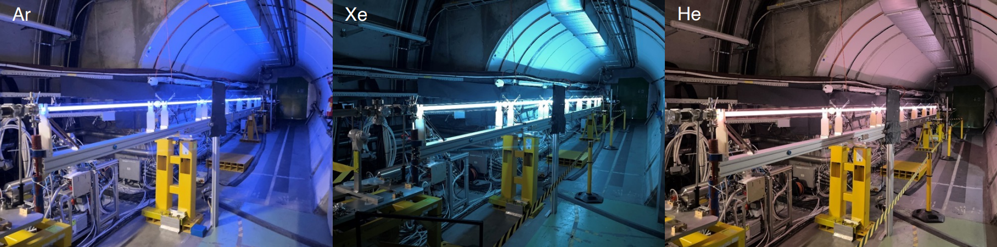
The AWAKE Run 2 Programme – Future
Run 2c (2029-):
Demonstrate electron acceleration and emittance control.
Run 2d (2030-):
Demonstrate scalable plasma sources. 10 m discharge prototype tested in May 2023!
(Image credit: CERN/E. Gschwendtner)
J. Wolfenden (joseph.wolfenden@cockcroft.ac.uk)
CI at AWAKE 20/02/2025
6

Slide 8
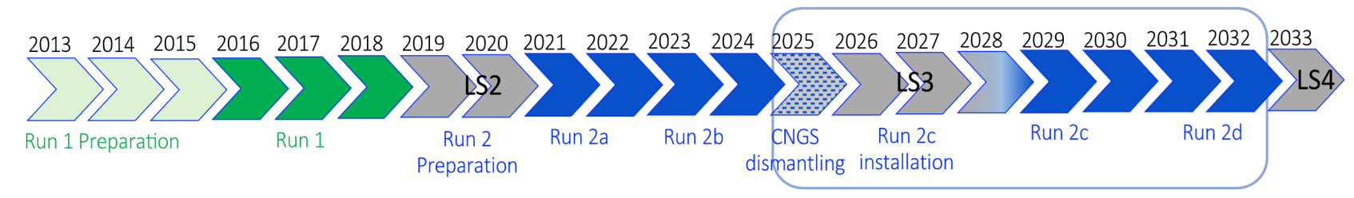
AWAKE Run 2 Approval
Both AWAKE Run 2c and 2d were approved in this year’s Medium-Term Plan.
“An amount of 10 MCHF is allocated in addition to AWAKE for the construction, during LS3, of the necessary hardware (e.g. second electron line) to be deployed in Runs 2c and 2d. Additional funds may be necessary for these runs.”
J. Wolfenden (joseph.wolfenden@cockcroft.ac.uk)
CI at AWAKE 20/02/2025
7

Slide 9
AWAKE Run 2 Major Challenges
The CNGS target area needs to be cleared.
Two plasma sources, both rubidium or one rubidium and one “scalable” ?
A new 150-MeV electron source injected between two plasma sources.
The LHC and accelerators scheduling.
Complete simulations of the process: complexity, runtime, flexibility, which code, etc.
Having an extended suite of diagnostics to fully characterise the process.
J. Wolfenden (joseph.wolfenden@cockcroft.ac.uk)
CI at AWAKE 20/02/2025
8

Slide 10
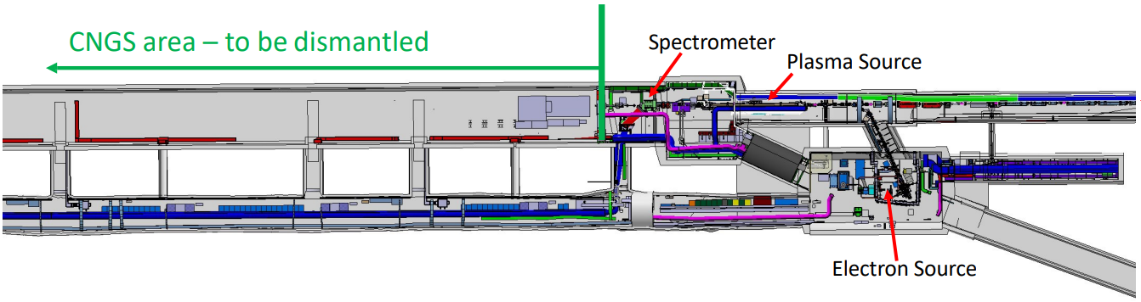
CNGS Dismantling for AWAKE Run 2
Run 2a/b
J. Wolfenden (joseph.wolfenden@cockcroft.ac.uk)
CI at AWAKE 20/02/2025
9

Slide 11
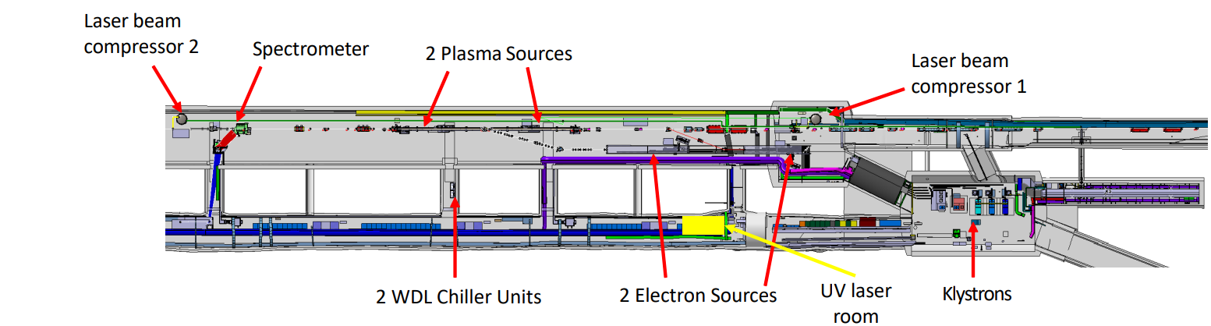
CNGS Dismantling for AWAKE Run 2
Run 2c/d
Run 2c begins in 2029 right after LS3
CNGS dismantling: mid 2025 – mid 2027
Run 2c installation: mid 2027– mid 2029
J. Wolfenden (joseph.wolfenden@cockcroft.ac.uk)
CI at AWAKE 20/02/2025
10

Slide 12
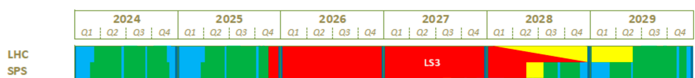
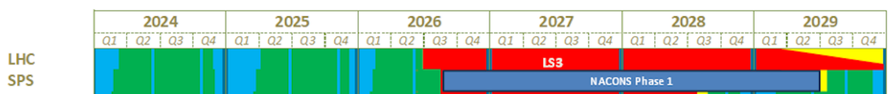
CERN Schedule and Affect on AWAKE
Decision from CERN last year to delay LS3
Previous schedule:
New schedule:
J. Wolfenden (joseph.wolfenden@cockcroft.ac.uk)
CI at AWAKE 20/02/2025
11

Slide 13
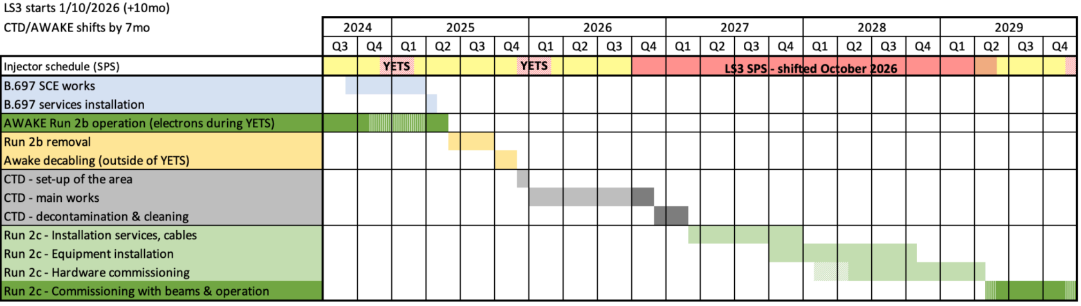
New AWAKE Schedule
J. Wolfenden (joseph.wolfenden@cockcroft.ac.uk)
CI at AWAKE 20/02/2025
12

Slide 14
AWAKE-UK

Slide 15
AWAKE-UK Overview
Collaboration of 7 UK universities across the 2 UK accelerator institutes
  John-Adams Institute: UCL, ICL, and UoOxford
  Cockcroft Institute: Liverpool, Manchester, Lancaster, and Strathclyde
Plays a key role in both the R&D and management:
  Matthew Wing (UCL) Deputy Spokesperson for AWAKE
  Guoxing Xia (Manchester) Publications Coordinator for AWAKE
  Carsten Welsch (Liverpool) Scientific Project Manager for AWAKE-UK
Collaboration meeting in Liverpool (March 2024) – considered one of the best ever!
J. Wolfenden (joseph.wolfenden@cockcroft.ac.uk)
CI at AWAKE 20/02/2025
14

Slide 16
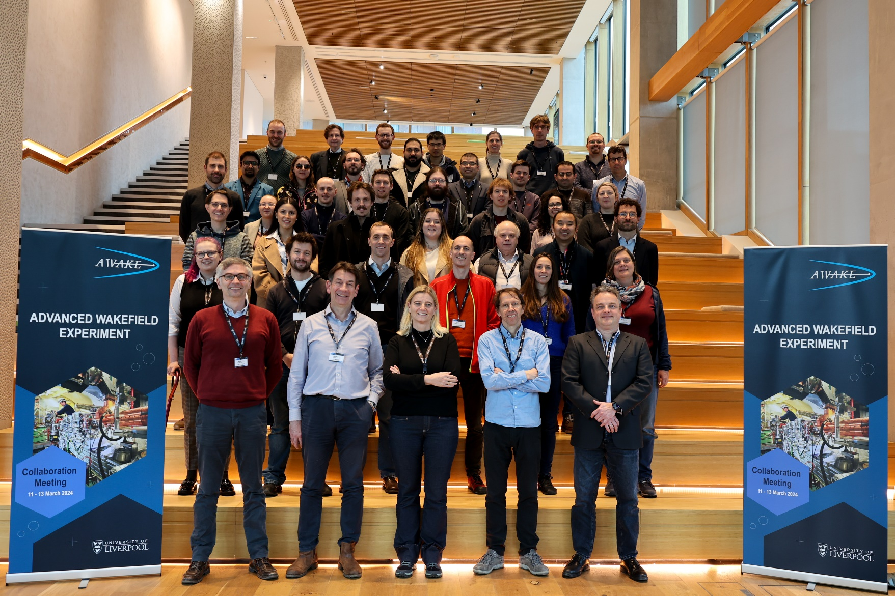
AWAKE-UK Overview
J. Wolfenden (joseph.wolfenden@cockcroft.ac.uk)
CI at AWAKE 20/02/2025
15

Slide 17
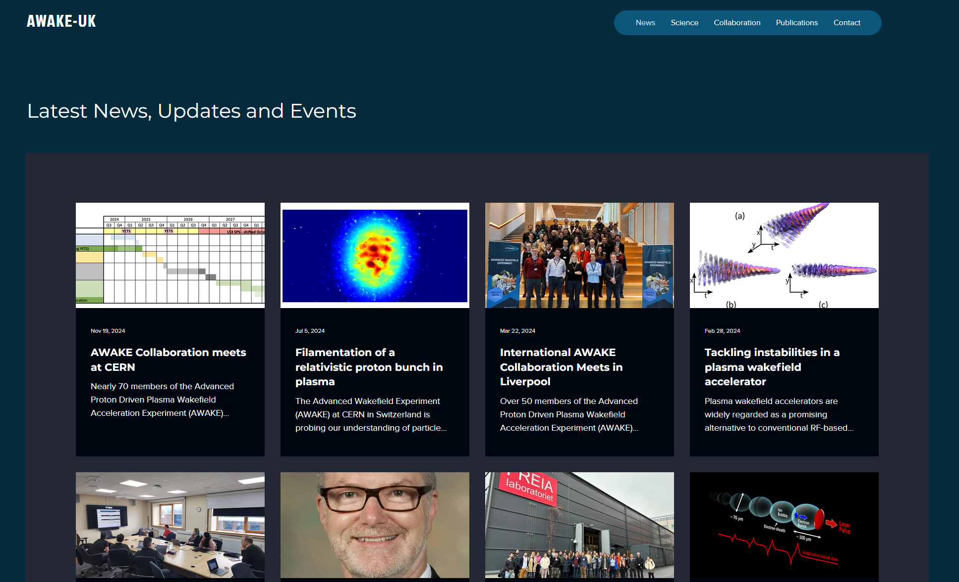
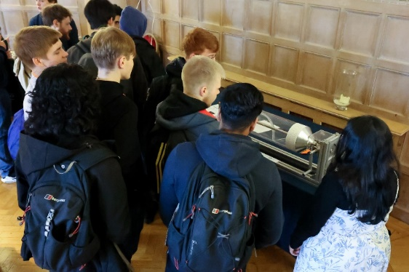
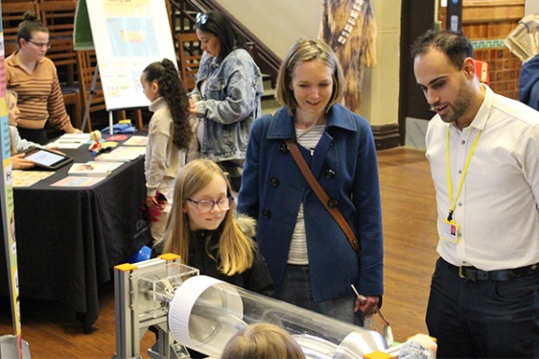
AWAKE-UK Communication and Outreach
Liverpool Project TEAM leads on communication and outreach, a key role within AWAKE
This includes:
  Active website
  Quarterly newsletter
  Outreach, e.g. Surfatron
    British Science Week (University of Liverpool, March 2024)
    “Shining a Light on Particle Physics and Accelerators” (Liverpool Cathedral, March 2024)
    “Questions of Science and Faith under the Moon” (Blackburn Cathedral, November 2024)
J. Wolfenden (joseph.wolfenden@cockcroft.ac.uk)
CI at AWAKE 20/02/2025
16

Slide 18
AWAKE-UK R&D
Three work-packages covering all objectives of AWAKE Run 2:
  WP1: Design and optimisation of the witness electron bunch
  WP2: Measuring the properties of the electron bunches
  WP3: A scalable plasma cell and diagnostics
J. Wolfenden (joseph.wolfenden@cockcroft.ac.uk)
AWAKE at CI 20/02/2025
17

Slide 19
R&D Highlights: WP1
WP1: Electron bunch synchronisation for Run 2c
Synchronisation of < 50fs required
PhD Student Joshua Gregory recently moved to CERN
Seed Bunch
16-19 MeV - (S-Band Gun & Linac)
1.2mm length/4ps (@ AWAKE Run 2a)
Witness Bunch
150-165 MeV - (S-Band Gun; X-Band Linac)
60um length/200fs - (@ 7e¹⁴ cm⁻³ plasma density)
t₁
Witness
δt
Modulated protons ~ 1.3mm
Modulated protons ~ 1.3mm
Modulated protons ~ 1.3mm
Seed Bunch ~1.3mm
J. Wolfenden (joseph.wolfenden@cockcroft.ac.uk)
CI at AWAKE 20/02/2025
18

Slide 20
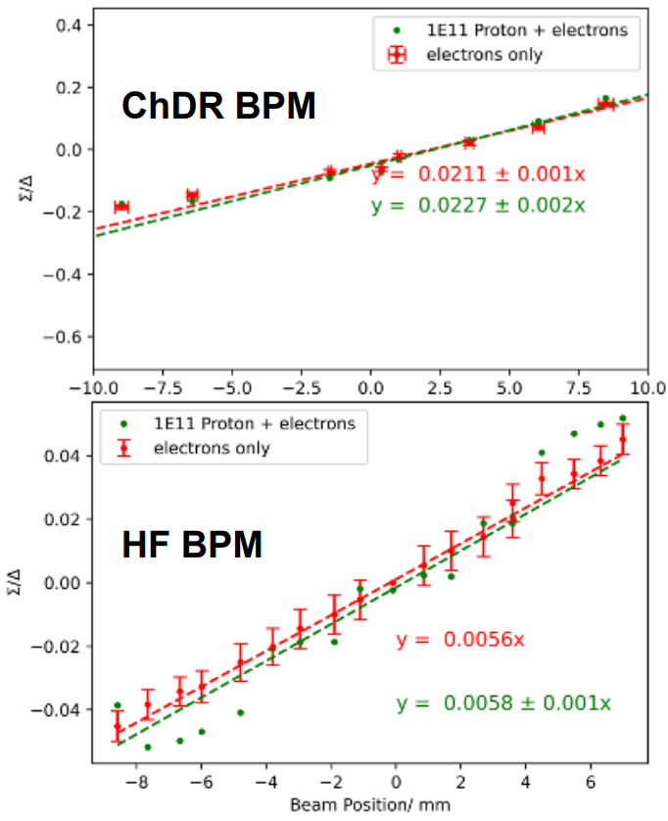
R&D Highlights: WP1
WP1: Electron BPMs for common beamline (p⁺ and e⁻)
Protons dominate standard-type BPM output
ChDR and HF BPMs under investigation
J. Wolfenden (joseph.wolfenden@cockcroft.ac.uk)
CI at AWAKE 20/02/2025
19

Slide 21
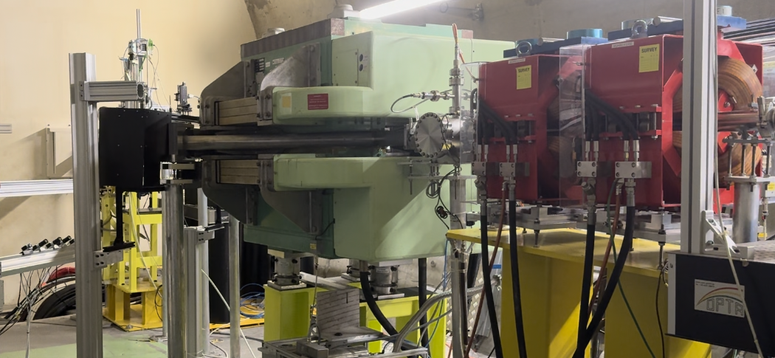
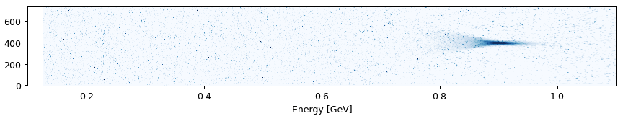
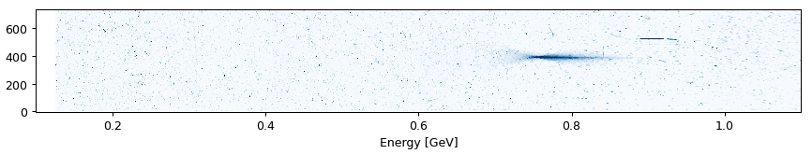
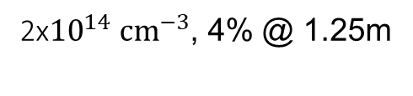
R&D Highlights: WP2
WP2: Energy spectrometer
Promising preliminary step results
Provides emittance measurement
Camera array
Scintillator screen
C-shaped dipole
Quadrupole doublet
2${\text{x}10}^{14} {cm}^{−3}$, 4% @ 1.25m
LBDP2
(10.3m)
Plunger 10
(9.5m)
J. Wolfenden (joseph.wolfenden@cockcroft.ac.uk)
CI at AWAKE 20/02/2025
20

Slide 22
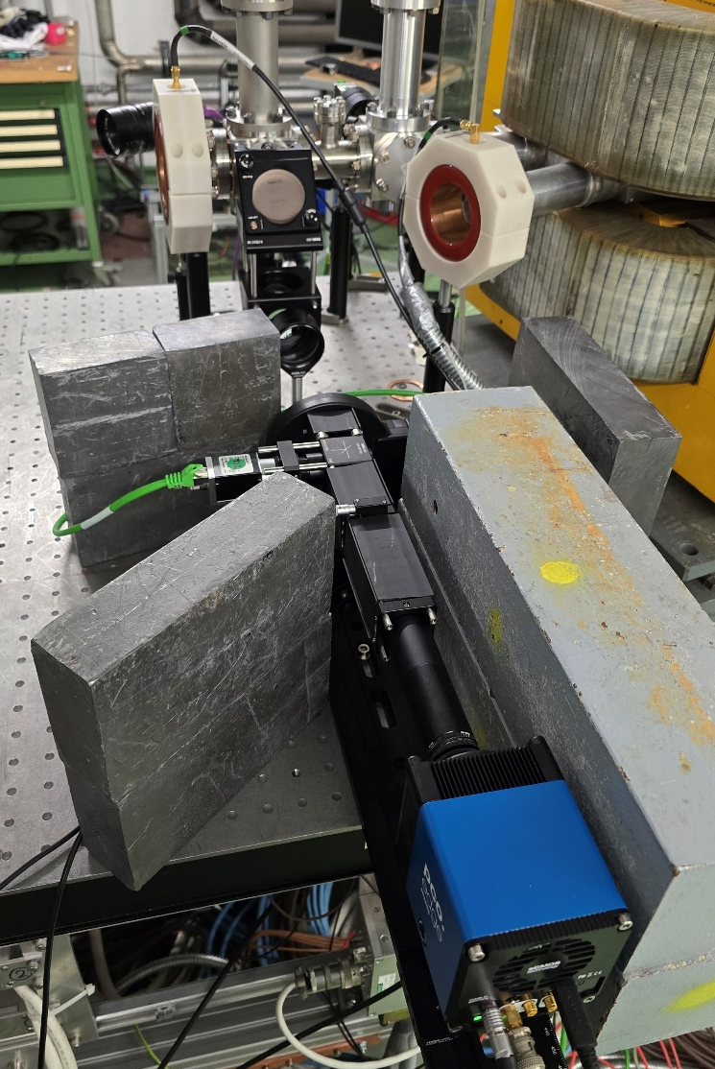
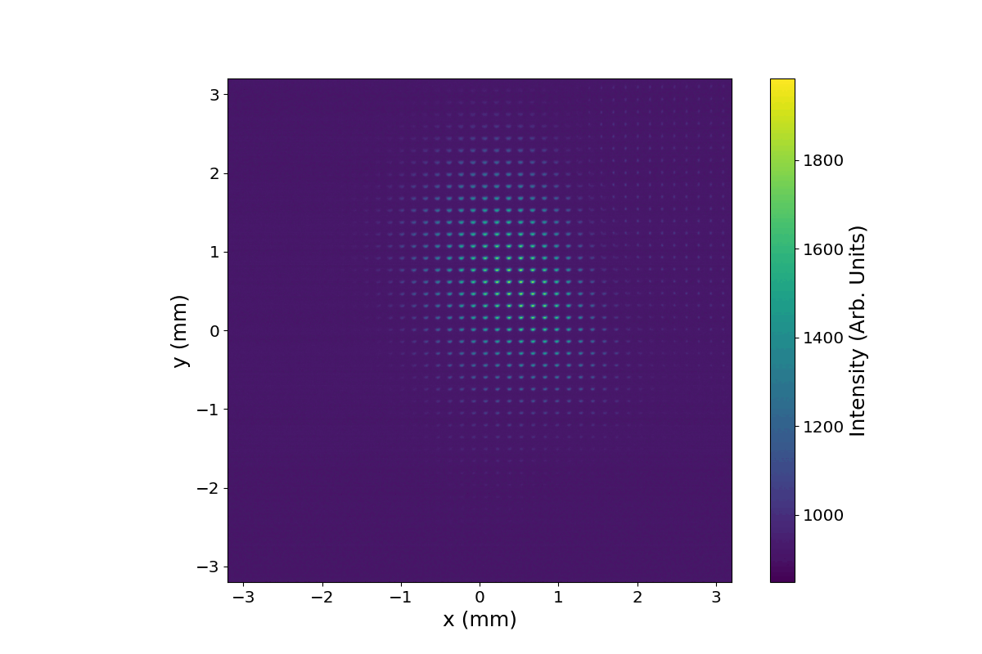
R&D Highlights: WP2
WP2: Emittance measurement
PoC single-shot non-invasive emittance
Recent and ongoing
OTR/OSR measurements
at CLEAR
Integration studies
underway
Spatial distribution
Micro-lens array
Angular distribution
J. Wolfenden (joseph.wolfenden@cockcroft.ac.uk)
CI at AWAKE 20/02/2025
21

Slide 23
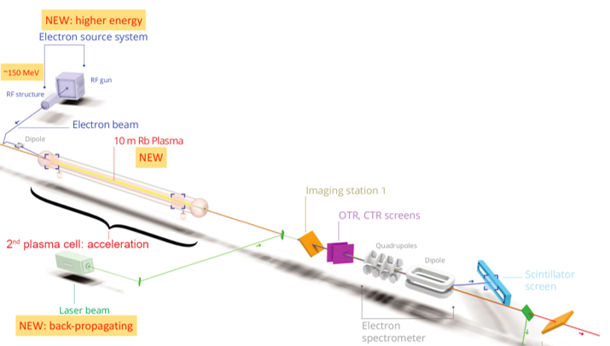
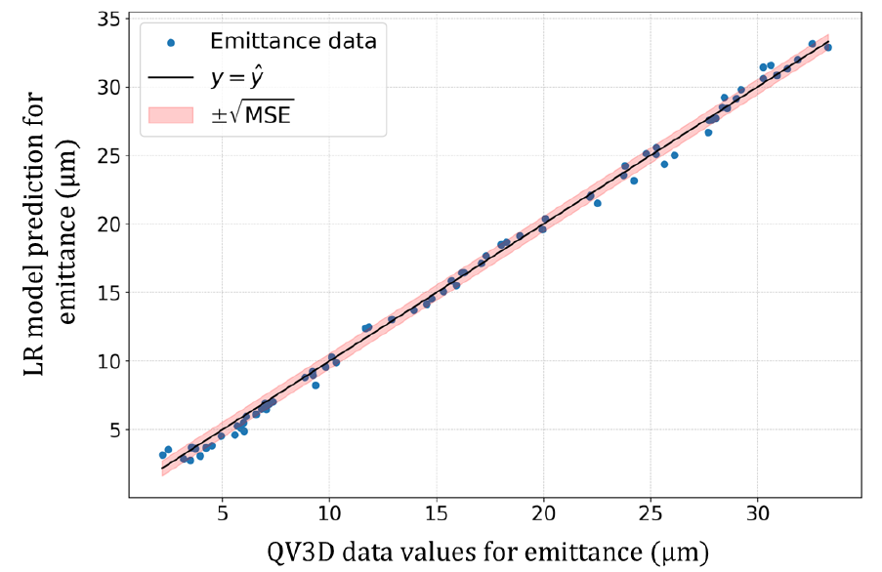

R&D Highlights: WP2
WP2: Betatron radiation
X-Ray -> UV radiation produced in 2nd plasma source
Spectrum can be linked to emittance
Integration studies and ML-based analysis under investigation
J. Wolfenden (joseph.wolfenden@cockcroft.ac.uk)
CI at AWAKE 20/02/2025
22

Slide 24

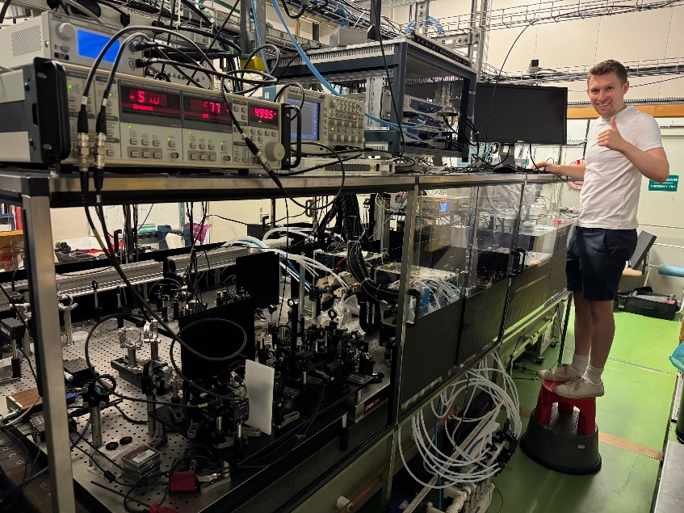
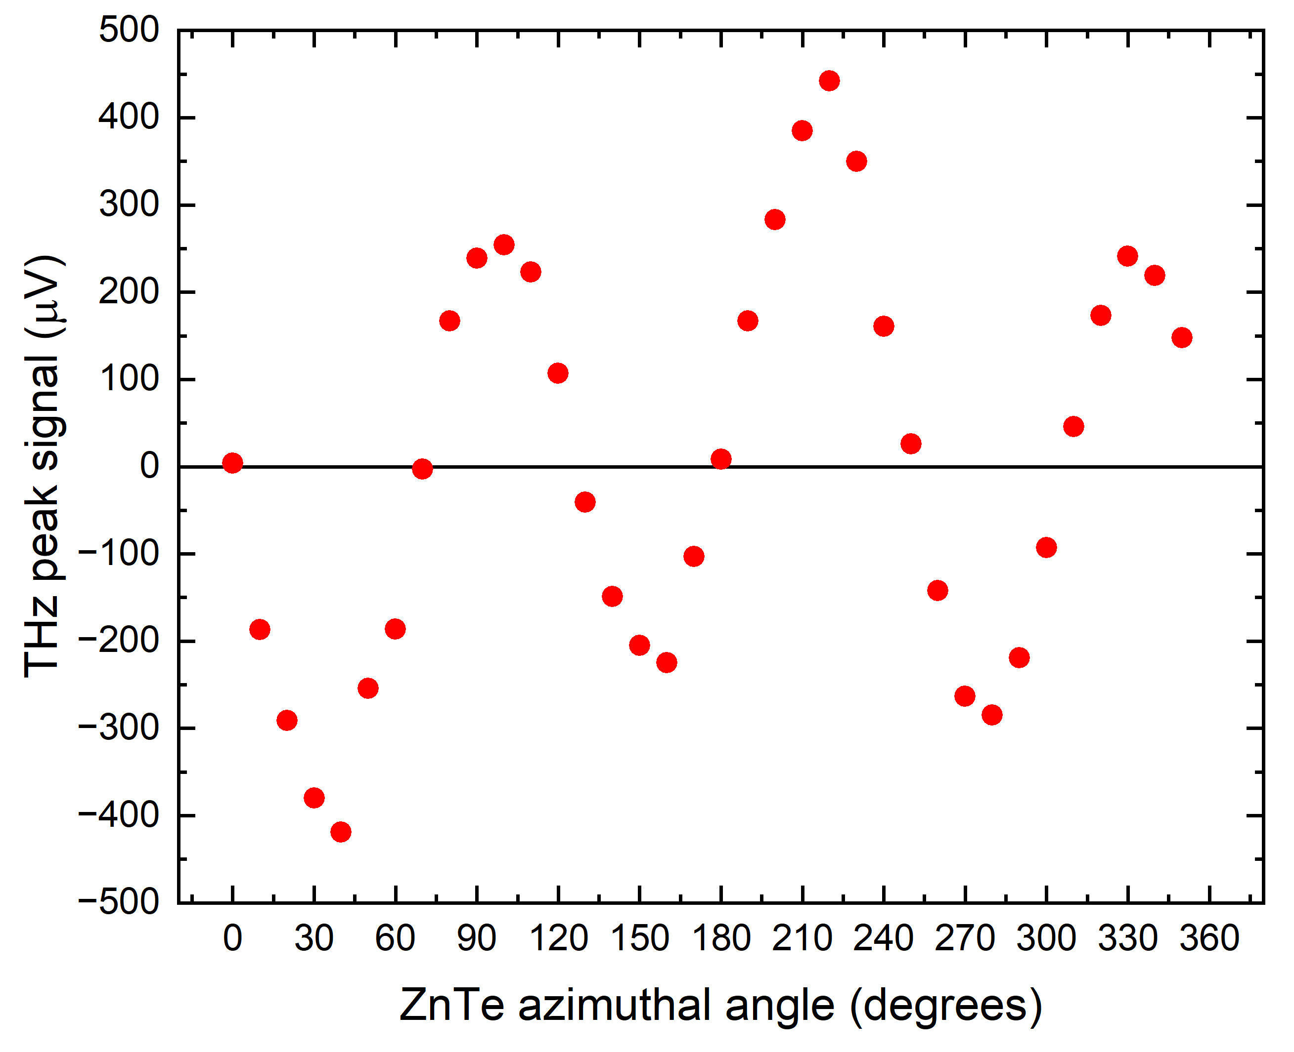
R&D Highlights: WP2
WP2: EO sampling
Measure bunch length, arrival time and jitter, and beam position between plasma sources
Complimentary THz
streaking with injector
CI PhD started Sep. 2024
on fs-resolution methods
J. Wolfenden (joseph.wolfenden@cockcroft.ac.uk)
CI at AWAKE 20/02/2025
23

Slide 25
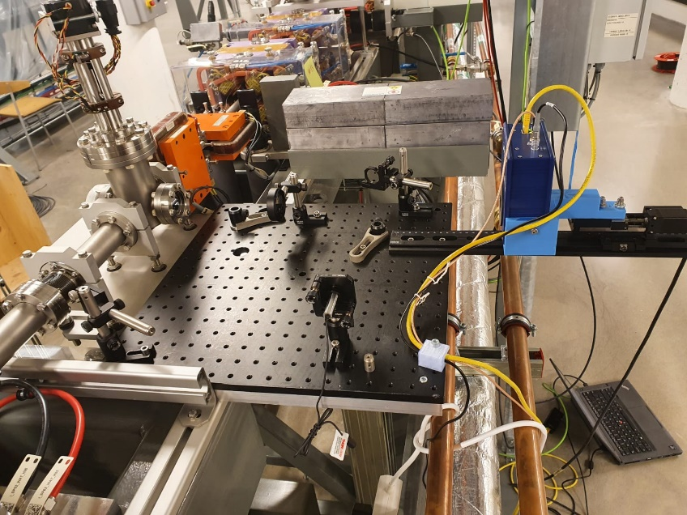
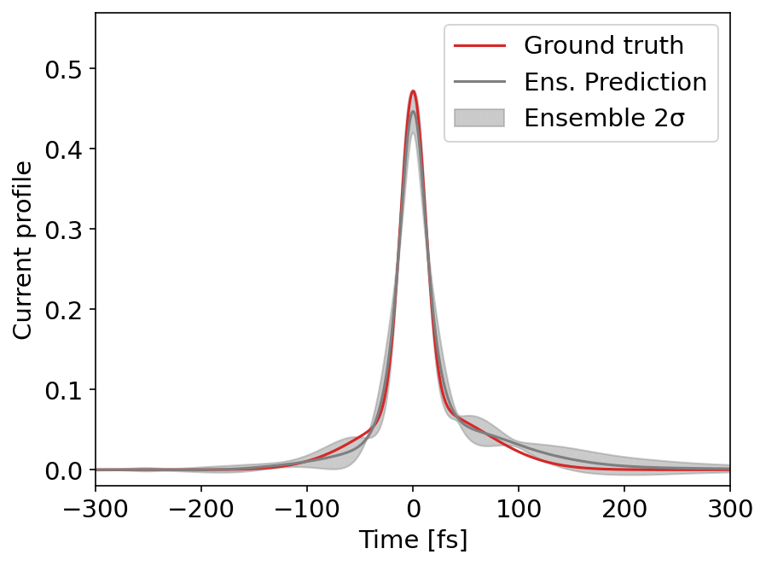
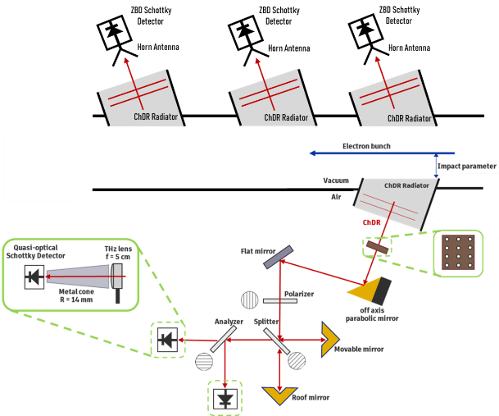
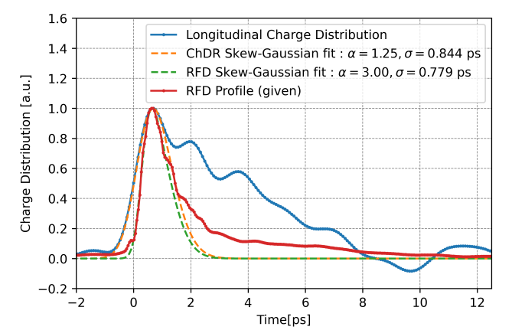
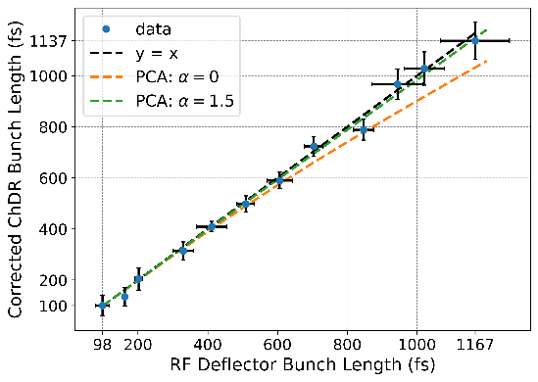
R&D Highlights: WP2
WP2: Bunch length measurements
Two studies: ChDR bunch length monitor and CT/SR Imaging
CT/SR imaging measurements at MAX IV
PhD (Jack McGunigal) now at CERN for ChDR
J. Wolfenden (joseph.wolfenden@cockcroft.ac.uk)
CI at AWAKE 20/02/2025
24

Slide 26
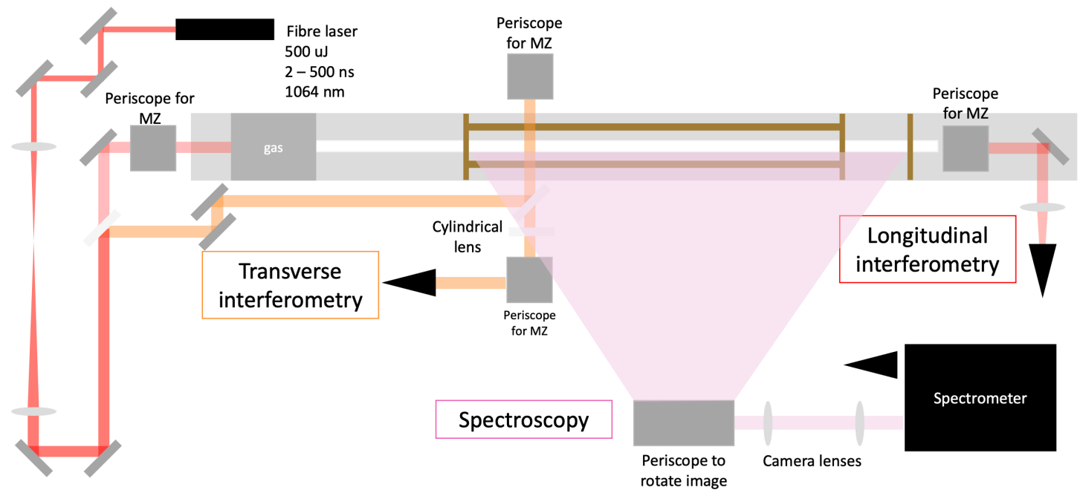
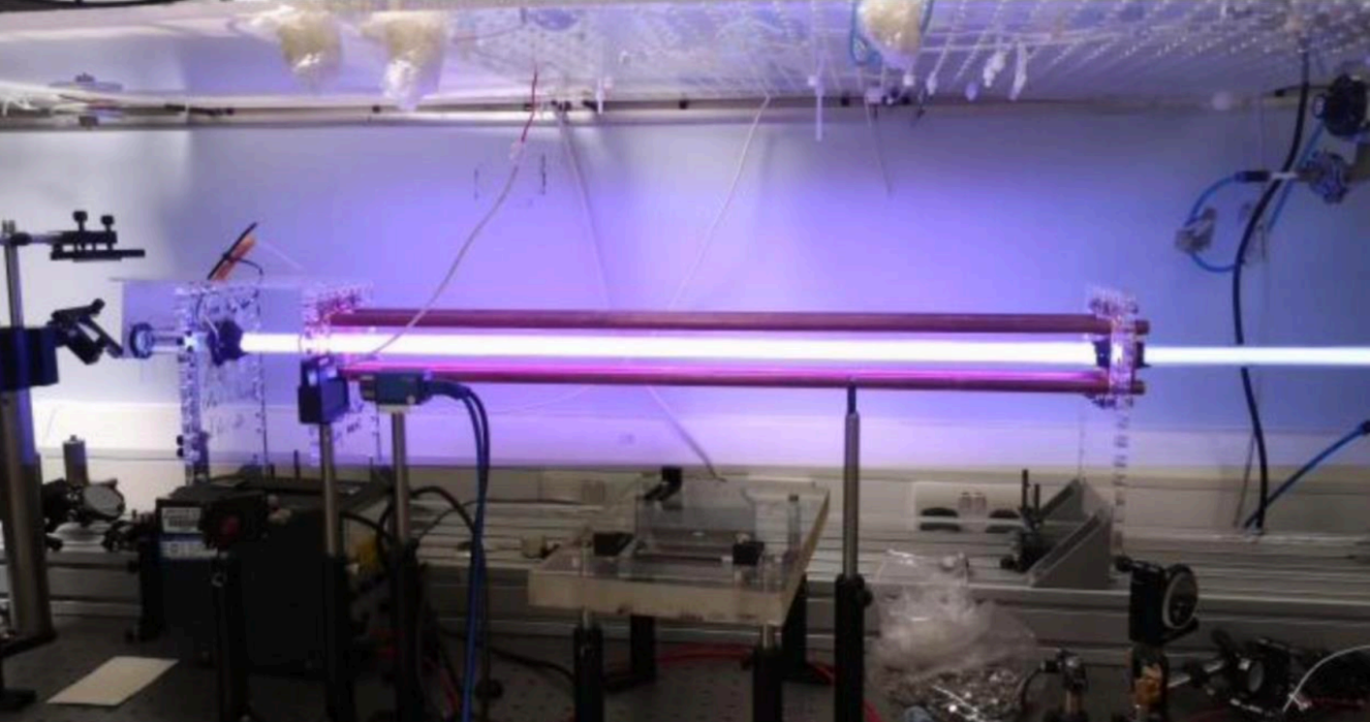
R&D Highlights: WP3
WP3: Discharge source diagnostics
Preliminary tests underway – including high voltage rep. rate of up to 1MHz
J. Wolfenden (joseph.wolfenden@cockcroft.ac.uk)
CI at AWAKE 20/02/2025
25

Slide 27
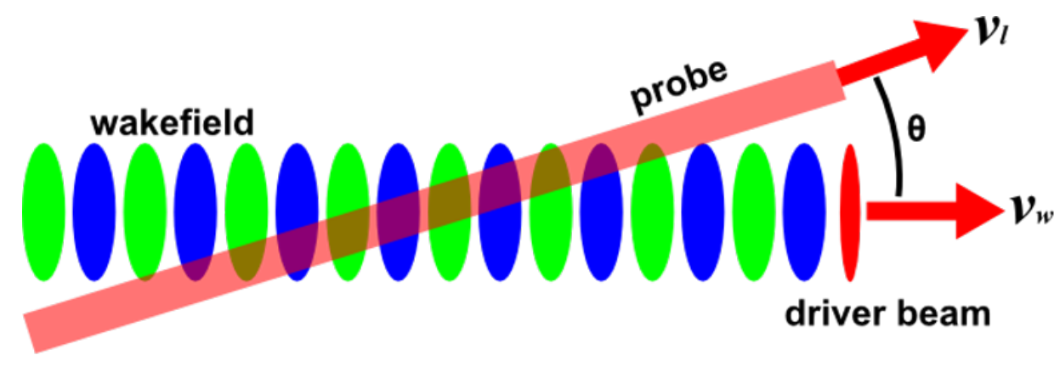
R&D Highlights: WP3
WP3: Frequency domain holography
Oblique-angle FDH developed as a single-shot diagnostic.
Reinforcement ML for fully automated alignment/DAQ nearing completion.
Integration phase unwrapping from FDH also almost complete.
J. Wolfenden (joseph.wolfenden@cockcroft.ac.uk)
CI at AWAKE 20/02/2025
26

Slide 28
The Cockcroft Institute and AWAKE

Slide 29
Cockcroft Institute at AWAKE
CI has a leading role in AWAKE and AWAKE-UK – particularly WP1 and WP2
Dedicated lab space at CI for prototyping and testing
A coherent CI strategy is required for the future (e.g. AWAKE-UK phase 3)
“Developing novel instrumentation to enable the demonstration of AWAKE for HEP applications”
Need to be closely linked with CERN and engaged with AWAKE requirements
Prerequisite is more of a presence at CERN – can SAC comment any further?
J. Wolfenden (joseph.wolfenden@cockcroft.ac.uk)
CI at AWAKE 20/02/2025
28

Slide 30
Cockcroft Institute at AWAKE
AWAKE requirements for Run 2c/d:
Emittance measurements for the accelerated electron beam
Bunch length diagnostics pre/post acceleration
Synchronisation
BPMs for the common beamline
Plasma diagnostics
End-to-end simulations
– UoL/UoM
– UoL/UoM
– UoLan/UoM
Endorsed by CERN/AWAKE
Strong contributions requested
Should AWAKE be a priority for CI long term?
J. Wolfenden (joseph.wolfenden@cockcroft.ac.uk)
CI at AWAKE 20/02/2025
29

Slide 31
Cockcroft Institute at AWAKE and beyond…
Many of aspects of this work are very applicable to other projects where the UK has a vested interest, for example:
EuPRAXIA – two sites (beam and laser), relatively similar instrumentation requirements, targeting FEL operation
PACRI – Horizon Europe project, advanced instrumentation for plasma accelerators, enabling diverse applications such as medical imaging, materials diagnostics, and even compact colliders
J. Wolfenden (joseph.wolfenden@cockcroft.ac.uk)
CI at AWAKE 20/02/2025
30

Slide 32
Summary

Slide 33
Summary
AWAKE
World-class project that has consistently delivered ground-breaking science.
Exceeded expectations, producing outstanding academic outputs enhancing the reputations of participating institutions and UK’s leadership in the field.
Proven to be excellent value for money, leveraging substantial contributions from CERN and other partners, with new extra funds for Run 2c,d.
An excellent example of a long-term strategic collaboration with CERN.
The project's high international visibility and focus on training the next generation of researchers underscore its importance.
J. Wolfenden (joseph.wolfenden@cockcroft.ac.uk)
CI at AWAKE 20/02/2025
32

Slide 34
Summary
AWAKE-UK
Key component in the success of AWAKE historically and moving forward.
Many members of AWAKE-UK hold critical roles within AWAKE.
Leading in instrumentation development, communication, and outreach.
CI is a large portion of the collaboration, working on essential technologies.
Cockcroft Institute
CI can (and should) be clear on a strategy for AWAKE and how this can be leveraged against other novel acceleration projects.
Many opportunities to transfer AWAKE outcomes to other high priority projects, e.g. EuPRAXIA, PACRI.
J. Wolfenden (joseph.wolfenden@cockcroft.ac.uk)
CI at AWAKE 20/02/2025
33

Slide 35
Thank you for your attention
J. Wolfenden on behalf of the AWAKE-UK collaboration
The Cockcroft Institute Scientific Advisory Committee 2025
20/02/2025

