Slide 1
Introduction and welcome
Cockcroft SAC 2025
Stewart Boogert
20th February 2025

Slide 2
Introduction
Cockcroft strategy
News from Cockcroft Partners
New staff members at Lancaster and Liverpool
New position in proton (and particle) beam therapy at Manchester
New business development manager (Dr Daryl McMannus)
Core grant and funding climate
IPAC 2029 @ Liverpool
MoU with ELI-NP

Slide 3
Emerging Cockcroft strategy
Advanced acceleration
  Full exploitation of unique Cockcroft related (i.e., ASTeC) facilities
    CLARA/FEBE
      External injection
      Beam driven acceleration
  THz, RF bunkers, DITA/laser labs
Medical applications of particle beams
  VHEE
  Christie proton therapy research room
    FLASH / beamline-B
Sustainability
  SCRF (thin films)
  Centre for excellence for Sustainable accelerators
Artificial Intelligence and Machine learning

Slide 4
Lancaster update (1)
New staff member Dr Christopher Arran (replaces Boella)
LHC crab prototype cryomodule was successfully validated in SM18 and is now being installed in SPS @ CERN
Grant success
  Sapphire (delivering medical accelerator training in Africa (led by Manjit Dosanjh), and we will run one school in Ghana and one in South Africa)
  Plasma Gasification, EPSRC, £500k. Amos Dexter
Terahertz-driven acceleration of subrelativistic electron beams using tapered rectangular dielectric-lined waveguides, PRAB EDITORS' SUGGESTION, accelerating 100 keV beams preserving beam quality
Conceptual design of a high reactive-power ferroelectric fast reactive tuner, PRAB, design of a high reactance FRT for beam loading applications
Radiotherapy and theranostics: a Lancet Oncology Commission, Lancet Oncology, review of international radiotherapy field
Beam breakup instability studies of powerful energy recovery linac for experiments, PRAB EDITORS' SUGGESTION

Slide 5

Lancaster update (2)

Slide 6
Lancaster update (3)
Departing PDRAs
  Nick Shipman (Berlin FRT)
  Lee Millar (CERN LD staff)
  Anis Baig (ASTeC)
  Amelia Edwards (CERN fellow)
New PDRAs
  Zaib Nisa
  Hongping Jiang
Research students
  Matt Southerby (PhD), “Electromagnetic design of a 3 GHz RF cavity for proton radiotherapy and analytical methods for solving the corresponding beam dynamics”
  Dan Turner (PhD), ” An investigation of the magnetic field of full flux penetration of superconducting materials for radio-frequency cavities” (University of Victoria)
  Sam Smith (PhD), “Novel Low Energy Linacs for 3D X-ray Scanning Applications’ (Rapiscan)
  Victoria Hill (MPhil), ‘Enhancing the Efficiency of RF Sources for Future Colliders’ (CERN)

Slide 7
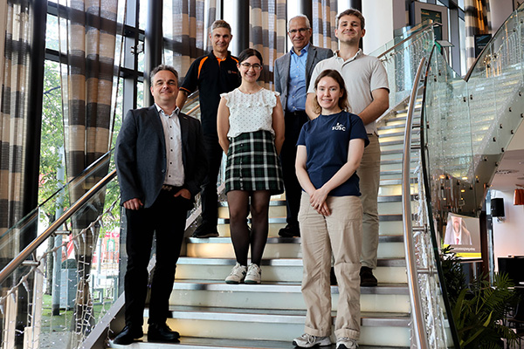
Liverpool update (1)
IBIC hosted in Liverpool this year
  7th -11th September @ University of Liverpool
  https://ibic2025.org
IPAC 2029 has been awarded to the UK
New staff member Dr Andrea Santamaria Garcia (replaces Charles)
Grant success
  PACRI (Plasma Accelerator Systems for Compact Research Infrastructures, funded by the EC’s HORIZON-INFRA-2024 programme (10M€)
  OptiX, funded by STFC (£400k)
Positronium Laser Cooling via the 13𝑆−23𝑃 Transition with a Broadband Laser Pulse, Physical Review Letters (February 2024) - selected as 2024 Top 10 Breakthrough by Physics world
Filamentation of a relativistic proton bunch in plasma, L. Verra et al. (AWAKE Collaboration), Phys. Rev. E 109, 055203 (2024) – editor’s suggestion

Slide 8
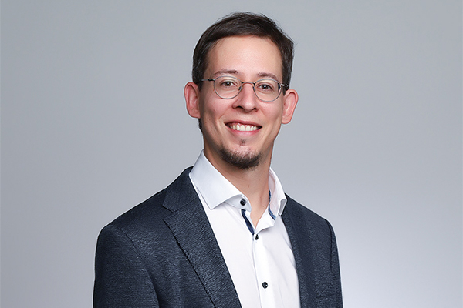
Liverpool update (2)
Appointments
  Benjamin Rienäcker elected as AEgIS Physics Co-ordinator (February 2024)
New PDRAs
  Dr Bifeng Lei
  Dr Maheshkumar Thorat
  Dr Shakti Prasad Sethi
  Dr Andrew Potter
Students
  Sara Morales Vigo, “Improvement of Accelerator Diagnostics via the Development of Beam Loss Calibration and Pattern Recognition Algorithms for the LHC Beam Loss Instrumentation Detectors”
  Liam Sommary, “The Development and Performance Characterisation of High-Brightness Photocathode Electron Sources for Particle Accelerators”
  Andrew Potter, "Beam Transport Issues in High Powered X-ray Free Electron Lasers"

Slide 9
Manchester update (1)
Dr Darren Grahame now the Manchester group leader (and PI on the core grant)
  Immeasurable thanks to Roger Jones for his leadership for many years
Developing new final year course in accelerator science for start in 26-27 AY
  Aim to attract more higher-quality PhD students to the Cockcroft
NanoAc collaboration initiated with colleagues from University of Valencia (Spain), Federal University of Health Science of Porto Alegre (UFCSPA in Brazil), University of Liverpool.
MoU with ELI-ALPS
Grant success
  European infrastructure grant (ELBEX) for a new beam-line at EU XFEL (£160k)
    Use EU XFEL beam for strong field QED and PWFA
  AWAKE Run 2 bridging grant (£50k)

Slide 10
Manchester update (2)
First in vitro measurement of VHEE relative biological effectiveness (RBE) in lung and prostate cancer cells using the ARES linac at DESY, Hannah C. Wanstall, Nicholas T. Henthorn, Roger M. Jones, Scientific Reports volume 14, 10957 (2024)
VHEE FLASH sparing effect measured at CLEAR, CERN with DNA damage of pBR322 plasmid as a biological endpoint, Hannah C. Wanstall, Nicholas T. Henthorn, Michael J. Merchant, Roger M. Jones, Scientific Reports volume 14, Article number: 14803 (2024)
Potential of the CLARA test facility for VHEE radiotherapy research, Angal-Kalinin, D., Boogert, S. & Jones, J. K., 2024, In: Frontiers in Physics. 12 (2024)
Characterising the Pelletron beam at the University of Melbourne, Norman, H., Appleby, R. B. 1 Feb 2024, In: Nuclear Instruments and Methods in Physics Research Section A: Accelerators, Spectrometers, Detectors and Associated Equipment. 1059, 169013 (2024)
Design and experimental verification of a bunch length monitor based on coherent Cherenkov diffraction radiation, accepted on 21 January 2025 in C. Davut, G. Xia et al., Physical Review Research.
Elevating electron energy gain and betatron x-ray emission in proton-driven wakefield acceleration, H. Saberi, G. Xia et al., Physics of Plasmas 31, 093104 (2024).
Filamentation of a relativistic proton bunch in plasma, AWAKE Collaboration, Physical Review E. 109, 5, 055203 (2024)
Plasmonic excitations in double-walled carbon nanotubes, G. Xia, Results in Physics 60, 107698 (2024)
Hosing of a long relativistic particle bunch in plasma. T. Nechaeva (AWAKE Collaboration), Physical Review Letters 132 (7), 075001 (2024).
Terahertz-driven acceleration of sub-relativistic electron beams using tapered rectangular dielectric-lined waveguides, Nix, L. J. R., Bradbury, J., Shaw, C., Hibberd, M., Graham, D., Appleby, R., Burt, G., Letizia, R. & Jamison, S. P., Physical Review Accelerators and Beams. 27, 041302 (2024)
Cryogenically-cooled periodically-poled lithium niobate wafer stacks for multi-cycle terahertz pulses, Dalton, P., Shaw, C., J. A., Appleby, R., Burt, G., Jamison, S. P., Hibberd, M. & Graham, D., 30 Sept 2024, In: Applied Physics Letters. 125, 14, 141101 (2024).
Adiabatic expansion cooling of antihydrogen, The ALPHA Collaboration, Physical Review Research. 6, 3, L032065 (2024)

Slide 11
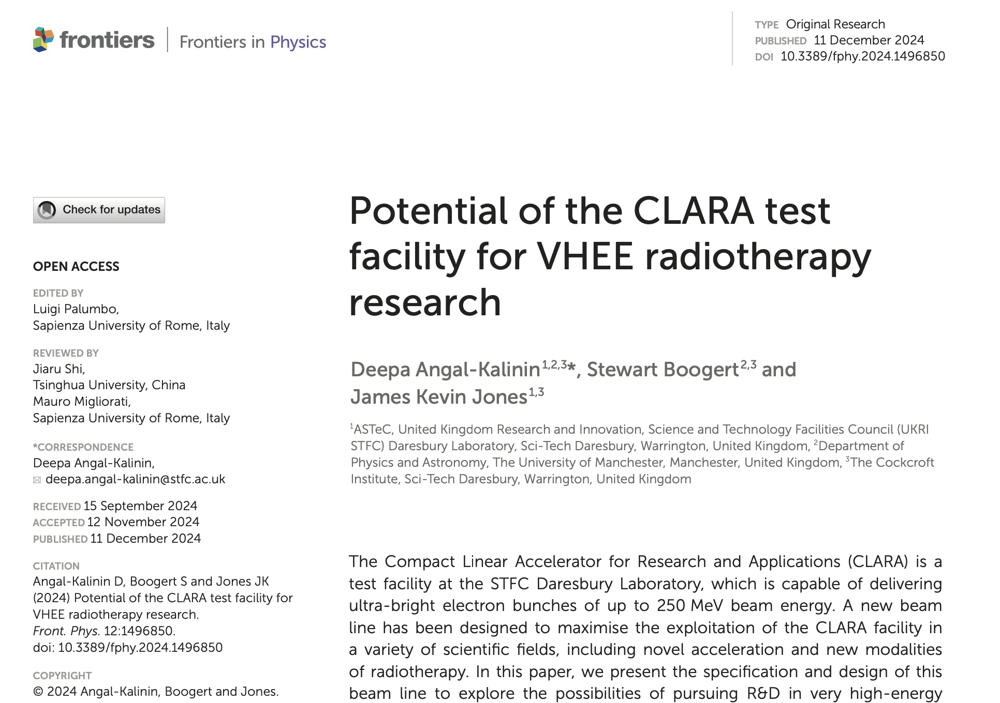
Manchester update (3)

Slide 12
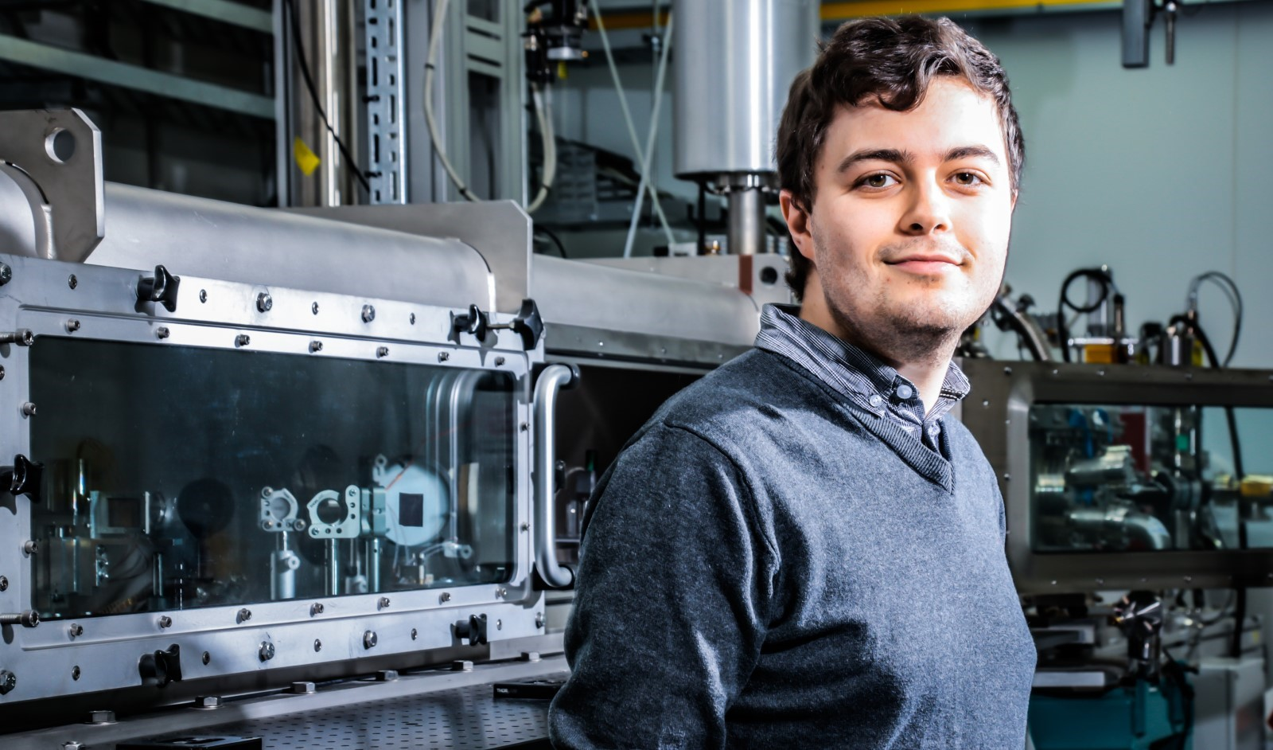
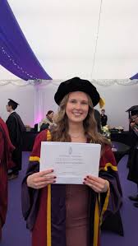
Manchester update (4)
PDRA starters
  Rohit Kumar, started November 2024T
PDRA leavers
  Can Davut (PDRA) leaving at the end of May 2025 (Turkish Atomic Energy Authority)
Students
  Christopher Shaw “Terahertz-driven electron beam manipulation for bunch compression and diagnostics”
  Hannah Wanstall “FLASH VHEE Radiotherapy: Cell Survival and DNA Damage Experiments to Measure RBE at CLARA, ARES and CLEAR”

Slide 13
Strathclyde update (1)
Dr Gordon Robb now PI for Strathcylde
Grant success
  18-month extension to STFC MoA #4132361 ‘Free Electron Lasers and Advanced Light Sources’: £169,723
  New EPSRC grant - PI: Paul McKenna; CIs: Ross Gray, Martin King, Robbie Wilson; Relativistic plasma apertures: Generating ultra-intense structured light with orbital angular momentum: £1,146,879
Grant success
  Extension for STFC funding LhARA PI: Colin Whyte; CIs: Paul McKenna, Ross Gray £119,876
Dr Fahim Habib is the Strathclyde representative in the Collaboration Board of the EuPraxia PP project
EPSRC Skills and Training Hub in Energy Transfer Technology: Collaboration Agreement signed between Strathclyde and Liverpool for Managing Partnership for the Hub. ~£9M to support up to 60 PhD projects starting from 2023-2027

Slide 14
Strathclyde update (2)
A Geometrical Approach to Physics (1st ed.). CRC Press. Burton, D.A., & Noble, A. (2024).
Unaveraged simulations of a cavity based free electron laser Results, Pornthep Pongchalee and Brian W.J. McNeil, Physics 57, 107390, 2024
Superradiant pulse saturation, Free Electron Laser Results in Physics 60, 107673, 2024, Pornthep Pongchalee and Brian W.J. McNeil
A neural network-based synthetic diagnostic of laser-accelerated proton energy spectra, Nature Communications Physics 8, 66 (2025), McQueen Christopher JG, Wilson Robbie, Frazer Timothy P, King Martin, Alderton Matthew, Bacon Ewan FJ, Dolier Ewan J, Dzelzainis Thomas, Patel Jesel K, Peat Maia P, Torrance Ben C, Gray Ross J, McKenna Paul
Stable laser-acceleration of high-flux proton beams with plasma collimation, Nature Communications 16, 1004 (2025) , Streeter M J V, Glenn G D, Dilorio S, Treffert F, Loughran B, Ahmed H, Astbury S, Borghesi M, Bourgeois N, Curry C B, Dann S J D, Dover N P, Dzelzainis T, Ettlinger O C, Gauthier M, Giuffrida L, Glenzer S H, Gray R J, Green J S, Hicks G S, Hyland C, Istokskaia V, King M, Margarone D, McCusker O, McKenna P, Najmudin Z, Parisuaña C, Parsons P, Spindloe C, Symes D R, Thomas AGR, Xu N, Palmer C A J
Laser harmonic generation with independent control of frequency and orbital angular momentum, Nature Communications 15, 6878 (2024) Trines Raoul, Schmitz Holger, King Martin, McKenna Paul, Bingham Robert
Narrow-band acceleration of gold ions to GeV energies from ultra-thin foils, Communications Physics. 7, 9 (2024) Martin, P., Ahmed, H., Doria, D., Cerchez, M., Hanton, F., Gwynne, D., Alejo, A., Fernández-Tobias, J., Green, J., Macchi, A., Maclellan, D., McKenna, P., Ruiz, J. Á., Swantusch, M., Willi, O., Zhai, S., Borghesi, M. & Kar, S.
Small tunable X-ray sources may have large impact. Nature Photonics 18, 1129 (2024). Gordon Robb
The CompactLight Design Study Adrian Cross, Liang Zhang European Physical Journal: Special Topics

Slide 15
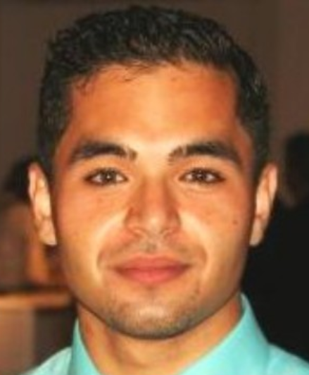
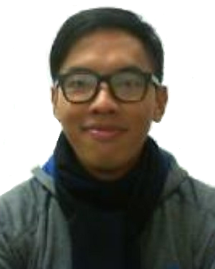
Strathcylde update (3)
PDRA starters
  Dr Fahim Habib 18-month position on ‘Free Electron Lasers and Advanced Light Sources’
  Dr Ewan Dolier – PDRA position on Laser-driven ion acceleration and underpinning physics.
Students
  Dr Ahmad Fahim Habib (Supervisors : Bernhard Hidding & Brian McNeil)
    Towards Plasma-based Attosecond-Ångstrom Class Free-Electron Laser
  Dr David McLellan (Supervisors : Dr Gordon Robb & Prof Thorsten Ackemann)
    Simulations of Radiation-Driven Instabilities
  Alana Horne
    Optimisation and measurement of bremsstrahlung and synchrotron radiation in ultra-intense laser-solid interactions
  Pornthep Ponchalee (Supervisors : Brian McNeil & Gordon Robb)
    Advanced Modelling of Free-Electron Lasers: Unaveraged Simulations, Sub-Wavelength Effects, and Superradiant Pulses Saturation

Slide 16
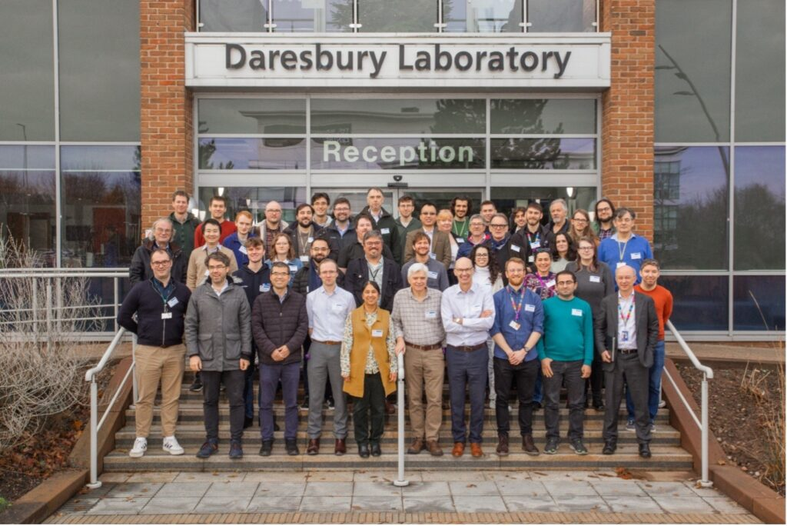
ASTEC
See presentations in SAC
  SCRF projects
  Thin films
  REUDI
CLARA/FEBE
  currently RF conditioning
  Vibrant CLARA/FEBE user meeting (link)
    ~11 presentations from potential CLARA/FEBE users
Specification and design for full energy beam exploitation of the compact linear accelerator for research and applications, E. W. Snedden. PRAB EDITORS’ SUGGESTION

Slide 17
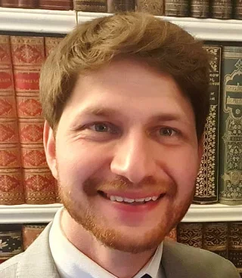

Dr Christopher Arran (Lancaster)
Moved from the University of York. Expertise in LWPA

Slide 18
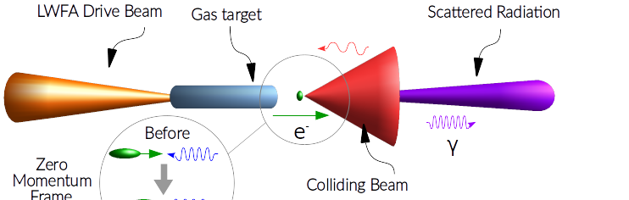
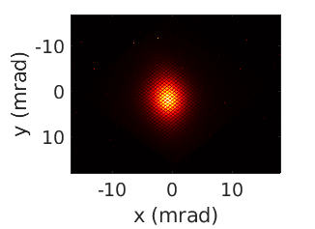
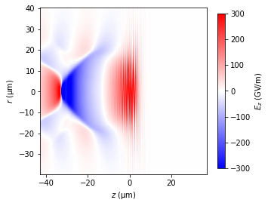
Using high intensity lasers as γ-sources
High intensity lasers → GeV-scale electrons → Bright γ-rays
Study strong field QED – Compton scattering and pair production
  Experiments at Gemini (UK), ZEUS (US), ELI-NP (Romania), and more
Simulated
100 GeV/m gradients from Laser Wakefield Acceleration
Measured MeV γ-rays from inverse Compton scattering

Slide 19
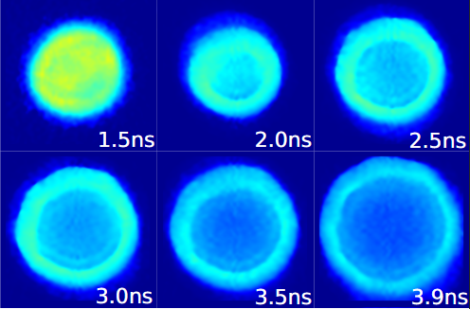
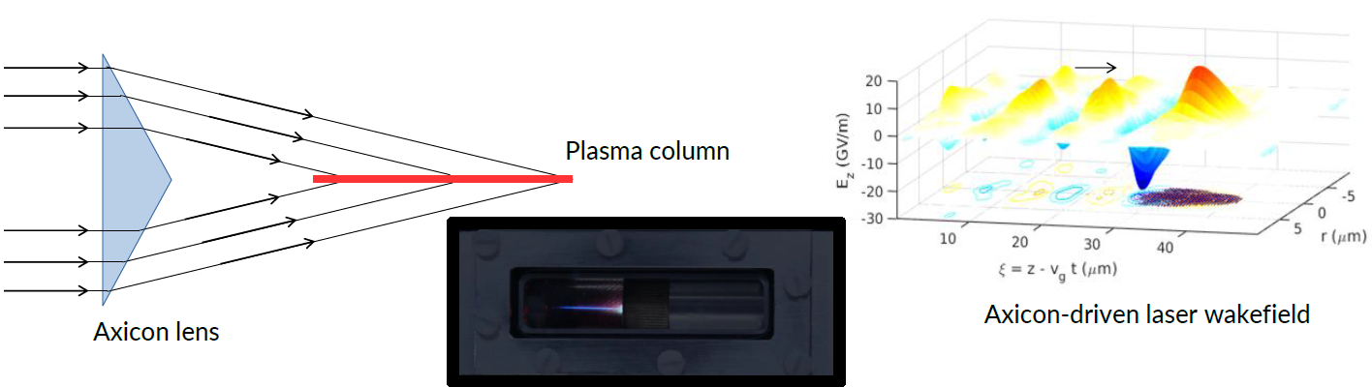
Next steps in Laser Wakefield Acceleration
Laser-driven wake-fields could accelerate e⁻ bunches from CLARA
Plasma-based optical fibres can guide laser pulses
Axicon lenses can extend the acceleration length

Slide 20

Dr Andrea Santamaria Garcia
Expert in AL/ML and particularly reinforcement learning. Moved from KIT

Slide 21
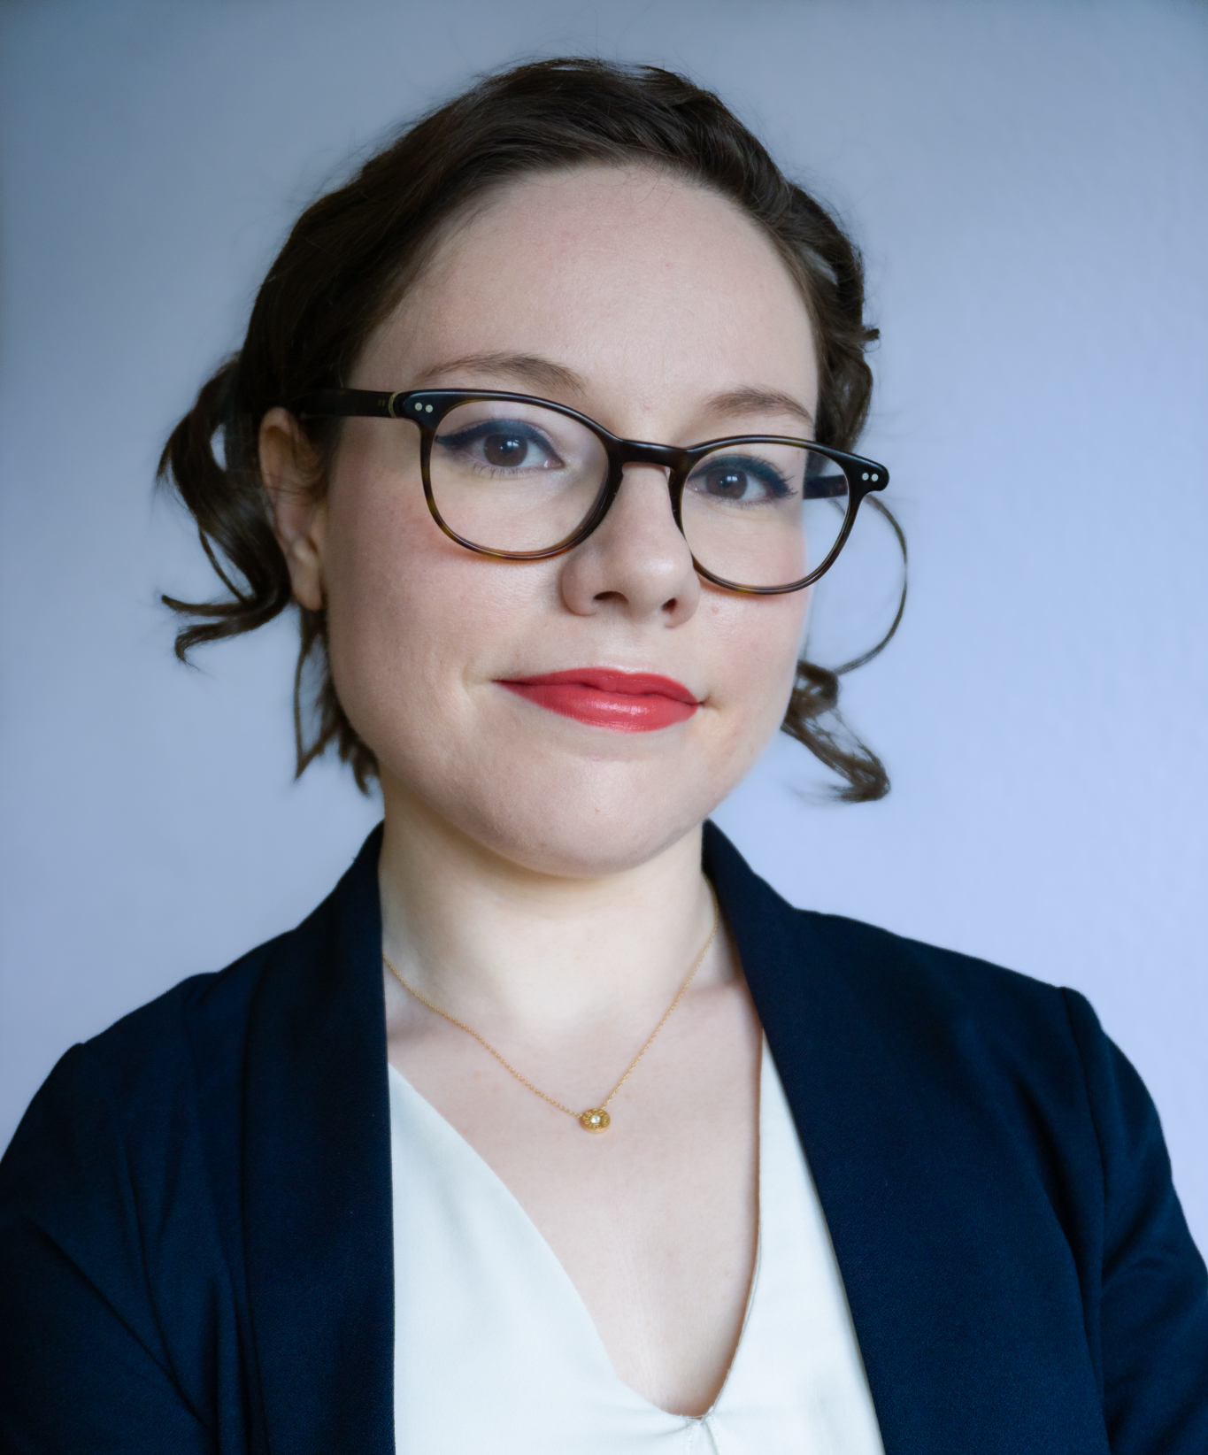
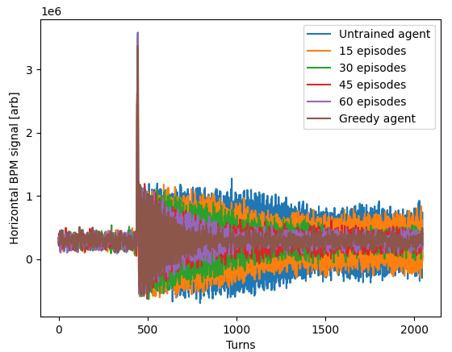
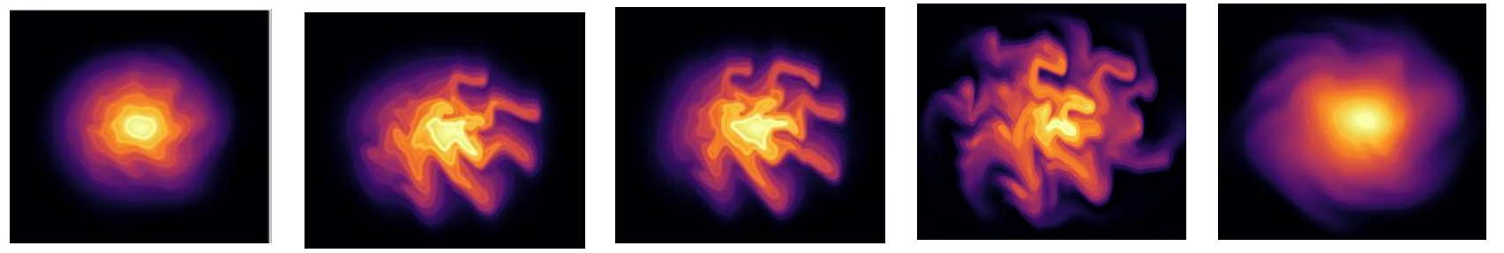
Potential of Reinforcement Learning (RL) in particle accelerators
Dr. Andrea Santamaria Garcia
Lecturer in AI for particle accelerators
RL is a powerful learning paradigm that can:
ansantam@liverpool.ac.uk
https://www.liverpool.ac.uk/people/andrea-santamaria-garcia
tackle control problems in large environments
deal with delayed consequences
learn from experience without a model of the dynamics
Converges faster than other algorithms and adapts to changing environment
Can be deployed without knowing the problem dynamics
external kick
Damping improves with experience: the system is learning!
J. Kaiser et al. Reinforcement learning-trained optimisers and Bayesian optimisation for online particle accelerator tuning. Sci.Rep. 14 (2024) 1, 15733
Can be employed to control instabilities
L. Scomparin et al. Microsecond-Latency Feedback at a Particle Accelerator by Online Reinforcement Learning on Hardware. e-Print: 2409.16177 [physics.acc-ph]
Towards a universal controller for accelerators!
Can be trained in a lattice agnostic way
C. Xu et al. Beam trajectory control with lattice-agnostic reinforcement learning. IPAC2023-THPL029.
L. Scomparin et al. Preliminary results on the reinforcement learning-based control of the microbunching instability. IPAC2024-TUPS61

Slide 22
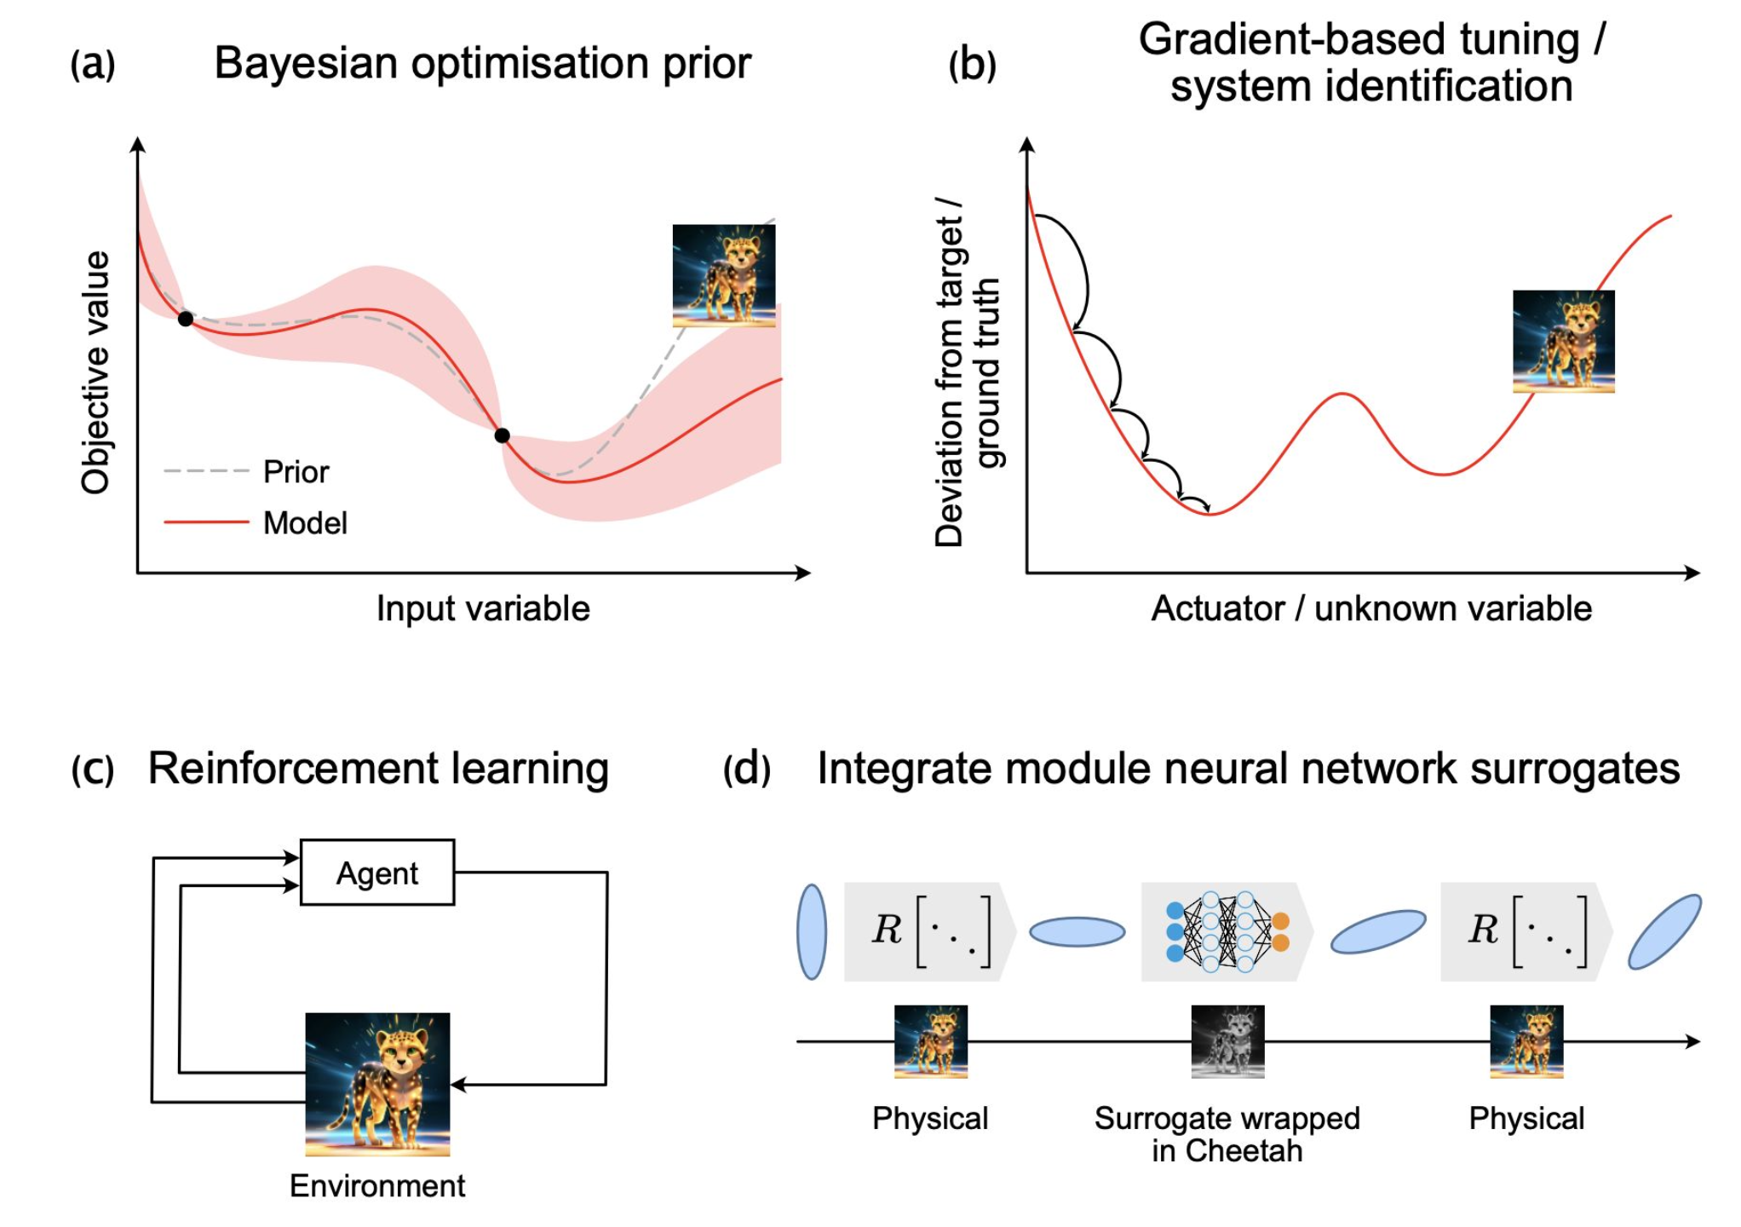
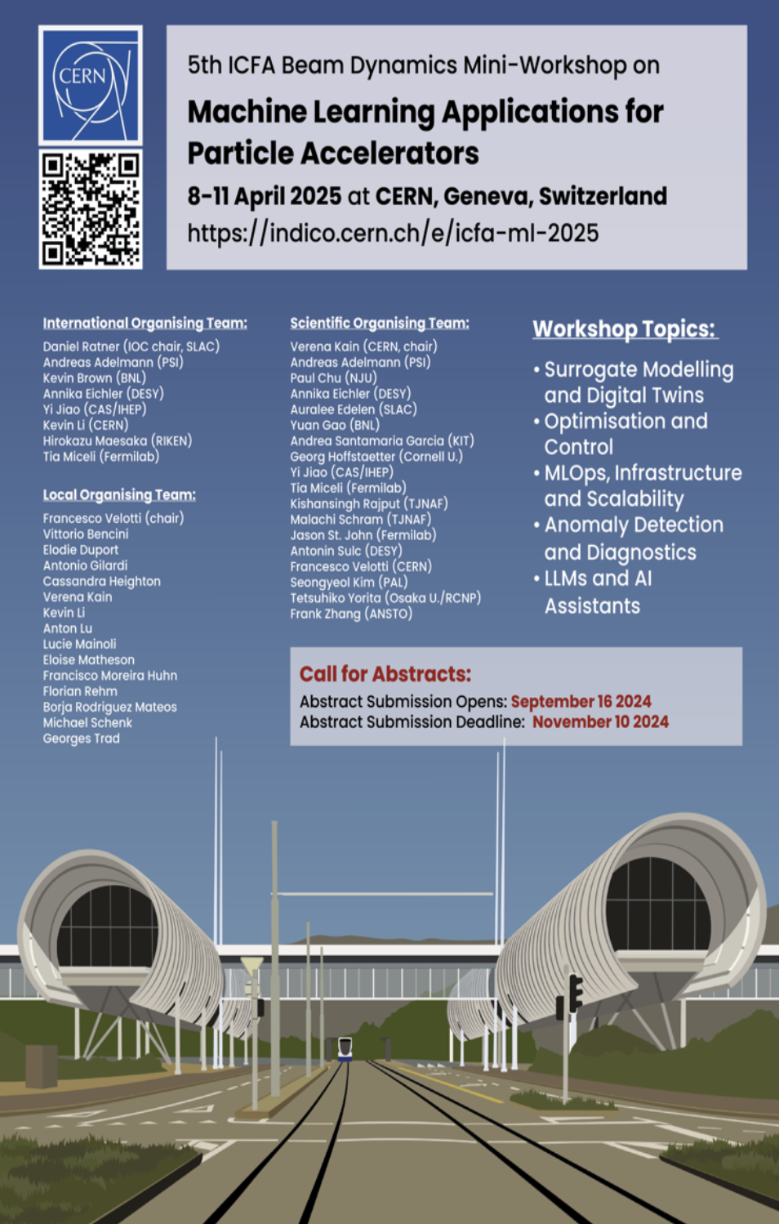
Cheetah
Differentiable Beam Dynamics Simulation
Dr. Andrea Santamaria Garcia
Lecturer in AI for particle accelerators
Python package for beam dynamics simulations based on PyTorch for use with machine learning applications
Ultra-fast compute: (at the cost of fidelity) Cheetah can run orders of magnitude faster than some other codes.
Differentiability: Based on PyTorch, Cheetah supports automatic differentiation for all its computations.
ansantam@liverpool.ac.uk
https://www.liverpool.ac.uk/people/andrea-santamaria-garcia
Join us at yearly workshops for hands on tutorials!
https://github.com/desy-ml/cheetah
J. Kaiser et al. Bridging the gap between machine learning and particle accelerator physics with high-speed, differentiable simulations. 10.1103/PhysRevAccelBeams.27.054601

Slide 23
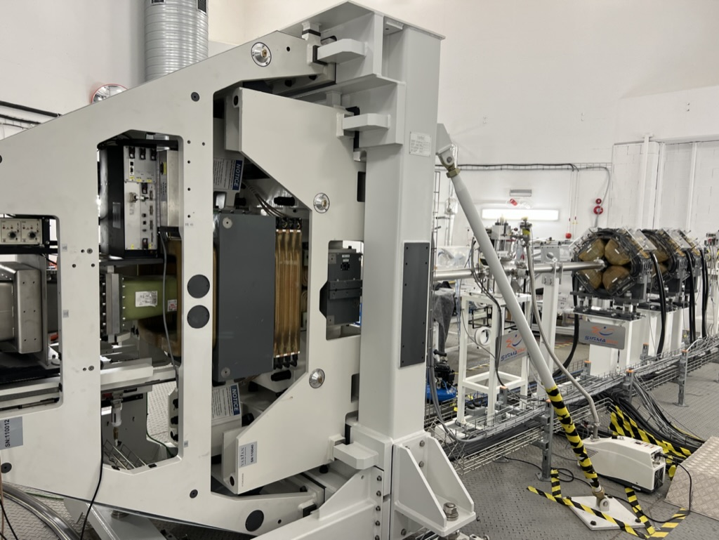
Proton therapy position @ Manchester
Rob Appleby, Mike Taylor and Stewart Boogert successfully lobbied for a new professorial post in particle/proton beam therapy
  Post to be in Faculty of Science and Engineering (FSE) and Department of Physics and Astronomy (P&A)
  Could be seen as a replacement for Karen Kirkby
  Focus in on the physics and engineering of PBT

Slide 24
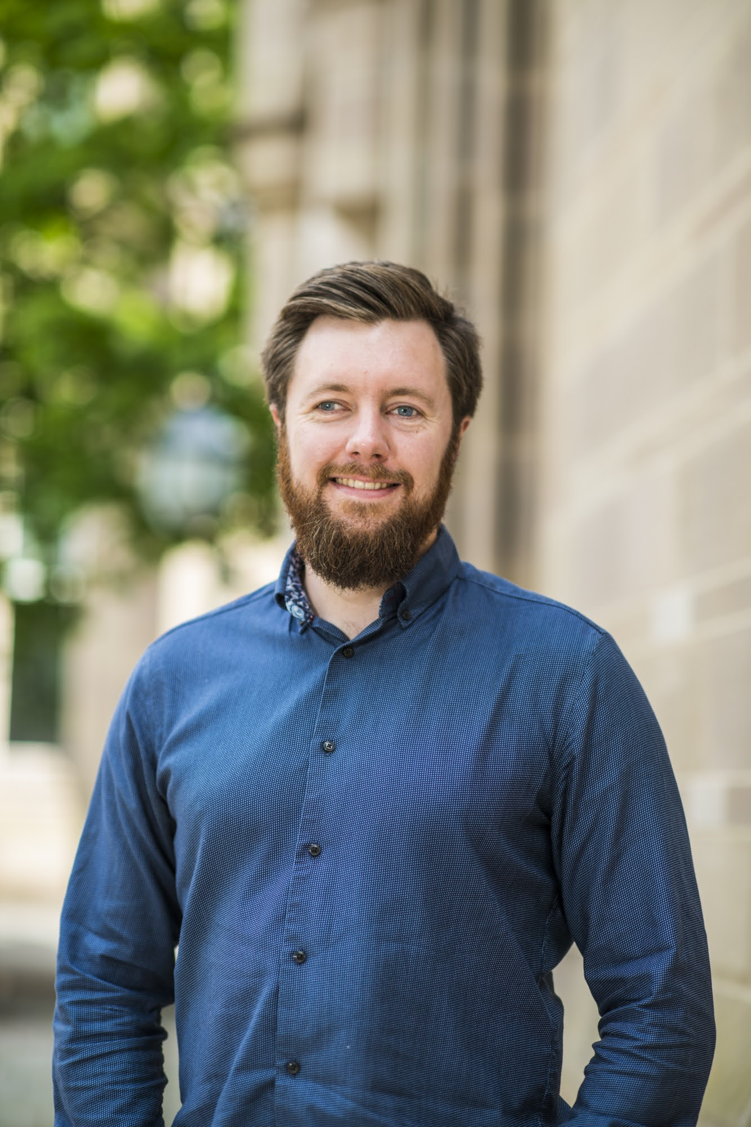
Business development
Warm welcome to Daryl McManus
  Already developing business development strategy
  External Industry advisory committee meeting (hosted at Rapiscan)
Raising profile of BD activities
  Visit all partners to promote the Cockcroft and raise awareness of our activities
  Prepare presentation on the Cockcroft for senior leadership at the CI partners
  Prepare talk for the CI members on how to access non research funding

Slide 25
Core grant (3.5 years starting April 2025)
In numbers
  Total request (100% FEC) : £11.03M
  Partner split :
    Lancaster: £3.11M (28.2%),
    Liverpool: £2.41M (21.9%),
    Manchester: £3.69M (33.4%),
    Strathclyde: £1.81M (16.4%)
  Category split :
    Staff: £959k
    PDRAs: £2753k
    Consumables: £685k
    Travel: £370k
    Equipment: £1051k
“Awarded”
  Approximately £10M (@100% FEC)
  Award to universities £7.2M (@80% FEC and without STFC admin staff)
  Flat award, so same amount of funding, eroded by inflation

Slide 26
UK GOV, UKRI, STFC Funding climate
Funding climate is particularly bad e.g.
  STFC has funded the Cockcroft at ”flat” cash, so no uplift for inflation
  New projects are almost impossible to get funded (e.g., H3+ beams)
  Existing projects (e.g. HL-LHC, AWAKE) could receive significantly less funding
  Issues likely to persist for medium term
Causes
  Overall inflation
  Reduction in government spending
  Pay settlement for STFC staff
  Cost over-runs in long term commitments.
Lack of clarity around infrastructure funding moving forward
  How will government fund large scale scientific infrastructure

Slide 27
Cockcroft response to funding climate
Need a serious strategy to diversity activities (and/or funding streams)
Relying on STFC in near term probably not best strategy
Should focus on other constituents of UKRI (MRC/EPSRC/Innovate)
Cockcroft core grant is a foundation on which projects are built
  E.g. H3+ beams was the aggregation of CI core grant and a project request
How we now use core funds when additional project funds are sparse
Improvement on developing industrially focused projects

Slide 28
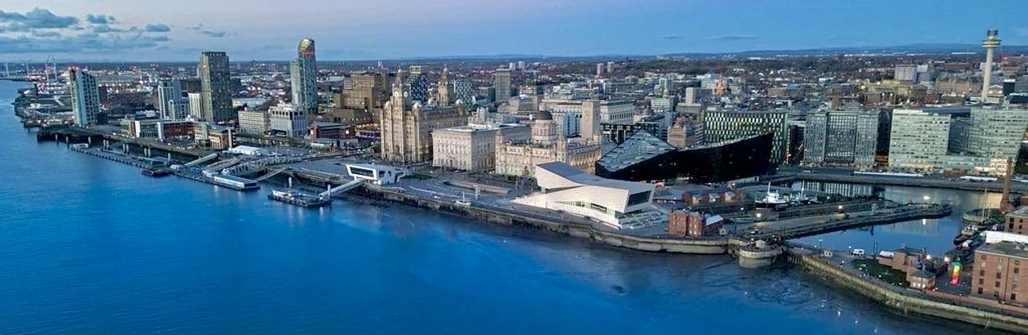

International particle accelerator conference 2029
Congratulations to Carsten and his team
Liverpool long building up to the “big one”, LINAC, IBIC & now IPAC
Faced stiff competition from excellent cities/labs

Slide 29

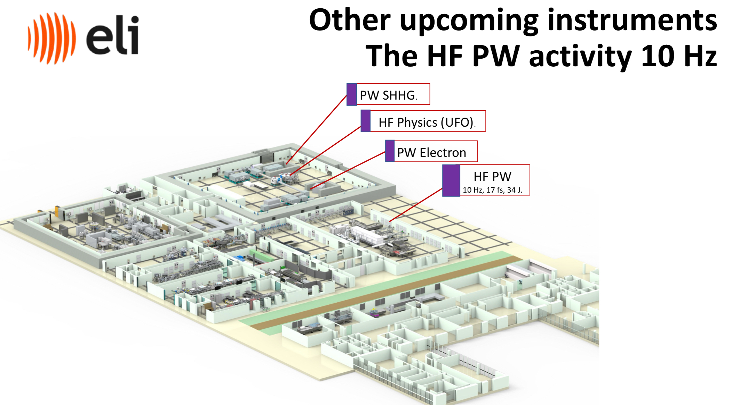
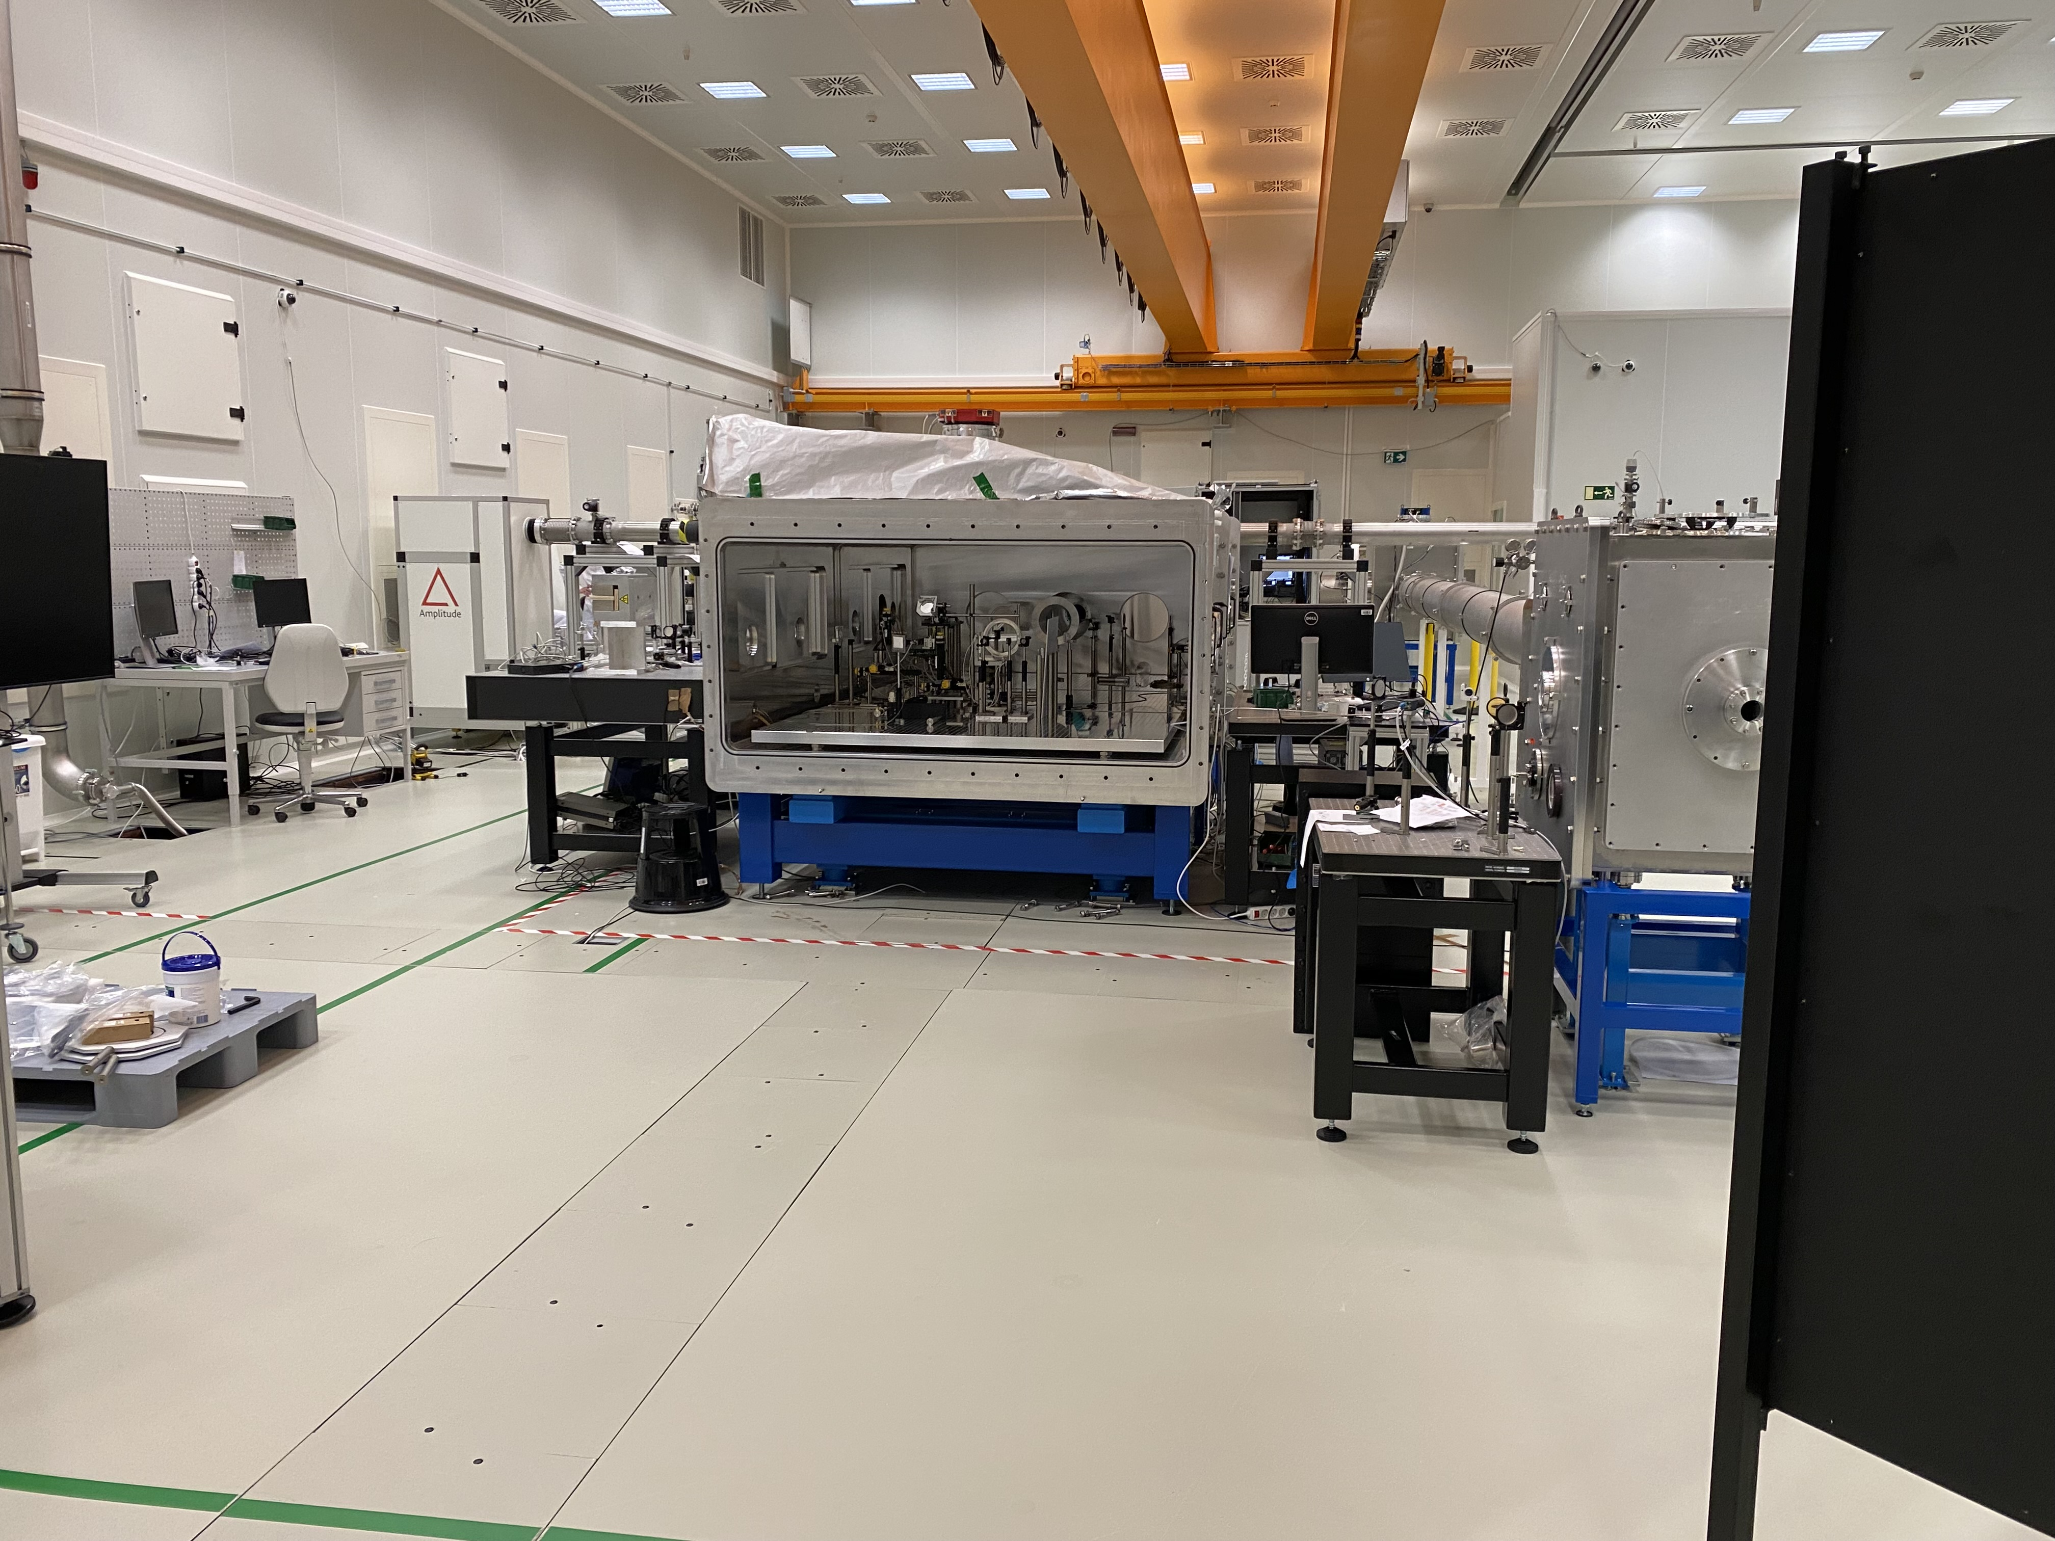
Collaboration with ELI-ALPS
The Cockcroft Institute and the Extreme Light Infrastructure (ELI) have signed a Memorandum of Understanding formalising our joint desire to pursue collaboration on laser wakefield acceleration and terahertz electron bunch manipulation techniques. This will help encourage collaboration, support the establishment of joint PhD studentships, and a reciprocal arrangement for hosting PhD and postdoctoral research associates.

Slide 30
SAC 2025 charge
Normal charge around reviewing our programme around
  the scientific & technical excellence
  the strategic importance & relevance of the main elements,
  the balance between the main elements,
  the ability of the CI organization and personnel to deliver the main objectives with the resources available.
But with a particular focus on the STFC funded “projects” presented at this year's SAC.
  Proton acceleration ITRF/LhARA
  AWAKE
  High luminosity LHC
  H3+ beams

Slide 31
Summary
Activities at partners vibrant and diverse
  High quality research output and funding still being won
Two new early career academic appointments.
  Strengthened LWFA activity (Dr Arran)
  Opportunity to grow AI/ML for accelerators (Dr Garcia)
Project funding from STFC looks depressed.
  Lower levels than our current levels
  But how low will this go down to? Real fear this might be zero
  Cockcroft needs to a proactive, informed and balanced response to funding issues that enable the best recovery when resources become available

