Slide 1
ISIS Developer Update
Sarah Foxley
Visitor Centre, Rutherford Appleton Laboratory, Didcot, UK
3rd November 2025

Slide 2
Who are we?
Mantid Team Lead and Engineering Manager – Sarah
Senior Scientific Software Engineers
  Tom - Core Product Owner
  Mial – LSS Product Owner
  Silke – Excitations/Vesuvio Product Owner
  Sarah – DevOps and Spectroscopy Product Owner
Senior Software Scientist
  Richard – Diffraction Product Owner

Slide 3
Who are we?
Scientific Software Engineers
  Caila
  James
  Jonathan
  Mohammed
  Rabiya
  Waruna
Software Scientists
  Adrian
  Andy
  Gui

Slide 4

What is an Epic?
Larger piece of work
  Takes 1 developer more than 3 months of work to complete
Reviewed and prioritised by the ISIS Mantid Programme Board
  Board comprises scientists representing different ISIS science areas
Tend to be scientific/user facing work

Slide 5
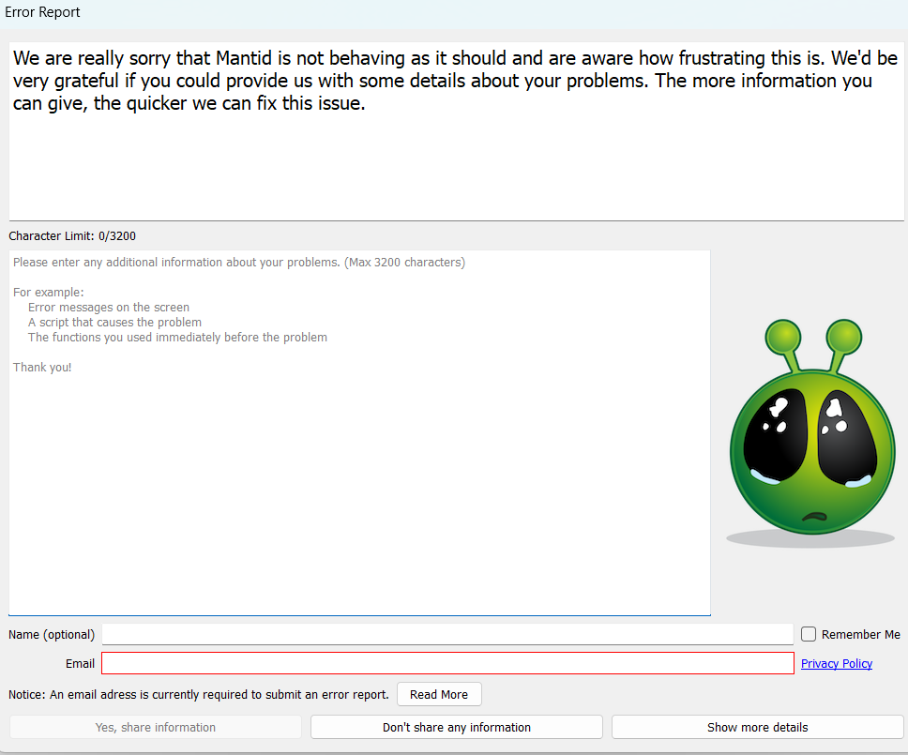
Mantid Error Reporting Enhancements

Slide 6
Polarised SANS
New math functions for hyperbolic trigonometry
New calibration steps requiring new algorithms
Modifications to existing algorithms
  PolarizedCorrectionsWildes computation time reduced by factor of 4
New algorithms include
  PolarizerEfficiency (v6.11)
  SavePolarisedNXcanSAS (v6.13)
  DetermineSpinStateOrder (v6.14)
  SANSISISPolarizationCorrections (v6.14)
  HeliumAnalyserEfficiencyTime (v6.14)

Slide 7
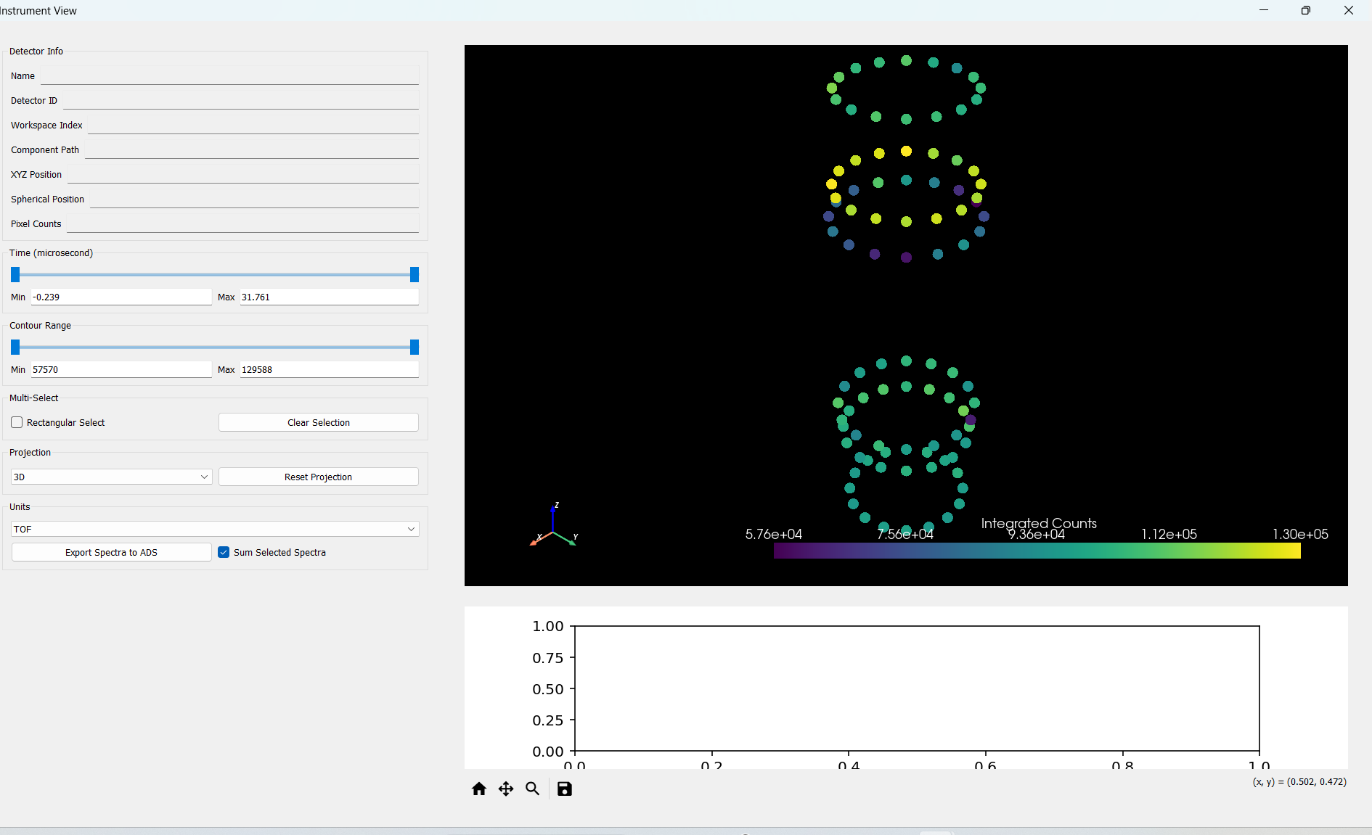
Instrument View

Slide 8




Not just epics…..
New ARM Mac package
Mslice now an optional dependency
Support for ORNL led project to overhaul NeXus API
Upgrade to Numpy v2.0
Upgrade to Python v3.11
Upgrade to Matplotlib v3.9
New algorithms
  ReflectometryISISCreateTransmission
  CreateMonteCarloWorkspace
… and much more besides

Slide 9

Releases
October 2024 – v6.11.0
February 2025 – v6.12.0
July 2025
  V6.13.0
  V6.13.1 patch release
October 2025 – v6.14.0
Release roles:-
Release Manager
Technical Release Manager
Quality Manager
Release Note Editor

Slide 10





Developer Operations (DevOps)
New Mac runners (courtesy of ILL)
New data mirror for ISIS runners
Non-trivial upgrades to
  Jenkins
  Java on runners
  Discourse (Forum software)
  Django (used in error reports and user reports)
  Ansible scripts/docker containers for all runners
Improved security
  CI tests only auto run for repo members
  Removed several unsecure Jenkins plugins
  Improved staging server design
Keeping pipelines running

Slide 11
One Team…
Two work streams…
Mantid Team Lead
Core Workstream Lead
Epics Workstream Lead
Team Members
Team Members

Slide 12
Benefits
Less `dead` time between pieces of work
More flexible resource when science areas have more/less requirements
Ability to focus on Epic work without distraction
  E.g. Polarised SANS completion
Less vulnerability to:-
  staff leaving
Expertise shared more widely
More opportunities for developers to extend/acquire new skills

Slide 13
Thank you for listening
Any questions?

