Slide 1
A Bayesian Tutorial
Targeted for science facilities
Anders Markvardsen
Analysis, Analytics and Infrastructure section leader
SciML Siminar, 6th Feb 2020
Rutherford Appleton Laboratory, UK

Slide 2
https://stfc365.sharepoint.com/sites/AnalysisAnalyticsandInfrastructuresection
Notes:
To help deliver Analysis, Analytics and Infrastructure software that enable ISIS staff and its users to new and improve existing science workflows at ISIS.
and from ISIS data and make existing workflows easier.
Analysis means, data analysis and answering questions about data in the past tense, Analytics means answering questions about what may happen next, and Infrastructure refers to services that enable this, including, where possible, with automation.

Slide 3
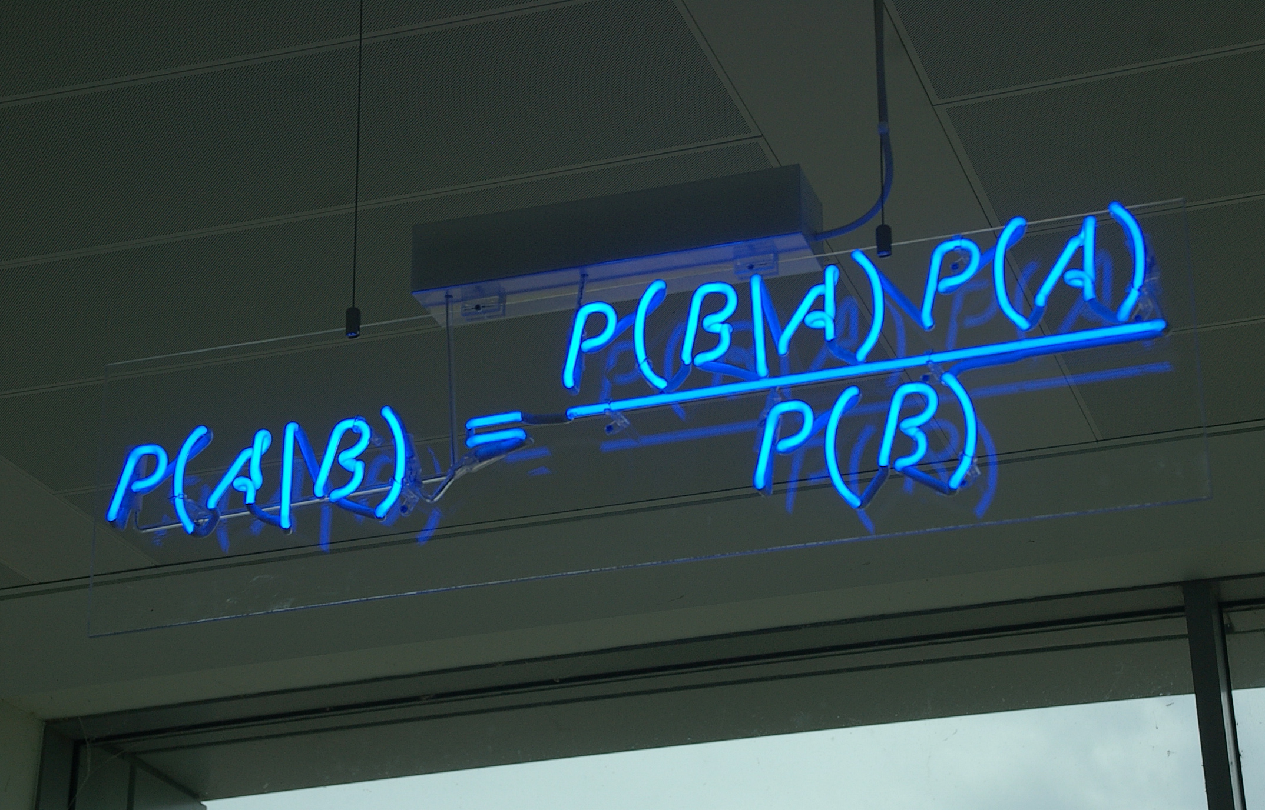
Agenda
Bayesian intro
Example 1: Extinction symbol determination
Example 2: Max-Likelihood
Concerning the picture:
By mattbuck (category) - Own work by mattbuck., CC BY-SA 3.0, https://commons.wikimedia.org/w/index.php?curid=14658489
Example 3: Hybrid Monte Carlo
Image © STFC Alan Ford

Slide 4
What are my Bayesian credentials?
PhD Physics
~50% Bayesian
Statistical department at Oxford Uni
PostDoc and as scientist at ISIS
Worked on applying Bayesian statistics

Slide 5
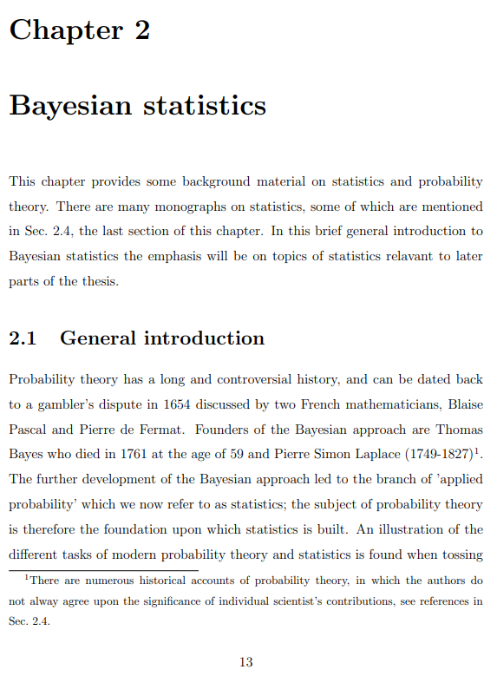
Bayesian intro
Will based this on chapter 2 of: https://ora.ox.ac.uk/objects/uuid:bef0c991-4e1c-4b07-952a-a0fe7e4943f7
Notes:
Chapter 2 is a short ~17 page intro

Slide 6
Controversial history
Frequency interpretation
Subjective (or Bayesian) interpretation

Slide 7
Notation – for probability
Notes:
Replace this guidance text with your own bullet pointed content.
For further guidance please see https://www.bdadyslexia.org.uk/advice/employers/creating-a-dyslexia-friendly-workplace/dyslexia-friendly-style-guide

Slide 8
Notation: conditional and joint
Notes:
Like the fundamental particles in physics

Slide 9
Fundamental relationship

Slide 10
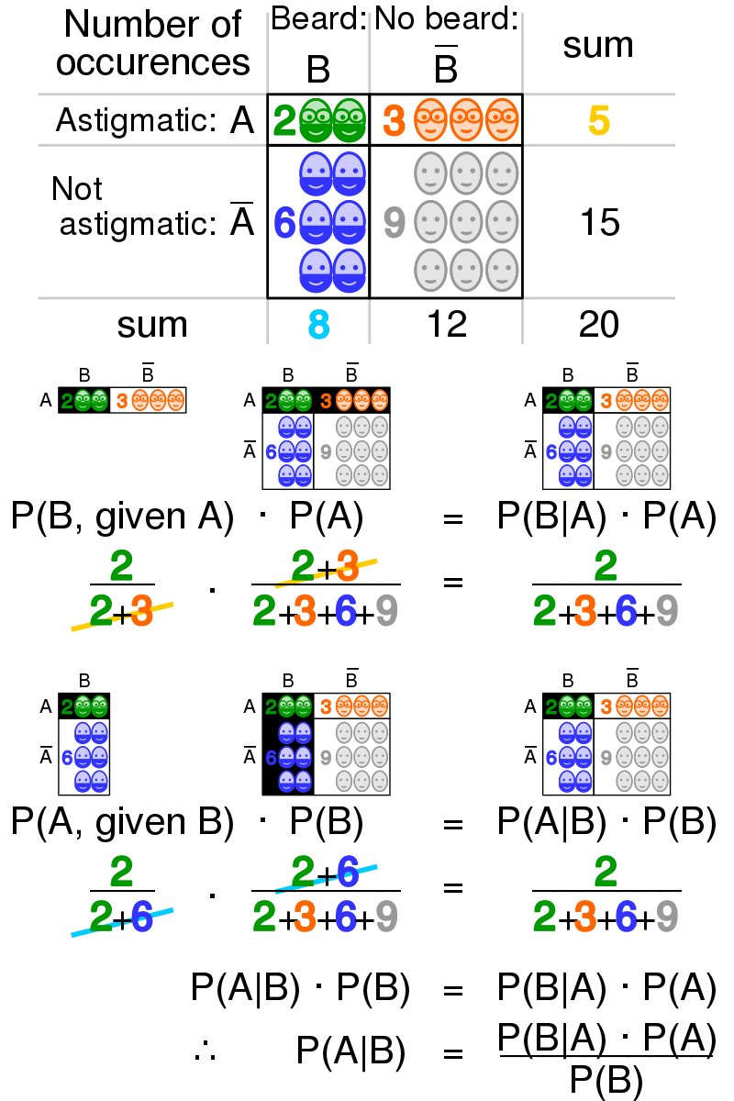
Frequentist Interpretation
Picture to the right copied from: https://en.wikipedia.org/wiki/Bayes%27_theorem#/media/File:Bayes_theorem_visualisation.svg

Slide 11
Bayesian Interpretation
Likelihood
Prior
Posterior
Marginal sometime called the evidence
Notes:
A bit like e.g. Newton equation of motion.
p(x) = p.d. that the evidence itself is true
p(theta|x) = p.d. of theta given the evidence
p(x|theta) = likelihood of the evidence x if theta is true)
p(theta) = prior

Slide 12
Marginal p.d.
Notes:
And of course can prior model constants can be converted to parameters by simple using the probability relation for conditional probabilities. Also, speak about where does the story ends!

Slide 13
“Cooking” up a prior p.d.
Example:
May be refereres to as prior model constants
Notes:
And of course can prior model constants can be converted to parameters by simple using the probability relation for conditional probabilities. Also, speak about where does the story ends!

Slide 14
Non-informative priors
In one sense the opposite of prior model constant
Notes:
Ask the audience what is wrong with the last two ‘probability’ densities

Slide 15
Robustness analysis
Notes:
And of course can prior model constants can be converted to parameters by simple using the probability relation for conditional probabilities. Also, speak about where does the story ends!

Slide 16
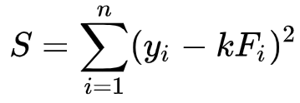
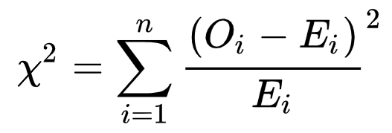
How the Chi-square p.d. may relates to the least squares (chi-square) figure-of-merit
4 examples of least-square FOM notations from the literature:
Notes:
Copied three examples from

Slide 17
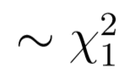
The Chi-square p.d.
Probably the most common summary statistic used in experiment physics
Define:
Notes:
A r.v. formed from a set of other r.v. is often referred to as a statistic

Slide 18
The Chi-square p.d. vs least-square/chi-square FOM
Further define:
$$v$$
$$u_{i}$$
$$Q\sim χ_{P}^{2}$$
Notes:
A r.v. formed from a set of other r.v. is often referred to as a statistic

Slide 19
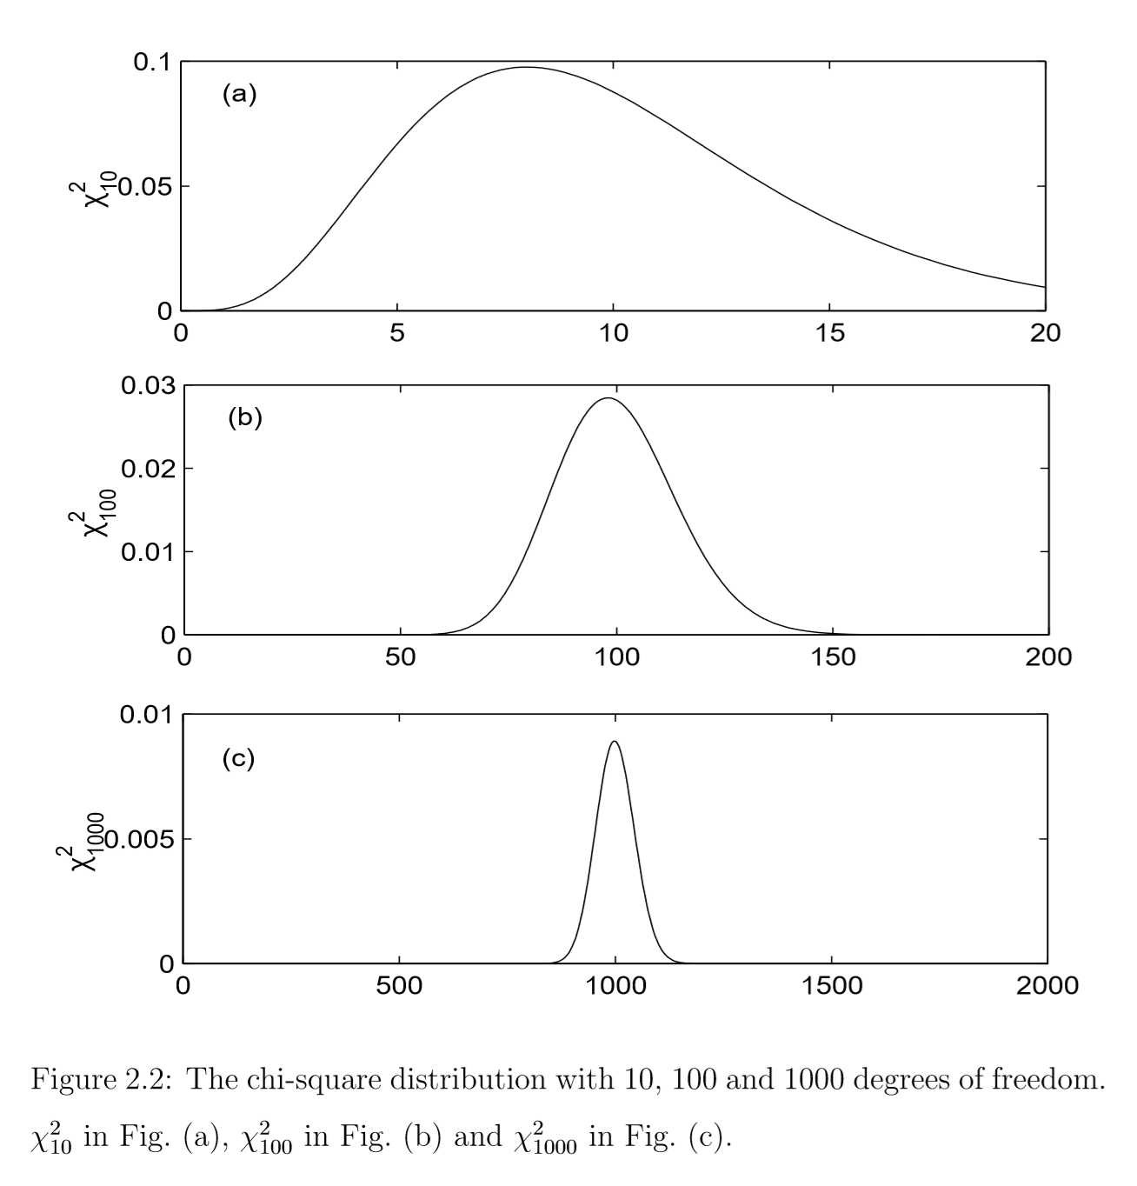
Notes:
Sciences with an ‘s’ meaning physics, biology, chemistry etc.

Slide 20
Move on to Example 1
Extinction Symbol Group determination
Notes:
The abstract pattern can be removed or repositioned if required. Be careful to ‘Send to Back’ so that it does not obscure any important information.

Slide 21
Example 1: Extinction symbol determination
Purpose: show a Bayesian analysis on facility data - more or less A to Z
Main work: A. J. Markvardsen, W. I. F. David, J. Johnston and K. Shankland, (2001) https://doi.org/10.1107/S0108767300012174
Extend prior expression: A. J. Markvardsen (2004):
https://aip.scitation.org/doi/abs/10.1063/1.1835216
Make software for this algorithm public (2008): https://doi.org/10.1107/S0021889808031087
Notes:
Chapter 2 is a short ~17 page intro

Slide 22
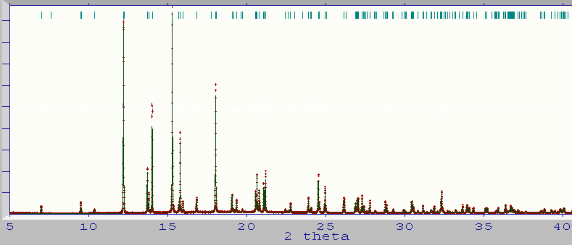
The user facing problem
Hydrochlorothiazide
fitted in P2

Slide 23
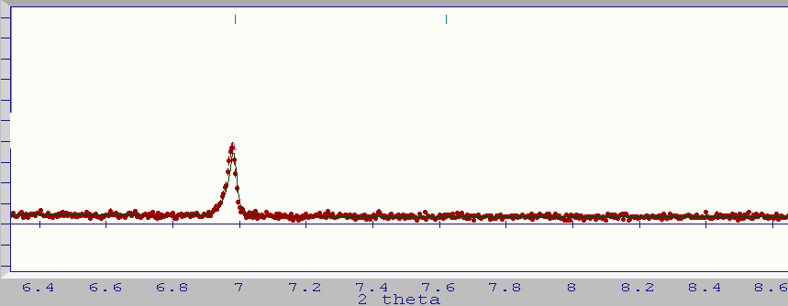
0 1 0
Absent?

Slide 24
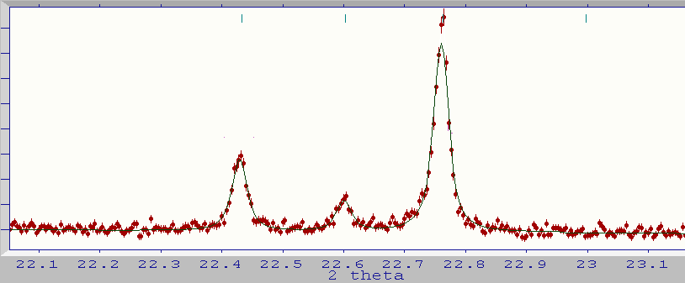
0 3 0
absent?

Slide 25
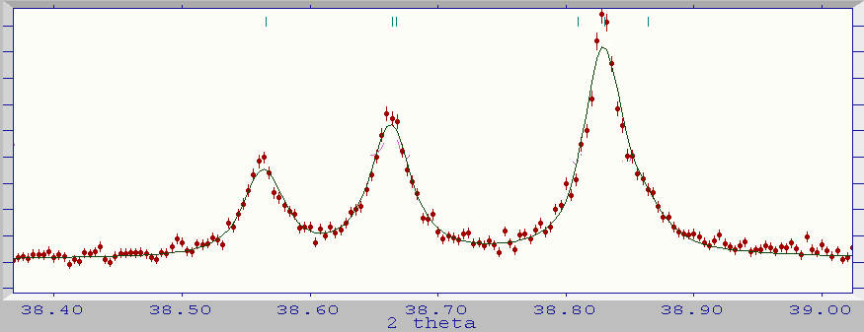
0 5 0
absent?
0 1 0
probably
absent
0 3 0
probably
absent
Hydrochlorothiazide
fitted in P2

Slide 26
$$E_{gr}$$
$$log\left[\frac{\left.p(E_{gr}|I^{p}\right)}{\left.p(P−−−|I^{p}\right)}\right]$$

Slide 27
“Feature extraction”
Intensity of a Bragg reflection h
background
Profile function value of
reflection h
Calculated raw counts
Sum over reflections

Slide 28
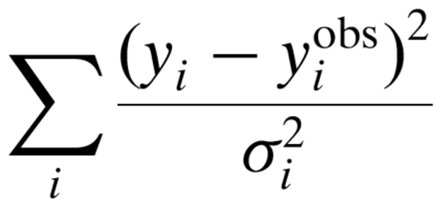
“Feature extraction”
Notes:
Linear-each regression with least-squares figure of merit

Slide 29
“Feature extraction”
new intensities from so-call Pawley refinement
multivariate intensity variables

Slide 30
Pros and cons of feature extraction
Pros:
Remove concerns background and profile shapes
Left with only the features that matters for this analysis
Cons:
Do we trust the feature extractions?
Notes:
And of course can prior model constants can be converted to parameters by simple using the probability relation for conditional probabilities. Also, speak about where does the story ends!

Slide 31
The goal is to calculate:
Observable features
Extinction symbol group

Slide 32
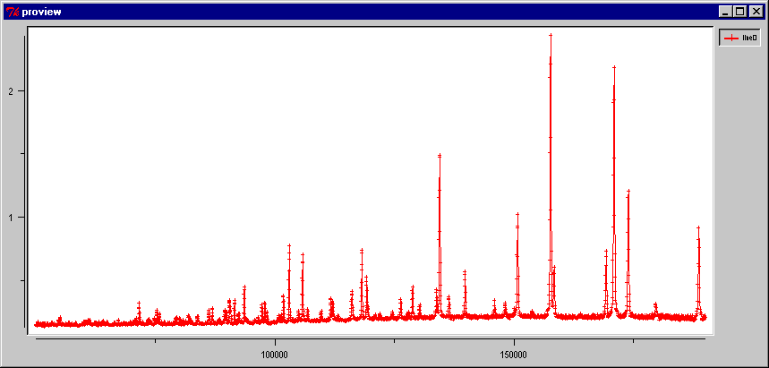
End goal – what the user sees
Example problem: Dopamine deuterobromide – orthorhombic unit cell
Data from HRPD @ ISIS. N. Shankland et al.

Slide 33
Some Bayesian manipulations:
Step 1
Step 2
Step 3
Notes:
I^P stands for the `new observables`, in this case obtained using the Pawley method, hence the notation superscript P – although in hindsight perhaps superscript ‘obs’ would have been clearer.
The last step in Step 3: look perhaps slightly schizophrenic in that it appears that you could ask “what is the p.d. of observing a given reflection given that on one hand E_gr is selected to a value such that given reflection is know to be absent but on the other hand I is selected to value that indicates this reflection is non-zero” which is clearly a nonsense (although perhaps not in the world of schodinger cat☺). Mathematically it may seem a bit like asking p(I^P | empty set) which in frequentist interpretation is undefined but in a Bayesian interpretation we would say is zero or some other value, however whatever value we assign to makes no difference to calculating p(I^P | E_{eg}) because of the prior and it being a delta-function in this case

Slide 34
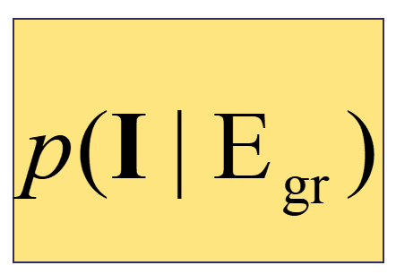
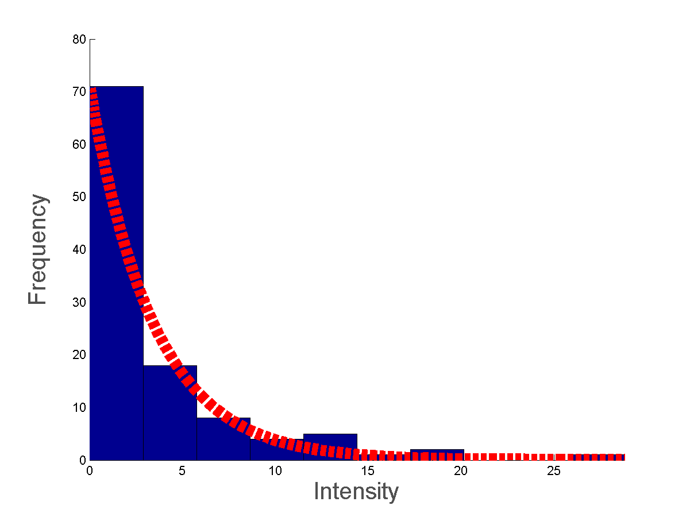
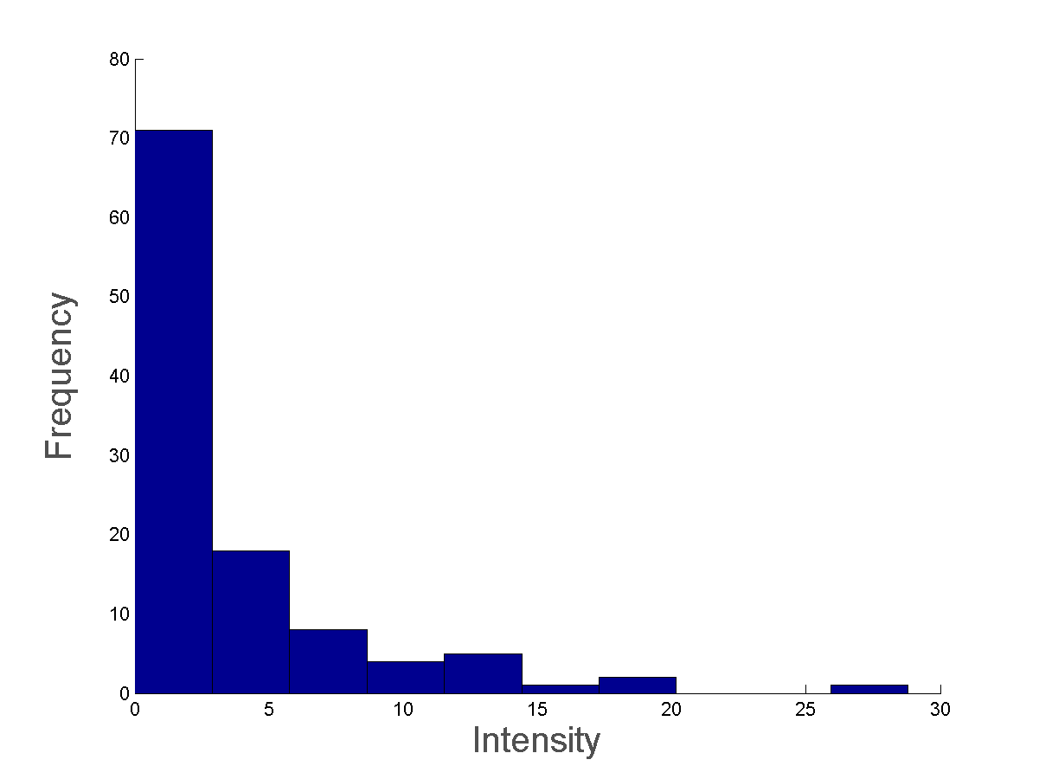
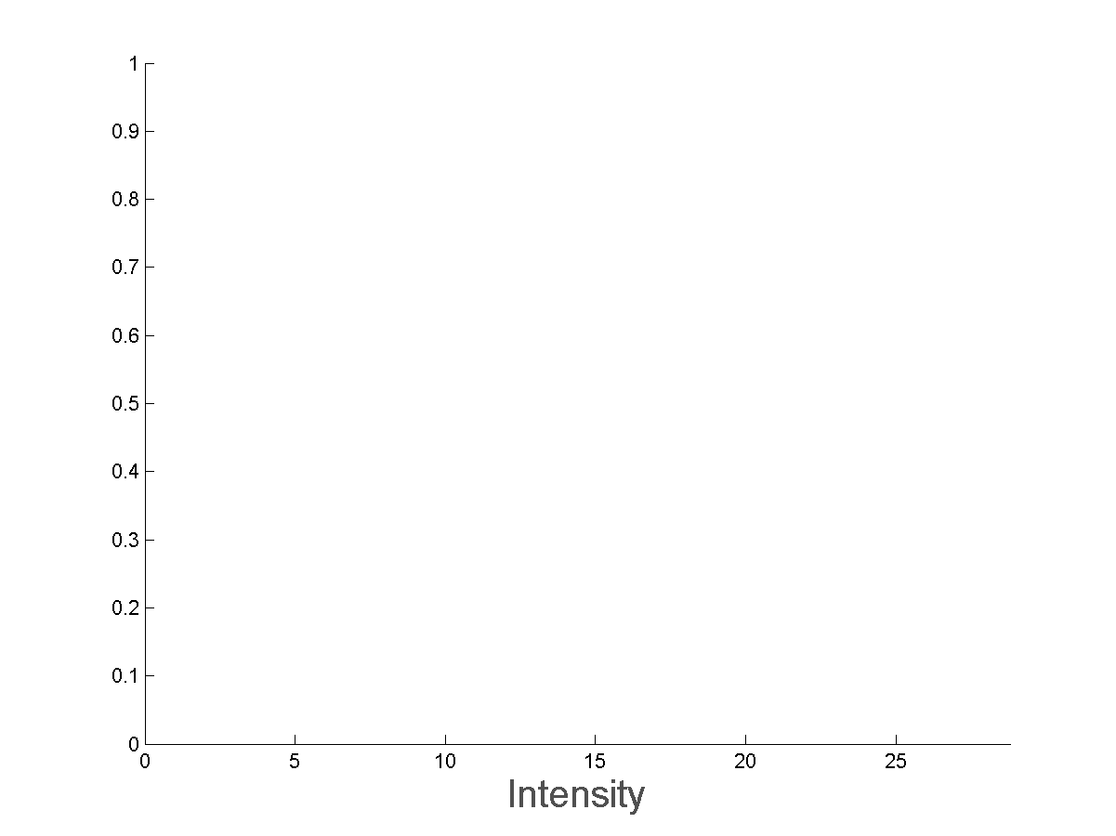
prob(I | absent)
prob(I | present)

Slide 36
The practicality of computation
Notes:
Applying the magnificent Monte Carlo techniques

Slide 37
Summary - assume perfect feature extraction
Showed a Bayesian analysis
What I did not have time to show:
Self contained method with zero parameters (or hyper-parameters)
Answer in ~1-2 seconds
Algorithm shipped with three commercial software and as standalone

Slide 38
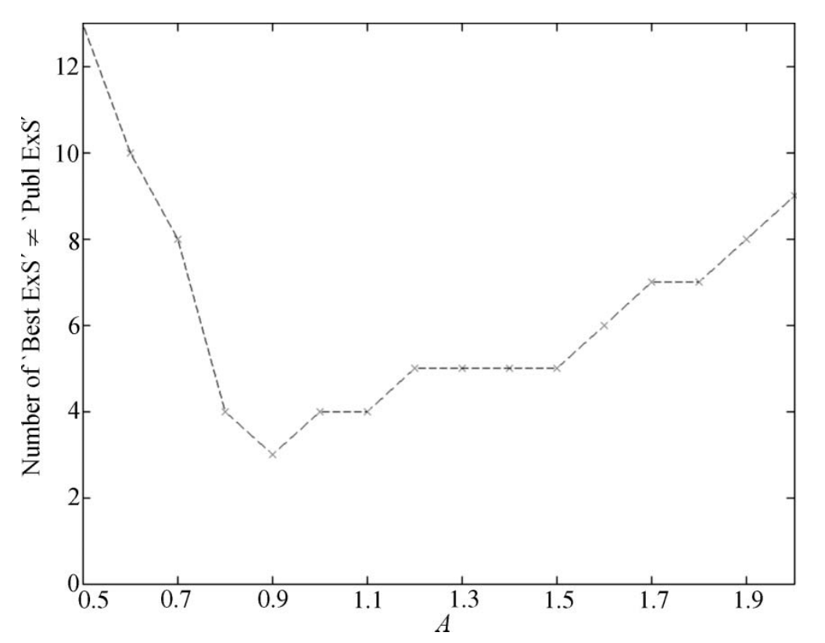
Summary – not assuming perfect feature extraction
Same as previous, but in one ‘hyper’ parameter
Notes:
You could ask the question why does it work!

Slide 39
Move on to Example 2
Maximum likelihood
Notes:
The abstract pattern can be removed or repositioned if required. Be careful to ‘Send to Back’ so that it does not obscure any important information.

Slide 40
Example 2: maximum likelihood
Purpose:
1) Another Bayesian analysis
2) Quirkiness of a commonly used statistical term, that is ‘maximum likelihood’
Work presented: A. J. Markvardsen, W. I. F. David, and K. Shankland, (2002) https://doi.org/10.1107/S010876730200510X
Notes:
Here adapting an approach successfully applied to single-crystal crystallography to powder crystallograpy

Slide 41
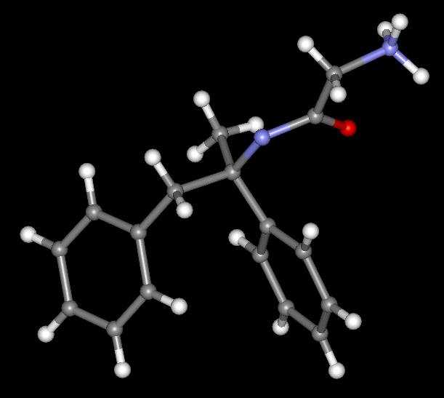
The user facing problem

Slide 42
The user facing problem
only the structural parameters of the remacemide ion are optimised

Slide 43
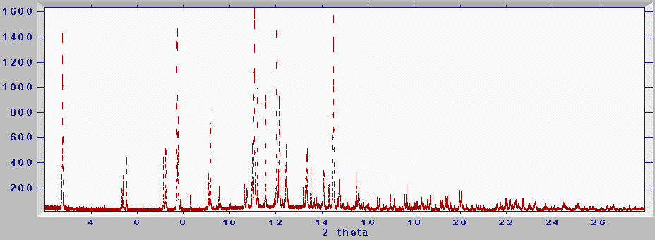
Feature extracted observed data either using
Pawley or Le Bail or by other method
Named!:
The intensity least squares FOM
Notes:
Within crystallographic community this is (intensity) chi-squared or (intensity) least-squares figure-of-merit. Although in fact it could also be named the maximum likelihood!

Slide 44
only the structural parameters of the remacemide ion are optimised

Slide 45
only the structural parameters of the remacemide ion are optimised
Series of 20 attempts searching for the global minimum of
1. - least-squares FOM

Slide 46
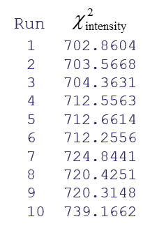
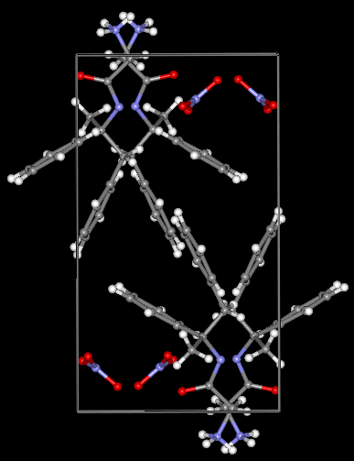
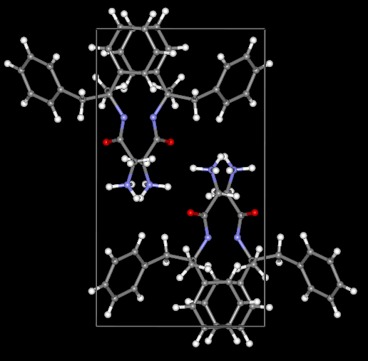
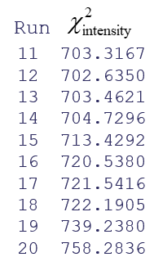
Searching for Global minimum of χ²_{intensity}
* 0% success rate
target
best least squares χ²_{intensity}

Slide 47
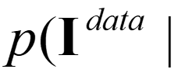
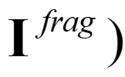
Symbolise: the p.d. the data given intensities calculated from a fragment BUT where these intensity are
uncertain/blurred due the assumption that other atoms are randomly distributed throughout the unit cell.
In hindsight, perhaps a better notation for this p.d. would have been:
$$\left.p\left(I^{data}\right|I^{frag}\right)$$
Notes:
Apologies for the confusion notation here. In hindsight perhaps could have denoted this p(I^data|I^frac with blur) or something like this

Slide 48
$$\left.p\left(I^{data}\right|I^{frag}\right)$$
$∝ex$p(- )
Notes:
Ignoring I^{frag} is OK in line 3 since the meaning of I is more specific than the blurry I^{frag}. It will therefore drive the definition of p(I^data | I, I^frag) stronger. Another way of expressing this is that the symbol I here has no blurriness associated with it and ‘given I’ is therefore a strong narrowing of the ‘space of options’ compared the that which can be associated with the symbol I^frag

Slide 49
Prior
Contributors:
Wilson (1949)
Luzzati (1952)
...
Bricogne, 1991
Read (1997)
In this work:
Sum over the atomic form factors of the “blur” component

Slide 50
only the structural parameters of the remacemide ion are optimised
Series of 20 attempts searching for the global minimum of
2. - likelihood FOM

Slide 51
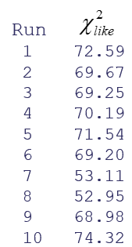
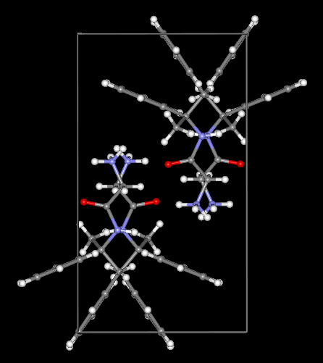
Searching for global minimum of χ²_{like}
* 35% success rate
target
maximum likelihood

Slide 52
Summary
Another example of a Bayesian analysis
How to introduce uncertainty in your model
A bit about the quirkiness of the term likelihood

Slide 53
Move on to Example 3
Hybrid Monte Carlo
Notes:
The abstract pattern can be removed or repositioned if required. Be careful to ‘Send to Back’ so that it does not obscure any important information.

Slide 54
Example 3: Hybrid Monte Carlo – Global Opt
Purpose:
1) Extending the Monte Carlo method to MCMC
2) Why statistical methods can be good Global optimizers
Main work: J. C. Johnston, W. I. F. David , A. J. Markvardsen , K. Shankland, (2002) https://doi.org/10.1107/S010876730200911X (note in this work symbol ‘p’ is used for momentum and ‘prop’ for probability density)
Detailed hyper-parameter investigation of above: J. C. Johnston, W. I. F. David , A. J. Markvardsen , K. Shankland, (2002)
https://doi.org/10.1107/S010876730200911X

Slide 57
Statistical Global Optimisers
$ex$p(- )

Slide 58
Marcov chain
$$\left.p(x^{i+1}|x^{i},x^{i−1},x^{i−2},…\right)$$

Slide 59
Marcov Chain Monte Carlo (MCMC)
$$\left.p(x^{i+1}|x^{i}\right)$$
$$\left.p\left(x^{i}\right)p\left(x^{i+1} | x^{i}\right)=p\left(x^{i+1}\right)p(x^{i}|x^{i+1}\right)$$

Slide 60
Metropolis et al.
$$\left.p\left(x^{i}\right)p\left(x^{i+1} | x^{i}\right)=p\left(x^{i+1}\right)p(x^{i}|x^{i+1}\right)$$
$$p\left(x^{i+1} | x^{i}\right)=p_{p}\left(x^{i+1} | x^{i}\right)p_{a}\left(x^{i+1} | x^{i}\right)$$
Propose new step
Accept new step
$$p_{a}\left(x^{i+1} | x^{i}\right)=min\left(1,\frac{\left.p\left(x^{i+1}\right)p_{p}(x^{i}|x^{i+1}\right)}{\left.p\left(x^{i}\right)p_{p}(x^{i+1}|x^{i}\right)}\right)$$
Notes:
By inserting the 2nd and 3rd equation into the top it is seen that detailed balanced is satisfied, i.e. the top equation

Slide 61
$$p_{p}\left(x^{i+1} | x^{i}\right)=random walk or similar$$

Slide 62
$$p_{p}\left(x^{i+1} | x^{i}\right)=Hamiltonian paths with random momenta$$
X

Slide 63
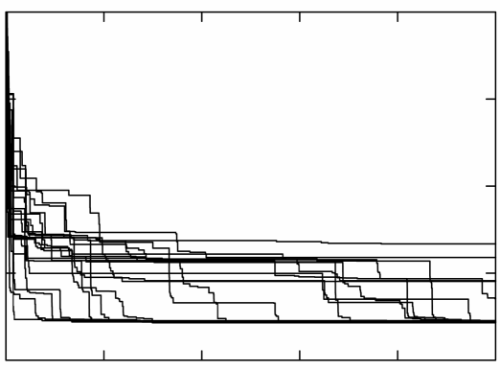
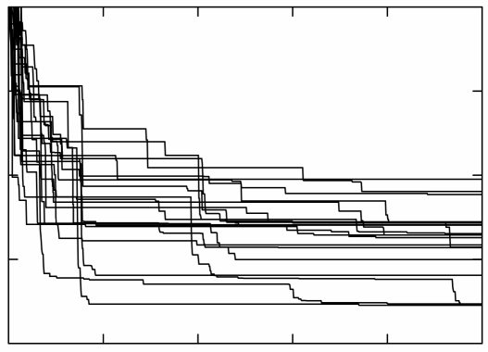
Hybrid Monte Carlo
Simulated annealing
Fit to data
Time
Time
~1 order of better performance than commercially available SA

Slide 64
Summary
Explained what a statistical global optimizer is
Hybrid Monte Carlo faster than a simulated annealing instance
Didn’t have time to show this:
Can run as black box

Slide 65
Summary all
Thank you for listening
Covered intro
Covered some examples
Welcome questions and visitors
We are located in to R2, room 1.10
Notes:
Could have gone in more details and I could cover other examples as well

