Slide 1
Continuous Improvement and Constructive Criticism
For Software Professionals

Slide 2
Disclaimer
This is based on my understanding of the subject
Some of the content might be obvious to some
There will be some oversimplifications involved
Happy to receive questions and feedback during the talk

Slide 3
Natural language is awful to communicate

Slide 4
Natural language is awful to communicate
It’s ambiguous and dependent on the context

Slide 5
Natural language is awful to communicate
Awful – Literally "full of awe", originally meant "inspiring wonder (or fear)", hence "impressive". In contemporary usage, the word means "extremely bad".
It’s ambiguous and dependent on the context
The meaning changes with time
Notes:
Semantic change

Slide 6
Natural language is awful to communicate
Awful – Literally "full of awe", originally meant "inspiring wonder (or fear)", hence "impressive". In contemporary usage, the word means "extremely bad".
"Snout-fair", for example, means "having a fair countenance; fair-faced, comely, handsome", while "sillytonian" refers to "a silly or gullible person, esp one considered as belonging to a notional sect of such people".
https://www.bbc.co.uk/news/uk-41266000
It’s ambiguous and dependent on the context
The meaning changes with time
Some words get lost with time
Notes:
Semantic change

Slide 7
Natural language is awful to communicate

Slide 8
But computers do exactly what you tell them to!

Slide 9
But computers do exactly what you tell them to!
Do they?

Slide 10
A simple program

Slide 11
A simple program
This is a user defined module – could be different for each system

Slide 12
A simple program
This is a dependency – functions defined here could change with newer versions

Slide 13
A simple program
In fact, this function has been deprecated since python 3.3 and was removed in 3.8

Slide 14
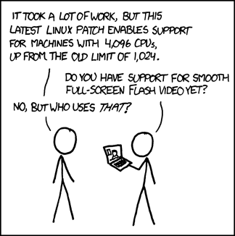
And this is without getting into kernel/OS limit overrides, hardware interactions, poor documentation or user inputs…

Slide 15
So what can we do?

Slide 16
I find it useful to break it down into 3:
WHY
WHAT
HOW

Slide 17
I find it useful to break it down into 3:
WHY
Why was this made? Who does this affect?
What are the current circumstances?
WHAT
HOW

Slide 18
I find it useful to break it down into 3:
WHY
Why was this made? Who does this affect?
What are the current circumstances?
WHAT
What’s the core task this is doing?
HOW

Slide 19
I find it useful to break it down into 3:
WHY
Why was this made? Who does this affect?
What are the current circumstances?
WHAT
What’s the core task this is doing?
HOW
What’s the specific implementation of it?

Slide 20
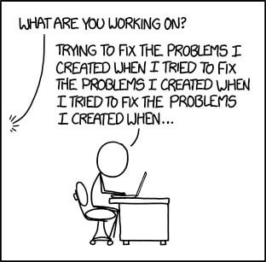
WHY – why was this made?
The motivation for this software or section of software
Is there some historic/political/legal background
What is it trying to do/fix?

Slide 21
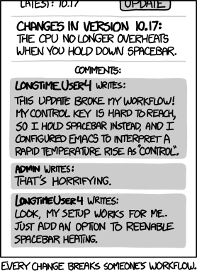
WHY – who does this affect?
stakeholders include:
users
admins
contributors
of this software.
Ideally if a change does not affect a group, it should be invisible to them, as this mean

Slide 22
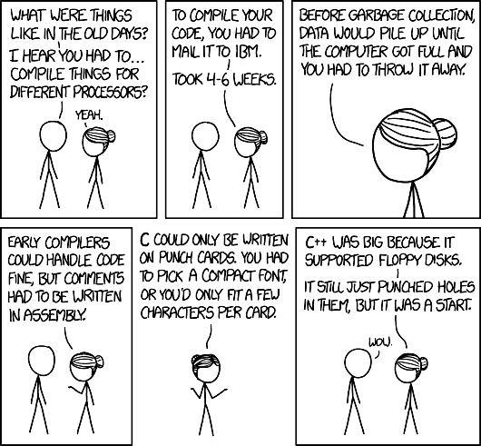
WHY – what are the current circumstances?
Any external factors affecting this software, e.g.
Hardware capability
Usage intensity
Operational costs
Available effort
Running costs

Slide 23
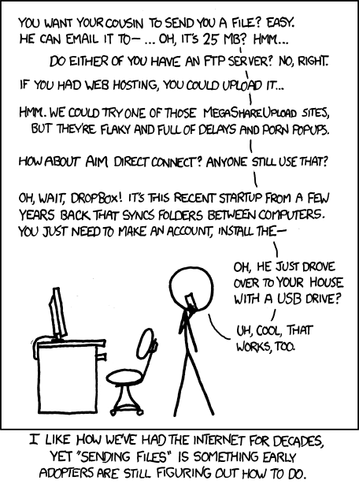
WHAT – what’s the core task this is addressing
Try to keep it as detached to the implementation / technical details as possible. This should be understandable by all stakeholders.
E.g. a way to transfer data between two endpoints
Sometimes a WHEN, WHERE or WHO might be part of this, e.g. if the task is time critical or needs to fit a pre-existing specification.
E.g. a way to sustain 100Gb/s of data between all sites part of the CERN collaboration

Slide 24
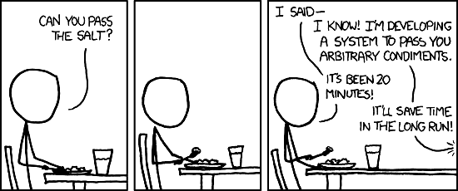
HOW – what’s the specific implementation of this task
The implementation doesn’t have to be technical
Depending on the situation, this could be addressed as:
A technical problem, e.g. by implementing interfaces to all supported technologies involved,
A policy issue, e.g. by agreeing on all sites using the same technology stack
Or a combination of both
There may be valid reasons to pursue either approach
This WILL change with time, either trough improvements or new feature, or by obsolescence of programming languages or dependencies

Slide 25
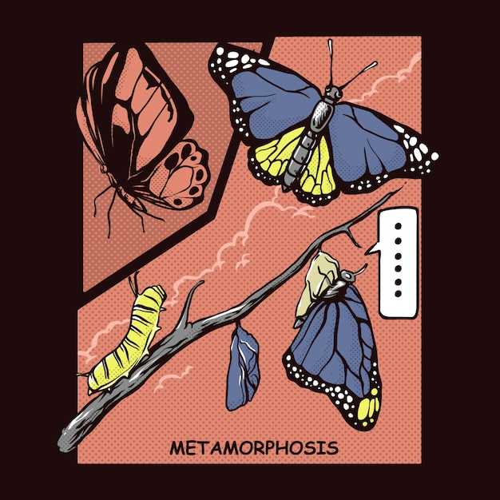
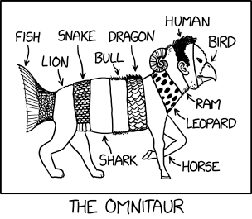
Sometimes, the WHAT and the WHY change…
New communities join in
A software finds an unexpected use in a different field
Scope creep…

Slide 26
Constructive Criticism
This is not about micro-optimization
Often the best solution is not feasible in the circumstances
E.g. technical debt mean the effort involved is higher than can be given for this priority
If you have a method you think would work, you can propose it, but it’s up to the actioner if they want to do it that way or a different way.
This can be used to have a critical look at your own work too

Slide 27
Continuous Improvement

Slide 28
Continuous Improvement
Is a series of implemented Constructive Criticisms

Slide 29
Thank You
Any feedback/questions?

