Slide 1
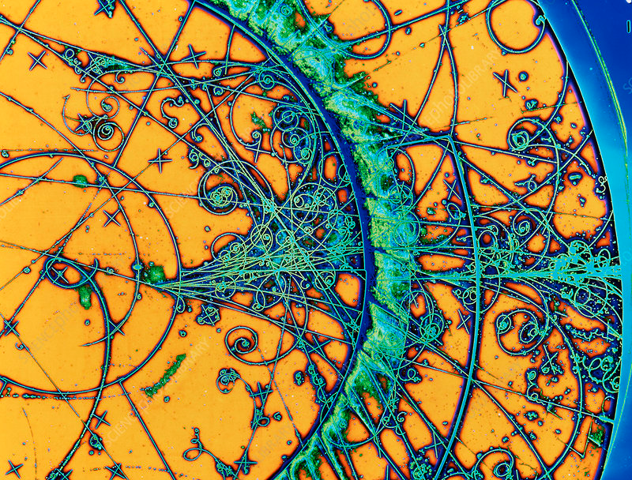
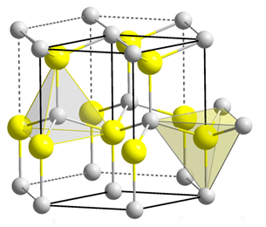
Gallium Nitride (GaN) for High Energy Physics
E.G. Villani D. Hynds

Slide 2
Outline
PhD project description
GaN material and properties
Some details of the proposed work
Conclusions

Slide 3
PhD Project description
Objectives: This PhD project aims at assessing the potential of GaN as a material for the fabrication of fast and radiation-hard devices for HEP applications, including particle detection and read out electronics for current and future colliders.
Project description:
1: investigation of GaN properties for HEP particle detection. Test and characterization of existing GaN devices before and after irradiation, to assess their suitability to HEP applications.
2: TCAD simulation of GaN devices to improve the modelling of radiation interaction and transport mechanisms. Effects of impact ionisation for the development of ultra fast timing detectors.
Design of a GaN sensor array to be interfaced with a custom CMOS ASIC developed at RAL.

Slide 4
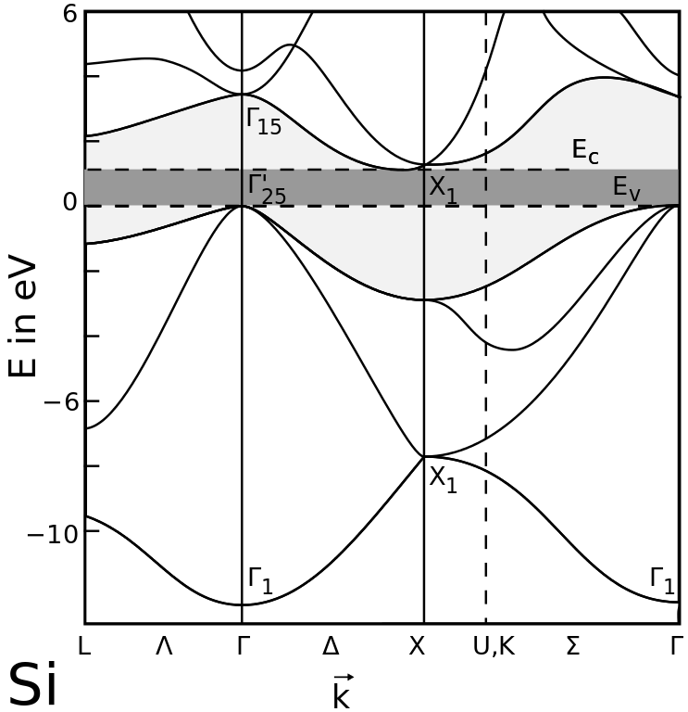
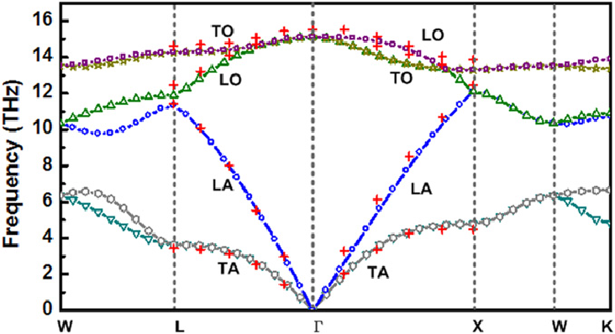
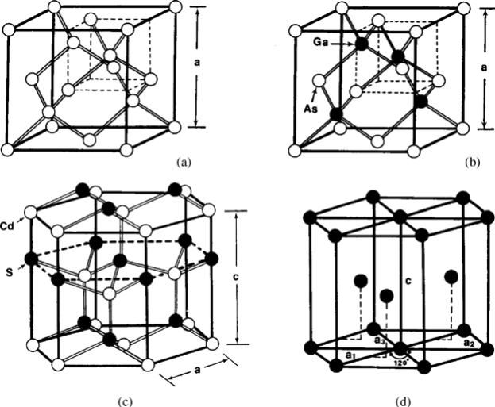
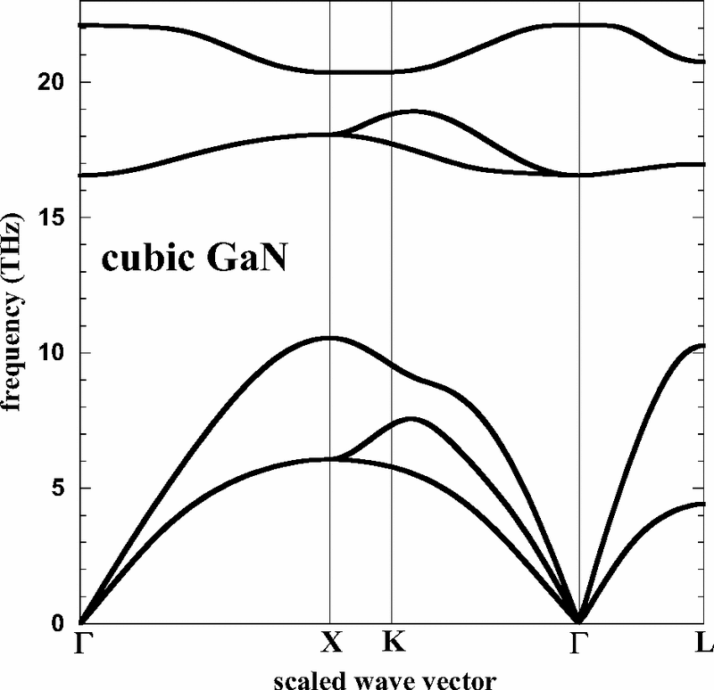
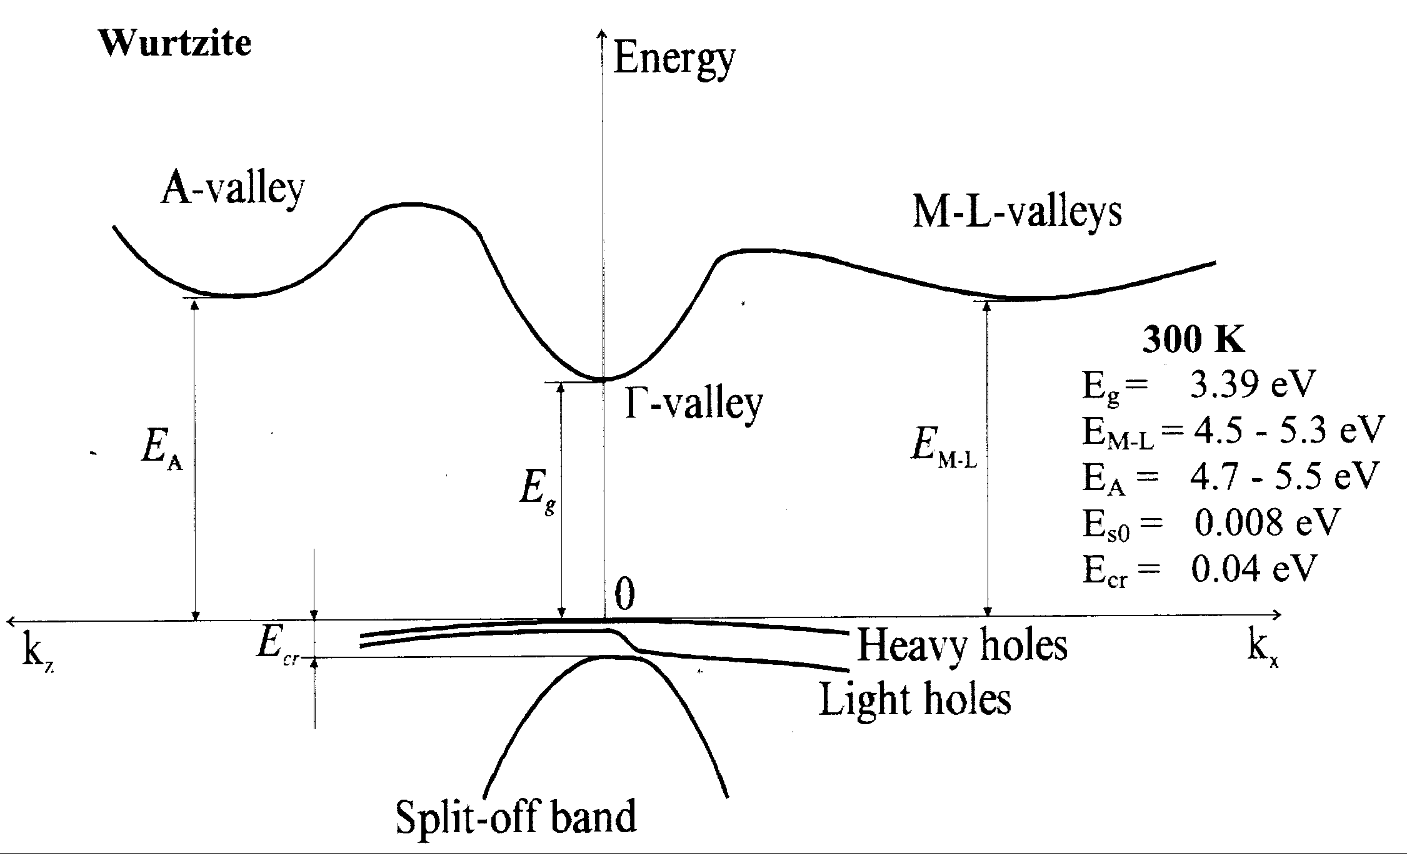
GaN properties
Diamond - Si
Wurtzite - GaN
GaN
GaN is a III-V compound semiconductor, of elements from groups III and V in the PT
GaN is usually synthesized in the hexagonal wurtzite crystal structure with lattice constants a = 3.189Å and c =5.185Å (in Si a = 5.43Å)
The bandgap of GaN is around 3.4 eV (1.12 in Si), making it insensitive to visible light. Its direct bandgap favours light emission

Slide 5
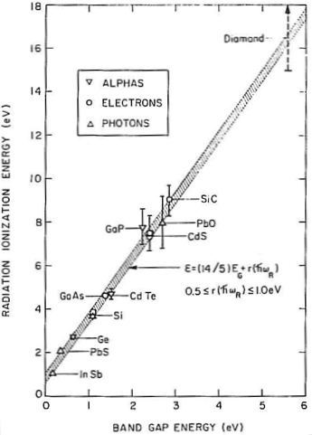
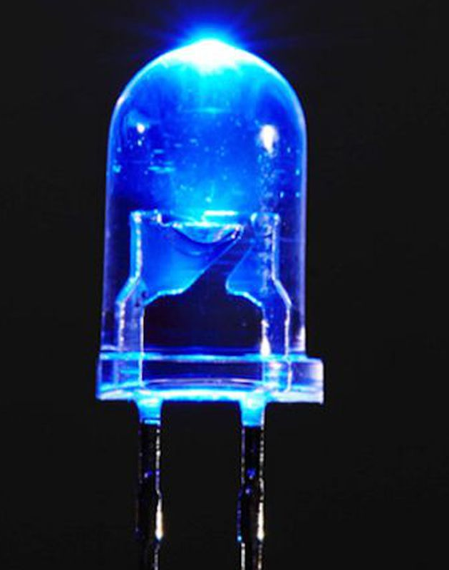
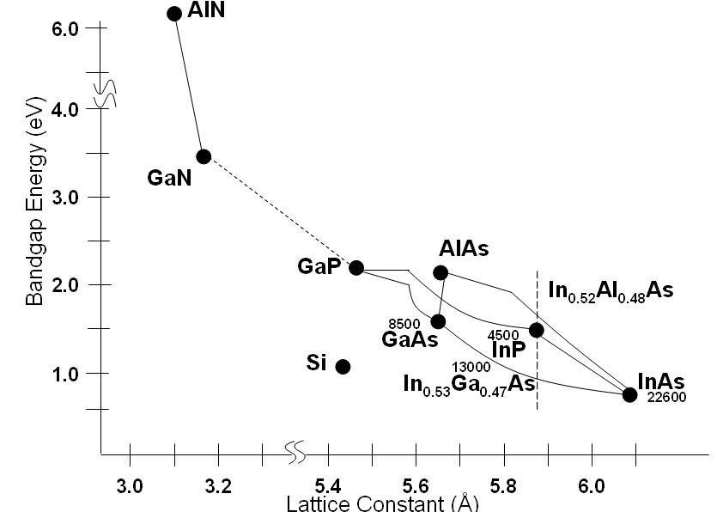
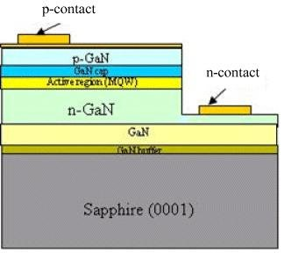
GaN properties
GaN blue LED – Nobel Prize 2014
GaN
GaN is an established technology in high-power and RF electronics and leading material for UV photodetectors*.
It is currently being investigated for ionising radiation applications: the mean ionization energy is 8.9 eV (in Si is 3.6 eV)
⇒ For particle detection, given the GaN higher density w.r.t. silicon (6.2 / 2.3 g cm⁻³) the Most Probable Value (MPV) signal created by a Minimum Ionising Particle is similar in both materials
*H. Xue, C. Storey, J.-P. Noel, R. Griffin. IEEE Can. Conf. Elect. Comp. Eng., August 6-9, Kingston, ON, Canada, 2024

Slide 6
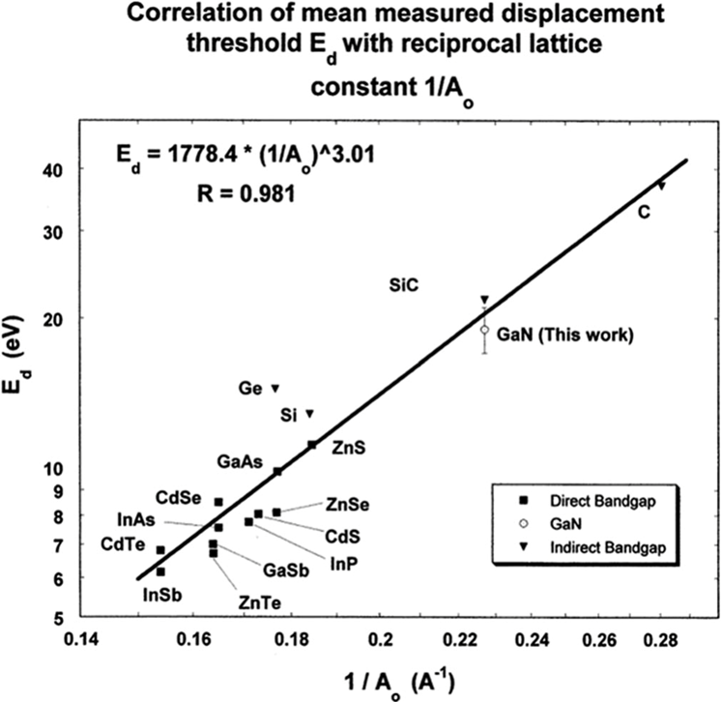
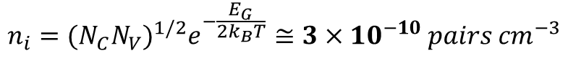


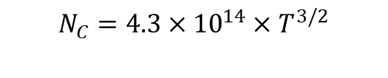
GaN properties
$$n_{i}={(N_{C}N_{V})}^{1/2}e^{−\frac{E_{G}}{2k_{B}T}}≅3×{10}^{−10} pairs {cm}^{−3}$$
For GaN:
$$N_{C}=4.3×{10}^{14}×T^{3/2}$$
$$N_{V}=8.9×{10}^{15}×T^{3/2}$$
For silicon n_{i} ~${10}^{10} pairs {cm}^{−3}$
Empirical relationship between E_{d} and inverse lattice parameter
( A. Ionascut-Nedelcescu et al. Radiation Hardness of Gallium Nitride, IEEE TRANSACTIONS ON NUCLEAR SCIENCE, VOL. 49, NO. 6, DECEMBER 2002).
The GaN mean displacement energy threshold is ∝⁻¹ to lattice parameter: in GaN ≃ 20 eV (in Si is ≃ 10-15 eV)
⇒ GaN should be more radiation resistant compared to silicon
⇒ At room temperature the intrinsic carrier density n_{i} for GaN would be very low << than Si, giving much lower leakage current and shot noise: however, like most diatomic compound, point defects during the crystal growth increase the carrier concentration and dislocation density

Slide 7
GaN properties
RT | Band Gap [eV] | µ_{n} [cm2/Vs] | µ_{h} [cm2/Vs] | e-h pair creation [eV] | Density [g/cm3] | ε_{r} | Z | Ed Energy [eV] | Ecrit [MV/cm] | vsat [1e7 cm/s]
Si | 1.12(i) | 1450 | 450 | 3.6 | 2.3 | 11.9 | 14 | 10-15 | 0.2 | 1
Ge | 0.66 | 3900 | 1900 | 2.8 | 5.3 | 16 | 32 | 23 | 0.1 | 0.6
GaN | 3.39(d) | 1000 | 30 | 8.9 | 6.2 | 9 | 31/7 | 20 | 3.3 | 2.7
Some advantages of GaN over traditional radiation detector materials (Si, Ge):
High bandgap: blind to visible light, reduced leakage current (i.e. lower shot noise in detectors);
Lower permittivity: lower capacitance detectors (i.e. reduced time constant)
High displacement threshold energy: high radiation resistance
High critical field: higher bias voltage to achieve full depletion
High saturation velocity: faster timing

Slide 8
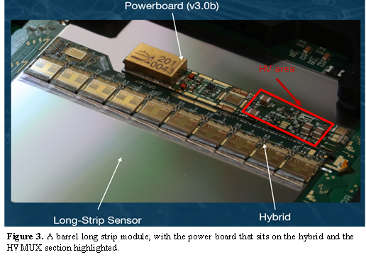
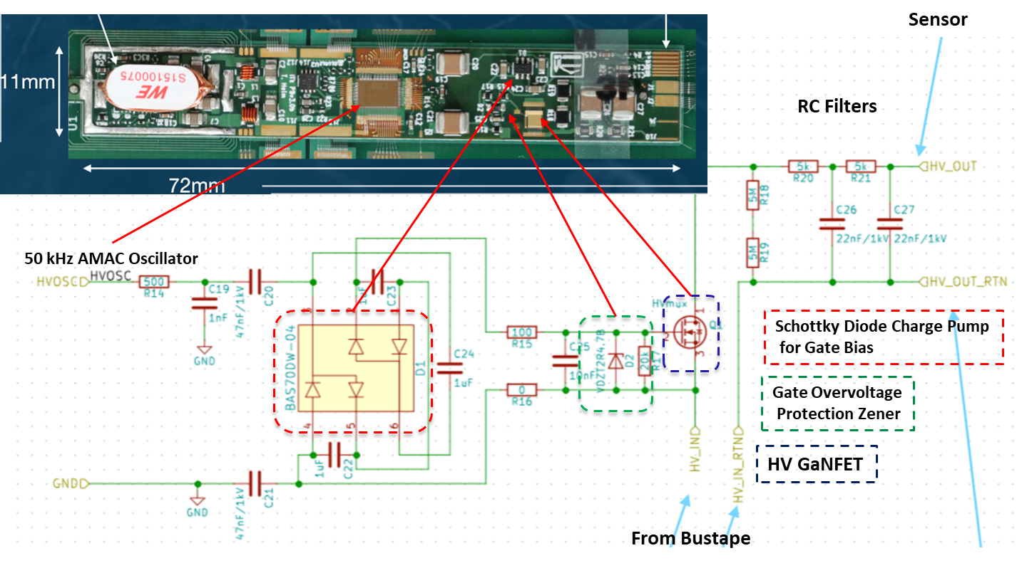
GaN uses in HEP applications
The ATLAS ITk strip power board. The HVMUX circuitry, which includes GaN transistors, occupies the area opposite to the DC-to-DC converter, which provides power to the front-end circuitry.
GaN devices have been implemented as high voltage switch HV (GaN FET) in the HVMUX* of ATLAS ITK
Radiation resistance up to 1x10¹⁶ n_{eq}/cm² and ∼ 200Mrad TID have been demonstrated
* E.G. Villani et al., HVMUX, a high voltage multiplexing for the ATLAS Tracker upgrade, 2017 JINST 12 C01076, DOI 10.1088/1748-0221/12/01/C0107

Slide 9
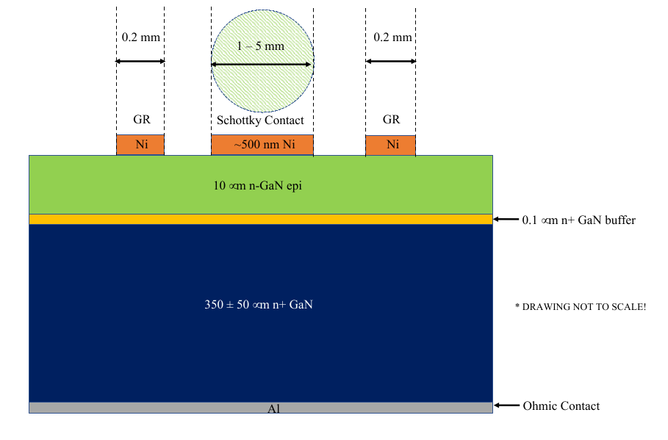
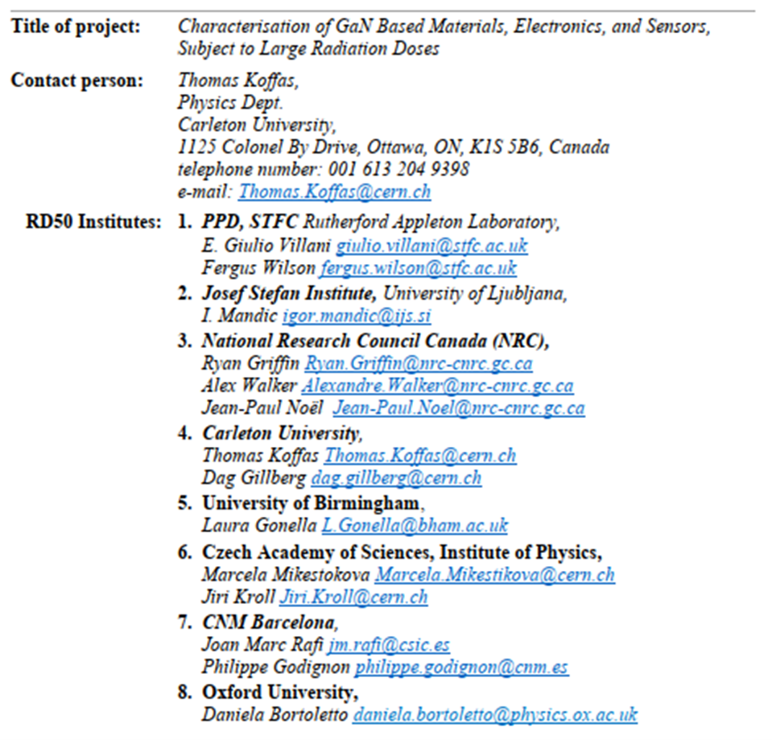
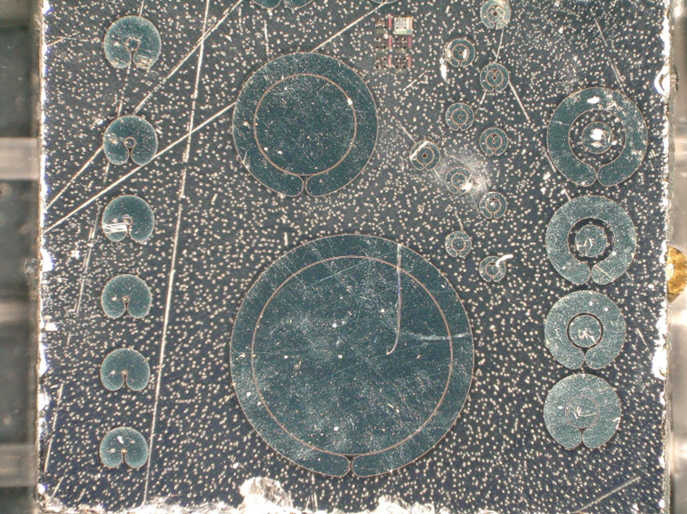
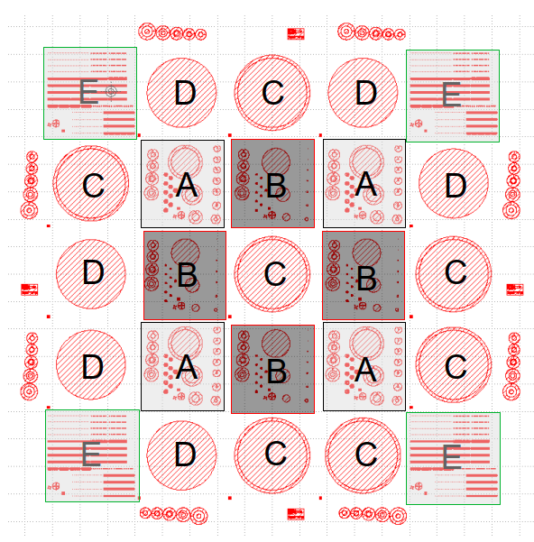
GaN project description
Investigation of GaN properties for HEP applications
Initial GaN Ni/Au Schottky devices have been fabricated at NRC (National Research Centre, Canada) and CNM (Centro Nacional de Microelectronica, Spain) on an n⁺- GaN substrate with n - GaN Epitaxial thickness of up to 10 µm.
The 10 µm n - GaN epitaxial has no intentional doping, with residual 5 x 10¹⁵ cm⁻³ free carrier density.
Schottky GaN

Slide 10
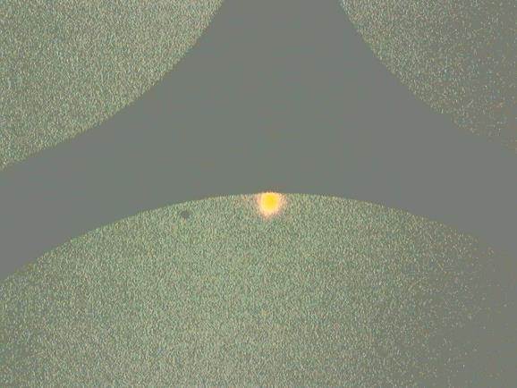
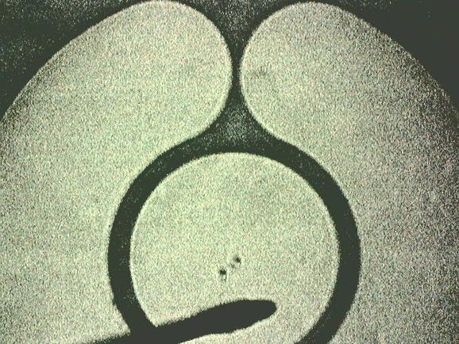
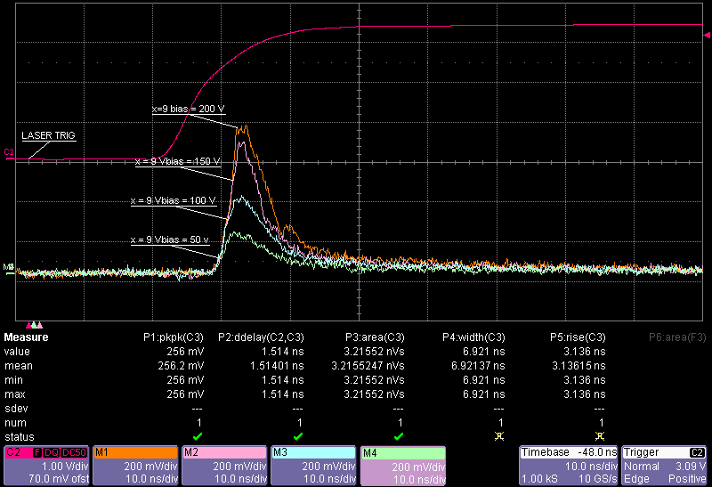
GaN project description
Laser Trig
X = 9 um
X = 0
Laser beam size 5 x 5 µm²
Guard ring
X
GaN Out
Cathode
Wire bond
Initial tests on charge collection done using UV Laser at RAL, 355 nm ( ~3.492 eV), Pulse width: 4.5 ns
The beam is focused on the cathode, moved in x-steps of 1 um and the data collected for bias voltage of [50,200]V, with guard ring floating
The signal from the GaN Schottky is read out using a 1 GHz Transimpedance Amplifier, 50 dB gain

Slide 11
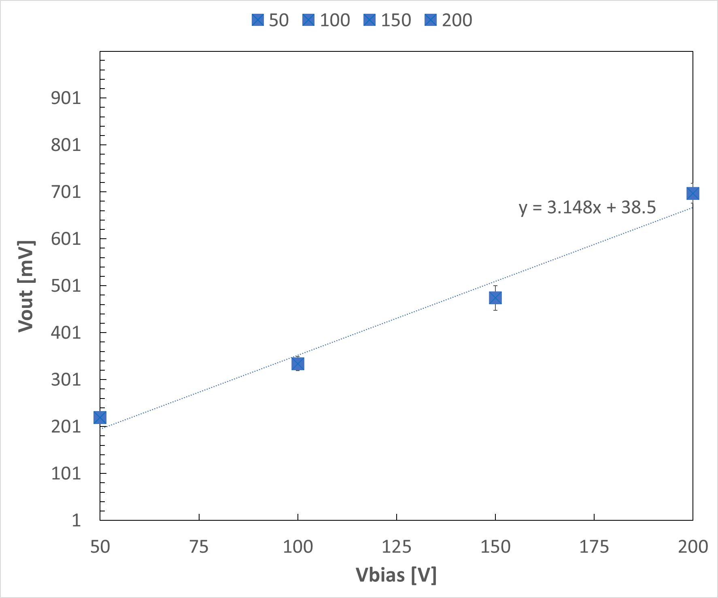
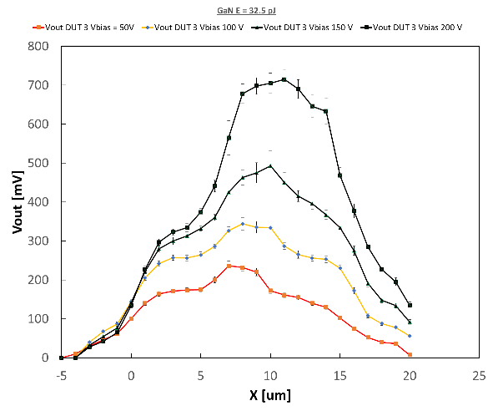
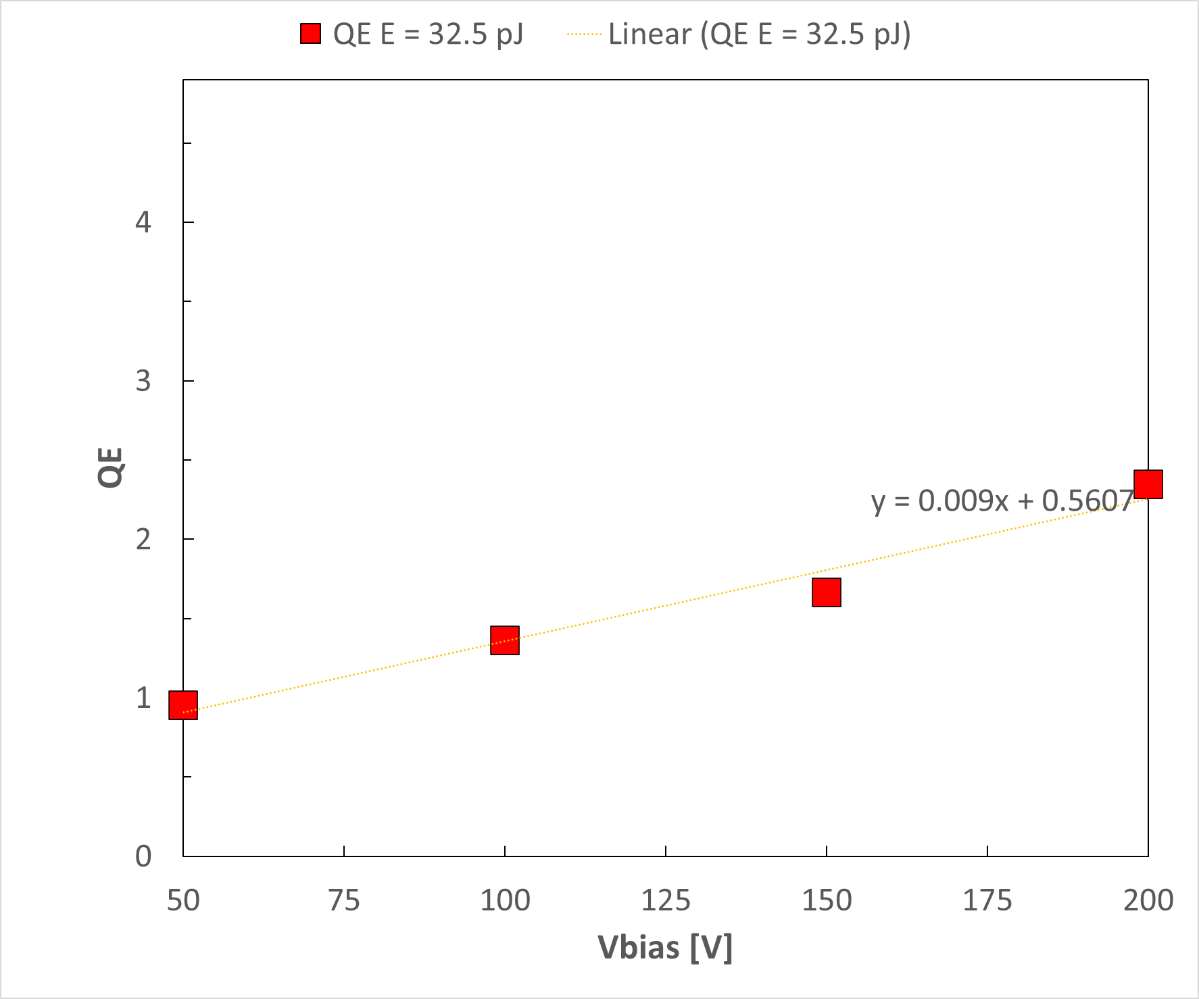
GaN project description
X = 9 um
X = 9 µm
V_{depl}
V_{depl}
The output pk-pk signal and Quantum Efficiency (collected charge in e⁻ / injected photons) increase with bias. A linear fitting well describes the signal output
It is observed that the signal and the area (∝ Q collected) increases in magnitude with bias voltage: this is not explained by an increase in depletion region (∝ √V)

Slide 12
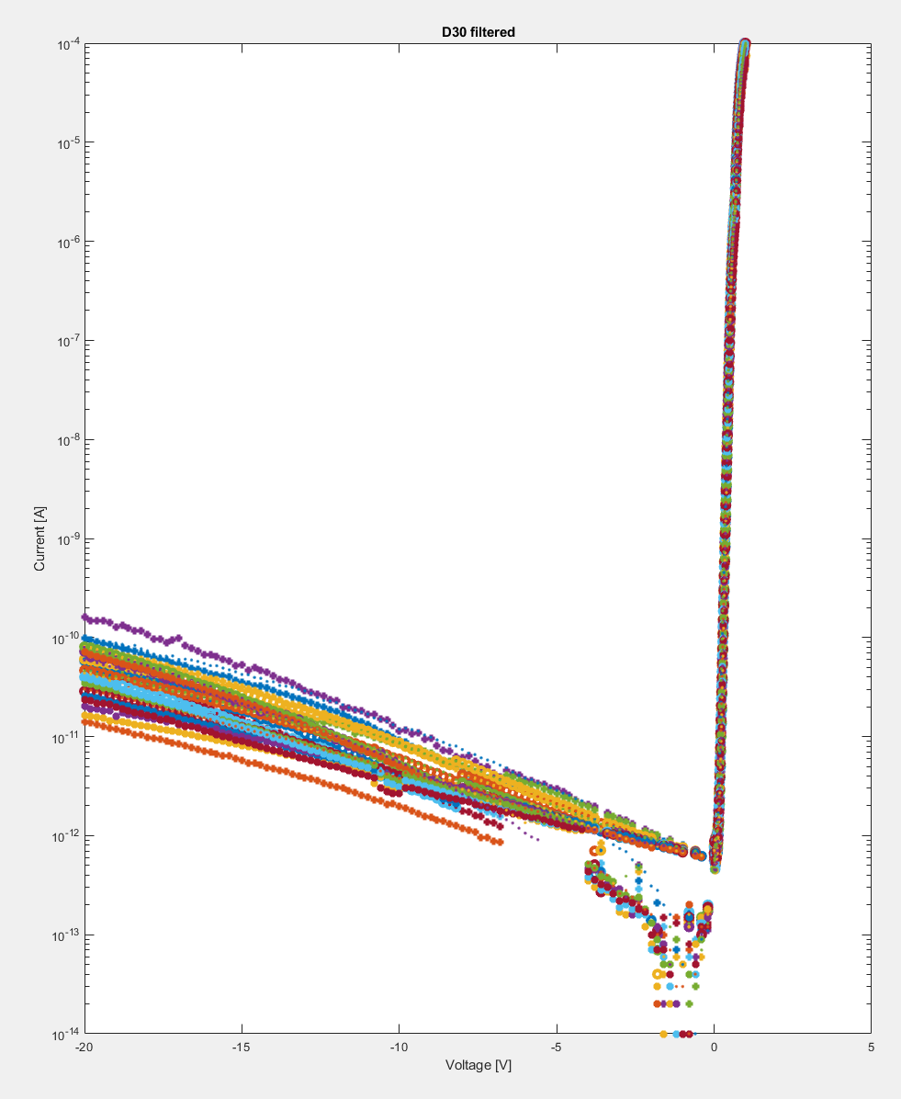
GaN project description
Si₃N₄
SiO₂
Ni/Pt/Au
Second batch of Ni/Pt/Au GaN devices currently being fabricated at CNM and NRC. Some very preliminary results indicate good IV characteristics of devices on wafer after three RTA* Increased top layer thickness (300 nm) to improve bonding reliability
Detailed characterization of existing devices before and after irradiation with n, p, γ :
Available tools include Semiconductor analyser, UV laser, cryostat to design a DLTS (Deep Level Transient Spectroscopy) / TSC (Thermally Stimulated Current) system
Synopsys TCAD modelling and simulation of existing devices:
implementation of realistic models from test results into TCAD for the design of next generation of HEP detectors
Design and simulation of GaN array of pixel sensor, for radiation detection/fast timing
possible read out via a custom 28 nm CMOS ASIC developed for LGAD
Epi GaN n-type 10 um
GaN n+-type
IV for D30 devices on wafer after 3 RTA anneals
*N. Miura, T. Nanjo, M. Suita, T. Oishi, Y. Abe, T. Ozeki, H. Ishikawa, T. Egawa, T. Jimbo. Solid-State Electronics, 48, 689-695, 2004.

Slide 13
Conclusions
PhD Objectives:
To assess the potential of GaN as a material for the fabrication of novel fast and radiation-hard devices for HEP applications, including particle detection and read out electronics for current and future colliders.
PhD Project description:
investigation of GaN properties, before and after irradiation, using available tools at RAL and Oxford University (OPMD). Given the novelty of the research, some of the tools and equipment, particularly for the UV fast timing test, will have to be designed by the student.
TCAD simulation of GaN devices to improve the modelling of radiation interaction and transport mechanisms. Effects of impact ionisation for the development of ultra fast timing detectors.
Design of a GaN sensor array to be interfaced with a custom CMOS ASIC developed at RAL.
Institutes involved:
RAL, Oxford, National Research Centre / Carleton University (Canada), Centro Nacional de Microelectronica (Spain), University of Birmingham (UK), Jožef Stefan Institute (Slovenia).

