Slide 1



Developing the Next-Generation Dark Matter Experiment
Paul Scovell & Amy Cottle – 19/02/2024
Notes:
The abstract pattern can be removed or repositioned if required. Be careful to ‘Send to Back’ so that it does not obscure any important information.

Slide 2
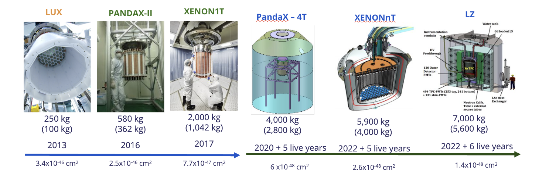
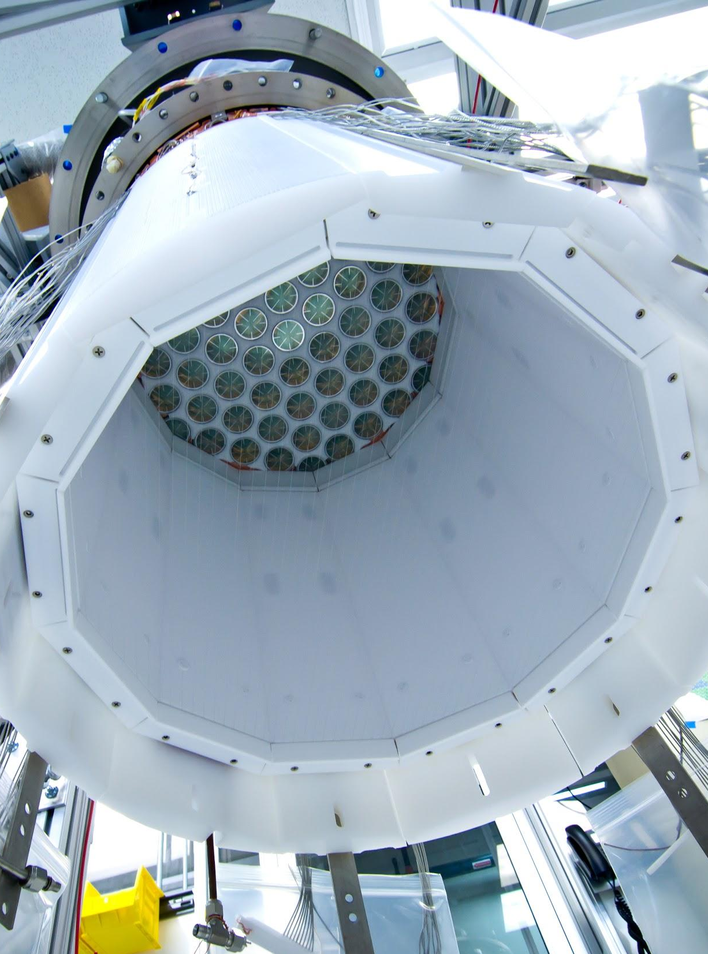
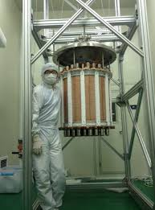
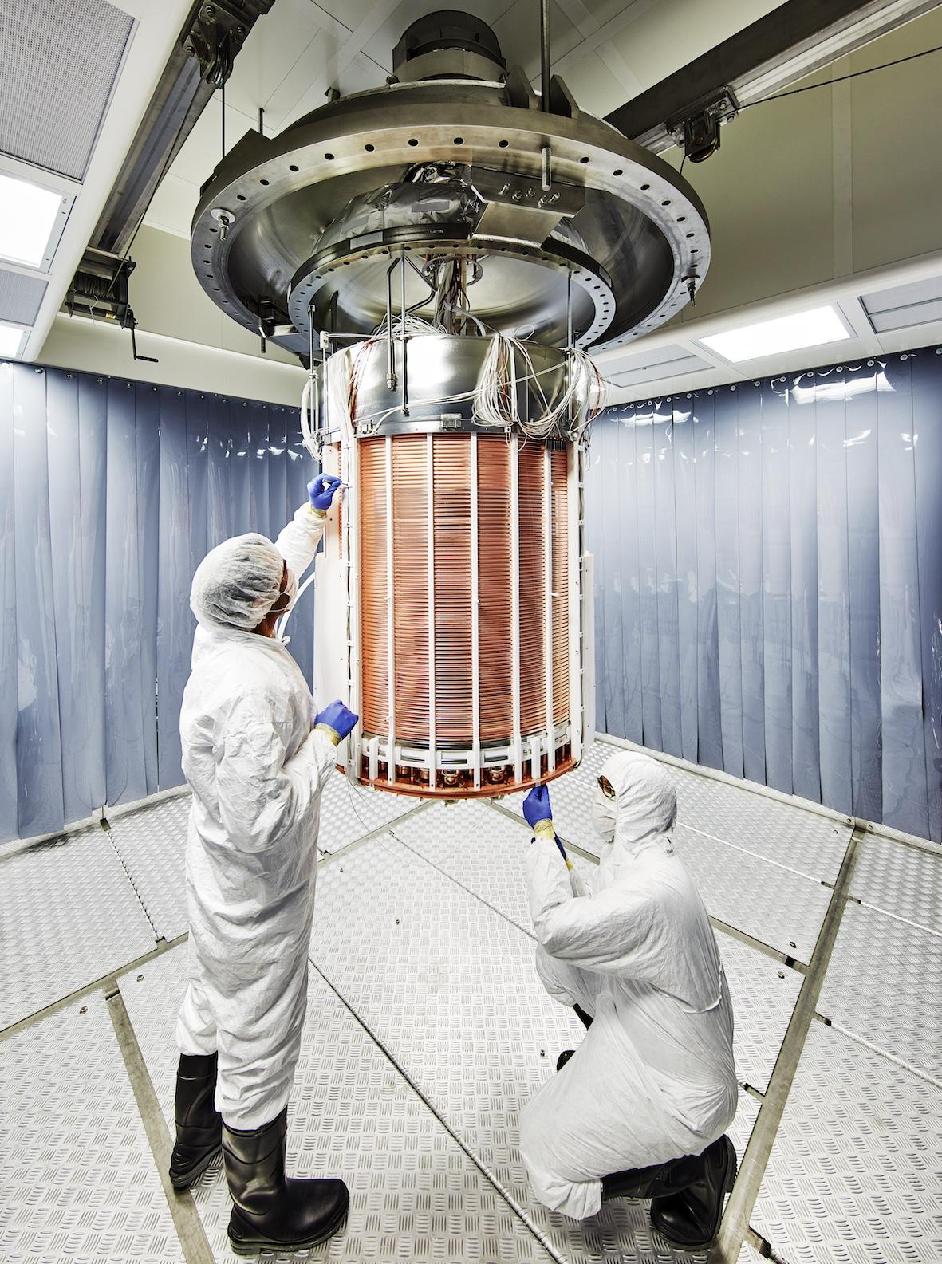
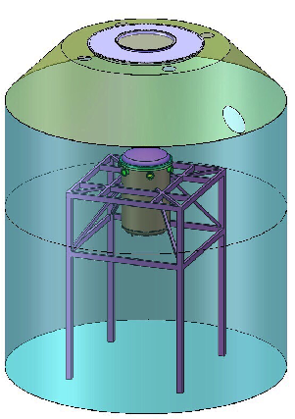
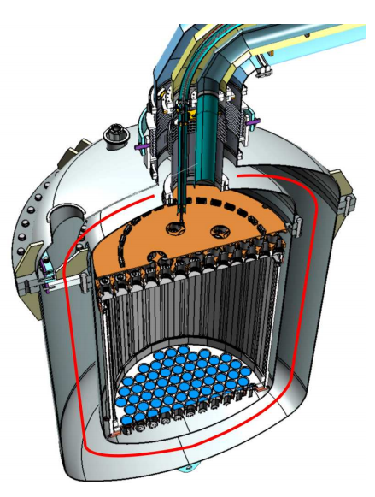
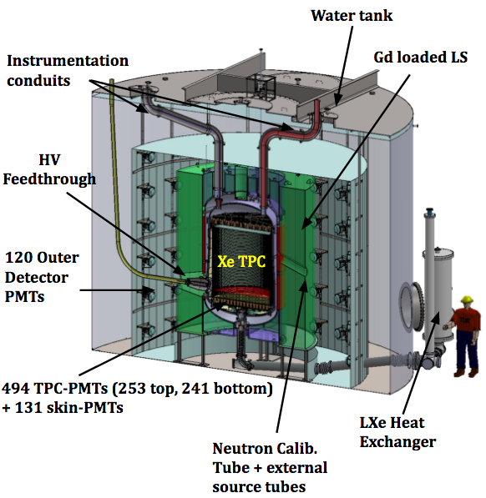
Dual-Phase Xenon Detectors
Rich heritage of these detectors looking to directly detect dark matter
LUX
PANDAX-II
XENON1T
PandaX – 4T
XENONnT
LZ
250 kg
(100 kg)
580 kg
(362 kg)
2,000 kg
(1,042 kg)
4,000 kg
(2,800 kg)
5,900 kg
(4,000 kg)
7,000 kg
(5,600 kg)
2013
2016
2017
2020 + 5 live years
2022 + 5 live years
2022 + 6 live years
3.4x10⁻⁴⁶ cm²
2.5x10⁻⁴⁶ cm²
7.7x10⁻⁴⁷ cm²
6 x10⁻⁴⁸ cm²
2.6x10⁻⁴⁸ cm²
1.4x10⁻⁴⁸ cm²
Modified from: https://indico.sanfordlab.org/event/29/contributions/396/attachments/291/733/LRT2022_XRL.pptx

Slide 3
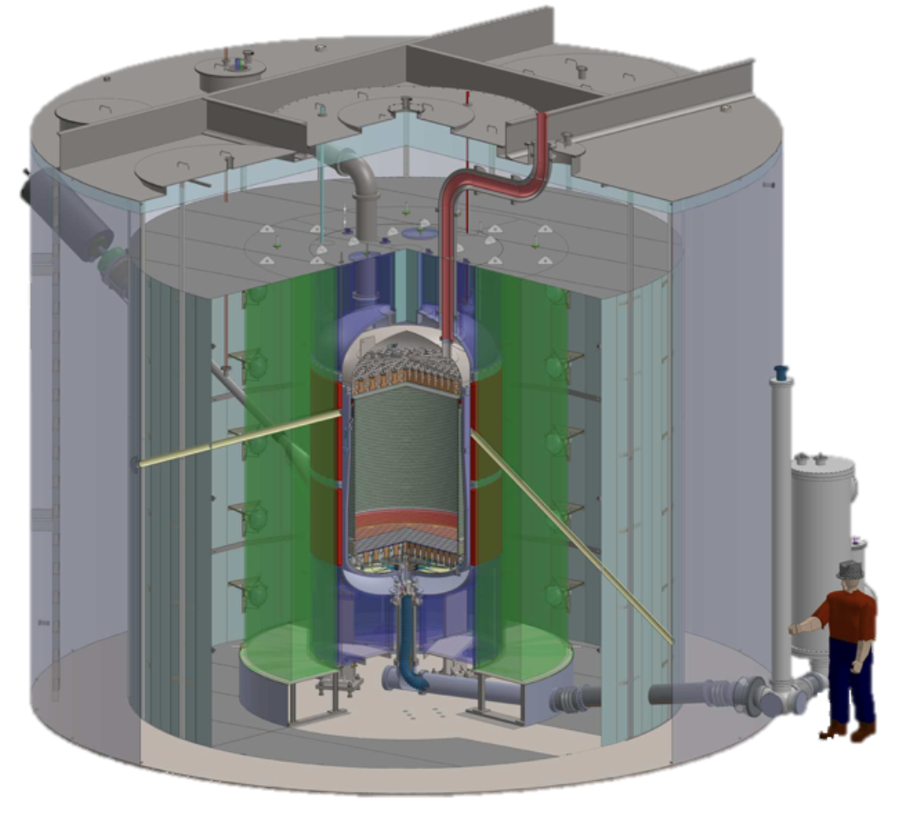
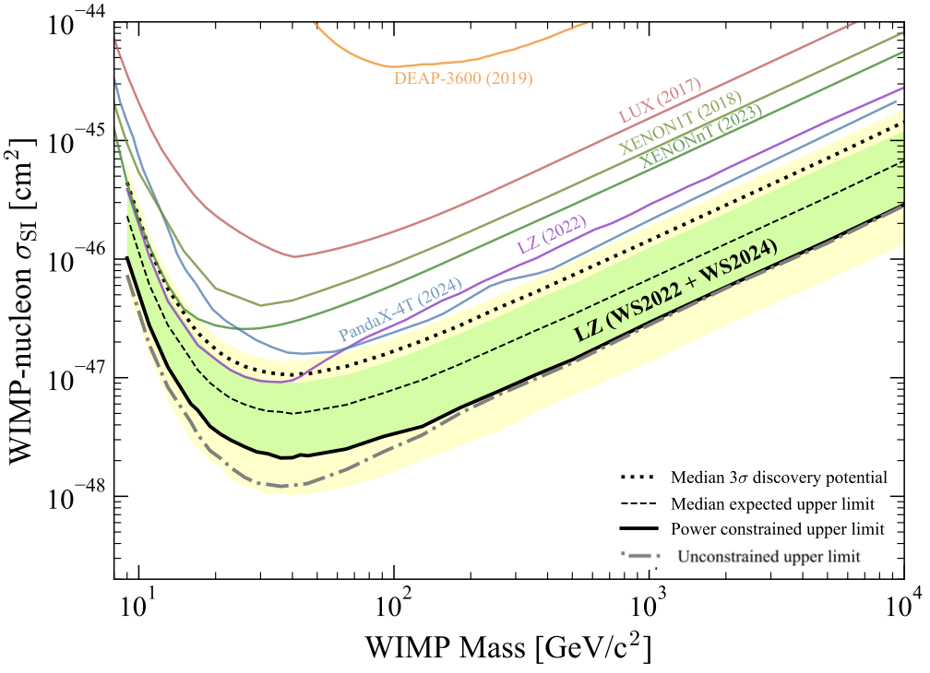
LUX-ZEPLIN
Largest dual-phase xenon TPC operating
World-leading limits set on WIMP-nucleon interactions with ~20% of planned live time
  Will take data until 2028 (during your PhD!)
Beyond WIMPs: searches for neutrinoless double-beta (0vbb) decay, dark photons etc.

Slide 4
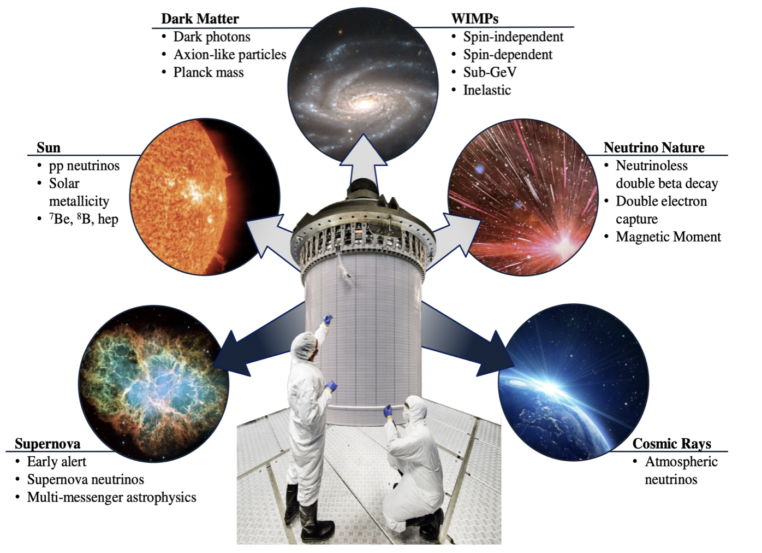
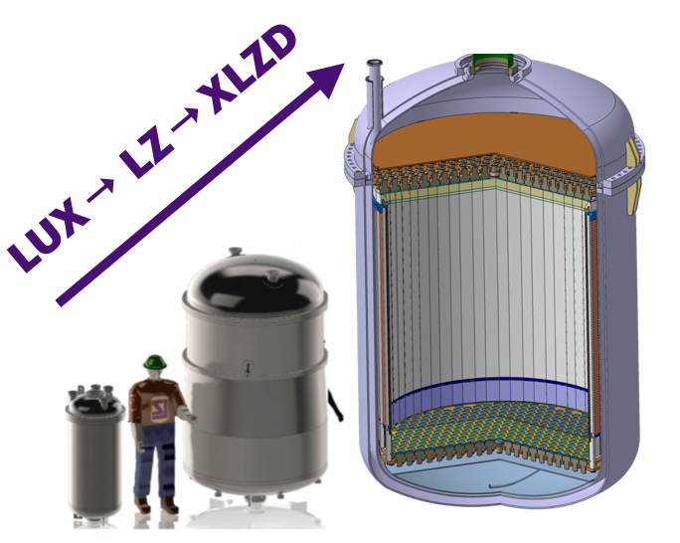
XLZD
Rare-event observatory: search for a range of BSM physics
The ultimate xenon dark matter detector
Order of magnitude bigger than LZ

Slide 5
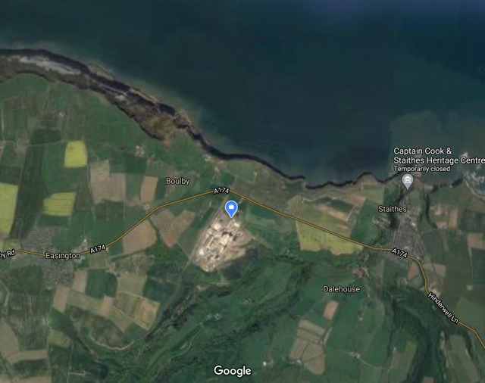
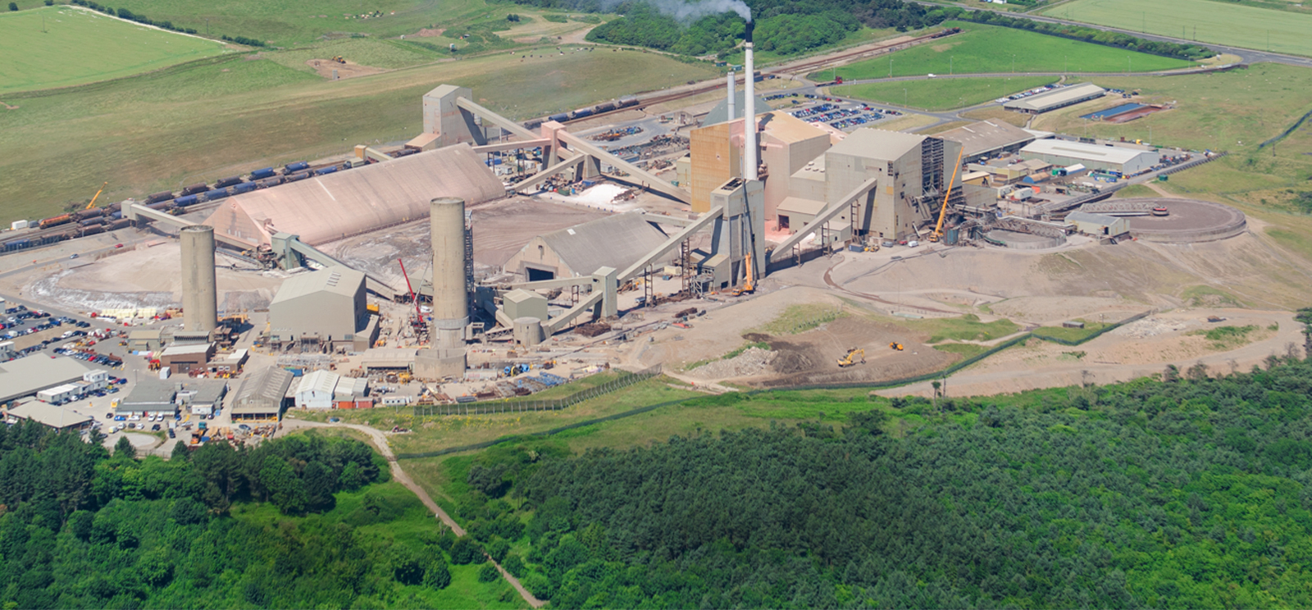
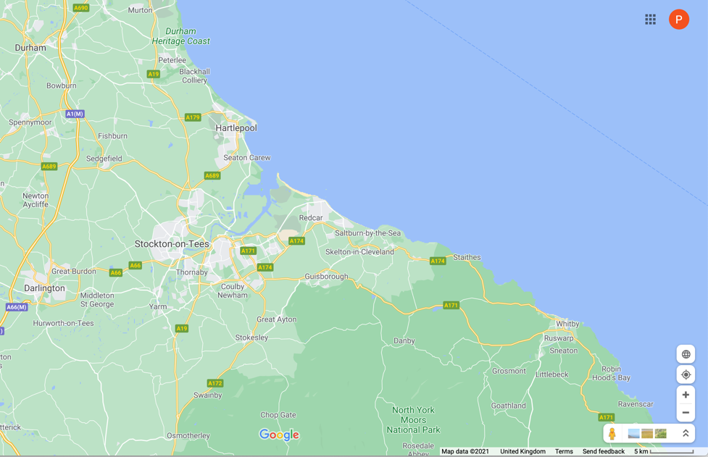
Boulby Mine
Boulby Mine is located in the north-east of England
About 25 minutes north-west of Whitby
Commercial Polyhalite and Salt mine
Credit: Qualter Hall
Credit: Google Maps

Slide 6
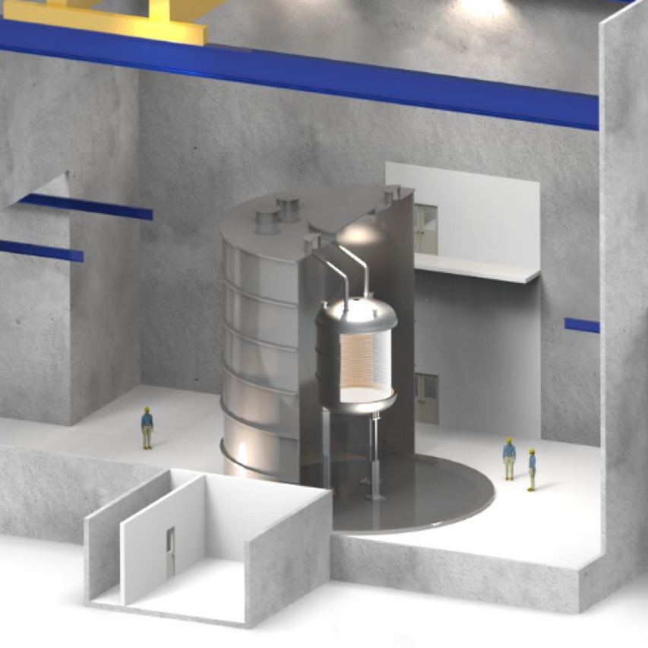
XLZD@Boulby
Exciting opportunity for the UK to host XLZD at Boulby
Boulby has hosted DM experiments for over two decades including NAIAD, DRIFT & ZEPLIN
XLZD pre-construction efforts underway in the UK
Your PhD will coincide with the design & planning phases of XLZD
→ high impact on the project

Slide 7
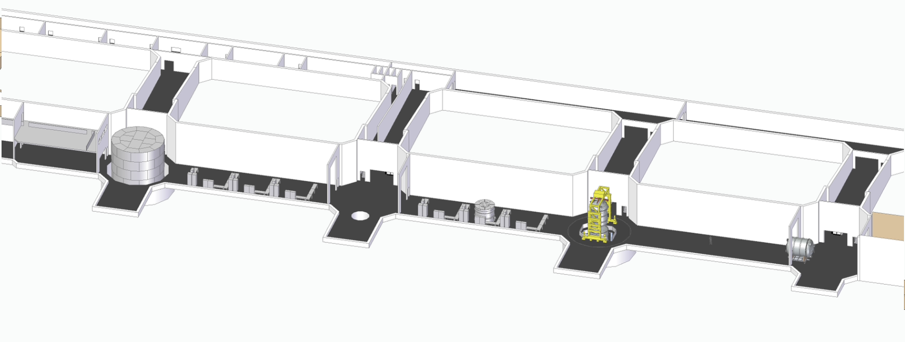
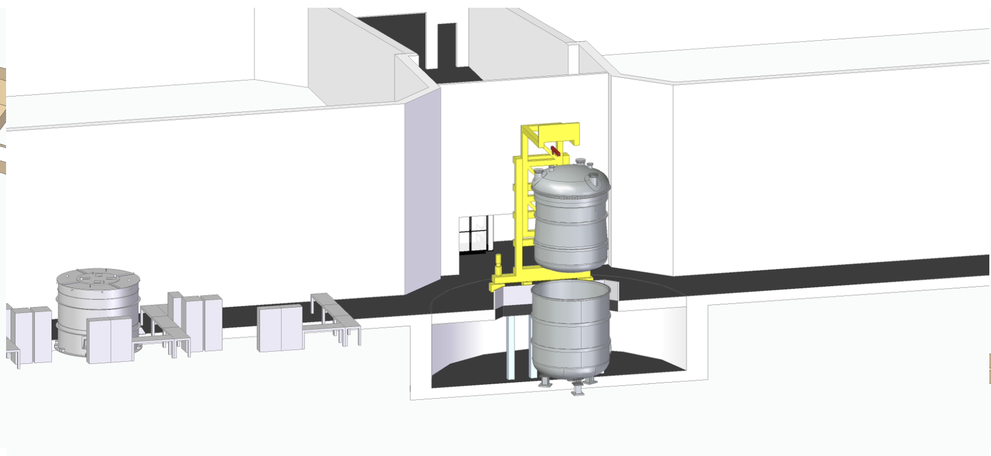
Infrastructure for construction of this experiment now being put together at Boulby
Excavation of a new dedicated facility has already begun
(Will be updated once we have the 80-tonne cryostat model)

Slide 9
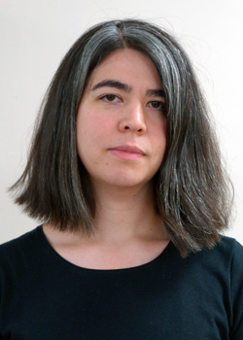
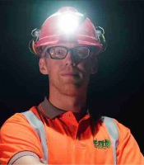
Your PhD in a Nutshell
Your Supervisors
Amy Cottle
Lecturer at UCL
Led LZ's WIMP search
Expert in background modelling & simulations
Co-leading work package on Clean Manufacture for XLZD-UK
Paul Scovell
Senior Scientist at Boulby
Expert in low-background techniques
Managed and delivered radioassays for LZ
What – XLZD development focussed on bottom-up backgrounds understanding – R&D for innovations in assessment & control
Where – primarily based at UCL, with significant on-site work underground at Boulby; possible long-term attachment (LTA) to work abroad with XLZD collaborators

Slide 10
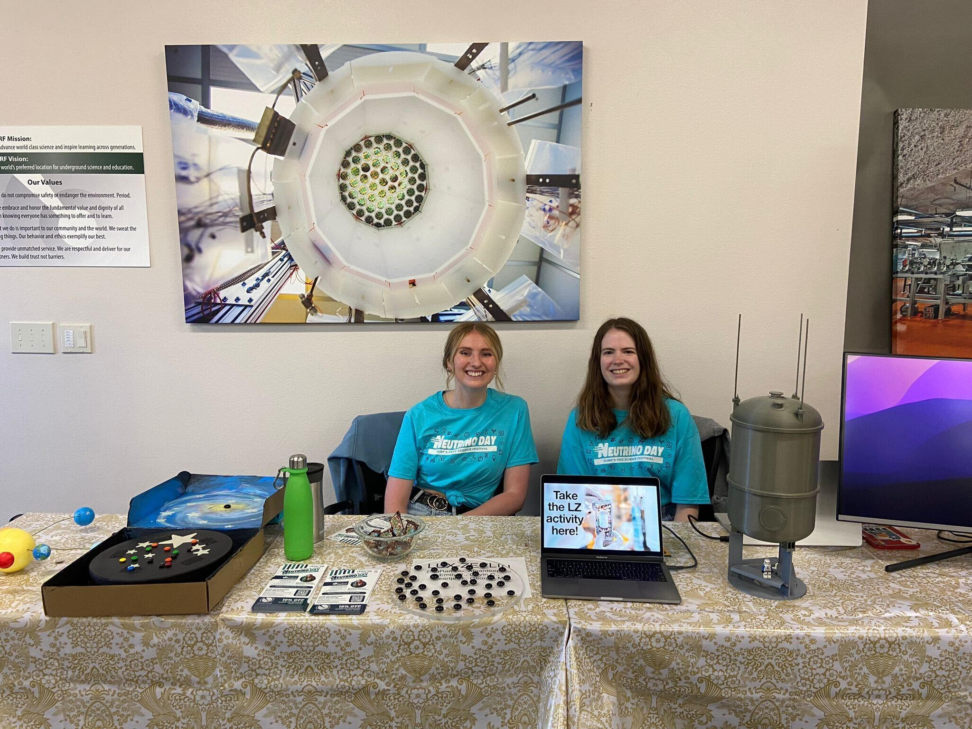
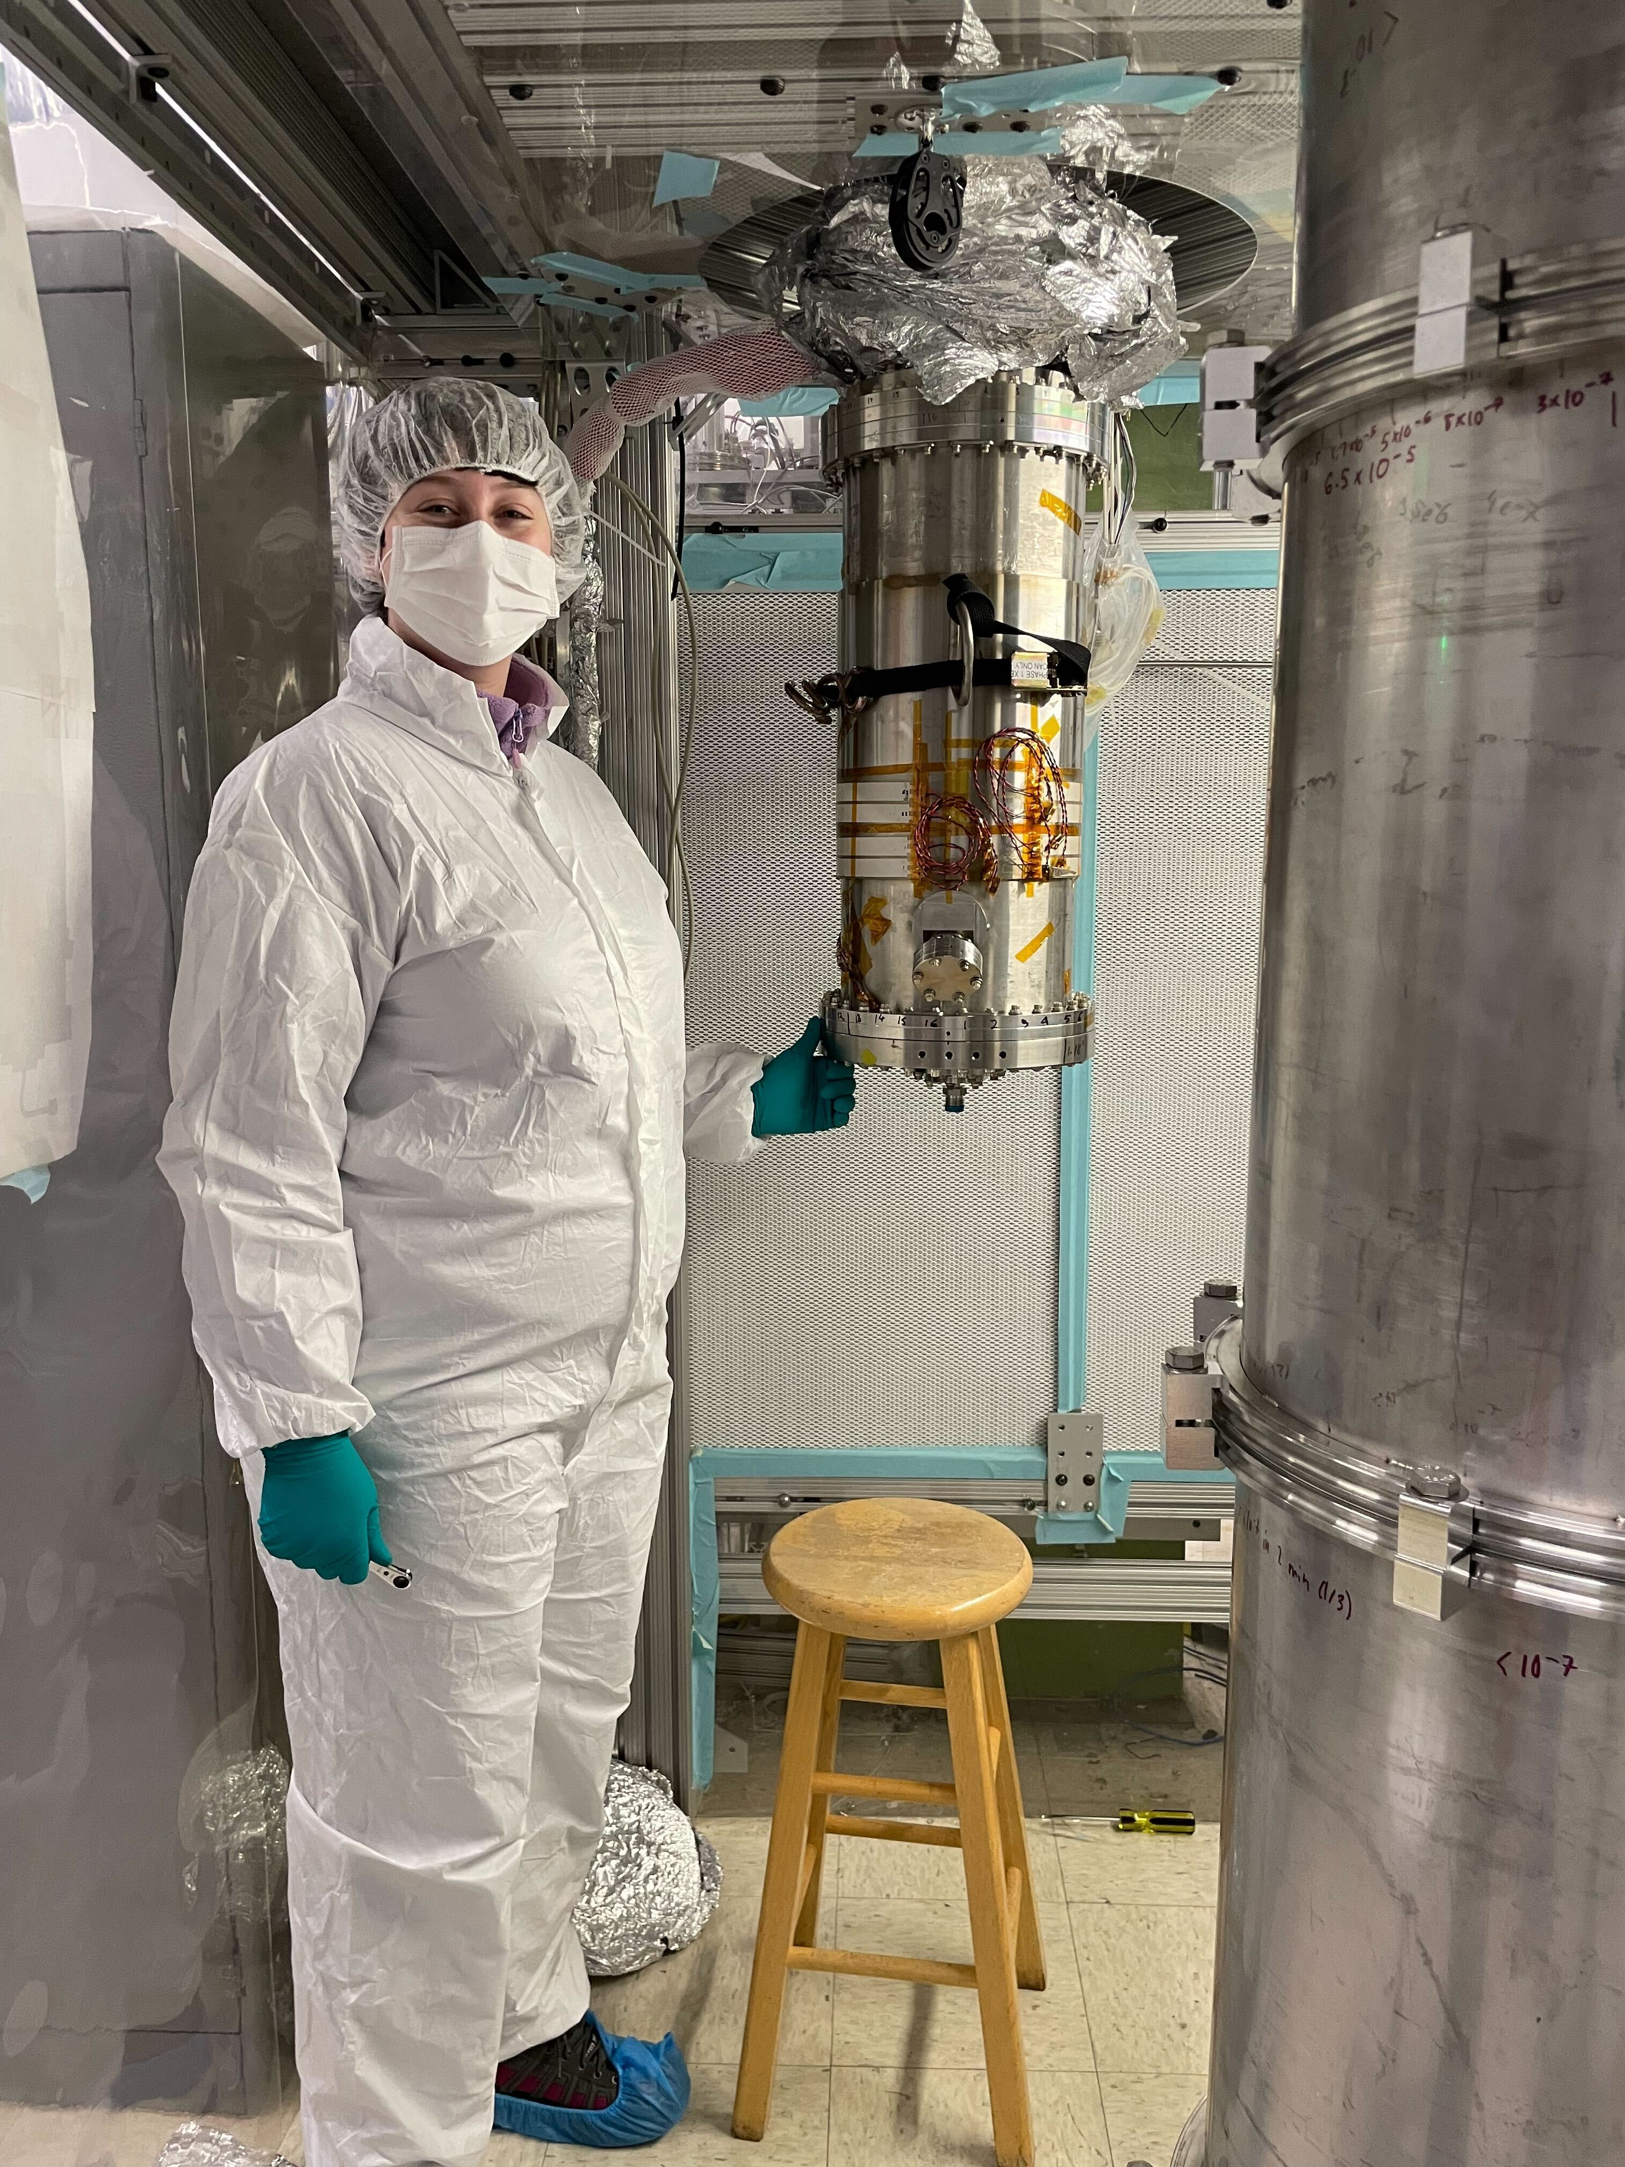
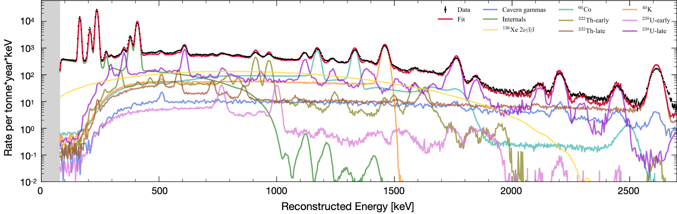
UCL
2 academics,
3 postdocs, 5 students
Leading roles on LZ
  Spokesperson
  WIMP search lead
  0vbb decay lead
  Statistics lead
Strong student contributions
for latest LZ papers/results
Now pivoting to XLZD R&D
Student on LTA at SLAC working on XLZD R&D
Dark Matter Day at LZ's host site in the US
Plot of gamma-ray and beta decay contributions produced by student for the LZ backgrounds paper

Slide 11
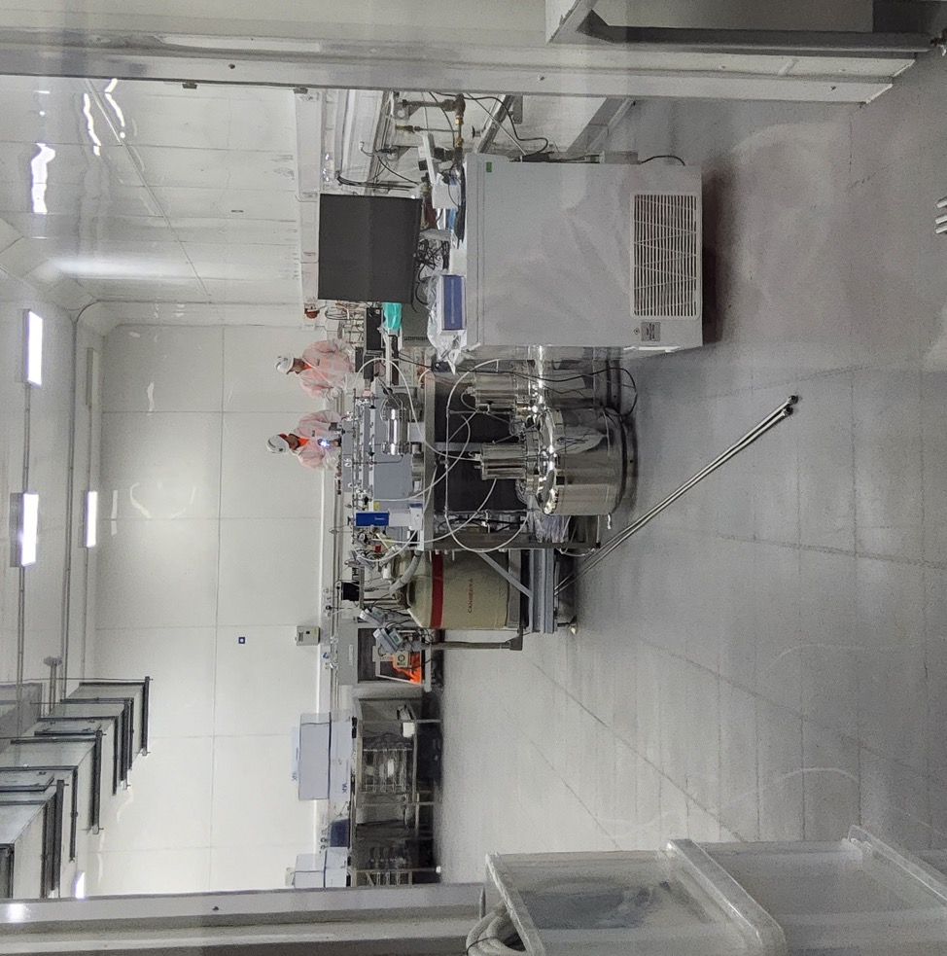
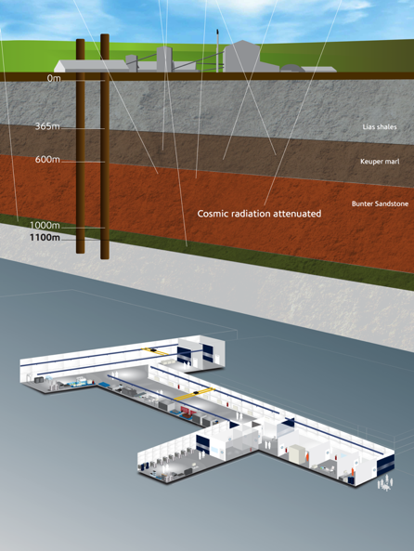
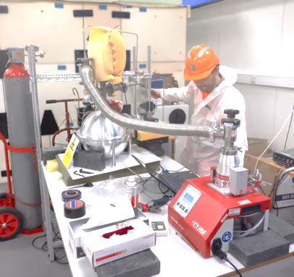
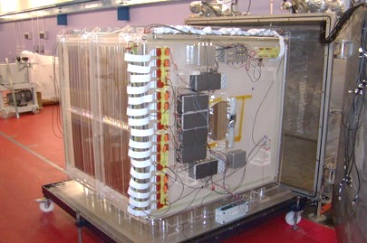
Current Boulby Facility
BUGS material screening suite
Boulby currently hosts CYGNUS directional DM programme,
NEWS-G/Dark-Sphere R&D
The BUGS lab provides ultra-low background material screening for experiments
worldwide, like LZ
LEC Area
Main Hall
BUGS Lab
DRIFT @ Boulby: Dual (1m³ total) Negative Ion drift TPC
NEWS-G: Spherical TPC R&D

Slide 12
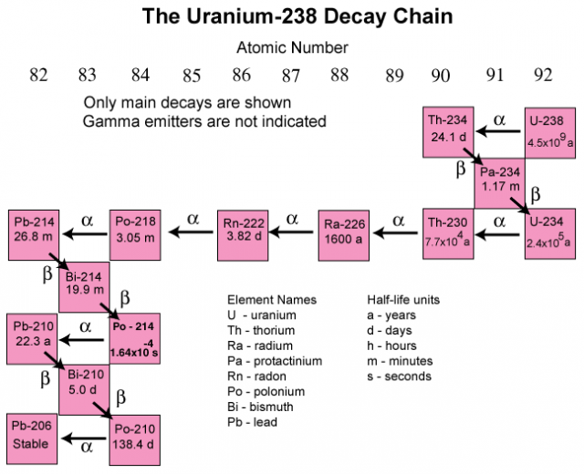
The Focus: Why is Radiopurity Important?
Radiopurity is a key factor in design of state-of-the-art dark matter detectors
The result is only as good as the radiopurity of the system
Many radioisotopes in decay chain
Alphas -> neutrons (⍺,n)
Neutrons -> "WIMPs"
Radon ->
no fiducial
Gammas -> $$$
ICP-MS
HPGe
RnEM
SurfaceAlpha

Slide 13
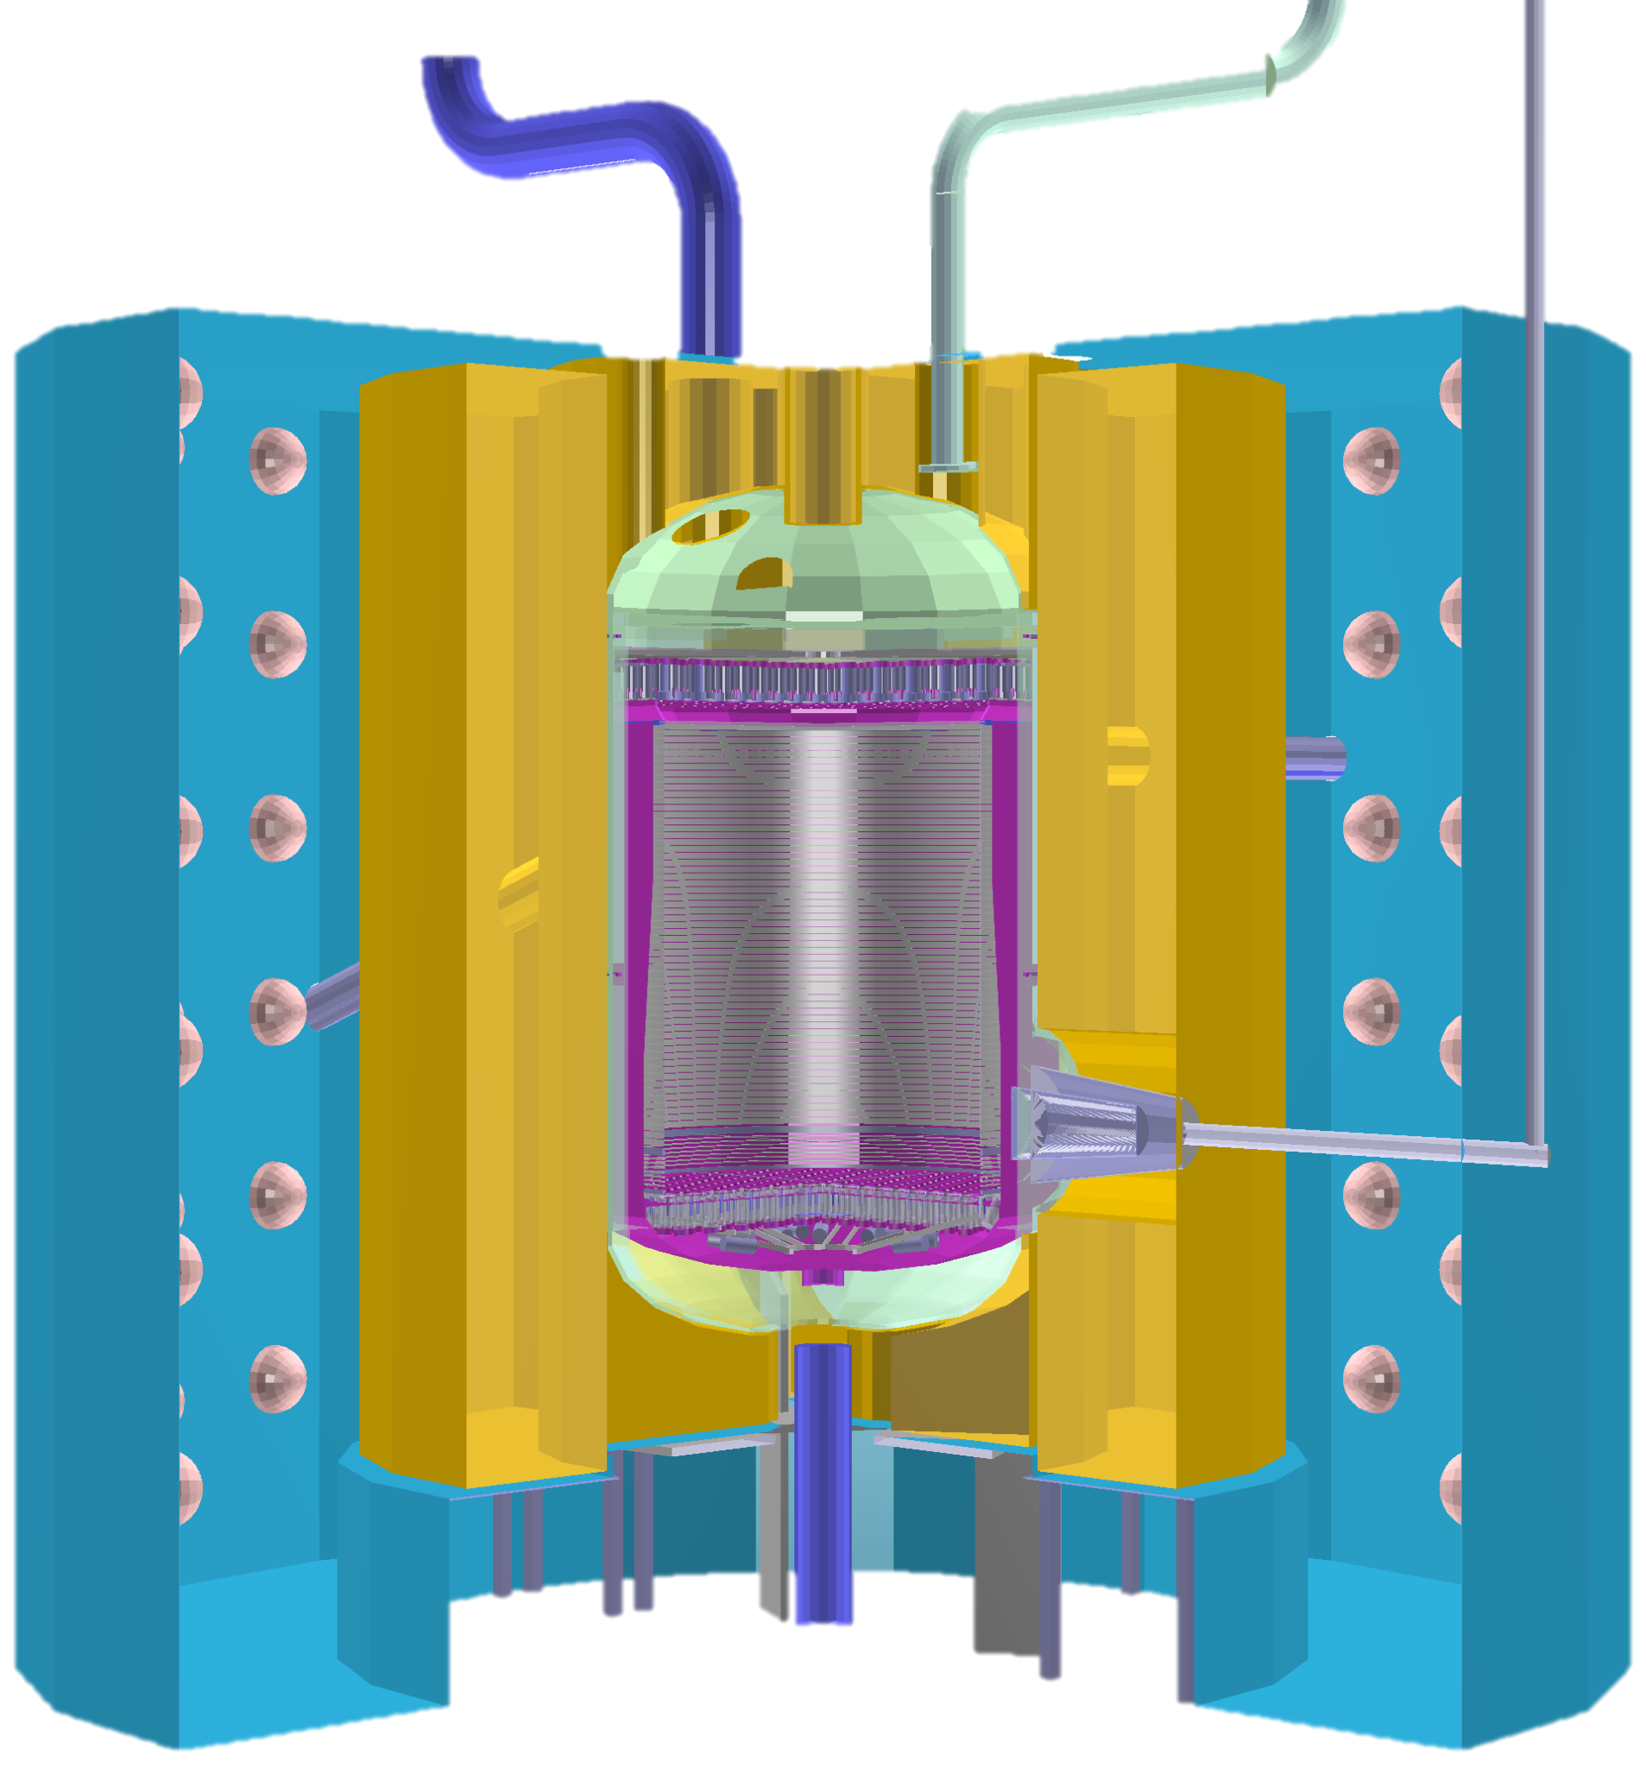
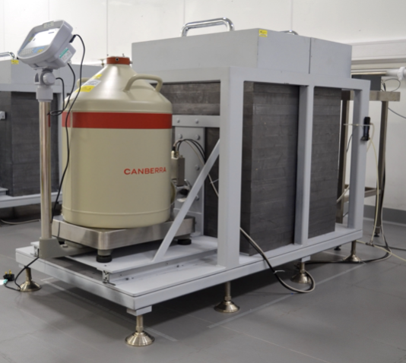
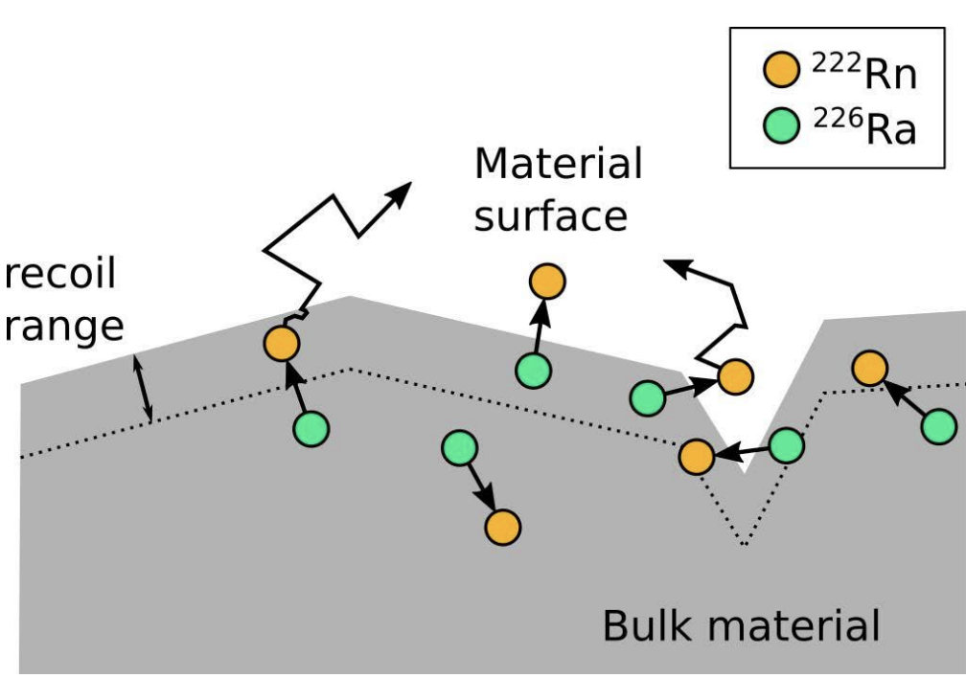
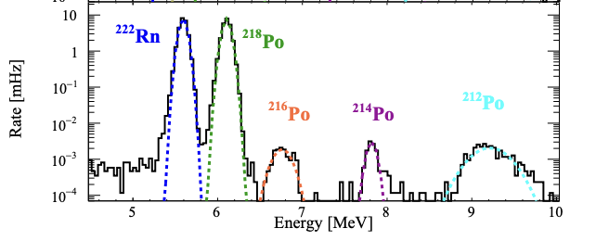
What Your PhD Could Involve
Developing & upgrading BUGS detectors to achieve better sensitivity
Studying radon emanation & devising techniques to measure & prevent it
Performing Geant4-based simulations & sensitivity studies for XLZD
Backgrounds analysis in LZ, informing XLZD & contributing to physics searches

Slide 14
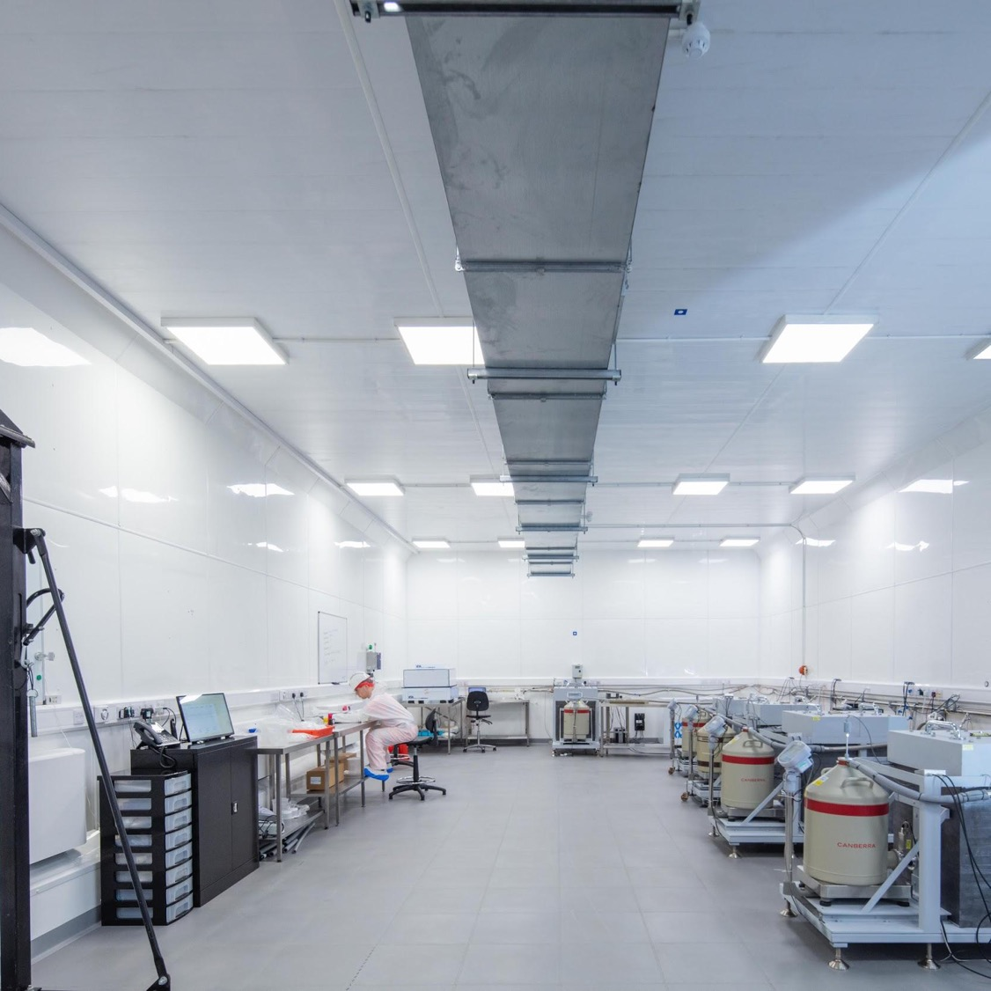
Summary
This project will study backgrounds and use results to understand the sensitivity of the XLZD experiment
You will spend significant time working with Boulby's radiopurity suite, employing many techniques to understand the full decay chain
You will also have the chance to analyse LZ data (online to 2028)
You will also have the opportunity
to spend time at other facilities in the EU and beyond​
Pic: Trevor Palin

Slide 15





boulby.stfc.ac.uk
@BoulbyLab
@BoulbyUndergroundLaboratory
Science and Technology Facilities Council
Notes:
The abstract pattern can be removed or repositioned if required. Be careful to ‘Send to Back’ so that it does not obscure any important information.

Slide 16
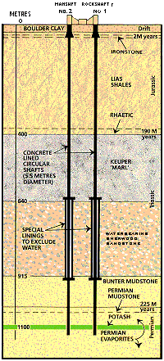

Boulby Mine
Commercial Polyhalite and Salt mine
Shafts sunk in 1968 with full production from 1976
Main tunnels mined through salt – remains of Zechstein sea
  Potash (previously mined) sits above
  Polyhalite sits below
https://en.wikipedia.org/wiki/Zechstein

Slide 17
XLZD@Boulby
Exciting opportunity for the UK to host XLZD
Boulby is aiming to host the ultimate liquid xenon dark matter detector
This will be the most sensitive detector ever built
At Boulby we are already putting in the infrastructure for construction of this experiment
Excavation of a new facility has already begun

Slide 18
The current facility
BUGS material screening suite
Boulby has hosted DM experiments for over two decades including NAIAD, DRIFT & ZEPLIN
Boulby currently hosts CYGNUS directional DM programme,
NEWS-G/Dark-Sphere R&D
The BUGS lab provides ultra-low background material screening for worldwide experiments like LZ
DRIFT @ Boulby: Dual (1m³ total) Negative Ion drift TPC
NEWS-G: Spherical TPC R&D

Slide 19
The current facility
Permian Evaporites
LEC Area
Main Hall
BUGS Lab

Slide 20
XLZD Development
This project will in part study materials and use results to understand the ultimate sensitivity of the XLZD experiment
Employing a number of techniques to understand the full decay chain
You will spend significant time working with Boulby radiopurity suite
Also opportunity to spend time with other facilities in EU and beyond

Slide 21
Conclusions
Radiopurity is a key factor in design of state-of-the-art detectors
The result is only as good as the radiopurity of the system
At Boulby we run a world class material radioassay suite
Pic: Trevor Palin

