Slide 1




PPD Project Office
David Celeste
02-12-2024
Notes:
The abstract pattern can be removed or repositioned if required. Be careful to ‘Send to Back’ so that it does not obscure any important information.

Slide 2
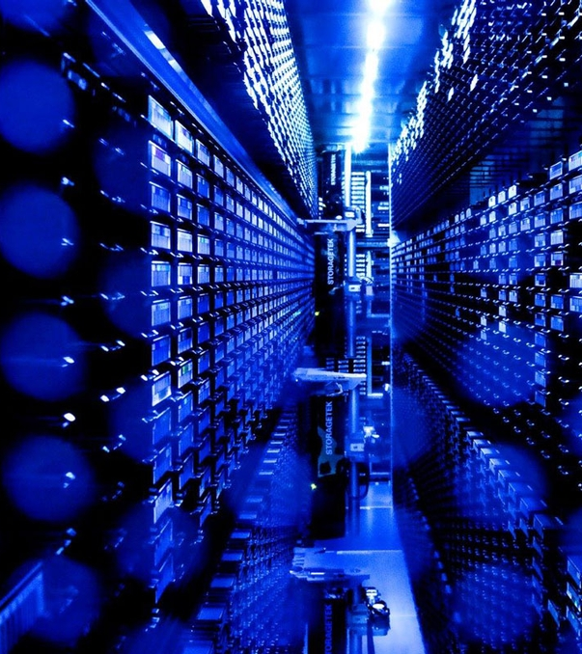
Agenda
1 What We Do
2 What We Want to Do
3 2024 in Review
4 New Year's Resolutions
5 Dear Santa
Image © STFC Alan Ford
Notes:
To replace photo with one of your own. 1) Send the geometric shape overlay to the back – Right-Click > Send to Back > Send to Back. 2) Replace image – use the guides provided to correctly position it. 3) Send your image to the back so that the geometric overlay re-appears over the image. Please remove or amend the image credit if you are using a different image to the one provided.

Slide 3
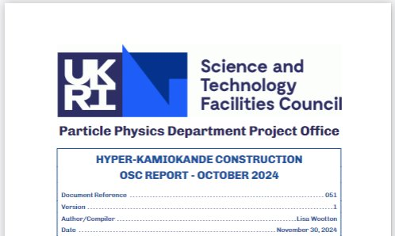
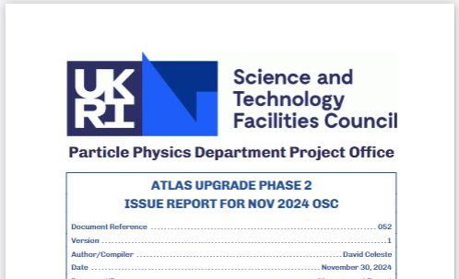
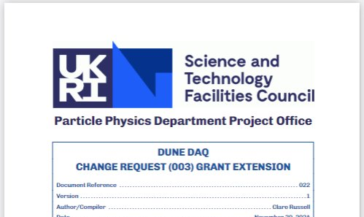
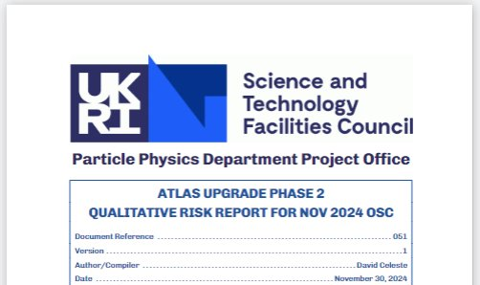
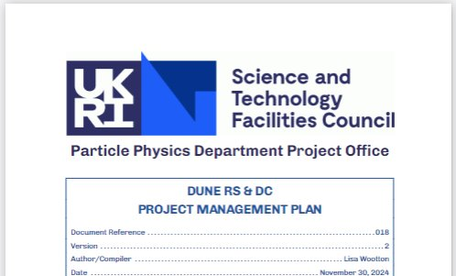

What we do – so far
Lots of project administration
Project planning & proposals
Risk, Issue & Change Management
OsC project reports and presentations
Panel members
Business cases
PRC monthly reports
Departmental reporting
Notes:
Please replace photo of presenter with a portrait of your own. 1) Send the geometric shape overlay to the back – Right-Click > Send to Back > Send to Back. 2) Replace image – use the guides provided to correctly position it. 3) Send your portrait to the back so that the geometric overlay re-appears over the portrait.

Slide 4
Who does what
Dr Christopher Townsley
Head of Project Office Division
Sandeep Rao Gopalam
Scheduling/Analytics
Andra Pirvu
Project Manager
(DUNE APA)
David Celeste
Project Manager
(ATLAS, HyperK, DUNE DAQ)
Dr Clare Allen
Associate Project Manager
(DUNE DAQ, ATLAS)
Caitlin Doherty
Graduate
TBD
Project Manager
(CMS, LHCb)
Lei Zhang
Associate Project Manager
(CMS, LHCb)
Joel Finneghan
Graduate
TBD
Project Manager
(XLZD, ?)
Lisa Wootton
Associate Project Manager
(HyperK, DUNE RS&DC, XLZD)
This is line management only:
  We operate as a matrix so projects shown are nominal
  Project Office development responsibilities not shown
  We are growing,
  and need to, fast!

Slide 5
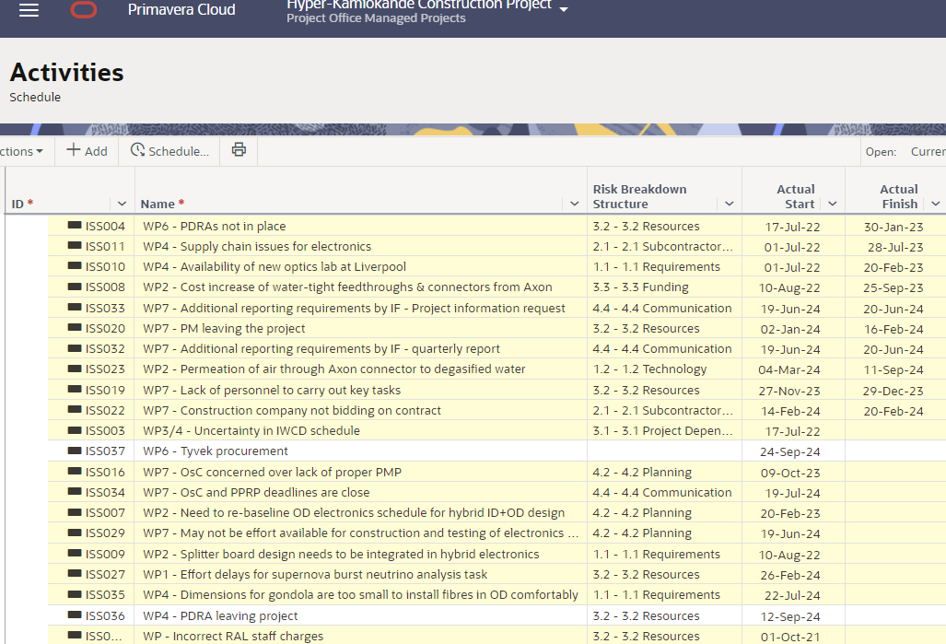

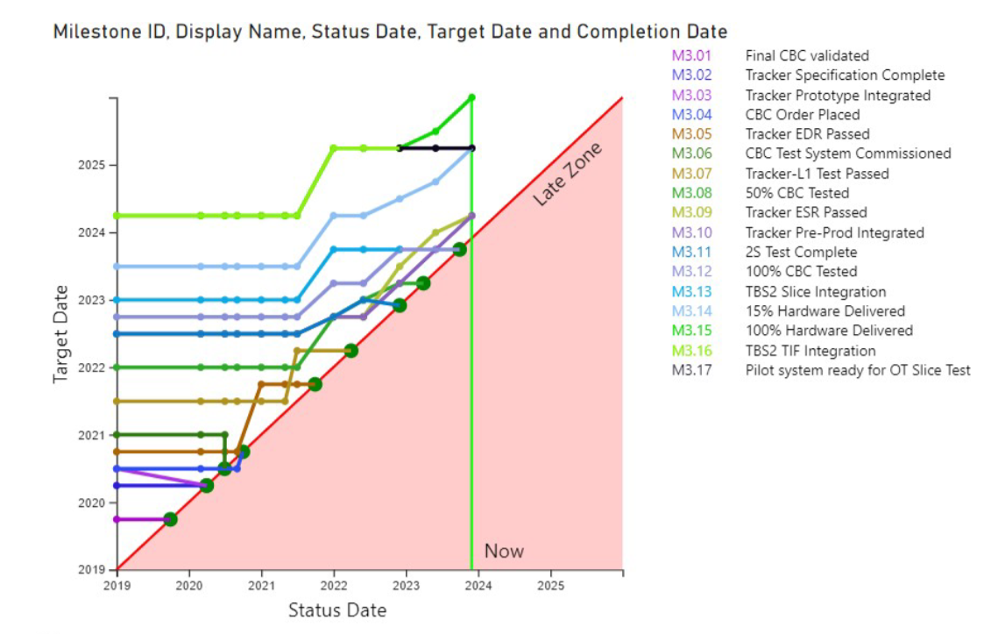
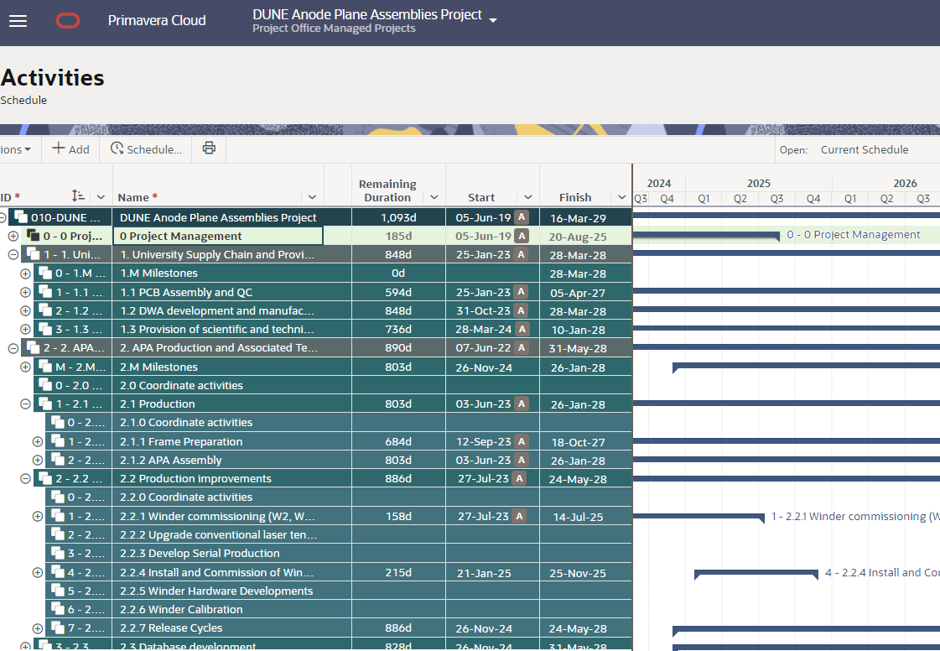
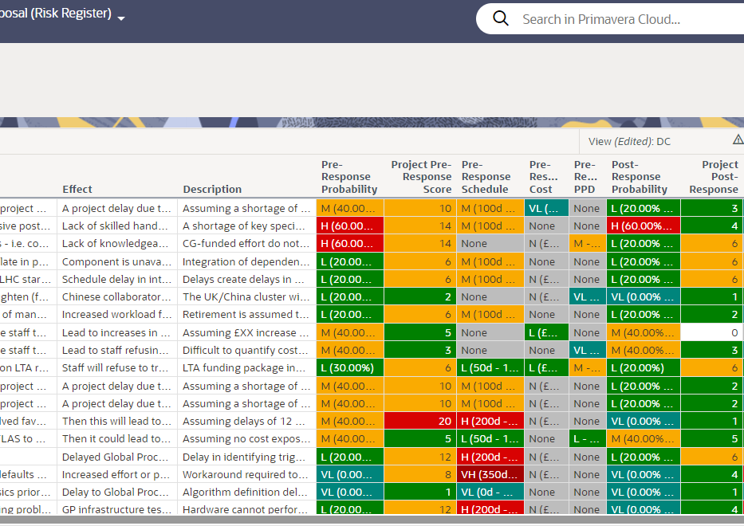
Active Projects
ATLAS
CMS
LBNF/DUNE as a whole
DUNE APA
DUNE DAQ
DUNE Software & Computing
Hyper-K
LHCb
XLZD
*Collaboration projects rather than PPD projects

Slide 6
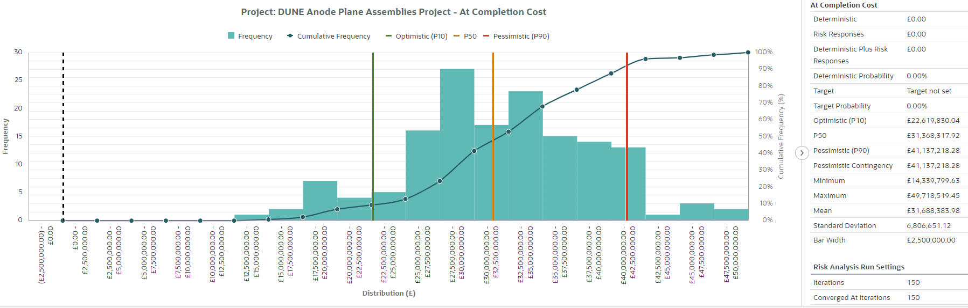
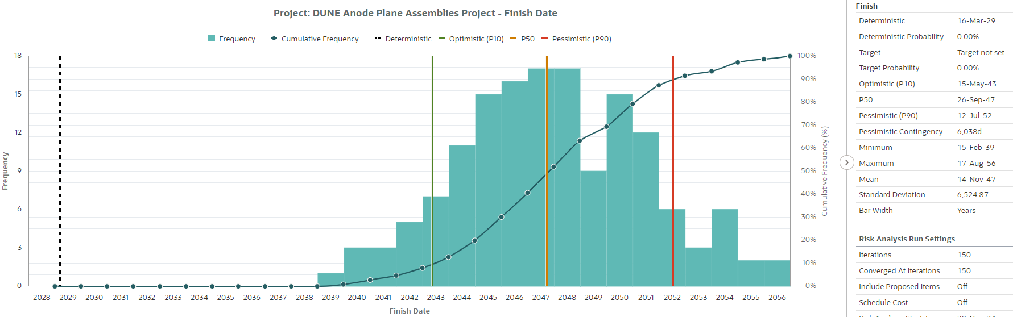
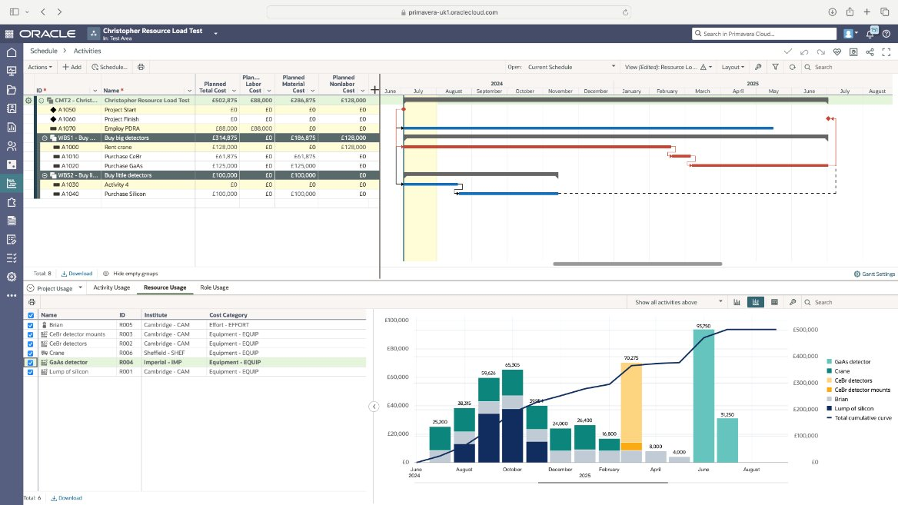
What we want to do
More accountable for projects
Deeper involvement in planning
Portfolio Management
Increasing analysis capabilities
  Monte Carlo (risk)
  Resource and cost loading
  More automated reporting
For example, APA
  we now have a lot of ownership
  more accountable
Notes:
Please replace photo of presenter with a portrait of your own. 1) Send the geometric shape overlay to the back – Right-Click > Send to Back > Send to Back. 2) Replace image – use the guides provided to correctly position it. 3) Send your portrait to the back so that the geometric overlay re-appears over the portrait.

Slide 7
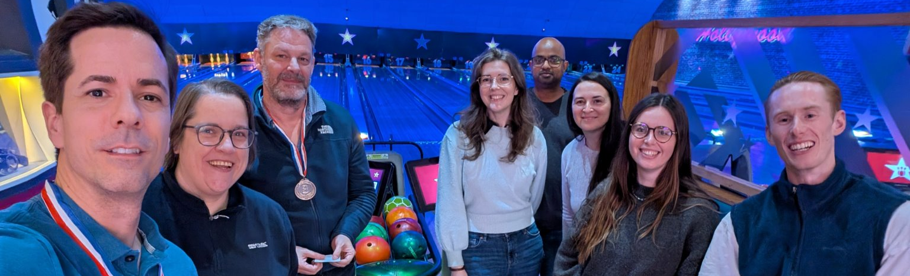

2024 in review
Submitted Proposals
  CMS
  DUNE RS&DC
  DUNE DAQ
DUNE APA PRR
Active proposals
  ATLAS
  Hyper-K
13+ OsC meetings
PM pipeline created (Associates, Graduates)
Notes:
Please replace photo of presenter with a portrait of your own. 1) Send the geometric shape overlay to the back – Right-Click > Send to Back > Send to Back. 2) Replace image – use the guides provided to correctly position it. 3) Send your portrait to the back so that the geometric overlay re-appears over the portrait.

Slide 8
New Year's Resolutions
Resource and cost loading
Developing analytics (PowerBI)
More automated reporting
Monte Carlo analysis
Developing project managers through time and exposure
Develop senior PMs
Re-invigorate long-term PO development plan and KPIs
Image © STFC John Dawson
Notes:
To replace photo with one of your own. 1) Send the geometric shape overlay to the back – Right-Click > Send to Back > Send to Back. 2) Replace image – use the guides provided to correctly position it. 3) Send your image to the back so that the geometric overlay re-appears over the image. Please remove or amend the image credit if you are using a different image to the one provided.

Slide 9

Dear Santa...
Removing external hiring freeze
Filling current PM vacancies
Attempt recruiting Particle Physicists as PM
Have been disabled, only doing admin, having issues recruiting
More funded-FTE per project
Fully staffed/experienced, we can add more value to PPD – take us beyond admin
  Need more PM effort in many active projects
Notes:
To replace photo with one of your own. 1) Send the geometric shape overlay to the back – Right-Click > Send to Back > Send to Back. 2) Replace image – use the guides provided to correctly position it. 3) Send your image to the back so that the geometric overlay re-appears over the image. Please remove or amend the image credit if you are using a different image to the one provided.

Slide 10



Notes:
The abstract pattern can be removed or repositioned if required. Be careful to ‘Send to Back’ so that it does not obscure any important information.

Slide 11





Search: STFC Particle Physics
@PPD_STFC
@STFC_Matters
Science and Technology Facilities Council
Notes:
The abstract pattern can be removed or repositioned if required. Be careful to ‘Send to Back’ so that it does not obscure any important information.

