Slide 1
PPD Away Day
LHCb presentation
Antonis Papanestis
STFC – RAL

Slide 2
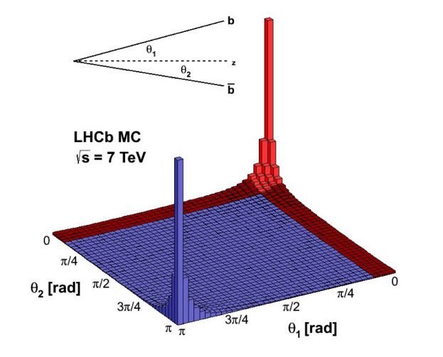
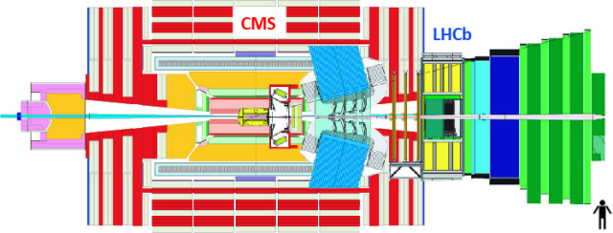
LHCb / Point 8
Forward spectrometer covering 2 < η < 5
Designed to study CP-violation (matter – antimatter differences) and rare decays of particles containing the b and c quarks

Slide 3
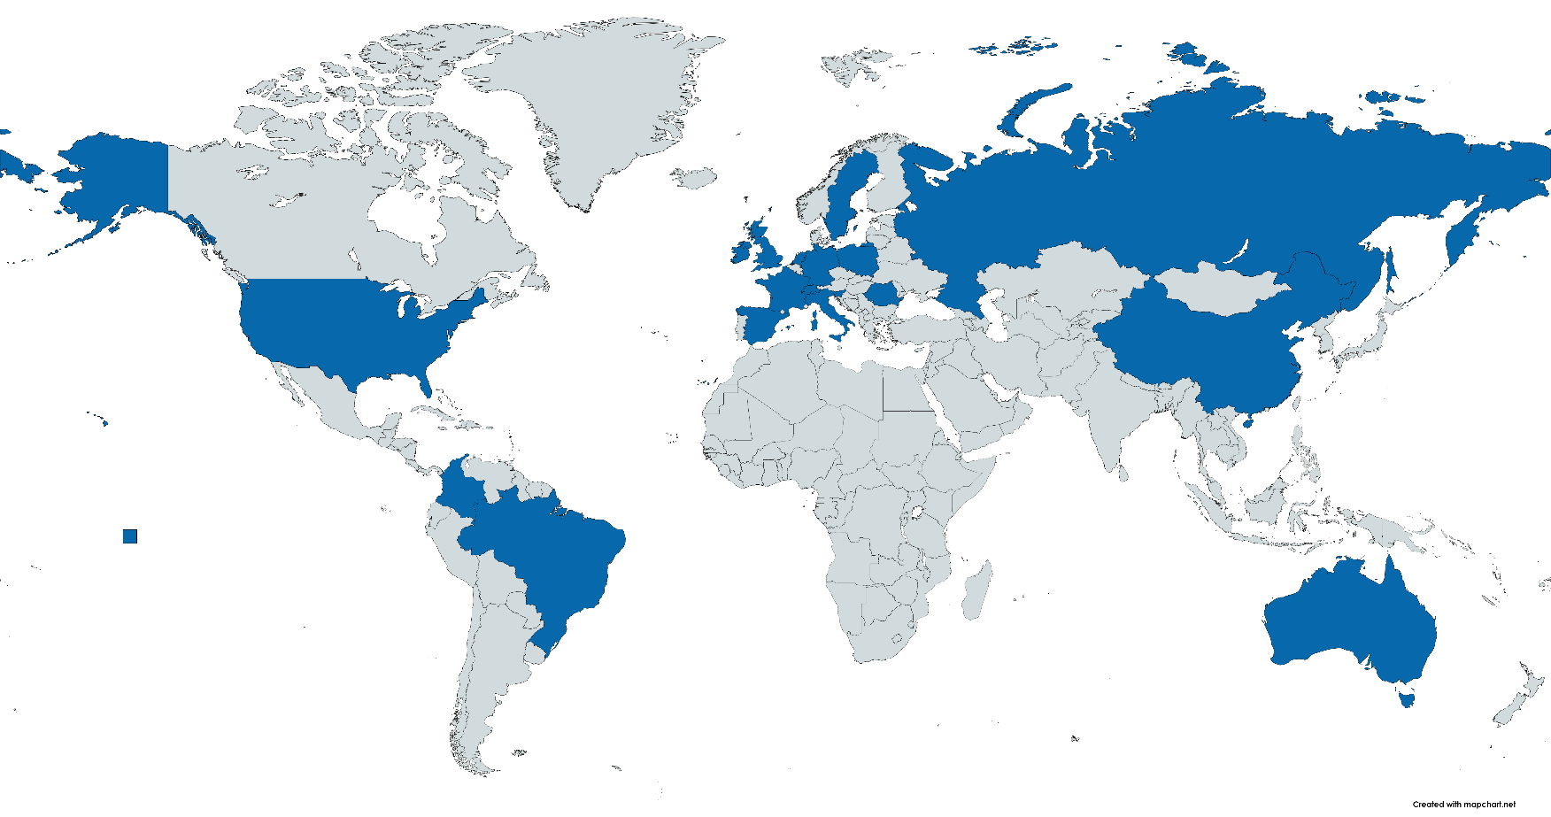
LHCb Collaboration (in 2023)
1620 Members
1118 Authors
96 Institutes
21 Countries
11 UK institutes
14.3% of M&O A
2nd after Italy (15.5%)
All others below 10%

Slide 4
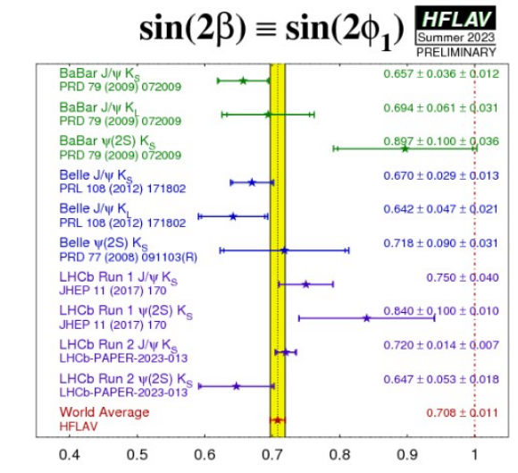
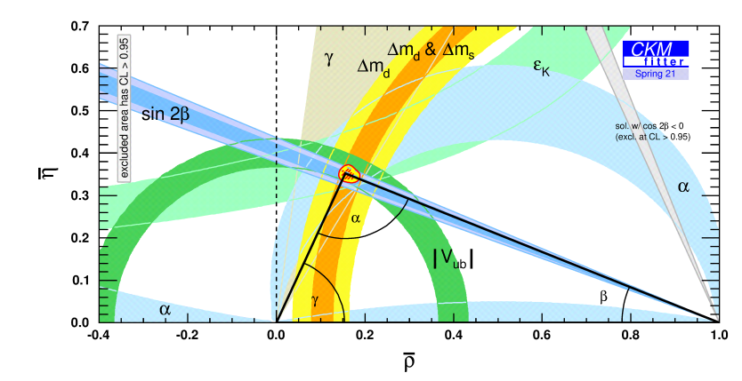
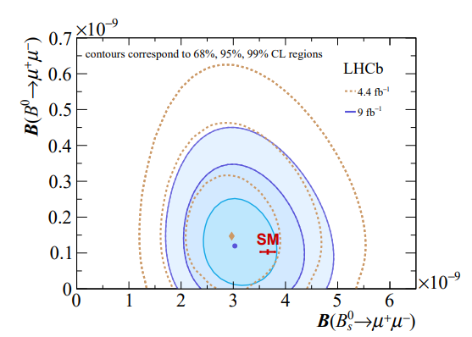
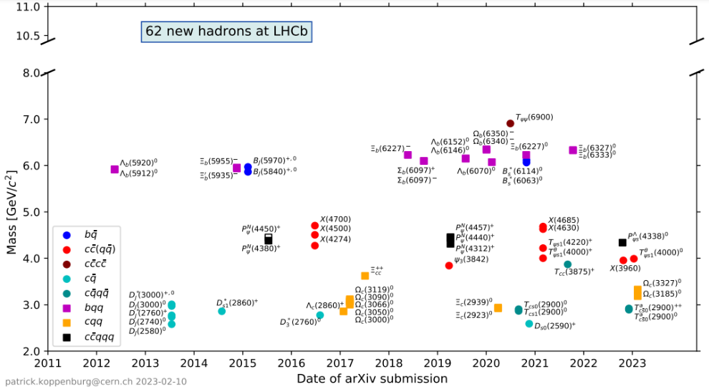
LHCb Physics

Slide 5
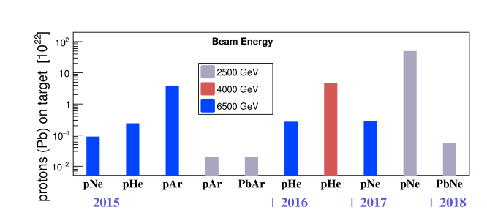
LHCb fixed target (@TeV energies)

Slide 6
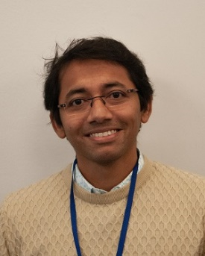
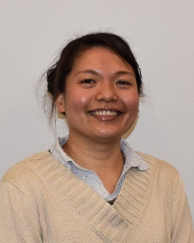
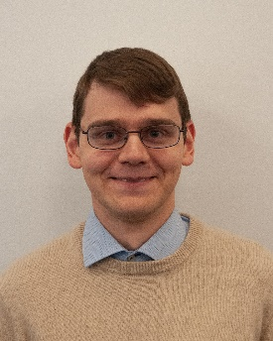
PPD LHCb Group
Antonis Papanestis (RICH)
Atanu Modak (Mighty Tracker)
Sajan Easo (CERN, RICH)
Stefania Ricciardi (RICH)
Tai-Hua Lin (RICH / Mighty Tracker)
Alexander Rogovskiy (Computing)
Alessandra Latham (Graduate)
Constantinos Vrahas
Lucas Girardey
Fergus Wilson
RICH Simulation / Databases
RICH Detector Control System / Operations
Grid computing (for LHCb)
Physics
Student supervision
LHCb Upgrade II

Slide 7
LHCb Upgrades
LHC
Extension
In 2024 LHCb collected more data than Run 1 and Run 2 together
HL-LHC ATLAS & CMS UPGRADES

Slide 8
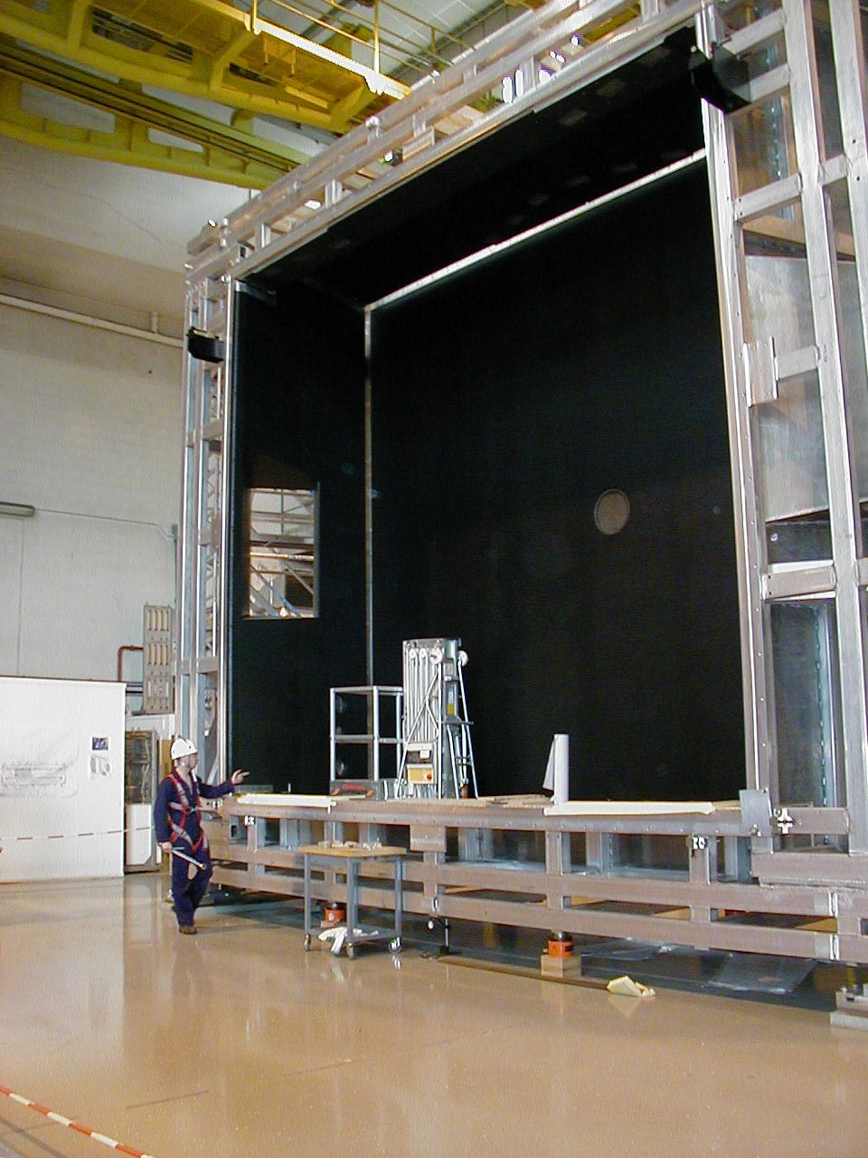
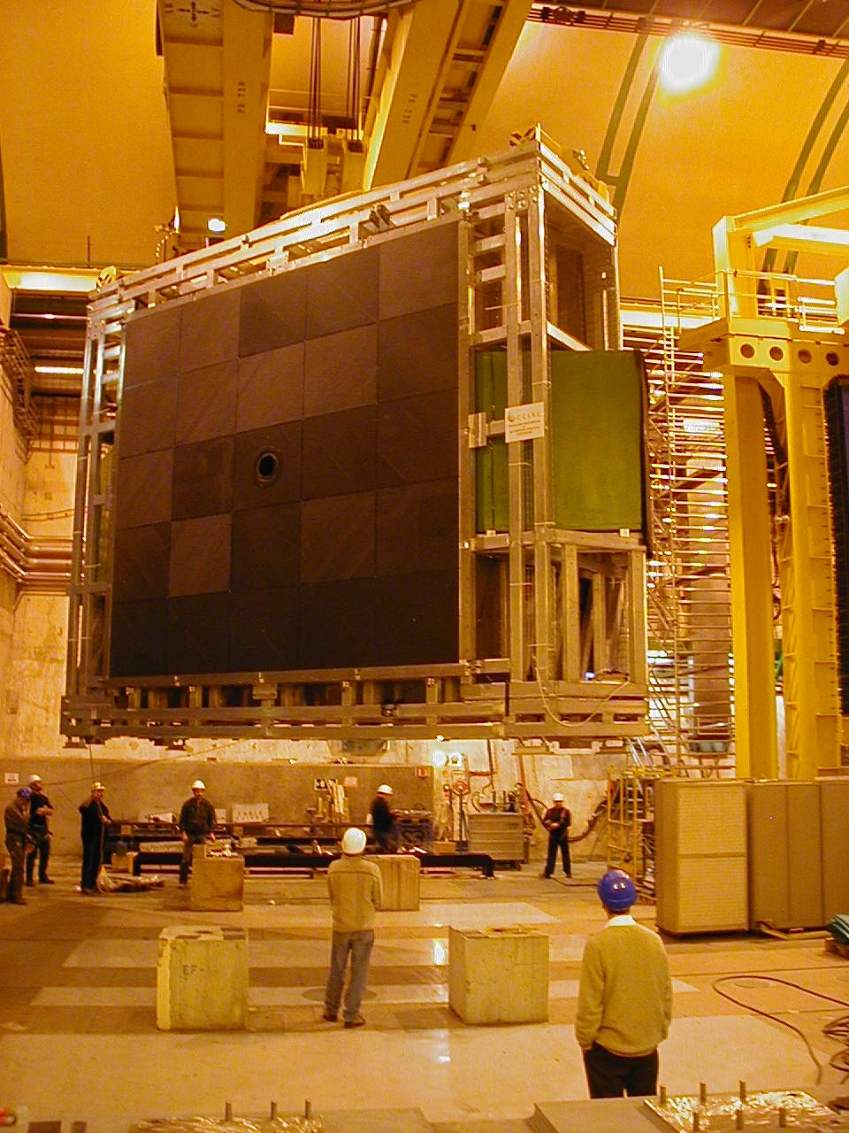
RICH 2 superstructure

Slide 9
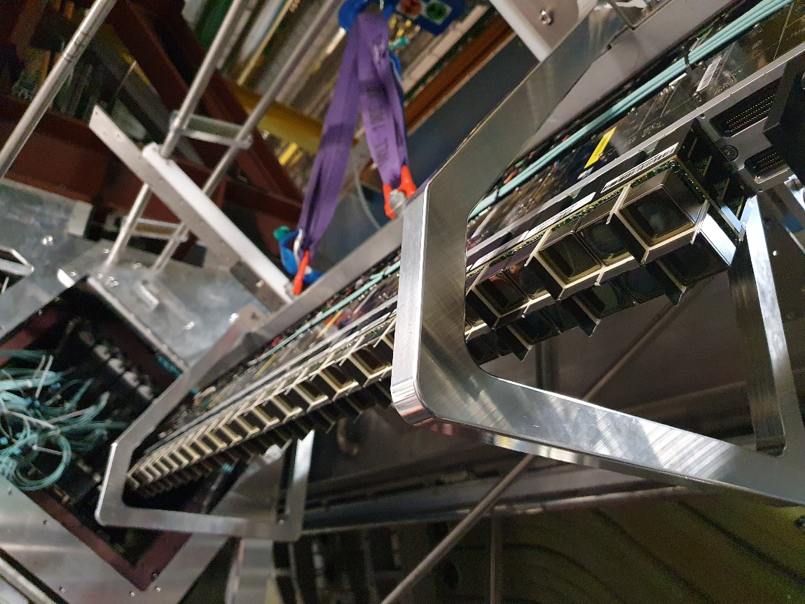
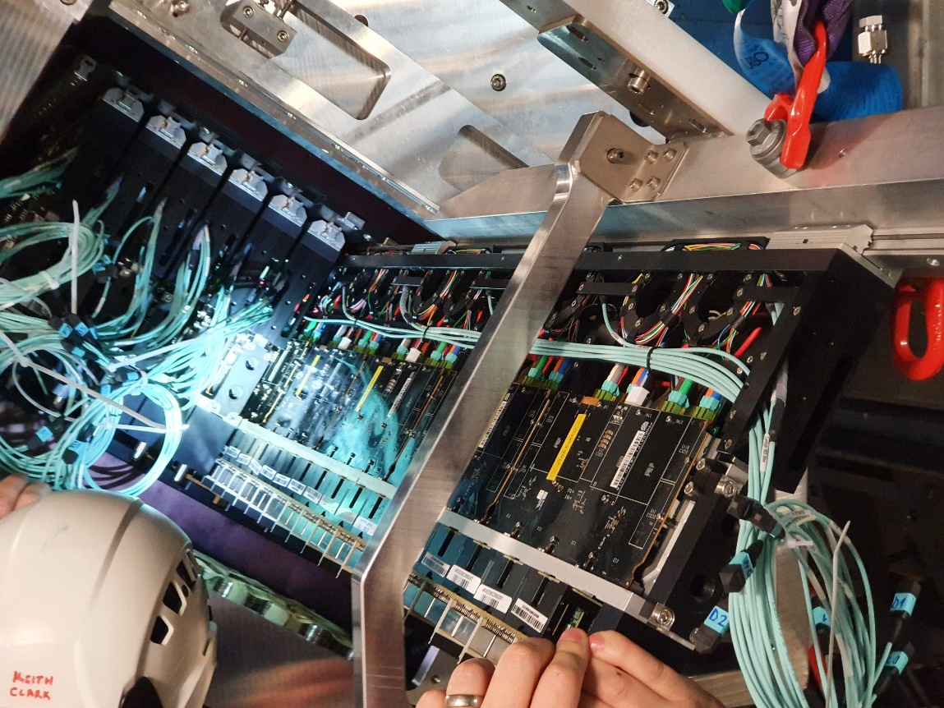
RICH 1 Up1 photon detector installation

Slide 10
Next season preview: Upgrade II

