Slide 1

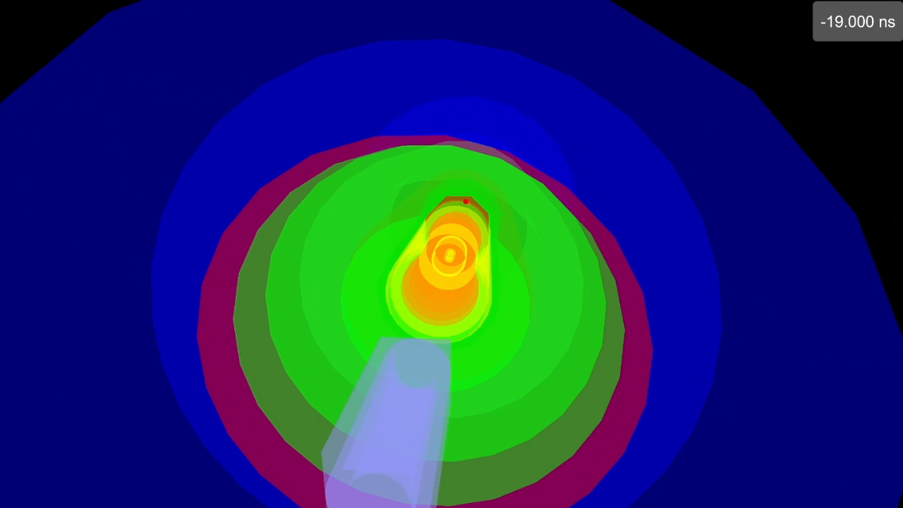


The Electron Ion Collider and the ePIC-UK Collaboration
Building the world’s most sophisticated particle detector for analyzing collisions between electrons and protons or other nuclei
The Electron-Ion Collider
Fergus Wilson
Particle Physics Department
On behalf of ePIC-UK collaboration
Fergus Wilson, Particle Physics Department, RAL
Notes:
The abstract pattern can be removed or repositioned if required. Be careful to ‘Send to Back’ so that it does not obscure any important information.

Slide 2
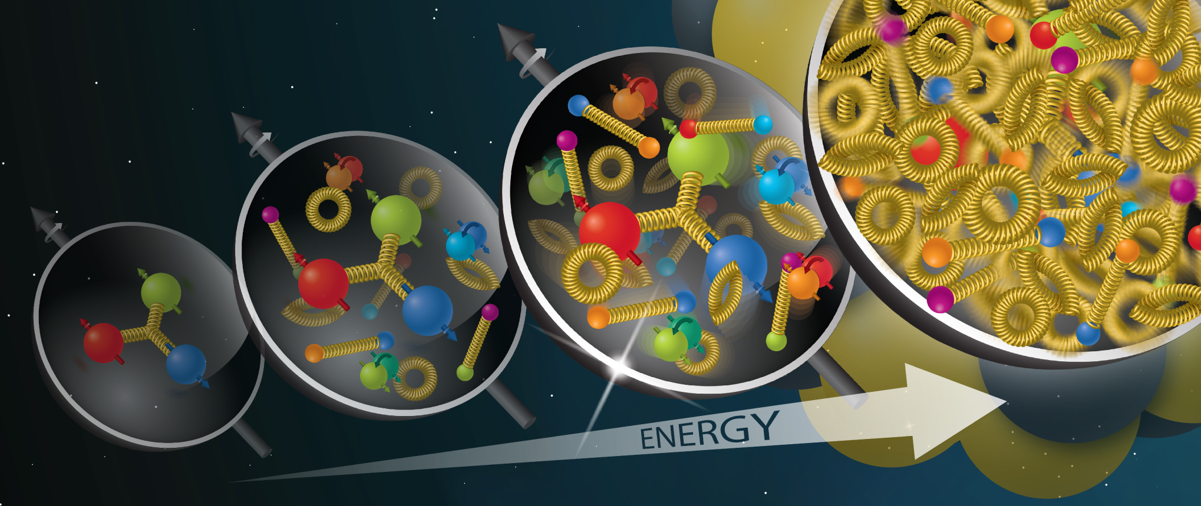
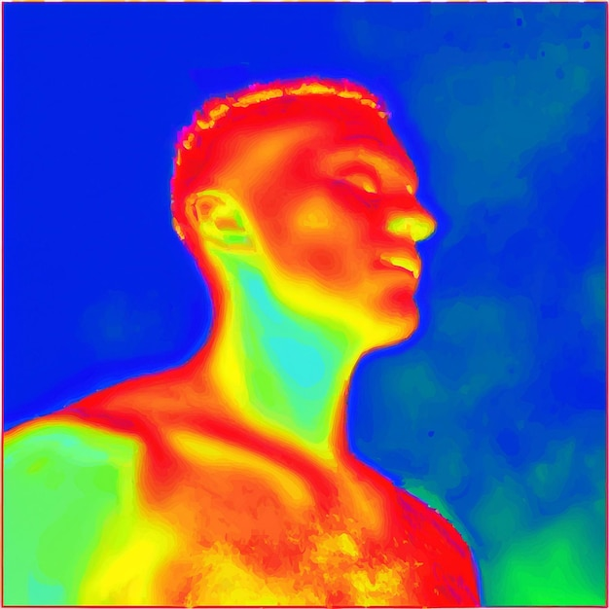

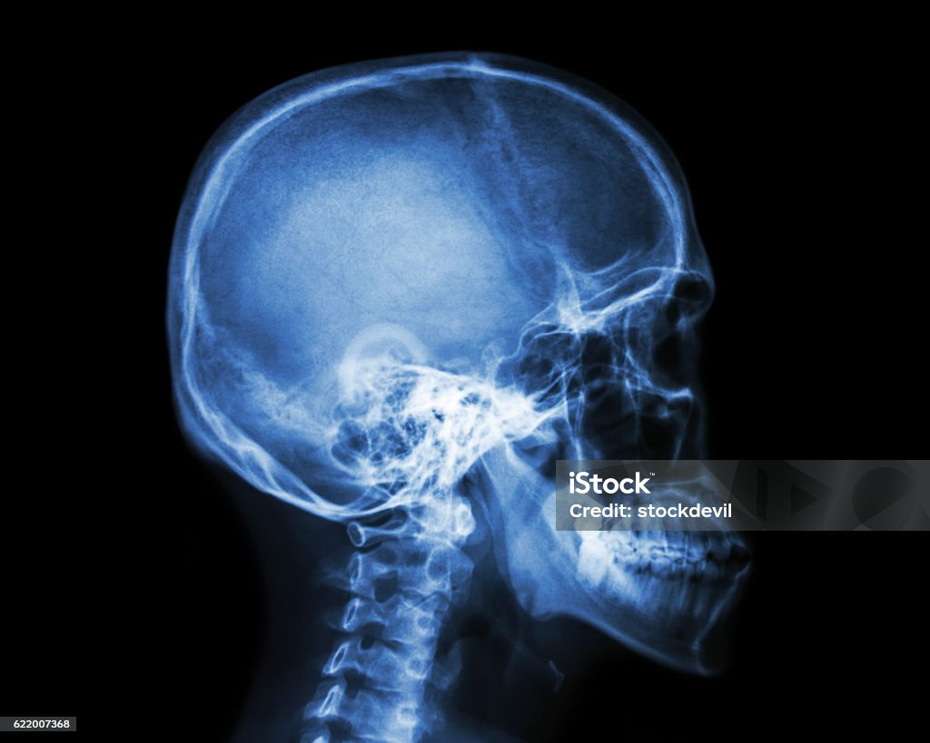
EiC is a very big electron-microscope
Atoms are made of nuclei and electrons
Nuclei are made of protons and neutrons
Protons and neutrons are made of quarks and gluons
Investigate mass, structure and contents of protons and nuclei.
gluons
Sea quarks
Valencequarks
Increasing Energy

Slide 3
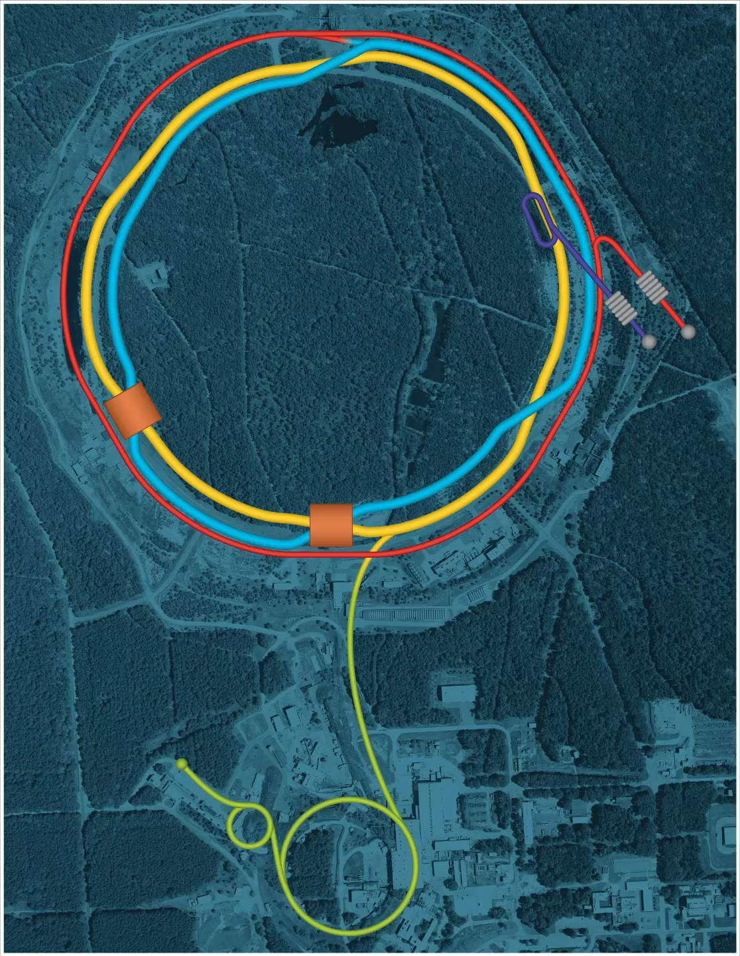


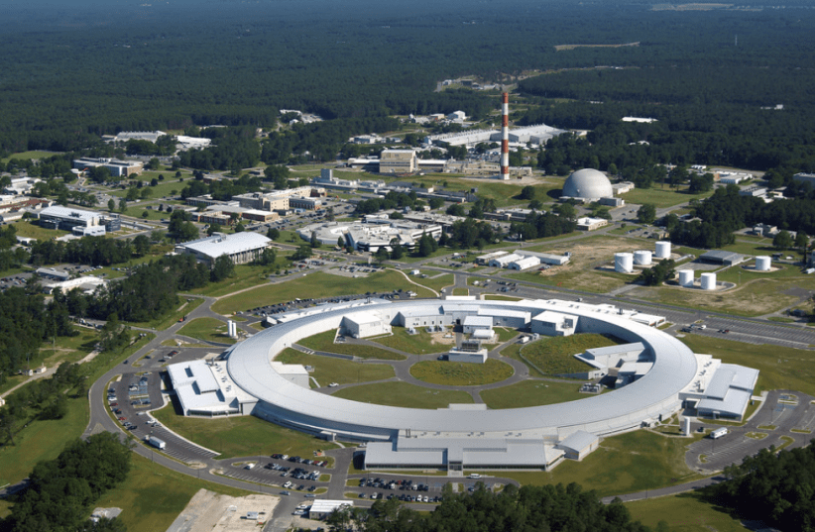


Electron Ion Collider
~1.2km
Typical accommodation in the Hamptons
Advance warning to UKLO:
Only $600,000 per month

Slide 4
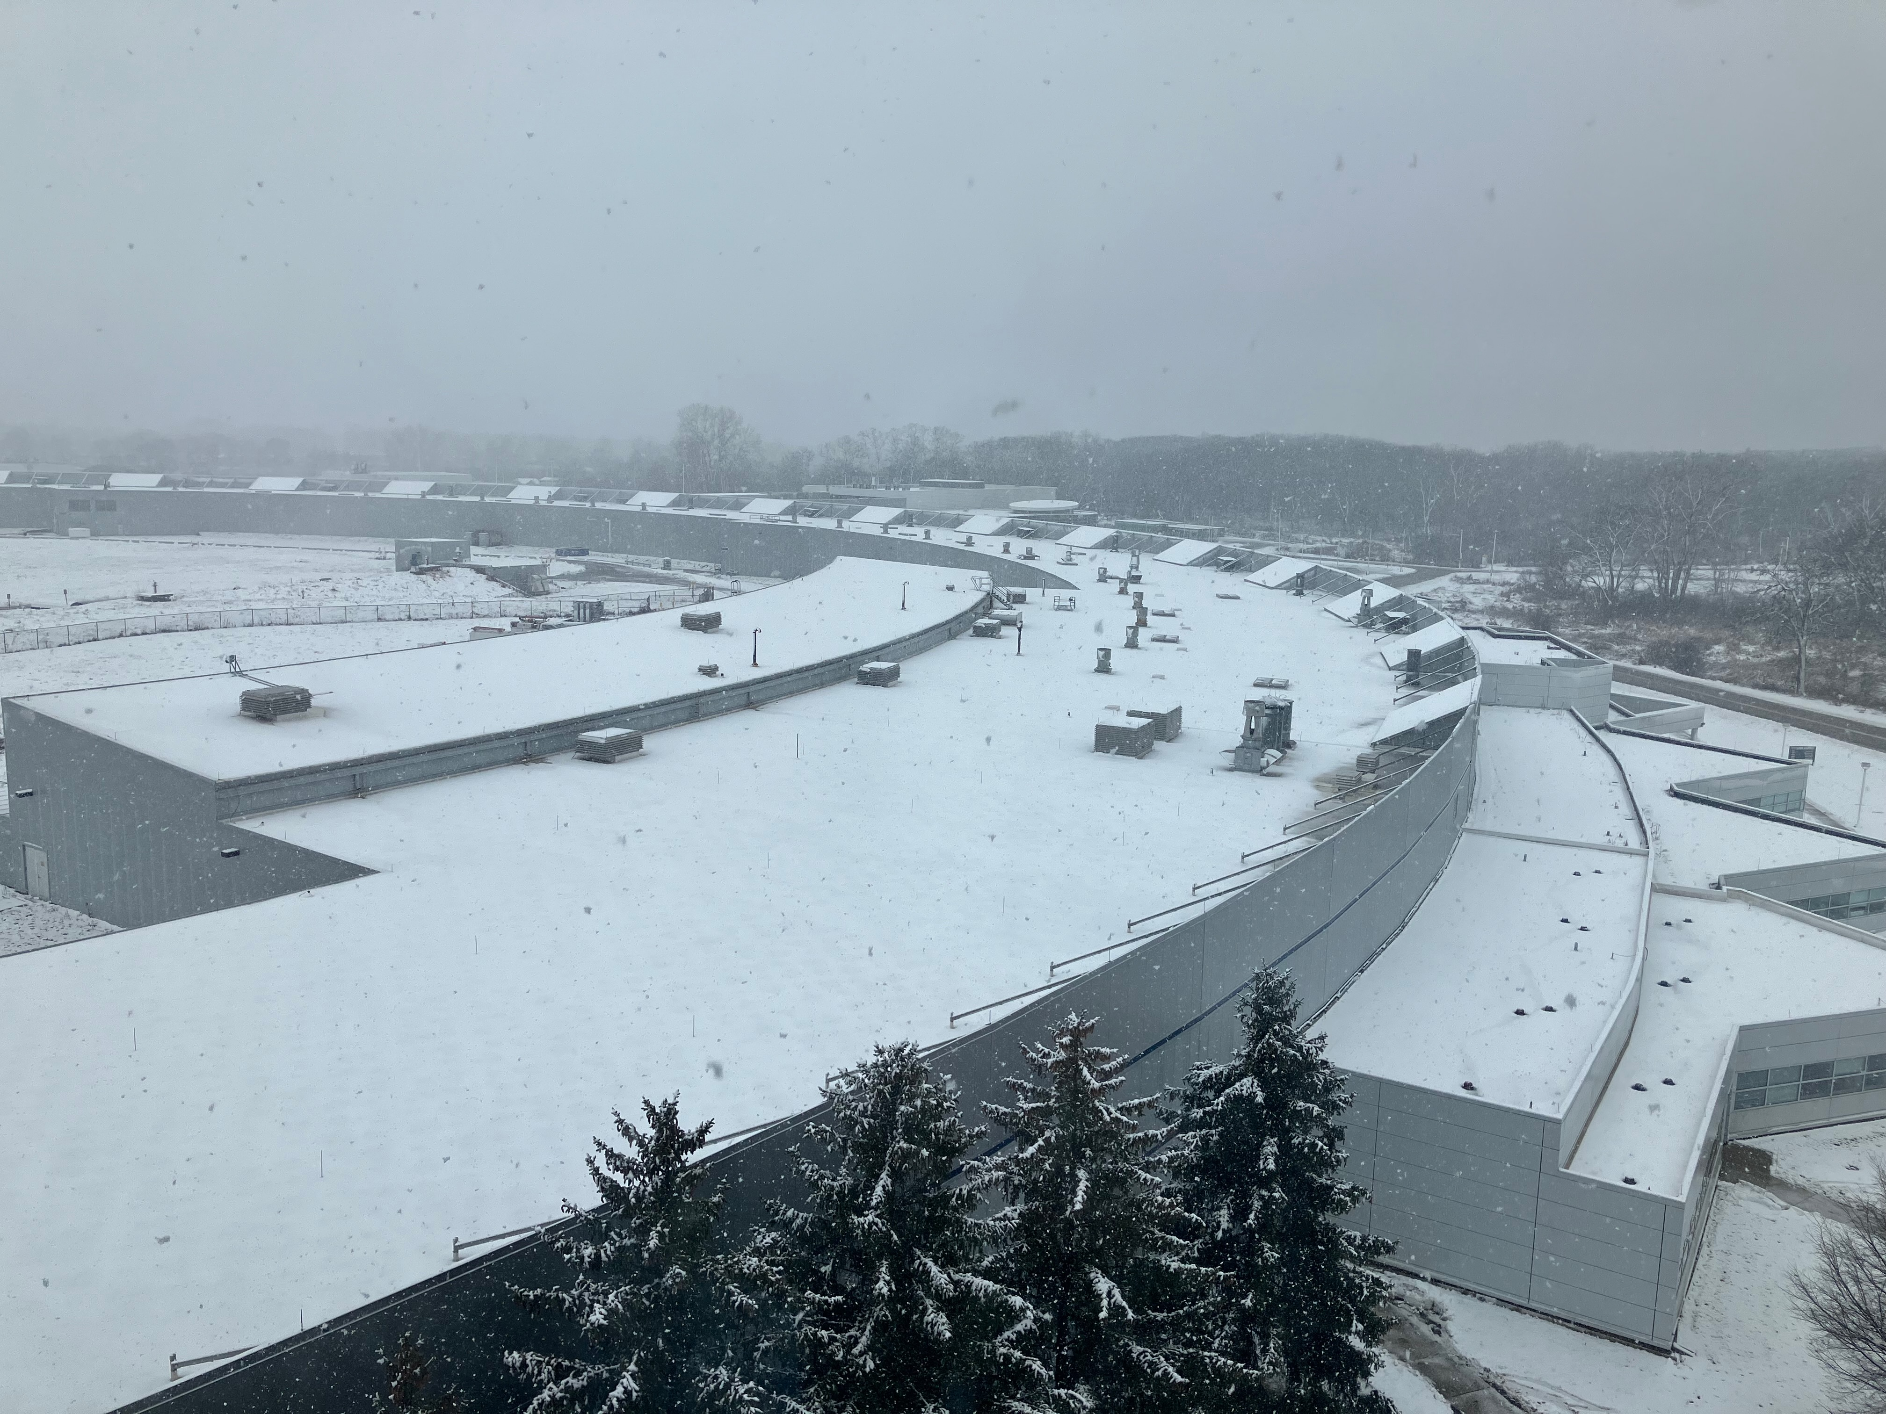
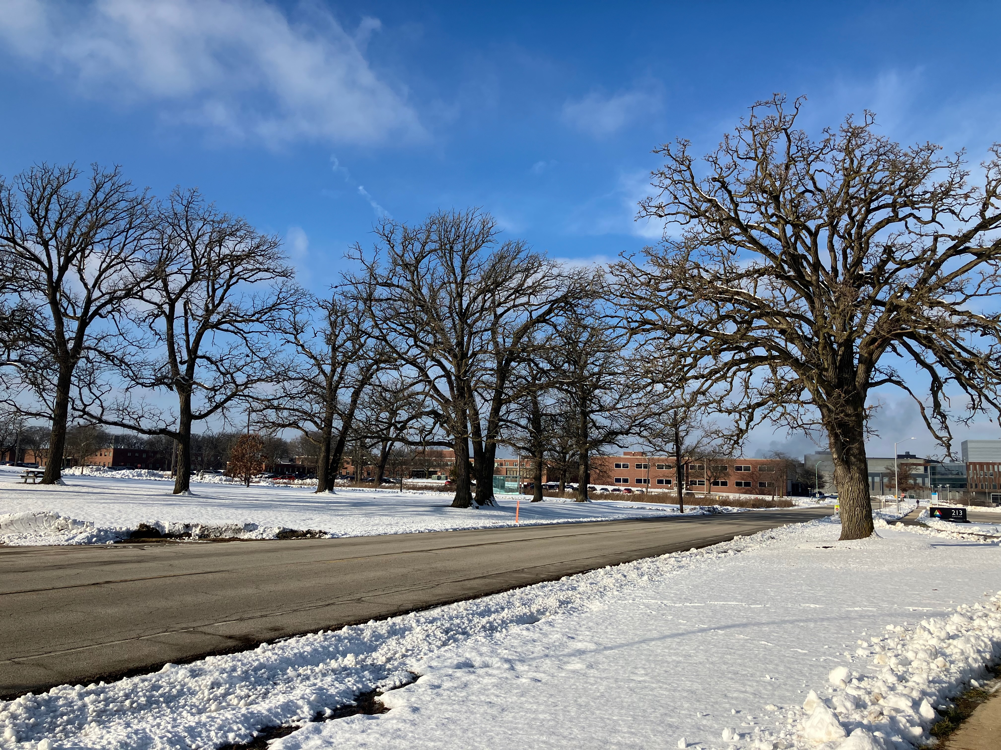
Nearest I can get to a Christmas theme.
EiC meeting January 2024 at Argonne National Laboratory, Chicago
Average day-time temperature: - 22 ºC

Slide 5

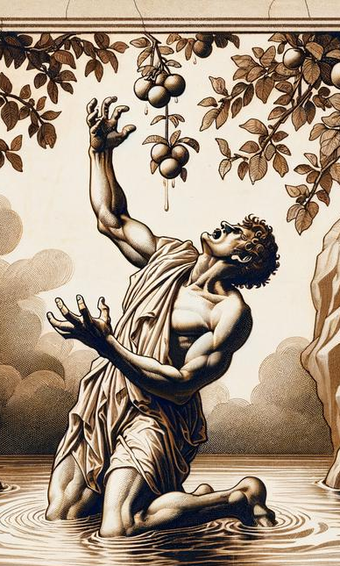
The ePIC Detector
~9m
Santa has arrived early: UK has been awarded £58.8M to build part of the ePIC detector.
Getting our hands on the money is another matter…
~6m
We want to build this bit at RAL
(“SVT outer barrel” tracker)

Slide 6
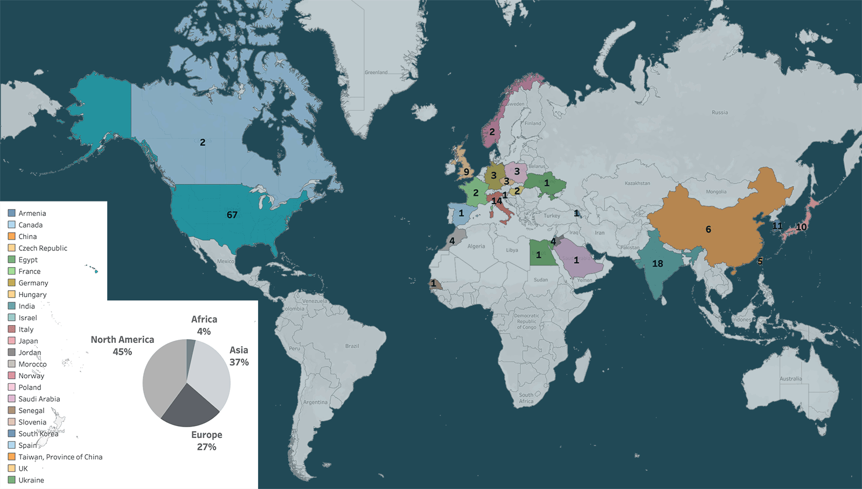

The ePIC Collaboration
24 nations
170+ institutes
1000 scientists
Still growing…

Slide 7
The Potential Good News for PPD/TD
PPD/TD funding starts April 2025 (if Santa Claus is real).
Funding for ~8 PPD/TD people
UK has to deliver by March 2031 (but schedule still changing).
Full scale UK production: 2027-2030

Slide 8
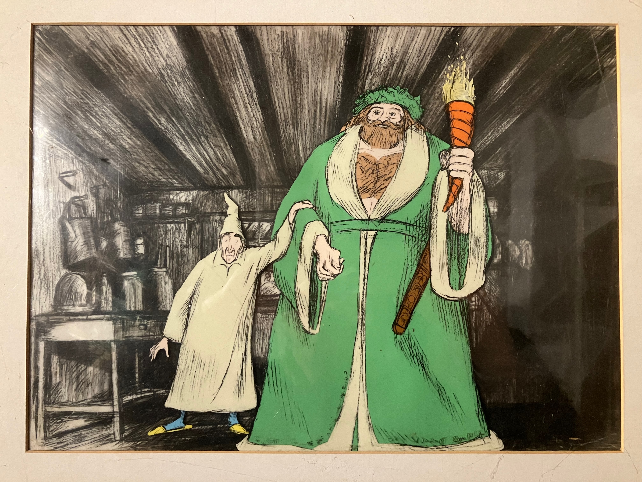
What will the future hold?

